Slide 1
HIV Prevention
Georgia Test, Link, and Care (TLC) Network
Presented To: TLC Network /MAI members TA Call
Presented By: Jamila Ealey, MPH and Melanie Gwynn, MPH
Date: June 9, 2014

Slide 2
Overview
Test, Link, and Care Network
ARTAS forms
ARTAS database
TLC Network Expectations
Upcoming TA calls

Slide 3
Georgia’s HIV Prevention Goals
Reduce new HIV infections
By increasing the provision of routine-opt screenings for HIV in Georgia where there are high concentrations of HIV infection.
By increasing the number of HIV tests conducted at public supported non-clinical sites in areas with high concentrations of HIV in Georgia.
Increase Access to Care and Improving Health Outcomes for people living with HIV
By increasing the provision of linkage to care, treatment, and prevention services for HIV-diagnosed individuals in Georgia.
By increasing the capacity of public health supported entities to refer all newly diagnosed person to partner services (PS).
Reduce HIV-Related Health Disparities
By funding a statewide social marketing campaign with tailored messages aimed at reducing HIV infection rates among gay and bisexual men.
By re-launching the Georgia Taking Control initiative to increase HIV testing and linkage to care for gay and bi-sexual men.
By distributing condoms in clinical and non-clinical sites.
By increasing the number of HIV-positive individuals in Georgia’s public health districts who are linked to other HIV-related medical and social services.
By funding a statewide social marketing campaign with tailored messages aimed at reducing HIV infection rates among black heterosexuals.
Notes:
In order to meet the goals of the National HIV AIDS Strategy we had to align our HIV Prevention Goals to match those of the strategy. The Test Link and Care demonstration project fall under Goal number 2: Increase Access to Care and Improving Health Outcomes for People living with HIV

Slide 4
Goal 2: Increase Access to Care and Improving Health Outcomes for people living with HIV
Roadmap to HIV Prevention

Slide 5
Georgia’s Test, Link, and Care
Network
HIV Prevention (CDC)
Newly Diagnosed
Previously Diagnosed
Four Public Health Districts (Clayton, Fulton, Cobb-Douglas, and DeKalb)
Seven ALCMs
Ryan White Part B (MAI)
Previously Diagnosed
Five Public Health Districts (Clayton, Fulton, Coastal, Albany, Augusta, Columbus)
Six ALCMs

Slide 6
Goals of the Georgia Test, Link, and Care Network:
Identify and promptly link persons who are living with HIV and not receiving care
To improve patient retention in HIV primary care
Test
Targeted HIV testing
Link
Linkage Case Managers (ALCM)
Network Providers
Linkage to care tools
3. Treat
Access to treatment
Increase retention in care
AIM to achieve viral suppression
Support for Linkage and Retention:
Linkage Case Managers trained on ARTAS
Create a wrap around approach to linkage services
Create client empowerment videos
Create strong inter-agency collaboration to facilitate communication and data sharing
Reinforce and replicate linkage and retention best practices as identified using the “Plan Do Study Act”
Notes:
The goal of the program is to identify and promptly link individuals who HIV positive to HIV medical care and other services as well as, improve retention in HIV care
As you can see on this slide, individuals are tested, linked to an ALCM where they will through the ARTAS intervention, and then are referred to a care provider for treatment services….
Through TLC we will create a supportive network for linkage and retention…really these supportive services are nothing new but a matter of formalizing the support that we offer clients and creating an environment that supports this collaboration to facilitate communication and data sharing; which includes sharing best practices.
We believe this program will be successful because it involves a variety of diverse organizations working together to accomplish a shared goal using a structured framework.
Improve coordination and linkages among providers of HIV/STD services, specifically HIV CTL sites, HIV primary care providers and HIV Surveillance

Slide 7
Each Core TLC Network:
ALCM
HIV Care Provider
2 CBOs
After establishing the core network, providers of other supportive services are invited to participate.
Notes:
Ideally each district will consist of the ALCM, 2 CBOs, and an HIV Care Provider for linkage….
Clayton is challenged in that they do not have CBOs so we have encouraged them to partner with non-traditional partners…that can encourage testing….They have begun working very closely with their Ryan White clinical staff to assist with referrals into ARTAS as well as expanding testing outreach efforts to high risk communities.

Slide 8
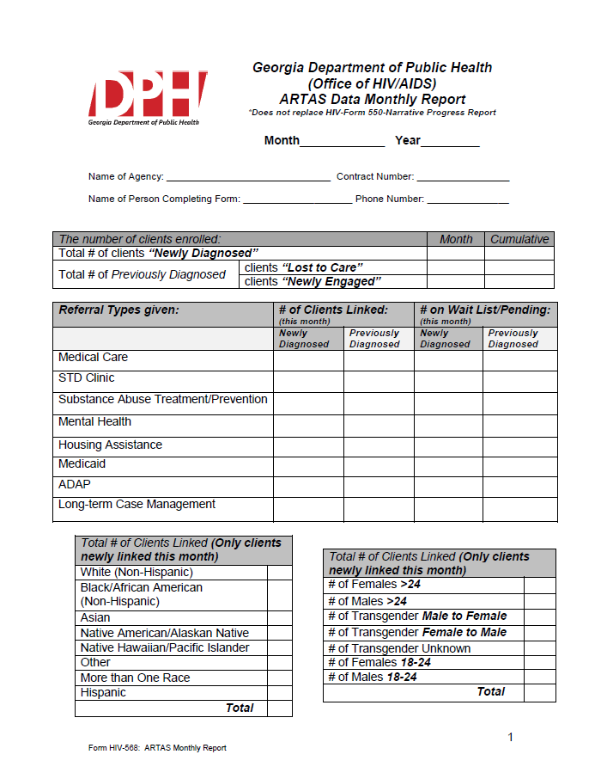
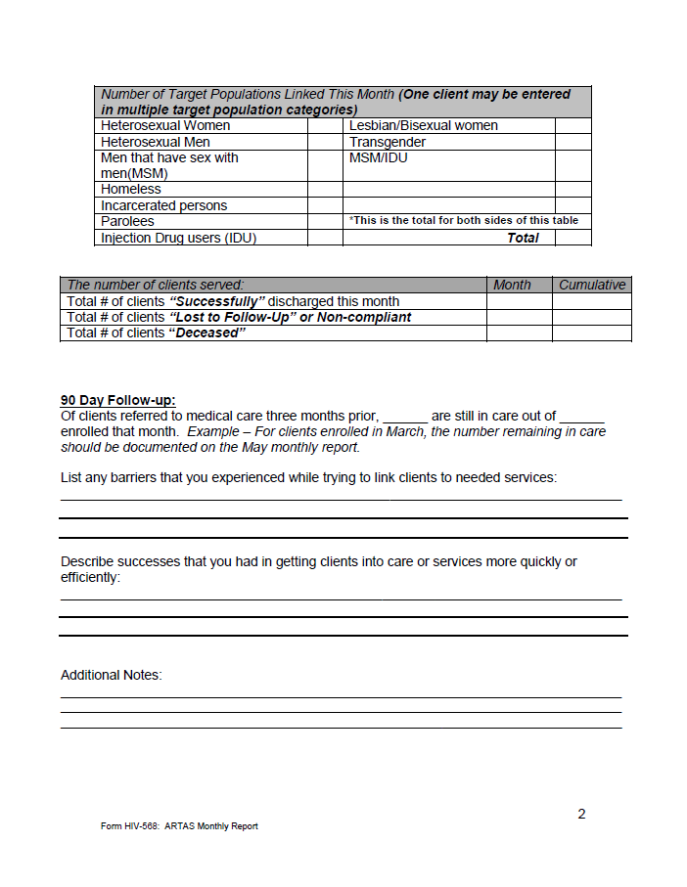
ARTAS Monthly Report Form

Slide 9
ARTAS Monthly Report
Completed monthly by ALCM
Aggregate data describing linkage activities under ARTAS program and in some cases general linkage
Should reflect data for month of reporting period as well as cumulative data
Due by the 15th of the following month
Important for aggregate quarterly, interim, and annual reports to federal funders.

Slide 10
ARTAS Monthly Report
Largely quantitative data
Some qualitative data sections to describe:
  Barriers to linking clients
  Successes, moderators, or best practices to linking clients
  Additional information that may be useful for reporting
Monthly narrative to capture important descriptive information
  MAI sites, monthly narrative incorporated on form

Slide 11
ARTAS Monthly Report Definitions
Linkage to medical care- process of assisting HIV-diagnosed clients into medical care with an HIV primary care provider following receipt of an HIV diagnoses. Linkage requires follow up and documentation.
Linkage to support services- process of assisting HIV diagnosed clients in accessing critical needs for supportive and ancillary medical services that may serve as barriers to HIV primary medical care. Linkage to supportive services requires follow up and documentation.
Referral – process of providing information but not assistance to accessing the service, does not require follow up to determine outcome of the referral (passive)

Slide 12
ARTAS Monthly Report Definitions
General Linkage- process of assisting HIV-diagnosed clients into medical care or support services without enrolling them into the ARTAS intervention. Requires follow up and documentation.
Newly Diagnosed – Having received an HIV diagnosis within the previous 12 months.
Previously Diagnosed - Having received a previous HIV diagnoses NOT within the preceding 12 months.
  Newly engaged
  Lost to care
Lost to follow up (designates linkage attempts) – three (3) unsuccessful attempts to contact the client within a 90 day period.

Slide 13

ARTAS Monthly Report Form
Month-reporting month that reflects the data being submitted
Year-current reporting year that reflects data
Name of Agency- name of your health department
Contract Number-# of funding source (i.e. 104)
Name or Person Completing Form/Phone Number-include the name and contact # of personnel completing monthly report

Slide 14

ARTAS Monthly Report Form
1
2
This table should include enrollment status of:
  Clients enrolled for the reporting month
    Newly Diagnosed – Diagnosed within the previous 12 months
    Previously Diagnosed ‘Lost to Care’ –A previous HIV diagnoses, without a visit for routine HIV medical care in the preceding 12 months
    Previously Diagnosed ‘Newly Engaged’ – A previous HIV diagnoses, but never having entered into HIV medical care
  Clients enrolled to date, including reporting month
1
2
Notes:
Previously diagnoses is defined as a previous HIV diagnoses NOT within the past month.
This table looks at enrollment for the reporting month and cumulative enrollment count to include the month that is being reported.

Slide 15
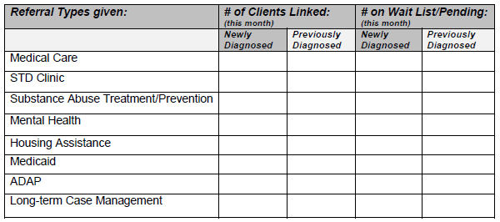
ARTAS Monthly Report Form
Linkage Status of those Enrolled & Referred
Include the number of clients enrolled this month, based on their enrollment status,
newly diagnosed
previously diagnosed
who were referred and received services (linked) for the respective categories OR waiting receipt of services.
3
4
1
2
1
2
3
4
Notes:
This table looks at those enrolled…Of those enrolled, what was their linkage status and categorization.
This includes referrals to mental health, substance abuse, employment, transportation, food services and other support services

Slide 16
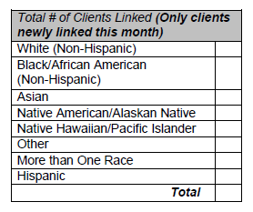
ARTAS Monthly Report Form
Race and Ethnicity
Only include clients linked this reporting month.
Provide the race and ethnicity counts, exclusively.
  If a client is reported as Hispanic, they should only be captured in the Hispanic field.
  A client who identifies as more than one race should only be counted in the More than Once Race field, NOT in multiple race categories.
The Total should equal the total number of clients who were linked for that reporting month and should match that of the next table.
Notes:
Now looking primarily at those linked to care.

Slide 17
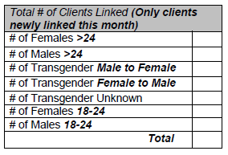
ARTAS Monthly Report Form
Gender and Age
Only include clients linked for the reporting month
Provide the gender and respective age breakdown for those clients linked in the reporting period
The Total should equal the total number of clients who were linked for that reporting month and should match that of the previous (Race/Ethnicity) table.

Slide 18
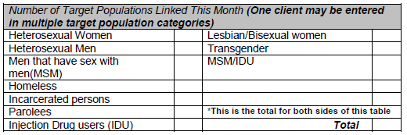
ARTAS Monthly Report Form
Behavioral Risk Category
Only include clients linked for the reporting month.
A client can be entered into multiple categories therefore the total will not always add up to the total number of clients linked for the month.

Slide 19

ARTAS Monthly Report Form
Outcome Status of clients served
1
2
3
Include clients who received services as apart of the ARTAS intervention.
  Newly Diagnosed and Previously Diagnosed clients
  All clients who received services for the reporting month AND
  All clients who received services to date
  The cumulative count should increase each month as more clients complete the intervention and are:
    Successfully linked Lost to follow up Deceased
1
2
3
within 90 days

Slide 20
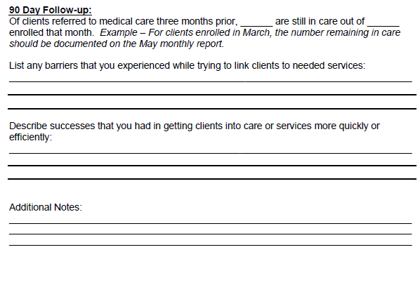
ARTAS Monthly Report Form
Descriptive narrative about linkage efforts during the reporting month.
Barriers/Challenges
Facilitators
Successes

Slide 21
ARTAS Excel Database
Electronically capture client level information for more detailed analysis.
Help organize ARTAS client enrollment and linkage information
Password protected
If you already have an electronic system to monitor and store client level information, excel worksheet is not necessary.

Slide 22
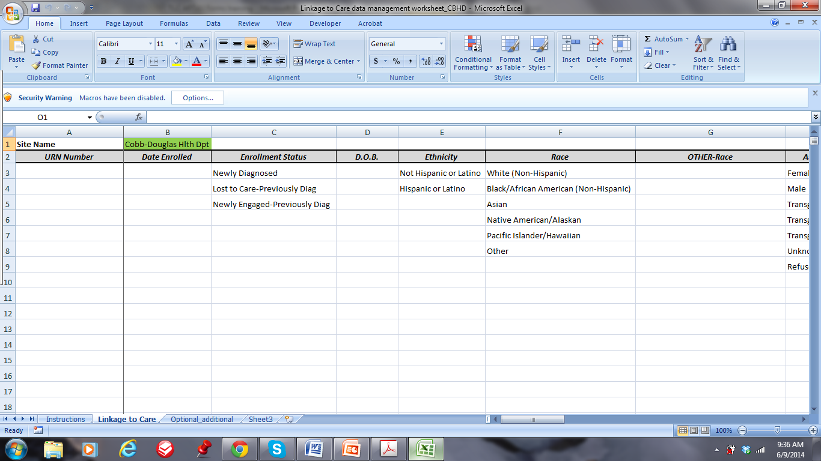
ARTAS Excel Database

Slide 23
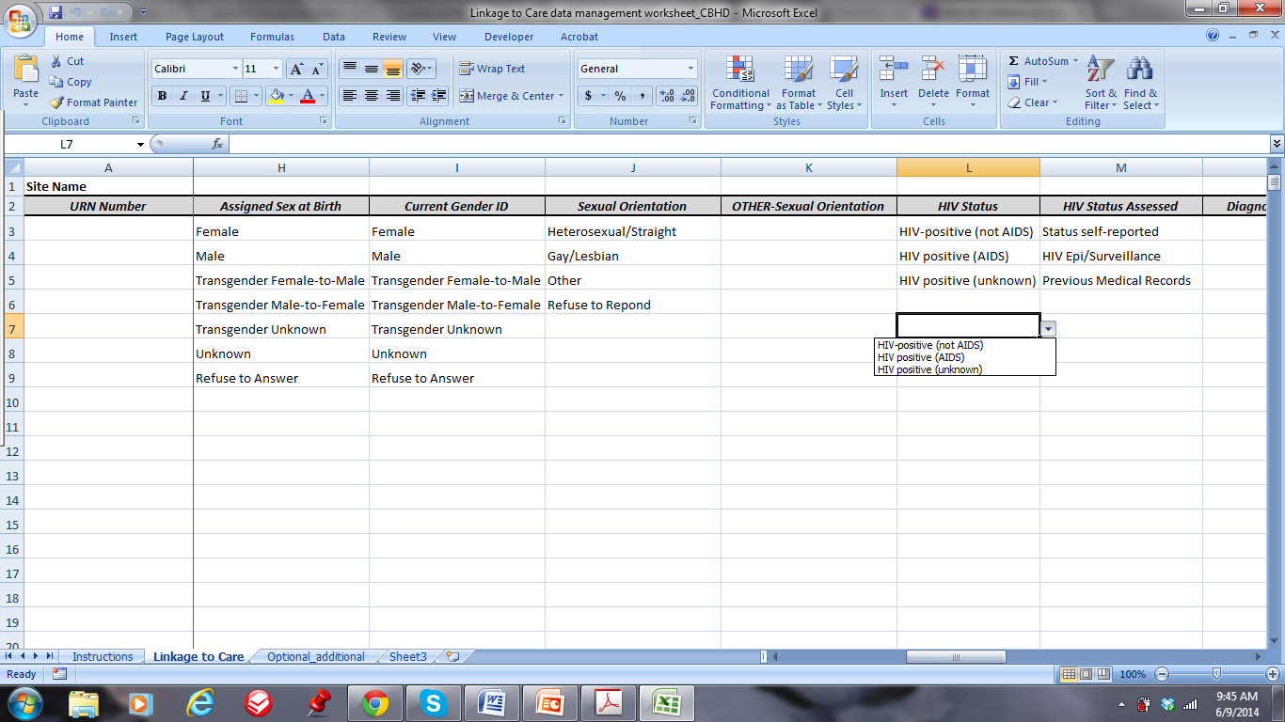
ARTAS Excel Database
Free Text
Drop down menus

Slide 24
Georgia Test, Link, & Care Network
Statewide Continuous Quality Improvement meeting held December 3, 2013
71 attendees from rural and urban areas
Topics discussed
  navigating the linkage process
  identifying community and private healthcare partners
  Facilitators and challenges of linkage
  other factors needed for successful linkage outcomes
Notes:
GDPH held a statewide Linkage to care continuous quality improvement training for our 4 TLC networks, including additional TLC networks supported under HIV Care as well as other entities throughout the state that are involved in linkage to care activities. We had 79 people register with 71 people actually attending. Attendees came from various public health and care disciplines including but not limited to CBOs/ASOs, health educators, case managers, volunteers, substance abuse and mental health facilities to name a few. We will be working on next steps from this statewide meeting.

Slide 25
Test Link Care Network
Purpose
  To utilize inter-organizational collaborations aimed to coordinate HIV testing, HIV primary care, and supportive services by:
      Identifying and promptly linking to care persons newly diagnosed or living with HIV but not receiving care (aware and unaware of their HIV status).
      Improving patient retention in HIV primary care.
Notes:
So now we will discuss expectations for the TLC Network. Just to reiterate, the network is intended to:
1. Identifying and promptly linking to care persons newly diagnosed or living with HIV
but not receiving care (aware and unaware of their HIV status).
2. Improving patient retention in HIV primary care.

Slide 26
Test Link Care Network
Core components of the network.
ACLM
2 CBOs/ASOs
HIV Care Provider
Notes:
Moving forward all ARTAS sites (HIV prevention and MAI) should establish a TLC network. At a minimum the network consists of a:
1. Linkage Coordinator
2. An HIV Care Provider (this can be the Ryan white provider)
3. Two CBOs/ASOs
Both traditional (private providers, behavioral health/mental health) and untraditional partners (churches, employment centers, food banks, corrections/probation offices) are welcomed to join the network.

Slide 27
Test Link Care Network
Helpful Documents
Refer to the “TLC Network” one pager (PDF). The document can be used as a template in order to recruit providers and CBOs/ASOs for your TLC Network.
Notes:
Included in the email sent out on 6/4 was a TLC network “one pager”. This document can serve as a template and can be used to recruit network members. If you would like the Word Publisher version of the document please send me an email

Slide 28
Test Link Care Network
List the components of your TLC Network.
  Forward your completed Excel spreadsheet by 6/30/14 to your contract monitor
Notes:
Also forwarded in the 6/4 email was a TLC Network Excel spreadsheet. Please complete the document in its entirety and forward to your respective contract monitor (either myself or Mirelys) by 6/30/2014. Please list the current components of your network. Additional partners can always be added in the future.

Slide 29
Test Link Care Network
  Expectations
    Network meetings should take place once a month
      Meetings can be in person or over the phone
    Meeting agenda and notes should be forwarded along with your monthly ARTAS narrative/aggregate reports to your contract monitor
    Meeting highlights/outcomes can be shared in the successes/ accomplishment section of your ARTAS narrative reports

Slide 30
Test Link Care Network
  Expectations
  The network meeting agenda should include the
  following items:
      Agency updates (personnel, changes in services, etc.)
      Facilitators for linkage to care
      Opportunities for collaboration
      Upcoming events
      Other pertinent information
  The meeting notes can be in a bulleted format. Be sure to include:
      Date, time, and location of meeting
      List of attended
      A synopsis of the meeting outcomes

Slide 31
THE NEXT TA CALL
Our next call is scheduled for July 14, 2014 @ 1-3pm. In future meeting we will cover:
Program highlights from each health district
Successes/Challenges from each health district
Data/Reporting
Upcoming Events
TA needs
Notes:
For the schedule for the remaining part of the year, please refer to the ARTAS TA Call schedule that was forwarded in the 6/4 email.

Slide 32
Questions???
Jamila Ealey
Jamila.Ealey@dph.ga.gov
Melanie Gwynn
Melanie.Gwynn@dph.ga.gov
Mirelys Ramos
  Mirleys.Ramos@dph.ga.gov

