Slide 1
Breast Pump Policy
Presentation to: Nutrition Services Directors and
Breastfeeding Coordinators
Presented by: Julianne Gaston MPH, RD, LD and
Pat Cwiklinski RD, LD, CLC
Date: December 2, 2015

Slide 2
Ordering Breast Pumps
Complete the “State Order Form for Breast Pumps” Quarterly:
  January 1st
  April 1st
  July 1st
  October 1st
After Delivery of Pumps:
Within (3) three business days verify packing slip, write “complete“ and fax to State WIC Breastfeeding (BF) Coordinator.
If not correct write “incomplete“ on packing slip with missing items and fax to State WIC Breastfeeding (BF) Coordinator.

Slide 3
Ordering
District may only purchase breast pumps, pump kits, or breastfeeding supplies through the state ordering system.
Districts are encouraged to have a six (6) month supply of breast pumps and supplies in inventory.

Slide 4
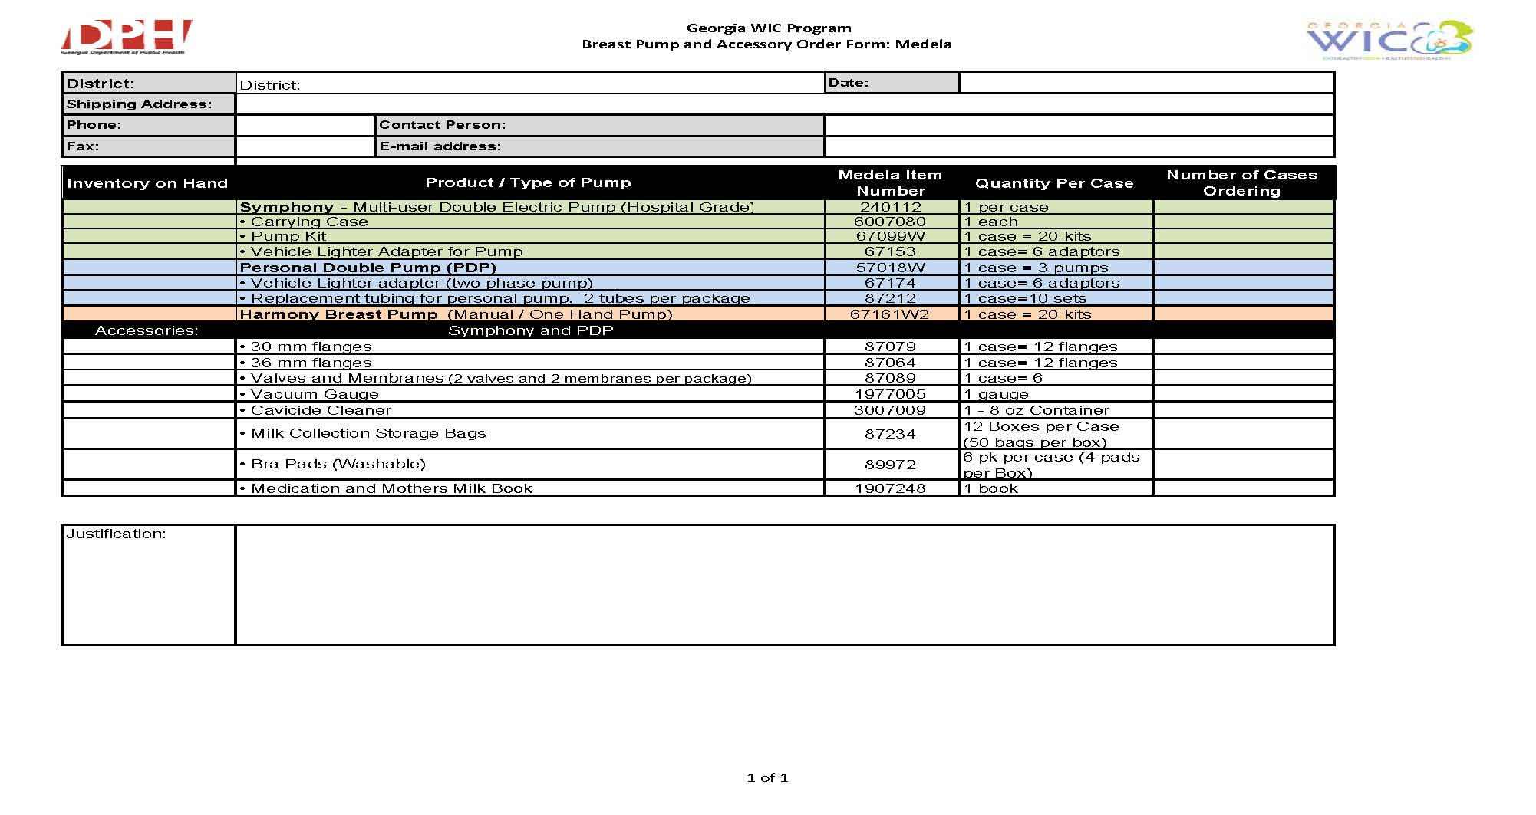

Slide 5
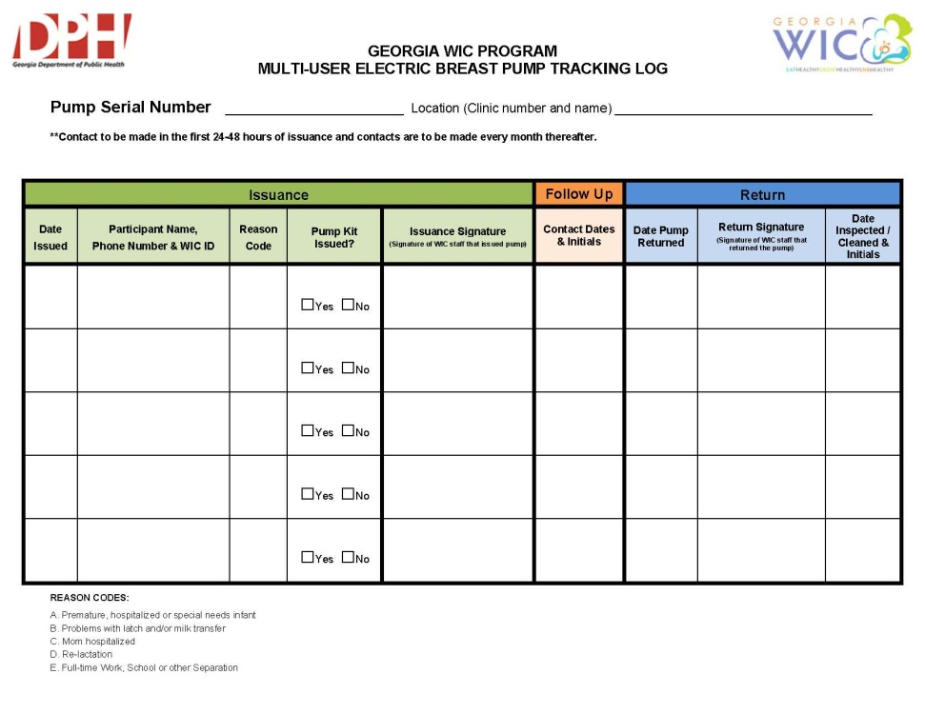
Tracking Multi-User Breast Pumps
Action Steps: Prior to storing and first issuance of Symphony Pumps.
Enter Multiuser pump tracking information into SENDSS Breast Pump Tracking Database.
Clearly mark all pumps and cases with “Georgia WIC Program” and District Inventory Number.
If SENDSS is not available fill out a Multi User Electric Breast Pump Tracking Log form for each pump.

Slide 6
Tracking of Personal Double Pumps (PDP), Manual Pumps and Supplies
Personal Double Pumps (PDP)
Manual Pumps
Car Adaptors
Breast Pads
Storage Bags
Symphony Pump Kits
Prior to storage and issuance of PDP, manual pumps and supplies, create an Issuance and Inventory Tracking Log
See Attachment BF-3

Slide 7
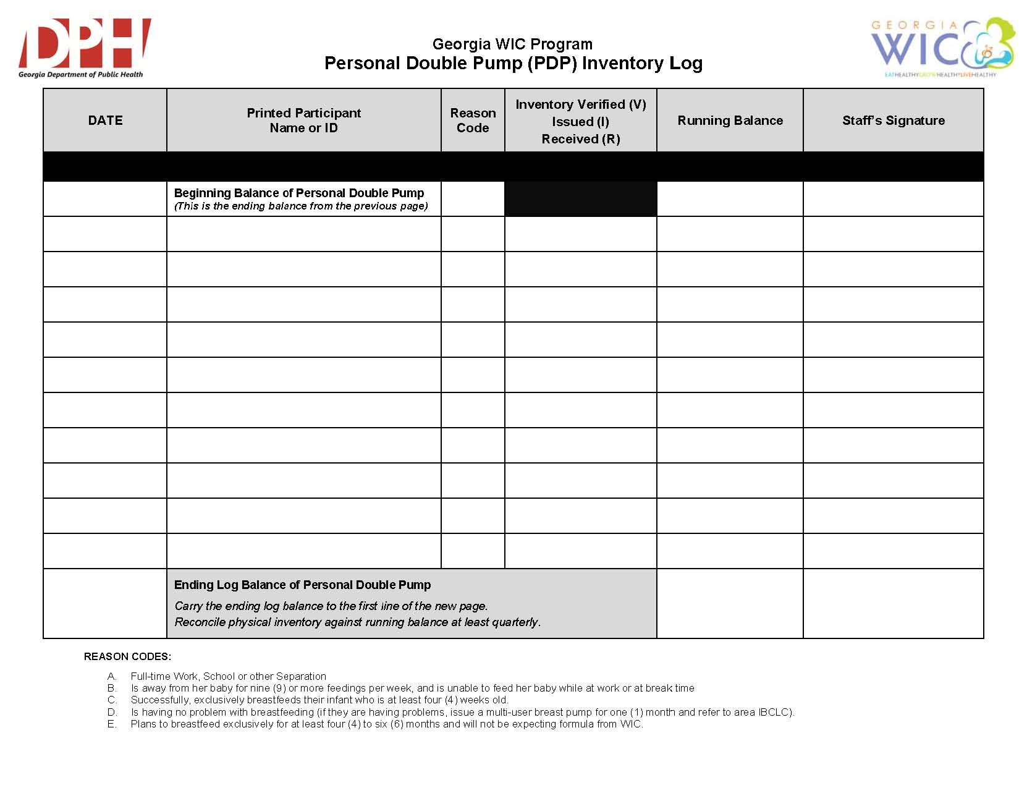

Slide 8
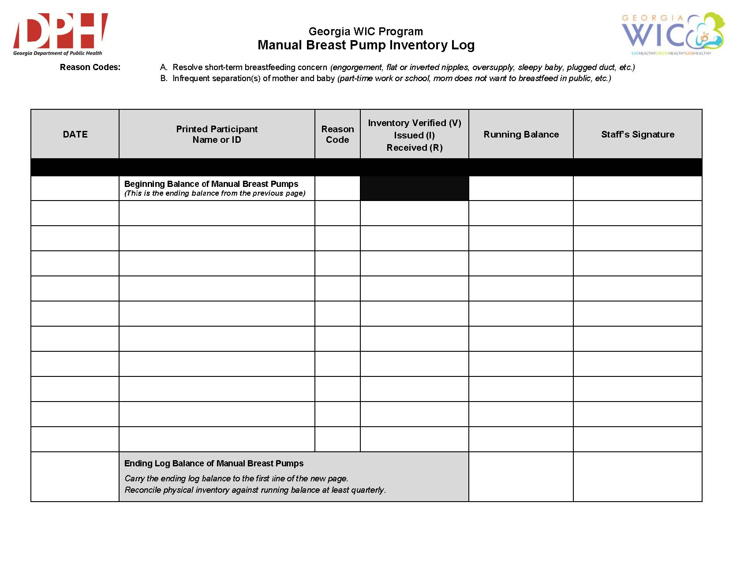

Slide 9
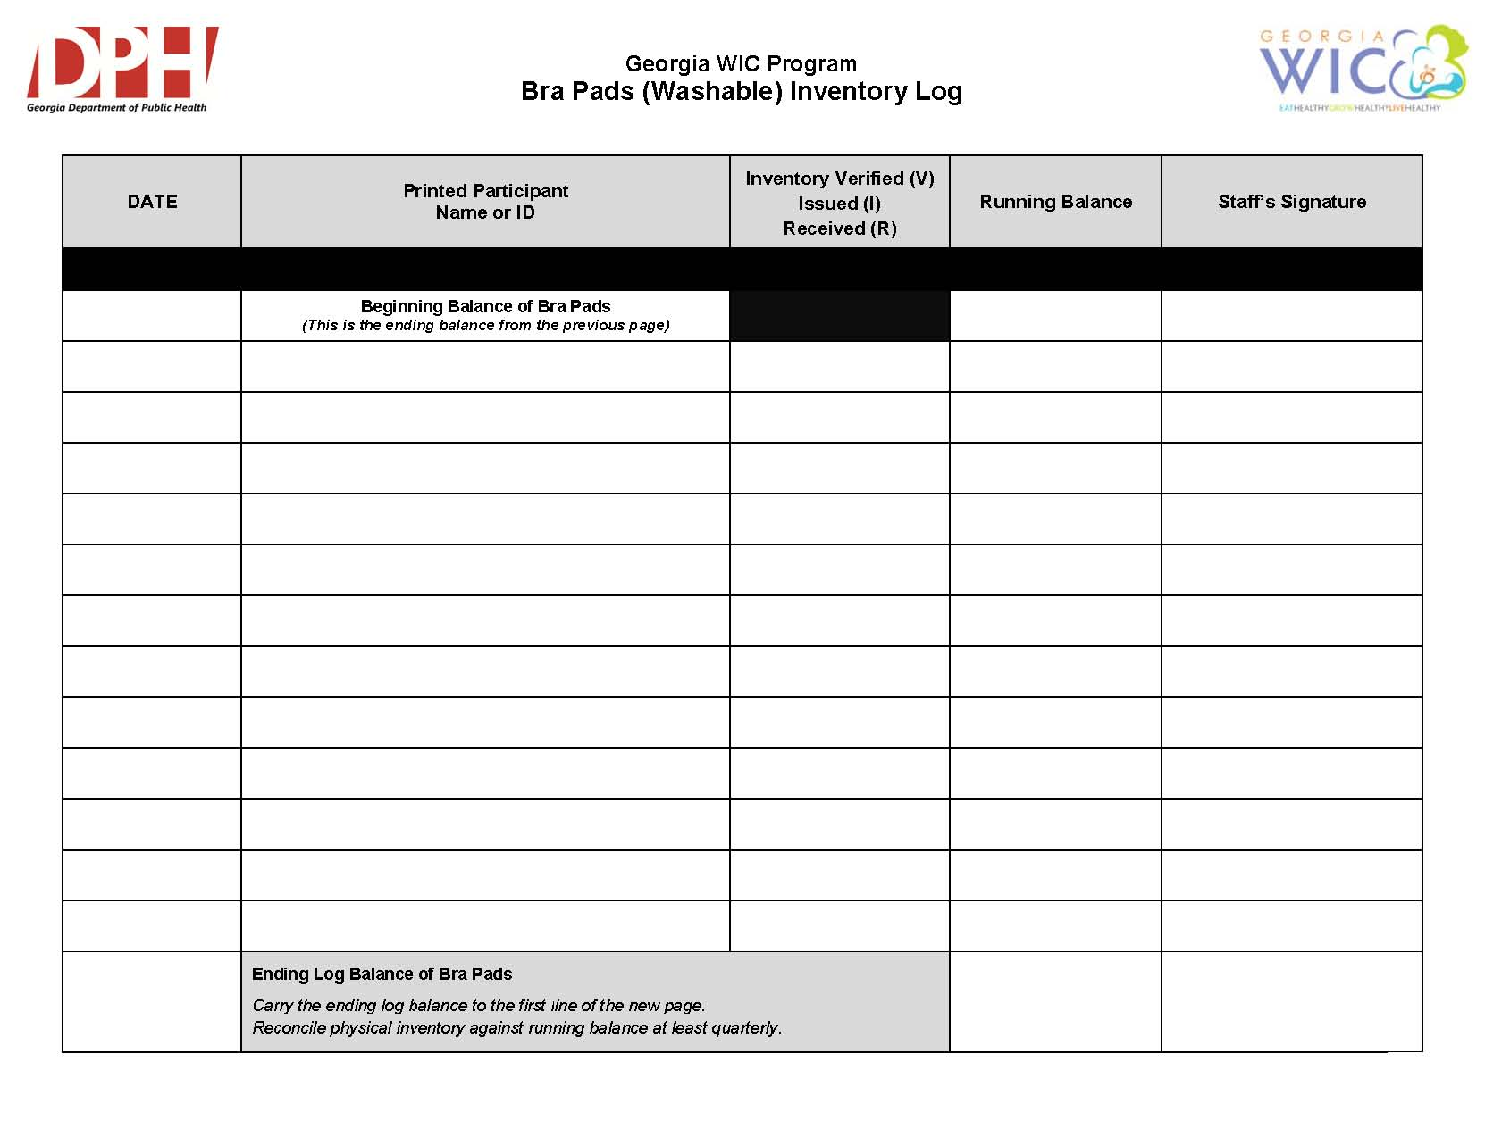

Slide 10


Slide 11


Slide 12
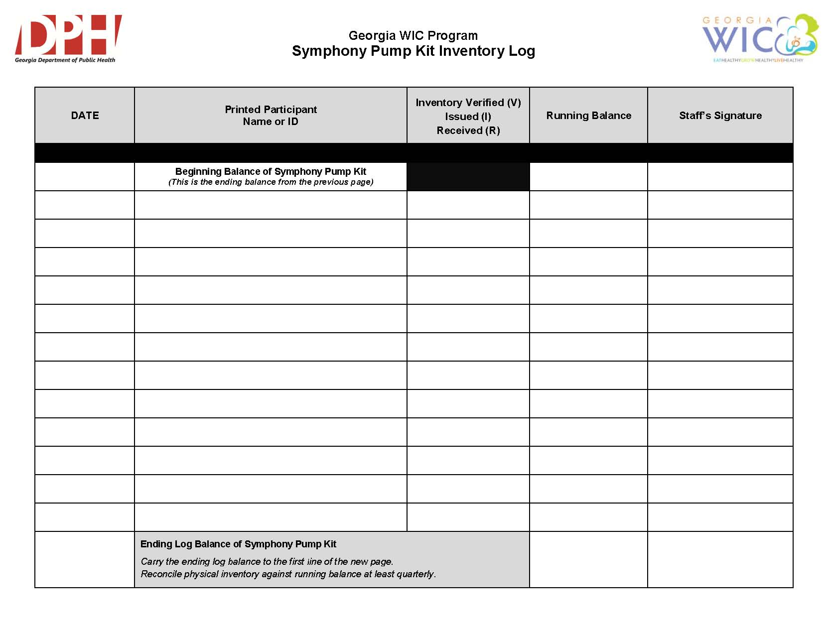

Slide 13


Slide 14
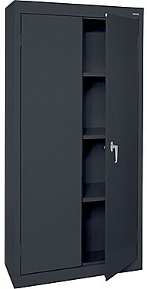
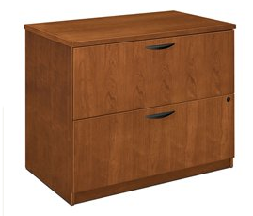
Storage of Pumps
Pump inventory must be stored and secured in a locked space accessible only by WIC staff.
  Storage cabinet or locked storage room is acceptable.

Slide 15
Pump Issuance and Guidance
Pump issuance must be provided only by WIC Authorized Personnel.
Peer Counselors are not allowed to clean pumps or manage the pump program; including, tracking or to inventory pumps.
Who can issue pumps?
CPAs
CLC or CLE Staff
Peer Counselors
Lactation Consultants
Staff must be trained in the use and issuance of breast pumps prior to issuing pumps.

Slide 16
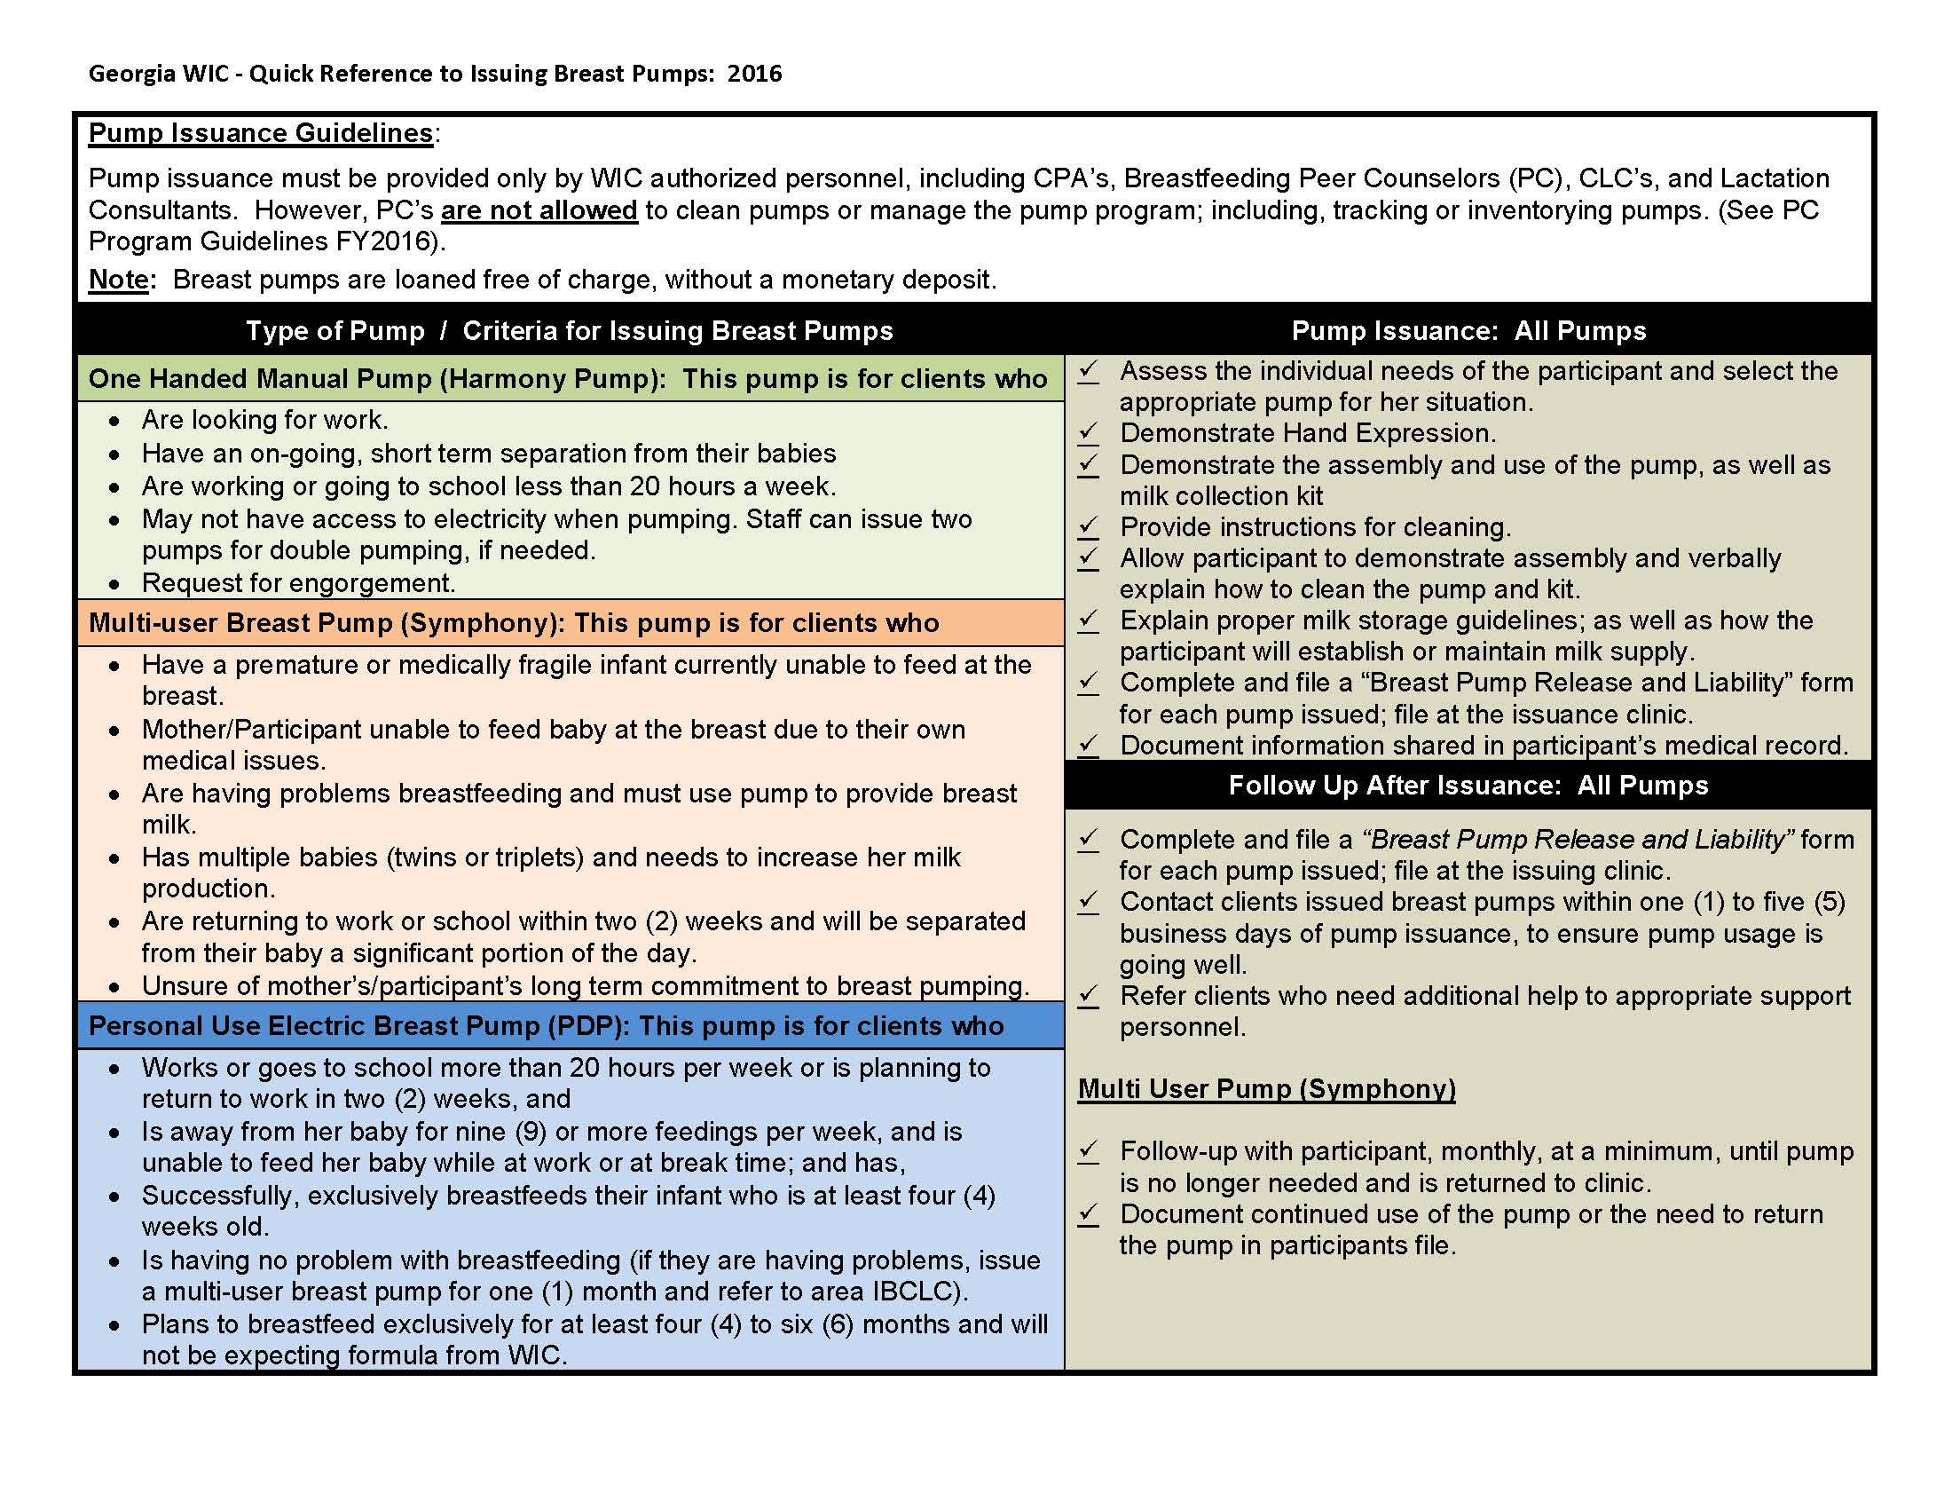

Slide 17
Guidelines for Issuing Breast Pumps
Demonstrate Hand Expression
Provide instructions for cleaning
Participant demonstrates assembly
Explain proper milk storage guidelines
Complete and file a “Breast Pump Release and Liability form when issuing a multi-user or PDP

Slide 18
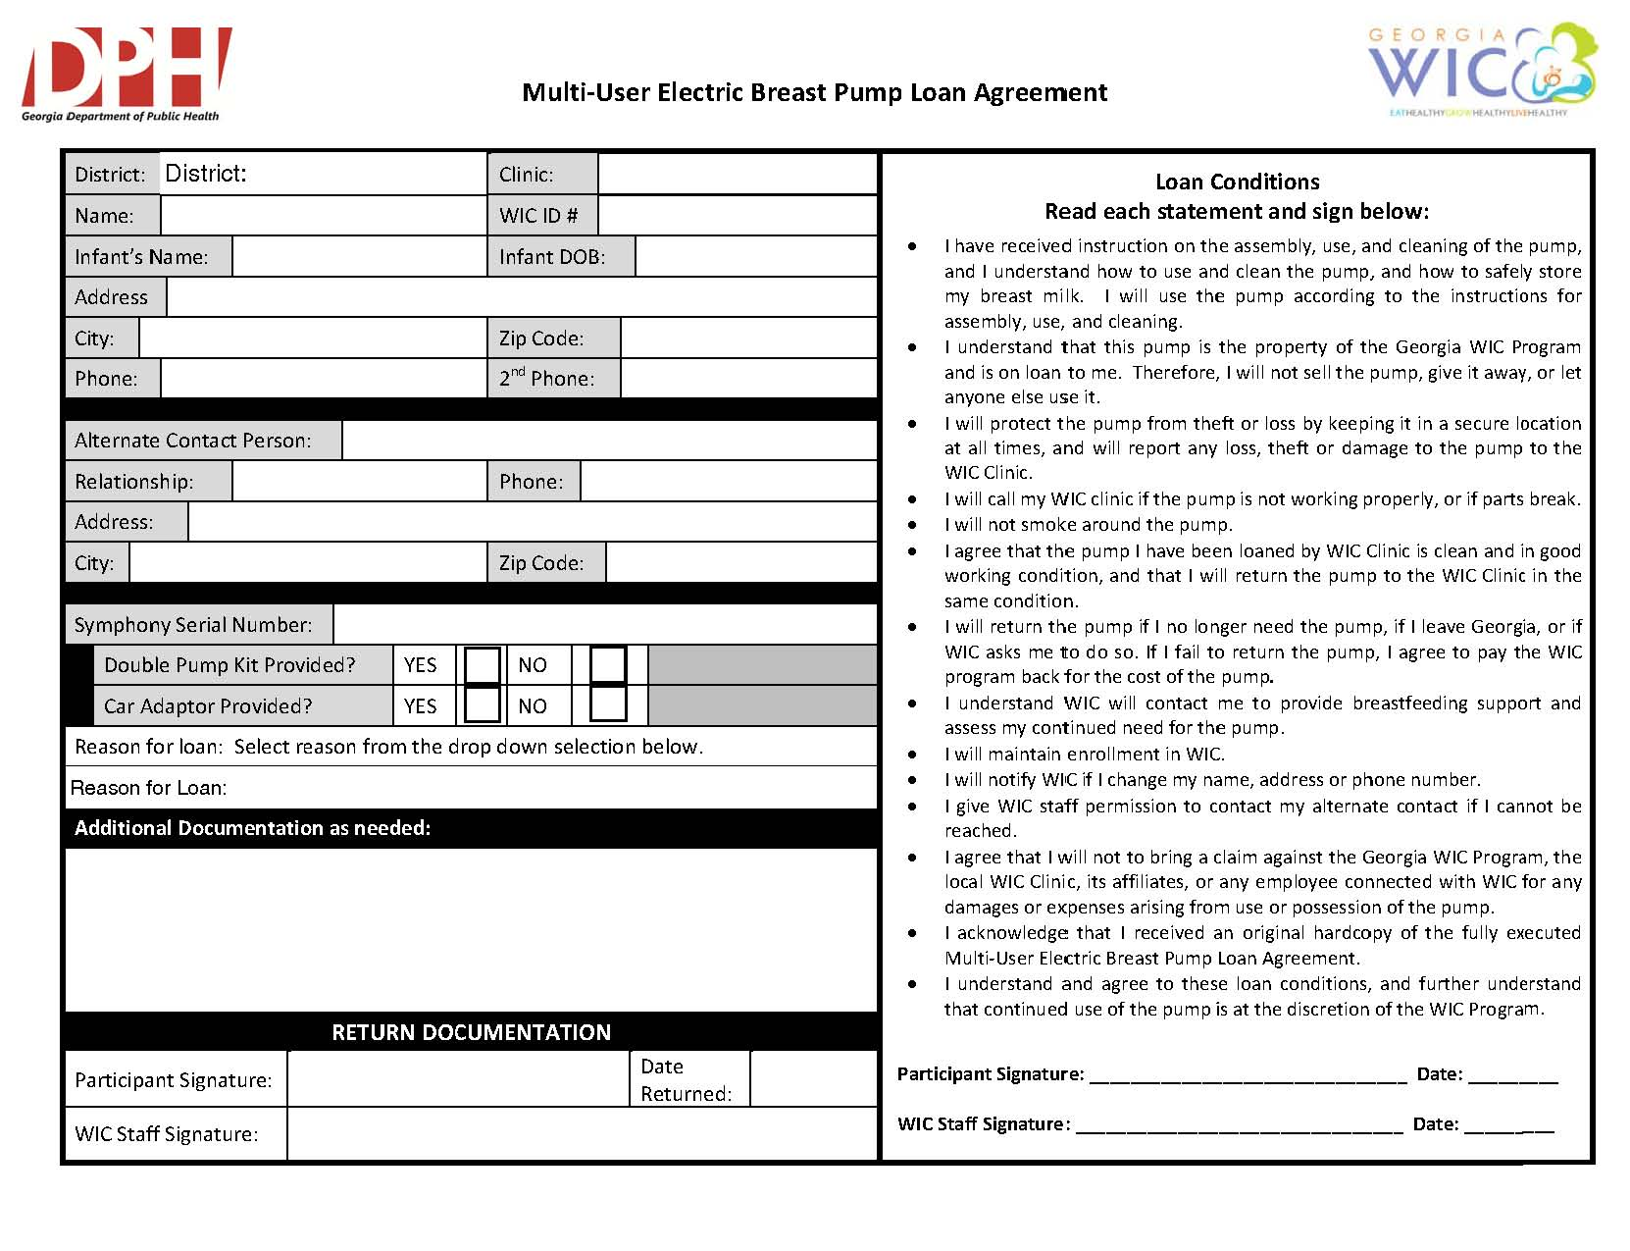

Slide 19
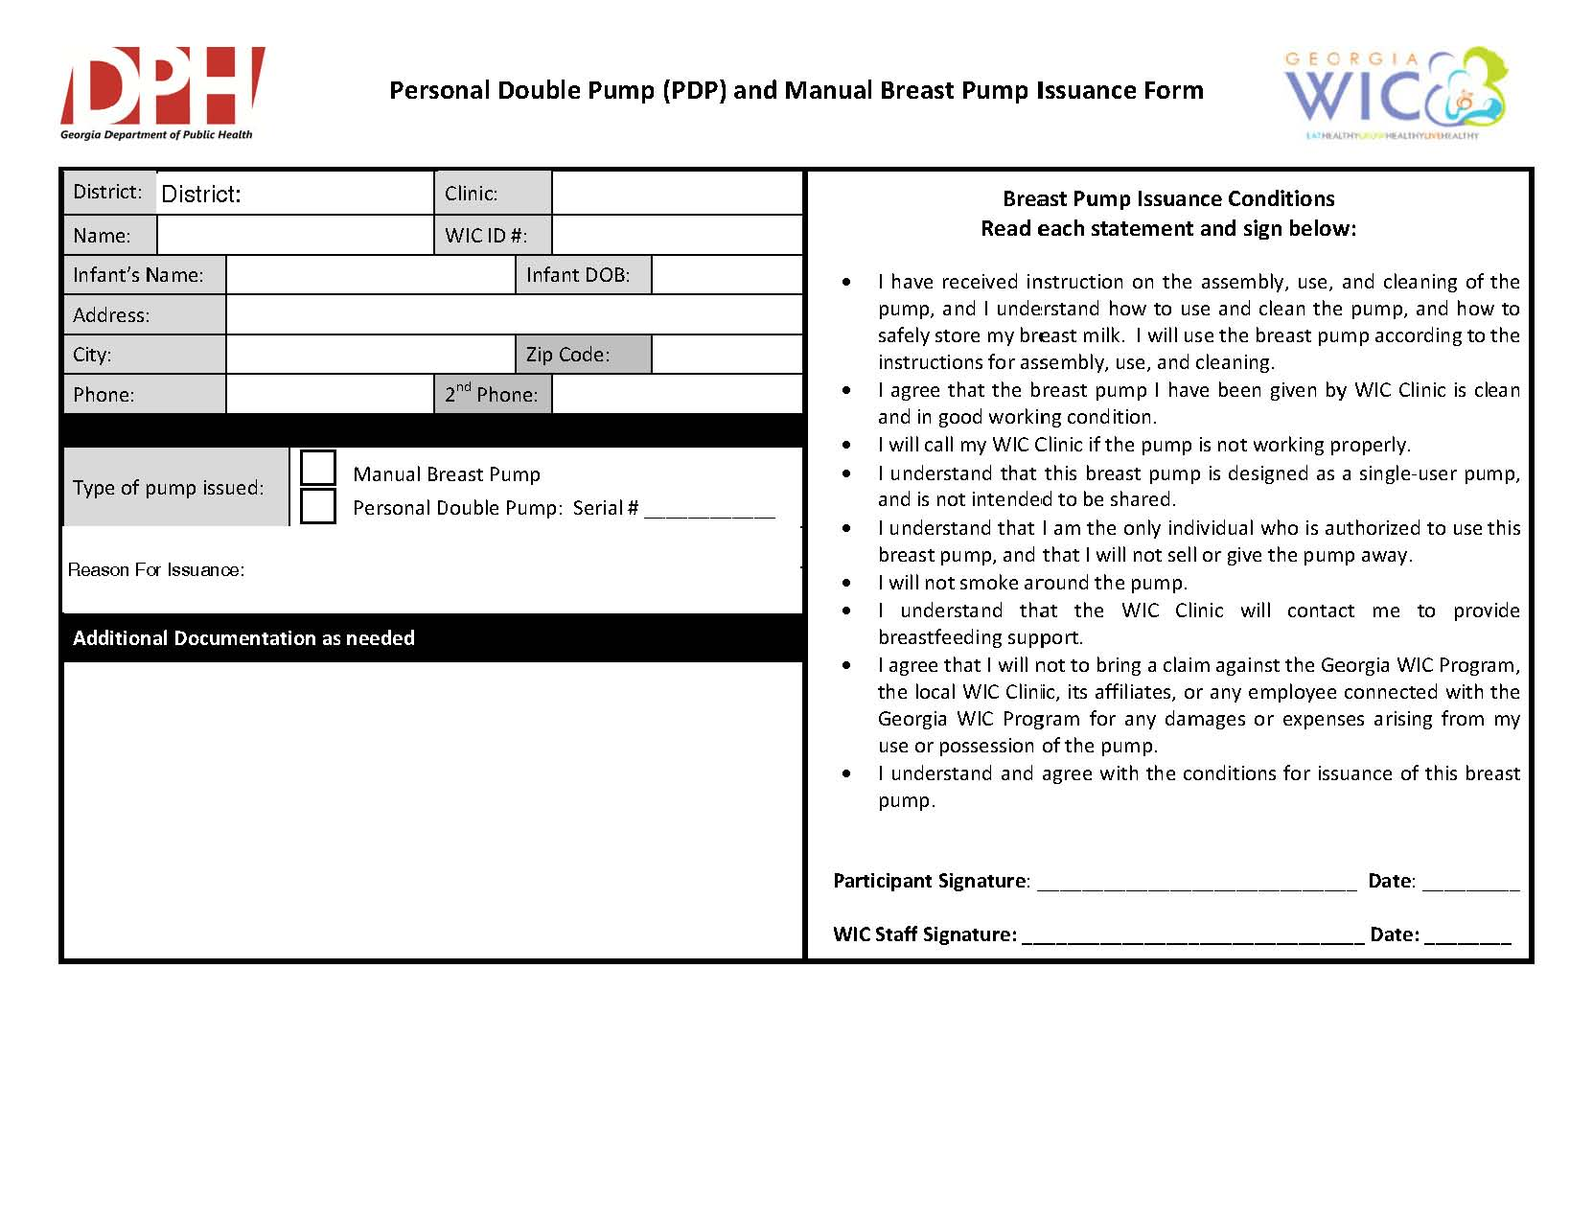

Slide 20
Client Follow-Up After Issuance
All pumps
contact client one (1) to five (5) business days after issuance to ensure pump usage is going well
Best practice is one (1) to three (3) days
Multi user pump:
BF assessment at minimum monthly
Document contact in SENDS Database.
Refer clients who need additional help

Slide 21
Inventory
Maintain inventory record for each clinic site of:
All Breast Pumps
Tracking Logs for all issued pumps and supplies
Reconcile inventory at a minimum quarterly, at each site

Slide 22
Staffing Requirements
Train staff in the use and issuance of breast pumps
Ensure staff available to issue within one (1) business day of established need
Allocate sufficient staff hours for managing pumps
  Approximately .5 FTE per 100 multi-user pumps in inventory

Slide 23
Cleaning Multi-User Pumps
Check for any damaged parts and possible pest infestation.
Discard used pump kit and pump kit accessories.
Place pumps in a clear bag that is sealed for one (1)- three (3) days.
Use Cavicide on a clean cloth to clean all parts.
Assess pump pressure with approved pressure gauge.
Seal cleaned pump in a clear plastic bag and labeled as “clean”.
Update pump status as clean in the SENDSS Database.

Slide 24
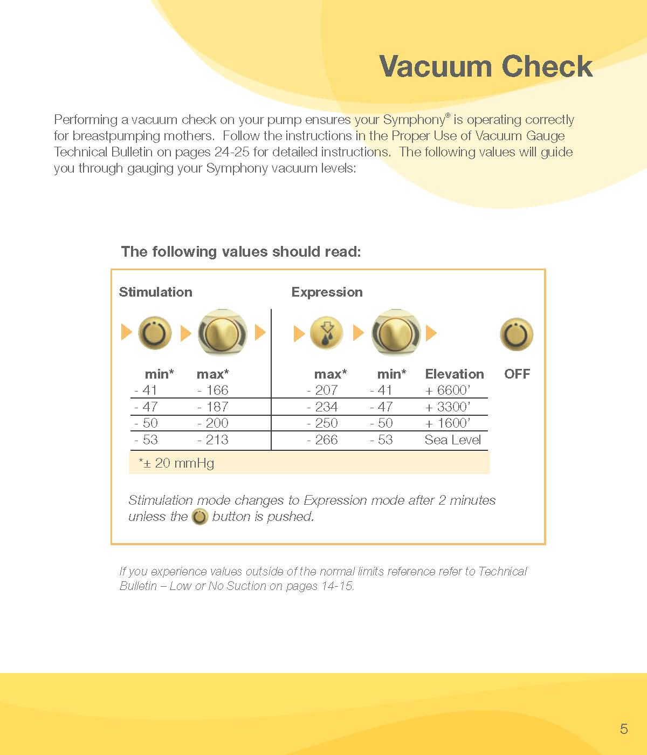

Slide 25
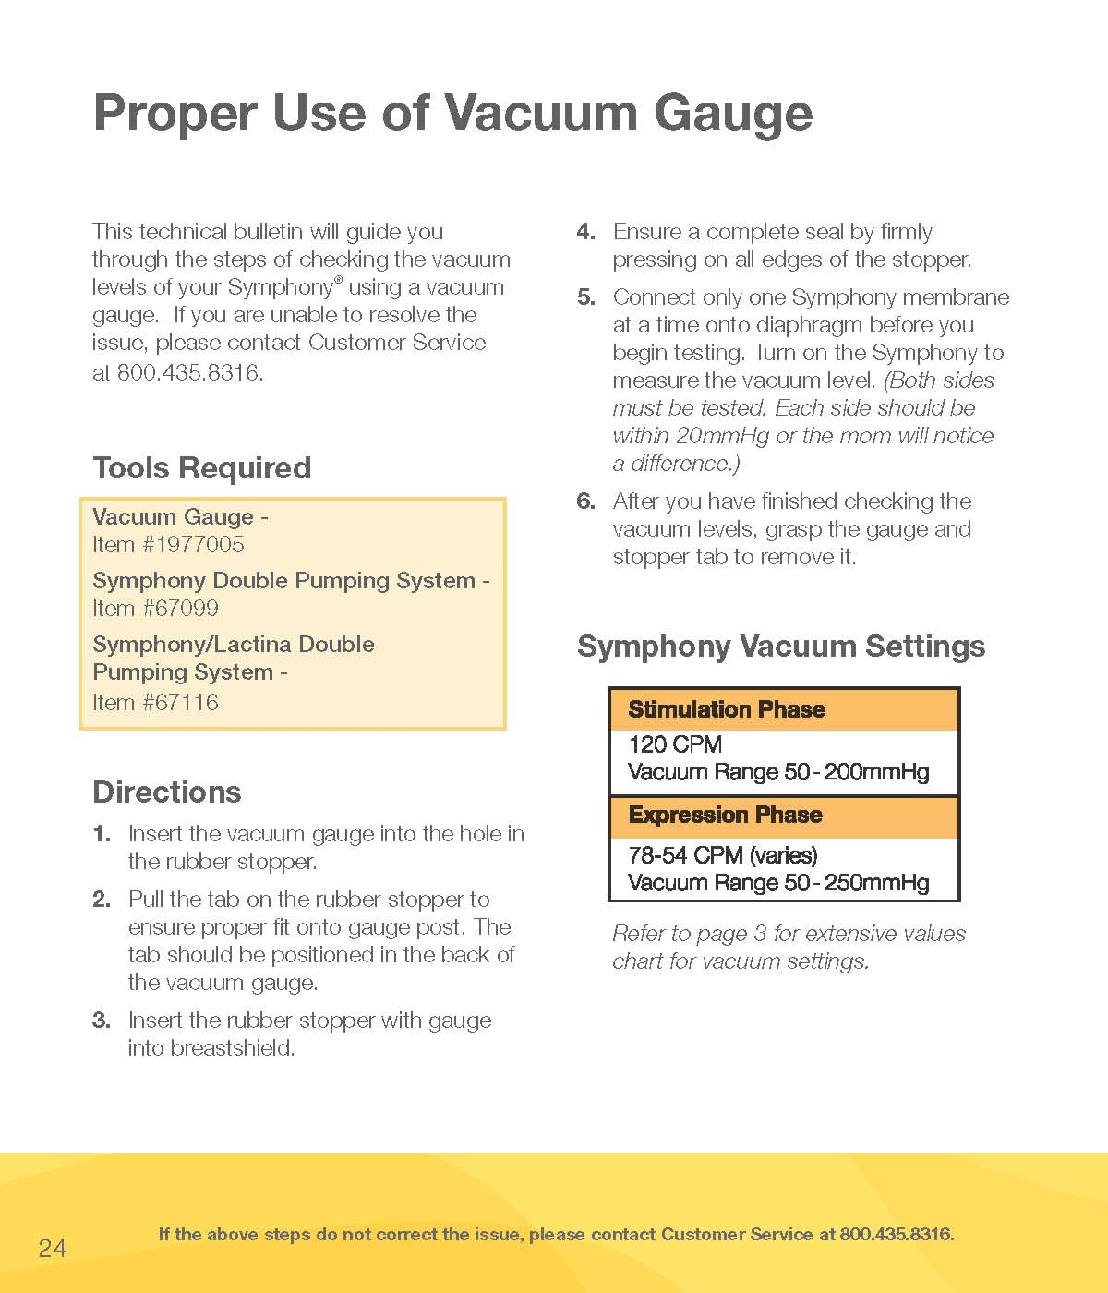

Slide 26
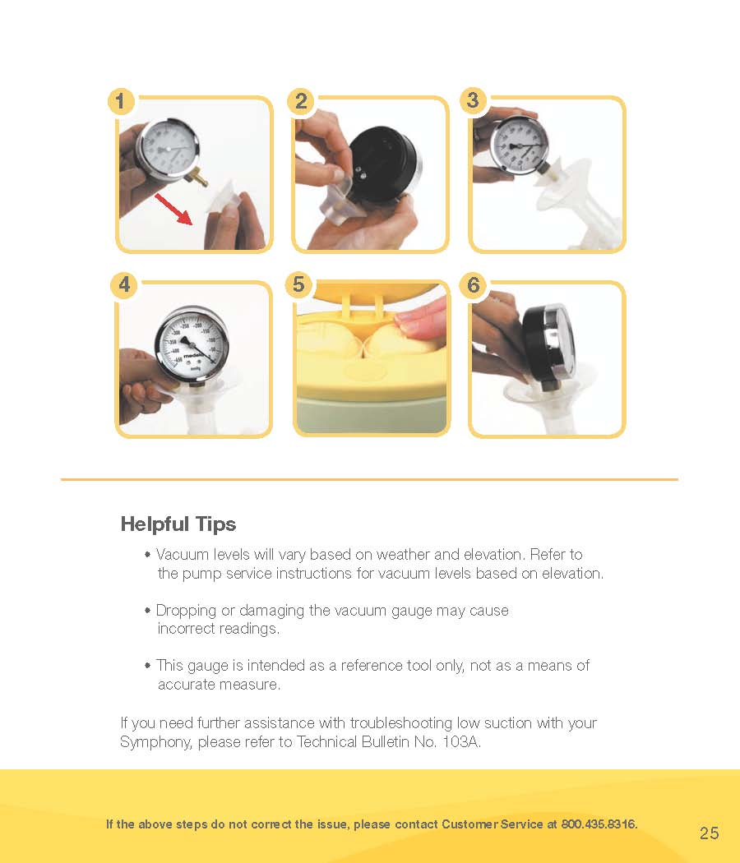

Slide 27
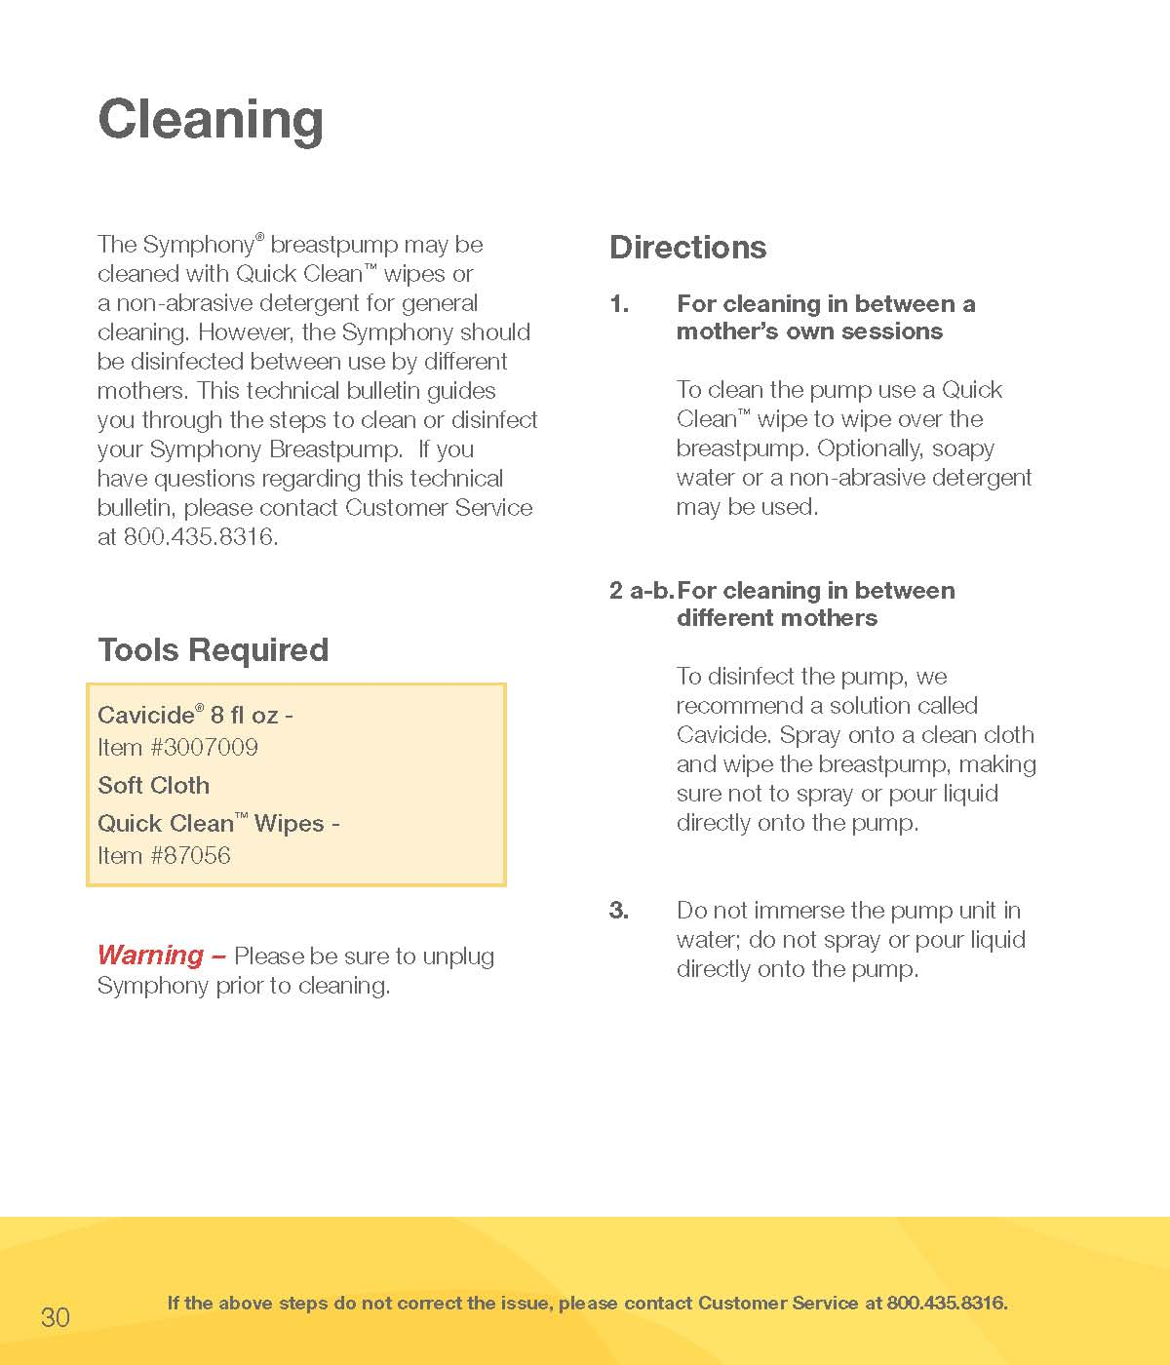

Slide 28
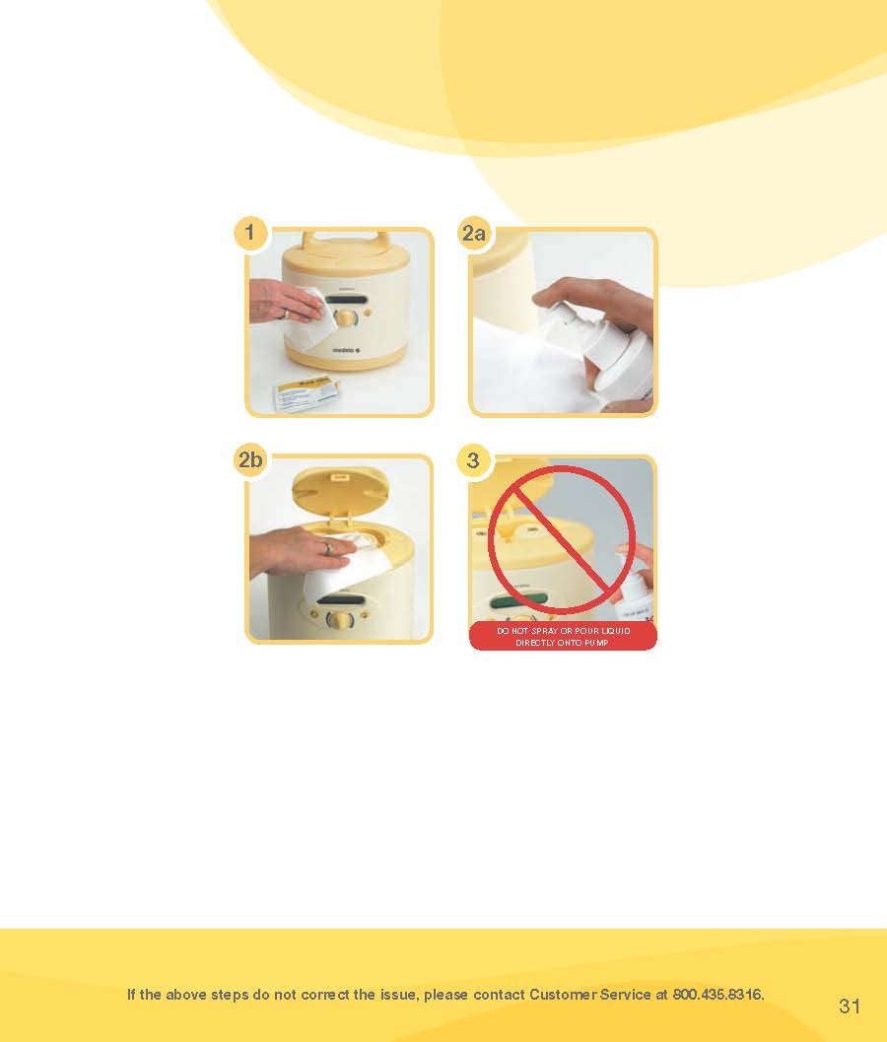

Slide 29
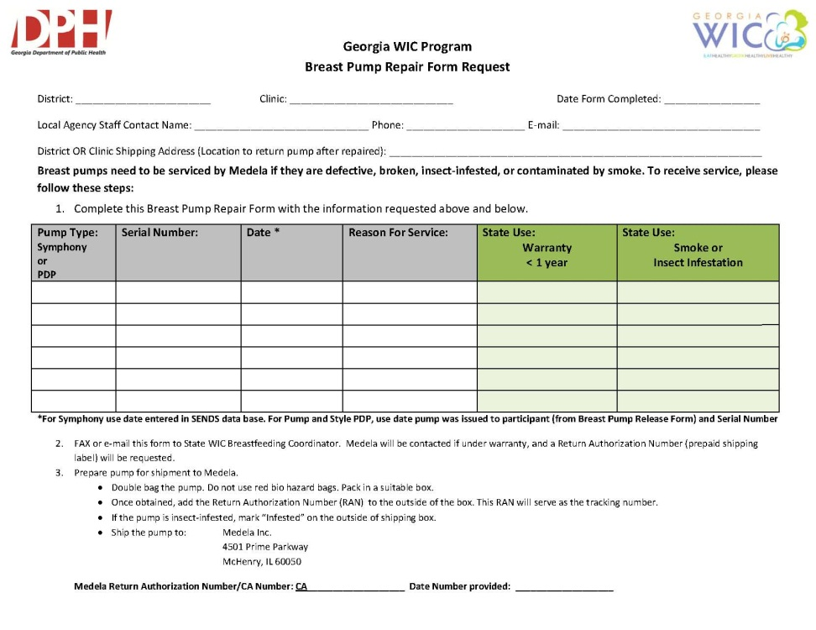
Request for Repair
Contact State BF Coordinator for:
Repair of broken pumps
Smoke or bug infested pumps

Slide 30
Transfer Pump Between Districts
Transfer is documented in SENDSS Breast Pump Tracking Database.
Action Requested:
Contact original clinic and report transfer
SENDSS will document transfer history under “Equipment Status Change” history.
Example: Grady clinic certifies mom and issues a Symphony pump. Mom transfers to Fulton for WIC services. Pump is transferred to Fulton inventory through SENDSS. The need for breastfeeding follow up should be clearly communicated with the receiving clinic.

Slide 31
Lost and Stolen Multi-User Pumps
Contact the participant by phone three(3) times, over a three (3) month period (a minimum of one (1) contact monthly
Document attempts in SENDS database
If unsuccessful send copy of loan agreement and recovery attempt documentation to the State BF Coordinator.

Slide 32
Lost and Stolen Multi-User Pumps
OIG Investigation
Stolen pumps will need a police report number
District will remove pump from inventory if OIG is unsuccessful in recovery after three (3) months
Notify SWO if participant returns pump to district after collection efforts have begun

Slide 33
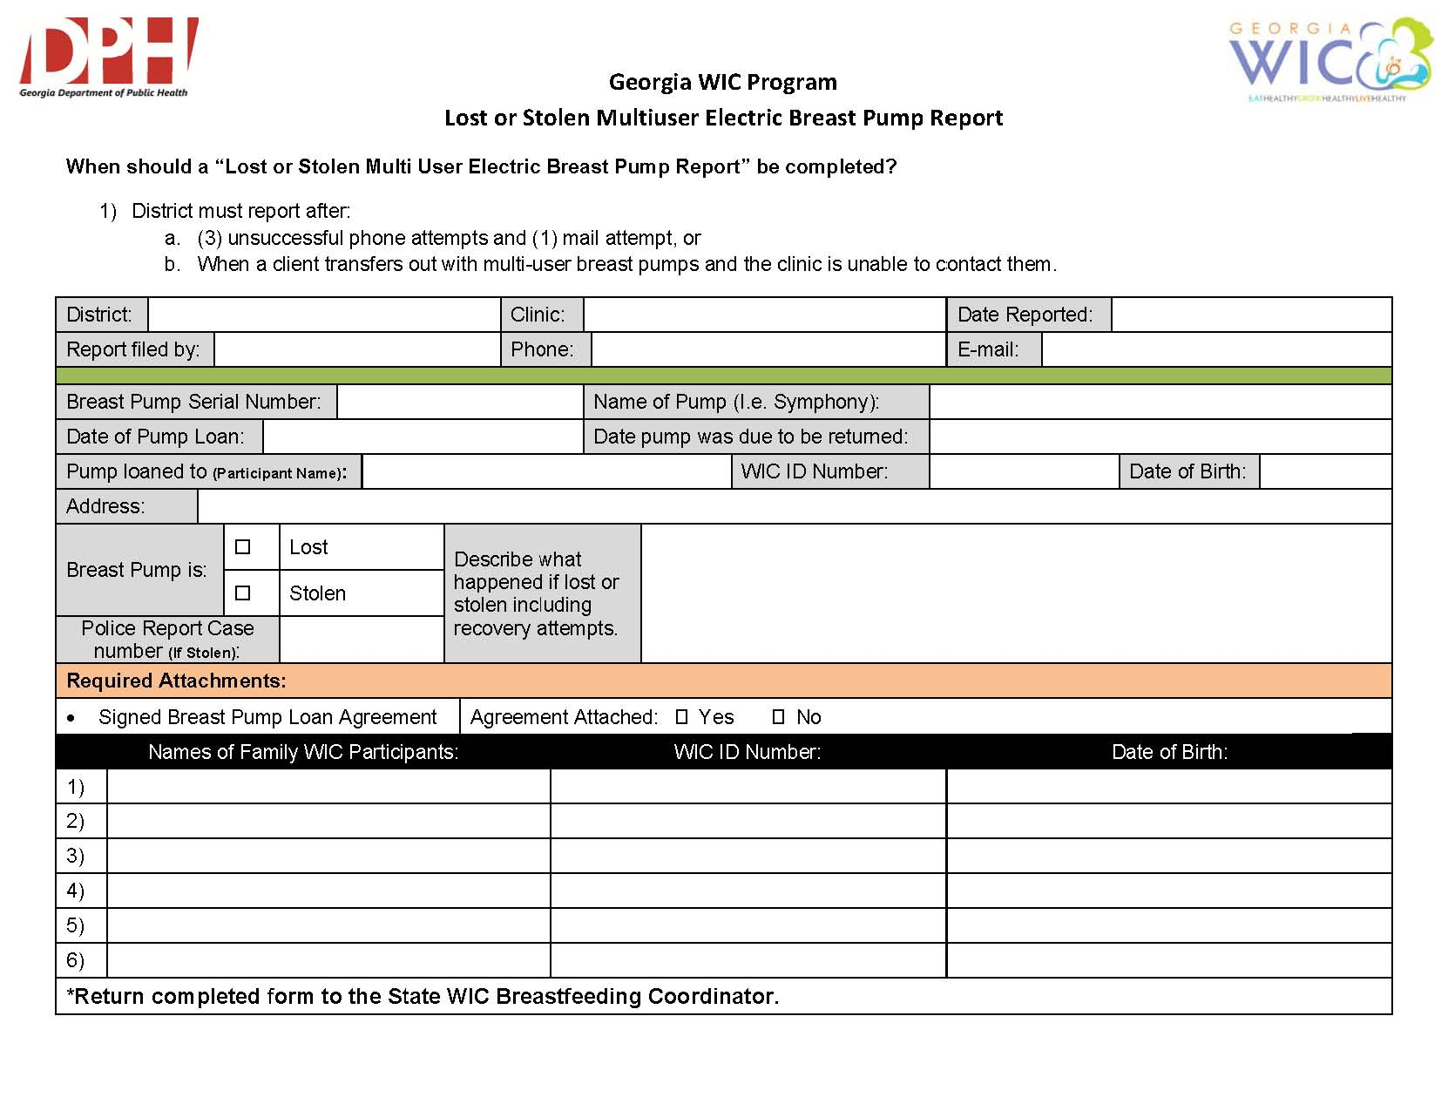

Slide 34
District Training
Breast Pump policy staff training must be completed by February 1, 2016
District will fax training sign-in sheets to State Breastfeeding Coordinator by February 15, 2016.
Breast Pump Policy review offered via VICS
December 14, 2015
2:30 pm - 4:00 pm
January 28, 2016
10:00 am - 11:30 am

Slide 35

Questions

