Slide 1
An Online HIV Prevention Intervention for HIV-negative MSM in Atlanta, Chicago, and New York
R. Craig Sineath, MPH
PRISM Health
Department of Epidemiology
Rollins School of Public Health
Emory University
Notes:
KIU.. An online intervention, YMSM, ages 18-24

Slide 2
Overview
Rationale and Development
KIU! Pilot Study
Implementation
Results
KIU! 2.0
Participant Timeline
Study Design
Intervention
Recruitment
Online Advertising Demonstration

Slide 3
Rationale and Development
Young MSM are one of the highest risk groups for HIV infection, accounting for about 70% of HIV diagnoses in all young people
In comparison to their heterosexual peers, YMSM are more likely to drink and use illicit drugs. Substance use continues to be a major risk factor for HIV among YMSM.
There are few HIV prevention programs that have been developed and proven effective for this group.
Notes:
YMSM make up about 70% of HIV diagnoses in all young people
In comparison to their heterosexual peers, YMSM are also more likely to drink and use illicit drugs.

Slide 4
Rationale and Development
Keep It Up! (KIU!), an interactive and engaging online HIV prevention program designed for YMSM (18-29)
Developed by Dr. Brian Mustanski (IMPACT Program, Northwestern University)
KIU! is designed specifically for online delivery:
Unique and timely way of reaching YMSM
To increase flexibility for wider participation
Notes:
Online delivery: unique and timely way of reaching YMSM
allow for anonymity
clients can complete the intervention from the privacy and convenience of their own home
Also increases flexibility for reaching a wider population, including rural populations

Slide 5
Pilot Study Implementation
Collaboration with LGBT focused CBOs in Chicago
113 participants (out of 334 approached) were enrolled in KIU! within 8 month time period
~40% African American
~20% Latino
Notes:
Center on Halsted (Chicago, IL) staff used a variety of intensive recruitment strategies to engage participants
Outreach events
Social marketing
Special KIU! events (e.g. pizza parties)
Friend referrals
Participants showed changes in knowledge and behavior over 3 months:
Increase in HIV knowledge
Decrease in number of unprotected sex partners

Slide 6
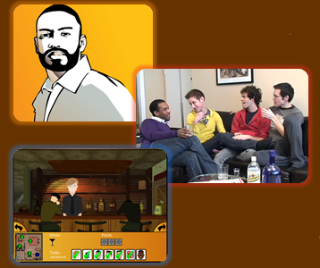
Pilot Study Results
KIU! reduced sexual risk taking in YMSM over 3 months:
44% decrease in unprotected anal sex compared to controls
Decreases in reports of condom errors
Increase in HIV knowledge
Participants rated the intervention very highly and one participant remarked: “this is the future of gay sex education!”

Slide 7
KIU! 2.0
Following the success of the KIU! pilot study, the next step is to establish the effectiveness of the intervention on a larger scale
Multi-site study in Chicago, Atlanta, New York City
Randomized control trial (RCT)
12-month follow up
Funded by the National Institute on Drug Abuse

Slide 8
Introduction Video

Slide 9
KIU! 2.0 Participant Timeline
YMSM client tests HIV negative
After information is entered into database, client is emailed a welcome message with link to start KIU!
Client fills out paper or tablet screener if interested in KIU!

Slide 10
Participant Timeline
Baseline
1. Baseline assessment and at-home STI test (Identigene) ($30)
2. Intervention Modules 1-7 and post-intervention assessment ($20)
3-month
6-month
12-month
Booster session and assessment ($20)
Booster session and assessment ($20)
Assessment and at-home STI test (Identigene) ($30)
At-home STI test if there was a positive result from baseline ($10)
At-home STI test if there was a positive result from baseline ($10)

Slide 11
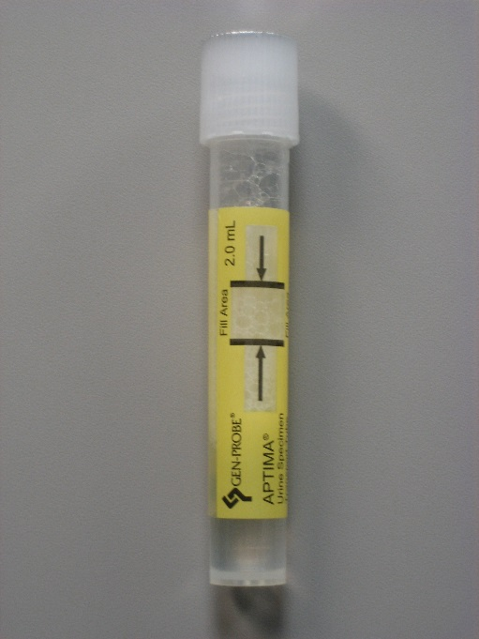
At-Home STI Testing
Urethral and Rectal testing for Gonorrhea and Chlamydia will be completed by participants at baseline and 12-month follow-up
Participants who test positive at baseline will also be sent kits at 3 and 6 months

Slide 12
KIU 2.0
Outcomes:
Unprotected anal sex acts
Sexually transmitted infection incidence
Differential efficacy across important sub groups of YMSM
race/ethnicity
relationship status
gay/bisexual identity

Slide 13
Study Design: Randomization Scheme
Intervention
Control
PowerPoint slides with information on HIV and STI prevention
Keep It Up! 2.0

Slide 14
Study Design: Randomization Scheme
Control – Non-interactive program for a general audience and similar to what can be found on the Internet
Topics are primarily focused on HIV and STI information
Information is presented in PowerPoint slides
Intervention – Interactive multimedia program specifically tailored to YMSM
Information is presented in animated clips, videos, and games
Topics include: community involvement, tips for safely hooking up online, and communication in relationships.
Notes:
Control = standard of care

Slide 15
Control Arm
Modules
Sexually Transmitted Infections (STIs)
HIV Myths and Facts
What is HIV and AIDS?
Who is Most at Risk for HIV Infection?
HIV Prevention
HIV Treatment Options
Setting Risk Reduction Goals
Boosters
3 Month Booster: Review of STIs
6 Month Booster: Review of HIV/AIDS & New HIV/AIDS Findings

Slide 16
KIU! Intervention Arm
KIU! Modules
Healthy and Whole Person (Diverse Peer Videos)
Hooking-Up Online (Stylized Animation)
Sex in the City (Scripted Soap Opera)
The Club Game (Virtual Reality Game)
Dating (an older partner) (Flash Animation Quiz)
A Serious Relationship (Flash Illustrated Story)
Setting Risk Reduction Goals (Scripted Flash Animation with Games)
KIU! Boosters
3 Month Booster: Repeat HIV Testing and Motivation for Condom Use
6 Month Booster: Healthy Romantic Relationships AKA “Boyfriend 101”

Slide 17
KIU! Preview: Module 1
Healthy and Whole Person
Street interviews in Atlanta, New York, and Chicago
Focuses on the role of the community, family, and relationships in keeping one healthy
Notes:
Welcomes and engages participants in the intervention.
Discusses connections to family, community, and romantic partners and setting positive peer norms for condom use and obtaining support from family of origin and choice.

Slide 18
KIU! Preview: Module 1

Slide 19
KIU! Preview: Module 2
Hooking Up Online
Objectives:
Learn to negotiate correct condom use and communicate assertively with hook ups
Recognize how their mood (i.e. boredom, horniness, loneliness) may influence sexual behavior
Notes:
Follow three YMSM chatting online with a focus on identifying triggers for unprotected sex. Embedded content focuses on the effects of mood on risk, negotiating correct condom use, consequences of drug and alcohol on decision making, and facts about STI symptoms and prevention

Slide 20
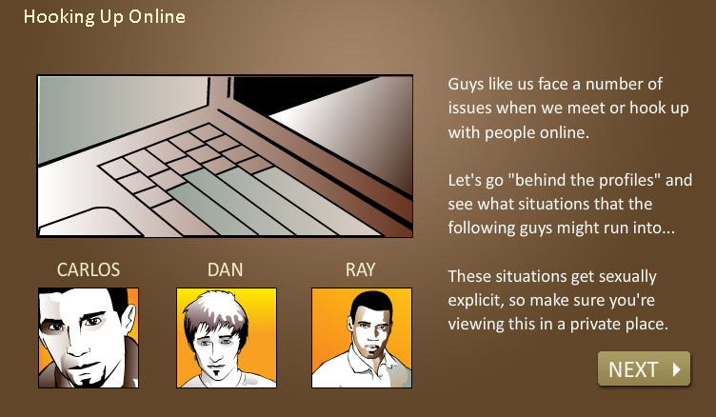
Module 2: Hooking Up Online

Slide 21
Module 2: Hooking Up Online

Slide 22
Module 2: Hooking Up Online

Slide 23
Module 2: Hooking Up Online

Slide 24
KIU! Preview: Module 3
Sex in the City
Objectives:
Understand the limitations of sero-sorting (asking a potential sex partner their HIV status) and making assumptions about partners’ HIV status
Distinguish between myths and facts regarding HIV transmission and prevention techniques
Notes:
A diverse case of YMSM highlight the risks in making assumptions about a partner’s HIV status or monogamy, the limits of serosorting in HIV negative YMSM when only ~20% of HIV+ YMSM known their status, the importance of regular testing and skills for negotiating condom use within relationships

Slide 25
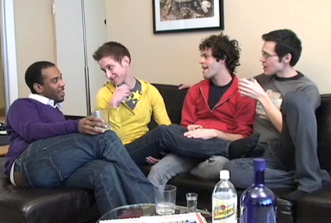
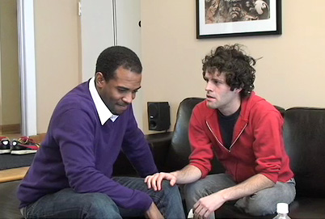
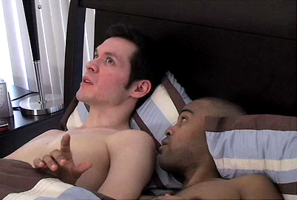
KIU! Preview: Module 3
Sex in the City

Slide 26
KIU! 2.0 Recruitment
Goal: 250 YMSM per city over 4 years of recruitment (N=750)
Strategies:
CBO-based recruitment at testing clinics
Outreach testing events
Online recruitment for at-home testing and testing on-site at Emory
Notes:
Online recruitment and at-home testing=remainder of talk

Slide 27
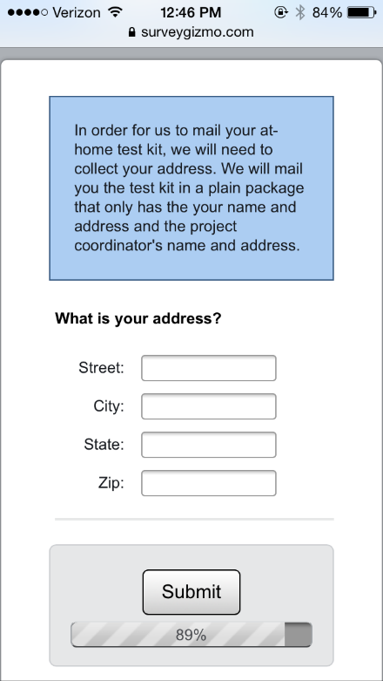
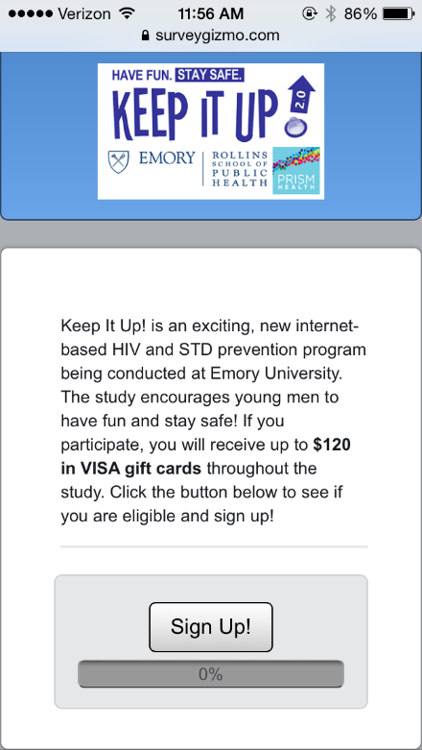
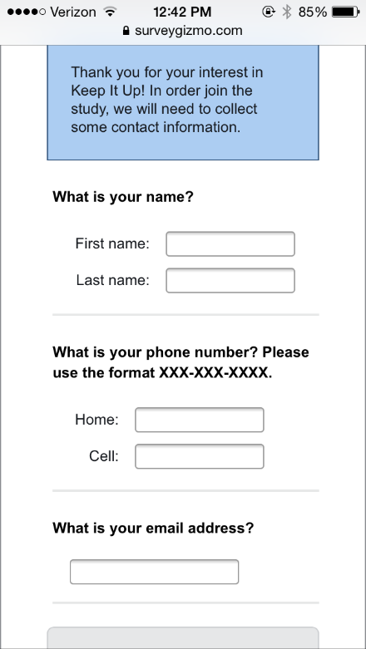
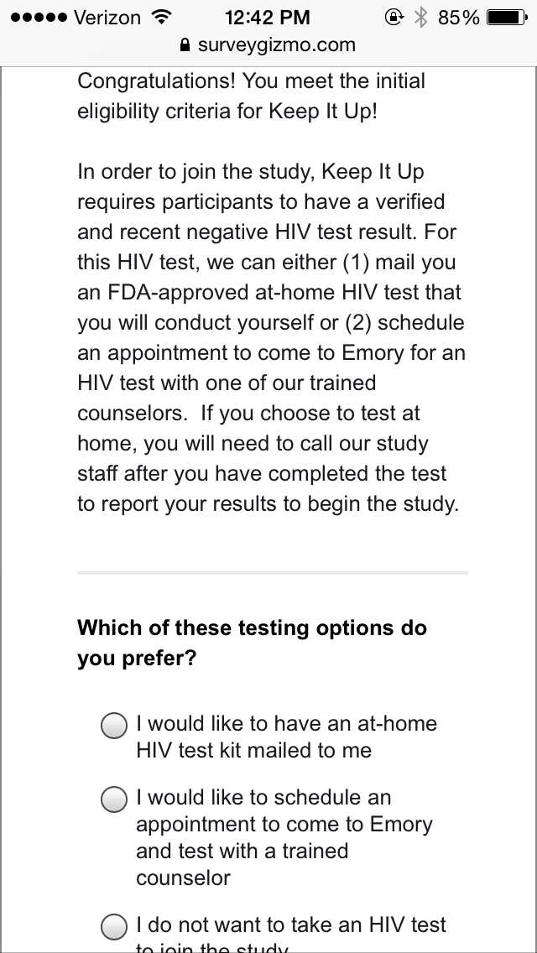
Recruitment: Online
Online advertisements linked to web-based screener placed on sites frequented by MSM

Slide 28
Online Recruitment
123 men provided contact through online screener

Slide 29
Testing at Emory
27 participants requested to come into Emory to test
We also allow participants to conduct the STI testing, baseline survey, and first part of the intervention during their visits at Emory.
Notes:
No problem getting most of these guys in for their visits.

Slide 30
Home Testing: Pilot – First 25 tests

Slide 31
Home Testing: Pilot – First 25 Participants
Welcome Calls

Slide 32
Home Testing: Remaining 71 Participants

Slide 33
Social Media for Participant Recruitment

Slide 34
Percent of internet users who use social networking sites, 2005-2013, Pew Research Center

Slide 35
Ad Targeting: Geotargeting
IP-based
Used by most social media sites to target by location
Sites that do not allow for profiles to be created, including non-social media sites, can geographically target an audience based on IP address
Ads on non-social media websites are often used for research
Usually chosen when they reach a particular audience and behavioral targeting is thus not needed

Slide 36
Ad Targeting: Keywords
Advertising linked to specific words or phrases
Commonly used by search engines
Ads are targeted towards words that are typed into the search box

Slide 37
Ad Targeting: Profile-based
Sites with profiles will allow you to target based on information on a person’s profile

Slide 38
Ad Targeting: Facebook
Facebook Targeting Options:
Location (based on IP and profile information)
Age
Gender
Interests
Connections to pages, apps, or events
Interested in
Relationship status
Languages
Education
Workplaces

Slide 39
Facebook Advertising Demonstration
https://www.facebook.com/ads/manage/campaigns/?act=32411375

Slide 40
Viral Marketing/Peer Share
Taps into social networks
Allows participants to refer their friends to the study
Email-based: ask participants to put in the email addresses of some of their friends at the end of the survey
Social-media based: show participant a list of their friends at the end of the survey and allow them to recruit peers within the social media website
Requires extensive development and programming
Can allow for restriction in referrals (i.e. gender, age, location)

Slide 41
Viral Marketing/Peer Share

Slide 42
Analytics: Performance
Impressions: Number of times the ad was shown
Clicks: Number of times the ad was clicked
Abandons or Bounces: Number of times someone clicked on the ad, made it to the survey, but exited out immediately
Disqualified: Clicked on the ad, completed the screener, and did not meet eligibility requirements
Partial: Clicked on the ad, completed the screener, met eligibility criteria, but did not submit last page of survey
Completed: Clicked on the ad, completed the screener, met eligibility criteria, and submitted last page of survey

Slide 43
Analytics: Performance
Example data from a national online survey recruited through Facebook targeting men who have sex with men
Impressions
5,731,330
Clicks
3661 (.064%)
Abandons
2132 (58%)
Partials
465 (13%)
Completes
999 (27%)
Disqualified
65 (2%)

Slide 44
Analytics: Cost
 | Black Gay Chat | Facebook
Cost | $270 | $221.02
Impressions | 744,816 | 1,024,368
Clicks | 1058 | 1906
Completes | 17 | 148
Cost per click | $0.26 | $0.12
Cost per 1,000 impressions | $0.36 | $0.22
Cost per complete | $15.88 | $1.49
Cost per click
Cost per 1,000 impressions
Cost per complete

Slide 45
Analytics: Cost
 | Black Gay Chat | Facebook
Cost | $270 | $221.02
Impressions | 744,816 | 1,024,368
Clicks | 1058 | 1906
Completes | 17 | 148
Cost per click | $0.26 | $0.12
Cost per 1,000 impressions | $0.36 | $0.22
Cost per complete | $15.88 | $1.49
Cost per click
Cost per 1,000 impressions
Cost per complete
Why use Black Gay Chat?

Slide 46
Analytics: Cost
 | Black Gay Chat | Facebook
Cost | $270 | $221.02
Impressions | 744,816 | 1,024,368
Clicks | 1058 | 1906
Completes | 17 | 148
Cost per click | $0.26 | $0.12
Cost per 1,000 impressions | $0.36 | $0.22
Cost per complete | $15.88 | $1.49
African American Respondents | 17 | 11
Cost per AA respondent | $15.88 | $20.09
Cost per click
Cost per 1,000 impressions
Cost per complete
Why use Black Gay Chat?

Slide 47
Variations in Cost with Targeting
Recruitment and cost data for banner advertisements on Facebook and Gay Ad Network for an online survey for MSM in Iowa, Minnesota, and South Carolina, 2010-2011
State | Impressions n | Clicks n (%) | Partial n (%) | Unique Eligible Completes n (%) | Cost per Unique Complete ($)
Iowa | 3,788,127 | 1412 (.037) | 196 (14) | 206 (15) | 10.54
Minnesota | 1,883,416 | 802 (.043) | 136 (17) | 181(23) | 9.69
South Carolina | 1,375,472 | 667 (.048) | 118 (18) | 107 (16) | 16.10
Total | 7,047,015 | 2881 (.041) | 450 (16) | 494 (17) | 11.43

Slide 48
Analytics: Geo-analytics
Example of mapped twitter data:
http://twitter.github.io/interactive/newyear2014/

Slide 49
Acknowledgements
IMPACT Program: Brian Mustanski, George Greene, Krystal Madkins, Dawn Brown, Benjamin Weis
CHEST: Jeffrey Parsons, Ruben Jimenez
PRISM Health Team: Patrick Sullivan, Josh Betts, Marcus Stanley, et al.
Emory Center for AIDS Research (P30 AI050409)
All of our partnering CBO’s in New York City, Atlanta, and Chicago
MCARTI Study at IDP

Slide 50
Questions?
Craig Sineath
rsineat@emory.edu
404-712-9211

