Slide 1
Childhood Immunization Update for WIC and
Clerical Personnel
Presented by:
Date:

Slide 2
Conflicts of Interest and Disclosures
Neither the planners or presenters indicated that they have any real or perceived vested interest that relate to this presentation nor any relationships with pharmaceutical companies, biomedical device manufacturers, and/or other corporations whose products and services are related to the vaccines we discuss.
There is no sponsorship or commercial support being received for this activity.
The mention of specific brands of vaccines in this presentation is for the purpose of providing education and does not constitute endorsement by the provider or ANCC of any commercial products.
For certain vaccines this may represent a slight departure from or off-label use of the vaccine package insert guidelines.
Notes:
Neither the planners or presenters indicated that they have any real or perceived vested interest that relate to this presentation nor any relationships with pharmaceutical companies, biomedical device manufacturers, and/or other corporations whose products and services are related to the vaccines we discuss.
There is no sponsorship or commercial support being received for this activity.
The mention of specific brands of vaccines in this presentation is for the purpose of providing education and does not constitute endorsement by the provider or ANCC of any commercial products.
For certain vaccines this may represent a slight departure from or off-label use of the vaccine package insert guidelines.

Slide 3
Overview of Topics
General vaccine guidelines
Review of vaccines on the Recommended Childhood and Adolescent Immunization Schedule
Summary of the Georgia requirements for child care and school attendance
Review of the Certificate of Immunization (Form 3231)
Notes:
Overview of topics to be discussed:
Discuss general vaccine guidelines that apply to all vaccines.
Review the vaccines on the Recommended Childhood and Adolescent Immunization Schedule. This schedule is updated annually. The state of Georgia utilizes this schedule to make immunization policies and recommendations.
(Optional Discussion)—Inquire if clerks will be issuing certificates or not, and if so, ask the coordinator if you need to cover these topics. If not, please delete these last 2 bullets on the slide.
Summary of the Georgia requirements for day care and school attendance
Review of the Certificate of Immunization (Form 3231)

Slide 4
TYPES OF VACCINES
LIVE VIRUS
MMR
VARICELLA
MMR / VARICELLA
INTRANASAL FLU
ROTAVIRUS VACCINE
ZOSTER VACCINE
Yellow Fever
INACTIVATED
DTaP
IPV
HEPATITIS A and B
HIB
PNEUMOCOCCAL
INJECTABLE FLU
Tdap and Td
MENINGOCOCCAL
DTaP/HIB
HEP B/HIB
DTaP/IPV/HEP B
HPV
Notes:
There are 2 basic types of injectable vaccines, live virus, such as the MMR and varicella or chickenpox vaccines, and inactivated or killed vaccines such as DTaP, IPV, hepatitis A and B vaccines, Hib, pneumococcal (both conjugate and polysaccharide), influenza, Tdap andTd, meningococcal vaccine, and the combination vaccines of DTaP/Hib, hepatitis B/Hib, DTaP/IPV/hepatitis B.
It may be necessary to know if a vaccine is a live virus or an inactivated vaccine when assessing recorded immunization dates for adequacy. This will be pointed out in the next slide.

Slide 5
VFC Program
All required vaccines are available through the GA VFC Program for VFC eligible children.
Notes:
The Vaccines For Children (VFC) program is a federally funded program that provides vaccines at no cost to children who might not otherwise be vaccinated because of inability to pay. CDC buys vaccines at a discount and distributes them to grantees—i.e., state health departments and certain local and territorial public health agencies—which in turn distribute them at no charge to those private physicians' offices and public health clinics registered as VFC providers. Children who are eligible* for VFC vaccines are entitled to receive those vaccines recommended by the Advisory Committee on Immunization Practices (ACIP).
All children who are VFC Eligible can receive required vaccines through the VFC program
This includes all children 0 through 18 years of age who are :
Medicaid eligible or American Indian or Alaska Native or Uninsured (no health insurance)or underinsured (have insurance but vaccines are not a covered benefit) or are enrolled in PeachCare.

Slide 6
The Impact of Vaccines
Disease | Average Annual Reported Cases Pre-vaccine* | Cases in U.S. 2013** | GA Cases 2013 | % Reduction In U.S. 2013
Smallpox | 48,164 | Eradicated worldwide in 1980
Diphtheria | 175,885 | 0 | 0 | 100%
Measles | 503,282 | 187 | 0 | >99.9%
Mumps | 152,209 | 584 | 10 | 99.6%
Pertussis | 147,271 | 28,639 | 317 | 80.6%
Polio (paralytic) | 16,316 | 1 | 0 | 99.9%
Rubella | 47,745 | 9 | 0 | >99.9%
Congenital Rubella Syndrome | 823 | 1 | 0 | 100%
Tetanus | 1,314 | 26 | 0 | 98.0%
H. Influenzae Type b Age<5 years | 20,000 | 31 | 0 | 99.8%
*MMWR 48(12);243-248 April 2, 1999
** MMWR 63(32);702-715 August 15, 2014
N/A = Data not available
Notes:
This table shows the impact of vaccines on the annual reported cases of some vaccine preventable diseases in the United States.
Column 2 shows the average number of reported cases of a specific disease prior to the licensure of the vaccine.
Column 3 shows the number of reported cases in the United States in 2013.
Column 4 shows the number of reported cases in Georgia in 2013.
Column 5 shows the percentage decrease in reported cases in the United States in 2013 compared with the pre-vaccine years.
Reference:
Achievements in Public Health, 1900-1999 Impact of Vaccines Universally Recommended for Children - United States, 1990-1998 MMWR April 02, 1999 / 48(12);243-248
MMWR 63(32);702-715 August 15, 2014

Slide 7
Herd Immunity
Immunized individuals block infection from reaching those who are unimmunized
UNIMMUNIZED
INFECTED
INFECTED
INFECTED
= immunized
Notes:
It is probably unrealistic to believe we can immunize everyone appropriately. There will always be young infants who have not received all recommended vaccines because of age and there are a significant number of adults who are not adequately immunized. Herd immunity refers to a situation in which a high percentage of a population is immune to a disease, essentially stopping the disease in its tracks because it cannot find new hosts. The threshold for herd immunity varies, depending on the disease, with more virulent infectious agents requiring vaccination of a higher percentage of the population to create the desired herd immunity. Most vaccination policies are focused on creating herd immunity. The creation of herd immunity is especially important in crowded environments which facilitate the spread of disease, like schools. It is also extremely important to receive regular boosters, as some vaccines lose their efficacy over time, leaving people vulnerable to an outbreak. Herd immunity led to the eradication of smallpox, and it explains why diseases such as polio and diphtheria are rare in developed nations with established vaccination policies.

Slide 8

Advisory Committee on Immunization Practices (ACIP)
15 voting members with expertise in one or more of the following:
Vaccinology
Immunology
Infectious diseases
Pediatrics
Internal Medicine
Preventive medicine
Public health
Consumer perspectives and/or social and community aspects of immunization programs
ACIP develops recommendations and schedules for the use of
licensed vaccines
Notes:
The dramatic reduction of vaccine preventable diseases in the United States can be attributed to the availability of vaccines, as well as recommendations and an organized vaccine schedule developed by the Advisory Committee on Immunization Practices (ACIP).
Ask the audience if they are familiar with the ACIP. If they are familiar with the ACIP the presenter can spend a minimal amount of time on this slide.
The nurse/non-physician partner will discuss the schedules later in the presentation.
The Advisory Committee on Immunization Practices (ACIP) consists of 15 experts in fields associated with immunization who have been selected by the Secretary of the U. S. Department of Health and Human Services to provide advice and guidance to the Secretary, the Assistant Secretary for Health, and the Centers for Disease Control and Prevention (CDC) on the most effective means to prevent vaccine-preventable diseases.
The Committee develops written recommendations for the routine administration of vaccines to the pediatric and adult populations, along with schedules regarding the appropriate periodicity, dosage, and contraindications applicable to the vaccines. ACIP is the only entity in the federal government which makes such recommendations.
The overall goals of the ACIP are to provide advice which will assist the Department and the Nation in reducing the incidence of vaccine preventable diseases and to increase the safe usage of vaccines and related biological products.
For more information: http://www.cdc.gov/vaccines/acip/index.html
Recommendations for each vaccine licensed by the FDA are developed by the Advisory Committee on Immunization Practices (ACIP):
-National committee coordinated by CDC
-Membership consists of experts in the fields of epidemiology and infectious diseases
-Represents areas of academia, research, and public and private providers
-Meets 3 times a year to review and discuss recommendations for each new vaccine that is approved by the FDA and to discuss any recommended changes for existing vaccines
-Has sole authority to add vaccines to the VFC Program
-A subcommittee of the ACIP, representing the AAP, AAFP, and CDC annually develop the Harmonized Recommended Childhood Immunization Schedule for the upcoming year.

Slide 9
Indications
Recommendations
Requirements
Indication
  -Information about the appropriate use of the vaccine
Recommendation
  -ACIP statement that broadens and further delineates the Indication found in the package insert
  -Basis for standards for best practice
Requirement
  -Mandate by a state that a particular vaccine must be administered and documented before entrance to child care and/or school
Notes:
9
EXAMPLES OF AN INDICATION
ADACEL vaccine is indicated for active booster immunization for the prevention of tetanus, diphtheria and pertussis as a single dose in persons 10 through 64 years of age.
BOOSTRIX® is indicated for active booster immunization against tetanus, diphtheria, and pertussis as a single dose in individuals 10 through 64 years of age.
EXAMPLE OF A RECOMMENDATION
Recommendations by ACIP for the routine administration of vaccines. May include other information and guidance on epidemiology of the disease, appropriate timing, dosage, contraindications to the vaccine and guidance for use in special populations. Appears first as “provisional recommendation” but once approved, appears in the MMWR as full recommendation
EXAMPLE OF VACCINE REQUIREMENTS FOR ENTRY INTO CHILD CARE FACILITIES IN GEORGIA
Consistent with the Recommended Childhood and Adolescent Immunization Schedule
Children are required to be age appropriately immunized against each of these diseases: Hepatitis B, Diphtheria, Tetanus, Pertussis, Polio, Hib, Pneumococcus, Measles, Mumps, Rubella, Varicella, Hepatitis A

Slide 10
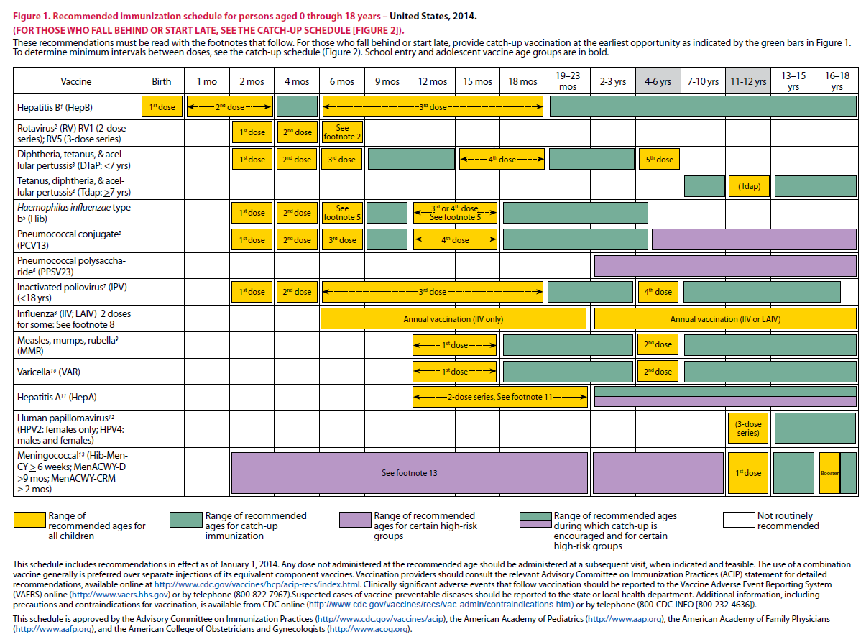
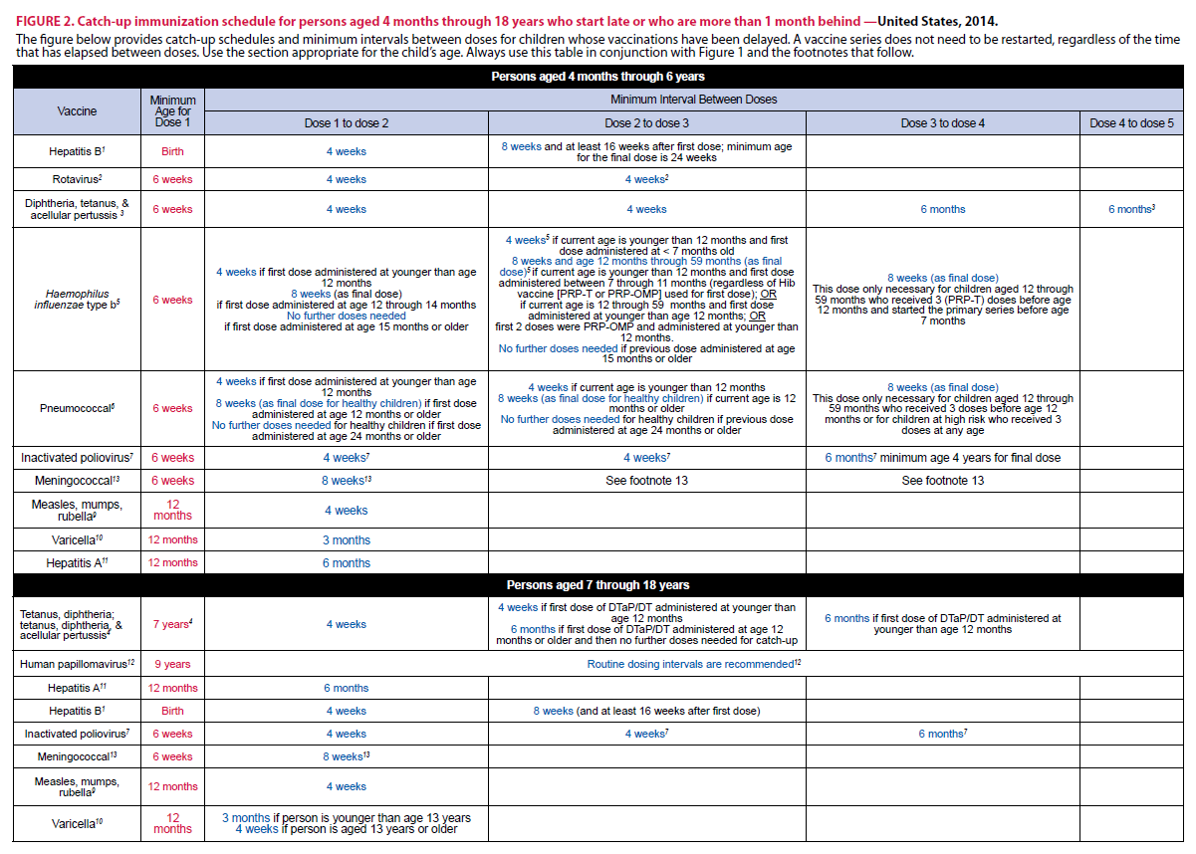
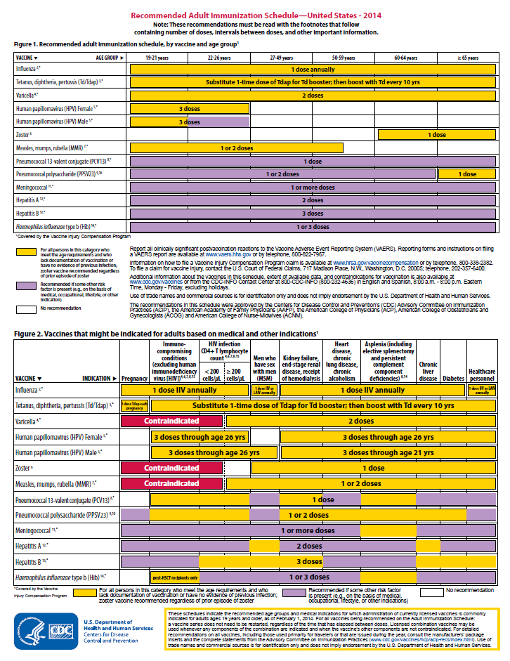
Immunization Schedules
All staff must use the same immunization schedule
Four Schedules:
  Children & Adolescents
  0 through 18 years
  Catch-up schedule for
  ages 4 months -18 years
  Adult 19 years and older
  Adult based on medical
  and other indications
READ THE FOOTNOTES
http://www.cdc.gov/vaccines/schedules/hcp/child-adolescent.html
http://www.cdc.gov/vaccines/schedules/hcp/adult.html
Notes:
10
10
Changes in the Schedule Effective January 26, 2015
•Figure 1, "Recommended Immunization Schedule for Persons Aged 0 through 18 Years” was modified to highlight the recommendations for influenza vaccination for children for 1) live attenuated influenza vaccine, which may only be administered beginning at 2 years of age, and 2) children 6 months through 8 years, who need two doses of influenza vaccine in the first year vaccinated, and in subsequent years they only require one dose of vaccine. Therefore, the gold bar for LAIV or IIV 1 or 2 doses extends from 2 through 8 years (midpoint of column for 7-10 years) and a new gold bar (1 dose) extends from 9 to 18 years to reflect these changes.
•A purple bar was added for measles-mumps-rubella vaccine for children 6-11 months of age, denoting the recommendation to vaccinate such children if they plan to travel or live abroad.
•The diphtheria/tetanus/acellular pertussis (DTaP) vaccine footnote had language added stating if the fourth dose DTaP vaccine was administered four months or more after the 3rd dose, at an appropriate age, it can be counted as a valid dose, and need not be repeated after the recommended six month interval between doses three and four.
•The meningococcal conjugate vaccine footnote was revised to more clearly present recommendations for use of MenACWY-CRM, MenACWY-D, and Hib-MenCY-TT in children with anatomic or functional asplenia, or with persistent complement deficiencies, aged 2 months and older.
•The pneumococcal vaccine footnote was updated to provide clearer guidance for vaccination of persons with high-risk conditions:
- Administer 1 dose of PCV13 if any incomplete schedule of 3 doses of PCV (PCV7 and/or PCV13) were received previously.
Administer 2 doses of PCV13 at least 8 weeks apart if unvaccinated or any incomplete schedule of fewer than 3 doses of PCV (PCV7 and/or PCV13) were received previously.
•Figure 2, Catch-Up Immunization Schedule: Haemophilus influenzae type b (Hib) conjugate vaccine, pneumococcal conjugate vaccine, and tetanus, diphtheria, acellular pertussis (Tdap), and varicella vaccine catch-up schedules were updated to provide more clarity. Minimum ages were noted as “not-applicable” for children 7 years of age and older for hepatitis A and B, polio, meningococcal, MMR, and varicella vaccines.
•The influenza vaccine footnote was updated to reflect revised contraindications for the live attenuated influenza vaccine (LAIV): LAIV should not be administered to some persons, including 1) persons who have experienced severe allergic reactions to LAIV, any of its components, or to a previous dose of any other influenza vaccine 2) children 2 through 17 years receiving aspirin or aspirin-containing products, 3) persons who are allergic to eggs; 4) pregnant women; 5) immunosuppressed persons; 6) children 2 through 4 years of age with asthma or who had wheezing in the past 12 months; or 7) persons who have taken influenza antiviral medications in the previous 48 hours. All other contraindications and precautions to use of LAIV are in the MMWR; August 15, 2014 / 63(32);691- 697 available at http://www.cdc.gov/mmwr/pdf/wk/mm6332.pdf [40 pages].
The 2015 adult immunization schedule contains the following changes from the 2014 schedule:
•Figure 1, the recommended adult immunization schedule by vaccine and age group, has been revised to designate PCV13 for adults aged 65 years or older as "recommended" (from the previous "recommended if some other risk is present"). Figure 2, showing vaccines that might be indicated for adults on the basis of medical and other indications, is unchanged.
•The footnotes for pneumococcal vaccination have been revised to provide algorithmic, patient-based guidance for the health care provider to arrive at appropriate vaccination decisions for individual patients.
•The footnote for influenza vaccination has been updated to indicate that adults aged 18 years or older (changed from adults aged 18 through 49 years) can receive RIV. A list of currently available influenza vaccines can be found at http://www.cdc.gov/flu/protect/vaccine/vaccines.htm.
•Table 1, showing contraindications and precautions to commonly used vaccines in adults, has been revised to update the section on LAIV to reflect the changes in the ACIP recommendations for the 2014–2015 influenza season. These changes include moving "influenza antiviral use within the last 48 hours" from the precautions column to the contraindications column, and moving asthma and chronic lung diseases; cardiovascular, renal, and hepatic diseases; and diabetes and other conditions from the contraindications column to the precautions column. Immune suppression, egg allergy, and pregnancy remain contraindications for LAIV.

Slide 11
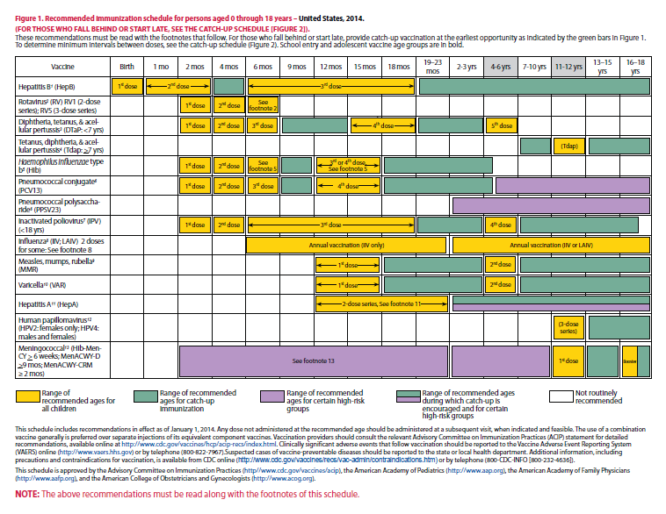
Notes:
(Encourage participants to look at the schedule.)
As we review the schedule for each vaccine, a good way to determine what immunizations are due for a child at a particular age is to hold a piece of paper at the end of the year that displays the child’s current age.
For example, in this slide this child is 7 months of age. To determine what he should have already been given, hold the piece of paper at the 6 month line. Whatever vaccines are completely to the left of the line (gray area) should have been administered ( Hepatitis B-2doses, rotavirus 3 doses, DTaP –3 doses, Hib- 2-3 doses,depending upon the brand , PCV- 3 doses, IPV- 2 doses, and possibly influenza). If not, those vaccines should be administered to begin to catch him up.
You will note that some vaccines, like the 3rd dose of hepatitis B and IPV are not completely to the left. This means that the 3rd dose of Hep B and IPV are recommended to be given by 18 months of age. The exact age at which the provider chooses to give these 3rd doses depends upon the child’s health status and other conditions, such as mother’s Hepatitis B surface antigen status or requirements for child care attendance. But in any situation the 3rd doses should be administered by 18 months. Influenza vaccination would be dependent upon the time of year.

Slide 12
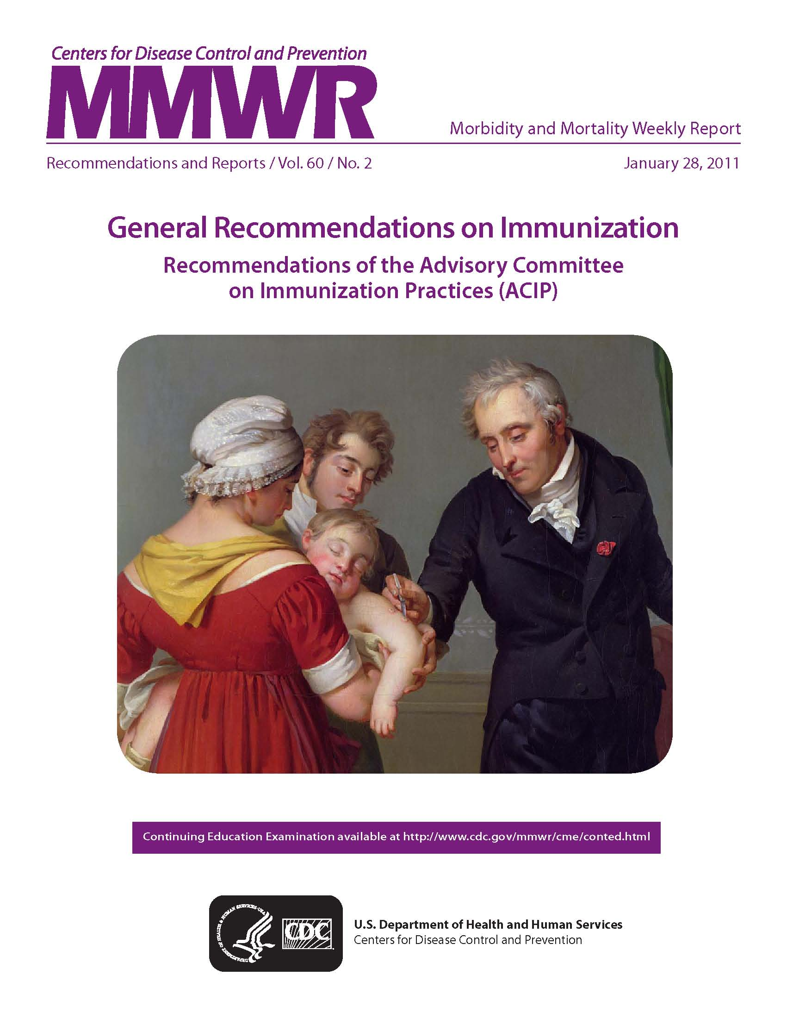
Observe the Guidelines
Route of administration
Number of doses required
4-day grace period
Minimal age for immunization
Minimal interval between doses
Notes:
In order to understand the how vaccines are administered you must understand the General Recommendations Guidelines.
The Guidelines are specific administration guidelines that have been established for each vaccine. Minimum age and intervals for vaccines are set by manufacturers during clinical trials; too young an age or too close together may alter effectiveness of a vaccine.
There is a 4-day grace period – vaccines given during the 4-day window before the recommended age/interval may be counted as valid. It is suggested that MMR and Varicella, not be given before one year of age. GRITS tables have been set up to calculate this correctly when a vaccine history is entered.
Some healthcare providers may feel that there is very little clinical significance when a vaccine is given 5 or 6 days before it is due and 4 days before it is due. The CDC has set the upper limit of the grace period at 4 days and healthcare providers should follow this recommendation.
Ref: General Recommendations on Immunization MWR 2011; 60 (No. RR-2) Jan 28, 2011

Slide 13
Vaccines Received Outside the U.S.
Accept doses if:
  written, dated record
  age, spacing, and timing comparable with that recommended in the U.S.
Special consideration for children adopted from orphanages
Table 12 in the General Recommendations ACIP Statement
Notes:
With the increase in immigrant and refugee populations, plus the migrant workers who may access WIC clinics, it is important to be familiar with some of the guidelines for evaluating vaccines received outside the U.S.
Accept doses if:
there is a written, dated record
the age at vaccine administration, the spacing, and the timing of vaccination is comparable with that recommended in the U.S.
Special consideration needs to be made in evaluating immunization records from children who were adopted from overseas orphanages
Table 12 in the General Recommendations ACIP Statement gives approaches to the evaluation and vaccination of internationally adopted children with no or questionable vaccination records.
If there is any question about the child’s record or vaccines received, refer him to his medical provider or the health department.

Slide 14
Vaccination of International Adoptees
Revaccination generally recommended if there is any doubt about the validity of vaccination record
Serologic testing should be considered, particularly for hepatitis B and DTaP if there are 3 or more documented doses
Notes:
If there is any doubt about the validity of the vaccination record or of any of the vaccines given, the child may need to be revaccinated.
Blood testing to check for immunity should be considered, particularly for hepatitis B and DTaP if there are more than 3 documented doses.
* General Recommendations on Immunization, MMWR, December 1, 2006, Vol. 55, No. RR-15, pg. 33/35.

Slide 15
DOCUMENTATION
Update the clinic immunization record and GRITS history from the child’s personal record as needed, and vice versa
Complete necessary WIC forms showing request for record, review of record, and/or referral for immunizations
Provide other referral information for client as needed (i.e., DFCS, PeachCare, local health department, etc.)
Notes:
If the child’s personal record shows more current immunizations than the clinic’s record, be sure to update the clinic record and the GRITS history, and vice versa.
Complete WIC documentation forms as needed.
Provide client with other referral information as needed (DFCS, PeachCare, health dept. information, etc.)

Slide 16
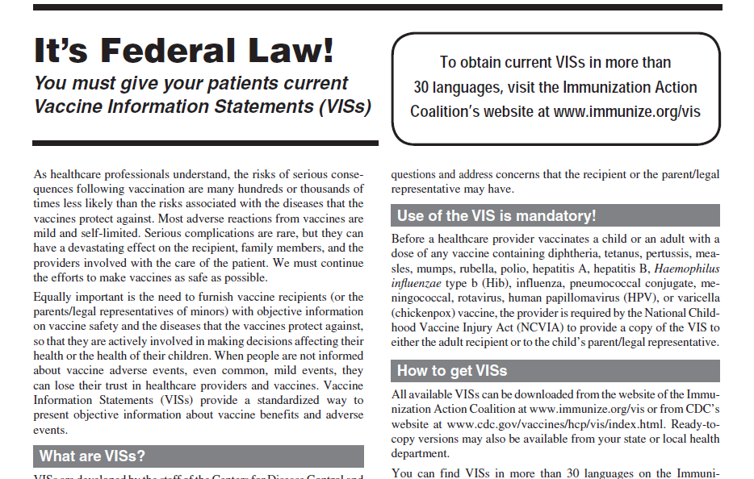
IT’s The Law!
Notes:
It’s Federal Law! You must give your patients current Vaccine Information Statements (VISs)
Equally important is the need to furnish vaccine recipients (or the parents/legal representatives of minors) with objective information on vaccine safety and the diseases that the vaccines protect against, so that they are actively involved in making decisions affecting their health or the health of their children. When people are not informed about vaccine adverse events, even common, mild events, they can lose their trust in healthcare providers and vaccines.
Vaccine Information Statements (VISs) provide a standardized way to present objective information about vaccine benefits and adverse events.
Before a healthcare provider vaccinates a child or an adult with a dose of any vaccine containing diphtheria, tetanus, pertussis, measles, mumps, rubella, polio, hepatitis A, hepatitis B, Haemophilus influenzae type b (Hib), influenza, pneumococcal conjugate, meningococcal, rotavirus, human papillomavirus (HPV), or varicella (chickenpox) vaccine, the provider is required by the National Childhood Vaccine Injury Act (NCVIA) to provide a copy of the VIS to either the adult recipient or to the child’s parent/legal representative.

Slide 17
What You Need To Know About
Vaccine Preventable Diseases
Notes:
17
Many healthcare workers, patients and parents of young children and adolescents have grown up in the vaccine era. They are not familiar with the world we lived in before the availability of vaccines when most children were infected with whooping cough, measles, mumps, and chicken pox during their preschool or school years. These diseases were called “childhood diseases” because most children had these diseases during their childhood years. Most children were sick for a short period of time and recovered. Some children developed complications and some were left with permanent physical and/or mental disabilities. Some died as a result of these diseases.
A much smaller number of children were infected with Haemophilus influenza, type b, pneumococcus, meningococcus and polio. Their course of illness was much more severe and complications and death were more common.
Adults who were not immune to these infections because they were not infected during childhood could contract these diseases after adolescence and experience a much more severe illness.
Patients and parents may ask about these diseases. Therefore, it is important for healthcare providers to be familiar with the symptoms of these vaccine preventable diseases.
YOU MUST KNOW ABOUT THESE DISEASES TO BE A
BETTER ADVOCATE FOR IMMUNIZATIONS

Slide 18
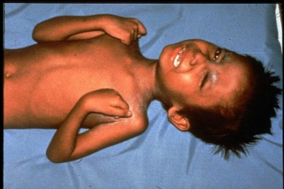

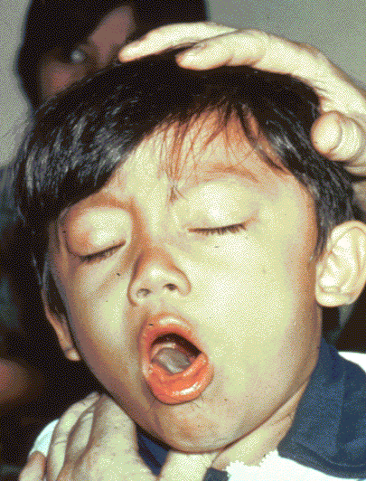

Diphtheria
Tetanus
Required for school and child care attendance
Pertussis
Notes:
Ask participants what are: Diphtheria, tetanus and pertussis?
Whooping cough (pertussis), tetanus, and diphtheria are serious diseases caused by bacteria.
Whooping cough and diphtheria are spread person-to-person through the air. Tetanus gets into the body through cuts or wounds.
Whooping cough can trigger such bad coughing that babies can’t breathe. Babies are the most likely to die from whooping cough and can have complications such as seizures and brain damage. Tetanus can cause extremely painful muscle cramps all over the body. Diphtheria can lead to severe breathing problems, heart problems, and paralysis. All these diseases can be deadly.
The diphtheria germ lives in the throat and mouth of the infected person.
The disease is spread through direct contact with the infected person.
Now we don’t see as much of this disease in the United States.
The tetanus germ lives in dirt and the intestines and the feces of animals
The germ enters the body through cuts, punctures, burns, and other wounds.
However, there are still outbreaks throughout the world, and the danger is for an international traveler to bring infection into the US.
Most cases of tetanus reported occur in adults who have not been immunized or who are under immunized; i.e., they have not received boosters to maintain a level of protection.
The pertussis germ lives in the mouth, nose, and throat of the infected person.
The germ is spread from person to person by coughing and sneezing.
Pertussis vaccine is given to prevent pertussis in infants and children.
Other complications include pneumonia, seizures, and death. Adults may also get pertussis, but they usually do not get very sick and may not be aware they have the disease.
Diphtheria, tetanus, and pertussis are illustrated on this slide
The top left picture is of a throat of a child who has diphtheria. You can see the thick gray coating over the back of the throat. This coating can eventually expand down through the airway, and if not treated, a person could die from suffocation, or suffer other complications such as paralysis, heart failure, or coma.
In the top right picture, this child is experiencing painful muscle spasms from tetanus. It is nearly impossible for him to move or control the muscles in his body. He cannot eat because the muscles in his mouth have become so tight and it is difficult for him to swallow. Other possible complications are broken bones from muscle spasms, breathing problems, and death.
The bottom picture shows a child who is suffering from pertussis, commonly know as “whooping cough”. He is experiencing coughing spasms, which produce a “whooping” sound. The sound occurs because the child is trying to catch his breath before the next round of coughing. Often children have difficulty breathing and experience vomiting and exhaustion from the severe coughing.

Slide 19
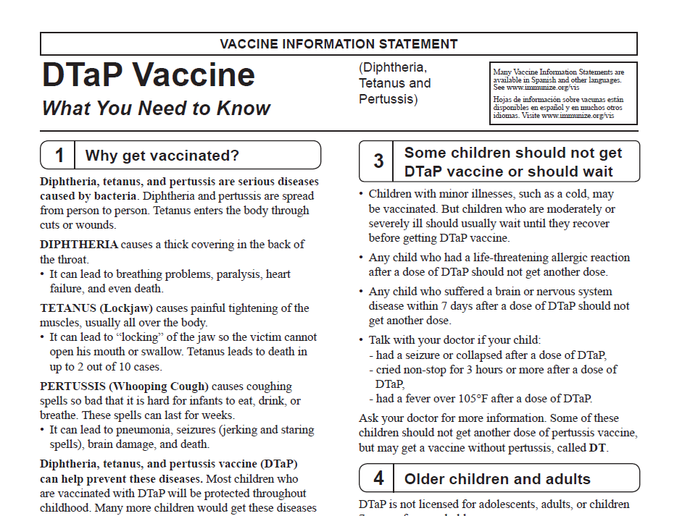
Notes:
Children should get 5 doses of DTaP vaccine, one dose
at each of the following ages:
􀂇2 months
􀂇4 months
􀂇6 months
􀂇15–18 months
􀂇4–6 years
DTaP may be given at the same time as other vaccines.
Some children should not get
DTaP vaccine or should wait
􀂇Children with minor illnesses, such as a cold, may be vaccinated. But children who are moderately or severely ill should usually wait until they recover before getting DTaP vaccine.
􀂇Any child who had a life-threatening allergic reaction after a dose of DTaP should not get another dose.
􀂇Any child who suffered a brain or nervous system disease within 7 days after a dose of DTaP should not get another dose.
􀂇Talk with your doctor if your child: had a seizure or collapsed after a dose of DTaP, cried non-stop for 3 hours or more after a dose of DTaP, had a fever over 105°F after a dose of DTaP.
Ask your doctor for more information. Some of these children should not get another dose of pertussis vaccine, but may get a vaccine without pertussis, called DT.
Kinrix (DTaP, IPV)
Indications for Use and Schedule
Approved for: Routine schedule of one dose at 4-6 years; Second booster dose of DTaP (5th dose) and IPV (4th dose); Ages 4 years through 6 years (6 years, 364 days)
Do not use:
· For dose 1, 2, 3, or 4 of DTaP or dose 1, 2, or 3 of IPV
· In children 7 years of age and older
Make sure minimum age and minimum intervals are met:
· Minimum age for the 5th dose of DTaP is 4 years
· Minimum interval between dose 4 & 5 of DTaP is 6 months
Pediarix (DTaP, IPV, HepB)
Indications for Use and Schedule
Approved for: Routine schedule 2, 4, 6 months of age; Dose 1, 2, 3 of DTaP; dose 1, 2, 3 of IPV; any dose of HepB Ages 6 weeks through 6 years (6 years, 364 days)
Do not use: For the 4th or 5th dose of DTaP or the 4th dose of IPV; For children 7 years of age or older
Make sure minimum age and minimum intervals are met: Minimum age for dose 1 is 6 weeks; Minimum age for dose 3 is 6 months; Minimum intervals: 4 weeks between dose 1 & 2; 8 weeks between dose 2 & 3
Pentacel (DTaP, IPV, Hib)
Indications for Use and Schedule
Approved for: Routine schedule of 2, 4, 6, and 15-18 months of age; Ages 6 weeks through 4 years (4 years, 364 days); For doses 1, 2, 3 or 4 of DTaP, IPV or Hib
Do not use: For any person 5 years of age and older; For the 5th dose of DTaP or, if needed, a 5th dose of IPV; Make sure minimum age and minimum intervals are met:
· Minimum age for dose 1 is 6 weeks; Minimum age for dose 4 is 12 months; Minimum intervals: 4 weeks between dose 1 & 2; 4 weeks between dose 2 & 3; 6 months between dose 3 & 4

Slide 20
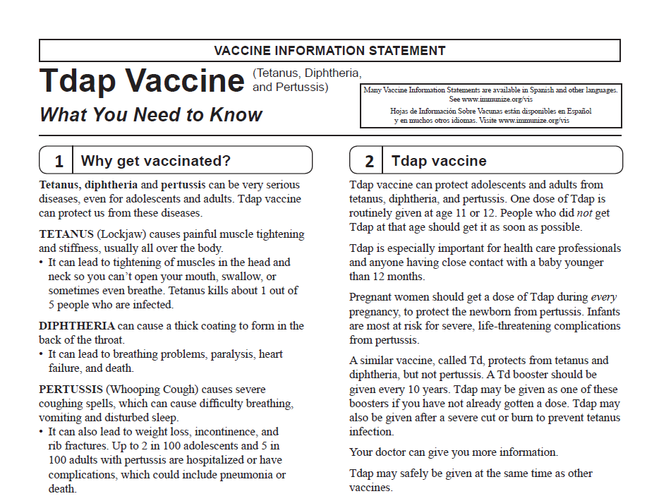
Notes:
Tdap vaccine can protect adolescents and adults from tetanus, diphtheria, and pertussis. One dose of Tdap is routinely given at age 11 or 12. People who did not get Tdap at that age should get it as soon as possible. Tdap is especially important for health care professionals and anyone having close contact with a baby younger than 12 months.
Pregnant women should get a dose of Tdap during every pregnancy, to protect the newborn from pertussis. Infants are most at risk for severe, life-threatening complications from pertussis.
Tdap Vaccines: Boostrix®: for persons aged 10 years and older/ Adacel®: for persons aged 10 through 64 years
Routine Indications for Use and Schedule:
Administer a single dose to: Adolescents at aged 11-12 years; Persons aged 13 years/older without a documented dose; Pregnant women during every pregnancy
Minimum interval: To ensure pertussis protection, administer a single Tdap dose regardless of the interval since last tetanus/diphtheria containing
vaccine (DTaP, Td)
SPECIAL SITUATIONS
Catch-up Recommendations for Children aged 7-10 Years
For children with an incomplete DTaP*/Td series or who have an unknown history of DTaP/Td vaccination: Give one dose of Tdap (preferably for the 1st dose, if more than one dose is needed); Use Td vaccine for any additional doses (possibly 1-2) necessary to complete a primary series; Use appropriate minimum intervals; A complete DTaP series is 5 doses or 4 doses with 1 dose at/after age 4 years that meet minimum age/interval requirements
Catch-Up Recommendation for Adolescents aged 13 Years and Older, including Health Care Personnel
• Should be given a Tdap regardless of the interval since the last tetanus or diphtheria-containing vaccine
• 3 doses (primary series) of tetanus and diphtheria containing vaccine are needed before a booster dose is effective
• Tdap should be substituted for a single dose of Td in the catch-up series; Use Td for the other doses; Use appropriate minimum intervals
Recommendations for Persons with Close Contact to an Infant Less than Age 12 Months
• Give Tdap as soon as feasible---at least 2 weeks before contact with infant (if no previous documented dose)
Recommendations for Pregnant Women (all ages)
• Administer one dose of Tdap to pregnant women during every pregnancy; optimal timing is between 27 and 36 weeks gestation
o If no history of a previous Tdap dose and if not administered during pregnancy, give a dose of Tdap immediately post-partum
o If indicated (i.e., wound management), Tdap may be given in any trimester of pregnancy
Use of Tdap for Wound Care (for wounds that are not clean and/or not minor)
• Do not miss an opportunity to provide pertussis protection---remember there is no minimum interval between Tdap and last Td
• For children aged 7-9 years, Tdap may be given in place of a Td vaccine for wound care if use of a pertussis-containing vaccine is also indicated
(see catch-up recommendations for this age group)
• Administer Tdap to persons aged 10 years and older who:
o Have not received any tetanus-containing vaccine in the last 5 years and
o Have not received a previous dose of Tdap vaccine
Effective July1, 2014
-children born on or after January 1, 2014 who are attending seventh grade, and children who are new entrants into a Georgia School in grades eight through twelve, must have received one dose of Tdap vaccine.

Slide 21
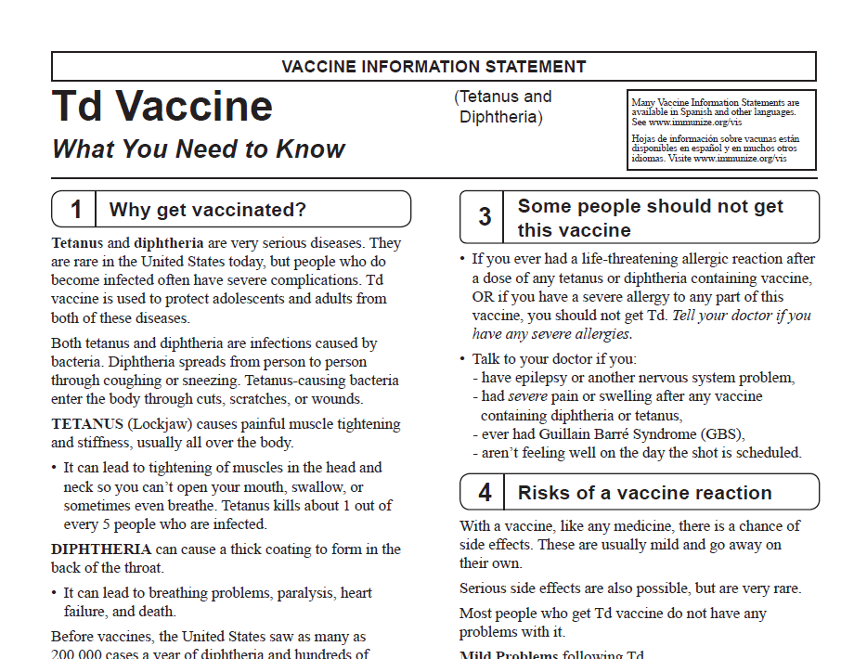
Notes:
Td vaccine can protect adolescents and adults from tetanus and diphtheria. Td is usually given as a booster dose every 10 years but it can also be given earlier after a severe and dirty wound or burn.
Use Tenivac Td for: Persons 7 years and older; Anyone who has previously received a Tdap vaccine; Person with a contraindication to pertussis vaccine
Schedule: Routine Schedule: 11-12 years; Booster dose every 10 years; Minimum Interval: 5 years
Routine Td Schedule Unvaccinated Persons 7 years of age or older
Dose* Interval
Primary 1 *****
Primary 2 4 weeks
Primary 3 6 to 12 months
Wound Care
Administer Td to persons with a wound that is not clean and/or not minor and it has been 5 years since the last dose of tetanus containing vaccine if they are: 7-9 years of age (Tdap may be used if there is an additional indication for a pertussis-containing vaccine); 10-64 years of age & have received a previous dose of Tdap vaccine 65 years of age and older (Tdap may be used if there is an additional indication for a pertussis-containing vaccine)
Contraindications
Allergic reaction to a previous dose of DTaP/Tdap/Td vaccine or a component of the vaccines
Moderate or severe illness
Precautions
History of Guillain-Barré Syndrome within 6 weeks of a tetanus-containing vaccine
History of a severe arthus-type reaction after a previous dose of a tetanus or diphtheria containing vaccine
Tip caps of the prefilled syringes may contain natural rubber latex which may cause allergic reactions in latex sensitive clients

Slide 22
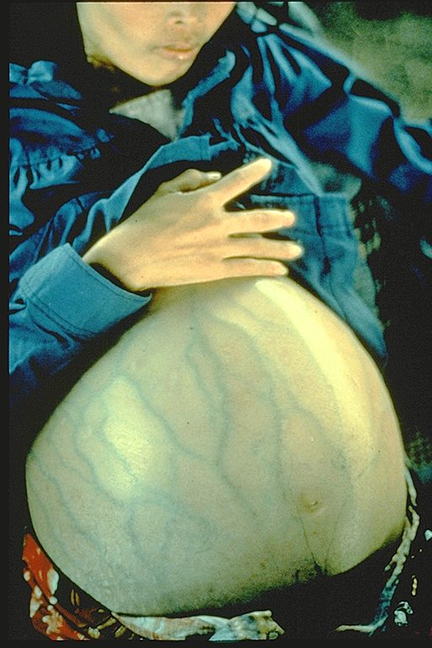
Hepatitis B
Notes:
Hepatitis B is a serious liver disease caused by a virus. Your can get infected with hepatitis B if you come in contact with an infected person’s blood or other body fluids. Babies can get the virus from their infected mothers at birth or if they live with or are cared for by an infected person. The virus can be spread just by sharing a toothbrush with an infected person. For some people, the virus remains in their body for years. During this time, the virus can attack the liver and cause serious problems like liver failure or cancer.
The woman shown in this slide has severe ascites due to liver damage caused by hepatitis B. Hepatitis B (she is not pregnant) can be prevented by Hepatitis B vaccine, the first vaccine listed on the schedule.
When administering Hepatitis B vaccine, it is important that you assess the mother’s hepatitis B surface antigen status so you will know how aggressively to administer the vaccine to the infant and also if you will need to do follow up testing on the infant.
Examples of methods of transmission include the following:
Using unsterilized needles
Sexual contact with a person who has hepatitis B
Sharing toothbrushes, razors, or washcloths
Babies can be infected during childbirth if the mom is infected
Babies and young children can be infected if the infected person pre-chews baby food.
Over half of the people who get hepatitis B have no symptoms. For people who do get symptoms, they might include:
Loss of appetite, nausea or vomiting
Weakness and tiredness
Fever and headaches
Yellow skin and eyes
Being immunized against Hepatitis B is also a requirement for attendance in child care and entry to school in GA.

Slide 23
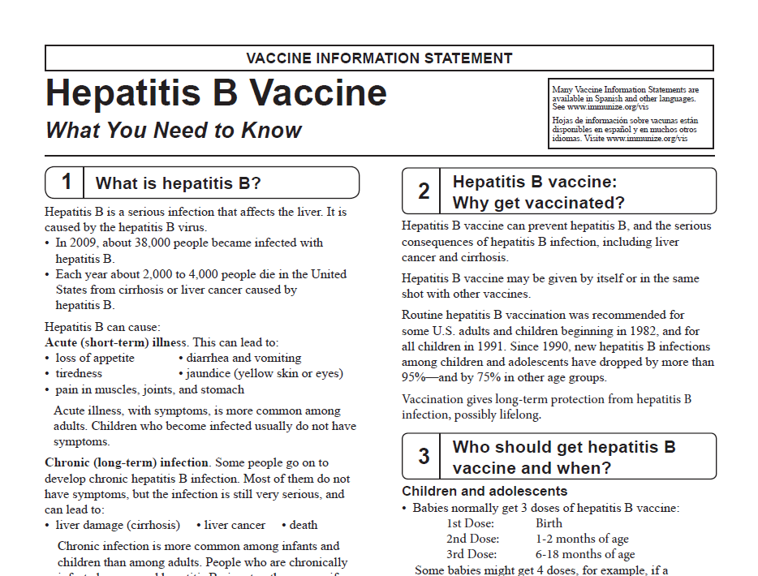
Notes:
Children and adolescents
􀂇Babies normally get 3 doses of hepatitis B vaccine:
1st Dose: Birth, 2nd Dose: 1-2 months of age, 3rd Dose: 6-18 months of age. Some babies might get 4 doses, for example, if a combination vaccine containing hepatitis B is used. (This is a single shot containing several vaccines.) The extra dose is not harmful. The final (third or fourth) dose in the HepB vaccine series should be administered no earlier than age 24 weeks. Administration of a total of 4 doses of HepB vaccine is permitted when a combination vaccine containing HepB is administered after the birth dose.
Infants who weigh less than 2000 grams at birth and are born to HBsAg- positive women, should be given post-exposure prophylaxis as described earlier. However the initial dose at birth should not be counted in the required 3 dose schedule. The next dose should be administered as described for low birth weight infants, when the infant is one month of age, chronologically. The third dose should be given 1-2 months after the second, and the fourth dose should be given at 6 calendar months of age.
*General Recommendations on Immunization, MMWR, December 1, 2006, Vol. 55, RR-15, pg. 13 (Table 1 footnotes).
Anyone through 18 years of age who didn’t get the vaccine when they were younger should also be vaccinated.
Adults
All unvaccinated adults at risk for hepatitis B infection should be vaccinated. This includes: sex partners of people infected with hepatitis B, men who have sex with men, people who inject street drugs, people with more than one sex partner, People with chronic liver or kidney disease, people under 60 years of age with diabetes, people with jobs that expose them to human blood or other body fluids, household contacts of people infected with hepatitis B, residents and staff in institutions for the developmentally disabled, Kidney dialysis patients, people who travel to countries where hepatitis B is common, people with HIV infection.
􀂇Other people may be encouraged by their doctor to get hepatitis B vaccine; for example, adults 60 and older with
diabetes. Anyone else who wants to be protected from hepatitis B infection may get the vaccine.
Pregnant women who are at risk for one of the reasons stated previously should be vaccinated. Other pregnant
women who want protection may be vaccinated.
Adults getting hepatitis B vaccine should get 3 doses—with the second dose given 4 weeks after the first and the third dose 5 months after the second. Your doctor can tell you about other dosing schedules that might be used in certain circumstances.
COMBINATION VACCINES
• Comvax- combination with Haemophilus influenzae type b (Hib) vaccine; licensed for use at 2, 4, and 12 through 15 months of
age; must not be administered to infants younger than 6 weeks of age or for doses at birth or 1 month of age for a child on a 0,1,6 month schedule
• Pediarix- Minimum age for the first dose is 6 weeks, cannot be used for the birth dose of the hepatitis B series; approved for
the first three doses of the DTaP and IPV series; it is not approved for fourth or fifth booster doses of the DTaP or IPV series
• Twinrix- approved for persons aged 18 years and older, and can be used in persons in this age group with indications for both
hepatitis A and hepatitis B vaccines; administered in a three-dose series at 0, 1, and 6 months; the first and third doses should be separated by at least 6 months; the first and second doses should be separated by at least 4 weeks, and the first and second
doses should be separated by at least 5 months.
PRECAUTIONS
• Persons with moderate or severe acute illness should not be vaccinated until their conditions improve; however, a minor
illness, such as an upper respiratory infection, is not a contraindication to vaccination
CONTRAINDICATIONS
• Severe allergic reaction (anaphylaxis) to yeast, or to any other component in the vaccine following a prior dose of hepatitis B
vaccine is a contraindication to further doses of vaccine
FURTHER POINTS
• You might be asked to wait 28 days before donating blood after getting hepatitis B vaccine. This is because the screening test
could mistake vaccine in the bloodstream (which is not infectious) for hepatitis B infection.

Slide 24
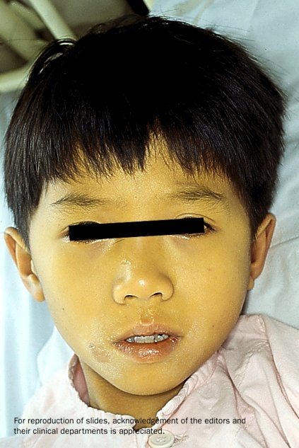

Hepatitis A
Required for school or child care attendance for children born on or after 1-1-06
Notes:
Hepatitis A is a serious liver disease caused by a virus. The virus is found in the feces (poop) of infected people. The hepatitis A virus is spread when invisible particles of feces (poop) get into a person’s mouth. You can get hepatitis A by eating contaminated food or drinking contaminated water, during sex, or just by living with an infected person. Hepatitis A can your skin and eyes turn yellow. You can get very sick for weeks, need to be hospitalized, and even die. Some people don’t look or feel sick, but they can still spread hepatitis A to others. Everyone is at some risk for getting infected with hepatitis A. People who travel outside the U.S. have an increased chance of getting infected.
The persons on this slide have hepatitis A . Note the jaundice of the skin and the sclera of the eye.
Optional information:
The nature of hepatitis A disease is that it is cyclical. Children plan an important role in HAV transmission. Symptomatic infection is uncommon in children, so they may be a source of infection for household or other close contacts. Almost half of persons with hepatitis A do not have an identified source of their infection. Groups of persons at risk for hepatitis A are international travelers, men who have sex with men, and illegal drug users. Food handlers are not at risk.

Slide 25
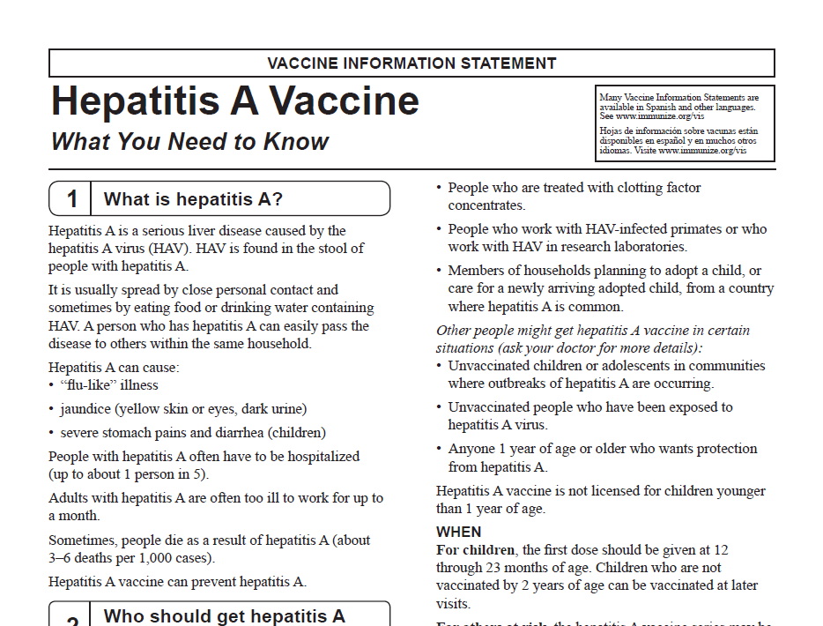
Notes:
For children, the first dose should be given at 12 through 23 months of age. Children who are not vaccinated by 2 years of age can be vaccinated at later visits.
For others at risk, the hepatitis A vaccine series may be started whenever a person wishes to be protected or is at risk of infection.
For travelers, it is best to start the vaccine series at least one month before traveling. (Some protection may still result if the vaccine is given on or closer to the travel date.)
Some people who cannot get the vaccine before traveling, or for whom the vaccine might not be effective, can get a shot called immune globulin (IG). IG gives immediate, temporary protection.
Adult Recommendation:
· Single-antigen vaccine formulations should be administered in a 2-dose schedule at either 0 and 6 to 12 months (Havrix), or 0 and 6 to 18 months (Vaqta). If the combined hepatitis A and hepatitis B vaccine (Twinrix) is used, administer 3 doses at 0, 1, and 6 months; alternatively, a 4-dose schedule may be used, administer on days 0, 7, and 21 to 30 followed by a booster dose at month 12.
Two doses of the vaccine are needed for lasting protection. These doses should be given at least 6 months apart.
Hepatitis A vaccine may be given at the same time as other vaccines.
WHO
Some people should be routinely vaccinated with hepatitis A vaccine:
􀂇 All children between their first and second birthdays (12 through 23 months of age).
􀂇 Anyone 1 year of age and older traveling to or working in countries with high or intermediate prevalence of hepatitis A, such as those located in Central or South America, Mexico, Asia (except Japan), Africa, and eastern Europe. For more information see www.cdc.gov/travel.
􀂇 Children and adolescents 2 through 18 years of age who live in states or communities where routine vaccination has been implemented because of high disease incidence.
􀂇 Men who have sex with men.
􀂇 People who use street drugs.
􀂇 People with chronic liver disease. People who are treated with clotting factor concentrates.
􀂇 People who work with HAV􀀐infected primates or who work with HAV in research laboratories.
􀂇 Members of households planning to adopt a child, or care for a newly arriving adopted child, from a country where hepatitis A is common. Other people might get hepatitis A vaccine in certain situations (ask your doctor for more details):
􀂇 Unvaccinated children or adolescents in communities where outbreaks of hepatitis A are occurring.
􀂇 Unvaccinated people who have been exposed to hepatitis A virus.
􀂇 Anyone 1 year of age or older who wants protection from hepatitis A. Hepatitis A vaccine is not licensed for children younger
than 1 year of age.
PRECAUTIONS
• Tell your doctor if you have any severe allergies, including a severe allergy to latex. All hepatitis A vaccines contain alum, and
some hepatitis A vaccines contain 2-phenoxyethanol.
• Anyone who is moderately or severely ill at the time the shot is scheduled should probably wait until they recover. Ask your
doctor. People with a mild illness can usually get the vaccine.
• Tell your doctor if you are pregnant. Because hepatitis A vaccine is inactivated (killed), the risk to a pregnant woman or her
unborn baby is believed to be very low. But your doctor can weigh any theoretical risk from the vaccine against the need for
protection.
CONTRAINDICATIONS
• Anyone who has ever had a severe (life threatening) allergic reaction to a previous dose of hepatitis A vaccine should not get another dose.

Slide 26
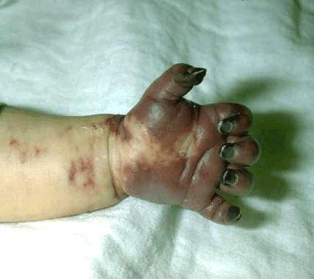
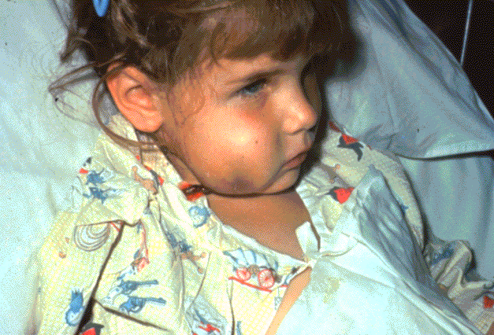
Haemophilus influenzae Type b (Hib)
Required only for child care and pre-K attendance
Notes:
What causes Hib disease? Hib disease is caused by a bacterium, Haemophilus influenzae type b. There are six different types of these bacteria (a through f). Type b organisms account for 95% of all strains that cause invasive disease, and this is the type against which the Hib vaccine
protects.
How does Hib disease spread? Hib disease is spread person-to-person by direct contact or through respiratory droplets. Usually the organisms
remain in the nose and throat, but occasionally the bacteria spread to the lungs or bloodstream and cause a serious infection in the individual.
How serious is Hib disease? Hib disease can be very serious. The most common type of invasive Hib disease is meningitis, an infection
of the membranes covering the brain (50%–65% of cases).
How common is Hib disease in the United States? Before the introduction of a Hib vaccine, H. influenzae type b (Hib) was the leading cause of bacterial meningitis among children younger than age five years in the United States. Every year about 20,000 children younger than age five years got severe Hib disease and about 1,000 children died. More than half of children who developed severe Hib disease were younger than age 12 months. From 1996 through 2000, an average of 68 reported cases of Hib disease occurred in children younger than age 5 years each year. By 2008, this number had dropped to just 30 cases and, although some of the 163 cases with unknown serotype could have been due to Hib, the significant decline in incidence (>99%) since the pre-vaccine era is truly remarkable.
Haemophilus influenzae Type B vaccine (Hib) protects against Hib disease. Haemophilus influenzae Type B vaccine (Hib) protects against Hib disease. It can also cause brain damage, seizures, paralysis, hearing loss.
The Hib germ enters the body through the nose and throat. It is spread by direct contact with an infected person. Adults and older children can be infected with this germ but not feel sick or show any symptoms.
This child on the right has a swollen cheek due to Hib infection. The tissue under the skin covering the jaw and cheek is infected and she is probably very sick. She may have a fever, severe headache, sore throat, or breathing problems. Hib disease can be very dangerous to children under five years of age, especially infants.
Hib vaccine is required for attendance in child care and pre-K for all children under age 5 years.

Slide 27
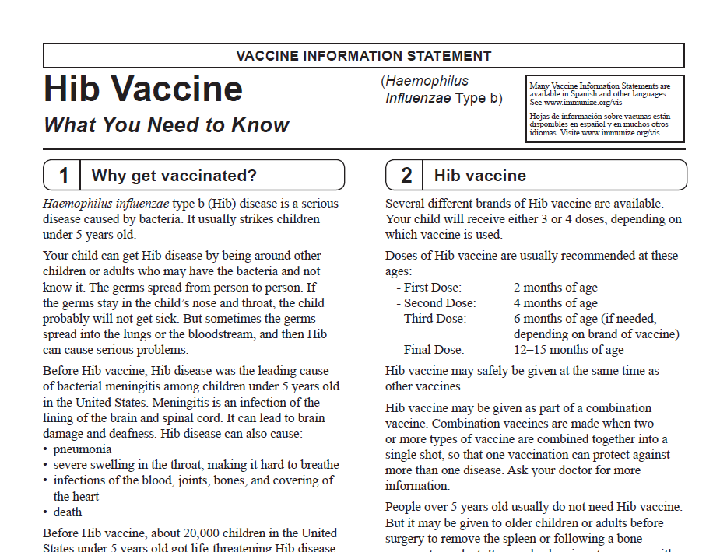
Notes:
What type of vaccine is it? The Hib conjugate vaccine is an inactivated vaccine. It is made by chemically bonding a polysaccharide (sugar) to a protein. This long chain of sugar molecules makes up the surface capsule of the bacterium.
How effective is this vaccine? All the Hib vaccines licensed for use are good at producing immunity to invasive Hib disease. More than 95% of infants will be protected after two or three doses.
Several different brands of Hib vaccine are available. Your child will receive either 3 or 4 doses, depending on which vaccine is used. Doses of Hib vaccine are usually recommended at these ages:
- First Dose: 2 months of age
- Second Dose: 4 months of age
- Third Dose: 6 months of age (if needed, depending on brand of vaccine)
- Final Dose: 12–15 months of age
Hib vaccine may safely be given at the same time as other vaccines.
Hib vaccine may be given as part of a combination vaccine. Combination vaccines are made when two or more types of vaccine are combined together into a single shot, so that one vaccination can protect against more than one disease.
Age Indications for Hib Vaccines (no doses prior to age 6 weeks)
ActHiB® (sanofi pasteur): for aged 2 months and older
PedvaxHiB® (Merck): for aged 2 months and older
Hiberix (Novartis): Last dose for age 15 months through 59 months
Indications for Use and Schedule (Primary Series)
ActHiB (4-dose series): a 3 dose primary series at 2, 4 & 6 months & booster dose at 12-15 months
PedvaxHiB ( 3-dose series): a 2-dose primary series at 2, 4 months & booster dose at 12-15 months
Delayed Vaccination Schedule:
Children starting late may not need entire 3-4 dose series; Number of doses child requires depends on current age
All children 15-59 months of age need at least one dose
Minimum age and intervals – 6 weeks with the exception of Hiberix, the conjugate Hib vaccines are interchangeable; 4 weeks between primary series doses; 8 weeks between booster dose and previous dose
People over 5 years old usually do not need Hib vaccine. But it may be given to older children or adults before surgery to remove the spleen or following a bone marrow transplant. It may also be given to anyone with certain health conditions such as sickle cell disease or HIV/AIDS.
Hib vaccine should not be given to infants younger than 6 weeks of age.
VACCINATION OF PERSONS WITH HIGH-RISK CONDITIONS:
Children aged 12 through 59 months at high risk for Hib diseases are: asplenics (including sickle cell disease), chemotherapy recipients, immunoglobulin deficiency, complement component deficiencies, or HIV
if no doses or only 1 dose of Hib vaccine given before 12 months of age, give 2 doses of Hib vaccine separated by 8 weeks
if 2 or more doses of Hib vaccine given before 12 months of age, give 1 dose of Hib vaccine 8 weeks later
If no history of at least one previous dose, for persons:
Aged 15 months or older who are having elective splenectomy, give 1 dose of Hib vaccine at least 14 days prior to surgery
Aged 5 years & older who are asplenic (including sickle cell disease); give 1 dose of Hib vaccine
Aged 5 through 18 years, who have HIV infection, give 1 dose of Hib vaccine
NOTE: Due to low risk of Hib infection, adults aged 19 years & older with HIV are not recommended for Hib vaccine
-Persons who have had hematopoietic stem cell transplant (HSCT), regardless of their Hib vaccine history, should be revaccinated with 3 doses of Hib vaccine, 6 to 12 months after successful transplant; doses should be at least 4 weeks apart
CONTRAINDICATIONS -An anaphylactic (severe allergic) reaction to a prior dose or a component of Hib vaccine
PRECAUTIONS -Moderate to severe acute illness with or without fever; Use caution when vaccinating latex-sensitive individuals since the vial stopper contains dry latex rubber that may cause allergic reactions
FURTHER POINTS
Hib vaccine is not routinely given once a child is 5 years (after age 59 months)
Administer ActHIB® within 24 hours after reconstitution and MenHibrix® within 30 minutes after reconstitution
For children 5 years or younger, if Hib vaccine dose(s) receive within 14 days of the start of or during chemotherapy/radiation treatment, repeat doses at least 3 months after therapy completion

Slide 28
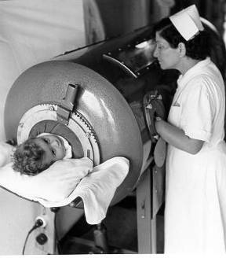
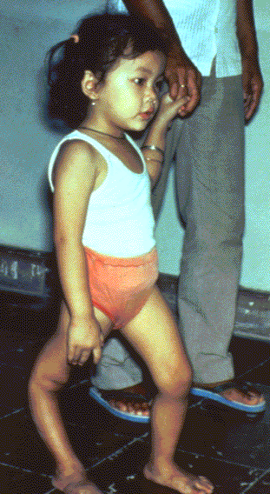
Polio
Required for school and childcare attendance
Ref. MMWR 2009; 58 (30);829-830 (August 7, 2009)
Source: World Health Organization
Notes:
28
28
28
What causes polio? Polio is caused by a virus.
How does polio spread? Polio is usually spread via the fecal-oral route (i.e., the virus is transmitted from the stool of an infected person to the mouth of another person from contaminated hands or such objects as eating utensils). Some cases may be spread directly via an oral to oral route. Polio can be very serious. Sometimes the infected person’s legs or arms become permanently paralyzed from the virus. Polio can also paralyze the breathing muscles and cause death. Polio has been eliminated from the U.S., thanks to vaccination. But the virus is still common in some parts of the world, so your child would be at risk of infection if they traveled to certain countries without being vaccinated. The virus could also be brought into the U.S. by a traveler.
How long does it take to show signs of polio after being exposed? The incubation period for polio is commonly 6–20 days, with a range of 3–35 days.
How long is a person with polio contagious? Patients infected with the polio virus can pass the virus on for 7–10 days before the onset of disease. In addition, they can continue to shed the virus in their stool for 3–6 weeks.
This slide shows a child in an iron lung due to weak respiratory muscles (common in polio era) This child has a severely deformed leg due to polio. However, different areas of the body may be affected. In the 1950’s, when a person’s respiratory muscles were paralyzed, they were placed in iron lung machines and a child with muscle weakness, as a result of polio, requiring the assistance of braces and crutches in order to walk.

Slide 29
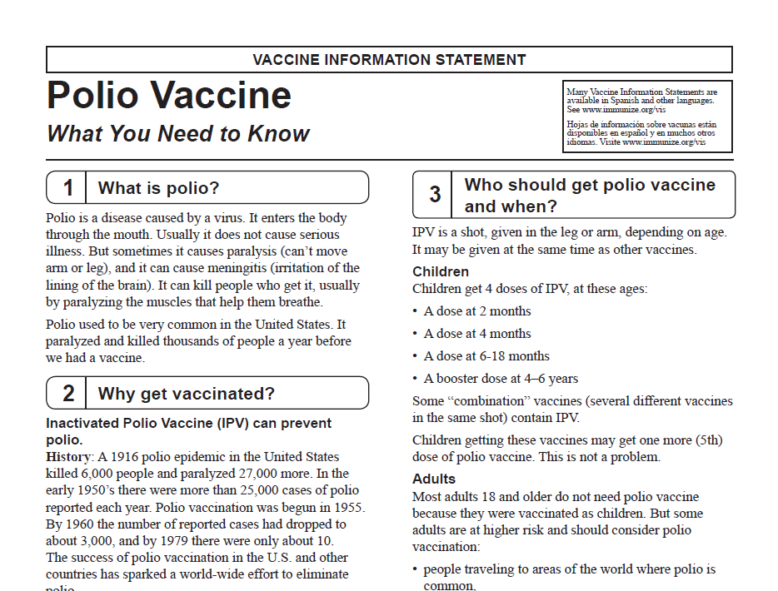
Notes:
Children
IPV is a shot, given in the leg or arm, depending on age. It may be given at the same time as other vaccines.
Children get 4 doses of IPV, at these ages:
􀂇A dose at 2 months
􀂇A dose at 4 months
􀂇A dose at 6-18 months
􀂇A booster dose at 4–6 years
Some “combination” vaccines (several different vaccines in the same shot) contain IPV. Children getting these vaccines may get one more (5th) dose of polio vaccine. This is not a problem.
Adults
Most adults 18 and older do not need polio vaccine because they were vaccinated as children. But some adults are at higher risk and should consider polio vaccination:
􀂇people traveling to areas of the world where polio is
common,
􀂇laboratory workers who might handle polio virus, and
􀂇health care workers treating patients who could have
polio.
Adults in these three groups:
􀂇who have never been vaccinated against polio should
get 3 doses of IPV:
- Two doses separated by 1 to 2 months, and
- A third dose 6 to 12 months after the second.
􀂇who have had 1 or 2 doses of polio vaccine in the past
should get the remaining 1 or 2 doses. It doesn’t matter
how long it has been since the earlier dose(s).
􀂇who have had 3 or more doses of polio vaccine in the
past may get a booster dose of IPV.
These people should not get IPV:
􀂇Anyone with a life-threatening allergy to any component of IPV, including the antibiotics neomycin, streptomycin or polymyxin B, should not get polio vaccine. Tell your doctor if you have any severe allergies.
􀂇Anyone who had a severe allergic reaction to a previous polio shot should not get another one.
These people should wait:
􀂇Anyone who is moderately or severely ill at the time the shot is scheduled should usually wait until they recover before getting polio vaccine. People with minor illnesses, such as a cold, may be vaccinated.
On June 2, 2014
CDC issued a health alert providing guidance to U.S. clinicians regarding new WHO polio vaccination requirements for travel by residents of and long-term visitors to countries with active poliovirus transmission (9). This report provides an update on CDC policy for polio vaccination of travelers for health protection. It also provides additional interim guidance for physicians whose U.S. resident patients will travel to or reside
in affected countries for >4 weeks, to ensure those patients will have evidence of administration of polio vaccine (IPV or OPV) within 12 months of travel that might be required when they depart from countries with active poliovirus transmission. This interim guidance is to ensure compliance with WHO International Health Regulations temporary recommendations for countries designated as “polio-infected” to reduce the risk for exportation of WPV from those countries.
Oral polio vaccine still used in third world countries where polio is still endemic (Mainly in Nigeria, India, Pakistan, and Afghanistan). Other countries in Africa have had small outbreaks.

Slide 30
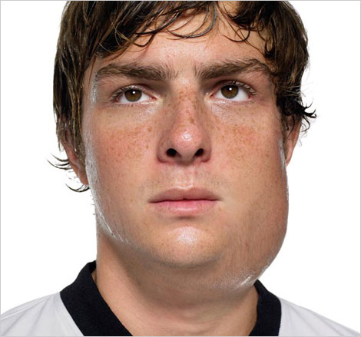
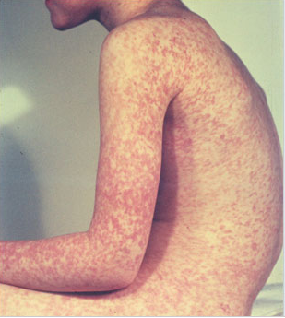
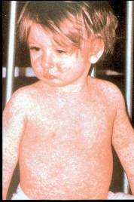
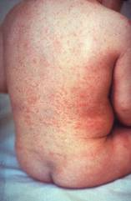
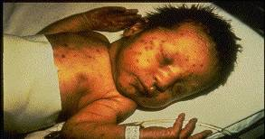
Measles, Mumps, Rubella
Measles (M)
Source: Creative Commons
Source: American Academy of Pediatrics
Red Book On Line Visual Library
Mumps (M)
Rubella (R)
Congenital Rubella (R)
Notes:
30
30
Measles is caused by the measles virus (a paramyxovirus). The measles virus is highly contagious. Measles is spread through droplet transmission from the nose, throat, and mouth of someone who is infected with the virus. These droplets are sprayed out when the infected person coughs or sneezes. Among unimmunized people exposed to the virus, over 90% will contract the disease.
MEASLES (caused by paramyxovirus)
Slide shows two children with typical measles rash and conjunctivitis in younger child
Initial symptoms are runny nose, followed by increasing fever (103º-105º), cough, conjunctivitis, Koplik spots, and a maculopapular rash that lasts 5-6 days; Complications include otitis media (7%), pneumonia (6%), and acute encephalitis (0.1%) 1 in 1000 cases, death (0.2%) Although measles elimination was declared in the United States in 2000 , importation of measles cases continues to occur. CDC evaluated cases reported by 16 states during January 1–August 24, 2013. A total of 159 cases of measles were reported during this period. Death occurs in 1 to 3 of every 1,000 cases.
MUMPS (caused by paramyxovirus)
Slide shows an adolescent with parotitis due to mumps
Parotitis occurs in 30-40% of infected persons, 40-50% have only nonspecific or respiratory symptoms
Complications include aseptic meningitis, & deafness
Post pubertal individuals may have orchitis, ovarian inflammation, & pancreatitis
RUBELLA (Caused by togavirus)
In children, the rash may be the first manifestation of infection. Adults may have low-grade fever, malaise, URI, and lymphadenopathy prior to rash. Arthralgia and arthritis is common in adults, especially women. Complications include encephalitis and hemorrhagic manifestations
Rubella is no longer endemic in the U.S. However, it is still present in other countries and can be imported
CONGENITAL RUBELLA
Slide shows an adult and child with a typical rash from rubella and an infant with congenital rubella syndrome Infant was infected in utero and has “blueberry muffin spots” on skin due to petechial lesions, cataracts, hearing loss and congenital heart lesion and will most likely be developmentally delayed.
All woman of child bearing age should be certain they are immune to rubella.
For additional information refer to: Epidemiology and Prevention of Vaccine-Preventable Diseases, 12th edition May 2012. HHS, CDC.

Slide 31
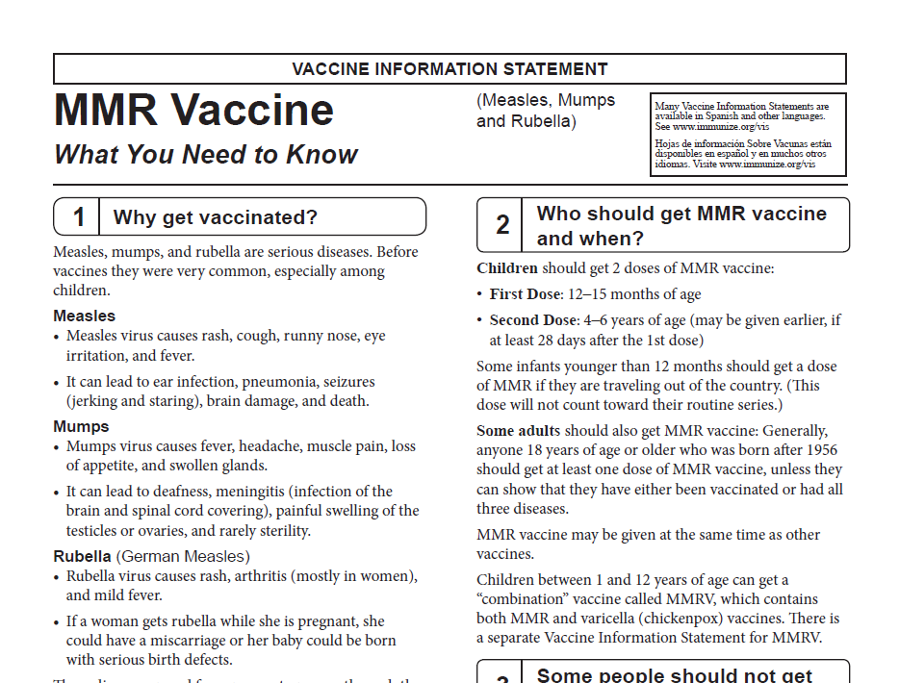
Notes:
MMR vaccine has been successful in reducing the cases of measles in the United States and many young physicians, physician’s assistants and nurse practitioners have never seen an acute case of measles. The symptoms of measles are more than a rash and include conjunctivitis, fever and white lesions (Koplik spots) on the buccal mucosa. Practitioners who have not seen a case of measles sometimes make a diagnosis solely on the basis of a rash. Serologic testing is now required to confirm a case of measles.
Required for school and child care attendance: Acceptable presumptive evidence of MMR immunity: Documentation of age appropriate vaccination with MMR vaccine, Laboratory evidence of immunity, Laboratory confirmation of disease, and Birth before 1957
Birth date not acceptable evidence of rubella immunity for women who could become pregnant
Measles Vaccine: The measles vaccine is very effective. One dose of measles vaccine is about 93% effective at preventing measles if exposed to the virus and two doses are about 97% effective. 5% or less may lose protection after several years.
Children should get 2 doses of MMR vaccine:
First Dose: 12–15 months of age
Second Dose: 4–6 years of age (may be given earlier, if at least 28 days after the 1st dose)
Some infants younger than 12 months should get a dose of MMR if they are traveling out of the country. (This
dose will not count toward their routine series.)
Some adults should also get MMR vaccine: Generally, anyone 18 years of age or older who was born after 1956 should get at least one dose of MMR vaccine, unless they can show that they have either been vaccinated or had all three diseases.
MMR vaccine may be given at the same time as other vaccines.
Children between 1 and 12 years of age can get a “combination” vaccine called MMRV, which contains both MMR and varicella (chickenpox) vaccines. There is a separate Vaccine Information Statement for MMRV.
Some people should not get
MMR vaccine or should wait.
􀁴Anyone who has ever had a life-threatening allergic reaction to the antibiotic neomycin, or any other component of MMR vaccine, should not get the vaccine. Tell your doctor if you have any severe allergies.
􀁴Anyone who had a life-threatening allergic reaction to a previous dose of MMR or MMRV vaccine should not get another dose.
􀁴Some people who are sick at the time the shot is scheduled may be advised to wait until they recover before getting MMR vaccine.
􀁴Pregnant women should not get MMR vaccine. Pregnant women who need the vaccine should wait until after giving birth. Women should avoid getting pregnant for 4 weeks after vaccination with MMR vaccine.
Any of these might be a reason to not get the vaccine, or
delay vaccination until later.
- Has HIV/AIDS, or another disease that affects the
immune system
- Is being treated with drugs that affect the immune
system, such as steroids
- Has any kind of cancer
- Is being treated for cancer with radiation or drugs
- Has ever had a low platelet count (a blood disorder)
- Has gotten another vaccine within the past 4 weeks
- Has recently had a transfusion or received other
blood products

Slide 32
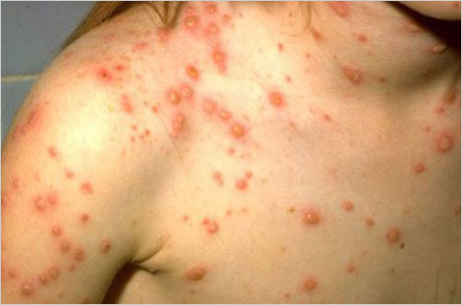
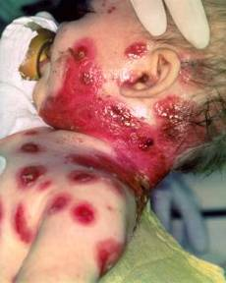
Varicella
(Chickenpox)
© Copyright American Academy of Pediatrics
Notes:
Why get vaccinated?
It is usually mild, but it can be serious, especially in young infants and adults. Most people who get chickenpox vaccine will not get chickenpox. But if someone who has been vaccinated does get chickenpox, it is usually very mild. They will have fewer blisters, are less likely to have a fever, and will recover faster.
This slide shows an adolescent with a typical varicella rash and infant with secondary bacterial infected varicella lesions, probably due to staph or strep. Chickenpox or varicella is caused by the varicella zoster virus. Prior to licensure of varicella vaccine approximately 100 previously healthy children died from chicken pox each year. Adults are 25 times more likely to die than children.

Slide 33
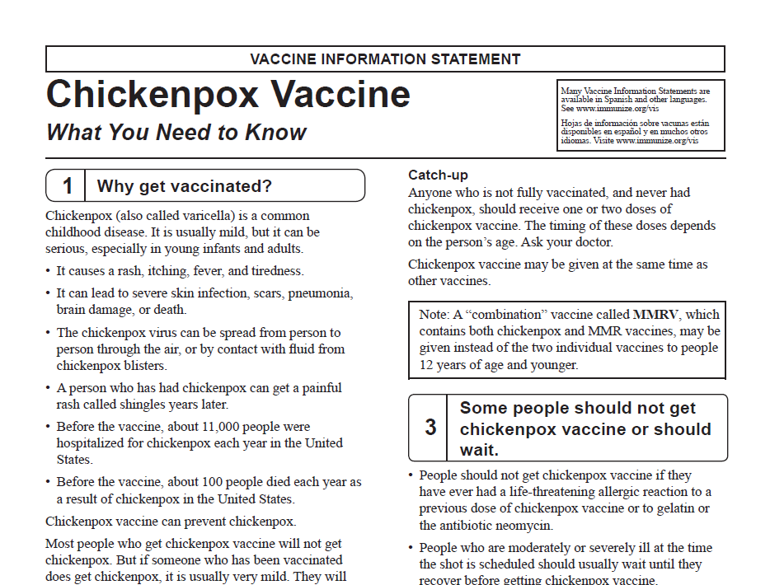
Notes:
Routine
Children who have never had chickenpox should get
2 doses of chickenpox vaccine at these ages:
1st Dose: 12–15 months of age
2nd Dose: 4–6 years of age (may be given earlier, if at least 3 months after the 1st dose)
People 13 years of age and older (who have never had chickenpox or received chickenpox vaccine) should get two doses at least 28 days apart.
Catch-up
Anyone who is not fully vaccinated, and never had chickenpox, should receive one or two doses of
chickenpox vaccine. The timing of these doses depends on the person’s age. Ask your doctor. Chickenpox vaccine may be given at the same time as other vaccines.
Some people should not get chickenpox vaccine or should wait:
􀂇People should not get chickenpox vaccine if they have ever had a life-threatening allergic reaction to a previous dose of chickenpox vaccine or to gelatin or the antibiotic neomycin.
􀂇People who are moderately or severely ill at the time the shot is scheduled should usually wait until they recover before getting chickenpox vaccine.
􀂇Pregnant women should wait to get chickenpox vaccine until after they have given birth. Women should not get pregnant for 1 month after getting chickenpox vaccine.
􀂇Some people should check with their doctor about whether they should get chickenpox vaccine, including
anyone who:
- Has HIV/AIDS or another disease that affects the immune system
- Is being treated with drugs that affect the immune system, such as steroids, for 2 weeks or longer
- Has any kind of cancer
- Is getting cancer treatment with radiation or drugs
􀂇People who recently had a transfusion or were given other blood products should ask their doctor when they may get chickenpox vaccine.
What are the criteria for evidence of immunity to varicella?
ACIP considers evidence of immunity to varicella to be:
Documentation of 2 doses of vaccine given no earlier than age 12 months, with at least 3 months between doses for children younger than age 13 years, or at least 4 weeks between doses for people age 13 years and older
• U.S.-born before 1980*
• A healthcare provider's diagnosis of varicella or verification of history of
varicella disease
• History of herpes zoster, based on healthcare provider diagnosis
• Laboratory evidence of immunity or laboratory confirmation of disease
*Note: year of birth is not considered as evidence of immunity for healthcare
personnel, immunosuppressed people, and pregnant women.
CONTRAINDICATIONS
• An anaphylactic reaction to a prior dose of a varicella-containing vaccine
• An anaphylactic reaction to a component of varicella vaccine including gelatin or neomycin
• Pregnant or planning on becoming pregnant in the next 4 weeks (inform girls/women in child-bearing years)
• Persons with immunosuppression due to leukemia, lymphoma, generalized malignancy, immune deficiency disease or
immunosuppressive therapy (i.e. chemotherapy, certain medications)
PRECAUTIONS
• Moderate to severe acute illness
• Receipt of blood or a blood product within the last year (wait time varies by the type of blood/product administered)
For further information refer to: General Recommendations on Immunization January 28, 2011 (page 39)

Slide 34


Pneumococcal Disease
Required for child care and pre-K attendance
Notes:
Pneumococcal disease is caused by a bacterium, Streptococcus pneumoniae, also called pneumococcus (about 90 known serotypes); Causes pneumonia, bacteremia, meningitis and otitis media; Highest rate of invasive disease is in children less than 2 years. Increased risk of infection in children with HIV infection, sickle cell disease, asplenia, day care attendees and in certain ethnic groups (African Americans, Alaskan natives and Native Americans). Increased risk in children & adults with cardiovascular disease, pulmonary disease, diabetes, alcoholism, cirrhosis, immunocompromising conditions; Individuals who have asthma and those who smoke cigarettes are also at increased risk. Estimated cases in the US each year are more than any other vaccine-preventable disease. Some serotypes of pneumococcus have become resistant to antibiotics.
Pneumococcal vaccines are the next vaccines on the list . Note that there are 2 types of pneumococcal vaccines on the schedule :
PCV13 or Pneumococcal Conjugate Vaccine and
PPSV23 or Pneumococcal Polysaccharide Vaccine
Both vaccines protect against pneumococcal disease caused by serotypes of Streptococcus pneumoniae.The major clinical syndromes of pneumococcal disease include pneumonia, bacteremia, and meningitis.
However each of these vaccines due to their composition are effective in protecting different age groups.
Here you see in the picture on the left, a child with asplenia and evidence of thrombocytopenic purpura on her face from invasive pneumococcal disease. Picture on the right: Orbital cellulitis with edema and erythema.
Both PCV13 and PPSV23 should be routinely administered in series to all adults 65 years or older.
PCV13: Adults should get one dose of this vaccine before starting or continuing doses of PPSV23. It is recommended for all adults 65 years or older and adults 19 years or older with certain medical conditions
PPSV23: Adults should get one, two, or three doses of this vaccine, depending on their age, health condition, and timing of the first dose. It is recommended for all adults 65 years or older, adults 19 years or older with certain health conditions and adults 19 years or older who smoke cigarettes
All the General Recommendations apply here with the exceptions of #1 & 2, when it concerns spacing with the other pneumococcal vaccine, pneumococcal polysaccharide.
This vaccine is a requirement for pre-K and childcare attendance.

Slide 35
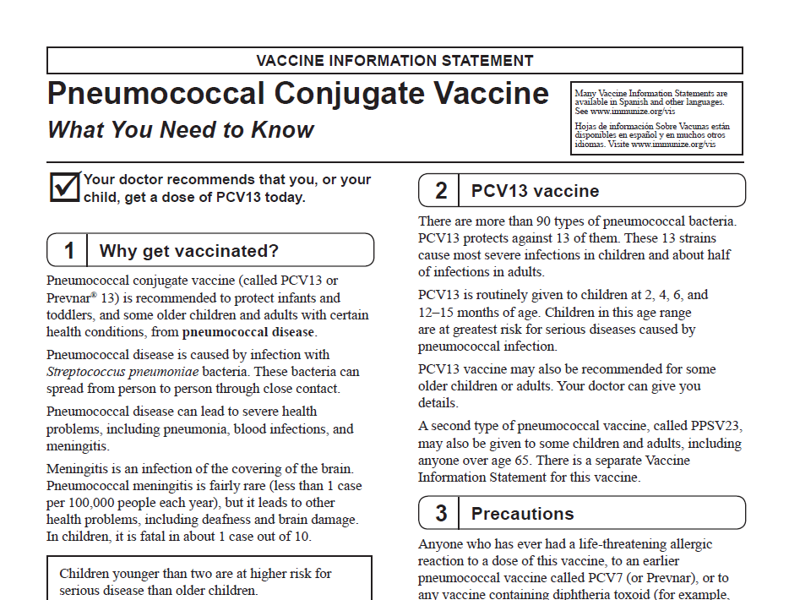
Notes:
There are more than 90 types of pneumococcal bacteria. PCV13 protects against 13 of them. These 13 strains cause most severe infections in children and about half of infections in adults.
PCV13 is routinely given to children at 2, 4, 6, and 12–15 months of age. Children in this age range are at greatest risk for serious diseases caused by pneumococcal infection.
TRANSITIONING TO PCV13 FROM PCV7
• Children through age 59 months that have completed a PCV7 series and have not received a dose of PCV13:
-Give one dose of PCV13
-Minimum interval of 8 weeks since the last dose of any pneumococcal vaccine (PCV13 or PPSV23)
• High Risk Children
-Ages 24 through 71 months2
· If incomplete schedule of 2 or less doses, give 2 doses of PCV13
· If incomplete schedule of 3 doses, give 1 dose of PCV13
· Use a minimum interval of 8 weeks since the last dose of PCV7, PCV13, or PPSV23
-Ages 6 through 18 years3
· Give a single supplemental dose of PCV13 if no previous dose of PCV13, regardless of previous history of
receiving PCV7 or PPSV23 vaccine
· Use a minimum interval of 8 weeks since the last dose of PCV7 or PPSV23
Precautions
Anyone who has ever had a life-threatening allergic reaction to a dose of this vaccine, to an earlier pneumococcal vaccine called PCV7 (or Prevnar), or to any vaccine containing diphtheria toxoid (for example, DTaP), should not get PCV13.
Anyone with a severe allergy to any component of PCV13 should not get the vaccine. If the person scheduled for vaccination is sick, you might decide to reschedule the shot on another day.
CONTRAINDICATIONS
An anaphylactic reaction to a prior dose of Pneumococcal Conjugate Vaccine (PCV7 or PCV13) or any diphtheria-toxoid
containing vaccine or an anaphylactic reaction to a component of PCV13 vaccine

Slide 36
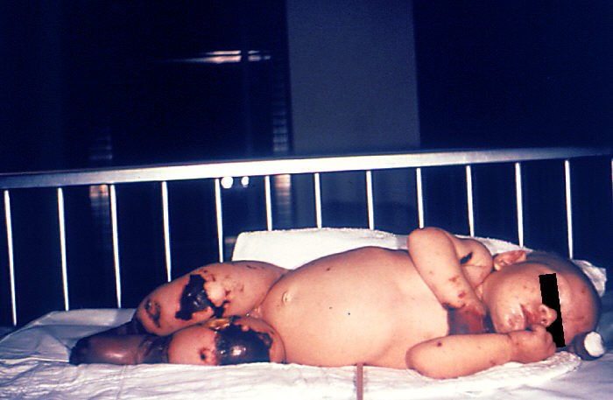
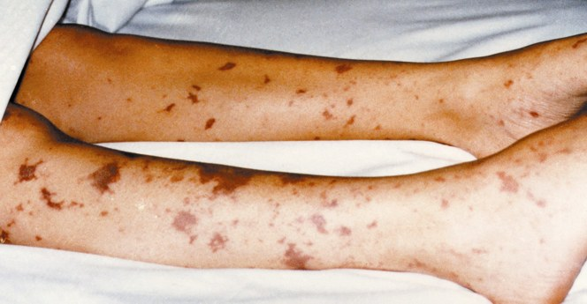
Meningococcal Disease
New 7th Grade School Requirement
Notes:
These very graphic photos show the possible results of a meningococcal infection becoming systemic and then infecting bodily tissues.
The 4 month old on the left has gangrene of the hands and lower extremities due to meningococcemia.
The picture on the right shows similar though not as severe tissue damage in an older child.
Meningitis ~50% of cases 9-10% fatality rate
Meningococcemia- 5%-20% of cases; Up to 40% fatality rate
(Rash, Vascular damage, Disseminated intravascular coagulation, Multi-organ failure, Shock, Death can occur in 24 hours)
11-19% of survivors have permanent sequelae (an abnormal condition resulting from a previous disease)
Ref: 1. Epidemiology and Prevention of Vaccine-Preventable Diseases. 12th Edition, May 2012.
2. AAP Red Book 2012

Slide 37
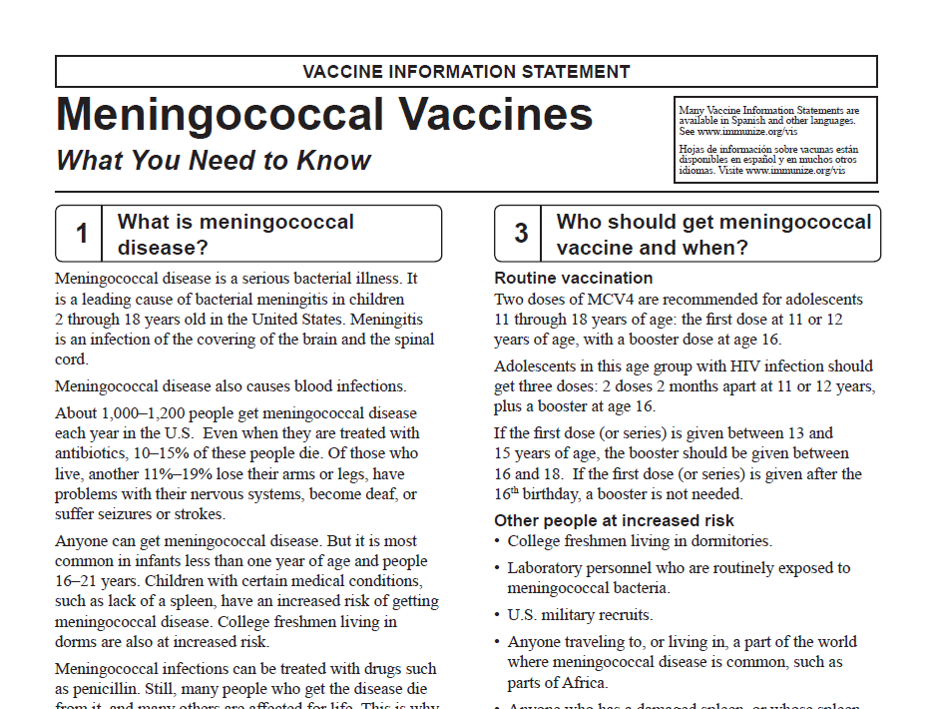
Notes:
Review the types of presentations your clinic offers and the correct administration methods.
There are two kinds of meningococcal vaccine in the U.S
-Menactra® (Sanofi Pasteur): for aged 9 months through 55 years
-MENVEO® (Novartis): for aged 2 through 55 years
􀂇Meningococcal conjugate vaccine (MCV4) is the preferred vaccine for people 55 years of age and younger.
􀂇Meningococcal polysaccharide vaccine (MPSV4) has been available since the 1970s. It is the only meningococcal vaccine licensed for people older than 55. Both vaccines can prevent 4 types of meningococcal disease, including 2 of the 3 types most common in the United States and a type that causes epidemics in Africa. There are other types of meningococcal disease; the
vaccines do not protect against these.
Routine vaccination
Two doses of MCV4 are recommended for adolescents 11 through 18 years of age: the first dose at 11 or 12 years of age, with a
booster dose at age 16.
Adolescents in this age group with HIV infection should get three doses: 2 doses 2 months apart at 11 or 12 years, plus a booster at age 16.
If the first dose (or series) is given between 13 and 15 years of age, the booster should be given between 16 and 18. If the first dose (or series) is given after the 16th birthday, a booster is not needed.
Other people at increased risk
􀂇College freshmen living in dormitories.
􀂇Laboratory personnel who are routinely exposed to meningococcal bacteria.
􀂇U.S. military recruits.
􀂇Anyone traveling to, or living in, a part of the world where meningococcal disease is common, such as parts of Africa.
􀂇Anyone who has a damaged spleen, or whose spleen has been removed.
􀂇Anyone who has persistent complement component deficiency (an immune system disorder).
􀂇People who might have been exposed to meningitis during an outbreak.
Children between 9 and 23 months of age, and anyone else with certain medical conditions need 2 doses for adequate protection. Ask your doctor about the number and timing of doses, and the need for booster doses.
MCV4 is the preferred vaccine for people in these groups who are 9 months through 55 years of age. MPSV4 can be used for adults older than 55.
CONTRAINDICATIONS
▪ An anaphylactic (severe allergic) reaction to a prior dose or a component of MCV4 vaccine
PRECAUTIONS
▪ Moderate to severe acute illness
FURTHER POINTS
• Persons indicated for a 2-dose primary series who previously received only a 1st dose of MCV4, should get a 2nd dose of MCV4
as soon as feasible; forecast the booster dose (if applicable) from the date of the 2nd primary series dose
• Persons aged 56 years or older who have never received a meningococcal vaccine and anticipate needing only on dose, MPSV4
(meningococcal polysaccharide vaccine) is preferred
• Persons who inadvertently receive MPSV4 should be revaccinated with MCV4 using a minimum interval of 8 weeks
• Both MCV4 vaccines contain serotypes A, C, Y, and W-135. Serotype B is not in either vaccine.

Slide 38
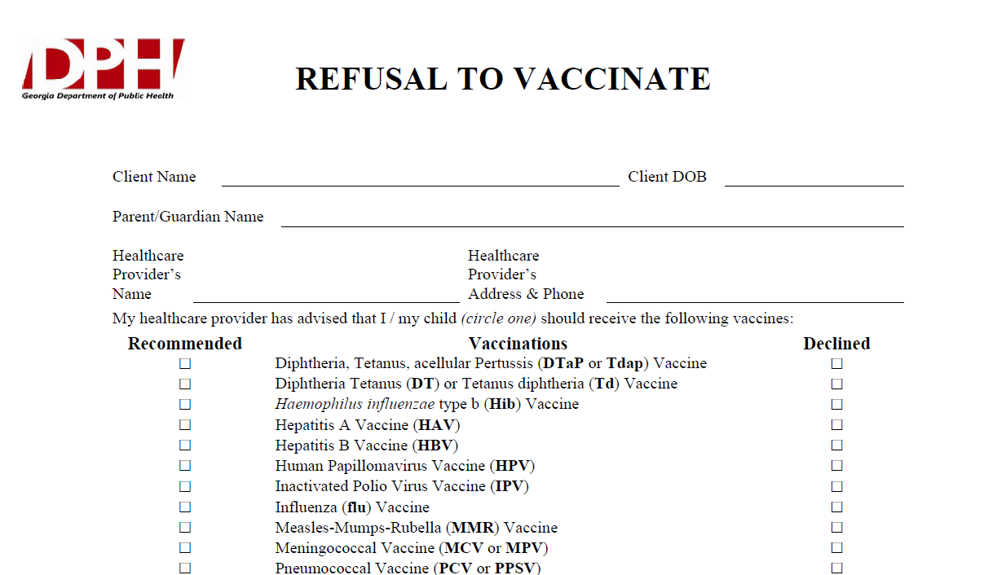
Notes:
What If Parents Refuse to Vaccinate?
Excluding children from your practice when their parents decline immunizations is not recommended. It can put the child at risk of many different health problems—not just vaccine-preventable diseases. Remember, unvaccinated infants did not decide for themselves to remain unvaccinated. They need your care. Make sure that parents are fully informed about clinical presentations of vaccine-preventable diseases, including early symptoms. Diseases like pertussis and measles are highly contagious and may present early as a non-specific respiratory illness. Parents who refuse vaccines should be reminded at every visit to call before bringing the child into the office, clinic, or emergency department when the child is ill so appropriate measures can be taken to protect others.
If a parent refuses to vaccinate, you can share the fact sheet
If You Choose Not to Vaccinate Your Child, Understand the Risks and Responsibilities (http://www.cdc.gov/vaccines/conversations),
which explains the risks involved with this decision including risks to other members of their community, and the additional responsibilities for parents, including the fact that, when their child is ill, they should always alert health care personnel to their child’s vaccination status to prevent the possible spread of vaccine-preventable diseases. You may wish to have them sign DPH’s Refusal to Vaccinate form in English or Spanish (https://dph.georgia.gov/sites/dph.georgia.gov/files/Immunizations/Health-Care-Professionals-Refusal-to-Vaccinate-Form-English_1.pdf) each time a vaccine is refused so that you have a record of their refusal in their child’s medical file.

Slide 39
School & Child Care Requirements
Some of the new vaccines that are RECOMMENDED for particular age groups, may NOT BE REQUIRED for school or child care attendance.
Remember, GRITS
  Calculates validity based on recommendations
  Prints certificates based on requirements
Notes:
Some of the new vaccines previously discussed are RECOMMENDED for particular age groups, but MAY NOT BE REQUIRED for school or child care attendance.
Remember, GRITS:
Calculates validity based on recommendations
Prints certificates based on requirements, which are first based on the recommendations.
Inform parents that the nurse will review his or her child’s record prior to vaccine administration.
-GRITS certificates are available from the GA Immunization Program Office and
-Can be printed from the GA Registry of Immunization Transactions and Services (GRITS) or
-Printed from office software systems
-Providers requests permission and receives approval for the certificate from the Georgia Immunization Program
-Provider has to be an active participant in GRITS
-Certificate must include exact information and have same appearance as DPH Certificate to be approved

Slide 40
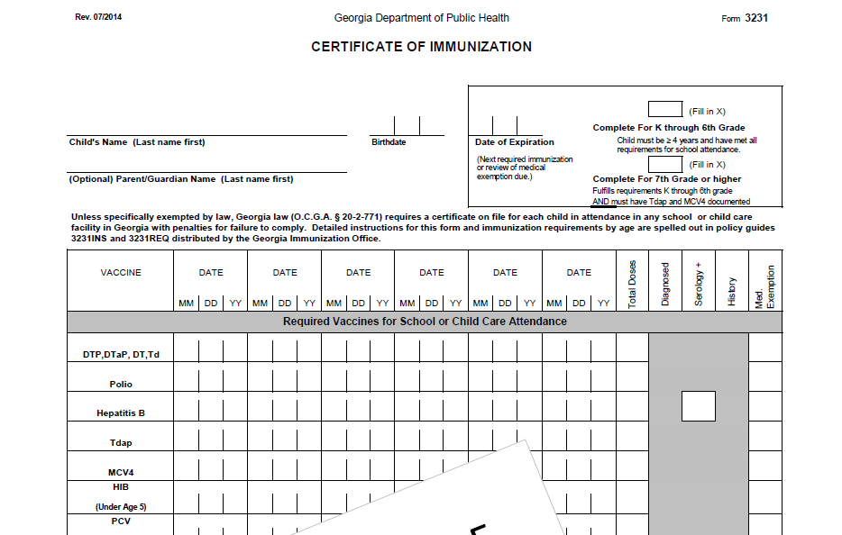
Form 3231
Notes:
This is a screen shot of the Immunization certificate. This top portion of the form contain vaccines that are required for school attendance and the bottom portion contain those vaccines that are recommended.
First we will look at the two boxes in the right upper corner; the top box is labeled “Complete For K through 6th Grade” and the bottom box is “Complete for 7th Grade or higher”. The instructions on how these two boxes are completed will be outlined on the 3231 INS.
Next, if you look at the arrow;
-”Td” has been added to the first line with the DTP, DTaP, DT section; Td will be designated with a (++) symbol and the Td explanation text will appear in the bottom left corner of the form when printed
-”Polio” is now on one line; no separate line for “IPV”/”OPV”; OPV is designated with (^^) symbol, the polio explanation text “**unspecified polio dose/OPV dose appears in the bottom left corner of the form when printed
-The next two changes are for “Tdap” and “MCV4”; they will be listed on their own separate lines; MCV4 row was moved up to the required section; only Menactra, Menveo and MCV4 unspecified doses will display; Menomune and Meningococcal unspecified do not display

Slide 41
Vaccine Injury Compensation Program (VICP)
National Vaccine Injury Compensation Program
provides compensation to individuals found to be injured by or have died from certain childhood vaccines.
  Established in 1988 by NCVIA
  Federal “no fault” system to compensate those injured
  Claim must be filed by individual, parent or guardian
  Must show that injury is on “Vaccine Injury Table”
Notes:
Vaccine safety is very important and the Vaccine Injury Compensation Program was established to provide compensation to individuals found to be injured or have died from certain childhood vaccines.
On October 1, 1988, the National Childhood Vaccine Injury Act of 1986 created the National Vaccine Injury Compensation Program (VICP). The VICP was established to ensure an adequate supply of vaccines, stabilize vaccine costs, and establish and maintain an accessible and efficient forum for individuals found to be injured by certain vaccines. The VICP is a no-fault alternative to the traditional public legal system for resolving vaccine injury claims that provides compensation to people found to be injured by certain vaccines.
The National Childhood Vaccine Injury Act (NCVIA) set forth 3 basic requirements for all vaccination providers, which are:
Providers must give the patient (or parent/legal representative of a minor) a copy of the relevant federal "Vaccine Information Statement" (VIS) for the vaccine they are about to receive.
Providers must record certain information about the vaccine(s) administered in the patient's medical record or a permanent office log.
Providers must document any adverse event following the vaccination that the patient experiences and that becomes known to the provider, whether or not it is felt to be caused by the vaccine, and submit the report to the Vaccine Adverse Event Reporting System (VAERS).

Slide 42
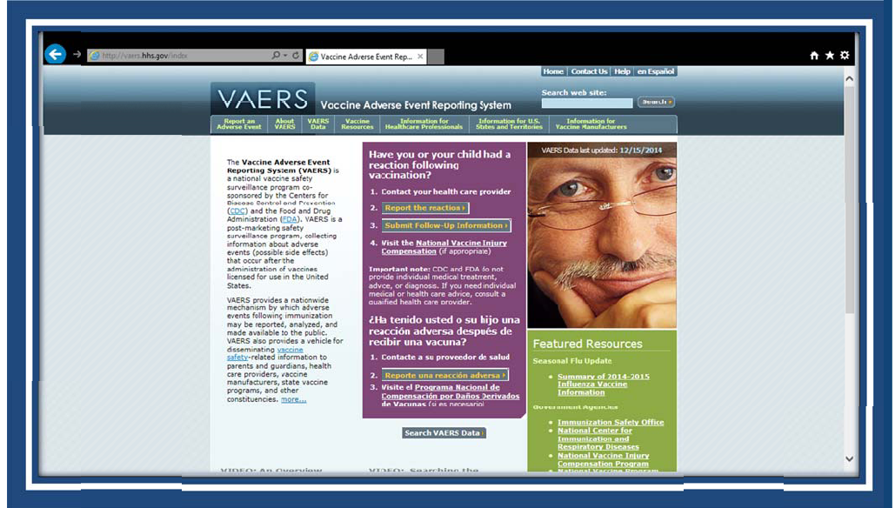
VAERS
Notes:
The Vaccine Adverse Event Reporting System (VAERS) provides a nationwide mechanism by which adverse events following immunization may be reported, analyzed, and made available to the public.
The primary objectives of VAERS are to:
Detect new, unusual, or rare vaccine adverse events;
Monitor increases in known adverse events;
Identify potential patient risk factors for particular types of adverse events;
Identify vaccine lots with increased numbers or types of reported adverse events; and
Assess the safety of newly licensed vaccines.
What Can Be Reported to VAERS?
VAERS encourages the reporting of any clinically significant adverse event that occurs after the administration of any vaccine licensed in the United States.
Who Reports to VAERS?
Anyone can file a VAERS report, including parents, health care providers, manufacturers, and vaccine recipients.
Does VAERS Provide General Vaccine Information?
No. VAERS only collects and analyzes adverse event reports. In another example, VAERS determined that there may be a potential for a small increase in risk for Guillain-Barre syndrome after the meningococcal conjugate vaccine, Menactra. As a result of this finding, a history of Guillain-Barre syndrome became a contraindication to the vaccine and further controlled studies are currently underway to research this issue.
The VAERS website for reporting is: http:vaers.hhs.gov/ or you can call to report at 1-800-822-7967

Slide 43

IT STARTS WITH YOU!
Notes:
What are you doing to help improve the immunization rates at your healthcare facility?

Slide 44

Healthcare Personnel (HCP) Need These Immunizations:
Annual influenza vaccine
Tdap or Td
Hepatitis B (exposure risk) Check immunity
Validate immune status of:
Varicella
Measles, Mumps & Rubella(MMR)
Are YOU up to date?
Notes:
44
As a healthcare provider we must all be responsible and make sure that we are also protected from Vaccine Preventable Diseases.
Healthcare Personnel need these immunizations:
Hepatitis B vaccine is recommended for health-care personnel with potential exposure to blood or body fluids. The antibody status of these health-care personnel should be checked 1-2 months after the 3rd dose. If a person fails to develop an adequate antibody titer after three doses of vaccine, follow current CDC recommendations for additional doses of hepatitis B vaccine. Some health-care providers may have received three doses of hepatitis B vaccine as children, adolescents or adults but have never had serologic testing to check for immunity. Follow the CDC Guidance for Evaluating Health-Care Personnel for Hepatitis B Virus Protection and for Administering Postexposure Management (Recommendations and Reports / Vol. 62 / No. 10 December 20, 2013)
Un-immunized HCP
Un-immunized healthcare workers are at risk of infecting patients, family members and community contacts
Immunized HCP
Protect patients from VPD’s
Help offices avoid potential liability cases. (The practice can be liable if an unimmunized HCP becomes infected with a vaccine preventable disease and infects a patient.)
Maintain productivity
Reduce illness and illness-related absenteeism
Evidence of Immunity to MMR
Documented administration of two doses of measles and mumps vaccine and one dose of rubella vaccine OR
Laboratory evidence of immunity or laboratory confirmation of disease (measles, mumps and rubella) OR
Born before 1957 (measles, mumps and rubella)
References: 1. General Recommendations on Immunization, Recommendations of the Advisory Committee on Immunization Practices (ACIP). MMWR (RR-2); January 28, 2011
2. Immunization of Health-Care Personnel: Recommendations of ACIP MMWR; November 25, 2011 / 60(RR07);1-45
3. CDC Guidance for Evaluating Health-Care Personnel for Hepatitis B Virus Protection and for Administering Postexposure Management (Recommendations and Reports / Vol. 62 / No. 10 December 20, 2013)

Slide 45


Resources
Local health department
District Immunization Coordinator
GA Immunization Program Office
  On call Help line: 404-657-3158
  GRITS Help Line:1-866-483-2958
  VFC Help Line:1-800-848-3868
  Website http://dph.georgia.gov/immunization-section
  Your local Immunization Program Consultant (IPC)
  Epidemiology: 1-866-782-4584
GA Chapter of the AAP
GA Academy of Family Physicians
Notes:
If you need further information about the changes, or to ask questions later, please contact the GA Immunization Office and our partners GA AAP and GA AFP
Your Local health department
District Immunization Coordinator (IPCs)
GA Immunization Program Office
404-657-3158
Website http://health.state.ga.us/programs/immunization
GA Chapter of the AAP
GAFP

Slide 46
http://dph.georgia.gov/immunization-section
Notes:
For those who have not logged onto the Immunization page website here is the link to the main page.

Slide 47


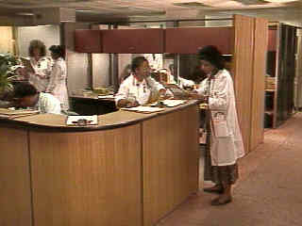
It’s a Team Effort!
High Immunization rates begin with a team designed plan!
What can your team do to improve rates?
Notes:
47
Remind your audience that “It is a team effort to immunize successfully”. Do not underestimate the
office team’s ability to affect immunization rates. It takes the physician, physician’s assistant, nurse
practitioner, nurse, medical assistant, and clerical staff working together to improve the office practice
and raise immunization rates.
Take any questions from the audience.
Ask participants how, based on the information presented, will they change the way they administer
vaccines.
Ask the audience what will they do to improve rates?
Ask participants to develop a plan to improve the immunization rates in their office
Jot down the plans the practice makes so that we can follow-up with them.

