Slide 1
Childhood Immunization Update for WIC and Clerical Personnel
Presented by:
Date:
Notes:
This presentation is used to train WIC and clerical staff on childhood immunization updates, VFC program and GA school and child care immunization requirements.

Slide 2
Overview of Topics
Recall the role vaccines have played in preventing diseases
Review of the Recommended Childhood and Adolescent Immunization Schedule
Discuss the Vaccines for Children Program
Review documentation of historical vaccines
Discuss the Georgia requirements for child care and school attendance
Notes:
Overview of topics to be discussed:
Recall the role vaccines have played in preventing diseases
Review of the Recommended Childhood and Adolescent Immunization Schedule
Discuss the Vaccines for Children Program
Review documentation of historical vaccines
Discuss the Georgia requirements for child care and school attendance

Slide 3
The Impact of Vaccines
Disease | Average Annual Reported Cases Pre-vaccine* | Cases in U.S. 2014** | Provisional Cases in U.S. 2015** | Provisional % Reduction In U.S. 2015
Smallpox | 48,164 | Eradicated worldwide in 1980
Diphtheria | 175,885 | 1 | 0 | 100%
Measles | 503,282 | 667 | 189 | >99.9%
Mumps | 152,209 | 1,196 | 1,057 | 99.3%
Pertussis | 147,271 | 32,118 | 18,166 | 87.7%
Polio (paralytic) | 16,316 | 0 | 0 | 100%
Rubella | 47,745 | 6 | 5 | >99.9%
Congenital Rubella Syndrome | 823 | 1 | 1 | >99.9%
Tetanus | 1,314 | 23 | 25 | 98.1%
H. Influenzae Type b Age<5 years | 20,000 | 40 | 23 | 99.9%
*MMWR 48(12);243-248 April 2, 1999
**MMWR 64(52), ND-923-ND-940, January 8, 2016
Notes:
This table shows the impact of vaccines on the annual reported cases of some vaccine preventable diseases in the United States.
Column 2 shows the average number of reported cases of a specific disease prior to the licensure of the vaccine.
Column 3 shows the number of reported cases in the United States in 2014.
Column 4 shows the provisional number of reported cases in the U.S in 2015.
Column 5 shows the percentage decrease in reported cases in the United States based on the provisional number of reported cases in 2015 compared with the pre-vaccine years.
*** If we look at the highlighted rows, over the past couple of years we have seen a spike in measles and mumps cases in the U.S. On January 10, 2017, DPH released a mumps advisory for colleges and universities signed by Dr. Fitzgerald outlining the high number of mumps cases reported to the CDC in 2016 (5, 311), noting the highest number of cases since 2006. Many cases were associated with outbreaks in college/university settings. At this time, a small number of mumps cases have been identified on college/university campuses in Georgia.
Reference:
Achievements in Public Health, 1900-1999 Impact of Vaccines Universally Recommended for Children - United States, 1990-1998 MMWR April 02, 1999 / 48(12);243-248
MMWR 63(53);733-746, January 9, 2015
MMWR 64(52);ND-923-ND-940, January 8, 2016

Slide 4
VPD | Vaccination Rate Needed for Herd Immunity
Measles | 92-94%
Pertussis | 92-94%
Diphtheria | 83-85%
Rubella | 83-85%
Mumps | 75-86%
Influenza | 30-75%
Notes:
We know that it is probably unrealistic to believe we can immunize everyone appropriately. We also know that there will always be young infants who have not received all recommended vaccines because of their age and a significant number of adults who are not adequately immunized. Herd immunity is the term most frequently used that refers to a situation in which a high percentage of a population is immune to a disease, essentially stopping the disease in its tracks because it cannot find new hosts. This chart illustrates the vaccination rate needed for each of the VPDs listed. For example, because measles is extremely contagious and can spread through the air, the immunity threshold needed to protect a community is high. The vaccination rate needed for measles is around 92-94%.
The threshold for herd immunity varies, depending on the disease, with more virulent infectious agents requiring vaccination of a higher percentage of the population to create the desired community immunity. The creation of herd immunity is especially important in crowded environments which facilitate the spread of disease, like schools. It is also extremely important to receive regular boosters, as some vaccines lose their efficacy over time, leaving people vulnerable to an outbreak. Herd immunity led to the eradication of smallpox, and it explains why diseases such as polio and diphtheria are rare in developed nations with established vaccination policies.
According to the 2015 National Immunization Study, coverage for childhood vaccines remains high.
-The majority of parents are vaccinating their young children against potentially serious diseases.
-The percentage of children who receive no vaccinations remains low, less than 1% (0.8%).
-Nationally, there were no significant changes in vaccination coverage among children 19-35 months of age for routinely recommended childhood vaccinations in 2015.*
-Vaccination coverage remained over 90% for measles, mumps, rubella (MMR), poliovirus, hepatitis B, and varicella.
If we look at the coverage rate for children 19-35 months for:
•Measles, mumps and rubella vaccine (MMR) (1 or more doses) was 92%; and specifically for Georgia the rate is at 94.2%
•Polio vaccine series (3 or more doses) was 94%
•Hepatitis B vaccine series (3 or more doses) was 93%
•Varicella vaccine ( 1 or more doses) was 92%

Slide 5
What You Need To Know About
Vaccine Preventable Diseases
Notes:
5
Many healthcare workers, patients and parents of young children and adolescents have grown up in the vaccine era. They are not familiar with the world we lived in before the availability of vaccines when most children were infected with whooping cough, measles, mumps, and chicken pox during their preschool or school years. These diseases were called “childhood diseases” because most children had these diseases during their childhood years. Most children were sick for a short period of time and recovered. Some children developed complications and some were left with permanent physical and/or mental disabilities. Some died as a result of these diseases.
Patients and parents may ask about these diseases. Therefore, it is important for healthcare providers to be familiar with the symptoms of these vaccine preventable diseases.
YOU MUST KNOW ABOUT THESE DISEASES TO BE A BETTER ADVOCATE FOR IMMUNIZATIONS

Slide 6
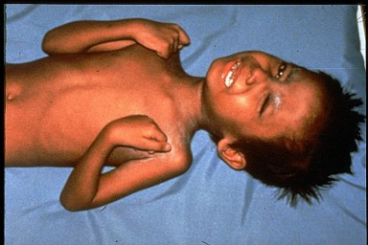

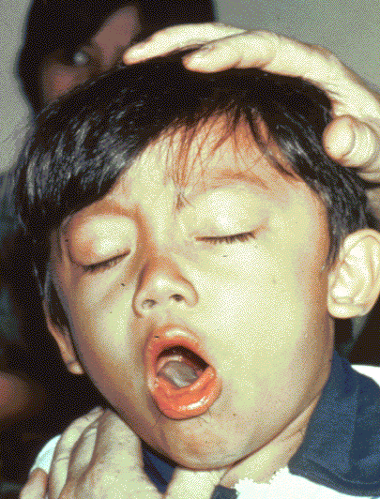
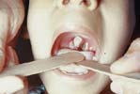
Diphtheria
Tetanus
Required for child care and school attendance
Pertussis
Notes:
Ask participants what are: Diphtheria, tetanus and pertussis?
Whooping cough (pertussis), tetanus, and diphtheria are serious diseases caused by bacteria.
Whooping cough and diphtheria are spread person-to-person through the air. Tetanus gets into the body through cuts or wounds.
Whooping cough can trigger such bad coughing that babies can’t breathe. Babies are most likely to die from whooping cough and can have complications such as seizures and brain damage. Tetanus can cause extremely painful muscle cramps all over the body. Diphtheria can lead to severe breathing problems, heart problems, and paralysis. All these diseases can be deadly.
ACIP recommends:
A 5 dose series of DTaP: Administered at 2, 4, 6, 15-18 months and 4-6 years (Do not administer after age 6)
Optional Information:
Diphtheria, tetanus, and pertussis are illustrated on this slide
The top left picture is of a throat of a child who has diphtheria. You can see the thick gray coating over the back of the throat. This coating can eventually expand down through the airway, and if not treated, a person could die from suffocation, or suffer other complications such as paralysis, heart failure, or coma.
In the top right picture, this child is experiencing painful muscle spasms from tetanus. It is nearly impossible for him to move or control the muscles in his body. He cannot eat because the muscles in his mouth have become so tight and it is difficult for him to swallow. Other possible complications are broken bones from muscle spasms, breathing problems, and death.
The bottom picture shows a child who is suffering from pertussis, commonly know as “whooping cough”. He is experiencing coughing spasms, which produce a “whooping” sound. The sound occurs because the child is trying to catch his breath before the next round of coughing. Often children have difficulty breathing and experience vomiting and exhaustion from the severe coughing.

Slide 7
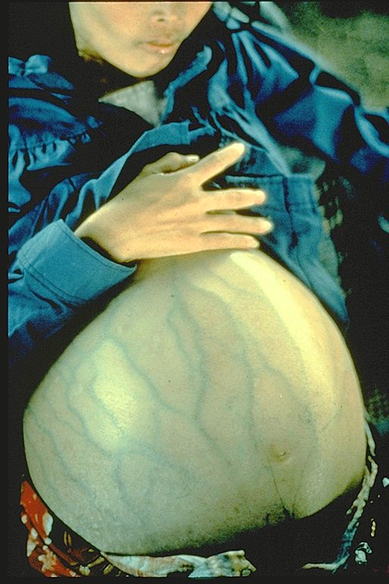
Hepatitis B
Required for child care and school attendance
Notes:
Review Hepatitis B virus:
Hepatitis B is a serious liver disease caused by a virus. Your can get infected with hepatitis B if you come in contact with an infected person’s blood or other body fluids. Babies can get the virus from their infected mothers at birth or if they live with or are cared for by an infected person. The virus can be spread just by sharing a toothbrush with an infected person. For some people, the virus remains in their body for years. During this time, the virus can attack the liver and cause serious problems like liver failure or cancer.
Presenter may want to use Hepatitis one-pager to discuss vaccine usage during slide.
Children and adolescents
Babies normally get 3 doses of hepatitis B vaccine:
1st Dose: Birth, 2nd Dose: 1-2 months of age, 3rd Dose: 6-18 months of age. Some babies might get 4 doses, for example, if a combination vaccine containing hepatitis B is used. (This is a single shot containing several vaccines.) The extra dose is not harmful. The final (third or fourth) dose in the HepB vaccine series should be administered no earlier than age 24 weeks. Administration of a total of 4 doses of HepB vaccine is permitted when a combination vaccine containing HepB is administered after the birth dose. Anyone through 18 years of age who didn’t get the vaccine when they were younger should also be vaccinated.
Adults
All unvaccinated adults at risk for hepatitis B infection should be vaccinated. This includes: sex partners of people infected with hepatitis B, men who have sex with men, people who inject street drugs, people with more than one sex partner, People with chronic liver or kidney disease, people under 60 years of age with diabetes, people with jobs that expose them to human blood or other body fluids, household contacts of people infected with hepatitis B, residents and staff in institutions for the developmentally disabled, Kidney dialysis patients, people who travel to countries where hepatitis B is common, people with HIV infection. Other people may be encouraged by their doctor to get hepatitis B vaccine; for example, adults 60 and older with diabetes. Anyone else who wants to be protected from hepatitis B infection may get the vaccine. Pregnant women who are at risk for one of the reasons stated previously should be vaccinated. Other pregnant women who want protection may be vaccinated. Adults getting hepatitis B vaccine should get 3 doses—with the second dose given 4 weeks after the first and the third dose 5 months after the second. Your doctor can tell you about other dosing schedules that might be used in certain circumstances.
Staff should work with other programs to make sure there are standing orders to vaccinate these vulnerable populations.

Slide 8
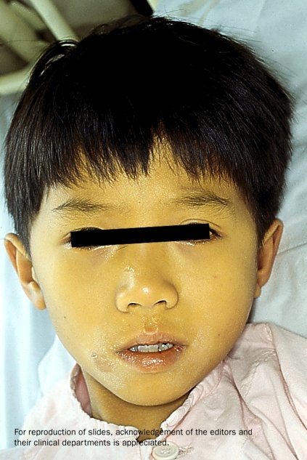

Hepatitis A
Required for school or child care attendance for children born on or after 1-1-06
Notes:
Hepatitis A is a serious liver disease caused by a virus. The virus is found in the feces (poop) of infected people. The hepatitis A virus is spread when invisible particles of feces (poop) get into a person’s mouth. You can get hepatitis A by eating contaminated food or drinking contaminated water, during sex, or just by living with an infected person. Hepatitis A can your skin and eyes turn yellow. You can get very sick for weeks, need to be hospitalized, and even die. Some people don’t look or feel sick, but they can still spread hepatitis A to others. Everyone is at some risk for getting infected with hepatitis A. People who travel outside the U.S. have an increased chance of getting infected.
For children, the first dose should be given at 12 through 23 months of age. Children who are not vaccinated by 2 years of age can be vaccinated at later visits.
The persons on this slide have hepatitis A . Note the jaundice of the skin and the sclera of the eye.
Optional information:
The nature of hepatitis A disease is that it is cyclical. Children plan an important role in HAV transmission. Symptomatic infection is uncommon in children, so they may be a source of infection for household or other close contacts. Almost half of persons with hepatitis A do not have an identified source of their infection. Groups of persons at risk for hepatitis A are international travelers, men who have sex with men, and illegal drug users. Food handlers are not at risk.

Slide 9
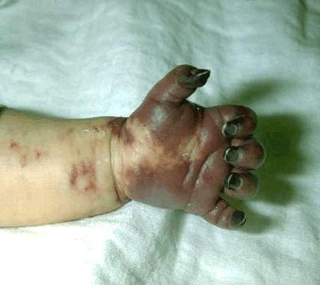
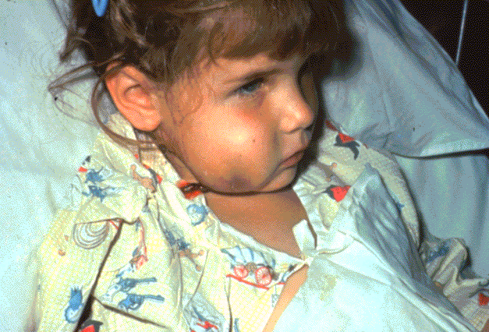
Haemophilus influenzae Type b (Hib)
Required only for child care and pre-K attendance
Notes:
What causes Hib disease? Hib disease is caused by a bacterium, Haemophilus influenzae type b. There are six different types of these bacteria (a through f). Type b organisms account for 95% of all strains that cause invasive disease, and this is the type against which the Hib vaccine
protects.
How does Hib disease spread? Hib disease is spread person-to-person by direct contact or through respiratory droplets. Usually the organisms
remain in the nose and throat, but occasionally the bacteria spread to the lungs or bloodstream and cause a serious infection in the individual.
How serious is Hib disease? Hib disease can be very serious. The most common type of invasive Hib disease is meningitis, an infection of the membranes covering the brain (50%–65% of cases).
ACIP recommends:
3-4 doses of Hib (depending on brand)
Dose 1 @ 2 months of age
Dose 2 @ 4 months of age
Dose 3 @ 6 months of age
(Not required if Pedvax HIB® is administered at 2 and 4 months of age)
Booster dose @ 12 through 15 months of age
One dose of Hib may be given to adults with immunocompromising conditions.

Slide 10
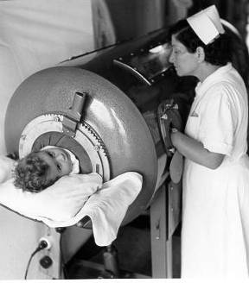
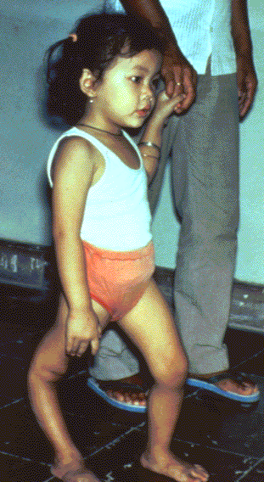
Polio
Required for child care and school attendance
Ref. MMWR 2009; 58 (30);829-830 (August 7, 2009)
Source: World Health Organization
Notes:
10
10
10
Discuss pictures on the slide. Pictures show a child in an iron lung due to weak respiratory muscles (common in polio era) and a child with muscle weakness, as a result of polio, requiring the assistance of braces and crutches in order to walk.
Polio, also called poliomyelitis and infantile paralysis is caused by an Enterovirus (Serotypes 1,2,3)
Infection acquired through mouth, virus replicates in pharynx and GI tract, then spreads to lymphatics and other tissues.
Attacks motor neurons in spinal cord & brain stem
in 2015, Nigeria was removed from the list of polio-endemic countries. The only 2 polio endemic countries now are Pakistan and Afghanistan. Remind staff to evaluate travelers for the need of polio vaccine if traveling to endemic countries.
ACIP recommends:
Four dose series of IPV at : 2, 4, 6 through 18 months
and 4 through 6 years of age.
Minimum interval from dose 3 to dose 4
is six months
Final dose at 4 years of age or older regardless of the number of previous doses
A booster dose may be recommended, depending on length of stay and the timing of the last dose of polio vaccine, for persons traveling to countries experiencing polio outbreaks.
For additional information about polio refer to: Epidemiology and Prevention of Vaccine-Preventable Diseases, 13th edition 2015. HHS, CDC.

Slide 11
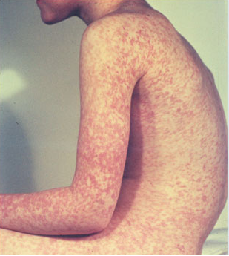
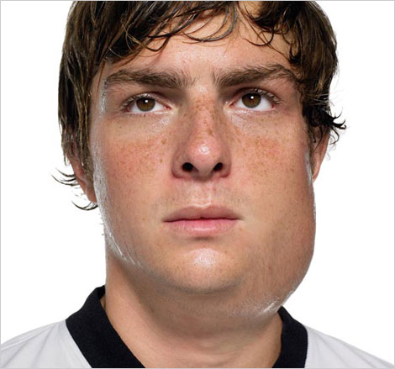
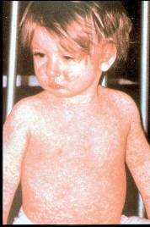
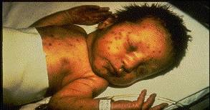
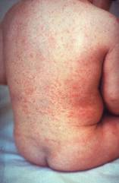
Measles, Mumps, Rubella
Measles (M)
Source: Creative Commons
Source: American Academy of Pediatrics
Red Book On Line Visual Library
Mumps (M)
Required for child care and school attendance
Rubella (R)
Congenital Rubella (R)
Notes:
11
11
MEASLES (caused by paramyxovirus)
Slide shows two children with typical measles rash and conjunctivitis in younger child
MUMPS (caused by paramyxovirus)
Slide shows an adolescent with parotitis due to mumps
Parotitis (inflammation of parotid gland) occurs in 30-40% of infected persons, 40-50% have only nonspecific or respiratory symptoms; Complications include aseptic meningitis, & deafness; Post pubertal individuals may have orchitis (inflammation of testicles), ovarian inflammation, & pancreatitis
RUBELLA (Caused by rubella virus and spread from person to person {togavirus})
In children, the rash may be the first manifestation of infection. Adults may have low-grade fever, malaise, URI, and lymphadenopathy prior to rash. Arthralgia and arthritis is common in adults, especially women. Complications include encephalitis and hemorrhagic manifestations
Rubella is no longer endemic in the U.S. However, it is still present in other countries and can be imported
CONGENITAL RUBELLA
Slide shows an adult and child with a typical rash from rubella and an infant with congenital rubella syndrome Infant was infected in utero and has “blueberry muffin spots” on skin due to petechial lesions, cataracts, hearing loss and congenital heart lesion and will most likely be developmentally delayed.
All woman of child bearing age should be certain they are immune to rubella.
For additional information refer to: Epidemiology and Prevention of Vaccine-Preventable Diseases, 12th edition May 2012. HHS, CDC.

Slide 12
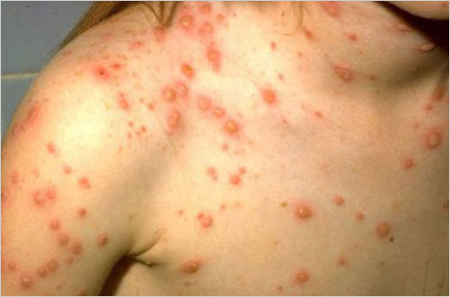
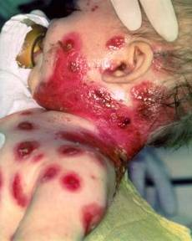
Varicella
(Chickenpox)
Required for child care and school attendance
© Copyright American Academy of Pediatrics
Notes:
Chicken pox is an illness caused by the varicella zoster virus. It was one an almost universal childhood experience. Now it’s much less common in the U.S. owing to widespread vaccination.
Why get vaccinated?
It is usually mild, but it can be serious, especially in young infants and adults. Most people who get chickenpox vaccine will not get chickenpox. But if someone who has been vaccinated does get chickenpox, it is usually very mild. They will have fewer blisters, are less likely to have a fever, and will recover faster. This slide shows an adolescent with a typical varicella rash and infant with secondary bacterial infected varicella lesions, probably due to staph or strep.
ACIP recommends:
Children who have never had chickenpox should get 2 doses of chickenpox vaccine at these ages:
1st Dose: 12–15 months of age
2nd Dose: 4–6 years of age (may be given earlier, if at least 3 months after the 1st dose)
People 13 years of age and older (who have never had chickenpox or received chickenpox vaccine) should get two doses at least 28 days apart.
Catch-up
Anyone who is not fully vaccinated, and never had chickenpox, should receive one or two doses of
chickenpox vaccine. The timing of these doses depends on the person’s age. Chickenpox vaccine may be given at the same time as other vaccines.
Reference: Prevention of Varicella - Recommendations of the Advisory Committee on Immunization
Practices (ACIP) MMWR (2007);56(No. RR-4):23

Slide 13


Pneumococcal Disease
Required for child care and pre-K attendance
Notes:
Pneumococcal disease is caused by a bacterium, Streptococcus pneumoniae, also called pneumococcus (about 90 known serotypes); Causes pneumonia, bacteremia, meningitis and otitis media; Highest rate of invasive disease is in children less than 2 years. Increased risk of infection in children with HIV infection, sickle cell disease, asplenia, day care attendees and in certain ethnic groups (African Americans, Alaskan natives and Native Americans). Increased risk in children & adults with cardiovascular disease, pulmonary disease, diabetes, alcoholism, cirrhosis, immunocompromising conditions; Individuals who have asthma and those who smoke cigarettes are also at increased risk. Estimated cases in the US each year are more than any other vaccine-preventable disease. Some serotypes of pneumococcus have become resistant to antibiotics.
PCV13 is routinely given to children at 2, 4, 6, and 12–15 months of age. Children in this age range are at greatest risk for serious diseases caused by pneumococcal infection.
This vaccine is a requirement for pre-K and childcare attendance.

Slide 14
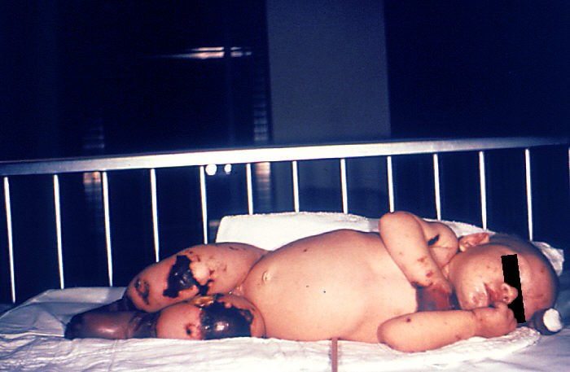
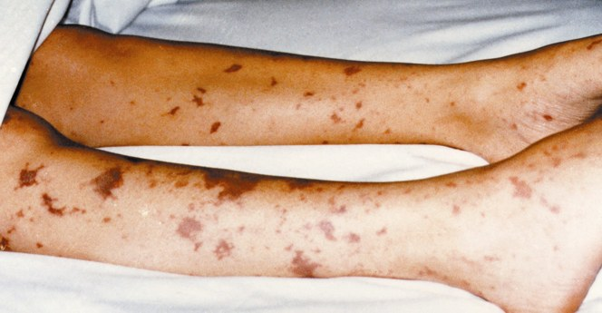
Meningococcal Disease
New 7th Grade School Requirement
Notes:
These very graphic photos show the possible results of a meningococcal infection becoming systemic and then infecting bodily tissues.
The 4 month old on the left has gangrene of the hands and lower extremities due to meningococcemia.
The picture on the right shows similar though not as severe tissue damage in an older child.
Meningitis ~50% of cases 9-10% fatality rate
Meningococcemia- 5%-20% of cases; Up to 40% fatality rate
(Rash, Vascular damage, Disseminated intravascular coagulation, Multi-organ failure, Shock, Death can occur in 24 hours)
11-19% of survivors have permanent sequelae (an abnormal condition resulting from a previous disease)
Ref: 1. Epidemiology and Prevention of Vaccine-Preventable Diseases. 12th Edition, May 2012.
2. AAP Red Book 2012

Slide 15

Advisory Committee on Immunization Practices (ACIP)
15 voting members with expertise in one or more of the following:
Vaccinology
Immunology
Infectious diseases
Pediatrics
Internal Medicine
Preventive medicine
Public health
Consumer perspectives and/or social and community aspects of immunization programs
ACIP develops recommendations and schedules for the use of
licensed vaccines
Notes:
Ask the audience if they are familiar with the ACIP. If they are familiar with the ACIP the presenter can spend a minimal amount of time on this slide.
The dramatic reduction of vaccine preventable diseases in the United States can be attributed to the availability of vaccines, as well as recommendations and an organized vaccine schedule developed by the Advisory Committee on Immunization Practices (ACIP).
The Advisory Committee on Immunization Practices (ACIP) consists of 15 experts in fields associated with immunization who have been selected by the Secretary of the U. S. Department of Health and Human Services to provide advice and guidance to the Secretary, the Assistant Secretary for Health, and the Centers for Disease Control and Prevention (CDC) on the most effective means to prevent vaccine-preventable diseases.
The Committee develops written recommendations for the routine administration of vaccines to the pediatric and adult populations, along with schedules regarding the appropriate periodicity, dosage, and contraindications applicable to the vaccines. ACIP is the only entity in the federal government which makes such recommendations.
The overall goals of the ACIP are to provide advice which will assist the Department and the Nation in reducing the incidence of vaccine preventable diseases and to increase the safe usage of vaccines and related biological products.
For more information: http://www.cdc.gov/vaccines/acip/index.html

Slide 16
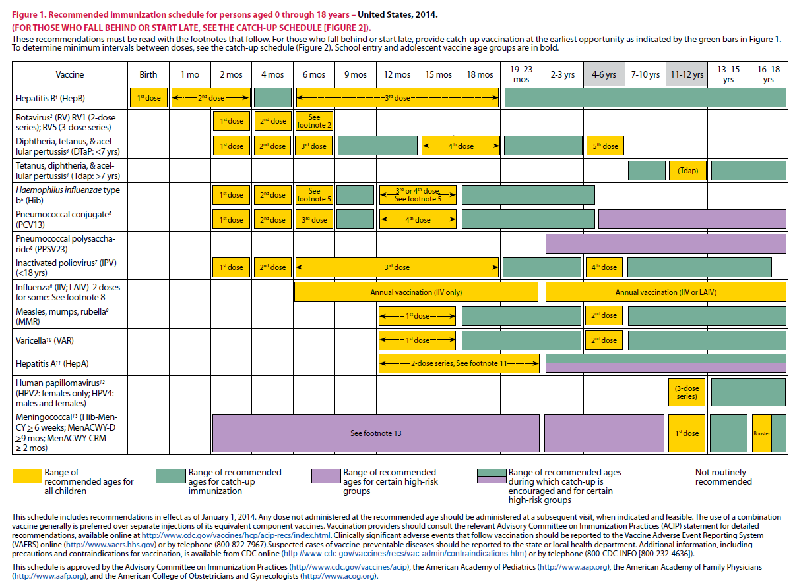
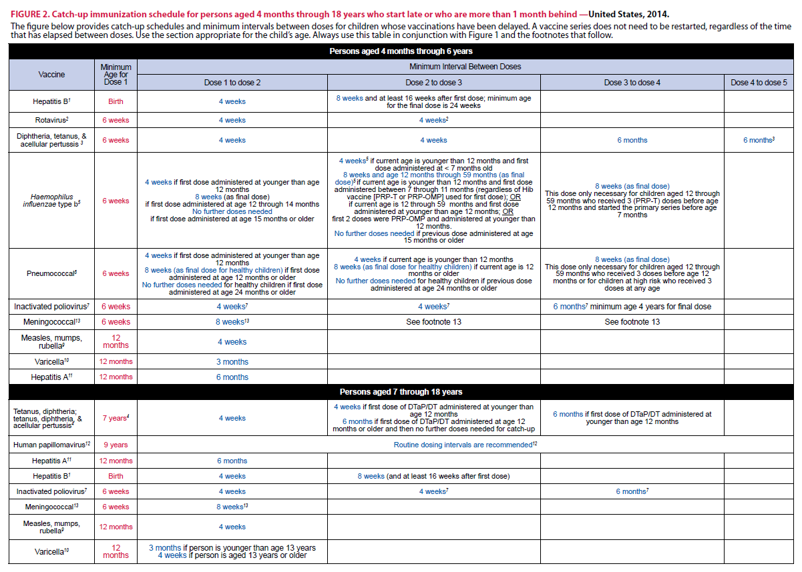
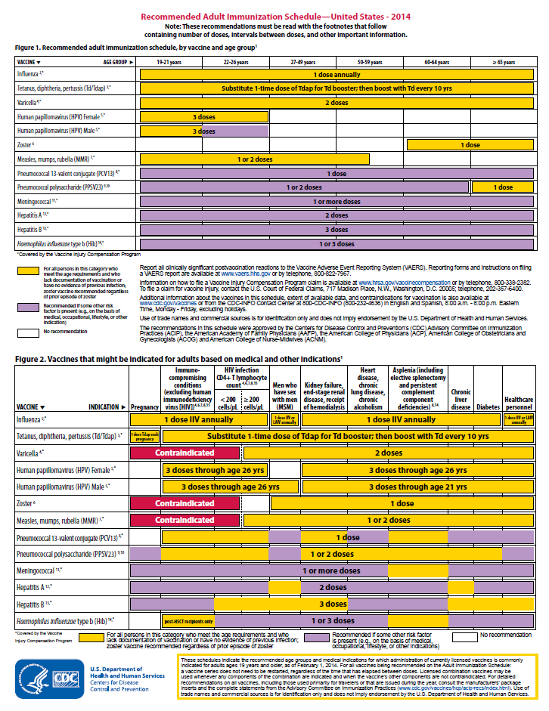
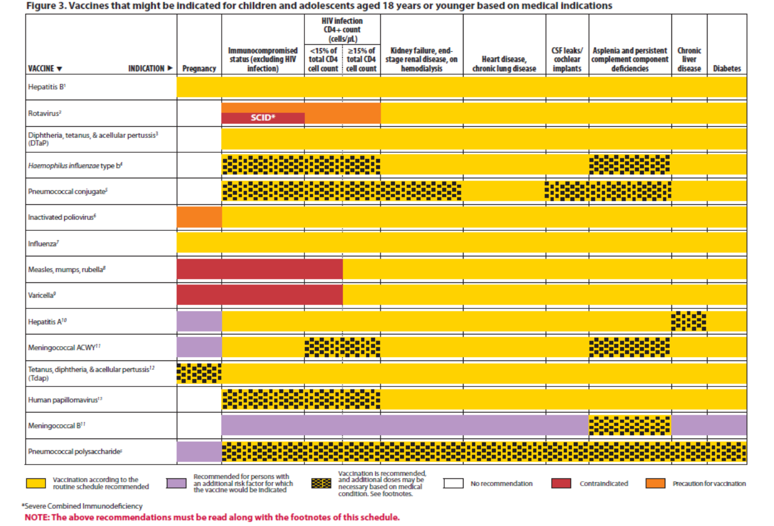
Immunization Schedule Updates
All staff must use the same
immunization schedule
Schedules:
  Children & Adolescents
  0 through 18 years
  Catch-up schedule for
  ages 4 months -18 years
  Children and Adolescents 18 years or younger based on medical indications
  Adult 19 years and older
  Adult based on medical
  and other indications
READ THE FOOTNOTES
http://www.cdc.gov/vaccines/schedules/hcp/child-adolescent.html
http://www.cdc.gov/vaccines/schedules/hcp/adult.html
Notes:
16
16
In October 2016, ACIP approved the 2017 Immunization Schedule for Children and Adolescents birth through 18 years, which became effective February 1, 2017.
It is important to remember that:
-All staff and providers should use the same immunization schedule
Schedules:
-Children & Adolescents aged 18 years or younger
-Catch-up schedule for ages 4 months -18 years
-Children and adolescents 18 years or younger based on medical indications (added in 2017)***
-Adult 19 years and older
-Adult based on medical and other indications
Always refer to and read the footnotes for additional guidance of the vaccines.

Slide 17
Indication
Recommendation
Requirement
Indication
  -Information about the appropriate use of the vaccine
Recommendation
  -ACIP statement that broadens and further delineates the Indication found in the package insert
  -Basis for standards for best practice
Requirement
  -Mandate by a state that a particular vaccine must be administered and documented before entrance to child care and/or school
Notes:
17
It is important that providers understand the difference between an indication, recommendation and a requirement when assessing immunization need.
An indication provides information about the appropriate use of the vaccines
EXAMPLE of an indication:
ADACEL vaccine is indicated for active booster immunization for the prevention of tetanus, diphtheria and pertussis as a single dose in persons 10 through 64 years of age.
BOOSTRIX® is indicated for active booster immunization against tetanus, diphtheria, and pertussis as a single dose in individuals 10 years and older.
The ACIP statement broadens and delineates the indication found in the package insert.
So an EXAMPLE of a recommendation:
The ACIP recommendation for Tdap would be, “Administer 1 dose of Tdap vaccine to all adolescents aged 11 through 12 years.” The recommendation may include other information and guidance on epidemiology of the disease, appropriate timing, dosage, contraindications to the vaccine and guidance for use in special populations. The recommendation appears first as “provisional recommendation” but once approved, it appears in the MMWR as a full recommendation.
Finally, a vaccine requirement is consistent with the ACIP Recommended Childhood and Adolescent Immunization Schedule and is a mandate by a state that a particular vaccine must be administered and documented before entrance to school or child care.
EXAMPLE of a state vaccine requirements:
Requirements are consistent with the Recommended Childhood and Adolescent Immunization Schedule. GA DPH rules and regulations state that children entering any school or child care facility in GA must be age appropriately immunized against each of these diseases: Hepatitis B, Diphtheria, Tetanus, Pertussis, Polio, Hib, Pneumococcus, Measles, Mumps, Rubella, Varicella, Hepatitis A and Meningococcal.

Slide 18
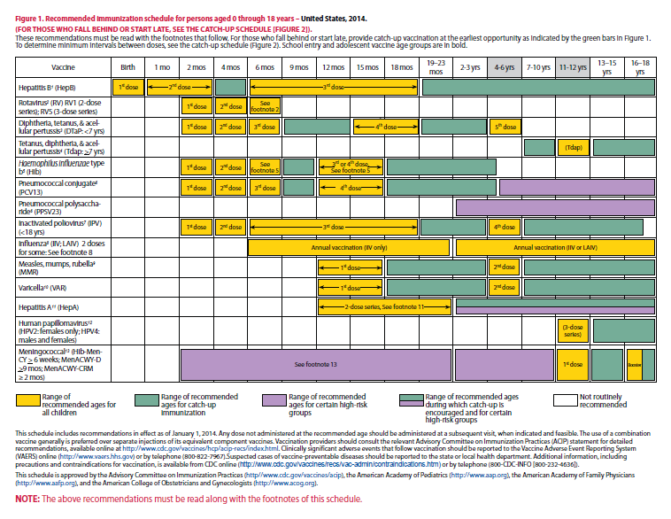
Notes:
Presenter may have copies of schedule for demonstration.
(Encourage participants to look at the schedule.)
As we review the schedule for each vaccine, a good way to determine what immunizations are due for a child at a particular age is to hold a piece of paper at the end of the year that displays the child’s current age.
For example, in this slide this child is 7 months of age. To determine what he should have already been given, hold the piece of paper at the 6 month line. Whatever vaccines are completely to the left of the line (gray area) should have been administered ( Hepatitis B-2doses, rotavirus 3 doses, DTaP –3 doses, Hib- 2-3 doses,depending upon the brand , PCV- 3 doses, IPV- 2 doses, and possibly influenza). If not, those vaccines should be administered to begin to catch him up.
You will note that some vaccines, like the 3rd dose of hepatitis B and IPV are not completely to the left. This means that the 3rd dose of Hep B and IPV are recommended to be given by 18 months of age. The exact age at which the provider chooses to give these 3rd doses depends upon the child’s health status and other conditions, such as mother’s Hepatitis B surface antigen status or requirements for child care attendance. But in any situation the 3rd doses should be administered by 18 months. Influenza vaccination would be dependent upon the time of year.

Slide 19
“It’s The Law”
Notes:
Ask the audience when should the VIS be given to a patient and to see how many different responses you receive. Explain process.
After a provider has determined the vaccines recommended for a patient the next step is to provide the patient with a Vaccine Information Statement.
As required under the National Childhood Vaccine Injury Act, all health care providers in the US who administer to any child or adult, any of the following vaccines diphtheria, tetanus, pertussis, measles, mumps, rubella, polio, hepatitis A & B, HIB, influenza, pneumococcal, meningococcal, rotavirus, HPV and varicella shall, prior to administration of each dose of the vaccine, provide a copy to keep of the relevant current edition vaccine information materials that have been produced by the CDC.
Presenter may include a copy of the handout for the Top 10 facts about the VIS to review with staff.
The top 10 facts about VIS are:
-It’s federal law, VIS are required for both public and private sectors, VIS must be provided before vaccine administered, must provide current VIS for each dose of vaccine, must provide VISs for combination vaccines too, VISs are available in other formats, including 30 languages (you may use laminated copies of VISs for patients and parents to read and return before leaving the clinic, but you must also offer the patient/parent a printed copy of the VIS to take home. If they prefer to download the VIS onto a mobile device, direct them to CDC’s VIS mobile Downloads web page: http://m.cdc.gov/VIS. Federal law does not require signed consent in order for a person to be vaccinated. To verify that a VIS was given, providers must record in the patient’s chart the published date of VIS, date the VIS was given, name, address and title of the person who administers vaccine, date vaccine administered, and vaccine manufacturer and lot number of each dose administered. VISs should not be altered. Provide VISs to all patients.

Slide 20
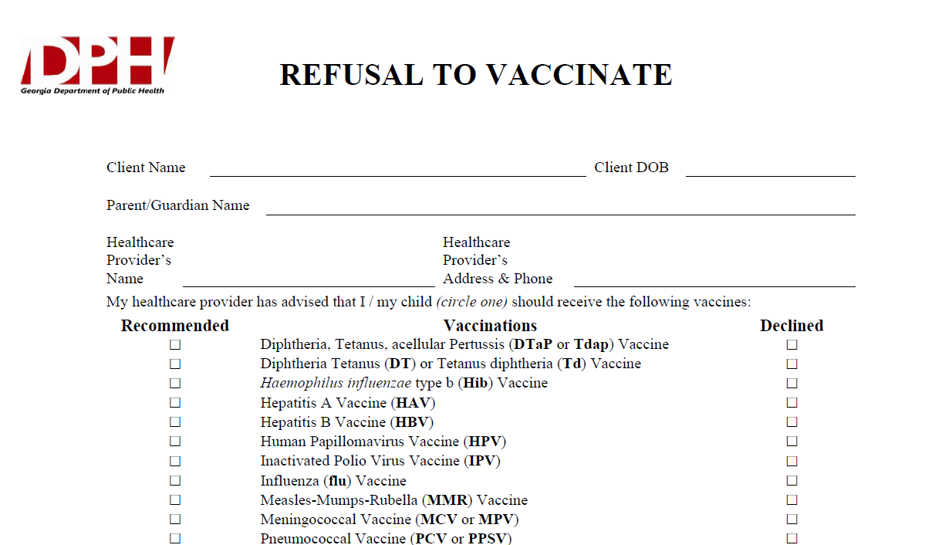
Notes:
What If Parents Refuse to Vaccinate?
Excluding children from your practice when their parents decline immunizations is not recommended. It can put the child at risk of many different health problems—not just vaccine-preventable diseases. Remember, unvaccinated infants did not decide for themselves to remain unvaccinated. They need your care. Make sure that parents are fully informed about clinical presentations of vaccine-preventable diseases, including early symptoms. Diseases like pertussis and measles are highly contagious and may present early as a non-specific respiratory illness. Parents who refuse vaccines should be reminded at every visit to call before bringing the child into the office, clinic, or emergency department when the child is ill so appropriate measures can be taken to protect others.
If a parent refuses to vaccinate, you can share the fact sheet
If You Choose Not to Vaccinate Your Child, Understand the Risks and Responsibilities (http://www.cdc.gov/vaccines/conversations),
which explains the risks involved with this decision including risks to other members of their community, and the additional responsibilities for parents, including the fact that, when their child is ill, they should always alert health care personnel to their child’s vaccination status to prevent the possible spread of vaccine-preventable diseases. You may wish to have them sign DPH’s Refusal to Vaccinate form in English or Spanish (https://dph.georgia.gov/sites/dph.georgia.gov/files/Immunizations/Health-Care-Professionals-Refusal-to-Vaccinate-Form-English_1.pdf) each time a vaccine is refused so that you have a record of their refusal in their child’s medical file.

Slide 21
VFC Program
The Vaccines For Children (VFC) program is a federally funded program that provides vaccines at no cost to children who might not otherwise be vaccinated because of inability to pay.
All ACIP routinely recommended vaccines are available through the GA VFC Program for VFC eligible children.
Notes:
The Vaccines For Children (VFC) program is a federally funded program that provides vaccines at no cost to children who might not otherwise be vaccinated because of inability to pay. CDC buys vaccines at a discount and distributes them to grantees—i.e., state health departments and certain local and territorial public health agencies—which in turn distribute them at no charge to those private physicians' offices and public health clinics registered as VFC providers. Children who are eligible* for VFC vaccines are entitled to receive those vaccines recommended by the Advisory Committee on Immunization Practices (ACIP).
All children who are VFC Eligible can receive required vaccines through the VFC program
This includes all children 0 through 18 years of age who are :
Medicaid eligible or American Indian or Alaska Native or Uninsured (no health insurance)or underinsured (have insurance but vaccines are not a covered benefit) or are enrolled in PeachCare.

Slide 22
VFC Eligibility Requirement
Medicaid-eligible
Uninsured
AI/AN, uninsured, underinsured if receiving a FQHC or RHC, or on Medicaid
Underinsured
Note: The parent would be responsible for the administration fee for any VFC vaccine administered to their child, but the administration fee must be waived if the parent cannot afford to pay it.
Notes:
Children through 18 years of age (under 19) who meet at least one of the following criteria are eligible to receive VFC vaccine:
Medicaid eligible- a child who is eligible for the Medicaid program.
Uninsured- A child who has no health insurance
American Indian or Alaska Native (AI/AN)- As defined by the Indian Health Care Improvement Act
Underinsured- a child who has health insurance, but the coverage does not include vaccines, or a child whose insurance does not cover all Advisory Committee on Immunization Practices (ACIP) recommended vaccines. The child would be eligible to receive those vaccines not covered by the insurance.
Very Important to inform staff:
All VFC providers must possess a working knowledge of all VFC eligibility criteria and use those criteria to screen children prior to administering VFC vaccines. VFC Providers must adhere to proper billing practices for vaccine administration fees and clearly understand that VFC vaccine is provided at no cost to both the VFC Provider and eligible children. At no time should billing occur for the cost of VFC vaccine. When administering VFC vaccine, Providers should NEVER bill two different “payers” for the same vaccine administration fee amount. The parent would be responsible for the administration fee for any VFC vaccine administered to their child, but patients cannot be turned away or reported to collections for inability to pay the administration fee. This also prohibits withholding immunization records/certificates.
Please refer to Vaccines for Children Requirements

Slide 23
DOCUMENTATION
Update the clinic immunization record and GRITS history from the child’s personal record as needed, and vice versa
Complete necessary WIC forms showing request for record, review of record, and/or referral for immunizations
Provide other referral information for client as needed (i.e., DFCS, PeachCare, local health department, etc.)
Notes:
Presenter will review with staff how to document immunization histories in GRITS. Consult with healthcare provider is there are any questionable records.
If the child’s personal record shows more current immunizations than the clinic’s record, be sure to update the clinic record and the GRITS history, and vice versa.
Complete WIC documentation forms as needed.
Provide client with other referral information as needed (DFCS, PeachCare, health dept. information, etc.)

Slide 24
Vaccines Received Outside the U.S.
Accept doses if:
  there is a written, dated record
  age, spacing, and timing comparable with that recommended in the U.S.
Special consideration for children adopted from orphanages
Refer to Table 12 in the General Recommendations ACIP Statement
If there is any question about the child’s record or vaccines received, refer him to his medical provider or the health department.
Notes:
With the increase in immigrant and refugee populations, plus the migrant workers who may access WIC clinics, it is important to be familiar with some of the guidelines for evaluating vaccines received outside the U.S.
Accept doses if:
there is a written, dated record
the age at vaccine administration, the spacing, and the timing of vaccination is comparable with that recommended in the U.S.
Special consideration needs to be made in evaluating immunization records from children who were adopted from overseas orphanages
Table 12 in the General Recommendations ACIP Statement gives approaches to the evaluation and vaccination of internationally adopted children with no or questionable vaccination records.
If there is any question about the child’s record or vaccines received, refer him to his medical provider or the health department.

Slide 25
Vaccination of International Adoptees
Revaccination generally recommended if there is any doubt about the validity of vaccination record
Serologic testing for antibodies can be considered to determine their immunity to certain disease
Notes:
Presenter should inform staff that if patients are international adoptees that they will evaluated by their healthcare provider to determine their immunization needs.
If there is any doubt about the validity of the vaccination record or of any of the vaccines given, the child may need to be revaccinated.
If you are unsure as to whether or not your child was vaccinated, the doctor can have their blood tested for antibodies to determine their immunity to certain diseases. However, these tests may not always be accurate, so the doctor may not be sure your child is truly protected. In some cases, doctors may prefer to revaccinate your child anyway for best protection.
* General Recommendations on Immunization, MMWR, December 1, 2006, Vol. 55, No. RR-15, pg. 33/35.

Slide 26
School & Child Care Requirements
Some of the new vaccines that are RECOMMENDED for particular age groups, may NOT BE REQUIRED for school or child care attendance.
Remember, GRITS
  Calculates validity based on recommendations
  Prints certificates based on requirements
Notes:
Explain to audience that some of the new vaccines previously discussed are RECOMMENDED for a particular age group, but MAY NOT BE REQUIRED (i.e.…..HPV, Influenza, Rotavirus) for school or child care attendance.
Remember, GRITS:
Calculates validity based on recommendations
Prints certificates based on requirements, which are first based on the recommendations.
Inform parents that the nurse will review his or her child’s record prior to vaccine administration.

Slide 27
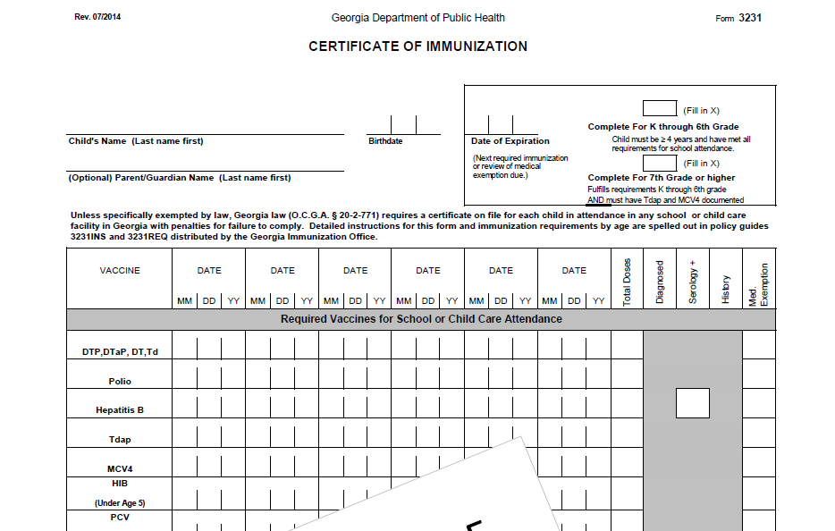
Form 3231
Notes:
Presenter will review form 3231 with audience while discussing slide.
The Immunization certificate was revised July 1, 2014 for new immunization requirements for 7th grade.
The two boxes in the right upper corner; the top box is labeled “Complete For K through 6th Grade” and the bottom box is “Complete for 7th Grade or higher”. The instructions on how these two boxes are completed will are outlined on the 3231 INS.
Additional updates include:
-”Td” has been added to the first line with the DTP, DTaP, DT section; Td will be designated with a (++) symbol and the Td explanation text will appear in the bottom left corner of the form when printed
-”Polio” is now on one line; no separate line for “IPV”/”OPV”; OPV is designated with (^^) symbol, the polio explanation text “**unspecified polio dose/OPV dose appears in the bottom left corner of the form when printed
-“Tdap” and “MCV4” are listed on their own separate lines; MCV4 row was moved up to the required section; only Menactra, Menveo and MCV4 unspecified doses will display; Menomune, MenB and Meningococcal unspecified do not display.

Slide 28
Vaccine Injury Compensation Program (VICP)
National Vaccine Injury Compensation Program
provides compensation to individuals found to be injured by or have died from certain childhood vaccines.
  Established in 1988 by NCVIA
  Federal “no fault” system to compensate those injured
  Claim must be filed by individual, parent or guardian
  Must show that injury is on “Vaccine Injury Table”
Notes:
Vaccine safety is very important and the Vaccine Injury Compensation Program was established to provide compensation to individuals found to be injured or have died from certain childhood vaccines.
On October 1, 1988, the National Childhood Vaccine Injury Act of 1986 created the National Vaccine Injury Compensation Program (VICP). The VICP was established to ensure an adequate supply of vaccines, stabilize vaccine costs, and establish and maintain an accessible and efficient forum for individuals found to be injured by certain vaccines. The VICP is a no-fault alternative to the traditional public legal system for resolving vaccine injury claims that provides compensation to people found to be injured by certain vaccines.
The National Childhood Vaccine Injury Act (NCVIA) set forth 3 basic requirements for all vaccination providers, which are:
Providers must give the patient (or parent/legal representative of a minor) a copy of the relevant federal "Vaccine Information Statement" (VIS) for the vaccine they are about to receive.
Providers must record certain information about the vaccine(s) administered in the patient's medical record or a permanent office log.
Providers must document any adverse event following the vaccination that the patient experiences and that becomes known to the provider, whether or not it is felt to be caused by the vaccine, and submit the report to the Vaccine Adverse Event Reporting System (VAERS).

Slide 29

VAERS
What can be reported to VAERS?
Who reports to VAERS?
Does VAERS provide general vaccine information?
Notes:
The Vaccine Adverse Event Reporting System (VAERS) is a national vaccine safety surveillance program co-sponsored by the Centers for Disease Control and Prevention (CDC) and the Food and Drug Administration (FDA). VAERS is a post-marketing safety surveillance program, collecting information about adverse events (possible side effects) that occur after the administration of vaccines licensed for use in the United States. VAERS is also standard #11 for the Standards for child, adolescent and adult immunization practices.
VAERS has demonstrated its public health importance by providing health scientists with signals about possible adverse events following immunization. In one instance, VAERS detected reports for intussusception over that what would be expected to occur by chance alone after the RotaShield rotavirus vaccine in 1999. Epidemiologic studies confirmed an increased risk, and these data contributed to the product's removal from the US market. In another example, VAERS determined that there may be a potential for a small increase in risk for Guillain-Barre' syndrome (GBS) after the meningococcal conjugate vaccine, Menactra. As a result of this finding, a history of GBS became a contraindication to the vaccine and further controlled studies are currently underway to research this issue.
The primary objectives of VAERS are to:
Detect new, unusual, or rare vaccine adverse events;
Monitor increases in known adverse events;
Identify potential patient risk factors for particular types of adverse events;
Identify vaccine lots with increased numbers or types of reported adverse events; and
Assess the safety of newly licensed vaccines.
What Can Be Reported to VAERS?
VAERS encourages the reporting of any clinically significant adverse event that occurs after the administration of any vaccine licensed in the United States.
Who Reports to VAERS?
Anyone can file a VAERS report, including parents, health care providers, manufacturers, and vaccine recipients.
Does VAERS Provide General Vaccine Information?
No. VAERS only collects and analyzes adverse event reports. In another example, VAERS determined that there may be a potential for a small increase in risk for Guillain-Barre syndrome after the meningococcal conjugate vaccine, Menactra. As a result of this finding, a history of Guillain-Barre syndrome became a contraindication to the vaccine and further controlled studies are currently underway to research this issue.

Slide 30

Healthcare Personnel (HCP) and Other Adults Need These Immunizations:
Annual influenza vaccine
Tdap or Td
Hepatitis B (exposure risk) Check immunity
Validate immune status of:
Varicella
Measles, Mumps & Rubella(MMR)
Are YOU up to date?
Notes:
30
Review with audience the vaccines recommended for HCP and other adults.
Un-immunized HCP
Un-immunized healthcare workers are at risk of infecting patients, family members and community contacts
Immunized HCP
Protect patients from VPD’s
Help offices avoid potential liability cases. (The practice can be liable if an unimmunized HCP becomes infected with a vaccine preventable disease and infects a patient.)
Maintain productivity
Reduce illness and illness-related absenteeism
Evidence of Immunity to MMR
Documented administration of two doses of measles and mumps vaccine and one dose of rubella vaccine OR
Laboratory evidence of immunity or laboratory confirmation of disease (measles, mumps and rubella) OR
Born before 1957 (measles, mumps and rubella)
References: 1. General Recommendations on Immunization, Recommendations of the Advisory Committee on Immunization Practices (ACIP). MMWR (RR-2); January 28, 2011
2. Immunization of Health-Care Personnel: Recommendations of ACIP MMWR; November 25, 2011 / 60(RR07);1-45
3. CDC Guidance for Evaluating Health-Care Personnel for Hepatitis B Virus Protection and for Administering Postexposure Management (Recommendations and Reports / Vol. 62 / No. 10 December 20, 2013)

Slide 31


State Resources
Local health department
District Immunization Coordinator
GA Immunization Program Office
  On call Help line: 404-657-3158
  GRITS Help Line:1-866-483-2958
  VFC Help Line:1-800-848-3868
  Website http://dph.georgia.gov/immunization-section
  Your local Immunization Regional Program Consultant (IRC)
  Epidemiology: 1-866-782-4584
GA Chapter of the AAP
GA Academy of Family Physicians
Notes:
If you need further information about the changes, or to ask questions later, please contact the GA Immunization Office and our partners GA AAP and GA AFP
Your Local health department
District Immunization Coordinator (IPCs)
GA Immunization Program Office
404-657-3158
Website http://health.state.ga.us/programs/immunization
GA Chapter of the AAP
GAFP

Slide 32

It’s a Team Effort!
High Immunization rates begin with a team designed plan!
What can your team do to improve rates?
Notes:
32
Remind your audience that “It is a team effort to immunize successfully”. Do not underestimate the
office team’s ability to affect immunization rates. It takes the physician, physician’s assistant, nurse
practitioner, nurse, medical assistant, and clerical staff working together to improve the office practice
and raise immunization rates.
Take any questions from the audience.
Ask participants how, based on the information presented, will they change the way they administer
vaccines.
Ask the audience what will they do to improve rates?
Ask participants to develop a plan to improve the immunization rates in their office
Jot down the plans the practice makes so that we can follow-up with them.

