Slide 1
Review of the Recommended Immunization Schedule
Notes:
Presenter will use this presentation to train clinicians on the ACIP Recommended Immunization Schedule for children, adolescents and adults.

Slide 2
Disclosure Statements
Neither the planners of this session nor I have any financial relationship with pharmaceutical companies, biomedical device manufacturers, or corporations whose products and services are related to the vaccines we discuss.
There is no commercial support being received for this event.
The mention of specific brands of vaccines in this presentation is for the purpose of providing education and does not constitute endorsement.
The GA Immunization Program utilizes ACIP recommendations as the basis for this presentation and for our guidelines, policies, and recommendations.
For certain vaccines this may represent a slight departure from or off-label use of the vaccine package insert guidelines.
Notes:
[Presenter is required to read this information to the audience before the program begins.]
Neither the planners of this session nor I have any financial relationship with pharmaceutical companies, biomedical device manufacturers, or corporations whose products and services are related to the vaccines we discuss.
There is no commercial support being received for this event.
The mention of specific brands of vaccines in this presentation is for the purpose of providing education and does not constitute endorsement.
The GA Immunization Program utilizes ACIP recommendations as the basis for this presentation and for our guidelines, policies, and recommendations.
For certain vaccines this may represent a slight departure from or off-label use of the vaccine package insert guidelines.

Slide 3
Disclosure Statement
To obtain nursing contact hours for this session, you must be present for the entire hour and complete an evaluation.
Continuing education will be provided through the Georgia Department of Public Health
Georgia Department of Public Health is an approved provider of continuing nursing education by the Alabama State Nurses Association, an accredited approver by the American Nurses Credentialing Center’s Commission of Accreditation

Slide 4
Objectives
At the end of this presentation, participants
will be able to:
Recall the role vaccines have played in preventing diseases
Discuss the importance of vaccines for children, adolescents and adults
Discuss the role of a vaccine champion
List at least two reliable sources for immunization information
Notes:
4
At the end of this presentation, you will be able to:
Recall the role vaccines have played in preventing diseases
Discuss the importance of vaccines for children, adolescents and adults
Discuss GA Immunization law and DPH rules and regulations for schools and childcare attendance
Discuss the role of a vaccine champion
List at least two reliable sources for immunization information

Slide 5
The Impact of Vaccines
Disease | Average Annual Reported Cases Pre-vaccine* | Cases in U.S. 2014** | Provisional Cases in U.S. 2015** | Provisional % Reduction In U.S. 2015
Smallpox | 48,164 | Eradicated worldwide in 1980
Diphtheria | 175,885 | 1 | 0 | 100%
Measles | 503,282 | 667 | 189 | >99.9%
Mumps | 152,209 | 1,196 | 1,057 | 99.3%
Pertussis | 147,271 | 32,118 | 18,166 | 87.7%
Polio (paralytic) | 16,316 | 0 | 0 | 100%
Rubella | 47,745 | 6 | 5 | >99.9%
Congenital Rubella Syndrome | 823 | 1 | 1 | >99.9%
Tetanus | 1,314 | 23 | 25 | 98.1%
H. Influenzae Type b Age<5 years | 20,000 | 40 | 23 | 99.9%
*MMWR 48(12);243-248 April 2, 1999
**MMWR 64(52), ND-923-ND-940, January 8, 2016
Notes:
This table shows the impact of vaccines on the annual reported cases of some vaccine preventable diseases in the United States.
Column 2 shows the average number of reported cases of a specific disease prior to the licensure of the vaccine.
Column 3 shows the number of reported cases in the United States in 2014.
Column 4 shows the provisional number of reported cases in the U.S in 2015.
Column 5 shows the percentage decrease in reported cases in the United States based on the provisional number of reported cases in 2015 compared with the pre-vaccine years.
Reference:
Achievements in Public Health, 1900-1999 Impact of Vaccines Universally Recommended for Children - United States, 1990-1998 MMWR April 02, 1999 / 48(12);243-248
MMWR 63(53);733-746, January 9, 2015
MMWR 64(52);ND-923-ND-940, January 8, 2016

Slide 6
Herd Immunity
Immunized individuals block infection from reaching those who are unimmunized
 | Vaccination Rate Needed for Herd Immunity
Measles | 92-94%
Pertussis | 92-94%
Diphtheria | 83-85%
Rubella | 83-85%
Mumps | 75-86%
Influenza | 30-75%
INFECTED
UNIMMUNIZED
Ref: Plotkin,SA, Orenstein, WA, Offit, PA
Vaccines. 6th ed. WB Saunders Co. 2013
= IMMUNIZED
Adapted from CDC
Notes:
Vaccines can prevent outbreaks of disease and save lives. When a critical portion of a community is immunized against a contagious disease, most members of the community are protected against that disease because there is little opportunity for an outbreak. Even those who are not eligible for certain vaccines—such as infants, pregnant women, or immunocompromised individuals—will get some protection because the spread of contagious disease is contained. This is known as "community or herd immunity.“ The more members of a human "herd" who are immune to a given disease, the better protected the whole populace will be from an outbreak of that disease.
The microbes that cause disease all have different infectious features. Some, like measles and influenza, pass from person to person more easily than others. Some tend to have more severe consequences in specific demographic groups. The chart illustrates the vaccination rate needed for herd immunity for each of the VPDs listed. Because measles is extremely contagious and can spread through the air, for example, the immunity threshold needed to protect a community is high, at 92-94%.
Most vaccination policies are focused on creating herd immunity. The creation of herd immunity is especially important in crowded environments which facilitate the spread of disease, like schools. It is also extremely important to receive regular boosters, as some vaccines lose their efficacy over time, leaving people vulnerable to an outbreak. Herd immunity led to the eradication of smallpox, and it explains why diseases such as polio and diphtheria are rare in developed nations with established vaccination policies.

Slide 7

Advisory Committee on Immunization Practices (ACIP)
15 voting members with expertise in one or more of the following:
Vaccinology
Immunology
Infectious diseases
Pediatrics
Internal Medicine
Preventive medicine
Public health
Consumer perspectives and/or social and community aspects of immunization programs
ACIP develops recommendations and schedules for the use of
licensed vaccines
Notes:
The dramatic reduction of vaccine preventable diseases in the United States can be attributed to the availability of vaccines, as well as recommendations and an organized vaccine schedule developed by the Advisory Committee on Immunization Practices (ACIP).
Ask the audience if they are familiar with the ACIP. If they are familiar with the ACIP the presenter can spend a minimal amount of time on this slide.
The Advisory Committee on Immunization Practices (ACIP) consists of 15 experts in fields associated with immunization who have been selected by the Secretary of the U. S. Department of Health and Human Services to provide advice and guidance to the Secretary, the Assistant Secretary for Health, and the Centers for Disease Control and Prevention (CDC) on the most effective means to prevent vaccine-preventable diseases.
The Committee develops written recommendations for the routine administration of vaccines to the pediatric and adult populations, along with schedules regarding the appropriate periodicity, dosage, and contraindications applicable to the vaccines. ACIP is the only entity in the federal government which makes such recommendations.
The overall goals of the ACIP are to provide advice which will assist the Department and the Nation in reducing the incidence of vaccine preventable diseases and to increase the safe usage of vaccines and related biological products.
For more information: http://www.cdc.gov/vaccines/acip/index.html

Slide 8
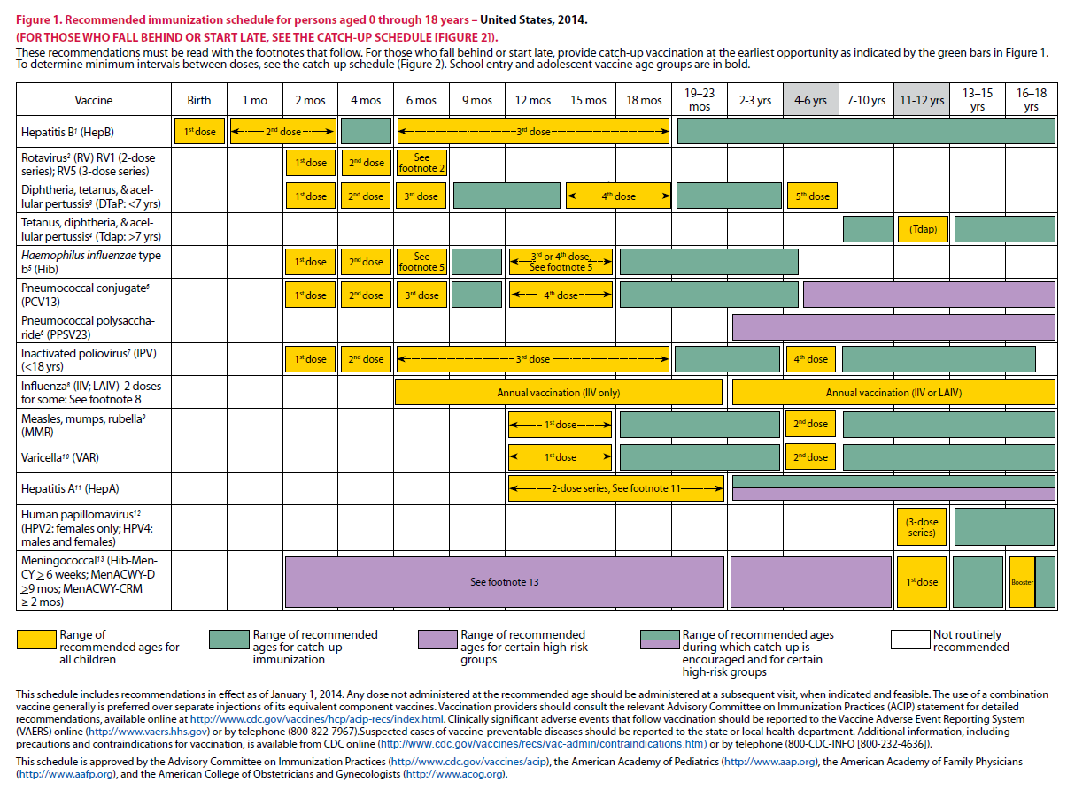
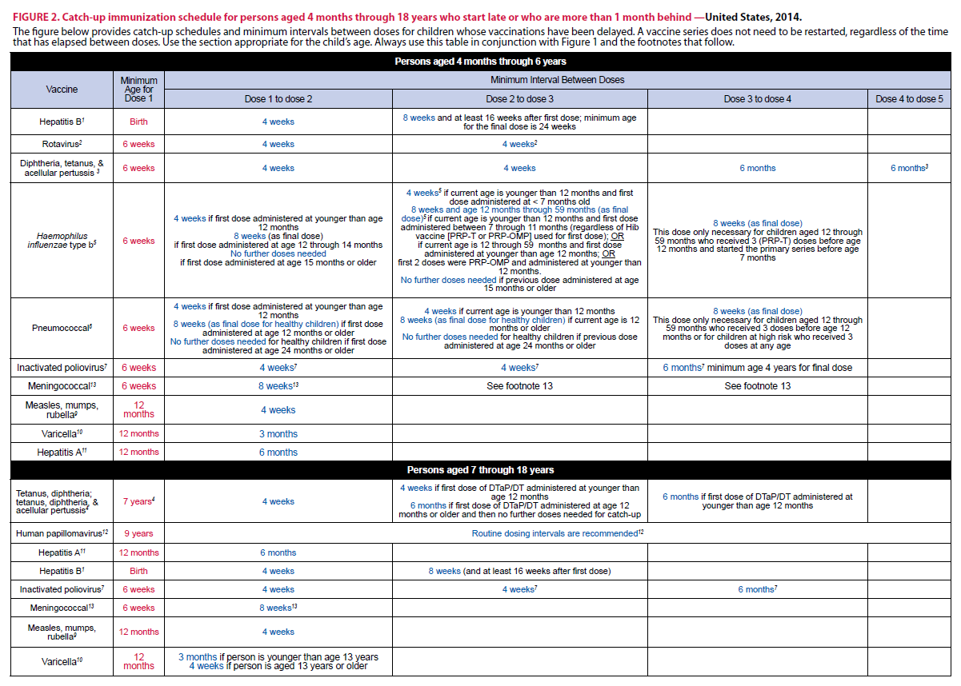
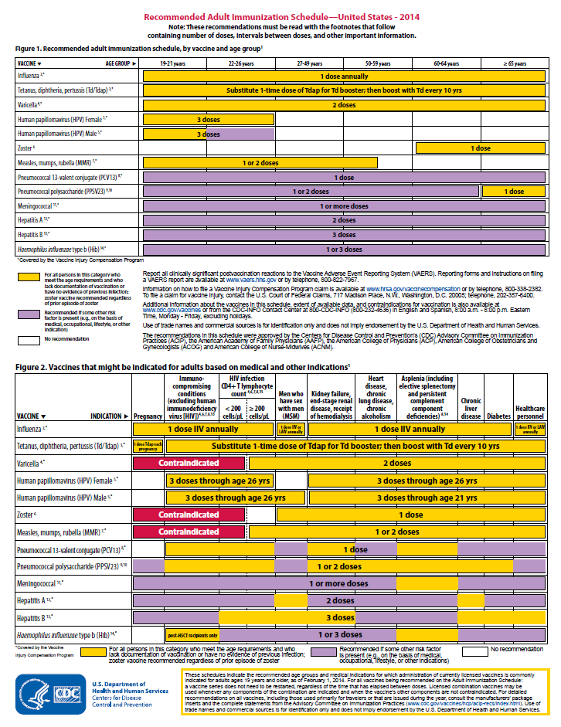
Immunization Schedules
All staff must use the same immunization schedule
Four Schedules:
  Children & Adolescents
  0 through 18 years
  Catch-up schedule for
  ages 4 months -18 years
  Adult 19 years and older
  Adult based on medical
  and other indications
READ THE FOOTNOTES
http://www.cdc.gov/vaccines/schedules/hcp/child-adolescent.html
http://www.cdc.gov/vaccines/schedules/hcp/adult.html
Notes:
8
8
As part of its mission to promote health and prevent disease, CDC publishes written recommendations for vaccinating US children and adults. These recommendations are set to protect infants, children, adolescents, and adults against vaccine-preventable diseases.
The final vaccine recommendations include: the Number of doses of each vaccine, Timing between each dose, Age when infants and children should receive the vaccine, and Precautions and contraindications (who should not receive the vaccine).
It is important that:
All staff must use the same immunization schedule
There are Four Schedules:
Children & Adolescents (0 through 18 years)
Catch-up schedule for ages 4 months -18 years
Adult 19 years and older
Adult based on medical and other indications
Always refer to and read the footnotes for additional guidance of the vaccines.

Slide 9
Indication
Recommendation
Requirement
Indication
  -Information about the appropriate use of the vaccine
Recommendation
  -ACIP statement that broadens and further delineates the Indication found in the package insert
  -Basis for standards for best practice
Requirement
  -Mandate by a state that a particular vaccine must be administered and documented before entrance to child care and/or school
Notes:
9
Ask the audience if they know the difference between an indication, recommendation and a requirement?
It is important for clinicians to understand and explain each term.
An indication provides information about the appropriate use of the vaccines
EXAMPLE of an indication:
ADACEL vaccine is indicated for active booster immunization for the prevention of tetanus, diphtheria and pertussis as a single dose in persons 10 through 64 years of age.
BOOSTRIX® is indicated for active booster immunization against tetanus, diphtheria, and pertussis as a single dose in individuals 10 years and older.
The ACIP statement broadens and delineates the indication found in the package insert.
EXAMPLE of a recommendation:
ACIP makes recommendations for the routine administration of vaccines. The recommendation may include other information and guidance on epidemiology of the disease, appropriate timing, dosage, contraindications to the vaccine and guidance for use in special populations. Appears first as “provisional recommendation” but once approved, appears in the MMWR as a full recommendation.
A vaccine requirement is consistent with the ACIP Recommended Childhood and Adolescent Immunization Schedule and is a mandate by a state that a particular vaccine must be administered and documented before entrance to school or child care.
EXAMPLE of a state vaccine requirements:
Requirements are consistent with the Recommended Childhood and Adolescent Immunization Schedule. GA DPH rules and regulations state that children entering any school or child care facility in GA must be age appropriately immunized against each of these diseases: Hepatitis B, Diphtheria, Tetanus, Pertussis, Polio, Hib, Pneumococcus, Measles, Mumps, Rubella, Varicella, Hepatitis A and Meningococcal.

Slide 10
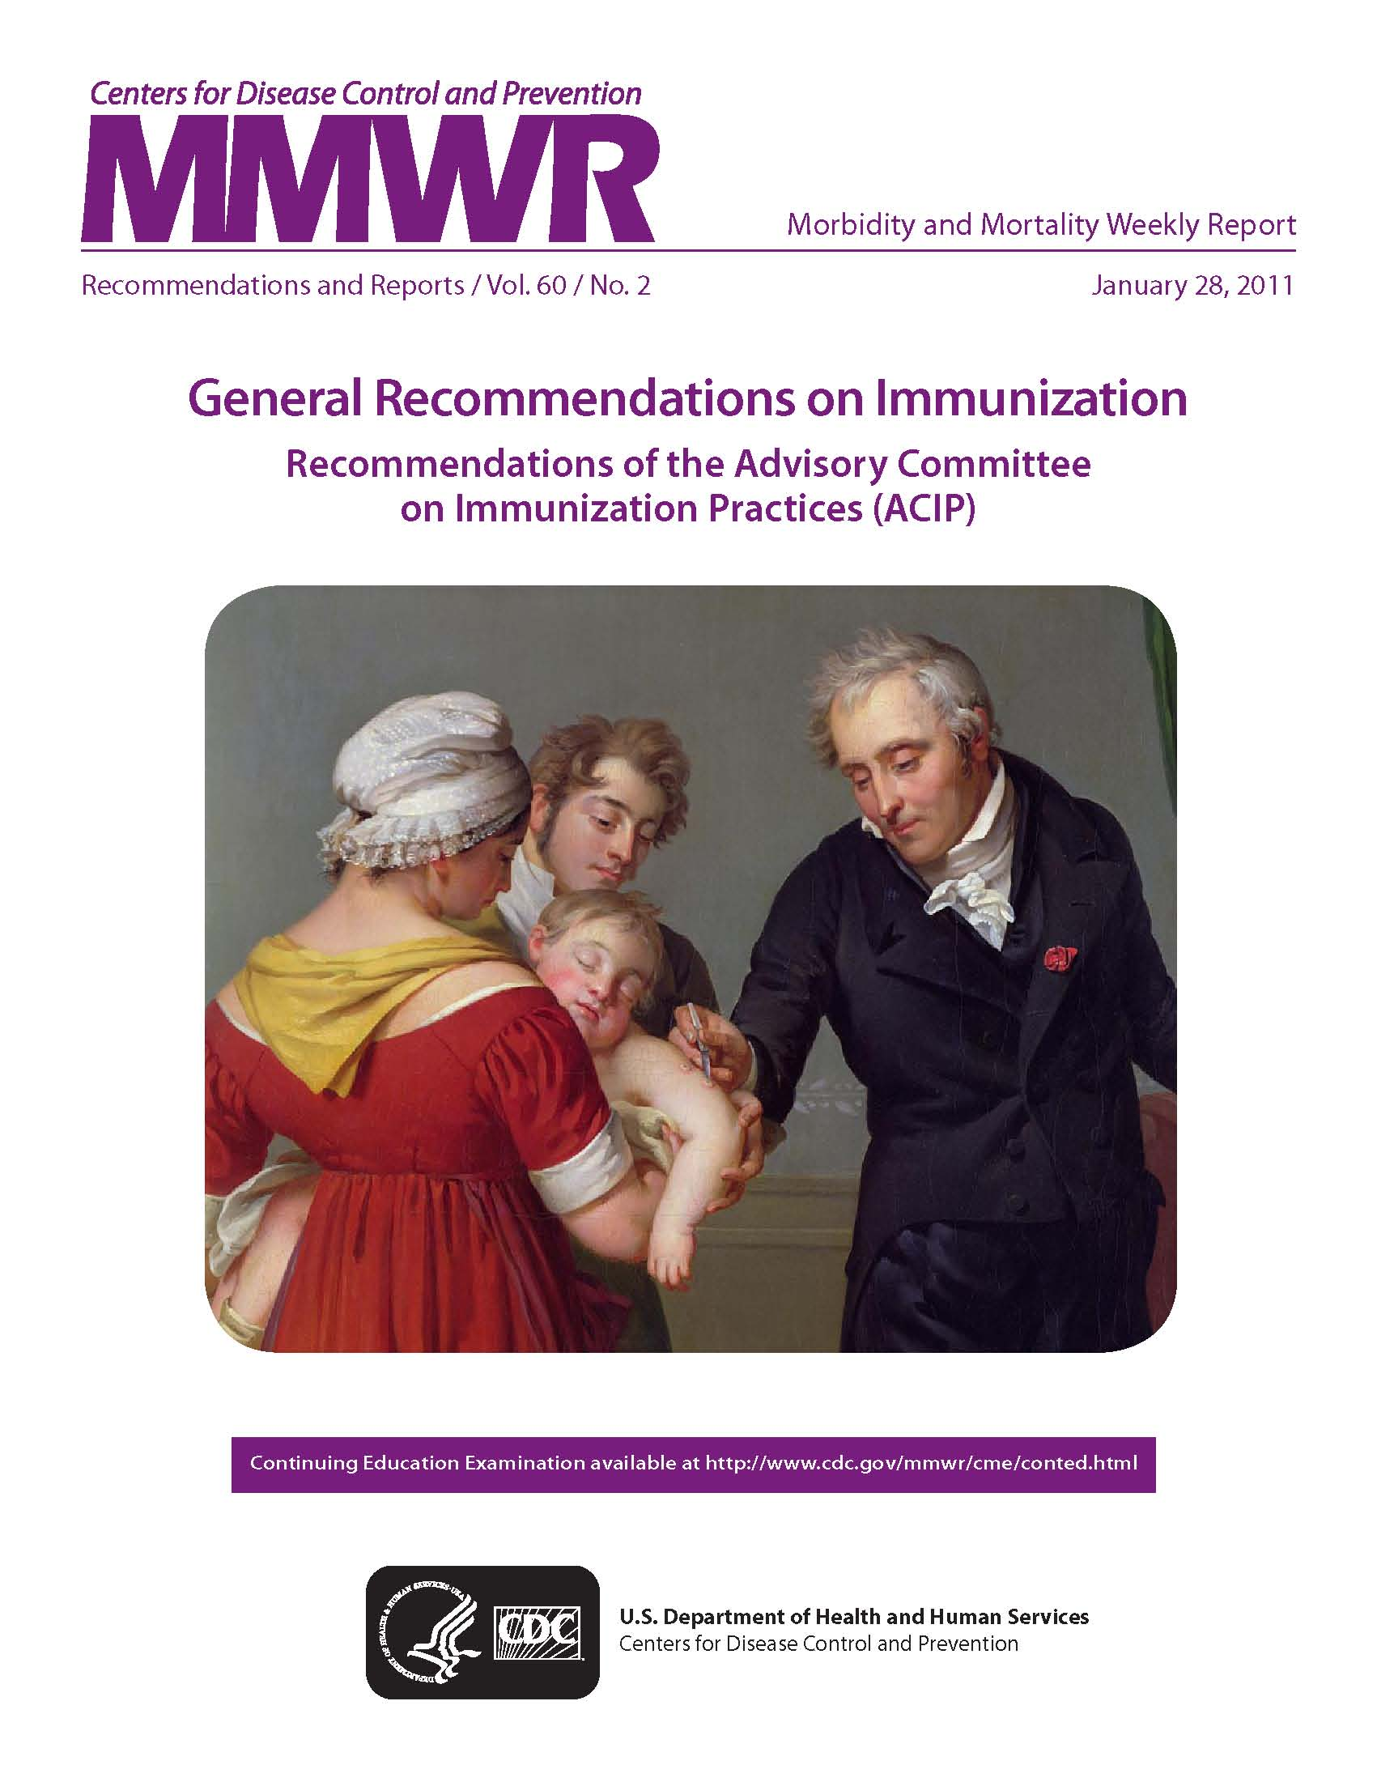
Observe the Guidelines
Route of administration
Number of vaccines administered
4-day grace period
Minimal age for immunization
Minimal interval between doses
Notes:
Before Vaccines are administered, clinicians should be familiar with the General Recommendations on Immunization Practices.
The General Recommendations provide information for clinicians and other health care providers about concerns that commonly arise when vaccinating persons of various ages. Providers and patients encounter numerous issues, such as, using the correct route of administration, the number of vaccines administered (simultaneous administration), when to use the 4-day grace period, minimal age for immunization, the timing and interval of each dose, screening for contraindications and precautions, the educational needs of patients and parents, and interpreting and responding to adverse events.
Staff should be able to access General Recs online to use as a reference if needed.
Ref: General Recommendations on Immunization MWR 2011; 60 (No. RR-2) Jan 28, 2011

Slide 11
General Recommendations
Simultaneous Administration
Non-Simultaneous Administration
Two live-vaccines
Violation of minimal time interval for live vaccines
Minimum time and age intervals
Violation of minimum time and age intervals/grace period
Administration of vaccines later than recommended schedule
Vaccine Administration principles
Administering combination vaccines
Contraindications and Precautions
Notes:
Provide the list of the general recommendations from the TTT website to discuss with audience while viewing slide. Point out the key concepts:
#1 There are no contraindications to simultaneous administration of any of the routinely recommended vaccines included on the childhood and adult schedules. Exception: PCV13 and PPSV23 must be separated by 8 weeks
#2 If two inactivated vaccines are not administered simultaneously, there is no minimal time interval with the exception we just mentioned with PPSV23 and PCV13 should not be administered on the same day and should be administered at least 8 weeks apart. VFC providers and the GA Immunization Program should follow ACIP recommendations. Not administering all vaccines indicated on the same visit results in a “missed opportunity.” Other causes of missed opportunities are: Lack of simultaneous administration, Client unaware he or she needs additional vaccines, Lack of Reimbursement for providers, Invalid contraindications
# 3 If two different live vaccines are not administered simultaneously, they must be separated by at least 28 days. Live vaccines listed on the schedule: MMR, Varicella, Rotavirus, and LAIV
#4 If two different live vaccines are given <28 days apart the vaccine given second should be repeated. This would apply to MMR and Varicella vaccines.
#5 General Recommendation applies to the minimum time and age intervals between doses of vaccines. Vaccine doses should not be given at intervals less than the minimum intervals or earlier than the minimum age.
#6 Violation of minimum time and age intervals/the “grace period.” This is ACIP’s recommendation that vaccine doses administered up to four days before the minimum interval or age can be counted as valid. ACIP believes that administering a dose a few days earlier than the minimum time interval or age is unlikely to have a significant negative effect on the immune response to that dose. This four day grace period can be applied to all age and time intervals listed in Table 1. But this also means that: Any doses given 5 or more days before the minimum age or time interval should be counted as invalid and should be repeated. When repeating invalid doses, the repeat dose should be spaced after the invalid dose by the recommended minimum interval noted in Table 1. There are a few rules about the “Grace Period” that should be emphasized: Grace period does not apply to time intervals between 2 different live vaccines (28 days) According to the DTaP footnote in Table 1, the minimum time interval between dose # 3 and dose #4 for DTaP is 4 months. *(The grace period DOES apply here, so dose #4 of DTaP does not need to be repeated if administered ≤4 days less than 4 months after DTaP dose #3.) Should not be used for scheduling future vaccination visits; Use primarily for reviewing vaccination records; In GA, Grace period does not conflict with requirements for child care and school. This is not true in all states. For instance, most state school requirements mandate by law that the first dose of MMR to be given on or after the first birthday.
# 7 General Recommendation the administration of vaccine later than recommended schedule. If vaccines are administered later than the recommended schedule: Do not need to repeat doses, Do not need to start over,
#8 recommendation discourages variance from administering vaccines from the recommended route and site. ACIP strongly discourages the administration of any vaccine by any route or in any site other than those stated in the package insert. However because this is such an issue, the following recommendations regarding route and site are outlined in the General Recommendations document. Accept all doses given by nonstandard route and site except: Rabies and Hepatitis B given in gluteus. Hepatitis B vaccine not given IM
#9 addresses the use of combination vaccines. Additional information regarding combination vaccines is included under the Minimum Time and Age Interval Chart and in the statement under the new schedule (see both handouts):
First, additional vaccines may be licensed and recommended during the year; Second, the statement addresses the general recommendations for administering licensed combination vaccines. Combination vaccines are generally preferred over separate injections of its equivalent component vaccines.
#10 A contraindication is a condition in the recipient that increases the risk for a serious adverse reaction.
The only true contraindication applicable to all vaccines is a history of a severe allergic reaction after a prior dose of vaccine or to a vaccine constituent (unless the individual has been desensitized) Severely immunocompromised persons and pregnant women should not receive live vaccines; Children who had encephalopathy at 7 days or less after receiving a dose of DTP or DTaP, not attributable to another cause should not receive further doses. A precaution is a condition in the recipient that might increase the risk for a serious adverse reaction or might compromise the ability of the vaccine to produce immunity; Under normal circumstances, defer vaccination but sometimes must weigh benefits vs. risks Should be deferred until precaution is not present. Give when child is well.
1. General Recommendations on Immunization, Recommendations of the Advisory Committee on Immunization Practices (ACIP). MMWR 2011; 60 (No. RR-2) January 28, 2011
2. Epidemiology and Prevention of Vaccine-Preventable Diseases, 12th edition May 2012. HHS, CDC. (Pink Book).

Slide 12
“It’s The Law”
Notes:
Ask the audience when should the VIS be given to a patient and to see how many different responses you receive.
After a provider has determined the vaccines recommended for a patient the next step is to provide the patient with a Vaccine Information Statement.
As required under the National Childhood Vaccine Injury Act, all health care providers in the US who administer to any child or adult, any of the following vaccines diphtheria, tetanus, pertussis, measles, mumps, rubella, polio, hepatitis A & B, HIB, influenza, pneumococcal, meningococcal, rotavirus, HPV and varicella shall, prior to administration of each dose of the vaccine, provide a copy to keep of the relevant current edition vaccine information materials that have been produced by the CDC.
Presenter may include a copy of the handout for the Top 10 facts about the VIS to review with staff.
The top 10 facts about VIS are:
-It’s federal law, VIS are required for both public and private sectors, VIS must be provided before vaccine administered, must provide current VIS for each dose of vaccine, must provide VISs for combination vaccines too, VISs are available in other formats, including 30 languages (you may use laminated copies of VISs for patients and parents to read and return before leaving the clinic, but you must also offer the patient/parent a printed copy of the VIS to take home. If they prefer to download the VIS onto a mobile device, direct them to CDC’s VIS mobile Downloads web page: http://m.cdc.gov/VIS. Federal law does not require signed consent in order for a person to be vaccinated. To verify that a VIS was given, providers must record in the patient’s chart the published date of VIS, date the VIS was given, name, address and title of the person who administers vaccine, date vaccine administered, and vaccine manufacturer and lot number of each dose administered. VISs should not be altered. Provide VISs to all patients.

Slide 13
Test Your Knowledge!
Varicella vaccine and MMR vaccine were administered to a 12 month old child. Before the child left the office the nurse noticed that the MMR vaccine expired at the end of the previous month (2 days ago).
What action should you take?
The dose must be repeated. Because MMR is a live virus vaccine you must wait at least 4 weeks after the expired dose was given before repeating the vaccine. If the expired dose was an inactivated vaccine, the dose should be repeated as soon as possible.
Ref: Immunization Action Coalition - Ask the Experts IAC Express - Issue number 789: April 6, 2009
Notes:
What should we do if a dose of expired vaccine is given to a patient?
The dose should be repeated. If the expired dose is a live virus vaccine, you should wait at least 4 weeks after the previous (expired) dose was given before repeating it. Refer to the General Recommendation Guidelines #4. If two different live vaccines are given < 28 days apart of or if the second dose given was invalid then the second dose should be repeated. This would apply to MMR and Varicella.
If the expired dose is not a live vaccine, the dose should be repeated as soon as possible. If you prefer, you can perform serologic testing to check for immunity for certain vaccinations (e.g., measles, mumps, rubella, varicella, and hepatitis A).

Slide 14
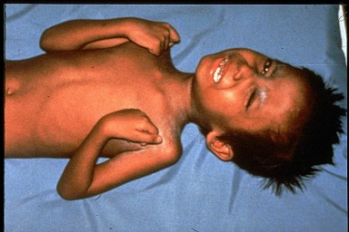

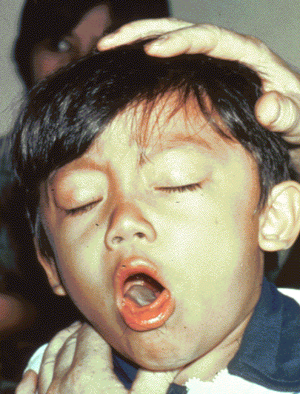

Diphtheria
Tetanus
Required for school and child care attendance
Pertussis
Notes:
Ask participants what are: Diphtheria, tetanus and pertussis?
Whooping cough (pertussis), tetanus, and diphtheria are serious diseases caused by bacteria.
Whooping cough and diphtheria are spread person-to-person through the air. Tetanus gets into the body through cuts or wounds.
Whooping cough can trigger such bad coughing that babies can’t breathe. Babies are most likely to die from whooping cough and can have complications such as seizures and brain damage. Tetanus can cause extremely painful muscle cramps all over the body. Diphtheria can lead to severe breathing problems, heart problems, and paralysis. All these diseases can be deadly.
The diphtheria germ lives in the throat and mouth of the infected person.
The disease is spread through direct contact with the infected person.
Now we don’t see as much of this disease in the United States.
The tetanus germ lives in dirt and the intestines and the feces of animals
The germ enters the body through cuts, punctures, burns, and other wounds.
However, there are still outbreaks throughout the world, and the danger is for an international traveler to bring infection into the US.
Most cases of tetanus reported occur in adults who have not been immunized or who are under immunized; i.e., they have not received boosters to maintain a level of protection.
The pertussis germ lives in the mouth, nose, and throat of the infected person.
The germ is spread from person to person by coughing and sneezing.
Pertussis vaccine is given to prevent pertussis in infants and children.
Other complications include pneumonia, seizures, and death. Adults may also get pertussis, but they usually do not get very sick and may not be aware they have the disease.
Diphtheria, tetanus, and pertussis are illustrated on this slide
The top left picture is of a throat of a child who has diphtheria. You can see the thick gray coating over the back of the throat. This coating can eventually expand down through the airway, and if not treated, a person could die from suffocation, or suffer other complications such as paralysis, heart failure, or coma.
In the top right picture, this child is experiencing painful muscle spasms from tetanus. It is nearly impossible for him to move or control the muscles in his body. He cannot eat because the muscles in his mouth have become so tight and it is difficult for him to swallow. Other possible complications are broken bones from muscle spasms, breathing problems, and death.
The bottom picture shows a child who is suffering from pertussis, commonly know as “whooping cough”. He is experiencing coughing spasms, which produce a “whooping” sound. The sound occurs because the child is trying to catch his breath before the next round of coughing. Often children have difficulty breathing and experience vomiting and exhaustion from the severe coughing.

Slide 15
Diphtheria, Tetanus and Pertussis Vaccines for Children, Adolescents, and Adults
ACIP recommends:
A 5 dose series of DTaP: Administered at 2, 4, 6, 15-18 months and 4-6 years (Do not administer after age 6)
one dose of Tdap:
  For children and adolescents starting at 11 or 12 years of age
  For all adults aged 19 years and older who have not had Tdap previously
Boostrix is licensed for persons 10 years and older
Adacel is licensed for persons 10 through 64 years
For adults 65 years and older Boostrix should be used, when feasible;
however, either vaccine product provides protection and is considered valid.
  There is no minimal interval between the last dose of Td and Tdap.
MMWR, September 23, 2011, Vol 60, #37 MMWR, January 14, 2011, Vol 60, #01 MMWR, June 29, 2012 Vol 61, #25
Notes:
Presenter may use one-pagers to discuss vaccine usage.
ACIP recommends:
A 5 dose series of DTaP: Administered at 2, 4, 6, 15-18 months and 4-6 years (Do not administer after age 6)
One dose of Tdap:
For children and adolescents starting at 11 or 12 years of age
For all adults aged 19 years and older who have not had Tdap previously
Boostrix is licensed for persons 10 years and older
Adacel is licensed for persons 10 through 64 years
For adults 65 years and older Boostrix should be used, when feasible;
however, either vaccine product provides protection and is considered valid.
There is no minimal interval between the last dose of Td and Tdap.

Slide 16
ADMINISTER THE RIGHT VACCINE!
PRODUCT | COMPONENT(S) | USE FOR AGES | USE FOR DTaP DOSES | ROUTE
Daptacel (SP) | DTaP | 6 wks. thru 6 yrs. | Doses 1 thru 5 | IM
Infanrix (GSK) | DTaP | 6 wks. thru 6 yrs. | Doses 1 thru 5 | IM
Pediarix (GSK) | DTaP-HepB-IPV | 6 wks. thru 6 yrs. | Doses 1 thru 3 | IM
Pentacel (SP) | DTaP-IPV/Hib | 6 wks. thru 4 yrs. | Doses 1 thru 4 | IM
Kinrix (GSK) | DTaP-IPV | 4 thru 6 yrs. | Dose 5 | IM
Quadracel (SP) | DTaP-IPV | 4 thru 6 yrs. | Dose 5 | IM
Notes:
Optional slide
If possible, it is a good practice to review all products with staff to reduce vaccine administration errors.
Make sure staff administer the right vaccine. There are several products that contain DTaP. Observe the use for ages and use for doses.

Slide 17
Tdap for Pregnant Women
ACIP recommends:
One dose of Tdap during each pregnancy, irrespective of a prior history of receiving Tdap.
To maximize the maternal antibody response and passive antibody transfer to the infant, optimal timing for Tdap administration is between 27 and 36 weeks gestation.
If Tdap is not given during pregnancy, and has not been given previously, administer Tdap immediately postpartum.
With the exception for pregnant women, ACIP does not recommend a second dose of Tdap for adolescents and adults.
MMWR February 22, 2013, Vol 60 #7 131-135
Notes:
Guidance on use of Tdap products for pregnant women:
All pregnant women should receive a dose of Tdap during each pregnancy, irrespective of prior history of receiving Tdap. Optimal timing for administration is between 27 and 36 weeks gestation to maximize the maternal antibody response and passive transfer to the infant. If a dose is given early in that same pregnancy, do NOT repeat it at 27-36 weeks. If not given during pregnancy, give Tdap immediately postpartum³.
With the exception for pregnant women, ACIP does not recommend a second dose of Tdap for adolescents and adults.
References:
1. MMWR, February 22, 2013, Vol 62, #7
2. www.immunize.org, Ask the Experts, Tetanus section, IAC, Sept. 2013

Slide 18







Cocooning Strategy
Parents
Siblings
Child Care Provider
Healthcare Worker
Grandparents
Notes:
Remind staff to take advantage of immunizing all family members when they present to your locations. Discuss the cocooning strategy.
Babies younger than 6 months old are more likely to develop certain infectious diseases than older children.
Cocooning is a way to protect babies from catching diseases from the people around them – people like their
parents, siblings, grandparents, friends, child-care providers, babysitters, and healthcare providers. Once these people are vaccinated, they are less likely to spread these contagious diseases to the baby. They surround the baby with a cocoon of protection against disease until he or she is old enough to get all the doses of vaccine needed to be fully protected. Everyone has the opportunity to protect babies by getting vaccinated themselves. Cocooning is an easy and effective way that people can work together to prevent the spread of whooping cough and flu to babies.

Slide 19
Test Your Knowledge!
Logan is an 8 year old boy who has never had DTaP vaccine. His mother was hesitant to immunize him when he was younger. Now she is willing to have him immunized.
What vaccine would you use to immunize him against diphtheria, tetanus and pertussis?
Logan should receive the following:
Tdap
Td 4 weeks after Tdap
Td 6 months after previous Td
Ref: Updated Recommendations for Use of Tetanus Toxoid, Reduced Diphtheria Toxoid and Acellular Pertussis (Tdap) Vaccine from the Advisory Committee on Immunization Practices, 2010 MMWR January 14, 2011 / 60(01);13-15

Slide 20
Test Your Knowledge!
Four month old Lucas was given Tdap instead of DTaP.
What should be done?
If Tdap was inadvertently given to a child under age 7 years, it should not be counted as either the first, second, or third dose of DTaP. The dose should be repeated with DTaP. Continue vaccinating on schedule. If the dose of Tdap was administered for the fourth or fifth DTaP dose, the Tdap dose can be counted as valid. Please remind your staff to always check the vaccine vial at least 3 times before administering any vaccine.
IAC Ask the Experts - Reviewed July 2014

Slide 21
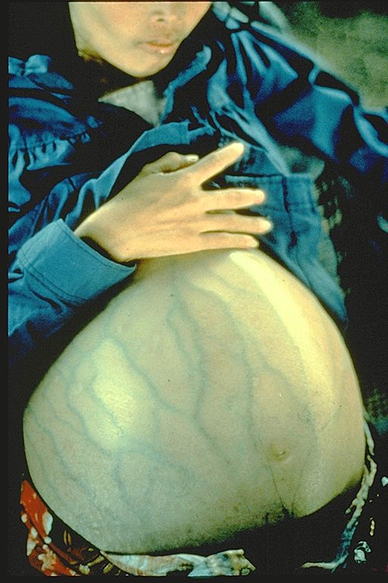
Hepatitis B
Notes:
Review Hepatitis B virus:
Hepatitis B is a serious liver disease caused by a virus. Your can get infected with hepatitis B if you come in contact with an infected person’s blood or other body fluids. Babies can get the virus from their infected mothers at birth or if they live with or are cared for by an infected person. The virus can be spread just by sharing a toothbrush with an infected person. For some people, the virus remains in their body for years. During this time, the virus can attack the liver and cause serious problems like liver failure or cancer.
Presenter may want to use Hepatitis one-pager to discuss vaccine usage during slide.
Children and adolescents
Babies normally get 3 doses of hepatitis B vaccine:
1st Dose: Birth, 2nd Dose: 1-2 months of age, 3rd Dose: 6-18 months of age. Some babies might get 4 doses, for example, if a combination vaccine containing hepatitis B is used. (This is a single shot containing several vaccines.) The extra dose is not harmful. The final (third or fourth) dose in the HepB vaccine series should be administered no earlier than age 24 weeks. Administration of a total of 4 doses of HepB vaccine is permitted when a combination vaccine containing HepB is administered after the birth dose. Anyone through 18 years of age who didn’t get the vaccine when they were younger should also be vaccinated.
Adults
All unvaccinated adults at risk for hepatitis B infection should be vaccinated. This includes: sex partners of people infected with hepatitis B, men who have sex with men, people who inject street drugs, people with more than one sex partner, People with chronic liver or kidney disease, people under 60 years of age with diabetes, people with jobs that expose them to human blood or other body fluids, household contacts of people infected with hepatitis B, residents and staff in institutions for the developmentally disabled, Kidney dialysis patients, people who travel to countries where hepatitis B is common, people with HIV infection. Other people may be encouraged by their doctor to get hepatitis B vaccine; for example, adults 60 and older with diabetes. Anyone else who wants to be protected from hepatitis B infection may get the vaccine. Pregnant women who are at risk for one of the reasons stated previously should be vaccinated. Other pregnant women who want protection may be vaccinated. Adults getting hepatitis B vaccine should get 3 doses—with the second dose given 4 weeks after the first and the third dose 5 months after the second. Your doctor can tell you about other dosing schedules that might be used in certain circumstances.
Staff should work with other programs to make sure there are standing orders to vaccinate these vulnerable populations.

Slide 22
Hepatitis B
Transmission:
1. Percutaneous or mucosal exposure to blood or body fluids including contaminated surfaces, or exposure by sexual contact
2. Perinatal infection from HBsAg + mother
ACIP recommends hepatitis B vaccine for:
All newborns before discharge from the nursery using single antigen vaccine and completion of the series per schedule.
All children and adolescents less than 19 years of age who did not complete the series as an infant.
All adults at risk for hepatitis B infection, including those aged 19 through 59 years with diabetes mellitus
Persons of any age at risk for infection by sexual exposure
All other adults seeking protection from HBV infection.
MMWR, December 23, 2005, Vol 54, #RR16 MMWR, December 8, 2006, Vol 55, #RR16 MMWR, December 22, 2011 Vol 60 #50
Notes:
Optional Slide
Hepatitis transmission from percutaneous or mucosal exposure to blood or body fluids including contaminated surfaces, or exposure by sexual contact or perinatal infection from HBsAg+ mothers. Incubation period from time of infection to onset of symptoms is 45 to 160 days (average, 90 days). Approximately 10% of acute hepatitis B infections progress to chronic Hepatitis B infection. 90% of infants and 30-50% of children 1-5 years of age with acute hepatitis B infection become carriers. Many with chronic infection are asymptomatic. Chronic infection may progress to cirrhosis, liver failure & hepatocellular carcinoma.
ACIP recommends:
All pregnant women should be tested routinely for HBsAg
90% of healthy adults & 95% of infants, children & adolescents develop adequate antibody response after a complete series. If no antibody response after 6 doses, person is a non-responder and is susceptible to hepatitis B. Booster doses NOT recommended for any age group
ACIP recommends hepatitis B vaccine for:
-All newborns before discharge from the nursery using single antigen vaccine and completion of the series per schedule.
-All children and adolescents less than 19 years of age who did not complete the series as an infant.
-All adults at risk for hepatitis B infection, including those aged 19 through 59 years with diabetes mellitus
-Persons of any age at risk for infection by sexual exposure
-All other adults seeking protection from HBV infection.
References:
1. A Comprehensive Immunization Strategy to Eliminate Transmission of Hepatitis B Virus Infection in the United States. Recommendations of the Advisory Committee on Immunization Practices (ACIP) Part 1: Immunization of Infants, Children and Adolescents MMWR Vol. 54/ No. RR-16 December 23, 2005
2. A Comprehensive Immunization Strategy to Eliminate Transmission of Hepatitis B Virus Infection in the United States. Recommendations of the Advisory Committee on Immunization Practices (ACIP) Part 2: Immunization of Adults MMWR Vol. 55/ No. RR-16 December 8, 2006

Slide 23
PRE-EXPOSURE EVALUATION FOR HEALTH-CARE PERSONNEL
PREVIOUSLY VACCINATED WITH COMPLETE, ≥3-DOSES OF HEP B VACCINE
SERIES WHO HAVE NOT HAD POSTVACCINATION SEROLOGIC TESTING
Measure antibody to hepatitis B surface antigen (anti-HBs)
anti-HBs <10 mIU/mL
anti-HBs ≥10mIU/mL
Administer 1 dose of HepB vaccine,
postvaccination serologic testing
No Action for
Hepatitis B prophylaxis
(regardless of source patient hepatitis B surface antigen status)
anti-HBs <10 mIU/mL
anti-HBs ≥ 10 mIU/mL
Administer 2 more doses of
HepB vaccine,
postvaccination serologic testing
anti-HBs <10 mIU/mL
anti-HBs ≥ 10mIU/mL
HCP need to receive hepatitis B evaluation for all exposures
MMWR, December 20, 2013, Vol 62. RR # 10
Notes:
Optional Slide
Post-vaccination Serologic Testing
Testing unvaccinated HCP for HBV infection is not generally indicated for persons being evaluated for hepatitis B protection because of occupational risk. Pre-vaccination serologic testing is indicated for all persons born in geographic regions with HBsAg (Hepatitis B surface antigen) prevalence of ≥2% (e.g., much of Eastern Europe, Asia, Africa, the Middle East, and the Pacific Islands) and certain indigenous populations from countries with overall low HBV endemicity (<2%); persons with behavioral exposures to HBV (e.g., men who have sex with men and past or current injection drug users); persons receiving cytotoxic or immunosuppressive therapy; and persons with liver disease of unknown etiology.
Testing HCP at risk for HBV infection should consist of a serologic assay for HBsAg ((Hepatitis B surface antigen), in addition to either anti-HBc (Total hepatitis B core antibody) or anti-HBs (Hepatitis B surface antibody). For unvaccinated HCP at risk for previous HBV infection, blood should be drawn for testing before the first dose of vaccine is administered.
HCP who have written documentation of a complete, ≥3-dose HepB vaccine series and subsequent post-vaccination (Hepatitis B surface antibody) anti-HBs ≥10 mIU/mL (milli-international units per milliliter) are considered hepatitis B immune. Immunocompetent persons have long-term protection against HBV and do not need further periodic testing to assess anti-HBs (Hepatitis B surface antibody) levels.
All HCP recently vaccinated or recently completing HepB vaccination who are at risk for occupational blood or body fluid exposure should undergo anti-HBs testing (Hepatitis B surface antibody). Anti-HBs (Hepatitis B surface antibody) testing should be performed 1–2 months after administration of the last dose of the vaccine series when possible. HCP with documentation of a complete ≥3-dose HepB vaccine series but no documentation of anti-HBs ≥10 mIU/mL who are at risk for occupational blood or body fluid exposure might undergo anti-HBs testing upon hire or matriculation. Testing should use a quantitative method that allows detection of the protective concentration of anti-HBs (≥10 mIU/mL) (e.g., enzyme-linked immunosorbent assay [ELISA]).
Completely vaccinated HCP with anti-HBs ≥10 mIU/mL are considered hepatitis B immune. Immunocompetent persons have long-term protection and do not need further periodic testing to assess anti-HBs levels.
Completely vaccinated HCP with anti-HBs <10 mIU/mL should receive an additional dose of HepB vaccine, followed by anti-HBs testing 1–2 months later. HCP whose anti-HBs remains <10 mIU/mL should receive 2 additional vaccine doses (usually 6 doses total), followed by repeat anti-HBs testing 1–2 months after the last dose. Alternatively, it might be more practical for very recently vaccinated HCP with anti-HBs <10 mIU/mL to receive 3 consecutive additional doses of HepB vaccine (usually 6 doses total), followed by anti-HBs testing 1–2 months after the last dose.
Ref: CDC Guidance for Evaluating Health-Care Personnel for Hepatitis B Virus Protection and for Administering Post Exposure Management MMWR Recommendations and Reports /Vol. 62/No. 10 December 20, 2013

Slide 24
Hepatitis A Vaccine for Children
ACIP recommends 2 doses of hepatitis A vaccine
for:
All children 12 through 23 months of age
(Separate the 2 doses by 6 to 18 months)
Any child or adolescent 2 through 18 years, who has not previously received the vaccine, can receive the vaccine at subsequent visits.
Required for school and child care attendance
MMWR, May 19, 2006, Vol 55, #RR-07
Notes:
Presenter may use Hep A one-pager while discussing slide.
Hepatitis A is a serious liver disease caused by a virus. The virus is found in the feces (poop) of infected people. The hepatitis A virus is spread when invisible particles of feces (poop) get into a person’s mouth. You can get hepatitis A by eating contaminated food or drinking contaminated water, during sex, or just by living with an infected person. Hepatitis A can your skin and eyes turn yellow. You can get very sick for weeks, need to be hospitalized, and even die. Some people don’t look or feel sick, but they can still spread hepatitis A to others. Everyone is at some risk for getting infected with hepatitis A. People who travel outside the U.S. have an increased chance of getting infected.
Optional information:
The nature of hepatitis A disease is that it is cyclical. Children plan an important role in HAV transmission. Symptomatic infection is uncommon in children, so they may be a source of infection for household or other close contacts. Almost half of persons with hepatitis A do not have an identified source of their infection. Groups of persons at risk for hepatitis A are international travelers, men who have sex with men, and illegal drug users. Food handlers are not at risk.
ACIP recommends 2 doses of hepatitis A vaccine for:
All children 12 through 23 months of age (Separate the 2 doses by 6 to 18 months)
Any child or adolescent 2 through 18 years, who has not previously received the vaccine, can receive the vaccine at subsequent visits.
For others at risk, the hepatitis A vaccine series may be started whenever a person wishes to be protected or is at risk of infection. For travelers, it is best to start the vaccine series at least one month before traveling. (Some protection may still result if the vaccine is given on or closer to the travel date.) Some people who cannot get the vaccine before traveling, or for whom the vaccine might not be effective, can get a shot called immune globulin (IG). IG gives immediate, temporary protection.
Prevention of Hepatitis A Through Active or Passive Immunization - Recommendations of the Advisory Committee on Immunization Practices (ACIP) MMWR Vol. 55/No. RR-7 May 19, 2006

Slide 25
Hepatitis A Vaccine for Adults
ACIP recommends hepatitis A vaccine for adults who are at high-risk of acquiring hepatitis A infection:
      Those traveling or working in countries with high or intermediate endemicity of infection
      Men who have sex with men
      Users of injecting and non-injecting drugs
      Persons working with HAV positive primates or with HAV in research laboratory settings
      Contact with adoptees from countries with high rates of hepatitis A if contact will be within 60 days of arrival in U.S. The first dose of the 2-dose series should be given as soon as adoption is planned.
MMWR, May 19, 2006, Vol 55, #RR-07 MMWR, September 18, 2009, Vol 58 #36
Notes:
ACIP recommends hepatitis A vaccine for adults who are at high-risk of acquiring hepatitis A infection:
Those traveling or working in countries with high or intermediate endemicity of infection
Men who have sex with men
Users of injecting and non-injecting drugs
Persons working with HAV positive primates or with HAV in research laboratory settings
Contact with adoptees from countries with high rates of hepatitis A if contact will be within 60 days of arrival in U.S. The first dose of the 2-dose series should be given as soon as adoption is planned.
References:
1. Prevention of Hepatitis A Through Active or Passive Immunization - Recommendations of the Advisory Committee on Immunization Practices (ACIP) MMWR Vol. 55/No. RR-7 May 19, 2006
2. Notice to Readers: FDA Approval of an Alternate Dosing Schedule for a Combined Hepatitis A and B Vaccine (Twinrix®) MMWR 56(40);1057 October 12, 2007
3. Updated Recommendations from the Advisory Committee on Immunization Practices (ACIP) for Use of Hepatitis A Vaccine in Close Contacts of Newly Arriving International Adoptees MMWR 58(36);1006-1007 September 18, 2009

Slide 26
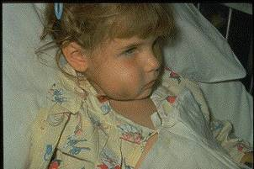
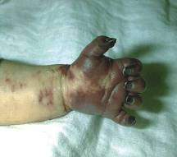
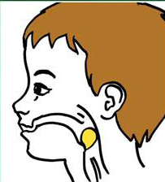
Haemophilus influenzae type b (Hib)
ACIP recommends:
3-4 doses of Hib (depending on brand)
  Dose 1 @ 2 months of age
  Dose 2 @ 4 months of age
  Dose 3 @ 6 months of age
  (Not required if Pedvax HIB® is administered at 2 and 4 months of age)
  Booster dose @ 12 through 15 months of age
One dose of Hib may be given to adults with immunocompromising conditions.
Required for school and child care attendance
MMWR, February 28, 2014, Vol 63, #RR01
Notes:
Presenter may use Hib one-pager to discuss and review slide.
What causes Hib disease? Hib disease is caused by a bacterium, Haemophilus influenzae type b. There are six different types of these bacteria (a through f). Type b organisms account for 95% of all strains that cause invasive disease, and this is the type against which the Hib vaccine
protects.
How does Hib disease spread? Hib disease is spread person-to-person by direct contact or through respiratory droplets. Usually the organisms
remain in the nose and throat, but occasionally the bacteria spread to the lungs or bloodstream and cause a serious infection in the individual.
How serious is Hib disease? Hib disease can be very serious. The most common type of invasive Hib disease is meningitis, an infection of the membranes covering the brain (50%–65% of cases).
ACIP recommends:
3-4 doses of Hib (depending on brand)
Dose 1 @ 2 months of age
Dose 2 @ 4 months of age
Dose 3 @ 6 months of age
(Not required if Pedvax HIB® is administered at 2 and 4 months of age)
Booster dose @ 12 through 15 months of age
One dose of Hib may be given to adults with immunocompromising conditions.

Slide 27
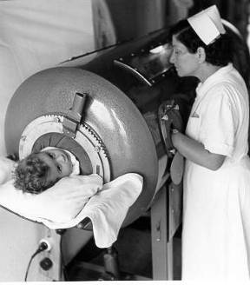
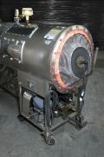
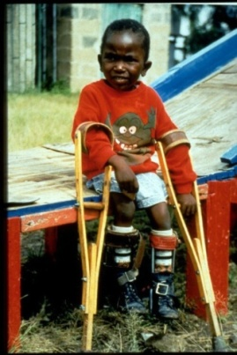
Polio
ACIP recommends:
Four dose series of IPV at : 2, 4, 6 through 18 months and 4 through 6 years of age.
  Minimum interval from dose 3 to dose 4
  is six months
  Final dose at 4 years of age or older regardless of the number of previous doses
A booster dose may be recommended, depending on length of stay and the timing of the last dose of polio vaccine, for persons traveling to countries experiencing polio outbreaks.
Required for school and child care attendance
MMWR, August 7, 2009, Vol 58, #30
MMWR, July 11, 2014, Vol 63, # 27
Source: World Health Organization
Notes:
Presenter may use Polio one-pager to review with slide.
Discuss pictures on the slide. Pictures show a child in an iron lung due to weak respiratory muscles (common in polio era) and a child with muscle weakness, as a result of polio, requiring the assistance of braces and crutches in order to walk.
Polio, also called poliomyelitis and infantile paralysis is caused by an Enterovirus (Serotypes 1,2,3)
Infection acquired through mouth, virus replicates in pharynx and GI tract, then spreads to lymphatics and other tissues.
Attacks motor neurons in spinal cord & brain stem
in 2015, Nigeria was removed from the list of polio-endemic countries. The only 2 polio endemic countries now are Pakistan and Afghanistan. Remind staff to evaluate travelers for the need of polio vaccine if traveling to endemic countries.
ACIP recommends:
Four dose series of IPV at : 2, 4, 6 through 18 months
and 4 through 6 years of age.
Minimum interval from dose 3 to dose 4
is six months
Final dose at 4 years of age or older regardless of the number of previous doses
A booster dose may be recommended, depending on length of stay and the timing of the last dose of polio vaccine, for persons traveling to countries experiencing polio outbreaks.
For additional information about polio refer to: Epidemiology and Prevention of Vaccine-Preventable Diseases, 13th edition 2015. HHS, CDC.

Slide 28
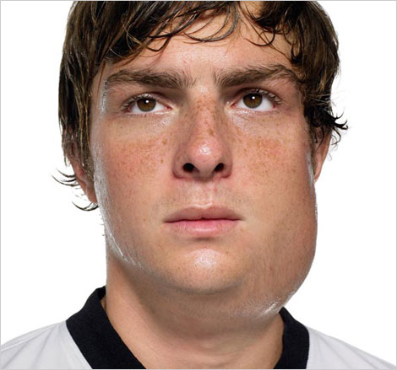
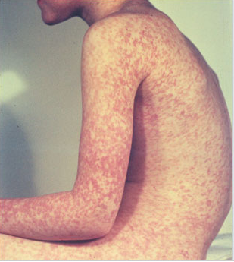
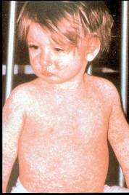
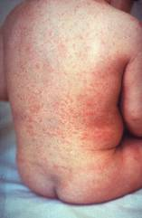
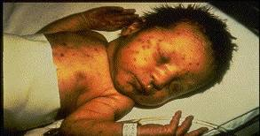
Measles, Mumps, Rubella
Measles (M)
Source: Creative Commons
Source: American Academy of Pediatrics
Red Book On Line Visual Library
Mumps (M)
Rubella (R)
Congenital Rubella (R)
Notes:
28
28
Presenter will review photos with audience.
MEASLES (caused by paramyxovirus)
Slide shows two children with typical measles rash and conjunctivitis in younger child
MUMPS (caused by paramyxovirus)
Slide shows an adolescent with parotitis due to mumps
Parotitis (inflammation of parotid gland) occurs in 30-40% of infected persons, 40-50% have only nonspecific or respiratory symptoms; Complications include aseptic meningitis, & deafness; Post pubertal individuals may have orchitis (inflammation of testicles), ovarian inflammation, & pancreatitis
RUBELLA (Caused by rubella virus and spread from person to person {togavirus})
In children, the rash may be the first manifestation of infection. Adults may have low-grade fever, malaise, URI, and lymphadenopathy prior to rash. Arthralgia and arthritis is common in adults, especially women. Complications include encephalitis and hemorrhagic manifestations
Rubella is no longer endemic in the U.S. However, it is still present in other countries and can be imported
CONGENITAL RUBELLA
Slide shows an adult and child with a typical rash from rubella and an infant with congenital rubella syndrome Infant was infected in utero and has “blueberry muffin spots” on skin due to petechial lesions, cataracts, hearing loss and congenital heart lesion and will most likely be developmentally delayed.
All woman of child bearing age should be certain they are immune to rubella.
For additional information refer to: Epidemiology and Prevention of Vaccine-Preventable Diseases, 12th edition May 2012. HHS, CDC.

Slide 29
MMR Vaccine
ACIP recommends 2 doses of MMR:
  Dose 1 @ 12 through 15 months of age
  Dose 2 @ 4 through 6 years of age
  Second dose can be administered at an earlier age provided the interval between the first and second dose is at least 28 days
Required for school and child care attendance
Acceptable presumptive evidence of MMR immunity
Documentation of age appropriate vaccination with MMR vaccine
Laboratory evidence of immunity
Laboratory confirmation of disease
Birth before 1957
Birth date not acceptable evidence of rubella immunity for women who could become pregnant
MMWR, June 14, 2013, Vol 62, #RR-04
Notes:
Presenter to discuss and review MMR one-pager with slide.
Required for school and child care attendance: Acceptable presumptive evidence of MMR immunity: Documentation of age appropriate vaccination with MMR vaccine, Laboratory evidence of immunity, Laboratory confirmation of disease, and Birth before 1957
Birth date not acceptable evidence of rubella immunity for women who could become pregnant
Measles Vaccine: The measles vaccine is very effective. One dose of measles vaccine is about 93% effective at preventing measles if exposed to the virus and two doses are about 97% effective. 5% or less may lose protection after several years.
Children should get 2 doses of MMR vaccine:
First Dose: 12–15 months of age
Second Dose: 4–6 years of age (may be given earlier, if at least 28 days after the 1st dose)
Some infants younger than 12 months should get a dose of MMR if they are traveling out of the country. (This
dose will not count toward their routine series.)
Some adults should also get MMR vaccine: Generally, anyone 18 years of age or older who was born after 1956 should get at least one dose of MMR vaccine, unless they can show that they have either been vaccinated or had all three diseases.
MMR vaccine may be given at the same time as other vaccines.
Children between 1 and 12 years of age can get a “combination” vaccine called MMRV, which contains both MMR and varicella (chickenpox) vaccines. There is a separate Vaccine Information Statement for MMRV.
Some people should not get MMR vaccine or should wait.
-Anyone who has ever had a life-threatening allergic reaction to the antibiotic neomycin, or any other component of MMR vaccine, should not get the vaccine. Tell your doctor if you have any severe allergies.
-Anyone who had a life-threatening allergic reaction to a previous dose of MMR or MMRV vaccine should not get another dose.
-Some people who are sick at the time the shot is scheduled may be advised to wait until they recover before getting MMR vaccine.
-Pregnant women should not get MMR vaccine. Pregnant women who need the vaccine should wait until after giving birth. Women should avoid getting pregnant for 4 weeks after vaccination with MMR vaccine.

Slide 30
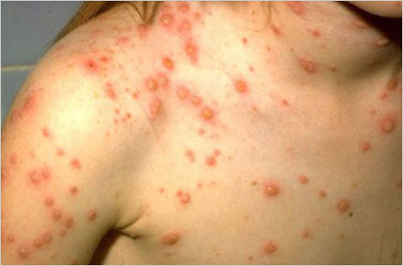
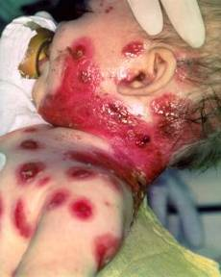
Varicella
(Chickenpox)
© Copyright American Academy of Pediatrics
ACIP recommends 2 doses of Varicella Vaccine
Dose 1 @ 12 months through 15 months of age
Dose 2 @ 4 through 6 years of age*
Those 13 years of age or older without evidence of immunity should receive 2 doses separated by 4 to 8 weeks.
*Second dose can be administered at an earlier age provided the interval between the first and second dose is at least 3 months.
Required for school and child care attendance
MMWR, June 22, 2007, Vol 56, #RR-04
Notes:
Presenter may use varicella one-pager with reviewing slide.
Chicken pox is an illness caused by the varicella zoster virus. It was one an almost universal childhood experience. Now it’s much less common in the U.S. owing to widespread vaccination.
Why get vaccinated?
It is usually mild, but it can be serious, especially in young infants and adults. Most people who get chickenpox vaccine will not get chickenpox. But if someone who has been vaccinated does get chickenpox, it is usually very mild. They will have fewer blisters, are less likely to have a fever, and will recover faster. This slide shows an adolescent with a typical varicella rash and infant with secondary bacterial infected varicella lesions, probably due to staph or strep.
ACIP recommends:
Children who have never had chickenpox should get 2 doses of chickenpox vaccine at these ages:
1st Dose: 12–15 months of age
2nd Dose: 4–6 years of age (may be given earlier, if at least 3 months after the 1st dose)
People 13 years of age and older (who have never had chickenpox or received chickenpox vaccine) should get two doses at least 28 days apart.
Catch-up
Anyone who is not fully vaccinated, and never had chickenpox, should receive one or two doses of
chickenpox vaccine. The timing of these doses depends on the person’s age. Chickenpox vaccine may be given at the same time as other vaccines.
Reference: Prevention of Varicella - Recommendations of the Advisory Committee on Immunization
Practices (ACIP) MMWR (2007);56(No. RR-4):23

Slide 31
Acceptable Evidence of
Varicella Immunity
Written documentation of age-appropriate vaccination
Laboratory evidence of immunity or laboratory confirmation of varicella disease
U.S.-born before 1980*
Healthcare provider diagnosis or verification of varicella disease
History of herpes zoster based on healthcare provider diagnosis.
* Birth year immunity criterion does not apply to healthcare personnel or pregnant women
MMWR 2007;56(RR-4); 16-17
Notes:
Written documentation of age-appropriate vaccination
Laboratory evidence of immunity or laboratory confirmation of varicella disease
U.S.-born before 1980*
Healthcare provider diagnosis or verification of varicella disease
History of herpes zoster based on healthcare provider diagnosis.
* Birth year immunity criterion does not apply to healthcare personnel or pregnant women

Slide 32
ACIP Recommendations for use of
MMRV (ProQuad®)
Licensed for ages 12 months through 12 years
Dose 1 at ages 12 through 47 months
Either MMR and varicella vaccines or MMRV vaccine can be used.
Providers who are considering administering MMRV should discuss the benefits and risks of both vaccination options with the parent or caregiver, since MMRV can lead to 1 extra febrile seizure for every 2300-2600 vaccinations.
Unless the parent or caregiver expresses a preference for MMRV vaccine, CDC recommends that MMR vaccine and varicella vaccines should be administered for the first dose in this age group.
Dose 1 or 2 given at ages 48 months and older
MMRV vaccine generally is preferred over separate injections of its equivalent component vaccines (i.e., MMR and varicella vaccines).
MMWR, May 7, 2010, Vol 59, #RR03
Notes:
Presenter may use MMRV one-pager while reviewing slide.
Dose 1 at ages 12 through 47 months
Either MMR and varicella vaccines or MMRV vaccine can be used.
Providers who are considering administering MMRV should discuss the benefits and risks of both vaccination options with the parent or caregiver, since MMRV can lead to 1 extra febrile seizure for every 2300-2600 vaccinations.
Unless the parent or caregiver expresses a preference for MMRV vaccine, CDC recommends that MMR vaccine and varicella vaccines should be administered for the first dose in this age group.
Dose 1 or 2 given at ages 48 months and older
MMRV vaccine generally is preferred over separate injections of its equivalent component vaccines (i.e., MMR and varicella vaccines).
Other MMRV Vaccine-related Guidance
New precaution for MMRV Vaccine Use
A personal or family (i.e., sibling, parent) history of seizures is a precaution for MMRV vaccination. Studies suggest that children who have a personal or family history of febrile seizures or family history of epilepsy are at increased risk for febrile seizures compared with children who do not have such histories. Children with a personal or family history of seizures generally should be vaccinated with MMR and varicella vaccines because the risks of using MMRV vaccine in this group of children generally outweigh the benefit of MMRV vaccine.
CDC has developed materials to help with the implementation of the updated recommendations for use of MMRV vaccine:
www.cdc.gov/vaccines/vpd-vac/combo-vaccines/mmrv/vacopt.htm
* The 47 month cut-off was chosen on the basis of the epidemiology of febrile seizures: first febrile seizures are uncommon after age 4 years, approximately 94% of febrile seizures occur in children aged less than 4 years.
† Provider assessment should include the number of injections, vaccine availability, likelihood of improved coverage, likelihood of patient return, and storage and cost consideration.

Slide 33
Spacing of Live Virus Vaccines and Other Products
PPD and live virus vaccine
  Apply PPD at same visit as MMR
  If MMR given first, delay PPD 4 weeks or longer
  Apply PPD first, then give MMR when skin test read
Spacing with antibody-containing products such as immune globulin (IG)
Notes:
PPD and live virus vaccine (using MMR as an example)
Apply PPD at same visit as MMR
Delay PPD 4 weeks or longer if MMR given first
Apply PPD first then give MMR when skin test read
This spacing will reduce the possibility of a false negative interpretation of the skin test.
Spacing with antibody-containing products such as immune globulin (IG)
---Antibody containing products (for example immune globulin) interact less with inactivated vaccines than with live vaccines. Administering inactivated vaccines either simultaneously or at any time interval before or after receiving an antibody containing product should not impair the immune response. The vaccine and antibody product should be administered at different sites using the standard recommended dose.
---Recommended intervals between receipt of various blood products and measles-containing vaccine and varicella vaccine are listed in Table 4 of the ACIP’s General recommendations on Immunization dated Feb. 8, 2002. If a dose of live virus vaccine is administered shorter than the recommended interval in Table 4, the vaccine dose should be repeated.
Source: ACIP General Recommendations on Immunization pages 6-8. Feb. 8, 2002.

Slide 34
Five-year-old Tonia received her second MMR a week ago.
How long should she wait before receiving live attenuated influenza vaccine (LAIV)?
Test Your Knowledge!
LAIV can be administered simultaneously with another live vaccine (for example, MMR, varicella), but if not given at the same time, ACIP recommends waiting four weeks before administering the second live vaccine.
IAC Ask the Experts - Reviewed January 2014

Slide 35
Pneumococcal Conjugate Vaccine for Children (PCV13)
ACIP recommends PCV13 for:
  All children 2 through 59 months of age
  Children 60 through 71 months who have underlying medical conditions that increase their risk of pneumococcal disease or complications
  Children and adolescents aged 6 through 18 years with:
    immunocompromising conditions
    functional or anatomic asplenia
    CSF leaks or cochlear implants,
    solid organ transplants or chronic renal failure
    those who have not previously received PCV 13
Required for school and child care attendance
MMWR, December 10, 2010, Vo1 59, #RR-11 MMWR, June 28, 2013, Vol 62, #25
Notes:
Presenter may use PCV13 one-pager while reviewing slide.
Pneumococcal disease is caused by a bacterium, Streptococcus pneumoniae, also called pneumococcus (about 90 known serotypes); Causes pneumonia, bacteremia, meningitis and otitis media; Highest rate of invasive disease is in children less than 2 years. Increased risk of infection in children with HIV infection, sickle cell disease, asplenia, day care attendees and in certain ethnic groups (African Americans, Alaskan natives and Native Americans). Increased risk in children & adults with cardiovascular disease, pulmonary disease, diabetes, alcoholism, cirrhosis, immunocompromising conditions; Individuals who have asthma and those who smoke cigarettes are also at increased risk. Estimated cases in the US each year are more than any other vaccine-preventable disease. Some serotypes of pneumococcus have become resistant to antibiotics.
ACIP recommends PCV13 for:
-All children 2 through 59 months of age
-Children 60 through 71 months who have underlying medical conditions that increase their risk of pneumococcal disease or complications
-Children and adolescents aged 6 through 18 years with:
immunocompromising conditions
functional or anatomic asplenia
CSF leaks or cochlear implants,
solid organ transplants or chronic renal failure
those who have not previously received PCV 13
*Particularly cyanotic congenital heart disease and cardiac failure
† Including asthma if treated with prolonged high-dose oral corticosteroids
§ Includes B- (humoral) or T-lymphocyte deficiency; complement deficiencies, particularly C1, C2, C3, and C4 deficiency; and phagocytic disorders (excluding chronic granulomatous disease)

Slide 36
Pneumococcal Polysaccharide Vaccine for Children (PPSV23)
ACIP recommends PPSV23 for children 2 years and older with:
Underlying medical conditions:
  Sickle cell disease, functional or anatomic asplenia, immunocompromising conditions
  These children should receive a second dose of vaccine 5 years after the first dose of PPSV23
Immunocompetent children with chronic illness:
  -heart disease, chronic lung disease, diabetes mellitus, CSF leaks, or cochlear implant
Administer ≥8 weeks after last indicated dose of PCV13
MMWR, December 10, 2010, Vo1 59, #RR-11
Notes:
ACIP recommends PPSV23 for children 2 years and older with:
Underlying medical conditions:
Sickle cell disease, functional or anatomic asplenia, immunocompromising conditions
These children should receive a second dose of vaccine 5 years after the first dose of PPSV23
Immunocompetent children with chronic illness:
-heart disease, chronic lung disease, diabetes mellitus, CSF leaks, or cochlear implant
Administer ≥8 weeks after last indicated dose of PCV13

Slide 37
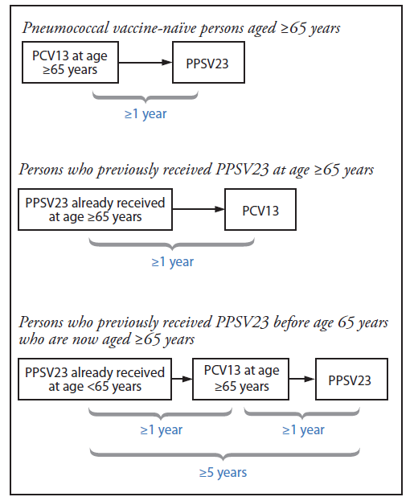
Pneumococcal Conjugate Vaccine for Adults (PCV13)
ACIP recommends 1 dose of PCV13 for:
Adults 19 years and older with the following:
Immunocompromising conditions
Functional or anatomic asplenia
Sickle cell disease
CSF leaks
Cochlear implants
Adults 65 years and older
PCV13 – PPSV23 spacing and timing of doses
65 years and older
MMWR 2014;Vol. 63 #37:822-5 MMWR, 2015 , Vol. 64, #34:944-7
Notes:
Presenter may use PCV13 and PPSV23 Use one-pager while reviewing slide.
When both PCV13 and PPSV23 are to be administered, PCV13 is recommended before PPSV23, based on studies demonstrating a better response to serotypes common to both vaccines when PCV was given first (5–7).
ACIP recommends 1 dose of PCV13 for:
Adults 19 years and older with the following:
-Immunocompromising conditions
-Functional or anatomic asplenia
-Sickle cell disease
-CSF leaks
-Cochlear implants
Adults 65 years and older
Intervals Between PCV13 and PPSV23 Vaccines: Recommendations of the Advisory Committee on Immunization Practices (ACIP) September 4, 2015 / 64(34);944-947
MMWR, December 10, 2010, Vo1 59, #RR-11 MMWR, June 28, 2013, Vol 62, #25

Slide 38
PCV13 – PPSV23 spacing and timing of doses 65 years and older
MMWR, 2015 , Vol. 64, #34:944-7
Notes:
Optional Slide

Slide 39
Pneumococcal Polysaccharide Vaccine for Adults (PPSV23)
ACIP recommends 1 dose of PPSV23 for:
  Adults 65 years and older
  Persons aged 2 through 64 years with medical conditions that increase their risk for pneumococcal infection
  Persons 19 through 64 years with asthma
  Cigarette smokers 19 years of age and older
  Revaccination not recommended for most persons until they reach age 65
Persons at highest risk, such as those with immunocompromising conditions, and/or functional or anatomic asplenia, who received a dose before age 65, should receive a 2nd dose 5 years after dose 1, and a 3rd dose at age 65.
MMWR, September 3, 2010, Vol 59, #34 MMWR, October 12,2012, Vol 61 #40
Notes:
ACIP recommends 1 dose of PPSV23 for:
Adults 65 years and older
Persons aged 2 through 64 years with medical conditions that increase their risk for pneumococcal infection
Persons 19 through 64 years with asthma
Cigarette smokers 19 years of age and older
Revaccination not recommended for most persons until they reach age 65
Persons at highest risk, such as those with immunocompromising conditions, and/or functional or anatomic asplenia, who received a dose before age 65, should receive a 2nd dose 5 years after dose 1, and a 3rd dose at age 65.
Ref: Updated Recommendations for Prevention of Invasive Pneumococcal Disease Among Adults Using the 23-Valent Pneumococcal Polysaccharide Vaccine (PPSV23) MMWR 2010; 59(34);1102-1106 September 3, 2010

Slide 40
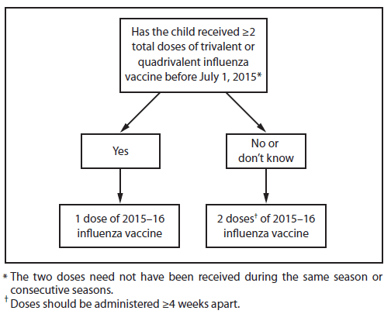
FDA Recommended Influenza Antigens
for 2015-2016 Season in the U.S.
Trivalent Vaccines (IIV3):
  A/California/7/2009 (H1N1)-like virus
  A/Switzerland/9715293/2013 (H3N2)-like virus
  B/Phuket/3073/2013-like virus
Algorithm for Children 6 months through 8 years
Quadrivalent Vaccines (IIV4) will
also include:
B/Brisbane/60/2008-like (Victoria lineage) virus
ACIP recommends annual influenza vaccine for all persons 6 months of age and older who do not have contraindications.
Notes:
Presenter may use Flu one-pager while discussing slide.
New strains of influenza appear frequently, the seasonal flu vaccine usually changes each year. Influenza surveillance centers around the world monitor the circulating influenza strains for trends year round. Genetic data is collected and new mutations are identified. The World Health Organization selects the strains most likely to genetically resemble circulating strains in the coming flu season.
ACIP recommends annual influenza vaccine for all persons 6 months of age and older who do not have contraindications.
Some illnesses that are not caused by influenza virus are often mistaken for flu. Flu vaccine will not prevent theses illnesses. It can only prevent influenza.
FURTHER POINTS
• LAIV4 & IIV4: Contain protection against 2 “A” flu strains (same as IIV3) and 2 “B” flu strains (1 same as IIV3 & 1 additional “B”strain)
• HCP who are pregnant or have chronic medical conditions other than severe immunosuppression, can administer LAIV4
• If LAIV4 is given to a close contact/HCP of a severely immunosuppressed person, contact should be avoided for 7 days
• LAIV4 should not be given with antiviral medications; Give IIV; See Influenza ACIP statement for further guidance

Slide 41
Inactivated Influenza Vaccines (IIV)
Administer by Injection:
Fluzone Quadrivalent Sanofi-Pasteur - 6 months of age and older (IIV4)
Fluzone Sanofi-Pasteur – (Multidose vial) 6 months of age and older (IIV3)
  Fluarix Quadrivalent GSK - 3 years of age and older (IIV4)
  FluLaval Quadrivalent GSK - 3 years of age and older (IIV4)
  Fluvirin Novartis - 4 years of age and older (IIV3)
  Afluria bioCSL - 9 years of age and older (IIV3)
  Flucelvax Novartis - 18 years of age and older (ccIIV3)*
  FluBlok Protein Sciences - 18 years of age and older (RIV3)**
  Fluzone Intradermal Quadrivalent Sanofi-Pasteur - 18 through 64 years (IIV4)
  Fluzone High-Dose Sanofi-Pasteur - 65 years and older (IIV3)
  Fluad Novartis – 65 years and older (IIV3)
*ccIIV3 = cell culture based trivalent inactivated influenza vaccine
**RIV3 = recombinant hemagglutinin influenza vaccine
MMWR; August 7, 2015 , Vol 64 #30; 818-825
Notes:
Presenter can review the list of flu products and discuss what products are used in their locations.
Administer by Injection (Trivalent) IIV3
Fluzone® sanofi-pasteur - 6 months of age and older
Fluarix® GSK - 3 years of age and older
FluLaval® GSK - 3 years of age and older IIV3 & IIV4#
Fluarix® Quadrivalent GSK - 3 years of age and older IIV4
Fluvirin® Novartis - 4 years of age and older
Afluria® CSL - 9 years of age and older
Flucelvax® Novartis - 18 years of age and older (ccIIV3)*
FluBlok ® Protein Sciences - 18 through 49 years (RIV3)**
Fluzone® Intradermal sanofi-pasteur - 18 through 64 years
Fluzone® High-Dose sanofi-pasteur - 65 years and older (4 X more antigen)
*ccIIV3 = cell culture based trivalent inactivated influenza vaccine
**RIV3 = recombinant hemagglutinin influenza vaccine

Slide 42
Live, Attenuated Influenza Vaccine (LAIV4)
  FluMist® MedImmune (Nasal Spray)
  licensed for healthy persons 2 through 49 years of age
ACIP interim recommendation on June 22, 2016
Due to poor effectiveness in past 3 seasons
LAIV4 should not be used in the 2016-17 season.
Currently only IIV provides protection against influenza and should be used for all persons
6 months and older who do not have contraindications.
AAP News June 23, 2016
Notes:
On June 22, ACIP voted that, for the upcoming 2016-'17 influenza season, LAIV should not be used. During the days leading up to this vote, the AAP worked closely with the ACIP Influenza Work Group to understand the scientific data on LAIV vaccine effectiveness from this past influenza season, and to view these new data in light of the two previous seasons.
Studies demonstrated that LAIV did not work in the 2013-'14 influenza season when the primary strain was the 2009 pandemic influenza A(H1N1) strain, in 2014-'15 when the primary circulating strain was a drifted A(H3N2) virus, or the 2015-'16 season when the primary circulating strain was again the 2009 pandemic influenza A(H1N1) strain. With knowledge that LAIV had no protective benefit during the past three influenza seasons, ACIP could not recommend its use in the upcoming 2016-'17 influenza season.
The AAP Committee on Infectious Diseases and the Board of Directors all had reached the same conclusion about not using LAIV for the upcoming influenza season.
The AAP has reached out to the manufacturer of LAIV and will be following closely both the need for pediatricians to cancel LAIV orders successfully, and to obtain additional quantities of injectable vaccine.
Excerpt from:
A Message from AAP CEO/Executive Director Karen Remley, MD, MBA, MPH, FAAP
June 27, 2016

Slide 43
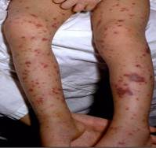
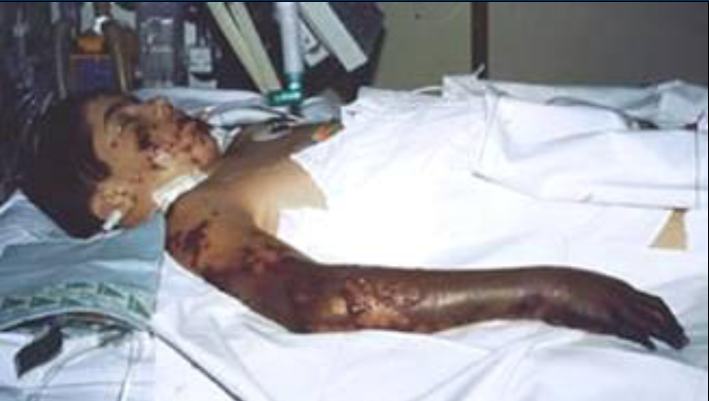
Meningococcal Disease
(caused by N. meningitidis)
Meningitis
~50% of cases 9-10% fatality rate
Meningococcemia
5%-20% of cases Up to 40% fatality rate
Rash
Vascular damage
Disseminated intravascular coagulation
Multi-organ failure
Shock
Death can occur in 24 hours
Photo courtesy CDC: Dr. Brodsky & Mr. Gust
11-19% of survivors have permanent sequelae
Ref: 1. Epidemiology and Prevention of Vaccine-Preventable Diseases. 13th Edition, 2015.
2. AAP Red Book 2015
Notes:
Presenter may use the meningococcal one-pager while discussing slide.
The most common clinical presentations of meningococcal disease are meningitis and meningococcemia.
-Neisseria meningitidis contains 13 serogroups, the most common being A, B, C, W, and Y. About 5-10% of adults are asymptomatic nasopharyngeal carriers of this organism.
-Individuals with meningococcemia may die within 24 hours of the onset of symptoms even with prompt treatment with appropriate antimicrobials and supportive care in an intensive care unit.
Meningitis makes up about ~50% of cases and has a 9-10% fatality rate
Meningococcemia- 5%-20% of cases; Up to 40% fatality rate; (Rash, Vascular damage, Disseminated intravascular coagulation, Multi-organ failure, Shock, Death can occur in 24 hours); 11-19% of survivors have permanent sequelae (an abnormal condition resulting from a previous disease)
Reference: 1. Epidemiology and Prevention of Vaccine-Preventable Diseases, 13th edition. 2015 HHS, CDC.
2. AAP Redbook 2015
3. Meningococcal Disease. About the Disease. http://www.cdc.gov/meningococcal/about/index.html

Slide 44
Meningococcal Conjugate Vaccine (MCV4)
(Men A,C,Y, W-135)
Menactra™ licensed for 9 mos. through 55 years
Menveo® licensed for ages 2 mos. through 55 years
ACIP recommends:
  First dose at age 11 or 12 years and a booster dose at 16 years.
  If first dose is at 13-15 years, give booster dose 5 years after the first dose or sooner if entering college or technical school.
  If first dose is received ≥ 16 years of age, a 2nd dose is not needed.
  Persons aged 21 years or younger attending school or college should have documentation of one dose of MVC4 not more than 5 years before enrollment.
For persons 56 years and older who need meningococcal vaccine, use MPSV4.
If MCV4 has been given previously and a booster is needed MCV4 is preferred.
Required for school attendance
MMWR, March 22, 2013, Vol 62, #RR02
Notes:
Recommendation for Routine Vaccination of Persons Aged 11 Through 18 Years
After a booster dose of meningococcal conjugate vaccine, antibody titers are higher than after the first dose and are expected to protect adolescents through the period of increased risk through age 21 years. Persons who receive their first dose of meningococcal conjugate vaccine at or after age 16 years do not need a booster dose. Routine vaccination of healthy persons who are not at increased risk for exposure to N. meningitidis is not recommended after age 21 years.
CDC Guidance for Transition to an Adolescent Booster Dose
Some schools, colleges, and universities have policies requiring vaccination against meningococcal disease as a condition of enrollment. For ease of program implementation, persons aged 21 years or younger should have documentation of receipt of a dose of meningococcal conjugate vaccine not more than 5 years before enrollment. If the primary dose was administered before the 16th birthday, a booster dose should be administered before enrollment in college. The booster dose can be administered anytime after the 16th birthday to ensure that the booster is provided. The minimum interval between doses of meningococcal conjugate vaccine is 8 weeks.
No data are available on the interchangeability of vaccine products. Whenever feasible, the same brand of vaccine should be used for all doses of the vaccination series. If vaccination providers do not know or have available the type of vaccine product previously administered, any product should be used to continue or complete the series.
Recommendations for Adults 56 years and older
MPSV4 is the only licensed meningococcal vaccine for adults aged ≥56 years and is immunogenic in older adults. For adults who have received MenACWY previously, limited data demonstrate a higher antibody response after a subsequent dose of MenACWY compared with a subsequent dose of MPSV4. For meningococcal vaccine-naïve persons aged ≥56 years who anticipate requiring a single dose of meningococcal vaccine (e.g., travelers and persons at risk as a result of a community outbreak), MPSV4 is preferred. For persons now aged ≥56 years who were vaccinated previously with MenACWY and are recommended for revaccination or for whom multiple doses are anticipated (e.g., persons with asplenia amd microbiologists), MenACWY is preferred.
Ref. 1. Prevention and Control of Meningococcal Disease - Recommendations of the Advisory Committee on Immunization Practices (ACIP) MMWR / March 22, 2013 / Vol. 62 / No. 2
2. Recommendation of the ACIP for Use of Quadrivalent Meningococcal Conjugate Vaccine (MenACWY-D) Among Children Aged 9 Through 23 Months at Increased Risk for Invasive Meningococcal Disease MMWR; October 14, 2011 / 60(40);1391-1392

Slide 45
Meningococcal Vaccines for High Risk
Children 2 months – 10 years
MENHIBRIX® (Men C&Y + Hib) licensed for ages 6 weeks through 18 months
Menveo® (Men A,C,Y, W-135) licensed for ages 2 mos. through 55 years
Menactra^{™ (}(Men A,C,Y, W-135) licensed for 9 mos. through 55 years
Recommended for children 2 months through 10 years with:
complement component deficiency
functional or anatomic asplenia
those who are part of a community outbreak
persons traveling internationally to regions with endemic meningococcal disease.
For details on doses and schedule refer to the current Childhood and Adolescent Immunization Schedule
MMWR, June 20, 2014, Vol 63 #24 MMWR, March 22, 2013, Vol 62, #RR02
Notes:
Meningococcal Vaccines for High Risk Children 2 months – 10 years
MENHIBRIX® (Men C&Y + Hib) licensed for ages 6 weeks through 18 months
Menveo® (Men A,C,Y, W-135) licensed for ages 2 mos. through 55 years
Menactra® (Men A, C, Y, W-135) licensed for 9 months through 55 years
Recommended for children 2 months through 10 years with:
-complement component deficiency
-functional or anatomic asplenia
-those who are part of a community outbreak
-persons traveling internationally to regions with endemic meningococcal disease.
For details on doses and schedule refer to the current Childhood and Adolescent Immunization Schedule

Slide 46
Serogroup B Meningococcal Vaccine
Bexsero® licensed for ages 10 through 25 years (2 dose)
Trumenba® licensed for ages 10 through 25 years (3 dose)
ACIP recommends serogroup B meningococcal vaccine for:
Persons with persistent complement component deficiencies
Persons with anatomic or functional asplenia
Microbiologists routinely exposed to isolates of Neisseria meningitidis
Persons identified to be at increased risk because of a serogroup B meningococcal disease outbreak
The 2 vaccine products are not interchangeable.
(Category B – Permissive recommendation)#
A Men B vaccine series may be administered to adolescents and young adults 16 through 23 years of age to provide short-term protection against most strains of Men B. Preferred age is 16-18 years.
MMWR; June 12, 2015 ,Vol. 64 #22; 608-611
# MMWR; October 23, 2015, Vol .64 #41; 1171-1176
Notes:
Presenter may use the new MenB one-pager while discussing slide
Bexsero® licensed for ages 10 through 25 years (2 dose)
Trumenba® licensed for ages 10 through 25 years (3 dose)
ACIP recommends serogroup B meningococcal vaccine for:
Persons with persistent complement component deficiencies
Persons with anatomic or functional asplenia
Microbiologists routinely exposed to isolates of Neisseria meningitidis
Persons identified to be at increased risk because of a serogroup B meningococcal disease outbreak
The 2 vaccine products are not interchangeable.
MenB is a Category B- permissive recommendation- Explain to audience the difference between a Category A and Category B recommendation. Category B means the recommendation allows for individual clinical decision making, but with Category A recommendations all persons in an age or risk factor based group may get the vaccine. Category B classification enables coverage by the VFC program and most insurance plans.
A Men B vaccine series may be administered to adolescents and young adults 16 through 23 years of age to provide short-term protection against most strains of Men B. Preferred age is 16-18 years.

Slide 47
Simon received MPSV4 at 5 years of age for international travel and a dose of MCV4 at age 11.
Does he need a booster dose of MCV4 vaccine at age 16?
Test Your Knowledge!
Yes. Any meningococcal vaccination given prior to the tenth birthday (either with MCV4 or MPSV4) does NOT count toward routinely recommended doses.
IAC Ask the Experts - Reviewed September 2013

Slide 48
Rotavirus Vaccines
RotaTeq® (Merck) and Rotarix® (GSK)
RotaTeq®: 3 doses; ages 2, 4, 6 months
Rotarix®: 2 doses; ages 2 and 4 months
ACIP recommends:
2-3 doses depending on brand
Administer either vaccine as directed below:
  Minimum age for first dose: 6 weeks
  Maximum age for first dose: 14 weeks 6 days
  Minimum interval between doses: 4 weeks
  Maximum age for last dose: 8 months 0 days
If any dose is Rotateq®, 3 doses are required
Use RotaTeq® if allergy to latex
MMWR, February 6, 2009, Vol 58, #RR-02
Notes:
Presenter may use Rotavirus one-pager while discussing slide.
Why get vaccinated?
Rotavirus is a virus that causes diarrhea, mostly in babies and young children. The diarrhea can be severe, and lead to dehydration. Vomiting and fever are also common in babies with rotavirus. Before rotavirus vaccine, rotavirus disease was a common and serious health problem for children in the United States. Almost all children in the U.S. had at least one rotavirus infection before their 5th birthday.
Every year:
More than 400,000 young children had to see a doctor for illness caused by rotavirus,
More than 200,000 had to go to the emergency room,
55,000 to 70,000 had to be hospitalized, and 20 to 60 died.
Rotavirus vaccine has been used since 2006 in the United States. Because children are protected by the vaccine, hospitalizations, and emergency visits for rotavirus have dropped dramatically.
ACIP recommends:
2-3 doses depending on brand
Administer either vaccine as directed below:
Minimum age for first dose: 6 weeks
Maximum age for first dose: 14 weeks 6 days
Minimum interval between doses: 4 weeks
Maximum age for last dose: 8 months 0 days
If any dose is Rotateq®, 3 doses are required
Use RotaTeq® if allergy to latex
Interchangeability of Rotavirus Vaccines
ACIP recommends that the rotavirus vaccine series be completed with the same product whenever possible. However, vaccination should not be deferred if the product used for previous doses is not available or is unknown. In this situation, the provider should continue or complete the series with the product available. If any dose in the series was RV5 or the product is unknown for any dose in the series, a total of three doses of rotavirus vaccine should be given.
Reference: 1. Prevention of Rotavirus Gastroenteritis Among Infants and Children - Recommendations of the Advisory Committee on Immunization Practices (ACIP) MMWR; February 6, 2009 / 58(RR02);1-25
2. Rotavirus Vaccine Information Statement 08/26/2013
3. MMWR, October 21, 2011 / 60(41);1427-1427

Slide 49
Types of Human Papilloma Virus (HPV)
Mucosal/Genital
~40 types
Cutaneous
~60 types
High risk types
16, 18, 31, 33, 45, 52, 58
(and others)
Low risk types
6, 11 and others
Cervical cancer
Anogenital cancer
Oropharyngeal Cancer
Cancer precursors
Low grade cervical disease
Genital Warts
Laryngeal Papillomas
Low grade cervical disease
Skin warts
Hands and Feet
Ref: 1.Epidemiology and Prevention of Vaccine Preventable Diseases 13th Edition, 2015
2. Red Book – AAP 2015 Report of the Committee on Infectious Diseases
Notes:
Presenter to discuss the types of HPV and the cancers caused.

Slide 50
HPV Vaccines
Cervarix® (HPV2) HPV types 16 & 18
Gardasil® (HPV4) HPV types 6, 11, 16, 18
Gardasil 9® (HPV9) HPV types 6, 11, 16, 18, 31, 33, 45, 52, 58
ACIP recommends HPV vaccine starting at age 11 or 12 years for:
-All females through 26 years of age using HPV2, HPV4 or HPV 9.
-All males through 26 years of age using HPV4 or HPV9.
HPV 9 may be used to complete the 3 dose series that was started with HPV2 or HPV4
Dose 2 should be given at least 1 to 2 months after first dose (1 month minimum)
Dose 3 should be given at least 6 months after the first dose
(minimum of 3 months between dose 2 and 3)
MMWR, March 27, 2015, Vo1 64, No. 11
Recommendation for routine use of HPV9 in males age 21 through 26 years is pending ACIP approval.
Notes:
Presenter may use the HPV one-pager while discussing slide.
Recommendations for Use of HPV Vaccines
Cervarix® (HPV2) HPV types 16 & 18
Gardasil® (HPV4) HPV types 6, 11, 16, 18
Gardasil 9® (HPV9) HPV types 6, 11, 16, 18, 31, 33, 45, 52, 58
ACIP recommends HPV vaccine starting at age 11 or 12 years for:
-All females through 26 years of age using HPV2, HPV4 or HPV 9.
-All males through 26 years of age using HPV4 or HPV9.
HPV 9 may be used to complete the 3 dose series that was started with HPV2 or HPV4
Dose 2 should be given at least 1 to 2 months after first dose (1 month minimum)
Dose 3 should be given at least 6 months after the first dose (minimum of 3 months between dose 2 and 3)
Optional information to share:
Georgia Estimated Vaccination Coverage Among Adolescents Aged 12 – 17 Years - 2014
≥1 Tdap 86.1% (87.6% U.S)
≥ 1 Men ACWY 74.9% (79.3% U.S)
≥1 HPV Female 65.4% (60.0% U.S)
≥3 HPV Female 47.1% (39.7% U.S)
≥1 HPV Male 41.2% (41.7% U.S)
≥3 HPV Male 21.0% (21.6% U.S)
The United States 2013 National Immunization Survey-Teen (13-17 years) estimated 37.6% of girls and 13.9% of boys have received ≥3 doses of HPV vaccine. In the 2012 survey 33.4% of girls and 6.8% of boys received ≥3 doses.
MMWR / March 27, 2015 / Vol. 64 / No. 11
MMWR July 31, 2015/64 (29); 784-792

Slide 51
Top 5 reasons for not vaccinating daughter, among parents with no intention to vaccinate in the next 12 months, NIS-Teen 2012
* Not mutually exclusive.
** Did not know much about HPV or HPV vaccine.
www.cdc.gov/vaccines/who/teens/for-hcp/downloads/HPV-provider-tip-sheet.pdf
Notes:
This slide shows the responses that parents gave when asked why they would not be getting the HPV vaccine for their daughter in the next year.
Three reasons that parents provided—lack of knowledge, not needed, and not sexually active—all demonstrate a lack of understanding on the part of the parent, especially why it is important to vaccinate at ages 11 or 12. Parents need to be told that HPV vaccine is cancer prevention and that it must be given prior to exposure.
Safety concerns can be allievated by sharing the tremendous amount of data before and after the vaccine was licensed that demonstrate that HPV vaccine is safe.
Practice with audience on how to speak with parents:
Encourage Parents To Immunize a Pre-teen or Adolescent
Try saying:
Your child needs three shots today that will prevent tetanus, diphtheria, whooping cough, and one type of meningitis and protect him/her from many cancers caused by HPV.
HPV vaccine produces a better immune response in preteens than it does in older teens and young women. I strongly believe in the importance of this cancer-preventing vaccine.

Slide 52
Reasons to Immunize Against HPV at 11-12 Years of Age
Higher antibody level attained when given to pre-teens rather than to older adolescents or women
At this age, more likely to be administered before onset of sexual activity
HPV can be transmitted by other skin-to-skin contact, not just sexual intercourse
This is an anti-cancer vaccine
Presentation by Anne Schuchat, MD, RADM US Public Health Service, Assistant Surgeon General, Director National Center for Immunization and Respiratory Diseases at Immunize Georgia Conference, Atlanta, GA September 11, 2014
Notes:
Clinicians also need to emphasize the importance of immunizing preteens and teens early because of the following:
-Higher antibody level attained when given to pre-teens rather than to older adolescents or women
-At this age, more likely to be administered before onset of sexual activity
-HPV can be transmitted by other skin-to-skin contact, not just sexual intercourse
-This is an anti-cancer vaccine
Reference:
1.National Immunization Survey-Teen (NIS-Teen), United States, 2014 MMWR/July 31, 2015/ Vol.64/No. 29

Slide 53
Test Your Knowledge!
Dakota is an 18 year girl who will be starting her first year of college in August. She had her first dose of HPV vaccine on April 5 and her second dose on May 8. She will not be coming home again until late November.
Should you give her the third dose of HPV vaccine before she leaves home in mid August?
No! The minimum interval between the second and third doses of vaccine is 12 weeks. The minimum interval between the first and third doses is 24 weeks.

Slide 54
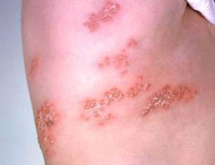
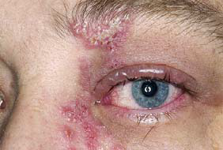
Herpes Zoster
Herpes zoster (HZ), or shingles, occurs through reactivation of latent varicella-zoster virus
Typically characterized by prodromal pain and an acute vesicular eruption (rash) accompanied by moderate to severe pain
One in three persons will develop zoster during their lifetime
Postherpetic neuralgia (PHN)is a common consequence of zoster
Risk for zoster and PHN increases with age
Photo courtesy of www.webmd.com
Notes:
Presenter may use shingles one-pager while discussing slide.
The picture on left shows zoster (shingles) on the upper chest and back.
The picture on right shows zoster on the face involving one of the cranial nerves.
What is shingles?
Shingles is a painful skin rash, often with blisters. It is also called Herpes Zoster, or just Zoster.
Shingles occurs when VZV reactivates and causes recurrent disease. Shingles usually starts as a rash with blisters that scab after 3 to 5 days. The most frequently mentioned symptom is pain. The rash and pain usually occur in a band on one side of the body, or clustered on one side of the face. The rash usually clears within 2 to 4 weeks. The risk of getting shingles increases as a person gets older. People who have medical conditions that keep the immune system from working properly, or people who receive immunosuppressive drugs are also at greater risk to get shingles. Very rarely, shingles can lead to pneumonia, hearing problems, blindness, scarring, brain inflammation (encephalitis), or death.

Slide 55
Zostavax®
Zostavax is licensed for use in persons 50 years and older
Overall Efficacy
51% fewer episodes of zoster and less severe disease
66% less postherpetic neuralgia
Protection wanes within the first 5 years and duration of protection beyond 5 years is uncertain
ACIP recommends one dose for adults 60 years and older, including those who have experienced previous episodes of shingles.
It is not necessary to ask patient about a history of varicella or to do serologic testing for immunity.
MMWR, August 22, 2014, Vol 63, #33 MMWR (RR) June 6, 2008, Vol 57 #05; 1-30
Notes:
Zostavax is licensed for use in persons 50 years and older
Overall Efficacy
51% fewer episodes of zoster and less severe disease
66% less postherpetic neuralgia
Protection wanes within the first 5 years and duration of protection beyond 5 years is uncertain
ACIP recommends one dose for adults 60 years and older, including those who have experienced previous episodes of shingles. It is not necessary to ask patient about a history of varicella or to do serologic testing for immunity.
Optional Information:
Insurance reimbursement for Zostavax will vary based on the patient’s insurance plan. Patients need to verify coverage with their insurance company. Zostavax is covered by Medicare under Part D, but there are many different plans available under Part D. Patients covered by Medicare should make sure the Part D plan they have selected covers Zostavax or they will be responsible for full payment. Many practices are not offering Zostavax to their patients because physicians can not bill Part D, unless their practice is approved to dispense prescription drugs. In Georgia, pharmacists who are trained in vaccine administration can give Zostavax and bill Medicare for the cost of the vaccine and an administrative charge, if the patient’s Part D plan covers the vaccine.

Slide 56
Test Your Knowledge!
Hazel is 61 years old. She had major surgery one month ago requiring a blood transfusion. During her visit to your office today she tells you she would like to get the shingles vaccine.
How would you respond to her request?
Zoster vaccine can be given to persons who have recently received blood products. The amount of antigen in zoster vaccine is so substantial that it overpowers any antibody to herpes zoster that may be in the blood product.
Ref: Immunization Action Coalition - Ask the Experts – September 2011

Slide 57
Test Your Knowledge!
Sixty five year old Nadine requests the shingles vaccine. In addition, she needs pneumococcal and influenza vaccine.
Should she receive all 3 vaccines on the same day?
Yes.
Although Merck reports one study showing a reduced immune response to Zostavax when administered at the same time as Pneumovax compared to administration 4 weeks apart, ACIP has not made this recommendation.

Slide 58
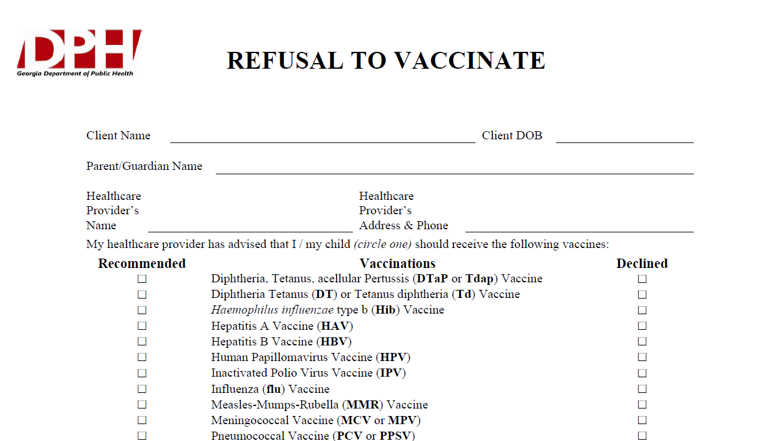
Notes:
What If Parents Refuse to Vaccinate?
Excluding children from your practice when their parents decline immunizations is not recommended. It can put the child at risk of many different health problems—not just vaccine-preventable diseases. Remember, unvaccinated infants did not decide for themselves to remain unvaccinated. They need your care. Make sure that parents are fully informed about clinical presentations of vaccine-preventable diseases, including early symptoms. Diseases like pertussis and measles are highly contagious and may present early as a non-specific respiratory illness. Parents who refuse vaccines should be reminded at every visit to call before bringing the child into the office, clinic, or emergency department when the child is ill so appropriate measures can be taken to protect others.
If a parent refuses to vaccinate, you can share the fact sheet
If You Choose Not to Vaccinate Your Child, Understand the Risks and Responsibilities (http://www.cdc.gov/vaccines/conversations),
which explains the risks involved with this decision including risks to other members of their community, and the additional responsibilities for parents, including the fact that, when their child is ill, they should always alert health care personnel to their child’s vaccination status to prevent the possible spread of vaccine-preventable diseases. You may wish to have them sign DPH’s Refusal to Vaccinate form in English or Spanish (https://dph.georgia.gov/sites/dph.georgia.gov/files/Immunizations/Health-Care-Professionals-Refusal-to-Vaccinate-Form-English_1.pdf) each time a vaccine is refused so that you have a record of their refusal in their child’s medical file.

Slide 59
Just as a reminder……
Regardless of:
  the availability of vaccine
  the funding of the vaccine (VFC, state-supplied, or private stock)
  whether the vaccine is required for school or child care or not……….
FOLLOW ACIP Recommendations!!!
Notes:
There seems to be some confusion among providers that
if there are vaccine shortages or the supply is low because it’s a new vaccine, or
if the patient doesn’t fit in a certain funding category, or
if the vaccine isn’t required for school or child care:
then they don’t feel they need to be concerned about whether to recommend or discuss that vaccine with the client or the parent. But the bottom line is-------the ACIP recommendation is the most important thing!! For instance, if a vaccine is recommended and the child is not VFC eligible, then give them your private stock of that vaccine if you have it. If not, refer the child out to receive it, but don’t ignore the fact that according to the ACIP Recommended schedule, he should have it.
Please be sure to emphasize this to any groups that you are educating about the recommended schedule.

Slide 60
Critical Elements for Immunization Services
Notes:
Critical Elements for immunization services include:
Appropriate storage and handling of all vaccines.
Correct administration of vaccines
Education of patients and parents about vaccines
Every office and clinic needs a vaccine champion.

Slide 61
Every Office and Clinic Needs
A Vaccine Champion!
Lead your immunization team.
Educate all staff about new vaccines and recommendations.
Teach new staff about vaccine storage, handling, & administration.
Initiate processes to improve immunization rates in your practice/facility.
Assure immunizations of all staff are up-to-date.
Notes:
61
61
Ask your audience “Who is your vaccine champion?” and then
“Who is this person’s backup?”
The vaccine champion will:
Lead your immunization team.
Educate all staff about new vaccines and recommendations.
Educate new staff about vaccine storage, handling, & administration.
Initiate processes to improve immunization rates in your practice/facility.
Assure immunizations of all staff are up-to-date.
Improving Access to immunizations
Immunization only visits
Walk-ins for immunizations
Implement standing orders
Early, extended, or weekend hours
Mass vaccination clinics
These 5 methods listed above can help patients access immunizations more readily but some of these methods may not be the right fit for some practices. The approach to improving access must be determined by individual practitioners and staff. Each practice must decide which method works best for their situation. In large practices or clinics this may be an administrative decision.

Slide 62
Standards for Child, Adolescent, and Adult Immunization Practices
Availability of vaccines
Assessment of client’s vaccination status
Effective communication with client or parent
Proper storage and handling of vaccines
Accurate documentation of vaccinations
Implementation of strategies to improve rates
Developing partnerships and community-based approaches to vaccine delivery
Notes:
Following the Standards for Child, Adolescent and Adult Immunization practices involve:
Availability of vaccines
Barriers identified
Client kept in medical home as much as possible
Client costs minimized
Assessment of client’s vaccination status
Review history each time
Assess for contraindications
Use GRITS
Effective communication with client or parent, especially re: risks/benefits
Proper storage and handling of vaccines
Accurate documentation of vaccinations---use of GRITS
Implementation of strategies to improve rates
Reminder/recall systems
Periodic assessment of practice coverage levels
Standing orders if appropriate
Developing partnerships and community-based approaches to vaccine delivery

Slide 63
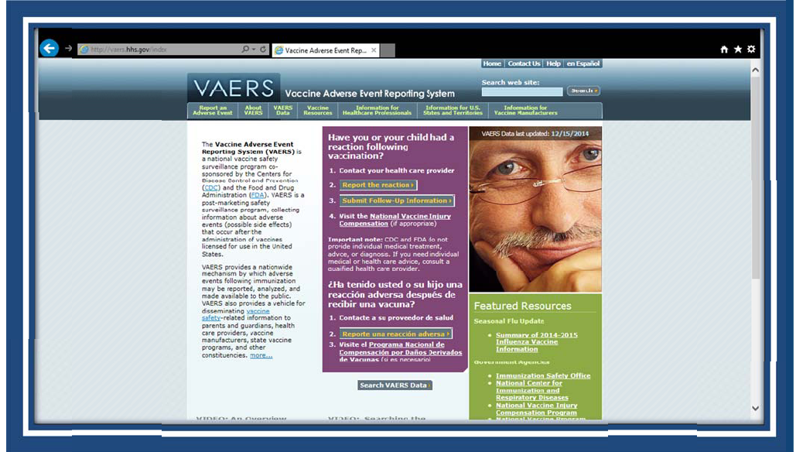
VAERS
Notes:
VAERS provides a nationwide mechanism by which adverse events following immunization may be reported, analyzed, and made available to the public.
The primary objectives of VAERS are to:
Detect new, unusual, or rare vaccine adverse events;
Monitor increases in known adverse events;
Identify potential patient risk factors for particular types of adverse events;
Identify vaccine lots with increased numbers or types of reported adverse events; and
Assess the safety of newly licensed vaccines.
What Can Be Reported to VAERS?
VAERS encourages the reporting of any clinically significant adverse event that occurs after the administration of any vaccine licensed in the United States.
Who Reports to VAERS?
Anyone can file a VAERS report, including parents, health care providers, manufacturers, and vaccine recipients.
Does VAERS Provide General Vaccine Information?
No. VAERS only collects and analyzes adverse event reports. In another example, VAERS determined that there may be a potential for a small increase in risk for Guillain-Barre syndrome after the meningococcal conjugate vaccine, Menactra. As a result of this finding, a history of Guillain-Barre syndrome became a contraindication to the vaccine and further controlled studies are currently underway to research this issue.
The VAERS website for reporting is: http:vaers.hhs.gov/ or you can call to report at 1-800-822-7967

Slide 64
Vaccine Injury Compensation Program (VICP)
National Vaccine Injury Compensation Program
provides compensation to individuals found to be injured by or have died from certain childhood vaccines.
  Established in 1988 by NCVIA
  Federal “no fault” system to compensate those injured
  Claim must be filed by individual, parent or guardian
  Must show that injury is on “Vaccine Injury Table”
Notes:
On October 1, 1988, the National Childhood Vaccine Injury Act of 1986 created the National Vaccine Injury Compensation Program (VICP). The VICP was established to ensure an adequate supply of vaccines, stabilize vaccine costs, and establish and maintain an accessible and efficient forum for individuals found to be injured by certain vaccines. The VICP is a no-fault alternative to the traditional public legal system for resolving vaccine injury claims that provides compensation to people found to be injured by certain vaccines.
The National Childhood Vaccine Injury Act (NCVIA) set forth 3 basic requirements for all vaccination providers, which are:
Providers must give the patient (or parent/legal representative of a minor) a copy of the relevant federal "Vaccine Information Statement" (VIS) for the vaccine they are about to receive.
Providers must record certain information about the vaccine(s) administered in the patient's medical record or a permanent office log.
Providers must document any adverse event following the vaccination that the patient experiences and that becomes known to the provider, whether or not it is felt to be caused by the vaccine, and submit the report to the Vaccine Adverse Event Reporting System (VAERS).

Slide 65

IT STARTS WITH YOU!

Slide 66

Healthcare Personnel (HCP) Need These Immunizations:
Annual influenza vaccine
Tdap or Td
Hepatitis B (exposure risk) Check immunity
Validate immune status of:
Varicella
Measles, Mumps & Rubella(MMR)
Are YOU up to date?
Notes:
66
Hepatitis B vaccine is recommended for health-care personnel with potential exposure to blood or body fluids. The antibody status of these health-care personnel should be checked 1-2 months after the 3rd dose. If a person fails to develop an adequate antibody titer after three doses of vaccine, follow current CDC recommendations for additional doses of hepatitis B vaccine. Some health-care providers may have received three doses of hepatitis B vaccine as children, adolescents or adults but have never had serologic testing to check for immunity. Follow the CDC Guidance for Evaluating Health-Care Personnel for Hepatitis B Virus Protection and for Administering Postexposure Management (Recommendations and Reports / Vol. 62 / No. 10 December 20, 2013)
Un-immunized HCP
Un-immunized healthcare workers are at risk of infecting patients, family members and community contacts
Immunized HCP
Protect patients from VPD’s
Help offices avoid potential liability cases. (The practice can be liable if an unimmunized HCP becomes infected with a vaccine preventable disease and infects a patient.)
Maintain productivity
Reduce illness and illness-related absenteeism
Evidence of Immunity to MMR
Documented administration of two doses of measles and mumps vaccine and one dose of rubella vaccine OR
Laboratory evidence of immunity or laboratory confirmation of disease (measles, mumps and rubella) OR
Born before 1957 (measles, mumps and rubella)
References: 1. General Recommendations on Immunization, Recommendations of the Advisory Committee on Immunization Practices (ACIP). MMWR (RR-2); January 28, 2011
2. Immunization of Health-Care Personnel: Recommendations of ACIP MMWR; November 25, 2011 / 60(RR07);1-45
3. CDC Guidance for Evaluating Health-Care Personnel for Hepatitis B Virus Protection and for Administering Postexposure Management (Recommendations and Reports / Vol. 62 / No. 10 December 20, 2013)

Slide 67









Resources for Factual & Responsible Vaccine Information
www.immunize.org
Notes:
67
67
These are sources for scientific and credible information
See information sheet in participant packet
http://www.cdc.gov/vaccines/vac-gen/safety/default.htm
www.idsociety.org/vaccine/index.html
www.who.int
www.gaaap.org
www.aap.org
www.cispimmunize.org
www.aafp.org
www.acponline.org
www.immunize.org/resources This site is a good resource for healthcare providers and for information written specifically for patient and parents.
www.immunizationinfo.org
www.pkids.org (support and counseling for children with infectious diseases)
www.vaccine.org
The Allied Vaccine Group (AVG) (www.vaccine.org) was formed for the purpose of making it easier for patients/parents/providers to find reliable, science-based information about vaccines and immunization on the internet. This web site was designed to counter the many anti-vaccine web sites that are now available on the internet.

Slide 68

Stay Current!
Sign up for listserv sites which provide timely information pertinent to your practice www.immunize.org/resources/emailnews.asp
  AAP Newsletter
  CDC immunization websites (32 in all)
  CHOP Parents Pack Newsletter
  IAC Express
  Websites specific to particular vaccines

Slide 69

Internet Resources
Georgia Department of Public Health
  http://dph.georgia.gov/immunization-section
CDC Immunization information
  http://www.cdc.gov/vaccines/
CDC Flu information
  http://www.cdc.gov/flu/
Immunization Action Coalition
  www.immunize.org

Slide 70


Resources
Local health department
District Immunization Coordinator
GA Immunization Program Office
  On call Help line: 404-657-3158
  GRITS Help Line:1-866-483-2958
  VFC Help Line:1-800-848-3868
  Website http://dph.georgia.gov/immunization-section
  Your local Immunization Program Consultant (IPC)
  Epidemiology: 1-866-782-4584
GA Chapter of the AAP
GA Academy of Family Physicians
Notes:
If you need further information about the changes, or to ask questions later, please contact the GA Immunization Office and our partners GA AAP and GA AFP
Your Local health department
District Immunization Coordinator (IPCs)
GA Immunization Program Office
404-657-3158
Website http://health.state.ga.us/programs/immunization
GA Chapter of the AAP
GAFP

Slide 71

It’s a Team Effort!
High Immunization rates begin with a team designed plan!
What can your team do to improve rates?
Notes:
71
Remind your audience that “It is a team effort to immunize successfully”. Do not underestimate the
office team’s ability to affect immunization rates. It takes the physician, physician’s assistant, nurse
practitioner, nurse, medical assistant, and clerical staff working together to improve the office practice
and raise immunization rates.
Take any questions from the audience.
Ask participants how, based on the information presented, will they change the way they administer
vaccines.
Ask the audience what will they do to improve rates?
Ask participants to develop a plan to improve the immunization rates in their office
Jot down the plans the practice makes so that we can follow-up with them.

