Slide 1
Review of the Recommended Immunization Schedule
Notes:
Presenter will use this presentation to train clinicians on the ACIP Recommended Immunization Schedule for children, adolescents and adults.

Slide 2
Disclosure Statements
Neither the planners of this session nor I have any financial relationship with pharmaceutical companies, biomedical device manufacturers, or corporations whose products and services are related to the vaccines we discuss.
There is no commercial support being received for this event.
The mention of specific brands of vaccines in this presentation is for the purpose of providing education and does not constitute endorsement.
The GA Immunization Program utilizes ACIP recommendations as the basis for this presentation and for our guidelines, policies, and recommendations.
For certain vaccines this may represent a slight departure from or off-label use of the vaccine package insert guidelines.
Notes:
[Presenter is required to read this information to the audience before the program begins.]
Neither the planners of this session nor I have any financial relationship with pharmaceutical companies, biomedical device manufacturers, or corporations whose products and services are related to the vaccines we discuss.
There is no commercial support being received for this event.
The mention of specific brands of vaccines in this presentation is for the purpose of providing education and does not constitute endorsement.
The GA Immunization Program utilizes ACIP recommendations as the basis for this presentation and for our guidelines, policies, and recommendations.
For certain vaccines this may represent a slight departure from or off-label use of the vaccine package insert guidelines.

Slide 3
Disclosure Statement
To obtain nursing contact hours for this session, you must be present for the entire session and complete an evaluation.
Continuing education will be provided through the Georgia Department of Public Health
Georgia Department of Public Health is an approved provider of continuing nursing education by the Alabama State Nurses Association, an accredited approver by the American Nurses Credentialing Center’s Commission of Accreditation

Slide 4
Objectives
At the end of this presentation, participants
will be able to:
Recall the role vaccines have played in preventing diseases
Discuss the importance of vaccines for children, adolescents and adults
Discuss the role of a vaccine champion
List at least two reliable sources for immunization information
Notes:
4
At the end of this presentation, you will be able to:
Recall the role vaccines have played in preventing diseases
Discuss the importance of vaccines for children, adolescents and adults
Discuss GA Immunization law and DPH rules and regulations for schools and childcare attendance
Discuss the role of a vaccine champion
List at least two reliable sources for immunization information

Slide 5
The Impact of Vaccines
Disease | Average Annual Reported Cases Pre-vaccine* | Cases in U.S. 2014** | Provisional Cases in U.S. 2015** | Provisional % Reduction In U.S. 2015
Smallpox | 48,164 | Eradicated worldwide in 1980
Diphtheria | 175,885 | 1 | 0 | 100%
Measles | 503,282 | 667 | 189 | >99.9%
Mumps | 152,209 | 1,196 | 1,057 | 99.3%
Pertussis | 147,271 | 32,118 | 18,166 | 87.7%
Polio (paralytic) | 16,316 | 0 | 0 | 100%
Rubella | 47,745 | 6 | 5 | >99.9%
Congenital Rubella Syndrome | 823 | 1 | 1 | >99.9%
Tetanus | 1,314 | 23 | 25 | 98.1%
H. Influenzae Type b Age<5 years | 20,000 | 40 | 23 | 99.9%
*MMWR 48(12);243-248 April 2, 1999
**MMWR 64(52), ND-923-ND-940, January 8, 2016
Notes:
This table shows the impact of vaccines on the annual reported cases of some vaccine preventable diseases in the United States.
Column 2 shows the average number of reported cases of a specific disease prior to the licensure of the vaccine.
Column 3 shows the number of reported cases in the United States in 2014.
Column 4 shows the provisional number of reported cases in the U.S in 2015.
Column 5 shows the percentage decrease in reported cases in the United States based on the provisional number of reported cases in 2015 compared with the pre-vaccine years.
*** If we look at the highlighted rows, over the past couple of years we have seen a spike in measles and mumps cases in the U.S. On January 10, 2017, DPH released a mumps advisory for colleges and universities signed by Dr. Fitzgerald outlining the high number of mumps cases reported to the CDC in 2016 (5, 311), noting the highest number of cases since 2006. Many cases were associated with outbreaks in college/university settings. At this time, a small number of mumps cases have been identified on college/university campuses in Georgia.
Reference:
Achievements in Public Health, 1900-1999 Impact of Vaccines Universally Recommended for Children - United States, 1990-1998 MMWR April 02, 1999 / 48(12);243-248
MMWR 63(53);733-746, January 9, 2015
MMWR 64(52);ND-923-ND-940, January 8, 2016

Slide 6
VPD | Vaccination Rate Needed for Herd Immunity
Measles | 92-94%
Pertussis | 92-94%
Diphtheria | 83-85%
Rubella | 83-85%
Mumps | 75-86%
Influenza | 30-75%
Notes:
We know that it is probably unrealistic to believe we can immunize everyone appropriately. We also know that there will always be young infants who have not received all recommended vaccines because of their age and a significant number of adults who are not adequately immunized. Herd immunity is the term most frequently used that refers to a situation in which a high percentage of a population is immune to a disease, essentially stopping the disease in its tracks because it cannot find new hosts. This chart illustrates the vaccination rate needed for each of the VPDs listed. For example, because measles is extremely contagious and can spread through the air, the immunity threshold needed to protect a community is high. The vaccination rate needed for measles is around 92-94%.
The threshold for herd immunity varies, depending on the disease, with more virulent infectious agents requiring vaccination of a higher percentage of the population to create the desired community immunity. The creation of herd immunity is especially important in crowded environments which facilitate the spread of disease, like schools. It is also extremely important to receive regular boosters, as some vaccines lose their efficacy over time, leaving people vulnerable to an outbreak. Herd immunity led to the eradication of smallpox, and it explains why diseases such as polio and diphtheria are rare in developed nations with established vaccination policies.
According to the 2015 National Immunization Study, coverage for childhood vaccines remains high.
-The majority of parents are vaccinating their young children against potentially serious diseases.
-The percentage of children who receive no vaccinations remains low, less than 1% (0.8%).
-Nationally, there were no significant changes in vaccination coverage among children 19-35 months of age for routinely recommended childhood vaccinations in 2015.*
-Vaccination coverage remained over 90% for measles, mumps, rubella (MMR), poliovirus, hepatitis B, and varicella.
If we look at the coverage rate for children 19-35 months for:
•Measles, mumps and rubella vaccine (MMR) (1 or more doses) was 92%; and specifically for Georgia the rate is at 94.2%
•Polio vaccine series (3 or more doses) was 94%
•Hepatitis B vaccine series (3 or more doses) was 93%
•Varicella vaccine ( 1 or more doses) was 92%

Slide 7

Advisory Committee on Immunization Practices (ACIP)
15 voting members with expertise in one or more of the following:
Vaccinology
Immunology
Infectious diseases
Pediatrics
Internal Medicine
Preventive medicine
Public health
Consumer perspectives and/or social and community aspects of immunization programs
ACIP develops recommendations and schedules for the use of
licensed vaccines
Notes:
Ask the audience if they are familiar with the ACIP. If they are familiar with the ACIP the presenter can spend a minimal amount of time on this slide.
The dramatic reduction of vaccine preventable diseases in the United States can be attributed to the availability of vaccines, as well as recommendations and an organized vaccine schedule developed by the Advisory Committee on Immunization Practices (ACIP).
The Advisory Committee on Immunization Practices (ACIP) consists of 15 experts in fields associated with immunization who have been selected by the Secretary of the U. S. Department of Health and Human Services to provide advice and guidance to the Secretary, the Assistant Secretary for Health, and the Centers for Disease Control and Prevention (CDC) on the most effective means to prevent vaccine-preventable diseases.
The Committee develops written recommendations for the routine administration of vaccines to the pediatric and adult populations, along with schedules regarding the appropriate periodicity, dosage, and contraindications applicable to the vaccines. ACIP is the only entity in the federal government which makes such recommendations.
The overall goals of the ACIP are to provide advice which will assist the Department and the Nation in reducing the incidence of vaccine preventable diseases and to increase the safe usage of vaccines and related biological products.
For more information: http://www.cdc.gov/vaccines/acip/index.html

Slide 8
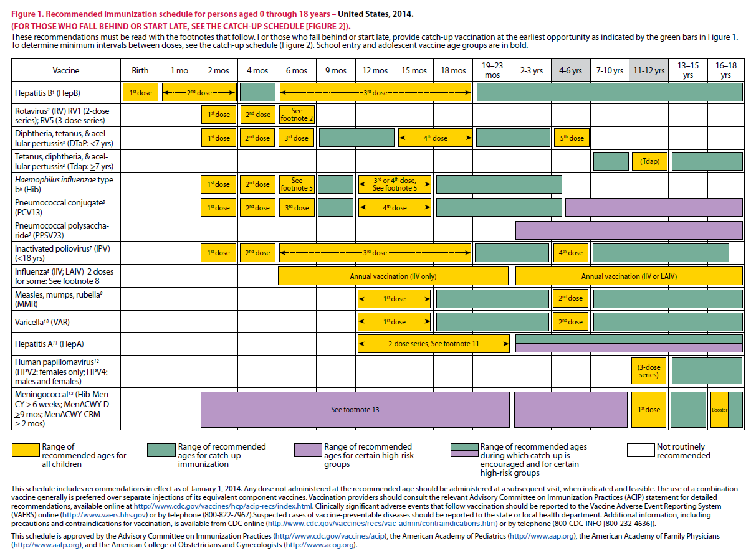
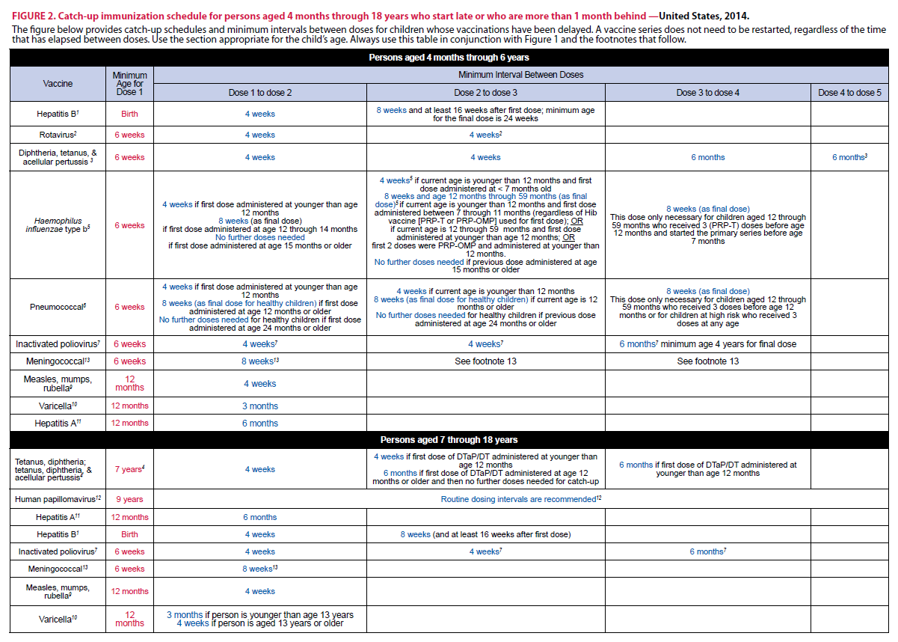
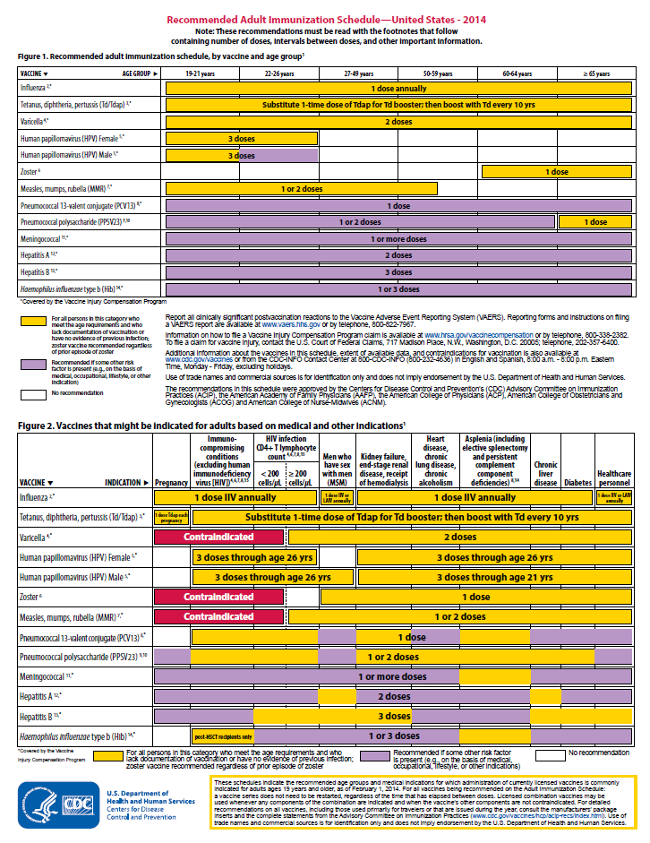
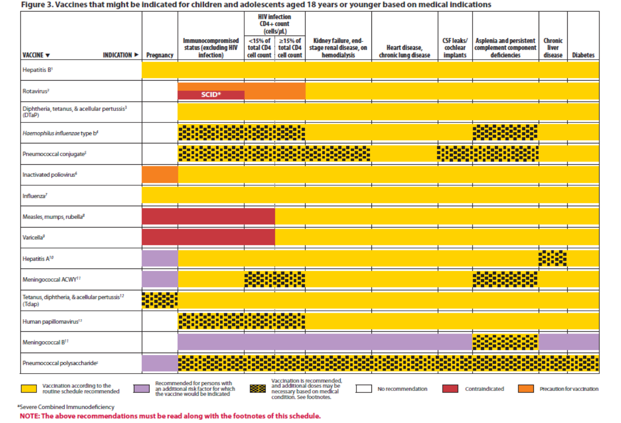
Immunization Schedule Updates
All staff must use the same
immunization schedule
Schedules:
  Children & Adolescents
  0 through 18 years
  Catch-up schedule for
  ages 4 months -18 years
  Children and Adolescents 18 years or younger based on medical indications
  Adult 19 years and older
  Adult based on medical
  and other indications
READ THE FOOTNOTES
http://www.cdc.gov/vaccines/schedules/hcp/child-adolescent.html
http://www.cdc.gov/vaccines/schedules/hcp/adult.html
Notes:
8
8
In October 2016, ACIP approved the 2017 Immunization Schedule for Children and Adolescents birth through 18 years, which became effective February 1, 2017.
It is important to remember that:
-All staff and providers should use the same immunization schedule
Schedules:
-Children & Adolescents aged 18 years or younger
-Catch-up schedule for ages 4 months -18 years
-Children and adolescents 18 years or younger based on medical indications (added in 2017)***
-Adult 19 years and older
-Adult based on medical and other indications
Always refer to and read the footnotes for additional guidance of the vaccines.

Slide 9
Notes:
We will look at the changes to the schedules.
Polio vaccine (New 02/17/2017) The January 13th and February 17, 2017 MMWRs provide additional guidance regarding assessment of poliovirus vaccination status and vaccination of children who have received poliovirus vaccine outside the United States. Specifically, the guidance provides information which offers additional clarification and changes impacting the IPV footnote in the 2017 catch-up schedule: (see footnotes for details)
We want to address specifically the Guidance for Assessment of Poliovirus Vaccination Status and Vaccination of Children Who Have Received Polio Vaccine Outside the United States”.
The errata will provide clarification that previous poliovirus vaccination is valid if a child’s documentation indicates receipt of IPV or tOPV. tOPV was used for routine poliovirus vaccination before April 1, 2016 in all OPV-using countries. Therefore, if a child has documentation of receipt of OPV doses (even if they are not marked “tOPV”) before April 1, 2016, the doses should be counted toward the U.S. vaccination schedule. The only exception to this would be if there is a specific notation a vaccine was administered during a vaccination campaign; in those instances, the dose would not count towards the U.S. vaccination requirements.
As Dr. Kroger also noted, providers do not need to inquire with parents (or do any other ascertainment) to determine whether the doses were given routinely or in campaigns. If the record does not indicate campaign, providers should look to see if there are dates which specify the precise dates the vaccine doses were administered. If the dates are before April 1, 2016, providers should count the doses. If the dates are on or after April 1, 2016, the doses should not be counted, and providers should administer IPV to complete the schedule according to the US IPV schedule. In almost all instances it is unlikely that an immunization record will note that a vaccine was administered during a campaign. Therefore the default in the face of uncertainty, as long as it was before April 1, 2016, is to assume the doses were routine doses.
Only trivalent OPV (tOPV) counts toward the U.S. vaccination requirements (tOPV was used for routine poliovirus vaccination in all OPV-using countries until April 1, 2016). See Guidance to assess doses documented as "OPV"(https://www.cdc.gov/mmwr/volumes/66/wr/mm6606a7.htm).
Diphtheria and tetanus toxoids and acellular pertussis vaccine The diphtheria and tetanus toxoids and acellular pertussis vaccine (DTaP) footnote was revised to more clearly present recommendations following an inadvertently early administered fourth dose of DTaP.
The tetanus and diphtheria toxoids and acellular pertussis vaccine (Tdap) footnote for vaccination of pregnant adolescents between gestational weeks 27–36 has been updated to reflect a preference for vaccination earlier during this period. Currently available data suggest that vaccinating earlier in the 27 through 36 week time period will maximize passive antibody transfer to the infant.
Hepatitis B vaccine Monovalent Hepatitis B vaccine should be administered within 24hr of birth for medically stable infants weighing ≥2,000 grams born to hepatitis B surface antigen (HBsAg)-negative mothers. (before it only stated before discharge). The recommendations for vaccination of infants <2,000 grams (as well as infants born to HBsAg-positive mothers or mothers whose hepatitis B status is unknown) remain unchanged. Preterm infants weighing <2,000 g born to HBsAg-negative mothers should receive the first dose of vaccine 1 month after birth or at hospital discharge.
Haemophilus influenzae type B vaccine Within the Haemophilus influenzae type b vaccine (Hib) footnote, Comvax was removed from the routine vaccination portion of footnote. This vaccine has been removed from the market, and all available doses have expired. Additionally, Hiberix has been added to the list of vaccines that may be used for the primary vaccination series.
Human papillomavirus vaccine A blue bar was added to the schedule for human papillomavirus vaccine (HPV) for children aged 9–10 years, indicating that persons in this age group may be vaccinated (even in the absence of a high-risk condition). The footnote for HPV vaccine has been updated to include the new 2-dose schedule for persons initiating the HPV vaccination series before age 15 years. Additionally, bivalent HPV vaccine has been removed from the schedule. This vaccine has been removed from the U.S. market, and all available vaccine doses have expired
Influenza vaccine Live attenuated influenza vaccine (LAIV) has been removed from the influenza row of the schedule. The influenza vaccine footnote has been updated to indicate that LAIV should not be used during the 2016-2017 influenza season.
Meningococcal vaccine The 16-year age column of the schedule has been separated from the 17–18-year age column to highlight the need for a meningococcal conjugate vaccine booster dose at age 16 years.
The meningococcal vaccines footnote has been updated to include recommendations for meningococcal vaccination of children with human immunodeficiency virus (HIV) infection and to reflect recommendations for the use of a 2-dose Trumenba (meningococcal B vaccine) schedule.
Pneumococcal vaccine Within the pneumococcal vaccine footnote, references to 7-valent pneumococcal conjugate vaccine (PCV7) have been removed. All healthy children who may have received PCV7 as part of a primary series have now aged out of the recommendation for pneumococcal vaccine

Slide 10
Notes:
Medical Conditions
A new figure, Figure 3 "Vaccines that might be indicated for children and adolescents aged 18 years or younger based on medical indications", has been added. This figure:
-Demonstrates most children with medical conditions can (and should) be vaccinated according to the routine child/adolescent immunization schedule.
-Indicates when additional doses of vaccines may be necessary because of a child's or adolescent's medical condition. Providers should consult the relevant footnotes for additional information
-Indicates when a medical condition is a precaution or contraindication to vaccination.

Slide 11
Indication
Recommendation
Requirement
Indication
  -Information about the appropriate use of the vaccine
Recommendation
  -ACIP statement that broadens and further delineates the Indication found in the package insert
  -Basis for standards for best practice
Requirement
  -Mandate by a state that a particular vaccine must be administered and documented before entrance to child care and/or school
Notes:
11
It is important that providers understand the difference between an indication, recommendation and a requirement when assessing immunization need.
An indication provides information about the appropriate use of the vaccines
EXAMPLE of an indication:
ADACEL vaccine is indicated for active booster immunization for the prevention of tetanus, diphtheria and pertussis as a single dose in persons 10 through 64 years of age.
BOOSTRIX® is indicated for active booster immunization against tetanus, diphtheria, and pertussis as a single dose in individuals 10 years and older.
The ACIP statement broadens and delineates the indication found in the package insert.
So an EXAMPLE of a recommendation:
The ACIP recommendation for Tdap would be, “Administer 1 dose of Tdap vaccine to all adolescents aged 11 through 12 years.” The recommendation may include other information and guidance on epidemiology of the disease, appropriate timing, dosage, contraindications to the vaccine and guidance for use in special populations. The recommendation appears first as “provisional recommendation” but once approved, it appears in the MMWR as a full recommendation.
Finally, a vaccine requirement is consistent with the ACIP Recommended Childhood and Adolescent Immunization Schedule and is a mandate by a state that a particular vaccine must be administered and documented before entrance to school or child care.
EXAMPLE of a state vaccine requirements:
Requirements are consistent with the Recommended Childhood and Adolescent Immunization Schedule. GA DPH rules and regulations state that children entering any school or child care facility in GA must be age appropriately immunized against each of these diseases: Hepatitis B, Diphtheria, Tetanus, Pertussis, Polio, Hib, Pneumococcus, Measles, Mumps, Rubella, Varicella, Hepatitis A and Meningococcal.

Slide 12
Observe the Guidelines
Calculating Intervals
4 weeks = 28 days
Intervals of 4 months or greater are determined by calendar months
Grace Period
≤ 4 days before minimal interval are valid
≥ 5 days earlier than minimum interval or minimum age not valid
Notes:
This slide is an example of the General Recommendations Guidelines; please be sure that your staff is familiar with the all of the General Recommendations.
The two examples listed here are an overview of observing the rules for calculating intervals and understanding the grace period.
Providers and patients encounter numerous issues, such as timing of each dose, screening for contraindications and precautions, the number of vaccines to be administered, the educational needs of patients and parents, and interpreting and responding to adverse events. All of this information and more can be found in the General Recommendations on Immunizations.
Minimum Time and Age Intervals:
-For purposes of calculating intervals between doses, 4 weeks = 28 days. Intervals of 4 months or greater are determined by calendar months.
Violation of minimum time and age intervals/grace period:
-Vaccine doses administered less than or equal to 4 days before the minimum interval are considered valid. Doses of any vaccine administered greater than or equal to 5 days earlier than the minimum interval or minimum age should not be counted as valid doses and should be repeated as age-appropriate. The repeat dose should be spaced after the invalid dose by the recommended minimum interval.
Luckily, we have our GRITS registry that helps to forecast vaccines needed using algorithms based on ACIP recommendations. Please refer to the General recommendations to review of all the guidelines list on Table 1.
General Recommendations:
Simultaneous Administration
Non-Simultaneous Administration
Two live-vaccines
Violation of minimal time interval for live vaccines
Minimum time and age intervals
Violation of minimum time and age intervals/grace period
Administration of vaccines later than recommended schedule
Vaccine Administration principles
Administering combination vaccines
Contraindications and Precautions

Slide 13
Test Your Knowledge!
If 2 different live injectable vaccines are given < (less than) 28 days apart, the one given second should be what?
IAC Ask the Experts - Reviewed July 2014
Notes:
If 2 different live injectable vaccines are given < 28 days apart, the one given second should be what?

Slide 14
Test Your Knowledge!
If 2 different live injectable vaccines are given < (less than) 28 days apart, the one given second should be what?
The second or invalid dose should be repeated greater than or equal to 28 days after the second or invalid dose.
IAC Ask the Experts - Reviewed July 2014
Notes:
The second or invalid dose should be repeated greater than or equal to 28 days after the second or invalid dose.

Slide 15
“It’s The Law”
Notes:
Ask the audience when should the VIS be given to a patient and to see how many different responses you receive.
After a provider has determined the vaccines recommended for a patient the next step is to provide the patient with a Vaccine Information Statement.
As required under the National Childhood Vaccine Injury Act, all health care providers in the US who administer to any child or adult, any of the following vaccines diphtheria, tetanus, pertussis, measles, mumps, rubella, polio, hepatitis A & B, HIB, influenza, pneumococcal, meningococcal, rotavirus, HPV and varicella shall, prior to administration of each dose of the vaccine, provide a copy to keep of the relevant current edition vaccine information materials that have been produced by the CDC.
Presenter may include a copy of the handout for the Top 10 facts about the VIS to review with staff.
The top 10 facts about VIS are:
-It’s federal law, VIS are required for both public and private sectors, VIS must be provided before vaccine administered, must provide current VIS for each dose of vaccine, must provide VISs for combination vaccines too, VISs are available in other formats, including 30 languages (you may use laminated copies of VISs for patients and parents to read and return before leaving the clinic, but you must also offer the patient/parent a printed copy of the VIS to take home. If they prefer to download the VIS onto a mobile device, direct them to CDC’s VIS mobile Downloads web page: http://m.cdc.gov/VIS. Federal law does not require signed consent in order for a person to be vaccinated. To verify that a VIS was given, providers must record in the patient’s chart the published date of VIS, date the VIS was given, name, address and title of the person who administers vaccine, date vaccine administered, and vaccine manufacturer and lot number of each dose administered. VISs should not be altered. Provide VISs to all patients.

Slide 16
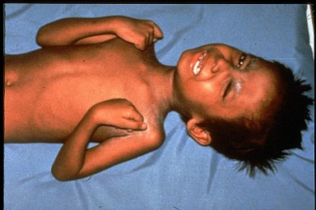
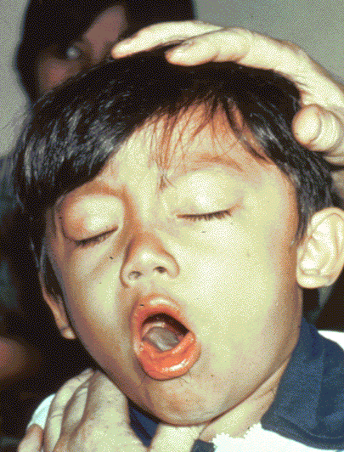

Diphtheria, Tetanus and Pertussis Vaccines
ACIP recommends:
  A 5 dose series of DTaP: Administered at 2, 4, 6, 15-18 months and
  4-6 years (Do not administer after age 6)
one dose of Tdap:
  For children and adolescents starting at 11 or 12 years of age
  For all adults aged 19 years and older who have not had Tdap previously
MMWR, September 23, 2011, Vol 60, #37 MMWR, January 14, 2011, Vol 60, #01 MMWR, June 29, 2012 Vol 61, #25
Notes:
Presenter may use one-pagers to discuss vaccine usage.
ACIP recommends:
Administer a 5-dose series of DTaP vaccine at ages 2, 4, 6, 15 through 18 months, and 4 through 6 years. The fourth dose may be administered as early as age 12 months, provided at least 6 months have elapsed since the third dose.
Inadvertent administration of fourth DTaP dose early; If the fourth dose of DTaP was administered at least 4 weeks after the third dose of DTaP and the child was 12 months of age or older, it does not need to be repeated.
One dose of Tdap:
For children and adolescents starting at 11 or 12 years of age; Tdap can be administered regardless of the interval since the last tetanus and diphtheria toxoid-containing vaccine; The new recommendations also clarify that children age 7 through 10 years who receive Tdap as part of a catch-up series may be given an additional Tdap for the routinely recommended adolescent dose at 11-12 years of age.**
For all adults aged 19 years and older who have not had Tdap previously; For adults 65 years and older Boostrix should be used, when feasible; however, either vaccine product provides protection and is considered valid.
Boostrix is licensed for persons 10 years and older
Adacel is licensed for persons 10 through 64 years
Required for school and child care attendance
The diphtheria germ lives in the throat and mouth of the infected person.
The disease is spread through direct contact with the infected person.
Now we don’t see as much of this disease in the United States.
The tetanus germ lives in dirt and the intestines and the feces of animals
The germ enters the body through cuts, punctures, burns, and other wounds.
However, there are still outbreaks throughout the world, and the danger is for an international traveler to bring infection into the US.
Most cases of tetanus reported occur in adults who have not been immunized or who are under immunized; i.e., they have not received boosters to maintain a level of protection.
The pertussis germ lives in the mouth, nose, and throat of the infected person.
The germ is spread from person to person by coughing and sneezing.
Pertussis vaccine is given to prevent pertussis in infants and children.
Other complications include pneumonia, seizures, and death. Adults may also get pertussis, but they usually do not get very sick and may not be aware they have the disease.

Slide 17
Tdap for Pregnant Women
ACIP recommends:
One dose of Tdap each pregnancy
Optimal timing early in the 27 through 36 week gestation window
If not given during pregnancy; administer immediately postpartum
Ref: Advisory Committee on Immunization Practices. Updated ACIP statement for pertussis, tetanus and diphtheria vaccines presented by Jennifer L. Liang, October 19, 2016.
Notes:
Guidance on use of Tdap products for pregnant women:
ACIP Recommends:
All pregnant women should receive a dose of Tdap during each pregnancy, irrespective of prior history of receiving Tdap. As stated, in October, ACIP voted to recommend administering Tdap vaccination early in the 27 through 36 week “window” to maximize passive antibody transfer to the infant. If a dose is given early in that same pregnancy, do NOT repeat it at 27-36 weeks. If not given during pregnancy, give Tdap immediately postpartum.
References:
1. Advisory Committee on Immunization Practices. Updated ACIP statement for per
2. MMWR, February 22, 2013, Vol 62, #7
3. www.immunize.org, Ask the Experts, Tetanus section, IAC, Sept. 2013

Slide 18
Test Your Knowledge!
Twelve month old Lucas was given his fourth dose of DTaP 4 months after his third dose of DTaP, does it need to be repeated?
What should be done?
IAC Ask the Experts - Reviewed July 2014
Notes:
Twelve month old Lucas was given his fourth dose of DTaP 4 months after his third dose of DTaP, does it need to be repeated?
In the case of inadvertent early administration of the fourth DTaP dose; If the fourth dose of DTaP was administered at least 4 months after the third dose of DTaP and the child was 12 months of age or older, it does not need to be repeated.

Slide 19
Test Your Knowledge!
Twelve month old Lucas was given his fourth dose of DTaP 4 months after his third dose of DTaP, does it need to be repeated?
What should be done?
No, In the case of inadvertent early administration of the fourth DTaP dose; If the fourth dose of DTaP was administered at least 4 months after the third dose of DTaP and the child was 12 months of age or older, it does not need to be repeated.
IAC Ask the Experts - Reviewed July 2014
Notes:
Twelve month old Lucas was given his fourth dose of DTaP 4 months after his third dose of DTaP, does it need to be repeated?
In the case of inadvertent early administration of the fourth DTaP dose; If the fourth dose of DTaP was administered at least 4 months after the third dose of DTaP and the child was 12 months of age or older, it does not need to be repeated.

Slide 20
Test Your Knowledge!
Logan is a 7 year old boy who was not fully immunized with DTaP and received 1 dose of Tdap in the catch-up series. Can he receive an additional dose of Tdap vaccine at 11 through 12 years?
Ref: Recommended Immunization Schedule for Children and Adolescents Aged 18 years or younger, United States, 2017
Notes:
Logan is a 7 year old boy who was not fully immunized with DTaP and received 1 dose of Tdap in the catch-up series. Can he receive an additional dose of Tdap vaccine at 11 through 12 years?
Yes, he can receive an adolescent Tdap vaccine dose at age 11 through 12 years.
Catch-up vaccination:
-Persons aged 7 years and older who are not fully immunized with DTaP vaccine should receive Tdap vaccine as 1 dose (preferably the first) in the catch-up series; if additional doses are needed, use Td vaccine. For children 7 through 10 years who receive a dose of Tdap as part of the catch-up series, an adolescent Tdap vaccine dose at age 11 through 12 years may be administered.
Additional Information:
-Persons aged 11 through 18 years who have not received Tdap vaccine should receive a dose, followed by tetanus and diphtheria toxoids (Td) booster doses every 10 years thereafter.
Inadvertent doses of DTaP vaccine:
-If administered inadvertently to a child aged 7 through 10 years, the dose may count as part of the catch-up series. This dose may count as the adolescent Tdap dose, or the child may receive a Tdap booster dose at age 11 through 12 years.
-If administered inadvertently to an adolescent aged 11 through 18 years, the dose should be counted as the adolescent Tdap booster.

Slide 21
Test Your Knowledge!
Logan is a 7 year old boy who was not fully immunized with DTaP and received 1 dose of Tdap in the catch-up series. Can he receive an additional dose of Tdap vaccine at 11 through 12 years?
Yes, he can receive an adolescent Tdap vaccine dose at age 11 through 12 years.
Ref: Recommended Immunization Schedule for Children and Adolescents Aged 18 years or younger, United States, 2017
Notes:
Logan is a 7 year old boy who was not fully immunized with DTaP and received 1 dose of Tdap in the catch-up series. Can he receive an additional dose of Tdap vaccine at 11 through 12 years?
Yes, he can receive an adolescent Tdap vaccine dose at age 11 through 12 years.
Catch-up vaccination:
-Persons aged 7 years and older who are not fully immunized with DTaP vaccine should receive Tdap vaccine as 1 dose (preferably the first) in the catch-up series; if additional doses are needed, use Td vaccine. For children 7 through 10 years who receive a dose of Tdap as part of the catch-up series, an adolescent Tdap vaccine dose at age 11 through 12 years may be administered.
Additional Information:
-Persons aged 11 through 18 years who have not received Tdap vaccine should receive a dose, followed by tetanus and diphtheria toxoids (Td) booster doses every 10 years thereafter.
Inadvertent doses of DTaP vaccine:
-If administered inadvertently to a child aged 7 through 10 years, the dose may count as part of the catch-up series. This dose may count as the adolescent Tdap dose, or the child may receive a Tdap booster dose at age 11 through 12 years.
-If administered inadvertently to an adolescent aged 11 through 18 years, the dose should be counted as the adolescent Tdap booster.

Slide 22







Cocooning Strategy
Parents
Siblings
Child Care Provider
Healthcare Worker
Grandparents
Notes:
Remind staff to take advantage of immunizing all family members when they present to your locations. Discuss the cocooning strategy.
Babies younger than 6 months old are more likely to develop certain infectious diseases than older children.
Cocooning is a way to protect babies from catching diseases from the people around them – people like their
parents, siblings, grandparents, friends, child-care providers, babysitters, and healthcare providers. Once these people are vaccinated, they are less likely to spread these contagious diseases to the baby. They surround the baby with a cocoon of protection against disease until he or she is old enough to get all the doses of vaccine needed to be fully protected. Everyone has the opportunity to protect babies by getting vaccinated themselves. Cocooning is an easy and effective way that people can work together to prevent the spread of whooping cough and flu to babies.

Slide 23
Hepatitis B Vaccine
Dose 1 @ birth
Dose 2 @ 4 months of age
  at least 1 month after first dose
Dose 3 @ 6-18 months of age:
  Minimum of 4 months after the first dose
  Minimum of 2 months after the second dose but not before an infant is 24 weeks of age
Notes:
On October 19, 2017, ACIP voted to approve a new guidance document that consolidates all previously published recommendations into a comprehensive statement. The committee reemphasized the importance of the Hep B birth dose as a safety net against chronic HBV infection, now recommending that all newborns of HBsAg-negative (hepatitis B surface antigen negative) mothers should be vaccinated with Hep B vaccine within 24 hours of birth. This removes previous policy language that allowed for a delay in administering the birth dose in certain rare circumstances and on a case-by-case basis.
Dose 2 at 4 months; at least 1 month after first dose
Dose 3 at 6-18 months; minimum of 4 months after the first dose; minimum of 2 months after the second dose, but not before an infant is 24 weeks of age
Required for child care and school attendance
Review Hepatitis B virus:
Hepatitis B is a serious liver disease caused by a virus. Your can get infected with hepatitis B if you come in contact with an infected person’s blood or other body fluids. Babies can get the virus from their infected mothers at birth or if they live with or are cared for by an infected person. The virus can be spread just by sharing a toothbrush with an infected person. For some people, the virus remains in their body for years. During this time, the virus can attack the liver and cause serious problems like liver failure or cancer.

Slide 24
Hepatitis B
Transmission:
ACIP recommends hepatitis B vaccine also for:
All children and adolescents less than 19 years of age who did not complete the series as an infant.
All adults at risk for hepatitis B infection, including those aged 19 through 59 years with diabetes mellitus
Persons of any age at risk for infection by sexual exposure
All other adults seeking protection from HBV infection.
MMWR, December 23, 2005, Vol 54, #RR16 MMWR, December 8, 2006, Vol 55, #RR16 MMWR, December 22, 2011 Vol 60 #50
Notes:
Optional Slide
Hepatitis transmission from percutaneous or mucosal exposure to blood or body fluids including contaminated surfaces, or exposure by sexual contact or perinatal infection from HBsAg+ mothers. Incubation period from time of infection to onset of symptoms is 45 to 160 days (average, 90 days). Approximately 10% of acute hepatitis B infections progress to chronic Hepatitis B infection. 90% of infants and 30-50% of children 1-5 years of age with acute hepatitis B infection become carriers. Many with chronic infection are asymptomatic. Chronic infection may progress to cirrhosis, liver failure & hepatocellular carcinoma.
ACIP recommends hepatitis B vaccine for:
-All newborns before discharge from the nursery using single antigen vaccine and completion of the series per schedule.
-All children and adolescents less than 19 years of age who did not complete the series as an infant.
-All adults at risk for hepatitis B infection, including those aged 19 through 59 years with diabetes mellitus
-Persons of any age at risk for infection by sexual exposure
-All other adults seeking protection from HBV infection.
References:
1. A Comprehensive Immunization Strategy to Eliminate Transmission of Hepatitis B Virus Infection in the United States. Recommendations of the Advisory Committee on Immunization Practices (ACIP) Part 1: Immunization of Infants, Children and Adolescents MMWR Vol. 54/ No. RR-16 December 23, 2005
2. A Comprehensive Immunization Strategy to Eliminate Transmission of Hepatitis B Virus Infection in the United States. Recommendations of the Advisory Committee on Immunization Practices (ACIP) Part 2: Immunization of Adults MMWR Vol. 55/ No. RR-16 December 8, 2006

Slide 25
Hepatitis A Vaccine
ACIP recommends 2 doses of hepatitis A vaccine
for:
All children 12 through 23 months of age
Any child or adolescent 2 through 18 years, not previously vaccinated
Caretakers who will have contact with adoptees from countries with high rates of hepatitis A
MMWR, May 19, 2006, Vol 55, #RR-07
Notes:
Required for child care attendance
Presenter may use Hep A one-pager while discussing slide.
Hepatitis A is a serious liver disease caused by a virus. The virus is found in the feces (poop) of infected people. The hepatitis A virus is spread when invisible particles of feces (poop) get into a person’s mouth. You can get hepatitis A by eating contaminated food or drinking contaminated water, during sex, or just by living with an infected person. Hepatitis A can your skin and eyes turn yellow. You can get very sick for weeks, need to be hospitalized, and even die. Some people don’t look or feel sick, but they can still spread hepatitis A to others. Everyone is at some risk for getting infected with hepatitis A. People who travel outside the U.S. have an increased chance of getting infected.
Optional information:
The nature of hepatitis A disease is that it is cyclical. Children plan an important role in HAV transmission. Symptomatic infection is uncommon in children, so they may be a source of infection for household or other close contacts. Almost half of persons with hepatitis A do not have an identified source of their infection. Groups of persons at risk for hepatitis A are international travelers, men who have sex with men, and illegal drug users. Food handlers are not at risk.
ACIP recommends 2 doses of hepatitis A vaccine for:
-All children 12 through 23 months of age
(Separate the 2 doses by 6 to 18 months)
-Any child or adolescent 2 through 18 years, who has not previously received the vaccine, can receive the vaccine at subsequent visits.
-Caretakers who will have contact with adoptees from countries with high rates of hepatitis A if contact will be within 60 days of arrival in U.S. The first dose of the 2-dose series should be given as soon as adoption is planned.
For others at risk, the hepatitis A vaccine series may be started whenever a person wishes to be protected or is at risk of infection. For travelers, it is best to start the vaccine series at least one month before traveling. (Some protection may still result if the vaccine is given on or closer to the travel date.) Some people who cannot get the vaccine before traveling, or for whom the vaccine might not be effective, can get a shot called immune globulin (IG). IG gives immediate, temporary protection.
Prevention of Hepatitis A Through Active or Passive Immunization - Recommendations of the Advisory Committee on Immunization Practices (ACIP) MMWR Vol. 55/No. RR-7 May 19, 2006

Slide 26
Hepatitis A Vaccine for Adults
ACIP recommends:
      Those traveling or working in countries with high or intermediate endemicity of infection
      Men who have sex with men
      Users of injecting and non-injecting drugs
      Persons working with HAV positive primates or with HAV in research laboratory settings
MMWR, May 19, 2006, Vol 55, #RR-07 MMWR, September 18, 2009, Vol 58 #36
Notes:
ACIP recommends hepatitis A vaccine for adults who are at high-risk of acquiring hepatitis A infection:
Those traveling or working in countries with high or intermediate endemicity of infection
Men who have sex with men
Users of injecting and non-injecting drugs
Persons working with HAV positive primates or with HAV in research laboratory settings
For others at risk, the hepatitis A vaccine series may be started whenever a person wishes to be protected or is at risk of infection. For travelers, it is best to start the vaccine series at least one month before traveling. (Some protection may still result if the vaccine is given on or closer to the travel date.) Some people who cannot get the vaccine before traveling, or for whom the vaccine might not be effective, can get a shot called immune globulin (IG). IG gives immediate, temporary protection.
References:
1. Prevention of Hepatitis A Through Active or Passive Immunization - Recommendations of the Advisory Committee on Immunization Practices (ACIP) MMWR Vol. 55/No. RR-7 May 19, 2006
2. Notice to Readers: FDA Approval of an Alternate Dosing Schedule for a Combined Hepatitis A and B Vaccine (Twinrix®) MMWR 56(40);1057 October 12, 2007
3. Updated Recommendations from the Advisory Committee on Immunization Practices (ACIP) for Use of Hepatitis A Vaccine in Close Contacts of Newly Arriving International Adoptees MMWR 58(36);1006-1007 September 18, 2009

Slide 27
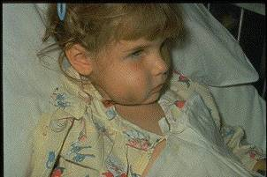
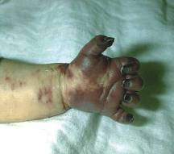
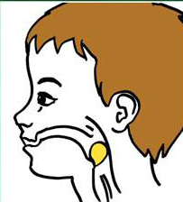
Haemophilus influenzae type b (Hib)
ACIP recommends:
3-4 doses of Hib (depending on brand)
  Dose 1 @ 2 months of age
  Dose 2 @ 4 months of age
  Dose 3 @ 6 months of age
  (Not required if Pedvax HIB® is administered at 2 and 4 months of age)
  Booster dose at 12 through 15 months of age
**Hiberix has been added to the list of vaccines that may be used for the primary vaccination series.
**Adult special populations
MMWR, February 28, 2014, Vol 63, #RR01
Notes:
Presenter may use Hib one-pager to discuss and review slide.
What causes Hib disease? Hib disease is caused by a bacterium, Haemophilus influenzae type b. There are six different types of these bacteria (a through f). Type b organisms account for 95% of all strains that cause invasive disease, and this is the type against which the Hib vaccine
protects.
How does Hib disease spread? Hib disease is spread person-to-person by direct contact or through respiratory droplets. Usually the organisms
remain in the nose and throat, but occasionally the bacteria spread to the lungs or bloodstream and cause a serious infection in the individual.
How serious is Hib disease? Hib disease can be very serious. The most common type of invasive Hib disease is meningitis, an infection of the membranes covering the brain (50%–65% of cases).
ACIP recommends:
3-4 doses of Hib (depending on brand)
Dose 1 @ 2 months of age
Dose 2 @ 4 months of age
Dose 3 @ 6 months of age
(Not required if Pedvax HIB® is administered at 2 and 4 months of age)
-Booster dose at 12 through 15 months of age
-Unvaccinated children aged 15-59 months, administer one dose
-One dose of Hib for unimmunized persons 5 through 18 years who have asplenia, sickle cell disease or HIV infection
Required for school and child care attendance
Haemophilus influenzae type B vaccine updates: Within the Haemophilus influenzae type b vaccine (Hib) footnote, Comvax was removed from the routine vaccination portion of footnote. This vaccine has been removed from the market, and all available doses have expired. Additionally, Hiberix has been added to the list of vaccines that may be used for the primary vaccination series.
Special populations:
Adults who have anatomical or functional asplenia or sickle cell disease, or are undergoing elective splenectomy should receive 1 dose of Hib if they have not previously received Hib. Hib should be administered at least 14 days before splenectomy. Adults with a hematopoietic stem cell transplant (HSCT) should receive 3 doses of Hib in at least 4 week intervals 6-12 months after transplant regardless of their Hib history. Hib is not routinely recommended for adults with HIV infection because their risk for Haemophilus influenzae type b infection is low.

Slide 28
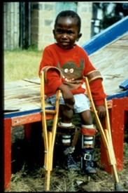
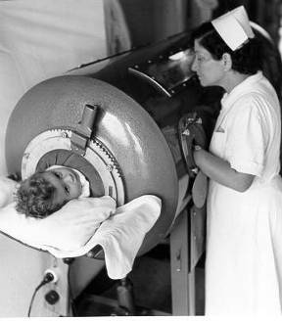
Polio
ACIP recommends:
4- dose series at 2, 4, 6 through 18 months, and 4 through 6 years
Final dose after the fourth birthday and at least 6 months after the previous dose
Evaluate travelers for the need of polio vaccine if traveling to endemic countries.
Notes:
Pictures show a child in an iron lung due to weak respiratory muscles (common in polio era) and a child with muscle weakness, as a result of polio, requiring the assistance of braces and crutches in order to walk.
Polio, also called poliomyelitis and infantile paralysis is caused by an Enterovirus (Serotypes 1,2,3)
Infection acquired through mouth, virus replicates in pharynx and GI tract, then spreads to lymphatics and other tissues.
Attacks motor neurons in spinal cord & brain stem
in 2015, Nigeria was removed from the list of polio-endemic countries. The only 2 polio endemic countries now are Pakistan and Afghanistan. Remind staff to evaluate travelers for the need of polio vaccine if traveling to endemic countries.
ACIP recommends:
Four dose series of IPV at : 2, 4, 6 through 18 months and 4 through 6 years of age. Final dose after fourth birthday and at least 6 months after the previous dose
A booster dose may be recommended, depending on length of stay and the timing of the last dose of polio vaccine, for persons traveling to countries experiencing polio outbreaks.
For additional information about polio refer to: Epidemiology and Prevention of Vaccine-Preventable Diseases, 13th edition 2015. HHS, CDC.
(New 02/17/2017) The January 13 and February 17, 2017 MMWRs provide additional guidance regarding assessment of poliovirus vaccination status and vaccination of children who have received poliovirus vaccine outside the United States. View the complete guidance(https://www.cdc.gov/mmwr/volumes/66/wr/mm6601a6.htm).
Specifically, the guidance provides information which offers additional clarification and changes impacting the IPV footnote in the 2017 catch-up schedule:
If both OPV and IPV were administered as part of a series, the total number of doses needed to complete the series is the same as that recommended for the U.S. IPV schedule. A minimum interval of 4 weeks should separate doses in the series, with the final dose administered on or after the fourth birthday and at least 6 months after the previous dose.
If only OPV was administered, and all doses were given before age 4 years, 1 dose of IPV should be given at 4 years or older and at least 6 months after the last OPV dose. This 6-month period is a change from the current footnote which indicates the period is 4 weeks after the last OPV dose. Only trivalent OPV (tOPV) counts toward the U.S. vaccination requirements (tOPV was used for routine poliovirus vaccination in all OPV-using countries until April 1, 2016). See Guidance to assess doses documented as "OPV"(https://www.cdc.gov/mmwr/volumes/66/wr/mm6606a7.htm).
Previous poliovirus vaccination is valid if documentation indicates receipt of IPV or tOPV. tOPV was used for routine poliovirus vaccination before April 1, 2016 in all OPV-using countries. Therefore, if a child has documentation of receipt of an OPV dose (rather than “tOPV”) before April 1, 2016, this represents a tOPV dose and should be counted towards the U.S. vaccination schedule, unless specifically notated that it was administered during a vaccination campaign.* Consistent with the polio eradication strategy, doses of OPV administered on or after April 1, 2016 are either bOPV (used in routine vaccination and campaigns), or mOPV (used in a type-specific outbreak response); these doses do not count towards the U.S. vaccination requirements for protection against all three poliovirus types. Persons aged <18 years with doses of OPV that do not count towards the U.S. vaccination requirements should receive IPV to complete the schedule according to the U.S. IPV schedule.* mOPV or bOPV were often used in vaccination campaigns but doses administered during vaccination campaigns are not typically recorded in parent-held records. These doses do not count towards the U.S. vaccination requirements.

Slide 29
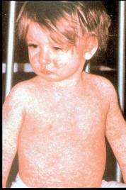
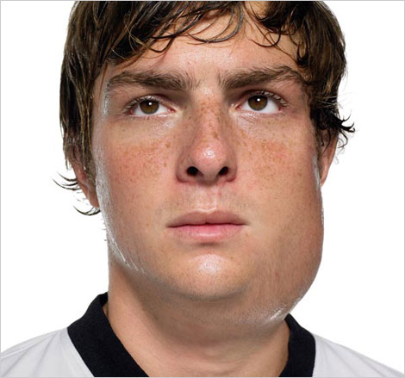
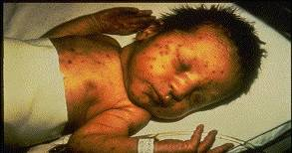
Measles, Mumps, Rubella
ACIP recommends:
2- dose series at ages 12 through 15 months and 4 through 6 years
at least 4 weeks between first and second dose
MMWR, June 14, 2013, Vol 62, #RR-04
Notes:
MEASLES (caused by paramyxovirus); Slide shows child with typical measles rash and conjunctivitis
MUMPS (caused by paramyxovirus); Slide shows an adolescent with parotitis due to mumps; Parotitis (inflammation of parotid gland) occurs in 30-40% of infected persons, 40-50% have only nonspecific or respiratory symptoms; Complications include aseptic meningitis, & deafness; Post pubertal individuals may have orchitis (inflammation of testicles), ovarian inflammation, & pancreatitis
RUBELLA (Caused by rubella virus and spread from person to person {togavirus}); In children, the rash may be the first manifestation of infection. Adults may have low-grade fever, malaise, URI, and lymphadenopathy prior to rash. Arthralgia and arthritis is common in adults, especially women. Complications include encephalitis and hemorrhagic manifestations
Rubella is no longer endemic in the U.S. However, it is still present in other countries and can be imported
CONGENITAL RUBELLA Slide shows an adult and child with a typical rash from rubella and an infant with congenital rubella syndrome Infant was infected in utero and has “blueberry muffin spots” on skin due to petechial lesions, cataracts, hearing loss and congenital heart lesion and will most likely be developmentally delayed.
All woman of child bearing age should be certain they are immune to rubella.
Children should get 2 doses of MMR vaccine:
-First Dose: 12–15 months of age
-Second Dose: 4–6 years of age; may be given earlier, if at least 28 days (4 weeks) after the 1st dose
-Some infants younger than 12 months should get a dose of MMR if they are traveling out of the country. (This
dose will not count toward their routine series.)
-Children between 1 and 12 years of age can get a “combination” vaccine called MMRV, which contains both MMR and varicella (chickenpox) vaccines
Required for school and child care attendance: Acceptable evidence of immunity to measles, mumps, or rubella in adults is: born before 1957, documentation of receipt of MMR, or laboratory evidence of immunity of disease. Documentation of healthcare provider-diagnosed disease without laboratory confirmation is not acceptable evidence of immunity. Birth date not acceptable evidence of rubella immunity for women who could become pregnant
Adults born in 1957 or later without acceptable evidence of immunity to measles, mumps, or rubella should receive 1 dose of MMR unless they have a medical contraindication to the vaccine, e.g., pregnancy or severe immunodeficiency

Slide 30
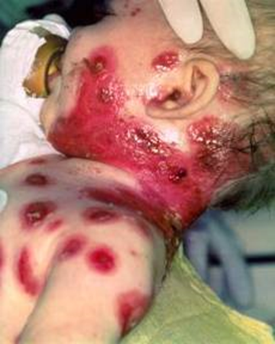
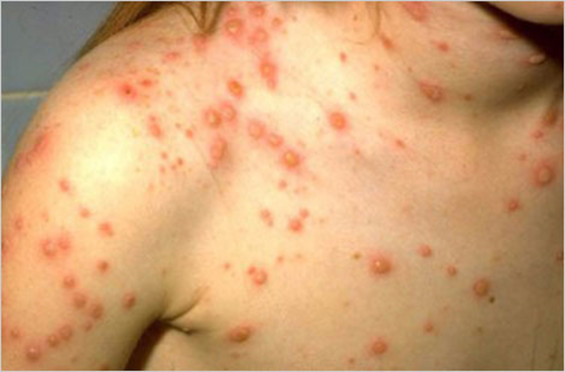
Varicella
ACIP recommends:
2-dose series at 12 through 15 months and 4 through 6 years
Second dose may be administered before age 4 years, provided 3 months have elapsed since the first dose
Notes:
Presenter may use varicella one-pager with reviewing slide.
Chicken pox is an illness caused by the varicella zoster virus. It was one an almost universal childhood experience. Now it’s much less common in the U.S. owing to widespread vaccination.
Why get vaccinated?
It is usually mild, but it can be serious, especially in young infants and adults. Most people who get chickenpox vaccine will not get chickenpox. But if someone who has been vaccinated does get chickenpox, it is usually very mild. They will have fewer blisters, are less likely to have a fever, and will recover faster. This slide shows an adolescent with a typical varicella rash and infant with secondary bacterial infected varicella lesions, probably due to staph or strep.
ACIP recommends:
Children who have never had chickenpox should get 2 doses of chickenpox vaccine at these ages:
1st Dose: 12–15 months of age
2nd Dose: 4–6 years of age (may be given earlier, if at least 3 months after the 1st dose); If the second dose was administered at least 4 weeks after the first dose, it can be accepted as valid.
Catch-up
Ensure that all persons aged 7 through 18 years without evidence of immunity have 2 doses of varicella vaccine. For children aged 7 through 12 years, the recommended minimum interval between doses is 3 months (if the second dose was administered at least 4 weeks after the first dose, it can be accepted as valid); for persons aged 13 years and older, the minimum interval between doses is 4 weeks.
Required for school and child care attendance
Reference: Prevention of Varicella - Recommendations of the Advisory Committee on Immunization
Practices (ACIP) MMWR (2007);56(No. RR-4):23

Slide 31
Acceptable Evidence of
Varicella Immunity
Written documentation of age-appropriate vaccination
Laboratory evidence of immunity or laboratory confirmation of varicella disease
U.S.-born before 1980*
Healthcare provider diagnosis or verification of varicella disease
History of herpes zoster based on healthcare provider diagnosis.
* Birth year immunity criterion does not apply to healthcare personnel or pregnant women
MMWR 2007;56(RR-4); 16-17
Notes:
Evidence of immunity to varicella includes any of the following:
•Documentation of age-appropriate varicella vaccination; ◦Preschool-age children (i.e., age 12 months through 3 years): 1 dose
◦School-age children, adolescents, adults: 2 doses
•Laboratory evidence of immunity or laboratory confirmation of disease
•Birth in the United States before 1980 (Should not be considered evidence of immunity for health care personnel, pregnant women, and immunocompromised persons)
•Diagnosis or verification of a history of varicella or herpes zoster by a health care provider
To verify a history of varicella, health care providers should inquire about:
•an epidemiologic link to another typical varicella case or to a laboratory confirmed case, or
•evidence of laboratory confirmation, if testing was performed at the time of acute disease
Persons who have neither an epidemiologic link nor laboratory confirmation of varicella should not be considered as having a valid history of disease. For these persons, a second dose of vaccine is recommended if they previously received only one dose. If a health care provider verifies the diagnosis based on the above criteria, then vaccination is not needed.

Slide 32
MMRV (ProQuad®)
Licensed for ages 12 months through 12 years
Dose 1 at ages 12 through 47 months
Either MMR and varicella vaccines or MMRV vaccine can be used.
Consider benefits and risks of both vaccination options
CDC recommends that MMR vaccine and varicella vaccines should be administered for the first dose in this age group.
Dose 1 or 2 given at ages 48 months and older
MMRV vaccine generally is preferred over separate injections of its equivalent component vaccines (i.e., MMR and varicella vaccines).
MMWR, May 7, 2010, Vol 59, #RR03
Notes:
Presenter may use MMRV one-pager while reviewing slide.
Dose 1 at ages 12 through 47 months
Either MMR and varicella vaccines or MMRV vaccine can be used.
Providers who are considering administering MMRV should discuss the benefits and risks of both vaccination options with the parent or caregiver, since MMRV can lead to 1 extra febrile seizure for every 2300-2600 vaccinations.
Unless the parent or caregiver expresses a preference for MMRV vaccine, CDC recommends that MMR vaccine and varicella vaccines should be administered for the first dose in this age group.
Dose 1 or 2 given at ages 48 months and older
MMRV vaccine generally is preferred over separate injections of its equivalent component vaccines (i.e., MMR and varicella vaccines). MMRV should not be administered to persons 13 years of age or older.
MMRV is not for use in persons with HIV infection.
Other MMRV Vaccine-related Guidance
New precaution for MMRV Vaccine Use
A personal or family (i.e., sibling, parent) history of seizures is a precaution for MMRV vaccination. Studies suggest that children who have a personal or family history of febrile seizures or family history of epilepsy are at increased risk for febrile seizures compared with children who do not have such histories. Children with a personal or family history of seizures generally should be vaccinated with MMR and varicella vaccines because the risks of using MMRV vaccine in this group of children generally outweigh the benefit of MMRV vaccine.
CDC has developed materials to help with the implementation of the updated recommendations for use of MMRV vaccine:
www.cdc.gov/vaccines/vpd-vac/combo-vaccines/mmrv/vacopt.htm
* The 47 month cut-off was chosen on the basis of the epidemiology of febrile seizures: first febrile seizures are uncommon after age 4 years, approximately 94% of febrile seizures occur in children aged less than 4 years.
† Provider assessment should include the number of injections, vaccine availability, likelihood of improved coverage, likelihood of patient return, and storage and cost consideration.

Slide 33
Spacing of Live Virus Vaccines and Other Products
PPD and live virus vaccine
  Apply PPD at same visit as MMR
  If MMR given first, delay PPD 4 weeks or longer
  Apply PPD first, then give MMR when skin test read
Spacing with antibody-containing products such as immune globulin (IG)
Notes:
PPD and live virus vaccine (using MMR as an example)
Apply PPD at same visit as MMR
Delay PPD 4 weeks or longer if MMR given first
Apply PPD first then give MMR when skin test read
This spacing will reduce the possibility of a false negative interpretation of the skin test.
Spacing with antibody-containing products such as immune globulin (IG)
---Antibody containing products (for example immune globulin) interact less with inactivated vaccines than with live vaccines. Administering inactivated vaccines either simultaneously or at any time interval before or after receiving an antibody containing product should not impair the immune response. The vaccine and antibody product should be administered at different sites using the standard recommended dose.
---Recommended intervals between receipt of various blood products and measles-containing vaccine and varicella vaccine are listed in Table 4 of the ACIP’s General recommendations on Immunization dated Feb. 8, 2002. If a dose of live virus vaccine is administered shorter than the recommended interval in Table 4, the vaccine dose should be repeated.
Source: ACIP General Recommendations on Immunization pages 6-8. Feb. 8, 2002.

Slide 34
Five-year-old Tonia received her second MMR a week ago. How long should she wait before receiving live attenuated influenza vaccine (LAIV)?
Test Your Knowledge!
LAIV can be administered simultaneously with another live vaccine (for example, MMR, varicella), but if not given at the same time, ACIP recommends waiting four weeks before administering the second live vaccine.
IAC Ask the Experts - Reviewed January 2014

Slide 35
Pneumococcal Conjugate Vaccine
(PCV13)
ACIP recommends:
  4- dose series at ages 2, 4, and 6 months and at 12 through 15 months
  1- dose to catch-up all healthy children 24 through 59 months
  Children 60 through 71 months who have underlying medical conditions that increase their risk of pneumococcal disease or complications and have not previously received PCV13
  Children and adolescents aged 6 through 18 years with:
    immunocompromising conditions
    functional or anatomic asplenia
    CSF leaks or cochlear implants,
    solid organ transplants or chronic renal failure who have not previously received PCV 13
MMWR, December 10, 2010, Vo1 59, #RR-11 MMWR, June 28, 2013, Vol 62, #25
Notes:
Presenter may use PCV13 one-pager while reviewing slide.
Pneumococcal disease is caused by a bacterium, Streptococcus pneumoniae, also called pneumococcus (about 90 known serotypes); Causes pneumonia, bacteremia, meningitis and otitis media; Highest rate of invasive disease is in children less than 2 years. Increased risk of infection in children with HIV infection, sickle cell disease, asplenia, day care attendees and in certain ethnic groups (African Americans, Alaskan natives and Native Americans). Increased risk in children & adults with cardiovascular disease, pulmonary disease, diabetes, alcoholism, cirrhosis, immunocompromising conditions; Individuals who have asthma and those who smoke cigarettes are also at increased risk. Estimated cases in the US each year are more than any other vaccine-preventable disease. Some serotypes of pneumococcus have become resistant to antibiotics.
ACIP recommends PCV13 for:
4- dose series at ages 2, 4, and 6 months and at 12 through 15 months
1- dose to catch-up all healthy children 24 through 59 months
-Children 60 through 71 months who have underlying medical conditions that increase their risk of pneumococcal disease or complications and have not previously received PCV13
-Children and adolescents aged 6 through 18 years with:
immunocompromising conditions
functional or anatomic asplenia
CSF leaks or cochlear implants,
solid organ transplants or chronic renal failure
those who have not previously received PCV 13
Required for school and child care attendance

Slide 36
Pneumococcal Polysaccharide Vaccine for Children (PPSV23)
ACIP recommends PPSV23 for children 2 years and older with:
Underlying medical conditions:
  Sickle cell disease, functional or anatomic asplenia, immunocompromising conditions
  These children should receive a second dose of vaccine 5 years after the first dose of PPSV23
Immunocompetent children with chronic illness:
  -heart disease, chronic lung disease, diabetes mellitus, CSF leaks, or cochlear implant
Administer ≥8 weeks after last indicated dose of PCV13
MMWR, December 10, 2010, Vo1 59, #RR-11
Notes:
ACIP recommends PPSV23 for children 2 years and older with:
Underlying medical conditions:
Sickle cell disease, functional or anatomic asplenia, immunocompromising conditions
These children should receive a second dose of vaccine 5 years after the first dose of PPSV23
Immunocompetent children with chronic illness:
-heart disease, chronic lung disease, diabetes mellitus, CSF leaks, or cochlear implant
Administer ≥8 weeks after last indicated dose of PCV13
On children, if Prevnar 13 and Pneumovax 23 are administered simultaneously, the Prevnar 13 dose should be repeated, and should be administered no earlier than 8 weeks after the pair of vaccines that was administered simultaneously.

Slide 37
Pneumococcal Conjugate Vaccine for Adults (PCV13)
ACIP recommends 1 dose of PCV13 for:
Adults 19 years and older with the following (PCV13 should be given first followed by PPSV23 8 weeks later):
Immunocompromising conditions
Functional or anatomic asplenia
Sickle cell disease
CSF leaks
Cochlear implants
Adults 65 years and older (PCV13 should be given first, followed by PPSV23 1 year later).
MMWR 2014;Vol. 63 #37:822-5 MMWR, 2015 , Vol. 64, #34:944-7
Notes:
Two randomized, multicenter, immunogenicity studies conducted in the United States and Europe among older adults showed that PCV13 induced an immune response as good as or better than that induced by PPSV23. In two randomized studies, Immunocompetent adults aged 50 years and older received a single dose of PCV13 and PPSV23. In adults aged 60-64 years older, PCV13 had comparable antibody titers or higher than the antibody responses to PPSV23. In adults aged ≥70 years who previously had been immunized with a single dose of PPSV23 ≥5 years before enrollment, PCV13 elicited antibody responses that were comparable with those elicited by PPSV23 for two serotypes and higher for 10 serotypes.
Individuals who were given PCV13 1 year after receiving PPSV23 had lower antibody responses compared to the ones that received PCV13 as the initial dose. Approximately, 20%–25% of IPD cases and 10% of community-acquired pneumonia cases in adults aged ≥65 years are caused by PCV13 serotypes and are potentially preventable with the use of PCV13 in this population (3,4). Broader protection is expected to be provided through use of both PCV13 and PPSV23 in series.
Prevnar 13 and Pneumovax 23 should not be administered simultaneously or at an interval less than 8 weeks. However, in adults, if Prevnar 13 and Pneumovax 23 are administered simultaneously or at an interval less than 8 weeks, neither dose needs to be repeated.
MMWR, September 19, 2014 / 63(37);822-825.
MMWR. September 4, 2015 / 64(34);944-947

Slide 38
Pneumococcal Polysaccharide Vaccine for Adults (PPSV23)
ACIP recommends 1 dose of PPSV23 for:
  Adults 65 years and older
  Persons aged 2 through 64 years with medical conditions that increase their risk for pneumococcal infection
  Persons 19 through 64 years with asthma
  Cigarette smokers 19 years of age and older
  Revaccination not recommended for most persons until they reach age 65
Persons at highest risk, such as those with immunocompromising conditions, and/or functional or anatomic asplenia, who received a dose before age 65, should receive a 2nd dose 5 years after dose 1, and a 3rd dose at age 65.
MMWR, September 3, 2010, Vol 59, #34 MMWR, October 12,2012, Vol 61 #40
Notes:
ACIP recommends 1 dose of PPSV23 for:
Adults 65 years and older
Persons aged 2 through 64 years with medical conditions that increase their risk for pneumococcal infection
Persons 19 through 64 years with asthma
Cigarette smokers 19 years of age and older
Revaccination not recommended for most persons until they reach age 65
Persons at highest risk, such as those with immunocompromising conditions, and/or functional or anatomic asplenia, who received a dose before age 65, should receive a 2nd dose 5 years after dose 1, and a 3rd dose at age 65.
Ref: Updated Recommendations for Prevention of Invasive Pneumococcal Disease Among Adults Using the 23-Valent Pneumococcal Polysaccharide Vaccine (PPSV23) MMWR 2010; 59(34);1102-1106 September 3, 2010

Slide 39
Influenza Vaccines for 2016-2017 Season in the U.S.
Trivalent Vaccines (IIV3):
  A/California/7/2009 (H1N1)pdm09-like virus
  A/Hong Kong/4801/2014 (H3N2)-like virus (NEW)
  B/Brisbane/60/2008-like virus
Quadrivalent Vaccines (IIIV4) will also include:
  B/Phuket/3073/2013-like virus
  ACIP recommends annual influenza vaccine for all persons 6 months of age and older who do not have contraindications.
FDA Advisers Pick 2016-2017 Influenza Vaccine Strains – Medscape Medical News, March 4, 2016
Notes:
On March 4, 2016, the Food and Drug Administration's Vaccines and Related Biologics Advisory Committee (VRBPAC) endorsed the WHO-recommended vaccine viruses for use in all U.S. seasonal flu vaccines for the 2016-2017 flu season.
Trivalent Vaccines (IIV3):
A/California/7/2009 (H1N1)pdm09-like virus
A/Hong Kong/4801/2014 (H3N2)-like virus (NEW)
B/Brisbane/60/2008-like virus
Quadrivalent Vaccines (IIIV4) will also include:
B/Phuket/3073/2013-like virus
ACIP recommends annual influenza vaccine for all persons 6 months of age and older who do not have contraindications.

Slide 40
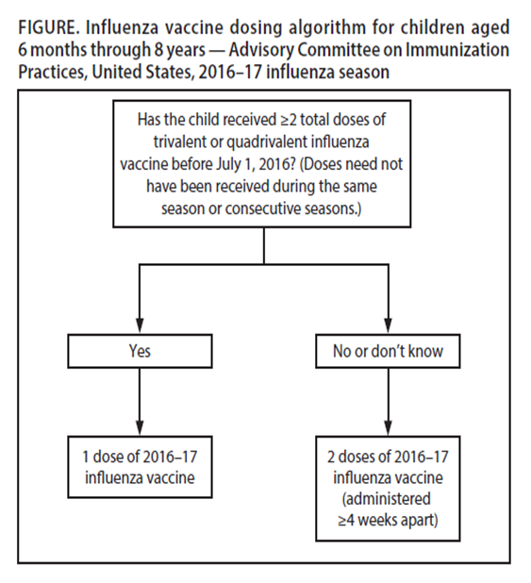
Dosing Algorithm
Notes:
For children aged 6 months through 8 years, the influenza vaccine dosing algorithm is a guide to determine if a child will need one or two doses of influenza vaccine. For the 2016-2017 season, administer 2 doses (separated by at least 4 weeks) to children who are receiving influenza vaccine for the first time or who have not previously received greater than or equal to two doses of trivalent or quadrivalent influenza vaccine before July 1, 2016. Doses need not have been received during the same season or consecutive seasons.

Slide 41
Influenza Vaccines for 2016-2017 Season
≥ 6 months | ≥ 3 years | ≥ 4 years | ≥ 9 years | ≥ 18 years | ≥ 65 years
Fluzone (II4V) (single dose) | Fluarix (II4V) | Fluvirin (II3V) | Afluria (II3V) | FluBlok (II3V) ** | Fluzone High-Dose (II3V)
Fluzone (II4V) (multidose vial) | FluLaval (II4V) | Flucelvax (II4V)* |  | Fluzone Intradermal (II4V) | Fluad (II3V)
FluLaval (II4V)
*
*Cell-cultured **Recombinant
Ref: Influenza Vaccine Products for the 2016-2017 Season - Immunization Action Coalition
Notes:
Flu presentations for 2016-2017 flu season are listed here. On November 18, 2016, the FDA approved an extension of the age range of quadrivalent FluLaval (inactivated influenza vaccine, GSK) to include children 6 through 35 months of age. FluLaval was previously approved for people 3 years of age and older. This approval of extended age range was based on a study showing an equivalent (non-inferior) response compared to children who received Fluzone (Sanofi Pasteur) pediatric formulation. The vaccine will be supplied for this indication in manufacturer-filled syringes and multi-dose vials. The dosage approved for children 6 through 35 months of age is 0.5mL- the same dosage as for people 3 years of age and older. ACIP has not yet issued a recommendation regarding the use of FluLaval in children 6 through 35 months of age. However, clinicians are free to use this and other vaccines in a manner consistent with their labeling.
On June 22, ACIP voted that, for the upcoming 2016-'17 influenza season, LAIV should not be used.
Studies demonstrated that LAIV did not work in the 2013-'14 influenza season when the primary strain was the 2009 pandemic influenza A(H1N1) strain, in 2014-'15 when the primary circulating strain was a drifted A(H3N2) virus, or the 2015-'16 season when the primary circulating strain was again the 2009 pandemic influenza A(H1N1) strain. With knowledge that LAIV had no protective benefit during the past three influenza seasons, ACIP could not recommend its use in the upcoming 2016-'17 influenza season.
The AAP Committee on Infectious Diseases and the Board of Directors all had reached the same conclusion about not using LAIV for the upcoming influenza season.
The AAP has reached out to the manufacturer of LAIV and will be following closely both the need for pediatricians to cancel LAIV orders successfully, and to obtain additional quantities of injectable vaccine.
Excerpt from:
A Message from AAP CEO/Executive Director Karen Remley, MD, MBA, MPH, FAAP
June 27, 2016

Slide 42
Influenza Vaccination of Persons with a History of Egg Allergy
Persons with a history of egg allergy who have had only hives after exposure to eggs should receive influenza vaccine.
Persons who report having had reactions to eggs such as angioedema, respiratory distress, lightheadedness, or recurrent emesis; or who required epinephrine or another emergency medical intervention may receive influenza vaccine. Vaccine should be administered in a medical setting supervised by a healthcare provider who is able to recognize and manage severe allergic conditions.
A previous severe allergic reaction to influenza vaccine is a contraindication to future receipt of the vaccine.
Recommendations and Reports Vol. 65 / No. 5 MMWR / August 26, 2016
Notes:
Recent studies with IIV and LAIV have indicated that a severe allergic reaction to egg-based influenza vaccine in a person with an egg allergy is very unlikely. Numerous studies have looked at egg-allergic patients receiving IIV3, LAIV in which mild allergic reactions occur and no anaphylactic reaction occurrences.
For the 2016-17 influenza season the ACIP has recommended If a person has a history of egg allergy and only experiences mild symptoms such as hives they can receive the flu vaccine. If they have experienced any other symptoms (angioedema, resp. distress) the flu vaccine should be administered in an appropriate medical setting and supervised by a health care provider who can manage emergent situation. If a patient has suffered a previous severe allergic reaction after receipt of the flu vaccine it is a contraindication and should not be administered.
Reference: MMWR. Prevention and Control of Seasonal Influenza with Vaccines Recommendations of the Advisory Committee on Immunization Practices-United, 2016-17 Influenza Season. August 26, 2016, Vol. 65; No. 5
EPIC 2017

Slide 43
Can a child who needs 2 doses of influenza receive 1 dose of quadrivalent vaccine and 1 dose of trivalent vaccine?
Test Your Knowledge!
Yes. You can give these two vaccines, as long as the 2 doses are appropriately spaced.
IAC Ask the Experts - Reviewed December 2016

Slide 44
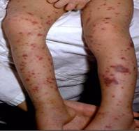
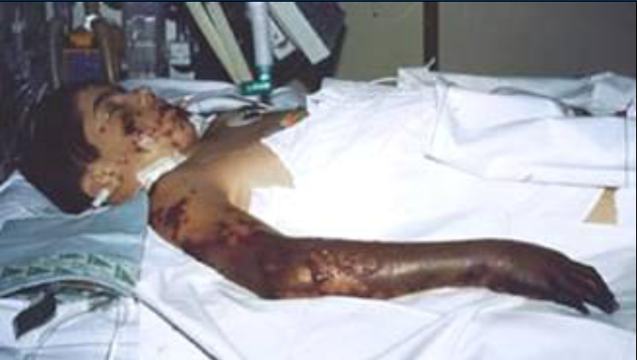
Meningococcal Conjugate Vaccine (MCV4)
(Men A,C,Y, W-135)
Menactra™ licensed for 9 mos. through 55 years
Menveo® licensed for ages 2 mos. through 55 years
ACIP recommends:
  First dose at age 11 or 12 years and a booster dose at 16 years.
  If first dose is at 13-15 years, give booster dose 5 years after the first dose or sooner if entering college or technical school.
  If first dose is received ≥ 16 years of age, a 2nd dose is not needed.
  Persons aged 21 years or younger attending school or college should have documentation of one dose of MVC4 not more than 5 years before enrollment.
MMWR, March 22, 2013, Vol 62, #RR02
Notes:
The most common clinical presentations of meningococcal disease are meningitis and meningococcemia.
-Neisseria meningitidis contains 13 serogroups, the most common being A, B, C, W, and Y. About 5-10% of adults are asymptomatic nasopharyngeal carriers of this organism.
-Individuals with meningococcemia may die within 24 hours of the onset of symptoms even with prompt treatment with appropriate antimicrobials and supportive care in an intensive care unit.
Meningitis makes up about ~50% of cases and has a 9-10% fatality rate
Meningococcemia- 5%-20% of cases; Up to 40% fatality rate; (Rash, Vascular damage, Disseminated intravascular coagulation, Multi-organ failure, Shock, Death can occur in 24 hours); 11-19% of survivors have permanent sequelae (an abnormal condition resulting from a previous disease)
Reference: 1. Epidemiology and Prevention of Vaccine-Preventable Diseases, 13th edition. 2015 HHS, CDC.
2. AAP Redbook 2015
3. Meningococcal Disease. About the Disease. http://www.cdc.gov/meningococcal/about/index.html
Routine recommendation: The first dose at 11 or 12 years and a booster at 16 years. After a booster dose of meningococcal conjugate vaccine, antibody titers are higher than after the first dose and are expected to protect adolescents through the period of increased risk through age 21 years. Persons who receive their first dose of meningococcal conjugate vaccine at or after age 16 years do not need a booster dose. Routine vaccination of healthy persons who are not at increased risk for exposure to N. meningitidis is not recommended after age 21 years.
Required for school attendance
CDC Guidance for Transition to an Adolescent Booster Dose
Some schools, colleges, and universities have policies requiring vaccination against meningococcal disease as a condition of enrollment. For ease of program implementation, persons aged 21 years or younger should have documentation of receipt of a dose of meningococcal conjugate vaccine not more than 5 years before enrollment. If the primary dose was administered before the 16th birthday, a booster dose should be administered before enrollment in college. The booster dose can be administered anytime after the 16th birthday to ensure that the booster is provided. The minimum interval between doses of meningococcal conjugate vaccine is 8 weeks.
No data are available on the interchangeability of vaccine products. Whenever feasible, the same brand of vaccine should be used for all doses of the vaccination series. If vaccination providers do not know or have available the type of vaccine product previously administered, any product should be used to continue or complete the series.
Ref. 1. Prevention and Control of Meningococcal Disease - Recommendations of the Advisory Committee on Immunization Practices (ACIP) MMWR / March 22, 2013 / Vol. 62 / No. 2
2. Recommendation of the ACIP for Use of Quadrivalent Meningococcal Conjugate Vaccine (MenACWY-D) Among Children Aged 9 Through 23 Months at Increased Risk for Invasive Meningococcal Disease MMWR; October 14, 2011 / 60(40);1391-1392
Required for school attendance

Slide 45
Meningococcal Vaccines for High Risk
Children 2 months – 55 years
MENHIBRIX® (Men C&Y + Hib) licensed for ages 6 weeks through 18 months
Menveo® (Men A,C,Y, W-135) licensed for ages 2 mos. through 55 years
Menactra™ (Men A,C,Y, W-135) licensed for 9 mos. through 55 years
Recommended for persons 6 weeks through 55 years:
Human immunodeficiency virus (HIV)
complement component deficiency
functional or anatomic asplenia (sickle cell disease)
Microbiologists exposed to isolates of N. meningitidis
part of a community outbreak due to vaccine serogroups
persons traveling internationally to regions with endemic meningococcal disease
For details on doses and schedule refer to the current Childhood and Adolescent Immunization Schedule
MMWR, June 20, 2014, Vol 63 #24 MMWR, March 22, 2013, Vol 62, #RR02
Notes:
Meningococcal Vaccines for High Risk Children 2 months – 10 years
MENHIBRIX® (Men C&Y + Hib) licensed for ages 6 weeks through 18 months
Menveo® (Men A,C,Y, W-135) licensed for ages 2 mos. through 55 years
Menactra® (Men A, C, Y, W-135) licensed for 9 months through 55 years
Recommended for children 2 months through 10 years with:
-complement component deficiency
-functional or anatomic asplenia
-those who are part of a community outbreak
-persons traveling internationally to regions with endemic meningococcal disease.
June 2016, ACIP recommended routine use of meningococcal conjugate vaccine for persons ages >2 months with human immunodeficiency virus infection. The majority of meningococcal disease among HIV-infected persons is caused by these four serogroups.
The same vaccine product should be used for all doses. ACIP recommends HIC-infected infants 2 through 23 months should receive MenACWY-CRM (Menveo). HIV-infected children < 2 years should not receive MenACWY-D(Menactra) due to immune interference with PCV13.
Reference:
MMWR, November 4, 2016, Vol 65(43).
For details on doses and schedule refer to the current Childhood and Adolescent Immunization Schedule

Slide 46
I have a 24-month-old patient with HIV infection and I want to use Menactra (Sanofi Pasteur) because this is the only vaccine we have available in our clinic. However, this child received DTaP vaccine yesterday at another clinic. Can I administer Menactra today?
Test Your Knowledge!
ACIP recommends that you wait 4 weeks from the dose of DTaP to administer the dose of Menactra. This is because data suggest a reduced response to the Menactra if given within a month after DTaP. If Menactra is to be administered to a child at increased risk for meningococcal disease, including children who have HIV infection, Menactra should be given either before or at the same visit as DTaP. Menveo brand MenACWY vaccine (GSK) can be given at any time before or after DTaP.
IAC Ask the Experts - Reviewed December 2016
Notes:
ACIP recommends that you wait 4 weeks from the dose of DTaP to administer the dose of Menactra. This is because data suggest a reduced response to the Menactra if given within a month after DTaP. If Menactra is to be administered to a child at increased risk for meningococcal disease, including children who have HIV infection, Menactra should be given either before or at the same visit as DTaP. Menveo brand MenACWY vaccine (GSK) can be given at any time before or after DTaP.

Slide 47
Serogroup B Meningococcal Vaccine
Bexsero® licensed for ages 10 through 25 years (2 dose)
Trumenba® licensed for ages 10 through 25 years (3 dose)
ACIP recommends serogroup B meningococcal vaccine for:
Persons with persistent complement component deficiencies
Persons with anatomic or functional asplenia
Microbiologists routinely exposed to isolates of Neisseria meningitidis
Persons identified to be at increased risk because of a serogroup B meningococcal disease outbreak
The 2 vaccine products are not interchangeable.
(Category B – Permissive recommendation)#
A Men B vaccine series may be administered to adolescents and young adults 16 through 23 years of age to provide short-term protection against most strains of Men B. Preferred age is 16-18 years.
MMWR; June 12, 2015 ,Vol. 64 #22; 608-611
# MMWR; October 23, 2015, Vol .64 #41; 1171-1176
Notes:
Presenter may use the new MenB one-pager while discussing slide
Bexsero® licensed for ages 10 through 25 years (2 dose)
Trumenba® licensed for ages 10 through 25 years (3 dose)
ACIP recommends serogroup B meningococcal vaccine for:
Persons with persistent complement component deficiencies
Persons with anatomic or functional asplenia
Microbiologists routinely exposed to isolates of Neisseria meningitidis
Persons identified to be at increased risk because of a serogroup B meningococcal disease outbreak
The 2 vaccine products are not interchangeable.
MenB is a Category B- permissive recommendation-
Explain to audience the difference between a Category A and Category B recommendation. Category B means the recommendation allows for individual clinical decision making, but with Category A recommendations all persons in an age or risk factor based group may get the vaccine. Category B classification enables coverage by the VFC program and most insurance plans.
A Men B vaccine series may be administered to adolescents and young adults 16 through 23 years of age to provide short-term protection against most strains of Men B. Preferred age is 16-18 years.

Slide 48
Serogroup B Meningococcal
Vaccine Administration
Bexsero® licensed for ages 10 through 25 years (2 dose)
Trumenba® licensed for ages 10 through 25 years (2 dose or 3 dose)
MenB-FHbp (Trumenba®)
  2 dose schedule – administered at 0, 6 months
  Given to healthy adolescents who are not at increased risk for meningococcal disease
  3 dose schedule – administered at 0, 1-2, 6 months
  Given to persons at increased risk for meningococcal disease and for use during serogroup B outbreaks
MenB-4C (Bexsero®)
  2 dose schedule – 0, 1-2 months
Notes:
In April 2016, the Food and Drug Administration approved a 2-dose schedule for Trumenba. In October 2016, the ACIP voted to recommend a 2- dose schedule of Trumenba for people not at increased risk of MenB (for example, healthy adolescents). The two doses should be administered at least 6 months apart. ACIP recommends that people at increased risk of MenB disease (complement component deficiency, functional or anatomic asplenia, at risk during outbreak of meningococcal B disease, and certain microbiologists) receive a 3- dose Trumenba series with dose #2 and dose #3 administered 2 and 6 months after dose #1. The schedule for Bexsero has not changed.
Administration of MenB vaccine in persons older than 25 years of age is an off-label use. Clinicians may choose to use vaccines off-label if they believe it would be of benefit to their patients. ACIP recommends routine MenB vaccination of certain high risk groups for those 10 years and older.

Slide 49
I have an HIV-positive 64 year old patient who received MenACWY vaccine last week. Was this the correct vaccine for this patient or should he have gotten meningococcal polysaccharide vaccine (MPSV4, Sanofi Pasteur) due to his age? Also, should this patient get another dose in 2 months?
Test Your Knowledge!
MenACWY was the correct vaccine in this situation. The 2013 ACIP recommendations on MenACWY vaccination recommend the use of meningococcal conjugate vaccine in adults age 56 years and older who were vaccinated previously with MenACWY and now need revaccination, or are recommended to receive multiple doses. A person of this age with HIV infection should receive 2 doses of MenACWY separated by 8-12 weeks. Both MenACWY vaccines are licensed for use in people through age 55 years, which means that the use of these vaccines in people age 56 and older is off-label but recommended by ACIP.
IAC Ask the Experts - Reviewed December 2016
Notes:
I have an HIV-positive 64 year old patient who received MenACWY vaccine last week. Was this the correct vaccine for this patient or should he have gotten meningococcal polysaccharide vaccine (MPSV4, Sanofi Pasteur) due to his age? Also, should this patient get another dose in 2 months?
MenACWY was the correct vaccine in this situation. The 2013 ACIP recommendations on MenACWY vaccination recommend the use of meningococcal conjugate vaccine in adults age 56 years and older who were vaccinated previously with MenACWY and now need revaccination, or are recommended to receive multiple doses. A person of this age with HIV infection should receive 2 doses of MenACWY separated by 8-12 weeks. Both MenACWY vaccines are licensed for use in people through age 55 years, which means that the use of these vaccines in people age 56 and older is off-label but recommended by ACIP.

Slide 50
Rotavirus Vaccines
RotaTeq® (Merck) and Rotarix® (GSK)
RotaTeq®: 3 doses; ages 2, 4, 6 months
Rotarix®: 2 doses; ages 2 and 4 months
ACIP recommends:
2-3 doses depending on brand
Administer either vaccine as directed below:
  Minimum age for first dose: 6 weeks
  Maximum age for first dose: 14 weeks 6 days
  Minimum interval between doses: 4 weeks
  Maximum age for last dose: 8 months 0 days
If any dose is Rotateq®, 3 doses are required
Use RotaTeq® if allergy to latex
MMWR, February 6, 2009, Vol 58, #RR-02
Notes:
Presenter may use Rotavirus one-pager while discussing slide.
Why get vaccinated?
Rotavirus is a virus that causes diarrhea, mostly in babies and young children. The diarrhea can be severe, and lead to dehydration. Vomiting and fever are also common in babies with rotavirus. Before rotavirus vaccine, rotavirus disease was a common and serious health problem for children in the United States. Almost all children in the U.S. had at least one rotavirus infection before their 5th birthday.
Every year:
More than 400,000 young children had to see a doctor for illness caused by rotavirus,
More than 200,000 had to go to the emergency room,
55,000 to 70,000 had to be hospitalized, and 20 to 60 died.
Rotavirus vaccine has been used since 2006 in the United States. Because children are protected by the vaccine, hospitalizations, and emergency visits for rotavirus have dropped dramatically.
ACIP recommends:
2-3 doses depending on brand
Administer either vaccine as directed below:
Minimum age for first dose: 6 weeks
Maximum age for first dose: 14 weeks 6 days
Minimum interval between doses: 4 weeks
Maximum age for last dose: 8 months 0 days
If any dose is Rotateq®, 3 doses are required
Use RotaTeq® if allergy to latex
Interchangeability of Rotavirus Vaccines
ACIP recommends that the rotavirus vaccine series be completed with the same product whenever possible. However, vaccination should not be deferred if the product used for previous doses is not available or is unknown. In this situation, the provider should continue or complete the series with the product available. If any dose in the series was RV5 or the product is unknown for any dose in the series, a total of three doses of rotavirus vaccine should be given.
Reference: 1. Prevention of Rotavirus Gastroenteritis Among Infants and Children - Recommendations of the Advisory Committee on Immunization Practices (ACIP) MMWR; February 6, 2009 / 58(RR02);1-25
2. Rotavirus Vaccine Information Statement 08/26/2013
3. MMWR, October 21, 2011 / 60(41);1427-1427

Slide 51
HPV Vaccine
Gardasil 9 (9vHPV) HPV types 6,11,16,18,31,33,45,52,58
ACIP recommends:
Starting at age 11 or 12 years for:
  All females through 26 years of age
  All males through 21 years of age
  Men 22 through 26 years who have sex with men or have an immunocompromising condition
  All other males 22 through 26 years
  9vHPV may be used to complete the 3 dose series that was started with 2vHPV or 4vHPV
Notes:
ACIP voted to change the HPV vaccination schedule from a 3-dose to a 2-dose series for adolescents who begin the HPV series at 9 through 14 years of age, regardless of age at series completion. Those who start the series later, at 15 through 26 years of age, or who are immunocompromised, will continue to need 3 doses.
ACIP recommends:
Starting at age 11 or 12 years for:
All females through 26 years of age
All males through 21 years of age
Men 22 through 26 years who have sex with men or have an immunocompromising condition
All other males 22 through 26 years
The 9vHPV vaccine is now the only HPV vaccine available in the U.S.. Merck is only distributing 9vHPV and supplies of 2vHPV are now depleted. HPV9 may be used to complete a series begun with 4vHPV or 2vHPV.
We continue to see a decline in the number of adolescents (males and females) who receive the HPV vaccine. Many parents are still reluctant and have questions about the need to begin the series at such an early age and the overall safety of the vaccine. According to the National Immunization Survey-Teen, there are some helpful tips for providers to use to when speaking with parents:
Reasons to Immunize Against HPV at 11-12 Years of Age
Clinicians also need to emphasize the importance of immunizing preteens and teens early because of the following:
-Higher antibody level attained when given to pre-teens rather than to older adolescents or women
-At this age, more likely to be administered before onset of sexual activity
-HPV can be transmitted by other skin-to-skin contact, not just sexual intercourse
-This is an anti-cancer vaccine
Reference:
1.National Immunization Survey-Teen (NIS-Teen), United States, 2014 MMWR/July 31, 2015/ Vol.64/No. 29

Slide 52
Burden of Disease Associated with HPV Vaccine Types
HPV Type | Cervical Cancer | All HPV-Associated Cancers | Anogenital Warts
6 |  |  | 90%
11
16 | 66% | 64%
18
31 | 15% | 10%
33
45
52
58
4vHPV
2vHPV
9vHPV
Provider Information: Gardasil 9 VIS – CDC, National Center for Immunization and Respiratory Diseases – Immunization Services Division - December 2015
Notes:
2vHPV, 4vHPV, and 9vHPV all protect against HPV 16 and 18, types that cause about 66% of cervical cancers and the majority of other HPV-attributable cancers in the United States (1,12). 9vHPV targets five additional cancer causing types, which account for about 15% of cervical cancers (12). 4vHPV and 9vHPV also protect against HPV 6 and 11, types that cause 90% of anogenital warts.
MMWR / March 27, 2015 / Vol. 64 / No. 11

Slide 53
Reasons to Immunize Against HPV at 11-12 Years of Age
Higher antibody level attained when given to pre-teens rather than to older adolescents or women
At this age, more likely to be administered before onset of sexual activity
HPV can be transmitted by other skin-to-skin contact, not just sexual intercourse
This is an anti-cancer vaccine
Presentation by Anne Schuchat, MD, RADM US Public Health Service, Assistant Surgeon General, Director National Center for Immunization and Respiratory Diseases at Immunize Georgia Conference, Atlanta, GA September 11, 2014
Notes:
We continue to see a decline in the number of adolescents (males and females) who receive the HPV vaccine. Many parents are still reluctant and have questions about the need to begin the series at such an early age and the overall safety of the vaccine. According to the National Immunization Survey-Teen, there are some helpful tips for providers to use to when speaking with parents:
Clinicians need to emphasize the importance of immunizing preteens and teens early because of the following:
-Higher antibody level attained when given to pre-teens rather than to older adolescents or women
-At this age, more likely to be administered before onset of sexual activity
-HPV can be transmitted by other skin-to-skin contact, not just sexual intercourse
-This is an anti-cancer vaccine
Reference:
1.National Immunization Survey-Teen (NIS-Teen), United States, 2014 MMWR/July 31, 2015/ Vol.64/No. 29

Slide 54
Addressing Parents’ Top Questions about HPV Vaccine
Why does my child need the HPV vaccine? | HPV Vaccine is important because it prevents cancer. This is why I recommend that your son/daughter be vaccinated today.
What diseases are caused by HPV? | Certain HPV types can cause cancer of the cervix, vagina, and vulva in females, cancer of the penis in men, and in both females and males, cancers of the anus and the throat. We can help prevent infection starting the HPV vaccine series for your child today.
Is my child really at risk for HPV? | HPV is a very common and widespread virus that infects both females and males. We can help protect your child from the cancers and diseases caused by the virus by starting HPV vaccination today.
Why do they need HPV vaccine at such a young age? | HPV vaccination works best at the recommended ages of 11 or 12 years.
Why do boys need HPV vaccine? | HPV infection can cause cancers of the penis, anus, and throat in men and it can also cause genital warts. HPV vaccine can help prevent the infection that lead to these diseases.
Notes:
The CDC’s Tips and TimeSavers document about HPV Vaccine addresses parents concerns about getting their child vaccinated. Here we have listed some of the common questions that parents have. CDC encourages providers to recommend the HPV vaccine the same way other adolescent vaccines are recommended.
Ex. “Your child is due for vaccination today to help protect against meningitis, HPV cancers and pertussis. We’ll give those at the end of the visit.”
Reference: Centers for Disease Control and Prevention. Retrieved from http://www.cdc.gov/vaccines/who/teens/for-hcp-tipsheet-hpv.pdf on April 25, 2016.
EPIC ADOLESCENT 2016

Slide 55
Test Your Knowledge!
If dose #1 of HPV vaccine was given before the 15th birthday and it has been more than a year since that dose was given, would the series be complete with just one additional dose?
Yes. Adolescents and adults who started the HPV vaccine series prior to the 15th birthday and who are not immunocompromised are considered to be adequately vaccinated with just one additional dose of HPV vaccine.

Slide 56
Test Your Knowledge!
Will the 2-dose recommendation be retroactive for children and teens vaccinated prior to 2016?
Yes. Any person who ever received 2 doses of any combination of HPV vaccines can be considered fully vaccinated if dose #1 was given before the 15th birthday and the 2 doses were separated by at least 5 months.

Slide 57
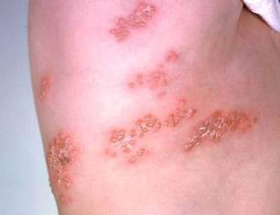
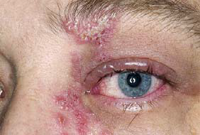
Herpes Zoster
Herpes zoster (HZ), or shingles, occurs through reactivation of latent varicella-zoster virus
Typically characterized by prodromal pain and an acute vesicular eruption (rash) accompanied by moderate to severe pain
One in three persons will develop zoster during their lifetime
Postherpetic neuralgia (PHN)is a common consequence of zoster
Risk for zoster and PHN increases with age
Photo courtesy of www.webmd.com
Notes:
Presenter may use shingles one-pager while discussing slide.
The picture on left shows zoster (shingles) on the upper chest and back.
The picture on right shows zoster on the face involving one of the cranial nerves.
What is shingles?
Shingles is a painful skin rash, often with blisters. It is also called Herpes Zoster, or just Zoster.
Shingles occurs when VZV reactivates and causes recurrent disease. Shingles usually starts as a rash with blisters that scab after 3 to 5 days. The most frequently mentioned symptom is pain. The rash and pain usually occur in a band on one side of the body, or clustered on one side of the face. The rash usually clears within 2 to 4 weeks. The risk of getting shingles increases as a person gets older. People who have medical conditions that keep the immune system from working properly, or people who receive immunosuppressive drugs are also at greater risk to get shingles. Very rarely, shingles can lead to pneumonia, hearing problems, blindness, scarring, brain inflammation (encephalitis), or death.

Slide 58
Zostavax®
Zostavax is licensed for use in persons 50 years and older
Overall Efficacy
51% fewer episodes of zoster and less severe disease
66% less postherpetic neuralgia
Protection wanes within the first 5 years and duration of protection beyond 5 years is uncertain
ACIP recommends one dose for adults 60 years and older, including those who have experienced previous episodes of shingles.
It is not necessary to ask patient about a history of varicella or to do serologic testing for immunity.
MMWR, August 22, 2014, Vol 63, #33 MMWR (RR) June 6, 2008, Vol 57 #05; 1-30
Notes:
Zostavax is licensed for use in persons 50 years and older
Overall Efficacy
51% fewer episodes of zoster and less severe disease
66% less postherpetic neuralgia
Protection wanes within the first 5 years and duration of protection beyond 5 years is uncertain
ACIP recommends one dose for adults 60 years and older, including those who have experienced previous episodes of shingles. It is not necessary to ask patient about a history of varicella or to do serologic testing for immunity.
Optional Information:
Insurance reimbursement for Zostavax will vary based on the patient’s insurance plan. Patients need to verify coverage with their insurance company. Zostavax is covered by Medicare under Part D, but there are many different plans available under Part D. Patients covered by Medicare should make sure the Part D plan they have selected covers Zostavax or they will be responsible for full payment. Many practices are not offering Zostavax to their patients because physicians can not bill Part D, unless their practice is approved to dispense prescription drugs. In Georgia, pharmacists who are trained in vaccine administration can give Zostavax and bill Medicare for the cost of the vaccine and an administrative charge, if the patient’s Part D plan covers the vaccine.

Slide 59
Test Your Knowledge!
Hazel is 61 years old. She had major surgery one month ago requiring a blood transfusion. During her visit to your office today she tells you she would like to get the shingles vaccine.
How would you respond to her request?
Zoster vaccine can be given to persons who have recently received blood products. The amount of antigen in zoster vaccine is so substantial that it overpowers any antibody to herpes zoster that may be in the blood product.
Ref: Immunization Action Coalition - Ask the Experts – September 2011

Slide 60
Test Your Knowledge!
Sixty five year old Nadine requests the shingles vaccine. In addition, she needs pneumococcal and influenza vaccine.
Should she receive all 3 vaccines on the same day?
Yes. Although Merck reports one study showing a reduced immune response to Zostavax when administered at the same time as Pneumovax compared to administration 4 weeks apart, ACIP has not made this recommendation.

Slide 61
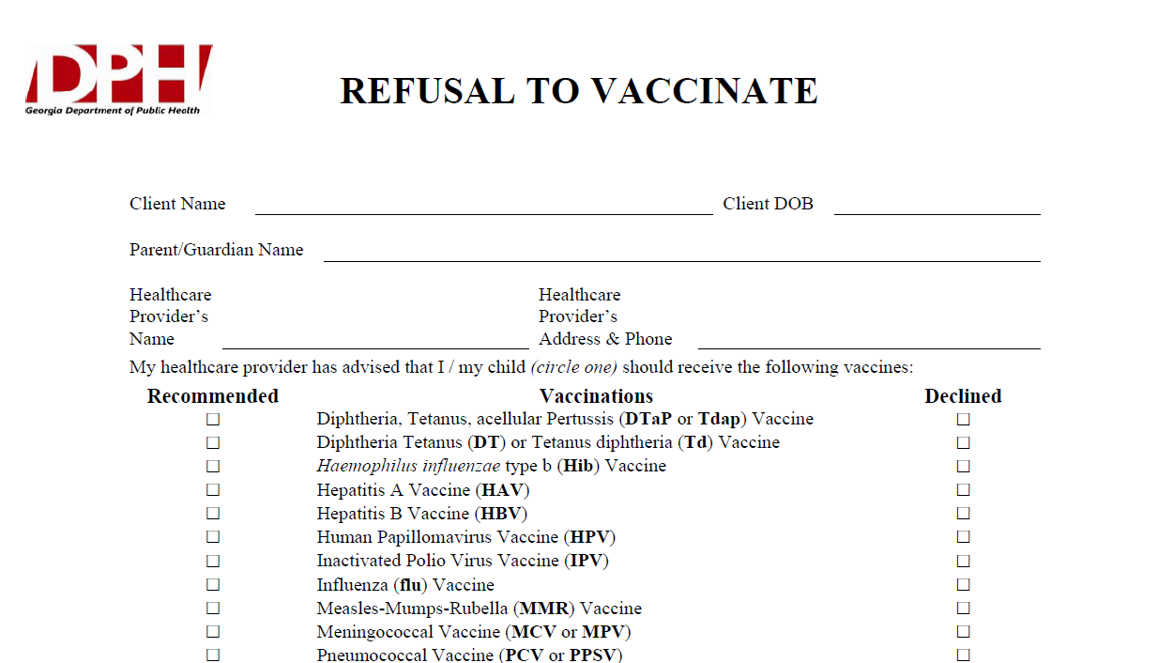
Notes:
What If Parents Refuse to Vaccinate?
Excluding children from your practice when their parents decline immunizations is not recommended. It can put the child at risk of many different health problems—not just vaccine-preventable diseases. Remember, unvaccinated infants did not decide for themselves to remain unvaccinated. They need your care. Make sure that parents are fully informed about clinical presentations of vaccine-preventable diseases, including early symptoms. Diseases like pertussis and measles are highly contagious and may present early as a non-specific respiratory illness. Parents who refuse vaccines should be reminded at every visit to call before bringing the child into the office, clinic, or emergency department when the child is ill so appropriate measures can be taken to protect others.
If a parent refuses to vaccinate, you can share the fact sheet
If You Choose Not to Vaccinate Your Child, Understand the Risks and Responsibilities (http://www.cdc.gov/vaccines/conversations),
which explains the risks involved with this decision including risks to other members of their community, and the additional responsibilities for parents, including the fact that, when their child is ill, they should always alert health care personnel to their child’s vaccination status to prevent the possible spread of vaccine-preventable diseases. You may wish to have them sign DPH’s Refusal to Vaccinate form in English or Spanish (https://dph.georgia.gov/sites/dph.georgia.gov/files/Immunizations/Health-Care-Professionals-Refusal-to-Vaccinate-Form-English_1.pdf) each time a vaccine is refused so that you have a record of their refusal in their child’s medical file.

Slide 62
Just as a reminder……
Regardless of:
  the availability of vaccine
  the funding of the vaccine (VFC, state-supplied, or private stock)
  whether the vaccine is required for school or child care or not……….
FOLLOW ACIP Recommendations!!!
Notes:
There seems to be some confusion among providers that
if there are vaccine shortages or the supply is low because it’s a new vaccine, or
if the patient doesn’t fit in a certain funding category, or
if the vaccine isn’t required for school or child care:
then they don’t feel they need to be concerned about whether to recommend or discuss that vaccine with the client or the parent. But the bottom line is-------the ACIP recommendation is the most important thing!! For instance, if a vaccine is recommended and the child is not VFC eligible, then give them your private stock of that vaccine if you have it. If not, refer the child out to receive it, but don’t ignore the fact that according to the ACIP Recommended schedule, he should have it.
Please be sure to emphasize this to any groups that you are educating about the recommended schedule.

Slide 63
Critical Elements for Immunization Services
Notes:
Critical Elements for immunization services include:
Appropriate storage and handling of all vaccines.
Correct administration of vaccines
Education of patients and parents about vaccines
Every office and clinic needs a vaccine champion.

Slide 64
Every Office and Clinic Needs
A Vaccine Champion!
Lead your immunization team.
Educate all staff about new vaccines and recommendations.
Teach new staff about vaccine storage, handling, & administration.
Initiate processes to improve immunization rates in your practice/facility.
Assure immunizations of all staff are up-to-date.
Notes:
64
64
Ask your audience “Who is your vaccine champion?” and then
“Who is this person’s backup?”
The vaccine champion will:
Lead your immunization team.
Educate all staff about new vaccines and recommendations.
Educate new staff about vaccine storage, handling, & administration.
Initiate processes to improve immunization rates in your practice/facility.
Assure immunizations of all staff are up-to-date.
Improving Access to immunizations
Immunization only visits
Walk-ins for immunizations
Implement standing orders
Early, extended, or weekend hours
Mass vaccination clinics
These 5 methods listed above can help patients access immunizations more readily but some of these methods may not be the right fit for some practices. The approach to improving access must be determined by individual practitioners and staff. Each practice must decide which method works best for their situation. In large practices or clinics this may be an administrative decision.

Slide 65
Standards for Child, Adolescent, and Adult Immunization Practices
Availability of vaccines
Assessment of client’s vaccination status
Effective communication with client or parent
Proper storage and handling of vaccines
Accurate documentation of vaccinations
Implementation of strategies to improve rates
Developing partnerships and community-based approaches to vaccine delivery
Notes:
Following the Standards for Child, Adolescent and Adult Immunization practices involve:
Availability of vaccines
Barriers identified
Client kept in medical home as much as possible
Client costs minimized
Assessment of client’s vaccination status
Review history each time
Assess for contraindications
Use GRITS
Effective communication with client or parent, especially re: risks/benefits
Proper storage and handling of vaccines
Accurate documentation of vaccinations---use of GRITS
Implementation of strategies to improve rates
Reminder/recall systems
Periodic assessment of practice coverage levels
Standing orders if appropriate
Developing partnerships and community-based approaches to vaccine delivery

Slide 66
Vaccine Injury Compensation Program (VICP)
National Vaccine Injury Compensation Program
provides compensation to individuals found to be injured by or have died from certain childhood vaccines.
  Established in 1988 by NCVIA
  Federal “no fault” system to compensate those injured
  Claim must be filed by individual, parent or guardian
  Must show that injury is on “Vaccine Injury Table”
Notes:
On October 1, 1988, the National Childhood Vaccine Injury Act of 1986 created the National Vaccine Injury Compensation Program (VICP). The VICP was established to ensure an adequate supply of vaccines, stabilize vaccine costs, and establish and maintain an accessible and efficient forum for individuals found to be injured by certain vaccines. The VICP is a no-fault alternative to the traditional public legal system for resolving vaccine injury claims that provides compensation to people found to be injured by certain vaccines.
The National Childhood Vaccine Injury Act (NCVIA) set forth 3 basic requirements for all vaccination providers, which are:
Providers must give the patient (or parent/legal representative of a minor) a copy of the relevant federal "Vaccine Information Statement" (VIS) for the vaccine they are about to receive.
Providers must record certain information about the vaccine(s) administered in the patient's medical record or a permanent office log.
Providers must document any adverse event following the vaccination that the patient experiences and that becomes known to the provider, whether or not it is felt to be caused by the vaccine, and submit the report to the Vaccine Adverse Event Reporting System (VAERS).

Slide 67
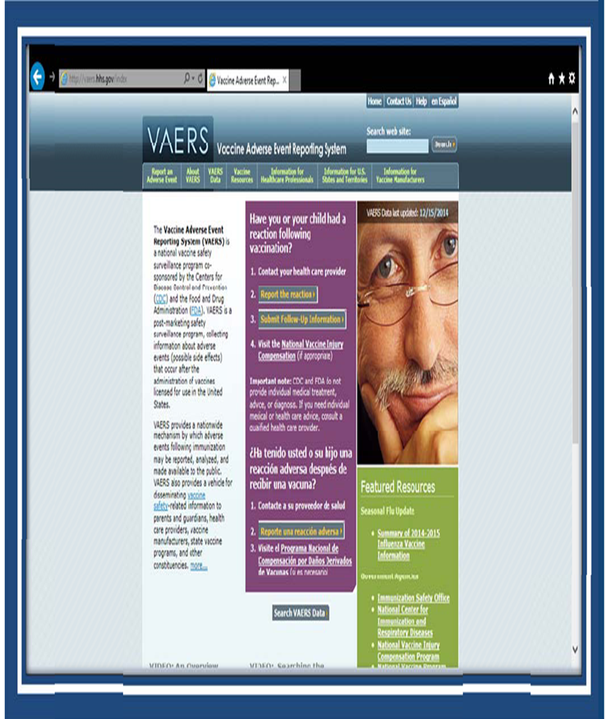
VAERS
What can be reported to VAERS?
Who reports to VAERS?
Does VAERS provide general vaccine information?
Notes:
The Vaccine Adverse Event Reporting System (VAERS) is a national vaccine safety surveillance program co-sponsored by the Centers for Disease Control and Prevention (CDC) and the Food and Drug Administration (FDA). VAERS is a post-marketing safety surveillance program, collecting information about adverse events (possible side effects) that occur after the administration of vaccines licensed for use in the United States. VAERS is also standard #11 for the Standards for child, adolescent and adult immunization practices.
VAERS has demonstrated its public health importance by providing health scientists with signals about possible adverse events following immunization. In one instance, VAERS detected reports for intussusception over that what would be expected to occur by chance alone after the RotaShield rotavirus vaccine in 1999. Epidemiologic studies confirmed an increased risk, and these data contributed to the product's removal from the US market. In another example, VAERS determined that there may be a potential for a small increase in risk for Guillain-Barre' syndrome (GBS) after the meningococcal conjugate vaccine, Menactra. As a result of this finding, a history of GBS became a contraindication to the vaccine and further controlled studies are currently underway to research this issue.
The primary objectives of VAERS are to:
Detect new, unusual, or rare vaccine adverse events;
Monitor increases in known adverse events;
Identify potential patient risk factors for particular types of adverse events;
Identify vaccine lots with increased numbers or types of reported adverse events; and
Assess the safety of newly licensed vaccines.
What Can Be Reported to VAERS?
VAERS encourages the reporting of any clinically significant adverse event that occurs after the administration of any vaccine licensed in the United States.
Who Reports to VAERS?
Anyone can file a VAERS report, including parents, health care providers, manufacturers, and vaccine recipients.
Does VAERS Provide General Vaccine Information?
No. VAERS only collects and analyzes adverse event reports. In another example, VAERS determined that there may be a potential for a small increase in risk for Guillain-Barre syndrome after the meningococcal conjugate vaccine, Menactra. As a result of this finding, a history of Guillain-Barre syndrome became a contraindication to the vaccine and further controlled studies are currently underway to research this issue.

Slide 68
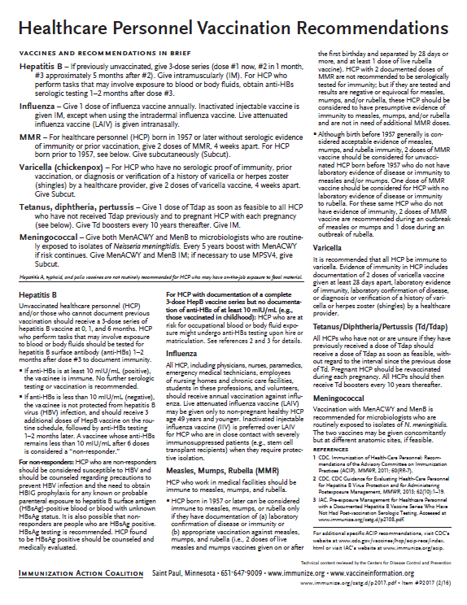
Recommended Healthcare Personnel Vaccinations
Hepatitis B
Influenza
Measles, Mumps, Rubella (MMR)
Varicella (Chickenpox)
Tetanus, Diphtheria, Pertussis (Tdap)
Meningococcal
Are YOU up to date?
Available at www.immunize.org, P#2017
Notes:
Un-immunized HCP
Un-immunized healthcare workers are at risk of infecting patients, family members and community contacts
Immunized HCP
Protect patients from VPD’s
Help offices avoid potential liability cases. (The practice can be liable if an unimmunized HCP becomes infected with a vaccine preventable disease and infects a patient.)
Maintain productivity
Reduce illness and illness-related absenteeism
Evidence of Immunity to MMR
Documented administration of two doses of measles and mumps vaccine and one dose of rubella vaccine OR
Laboratory evidence of immunity or laboratory confirmation of disease (measles, mumps and rubella) OR
Born before 1957 (measles, mumps and rubella)
Because of their contact with patients or infective material from patients, many HCP are at risk for exposure to (and possible transmission of) vaccine-preventable diseases. Employers and HCP have a shared responsibility to prevent occupationally acquired infections and avoid causing harm to patients by taking reasonable precautions to prevent transmission of vaccine-preventable diseases.
Optimal use of recommended vaccines helps maintain immunity and safeguard HCP from infection, thereby helping protect patients from becoming infected. The recommendations for vaccination of HCP are presented in two categories: 1) those diseases for which routine vaccination or documentation of immunity is recommended for HCP because of risks to HCP in their work settings and, should HCP become infected, to the patients they serve and 2) those diseases for which vaccination of HCP might be indicated in certain circumstances. Vaccines recommended in the first category are hepatitis B, seasonal influenza, measles, mumps, and rubella, pertussis, and varicella vaccines. Vaccines in the second category are meningococcal, typhoid, and polio vaccines.
1. General Recommendations on Immunization, Recommendations of the Advisory Committee on Immunization Practices (ACIP). MMWR (RR-2); January 28, 2011
MMWR; November 25, 2011 / 60(RR07);1-45

Slide 69
PRE-EXPOSURE EVALUATION FOR HEALTH-CARE PERSONNEL
PREVIOUSLY VACCINATED WITH COMPLETE, ≥3-DOSES OF HEP B VACCINE
SERIES WHO HAVE NOT HAD POSTVACCINATION SEROLOGIC TESTING
Measure antibody to hepatitis B surface antigen (anti-HBs) anti-HBs ≥10 mIU/mL
Below adequate level
anti-HBs ≥10mIU/mL
1 dose of HepB vaccine,
4-6 wks.--- serologic testing
No Action for
Hepatitis B prophylaxis
(regardless of source patient hepatitis B surface antigen status)
Below adequate level
At or above adequate level
2 more doses of HepB vaccine,
4-6 wks.--- serologic testing
Vaccinated HCP whose anti-HBs remains <10 mIU/mL after revaccination (i.e., after receiving a total of 6 doses) should be tested for HBsAg and anti-HBc to determine infection status.
Below adequate level
At or above adequate level
HCP need to receive hepatitis B evaluation for all exposures
MMWR, December 20, 2013, Vol 62. RR # 10
Notes:
Postvaccination Serologic Testing
Testing unvaccinated HCP for HBV infection is not generally indicated for persons being evaluated for hepatitis B protection because of occupational risk.
Prevaccination serologic testing is indicated for:
all persons born in geographic regions with HBsAg prevalence of ≥2% (e.g., much of Eastern Europe, Asia, Africa, the Middle East, and the Pacific Islands)
certain indigenous populations from countries with overall low HBV endemicity (<2%)
persons with behavioral exposures to HBV (e.g., men who have sex with men and past or current injection drug users)
persons receiving cytotoxic or immunosuppressive therapy
persons with liver disease of unknown etiology.
Testing HCP at risk for HBV infection should consist of a serologic assay for HBsAg, in addition to either anti-HBc or anti-HBs. For unvaccinated HCP at risk for previous HBV infection, blood should be drawn for testing before the first dose of vaccine is administered.
HCP who have written documentation of a complete, ≥3-dose HepB vaccine series and subsequent postvaccination anti-HBs ≥10 mIU/mL are considered hepatitis B immune. Immunocompetent persons have long-term protection against HBV and do not need further periodic testing to assess anti-HBs levels.
All HCP recently vaccinated or recently completing HepB vaccination who are at risk for occupational blood or body fluid exposure should undergo anti-HBs testing. Anti-HBs testing should be performed 1–2 months after administration of the last dose of the vaccine series when possible. HCP with documentation of a complete ≥3-dose HepB vaccine series but no documentation of anti-HBs ≥10 mIU/mL who are at risk for occupational blood or body fluid exposure might undergo anti-HBs testing upon hire or matriculation. Testing should use a quantitative method that allows detection of the protective concentration of anti-HBs (≥10 mIU/mL) (e.g., enzyme-linked immunosorbent assay [ELISA]).
Completely vaccinated HCP with anti-HBs ≥10 mIU/mL are considered hepatitis B immune. Immunocompetent persons have long-term protection and do not need further periodic testing to assess anti-HBs levels.
Completely vaccinated HCP with anti-HBs <10 mIU/mL should receive an additional dose of HepB vaccine, followed by anti-HBs testing 1–2 months later. HCP whose anti-HBs remains <10 mIU/mL should receive 2 additional
vaccine doses (usually 6 doses total), followed by repeat anti-HBs testing 1–2 months after the last dose. Alternatively, it might be more practical for very recently vaccinated HCP with anti-HBs <10 mIU/mL to receive 3 consecutive additional doses of HepB vaccine (usually 6 doses total), followed by anti-HBs testing 1–2 months after the last dose.
Ref: CDC Guidance for Evaluating Health-Care Personnel for Hepatitis B Virus Protection and for Administering Post Exposure Management MMWR Recommendations and Reports /Vol. 62/No. 10 December 20, 2013

Slide 70









Resources for Factual & Responsible Vaccine Information
www.immunize.org
Notes:
70
70
These are sources for scientific and credible information
See information sheet in participant packet
http://www.cdc.gov/vaccines/vac-gen/safety/default.htm
www.idsociety.org/vaccine/index.html
www.who.int
www.gaaap.org
www.aap.org
www.cispimmunize.org
www.aafp.org
www.acponline.org
www.immunize.org/resources This site is a good resource for healthcare providers and for information written specifically for patient and parents.
www.immunizationinfo.org
www.pkids.org (support and counseling for children with infectious diseases)
www.vaccine.org
The Allied Vaccine Group (AVG) (www.vaccine.org) was formed for the purpose of making it easier for patients/parents/providers to find reliable, science-based information about vaccines and immunization on the internet. This web site was designed to counter the many anti-vaccine web sites that are now available on the internet.

Slide 71

Stay Current!
Sign up for listserv sites which provide timely information pertinent to your practice www.immunize.org/resources/emailnews.asp
  AAP Newsletter
  CDC immunization websites (32 in all)
  CHOP Parents Pack Newsletter
  IAC Express
  Websites specific to particular vaccines

Slide 72

Internet Resources
Georgia Department of Public Health
  http://dph.georgia.gov/immunization-section
CDC Immunization information
  http://www.cdc.gov/vaccines/
CDC Flu information
  http://www.cdc.gov/flu/
Immunization Action Coalition
  www.immunize.org

Slide 73

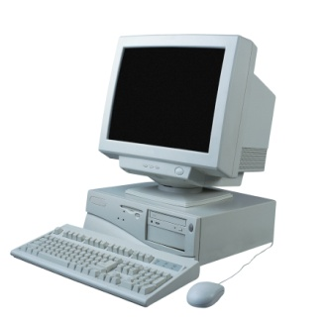
Resources
Local health department
District Immunization Coordinator
GA Immunization Program Office
  On call Help line: 404-657-3158
  GRITS Help Line:1-866-483-2958
  VFC Help Line:1-800-848-3868
  Website http://dph.georgia.gov/immunization-section
  Your local Immunization Regional Program Consultant (IRC)
  Epidemiology: 1-866-782-4584
GA Chapter of the AAP
GA Academy of Family Physicians
Notes:
If you need further information about the changes, or to ask questions later, please contact the GA Immunization Office and our partners GA AAP and GA AFP
Your Local health department
District Immunization Coordinator (IPCs)
GA Immunization Program Office
404-657-3158
Website http://health.state.ga.us/programs/immunization
GA Chapter of the AAP
GAFP

Slide 74

It’s a Team Effort!
High Immunization rates begin with a team designed plan!
What can your team do to improve rates?
Notes:
74
Remind your audience that “It is a team effort to immunize successfully”. Do not underestimate the
office team’s ability to affect immunization rates. It takes the physician, physician’s assistant, nurse
practitioner, nurse, medical assistant, and clerical staff working together to improve the office practice
and raise immunization rates.
Take any questions from the audience.
Ask participants how, based on the information presented, will they change the way they administer
vaccines.
Ask the audience what will they do to improve rates?
Ask participants to develop a plan to improve the immunization rates in their office
Jot down the plans the practice makes so that we can follow-up with them.

