Slide 1
Review of the Recommended Schedule
Presentation to:
Presented by:
Date:

Slide 2
Conflicts of Interest and Disclosures
Neither the planners or presenters indicated that they have any real or perceived vested interest that relate to this presentation nor any relationships with pharmaceutical companies, biomedical device manufacturers, and/or other corporations whose products and services are related to the vaccines we discuss.
There is no sponsorship or commercial support being received for this activity.
The mention of specific brands of vaccines in this presentation is for the purpose of providing education and does not constitute endorsement by the provider or ANCC of any commercial products.
For certain vaccines this may represent a slight departure from or off-label use of the vaccine package insert guidelines.
Notes:
Neither the planners or presenters indicated that they have any real or perceived vested interest that relate to this presentation nor any relationships with pharmaceutical companies, biomedical device manufacturers, and/or other corporations whose products and services are related to the vaccines we discuss.
There is no sponsorship or commercial support being received for this activity.
The mention of specific brands of vaccines in this presentation is for the purpose of providing education and does not constitute endorsement by the provider or ANCC of any commercial products.
For certain vaccines this may represent a slight departure from or off-label use of the vaccine package insert guidelines.

Slide 3
Disclosure Statement
To obtain nursing contact hours for this training, you must be present for the entire training and complete an evaluation
Contact hours are available for this training from 02/05/2013 until 02/05/2015

Slide 4
Objectives
At the end of this presentation, you will be able to:
Explain the difference between a vaccine indication, recommendation and requirement
Discuss the ACIP General Recommendations for the use and administration of vaccines
Discuss herd immunity and the cocooning strategy
Identify the vaccine antigens used for infants, children, adolescents and adults to prevent Vaccine Preventable Diseases
Discuss the role of a vaccine champion
List at least 2 reliable sources for immunization information
Notes:
4
Overview of topics to be discussed:
First we will review a summary of the status of licensure and the published recommendations of the new vaccines.
Next we will review the format changes to the 2011 Childhood and Adolescent Immunization Schedule as well as the footnotes; plus the 2nd part of the schedule called the Catch-up Schedule and the changes there. If you are presenting to Family Practitioners or Public Health departments, you may want to include a discussion of the adult schedule at the beginning of the presentation. If so, please add a bullet to this slide at the point when you would include it.
Then we will review with you the general principles or recommendations that can be applied when administering the vaccines that are routinely recommended for children, adolescents and adults.
In January 2011, the ACIP published an update of the “General Recommendations on Immunization”. I will point out some highlights of this document as it relates to the use of the recommended childhood immunization schedule.
Next we will review and point out specific recommendations and information for the individual vaccines that are listed on the Childhood and Adolescent Immunization Schedule. The Recommended Childhood and Adolescent Schedule is updated annually. The State of Georgia utilizes this schedule to make immunization policies and recommendations.
Finally we will provide you with some Immunization Resources.

Slide 5
Indications
Recommendations
Requirements
Indication
  Information about the appropriate use of the vaccine
Recommendation
  ACIP statement that broadens and further delineates the Indication found in the package insert
  Basis for standards for best practice
Requirement
  Mandate by a state that a particular vaccine must be administered and documented before entrance to child care and/or school
Notes:
5
EXAMPLES OF AN INDICATION
ADACEL vaccine is indicated for active booster immunization for the prevention of tetanus, diphtheria and pertussis as a single dose in persons 11 through 64 years of age.
BOOSTRIX® is indicated for active booster immunization against tetanus, diphtheria, and pertussis as a single dose in individuals 10 through 64 years of age.
EXAMPLE OF A RECOMMENDATION
Recommendations by ACIP for the routine administration of vaccines. May include other information and guidance on epidemiology of the disease, appropriate timing, dosage, contraindications to the vaccine and guidance for use in special populations. Appears first as “provisional recommendation” but once approved, appears in the MMWR as full recommendation
EXAMPLE OF VACCINE REQUIREMENTS FOR ENTRY INTO CHILD CARE FACILITIES IN GEORGIA
Consistent with the Recommended Childhood and Adolescent Immunization Schedule
Children are required to be age appropriately immunized against each of these diseases: Hepatitis B, Diphtheria, Tetanus, Pertussis, Polio, Hib, Pneumococcus, Measles, Mumps, Rubella, Varicella, Hepatitis A

Slide 6
How Recommendations and Schedules Are Developed: ACIP Committee
National committee
Membership:
  Experts in fields of epidemiology and infectious diseases
  Represent areas of academia, research, and public and private providers
Meets 3 times a year
Has sole authority to add vaccines to the VFC Program
Notes:
Before we discuss some of the general recommendations that apply to vaccine administration, it is important that you understand how these recommendations and the recommended schedules are developed.
Recommendations for each vaccine licensed by the FDA are developed by the Advisory Committee on Immunization Practices (ACIP):
National committee coordinated by CDC
Membership consists of experts in the fields of epidemiology and infectious diseases
Represents areas of academia, research, and public and private providers
Meets 3 times a year to review and discuss recommendations for each new vaccine that is approved by the FDA and to discuss any recommended changes for existing vaccines
Has sole authority to add vaccines to the VFC Program
A subcommittee of the ACIP, representing the AAP, AAFP, and CDC annually develop the Harmonized Recommended Childhood Immunization Schedule for the upcoming year.

Slide 7
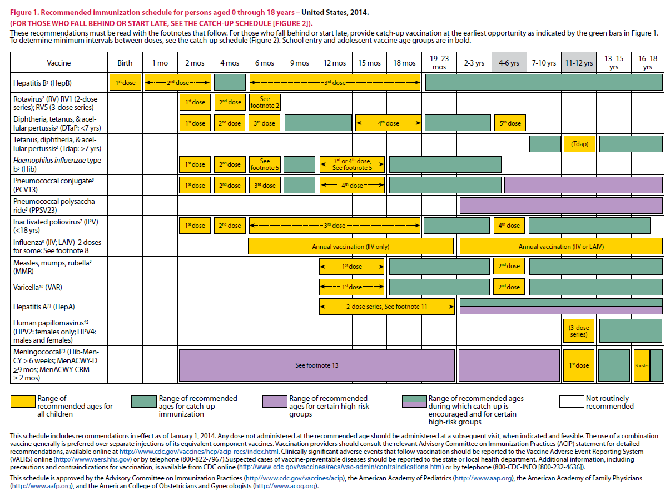
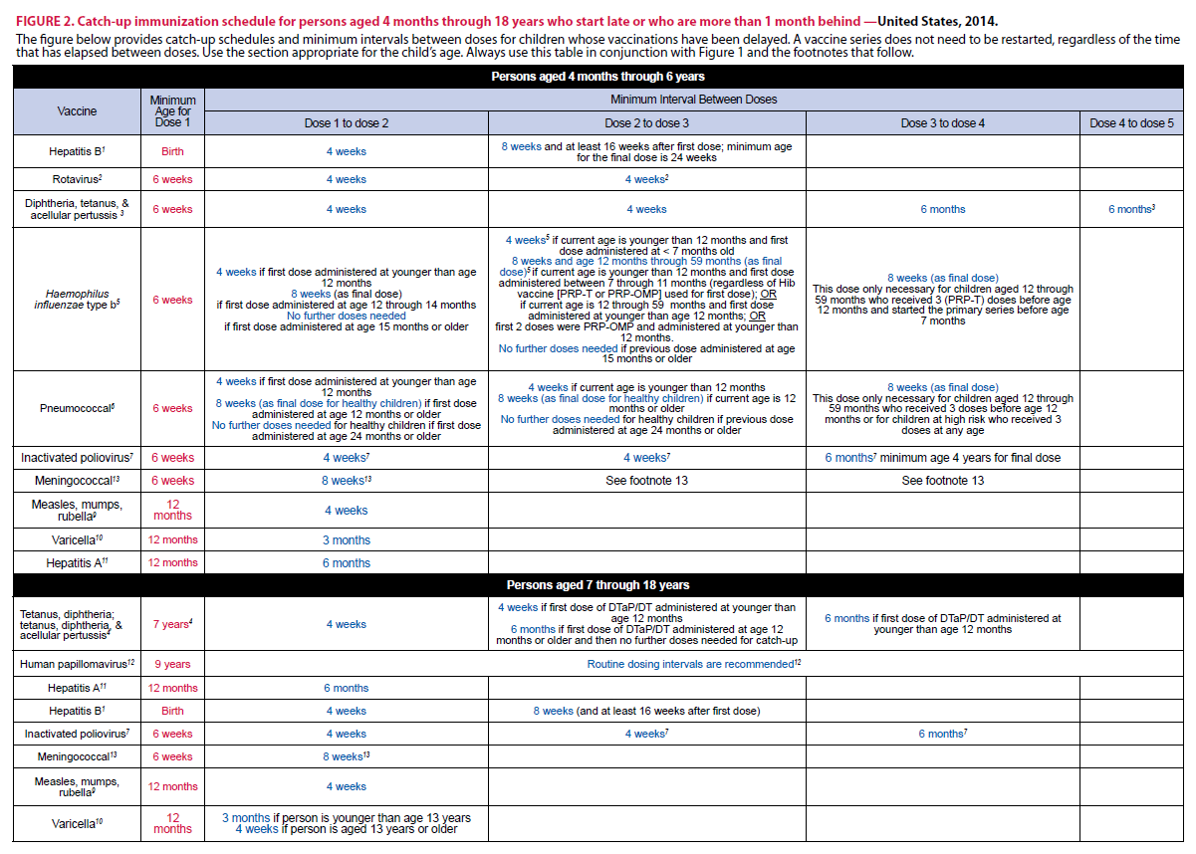
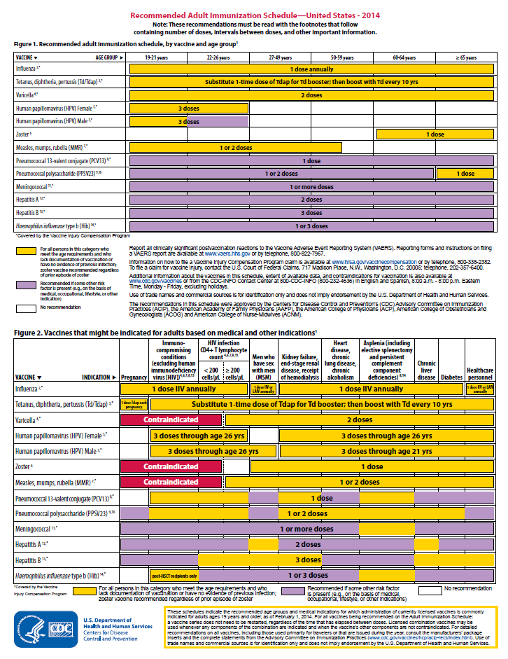
2014 Immunization Schedules
All staff must use the same immunization schedule
Four Schedules:
  Children & Adolescents
  0 through 18 years
  Catch-up schedule for
  ages 4 months -18 years
  Adult 19 years and older
  Adult based on medical
  and other indications
READ THE FOOTNOTES
http://www.cdc.gov/vaccines/schedules/hcp/child-adolescent.html
http://www.cdc.gov/vaccines/schedules/hcp/adult.html
Notes:
7
7

Slide 8
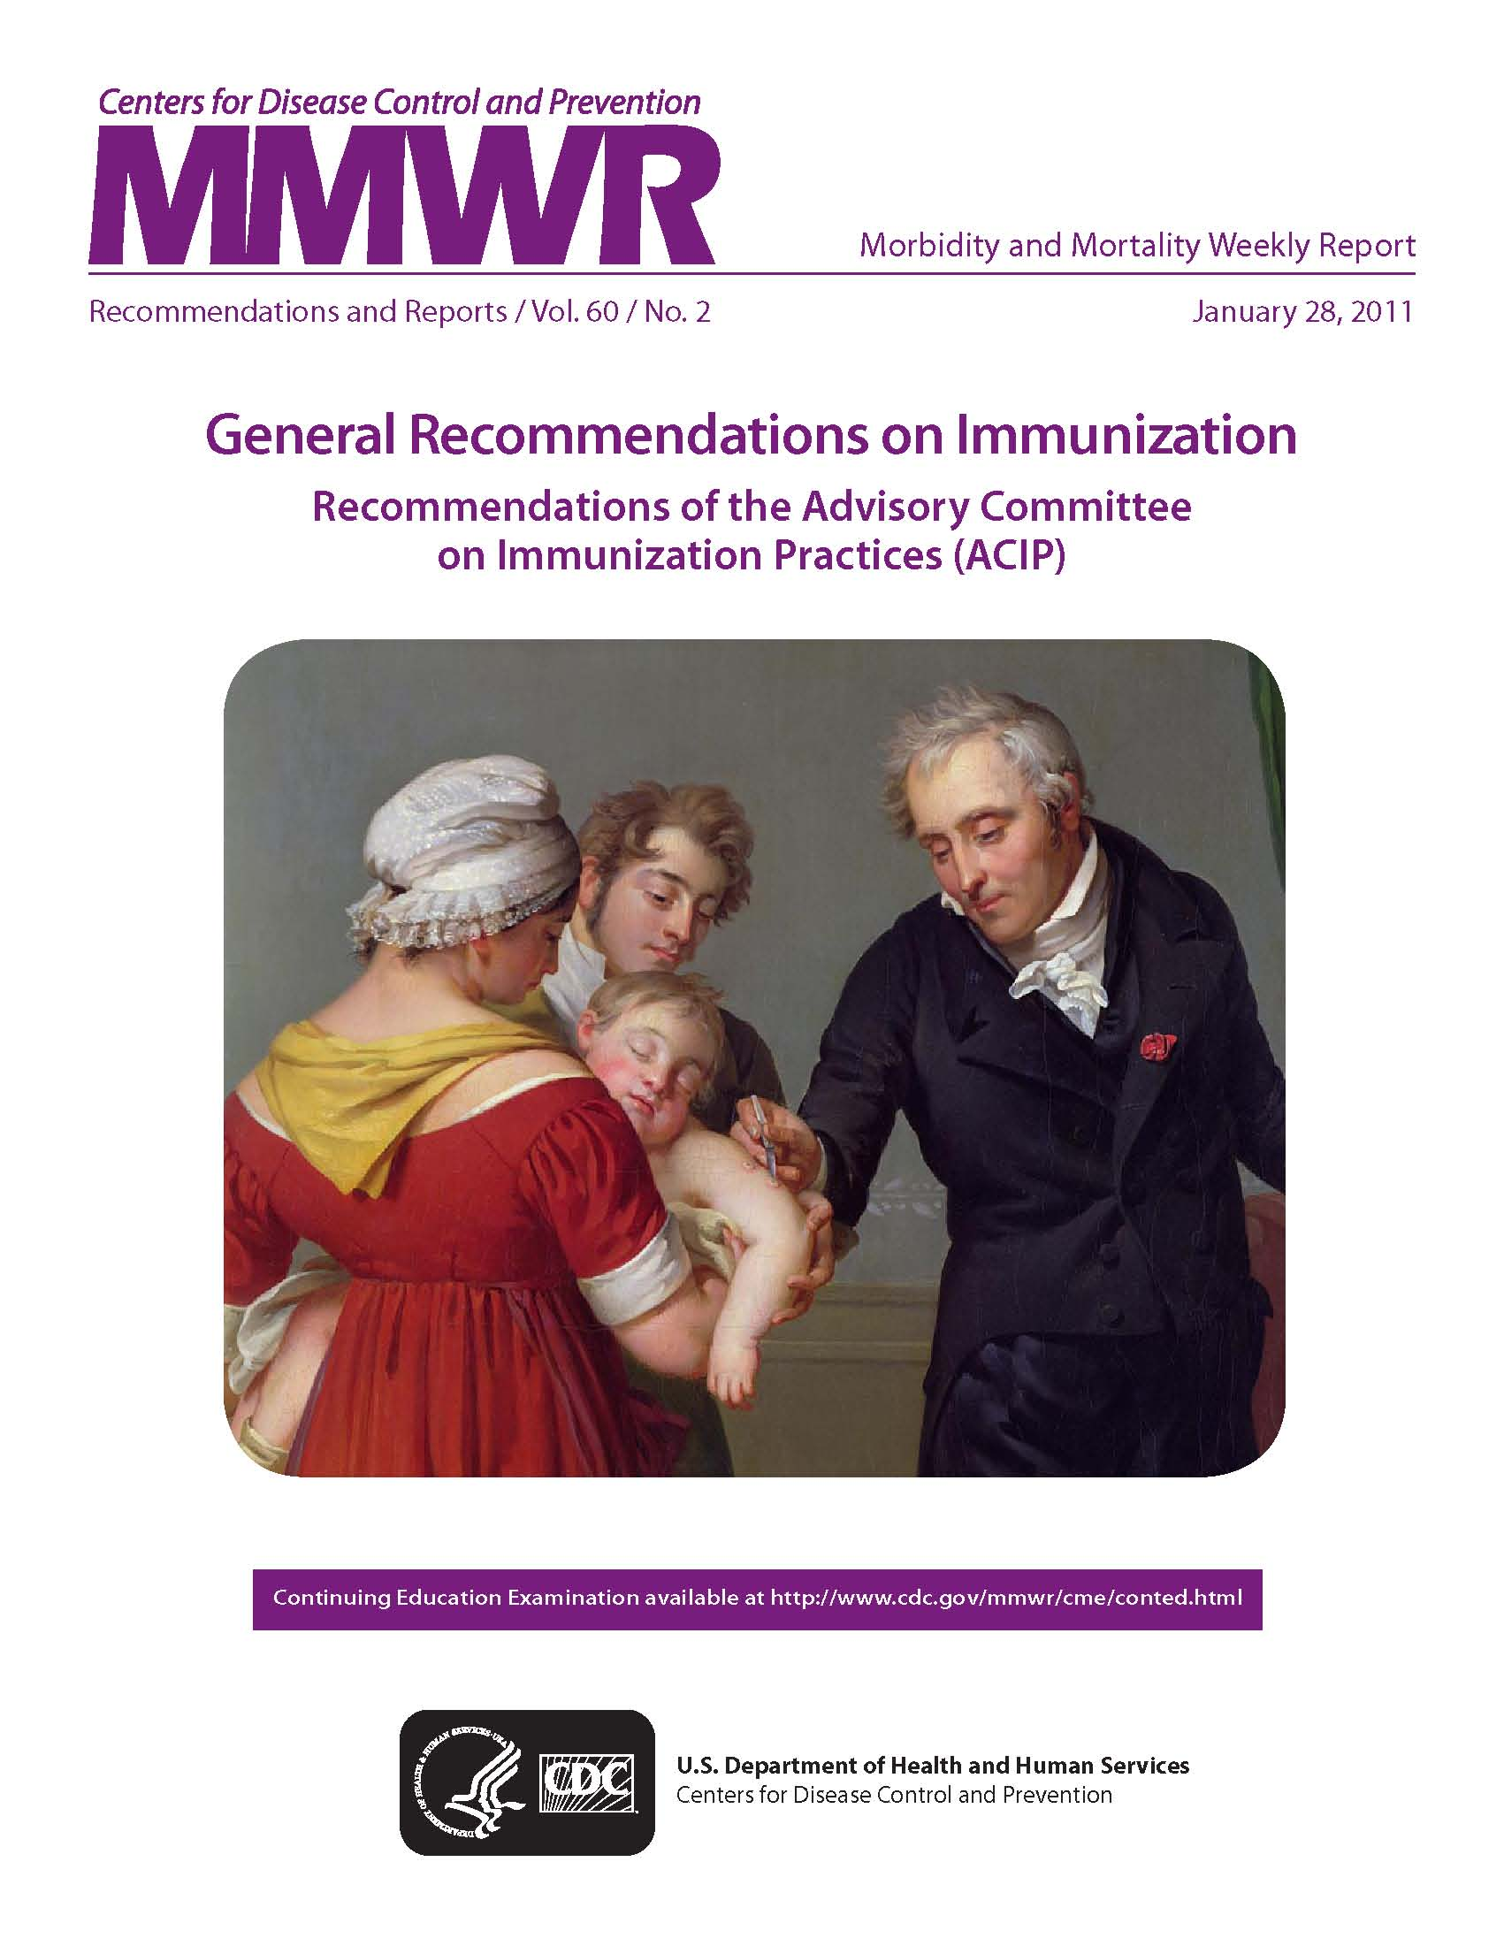
GENERAL RECOMMENDATIONS ON IMMUNIZATION
Published
January 2011
Notes:
The picture of the updated General Recommendations on Immunization shows a child being vaccinated against smallpox. It was published January 2011.
The principal changes from the 2002 version are:
expansion of the discussion of vaccination spacing and timing
an increased emphasis on the importance of injection technique/age/body mass in determining appropriate needle lengths
expansion of the discussion of storage and handling of vaccines with a table defining the correct storage temperature range for individual vaccines
expansion of the discussion of altered immunocompetence
minor changes to the recommendations about vaccination during pregnancy and vaccination of internationally adopted children
Most ACIP statements address a single vaccine or vaccination issue. The General Recommendations on Immunization is unique among ACIP statements because it provides guidance on vaccination issues common to more than one vaccine.
The document is revised on an ad hoc basis, generally every 3 to 5 years.
It was first published in November 1976, and has been revised four times since then.

Slide 9
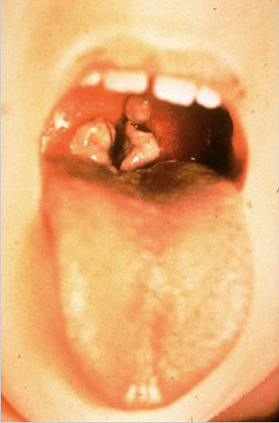
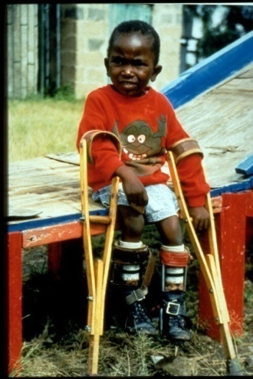
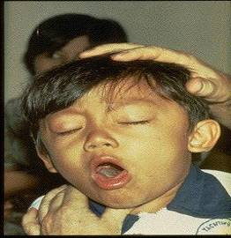
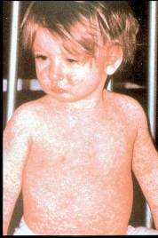
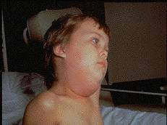
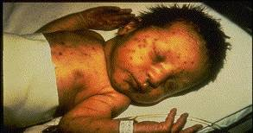
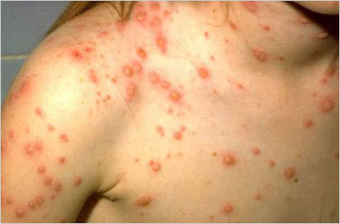
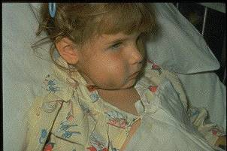
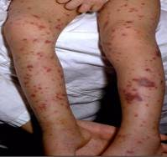
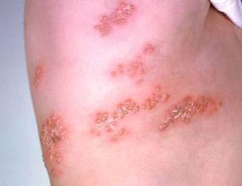
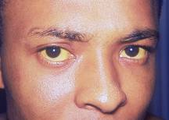
Why Do We Immunize?
We Immunize To Prevent These Diseases

Slide 10
20th Century Peak & Current Morbidity for VPDs
Disease | Prevaccine (in peak year) | 2012 | % Reduction of Cases
Diphtheria | 30, 508 | 1 | 99.9
Measles | 763,094 | 55 | 99.9
Mumps | 212,932 | 229 | 99.9
Pertussis | 265,269 | 48,277 | 81.8
Paralytic polio | 63,302 | 0 | 100
Rubella | 488,796 | 9 | 99.9
Tetanus | 601 | 37 | 93.8
Hib, type b (age < 5 yrs.) | 20,000 (yearly average in 1980’s) | 30, plus 210 of unknown type | >99.8
MMWR (Weekly), August 23, 2013, 62(33); 669-682
Notes:
The 2nd column of this chart shows the number of cases in the peak year of the 20th century (prevaccine) for each of the VPDs listed in the 1st column.
The 3rd column shows the number of cases reported in 2012.
The last column shows the percent reduction in those disease cases after the introduction of vaccine.
You can clearly see the impact vaccines have made. However, pertussis is the only vaccine-preventable disease with increasing case numbers and without a percent reduction < 90%. Pertussis is the only VPD that is on the rise; increasing by 61.2% from 2011 to 2012.
Of the 55 measles cases in 2012, 34 were indigenous and 21 were imported
In 2012, there were 13,447 cases of varicella (chickenpox); 3 deaths from chickenpox
In addition, it has been estimated that vaccination with 7 of the 12 routinely recommended childhood vaccines prevents an estimated 33,000 deaths and 14 million cases of disease in every birth cohort, saves $10 billion in direct costs in each birth cohort, and saves society an additional $33 billion in costs that include disability and lost productivity.*
* Zhou F, Santoli J, Messonnier JL, et al. Economic evaluation of the 7-vaccine routine childhood immunization schedule in the United States, 2001, Archives of Pediatric & Adolescent Medicine, 2005;159(12):1136-1144.

Slide 11
Herd Immunity
Immunized individuals block infection from reaching those who are unimmunized
UNIMMUNIZED
INFECTED
INFECTED
INFECTED
= immunized
Notes:
It is probably unrealistic to believe we can immunize everyone appropriately. There will always be young infants who have not received all recommended vaccines because of age and there are a significant number of adults who are not adequately immunized. Herd immunity refers to a situation in which a high percentage of a population is immune to a disease, essentially stopping the disease in its tracks because it cannot find new hosts. The threshold for herd immunity varies, depending on the disease, with more virulent infectious agents requiring vaccination of a higher percentage of the population to create the desired herd immunity. Most vaccination policies are focused on creating herd immunity. The creation of herd immunity is especially important in crowded environments which facilitate the spread of disease, like schools. It is also extremely important to receive regular boosters, as some vaccines lose their efficacy over time, leaving people vulnerable to an outbreak. Herd immunity led to the eradication of smallpox, and it explains why diseases such as polio and diphtheria are rare in developed nations with established vaccination policies.

Slide 12
What You Need To Know About
Vaccine Preventable Diseases
Notes:
12
Many healthcare workers, patients and parents of young children and adolescents have grown up in the vaccine era. They are not familiar with the world we lived in before the availability of vaccines when most children were infected with whooping cough, measles, mumps, and chicken pox during their preschool or school years. These diseases were called “childhood diseases” because most children had these diseases during their childhood years. Most children were sick for a short period of time and recovered. Some children developed complications and some were left with permanent physical and/or mental disabilities. Some died as a result of these diseases.
A much smaller number of children were infected with Haemophilus influenza, type b, pneumococcus, meningococcus and polio. Their course of illness was much more severe and complications and death were more common.
Adults who were not immune to these infections because they were not infected during childhood could contract these diseases after adolescence and experience a much more severe illness.
Patients and parents may ask about these diseases. Therefore, it is important for healthcare providers to be familiar with the symptoms of these vaccine preventable diseases.
YOU MUST KNOW ABOUT THESE DISEASES TO BE A
BETTER ADVOCATE FOR IMMUNIZATIONS

Slide 13
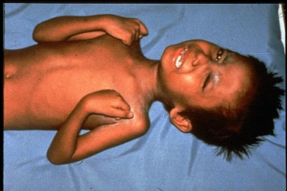

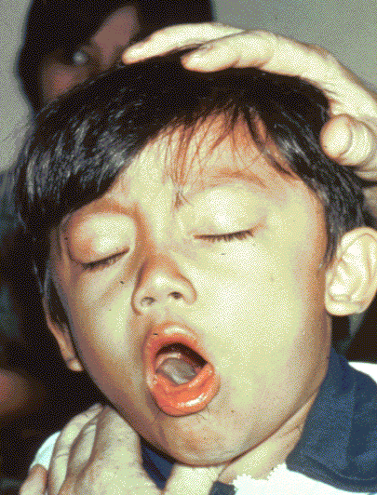

Diphtheria
Tetanus
Required for school and child care attendance
Pertussis
Notes:
The second vaccine listed on the schedule, DTaP, protects against diphtheria, tetanus and pertussis, or whooping cough.
diphtheria, tetanus, and pertussis are illustrated on this slide
The top left picture is of a throat of a child who has diphtheria. You can see the thick gray coating over the back of the throat. This coating can eventually expand down through the airway, and if not treated, a person could die from suffocation, or suffer other complications such as paralysis, heart failure, or coma.
In the top right picture, this child is experiencing painful muscle spasms from tetanus. It is nearly impossible for him to move or control the muscles in his body. He cannot eat because the muscles in his mouth have become so tight and it is difficult for him to swallow. Other possible complications are broken bones from muscle spasms, breathing problems, and death.
The bottom picture shows a child who is suffering from pertussis, commonly know as “whooping cough”. He is experiencing coughing spasms, which produce a “whooping” sound. The sound occurs because the child is trying to catch his breath before the next round of coughing. Often children have difficulty breathing and experience vomiting and exhaustion from the severe coughing.
The recommendations for administering DTaP did not change since last year. Pertussis cases and infant deaths have increased over the past couple of years. Often infants who are too young to have completed their initial vaccination series, contract the disease from an older child or an adult in their household. Currently the DTaP vaccine is licensed for persons under 7 years of age. Two acellular pertussis vaccines were licensed in 2005 that can now be given to older children and adults. Hopefully this will decrease the number of young infants who contract this disease. We will discuss Tdap and Td after we cover DTaP.
Optional information about diphtheria, tetanus, and pertussis:
The diphtheria germ lives in the throat and mouth of the infected person.
The disease is spread through direct contact with the infected person.
Now we don’t see as much of this disease in the United States.
The tetanus germ lives in dirt and the intestines and the feces of animals
The germ enters the body through cuts, punctures, burns, and other wounds.
However, there are still outbreaks throughout the world, and the danger is for an international traveler to bring infection into the US.
Most cases of tetanus reported occur in adults who have not been immunized or who are under immunized; i.e., they have not received boosters to maintain a level of protection.
The pertussis germ lives in the mouth, nose, and throat of the infected person.
The germ is spread from person to person by coughing and sneezing.
Pertussis vaccine is given to prevent pertussis in infants and children.
Other complications include pneumonia, seizures, and death. Adults may also get pertussis, but they usually do not get very sick and may not be aware they have the disease.

Slide 14
Diphtheria, Tetanus and Pertussis Vaccines for Children and Adolescents
Infants and young children: 5 dose series of DTaP
  -At 2, 4, 6, 15-18 months and 4-6 years
  -Do not give DTaP after 6 years of age
Older Children and Adolescents: Booster Dose of Tdap*
  -one dose to all 11 through 12 years; Catch-up for all adolescents who have not received Tdap
  -Use Tdap regardless of interval since last Td
Effective July 1, 2014 children born on or after January 1, 2002 who are attending seventh grade, and children who are new entrants into a Georgia school in grades eight through twelve, must have received one dose of Tdap vaccine.
Ref: Updated Recommendations for Use of Tdap Vaccine from ACIP, 2010 MMWR 2011; 60(01);13-15 Jan 14, 2011
Notes:
14
14
Ref: Updated Recommendations for Use of Tdap Vaccine from ACIP, 2010 MMWR 2011; 60(01);13-15 Jan 14, 2011
Effective July1, 2014
-children born on or after January 1, 2014 who are attending seventh grade, and children who are new entrants into a Georgia School in grades eight through twelve, must have received one dose of Tdap vaccine.

Slide 15
Immunize Pregnant Adolescents with Tdap
-One dose of Tdap should be administered during each pregnancy, irrespective of the prior history of receiving Tdap.
-To maximize the maternal antibody response and passive antibody transfer to the infant the optimal timing for the administration of Tdap is between 27 and 36 weeks gestation.
-If Tdap is not given during pregnancy, and has not been given previously, administer Tdap immediately postpartum³.
With the exception for pregnant women, ACIP does not recommend a second dose of Tdap for adolescents and adults.
Reference: 1. MMWR February 22, 2013; 62 (7); 131-135
Notes:
15
Two Tdap vaccines are licensed in the United States.
Boostrix (GlaxoSmithKline Biologicals, Rixensart, Belgium) is approved for use in persons aged 10 years and older.
Adacel (Sanofi Pasteur, Toronto, Canada) is approved for use in persons aged 11 through 64 years.
Updated recommendation
For adults aged 19 years and older who previously have not received a dose of Tdap, a single dose of Tdap should be given.
Tdap should be administered regardless of interval since the last tetanus or diphtheria toxoid-containing vaccine.
There is no recommendation for a routine booster dose of Tdap.
Guidance on use of Tdap products for adults aged 65 years and older
Providers should not miss an opportunity to vaccinate persons aged 65 years and older with Tdap, and may administer the vaccine that is available.
When feasible, for adults aged 65 years and older, Boostrix should be used; however, either vaccine product administered to a person aged 65 years and older provides protection and is considered valid.
Guidance on use of Tdap products for pregnant women:
All pregnant women should receive a dose of Tdap during each pregnancy, irrespective of prior history of receiving Tdap. Optimal timing for administration is between 27 and 36 weeks gestation. If a dose is given early in that same pregnancy, do NOT repeat it at 27-36 weeks. If not given during pregnancy, give Tdap immediately postpartum³.
References:
1. ACIP Updated Recommendations for Use of Tdap, 2010, MMWR January 14, 2011; 60 (1); 13-15
2.ACIP Updated Recommendations for Use of Tdap in Adults Aged 65 Years and Older, MMWR June 29, 2012; 61(25);468-470
3. MMWR, February 22, 2013, Vol 62, #7
4. www.immunize.org, Ask the Experts, Tetanus section, IAC, Sept. 2013

Slide 16







Cocooning Strategy
Parents
Siblings
Child Care Provider
Grandparents
Healthcare Worker
Notes:
An infant who is infected with pertussis under 6 months of age can experience a devastating disease, frequently resulting in death, because the infant can not tolerate the severe inflammation of the respiratory tract. The primary series of DTaP is usually not completed until 6 months of age. Therefore, the best method to prevent the infant from infection with pertussis is to eliminate exposure to the disease. This is accomplished by immunizing ALL caregivers with Tdap vaccine. This is called the “Cocooning Strategy”. Ninety percent of pertussis deaths between 2000-2009 were in infants less than 3 months of age.

Slide 17
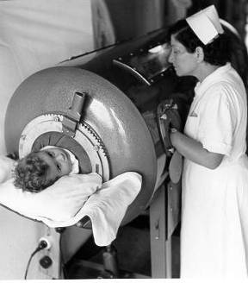
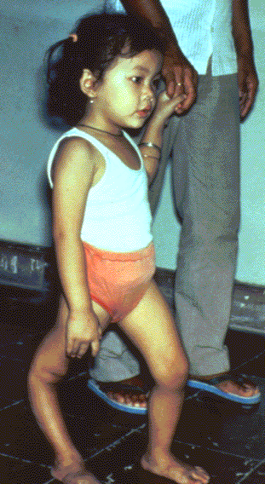
Polio
For infants & children: 4 doses of IPV:
  Dose @ 2, 4, and 6 – 18 months of age (usually administered at 12 – 18 months)
  Dose 4 @ 4 through 6 years of age
Final dose at 4 years of age or older regardless of the number of previous doses; at least 6 months following previous dose required
Single lifetime booster for travel to polio-endemic countries (Check www.cdc.gov/travel)
Required for school and childcare attendance
Ref. MMWR 2009; 58 (30);829-830 (August 7, 2009)
Source: World Health Organization
Notes:
17
17
17
Slide shows child in an iron lung due to weak respiratory muscles (common in polio era) This child has a severely deformed leg due to polio. However, different areas of the body may be affected. In the 1950’s, when a person’s respiratory muscles were paralyzed, they were placed in iron lung machines and a child with muscle weakness, as a result of polio, requiring the assistance of braces and crutches in order to walk.
IPV is the only polio vaccine listed on the schedule. IPV has been the only polio vaccine routinely recommended for all four doses of polio, since Jan 2000.
OPV is no longer being manufactured in the US. The last production lot expired in November, 2000.
All the General Recommendations that apply to inactivated vaccines apply here.
Optional polio information:
Polio is a virus and lives in the throat and intestines of an infected person and is spread by direct contact. It can be spread to other people through contact with feces. This is an example of good hand washing being crucial in preventing the transmission of disease, in addition to being immunized.
Thankfully, the incidence of this disease has decreased and we do not see this disease in the US anymore. In fact, the last case due to wild polio virus in GA was in 1979,and until July of 2000, the last case in the Western Hemisphere was in 1991 in Peru. In 2001, there was an outbreak of polio ( 20 reported cases as of 12/00) in the Dominican Republic. We still immunize because we are a global society and there is a danger of international importation of this virus. Our goal is to have polio as the next vaccine preventable disease that is eliminated worldwide.
The recommendations for an all IPV schedule:
First dose at 2 months of age
Second dose at 4 months of age
Third dose at 6 months of age
Fourth dose at 4-6 years of age
The minimum time interval between 1-3 doses is 4 weeks, the minimum time interval between the 3rd and 4th dose is 6 months.
The final dose in the series should be administered on or after the 4th birthday and at least 6 months following the previous dose.
• If 4 doses are administered prior to age 4 years a fifth dose should be administered at age 4 through 6 years. See MMWR 2009;58(30):829–30.
For children on a catch up Immunization schedule:
A fourth dose is not necessary if the third dose was administered at age 4 years or older and at least 6 months following the previous dose.
Oral polio vaccine still used in third world countries where polio is still endemic (Mainly in Nigeria, India, Pakistan, and Afghanistan). Other countries in Africa have had small outbreaks.
For additional information about polio refer to: Epidemiology and Prevention of Vaccine-Preventable Diseases, 12th edition May 2011. HHS, CDC.

Slide 18
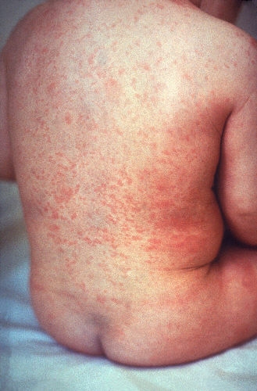
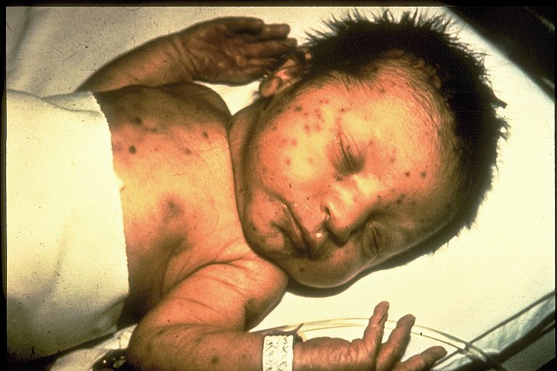
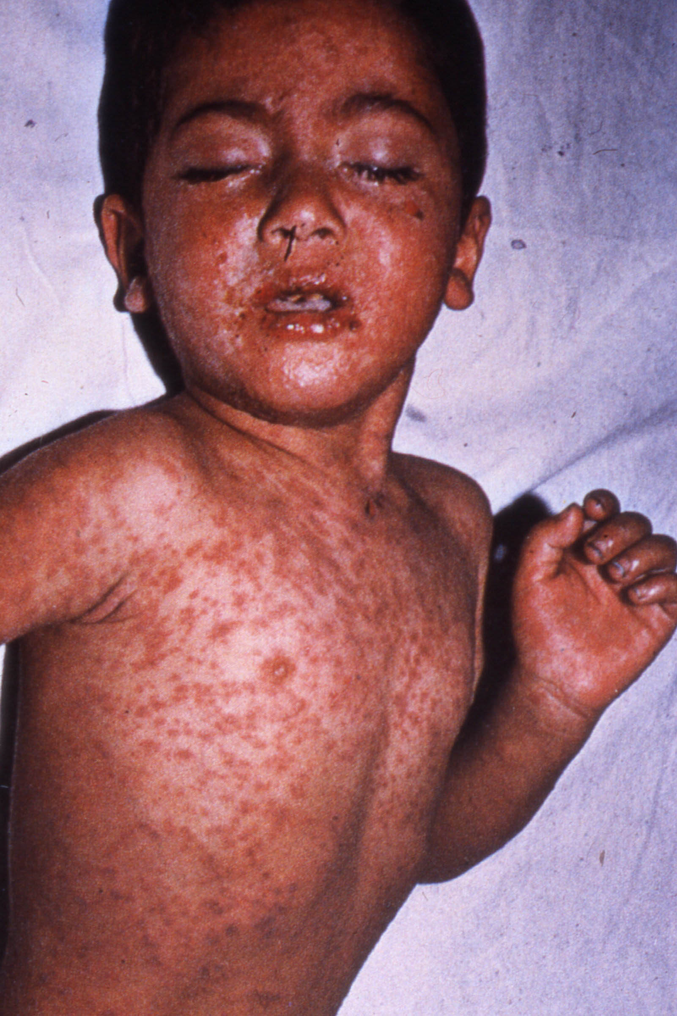
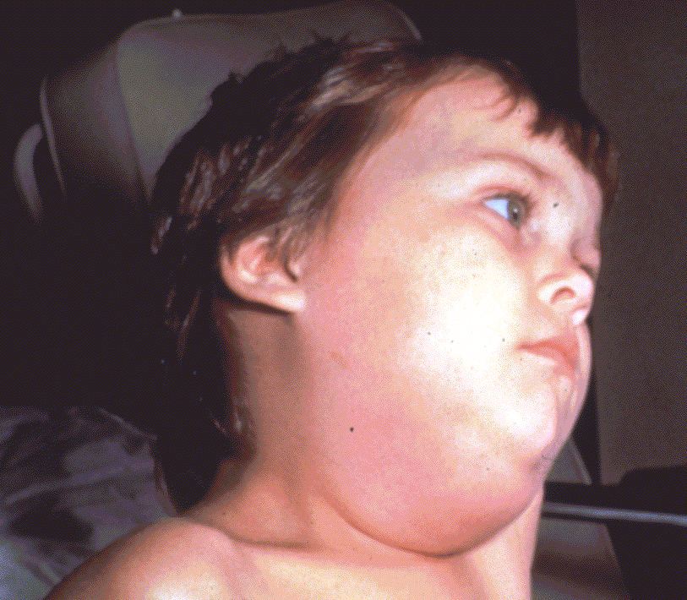
Rubella
Measles
Required for school and child care attendance
Mumps
Notes:
Measles, Mumps, and Rubella vaccine or MMR protects against these diseases.
We now have a new vaccine, MMRV, which provides the same protection in addition to varicella immunity. We will discuss this combination vaccine later.
The child in the top left slide has a bad rash caused by measles. The rash usually begins along the hairline and moves downward over the course of 4 days to the face, neck, body, hands, and feet.
The bottom slide illustrates a child who has the mumps. As you can see, the child is swollen under the jaw and in the cheeks. She may have a fever and headache
The 2 pictures on the top right of the slide show a rubella rash on a young child, and also an infant suffering from congenital rubella syndrome, a potentially very devastating form of rubella.
The routine recommendations and footnotes for measles, mumps, and rubella did not change.

Slide 19
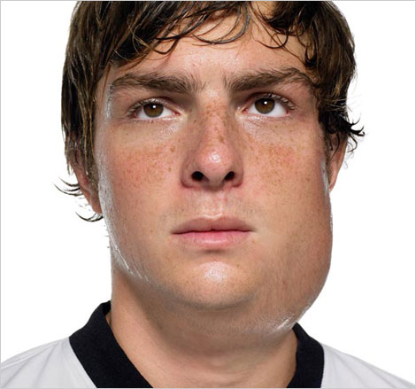
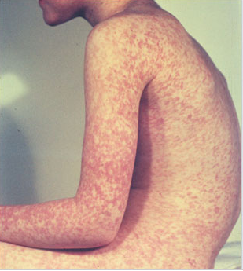
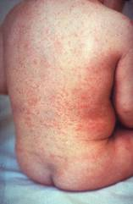
Measles, Mumps, Rubella
Measles (M)
Source: Creative Commons
Mumps (M)
Source: American Academy of Pediatrics
Red Book On Line Visual Library
Rubella (R)
Congenital Rubella (R)
Notes:
19
19
MEASLES (caused by paramyxovirus)
Slide shows two children with typical measles rash and conjunctivitis in younger child
Initial symptoms are runny nose, followed by increasing fever (103º-105º), cough, conjunctivitis, Koplik spots, and a maculopapular rash that lasts 5-6 days
Complications include otitis media (7%), pneumonia (6%), and acute encephalitis (0.1%) 1 in 1000 cases, death (0.2%) Although measles elimination was declared in the United States in 2000 , importation of measles cases continues to occur. CDC evaluated cases reported by 16 states during January 1–August 24, 2013. A total of 159 cases of measles were reported during this period.
MUMPS (caused by paramyxovirus)
Slide shows an adolescent with parotitis due to mumps
Parotitis occurs in 30-40% of infected persons, 40-50% have only nonspecific or respiratory symptoms
Complications include aseptic meningitis, & deafness
Post pubertal individuals may have orchitis, ovarian inflammation, & pancreatitis
RUBELLA (Caused by togavirus)
In children, the rash may be the first manifestation of infection. Adults may have low-grade fever, malaise, URI, and lymphadenopathy prior to rash. Arthralgia and arthritis is common in adults, especially women. Complications include encephalitis and hemorrhagic manifestations
Rubella is no longer endemic in the U.S. However, it is still present in other countries and can be imported
CONGENITAL RUBELLA
Slide shows an adult and child with a typical rash from rubella and an infant with congenital rubella syndrome Infant was infected in utero and has “blueberry muffin spots” on skin due to petechial lesions, cataracts, hearing loss and congenital heart lesion and will most likely be developmentally delayed.
All woman of child bearing age should be certain they are immune to rubella.
For additional information refer to: Epidemiology and Prevention of Vaccine-Preventable Diseases, 12th edition May 2012. HHS, CDC.

Slide 20
MMR Vaccine
2 Dose Series for children
  Dose 1 @ 12 through 15 months of age
  Dose 2 @ 4 through 6 years of age
Acceptable presumptive evidence of MMR immunity¹
Documentation of age appropriate vaccination with MMR vaccine
Laboratory evidence of immunity
Laboratory confirmation of disease
Birth before 1957
Birth date not acceptable evidence of rubella immunity for women who could become pregnant
1. Recommendations and Reports June 14, 2013 / 62(RR04);1-34
Notes:
20
20
20
MMR vaccine has been successful in reducing the cases of measles in the United States and many young physicians, physician’s assistants and nurse practitioners have never seen an acute case of measles. The symptoms of measles are more than a rash and include conjunctivitis, fever and white lesions (Koplik spots) on the buccal mucosa. Practitioners who have not seen a case of measles sometimes make a diagnosis solely on the basis of a rash. Serologic testing is now required to confirm a case of measles.

Slide 21
Recommendations for use of
MMRV (ProQuad®)
Licensed for ages 12 months through 12 years
Dose 1 at ages 12 through 47 months
Either MMR and varicella vaccines or MMRV vaccine can be used.
Providers who are considering administering MMRV should discuss the benefits and risks of both vaccination options with the parent or caregiver.
Unless the parent or caregiver expresses a preference for MMRV vaccine, CDC recommends that MMR vaccine and varicella vaccines should be administered for the first dose in this age group.
Dose 1 or 2 given at ages 48 months and older
MMRV vaccine generally is preferred over separate injections of its equivalent component vaccines (i.e., MMR and varicella vaccines).
Ref. MMWR Recommendations and Reports Vol. 59/RR-3 May 7, 2010
Notes:
Dose 1 at Ages 12 through 47 Months
For the first dose of measles, mumps, rubella, and varicella vaccines at ages 12 through 47 months, either MMR and varicella vaccines or MMRV vaccine can be used. Providers who are considering administering MMRV vaccine should discuss the benefits and risks of both vaccination options with the parents or caregivers. Compared with use of MMR and varicella vaccines at the same visit, use of MMRV vaccine results in one fewer injection but is associated with a higher risk for fever and febrile seizures 5 through 12 days after the first dose among children aged 12 through 23 months* (about one extra febrile seizure for every 2,300–2,600 MMRV vaccine doses). Use of MMR and varicella vaccines avoids this increased risk for fever and febrile seizures following MMRV vaccine. Providers who face barriers to clearly communicating these benefits and risks for any reason (e.g., language barriers) should administer MMR and varicella vaccines.
Dose 1 at Ages 48 Months and Older and Dose 2 at any Age
For the first dose of measles, mumps, rubella, and varicella vaccines at ages 48 months and older and for dose 2 at any age (15 months through 12 years), use of MMRV vaccine generally is preferred over separate injections of its equivalent component vaccines (i.e., MMR and varicella vaccines). Considerations should include provider assessment†, patient preference, and the potential for adverse events.
Of note, the routinely recommended ages for measles, mumps, rubella and varicella vaccination continue to be 12 through 15 months of age for dose 1 and 4 through 6 years of age for dose 2.
Other MMRV Vaccine-related Guidance
New precaution for MMRV Vaccine Use
A personal or family (i.e., sibling, parent) history of seizures is a precaution for MMRV vaccination. Studies suggest that children who have a personal or family history of febrile seizures or family history of epilepsy are at increased risk for febrile seizures compared with children who do not have such histories. Children with a personal or family history of seizures generally should be vaccinated with MMR and varicella vaccines because the risks of using MMRV vaccine in this group of children generally outweigh the benefit of MMRV vaccine.
CDC has developed materials to help with the implementation of the updated recommendations for use of MMRV vaccine:
www.cdc.gov/vaccines/vpd-vac/combo-vaccines/mmrv/vacopt.htm
* The 47 month cut-off was chosen on the basis of the epidemiology of febrile seizures: first febrile seizures are uncommon after age 4 years, approximately 94% of febrile seizures occur in children aged less than 4 years.
† Provider assessment should include the number of injections, vaccine availability, likelihood of improved coverage, likelihood of patient return, and storage and cost consideration.
This document can be found on the CDC website at: http://www.cdc.gov/mmwr/preview/mmwrhtml/rr5903a1.htm

Slide 22
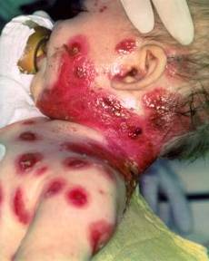
Varicella
(Chickenpox)
© Copyright American Academy of Pediatrics
Routine Recommendations for Varicella Vaccine
Dose 1 @ 12 months through 15 months of age
Dose 2 @ 4 through 6 years of age*
Those 13 years of age or older without evidence of immunity should receive 2 doses separated by 4 to 8 weeks.
Required for school and child care attendance
*Second dose can be administered at an earlier age provided the interval between the first and second dose is at least 3 months.
Notes:
22
22
Slide shows an adolescent with typical varicella rash and infant with secondary bacterial infected varicella lesions, probably due to staph or strep
Chicken pox or varicella is caused by the varicella zoster virus
Prior to licensure of varicella vaccine approximately 100 previously healthy children died from chicken pox each year
Newborns are in the highest risk group if maternal rash is 5 days before or 2 days after delivery
Adults are 25 times more likely to die than children
Varicella Vaccine:
Live attenuated virus vaccine licensed in Japan and Korea in 1988, and in U.S. in 1995
One dose of vaccine is 85% effective; two doses provide nearly 88-98% efficacy.
Breakthrough chicken pox may occur individuals who have received the vaccine
All cases of breakthrough chicken pox have been mild
Vaccine may be effective in preventing illness if given within 3 days and possibly up to 5 days after exposure.
The requirements for children entering kindergarten and sixth (6th) grade, or students entering a Georgia school for the first time in any grade (kindergarten through 12th grade) are two (2) doses of a varicella-containing vaccine, or healthcare provider documentation of immunity from disease history or serologic proof of immunity.
Preteen children who were up-to-date with one dose of varicella vaccine prior to starting school may not have received the second dose, so should receive it as soon as possible.
Reference: Prevention of Varicella - Recommendations of the Advisory Committee on Immunization Practices (ACIP) MMWR (2007);56(No. RR-4):23

Slide 23
Immunity
What are the criteria for evidence of immunity to varicella?
ACIP considers evidence of immunity to varicella to be
Documentation of 2 doses of vaccine given no earlier than age 12 months, with at least 3 months between doses for children younger than age 13 years, or at least 4 weeks between doses for people age 13 years and older
• U.S.-born before 1980*
• A healthcare provider's diagnosis of varicella or verification of history of
varicella disease
• History of herpes zoster, based on healthcare provider diagnosis
• Laboratory evidence of immunity or laboratory confirmation of disease
*Note: year of birth is not considered as evidence of immunity for healthcare
personnel, immunosuppressed people, and pregnant women.
Notes:
If a healthcare worker does not have a history of varicella vaccination or disease but has had a clinically diagnosed case of shingles, does she or he still need varicella vaccination?
No. A healthcare provider's diagnosis or verification of a history of shingles is acceptable evidence of immunity to varicella. According to ACIP, acceptable evidence of varicella immunity in healthcare personnel includes (1) documentation of 2 doses of varicella vaccine given at least 28 days apart, (2) history of varicella or herpes zoster based on physician diagnosis, (3) laboratory evidence of immunity, or (4) laboratory confirmation of disease.
Should a child who has had chickenpox prior to the first birthday get the first dose of varicella vaccine at age 1 year?
If the child had confirmed varicella disease or laboratory evidence of prior disease, it is not necessary to vaccinate regardless of age at infection. If there is any doubt that the illness was actually varicella, the child should be vaccinated.

Slide 24


Pneumococcal Disease
Required for child care and pre-K attendance
Notes:
Pneumococcal vaccines are the next vaccines on the list . Note that there are 2 types of pneumococcal vaccines on the schedule :
PCV13 or Pneumococcal Conjugate Vaccine and
PPSV23 or Pneumococcal Polysaccharide Vaccine
Both vaccines protect against pneumococcal disease caused by serotypes of Streptococcus pneumoniae.The major clinical syndromes of pneumococcal disease include pneumonia, bacteremia, and meningitis.
However each of these vaccines due to their composition are effective in protecting different age groups.
Here you see in the picture on the left, a child with asplenia and evidence of thrombocytopenic purpura on her face from invasive pneumococcal disease. Picture on the right: Orbital cellulitis with edema and erythema.
There were no changes in the recommendations for PCV or PPSV.
All the General Recommendations apply here with the exceptions of #1 & 2, when it concerns spacing with the other pneumococcal vaccine, pneumococcal polysaccharide.
This vaccine will become a requirement for pre-K and childcare attendance as of 7-1-07.
Pneumococcal disease is caused by a bacterium, Streptococcus pneumoniae, also called pneumococcus (about 90 known serotypes)
Causes pneumonia, bacteremia, meningitis and otitis media
Highest rate of invasive disease is in children less than 2 years
Increased risk of infection in children with HIV infection, sickle cell disease, asplenia, day care attendees and in certain ethnic groups (African Americans, Alaskan natives and Native Americans)
Increased risk in children & adults with cardiovascular disease, pulmonary disease, diabetes, alcoholism, cirrhosis, immunocompromising conditions
Individuals who have asthma and those who smoke cigarettes are also at increased risk
Estimated cases in the US each year more than any other vaccine-preventable disease
Some serotypes of pneumococcus have become resistant to antibiotics

Slide 25
Pneumococcal Conjugate Vaccine
(PCV13)
ACIP recommends PCV13 for:
  All children 2 through 59 months of age
  Children 60 through 71 months who have underlying medical conditions that increase their risk of pneumococcal disease or complications
  Children and adolescents aged 6 through 18 years with immunocompromising conditions, functional or anatomic asplenia, CSF leaks or cochlear implants who have not previously received PCV 13
Ref: 1.Prevention of Pneumococcal Disease Among Infants and Children – Use of 13-Valent Pneumococcal Conjugate Vaccine and 23-Valent Pneumococcal Polysaccharide Vaccine Recommendations of the Advisory Committee on Immunization Practices (ACIP) MMWR Vol. 59 (No. RR-11) December 10, 2010.
2. Use of 13-Valent Pneumococcal Conjugate Vaccine and 23-Valent Pneumococcal Polysaccharide Vaccine Among Children Aged 6-18 Years with Immunocompromising Conditions: Recommendations of ACIP MMWR Vol. 62 (No. 25) June 28, 2013.
Notes:
25
The number of doses of PCV13 recommended will depend on the age of the child and the number of doses of PCV7 given previously. Practitioners should refer to the detailed ACIP recommendations/guidelines for each child.
*Particularly cyanotic congenital heart disease and cardiac failure
† Including asthma if treated with prolonged high-dose oral corticosteroids
§ Includes B- (humoral) or T-lymphocyte deficiency; complement deficiencies, particularly C1, C2, C3, and C4 deficiency; and phagocytic disorders (excluding chronic granulomatous disease)
EPIC 2013
25

Slide 26
Pneumococcal Polysaccharide Vaccine for Children (PPSV23)
Recommended for children 2 years and older with underlying medical conditions:
  Sickle cell disease, functional or anatomic asplenia, immunocompromising conditions
  Immunocompetent children with chronic illness:
  heart disease, chronic lung disease, diabetes mellitus,
  CSF leaks, or cochlear implant
Administer ≥8 weeks after last indicated dose of PCV13
Children with sickle cell disease, functional or anatomic asplenia, immunocompromising conditions should receive a second dose of vaccine 5 years after the first dose of PPSV23
Ref: MMWR 2010; 59/RR-11 December 10, 2010
Notes:
26

Slide 27
Pneumococcal Polysaccharide Vaccine for Adults (PPSV23)
Recommended for:
  Adults 65 years and older
  Persons aged 2 through 64 years with medical conditions that increase their risk for pneumococcal infection
  Persons 19 through 64 years with asthma
  Cigarette smokers 19 years of age and older
Persons who received PPSV23 before age 65 years should receive a second dose of vaccine at age 65 years or later if at least 5 years have passed since the previous dose.
A third dose of PPSV23 may be recommended for persons with immunocompromising conditions, and/or functional or anatomic asplenia.
Ref: Updated Recommendations for Prevention of Invasive Pneumococcal Disease Among Adults Using the 23-Valent Pneumococcal Polysaccharide Vaccine (PPSV23) MMWR 2010; 59(34);1102-1106 September 3, 2010
Notes:
27
27
27
Updated recommendations for administration of 23-valent pneumococcal polysaccharide vaccine (PPSV23) among adults aged ≥19 years — Advisory Committee on Immunization Practices (ACIP), United States
• PPSV23 should be administered to adults aged 19–64 years with chronic or immunosuppressing medical conditions, including those who have asthma.
• Adults aged 19–64 years who smoke cigarettes should receive PPSV23 and smoking cessation guidance.
• All persons should be vaccinated with PPSV23 at age 65 years. Those who received PPSV23 before age 65 years for any indication should receive another dose of the vaccine at age 65 years or later if at least 5 years have passed since their previous dose. Those who receive PPSV23 at or after age 65 years should receive only a single dose.
• ACIP does not recommend routine revaccination for most persons for whom PPSV23 is indicated.
ACIP does recommend a third dose of PPSV23 in addition to PCV13 for some persons at increased risk for pneumococcal infection.
Ref: Updated Recommendations for Prevention of Invasive Pneumococcal Disease Among Adults Using the 23-Valent Pneumococcal Polysaccharide Vaccine (PPSV23) MMWR 2010; 59(34);1102-1106 September 3, 2010
See PCV13 slide for adults for information about a third dose of PPSV23.

Slide 28
Pneumococcal Conjugate Vaccine (PCV13) for Adults
Licensed for adults 50 years and older
Recommended by ACIP for use in adults 19 years and older with immunocompromising conditions, functional or anatomic asplenia, CSF leaks or cochlear implants.
Refer to ACIP recommendation for spacing between PPSV23 and PCV13 and timing of revaccination with PPSV23.
MMWR Vol. 61/No. 40 October 12, 2012
Notes:
28
28
28
ACIP Recommendations for Use of Pneumococcal Conjugate Vaccine (PCV13) for adults
Adults 19 years of age or older with immunocompromising conditions, functional or anatomic asplenia
No previous doses of PCV13 or PPSV23
One dose of PCV13 followed by PPSV23 at least 8 weeks later
Second dose of PPSV23 - 5 years after previous dose
Third dose of PPSV23 at age 65 or later if at least 5 years since previous dose
One dose of PPSV23 previously
One dose of PCV13 at least one year after last dose of PPSV23
Second dose of PPSV23 - 5 years after previous dose
Third dose of PPSV23 at age 65 or later if at least 5 years since previous dose
Adults 19 years of age or older with cochlear implants or CSF leaks
No previous doses of PCV13 or PPSV23
One dose of PCV13 followed by PPSV23 at least 8 weeks later
Second dose of PPSV23 at age 65 or later if at least 5 years since previous dose
One dose of PPSV23 previously
One dose of PCV13 at least one year after last dose of PPSV23
Second dose of PPSV23 at age 65 or later if at least 5 years since previous dose
ACIP Recommendation MMWR Vol. 61/ No. 40 October 12, 2012

Slide 29
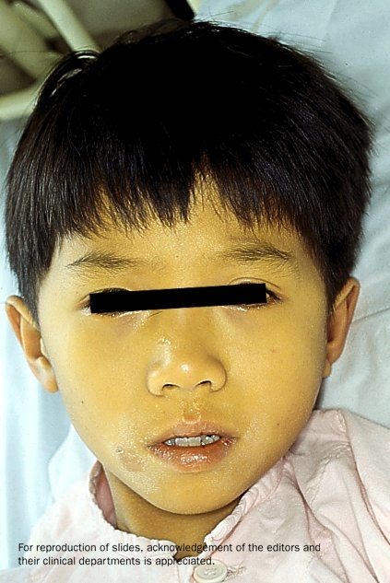

Hepatitis A
Required for school or child care attendance for children born on or after 1-1-06
Notes:
Now let’s look at hepatitis A vaccine .
The persons on this slide have hepatitis A . Note the jaundice of the skin and the sclera of the eye.
This vaccine is now routinely recommended for all children ages 12-23 months.
Optional information:
The nature of hepatitis A disease is that it is cyclical. It is spread by fecal/oral transmission.
Children plan an important role in HAV transmission. Symptomatic infection is uncommon in children, so they may be a source of infection for household or other close contacts. Almost half of persons with hepatitis A do not have an identified source of their infection. Groups of persons at risk for hepatitis A are international travelers, men who have sex with men, and illegal drug users. Food handlers are not at risk.

Slide 30
Hepatitis A Recommendations
All children aged 12 through 23 months are recommended to receive this vaccine
Children not vaccinated by age 2 years can be vaccinated at subsequent visits
Continues to be recommended for persons 2 years of age and older who are at high risk for disease
Requirement for entrance to school and child care as of
7-1-07 for those children born on or after 1-1-06.
Notes:
The Hepatitis A footnote on the schedule now states that this vaccine is routinely recommended for all children aged 12 through 23 months as noted in the 2007 Recommended Childhood Schedule.
Children not vaccinated by age 2 can be vaccinated at subsequent visits.
The vaccine continues to be recommended for persons 2 years of age and older who are at high risk for disease. Note the purple bar on the schedule
Existing Hep A vaccination programs for children 2-18 yrs. should be maintained and new programs implemented statewide as supply allows..
Will become a requirement for entrance to school and child care 7-1-07 for those children born on or after 1-1-06.
If you are a VFC provider, and a VFC-eligible child between 12 months and 18 years of age requests hepatitis A vaccine, you should give him/her the vaccine from VFC stock.

Slide 31
Hepatitis A Vaccination of Adults
Adults at high-risk of acquiring hepatitis A infection should be immunized:
      Those traveling or working in countries with high or intermediate endemicity of infection
      Men who have sex with men
      Users of injecting and non-injecting drugs
      Persons working with HAV positive primates or with HAV in research laboratory settings
      Contact with adoptees from countries with high rates of hepatitis A if contact will be within 60 days of arrival in U.S. The first dose of the 2-dose series should be given as soon as adoption is planned.
Ref. MMWR 2009; 58(36):1006-1007
Notes:
31
31
The Advisory Committee on Immunization Practices of the Centers for Disease Control and Prevention has recommended hepatitis A vaccine for all previously unvaccinated persons who will have close contact with international adoptees from countries with high or intermediate hepatitis A endemicity. The vaccine should be given during the first 60 days following the adoptee’s arrival in the United States.³
References:
1. Prevention of Hepatitis A Through Active or Passive Immunization - Recommendations of the Advisory Committee on Immunization Practices (ACIP) MMWR Vol. 55/No. RR-7 May 19, 2006
2. Notice to Readers: FDA Approval of an Alternate Dosing Schedule for a Combined Hepatitis A and B Vaccine (Twinrix®) MMWR 56(40);1057 October 12, 2007
3. Updated Recommendations from the Advisory Committee on Immunization Practices (ACIP) for Use of Hepatitis A Vaccine in Close Contacts of Newly Arriving International Adoptees MMWR 58(36);1006-1007 September 18, 2009
took the capital letters out

Slide 32
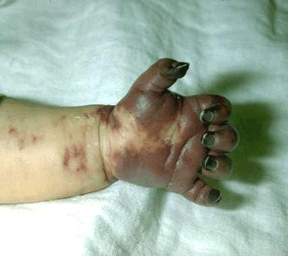
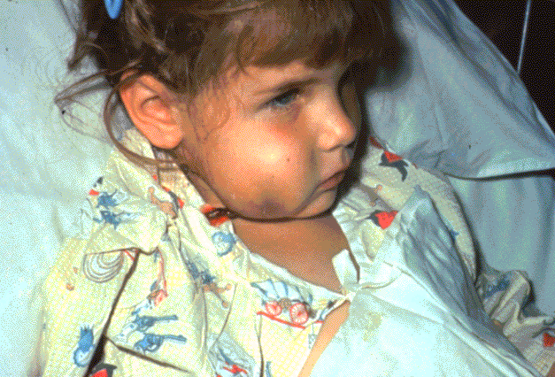
Haemophilus influenzaeType b (Hib)
Required only for child care and pre-K attendance
Notes:
Haemophilus influenzae Type B vaccine (Hib) protects against Hib disease.
This child on the right has a swollen cheek due to Hib infection. The tissue under the skin covering the jaw and cheek is infected and she is probably very sick. She may have a fever, severe headache, sore throat, or breathing problems. Hib disease can be very dangerous to children under five years of age, especially infants.
The 1st^{d} photo shows the tissue damage that can come from invasive Hib disease.
In Georgia , Hib vaccine is required for attendance in child care and pre-K for all children under age 5 years.
2009 ACIP Recommended Catch up Immunization Schedule added Information (footnote 4) about the use of Haemophilus influenzae type b (Hib) conjugate vaccine among persons aged 5 years and older at increased risk for invasive Hib disease. Use of Hib vaccine for these persons is not contraindicated.
All the General Recommendations that apply to inactivated vaccines would apply to HIB. You might want to take special note of #4, regarding the use of combination vaccines, since HIB is combined with hepatitis B in the vaccine product, Comvax®.
Optional information about Hib disease:
It can also cause brain damage, seizures, paralysis, hearing loss.
The Hib germ enters the body through the nose and throat.
It is spread by direct contact with an infected person. Adults and older children can be infected with this germ but not feel sick or show any symptoms.
Hib vaccine has made a dramatic impact on the decreased incidence of this disease. In the early 1980’s, it was estimated that 20,000 cases occurred annually in the U.S., primarily in children under 5 years of age.

Slide 33
Haemophilus influenzae type b (Hib)
Infants: 3 or 4 dose schedule
  Dose 1 @ 2 months of age
  Dose 2 @ 4 months of age
  Dose 3 @ 6 months of age
  (Not required if Pedvax HIB® or Comvax® administered at 2 and 4 months of age)
  Booster dose @ 12 through 15 months of age
  MenHibrix ® approved for use in children 6 weeks of age through 18 months of age; MenHibrix is recommended by ACIP only for infants at increased risk for meningococcal disease.
  Hiberix ® can only be used as a booster dose (final) for children
who have previously received the primary 2 or 3 dose series of
Hib vaccine.
Notes:
33
33
33
Let’s take just a moment to review the highlights of the recommended schedule for administering Hib vaccine.
Since Hib is a conjugate vaccine it is important to remember that conjugate vaccines should not be given before an infant is 6 weeks of age and that the total number needed depends on the brand/or brands of Hib vaccine administered and the age the infant receives the first dose The detailed schedule is outlined in the CDC pink book and the ACIP Recommendations.
-PedvaxHIB®, manufactured by Merck requires 3 doses of vaccine. Currently this is the brand of vaccine that we are shipping to VFC providers. (This is also the type of Hib vaccine in the combination vaccine, Comvax®.) The first two doses should be administered on the same schedule as the other brands. If the infant had PedvaxHIB® or Comvax® for the first two doses, a third dose is not needed at 6 months. The booster dose is recommended at 12-15 months.
-ActHIB ®, requires 3 doses of vaccine. Previously unvaccinated infants aged 2 through 6 months should receive three doses administered 2 months apart, followed by a booster dose at age 12-15 months, administered at least 2 months after the last dose.
-Pentacel®, a combination vaccine that contains lyophilized Hib (ActHIB) vaccine that is reconstituted with a liquid DTaP-IPV solution; approved for doses 1 through 4 among children 6 weeks through 4 years of age
-What if a child receives a combination of different brands (including PedvaxHIB or Comvax) or if you do not know the brand of Hib vaccine that a child received for previous doses, How many doses should a child receive? The child needs a total of 4 doses. Three doses are acceptable only when a child has received Pedvax Hib or Comvax for all 3 doses with the last dose administered on or after 12 months of age.
Hiberix® is licensed for use as the booster (final) dose for Hib vaccination for children aged 15 months through 4 years (before the 5th birthday) who have received a primary Hib vaccination series of 2 or 3 doses (depending on the formulation of the primary series vaccines). ACIP recommends Hib booster dosing at ages 12 through 15 months. It can NOT be used as the ONLY Hib dose in a child who has received no prior doses.
Hiberix® is not licensed for the primary Hib vaccination series; however, if Hiberix® is administered inadvertently during the primary vaccination series, the dose should be counted as a valid PRP-T dose that does not need to be repeated if it was administered according to schedule. In these children, a total of 3 doses will complete the routine primary series.
However regardless of which brand or brands are utilized for the primary series, it is important to note that the booster dose should not be given prior to the first birthday and should be given a minimum of 2 months after the previous dose.
Also note that the number of recommended doses may vary depending on the age the child begins receiving the vaccine. A detailed schedule outlining the number of recommended doses based on the age of initiating the series is in the Pink Book.
If a child is under 5 years of age and has not received any doses or is lacking the appropriate number of Hib vaccine doses please utilize the catch up schedule to administer the vaccine. A single dose of any brand of Hib conjugate vaccine is sufficient for any child who is 15-59 months of age.
Please note that Hib vaccine is not routinely recommended for children over 5 yrs of age unless they have a high risk condition such as immunosuppression or asplenia.
Slide shows a child with cellulitis of cheek and an infant with gangrenous fingers due to invasive Hib disease; The drawing shows a child with a markedly swollen epiglottis due to epiglottitis (croup) due to Hib infection.
Haemophilus influenza infection is caused by a bacteria which has 6 different polysaccharide serotypes and some non-typable strains
Type b (Hib) causes 95% of invasive disease
Hib enters body through the nasopharynx, spreads via blood stream to other sites (meninges, joints, skin, epiglottis and/or bone)
Prior to lincensure of a vaccine Hib was the leading cause of bacterial meningitis in young children with a case fatality rate of 2-5%. 15-30% of survivors had hearing impairment and neurologic sequelae.
Hib also causes cellulitis, septic arthritis, osteomyelitis, pneumonia and epiglottitis.
Peak age for infection is 6-7 months. Invasive Hib disease is uncommon beyond 5 years of age.
Before Hib vaccine was licensed there were about 20,000 cases of invasive Hib in the U.S. each year
By 5 years post licensure of Hib vaccine, the incidence decreased by > 99%. In 2010, 23 cases of Hib were reported in the U.S. No cases were reported in Georgia
Many physicians and nurses who were trained after the mid 1990s have never seen a case of invasive Hib
For additional information refer to:
Epidemiology and Prevention of Vaccine-Preventable Diseases, 12th edition May 2011. HHS, CDC.

Slide 34
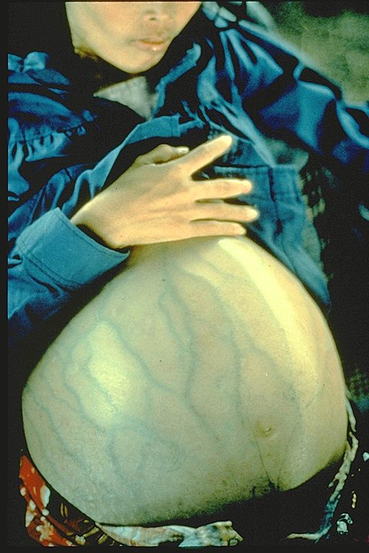
Hepatitis B
Required for school and child care attendance
Notes:
The woman shown in this slide has severe ascites due to liver damage caused by hepatitis B. Hepatitis B (she is not pregnant) can be prevented by Hepatitis B vaccine, the first vaccine listed on the schedule.
When administering Hepatitis B vaccine, it is important that you assess the mother’s hepatitis B surface antigen status so you will know how aggressively to administer the vaccine to the infant and also if you will need to do follow up testing on the infant.
Hepatitis B disease:
Hepatitis B is a viral disease that attacks the liver and cause severe illness and on going liver damage and/or cancer. It is now the most prevalent form of acute viral hepatitis in the US.
It is spread by contact with infected body fluids or blood. Examples of methods of transmission include the following:
Using unsterilized needles
Sexual contact with a person who has hepatitis B
Sharing toothbrushes, razors, or washcloths
Babies can be infected during childbirth if the mom is infected
Babies and young children can be infected if the infected person pre-chews baby food.
Over half of the people who get hepatitis B have no symptoms. For people who do get symptoms, they might include:
Loss of appetite, nausea or vomiting
Weakness and tiredness
Fever and headaches
Yellow skin and eyes
Being immunized against Hepatitis B is also a requirement for attendance in child care and entry to school in GA.

Slide 35
Hepatitis B Vaccine
Dose 1 @ birth
Dose 2 @ 4 months of age
  at least 1 month after first dose
Dose 3 @ 6-18 months of age:
  Minimum of 4 months after the first dose
  Minimum of 2 months after the second dose but not before an infant is 24 weeks of age
Notes:
If the woman has been tested and found not to have any sign of hepatitis B infection, she is considered “negative.” A “positive” designation means the mother may be actively or chronically infected with the hepatitis B virus and this obviously can have implications for her newborn baby.
For infants born to HBsAg- negative mothers, the routinely recommended schedule is:
The first dose should be administered at birth. This is the strong recommendation with the 2007 schedule. However, the footnote does state, “If mother is HBsAg-negative mothers, the birth dose can only be delayed with a physician’s order and mother’s HBsAg-negative laboratory report documented in the infant’s medical record.”
The recommended time intervals between doses did not change.
The second dose should be given by 4 months of age. However, there should be at least 4 weeks or 1 month between the 1st and 2nd doses.
The third dose may be given at 6-18 months of age. As mentioned earlier, it should be given at least 4 months after the 1st dose, 2 months after the 2nd dose, but not before 24 weeks of age.
Recommended Hepatitis B Vaccine Schedule
For Infants Born to HBsAg-Positive Mothers
The infant should receive the first dose of hepatitis B vaccine plus 0.5-mL hepatitis B immune globulin (HBIG) within 12 hours of birth at separate sites. (HBIG can be given up to 7 days after birth).
The 2nd dose is recommended at 1-2 months of age.
The 3rd dose should be given at 6 calendar months of age but not before 24 weeks of age.
It is especially important that these infants receive their vaccine doses on schedule and complete the series at 6 calendar months of age. In addition, they need to have a blood test (PVT- post vaccination test which must be a minimum of one month after final Hep B vaccine dose) between 9-18 mos. of age to make sure their vaccine protected them. (Wait till at least 9 mos. of age to eliminate the possibility of interference from the birth dose of HBIG, but get them in as soon as possible after that.)
If the mother does not know her antigen status, this is the schedule that should be followed. If she is later determined to be negative for hepatitis B surface antigen, her baby would not need to have the blood test at 9-18 months of age.
Recommended Hepatitis B Schedule for Infants< 2000 Grams
Infants under 2000 grams (4.4 lbs) respond poorly to vaccine
Premature infants born to HBsAg- negative moms: vaccinate at the chronological age of 1 month, regardless of weight.
Premature infants born to HBsAg- positive moms: vaccinate at birth
Next dose : 1 month of age, chronologically
Third dose: 1-2 months after the second dose
Fourth dose: At 6 months of age, but not before 24 weeks of age

Slide 36
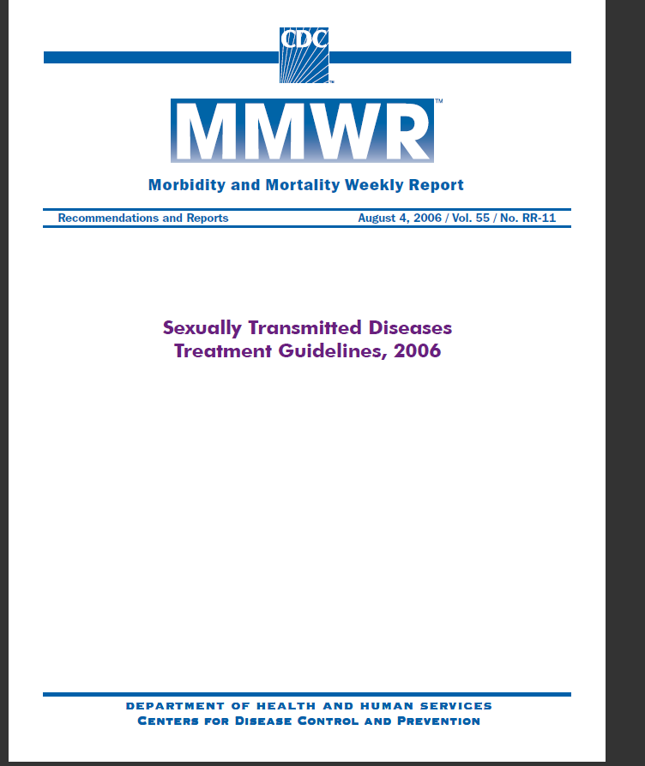
Every person being evaluated or treated for an STD, who is not already vaccinated, should receive hepatitis b
vaccination

Slide 37
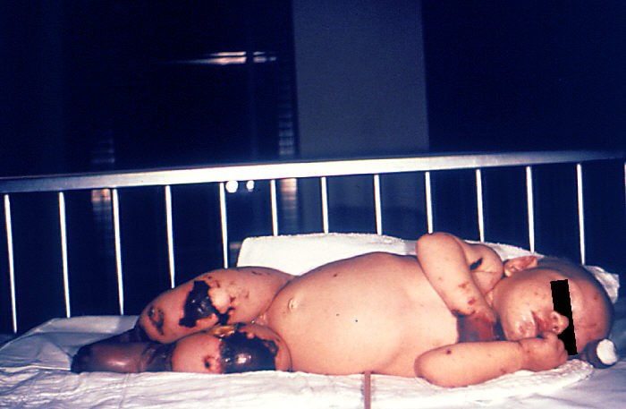
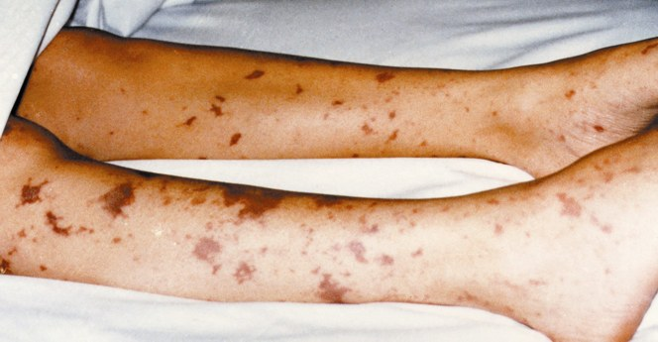
Meningococcal Disease
New 7th Grade School Requirement
Notes:
These very graphic photos show the possible results of a meningococcal infection becoming systemic and then infecting bodily tissues.
The 4 month old on the left has gangrene of the hands and lower extremities due to meningococcemia.
The picture on the right shows similar though not as severe tissue damage in an older child.

Slide 38
Meningococcal Disease
Meningitis
~50% of cases 9-10% fatality rate
Meningococcemia
5%-20% of cases Up to 40% fatality rate
Rash
Vascular damage
Disseminated intravascular coagulation
Multi-organ failure
Shock
Death can occur in 24 hours
Photo courtesy CDC: Dr. Brodsky & Mr. Gust
11-19% of survivors have permanent sequelae
Ref: 1. Epidemiology and Prevention of Vaccine-Preventable Diseases. 12th Edition, May 2012.
2. AAP Red Book 2012
Notes:
38
The most common clinical presentations of meningococcal disease are meningitis and meningococcemia.
Individuals with meningococcemia may die within 24 hours of the onset of symptoms even with prompt treatment with appropriate antimicrobials and supportive care in an intensive care unit.
Reference: 1. Epidemiology and Prevention of Vaccine-Preventable Diseases, 12th edition. May 2012 HHS, CDC.
2. AAP Redbook 2012

Slide 39
Meningococcal Conjugate Vaccine (MCV4)
(Men A,C,Y, W-135)
Menactra™ licensed for 9 mos. through 55 years
Menveo® licensed for ages 2 mos. through 55 years
ACIP Recommendation:
  One dose at 11 or 12 years of age and a booster dose at 16 yrs.
  If first dose is at 13-15 years, give one booster dose 5 years after the first dose or sooner if entering college or technical school
  If first dose given ≥ 16 years of age, a 2nd dose is not needed
  Persons aged 21 years or younger attending school or college should have documentation of one dose of MVC4 not more than 5 years before enrollment.
Prevention and Control of Meningococcal Disease: Recommendations of the Advisory Committee on Immunization Practices (ACIP) Recommendations and Reports March 22, 2013 / 62(RR02);1-22
Notes:
39
39
39
Recommendation for Routine Vaccination of Persons Aged 11 Through 18 Years
After a booster dose of meningococcal conjugate vaccine, antibody titers are higher than after the first dose and are expected to protect adolescents through the period of increased risk through age 21 years. Persons who receive their first dose of meningococcal conjugate vaccine at or after age 16 years do not need a booster dose. Routine vaccination of healthy persons who are not at increased risk for exposure to N. meningitidis is not recommended after age 21 years.
CDC Guidance for Transition to an Adolescent Booster Dose
Some schools, colleges, and universities have policies requiring vaccination against meningococcal disease as a condition of enrollment. For ease of program implementation, persons aged 21 years or younger should have documentation of receipt of a dose of meningococcal conjugate vaccine not more than 5 years before enrollment. If the primary dose was administered before the 16th birthday, a booster dose should be administered before enrollment in college. The booster dose can be administered anytime after the 16th birthday to ensure that the booster is provided. The minimum interval between doses of meningococcal conjugate vaccine is 8 weeks.
No data are available on the interchangeability of vaccine products. Whenever feasible, the same brand of vaccine should be used for all doses of the vaccination series. If vaccination providers do not know or have available the type of vaccine product previously administered, any product should be used to continue or complete the series.
Recommendations for Adults 56 years and older
MPSV4 is the only licensed meningococcal vaccine for adults aged ≥56 years and is immunogenic in older adults. For adults who have received MenACWY previously, limited data demonstrate a higher antibody response after a subsequent dose of MenACWY compared with a subsequent dose of MPSV4. For meningococcal vaccine-naïve persons aged ≥56 years who anticipate requiring a single dose of meningococcal vaccine (e.g., travelers and persons at risk as a result of a community outbreak), MPSV4 is preferred. For persons now aged ≥56 years who were vaccinated previously with MenACWY and are recommended for revaccination or for whom multiple doses are anticipated (e.g., persons with asplenia amd microbiologists), MenACWY is preferred.
Ref. 1. Prevention and Control of Meningococcal Disease - Recommendations of the Advisory Committee on Immunization Practices (ACIP) MMWR / March 22, 2013 / Vol. 62 / No. 2
2. Recommendation of the ACIP for Use of Quadrivalent Meningococcal Conjugate Vaccine (MenACWY-D) Among Children Aged 9 Through 23 Months at Increased Risk for Invasive Meningococcal Disease MMWR; October 14, 2011 / 60(40);1391-1392

Slide 40
Meningococcal Vaccines for High Risk
Children 2 months – 10 years
MENHIBRIX® (Men C&Y + Hib) licensed for ages 6 weeks through 18 months
Menveo® (Men A,C,Y, W-135) licensed for ages 2 mos. through 55 years
Menactra^{™ (}(Men A,C,Y, W-135) licensed for 9 mos. through 55 years
Recommended for children 2 months through 10 years with complement component deficiency, functional or anatomic asplenia, and those who are part of a community outbreak or travelling internationally to regions with endemic meningococcal disease.
For details on doses and schedule refer to:
Advisory Committee on Immunization Practices
Vaccines For Children Program
Vaccines To Prevent Meningococcal Disease
Adopted October 23, 2013
http://www.cdc.gov/vaccines/programs/vfc/downloads/resolutions/1013-mening-mcv.pdf

Slide 41
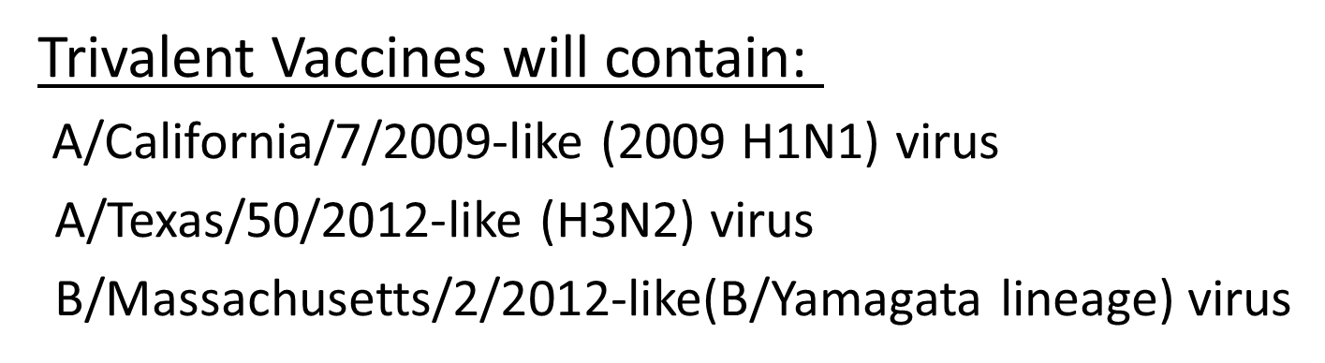
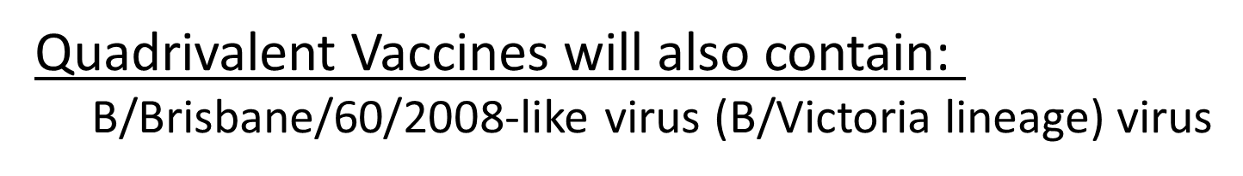


Composition of Influenza Vaccines for 2014-2015 Season in the U.S.
Notes:
Composition of the 2014-2015 Influenza Vaccine
The World Health Organization (WHO) has recommended vaccine viruses for the 2014-2015 Northern Hemisphere influenza vaccines, and the Food and Drug Administration’s Vaccines and Related Biological Products Advisory Committee (VRBPAC) has made recommendations for the composition of the 2014-2015 influenza vaccines to be used in the United States. Both agencies recommend that trivalent vaccines contain an A/California/7/2009-like (2009 H1N1) virus, an A/Texas/50/2012-like (H3N2) virus, and a B/Massachusetts/2/2012-like (B/Yamagata lineage) virus. It is recommended that quadrivalent vaccines containing an additional influenza B virus contain a B/Brisbane/60/2008-like (B/Victoria lineage) virus in addition to the viruses recommended for the trivalent vaccines. These recommendations were based on global influenza virus surveillance data related to epidemiology and antigenic characteristics, serological responses to 2013-2014 seasonal vaccines, and the availability of candidate strains and reagents.
http://www.cdc.gov/flu/weekly/
Inactivated Influenza Vaccines (IIV)
Live, Attenuated Influenza Vaccine (LAIV4)
Administer by Nasal spray:
FluMist® Medimmune - for healthy persons 2 through 49 years of age
- not for pregnant women

Slide 42
Inactivated Influenza Vaccines (IIV)
Administer by Injection (Trivalent) IIV3
Fluzone® sanofi-pasteur - 6 months of age and older
  Fluarix® GSK - 3 years of age and older
  FluLaval® GSK - 3 years of age and older IIV3 & IIV4#
  Fluarix® Quadrivalent GSK - 3 years of age and older IIV4
  Fluvirin® Novartis - 4 years of age and older
  Afluria® CSL - 9 years of age and older
  Flucelvax® Novartis - 18 years of age and older (ccIIV3)*
  FluBlok ® Protein Sciences - 18 through 49 years (RIV3)**
  Fluzone® Intradermal sanofi-pasteur - 18 through 64 years
  Fluzone® High-Dose sanofi-pasteur - 65 years and older (4 X more antigen)
*ccIIV3 = cell culture based trivalent inactivated influenza vaccine
**RIV3 = recombinant hemagglutinin influenza vaccine
Ref. Prevention and Control of Seasonal Influenza with Vaccines: Recommendations of the Advisory Committee on Immunization Practices — United States, 2013–2014, September 20, 2013 / 62(RR07);1-43
# Flulaval licensed by FDA for children 3 years and older August 16, 2013
Notes:
42
42

Slide 43
Live, Attenuated Influenza Vaccine (LAIV4)
  Administer by Nasal spray: FluMist® Medimmune
  - for healthy persons 2 through 49 years of age
  - not for pregnant women
Ref: Prevention and Control of Seasonal Influenza with Vaccines: Recommendations of the Advisory Committee on Immunization Practices — United States, 2013–2014, September 20, 2013 / 62(RR07);1-43
Notes:
43
43

Slide 44
Rotavirus Vaccines
RotaTeq® (Merck) and Rotarix® (GSK)
RotaTeq®: 3 doses; ages 2, 4, 6 months
Rotarix®: 2 doses; ages 2 and 4 months
Both vaccines:
  Minimum age for first dose: 6 weeks
  Maximum age for first dose: 14 weeks 6 days
  Minimum interval between doses: 4 weeks
  Maximum age for last dose: 8 months 0 days
If any dose is Rotateq®, 3 doses are required
Use RotaTeq® if allergy to latex
If the child spits out or regurgitates the vaccine, do not re-administer. Continue with the series at recommended intervals.
Notes:
44
44
44
The routine use of Rotavirus vaccine has resulted in a dramatic decrease in hospitalizations for the management of dehydration. In the developing world the use of the vaccine has dramatically reduced deaths from rotavirus infection.
Rotateq® (Merck & Co) is a live, oral pentavalent vaccine that contains of 5 live reassortant rotaviruses. (G1, G2, G3 and G4.) It is referred to as RV5 rotavirus vaccine.
Ref: Rotateq® Prescribing Information December 2009
Rotarix® (GSK) is a live, oral, monovalent attenuated rotavirus vaccine. It is referred to as RV1 rotavirus vaccine. Ref: Rotarix® Prescribing Information October 2008
ACIP does not express a preference for RV5 or RV1.
Interchangeability of Rotavirus Vaccines
ACIP recommends that the rotavirus vaccine series be completed with the same product whenever possible. However, vaccination should not be deferred if the product used for previous doses is not available or is unknown. In this situation, the provider should continue or complete the series with the product available. If any dose in the series was RV5 or the product is unknown for any dose in the series, a total of three doses of rotavirus vaccine should be given.
Contraindications
Latex rubber is contained in the RV1 oral applicator, so infants with a severe (anaphylactic) allergy to latex should not receive RV1. The RV5 dosing tube is latex-free.
A virus (or parts of a virus) called porcine circovirus is present in both vaccines. There is no evidence that this virus is a safety risk or causes illness in humans².
Some studies have shown a small increase in cases of intussusception within one week after the first dose of rotavirus vaccine. The estimated risk is 1 case per 100,000 infants receiving the vaccine². However, the benefits of the vaccine outweigh the risk.
Reference: 1. Prevention of Rotavirus Gastroenteritis Among Infants and Children - Recommendations of the Advisory Committee on Immunization Practices (ACIP) MMWR; February 6, 2009 / 58(RR02);1-25
2. Rotavirus Vaccine Information Statement 12/6/2010

Slide 45
Types of Human Papilloma Virus (HPV)
Mucosal/Genital
~40 types
Cutaneous
~60 types
High risk types
16, 18, 31, 45
(and others)
Low risk types
6, 11 and others
Cervical cancer
Anogenital cancer
Oropharyngeal Cancer
Cancer precursors
Low grade cervical disease
Genital Warts
Laryngeal Papillomas
Low grade cervical disease
Skin warts
Hands and Feet
Ref: 1.Epidemiology and Prevention of Vaccine Preventable Diseases 12th Edition, May 2012
2. Red Book – AAP 2012 Report of the Committee on Infectious Diseases

Slide 46
HPV Vaccines
Gardasil® (HPV4)
Licensed for prevention of infection with HPV types 6, 11, 16, 18.
Recommended for females 9 through 26 years & males 9 through 21 years. May be given to males 22 through 26 years. (3 dose schedule)
Cervarix® (HPV2)
Licensed for prevention of infection with HPV types 16 & 18.
Recommended for females 9 through 26 years. (3 dose schedule)
Ref: MMWR; December 23, 2011 / 60(50);1705-8
Notes:
46
46
On December 22, 2010 the FDA approved Gardasil for the prevention of anal cancer and associated precancerous lesions due to HPV types 6, 11, 16, and 18 in people 9 through 26 years.
Cervarix is licensed for females 9 through 25 years of age, but ACIP recommends Cervarix for females 9 through 26 years of age.
Addendum:
On April 6, 2011 the FDA rejected the request by Merck to expand the indication for the use of Gardasil in women 27 through 45 years of age. Gardasil has not been demonstrated to prevent HPV-related CIN 2/3 or worse in women older than 26 years of age.
References:
Recommendations on Use of Quadrivalent HPV in Males MMWR;December 23, 2011 / 60(50);1705-8
2. Quadrivalent Human Papillomavirus Vaccine (HPV4, Gardasil) for Use in Males and Guidance from the ACIP MMWR; May 28, 2010 / 59(20);630-632
3. Quadrivalent Human Papillomavirus Vaccine: Recommendations of the ACIP
MMWR; March 12, 2007 / 56(Early Release);1-24

Slide 47
Encourage Parents To Immunize a
Pre-teen or Adolescent
Try saying:
Your child needs three shots today that will prevent tetanus, diphtheria, whooping cough, and one type of meningitis and protect him/her from many cancers caused by HPV.
HPV vaccine produces a better immune response in preteens than it does in older teens and young women. I strongly believe in the importance of this cancer-preventing vaccine.

Slide 48
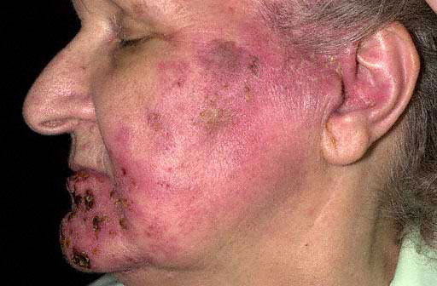
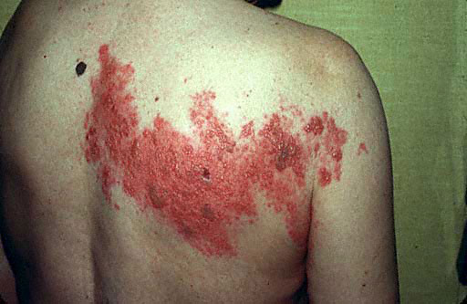
Herpes Zoster
“Shingles”
Notes:
These are images of different ways shingles can appear. It usually appears on one side of the face or body and last 7-10 days.
The main symptom is pain but other symptoms can include fever, headache, chills, and upset stomach.
For about 1 person in 5, the severe pain can continue, even after the rash has cleared up. This is called post-herpetic neuralgia.
It does not happen commonly but a person who has never had chickenpox, could get chickenpox from contact with a person with shingles.
Shingles can occur in anyone with a previous history of chickenpox, but is much more common in persons age 60 and older.

Slide 49
Herpes Zoster
Herpes zoster (HZ), or shingles, occurs through reactivation of latent varicella-zoster virus
Typically characterized by prodromal pain and an acute vesicular eruption (rash) accompanied by moderate to severe pain
One in three persons will develop zoster during their lifetime
A common consequence of zoster
is post-herpetic neuralgia (PHN).
Risk for zoster and post-herpetic
neuralgia increases with age
Notes:
49
49
The is a picture of zoster (shingles) on the upper chest and back.

Slide 50
Zostavax®
One dose recommended for adults 60 years and older, including those who have experienced previous episodes of shingles
Overall Efficacy*
51% fewer episodes of zoster and less severe disease
66% less postherpetic neuralgia
On March 24, 2011 FDA approved Zostavax
for use in ages 50-59 years
ACIP has not made a recommendation for this age group
*Ref: Epidemiology and Prevention of Vaccine-Preventable Diseases. 12th Edition, May 2012.
Notes:
50
Zostavax was licensed by the FDA in May 2006 for individuals 60 Years of age and older. On March 24, 2011 the FDA approved Zostavax for individuals 50 through 59 years of age.
At the October 2013 meeting the ACIP still did not vote to recommend Zostavax for people 50 through 59 years. There is no data yet showing how long vaccine effectiveness will last. Practitioners can legally administer the vaccine to the 50-59 age group, but some insurance carriers may not reimburse for the vaccine because it has not been recommended by the ACIP.
Insurance reimbursement for Zostavax will vary based on the patient’s insurance plan. Patients need to verify coverage with their insurance company. Zostavax is covered by Medicare under Part D, but there are many different plans available under Part D. Patients covered by Medicare should make sure the Part D plan they have selected covers Zostavax or they will be responsible for full payment. Many practices are not offering Zostavax to their patients because physicians can not bill Part D, unless their practice is approved to dispense prescription drugs. In Georgia, pharmacists who are trained in vaccine administration can give Zostavax and bill Medicare for the cost of the vaccine and an administrative charge, if the patient’s Part D plan covers the vaccine.

Slide 51
Is Shingles Contagious?
Shingles cannot be passed from one person to another.
However, a person with shingles can spread the virus to a person who has never had chickenpox.
If the person who has never had chickenpox becomes infected with the virus, he or she will develop chickenpox, not shingles.
Notes:
Burden of Shingles
Varicella zoster remains dormant in anyone who has had chickenpox
Virus reactivates and travels pathway along nerves to skin
Results in skin rash/blisters and pain due to inflamed nerves

Slide 52
Just as a reminder……
Regardless of:
  the availability of vaccine
  the funding of the vaccine (VFC, state-supplied, or private stock)
  whether the vaccine is required for school or child care or not……….
FOLLOW ACIP Recommendations!!!
Notes:
There seems to be some confusion among providers that
if there are vaccine shortages or the supply is low because it’s a new vaccine, or
if the patient doesn’t fit in a certain funding category, or
if the vaccine isn’t required for school or child care:
then they don’t feel they need to be concerned about whether to recommend or discuss that vaccine with the client or the parent. But the bottom line is-------the ACIP recommendation is the most important thing!! For instance, if a vaccine is recommended and the child is not VFC eligible, then give them your private stock of that vaccine if you have it. If not, refer the child out to receive it, but don’t ignore the fact that according to the ACIP Recommended schedule, he should have it.
Please be sure to emphasize this to any groups that you are educating about the recommended schedule.

Slide 53
Every Office and Clinic Needs
A Vaccine Champion!
Lead your immunization team.
Educate all staff about new vaccines and recommendations.
Teach new staff about vaccine storage, handling, & administration.
Initiate processes to improve immunization rates in your practice/facility.
Assure immunizations of all staff are up-to-date.
Notes:
53
53
Ask your audience “Who is your vaccine champion?” and then
“Who is this person’s backup?”
The vaccine champion will:
Lead your immunization team.
Educate all staff about new vaccines and recommendations.
Educate new staff about vaccine storage, handling, & administration.
Initiate processes to improve immunization rates in your practice/facility.
Assure immunizations of all staff are up-to-date.
Improving Access to immunizations
Immunization only visits
Walk-ins for immunizations
Implement standing orders
Early, extended, or weekend hours
Mass vaccination clinics
These 5 methods listed above can help patients access immunizations more readily but some of these methods may not be the right fit for some practices. The approach to improving access must be determined by individual practitioners and staff. Each practice must decide which method works best for their situation. In large practices or clinics this may be an administrative decision.

Slide 54

Healthcare Personnel (HCP) Need These Immunizations
Annual influenza vaccine
Tdap or Td
Hepatitis B (exposure risk) Check immunity
Validate immune status of:
Varicella
Measles, Mumps & Rubella(MMR)
Are YOU up to date?
Notes:
54
Hepatitis B vaccine is recommended for health-care personnel with potential exposure to blood or body fluids. The antibody status of these health-care personnel should be checked 1-2 months after the 3rd dose. If a person fails to develop an adequate antibody titer after three doses of vaccine, follow current CDC recommendations for additional doses of hepatitis B vaccine. Some health-care providers may have received three doses of hepatitis B vaccine as children, adolescents or adults but have never had serologic testing to check for immunity. Follow the CDC Guidance for Evaluating Health-Care Personnel for Hepatitis B Virus Protection and for Administering Postexposure Management (Recommendations and Reports / Vol. 62 / No. 10 December 20, 2013)
Un-immunized HCP
Un-immunized healthcare workers are at risk of infecting patients, family members and community contacts
Immunized HCP
Protect patients from VPD’s
Help offices avoid potential liability cases. (The practice can be liable if an unimmunized HCP becomes infected with a vaccine preventable disease and infects a patient.)
Maintain productivity
Reduce illness and illness-related absenteeism
Evidence of Immunity to MMR
Documented administration of two doses of measles and mumps vaccine and one dose of rubella vaccine OR
Laboratory evidence of immunity or laboratory confirmation of disease (measles, mumps and rubella) OR
Born before 1957 (measles, mumps and rubella)
References: 1. General Recommendations on Immunization, Recommendations of the Advisory Committee on Immunization Practices (ACIP). MMWR (RR-2); January 28, 2011
2. Immunization of Health-Care Personnel: Recommendations of ACIP MMWR; November 25, 2011 / 60(RR07);1-45
3. CDC Guidance for Evaluating Health-Care Personnel for Hepatitis B Virus Protection and for Administering Postexposure Management (Recommendations and Reports / Vol. 62 / No. 10 December 20, 2013)

Slide 55
Vaccine Adverse Event Reporting System
The Vaccine Adverse Event Reporting System (VAERS) is a national vaccine safety surveillance program co-sponsored by the Centers for Disease Control and Prevention and the Food and Drug Administration.
What Can Be Reported to VAERS?
Who Reports to VAERS?
Does VAERS Provide General Vaccine Information?
http://vaers.hhs.gov/ or 1-800-822-7967
Notes:
VAERS provides a nationwide mechanism by which adverse events following immunization may be reported, analyzed, and made available to the public.
The primary objectives of VAERS are to:
Detect new, unusual, or rare vaccine adverse events;
Monitor increases in known adverse events;
Identify potential patient risk factors for particular types of adverse events;
Identify vaccine lots with increased numbers or types of reported adverse events; and
Assess the safety of newly licensed vaccines.
What Can Be Reported to VAERS?
VAERS encourages the reporting of any clinically significant adverse event that occurs after the administration of any vaccine licensed in the United States.
Who Reports to VAERS?
Anyone can file a VAERS report, including parents, health care providers, manufacturers, and vaccine recipients.
Does VAERS Provide General Vaccine Information?
No. VAERS only collects and analyzes adverse event reports. In another example, VAERS determined that there may be a potential for a small increase in risk for Guillain-Barre syndrome after the meningococcal conjugate vaccine, Menactra. As a result of this finding, a history of Guillain-Barre syndrome became a contraindication to the vaccine and further controlled studies are currently underway to research this issue.
The VAERS website for reporting is: http:vaers.hhs.gov/ or you can call to report at 1-800-822-7967

Slide 56
Vaccine Injury Compensation Program (VICP)
National Vaccine Injury Compensation Program
provides compensation to individuals found to be injured by or have died from certain childhood vaccines.
  Established in 1988 by NCVIA
  Federal “no fault” system to compensate those injured
  Claim must be filed by individual, parent or guardian
  Must show that injury is on “Vaccine Injury Table”
Notes:
On October 1, 1988, the National Childhood Vaccine Injury Act of 1986 created the National Vaccine Injury Compensation Program (VICP). The VICP was established to ensure an adequate supply of vaccines, stabilize vaccine costs, and establish and maintain an accessible and efficient forum for individuals found to be injured by certain vaccines. The VICP is a no-fault alternative to the traditional public legal system for resolving vaccine injury claims that provides compensation to people found to be injured by certain vaccines.
The National Childhood Vaccine Injury Act (NCVIA) set forth 3 basic requirements for all vaccination providers, which are:
Providers must give the patient (or parent/legal representative of a minor) a copy of the relevant federal "Vaccine Information Statement" (VIS) for the vaccine they are about to receive.
Providers must record certain information about the vaccine(s) administered in the patient's medical record or a permanent office log.
Providers must document any adverse event following the vaccination that the patient experiences and that becomes known to the provider, whether or not it is felt to be caused by the vaccine, and submit the report to the Vaccine Adverse Event Reporting System (VAERS).

Slide 57

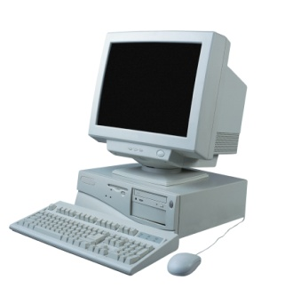
Resources
Local health department
District Immunization Coordinator
GA Immunization Program Office
  On call Help line: 404-657-3158
  GRITS Help Line:1-866-483-2958
  VFC Help Line:1-800-848-3868
  Website http://dph.georgia.gov/immunization-section
  Your local Immunization Program Consultant (IPC)
GA Chapter of the AAP
GA Academy of Family Physicians
Notes:
If you need further information about the changes, or to ask questions later, please contact the GA Immunization Office and our partners GA AAP and GA AFP
Your Local health department
District Immunization Coordinator (IPCs)
GA Immunization Program Office
404-657-3158
Website http://health.state.ga.us/programs/immunization
GA Chapter of the AAP
GAFP

Slide 58
http://dph.georgia.gov/immunization-section
Notes:
For those who have not logged onto the Immunization page website here is the link to the main page.

