Slide 1
Vaccine Administration Technique
Presented by: Janet McGruder, Nurse Consultant
Date: 02/02/2016

Slide 2
Disclosure Statements
Neither the planners of this session nor I have any conflicts of interest or financial relationship with pharmaceutical companies, biomedical device manufacturers, or corporations whose products and services are related to the vaccines we discuss.
There is no commercial support being received for this event.
The mention of specific brands of vaccines in this presentation is for the purpose of providing education and does not constitute endorsement.
The GA Immunization Program utilizes ACIP recommendations as the basis for this presentation and for our guidelines, policies, and recommendations.
For certain vaccines this may represent a slight departure from or off- label use of the vaccine package insert guidelines.
Notes:
[Presenter is required to read this information to the audience before the program begins.]
Neither the planners of this session nor I have any financial relationship with pharmaceutical companies, biomedical device manufacturers, or corporations whose products and services are related to the vaccines we discuss.
There is no commercial support being received for this event.
The mention of specific brands of vaccines in this presentation is for the purpose of providing education and does not constitute endorsement.
The GA Immunization Program utilizes ACIP recommendations as the basis for this presentation and for our guidelines, policies, and recommendations.
For certain vaccines this may represent a slight departure from or off-label use of the vaccine package insert guidelines.

Slide 3
Disclosure Statements
To obtain nursing contact hours for this session, you must be present for the entire hour and complete an evaluation.
Notes:
To obtain nursing contact hours for this session, you must be present for the entire hour and complete an evaluation.
Contact hours for this session only are available for two (2) years from the date of implementation.

Slide 4
Objectives
Discuss staff training needs and strategies for communication
List positioning, comforting and pain control techniques
Review infection control guidelines
Discuss vaccine preparation, administration routes, sites, and needle sizes
Explain vaccine administration special situations
Review documentation requirements
Discuss avoiding vaccine administration errors and managing adverse events
Notes:
We will briefly discuss each of these key issues that should be considered when administering vaccines.
Communication
Review of the recommended vaccine administration routes
Appropriate injection sites and needle sizes
Universal Precautions
Multiple Injections
Positioning, Pain Control and Comforting Techniques
Documentation
Adverse Events Management
Refer to hand out of notes and Vaccine Administration Techniques

Slide 5
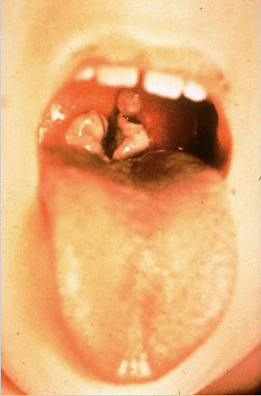
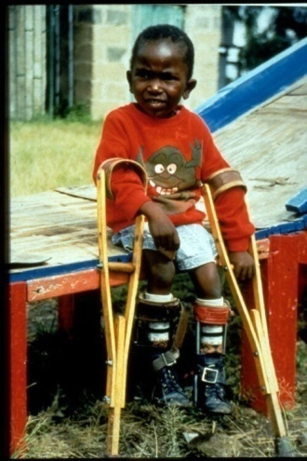
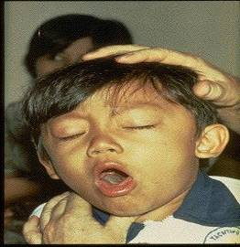
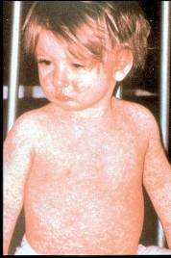
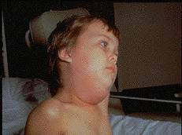
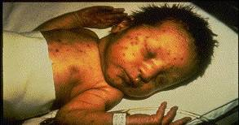
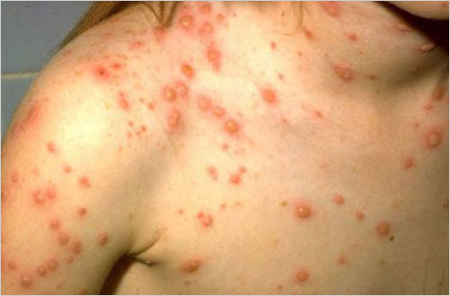
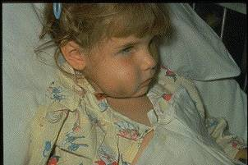
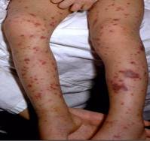
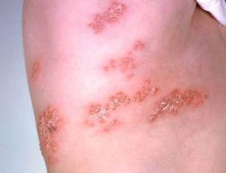
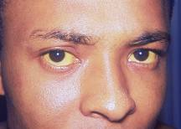
Why Do We Immunize?
We Immunize To Prevent These Diseases
Notes:
Why do we immunize? These pictures represent the vaccine preventable diseases that we provide immunization to prevent.
The top left picture is of a throat of a child who has diphtheria; diphtheria germ lives in the throat and mouth of the infected person; spread through direct contact . You can see the thick gray coating over the back of the throat. This coating can eventually expand down through the airway, and if not treated, a person could die from suffocation, or suffer other complications such as paralysis, heart failure, or coma.
The next picture to the right is of a child experiencing painful muscle spasms from tetanus. It is nearly impossible for him to move or control the muscles in his body. He cannot eat because the muscles in his mouth have become so tight and it is difficult for him to swallow. Other possible complications are broken bones from muscle spasms, breathing problems, and death.
This next picture shows a child who is suffering from pertussis, commonly know as “whooping cough”. He is experiencing coughing spasms, which produce a “whooping” sound. The sound occurs because the child is trying to catch his breath before the next round of coughing. Often children have difficulty breathing and experience vomiting and exhaustion from the severe coughing.
The top right picture is a child suffering from muscle weakness from polio; In the 1950’s, when a person’s respiratory muscles were paralyzed, they were placed in iron lung machines for treatment for muscle weakness, as a result of polio, they required the assistance of braces and crutches in order to walk.
We also see pictures of Chicken pox, Measles, mumps, and congenital rubella
Hib, hepatitis b, meningitis, and zoster shown on bottom row.
The objective of providing immunization is to establish Herd Immunity; In order to achieve herd immunity Immunized individuals block infection from reaching those who are unimmunized; It is probably unrealistic to believe we can immunize everyone appropriately. There will always be young infants who have not received all recommended vaccines because of age and immunocompromising conditions; there are a significant number of adults who are not adequately immunized. Herd immunity refers to a situation in which a high percentage of a population is immune to a disease, essentially stopping the disease in its tracks because it cannot find new hosts.

Slide 6
The Impact of Vaccines
Disease | Average Annual Reported Cases Pre-vaccine* | Cases in U.S. 2014** | % Reduction In U.S. 2013
Smallpox | 48,164 | Eradicated worldwide in 1980
Diphtheria | 175,885 | 1 | 99.9%
Measles | 503,282 | 667 | 99.8%
Mumps | 152,209 | 1,223 | 99.6%
Pertussis | 147,271 | 32,971 | 77.6%
Polio (paralytic) | 16,316 | 0 | 100%
Rubella | 47,745 | 6 | 99.9%
Congenital Rubella Syndrome | 823 | 1 | 99.8%
Tetanus | 1,314 | 25 | 98.0%
H. Influenzae Type b Age<5 years | 20,000 | 40 | 99.8%
*MMWR 48(12);243-248 April 2, 1999
** MMWR 64(36);1019-1033 September 18, 2015
Notes:
This next slide is a chart that illustrates the impact of vaccines in the United States. Historically, Vaccines are one of the greatest success stories in public health as illustrated by this table.
The 2nd column of this chart shows the number of cases in the peak year of the 20th century (prevaccine) for each of the VPDs listed in the 1st column.
The 3rd column shows the number of cases reported in 2014.
The last column shows the percent reduction in those disease cases after the introduction of vaccine.
You can clearly see the impact vaccines have made. However, pertussis is the only vaccine-preventable disease with increasing case numbers and without a percent reduction greater than 90%.

Slide 7
Vaccine Administration Technique Training
Notes:
Proper vaccine administration is a critical component of a successful immunization program. It is a key part of ensuring that vaccination is as safe and effective as possible.
It is Key to ensure vaccination is as safe and effective as possible, you must
Incorporate
professional standards for medication administration
manufacturer’s vaccine-specific guidelines
evidence-based safe injection practices on CDC’s Injection Safety Information for Providers webpage

Slide 8
Staff Training and Education
All personnel who will administer vaccines should receive competency-based training and education on vaccine administration before providing vaccines to patients. Providers need to orient new staff to vaccines used in their office and validate staff’s knowledge and skills about vaccine administration with a skills checklist.
You can obtain templates for “Skills Checklist for Immunization” at
www.eziz.org/assets/docs/IMM-694.pdf).
http://www.immunize.org/handouts/administering-vaccines.asp
Providers should remember to include temporary personnel who may be filling in on days when the facility is short staffed or helping during peak times such as flu season.
Notes:
Improper administration of vaccines may result in injuries or prevent the vaccines from providing optimal protection.
Staff Training and Education
Before administering vaccines, all personnel who administer vaccines should
receive competency-based training
validate knowledge and skills
Integrate training into
new staff orientation
annual education requirements
when vaccine administration recommendations are updated
when new vaccines are added to the inventory
Trainings should also be offered to temporary personnel who may be filling in on days when the facility is short staffed or helping during peak times such as flu season.

Slide 9
Communication
Discuss vaccines indicated on day of visit
Use Vaccine Information Statements (VIS)
Encourage questions
Address concerns
Sign consent form (consent for services)
Inform of next immunization due date
Displaying a positive attitude through facial expressions, body language, and comment
Using a soft and calm tone of voice
Making eye contact, even with small children
Explaining why vaccines are needed (e.g., “this medicine will protect you from getting sick” or “this shot is a shield to protect your body against infection)
Being honest and explaining what to expect (e.g., do not say that the injection will not hurt).
Notes:
Research shows that parents want clear, consistent information from multiple sources they consider credible. Many of today’s parents do not know very much about vaccine-preventable diseases, and therefore do not understand vaccines’ disease-protection benefits. They often cite the Internet as the source of vaccine information. However, some of the information available online is not accurate and conflicting. It can be difficult for a parent to know which sites to believe. Therefore, parents may turn to their most trusted information source of vaccine information: their child’s doctor or nurse. Healthcare professionals need to be ready to provide parents with timely and transparent information about vaccine benefits and risks.
Establishing an open dialogue promotes a safe, trust-building environment in which individuals can freely evaluate information, discuss vaccine concerns and make informed decisions regarding immunizations. Not all parents want the same level of medical or scientific information about vaccines. Healthcare professionals are encouraged to assess the level of information that each parent wants and provide clear and transparent information. Research shows that a provider’s recommendation for vaccination is a powerful motivator. Immunization providers should be prepared to discuss the benefits and risks of vaccines, as well as the risks of vaccine-preventable diseases (VPD), using Vaccine Information Statements (VIS) and other reliable resources.
Communication is the KEY to a client’s understanding about vaccines and being compliant in returning for recommended vaccines. Prior to administering vaccines, the nurse should first establish communication with the client or the parent/guardian.
Establishing an open dialogue promotes a safe, trust-building environment in which individuals can freely evaluate information, discuss vaccine concerns and make informed decisions regarding immunizations. Providers are also encouraged to discuss after care instructions with patients or parents/guardians (see additional information in Chapter 4 and Appendices E and F).

Slide 10
Positioning & Comforting Techniques
IM: Position limb to allow relaxation of muscle injected
  Deltoid: flex arm
  Anterolateral thigh: some degree of internal rotation
Infants and Young Children:
  Hold securely in parent’s lap
Older Children:
  Sit on parent’s lap or edge of exam table and hug parent’s chest
Adolescents and adults should be seated for immunizations
Comfort
Safety
Age
Activity level
Site of administration
ACIP recommends observing client for 15 minutes after immunization (s) while seated or lying down.
Notes:
The healthcare provider should accommodate for the patient’s comfort, safety, age, activity level, and the site of administration when considering patient positioning and restraint. Parent should be encouraged to hold the child during administration. Parent participation has been shown to increase the child’s comfort. Parent should be instructed on how to help the child stay still so the vaccine can be administered safely. If the parent is uncomfortable, another person may assist or the patient may be positioned safely on an examination table. Research supports the belief that children are less fearful and experience less pain when receiving an injection if they are sitting up rather than lying down; the mechanism behind this phenomenon may be the child’s anxiety level is reduced, which in turn reduces the child’s perception of pain.
For IM injections:
The patient’s limb should be positioned to allow relaxation of the muscle injected.
For the deltoid, some flexion of the arm may be required.
For the anterolateral thigh, some degree of internal rotation may be helpful.
A rapid plunge of the needle through the skin without aspirating and a rapid injection may decrease discomfort. If multiple injections are to be given, having different health care professional administer them simultaneously at multiple sites may lessen anticipation of the next injection. (Red Book, 2012, pg. 24)
Infants and Young Children:
Infants and young children may exhibit less pain behavior when held on the lap of a parent or caregiver. The parent should be instructed to hold the child securely.
When the child is held on the mother’s lap for an injection, her leg can be crossed over the leg of the child to hold the leg securely. The mother should hug the child with both arms to secure the child’s arms.
Older children may be more comfortable sitting on the parent’s lap or on the edge of the exam table, hugging their parent’s chest while the injection is being given.
Adolescents and adults should be seated for immunizations. “Syncope may occur after immunization, particularly in adolescents and young adults. Personnel should be aware of pre-syncopal (fainting) manifestations and take appropriate measures to prevent injuries if weakness, dizziness, or loss of consciousness occurs. The relatively rapid onset of syncope in most cases suggests that health care professionals should consider observing adolescents for 15 minutes after they are immunized. Having vaccine recipients sit or lie down for 15 minutes after immunizations could avert many syncope episodes and secondary injuries. If syncope develops, patients should be observed until symptoms resolve. Syncope following receipt of a vaccine is not a contraindication to subsequent doses.” (Red Book 2012, p.20)

Slide 11
Pain Control
Physical Techniques
Psychological Techniques
Pharmacologic Techniques
*Antipyretics - An age-appropriate dose of a non-aspirin-containing pain reliever may be considered to decrease discomfort and fever if it should occur after vaccination. ACIP does not recommend the prophylactic use of analgesics before or at the time of vaccination.
Notes:
Concern and anxiety about injections are common for all ages. Fear of injections and needle stick pain are often cited as reasons why children and adults, including health-care personnel, refuse vaccines. Immunizations are the most common source of iatrogenic pain and are administered repeatedly to children throughout infancy, childhood and adolescence. If not addressed, this pain can have long term effects such as pre-procedural anxiety, fear of needles and avoidance of healthcare behaviors through the lifetime.
Parents should be educated about techniques for reducing injection pain or distress.
Parents should be advised not to threaten children with injections or use them as a punishment for inappropriate behavior. Techniques for minimizing pain can be divided into physical, psychological, and pharmacologic. Combinations of techniques are useful. Routine preemptive administration of acetaminophen is not recommended. (Red Book, 2012, pg. 23)
Physical Techniques- skin-to-skin contact between mothers and their infants has been shown to reduce crying and decrease heart rate significantly during heel sticks. In addition, breastfeeding is a potent analgesic intervention in newborn infants during blood collection. Nonnutritive sucking on a pacifier also may have analgesic properties. Infants may exhibit less pain behavior when held on the lap of a parent or other caregiver. Older children may be more comfortable sitting on a parent’s lap or examination table edge and hugging their parent chest to chest, while an immunization is administered. Stroking or rocking a child after an injection decreases crying and other pain behaviors.
Psychological Techniques – For younger children, parents may soothe, stroke, and calm the child. For older children parent demeanor affects the child’s pain behavior. Humor and distraction techniques tend to decrease distress, whereas excessive parental reassurance, concern, or apology tends to increase distress. Breathing and distraction techniques, such as “blowing the pain away”, use of pinwheels or soap bubbles, telling children stories, reading books, or use of music, are effective.
Pharmacologic Techniques- Topically applied agents may reduce the pain of injection (lidocaine/prilocaine) have demonstrated to provide pain relief. Oral administration of a small volume of 25% to 75% sucrose solution just before the injection reduces crying time in infants younger than 6 months of age.
*Antipyretics - An age-appropriate dose of a non-aspirin-containing pain reliever may be considered to decrease discomfort and fever if it should occur after vaccination. ACIP does not recommend the prophylactic use of analgesics before or at the time of vaccination. On Oct. 17, 2009, The Lancet published a study that found that infants who received 3 doses of acetaminophen following immunization had reduced immune responses to certain vaccines. Based on these findings, should we stop recommending acetaminophen for fever or discomfort after infant immunization?
A: Evidence from this study discourages the prophylactic use of paracetamol (acetaminophen) prior to or immediately following vaccination. Acetaminophen can be used to treat pain or fever if it should occur following vaccination. In the upcoming 2010 General Recommendations on Immunization, CDC will remove all recommendations for prophylactic use of acetaminophen or other analgesics BEFORE or AT THE TIME OF vaccination. AAP has already removed such recommendations from the Red Book.
Some evidenced-based strategies to ease the injection process include:
Antipyretics-an age appropriate dose of a non-aspirin-containing pain reliever may be considered to decrease discomfort and fever if it should occur after vaccination. ACIP does not recommend the prophylactic use of analgesics before or at the time of vaccination
Distraction techniques-age appropriate, non-pharmacologic techniques may provide distraction from pain; parents should be encouraged to use distraction methods such as playing music, books, pretending to blow bubbles, deep breathing
Ingestion of sweet-tasting liquids or breastfeeding- several studies have demonstrated a reduction in crying after injections when young children (1 year or younger) ingest a small amount of a sugary solution prior to administration; breastfeeding has also been demonstrated as a soothing measure for young children.
Order of injections-injecting the most painful vaccine last when multiple injections are being administered may also decrease the pain of injection (MMR, PCV, HPV)
Tactile stimulation-rubbing or stroking the skin near injection site with moderate intensity may decrease pain in older children and adults
Administration techniques-performing intramuscular injections rapidly without aspiration has also demonstrated a reduction in pain.
Topical analgesia-may be applied to decrease pain at the injection site (lidocaine-prilocaine emulsion or refrigerant spray)
The 2012Red Book (p.24) addresses the administration of multiple shots as follows:
“If multiple injections are to be given, having different health care professionals administer them simultaneously at multiple sites (e.g. right and left anterolateral thighs), may lessen anticipation of the next injection. Allowing older children some choice in selecting the injection site may be helpful by allowing a degree of control.”

Slide 12
Infection Control
Handwashing
-Critical to prevent the spread of illness and disease
Gloves
-OSHA regulations do not require gloves to be worn when administering vaccines unless the person administering the vaccine is likely to come into contact with potentially infectious body fluids or has open lesions on the hands
Equipment Disposal
-Used needles should not be recapped, cut or detached from the syringes before disposal
-Filled sharps containers should be disposed of properly; never dispose of sharps containers or empty vaccine vials at an outreach site.
DHR Rule 290-5-60,”Sharps Injury Prevention”
Notes:
Healthcare providers should follow Standard Precautions to minimize the risks of spreading disease during the administration of vaccines.
Handwashing - Handwashing is critical to prevent the spread of illness and disease. Hands should be washed thoroughly with soap and water or cleansed with an alcohol-based waterless antiseptic before vaccine preparation, between patients, and any time hands become soiled, e.g. diapering or cleansing excreta.
Gloves - Occupational Safety and Health Administration (OSHA) regulations do not require gloves to be worn when administering vaccines unless the person administering the vaccine is likely to come into contact with potentially infectious body fluids or has open lesions on the hands. If gloves are worn, they should be changed between patients. Gloves will not prevent needle stick injuries. Any needle stick injury should be reported immediately to the site supervisor, with appropriate care and follow-up given as directed by local/state guidelines.
Equipment Disposal - Used needles should NOT be recapped, cut, or detached from the syringes before disposal. All used syringe/needle devices should be placed in puncture proof containers to prevent accidental needle sticks and reuse. Empty or expired vaccine vials are considered medical waste and should be disposed of according to state regulations. Discard syringe and needle in a puncture proof sharps container.
Filled sharps containers should be disposed of properly; never dispose of sharps containers or empty vaccine vials at an outreach site.
DHR Rule 290-5-60,”Sharps Injury Prevention”

Slide 13
Vaccine Preparation
Syringe/Needle Selection
Inspecting Vaccine
Reconstitution
Filling Syringes
Diluent + Lyophilized Powder = Reconstituted Vaccine
Notes:
Proper vaccine handling and preparation is critical in maintaining the integrity of the vaccine during transfer from the manufacturer's vial to the syringe and ultimately to the patient.
Equipment Selection
-Syringe Selection/Needle Selection - A separate needle and syringe should be used for each injection. Vaccine must reach the desired tissue site for optimal immune response to occur. Therefore, needle selection should be based on the prescribed route, size of the individual, volume and viscosity of the vaccine, and injection technique. A supply of needles in varying lengths appropriate for the facility’s patient population should be available to staff. Typically, vaccines are not highly viscous so a fine gauge needle (22-25 gauge) can be used.
Inspecting Vaccine - Each vaccine and diluent vial should be carefully inspected for damage or contamination prior to use. The expiration date printed on the vial or box should be checked. Expired vaccine or diluent should never be used.
Reconstitution - Vaccines should be reconstituted according to manufacturer guidelines using only the specific diluent supplied by the manufacturer for that vaccine. If the wrong diluent is used, the vaccine dose is not valid and will need to be repeated using the correct diluent. Reconstitute vaccine just before using. Use all of the diluent supplied for a single dose and then draw up all of the vaccine after it is thoroughly reconstituted. Once reconstituted, the vaccine must be either administered within the time guidelines specified in the manufacturer’s product information or discarded. Changing the needle between drawing vaccine from the vial and administering the vaccine is not necessary unless the needle is contaminated or damaged
• Filling Syringes - Agitate (shake) the vial to mix the vaccine thoroughly and obtain a uniform suspension prior to withdrawing each dose.
Whenever solution and container permit, inspect vaccine visually for particulate matter and/or discoloration prior to administration. If problems are noted (e.g., vaccine cannot be re-suspended), the vaccine should not be administered. Standard medication preparation guidelines should be followed for drawing a dose of vaccine into a syringe. A vaccine dose should not be drawn into the syringe until it is to be administered. Sometimes providers pre-fill many syringes themselves. This practice is strongly discouraged by CDC. Single-dose vials and manufacturer-filled syringes are designed for single-dose administration and should be discarded if vaccine has been withdrawn or reconstituted and subsequently not used within the time frame specified by the manufacturer. Vaccines should never be combined in a single syringe except when specifically approved by the FDA and packaged for that specific purpose. Vaccine should never be transferred from one syringe to another. Partial doses from separate vials should not be combined into a single dose. Both of these practices increase the risk of contamination. Instilling air into a multi-dose vial prior to withdrawing a vaccine dose may not be necessary. It could cause a “spritz” of vaccine to be lost each time the air is injected, which through time can decrease the amount of vaccine in the vial and lead to the loss of a dose (e.g., obtaining only 9 full doses from a 10-dose vial).
Pink Book Appendix D

Slide 14
Injections
Routes, Site and Needle Size Based upon:
Age
Volume of material
Viscosity of material
Size of muscle
Recommended depth
Notes:
It important to use the correct route when administering vaccines. It is important to inset the needle at the appropriate angle to insure delivery to the muscle or subcutaneous tissue.
A decision on the site and needle size must be made for each person based upon age, volume of material to be administered, viscosity of material, size of muscle, and the depth into which the material is to be injected. (MMWR , General Recommendations )
The needle for IM injections should be long enough to reach the muscle mass and prevent vaccine from seeping into the subcutaneous tissue, but not so long to endanger underlying neurovascular structures and bone.

Slide 15
Importance of Administering
Vaccines Correctly
Ensure Optimal Vaccine Efficacy
Decreased Localized and Systemic Reactions
Decreased Pain
Notes:
The recommended route, site, and needle selection for each vaccine are based on clinical trials, practical experience and theoretical considerations.
It is important to administer vaccines correctly to:
Insure optimal vaccine efficacy
Decreased Localized and Systemic reaction
Decreased Pain

Slide 16
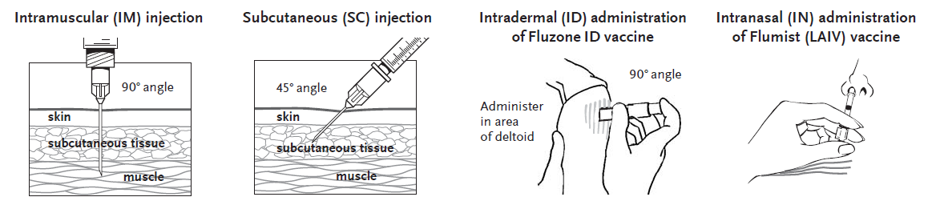
Routes of Administration
Notes:
It is important to inset the needle at the appropriate angle to insure delivery to the muscle or subcutaneous tissue.
IM: The angle of the needle is perpendicular to the skin, generally, though one can use a 45 degree angle if it is a certain muscle being reached. Introduce the needle with a quick thrust. Retain pressure on the skin around the injection site with the thumb and index fingers of the other hand for the entire time the needle is being inserted.
SC: The angle of the needle insertion is 45 degrees to the skin. Pinching up a bit of the subcutaneous tissue with the other hand may help prevent inadvertent IM injection.
ID: The syringe should be gently shaken before the needle cap is removed. Hold the syringe between the thumb and the middle finger. Using a short quick motion insert the needle perpendicular to the skin into the deltoid region of the upper arm. Push on the plunger with the index finger without aspirating. Because the needle is very short the vaccine will be delivered just under the skin into the dermal layer. This vaccine should NOT be administered into the volar aspect of the forearm or by the intradermal technique used to administer a tuberculin skin test.
Oral (PO) Route - Rotavirus vaccines (RV1/Rotarix, RV5/RotaTeq) and oral typhoid (TY21a/Vivotif) are the only U.S.-licensed vaccines that are administered by the oral route. RV1/Rotarix requires reconstitution prior to oral administration. Oral vaccines should generally be administered prior to administering injections or performing other procedures that might cause discomfort. Administer the liquid slowly down one side of the inside of the cheek (between the cheek and gum) toward the back of the infant’s mouth. Care should be taken not to go far enough back to initiate the gag reflex. Never administer or spray (squirt) the vaccine directly into the throat.

Slide 17
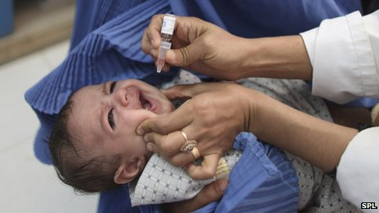
Oral (PO) Route
-Administer prior to injections
-Administer slowly
-Careful not to initiate gag reflex
-Never administer or squirt directly into the throat
Notes:
• Oral (PO) Route - Rotavirus vaccines (RV1/Rotarix, RV5/RotaTeq) and oral typhoid (TY21a/Vivotif) are the only U.S.-licensed vaccines that are administered by the oral route. RV1/Rotarix requires reconstitution prior to oral administration. Oral vaccines should generally be administered prior to administering injections or performing other procedures that might cause discomfort. Administer the liquid slowly down one side of the inside of the cheek (between the cheek and gum) toward the back of the infant’s mouth. Care should be taken not to go far enough back to initiate the gag reflex. Never administer or spray (squirt) the vaccine directly into the throat.
ACIP does not recommend re-administering a dose of rotavirus vaccine to an infant who regurgitates, spits out, or vomits during or after administration. No data exist on the benefits or risks associated with re-administering a dose. The infant should receive the remaining recommended doses of rotavirus vaccine following the routine schedule (with a 4-week minimum interval between doses). There are no restrictions on the infant’s consumption of breast milk or any other liquid before or after administration of either of these vaccines.

Slide 18
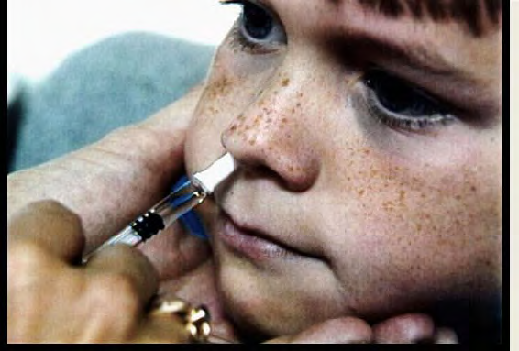
Intranasal (IN) Route
-LAIV, FluMist
-Seated upright position with head tilted back
-Breathe normally
-Tip of sprayer inserted slightly in naris
-Do Not repeat if patient coughs, sneezes, or expels dose
Notes:
• Intranasal Route -The live attenuated influenza vaccine (LAIV, FluMist) is currently the only vaccine administered by the nasal route
The patient should be seated in an upright position with head tilted back. Instruct the patient to breathe normally. The provider should gently place a hand behind the patient’s head. The tip of the nasal sprayer should be inserted slightly into the naris. Half of the contents of the sprayer (0.1 mL) are sprayed into the nostril; the dose-divider clip is then removed and the procedure is repeated in the other nostril.
The dose does not need to be repeated if the patient coughs, sneezes, or expels the dose in any other way.

Slide 19
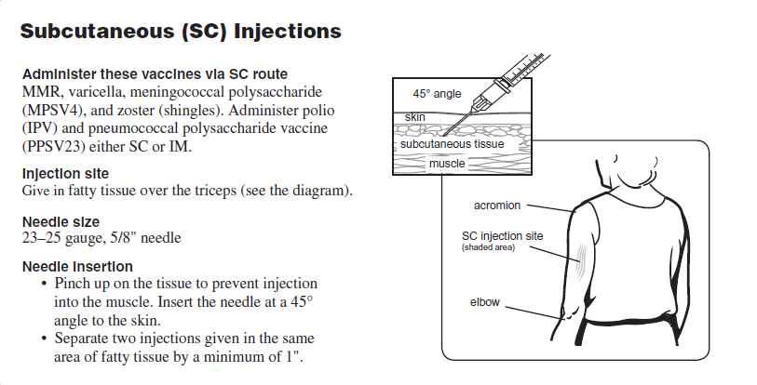
SC Injections
Notes:
Make copy for handouts
SC: Needle should be short enough and must be inserted at a 45 degree angle to avoid the muscle. (5/8” ; 23-25 gauge)
Infants- should use the anterolateral aspect of the thigh
Toddlers, children and adults- use outer aspect of upper arm. May also use fatty area of anterolateral thigh for toddlers.
Pinching up a bit of the subcutaneous tissue with the other hand may help prevent inadvertent IM injection.
Vaccines administered SC:
MMR
MMRV
IPV (inactivated polio)
Pneumococcal (polysaccharide); can also be administered IM
Varicella
Meningococcal (polysaccharide)
Herpes zoster

Slide 20
Vaccines Administered SC
Notes:
MMR, MMRV, IPV(inactivated polio), Pneumococcal (polysaccharide), Varicella, Meningococcal (polysaccharide), Herpes zoster
AGE: Infants (birth-12 months) administer in fatty tissue over the anterolateral thigh muscle using a 5/8” needle 23-25 gauge; for children 12 mos.-older administer in fatty tissue over the anterolateral thigh or fatty tissue over triceps (upper arm) using a 5/8” needle 23-25 gauge.

Slide 21
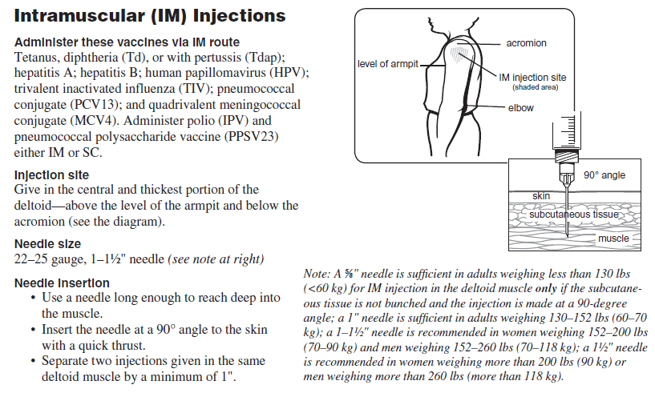
IM Injections
Notes:
Make copy for handouts
Two routinely recommended IM sites: Anterolateral thigh and deltoid; Injection at these sites reduces the chance of involving neural or vascular structures. The site depends on the age of the individual and the degree of muscle development. Because there are no large blood vessels in the recommended sites, aspiration before injection of vaccines is not necessary. The muscles of the buttock are not used for administration of vaccines in infants and children because of concern about potential injury to the sciatic nerve, which is well documented after injection of antimicrobial agents into the buttock. If the gluteal muscle must be used, care should be taken to define the anatomic landmarks.
IM: The angle of the needle is perpendicular to the skin. Introduce the needle with a quick thrust. Retain pressure on the skin around the injection site with the thumb and index fingers of the other hand for the entire time the needle is being inserted.
IM Vaccines:
DTaP, DT, Tdap, and Td ; Hepatitis A and B; Hib ; Influenza; IPV; Pneumococcal (polysaccharide); Pneumococcal (conjugate);Meningococcal (conjugate); Human Papillomavirus (HPV)

Slide 22
Vaccines Administered IM
Notes:
What sites are appropriate for infants? Vastus Lateralis in the anterolateral aspect of the middle or upper thigh, needs to be used for infants and may be used for children up to three years of age or older. For infants under 1 month of age, you might use a 5/8” needle (General Recommendations, 12/6/06, Table 7.) but after that, a 1” needle should be used and a 22-25 gauge.
What sites are appropriate for toddlers? By age 12 months, the deltoid may have developed sufficiently to be used. This muscle is shallow and can accommodate only a small volume of fluid. Requires individual decision based on child’s muscle mass. Anterolateral aspect of mid or upper thigh is also acceptable. Both ACIP and the Red Book recommend 1”-1 ¼” for thigh muscle. A 5/8” needle could be used in the deltoid but it would be necessary to evaluate the individual patient. Both resources recommend 22-25 gauge needle
What sites are appropriate for older children, adolescents, and adults?
The deltoid muscle is recommended for routine intramuscular vaccinations. The anterolateral thigh also can be used.
What size needle is appropriate for adolescents and adults?
1-1 ½”, 20-25 gauge
With hepatitis B vaccine, it is important to always use longer size to reach the muscle.
Do not use gluteus muscle for any vaccine except IG.
Needle length can also depend on whether the tissue at the injection site is stretched flat or bunched. For further details, please see the ACIP statement, General Recommendations, MMWR 12/1/06, Vol. 55, No. RR-13.

Slide 23
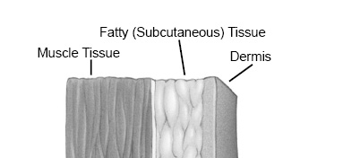
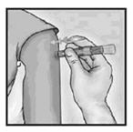
Intradermal (ID) Route
-Fluzone licensed for use in persons 18 through 64 years
-Deltoid region of upper arm used
-Patient seated with arm bent at elbow and hand on hip to ensure proper administration
-Not administered into the volar aspect of the forearm or by the intradermal technique used to administer a tuberculin skin test
Notes:
• Intradermal (ID) Route. Fluzone Intradermal is the only U.S.-licensed vaccine that is administered by the intradermal route. It is approved only for use in persons 18 through 64 years of age. This Fluzone formulation is not the same as intramuscular formulations of inactivated influenza vaccine (IIV). Other IIV formulations should NOT be administered by the intradermal route.
-Site - The site of administration is the deltoid region of the upper arm. The patient should be seated with the arm bent at the elbow and the hand on the hip to ensure that the site of administration is prominent.
-Technique
The syringe should be gently shaken before the needle cap is removed. Hold the syringe between the thumb and the middle finger. Using a short quick motion insert the needle perpendicular to the skin into the deltoid region of the upper arm. Push on the plunger with the index finger without aspirating. Because the needle is very short the vaccine will be delivered just under the skin into the dermal layer. This vaccine should NOT be administered into the volar aspect of the forearm or by the intradermal technique used to administer a tuberculin skin test.
Intradermal (ID)
PPD (¼ - ¾”) Volar surface 25-27 gauge of forearm
Fluzone (ID)18-64Yrs; Deltoid area

Slide 24
Special Situations
Multiple Vaccinations
Persons with Bleeding Disorders
Nonstandard Administration
Managing Acute Vaccine Reactions
Notes:
Next we will review some special situations for administering vaccines. Multiple vaccinations, persons with bleeding disorders, nonstandard administration, and managing acute vaccine reactions.

Slide 25
Multiple Vaccines
When multiple vaccines are administered, separate sites should ordinarily be used if possible.
When necessary, two vaccines may be given in the same limb at a single visit.
The thigh is the preferred site for infants and smaller children for two simultaneous IM injections because of its greater muscle mass.
The distance for separating the two injections is arbitrary but should be sufficient (e.g., 1 to 2 in. apart) so that local reactions are unlikely to develop.
Multiple vaccines should not be mixed in a single syringe unless specifically licensed and labeled for administering in one syringe.
Notes:
With the current number or recommended vaccines it is possible that a child may receive as many as 7 vaccines in one visit.

Slide 26
Bleeding Disorders
Individuals with a bleeding disorder or who are receiving anticoagulant therapy may develop hematomas in IM injection sites. When any intramuscularly administered vaccine is indicated for a patient with a bleeding disorder, the vaccine should be administered intramuscularly if a physician familiar with the patient’s bleeding risk determines that the vaccine can be administered by this route with reasonable safety.
Notes:
Prior to administration of IM vaccines the patient or family should be instructed about the risk of hematoma formation from the injection. If the patient periodically receives antihemophilia or similar therapy, IM vaccine administration should be scheduled shortly after such therapy is administered. A 23-gauge or finer needle should be used and firm pressure applied to the site for at least 2 minutes after injection. The site should not be rubbed or massaged. Patients receiving anticoagulation therapy presumably have the same bleeding risk as patients with clotting factor disorders and providers should follow the same guidelines for intramuscular administration.
Other Special Conditions:
Mastectomy:
Do not use arm on the side of the mastectomy
If double mastectomy, use another site other than the arm. (Leg)
Lost Immunization Records
Give what is age appropriate on that visit and instruct parent to look for record. If unable to locate, must give all the vaccine doses that are for age.

Slide 27
Non-Standard Administration
CDC discourages deviating from the recommended route, site, dosage, or number of doses for any vaccine. Deviation can result in reduced protection and increase the risk of an exaggerated local reaction. For certain vaccines, the ACIP recommends revaccination if a nonstandard route or site is used.
Larger than recommended dosages can be hazardous because of excessive local or systemic concentrations of antigens or other vaccine constituents deposited into the tissue.
Notes:
All vaccines should be administered by the manufacturer’s recommended route, but there are no ACIP recommendations to repeat doses of other vaccines administered by another route. (See ACIP General Recommendations for more detail).

Slide 28
*Pre-Drawing Vaccines
CDC recommends that providers draw up
vaccines only at the time of administration.
Do Not pre-draw doses before they are
needed.
Notes:
Problems Associated with Predrawing Vaccines
CDC discourages predrawing vaccines and has identified the following problems associated with this practice:
to administration errors.
Predrawing vaccines leads to vaccine waste and increases the risk of vaccine storage under inappropriate conditions.
Most syringes are designed for immediate administration and not for vaccine storage. Bacterial contamination and growth can occur in syringes with predrawn vaccine that do not contain bacteriostatic agents.
No stability data are available for vaccines stored in plastic syringes. Vaccine components may interact with the polymers in plastic syringes over time potentially reducing vaccine potency.
An individual should only administer a vaccine he or she has prepared and drawn up. If a vaccine is drawn up by one person and then administered by a different person, the person administering the vaccine cannot be sure of the composition and sterility of the dose. This is a quality control and patient safety issue and a best practice standard of medication administration.
Influenza Clinics and Predrawing Vaccines
Vaccine manufacturers do not recommend that influenza vaccines be predrawn in advance of a large influenza vaccination clinic because there are no data on the stability of vaccines stored in syringes that have been filled by providers. CDC discourages this practice for the reasons noted in the previous section. As an alternative to predrawing vaccines, CDC recommends using manufacturer-filled syringes for large immunization events such as community influenza clinics. These syringes are designed for both storage and administration.

Slide 29
Managing Acute Vaccine Reactions
Thorough screening for contraindications and precautions
Procedures in place for managing reaction
Be familiar with the signs & symptoms of anaphylaxis
Know staff role in the event of an emergency
CPR certified
Emergency cart & equipment available
Notes:
Managing Acute Vaccine Reactions - Severe, life-threatening anaphylactic reactions following vaccination are rare. Thorough screening for contraindications and precautions prior to vaccination can often prevent reactions. Staff must have in place and be familiar with procedures for managing a reaction. Staff should be familiar with the signs and symptoms of anaphylaxis because they usually begin within minutes of vaccination. These signs and symptoms can include, but are not limited to: flushing, facial edema, urticaria, itching, swelling of the mouth or throat, wheezing, and difficulty breathing. Each staff member should know their role in the event of an emergency and all vaccination providers should be certified in cardiopulmonary resuscitation (CPR). Epinephrine and equipment for maintaining an airway should be available for immediate use. Additional drugs may also be used (see ACIP General Recommendations, Table 8 for more detailed information). After the patient is stabilized, arrangements should be made for immediate transfer to an emergency facility for additional evaluation and treatment. (See “Medical Management of Vaccine Reactions in Children and Teens” at http://www.immunize.org/catg.d/p3082a.pdf and “Medical Management of Vaccine Reactions in Adult Patients” at http://www.immunize.org/catg.d/p3082.pdf.

Slide 30
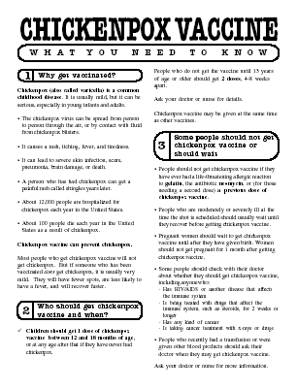

Always Document…
Accept only written documentation of prior immunizations
After vaccine administration, document:
  Publication date of VIS & date VIS given
  Date, site, route, antigen(s), manufacturer, lot #
  Person administering vaccine, practice name and address
  Vaccine refusals with a signed “Refusal to Vaccinate Form”
  GA law does not require signed consent for immunizations
Notes:
30
Vaccine Information Sheets
VIS required by law for each vaccine given and each time that vaccine is given. The most current VIS must be used. For VIS statements in English and many other languages: www.immunize.org; www.cdc.gov/vaccines/ or call the National Immunization Program Information Hotline at 800-232-2522.
Document all information listed on slide. Information will also be helpful if a specific lot of vaccine is recalled in the future.
Refusal to consent for an immunization should be documented for liability purposes and chart completeness. There is no way to document this in GRITS. You can obtain a Refusal to vaccinate form in English/Spanish from the State Immunization Office or from the website at https://dph.georgia.gov/health-care-professionals
Georgia recognizes only medical and religious exemptions and there are no special forms for religious exemptions. Medical exemptions must be re-evaluated every year.
Georgia law does not require signed consent for immunization. Patients, parents or legal guardians may verbally consent to immunization. However, some practices may require written consent for all medical care.

Slide 31

The 7 Rights of Vaccine Administration
Right Patient
Right Vaccine or Diluent
Right Time*
Right Dosage
Right Route, Needle Length, Technique
Right Site for route indicated
Right Documentation
* Correct age, appropriate interval, and administer before vaccine or diluent expires
Ref: Epidemiology and Prevention of Vaccine-Preventable Diseases. 12th Edition, May 2012.
Notes:
31
Be sure to check package insert for correct route, correct sites for the route and correct needle length.
Much of this information is available in the ACIP General Recommendations document.
*Make a chart of this information for use in your office*. Or have a VACS FACS available in your office.
Ref: General Recommendations on Immunization MWR 2011; 60 (No. RR-2) Jan 28, 2011

Slide 32
Avoiding Vaccine Errors
When possible, involve staff in selection of vaccine products
Keep current reference materials on each vaccine
Rotate vaccines
Consider the potential for product mix-up
Triple Check Your work
Notes:
Strategies to Prevent Administration Errors
Vaccine administration errors can result in a patient receiving an ineffective immunization. This can leave the person vulnerable to infection. In addition to strict adherence to the “Rights of Medication Administration” and ongoing training and education of staff, listed below are other strategies that can be implemented to help prevent administration errors.
--When possible, involve staff in the selection of vaccine products to be used in your facility. Different brands of the same vaccine can have different schedules, age indications, or other indications. Stocking multiple brands might lead to staff confusion and vaccine administration errors.
--Keep current reference materials available for staff on each vaccine used in your facility. Keep reference sheets for timing and spacing, recommended sites, routes, and needle lengths posted for easy reference in your medication preparation area.
--Rotate vaccines so that those with the shortest expiration dates are in the front of the storage unit. Use these first and frequently check the storage unit to remove any expired vaccine.
--Consider the potential for product mix-ups when storing vaccines. Do not store sound-alike and look-alike vaccines next to each other (e.g., DTaP and Tdap). Consider color coding labels on vaccine storage containers and/or including the vaccine type and age indications.
Administer only vaccines that you have prepared for administration.
--Triple check your work before you administer a vaccine and ask other staff to do the same.
Counsel parents and patients about vaccines to be administered and on how important it is for them to maintain immunization records on all family members. Educated clients may notice a potential error and help prevent it.

Slide 33
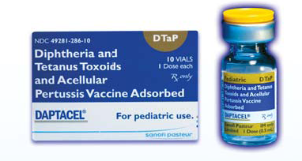
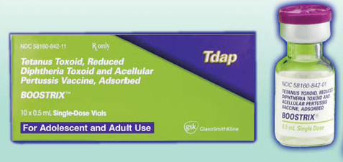
Avoiding Vaccine Errors
DTaP
Tdap
Notes:
Consider the potential for product mix-ups when storing vaccines. Do not store sound-alike and look-alike vaccines next to each other (e.g., DTaP and Tdap). Consider color coding labels on vaccine storage containers and/or including the vaccine type and age indications.

Slide 34
Test Your Knowledge!
Four month old Lucas was given Tdap instead of DTaP.
What should be done?

Slide 35
Test Your Knowledge!
Four month old Lucas was given Tdap instead of DTaP.
What should be done?
If Tdap was inadvertently given to a child under age 7 years, it should not be counted as either the first, second, or third dose of DTaP. The dose should be repeated with DTaP. Continue vaccinating on schedule. If the dose of Tdap was administered for the fourth or fifth DTaP dose, the Tdap dose can be counted as valid. Please remind your staff to always check the vaccine vial at least 3 times before administering any vaccine.
IAC Ask the Experts - Reviewed July 2014
Notes:
If Tdap was inadvertently given to a child under age 7 years, it should not be counted as either the first, second, or third dose of DTaP. The dose should be repeated with DTaP. Continue vaccinating on schedule. If the dose of Tdap was administered for the fourth or fifth DTaP dose, the Tdap dose can be counted as valid. Please remind your staff to always check the vaccine vial at least 3 times before administering any vaccine.

Slide 36
Test Your Knowledge!
Lillian, a 50 year old grandmother, was given DTaP instead of Tdap.
Does she need to receive one dose of Tdap?

Slide 37
Test Your Knowledge!
Lillian, a 50 year old grandmother, was given DTaP instead of Tdap.
Does she need to receive one dose of Tdap?
Lillian received the appropriate amount of tetanus toxoid and MORE diphtheria toxoid and pertussis antigen than is recommended. Count the dose as Tdap. The patient does not need a repeat dose of Tdap.
Take measures to prevent this error in the future.
IAC Ask the Experts - Reviewed July 2014
Notes:
Lillian received the appropriate amount of tetanus toxoid and MORE diphtheria toxoid and pertussis antigen than is recommended. Count the dose as Tdap. The patient does not need a repeat dose of Tdap.
Take measures to prevent this error in the future.

Slide 38
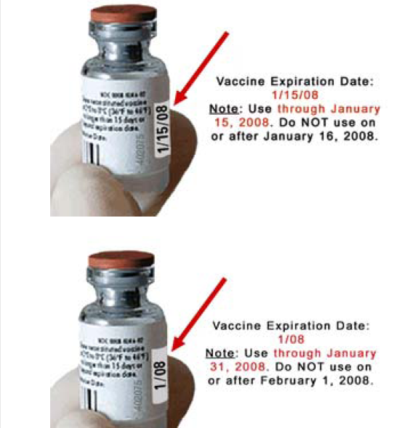
Check Expiration Dates
Notes:
Rotate vaccines so that those with the shortest expiration dates are in the front of the storage unit. Use these first and frequently check the storage unit to remove any expired vaccine.

Slide 39
Five-year-old Tonia received her second MMR a week ago.
How long should she wait before receiving live attenuated influenza vaccine (LAIV)?
Test Your Knowledge!

Slide 40
Five-year-old Tonia received her second MMR a week ago.
How long should she wait before receiving live attenuated influenza vaccine (LAIV)?
Test Your Knowledge!
LAIV can be administered simultaneously with another live vaccine (for example, MMR, varicella), but if not given at the same time, ACIP recommends waiting four weeks before administering the second live vaccine.
IAC Ask the Experts - Reviewed January 2014

Slide 41
Vaccine Injury Compensation Program (VICP)
VICP is a no-fault alternative to the traditional tort system for resolving vaccine injury claims. It was established as part of the National Childhood Vaccine Injury Act of 1986, after a rash of lawsuits against vaccine manufacturers and healthcare providers threatened to cause vaccine shortages and reduce vaccination rates.
Who can file a claim?
  Claim must be filed by individual, parent or guardian, legal representative, non-United States citizen
  Must show that injury is on “Vaccine Injury Table”
  In addition, to be eligible to file a claim, the effects of the person’s injury must have:
  Lasted for more than 6 months after vaccine was given
  Resulted in hospital stay and surgery
  Resulted in death
Notes:
The National Childhood Vaccine Injury Act (NCVIA) set forth 3 basic requirements for all vaccination providers, which are:
Providers must give the patient (or parent/legal representative of a minor) a copy of the relevant federal "Vaccine Information Statement" (VIS) for the vaccine they are about to receive.
Providers must record certain information about the vaccine(s) administered in the patient's medical record or a permanent office log.
Providers must document any adverse event following the vaccination that the patient experiences and that becomes known to the provider, whether or not it is felt to be caused by the vaccine, and submit the report to the Vaccine Adverse Event Reporting System (VAERS).

Slide 42
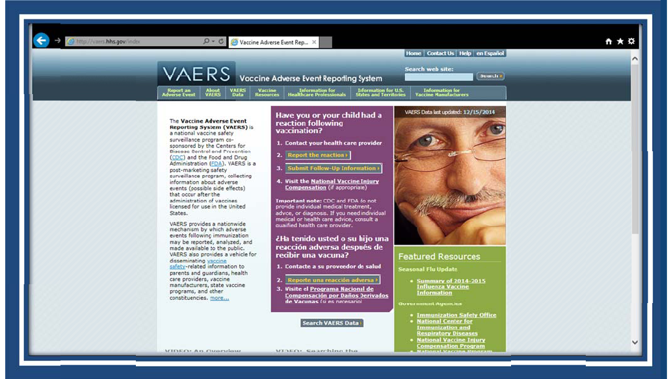
VAERS http:vaers.hhs.gov/
Notes:
The Vaccine Adverse Event Reporting System (VAERS) accepts all reports of adverse events occurring with vaccinations, including reports of vaccination errors. VAERS is primarily concerned with monitoring adverse health events and encourages reporting of clinically significant adverse health events following vaccination. Using clinical judgment, healthcare professionals can decide whether or not to report a medical error at their own discretion. For example, a healthcare professional may elect to report vaccination errors that do not have an associated adverse health event, especially if they think the vaccination error may pose a safety risk (e.g., administering a live vaccine to an immunocompromised patient) or that the error would be preventable with public health action or education.
The primary objectives of VAERS are to:
Detect new, unusual, or rare vaccine adverse events;
Monitor increases in known adverse events;
Identify potential patient risk factors for particular types of adverse events;
Identify vaccine lots with increased numbers or types of reported adverse events; and
Assess the safety of newly licensed vaccines.
What Can Be Reported to VAERS?
VAERS encourages the reporting of any clinically significant adverse event that occurs after the administration of any vaccine licensed in the United States.
Who Reports to VAERS?
Anyone can file a VAERS report, including parents, health care providers, manufacturers, and vaccine recipients.
Does VAERS Provide General Vaccine Information?
No. VAERS only collects and analyzes adverse event reports. In another example, VAERS determined that there may be a potential for a small increase in risk for Guillain-Barre syndrome after the meningococcal conjugate vaccine, Menactra. As a result of this finding, a history of Guillain-Barre syndrome became a contraindication to the vaccine and further controlled studies are currently underway to research this issue.
The VAERS website for reporting is: http:vaers.hhs.gov/ or you can call to report at 1-800-822-7967

Slide 43

Are YOU up to date?
Healthcare Personnel (HCP) Need These Immunizations
Annual influenza vaccine
Tdap or Td
Hepatitis B (exposure risk) Check immunity
Validate immune status of:
Varicella
Measles, Mumps & Rubella(MMR)
Notes:
43
HCP are defined as all paid and unpaid persons working in health-care settings who have the potential for exposure to patients and/or to infectious materials, including body substances, contaminated medical supplies and equipment, contaminated environmental surfaces, or contaminated air. HCP might include (but are not limited to) physicians, nurses, nursing assistants, therapists, technicians, emergency medical service personnel, dental personnel, pharmacists, laboratory personnel, autopsy personnel, students and trainees, contractual staff not employed by the health-care facility, and persons (e.g., clerical, dietary, housekeeping, laundry, security, maintenance, administrative, billing, and volunteers) not directly involved in patient care but potentially exposed to infectious agents that can be transmitted to and from HCP and patients (2).
Hepatitis B vaccine is recommended for health-care personnel with potential exposure to blood or body fluids. The antibody status of these health-care personnel should be checked 1-2 months after the 3rd dose. If a person fails to develop an adequate antibody titer after three doses of vaccine, follow current CDC recommendations for additional doses of hepatitis B vaccine. Some health-care providers may have received three doses of hepatitis B vaccine as children, adolescents or adults but have never had serologic testing to check for immunity. Follow the CDC Guidance for Evaluating Health-Care Personnel for Hepatitis B Virus Protection and for Administering Postexposure Management (Recommendations and Reports / Vol. 62 / No. 10 December 20, 2013)
Un-immunized HCP
Un-immunized healthcare workers are at risk of infecting patients, family members and community contacts
Immunized HCP
Protect patients from VPD’s
Help offices avoid potential liability cases. (The practice can be liable if an unimmunized HCP becomes infected with a vaccine preventable disease and infects a patient.)
Maintain productivity
Reduce illness and illness-related absenteeism
Evidence of Immunity to MMR
Documented administration of two doses of measles and mumps vaccine and one dose of rubella vaccine OR
Laboratory evidence of immunity or laboratory confirmation of disease (measles, mumps and rubella) OR
Born before 1957 (measles, mumps and rubella)
References: 1. General Recommendations on Immunization, Recommendations of the Advisory Committee on Immunization Practices (ACIP). MMWR (RR-2); January 28, 2011
2. Immunization of Health-Care Personnel: Recommendations of ACIP MMWR; November 25, 2011 / 60(RR07);1-45
3. CDC Guidance for Evaluating Health-Care Personnel for Hepatitis B Virus Protection and for Administering Postexposure Management (Recommendations and Reports / Vol. 62 / No. 10 December 20, 2013)

Slide 44


Resources
Local health department
District Immunization Coordinator
GA Immunization Program Office
  On call Help line: 404-657-3158
  GRITS Help Line:1-866-483-2958
  VFC Help Line:1-800-848-3868
  Website http://dph.georgia.gov/immunization-section
  Your local Immunization Program Consultant (IPC)
GA Chapter of the AAP
GA Academy of Family Physicians
Notes:
If you need further information about the changes, or to ask questions later, please contact the GA Immunization Office and our partners GA AAP and GA AFP
Your Local health department
District Immunization Coordinator (IPCs)
GA Immunization Program Office
404-657-3158
Website http://health.state.ga.us/programs/immunization
GA Chapter of the AAP
GAFP

Slide 45
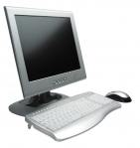
Internet Resources
Georgia Department of Public Health
  http://dph.georgia.gov/immunization-section
CDC Immunization information
  http://www.cdc.gov/vaccines/
CDC Flu information
  http://www.cdc.gov/flu/
Immunization Action Coalition
  www.immunize.org

Slide 46
QUESTIONS?

