Slide 1
Georgia Requirements for School and Childcare Attendance
Presentation to:
Presented by:
Date:

Slide 2
Conflicts of Interest and Disclosures
Neither the planners or presenters indicated that they have any real or perceived vested interest that relate to this presentation nor any relationships with pharmaceutical companies, biomedical device manufacturers, and/or other corporations whose products and services are related to the vaccines we discuss.
There is no sponsorship or commercial support being received for this activity.
The mention of specific brands of vaccines in this presentation is for the purpose of providing education and does not constitute endorsement by the provider or ANCC of any commercial products.
Off Label Use- For certain vaccines a slight departure from or
off-label use of the vaccine package insert guidelines may be discussed during presentation.
Notes:
[Presenter is required to read this information to the audience before the program begins.]
Neither the planners of this session nor I have any financial relationship with pharmaceutical companies, biomedical device manufacturers, or corporations whose products and services are related to the vaccines we discuss.
There is no commercial support being received for this event.
The mention of specific brands of vaccines in this presentation is for the purpose of providing education and does not constitute endorsement.
The GA Immunization Office utilizes ACIP recommendations as the basis for this presentation and for our guidelines, policies, and recommendations.
For certain vaccines this may represent a slight departure from or off-label use of the vaccine package insert guidelines.

Slide 3
Notice of Requirements for successful completion
To obtain nursing contact hours for this session, you must be present for the entire presentation and complete and submit an evaluation.
Contact hours for this session will be available from 02/1/2012 until 02/01/2014 only for those who successfully complete this educational activity.
Notes:
To obtain nursing contact hours for this session, you must be present for the entire hour and complete an evaluation.
Contact hours for this session only are available for two (2) years from the date of implementation.

Slide 4
Objectives
Identify vaccine preventable diseases and how vaccines impact morbidity rates for these preventable diseases in GA
Recall GA immunization law, DPH rules and regulations for GA immunization certificates and provider, school facilities and parent responsibility to enforce the law
Describe standards for issuing and filing certificates of immunizations
Identify valid and invalid GA immunization certificates and how to use filing tickler system
Notes:
At the end of this presentation the participant will be able to:
Identify vaccine preventable diseases and how vaccines impact these preventable diseases GA
Recall GA immunization law and DPH rules and regulations for GA immunization certificates
Describe standards for issuing and filing certificates of immunizations
Identify valid and invalid GA immunization

Slide 5
Objectives continued….
Describe the public health audit process and the responsibilities of school and child care facilities
Identify common errors seen on GA Immunization certificates
Notes:
Describe audit process and how to use filing tickler system
Identify some common errors seen on certificates

Slide 6
Topics
Review of childhood vaccine preventable diseases
Georgia immunization requirements for preschool, child care, and school attendance
Review policy guide for completing form 3231
How to monitor, follow up and enforce the requirements for the certificates of attendance
Resources
Notes:
Review of childhood vaccine preventable diseases and why we immunize
GA immunization requirements for preschool, child care, and school attendance
How to monitor, follow up and enforce the requirements for the certificates of attendance
Helpful resources

Slide 7
Diphtheria
Spread by direct contact
Incidence in United States has decreased
Still occurs in other countries
Disease can be prevented by vaccine
Vaccine given in combination with tetanus and pertussis (DTaP, DT, Tdap,or Td)
Required for school and child care attendance
Notes:
(Suggestion: Refer attendees to “Hop To IT! Immunization Schedule or the Recommended Childhood and Adolescent Immunization Schedule)
This is a slide of the throat of a child who has diphtheria. You can see the thick gray coating over the back of the throat. This coating can eventually expand down through the airway, and if not treated, a person could die from suffocation, or suffer other complications such as paralysis, heart failure, or coma. The diphtheria germ lives in the throat and mouth of the infected person.
The disease is spread through direct contact with the infected person.
Now we don’t see as much of this disease in the United States
However, there are still outbreaks throughout the world, and the danger is for an international traveler to bring infection into the US. The most recent outbreak was in Russia and the Ukraine.
Diphtheria is easy to prevent in children and adults with vaccine.
It is usually given in combination with the vaccines to prevent tetanus and pertussis, called DTaP, DT, Tdap, or Td. It is the “D” component of those vaccines.
Required for school and child care attendance

Slide 8
Tetanus
Tetanus germ lives in dirt and the intestines and feces of animals
Germ enters the body through cuts, punctures, burns, and other wounds
Disease can be prevented by vaccine
Vaccine given in combination with diphtheria and pertussis (DTaP, DT, Tdap, or Td)
Vaccine needs to be given periodically throughout lifetime
Required for school and child care attendance
Notes:
Both the child and the adult in these pictures are experiencing painful muscle spasms from tetanus. It is nearly impossible for them to move or control the muscles in their bodies The child cannot eat because the muscles in her mouth have become so tight and it is difficult for her to swallow. Other possible complications are broken bones from muscle spasms, breathing problems, and death.
The tetanus germ lives in dirt and the intestines and the feces of animals.
The germ enters the body through cuts, punctures, burns, and other wounds.
Most cases of tetanus reported occur in adults who have not been immunized or who are under immunized; i.e., they have not received boosters to maintain a level of protection.
Tetanus is easy to prevent in children and adults with vaccine.
It is usually given along with diphtheria and pertussis as the “T” component of the DTaP, DT, Tdap, or Td vaccine.
It is one of the vaccines that needs to be given periodically (every 10 years) as a booster, throughout a person’s lifetime
Required for school and child care attendance

Slide 9
Pertussis
Pertussis germ lives in mouth, nose, and throat of infected person
Spread by coughing and sneezing
Disease can be prevented by vaccine
Vaccine given in combination with diphtheria and tetanus (DTaP or Tdap)
Required for school and child care attendance
Notes:
This is a slide of a child who is suffering from pertussis, commonly know as “whooping cough”.
He is experiencing coughing spasms, which produce a “whooping” sound. The sound occurs because the child is trying to catch his breath before the next round of coughing. Often children have difficulty breathing and experience vomiting and exhaustion from the severe coughing. Other complications include pneumonia, seizures, and death. Adults may also get pertussis, but they usually do not get very sick and may not be aware they have the disease. Unfortunately, they can spread the disease to infants who are too young to have completed the vaccine series.
The pertussis germ lives in the mouth, nose, and throat of the infected person.
The germ is spread from person to person by coughing and sneezing.
Pertussis vaccine is given to prevent pertussis in infants and children.
It is the “P” component of the DTaP or Tdap.
Most of the cases reported in Georgia occurred in infants under 6 weeks of age. They were too young to be immunized.
In GA it is a requirement that all children in child care and school facilities be immunized against diphtheria, tetanus and pertussis

Slide 10
Hospital Respiratory Ward, 1952
Notes:
Question audience to see who knows what disease is illustrated in this slide.
Polio
The photo was taken in a hospital respiratory ward Los Angeles, CA in 1952 when thousands of people were dying from or crippled by polio. These people are in “iron lungs” which were breathing machines. Due to paralysis of the breathing muscles caused by polio, they are unable to breathe on their own.

Slide 11
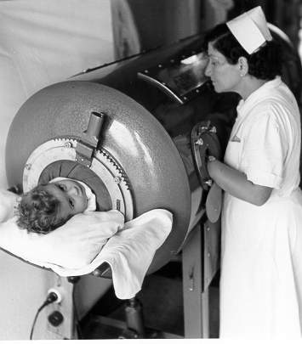
Polio
Incidence decreasing
Viral infection spread through direct contact
Disease can be prevented by vaccine
Vaccinate children up to age 18 and also some international travelers
In Georgia, immunization against polio is required for child care and school attendance
Notes:
The top picture shows you a child being cared for in an iron lung, a scenario out of the 1940s or 1950s, in the pre-vaccine era. The other photo show a more current view of a child with a severely deformed leg due to polio. However, as we saw in the previous slide, different areas of the body may be affected
Thankfully, the incidence of this disease has decreased and we do not see this disease in the US anymore. In fact, the last case due to wild polio virus in GA was in 1979,and until July of 2000, the last case in the Western Hemisphere was in 1991 in Peru. In 2001, there was an outbreak of polio ( 20 reported cases as of 12/00) in the Dominican Republic. We still immunize because we are a global society and there is a danger of international importation of this virus. Our goal is to have polio as the next vaccine preventable disease that is eliminated worldwide. In 2011, only four countries (Afghanistan, India, Nigeria and Pakistan) remain polio-endemic, down from more than 125 in 1988. The World Health Organization has developed objectives to:
interrupt transmission of wild poliovirus as soon as possible;
to achieve certification of global polio eradication;
to contribute to health systems development and strengthen routine immunization and surveillance for communicable diseases in a systematic way
Polio is a virus and lives in the throat and intestines of an infected person and is spread by direct contact. It can be spread to other people through contact with feces. This is an example of good hand washing being crucial in preventing the transmission of disease, in addition to being immunized.
This disease can be prevented by immunization.
Children up through age 18 years need to be vaccinated against polio. Immunization is recommended for some international travelers as well.
In GA it is a requirement that all children in child care and school facilities be immunized against polio.

Slide 12
Measles
Viral infection
Spread by coughing, sneezing, or talking
Disease can be prevented by vaccine
Vaccine given in combination with mumps and rubella vaccines (MMR or MMRV)
Required for school and child care attendance
Notes:
This child has a bad rash caused by measles. The rash usually begins along the hairline and moves downward over the course of 4 days to the face, neck, body, hands, and feet. You will notice her eyes are red and runny and she also has a runny nose and fever.
Children infected with measles are very sick and can suffer from other complications such as pneumonia, ear infections, seizures, brain damage, and death.
Measles is a viral infection and is highly contagious.
It spreads through coughing, sneezing, or just talking to an infected person.
Measles is easy to prevent with vaccine. All children need to be vaccinated and some adults need to be vaccinated, especially those who work in a health care setting.
Measles vaccine is usually given in combination with two other vaccines, Mumps and Rubella, known as MMR. Measles is the first “M” in MMR or MMRV.
Required for school and child care attendance

Slide 13
Mumps
Viral infection
Spread by coughing, sneezing, or talking
Disease can be prevented by vaccine
Vaccine given in combination with measles and rubella vaccines (MMR or MMRV)
Proof of immunity or 2 doses of vaccine required for entrance to school after 7-1-07
Notes:
This slide illustrates a child who has the mumps. As you can see, the child is swollen under the jaw and in the cheeks. She may have a fever and headache. Possible complications include swelling of the brain or spinal cord and deafness.
The mumps is a viral infection.
It is spread through coughing, sneezing, or just talking.
Mumps is easy to prevent with vaccine.
The second “M” in the combination MMR or MMRV vaccine stands for the mumps vaccine.
Proof of immunity or 2 doses of vaccine required for entrance to school after 7-1-07

Slide 14
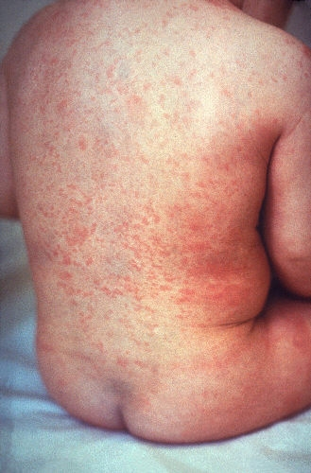
Rubella
Viral infection
Spread by coughing, sneezing, or talking
Harmful to unborn infants
Disease can be prevented by vaccine
Vaccine given in combination with measles and mumps vaccines (MMR or MMRV)
In Georgia, immunizations against measles, mumps, and rubella are required for child care attendance and school entrance
Notes:
This child has a rash on his body from rubella. He may also have swollen glands and a slight fever. Adults and children may contract this disease.
Rubella is caused by a virus.
It is spread through coughing, sneezing, or just talking to an infected person.
This disease can be harmful to unborn infants. If a pregnant woman is exposed to the disease in early pregnancy and is not immune, her unborn baby could have deafness, blindness, heart damage, or mental retardation.
Rubella can be prevented by vaccine. All children and some adults need to be vaccinated.
The “R” in the combination MMR or MMRV vaccine stands for the rubella vaccine.
In GA, the immunization against measles, mumps, and rubella is required for attending child care or entering school.

Slide 15
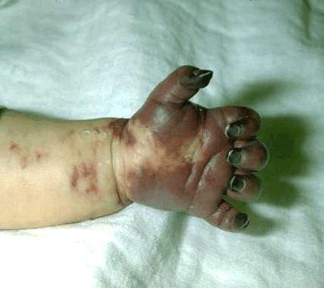
Haemophilus influenzae type b (Hib)
Hib germ enters the body through nose and throat
Spread by direct contact
Hib vaccine responsible for dramatic decrease in incidence of disease
Vaccine given to infants and children under age 5
Immunization required for child care attendance
  (includes 4 year Pre-K)
Notes:
This child has a swollen cheek due to Hib infection. The tissue under the skin covering the jaw and cheek is infected and she is probably very sick. She may have a fever, severe headache, sore throat, or breathing problems. Hib disease can be very dangerous to children under five years of age, especially infants. It can cause brain damage, seizures, paralysis, and hearing loss.
Invasive Hib disease can cause the severe tissue damage you see in the bottom photo.
The Hib germ enters the body through the nose and throat.
It is spread by direct contact with an infected person. Adults and older children can be infected with this germ but not feel sick or show any symptoms.
Like the other vaccines mentioned, hib vaccine has made a dramatic impact on the decreased incidence of this disease. In the early 1980’s, it was estimated that 20,000 cases occurred annually in the U.S., primarily in children under 5 years of age. In 2002, fewer than 167 cases of type b and unknown types were reported in children under the age of 5 years.
The vaccine is recommended for all infants and children under age 5.
Children in child care, including 4 year old Pre-K, are required to have this vaccine. This requirement is specified on the Certificate of Immunization (Form 3231) and in the accompanying instruction guidelines (3231 INS) and the age requirement guidelines (3231REQ). Since Hib vaccine is not routinely recommended for children age five and older, this vaccine is not required for children who are entering school (5 year old Kindergarten through grade 12

Slide 16
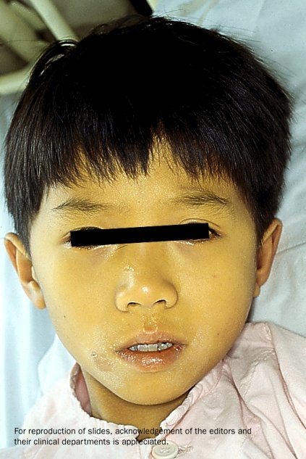

Hepatitis A
Viral infection which attacks the liver
Fecal-oral route of infection
Symptoms may include nausea, anorexia, fever, dark urine, and jaundice of skin and eyes.
Symptoms uncommon in children, but can infect others
As of 7-1-07, required for children born on or after 1-1-06 for school and childcare attendance
Notes:
Viral infection which attacks the liver
Fecal-oral route of infection
Symptoms may include nausea, anorexia, fever, dark urine, and jaundice of skin and eyes.
Symptoms uncommon in children
As of 7-1-07, this is a school and childcare requirement for children born on or after 1-1-06.

Slide 17
Hepatitis B
Viral disease which attacks the liver
Spread by contact with infected body fluids or blood
Person may have disease and not have symptoms
Disease can be prevented by using universal precautions and by vaccine
Vaccine recommended for all infants and children and some adults
Immunization is required for child care attendance and entry to school
Notes:
The man shown in this slide has yellowing skin and eyes (jaundice) which are signs of hepatitis.
Hepatitis B is a viral disease that attacks the liver and cause severe illness and on going liver damage and/or cancer. It is the most common type of viral hepatitis in the U.S.
It is spread by contact with infected body fluids or blood. Examples of methods of transmission include the following
Using unsterilized needles
Sexual contact with a person who has hepatitis B
Sharing toothbrushes, razors, or washcloths
Babies can be infected during childbirth if the mom is infected
Babies and young children can be infected if the infected person pre-chews baby food.
Over half of the people who get hepatitis B have no symptoms. For people who do get symptoms, they might include:
Loss of appetite, nausea or vomiting
Weakness and tiredness
Fever and headaches
Yellow skin and eyes
Using universal precautions and being immunized are ways to prevent transmission of this disease.
It is recommended that all infants and children be vaccinated and also many adults.
Being immunized against Hepatitis B is also a requirement for attendance to child care and entry to school in GA.

Slide 18
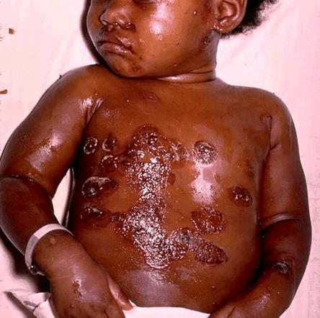
Varicella/chickenpox
Spread through coughing, sneezing, or contact with infected sores
Can be severe, especially in teens and adults
Can be prevented by a vaccine
Vaccine recommended for all persons over one year of age who have not had the disease
Vaccine or proof of immunity is required
  For child care attendance (1 dose)
  Entry to school (2 doses)
  Entry to 6th grade (2 doses)
Notes:
This boy at the top has a typical chicken pox rash. Some of the sores are red spots and some are blisters. The red spots will become blisters and new red spots will form. The photo at the bottom shows an infant with a secondary bacterial infection of varicella lesions, probably with staph or strep organisms.
Varicella or chicken pox is usually thought of as a mild disease or just a discomfort to the child. Millions of children get chickenpox each year in the U. S. This disease can be quite severe and complications such as strep infections and pneumonia can occur.
It is easily spread through coughing, sneezing, or contact with the infected sores.
Chickenpox can be especially serious in teens and adults; they are much more likely to be hospitalized or to die from this disease.
However, this disease can also be costly in what we call direct (medical) cost and indirect cost (time lost from work). Once someone is exposed, it takes 13-17 days to contract the disease. Also, a person may be considered contagious for 5 days prior to breaking out with the rash up to five or more days after the first crop of blisters appear.
Chickenpox may be prevented with the vaccine. In fact, there are recommendations to give this vaccine after exposure to the disease to susceptible persons.
This vaccine which was licensed in 1995, should be routinely given to all persons who are one year of age or older who have never had the disease. This would include teens and adults.
Documented impact of vaccine:
Disease burden decreased by 90%
Hospitalizations decreased by 88%
Proof of varicella immunity was required for all children attending child care and entering school in Georgia, starting August 1, 2000. In 2001, this requirement was extended to include all students entering 6th grade.
As of 7-1-07, the school requirement of 2 doses of vaccine.
(Control of Communicable Diseases Manual,, David Heymann, MD, 2004)

Slide 19

Pneumococcal Disease
Caused by Streptococcus pneumoniae bacterium
Droplet spread from person to person
Invasive pneumococcal disease can result in pneumonia, bacteremia, or meningitis
Pneumococcal disease kills more people in the United States each year than all other vaccine-preventable diseases combined
As of 7-1-07 PCV13 vaccine is a requirement for all children under 5 years of age who attend child care facilities
Notes:
Caused by Streptococcus pneumoniae bacterium
Droplet spread from person to person
Invasive pneumococcal disease can result in pneumonia, bacteremia, or meningitis
Pneumococcal disease kills more people in the United States each year than all other vaccine-preventable diseases combined
As of 7-1-07 PCV vaccine is a requirement for all children under 5 years of age who attend child care facilities

Slide 20
20th Century Peak & Current Morbidity for VPDs
 | Prevaccine (in peak year) | 2011 | % Reduction of Cases
Diphtheria | 30, 508 | 0 | 100
Measles | 763,094 | 222 | 99.9
Mumps | 212,932 | 404 | 99.8
Pertussis | 265,269 | 18,719 | 92.9
Paralytic polio | 63,302 | 0 | 100
Rubella | 488,796 | 4 | 99.9
Tetanus | 601 | 36 | 94.0
Hib, type b (age < 5 yrs) | 20,000 (yearly average in 1980’s) | 4, plus 226 of unknown type | >99.8
MMWR (Weekly), August 17, 2012, 61(32); 624-637
Notes:
20
The 2nd column of this chart shows the number of cases in the peak year of the 20th century (prevaccine) for each of the VPDs listed in the 1st column.
The 3rd column shows the number of cases reported in 2011.
The last column shows the percentage of reduction in those disease cases after the introduction of vaccine.
You can clearly see the impact vaccines have made, though we still have a ways to go with pertussis.
Of the 222 measles cases in 2010, 142 were indigenous and 80 were imported
In addition, it has been estimated that vaccination with 7 of the 12 routinely recommended childhood vaccines prevents an estimated 33,000 deaths and 14 million cases of disease in every birth cohort, saves $10 billion in direct costs in each birth cohort, and saves society an additional $33 billion in costs that include disability and lost productivity.*
* Zhou F, Santoli J, Messonnier JL, et al. Economic evaluation of the 7-vaccine routine childhood immunization schedule in the United States, 2001, Archives of Pediatric & Adolescent Medicine, 2005;159(12):1136-1144.

Slide 21
Low Rates of Childhood
Vaccine Preventable Diseases
Vaccines work
Goal of 100% compliance level*
Immunization Laws work
Partnerships work
*http://health.state.ga.us/pdfs/prevention/immunization/Georgia%20Immunization%20Program%20Manual%20Complete%20Oct%202012.pdf
Notes:
So in summary, why do we periodically change the Immunization rules and regulations?
As illustrated in the previous slide, vaccines work. New vaccines are being developed and recommendations for existing vaccines are being expanded. As these new vaccines become routinely recommended for children and adolescents who attend school and child care by the ACIP, AAP and AAFP we incorporate these recommendations into our school requirements . If we can adequately immunize our children and maintain high coverage levels, then the incidence of these vaccine preventable diseases will remain low. Our goal is to have 100% of all children attending child care and schools appropriately immunized for their age with all the recommended and required vaccinations. The CDC target bench mark is 95% compliance level per Healthy People 2020 Immunizations and Infectious Diseases.
*http://health.state.ga.us/pdfs/prevention/immunization/Georgia%20Immunization%20Program%20Manual%20Complete%20Oct%202012.pdf
http://www.healthypeople.gov/2020/topicsobjectives2020/objectiveslist.aspx?topicId=23
Also immunization laws work! Laws requiring vaccination of school age children have been established for over thirty years. Laws requiring vaccination of infants and children attending child care facilities have been in existence for the past twenty years. These laws were established as a means to ensure that infants and children are adequately vaccinated and that high levels of immunization are maintained in all communities throughout Georgia.
These legal requirements have resulted in the need for partnerships to be developed between health care providers, parents, child care facilities, and schools. Each partner has specific responsibilities and plays an important role in ensuring that Georgia’s children are adequately protected from vaccine preventable diseases. As a result of the collaborative efforts of each partner, immunization rates are maintained and the incidence of disease remains low.
So, partnerships work! Counting on you to help us continue to keep our coverage levels high and incidence of VPDs low!

Slide 22
Georgia Requirements
Georgia law requires that all children attending a facility or school must be immunized according to the rules and regulations established by the Department of Public Health (DPH)
“Facility” is defined as any public or private child care center or nursery intended for the care, supervision, or instruction of children
“School” is defined as any public or private educational program or institution instructing children at any level or levels, kindergarten through twelfth grade
“New entrant” means any child entering any school or facility in GA for the 1st time or entering after having been absent from a GA school or facility for >12 mos. or 1 school year.
Notes:
Let’s take a few minutes to review highlights of the Georgia requirements for children to attend day care and enter school.
Georgia law requires that all children attending a facility or school must be immunized according to the rules and regulations established by the Department of Public Health (DPH). These rules were most recently revised in early 2007 and will be discussed in the next few slides.
“Facility” is defined as any public or private child care center or nursery intended for the care, supervision, or instruction of children. This would include Pre-K programs, regardless of their physical location.
“School” is defined as any public or private educational program or institution instructing children at any level or levels, kindergarten through twelfth grade, or children ages five through nineteen if grade divisions are not used.
“New entrant” means any child entering any school or facility in GA for the 1st time or entering after having been absent from a GA school or facility for >12 mos. or 1 school year

Slide 23
DPH Rules and Regulations
Provide definition of terms
Stipulate the specific requirements
  List required vaccines or
  Acceptable proof of immunity
  Define medical and religious exemptions
Provide directions for issuing, maintaining, and inspecting certificates
Notes:
The DPH rules and regulations provide the details of those requirements by
Defining terms for facility, school, and certificate of immunization
Define “Facility” is defined as any public or private day center or nursery intended for the care, supervision, or instruction of children
“School” is defined as any public or private educational program or institution instructing children at any level or levels, kindergarten through twelfth grade, or children of ages five through nineteen if grade divisions are not used
Certificate of Immunization is a certification by a physician licensed under GA law, advanced practice registered nurse or physician assistant or qualified employee of a local Board of Health or the State Immunization Program , on a form provided by the DPH that the named person has been immunized in accordance with the R&R of DPH- Requirement for Certificate of Immunization as means of documentation was mandated in 1981
Determining the specific requirements for immunization based on an immunization regimen equivalent to the current immunization schedule developed by the ACIP and adopted by DPH.
State which immunizations are required
Provide acceptable means for documentation of immunity and for medical exemption and religious exemption
Providing directions for issuing, maintaining, and inspecting certificates

Slide 24
Responsibilities Associated with
Immunization Requirements
Physicians and Public Health Clinics:
  Know current legal requirements for attendance and accurately completing the certificate
  Administering immunizations according to the current Recommended Childhood and Adolescent Immunization Schedule
  Report the occurrence of any disease listed on the “Notifiable Disease List”
  Report any adverse event following the administration of a vaccine to VAERS
Child Care and School :
  Review the certificates for validity prior to accepting
  Develop a system for immunization certificate management/Tickler system
  Have certificates available for inspection and audit by health officials
  Report the occurrence of any disease listed on the “Notifiable Disease List”
Notes:
Let’s discuss some of the responsibilities of health care providers and day care facilities and schools that are required by the Rules and Regulations.
Physicians and Public Health Clinics:
Knowing the current legal immunization requirements for attendance and accurately completing the certificate. We will discuss these today. To assist with this discussion, we will be using the 3231REQ, which has charts showing the requirements.
Administering immunizations according to the current Recommended Childhood and Adolescent Immunization Schedule. You will see from today’s discussion, that basically if you follow this schedule, your patients will meet the requirements for child care and school attendance. In addition you will be following the standards for “best practice” outlined in the “Standards for Pediatric Immunization Practice” which are published by the US Public Health Service and endorsed by the AAP.
Reporting the occurrence of any disease listed on the “Notifiable Disease List”
Reporting any adverse event that occurs following the administration of any of the recommended childhood vaccines to the Vaccine Adverse Event Reporting System (VAERS). This reporting will help determine if there is a problem with a particular vaccine as well as help maintain our credibility.
Child Care and Schools:
Principals and child care facility directors are held legally liable for enforcing the requirements.
Review the certificates for validity prior to accepting.
Develop a system for immunization certificate management. Keep certificates files current. Send notices home to parents for certificates that are going to expire within the next month. If it is 30 days or more after a certificate has expired, exclude the child from school or child care.
Have certificates available for inspection and audit by health officials. The document that can help outline this is the 3231INS, or Standards for Issuing and Filing Certificates.
Report the occurrence of any disease listed on the “Notifiable Disease List.”

Slide 25
Responsibilities of Parents or Caregivers
Take child to health care provider well check ups and immunizations at the recommended times
Review all vaccine facts that they receive before their child is immunized
Discuss any questions or concerns about vaccines with the child’s doctor or nurse
Keep child’s personal immunization record and take it with them on each visit to the health care provider to be assessed and updated
Mark the child’s vaccination due date and stay on schedule
Obtain appropriate certificate for child care and school attendance from health care provider
Give a copy of the certificate to each facility the child attends
Notes:
All of these legal requirements have resulted in the need for collaborative partnerships between parents, child care facilities, schools, and health care providers. Let’s now look at specific responsibilities of each partner as they relate to the implementation and enforcement of the requirements.
The Responsibilities of Parents or Caregivers are:
Take child to health care provider for well check ups and immunizations at the recommended times
Review all vaccine facts that they receive before their child is immunized
Discuss any questions or concerns about vaccines with the child’s doctor or nurse
Keep child’s personal immunization record and take it with them on each visit to the health care provider to be assessed and updated.
Mark the date that a child’s vaccination is due and stay on schedule
Obtain certificate for child care and school attendance from health care provider
Give a copy of the certificates to each facility the child attends

Slide 26
Vaccine Requirements
Consistent with the Recommended Childhood and Adolescent Immunization Schedule
Children are required to be age appropriately immunized against each of these diseases:
Hepatitis B Polio
Diphtheria Measles
Tetanus Mumps*
Pertussis Rubella
Haemophilus Influenzae type b Hepatitis A
Varicella (chicken pox)* Pneumococcal disease
AS OF 7-1-07
*2 doses Mumps PCV13 if <5 yrs. old
*2 doses Varicella Hep A if born after 1-1-06
Notes:
Also on page 3 of R & R under —Official Immunization Schedules, bullet #1 states that an immunization regimen equivalent with the current Immunization Schedule developed by the Advisory Committee on Immunization Practices (ACIP), the American Academy of Pediatrics (AAP), and the American Academy of Family Physicians (AAFP) shall be deemed the minimum regimen of immunization. So our vaccine requirements are consistent with the current schedule
This means that for children to enter a Georgia School for the first time and to attend child care facilities, they are required to be age appropriately immunized against each of the diseases stated in the DPH Rules and Regulations, Section 290-5-4-.02
These diseases are: Hepatitis B, Hepatitis A, Diphtheria, Tetanus, Pertussis, Haemophilus Influenzae type b(not required on or after 5th birthday), Measles, Mumps, Rubella, Varicella, and Pneumococcal disease(not required on or after 5th birthday)
You can see that the 2 new vaccines are required , hepatitis A and pneumococcal, and the * indicates the new requirement for 2 doses mumps and 2 doses varicella for a child entering school for the first time or entering 6th grade; Also children attending any childcare facility (including pre-kindergarten programs) must show evidence of protection against pneumococcal disease and must have proof of protection against Hepatitis A disease (vaccination or serology).

Slide 27
School Vaccine Requirements
A “new entrant” enrolling in a Georgia school at any grade or level, must be age appropriately immunized with all the required vaccines.
The number of doses for each vaccine depends on the child’s age at the time of school entry*
Once enrolled and a “Complete for School” certificate is on file, further immunizations may be recommended but are not required.
  Exception: Recheck measles, mumps, varicella immunity status at entry to 6th grade
Notes:
New Vaccine Dose Requirements
A new entrant enrolling in a GA school at any grade or level, must be age appropriately immunized with all required vaccines. (i.e. this could be at kindergarten or 10th grade).
Remember the new definition of “1st time entrant” or “new entrant” is any child entering for the 1st time, or after having been absent from a Georgia school or facility for more than 12 months or one school year. GRITS does not document “New Entrant”
The number of doses for each vaccine now depends on the child’s age at the time of school attendance.
Each dose of all the required vaccines or the immunity status for each must be documented on the certificate.

Slide 28
Child Care Vaccine Requirements
The number of doses for each required vaccine depends on the child’s age at the time of child care attendance.
  If under 4 years of age, child will always need more doses and Certificate of Immunization should have a current “Expiration Date” indicated.
  If 4 years or older, and has met all requirements, and has a Certificate of Immunization marked as “Complete for School,” child is considered adequate for both school and child care.
Notes:
In regards to the vaccine dose requirements for day care:
A child attending day care be age appropriately immunized with all the required vaccines while he attends. This is not new.
The number of doses for each vaccine depends on the child’s age at the time of day care attendance.

Slide 29
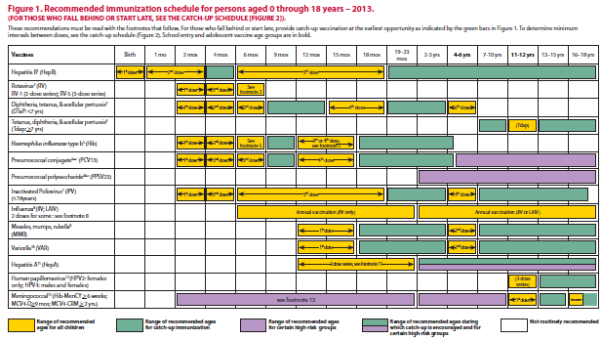
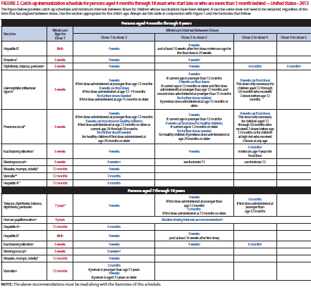
2013 Immunization Schedules
Children
0-18 years
Catch-Up schedule for children
4 months -18 years
Be sure to review the “Notes” section – many changes
Notes:
29
29
Be sure to review the “Notes” section – many changes
For 2013, several new references and links to additional information have been added, including one for travel vaccine requirements and recommendations. New references also are provided for vaccination of persons with primary and secondary immunodeficiencies. Changes to the previous schedules include the following:
Figure 1, “Recommended immunization schedule for persons aged 0 through 18 years” replaces “Recommended immunization schedule for persons aged 0 through 6 years” and “Recommended immunization schedule for persons aged 7 through 18 years.”
Wording was added to bars to represent the respective vaccine dose numbers in the series.
The meningococcal conjugate vaccine (MCV4) purple bar was extended to age 6 weeks, to reflect licensure of Hib-MenCY vaccine.
The hepatitis A (HepA) vaccine yellow bar was extended to better reflect routine age recommendations for use of HepA vaccine. New green and purple bars were added to reflect hepatitis A vaccine recommendations for older children.
Abbreviations for influenza vaccine were updated with the anticipation of quadrivalent vaccine for the 2013–14 influenza season.
Pneumococcal polysaccharide vaccine (PPSV23) was added to Figure 1.
Footnotes were combined and standardized formatting was used to provide recommendations for each vaccine related to routine vaccination, catch-up vaccination, and vaccination of persons with high-risk medical conditions or under special circumstances.
Meningococcal conjugate vaccine (MCV4) footnotes were updated to reflect recent recommendations.
Tetanus and diphtheria toxoids and acellular pertussis (Tdap) vaccine footnotes were updated to reflect recent recommendations.
Influenza vaccine footnotes were updated to provide dosing guidance for children aged 6 months through 8 years for the 2012–13 and 2013–14 influenza seasons.
Meningococcal conjugate (MCV4) vaccine minimum ages and intervals were updated in Figure 2, “Catch-up immunization schedule for persons...” to reflect licensure of Hib-MenCY vaccine.

Slide 30
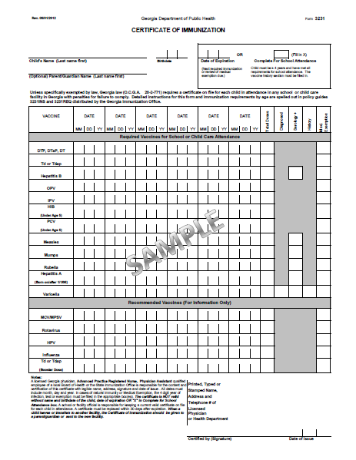
Form 3231 as of 8-1-12
REQUIRED
RECOMMENDED
Notes:
Certificate of Immunization (Form 3231)
The DPH Rules and Regulations provide a method for documenting immunity.
The method that is used to document that a child has been immunized according to the Rules and Regulations is a Certificate of Immunization. (Refer to Certificate of Immunization –Form 3231 and Policy Guides 3231 REQ and 3231 INS and have participants reference during the rest of the presentation)
The Georgia Department of Public Health Certificate of Immunization (Form 3231) is the only immunization certificate that must be completed for a child to attend child care or school. This form was recently revised in August, 2012 to include:
-Advance Practice Registered Nurses (APRN) and Physician Assistant (PA) as qualified signers and responsible parties for interpreting the requirements set forth in Chapter 290-5-4 of the Rules of the Department of Public Health
All dates of vaccine administration, disease history, or positive serology must now be completed regardless of the child’s age.
The chart is divided into 2 sections:
The top section contains spaces to document the vaccines required for school and/or child care attendance.
The bottom section contains spaces to document recommended vaccines that the child might also receive, but that are not required at this time. Having these 2 sections on the same form will give a more complete picture of the child’s total immunization status.
In the small print in the bottom left hand corner, the certificate spells out some of the DPH requirements for completing certificates.

Slide 31
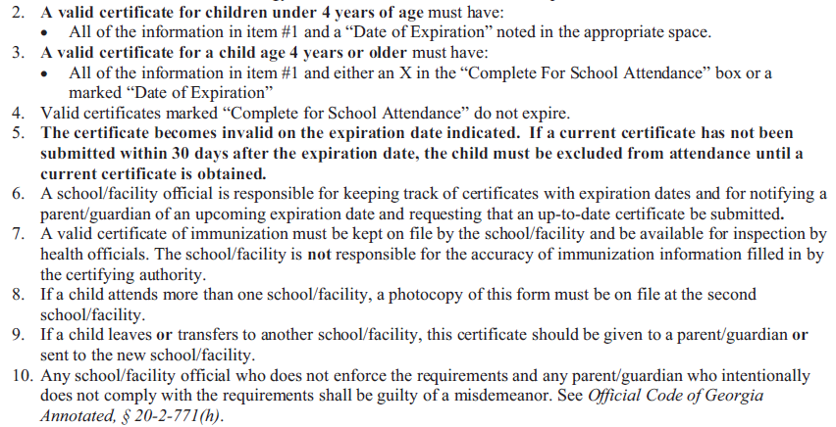
Policy Guide 3231 REQ
Notes:
Policy Guide 3231INS
“Standards for Issuing and Filing Certificates of Immunization”
Look at the third section entitled, “How to File and Maintain Certificates:”
Facilities and schools are responsible for checking the validity of a certificate prior to accepting it for their files. In other words, is all the required information legibly completed and do the dates indicate that the certificate is current? In number 7, it states that you are, as a health care provider, responsible for the accuracy of the information. Number 1 of this section defines a “valid certificate.”

Slide 32
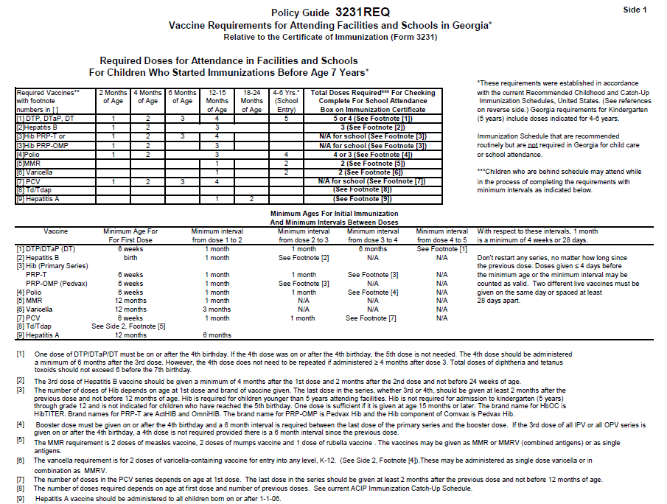
Policy Guide 3231 REQ
Notes:
The Policy Guide 3231 REQ-
“Vaccine Requirements for Attending Facilities and Schools in Georgia “ If you look closely at this document, you will see that as we discussed earlier, the ACIP recommendations for minimum ages and time intervals for doses of each of the required vaccines are summarized in the tables displayed. The only exception is that the booster doses of DTaP, polio, varicella, and MMR are required in GA by the time a child is 5 yrs old to enter kindergarten not necessarily by the child’s 6 yr old birthday.
This information is more for school nurses or those who are being trained to perform audits:
On side 1 the table relate to children who started receiving their vaccines prior to age 7 yr of age, side 2 relates only to those children who start their immunization at age 7 years or older..
1)DTaP: The 4th dose does not need to be repeated if administered ≥ 4 months after dose 3. Six months, however, is still the recommended interval from the 3rd dose to the 4th dose. Total doses of diptheria and tetanus toxoids should not exceed 6 before the 7th birthday.
2)Hepatitis B: “The 3rd dose of hepatitis B should be given a minimum of 4 months after the 1st dose and 2 months after the 2nd dose and not before 24 weeks of age.”
3) Polio: Provided that the minimum ages and intervals have been maintained, a child who has received 4 doses of all OPV, all IPV or a combination of IPV and OPV is considered to be adequately immunized. If the 3rd dose of an all IPV or all OPV series is given on or after the 4th birthday, a 4th dose is not needed.
4) New requirements for new entrants into a GA school or into 6th grade as of 7-1-07:
2 doses mumps vaccine
2 doses varicella vaccine
5) New requirements for children enrolled in child care facilities as of 7-1-07:
Must show evidence of protection against pneumococcal disease
Must show evidence of protection against Hepatitis A if born on or after 1-1-06
6) The number of doses of Td/Tdap depends on age at first dose and number of previous doses. Refer to current ACIP Catch-up Schedule.
These new requirements have been added to the appropriate tables on the 3231REQ and are further explained in the footnotes.

Slide 33
Standards for Issuing and Filing Certificates of Immunization
(Policy Guide 3231 INS and 3231 REQ)
Who is required to have a certificate
Who may issue certificates
How certificates are to be reviewed, filed and maintained
How health care providers are to complete the certificates
What exemptions are acceptable
How health care providers may order certificates
Required doses for each of the vaccines
Notes:
The Policy Guides 3231 INS and REQ categorically outline standards for Issuing and Filing Certificates of Immunization
Who is required to have a certificate
Who may issue certificates
How certificates are to be reviewed, filed and maintained
How health care providers are to complete the certificates
What exemptions are acceptable
How health care providers may order certificates
Required doses for each of the vaccines
We have already discussed the first standard. Every child attending a child care facility or school must have a certificate on file. Now we will discuss the other standards listed on this slide.
(Optional note):
Besides copies of these policy guides, we have also included in your handouts a Summary of the Georgia Immunization Requirements, which is a one page document, based on the Policy Guides 3231 INS and REQ.

Slide 34
Certificate of Immunization
(Form 3231)
A child must have a certificate on file at each facility or school he attends
Photocopies of appropriately completed and signed certificates are acceptable
If a certificate is not on file for each child attending, the facility is held legally responsible
A licensed Georgia physician, APRN, PA or public health official is responsible for the interpretation of and compliance with the requirements for vaccines and completing the certificate
Only physician offices and health clinics can obtain blank certificates
Notes:
Certificate of Immunization (Form 3231)
(Refer to Policy Guide 3231 INS)
Again these details for completing certificates are outlined in the policy Guide 3231INS: Section 3 “How to file and maintain certificates” and Section 4, “Instructions for completing certificates”:
*A child must have a certificate on file at each facility or school he attends. For example, if a child is enrolled in school and attends a child care facility after school, he must have a certificate on file at each facility.
Photocopies of appropriately completed and signed certificates are acceptable.
If a certificate is not on file for each child attending, the facility is held legally responsible.
A licensed Georgia physician, APRN, PA or public health official is responsible for the interpretation of and compliance with the requirements for vaccines and completing the certificate. (See both policy guides: 3231 REQ addresses the number of doses and 3231 INS addresses the completion of certificates.)
*This means that only physician offices and health clinics can obtain blank certificates.

Slide 35
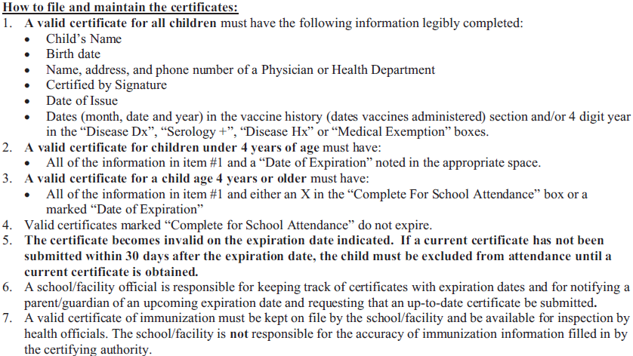
Policy Guide 3231 INS
Notes:
Policy Guide 3231INS
“Standards for Issuing and Filing Certificates of Immunization”
You have the responsibility of knowing and enforcing the immunization requirements as outlined in the Policy Guide 3231INS, “Standards for Issuing and Filing Certificates of Immunization.”
(Refer to handout Policy Guide 3231INS, “Standards for Issuing and Filing Certificates of Immunization” and have participants follow along.)

Slide 36
Age of Child “Marks the Spot”
If child is under four years of age, a certificate:
  Must be marked with a “Date of Expiration”
  Must have vaccine administration dates, year of diagnosis, positive serology, disease history, or medical exemption
If child is over four years of age, a certificate must be completed with:
  Vaccine administration dates, and /or year of disease diagnosis, positive serology, disease history, or medical exemption; and
  A “Date of Expiration”; or
  A mark in the “Complete for School Attendance” box
Notes:
When completing and/or evaluating a certificate, what standards should be used?
The age of a child determines how a certificate should be completed and what you should review for validity.
If child is under four years of age, a certificate
Must be marked with a “Date of Expiration”. This provides an opportunity to ensure that preschool children are immunized according to the current childhood immunization schedule recommendations, including Hib, hepatitis A, and pneumococcal vaccine.
Must have vaccine administration dates, year of diagnosis, positive serology, disease history, or medical exemption
If over four years of age must be completed with:
Vaccine administration dates;
The dates of vaccine administration must be filled in with month/day/year and/or a year in the disease diagnosis, positive serology, disease history, or medical exemption boxes as indicated.
You will note that the blacked out boxes should not be completed with dates. Immunity or medical exemption may be marked only in those boxes for which that specific criteria is acceptable. For example, only a date of positive serology or medical exemption is acceptable in lieu of a vaccine administration date for hepatitis B, measles, mumps, rubella, hepatitis A, or varicella.
The categories for physician’s diagnosis or history of disease apply to varicella only.
and
A “Date of Expiration”; or
A mark in the “Complete for School Attendance “box

Slide 37
Certificate Expiration Date
Expires on the date entered as “Expiration Date”
Must be replaced with a current certificate within 30 days after the expiration date, or child is excluded from attending
Allows for a child who does not meet all the immunization requirements to attend child care or school while he is catching up
Required for all children under four years of age
Required if a medical exemption for a vaccine(s) is marked
Should not be completed if “Complete for School” is marked
Notes:
The date of expiration is further explained in the 3rd section of Policy Guide 3231INS. An expiration date on the certificate:
Expires on the date entered as “Expiration Date”
The certificate must be replaced within 30 days after the “Expiration Date” or the child must be excluded from attending.
Allows a child who does not meet all the immunization requirements to attend child care or school while he is catching up. This is indicated on the certificate by marking a new expiration date each time the child gets a vaccine until all the requirements for school entry are met.
And, as explained earlier is:
Required for all children under four years of age
Required if a medical exemption for a vaccine(s) is marked
Should not be completed if “Complete for School” is marked

Slide 38
Certificates Marked
“Complete for School Attendance”
Do not expire
May be issued only to children who:
  Are four years of age or older; and
  Have met all the requirements for school attendance as outlined in the Policy Guide 3231REQ; and
  Have all the required vaccine administration dates or natural immunity dates filled in; and
  Do not have a “Date of Expiration” completed
Notes:
The criteria for certificates marked “Complete for School Attendance” are explained in the 3rd section of Policy Guide 3231INS, “How to File and Maintain the Certificates.” To summarize, the standards state that the certificates marked as “Complete for School Attendance”:
Do not expire
May be issued only to children who:
Are four years of age or older (This would apply to children who are four years of age, attending a Pre-K program, and have completed all vaccines required for school entry, including those required for child care attendance such as Hib, Hepatitis A and pneumococcal vaccine); and
-Have met all the requirements for school attendance as outlined in the Policy Guide 3231REQ (“Vaccine Requirements for Attending Facilities and Schools”); and
Have completed all the required vaccine administration dates, or natural immunity dates. The health care provider is responsible for accurately completing this information.
-Do not have a “Date of Expiration” indicated on the same certificate
Let’s review the criteria for documenting natural immunity and medical exemption as outlined in Section 5, number 1.

Slide 39
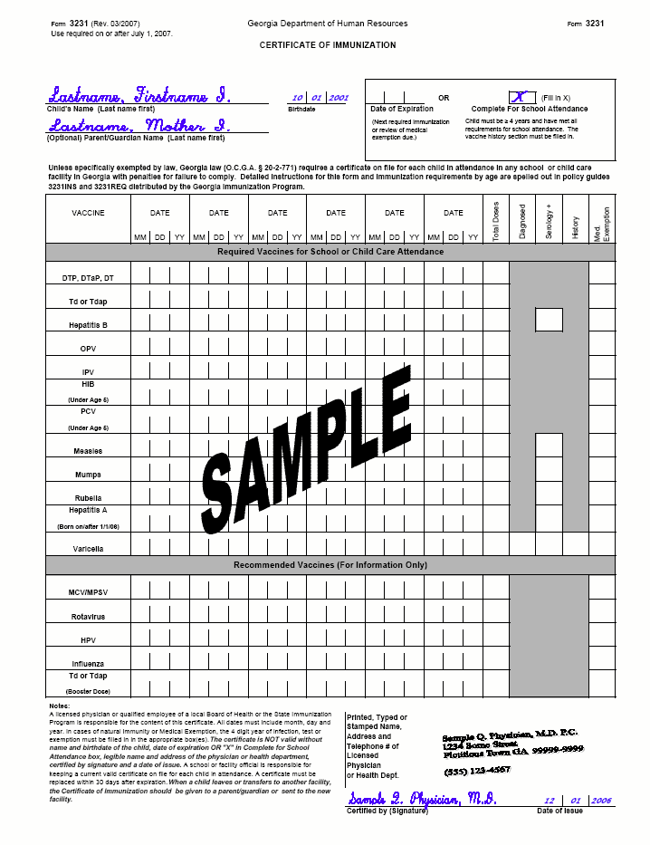
Immunity and Medical Exemptions
Medical Exemption
Serology
Diagnosed
History
Notes:
Immunity may be marked only for those boxes for which that specific criteria is indicated. You will note that the blacked out boxes should not be completed with dates. Many of you who have computer generated certificates may have to hand-write this information in. For example:
A date of positive serology is acceptable in lieu of a vaccine administration date for hepatitis B, measles, mumps, rubella, hepatitis A, or varicella
The categories for physician’s diagnosis or history of disease apply to varicella only
Varicella disease history is defined in #8 of section four in the Policy Guide 3231INS as a health care provider’s interpretation that a parent/guardian description of chickenpox disease history is indicative of past infection; filling in a 4-digit year for the year of infection is required.
If the parent/guardian description of the chickenpox disease history is not clear, or there is any question that the child had the disease, the ACIP recommendation is to vaccinate.
Georgia law provides for two exemptions: Medical and Religious
Medical: medical exemptions should be documented on the 3231 in the last column. Lets discuss exemptions in a little more detail

Slide 40
Exemptions
Medical:
  Should be used only when there is a physical disability or condition that contraindicates immunization for that specific vaccine
  Should be documented in the medical exemption box indicated for each vaccine
  Should be reviewed annually
Notes:
The Official Code of Georgia provides for only two types of exemptions from immunization requirements:
Section 5 of the Standards for Issuing and Filing Certificates of Immunization outlines the standards for “Exemptions:”
Medical:
Should be used only when there is a condition that contraindicates the administration of a required vaccine
Should be documented in the medical exemption box indicated for each vaccine
Should be reviewed annually and the certificate must be reissued with or without indication of exemption
O.C.G.A. § 20-2-771 (d)

Slide 41
Exemptions
Religious:
  Not documented on the certificate
  No special certificate available or needed
  Documented by a notarized affidavit stating that immunization conflicts with the parent/guardian’s religious belief
  Notarized statement should be kept on file by the school or facility in lieu of a Certificate of Immunization
  Do not expire
Notes:
Section 5 of the Standards for Issuing and Filing Certificates of Immunization outlines the standards for “Exemptions:”
Religious:
Not documented on the certificate
There is not a special certificate available or needed to document religious exemption.
Documented by a notarized affidavit stating that immunization conflicts with the parent/guardian’s religious belief
Notarized statement should be kept on file by the school or facility in lieu of a Certificate of Immunization
Do not expire
Under both exemptions, in the event of an outbreak, the law states that a child must be excluded from attending child care or school until protected by immunization or natural immunity or all danger is passed.
O.C.G.A. § 20-2-771 (e)

Slide 42
Evidence of Varicella Immunity
Documentation of age-appropriate vaccination:
  Preschool-aged children > 12 months: 1 dose
  School-aged children, adolescents and adults: 2 doses
Laboratory evidence of immunity or laboratory confirmation of disease
Born in US before 1980
A healthcare provider diagnosis or verification of varicella or healthcare provider verification of history of varicella disease. For mild or atypical case:
  Assessment by physician is recommended to determine:
    Epidemiological link to typical case
    Laboratory evidence of immunity if titer done at time of disease
History of herpes zoster based on healthcare provider diagnosis
Notes:
Documentation of age-appropriate vaccination:
Preschool-aged children > 12 months: 1 dose
School-aged children, adolescents and adults: 2 doses
Laboratory evidence of immunity or laboratory confirmation of disease
Born in US before 1980 EXCEPT for:
Healthcare providers
Pregnant women
Persons born outside the United States should meet one of the other criteria for varicella immunity
A healthcare provider diagnosis of varicella or healthcare provider verification of history of varicella disease. For mild or atypical case:
Assessment by physician is recommended to determine:
Epidemiological link to typical case
Laboratory evidence of immunity if titer done at time of disease
History of herpes zoster based on healthcare provider diagnosis

Slide 43
Guidelines for Public Health Clinics Documentation of Varicella Immunity
Documentation of age-appropriate immunization
Laboratory evidence of immunity
Born in the US before 1980
Licensed healthcare provider diagnosis of disease or documentation of history of disease
  Typical case history
    Recollection of typical symptoms
    Documentation made by LICENSED medical personnel
  Mild or atypical case history
    Assessment should be made by licensed med. personnel
      Epidemiology link to a typical case or lab-confirmed atypical case
History of shingles based on healthcare provider diagnosis
Notes:
Documentation of age-appropriate vaccination:
Preschool-aged children 12 months or older-------1 dose
School-aged children, adolescents, and adults--------2 doses
Laboratory evidence of immunity or confirmation of disease
Born in the US before 1980
HCP diagnosis of disease or documentation of history of disease
Typical case history
Itchy, blister-like rash that lasted about a wk. With
History of known exposure to shingles or typical case of chickenpox (I.e. fever and maculopapular rash with successive crops of vesicular lesions in different stages)
Documentation should be made by LICENSED medical personnel (e.g., physician, PHN, physician’s assistant, or nurse practitioner); however, the 3231 must be signed by a physician licensed in GA; by a public health official; or be issued from GRITS.
Mild or atypical case history
Assessment should be made by LICENSED medical personnel and one of the following should be sought:
Epidemiologic link to a typical varicella case, or a lab-confirmed atypical or breakthrough case
Epidemiologic link to an atypical case with evidence of lab confirmation, if the testing was performed at the time of acute disease
If none of the above can be ascertained, vaccination with appropriate doses of varicella vaccine should be considered
History of herpes zoster (shingles) based on HCP diagnosis

Slide 44
6th Grade Requirement
Proof of Measles, Mumps, and Varicella Immunity required for all students entering 6th grade or age equivalent grade
Supplemental Certificate, Form 3189, no longer needed. Document on Form 3231.
Notes:
The only time that children who are already enrolled in school need to meet additional requirements from those that were in place at the time of their first entry to a GA school is upon entry to 6th grade.
The Rules and Regulations require proof of Measles, Mumps, and Varicella Immunity for all students entering 6th grade or age equivalent grade.
Child must show evidence of immunity to the above 3 diseases, or have had 2 doses of each of those vaccines.
Supplemental Certificate, Form 3189, no longer needed. Document on the
Form 3231

Slide 45

Maintenance of Certificates
To be valid, certificates must be current
  Certificate becomes invalid on the “Date of Expiration”
  Child must submit a current certificate within 30 days after the expiration date or be excluded from attendance
  Facility or school is responsible for notifying parent/guardian of an upcoming expiration date and requesting a current certificate be submitted
  Any school/facility official who does not enforce the requirements shall be guilty of a misdemeanor
Notes:
Certificates must be legibly completed with all the information we have discussed.
To be valid, certificates must be current:
A certificate becomes invalid on the “Date of Expiration.”
Child must submit a current certificate within 30 days after the expiration date or be excluded from attendance.
Facility or School is responsible for notifying parent/guardian of an upcoming expiration date and requesting a current certificate be submitted.
Any school/ facility official who does not enforce the requirements shall be guilty of a misdemeanor.

Slide 46
Filing of Certificates
All children enrolled must have a valid Certificate of Immunization on file
Certificates must be available for inspection by health officials
If child attends more than one facility, a photocopy to the second facility is acceptable
If child leaves or transfers to another school or facility, the certificate should be given to a parent/guardian or sent to the new school/facility
In the case of religious exemption, a dated notarized statement must be on file
Notes:
Schools and child care facilities have the responsibility of developing and maintaining a system for certificate management.
The standards for maintaining files are outlined in the third section of the Policy Guide 3231INS.
Additional details can be found in the brochure entitled “Immunization Guidelines for Child Care Facility Operators and School Personnel,” Form 3258. This brochure can be located on the Georgia Immunization website under School and Child Care Resources
As mentioned earlier, all children enrolled must have a valid Certificate of Immunization on file.
Certificates must be available for inspection by health officials.
If child attends more than one facility, a photocopy to the second facility is acceptable.
If child leaves or transfers to another school or facility, the certificate should be given to a parent/guardian or sent to the new school/facility.
If a child has a religious exemption, a dated notarized statement from the parent/legal guardian stating that immunizations are against his religious beliefs is required to be on file in lieu of the Certificate of Immunization.

Slide 47
Tickler Filing System
Immunization Guidelines for Child Care Facility Operators & School Personnel (Form 3258) provides “how to” instructions
Tickler system is method for filing and maintaining current certificates (set up by month and year)
Remind parents or care givers
Give parents information sheet about requirements
Document follow-up
Enforce requirements
Notes:
The best method for maintaining current files is to develop an organized, user friendly, simple tickler filing system.
Specific details for setting up a tickler system are outlined in the Immunization Guidelines for Child Care Facility Operators and School Personnel (Form 3258).
Basically, a tickler system is a method for filing the immunization certificate for each child attending and for maintaining current certificates. Usually, these systems are set up by the month and year. A child’s certificate is filed under the month and year that it will expire or that a new certificate needs to be obtained. Also you need to keep track of those new attendees who are given 30 days by the facility or school official to obtain a certificate. (This applies to new students only). Thirty days may be granted by a facility or school official to students to obtain a certificate either showing complete for school or an expiration date indicating they are in the process of receiving the needed vaccines.)
You have the responsibility of reminding parents of upcoming expiration dates. It is a good idea to notify them at least a month ahead of time. (Suggestion: organize a sample tickler certificate notebook and offer to let attendees look at it at the break or after the presentation.)
Also, when a parent inquires about enrolling his child in day care or school, give him information about the immunization requirements. Refer to handouts:
“ Child Care Center/School’s Policy about Your Child’s Immunization Certificate” is a sample sheet of information you can personalize and copy for your facility to give parents to inform them at the time of enrollment about the requirements for a certificate.
“Summary of Georgia Immunization Requirements for Child Care and School Attendance” (Form 3193-English) or (Form 3194-Spanish)
Document follow up or any notices you give to parents reminding them of need to take child in for next immunization and obtain an updated certificate.
Enforce requirements. Once you have reminded parents of the need to have child’s immunizations reevaluated and a new certificate obtained, and it has been over 30 days after the certificate expires, it is your responsibility to exclude the child from attending until the requirements have been met.
Maintaining an organized certificate management system enables you to provide more efficient follow up in the incidence of an occurrence of a disease in which contact notification and follow up is needed and also provides for a method for quickly assessing and auditing records.

Slide 48
Public Health Responsibilities
Auditing child care facilities and schools
Educating all partners regarding recommended schedule and requirements for attendance
Providing surveillance and outbreak control of all “notifiable diseases”
Notes:
Public health, including local health departments and representatives from the state immunization program, is responsible for auditing child care facilities and schools to ensure all infants and children attending have adequate certificates on file. (If presenting to public health, discuss who is responsible for audits of child care and schools in the area you are addressing. If school is responsible for reviewing certificates and completing audit form, it is the health department’s responsibility to instruct the school how to review the certificates and dates of vaccine administration.)
Public health is also responsible for educating all partners regarding the recommendations for immunizations and the requirements for attending child care and school.
Providing surveillance and outbreak control of all “notifiable diseases.” Health care providers, child care facilities and schools are all required by law to report any of the “notifiable diseases,” which include vaccine preventable diseases, to public health .

Slide 49
Immunization Audits
What is the total number of children enrolled?
How many children have “valid” certificates (up to date) certificates?
  For a child care, how many children have a certificate marked with a current “Date of Expiration”?
  For a child care/ school facility, how many children are marked as “Complete for School Attendance”?
How many children have certificates with expired “Date of Expiration”?
How many children have certificates “Complete” but missing required doses?
For a child care facility or school, how many have been enrolled less than the allowed waiver time period?
How many children have nothing on file?
How many children have religious exemptions?
How many medical exemptions?
Notes:
Optional for Health Care provider presentation
When audits are performed, the health department or state immunization program representative is checking for the following information (This list is included in your handouts.). By assessing the information obtained, public health is able to evaluate the levels of immunization coverage for children enrolled in day care and schools. If you have maintained your records as recommended and outlined in the policy guide 3231 INS or Form 3258, you will find that this is not a dreaded task, but a time to validate that a high rate of your children are protected against the vaccine preventable diseases:
-What is the total number of children enrolled?
-How many children have valid certificates (certificates with current expiration dates)
For a child care facility, how many children have a certificate marked with a current “Date of Expiration”? (Dates in future or < 30 days expired)
For child care/ school facilities , how many children (should be 4 yrs of age and older) have certificates marked as “Complete for School Attendance”?
How many children have certificates with expired “Date of Expiration”?
How many children have certificates certified as “Complete” but have required missing doses?
How many children have been enrolled in the day care or school less than the allowed waiver time period? (Thirty days)
How many children have nothing on file and are not within the waiver period?
How many children have religious exemptions?
How many children have medical exemptions?
Certificates should also be marked with a current “Date of Expiration” (within 12 months of the date of issue)

Slide 50
Immunization Inventories
Childcare Facilities
Prior to 07/01/2007:
  Based on rules and regulations in operation at that time
  Educate operators and parents of new requirements
On or After 07-01-2007:
  Base on the revised rules and regulations and documentation should be on Form 3231 (Revised 8/2012) with following exceptions:
    Children who have certificates that will expire after 7/1/07 are considered to be current until the “Date of Expiration”.
    Children who are enrolled in both school and child care or “after school” programs and have “Complete for School” certificates on file at both facilities, do not need to obtain a revised certificate.
Notes:
Prior to 7/01:
Based on rules and regulations in operation at that time
Educate operators and parents of new requirements
On or After 7-1-07:
Base on the revised rules and regulations and documentation should be on Form 3231 (Revised 3/2007) with following exceptions:
Children who have certificates that will expire after 7/1/07 are considered to be current until the “Date of Expiration” is reached.
Children who are enrolled in both school and child care /“after school” programs and and have “Complete for School” certificates on file at both facilities, do not need to obtain a revised certificate. However ,when child does get vaccinations, should also get new certificate and give to all facilities /schools

Slide 51
School Immunization
Inventories
On or after 7-1-07:
  For children entering kindergarten, 6th grade and all “new entrants”, base on the revised rules and regulations.
Documentation should be on Form 3231 (Revised 8/2012) with following exception:
  If student has a Form 3231 (revised 03/2007) that is marked as “Complete for School Attendance” and the new requirements for 2 doses of varicella and mumps vaccines or proof of immunity are appropriately documented.
    Children who have certificates that will expire after 7/1/07 are considered to be current until the “Date of Expiration”.
    Children who are enrolled in both school and child care or “after school” programs and have “Complete for School” certificates on file at both facilities, do not need to obtain a revised certificate.
Notes:
After 7-1-07:
For children entering 5 year old kindergarten, 6th grade and all “new entrants”, base on the revised rules and regulations.
Documentation should be on Form 3231 (Revised 3/2007) with following exception:
If student has a Form 3231 (revised 10/2003) that is marked as “Complete for School Attendance” and the new requirements for 2 doses of varicella and mumps vaccines or proof of immunity are appropriately documented.
In this case, a student will not need to get the revised Certificate of Immunization
It will be important for schools to take a few minutes to asses Certificates which are submitted by children entering kindergarten and are already on file for those 5th graders who will be going to 6th grade to determine if the certificates are marked a s “Complete for school attendance” and include documentation of the new requirements. Taking this step will help tremendously with the ease of implementation of the new requirements for all partners.
We realize that this may be something schools are not used to doing and some efforts will have to be made to educate appropriate personnel to check for this information in addition to the other criteria for valid certificate such as name and physician signature.
We suggest that if there is any question about the validity of a certificate in these situations, the school utilize GRITS to determine validity and print out a new certificate or refer student back to the health care provider for assessment of their immunization status and documentation on the new revised form dated 3/2007

Slide 52

School Immunization Inventories
Children currently enrolled in schools, who have a valid certificate on file,
  will not be required to meet the new rules and regulations and
  will not be required to obtain the revised Certificate of Immunization dated 8/2012.
Exceptions are:
  Students entering 6th grade
  Students who do not have a certificate on file
  Students who leave and return as “New Entrants”
Notes:
Children currently enrolled in schools,who have a valid certificate on file, will not be required to meet the new rules and regulations and will not be required to obtain the revised Certificate of Immunization dated 3/2007.
Exceptions are:
Students entering 6th grade
Students who do not have a certificate on file
Students who leave and return as “New Entrants”.
Even though not required , do encourage providers to administer recommended vaccines when they have the opportunity.

Slide 53
School & Child Care Requirements
Some of the new vaccines that are RECOMMENDED for particular age groups, may NOT BE REQUIRED for school or child care attendance.
Remember, GRITS
  Calculates validity based on recommendations
  Prints certificates based on requirements
Notes:
Some of the new vaccines previously discussed are RECOMMENDED for particular age groups, but MAY NOT BE REQUIRED for school or child care attendance.
Remember, GRITS:
Calculates validity based on recommendations
Prints certificates based on requirements, which are first based on the recommendations.

Slide 54
New Child Care Requirements
(Includes Head Start and 4 year old Pre-k)
Hepatitis A vaccination if born 1-1-2006 or later or proof of immunity
Pneumococcal vaccination (If under 5 years of age)
Documentation should be on Revised Form 3231 (8/2012) with following exceptions:
  Children enrolled prior to 7/1/07 who have certificates with current expiration dates are considered “current” until the “Date of Expiration.”
  Children enrolled in both school and child care or “after school” programs prior to 7/1/07 and have “Complete for School” certificates on file at both facilities.
Notes:
To summarize :
These new requirements will be effective for the following groups of children 7-1-07
For children attending child care facilities, these vaccines are required:
Hepatitis A vaccination if born 1-1-2006 or later or proof of immunity
Pneumococcal vaccination (age appropriate)
Do not need new certificates because not considered “new Entrant” – has not been over a year.

Slide 55

School Requirements effective 7/1/07
Children entering kindergarten, sixth grade and new entrants at any grade
  Vaccination with 2nd dose of mumps and varicella vaccines or proof of immunity
Children enrolled in schools prior to 7/1/07, who have a valid certificate on file
  Are not required to meet the new rules and regulations and
  Are not required to obtain the revised Certificate of Immunization dated 8/2012
Notes:
Children currently enrolled in schools who have a valid certificate on file, will not be required to meet the new rules and regulations and will not be required to obtain the revised Certificate of Immunization dated 3/2007.
Exceptions are:
Students entering 6th grade
Students who do not have a certificate on file
Students who leave and return as “New Entrants”.
Even though not required , do encourage providers to administer recommended vaccines when they have the opportunity.

Slide 56
Availability of Required Vaccines from GA VFC Program
All required vaccines are available through the GA VFC Program for VFC eligible children.
If experiencing varicella vaccine shipping delay:
  Providers should print out new certificate, enter expiration date to allow for receipt of vaccine, initial and document vaccine delay
  Schools/ Facilities should keep tickler file
  Providers should keep recall list
  Both providers and schools/facilities need to send reminder notices
Notes:
All children who are VFC Eligible can receive the newly required vaccines through the VFC program
This includes : all children 0 through 18 years of age who are :
Medicaid eligible or American Indian or Alaska Native or Uninsured (no health insurance)or underinsured( have insurance but vaccines are not a covered benefit) or is enrolled in Peachcare.
PCV13:
All children 6 weeks through 59 months of age
Hepatitis A
All children 12 months through 18 years of age
The emphasis is still on children 12-23 mos. of age, but if any child through age 18 comes into clinic requesting the vaccine, and are VFC eligible, they may have it.
Refer to Public Health Eligibility Criteria for State-Supplied Vaccines chart for risk groups)
Mumps :
All children 12 months through 18 yrs .
Supplied in combination vaccine as MMR or MMRV
MMRV
1 or 2 doses as indicated for eligible children 1 through 12 yrs. of age
At this time, try to administer 2nd dose varicella ONLY TO:
Children 4-6 yrs. of age who are receiving the required boosters for entry into 5 yr. old kindergarten
Children entering 6th grade
Children entering into the GA School System for the 1st time
Adolescents (18 years of age or younger) entering college
Any other age groups will need to be provided with privately purchased varicella vaccine or deferred until the next age for catch-up vaccination as defined above.

Slide 57
Revised Certificates of Immunization
(Form 3231)
Are available from the GA Immunization Program Office
Can be printed from the GA Registry of Immunization Transactions and Services (GRITS)
Can be printed from office software systems
  If a provider requests permission and receives approval for the certificate from the Georgia Immunization Program
  If provider is an active participant in GRITS
  Certificate must include exact information and have same appearance as DPH Certificate to be approved
Notes:
Revised certificates are available from the GA Immunization Program Office
Can be printed from the GA Registry of Immunization Transactions and Services (GRITS) (3/5/07)
Can be printed from office software systems
If a provider requests permission and receives approval for the certificate from the Georgia Immunization Program
If provider is an active participant in GRITS
Certificate must include exact information and have same appearance as DCH Certificate to be approved

Slide 58
Top Ten Certificate “Bloopers”
3: Completing both boxes:
Should be one or the other
10: “Complete for School” checked for child under age 4
9: No dose DTaP after 4th birthday
2: Doses Hep B spaced incorrectly
7: 1st dose MMR given before age 1 yr.
5: Varicella Immunity not documented by vaccine or hx/dx/serology date
6: 1st dose varicella given before age 1 yr.
8: No 2nd dose varicella documented
4: Address and/or contact information not completed
1: No physician, APRN or PA signature
Notes:
10. “Complete for School” checked for child under age 4.
9. No DTP/DTaP/DT given on or after the 4th birthday.
8. No 2nd dose of varicella documented.
7. 1st dose MMR given before age 1 yr.
6. 1st dose varicella given before age 1 yr.
5. Varicella immunity not documented. A vaccine administration date, or a 4 year digit in the
box for diagnosed/serology/history is required.
4. Address and/or contact information not completed.
3. Writing in an expiration date AND checking the “Complete for School Attendance” box. It
should be one or the other. The most common mistake is that some providers fill in the date
for the Tdap/Td booster here. Students in Georgia are encouraged but not routinely required to
have this booster.
2. Doses of Hepatitis B spaced incorrectly. Frequently the 3rd dose is given before 24 wks. of
age, the absolute minimum age.
1. No physician signature. By law, the form must be signed by a physician, Advance Practice Registered Nurse, or Physician Assistant licensed in Georgia, public health official, or state immunization program personnel. A stamp of a physician, APRN or PA’s written signature is permissible when cosigned by an office staff member.

Slide 59
Case #1: Elizabeth
Birth Date: July 1, 2009
Purpose of Visit: Well check up (3/11/11) and will be
entering child care on 3/12/11; will be attending different day care facilities
Medical History: Well today; no known allergies or problems with previous vaccines
Vaccine History:
DTaP: 9/1/09
Hep B: 7/01/09, 9/1/09
Hib: 9/1/09
IPV: 9/1/09
Notes:
To better illustrate these new vaccine and vaccine dose requirements, let’s review a few case scenarios. You will need to refer to your copies of the Certificate of Immunization and both Policy Guides.
Case #1: Elizabeth
Visit Date: March 11, 2011
Birth Date: July 1, 2009 (20 months of age)
Purpose of Visit: Well check up and entering child care tomorrow; will be attending 2 different child care facilities
Medical History: Well today; no known allergies or problems with previous vaccines.
Vaccine History: DTaP: 9/1/09
Hep B: 7/1/09, 9/1/09
Hib: 9/1/09
IPV: 9/1/09

Slide 60
Case #1: Elizabeth…. continued
Can a certificate be issued today without administering any vaccines?
  No
Which tables on the policy guide should be utilized to determine the required vaccines for child care attendance and minimal time intervals for doses if indicated?
  Required Doses for Attendance in Facilities and Schools For Children Who Started Immunization Before Age 7 Years; and
  Minimal Intervals Between Doses
What vaccines if any should routinely be given today?
  #2 DTaP; #2 HIB, #3 Hep B, #2 IPV, #1 MMR, #1 Varicella, #1 PCV13 , and #1 Hep A
Notes:
Case #1: Elizabeth... Continued:
Can a certificate be issued today without administering any vaccines?
No
Which tables should be utilized to determine the required vaccines and minimal time intervals for doses if indicated?
Required Doses for Attendance in Facilities and Schools For Children Who Started Immunization Before Age 7 Years; and
Minimal Intervals Between Doses
What vaccines if any should routinely be given today?
#2 DTaP
#2 Hib
#3 Hep B
#2 IPV
#1 MMR
#1 Varicella
#1 PCV7 (required for attendance as of 7-1-07)
#1 Hep A (recommended for child care attendance but not required since she was born before 1-1-06)
or
Pediarix
#2 Hib
#1 MMR
#1 Varicella ( if available, could give MMR and varicella as MMRV)
#1 PCV7
#1 Hep A

Slide 61
10/01/2003
Elizabeth Jones
07/01/09
04/08/11
Kim and Zach Jones
9/1/09
3/11/11
7/1/09
9/1/09
3/11/11
9/1/09
3/11/11
9/1/09
3/11/11
3/11/11
3/11/11
3/11/11
3/11/11
3/11/11
3/11/11
GA Immunization Program
#2 Peachtree Street
Atlanta, GA 30303
404-657-3158
Penny Conner RN
03/11/11
Notes:
Case #1: Elizabeth….. continued:
Display a completed certificate for Elizabeth:
How should the Certificate of Immunization be completed?
Complete all the identifying information at the top
Complete the Date of Expiration for 28 days or 4 weeks from today’s date
Make sure all vaccine administration dates are entered. The Hep A vaccine administration date was entered here, even though Elizabeth was not required to have it at this time.
Complete the name, address and phone number of the physician or clinic
Sign and date the certificate (original signature or stamp written signature, co-sign with full name)
Give photocopy of completed certificate for mother to take to other day care

Slide 62
Case #2: Zachary
Birth Date: January 15, 2007 (age 4 years)
Purpose of Visit: Well check up 3/11/11 and entering Pre-K 8/12/11; will be attending 2 child care
facilities
Medical History: Well today; no known allergies or problems
with previous vaccines. Parent thinks child
had chickenpox in July 2009, no known
exposure to a case. Had several blister like
sores on arms and legs.
Vaccine History: DTaP: 3/17/07; 5/17/07; 7/20/07; 7/12/08
Hepatitis B: 1/15/07; 3/17/07; 5/17/07
Hib: 3/17/07; 5/17/07; 7/20/07
IPV: 3/17/07; 5/17/07; 7/12/08
MMR: 2/12/08
Notes:
Case #2: Zachary
Visit date: March 11, 2011
Birth Date: January 15, 2007 (age 4 years)
Purpose of Visit: Well check up and entering Pre-K in 8/12/11;
will be attending a different child care facility
after Pre-K each day.
Medical History: Well today; no known allergies or problems with previous vaccines. Parent thinks child had chickenpox in July 2009, no known exposure to a case. Had several blister like sores on arms and legs.
Vaccine History:
DTaP: 3/17/07; 5/17/07; 7/20/07; 7/12/08
Hepatitis B: 1/15/07; 3/17/07; 5/17/07
Hib: 3/17/07; 5/17/07; 7/20/07
IPV: 3/17/07; 5/17/07; 7/12/08
MMR: 2/12/08

Slide 63
Case #2: Zachary…continued
Can a certificate be issued today without administering any vaccines?
  No
Which tables in the policy guide should be utilized to determine the required vaccines for PreK attendance and minimal time intervals for doses if indicated?
  Required Doses for Attendance in Facilities and Schools For Children Who Started Immunization Before Age 7 Years and
  Minimal Intervals Between Doses
What vaccines if any should routinely be given today?
  #5 DTaP; #4 hepatitis B; #4 Hib; #4 IPV; #2 MMR; #1 Varicella, #1 PCV13, and #1 Hep A
Notes:
Case #2: Zachary….continued:
Can a certificate be issued today without administering any vaccines?
No
Which tables should be utilized to determine the required vaccines and minimal time intervals for doses if indicated?
Required Doses for Attendance in Facilities and Schools For Children Who Started Immunization Before Age 7 Years; and
Minimal Intervals Between Doses
What vaccines if any should be routinely given today?
#5 DTaP
#4 hepatitis B ( 3rd dose given prior to 6 mo or 24 weeks of age )
#4 Hib ( never had the booster-could give Comvax for both Hep B and Hib today)
#4 IPV
#2 MMR
#1 Varicella (if available, MMR and varicella could be given as MMRV)
#1 PCV (required for attendance in child care and Pre-K )
#1 Hep A (recommended since he is in child care and Pre-K, though not required because he was born before 1-1-06)
Note:
Pediarix cannot be used for the 5th dose of DTaP or the 4th dose of IPV-------it is licensed only for the primary series.
The 4th dose of HIB is needed because the 3rd dose was given before Zachary was 1 y/o. The last dose of HIB should be given on or after 1 year of age.

Slide 64
Zachary Barnes
01/15/07
7/01/12
Kim and Zach Barnes
3/17/03
3/17/07
5/17/03
5/17/07
7/20/07
7/12/08
3/11/11
115/073 17 07 51707
3/17/07 5/17/07 7/12/07 3/11/11
3/17/037 5/17/07 7/20/07 3/11/11
3/11/11
2/12/08 3/11/11
3/11/11
3/11/11
GA Immunization Program
2 Peachtree St., NW, Ste. 13-476
Atlanta, GA 30303
404-657-3158
Penny Conner, RN
3/11/11
Notes:
How should the Certificate of Immunization be completed?
Complete all the identifying information at the top.
Fill in all vaccine administration dates.
Fill in Date of Expiration box.(for him to get his 2nd varicella before starting kindergarten.) He should return in 6 months to get the 2nd dose of hepatitis A vaccine, but this should not be reflected in the date of expiration because it is not a required vaccine for him. He could get the 2nd varicella dose at that time if desired.
Complete the name, address and phone number of the physician or clinic.
Sign and date the certificate.
Give photocopy of completed certificate for mother to take to other child care facility.

Slide 65
Case #3: Carlos
Birth Date: February 2, 2000 (age 11yrs)
Purpose of Visit: Currently enrolled in 5th grade in GA. Needs certificate to enter 6th grade.
Medical History: Well today; no known allergies. Parent recalls child had chickenpox in spring 2006. Exposed to children in same kindergarten class. Had several blister like sores all over his body. Out of school for over one week.
Vaccine History: DTaP: 4/5/00, 6/12/00, 8/4/00, 3/28/01, 4/15/04
        OPV: 4/5/00, 6/12/00, 3/28/01
        IPV: 4/15/04
        MMR: 3/28/01
        Hep B: 4/5/00, 6/12/00, 8/14/00
Notes:
Case #3: Carlos
Today’s Date: March 11, 2011
Birth Date: February 2,1900 (age 11yrs)
Purpose of Visit: Currently enrolled in school system in GA.
Currently in 5th grade . Will be in 6th grade in
school year 20011-12. Needs certificate to enter
6th grade.
Medical History: Well today; no known allergies. Parent recalls
child had chickenpox in spring 2006. Exposed
to children in same kindergarten class. Had
several blister like sores all over his body. Out
of school for over one week.
Vaccine History: DTaP: 4/5/00, 6/12/00, 8/4/00, 3/28/01, 4/15/01
OPV: 4/5/00, 6/12/00, 3/28/01, 4/15/04
MMR: 3/28/01
Hep B: 4/5/00, 6/12/00, 8/14/00

Slide 66
Case #3: Carlos…continued
What vaccines should routinely be administered today for Carlos to be given a certificate?
  # 2 MMR
How should immunity to varicella be documented?
  Enter in date of history of varicella disease (year)
Are there any other vaccines recommended for Carlos that are not required? If so what?
  Yes : MCV4
  Hep A
  Tdap
  HPV
What form should be used to document Carlos’ immunity to measles and varicella?
Form 3231, revised 8/12

Slide 67
Smith, Carlos
2/2/00
X
Tom and Ethel Smith
4 5 00 6 1200 8 4 00 3 2801 4 15 04
4/5/00 6/12/00 8/14/00
4/5/00 6/12/00 3/28/01
4/15/04
3/28/01 3/11/11
3/28/11 3/11/11
3/28/11 3/11/11
3/11/11
2002
3/11/11
3/11/11
3/11/11
GA Immunization Program
2 Peachtree St., NW, Ste. 13-476
Atlanta, GA 30303
404-657-3158
3/11/07
Penny Conner, RN
3/11/11
Notes:
Case # 3: Carlos continued…..
Display a completed certificate for Carlos
Complete all identifying information at the top
Make sure all vaccine administration dates or dates of immunity are completed
The recommended vaccines, Tdap, HPV, Hepatitis A and MCV4, were administered and entered in the appropriate boxes. Though he should return to clinic in 2 months for 2nd HPV, and then 6 months for the 2nd dose of hepatitis A vaccine and 3rd dose of HPV, this date should NOT be recorded as the Date of Expiration on the certificate, since this vaccine is not a requirement for him.
Complete the name, address, phone number of the physician or clinic
Sign and date the certificate

Slide 68
Healthcare Worker Immunization
HCW immunization is an important safety measure
Medical facilities providing direct patient care should formulate an immunization policy for their employees.
Recommended for Healthcare Workers |  | Recommended for HCWs with Other Risk Factors
Hepatitis B |  | Hepatitis A
Flu |  | Pneumococcal
MMR |  | Meningococcal
Varicella
Diphtheria,Tetanus, & Pertussis
Notes:
It is important to establish employee immunizations as a safety measure:
“Because of their contact with patients or infective material from patients, many health-care workers (HCWs), such as physicians, nurses, nursing students, lab technicians, volunteers, and administrative staff are at risk for exposure to and possible transmission of vaccine-preventable diseases. Maintenance of immunity is therefore an essential part of prevention and infection control programs for HCWs.”
“Any medical facility or health department that provides direct patient care is encouraged to formulate a comprehensive immunization policy for all HCWs.”
Both of these quotes come from the ACIP statement, “Immunization of Health-Care Workers,” MMWR, 12-26-97.
Also, this table is derived from that statement and also from the Adult Immunization Schedule, based on perceived risks for the different populations. (Review table.)
The left side of the table indicates those diseases for which HCWs should have immunity, either through history of disease (which could be MMR, varicella, hepatitis B), or documentation of vaccination, or positive serology.
The right side of the table indicates other vaccines which may be needed by some HCWs who have additional medical risks.
This information can also be seen in the 2009 Adult Immunization Schedule, as well as the information about immunization of persons with other conditions, such as pregnancy, diabetes, immunodeficiency, etc. which could pertain to HCWs as well.
Another excellent resource is the IAC document, Item #P2017, “Healthcare Worker Vaccination Recommendations.” This is a one page summary of the above information which would make a good handout.

Slide 69
Other Considerations for HCW Immunization Plan/Policy
Immunization/immunity record maintained by the facility on each HCW
Catch-up programs for current employees and policies for newly-hired workers
Work restriction policies for susceptible workers after exposure
Management and control of outbreaks
Options for refusal of vaccination by employees
Notes:
Immunization/immunity record maintained by the facility on each HCW
This would be useful information in the event of a VPD occurrence among the patients or other HCWs
Catch-up programs for current employees and policies for newly-hired workers
Work restriction policies for susceptible workers after exposure
Have plans for the management and control of outbreaks in the facility
Options for refusal of vaccination by employees
Some policies recommend having the employee sign a standard form, indicating his/her refusal of a particular vaccine and outlining his/her understanding of the necessary actions of furloughs, temporary reassignment of duties, etc. that may be necessary in the event of a VPD in the facility.
Employers are strongly encouraged to access both of the following ACIP statements for more details:
US Department of Health and Human Services, CDC, “Immunization of Health-Care Workers, Recommendations of the Advisory Committee on Immunization Practices (ACIP) and the Hospital Infection Control Practices Advisory Committee (HICPAC),” MMWR, December 26, 1997/Vol. 46/No. RR-18
US Department of Health and Human Services, CDC, “Influenza Vaccination of Health-Care Personnel, Recommendations of the Healthcare Infection Control Practices Advisory Committee (HICPAC) and the Advisory Committee on Immunization Practices (ACIP),” MMWR, February 24, 2006/Vol. 55/No. RR-2

Slide 70
Vaccine Adverse Event Reporting System
The Vaccine Adverse Event Reporting System (VAERS) is a national vaccine safety surveillance program co-sponsored by the Centers for Disease Control and Prevention and the Food and Drug Administration.
What Can Be Reported to VAERS?
Who Reports to VAERS?
Does VAERS Provide General Vaccine Information?
http://vaers.hhs.gov/ or 1-800-822-7967
Notes:
VAERS provides a nationwide mechanism by which adverse events following immunization may be reported, analyzed, and made available to the public.
The primary objectives of VAERS are to:
Detect new, unusual, or rare vaccine adverse events;
Monitor increases in known adverse events;
Identify potential patient risk factors for particular types of adverse events;
Identify vaccine lots with increased numbers or types of reported adverse events; and
Assess the safety of newly licensed vaccines.
What Can Be Reported to VAERS?
VAERS encourages the reporting of any clinically significant adverse event that occurs after the administration of any vaccine licensed in the United States.
Who Reports to VAERS?
Anyone can file a VAERS report, including parents, health care providers, manufacturers, and vaccine recipients.
Does VAERS Provide General Vaccine Information?
No. VAERS only collects and analyzes adverse event reports. In another example, VAERS determined that there may be a potential for a small increase in risk for Guillain-Barre syndrome after the meningococcal conjugate vaccine, Menactra. As a result of this finding, a history of Guillain-Barre syndrome became a contraindication to the vaccine and further controlled studies are currently underway to research this issue.
The VAERS website for reporting is: http:vaers.hhs.gov/ or you can call to report at 1-800-822-7967

Slide 71
National Vaccine Injury Compensation Program (VICP)
National Vaccine Injury Compensation Program
provides compensation to individuals found to be injured by or have died from certain childhood vaccines.
  Established in 1988 by NCVIA
  Federal “no fault” system to compensate those injured
  Claim must be filed by individual, parent or guardian
  Must show that injury is on “Vaccine Injury Table”
Notes:
On October 1, 1988, the National Childhood Vaccine Injury Act of 1986 created the National Vaccine Injury Compensation Program (VICP). The VICP was established to ensure an adequate supply of vaccines, stabilize vaccine costs, and establish and maintain an accessible and efficient forum for individuals found to be injured by certain vaccines. The VICP is a no-fault alternative to the traditional public legal system for resolving vaccine injury claims that provides compensation to people found to be injured by certain vaccines.
The National Childhood Vaccine Injury Act (NCVIA) set forth 3 basic requirements for all vaccination providers, which are:
Providers must give the patient (or parent/legal representative of a minor) a copy of the relevant federal "Vaccine Information Statement" (VIS) for the vaccine they are about to receive.
Providers must record certain information about the vaccine(s) administered in the patient's medical record or a permanent office log.
Providers must document any adverse event following the vaccination that the patient experiences and that becomes known to the provider, whether or not it is felt to be caused by the vaccine, and submit the report to the Vaccine Adverse Event Reporting System (VAERS).

Slide 72


Resources
Local health department
District Immunization Coordinator
GA Immunization Program Office
  On call Help line: 404-657-3158
  GRITS Help Line:1-866-483-2958
  VFC Help Line:1-800-848-3868
  Website http://health.state.ga.us/programs/immunization
  Your local Immunization Program Consultant (IPC)
GA Chapter of the AAP
GA Academy of Family Physicians
Notes:
If you need further information about the changes, or to ask questions later, these are some resources you can to go to help you with that.
Local health department
District Immunization Coordinator
GA Immunization Program Office
404-657-3158
Website http://health.state.ga.us/programs/immunization
GA Chapter of the AAP
GAFP

Slide 73
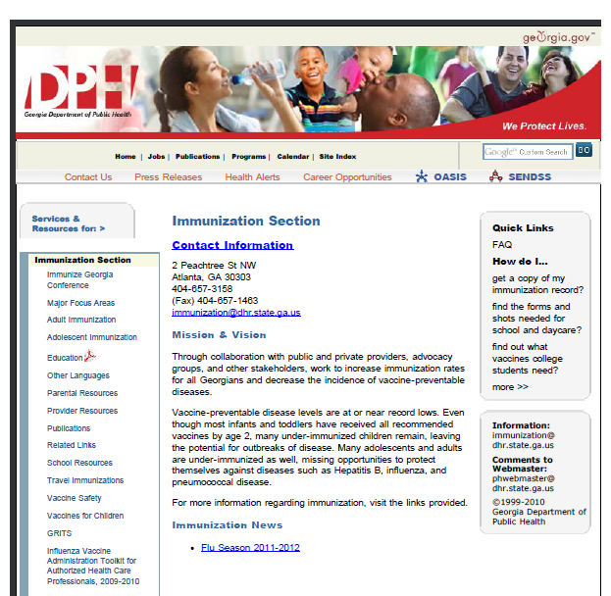
http://health.state.ga.us/programs/immunization
Notes:
The Immunization Program webpage contains various helpful information. The webpage address is at the top of the slide.

