Slide 1
CLINIC HOURS
Presentation to: Nutrition Services Directors and Staff
Presented by: Sonia Jackson, MSL and Barry Cross
Date: March 28, 2017

Slide 2
Objectives
Identify barriers to current clinic hours
Outline guidance of how clinic hours can be extended to meet policy
Summarize the updates of the SENDSS clinic listing

Slide 3
Clinic Hours
Federal Regulation CFR.246.7(b)(4) states: Each local agency that does not routinely schedule appointments shall schedule appointments for employed adult individuals seeking to apply or reapply for participation in the WIC Program for themselves or on behalf of others so as to minimize the time such individuals are absent from the workplace due to such application.

Slide 4
Site Hours Of Operations Policy OM-420.04
Policy:
Georgia Local WIC clinics must ensure that all full time sites are open to provide WIC Services to reduce barriers to participation in the WIC Program in accordance with Federal guidelines.
Purpose:
To ensure the District clinics offer core and alternative/extended hours of operation that reflect the best method to serve participants, accommodating the needs of working and student applicants/participants in the community.

Slide 5
Barriers Found in Current Clinic Hours
Some of the barriers that have been noted in many clinics are listed below:
Clinics closing for lunch from 11:00 AM-1:00 PM
From 12:00 PM - 2:00 PM (During Lunch Time) no appointments are given, even with staggered lunch hours for staff
Clinics cut off time to see participants is 3:00 PM
Clinics closing early on Fridays
Starting time to see participants is 9:00 AM, when clinic opens at 8:00 AM
Clinics rescheduling appointments for participants that are more than five minutes late

Slide 6
Core Hours vs. Extended Hours
Core Hours: Traditional business hours are 8:00 AM to 12:00 PM and 1:00 PM to 5:00 PM, Monday through Friday. Most clinics operate on these hours only.
Extended hours: The hours before 8:00 AM or after 5:00 PM, during the business week, or on Saturday or Sunday. The lunch hour shall not be considered an extended clinic hour; however, operation during the lunch hour is encouraged. Clinics must incorporate extended hours according to policy to better serve participants and increase caseload.

Slide 7
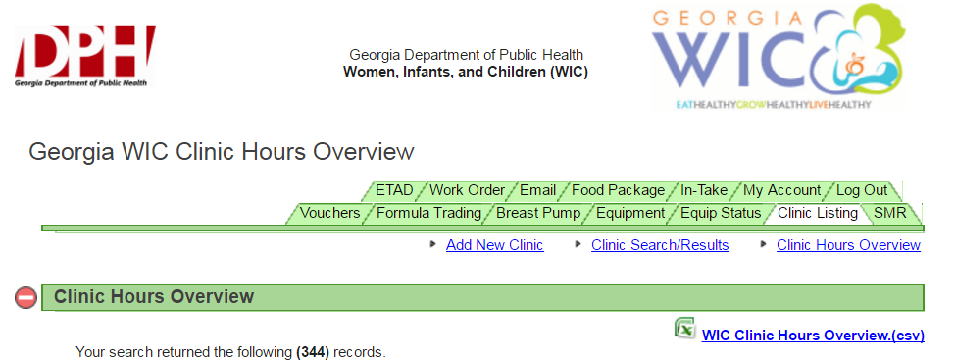
Clinic Hours in SENDSS
The SENDSS clinic listing has a new look:

Slide 8
SENDSS Clinic Update
SENDSS clinic information must be updated for all clinics.
The update must include:
clinic hours of operations
appointment hours
walk-in hours
call-center hours

Slide 9
Sample SENDSS Data

Slide 10
SENDSS Call Center Schedule

Slide 11
Summary
To increase caseload, we must reduced barriers to participant access.
Clinics must incorporate extended hours in their hours of operation. The hours before 8:00 AM or after 5:00 PM, during the business week, or on Saturday or Sunday are considered extended hours.
The lunch hour shall not be considered an extended clinic hour; however, operation during the lunch hour is encouraged.

Slide 12
Summary (cont’d)
The SENDSS database clinic listing has been revised to better identify clinic hours for external and internal partners, participants and staff.
All clinic information must be updated in SENDSS. An Action Memo will be coming out soon to address the policy and the data base requirements.
The new SENDSS data will help identify clinics with extended clinic hours.

Slide 13
What Questions Do You Have?

Slide 14
Sonia.Jackson@dph.ga.gov (404) 657-2908 Barry.Cross@dph.ga.gov (404)657-2903

