Slide 1
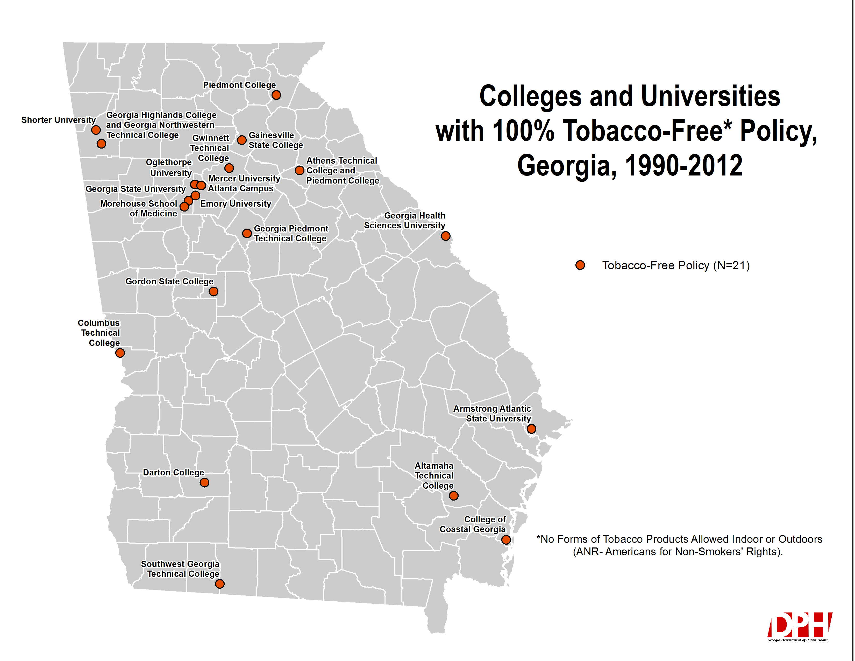
N = 21 Tobacco-Free Colleges/Universities as of December 2013

