Slide 1
Adolescent and Adult Immunization Update
Presentation to:
Presented by:
Date:

Slide 2
Disclosure Statements
To obtain nursing contact hours for this session, you must be present for the entire presentation and complete an evaluation.
Neither the planners of this session nor I have any financial relationship with pharmaceutical companies, biomedical device manufacturers, or corporations whose products and services are related to the vaccines we discuss.
There is no commercial support being received for this event.
The mention of specific brands of vaccines in this presentation is for the purpose of providing education and does not constitute endorsement.
The GA Immunization Office utilizes ACIP recommendations as the basis for this presentation and for our guidelines, policies, and recommendations.
For certain vaccines this may represent a slight departure from or off-label use of the vaccine package insert guidelines.
Notes:
[Presenter is required to read this information to the audience before the program begins.]
To obtain nursing contact hours for this session, you must be present for the entire hour and complete an evaluation.
Neither the planners of this session nor I have any financial relationship with pharmaceutical companies, biomedical device manufacturers, or corporations whose products and services are related to the vaccines we discuss.
There is no commercial support being received for this event.
The mention of specific brands of vaccines in this presentation is for the purpose of providing education and does not constitute endorsement.
The GA Immunization Program utilizes ACIP recommendations as the basis for this presentation and for our guidelines, policies, and recommendations.
For certain vaccines this may represent a slight departure from or off-label use of the vaccine package insert guidelines.

Slide 3
Notice of Requirements
To obtain nursing contact hours for this session, you must be present for the entire presentation and complete and submit an evaluation.
Contact hours for this session will be available only for those who successfully complete this educational activity.
Notes:
To obtain nursing contact hours for this session, you must be present for the entire presentation and complete an evaluation.
Contact hours for this session only are available until 8/31/2015.

Slide 4
Objectives
Define Herd Immunity and Cocooning Strategy; Current Morbidity for VPDs
Discuss Indications, Recommendations, and Requirements; Review Adult Immunization Schedule and Routinely Recommended vaccines for Adolescents and Adults
Overview of GRITS
Challenges To Adult Vaccinations
Recommended Vaccines for HCW
VAERS/NVICP
Resources
Notes:
Overview of topics to be discussed:
Today’s topics will include:
Status of licensure and review of new vaccines
an overview of the adult immunization schedule
some general vaccination guidelines
the vaccines that are routinely recommended for adolescents and adults
brief overview of vaccines indicated due to special circumstances:
hepatitis A, meningitis, rabies, and certain vaccines for travel purposes
a brief overview of the Georgia immunization registry, GRITS
a few points about missed opportunities
immunization resources

Slide 5
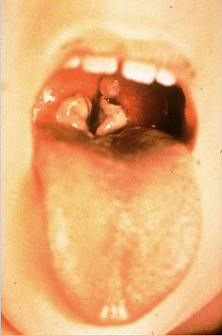
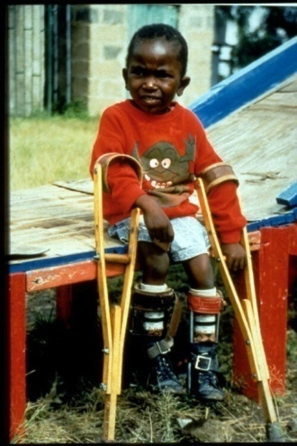
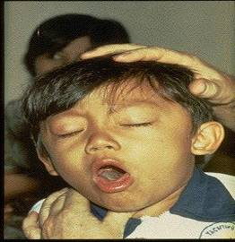
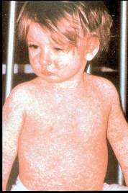
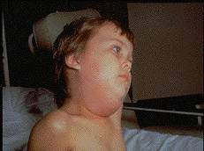
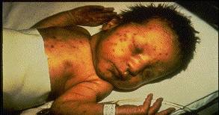
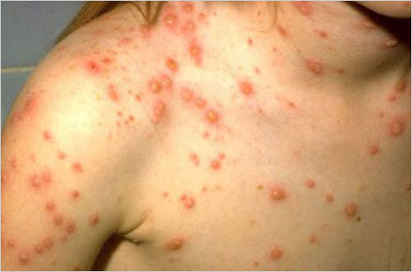
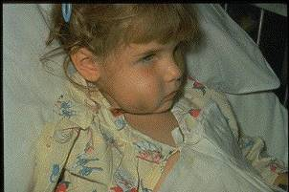
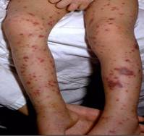
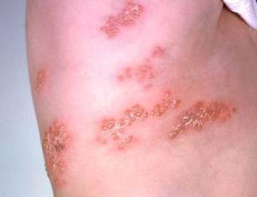
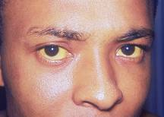
Why Do We Immunize?
We Immunize To Prevent These Diseases

Slide 6
Herd Immunity
Immunized individuals block infection from reaching those who are unimmunized
UNIMMUNIZED
INFECTED
INFECTED
INFECTED
= immunized
Notes:
It is probably unrealistic to believe we can immunize everyone appropriately. There will always be young infants who have not received all recommended vaccines because of age and there are a significant number of adults who are not adequately immunized. Herd immunity refers to a situation in which a high percentage of a population is immune to a disease, essentially stopping the disease in its tracks because it cannot find new hosts. The threshold for herd immunity varies, depending on the disease, with more virulent infectious agents requiring vaccination of a higher percentage of the population to create the desired herd immunity. Most vaccination policies are focused on creating herd immunity. The creation of herd immunity is especially important in crowded environments which facilitate the spread of disease, like schools. It is also extremely important to receive regular boosters, as some vaccines lose their efficacy over time, leaving people vulnerable to an outbreak. Herd immunity led to the eradication of smallpox, and it explains why diseases such as polio and diphtheria are rare in developed nations with established vaccination policies.

Slide 7
20th Century Peak & Current Morbidity for VPDs
Disease | Prevaccine (in peak year) | 2012 | % Reduction of Cases
Diphtheria | 30, 508 | 1 | 99.9
Measles | 763,094 | 55 | 99.9
Mumps | 212,932 | 229 | 99.9
Pertussis | 265,269 | 48,277 | 81.8
Paralytic polio | 63,302 | 0 | 100
Rubella | 488,796 | 9 | 99.9
Tetanus | 601 | 37 | 93.8
Hib, type b (age < 5 yrs.) | 20,000 (yearly average in 1980’s) | 30, plus 210 of unknown type | >99.8
MMWR (Weekly), August 23, 2013, 62(33); 669-682
Notes:
The 2nd column of this chart shows the number of cases in the peak year of the 20th century (prevaccine) for each of the VPDs listed in the 1st column.
The 3rd column shows the number of cases reported in 2012.
The last column shows the percent reduction in those disease cases after the introduction of vaccine.
You can clearly see the impact vaccines have made. However, pertussis is the only vaccine-preventable disease with increasing case numbers and without a percent reduction < 90%. Pertussis is the only VPD that is on the rise; increasing by 61.2% from 2011 to 2012.
Of the 55 measles cases in 2012, 34 were indigenous and 21 were imported
In 2012, there were 13,447 cases of varicella (chickenpox); 3 deaths from chickenpox
In addition, it has been estimated that vaccination with 7 of the 12 routinely recommended childhood vaccines prevents an estimated 33,000 deaths and 14 million cases of disease in every birth cohort, saves $10 billion in direct costs in each birth cohort, and saves society an additional $33 billion in costs that include disability and lost productivity.*
* Zhou F, Santoli J, Messonnier JL, et al. Economic evaluation of the 7-vaccine routine childhood immunization schedule in the United States, 2001, Archives of Pediatric & Adolescent Medicine, 2005;159(12):1136-1144.

Slide 8
Indications
Recommendations
Requirements
Indication
  Information about the appropriate use of the vaccine
Recommendation
  ACIP statement that broadens and further delineates the Indication found in the package insert
  Basis for standards for best practice
Requirement
  Mandate by a state that a particular vaccine must be administered and documented before entrance to child care and/or school
Notes:
8
EXAMPLES OF AN INDICATION
ADACEL vaccine is indicated for active booster immunization for the prevention of tetanus, diphtheria and pertussis as a single dose in persons 11 through 64 years of age.
BOOSTRIX® is indicated for active booster immunization against tetanus, diphtheria, and pertussis as a single dose in individuals 10 through 64 years of age.
EXAMPLE OF A RECOMMENDATION
Recommendations by ACIP for the routine administration of vaccines. May include other information and guidance on epidemiology of the disease, appropriate timing, dosage, contraindications to the vaccine and guidance for use in special populations. Appears first as “provisional recommendation” but once approved, appears in the MMWR as full recommendation
EXAMPLE OF VACCINE REQUIREMENTS FOR ENTRY INTO CHILD CARE FACILITIES IN GEORGIA
Consistent with the Recommended Childhood and Adolescent Immunization Schedule
Children are required to be age appropriately immunized against each of these diseases: Hepatitis B, Diphtheria, Tetanus, Pertussis, Polio, Hib, Pneumococcus, Measles, Mumps, Rubella, Varicella, Hepatitis A

Slide 9
How Recommendations and Schedules Are Developed: ACIP Committee
National committee
Membership:
  Experts in fields of epidemiology and infectious diseases
  Represent areas of academia, research, and public and private providers
Meets 3 times a year
Has sole authority to add vaccines to the VFC Program
Notes:
Before we discuss some of the general recommendations that apply to vaccine administration, it is important that you understand how these recommendations and the recommended schedules are developed.
Recommendations for each vaccine licensed by the FDA are developed by the Advisory Committee on Immunization Practices (ACIP):
National committee coordinated by CDC
Membership consists of experts in the fields of epidemiology and infectious diseases
Represents areas of academia, research, and public and private providers
Meets 3 times a year to review and discuss recommendations for each new vaccine that is approved by the FDA and to discuss any recommended changes for existing vaccines
Has sole authority to add vaccines to the VFC Program
A subcommittee of the ACIP, representing the AAP, AAFP, and CDC annually develop the Harmonized Recommended Childhood Immunization Schedule for the upcoming year.

Slide 10
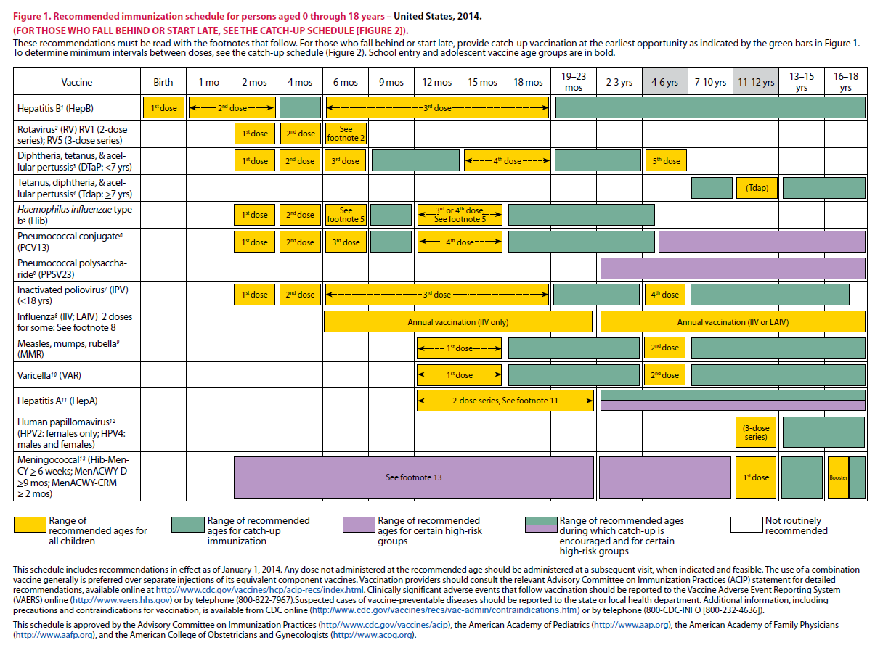
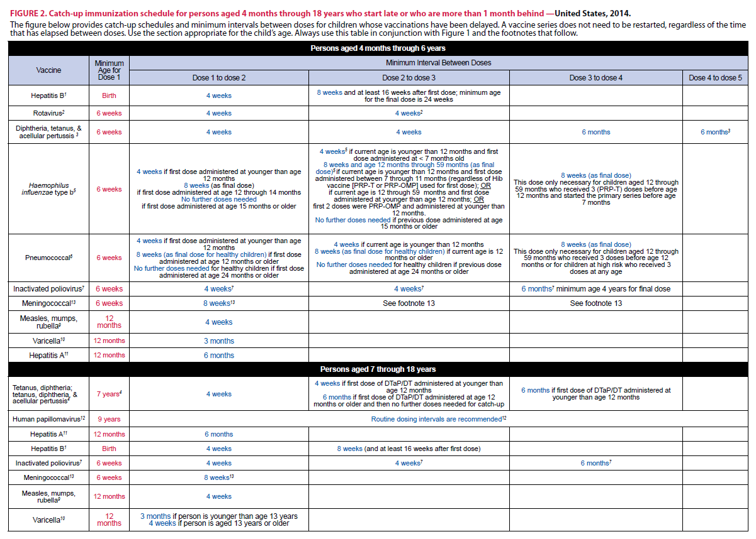
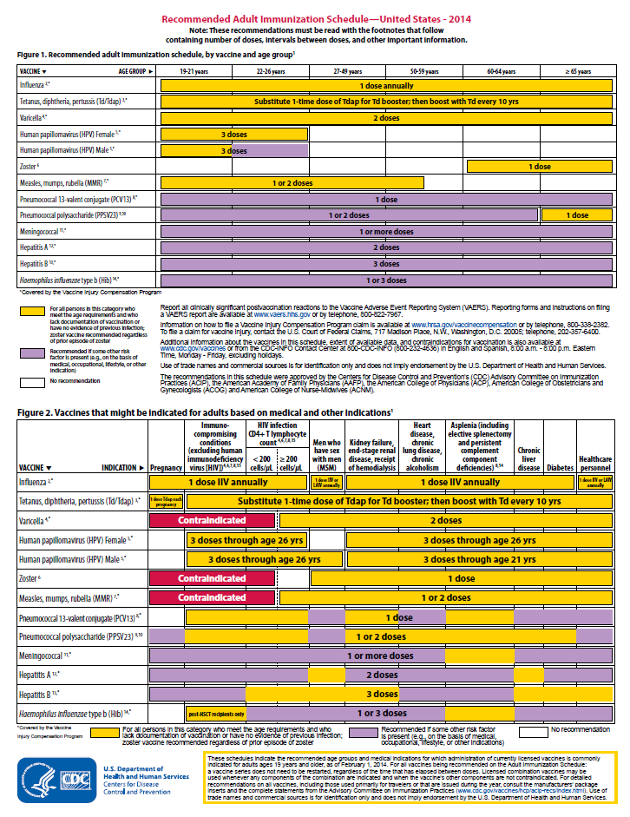
2014 Immunization Schedules
All staff must use the same immunization schedule
Four Schedules:
  Children & Adolescents
  0 through 18 years
  Catch-up schedule for
  ages 4 months -18 years
  Adult 19 years and older
  Adult based on medical
  and other indications
READ THE FOOTNOTES
http://www.cdc.gov/vaccines/schedules/hcp/child-adolescent.html
http://www.cdc.gov/vaccines/schedules/hcp/adult.html
Notes:
10
10

Slide 11
2014 Footnote Changes
Hib vaccine:
  Adults at increased risk for Hib who have not received the vaccine before. Adults who have had a successful hematopoietic stem cell transplant are recommended to receive a 3-dose series of Hib vaccine 6 to 12 months after the transplant regardless of prior Hib vaccination status.
  Prior Hib vaccine guidance recommended that Hib vaccination of persons infected with HIV be considered, but updated guidance no longer recommends Hib vaccination of previously unvaccinated adults with HIV infection because their risk for Hib infection is low.
Pneumococcal vaccines:
  Because PCV13 is recommended to be administered before PPSV23 among persons for whom both vaccines are recommended, the PCV13 footnote now precedes the PPSV23 footnote and includes wording to remind providers of the appropriate order of these vaccines when both are indicated.

Slide 12
2014 Footnote Changes
Tdap and Td vaccines –
  The Td/Tdap vaccine footnote was edited to harmonize with the language used in the pediatric immunization schedule.
  A single dose of Tdap vaccine is recommended for previously unvaccinated persons aged 11 years or older, and Td booster should be administered every 10 years thereafter.
  Pregnant women continue to be recommended to receive a dose of Tdap vaccine during each pregnancy, preferably during 27 to 36 weeks’ gestation, regardless of the interval since the prior dose of Tdap or Td vaccination.
Influenza vaccines-
  Information on the RIV and the use of RIV and IIV among egg-allergic patients was added to the footnote and indicates that RIV or IIV can be used among persons with hives-only allergy to eggs. The RIV contains no egg protein and can be used among persons aged 18 to 49 years who have egg allergy of any severity.

Slide 13
2014 Footnote Changes
Meningococcal vaccines:
  The meningococcal vaccine footnote was edited to clarify which persons need either 1 or 2 doses of vaccine and to provide greater clarity regarding which patients should receive the meningococcal conjugate versus the meningococcal polysaccharide quadrivalent vaccines.
Healthcare workers:
  Both the HPV vaccine footnote and the zoster footnote were simplified, with removal of the bullet regarding health care personnel (HCP). Being a health care worker is not a specific indication for these vaccines, but they should be given to HCP and others who meet age and other indications for these vaccines.
No changes or minor clarifications were made to the footnotes for the MMR, hepatitis A, or hepatitis B vaccines; no changes in recommendations were made.

Slide 14
2014 Adult Contraindication
Table Changes
•The contraindications and precautions table was updated to include information on RIV, an influenza vaccine that contains no egg protein and is indicated for persons aged 18 to 49 years.
•The Hib vaccine was added to the table.

Slide 15
Frequently Asked Question?
Why do ACIP recommendations not always agree with vaccine package inserts?
There is usually very close agreement between vaccine package inserts and ACIP statements. The Food and Drug Administration (FDA) must approve the package insert, and requires documentation for all claims and recommendations made in the insert. Occasionally, ACIP may use different data to formulate its recommendations, or try to add flexibility to its recommendations, which results in wording different than on the package insert. ACIP sometimes makes recommendations based on expert opinion and public health considerations. Published recommendations of national advisory groups (such as ACIP or AAP's Committee on Infectious Diseases) should be considered equally as authoritative as those on the package insert.
Source: IAC’s Ask the Experts
www.immunize.org/askexperts/experts_general.asp

Slide 16
Vaccines
Vaccine - A product that interacts with the immune system to produce active immunity against a disease without the risk of the disease and its potential complications.
Live,Attenuated
  Measles,Mumps & Rubella (MMR)
  Varicella
  LAIV- (Nasal Spray flu)
  Rotavirus
  Herpes Zoster/Shingles
  Inactivated
    Toxoids (tetanus, diphtheria)
    Whole (Hepatitis A, polio)
    Fractional subunits- (Influenza, acellular pertussis)
    Recombinant vaccines (Hepatitis B, HPV)
    Polysaccharide vaccines (PPSV23, MPSV4)
    Conjugated vaccines (Hib, PCV13, MCV4)
Notes:
When a vaccine is administered an immunologic memory is produced similar to that produced by having natural disease. Host factors (age, nutritional status, genetics, co-existing disease), maternal antibodies, dose of antigen, route of administration, and the presence of adjuvants (products added to improve immunogenicity of the vaccine) may influence the immune response to vaccines.
Live attenuated vaccines are produced by modifying a virus or bacteria. The bacteria or virus in these vaccines must replicate in the vaccinated person in order to produce an immune response. Although the live attenuated vaccines replicate, they usually do not cause illness. The immune response is similar to that which occurs after the natural infection. Live attenuated vaccines include: measles, mumps, rubella, varicella, influenza (intranasal), yellow fever, rotavirus and herpes zoster.
Inactivated vaccines are produced by inactivating bacteria or virus with heat and/or chemicals. These vaccines always require more than one dose for protective immunity to develop. Some vaccines require periodic booster doses to maintain adequate immunity. Inactivated vaccines come in several forms:
Whole viral vaccines (polio, hepatitis A, rabies)
Fractional subunits (hepatitis B, influenza, acellular pertussis, typhoid Vi)
Fractional toxoids (tetanus, diphtheria)
Whole inactivated bacterial vaccines (pertussis, typhoid, cholera and plague – these are no longer available in the United States)
Polysaccharide vaccines (PPSV23 and MPSV4) These are inactivated subunit vaccines composed of long chain sugar molecules that make up the surface capsule of certain bacteria. Young children, less than 2 years of age, do not respond consistently to polysaccharide antigens probably because of their immature immune system.
Conjugated vaccines (Haemophilus influenzae type b, PCV7, MCV4) These vaccines are produced by chemically bonding a polysaccharide to a protein "carrier" which is a more effective antigen and greatly improves immunogenicity, particularly in young children.
Recombinant vaccines contain a genetically engineered antigen. Hepatitis B vaccines are produced by insertion of a plasmid containing the gene for HBsAg into common baker's yeast. The modified yeast cell produces pure hepatitis B surface antigen when grown. Live typhoid vaccine (Ty21a) is Salmonella typhi bacteria that has been genetically modified to produce immunity but not cause disease.
References: 1. Atkinson W, Wolfe S, Hamborsky J, McIntyre L, (eds.) (2009) Epidemiology and Prevention of Vaccine-Preventable Diseases, 11th edition. HHS, CDC. Pages 1-7
2. Vaccine Abbreviations on CDC website at http://www.cdc.gov/vaccines/recs/acip/downloads/vac-abbrev.pdf

Slide 17
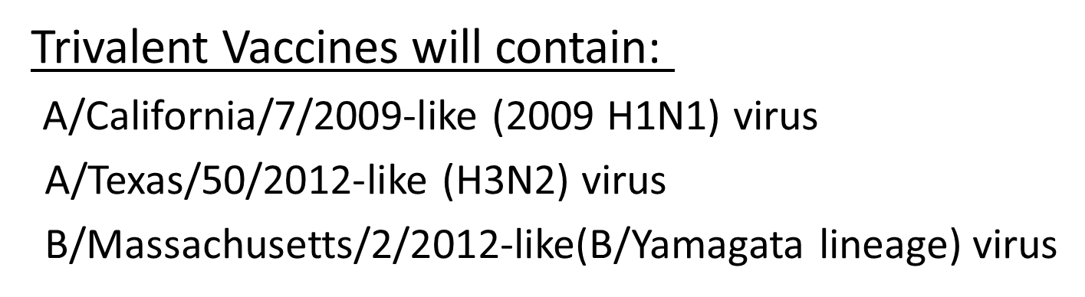
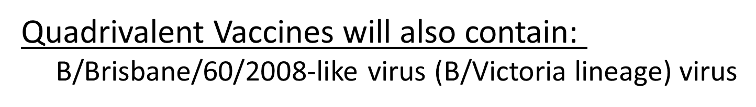
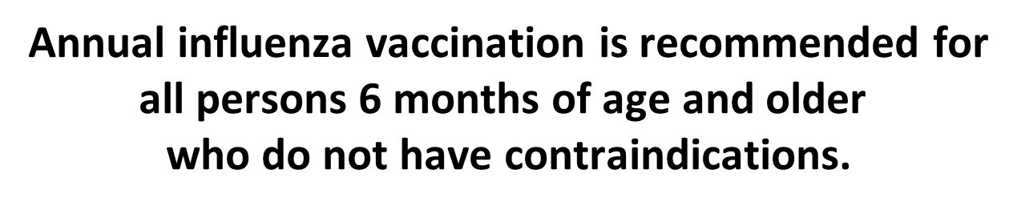

Composition of Influenza Vaccines for 2014-2015 Season in the U.S.
Notes:
Composition of the 2014-2015 Influenza Vaccine
The World Health Organization (WHO) has recommended vaccine viruses for the 2014-2015 Northern Hemisphere influenza vaccines, and the Food and Drug Administration’s Vaccines and Related Biological Products Advisory Committee (VRBPAC) has made recommendations for the composition of the 2014-2015 influenza vaccines to be used in the United States. Both agencies recommend that trivalent vaccines contain an A/California/7/2009-like (2009 H1N1) virus, an A/Texas/50/2012-like (H3N2) virus, and a B/Massachusetts/2/2012-like (B/Yamagata lineage) virus. It is recommended that quadrivalent vaccines containing an additional influenza B virus contain a B/Brisbane/60/2008-like (B/Victoria lineage) virus in addition to the viruses recommended for the trivalent vaccines. These recommendations were based on global influenza virus surveillance data related to epidemiology and antigenic characteristics, serological responses to 2013-2014 seasonal vaccines, and the availability of candidate strains and reagents.
http://www.cdc.gov/flu/weekly/
Inactivated Influenza Vaccines (IIV)
Live, Attenuated Influenza Vaccine (LAIV4)
Administer by Nasal spray:
FluMist® Medimmune - for healthy persons 2 through 49 years of age
- not for pregnant women

Slide 18
Inactivated Influenza Vaccines (IIV)
Administer by Injection (Trivalent) IIV3
Fluzone® sanofi-pasteur - 6 months of age and older
  Fluarix® GSK - 3 years of age and older
  FluLaval® GSK - 3 years of age and older IIV3 & IIV4#
  Fluarix® Quadrivalent GSK - 3 years of age and older IIV4
  Fluvirin® Novartis - 4 years of age and older
  Afluria® CSL - 9 years of age and older
  Flucelvax® Novartis - 18 years of age and older (ccIIV3)*
  FluBlok ® Protein Sciences - 18 through 49 years (RIV3)**
  Fluzone® Intradermal sanofi-pasteur - 18 through 64 years
  Fluzone® High-Dose sanofi-pasteur - 65 years and older (4 X more antigen)
*ccIIV3 = cell culture based trivalent inactivated influenza vaccine
**RIV3 = recombinant hemagglutinin influenza vaccine
Ref. Prevention and Control of Seasonal Influenza with Vaccines: Recommendations of the Advisory Committee on Immunization Practices — United States, 2013–2014, September 20, 2013 / 62(RR07);1-43
# Flulaval licensed by FDA for children 3 years and older August 16, 2013
Notes:
18
18

Slide 19
Live, Attenuated Influenza Vaccine (LAIV4)
  Administer by Nasal spray: FluMist® Medimmune
  - for healthy persons 2 through 49 years of age
  - not for pregnant women
Ref: Prevention and Control of Seasonal Influenza with Vaccines: Recommendations of the Advisory Committee on Immunization Practices — United States, 2013–2014, September 20, 2013 / 62(RR07);1-43
Notes:
19
19

Slide 20
Influenza Vaccines Produced via Non-Egg-Based Technologies
Flucelvax (Novartis)
  Approved for persons 18 yrs and older
  Vaccine viruses are not propagated in eggs; however, initial reference strains have been passaged in eggs
  Cannot be considered egg-free, though expected to contain less egg protein than other IIVs
  Abbreviated ccIIV

Slide 21
Influenza Vaccines Produced via Non-Egg-Based Technologies
FluBlok (Protein Sciences)
  Approved for persons 18 through 49 years
  Vaccine contains recombinant influenza virus hemagglutinin
    Protein is produced in insect cell line
    No eggs or influenza viruses used in production
  Egg-free
  Abbreviated (RIV)

Slide 22

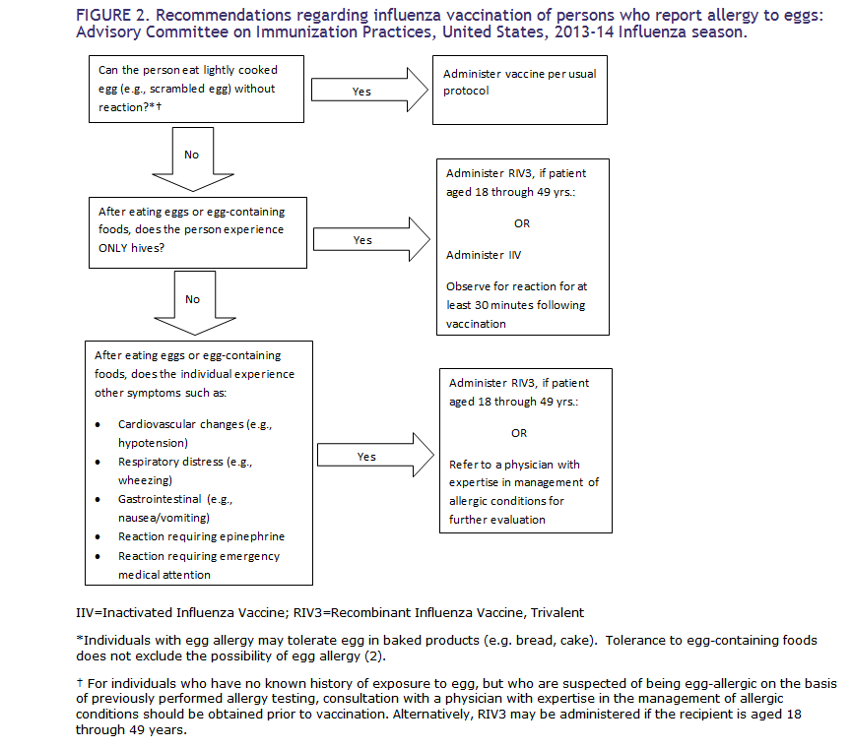
Influenza Vaccine and Egg Allergy

Slide 23
Inactivated Influenza Vaccine Efficacy
70%-90% effective among healthy persons younger than 65 years of age
30% - 40% effective among persons older than 65 yrs
  50%-60% effective in preventing hospitalization
  80% effective in preventing death
Notes:
Statistics are for seasonal influenza vaccine.

Slide 24
I got the flu shot and still got the flu…
For healthy persons takes about 2 weeks after the shot before your body makes enough antibodies to be protected
You are vulnerable to flu infection during this time
Flu vaccination does not protect you from colds, sinus infections, and other respiratory illnesses that also circulate during flu season

Slide 25
Frequently Asked Questions
Some of my patients refuse influenza vaccination because they insist they "got the flu" after receiving the injectable vaccine in the past. What can I tell them?
How long does immunity from influenza last?
In which month is it too late to receive influenza vaccine?
My patient came in last February and asked for a “flu” shot. Should I have given it to her?
Notes:
Less than 1% of people who are vaccinated with the injectable vaccine develop flu-like symptoms. These side effects are not the same as having influenza, but people confuse the symptoms.
Protective immunity doesn't develop until 1–2 weeks after vaccination. Vaccinees may develop influenza because they were exposed to someone with the virus before they became immune. It is not the result of the vaccination.
The influenza vaccine is not 100% effective, especially in older persons. The vaccine is only 30%–40% effective in preventing illness among frail elderly persons (although among elderly persons, the vaccine is 50%–60% effective in preventing hospitalization and 80% effective in preventing death).
To many people "the flu" is any illness with fever and cold symptoms. If they get any viral illness, they may blame it on the flu shot or think they got "the flu" despite being vaccinated. Influenza vaccine only protects against certain influenza viruses, not all viruses
How long does immunity from influenza last? Protection from influenza vaccine is thought to persist for a year or less because of waning antibody and because of changes in the circulating influenza virus from year to year.
In which month is it too late to receive influenza vaccine? Influenza vaccine can be administered whenever influenza is present in the community (generally through the end of MARCH). For maximum protection, flu vaccine should be administered during October and November, prior to the onset of influenza season.
My patient came in last February and asked for a “flu” shot. Should I have given it to her?
Yes. Influenza vaccine may be given at any time during the influenza season. Healthcare providers should continue to offer influenza vaccine to unvaccinated persons who desire it throughout the influenza season.
Source: Ask the Experts: William Atkinson, MD, MPH of the Centers for Disease Control and Prevention provided the answers to these questions.

Slide 26
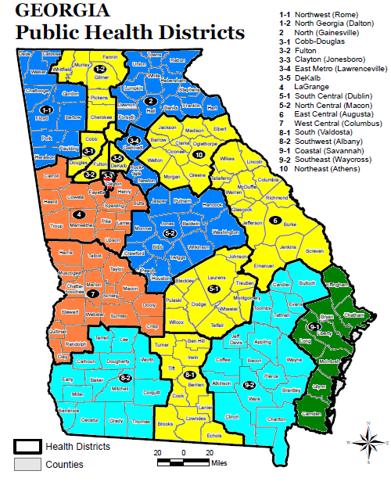
Percentage of individuals > 65 yrs reported receiving Influenza vaccination, 2012*
<50%
50.1-54.9%
55.0-59.9%
60.0-64.9%
65.0-69.9%
>70%
Healthy People 2020 Goal: 90%
United States: 60.1%
Georgia: 60.1%
*Data Source: Behavioral Risk Factor Surveillance Survey (BRFSS)
Individuals may have been vaccinated at physician offices, public health clinics, hospitals, retail pharmacies, or place of employment

Slide 27
Pneumococcal Polysaccharide Vaccine for Adults (PPSV23)
Recommended for:
  Adults 65 years and older
  Persons aged 2 through 64 years with medical conditions that increase their risk for pneumococcal infection
  Persons 19 through 64 years with asthma
  Cigarette smokers 19 years of age and older
Persons who received PPSV23 before age 65 years should receive a second dose of vaccine at age 65 years or later if at least 5 years have passed since the previous dose.
A third dose of PPSV23 may be recommended for persons with immunocompromising conditions, and/or functional or anatomic asplenia.
Ref: Updated Recommendations for Prevention of Invasive Pneumococcal Disease Among Adults Using the 23-Valent Pneumococcal Polysaccharide Vaccine (PPSV23) MMWR 2010; 59(34);1102-1106 September 3, 2010
Notes:
27
27
27
Updated recommendations for administration of 23-valent pneumococcal polysaccharide vaccine (PPSV23) among adults aged ≥19 years — Advisory Committee on Immunization Practices (ACIP), United States
• PPSV23 should be administered to adults aged 19–64 years with chronic or immunosuppressing medical conditions, including those who have asthma.
• Adults aged 19–64 years who smoke cigarettes should receive PPSV23 and smoking cessation guidance.
• All persons should be vaccinated with PPSV23 at age 65 years. Those who received PPSV23 before age 65 years for any indication should receive another dose of the vaccine at age 65 years or later if at least 5 years have passed since their previous dose. Those who receive PPSV23 at or after age 65 years should receive only a single dose.
• ACIP does not recommend routine revaccination for most persons for whom PPSV23 is indicated.
ACIP does recommend a third dose of PPSV23 in addition to PCV13 for some persons at increased risk for pneumococcal infection.
Ref: Updated Recommendations for Prevention of Invasive Pneumococcal Disease Among Adults Using the 23-Valent Pneumococcal Polysaccharide Vaccine (PPSV23) MMWR 2010; 59(34);1102-1106 September 3, 2010
See PCV13 slide for adults for information about a third dose of PPSV23.

Slide 28
Pneumococcal Conjugate Vaccine (PCV13) for Adults
Licensed for adults 50 years and older
Recommended by ACIP for use in adults 19 years and older with immunocompromising conditions, functional or anatomic asplenia, CSF leaks or cochlear implants.
Refer to ACIP recommendation for spacing between PPSV23 and PCV13 and timing of revaccination with PPSV23.
MMWR Vol. 61/No. 40 October 12, 2012
Notes:
28
28
28
ACIP Recommendations for Use of Pneumococcal Conjugate Vaccine (PCV13) for adults
Adults 19 years of age or older with immunocompromising conditions, functional or anatomic asplenia
No previous doses of PCV13 or PPSV23
One dose of PCV13 followed by PPSV23 at least 8 weeks later
Second dose of PPSV23 - 5 years after previous dose
Third dose of PPSV23 at age 65 or later if at least 5 years since previous dose
One dose of PPSV23 previously
One dose of PCV13 at least one year after last dose of PPSV23
Second dose of PPSV23 - 5 years after previous dose
Third dose of PPSV23 at age 65 or later if at least 5 years since previous dose
Adults 19 years of age or older with cochlear implants or CSF leaks
No previous doses of PCV13 or PPSV23
One dose of PCV13 followed by PPSV23 at least 8 weeks later
Second dose of PPSV23 at age 65 or later if at least 5 years since previous dose
One dose of PPSV23 previously
One dose of PCV13 at least one year after last dose of PPSV23
Second dose of PPSV23 at age 65 or later if at least 5 years since previous dose
ACIP Recommendation MMWR Vol. 61/ No. 40 October 12, 2012

Slide 29
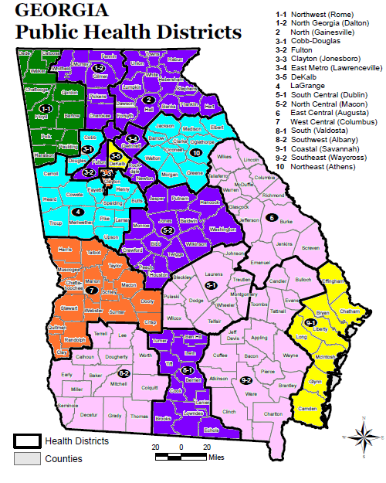
Percentage of individuals > 65 yrs reported receiving Pneumococcal vaccination, 2012*
50.1-54.9%
55.0-59.9%
60.0-64.9%
65.0-69.9%
70.0-74.9%
>75.0%
Healthy People 2020 Goal: 90%
United States: 68.8%
Georgia: 66.2%
*Data Source: 2012 Behavioral Risk Factor Surveillance Survey (BRFSS)
Individuals may have been vaccinated at physician offices, public health clinics, hospitals, retail pharmacies, or place of employment

Slide 30






Cocooning Strategy
Notes:
An infant who is infected with Pertussis under 6 months of age can experience a devastating disease, frequently resulting in death, because the infant can not tolerate the severe inflammation of the respiratory tract. The primary series of DTaP is usually not completed until 6 months of age. Therefore, the best method to prevent the infant from infection with Pertussis is to eliminate exposure to the disease. This is accomplished by immunizing ALL caregivers with Tdap vaccine. This is called the “Cocooning Strategy”.

Slide 31
Diphtheria, Tetanus and Pertussis Vaccines for Adolescents
Older Children and Adolescents: Booster Dose of Tdap*
  -one dose to all 11 through 12 years; Catch-up for all adolescents who have not received Tdap
  -Use Tdap regardless of interval since last Td
Effective July 1, 2014 children born on or after January 1, 2002 who are attending seventh grade, and children who are new entrants into a Georgia school in grades eight through twelve, must have received one dose of Tdap vaccine.
Ref: Updated Recommendations for Use of Tdap Vaccine from ACIP, 2010 MMWR 2011; 60(01);13-15 Jan 14, 2011
Notes:
31
31
Ref: Updated Recommendations for Use of Tdap Vaccine from ACIP, 2010 MMWR 2011; 60(01);13-15 Jan 14, 2011
Effective July1, 2014
-children born on or after January 1, 2014 who are attending seventh grade, and children who are new entrants into a Georgia School in grades eight through twelve, must have received one dose of Tdap vaccine.

Slide 32
Immunize Pregnant Adolescents with Tdap
-One dose of Tdap should be administered during each pregnancy, irrespective of the prior history of receiving Tdap.
-To maximize the maternal antibody response and passive antibody transfer to the infant the optimal timing for the administration of Tdap is between 27 and 36 weeks gestation.
-If Tdap is not given during pregnancy, and has not been given previously, administer Tdap immediately postpartum³.
Reference: 1. MMWR February 22, 2013; 62 (7); 131-135
Notes:
32
Two Tdap vaccines are licensed in the United States.
Boostrix (GlaxoSmithKline Biologicals, Rixensart, Belgium) is approved for use in persons aged 10 years and older.
Adacel (Sanofi Pasteur, Toronto, Canada) is approved for use in persons aged 11 through 64 years.
Updated recommendation
For adults aged 19 years and older who previously have not received a dose of Tdap, a single dose of Tdap should be given.
Tdap should be administered regardless of interval since the last tetanus or diphtheria toxoid-containing vaccine.
There is no recommendation for a routine booster dose of Tdap.
Guidance on use of Tdap products for adults aged 65 years and older
Providers should not miss an opportunity to vaccinate persons aged 65 years and older with Tdap, and may administer the vaccine that is available.
When feasible, for adults aged 65 years and older, Boostrix should be used; however, either vaccine product administered to a person aged 65 years and older provides protection and is considered valid.
Guidance on use of Tdap products for pregnant women:
All pregnant women should receive a dose of Tdap during each pregnancy, irrespective of prior history of receiving Tdap. Optimal timing for administration is between 27 and 36 weeks gestation. If a dose is given early in that same pregnancy, do NOT repeat it at 27-36 weeks. If not given during pregnancy, give Tdap immediately postpartum³.
References:
1. ACIP Updated Recommendations for Use of Tdap, 2010, MMWR January 14, 2011; 60 (1); 13-15
2.ACIP Updated Recommendations for Use of Tdap in Adults Aged 65 Years and Older, MMWR June 29, 2012; 61(25);468-470
3. MMWR, February 22, 2013, Vol 62, #7
4. www.immunize.org, Ask the Experts, Tetanus section, IAC, Sept. 2013

Slide 33
Immunize Adults with Tdap
All adults aged 19 years and older, who have not previously received Tdap, should receive a single dose of Tdap regardless of the interval since the last dose of tetanus or diphtheria (Td).¹
For adults 65 years and older Boostrix should be used, when feasible; however, either vaccine product provides protection and is considered valid.²
With the exception for pregnant women, ACIP does not recommend a second dose of Tdap for adolescents and adults.
References: 1. MMWR January 14, 2011; 60 (1); 13-15 2. MMWR June 29, 2012; 61(25); 468-470
3. MMWR February 22, 2013; 62 (7); 131-135
Notes:
33
Two Tdap vaccines are licensed in the United States.
Boostrix (GlaxoSmithKline Biologicals, Rixensart, Belgium) is approved for use in persons aged 10 years and older.
Adacel (Sanofi Pasteur, Toronto, Canada) is approved for use in persons aged 11 through 64 years.
Updated recommendation
For adults aged 19 years and older who previously have not received a dose of Tdap, a single dose of Tdap should be given.
Tdap should be administered regardless of interval since the last tetanus or diphtheria toxoid-containing vaccine.
There is no recommendation for a routine booster dose of Tdap.
Guidance on use of Tdap products for adults aged 65 years and older
Providers should not miss an opportunity to vaccinate persons aged 65 years and older with Tdap, and may administer the vaccine that is available.
When feasible, for adults aged 65 years and older, Boostrix should be used; however, either vaccine product administered to a person aged 65 years and older provides protection and is considered valid.
Guidance on use of Tdap products for pregnant women:
All pregnant women should receive a dose of Tdap during each pregnancy, irrespective of prior history of receiving Tdap. Optimal timing for administration is between 27 and 36 weeks gestation. If a dose is given early in that same pregnancy, do NOT repeat it at 27-36 weeks. If not given during pregnancy, give Tdap immediately postpartum³.
References:
1. ACIP Updated Recommendations for Use of Tdap, 2010, MMWR January 14, 2011; 60 (1); 13-15
2.ACIP Updated Recommendations for Use of Tdap in Adults Aged 65 Years and Older, MMWR June 29, 2012; 61(25);468-470
3. MMWR, February 22, 2013, Vol 62, #7
4. www.immunize.org, Ask the Experts, Tetanus section, IAC, Sept. 2013

Slide 34
Hepatitis A Vaccination of Adults
Adults at high-risk of acquiring hepatitis A infection should be immunized:
      Those traveling or working in countries with high or intermediate endemicity of infection
      Men who have sex with men
      Users of injecting and non-injecting drugs
      Persons working with HAV positive primates or with HAV in research laboratory settings
      Contact with adoptees from countries with high rates of hepatitis A if contact will be within 60 days of arrival in U.S. The first dose of the 2-dose series should be given as soon as adoption is planned.
Ref. MMWR 2009; 58(36):1006-1007
Notes:
34
34
The Advisory Committee on Immunization Practices of the Centers for Disease Control and Prevention has recommended hepatitis A vaccine for all previously unvaccinated persons who will have close contact with international adoptees from countries with high or intermediate hepatitis A endemicity. The vaccine should be given during the first 60 days following the adoptee’s arrival in the United States.³
References:
1. Prevention of Hepatitis A Through Active or Passive Immunization - Recommendations of the Advisory Committee on Immunization Practices (ACIP) MMWR Vol. 55/No. RR-7 May 19, 2006
2. Notice to Readers: FDA Approval of an Alternate Dosing Schedule for a Combined Hepatitis A and B Vaccine (Twinrix®) MMWR 56(40);1057 October 12, 2007
3. Updated Recommendations from the Advisory Committee on Immunization Practices (ACIP) for Use of Hepatitis A Vaccine in Close Contacts of Newly Arriving International Adoptees MMWR 58(36);1006-1007 September 18, 2009
took the capital letters out

Slide 35
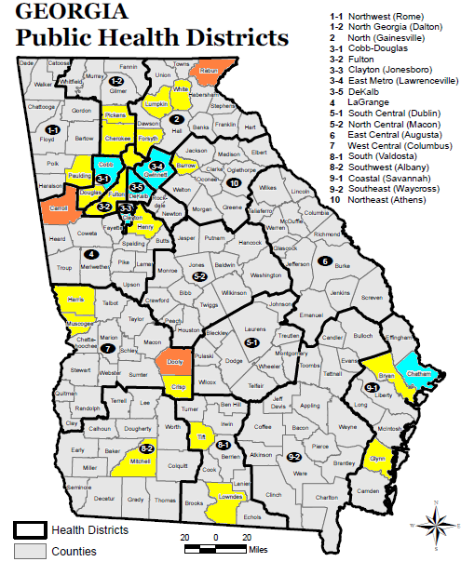
2012 Incidence* of acute hepatitis A
United States- Not yet published
Georgia 0.5
*Per 100,000 population
<1
1-4
5-9
>10

Slide 36
Hepatitis B
Transmission:
1. Percutaneous or mucosal exposure to blood or body fluids including contaminated surfaces
2. Perinatal infection from HBsAg + mother.
Vaccine Recommendations
Hepatitis B vaccine series for all adolescents less than 19 years of age
All adults at risk for hepatitis B infection, including those aged 19 through 59 years with diabetes mellitus and persons of any age at risk for infection by sexual exposure
All adults seeking protection from HBV infection should be vaccinated according to recommended adult schedule.
Notes:
36
36
Incubation period from time of infection to onset of symptoms is 45 to 160 days (average, 90 days)
Approximately 10% of acute hepatitis B infections progress to chronic Hepatitis B infection.
90% of infants and 30-50% of children 1-5 years of age with acute hepatitis B infection become carriers
Many with chronic infection are asymptomatic. Chronic infection may progress to cirrhosis, liver failure & hepatocellular carcinoma
The ACIP recommends Hepatitis B vaccine for unvaccinated adults with diabetes mellitus ages 19 through 59 years. Hepatitis B vaccine may be administered to those age 60 years and older at the discretion of the treating clinician. (MMWR/December 23, 2011/Vol.60/No. 50)
All pregnant women should be tested routinely for HBsAg
90% of healthy adults & 95% of infants, children & adolescents develop adequate antibody response after a complete series
If no antibody response after 6 doses, person is a non-responder and is susceptible to hepatitis B
Booster doses NOT recommended for any age group
References:
1. A Comprehensive Immunization Strategy to Eliminate Transmission of Hepatitis B Virus Infection in the United States. Recommendations of the Advisory Committee on Immunization Practices (ACIP) Part 1: Immunization of Infants, Children and Adolescents MMWR Vol. 54/ No. RR-16 December 23, 2005
2. A Comprehensive Immunization Strategy to Eliminate Transmission of Hepatitis B Virus Infection in the United States. Recommendations of the Advisory Committee on Immunization Practices (ACIP) Part 2: Immunization of Adults MMWR Vol. 55/ No. RR-16 December 8, 2006
Changed spacing of references

Slide 37
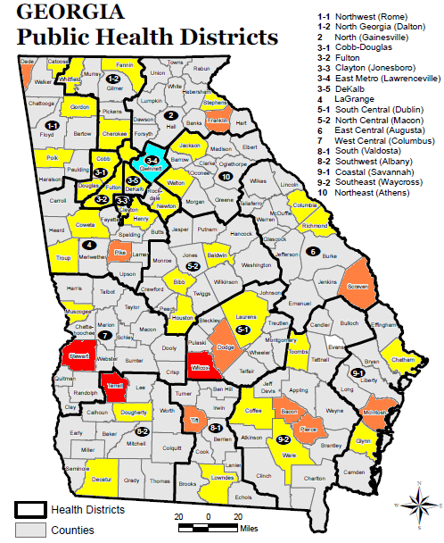
2012 Incidence* of acute hepatitis B
United States- Not yet published
Georgia 1.1
*Per 100,000 population
<1
1-4
5-9
>10

Slide 38
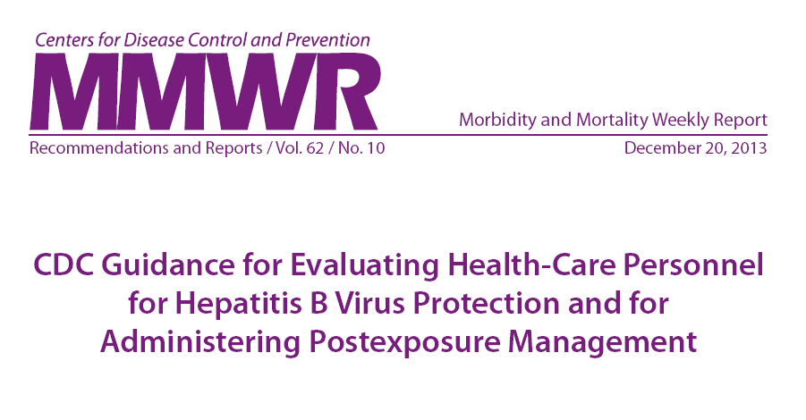
Hepatitis B vaccination and testing guidelines for Healthcare workers

Slide 39
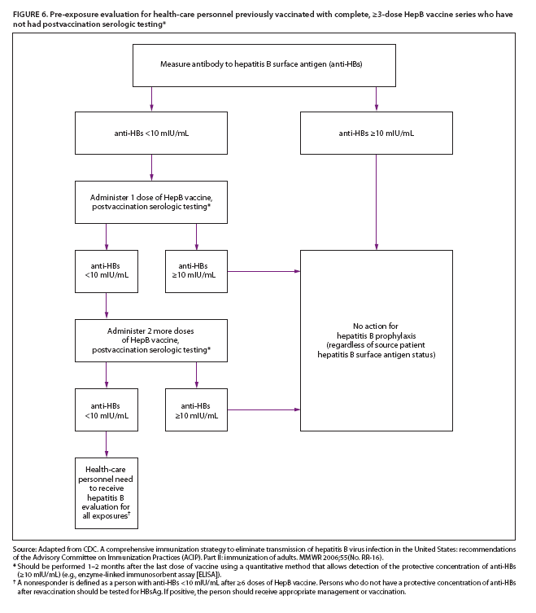
Algorithm for persons with 3 documented doses of Hep B vaccine, but who have
not had postvaccination serologic testing

Slide 40
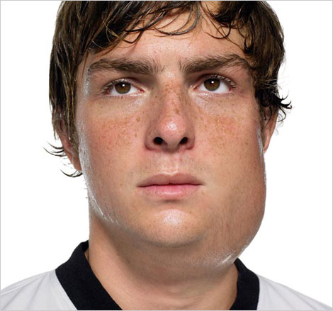
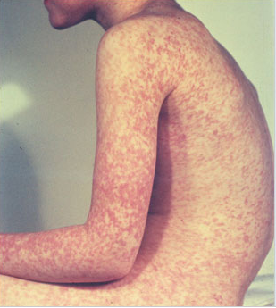
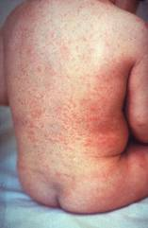
Measles, Mumps, Rubella
Measles (M)
Source: Creative Commons
Mumps (M)
Source: American Academy of Pediatrics
Red Book On Line Visual Library
Rubella (R)
Congenital Rubella (R)
Notes:
40
40
MEASLES (caused by paramyxovirus)
Slide shows two children with typical measles rash and conjunctivitis in younger child
Initial symptoms are runny nose, followed by increasing fever (103º-105º), cough, conjunctivitis, Koplik spots, and a maculopapular rash that lasts 5-6 days
Complications include otitis media (7%), pneumonia (6%), and acute encephalitis (0.1%) 1 in 1000 cases, death (0.2%) Although measles elimination was declared in the United States in 2000 , importation of measles cases continues to occur. CDC evaluated cases reported by 16 states during January 1–August 24, 2013. A total of 159 cases of measles were reported during this period.
MUMPS (caused by paramyxovirus)
Slide shows an adolescent with parotitis due to mumps
Parotitis occurs in 30-40% of infected persons, 40-50% have only nonspecific or respiratory symptoms
Complications include aseptic meningitis, & deafness
Post pubertal individuals may have orchitis, ovarian inflammation, & pancreatitis
RUBELLA (Caused by togavirus)
In children, the rash may be the first manifestation of infection. Adults may have low-grade fever, malaise, URI, and lymphadenopathy prior to rash. Arthralgia and arthritis is common in adults, especially women. Complications include encephalitis and hemorrhagic manifestations
Rubella is no longer endemic in the U.S. However, it is still present in other countries and can be imported
CONGENITAL RUBELLA
Slide shows an adult and child with a typical rash from rubella and an infant with congenital rubella syndrome Infant was infected in utero and has “blueberry muffin spots” on skin due to petechial lesions, cataracts, hearing loss and congenital heart lesion and will most likely be developmentally delayed.
All woman of child bearing age should be certain they are immune to rubella.
For additional information refer to: Epidemiology and Prevention of Vaccine-Preventable Diseases, 12th edition May 2012. HHS, CDC.

Slide 41
MMR Vaccine
2 Dose Series for children
  Dose 1 @ 12 through 15 months of age
  Dose 2 @ 4 through 6 years of age
Acceptable presumptive evidence of MMR immunity¹
Documentation of age appropriate vaccination with MMR vaccine
Laboratory evidence of immunity
Laboratory confirmation of disease
Birth before 1957
Birth date not acceptable evidence of rubella immunity for women who could become pregnant
1. Recommendations and Reports June 14, 2013 / 62(RR04);1-34
Notes:
41
41
41
MMR vaccine has been successful in reducing the cases of measles in the United States and many young physicians, physician’s assistants and nurse practitioners have never seen an acute case of measles. The symptoms of measles are more than a rash and include conjunctivitis, fever and white lesions (Koplik spots) on the buccal mucosa. Practitioners who have not seen a case of measles sometimes make a diagnosis solely on the basis of a rash. Serologic testing is now required to confirm a case of measles.

Slide 42
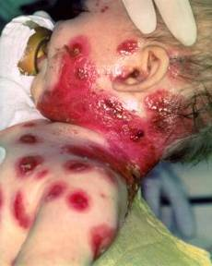
Varicella
(Chickenpox)
© Copyright American Academy of Pediatrics
Routine Recommendations for Varicella Vaccine
Dose 1 @ 12 months through 15 months of age
Dose 2 @ 4 through 6 years of age*
Those 13 years of age or older without evidence of immunity should receive 2 doses separated by 4 to 8 weeks.
Required for school and child care attendance
*Second dose can be administered at an earlier age provided the interval between the first and second dose is at least 3 months.
Notes:
42
42
Slide shows an adolescent with typical varicella rash and infant with secondary bacterial infected varicella lesions, probably due to staph or strep
Chicken pox or varicella is caused by the varicella zoster virus
Prior to licensure of varicella vaccine approximately 100 previously healthy children died from chicken pox each year
Newborns are in the highest risk group if maternal rash is 5 days before or 2 days after delivery
Adults are 25 times more likely to die than children
Varicella Vaccine:
Live attenuated virus vaccine licensed in Japan and Korea in 1988, and in U.S. in 1995
One dose of vaccine is 85% effective; two doses provide nearly 88-98% efficacy.
Breakthrough chicken pox may occur individuals who have received the vaccine
All cases of breakthrough chicken pox have been mild
Vaccine may be effective in preventing illness if given within 3 days and possibly up to 5 days after exposure.
The requirements for children entering kindergarten and sixth (6th) grade, or students entering a Georgia school for the first time in any grade (kindergarten through 12th grade) are two (2) doses of a varicella-containing vaccine, or healthcare provider documentation of immunity from disease history or serologic proof of immunity.
Preteen children who were up-to-date with one dose of varicella vaccine prior to starting school may not have received the second dose, so should receive it as soon as possible.
Reference: Prevention of Varicella - Recommendations of the Advisory Committee on Immunization Practices (ACIP) MMWR (2007);56(No. RR-4):23

Slide 43
Immunity
What are the criteria for evidence of immunity to varicella?
ACIP considers evidence of immunity to varicella to be
Documentation of 2 doses of vaccine given no earlier than age 12 months, with at least 3 months between doses for children younger than age 13 years, or at least 4 weeks between doses for people age 13 years and older
• U.S.-born before 1980*
• A healthcare provider's diagnosis of varicella or verification of history of
varicella disease
• History of herpes zoster, based on healthcare provider diagnosis
• Laboratory evidence of immunity or laboratory confirmation of disease
*Note: year of birth is not considered as evidence of immunity for healthcare
personnel, immunosuppressed people, and pregnant women.
Notes:
If a healthcare worker does not have a history of varicella vaccination or disease but has had a clinically diagnosed case of shingles, does she or he still need varicella vaccination?
No. A healthcare provider's diagnosis or verification of a history of shingles is acceptable evidence of immunity to varicella. According to ACIP, acceptable evidence of varicella immunity in healthcare personnel includes (1) documentation of 2 doses of varicella vaccine given at least 28 days apart, (2) history of varicella or herpes zoster based on physician diagnosis, (3) laboratory evidence of immunity, or (4) laboratory confirmation of disease.
Should a child who has had chickenpox prior to the first birthday get the first dose of varicella vaccine at age 1 year?
If the child had confirmed varicella disease or laboratory evidence of prior disease, it is not necessary to vaccinate regardless of age at infection. If there is any doubt that the illness was actually varicella, the child should be vaccinated.

Slide 44
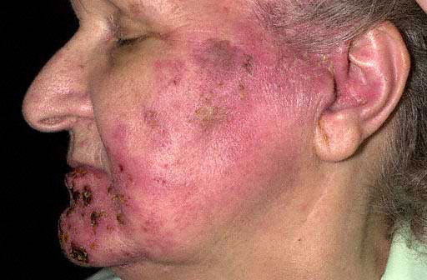
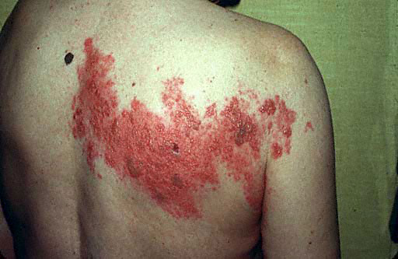
Herpes Zoster
“Shingles”
Notes:
These are images of different ways shingles can appear. It usually appears on one side of the face or body and last 7-10 days.
The main symptom is pain but other symptoms can include fever, headache, chills, and upset stomach.
For about 1 person in 5, the severe pain can continue, even after the rash has cleared up. This is called post-herpetic neuralgia.
It does not happen commonly but a person who has never had chickenpox, could get chickenpox from contact with a person with shingles.
Shingles can occur in anyone with a previous history of chickenpox, but is much more common in persons age 60 and older.

Slide 45
Zostavax®
One dose recommended for adults 60 years and older, including those who have experienced previous episodes of shingles
Overall Efficacy*
51% fewer episodes of zoster and less severe disease
66% less postherpetic neuralgia
On March 24, 2011 FDA approved Zostavax
for use in ages 50-59 years
ACIP has not made a recommendation for this age group
*Ref: Epidemiology and Prevention of Vaccine-Preventable Diseases. 12th Edition, May 2012.
Notes:
45
Zostavax was licensed by the FDA in May 2006 for individuals 60 Years of age and older. On March 24, 2011 the FDA approved Zostavax for individuals 50 through 59 years of age.
At the October 2013 meeting the ACIP still did not vote to recommend Zostavax for people 50 through 59 years. There is no data yet showing how long vaccine effectiveness will last. Practitioners can legally administer the vaccine to the 50-59 age group, but some insurance carriers may not reimburse for the vaccine because it has not been recommended by the ACIP.
Insurance reimbursement for Zostavax will vary based on the patient’s insurance plan. Patients need to verify coverage with their insurance company. Zostavax is covered by Medicare under Part D, but there are many different plans available under Part D. Patients covered by Medicare should make sure the Part D plan they have selected covers Zostavax or they will be responsible for full payment. Many practices are not offering Zostavax to their patients because physicians can not bill Part D, unless their practice is approved to dispense prescription drugs. In Georgia, pharmacists who are trained in vaccine administration can give Zostavax and bill Medicare for the cost of the vaccine and an administrative charge, if the patient’s Part D plan covers the vaccine.

Slide 46
Is Shingles Contagious?
Shingles cannot be passed from one person to another.
However, a person with shingles can spread the virus to a person who has never had chickenpox.
If the person who has never had chickenpox becomes infected with the virus, he or she will develop chickenpox, not shingles.
Notes:
Burden of Shingles
Varicella zoster remains dormant in anyone who has had chickenpox
Virus reactivates and travels pathway along nerves to skin
Results in skin rash/blisters and pain due to inflamed nerves

Slide 47
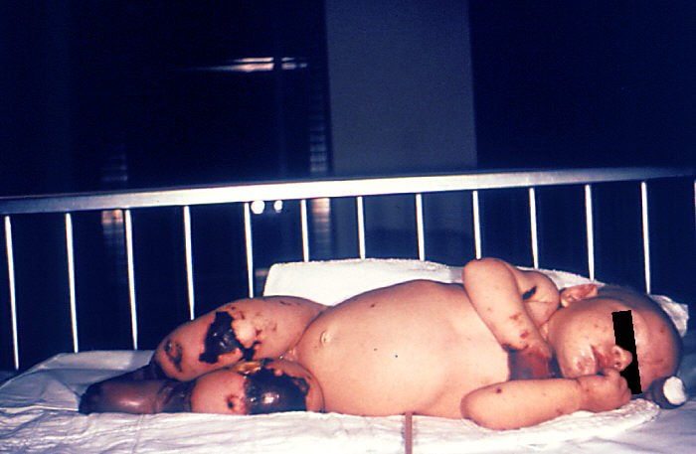
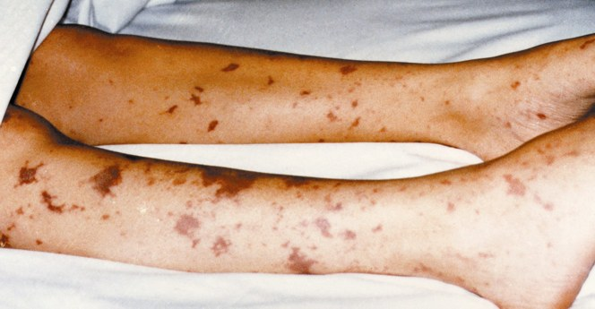
Meningococcal Disease
Notes:
These very graphic photos show the possible results of a meningococcal infection becoming systemic and then infecting bodily tissues.
The 4 month old on the left has gangrene of the hands and lower extremities due to meningococcemia.
The picture on the right shows similar though not as severe tissue damage in an older child.

Slide 48
Meningococcal Disease
Meningitis
~50% of cases 9-10% fatality rate
Meningococcemia
5%-20% of cases Up to 40% fatality rate
Rash
Vascular damage
Disseminated intravascular coagulation
Multi-organ failure
Shock
Death can occur in 24 hours
Photo courtesy CDC: Dr. Brodsky & Mr. Gust
11-19% of survivors have permanent sequelae
Ref: 1. Epidemiology and Prevention of Vaccine-Preventable Diseases. 12th Edition, May 2012.
2. AAP Red Book 2012
Notes:
48
The most common clinical presentations of meningococcal disease are meningitis and meningococcemia.
Individuals with meningococcemia may die within 24 hours of the onset of symptoms even with prompt treatment with appropriate antimicrobials and supportive care in an intensive care unit.
Reference: 1. Epidemiology and Prevention of Vaccine-Preventable Diseases, 12th edition. May 2012 HHS, CDC.
2. AAP Redbook 2012

Slide 49
Meningococcal Conjugate Vaccine (MCV4)
(Men A,C,Y, W-135)
Menactra™ licensed for 9 mos. through 55 years
Menveo® licensed for ages 2 mos. through 55 years
ACIP Recommendation:
  One dose at 11 or 12 years of age and a booster dose at 16 yrs.
  If first dose is at 13-15 years, give one booster dose 5 years after the first dose or sooner if entering college or technical school
  If first dose given ≥ 16 years of age, a 2nd dose is not needed
  Persons aged 21 years or younger attending school or college should have documentation of one dose of MVC4 not more than 5 years before enrollment.
Prevention and Control of Meningococcal Disease: Recommendations of the Advisory Committee on Immunization Practices (ACIP) Recommendations and Reports March 22, 2013 / 62(RR02);1-22
Notes:
49
49
49
Recommendation for Routine Vaccination of Persons Aged 11 Through 18 Years
After a booster dose of meningococcal conjugate vaccine, antibody titers are higher than after the first dose and are expected to protect adolescents through the period of increased risk through age 21 years. Persons who receive their first dose of meningococcal conjugate vaccine at or after age 16 years do not need a booster dose. Routine vaccination of healthy persons who are not at increased risk for exposure to N. meningitidis is not recommended after age 21 years.
CDC Guidance for Transition to an Adolescent Booster Dose
Some schools, colleges, and universities have policies requiring vaccination against meningococcal disease as a condition of enrollment. For ease of program implementation, persons aged 21 years or younger should have documentation of receipt of a dose of meningococcal conjugate vaccine not more than 5 years before enrollment. If the primary dose was administered before the 16th birthday, a booster dose should be administered before enrollment in college. The booster dose can be administered anytime after the 16th birthday to ensure that the booster is provided. The minimum interval between doses of meningococcal conjugate vaccine is 8 weeks.
No data are available on the interchangeability of vaccine products. Whenever feasible, the same brand of vaccine should be used for all doses of the vaccination series. If vaccination providers do not know or have available the type of vaccine product previously administered, any product should be used to continue or complete the series.
Recommendations for Adults 56 years and older
MPSV4 is the only licensed meningococcal vaccine for adults aged ≥56 years and is immunogenic in older adults. For adults who have received MenACWY previously, limited data demonstrate a higher antibody response after a subsequent dose of MenACWY compared with a subsequent dose of MPSV4. For meningococcal vaccine-naïve persons aged ≥56 years who anticipate requiring a single dose of meningococcal vaccine (e.g., travelers and persons at risk as a result of a community outbreak), MPSV4 is preferred. For persons now aged ≥56 years who were vaccinated previously with MenACWY and are recommended for revaccination or for whom multiple doses are anticipated (e.g., persons with asplenia amd microbiologists), MenACWY is preferred.
Ref. 1. Prevention and Control of Meningococcal Disease - Recommendations of the Advisory Committee on Immunization Practices (ACIP) MMWR / March 22, 2013 / Vol. 62 / No. 2
2. Recommendation of the ACIP for Use of Quadrivalent Meningococcal Conjugate Vaccine (MenACWY-D) Among Children Aged 9 Through 23 Months at Increased Risk for Invasive Meningococcal Disease MMWR; October 14, 2011 / 60(40);1391-1392

Slide 50
Types of Human Papilloma Virus (HPV)
Mucosal/Genital
~40 types
Cutaneous
~60 types
High risk types
16, 18, 31, 45
(and others)
Low risk types
6, 11 and others
Cervical cancer
Anogenital cancer
Oropharyngeal Cancer
Cancer precursors
Low grade cervical disease
Genital Warts
Laryngeal Papillomas
Low grade cervical disease
Skin warts
Hands and Feet
Ref: 1.Epidemiology and Prevention of Vaccine Preventable Diseases 12th Edition, May 2012
2. Red Book – AAP 2012 Report of the Committee on Infectious Diseases

Slide 51
HPV Vaccines
Gardasil® (HPV4)
Licensed for prevention of infection with HPV types 6, 11, 16, 18.
Recommended for females 9 through 26 years & males 9 through 21 years. May be given to males 22 through 26 years. (3 dose schedule)
Cervarix® (HPV2)
Licensed for prevention of infection with HPV types 16 & 18.
Recommended for females 9 through 26 years. (3 dose schedule)
Ref: MMWR; December 23, 2011 / 60(50);1705-8
Notes:
51
51
On December 22, 2010 the FDA approved Gardasil for the prevention of anal cancer and associated precancerous lesions due to HPV types 6, 11, 16, and 18 in people 9 through 26 years.
Cervarix is licensed for females 9 through 25 years of age, but ACIP recommends Cervarix for females 9 through 26 years of age.
Addendum:
On April 6, 2011 the FDA rejected the request by Merck to expand the indication for the use of Gardasil in women 27 through 45 years of age. Gardasil has not been demonstrated to prevent HPV-related CIN 2/3 or worse in women older than 26 years of age.
References:
Recommendations on Use of Quadrivalent HPV in Males MMWR;December 23, 2011 / 60(50);1705-8
2. Quadrivalent Human Papillomavirus Vaccine (HPV4, Gardasil) for Use in Males and Guidance from the ACIP MMWR; May 28, 2010 / 59(20);630-632
3. Quadrivalent Human Papillomavirus Vaccine: Recommendations of the ACIP
MMWR; March 12, 2007 / 56(Early Release);1-24

Slide 52
HPV Vaccine Safety
The most common adverse events reported are considered mild
For serious adverse events reported, no unusual pattern or clustering that suggest events were caused by the HPV vaccine
These findings are similar to the safety reviews of MCV4 and Tdap vaccines
57 million doses of HPV vaccine distributed in US since 2006
Notes:
More than 175 million doses of HPV vaccine have been distributed worldwide and 57 million doses have been distributed in the United States. In the seven years of HPV vaccine safety studies and monitoring that have been conducted since the vaccine was licensed, no serious safety concerns have been identified. Reports to the Vaccine Adverse Event Reporting System (VAERS) have decreased each year since 2008.

Slide 53
Encourage Parents To Immunize a
Pre-teen or Adolescent
Try saying:
Your child needs three shots today that will prevent tetanus, diphtheria, whooping cough, and one type of meningitis and protect him/her from many cancers caused by HPV.
HPV vaccine produces a better immune response in preteens than it does in older teens and young women. I strongly believe in the importance of this cancer-preventing vaccine.

Slide 54
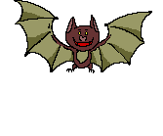
Rabies Vaccine Recommendations
Post-exposure prophylaxis
…can be considered for persons who were in the same room as the bat and who might be unaware that a bite or direct contact had occurred (e.g., a sleeping person awakens to find a bat in the room or an adult witnesses a bat in the room with a previously unattended child, mentally disabled person, or intoxicated person) and rabies cannot be ruled out by testing the bat. Post-exposure prophylaxis would not be warranted for other household members.
Notes:
Post-exposure prophylaxis:
Indicated for persons with possible exposure to a rabid animal through a bite or contamination of open wounds, abrasions, mucous membranes, or scratches with saliva or other potentially infectious material from a rabid animal.
Postexposure prophylaxis is also recommended in the case where a bat is found in a room where a person is sleeping. The Fall/Winter 2001-2002 edition of Needle Tips recommends, “When a bat is found in a dwelling, even in the absence of a known bite or scratch, the recommendation calls for aggressive use of postexposure prophylaxis. If possible the bat should be safely collected and submitted for rabies diagnosis.” Details of these recommendations were published in the MMWR, 1998; Vol. 47, No. 1.
Consult your local health department regarding the need for rabies vaccine.
Consult your clinic or district protocol for follow-up of rabies cases and/or procuring and administering vaccine.

Slide 55
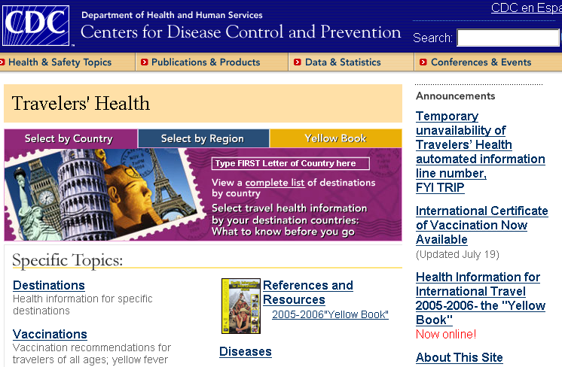
www.cdc.gov/travel
Yellow Fever
Typhoid
Polio
Notes:
Yellow Fever---this is a mosquito-borne disease found in tropical climates. Vaccine would be indicated for travel to certain countries where yellow fever is endemic or where vaccine may be required for entry. The 1st time this vaccine is given it must be administered at least 10 days before entering the country in question, and the traveler must have the vaccination documented in the yellow international vaccination record. For travel in subsequent years, a booster is needed every 10 years. See package insert for dosage and administration information.
Typhoid Fever ---this is an illness caused by a particular strain of salmonella bacteria that can contaminate water sources. There are currently 3 types of prevention available for this disease: 2 injectable vaccines, and capsules to be taken orally. Dosage and timing information can be accessed from the package insert.
Polio---adolescents and adults who have previously been adequately immunized with either oral or inactivated polio vaccine would not generally need further boosters. However, for adults traveling to areas of the world where polio still exists, a one time dose of injectable polio vaccine may be recommended. To administer, give 0.5 ml subcutaneously.
Japanese Encephalitis---this is a mosquito-borne infection found in parts of the Far East, southeast Asia, and the Indian subcontinent. In general, risk of disease is very low but depends on such factors as season, duration and location of travel, and activities. Vaccine may be 2 or 3 doses given at intervals. Refer to package insert for more information.
Other vaccines mentioned in earlier portions of the presentation (Hep A, Hep B, MMR, meningitis, etc.) may be needed for travel to certain areas. Travelers should consult a travel clinic or the CDC travel website for information regarding vaccinations recommended for their specific destination.

Slide 56
Just as a reminder……
Regardless of:
  the availability of vaccine
  the funding of the vaccine (VFC, state-supplied, or private stock)
  whether the vaccine is required for school or child care or not……….
FOLLOW ACIP Recommendations!!!
Notes:
There seems to be some confusion among providers that
if there are vaccine shortages or the supply is low because it’s a new vaccine, or
if the patient doesn’t fit in a certain funding category, or
if the vaccine isn’t required for school or child care:
then they don’t feel they need to be concerned about whether to recommend or discuss that vaccine with the client or the parent. But the bottom line is-------the ACIP recommendation is the most important thing!! For instance, if a vaccine is recommended and the child is not VFC eligible, then give them your private stock of that vaccine if you have it. If not, refer the child out to receive it, but don’t ignore the fact that according to the ACIP Recommended schedule, he should have it.
Please be sure to emphasize this to any groups that you are educating about the recommended schedule.

Slide 57
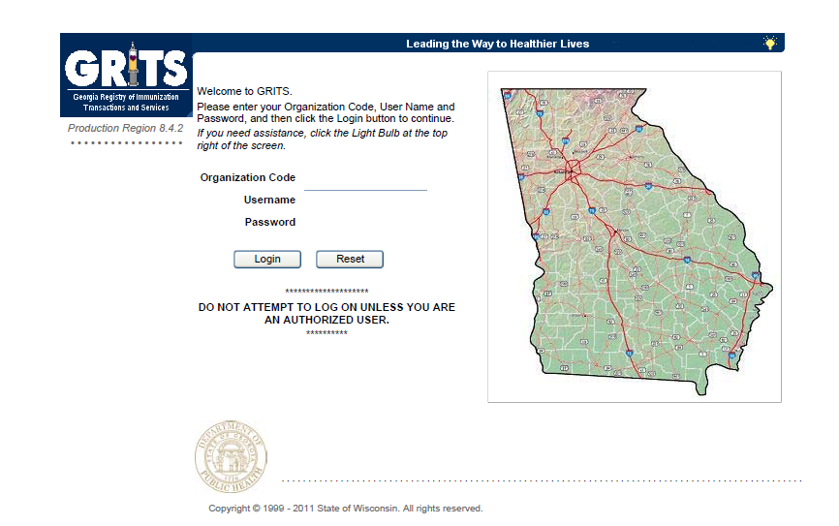
Georgia Registry of Immunization Transactions and Services (GRITS)
Notes:
We will talk briefly about Georgia’s immunization registry, or GRITS.

Slide 58

A “Birth to Death” Immunization Registry
Providers administering vaccines in Georgia must provide appropriate information to GRITS.
Create an interface between your system and GRITS that will drastically decrease data entry
Reduced missed opportunities to vaccinate at risk individuals
Reduction of over immunization of individuals
Accurate Vaccine Inventory Tracking by Lot # for privately and public funded vaccine
Reminder/recall notices for parents
Notes:
58
In 2004, House Bill 1526 was passed making the Georgia Immunization Registry a birth to death registry mandating that providers of immunizations in Georgia report those immunizations into the registry database. Immunization data may now be shared by all providers of immunizations to Georgians of any age, and to schools, daycares, colleges and universities, and long term care facilities. The patient (age 18 or older) or parent or legal guardian may OPT-OUT of the registry.
Contact GRITS to enroll: 1-888-223-8644
Benefits of GRITS include: accurate immunization records, inventory tracking, reduction in missed opportunities or over-immunization, generation of school entrance forms/college immunization forms, reminder/recall notices for parents, assistance in generating reporting of immunizations to HEDIS/COCASA, and elimination of phone calls to providers for immunization records. The GRITS program is web-based. New users to the system will have to attend a training session and receive a password.
Advantages of a statewide registry are as follows:
Benefits to the Community
Enhance the overall health status by facilitating identification of inadequately immunized segments of the population
Decrease occurrence of over-immunization due to inability to locate past records
Assist in issuing reminders to patients for pending and overdue immunizations
Benefits to Healthcare Providers
Reduce staff time needed to obtain complete immunization history of patients
Provide printouts of school certificates
Provide vaccine information and simplify complex and dynamic immunization schedules
Streamline vaccine inventory process
Generate HEDIS and other reports
Reinforce the concept of a medical home
Benefits to Public Health Officials
Provide an accurate measure of immunization rates for districts, counties, and the state
Allow Georgia healthcare providers to update and exchange immunization information about their patients in a confidential manner
Facilitate community outreach programs
The Georgia Code 31-12-3.1, which took affect July 1, 1996 and House Bill 1526, which took affect July 1, 2004 states:
Any person who administers a vaccine or vaccines licensed for use by the United States Food and Drug Administration to a person shall, for each such vaccination, provide to the department such data as are deemed by the department to be necessary and appropriate for purposes of the vaccination registry established pursuant to subsection (a) of this Code section…
At the present time the mandatory use of GRITS is not being strictly enforced but will be sometime in the future.

Slide 59
Challenges to Adult Vaccination
Most patients indicate that they are likely to receive
a vaccination if their healthcare provider (you) recommends it
Ref: Johnson DR, et al. Am J Med. 2008;121 (7 Suppl 2):S28-S35.

Slide 60
Talking with Patients about Vaccines
Inform that more vaccines are now available for adults
Make your recommendation about vaccines
Use language patients can understand
Give Vaccine Information Statement (VIS) prior to administering a vaccine
Solicit and welcome questions
Draw upon your experience as a health care provider for those who are hesitant about receiving a vaccine
Adapted from Glen Nowak, PhD. CDC
Notes:
60

Slide 61
Important Office Practices
Use Reminders
Electronic health record pop-ups or chart reminders
Send patient reminders
Recall
Recall for routine immunizations
Recall when vaccine is available after a vaccine shortage
Notes:
Reminders and Recall
For providers: A reminder communicating to the health care provider that a patient needs an immunization can be as simple as a chart clip, “sticky note” on the immunization record/ patient record, or a flag on the electronic medical record
For patients: A reminder is a message notifying a patient/parent of an upcoming appointment and/or a need for an immunization
A recall is a message notifying a patient that they are past due for an appointment and/or immunization
These can be automated or manual, computerized, telephonic, or written
If one member of a family is scheduled for an appointment, be sure and check all family member records for up to date immunizations and send reminder home at that time!
Reference: General Recommendations on Immunization, Recommendations of the Advisory Committee on Immunization Practices (ACIP). MMWR 60(RR-2); January 28, 2011
Dentists and veterinarians do a much better job with reminders and recalls than physicians
61

Slide 62
Every Office and Clinic Needs
A Vaccine Champion!
Lead your immunization team.
Educate all staff about new vaccines and recommendations.
Teach new staff about vaccine storage, handling, & administration.
Initiate processes to improve immunization rates in your practice/facility.
Assure immunizations of all staff are up-to-date.
Notes:
62
62
Ask your audience “Who is your vaccine champion?” and then
“Who is this person’s backup?”
The vaccine champion will:
Lead your immunization team.
Educate all staff about new vaccines and recommendations.
Educate new staff about vaccine storage, handling, & administration.
Initiate processes to improve immunization rates in your practice/facility.
Assure immunizations of all staff are up-to-date.
Improving Access to immunizations
Immunization only visits
Walk-ins for immunizations
Implement standing orders
Early, extended, or weekend hours
Mass vaccination clinics
These 5 methods listed above can help patients access immunizations more readily but some of these methods may not be the right fit for some practices. The approach to improving access must be determined by individual practitioners and staff. Each practice must decide which method works best for their situation. In large practices or clinics this may be an administrative decision.

Slide 63

Healthcare Personnel (HCP) Need These Immunizations
Annual influenza vaccine
Tdap or Td
Hepatitis B (exposure risk) Check immunity
Validate immune status of:
Varicella
Measles, Mumps & Rubella(MMR)
Are YOU up to date?
Notes:
63
Hepatitis B vaccine is recommended for health-care personnel with potential exposure to blood or body fluids. The antibody status of these health-care personnel should be checked 1-2 months after the 3rd dose. If a person fails to develop an adequate antibody titer after three doses of vaccine, follow current CDC recommendations for additional doses of hepatitis B vaccine. Some health-care providers may have received three doses of hepatitis B vaccine as children, adolescents or adults but have never had serologic testing to check for immunity. Follow the CDC Guidance for Evaluating Health-Care Personnel for Hepatitis B Virus Protection and for Administering Postexposure Management (Recommendations and Reports / Vol. 62 / No. 10 December 20, 2013)
Un-immunized HCP
Un-immunized healthcare workers are at risk of infecting patients, family members and community contacts
Immunized HCP
Protect patients from VPD’s
Help offices avoid potential liability cases. (The practice can be liable if an unimmunized HCP becomes infected with a vaccine preventable disease and infects a patient.)
Maintain productivity
Reduce illness and illness-related absenteeism
Evidence of Immunity to MMR
Documented administration of two doses of measles and mumps vaccine and one dose of rubella vaccine OR
Laboratory evidence of immunity or laboratory confirmation of disease (measles, mumps and rubella) OR
Born before 1957 (measles, mumps and rubella)
References: 1. General Recommendations on Immunization, Recommendations of the Advisory Committee on Immunization Practices (ACIP). MMWR (RR-2); January 28, 2011
2. Immunization of Health-Care Personnel: Recommendations of ACIP MMWR; November 25, 2011 / 60(RR07);1-45
3. CDC Guidance for Evaluating Health-Care Personnel for Hepatitis B Virus Protection and for Administering Postexposure Management (Recommendations and Reports / Vol. 62 / No. 10 December 20, 2013)

Slide 64
Vaccine Adverse Event Reporting System
The Vaccine Adverse Event Reporting System (VAERS) is a national vaccine safety surveillance program co-sponsored by the Centers for Disease Control and Prevention and the Food and Drug Administration.
What Can Be Reported to VAERS?
Who Reports to VAERS?
Does VAERS Provide General Vaccine Information?
http://vaers.hhs.gov/ or 1-800-822-7967
Notes:
VAERS provides a nationwide mechanism by which adverse events following immunization may be reported, analyzed, and made available to the public.
The primary objectives of VAERS are to:
Detect new, unusual, or rare vaccine adverse events;
Monitor increases in known adverse events;
Identify potential patient risk factors for particular types of adverse events;
Identify vaccine lots with increased numbers or types of reported adverse events; and
Assess the safety of newly licensed vaccines.
What Can Be Reported to VAERS?
VAERS encourages the reporting of any clinically significant adverse event that occurs after the administration of any vaccine licensed in the United States.
Who Reports to VAERS?
Anyone can file a VAERS report, including parents, health care providers, manufacturers, and vaccine recipients.
Does VAERS Provide General Vaccine Information?
No. VAERS only collects and analyzes adverse event reports. In another example, VAERS determined that there may be a potential for a small increase in risk for Guillain-Barre syndrome after the meningococcal conjugate vaccine, Menactra. As a result of this finding, a history of Guillain-Barre syndrome became a contraindication to the vaccine and further controlled studies are currently underway to research this issue.
The VAERS website for reporting is: http:vaers.hhs.gov/ or you can call to report at 1-800-822-7967

Slide 65
Vaccine Injury Compensation Program (VICP)
National Vaccine Injury Compensation Program
provides compensation to individuals found to be injured by or have died from certain childhood vaccines.
  Established in 1988 by NCVIA
  Federal “no fault” system to compensate those injured
  Claim must be filed by individual, parent or guardian
  Must show that injury is on “Vaccine Injury Table”
Notes:
On October 1, 1988, the National Childhood Vaccine Injury Act of 1986 created the National Vaccine Injury Compensation Program (VICP). The VICP was established to ensure an adequate supply of vaccines, stabilize vaccine costs, and establish and maintain an accessible and efficient forum for individuals found to be injured by certain vaccines. The VICP is a no-fault alternative to the traditional public legal system for resolving vaccine injury claims that provides compensation to people found to be injured by certain vaccines.
The National Childhood Vaccine Injury Act (NCVIA) set forth 3 basic requirements for all vaccination providers, which are:
Providers must give the patient (or parent/legal representative of a minor) a copy of the relevant federal "Vaccine Information Statement" (VIS) for the vaccine they are about to receive.
Providers must record certain information about the vaccine(s) administered in the patient's medical record or a permanent office log.
Providers must document any adverse event following the vaccination that the patient experiences and that becomes known to the provider, whether or not it is felt to be caused by the vaccine, and submit the report to the Vaccine Adverse Event Reporting System (VAERS).

Slide 66










Resources for Factual & Responsible Vaccine Information
www.immunize.org
Notes:
66
66
These are sources for scientific and credible information
See information sheet in participant packet
http://www.cdc.gov/vaccines/vac-gen/safety/default.htm
www.idsociety.org/vaccine/index.html
www.who.int
www.gaaap.org
www.aap.org
www.cispimmunize.org
www.aafp.org
www.acponline.org
www.immunize.org/resources This site is a good resource for healthcare providers and for information written specifically for patient and parents.
www.immunizationinfo.org
www.pkids.org (support and counseling for children with infectious diseases)
www.vaccine.org
The Allied Vaccine Group (AVG) (www.vaccine.org) was formed for the purpose of making it easier for patients/parents/providers to find reliable, science-based information about vaccines and immunization on the internet. This web site was designed to counter the many anti-vaccine web sites that are now available on the internet.

Slide 67

Internet Resources
Georgia Department of Public Health
  http://dph.georgia.gov/immunization-section
CDC Immunization information
  http://www.cdc.gov/vaccines/
CDC Flu information
  http://www.cdc.gov/flu/
Immunization Action Coalition
  www.immunize.org

Slide 68


Resources
Local health department
District Immunization Coordinator
GA Immunization Program Office
  On call Help line: 404-657-3158
  GRITS Help Line:1-866-483-2958
  VFC Help Line:1-800-848-3868
  Website http://dph.georgia.gov/immunization-section
  Your local Immunization Program Consultant (IPC)
GA Chapter of the AAP
GA Academy of Family Physicians
Notes:
If you need further information about the changes, or to ask questions later, please contact the GA Immunization Office and our partners GA AAP and GA AFP
Your Local health department
District Immunization Coordinator (IPCs)
GA Immunization Program Office
404-657-3158
Website http://health.state.ga.us/programs/immunization
GA Chapter of the AAP
GAFP

Slide 69
http://dph.georgia.gov/immunization-section
Notes:
For those who have not logged onto the Immunization page website here is the link to the main page.

