Slide 1
Georgia Requirements for School and Childcare Attendance
Presentation to:
Presented by:
Date:

Slide 2
Conflicts of Interest and Disclosures
Neither the planners or presenters indicated that they have any real or perceived vested interest that relate to this presentation nor any relationships with pharmaceutical companies, biomedical device manufacturers, and/or other corporations whose products and services are related to the vaccines we discuss.
There is no sponsorship or commercial support being received for this activity.
The mention of specific brands of vaccines in this presentation is for the purpose of providing education and does not constitute endorsement by the provider or ANCC of any commercial products.
For certain vaccines this may represent a slight departure from or off-label use of the vaccine package insert guidelines.
Notes:
Neither the planners or presenters indicated that they have any real or perceived vested interest that relate to this presentation nor any relationships with pharmaceutical companies, biomedical device manufacturers, and/or other corporations whose products and services are related to the vaccines we discuss.
There is no sponsorship or commercial support being received for this activity.
The mention of specific brands of vaccines in this presentation is for the purpose of providing education and does not constitute endorsement by the provider or ANCC of any commercial products.
For certain vaccines this may represent a slight departure from or off-label use of the vaccine package insert guidelines.

Slide 3
Notice of Requirements
To obtain nursing contact hours for this session, you must be present for the entire presentation and complete and submit an evaluation.
Contact hours for this session will be available 5/1/2014 through 8/31/2015 only for those who successfully complete this educational activity.
Notes:
To obtain nursing contact hours for this session, you must be present for the entire presentation and complete an evaluation.
Contact hours for this session only are available until 8/31/2015.

Slide 4
Objectives
Explain vaccine preventable diseases and morbidity rates for preventable diseases in GA
Discuss the GA immunization law and DPH rules and regulations for GA immunization certificates and also the new seventh grade school requirements
Describe the public health assessment process and the responsibilities of providers, schools and parents enforced by the law
Describe the standards for issuing and filing certificates of immunizations
Identify common errors seen on GA Immunization certificates
Notes:
At the end of this presentation the participant will be able to:
Review vaccine preventable diseases and morbidity rates for these preventable diseases in GA
Discuss GA immunization law and DPH rules and regulations for GA immunization certificates; including the new seventh grade school requirements
Review the provider, school and parent responsibility to enforce the law
Describe standards for issuing and filing certificates of immunizations
Review the public health assessment process
Identify common errors seen on GA Immunization certificates

Slide 5
Topics
Review of childhood vaccine preventable diseases
Georgia immunization requirements for preschool, child care, and school attendance; including the implementation of the new 7th grade requirements
Review updates to the new Immunization Certificate and the policy guide for completing form 3231
How to monitor, follow up and enforce the requirements for the certificate of attendance
Review available resources for providers, schools and parents
Notes:
Topics to be discussed:
Review of childhood vaccine preventable diseases
Georgia immunization requirements for preschool, child care, and school attendance; including the implementation of the new 7th grade requirements
Review updates to the new Immunization Certificate and the policy guide for completing form 3231
How to monitor, follow up and enforce the requirements for the certificate of attendance
Review available resources for providers, schools and parents

Slide 6
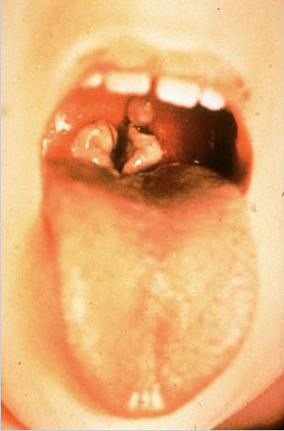
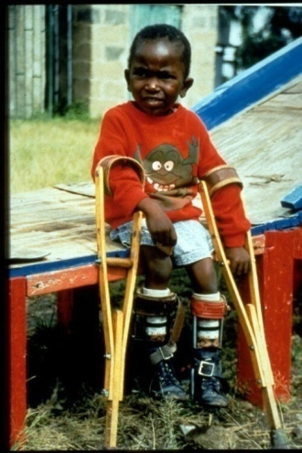
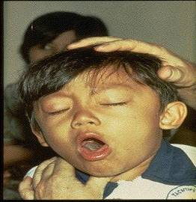
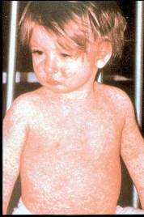
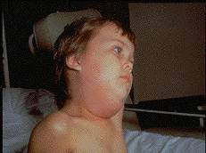
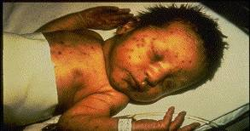
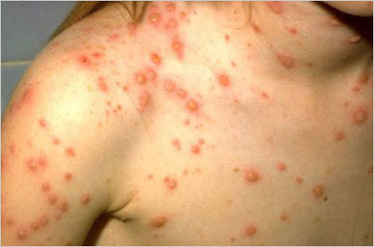
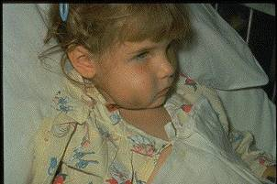
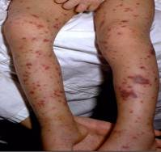
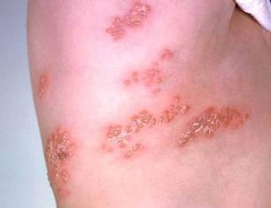
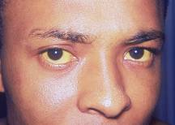
Why Do We Immunize?
We Immunize To Prevent These Diseases
Notes:
Why do we immunize?
Children need immunizations (shots) to protect them from dangerous childhood diseases. These diseases can have serious complications and even kill children.

Slide 7
Herd Immunity
Immunized individuals block infection from reaching those who are unimmunized
UNIMMUNIZED
INFECTED
INFECTED
INFECTED
= immunized
Notes:
Herd immunity is a form of immunity that occurs when the vaccination of a significant portion of a population (or herd) provides a measure of protection for individuals who have not developed immunity. It arises when a high percentage of the population is protected through vaccination against a virus or bacteria, making it difficult for a disease to spread because there are so few susceptible people left to infect. This can effectively stop the spread of disease in the community. It is particularly crucial for protecting people who cannot be vaccinated. These include children who are too young to be vaccinated, people with immune system problems, and those who are too ill to receive vaccines. The proportion of the population which must be immunized in order to achieve herd immunity varies for each disease but the underlying idea is simple: once enough people are protected, they help to protect vulnerable members of their communities by reducing the spread of the disease. Most vaccination policies are focused on creating herd immunity. The creation of herd immunity is especially important in crowded environments which facilitate the spread of disease, like schools. It is also extremely important to receive regular boosters, as some vaccines lose their efficacy over time, leaving people vulnerable to an outbreak. Herd immunity led to the eradication of smallpox, and it explains why diseases such as polio and diphtheria are rare in developed nations with established vaccination policies.

Slide 8
What You Need To Know About
Vaccine Preventable Diseases
Notes:
8
Many healthcare workers, patients and parents of young children and adolescents have grown up in the vaccine era. They are not familiar with the world we lived in before the availability of vaccines when most children were infected with whooping cough, measles, mumps, and chicken pox during their preschool or school years. These diseases were called “childhood diseases” because most children had these diseases during their childhood years. Most children were sick for a short period of time and recovered. Some children developed complications and some were left with permanent physical and/or mental disabilities. Some died as a result of these diseases.
Patients and parents may ask about these diseases. Therefore, it is important for healthcare providers to be familiar with the symptoms of these vaccine preventable diseases.
YOU MUST KNOW ABOUT THESE DISEASES TO BE A
BETTER ADVOCATE FOR IMMUNIZATIONS

Slide 9
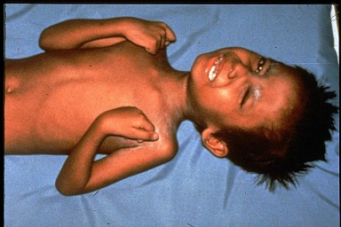

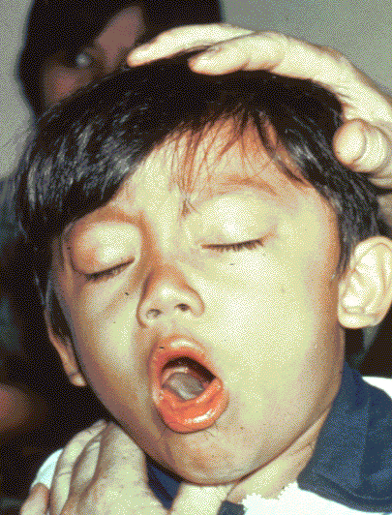

Diphtheria
Tetanus
Required for school and child care attendance
Pertussis
Notes:
First we will take a look at diphtheria, tetanus and pertussis, or whooping cough which DTaP vaccine helps to protect against.
The top left picture is of a throat of a child who has diphtheria. You can see the thick gray coating over the back of the throat. This coating can eventually expand down through the airway, and if not treated, a person could die from suffocation, or suffer other complications such as paralysis, heart failure, or coma.
In the top right picture, this child is experiencing painful muscle spasms from tetanus. It is nearly impossible for him to move or control the muscles in his body. He cannot eat because the muscles in his mouth have become so tight and it is difficult for him to swallow. Other possible complications are broken bones from muscle spasms, breathing problems, and death.
The bottom picture shows a child who is suffering from pertussis, commonly know as “whooping cough”. He is experiencing coughing spasms, which produce a “whooping” sound. The sound occurs because the child is trying to catch his breath before the next round of coughing. Often children have difficulty breathing and experience vomiting and exhaustion from the severe coughing.
The recommendations for administering DTaP did not change since last year. Pertussis cases and infant deaths have increased over the past couple of years. Often infants who are too young to have completed their initial vaccination series, contract the disease from an older child or an adult in their household. Currently the DTaP vaccine is licensed for persons under 7 years of age. Two acellular pertussis vaccines were licensed in 2005 that can now be given to older children and adults. Hopefully this will decrease the number of young infants who contract this disease. We will discuss Tdap and Td after we cover DTaP.

Slide 10
Diphtheria, Tetanus and Pertussis Vaccines for Children and Adolescents
Infants and young children: 5 dose series of DTaP
  -At 2, 4, 6, 15-18 months and 4-6 years
  -Do not give DTaP after 6 years of age
Older Children and Adolescents: Booster Dose of Tdap*
  -one dose to all 11 through 12 years; Catch-up for all adolescents who have not received Tdap
  -Use Tdap regardless of interval since last Td
Effective July 1, 2014 children born on or after January 1, 2002 who are attending seventh grade, and children who are new entrants into a Georgia school in grades eight through twelve, must have received one dose of Tdap vaccine.
Ref: Updated Recommendations for Use of Tdap Vaccine from ACIP, 2010 MMWR 2011; 60(01);13-15 Jan 14, 2011
Notes:
10
10
Ref: Updated Recommendations for Use of Tdap Vaccine from ACIP, 2010 MMWR 2011; 60(01);13-15 Jan 14, 2011
Infants and young children: 5 dose series of DTaP
-At 2, 4, 6, 15-18 months and 4-6 years
-Do not give DTaP after 6 years of age
Older Children and Adolescents: Booster Dose of Tdap*
-one dose to all 11 through 12 years; Catch-up for all adolescents who have not received Tdap
-Use Tdap regardless of interval since last Td
Effective July1, 2014
-children born on or after January 1, 2014 who are attending seventh grade, and children who are new entrants into a Georgia School in grades eight through twelve, must have received one dose of Tdap vaccine.

Slide 11
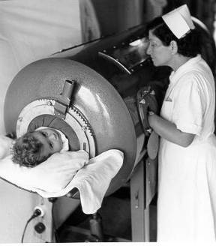
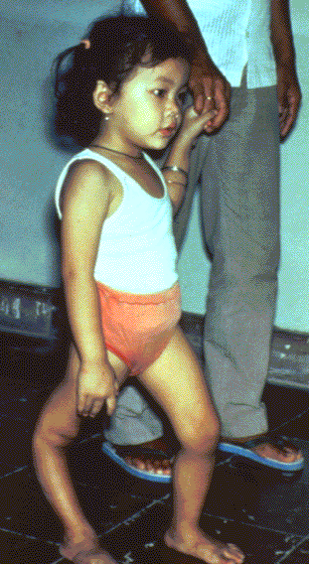
Polio
For infants & children: 4 doses of IPV:
  Dose @ 2, 4, and 6 – 18 months of age (usually administered at 12 – 18 months)
  Dose 4 @ 4 through 6 years of age
Final dose at 4 years of age or older regardless of the number of previous doses; at least 6 months following previous dose required
Single lifetime booster for travel to polio-endemic countries (Check www.cdc.gov/travel)
Required for school and childcare attendance
Ref. MMWR 2009; 58 (30);829-830 (August 7, 2009)
Source: World Health Organization
Notes:
11
11
11
In this slide we will take a look at Polio. Can anyone identify the top picture?
The top picture shows a child in an iron lung due to weak respiratory muscles (common in polio era); In the 1950’s, when a person’s respiratory muscles were paralyzed, they were placed in iron lung machines and a child with muscle weakness, as a result of polio. The bottom picture shows a child who has a severely deformed leg requiring the assistance of braces and crutches in order to walk.
Polio is a virus and lives in the throat and intestines of an infected person and is spread by direct contact. It can be spread to other people through contact with feces. This is an example of good hand washing being crucial in preventing the transmission of disease, in addition to being immunized.
IPV is the only polio vaccine listed on the schedule. IPV has been the only polio vaccine routinely recommended for all four doses of polio, since Jan 2000.
OPV is no longer being manufactured in the US. The last production lot expired in November, 2000.
All the General Recommendations that apply to inactivated vaccines apply here.
The recommendations for an all IPV schedule:
First dose at 2 months of age
Second dose at 4 months of age
Third dose at 6 months of age
Fourth dose at 4-6 years of age
The minimum time interval between 1-3 doses is 4 weeks, the minimum time interval between the 3rd and 4th dose is 6 months.
The final dose in the series should be administered on or after the 4th birthday and at least 6 months following the previous dose.
• If 4 doses are administered prior to age 4 years a fifth dose should be administered at age 4 through 6 years. See MMWR 2009;58(30):829–30.
For children on a catch up Immunization schedule:
A fourth dose is not necessary if the third dose was administered at age 4 years or older and at least 6 months following the previous dose.
Oral polio vaccine still used in third world countries where polio is still endemic (Mainly in Nigeria, India, Pakistan, and Afghanistan). Other countries in Africa have had small outbreaks.
For additional information about polio refer to: Epidemiology and Prevention of Vaccine-Preventable Diseases, 12th edition May 2011. HHS, CDC.

Slide 12
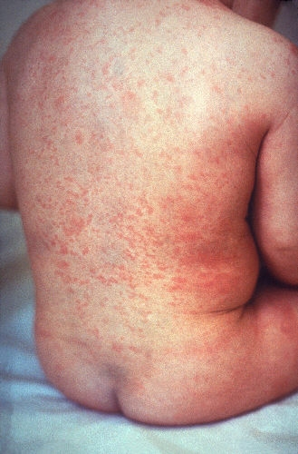
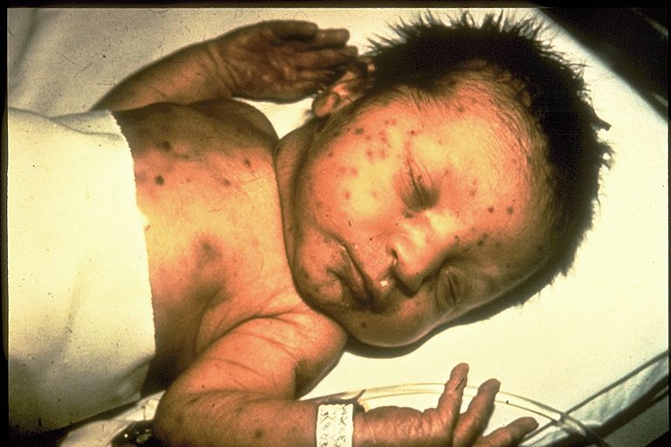
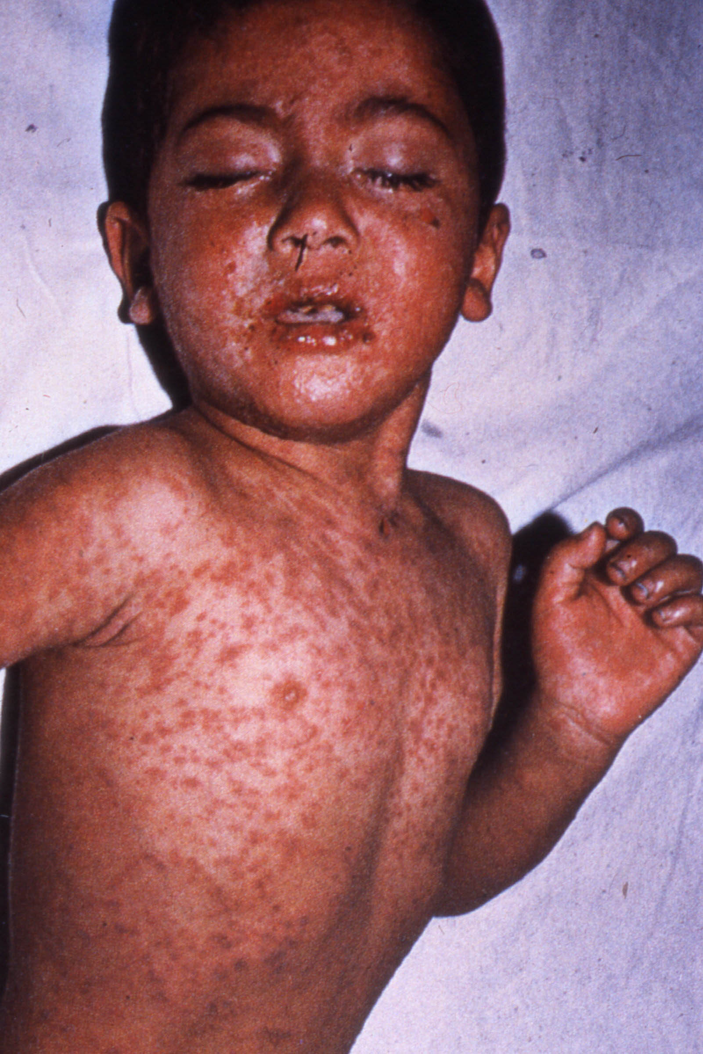
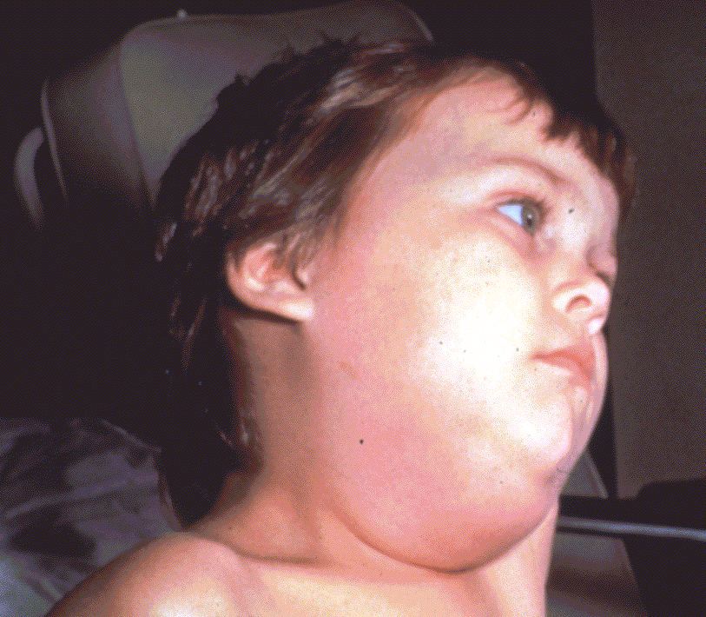
Rubella
Measles
Required for school and child care attendance
Mumps
Notes:
Next slide is Measles, Mumps, and Rubella. Today, measles vaccination rate is above 95% for children of kindergarten age. But there has been a small but growing trend of parents seeking exemptions for their children from school-entry vaccination requirements for religious or philosophical reasons.
-The child in the top left slide has a bad rash caused by measles. The rash usually begins along the hairline and moves downward over the course of 4 days to the face, neck, body, hands, and feet.
-The bottom slide illustrates a child who has the mumps. As you can see, the child is swollen under the jaw and in the cheeks. She may have a fever and headache
-The 2 pictures on the top right of the slide show a rubella rash on a young child, and also an infant suffering from congenital rubella syndrome, a potentially very devastating form of rubella.
MMR protects against these diseases.
We also have MMRV, which provides the same protection in addition to varicella immunity.
The routine recommendations and footnotes for measles, mumps, and rubella did not change.

Slide 13
MMR Vaccine
2 Dose Series for children
  Dose 1 @ 12 through 15 months of age
  Dose 2 @ 4 through 6 years of age
However , if it is given a minimum of 4 weeks after the 1st dose (12 months of age or later), the dose at 4-6 years of age is not needed
Notes:
13
13
13
The first dose of MMR should be given on or after the first birthday. Any dose of measles-containing vaccine given before 12 months of age should not be counted as part of the series. Children vaccinated with measles-containing vaccine before 12 months of age should be revaccinated with two doses of MMR vaccine, the first of which should be administered when the child is at least 12 months of age.
A second dose of MMR is recommended to produce immunity in those who failed to respond to the first dose. The second dose of MMR vaccine should routinely be given at age 4–6 years, before a child enters kindergarten or first grade. The recommended visit at age 11 or 12 years can serve as a catch-up opportunity to verify vaccination status and administer MMR vaccine to those children who have not yet received two doses of MMR.
If a child has not received the second dose by 11-12 years of age, the opportunity should be utilized to assess and “catch up”; Minimal time interval between doses: 28 days
Second measles dose required for first time GA school entry and entry to 6th grade.
*Note the following guidelines regarding the administration of MMR vaccine:
The first dose should not be administered prior to first birthday except when there is a chance of exposure. If this occurs, that dose would need to be repeated after the first birthday. (This would be indicated if the infant will be traveling to a country where measles is endemic or you may see this on a previous immunization record , if the infant came from country where measles was endemic.)
The second dose of MMR is recommended to be routinely administered at age 4-6 years. However it can be administered on any visit, provided at least 4 weeks (28days) have lapsed since the receipt of the first dose, and both doses are administered at or after 12 months of age

Slide 14
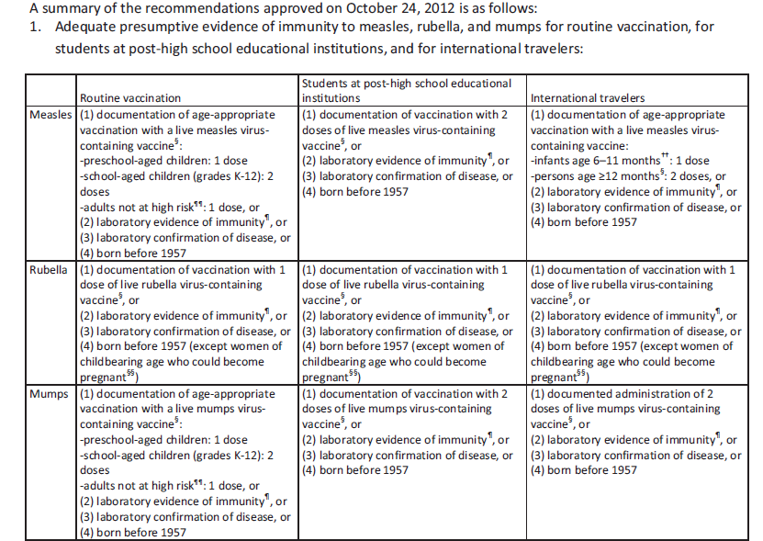
Evidence of Immunity
Notes:
In a 2013 revision of the MMR vaccine recommendations, ACIP now includes lab confirmation of disease as evidence of MMR immunity. ACIP removed physician diagnosis of disease as evidence of measles and mumps. Physician diagnosis of disease had not previously been accepted as evidence of immunity for rubella. With the decrease in measles and mumps cases over the last 30 years, the validity of physician diagnosed disease has become questionable.
This chart is a summary of the recommendations approved on October 24, 2012.

Slide 15
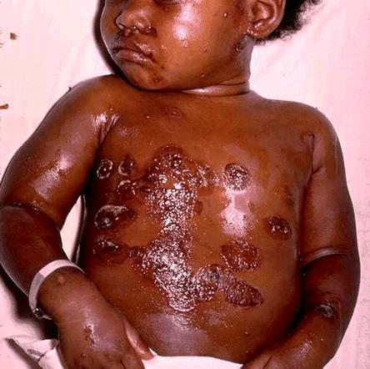
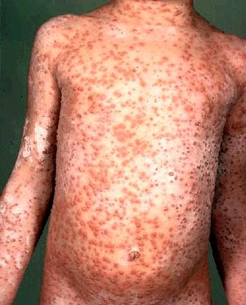
Varicella
(Chickenpox)
Routine Recommendations for Varicella Vaccine
Dose 1 @ 12 months through 15 months of age
Dose 2 @ 4 through 6 years of age*
Those 13 years of age or older without evidence of immunity should receive 2 doses separated by 4 to 8 weeks.
Required for school and child care attendance
*Second dose can be administered at an earlier age provided the interval between the first and second dose is at least 3 months.
Notes:
15
15
Varicella spreads from person to person by direct contact via air coughing and sneezing. People with varicella are infectious for 4 to 7 days after the appearance of skin lesions and until all lesions are crusted over.Prior to the availability of varicella vaccine there were approximately 4 million cases of varicella a year in the U.S. The most common complications from varicella include bacterial super-infections of the skin lesions, pneumonia, central nervous system involvement, and thrombocytopenia (low platelet count).
The requirements for children entering kindergarten and sixth (6th) grade, or students entering a Georgia school for the first time in any grade (kindergarten through 12th grade) are two (2) doses of a varicella-containing vaccine, or healthcare provider documentation of immunity from disease history or serologic proof of immunity.
Preteen children who were up-to-date with one dose of varicella vaccine prior to starting school need the second dose if they have not received dose 2.
However regardless of the child’s age, if the 2nd dose was administered at least 28 days following the 1st dose, the 2nd dose does not need to be repeated
If using MMRV for children 12 months through 12 years of age: 3 months between doses
Reference: Prevention of Varicella - Recommendations of the Advisory Committee on Immunization Practices (ACIP) MMWR (2007);56(No. RR-4):23

Slide 16
Immunity
What are the criteria for evidence of immunity to varicella?
ACIP considers evidence of immunity to varicella to be
Documentation of 2 doses of vaccine given no earlier than age 12 months, with at least 3 months between doses for children younger than age 13 years, or at least 4 weeks between doses for people age 13 years and older
• U.S.-born before 1980*
• A healthcare provider's diagnosis of varicella or verification of history of
varicella disease
• History of herpes zoster, based on healthcare provider diagnosis
• Laboratory evidence of immunity or laboratory confirmation of disease
*Note: year of birth is not considered as evidence of immunity for healthcare
personnel, immunosuppressed people, and pregnant women.
Notes:
ACIP considers evidence of immunity to varicella to be:
-Documentation of 2 doses of vaccine given no earlier than age 12 months, with at least 3 months between doses for children younger than age 13 years, or at least 4 weeks between doses for people age 13 years and older
-U.S.-born before 1980*
-A healthcare provider's diagnosis of varicella or verification of history of varicella disease; *Note: year of birth is not considered as evidence of immunity for healthcare personnel, immunosuppressed people, and pregnant women.
- History of herpes zoster, based on healthcare provider diagnosis
- Laboratory evidence of immunity or laboratory confirmation of disease
ASK THE EXPERTS
If a healthcare worker does not have a history of varicella vaccination or disease but has had a clinically diagnosed case of shingles, does she or he still need varicella vaccination?
No. A healthcare provider's diagnosis or verification of a history of shingles is acceptable evidence of immunity to varicella. According to ACIP, acceptable evidence of varicella immunity in healthcare personnel includes (1) documentation of 2 doses of varicella vaccine given at least 28 days apart, (2) history of varicella or herpes zoster based on physician diagnosis, (3) laboratory evidence of immunity, or (4) laboratory confirmation of disease.
Should a child who has had chickenpox prior to the first birthday get the first dose of varicella vaccine at age 1 year?
If the child had confirmed varicella disease or laboratory evidence of prior disease, it is not necessary to vaccinate regardless of age at infection. If there is any doubt that the illness was actually varicella, the child should be vaccinated.

Slide 17


Pneumococcal Disease
Required for child care and pre-K attendance
Notes:
Pneumococcal vaccines are the next vaccines on the list . Note that there are 2 types of pneumococcal vaccines on the schedule :
PCV13 or Pneumococcal Conjugate Vaccine and
PPSV23 or Pneumococcal Polysaccharide Vaccine
Both vaccines protect against pneumococcal disease caused by serotypes of Streptococcus pneumoniae. The major clinical syndromes of pneumococcal disease include pneumonia, bacteremia, and meningitis.
However each of these vaccines due to their composition are effective in protecting different age groups.
Here you see in the picture on the left, a child with asplenia and evidence of thrombocytopenic purpura on her face from invasive pneumococcal disease. Picture on the right: Orbital cellulitis with edema and erythema.
There were no changes in the recommendations for PCV13 or PPSV23.
All the General Recommendations apply here with the exceptions of #1 & 2, when it concerns spacing with the other pneumococcal vaccine, pneumococcal polysaccharide.
This vaccine will become a requirement for pre-K and childcare attendance as of 7-1-07.
Pneumococcal disease is caused by a bacterium, Streptococcus pneumoniae, also called pneumococcus (about 90 known serotypes)
Causes pneumonia, bacteremia, meningitis and otitis media
Highest rate of invasive disease is in children less than 2 years
Increased risk of infection in children with HIV infection, sickle cell disease, asplenia, day care attendees and in certain ethnic groups (African Americans, Alaskan natives and Native Americans)
Increased risk in children & adults with cardiovascular disease, pulmonary disease, diabetes, alcoholism, cirrhosis, immunocompromising conditions
Individuals who have asthma and those who smoke cigarettes are also at increased risk
Estimated cases in the US each year more than any other vaccine-preventable disease
Some serotypes of pneumococcus have become resistant to antibiotics

Slide 18
PCV13 Vaccine
All children 6 weeks through 23 months of age
All unvaccinated healthy children aged 24--59 months should receive a single dose of PCV13.
For children aged 24--71 months with underlying medical conditions who have received any incomplete schedule of <3 doses of PCV (PCV7 or PCV13) before age 24 months, 2 doses of PCV13 are recommended. For children with underlying medical conditions who have received 3 doses of PCV (PCV7 or PCV13), a single dose of PCV13 is recommended
Notes:
All children 6 weeks through 23 months of age
All unvaccinated healthy children aged 24--59 months should receive a single dose of PCV13.
For children aged 24--71 months with underlying medical conditions who have received any incomplete schedule of <3 doses of PCV (PCV7 or PCV13) before age 24 months, 2 doses of PCV13 are recommended. For children with underlying medical conditions who have received 3 doses of PCV (PCV7 or PCV13), a single dose of PCV13 is recommended

Slide 19
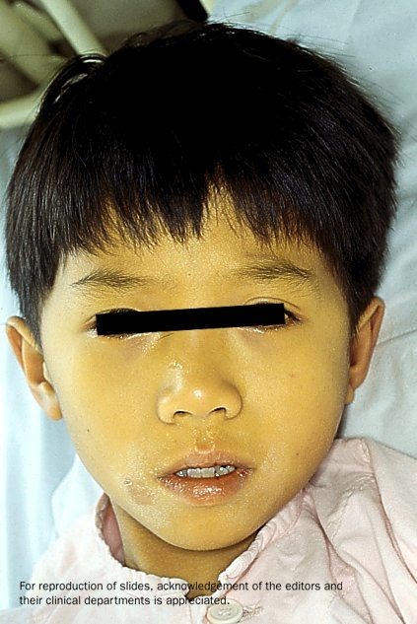

Hepatitis A
Required for school or child care attendance for children born on or after 1-1-06
Notes:
Now let’s look at hepatitis A vaccine .
The persons on this slide have hepatitis A . Note the jaundice of the skin and the sclera of the eye.
-The nature of hepatitis A disease is that it is cyclical. It is spread by fecal/oral transmission.
-Children plan an important role in HAV transmission. Symptomatic infection is uncommon in children, so they may be a source of infection for household or other close contacts. Almost half of persons with hepatitis A do not have an identified source of their infection. Groups of persons at risk for hepatitis A are international travelers, men who have sex with men, and illegal drug users. Food handlers are not at risk.
This vaccine is now routinely recommended for all children ages 12-23 months.

Slide 20
Hepatitis A Recommendations
All children aged 12 through 23 months are recommended to receive this vaccine
Children not vaccinated by age 2 years can be vaccinated at subsequent visits
Continues to be recommended for persons 2 years of age and older who are at high risk for disease
Requirement for entrance to school and child care as of 7-1-07 for those children born on or after 1-1-06.
Notes:
The Hepatitis A is routinely recommended for all children aged 12 through 23 months
Children not vaccinated by age 2 can be vaccinated at subsequent visits.
The vaccine continues to be recommended for persons 2 years of age and older who are at high risk for disease. Note the purple bar on the schedule
is a requirement for entrance to school and child care for those children born on or after 1-1-06.
If you are a VFC provider, and a VFC-eligible child between 12 months and 18 years of age requests hepatitis A vaccine, you should give him/her the vaccine from VFC stock.

Slide 21
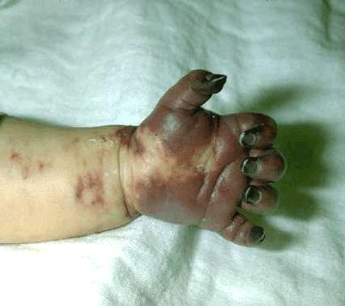
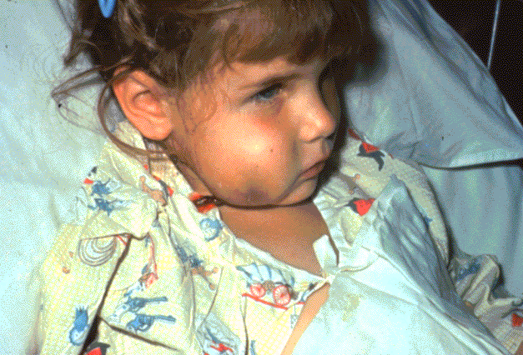
Haemophilus influenzae Type b (Hib)
Required only for child care and pre-K attendance
Notes:
Haemophilus influenzae Type b (Hib) is a polysaccharide-encapsulated bacteria that causes a variety of invasive disease, such as meningitis, Epiglottitis (inflammation of the tissue that covers the trachea (windpipe), and pneumonia. It can also cause brain damage, seizures, paralysis, and hearing loss. It enters the body through the nose and throat.
The child on the right has a swollen cheek due to Hib infection. The tissue under the skin covering the jaw and cheek is infected and she is probably very sick. She may have a fever, severe headache, sore throat, or breathing problems.
The photo on the left shows the tissue damage that can come from invasive Hib disease. Hib disease can be very dangerous to children under five years of age, especially infants.
Haemophilus influenzae Type B vaccine (Hib) protects against Hib disease.
In Georgia , Hib vaccine is required for attendance in child care and pre-K for all children under age 5 years.
2009 ACIP Recommended Catch up Immunization Schedule added Information (footnote 4) about the use of Haemophilus influenzae type b (Hib) conjugate vaccine among persons aged 5 years and older at increased risk for invasive Hib disease. Use of Hib vaccine for these persons is not contraindicated.
All the General Recommendations that apply to inactivated vaccines would apply to HIB.

Slide 22
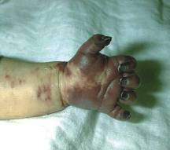
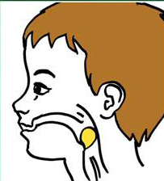
Haemophilus influenzae type b (Hib)
Infants: 3 or 4 dose schedule
  Dose 1 @ 2 months of age
  Dose 2 @ 4 months of age
  Dose 3 @ 6 months of age
  (Not required if Pedvax HIB® or Comvax® administered at 2 and 4 months of age)
  Booster dose @ 12 through 15 months of age
  MenHibrix ® approved for use in children 6 weeks of age through 18 months of age; MenHibrix is recommended by ACIP only for infants at increased risk for meningococcal disease.
  Hiberix ® can only be used as a booster dose (final) for children
who have previously received the primary 2 or 3 dose series of
Hib vaccine.
Notes:
22
22
22
Let’s take just a moment to review the highlights of the recommended schedule for administering Hib vaccine.
Since Hib is a conjugate vaccine it is important to remember that conjugate vaccines should not be given before an infant is 6 weeks of age and that the total number needed depends on the brand/or brands of Hib vaccine administered and the age the infant receives the first dose :
Infants: 3 or 4 dose schedule
Dose 1 @ 2 months of age
Dose 2 @ 4 months of age
Dose 3 @ 6 months of age
(Not required if Pedvax HIB® or Comvax® administered at 2 and 4 months of age)
Booster dose @ 12 through 15 months of age
MenHibrix ® approved for use in children 6 weeks of age through 18 months of age; MenHibrix is recommended by ACIP only for infants at increased risk for meningococcal disease.
Hiberix ® can only be used as a booster dose (final) for children
who have previously received the primary 2 or 3 dose series of
Hib vaccine.
-PedvaxHIB®, manufactured by Merck requires 3 doses of vaccine. Currently this is the brand of vaccine that we are shipping to VFC providers. (This is also the type of Hib vaccine in the combination vaccine, Comvax®.) The first two doses should be administered on the same schedule as the other brands. If the infant had PedvaxHIB® or Comvax® for the first two doses, a third dose is not needed at 6 months. The booster dose is recommended at 12-15 months.
-ActHIB ®, requires 3 doses of vaccine. Previously unvaccinated infants aged 2 through 6 months should receive three doses administered 2 months apart, followed by a booster dose at age 12-15 months, administered at least 2 months after the last dose.
-Pentacel®, a combination vaccine that contains lyophilized Hib (ActHIB) vaccine that is reconstituted with a liquid DTaP-IPV solution; approved for doses 1 through 4 among children 6 weeks through 4 years of age
-What if a child receives a combination of different brands (including PedvaxHIB or Comvax) or if you do not know the brand of Hib vaccine that a child received for previous doses, How many doses should a child receive? The child needs a total of 4 doses. Three doses are acceptable only when a child has received Pedvax Hib or Comvax for all 3 doses with the last dose administered on or after 12 months of age.
Hiberix® is licensed for use as the booster (final) dose for Hib vaccination for children aged 15 months through 4 years (before the 5th birthday) who have received a primary Hib vaccination series of 2 or 3 doses (depending on the formulation of the primary series vaccines). ACIP recommends Hib booster dosing at ages 12 through 15 months. It can NOT be used as the ONLY Hib dose in a child who has received no prior doses.
Hiberix® is not licensed for the primary Hib vaccination series; however, if Hiberix® is administered inadvertently during the primary vaccination series, the dose should be counted as a valid PRP-T dose that does not need to be repeated if it was administered according to schedule. In these children, a total of 3 doses will complete the routine primary series.
Also note that the number of recommended doses may vary depending on the age the child begins receiving the vaccine. A detailed schedule outlining the number of recommended doses based on the age of initiating the series is in the Pink Book.

Slide 23
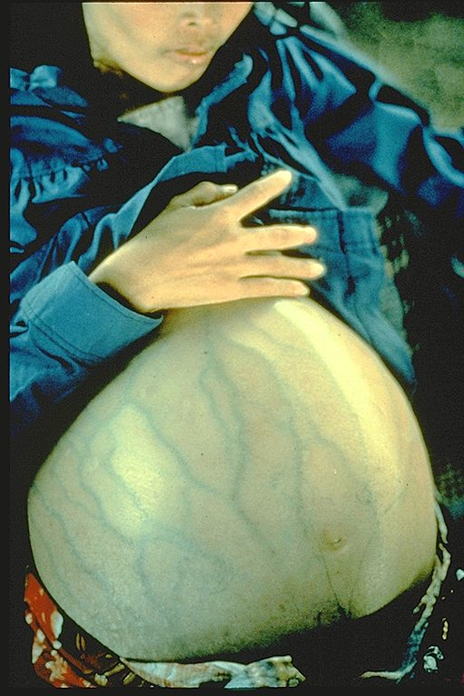
Hepatitis B
Required for school and child care attendance
Notes:
The woman shown in this slide has severe ascites due to liver damage caused by hepatitis B. Hepatitis B (she is not pregnant) can be prevented by Hepatitis B vaccine, the first vaccine listed on the schedule.
When administering Hepatitis B vaccine, it is important that you assess the mother’s hepatitis B surface antigen status so you will know how aggressively to administer the vaccine to the infant and also if you will need to do follow up testing on the infant.
Hepatitis B disease:
Hepatitis B is a viral disease that attacks the liver and cause severe illness and on going liver damage and/or cancer. It is now the most prevalent form of acute viral hepatitis in the US.
It is spread by contact with infected body fluids or blood. Examples of methods of transmission include the following:
Using unsterilized needles
Sexual contact with a person who has hepatitis B
Sharing toothbrushes, razors, or washcloths
Babies can be infected during childbirth if the mom is infected
Babies and young children can be infected if the infected person pre-chews baby food.
Over half of the people who get hepatitis B have no symptoms. For people who do get symptoms, they might include:
Loss of appetite, nausea or vomiting
Weakness and tiredness
Fever and headaches
Yellow skin and eyes
Being immunized against Hepatitis B is also a requirement for attendance in child care and entry to school in GA.

Slide 24
Hepatitis B Vaccine
Dose 1 @ birth
Dose 2 @ 4 months of age
  at least 1 month after first dose
Dose 3 @ 6-18 months of age:
  Minimum of 4 months after the first dose
  Minimum of 2 months after the second dose but not before an infant is 24 weeks of age
Notes:
If the woman has been tested and found not to have any sign of hepatitis B infection, she is considered “negative.” A “positive” designation means the mother may be actively or chronically infected with the hepatitis B virus and this obviously can have implications for her newborn baby.
For infants born to HBsAg- negative mothers, the routinely recommended schedule is:
The first dose should be administered at birth. This is the strong recommendation with the 2007 schedule. However, the footnote does state, “If mother is HBsAg-negative mothers, the birth dose can only be delayed with a physician’s order and mother’s HBsAg-negative laboratory report documented in the infant’s medical record.”
The recommended time intervals between doses did not change.
The second dose should be given by 4 months of age. However, there should be at least 4 weeks or 1 month between the 1st and 2nd doses.
The third dose may be given at 6-18 months of age. As mentioned earlier, it should be given at least 4 months after the 1st dose, 2 months after the 2nd dose, but not before 24 weeks of age.
Recommended Hepatitis B Vaccine Schedule
For Infants Born to HBsAg-Positive Mothers
The infant should receive the first dose of hepatitis B vaccine plus 0.5-mL hepatitis B immune globulin (HBIG) within 12 hours of birth at separate sites. (HBIG can be given up to 7 days after birth).
The 2nd dose is recommended at 1-2 months of age.
The 3rd dose should be given at 6 calendar months of age but not before 24 weeks of age.
It is especially important that these infants receive their vaccine doses on schedule and complete the series at 6 calendar months of age. In addition, they need to have a blood test (PVT- post vaccination test which must be a minimum of one month after final Hep B vaccine dose) between 9-18 mos. of age to make sure their vaccine protected them. (Wait till at least 9 mos. of age to eliminate the possibility of interference from the birth dose of HBIG, but get them in as soon as possible after that.)
If the mother does not know her antigen status, this is the schedule that should be followed. If she is later determined to be negative for hepatitis B surface antigen, her baby would not need to have the blood test at 9-18 months of age.
Recommended Hepatitis B Schedule for Infants< 2000 Grams
Infants under 2000 grams (4.4 lbs) respond poorly to vaccine
Premature infants born to HBsAg- negative moms: vaccinate at the chronological age of 1 month, regardless of weight.
Premature infants born to HBsAg- positive moms: vaccinate at birth
Next dose : 1 month of age, chronologically
Third dose: 1-2 months after the second dose
Fourth dose: At 6 months of age, but not before 24 weeks of age

Slide 25
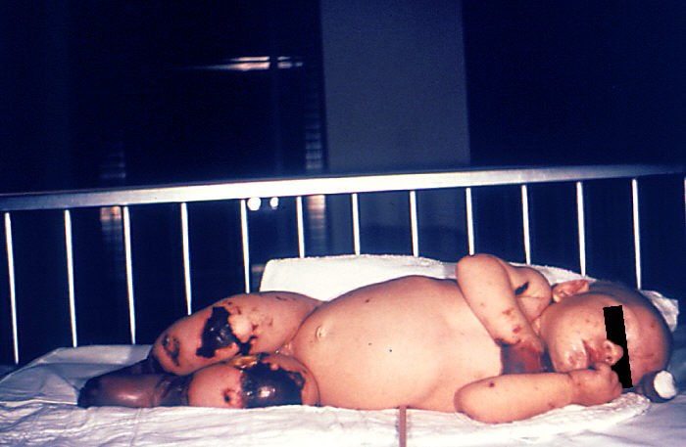
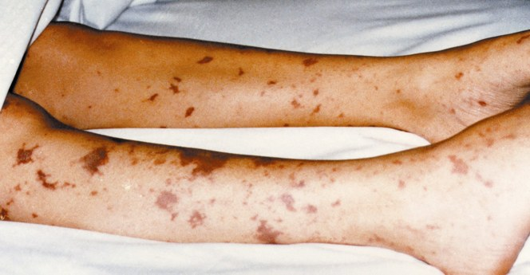
Meningococcal Disease
New 7th Grade School Requirement
Notes:
These very graphic photos show the possible results of a meningococcal infection becoming systemic and then infecting bodily tissues.
The 4 month old on the left has gangrene of the hands and lower extremities due to meningococcemia.
The picture on the right shows similar though not as severe tissue damage in an older child.

Slide 26
Meningococcal Disease
Meningitis
Fever and headache
(flu-like symptoms)
Stiff neck
Nausea
Altered mental status
Seizures
~50% of cases
3%-10% fatality rate
Meningococcemia
Rash
Vascular damage
Disseminated intravascular
coagulation
Multi-organ failure
Shock
Death can occur in 24 hours
~5%-20% of cases
Up to 40% fatality rate
Rosenstein NE, et al. J Infect Dis. 1999;180:1894
Rosenstein NE, et al. NEJM 2001;344:1378
Notes:
Sometimes there is confusion about the difference between meningitis and meningococcemia. Both are caused by the Neisseria meningitidis organism, but can infect different body tissues, thus causing different symptoms and outcomes.
The most common clinical presentations of Meningococcal Disease are meningitis (inflammation of the membranes covering the brain and spinal cord) and meningococcemia (acute infection of the bloodstream and inflammation of the blood vessels.)
Meningitis: Symptoms appear quickly over several days; typically 3-7 days after exposure. In non-fatal cases permanent disabilities can include hearing loss and brain damage.
Fever and headache (flu-like symptoms), Stiff neck, Nausea, Altered mental status, Seizures
~50% of cases
3%-10% fatality rate
Meningococcemia: the bacteria enters the bloodstream and multiply, damaging the walls of the blood vessels and causing bleeding into the skin and organs. Symptoms include:
Rash, Vascular damage, Disseminated intravascular coagulation, Multi-organ failure, Shock, and Death can occur in 24 hours
~5%-20% of cases
Up to 40% fatality rate

Slide 27
Meningococcal Conjugate Vaccine (MCV4)
Menactra™ licensed for 9 months through 55 years
Menveo® licensed for ages 2 through 55 years
ACIP Recommendation:
  One dose at 11 or 12 years of age and a booster dose at 16 years of age
Effective July 1, 2014 children born on or after January 1, 2002 who are attending seventh grade, and children who are new entrants into a Georgia school in grades eight through twelve, must have received one dose of meningococcal conjugate vaccine (MCV4).
Ref. Updated Recommendations for Use of Meningococcal Conjugate Vaccines – Advisory Committee on Immunization Practices (ACIP) MMWR 2011; 60(3);72-76 January 28, 2011
27
Notes:
27
27
27
27
Recommendation for Routine Vaccination of Persons Aged 11 Through 18 Years
After a booster dose of meningococcal conjugate vaccine, antibody titers are higher than after the first dose and are expected to protect adolescents through the period of increased risk through age 21 years. Persons who receive their first dose of meningococcal conjugate vaccine at or after age 16 years do not need a booster dose. Routine vaccination of healthy persons who are not at increased risk for exposure to N. meningitidis is not recommended after age 21 years.
CDC Guidance for Transition to an Adolescent Booster Dose
Some schools, colleges, and universities have policies requiring vaccination against meningococcal disease as a condition of enrollment. For ease of program implementation, persons aged 21 years or younger should have documentation of receipt of a dose of meningococcal conjugate vaccine not more than 5 years before enrollment. If the primary dose was administered before the 16th birthday, a booster dose should be administered before enrollment in college. The booster dose can be administered anytime after the 16th birthday to ensure that the booster is provided. The minimum interval between doses of meningococcal conjugate vaccine is 8 weeks.
Children 9 through 23 months of age with persistent complement component deficiency, who are traveling to or residents of countries where meningococcal disease is hyperendemic or epidemic, and who are in a defined risk group during a community or institutional meningococcal outbreak should receive a 2-dose series of Menactra brand MCV4, 3 months apart. Because of their high risk for invasive pneumococcal disease, children with functional or anatomic asplenia should be vaccinated with MCV4 beginning at age 2 years to avoid interference with the immunologic response to the infant series of pneumococcal conjugate vaccine (PCV). The minimum interval between doses is 8 weeks.
Persons who received the first dose of MCV or MPSV before 7 years of age and remain at increased risk for meningococcal disease should be revaccinated 3 years after the first dose. Persons who received a dose of MCV or MPSV at 7 years of age or older and remain at increased risk for meningococcal disease should be revaccinated 5 years after their previous dose.
No data are available on the interchangeability of vaccine products. Whenever feasible, the same brand of vaccine should be used for all doses of the vaccination series. If vaccination providers do not know or have available the type of vaccine product previously administered, any product should be used to continue or complete the series.
Ref. 1.Upated Recommendations for Use of Meningococcal Conjugate Vaccines – Advisory Committee on Immunization Practices (ACIP) MMWR January 28, 2011 / 60(03);72-76
2. Recommendation of the ACIP for Use of Quadrivalent Meningococcal Conjugate Vaccine (MenACWY-D) Among Children Aged 9 Through 23 Months at Increased Risk for Invasive Meningococcal Disease MMWR; October 14, 2011 / 60(40);1391-1392

Slide 28
20th Century Peak & Current Morbidity for VPDs
Disease | Prevaccine (in peak year) | 2012 | % Reduction of Cases
Diphtheria | 30, 508 | 1 | 99.9
Measles | 763,094 | 55 | 99.9
Mumps | 212,932 | 229 | 99.9
Pertussis | 265,269 | 48,277 | 81.8
Paralytic polio | 63,302 | 0 | 100
Rubella | 488,796 | 9 | 99.9
Tetanus | 601 | 37 | 93.8
Hib, type b (age < 5 yrs.) | 20,000 (yearly average in 1980’s) | 30, plus 210 of unknown type | >99.8
MMWR (Weekly), August 23, 2013, 62(33); 669-682
Notes:
This chart represents the 20th century peak and current morbidity for VPDs:
The 2nd column of this chart shows the number of cases in the peak year of the 20th century (prevaccine) for each of the VPDs listed in the 1st column.
The 3rd column shows the number of cases reported in 2012.
The last column shows the percent reduction in those disease cases after the introduction of vaccine.
You can clearly see the impact vaccines have made. However, pertussis is the only vaccine-preventable disease with increasing case numbers and without a percent reduction < 90%. Pertussis is the only VPD that is on the rise; increasing by 61.2% from 2011 to 2012.
Of the 55 measles cases in 2012, 34 were indigenous and 21 were imported
In 2012, there were 13,447 cases of varicella (chickenpox); 3 deaths from chickenpox
In addition, it has been estimated that vaccination with 7 of the 12 routinely recommended childhood vaccines prevents an estimated 33,000 deaths and 14 million cases of disease in every birth cohort, saves $10 billion in direct costs in each birth cohort, and saves society an additional $33 billion in costs that include disability and lost productivity.*
* Zhou F, Santoli J, Messonnier JL, et al. Economic evaluation of the 7-vaccine routine childhood immunization schedule in the United States, 2001, Archives of Pediatric & Adolescent Medicine, 2005;159(12):1136-1144.

Slide 29
Recommendations vs. Requirements
Recommendations:
  Developed by ACIP
  Basis for :
    Standards for best practice
    School/ Child care requirements
    (Not mandates)
    GRITS Algorithms
Requirements:
  Developed by each state in US
  Based on ACIP Recommendations
  May not include all recommended vaccines
Notes:
Now, let’s cover the difference between “recommendations” and “requirements” as we get into the school and child care requirements for attendance.
Recommendations are:
Developed by the ACIP
The basis for
Standards for best practice
the school and child care requirements (not mandates for states to make them requirements)
the GRITS algorithms or tables and logic
Requirements for school and child care are:
Developed by each state in US
Based on ACIP Recommendations
May not include all recommended vaccines

Slide 30
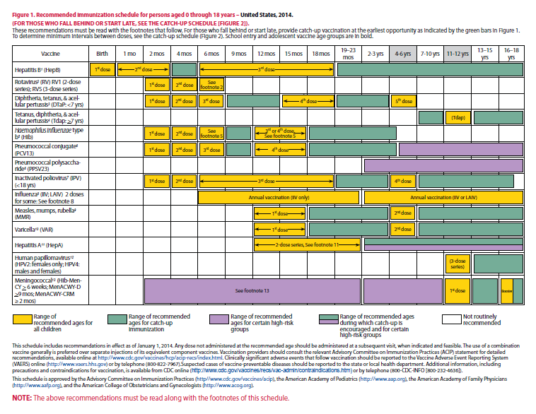
2014 Immunization Schedules
Children
0-18 years/Catch-Up schedule for children 4 months -18 years
Be sure to review the “Notes” section – many changes
Notes:
30
30
School and child care requirements are based on ACIP routinely recommended vaccines for children. The schedule is released annually, normally at the end January.

Slide 31
Vaccine Requirements
Consistent with the Recommended Childhood and Adolescent Immunization Schedule
Children are required to be age appropriately immunized against each of these diseases:
Hepatitis B Polio
Diphtheria* Measles
Tetanus* Mumps
Pertussis* Rubella
Haemophilus Influenzae type b Hepatitis A
Varicella (chicken pox) Pneumococcal disease
Meningococcal disease*
*Effective July 1, 2014 requirement for Tdap and MCV4 for 7th grade, born 1-1-2002 and new entrants 8th through 12th grade
Notes:
Vaccine requirements are consistent with the recommended childhood and adolescent immunization schedule; children are required to be age appropriately immunized against each of the listed diseases.
On the Rules & Regulations under —Official Immunization Schedules, bullet #1 states that an immunization regimen equivalent with the current Immunization Schedule developed by the Advisory Committee on Immunization Practices (ACIP), the American Academy of Pediatrics (AAP), and the American Academy of Family Physicians (AAFP) shall be deemed the minimum regimen of immunization. So our vaccine requirements are consistent with the current schedule
This means that for children to enter a Georgia School for the first time and to attend child care facilities, they are required to be age appropriately immunized against each of the diseases stated in the DPH Rules and Regulations, Section 290-5-4-.02

Slide 32
Strongly Recommended Vaccines
Rotavirus
-RotaTeq: 3 doses; ages 2,4,6 months
-Rotarix: 2 doses; ages 2 and 4 months
HPV
-Gardasil: 3 doses; 0, 2, and 6 months
(male and females)
-Cervarix: 3 doses; 0, 2, and 6 months
(females only)
Influenza
-Recommended for all people age 6 months and older.
-Children aged 6 months through 8 years who receive
influenza vaccine for the first time require 2 doses, administered 4 weeks apart.
Notes:
This is a list of vaccines that are not required for school attendance, but are strongly recommended.
The routine use of Rotavirus vaccine has resulted in a dramatic decrease in hospitalizations for the management of dehydration. In the developing world the use of the vaccine has dramatically reduced deaths from rotavirus infection.
Rotateq® (Merck & Co) is a live, oral pentavalent vaccine that contains of 5 live reassortant rotaviruses. (G1, G2, G3 and G4.) It is referred to as RV5 rotavirus vaccine.
Ref: Rotateq® Prescribing Information December 2009
Rotarix® (GSK) is a live, oral, monovalent attenuated rotavirus vaccine. It is referred to as RV1 rotavirus vaccine. ACIP does not express a preference for RV5 or RV1.
Gardasil® (HPV4) from Merck is a quadrivalent HPV vaccine, licensed 6-8-06 for females ages 9 through 26 years and in October 2009 the ACIP issued a permissive provisional recommendation for this 3-dose vaccine series to be administered to males aged 9-18 years at their pre-adolescent visit to their healthcare provider to reduce their likelihood of acquiring genital warts.
Routine recommendations: 11-12 yrs. of age with catch-up for 13-26 year olds. The vaccination series can be started beginning at age 9 years.
Prevents infection from 4 serotypes:
HPV types 6,11,16,18
Types 6 and 11 cause 70% of cervical cancer
Together these 4 serotypes cause 90% of genital warts
Cervarix ® (HPV2) is a bivalent vaccine licensed for females ages 9 through 26 years.
Prevents infection from 2 serotypes:
HPV types 16,18
Routine annual influenza vaccination is recommended for all persons aged ≥6 months. To permit time for production of protective antibody levels (4,5), vaccination optimally should occur before onset of influenza activity in the community. Therefore, vaccination providers should offer vaccination as soon as vaccine is available. Vaccination should be offered throughout the influenza season (i.e., as long as influenza viruses are circulating in the community).

Slide 33
Goal
Vaccines work
Goal 100 % compliance rate
Immunization Laws work
Partnerships work
Notes:
Why do we periodically change the Immunization rules and regulations?
As illustrated in the previous slides, vaccines do work. New vaccines are being developed and recommendations for existing vaccines are being expanded. As these new vaccines become routinely recommended for children and adolescents who attend school and child care by the ACIP, AAP and AAFP we incorporate these recommendations into our school requirements . If we can adequately immunize our children and maintain high coverage levels, then the incidence of these vaccine preventable diseases will remain low. Our goal is to have 100% of all children attending child care and schools appropriately immunized for their age with all the recommended and required vaccinations,
Also immunization laws work! Laws requiring vaccination of school age children have been established for over thirty years. Laws requiring vaccination of infants and children attending child care facilities have been in existence for the past twenty years. These laws were established as a means to ensure that infants and children are adequately vaccinated and that high levels of immunization are maintained in all communities throughout Georgia.
These legal requirements have resulted in the need for partnerships to be developed between health care providers, parents, child care facilities, and schools. Each partner has specific responsibilities and plays an important role in ensuring that Georgia’s children are adequately protected from vaccine preventable diseases. As a result of the collaborative efforts of each partner, immunization rates are maintained and the incidence of disease remains low.
So, partnerships work! Counting on you to help us continue to keep our coverage levels high and incidence of VPDs low!

Slide 34
DPH Rules and Regulations
Provide definition of terms
Stipulate the specific requirements
  List required vaccines or
  Acceptable proof of immunity
  Define medical and religious exemptions
Provide directions for issuing, maintaining, and inspecting certificates
GA Rules and Regulations updated for the 2014-2015 school year to reflect the new school requirements. (511-2-2)
Notes:
DPH Rules and Regulations were updated for the 2014-2015 school year to reflect the new school requirements.
(511-2-2)
The DPH rules and regulations provide the details of those requirements by:
Defining terms for facility, school, and certificate of immunization
Define “Facility” is defined as any public or private day center or nursery intended for the care, supervision, or instruction of children
“School” is defined as any public or private educational program or institution instructing children at any level or levels, kindergarten through twelfth grade, or children of ages five through nineteen if grade divisions are not used
Certificate of Immunization is a certification by a physician licensed under GA law, advanced practice registered nurse or physician assistant or qualified employee of a local Board of Health or the State Immunization Program , on a form provided by the DPH that the named person has been immunized in accordance with the R&R of DPH- Requirement for Certificate of Immunization as means of documentation was mandated in 1981
Determining the specific requirements for immunization based on an immunization regimen equivalent to the current immunization schedule developed by the ACIP and adopted by DPH.
State which immunizations are required
Provide acceptable means for documentation of immunity and for medical exemption and religious exemption
Providing directions for issuing, maintaining, and inspecting certificates

Slide 35
Georgia Requirements
Georgia law requires that all children attending a facility or school must be immunized according to the rules and regulations established by the Department of Public Health (DPH)
“Facility” is defined as any public or private child care center or nursery intended for the care, supervision, or instruction of children
“School” is defined as any public or private educational program or institution instructing children at any level or levels, kindergarten through twelfth grade
“New entrant” means any child entering any school or facility in GA for the 1st time or entering after having been absent from a GA school or facility for >12 mos. or 1 school year.
Notes:
Let’s take a few minutes to review highlights of the Georgia requirements for children to attend day care and enter school.
Georgia law requires that all children attending a facility or school must be immunized according to the rules and regulations established by the Department of Public Health (DPH). These rules were most recently revised in early 2007 and will be discussed in the next few slides.
“Facility” is defined as any public or private child care center or nursery intended for the care, supervision, or instruction of children. This would include Pre-K programs, regardless of their physical location.
“School” is defined as any public or private educational program or institution instructing children at any level or levels, kindergarten through twelfth grade, or children ages five through nineteen if grade divisions are not used.
“New entrant” means any child entering any school or facility in GA for the 1st time or entering after having been absent from a GA school or facility for >12 mos. or 1 school year

Slide 36
New Requirements
Effective July 1, 2014—
All Children born on or after January 1, 2002 who are attending seventh grade, and children who are new entrants into a Georgia school in grades eight through twelve, must have received one dose of Tdap vaccine and one dose of meningococcal conjugate vaccine.
Notes:
The new requirements will take effect July 1, 2014 for the 2014-2015 academic year. Children born on or after January 1, 2002 who are attending seventh grade, and children who are new entrants into a Georgia school in grades eight through twelve, must have received one dose of Tdap vaccine and one dose of meningococcal conjugate vaccine.
All new entrants transferring into the 8th through 12th grades are also subject to the new requirements.

Slide 37
Tdap Requirement
Meets the Requirement | Vaccine | When given?
Yes, meets the requirement | Tdap (Adacel, Boostrix) | Given on or after the 7th birthday
Yes, meets the requirement | DTaP (TriHiBit, Pediarix, Daptacel, Infanrix, Tripedia Pentacel, Kinrix | In adolescents (aged 11-18 years) who inadvertently receive a pediatric DTaP, that dose should be considered the adolescent Tdap and does meet the 7th grade requirement
No, does not meet requirement | Tdap (Adacel, Boostrix) | Given before the 7th birthday
No, does not meet requirement | Td; DT; DTaP or DTP given before the 7th birthday; History of pertussis disease; results of blood tests for immunity to pertussis
Notes:
This next slide displays a chart taken from the Q&A guide developed as a resource for school and public health nurses. The chart provides a quick look at which vaccines meet the requirement and at what age vaccines administered meet the requirement:
So, A dose of Tdap either (Adacel or Boostrix) given on or after the 7th birthday, will meet the requirement.
A dose of DTaP or DTP inadvertently given at age 11 years or older, will meet the requirement, but these vaccines are not licensed for use or recommended for children 7 years of age or older; this would be considered off-label use.
(The pediatric formulations usually have 3-5 times as much of the diphtheria component than what is in the adult formulation. This is indicated by an upper-case "D" for the pediatric formulation (i.e., DTaP, DT) and a lower case "d" for the adult formulation (Tdap, Td). The amount of tetanus toxoid in each of the products is equivalent, so it remains an upper-case "T.“)
A dose of Tdap either (Adacel or Boostrix) given before the 7th birthday, does not meet the requirement.
And finally, Td; DT; DTaP or DTP given before the 7th birthday, a History of pertussis disease, results of blood test for immunity to pertussis, does not meet the requirement.
Again, it is recommended that you always follow ACIP recommended minimum age and intervals when administering vaccines.
Extra Notes:
• Tdap given to a child younger than age 7 years as either dose 1, 2, or 3, is NOT valid. Repeat with DTaP as soon as feasible.
• Tdap given to a child younger than age 7 years as either dose 4 or 5 can be counted as valid for DTaP dose 4 or 5.
• DTaP given to patients age 7 or older can be counted as valid for the one-time Tdap dose.

Slide 38
MCV4 Requirement
Meets the Requirement | Vaccine | When given?
YES, meets the requirement | MCV4 (Menactra, Menveo) | Given on or after the 10th birthday
NO, does not meet requirement | MCV4 (Menactra, Menveo) | Given before the 10th birthday
NO, does not meet requirement | MPSV4 (Menomune)
NO, does not meet requirement | History of meningitis; Results of blood tests for immunity to meningitis
Notes:
This chart also taken from the guide provides a glance at what Meningococcal vaccines meet the requirement and at what age the vaccine administered meet the requirement:
MCV4 administered before the 10th birthday, does not fulfill the requirement, even if given immediately before the 10th birthday.
The student should receive another meningococcal conjugate vaccination after the 10th birthday to fulfill the requirement.
A dose of (polysaccharide) MPSV4; does not meet the requirement.
And finally, history of meningitis, results of blood tests for immunity to meningitis are not reliable and will not meet the school requirement.

Slide 39
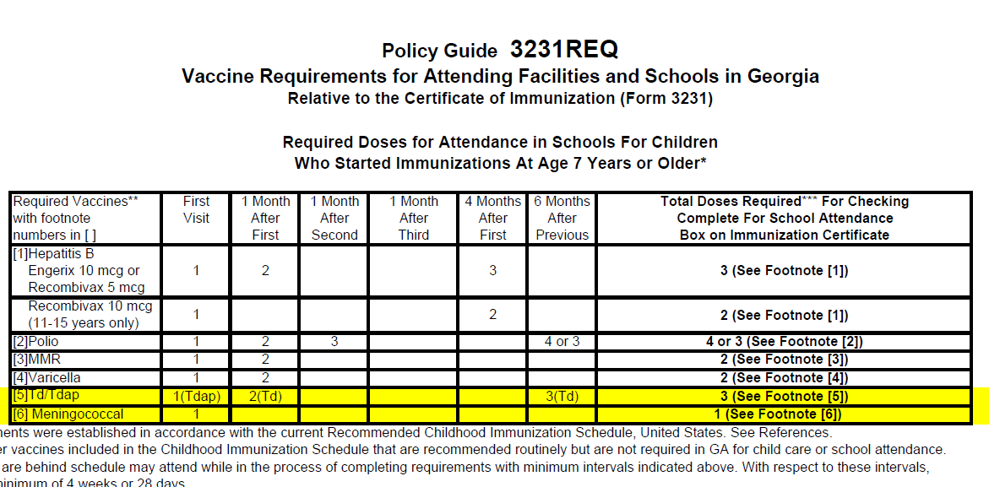
3231 REQ
Notes:
The first document we will review is the Policy Guide 3231 REQ
The 3231 REQ highlights those “Vaccine Requirements for Attending Facilities and Schools in Georgia “; This guide is relative to the certificate of Immunization (form 3231) and was established in accordance with the current Recommended Childhood and Catch-up Immunization Schedules.
The guide is helpful for those school and public health nurses trained to perform assessments and also valuable for providers to understand what vaccines are required for child care and school attendance when immunizing and scheduling patients for future appointments:
The REQ has two sides; On side 1, the table relates to children who started receiving their vaccines prior to age 7 years and side 2 relates only to those children who start their immunizations at age 7 years or older.
So for the purpose of the new school requirements, we will review the changes to Side 2 ****New Requirements
If you look at footnote #5 the language has been updated to include
5) One dose of Tdap is required for 7th grade; Tdap can be administered regardless of the interval since the last Td. If a primary series is indicated, one dose preferably the first dose, should be Tdap. A dose of Tdap given on or after the 7th birthday meets school requirement. The number of doses of Td/Tdap depends on age at first dose and number of previous doses. You would refer to the current ACIP Catch-up Schedule when administering vaccines.
And for footnote #6 the update includes
6) One dose of MCV4 is required for 7th grade; administer MCV4 vaccine routinely at age 11-12 years. A dose of MCV4 given on or after the 10th birthday meets school requirement.
This document can be found on the GA State Immunization Website: http://dph.georgia.gov/schools-and-childcare

Slide 40
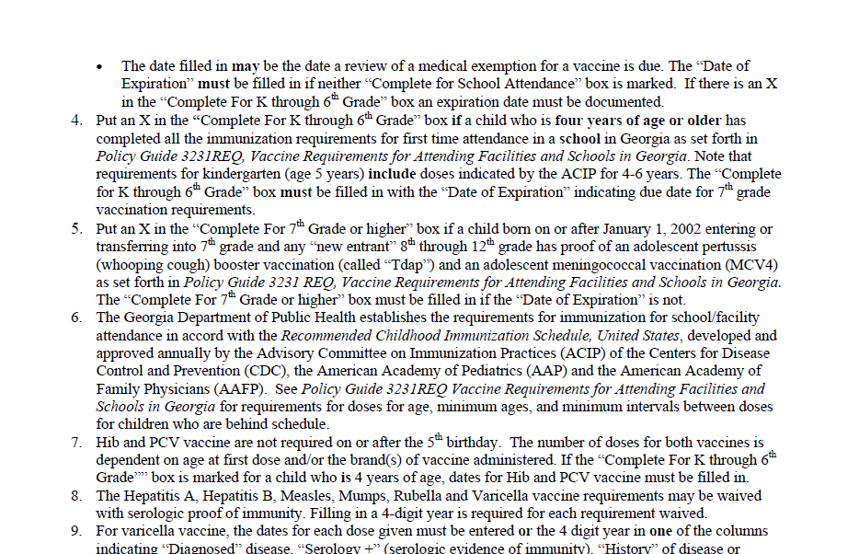
3231 INS
Notes:
The next form is the Policy Guide 3231INS which is the “Standards for Issuing and Filing Certificates of Immunization”
You have the responsibility of knowing and enforcing the immunization requirements as outlined in the Policy Guide 3231INS.
The 3231INS provides instructions on who is required to have the certificate of Immunizations (form 3231), who may issue a certificate, how to file and maintain certificates, instructions for completing certificates, and guidelines for the two recognized GA state immunization exemptions.
Basically, the 3231 INS instructions were updated based on the new requirements, we will review those physical changes to Immunization certificate in the next couple of slides.

Slide 41
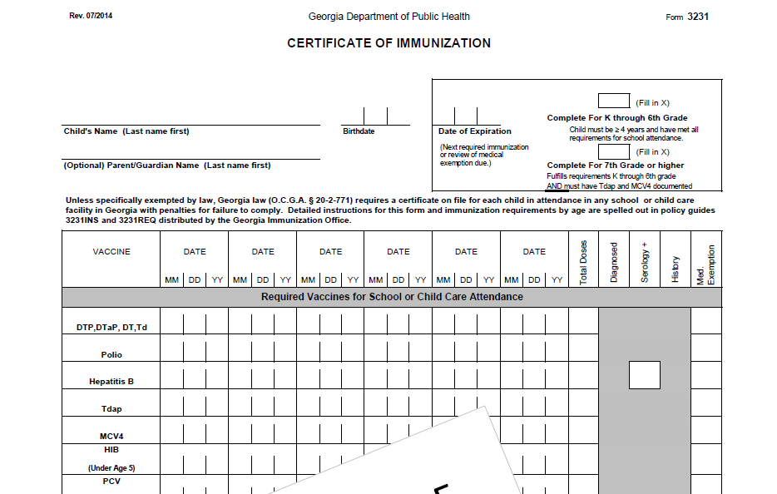
Form 3231
Notes:
This is a screen shot of how the Immunization certificate will appear as of July 1, 2014. This top portion of the form has several areas that have been updated.
First we will look at the two boxes in the right upper corner; the top box is labeled “Complete For K through 6th Grade” and the bottom box is “Complete for 7th Grade or higher”. So the instructions on how these two boxes are completed will be outlined on the 3231 INS.
Next, if you look at the arrow;
-”Td” has been added to the first line with the DTP, DTaP, DT section; Td will be designated with a (++) symbol and the Td explanation text will appear in the bottom left corner of the form when printed
-”Polio” is now on one line; no separate line for “IPV”/”OPV”; OPV is designated with (^^) symbol, the polio explanation text “**unspecified polio dose/OPV dose appears in the bottom left corner of the form when printed
-The next two changes are for “Tdap” and “MCV4”; they will be listed on their own separate lines; MCV4 row was moved up to the required section; only Menactra, Menveo and MCV4 unspecified doses will display; Menomune and Meningo unspecified do not display

Slide 42
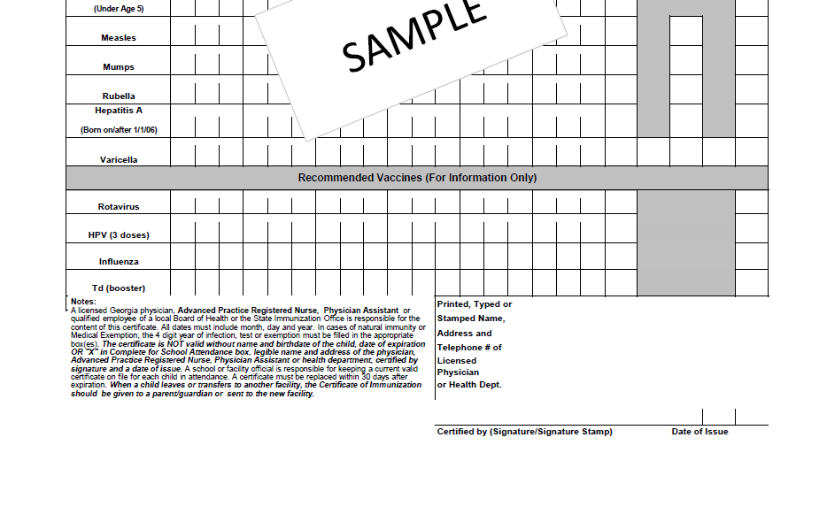
Form 3231
Notes:
The bottom section of the new certificate documents those recommended vaccines you may also administer, but at this time are not required for school.
Key Changes to the recommended section include:
HPV has been renamed to HPV(3 doses); it is our hope that this simple change will be a reminder trigger for providers as well as parents to complete the HPV series
Booster doses of Td will also be listed here after the primary series is complete
And finally, the certified by line reads “Signature/Signature stamp”.

Slide 43
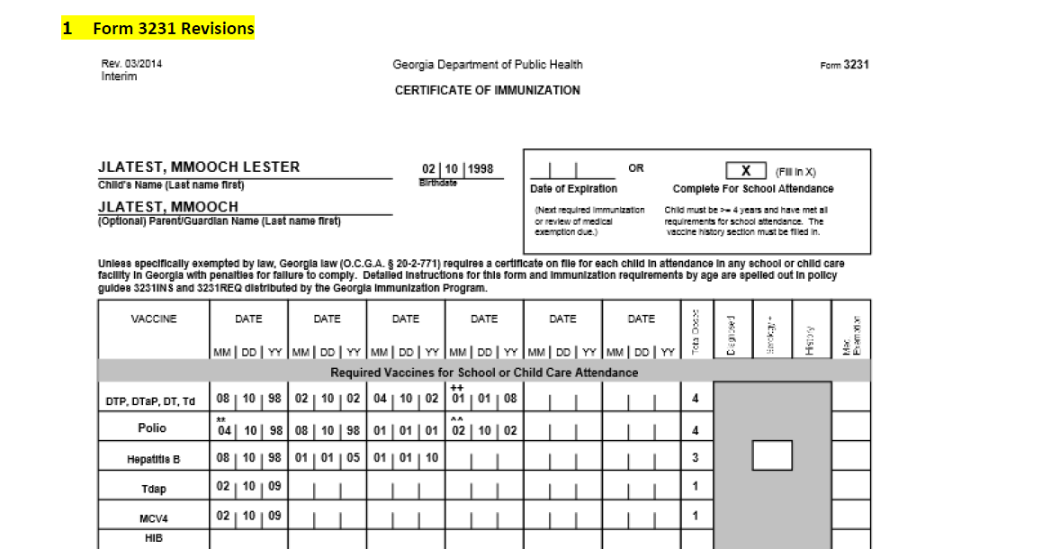
Interim 3231/March 2014
Notes:
The Immunization Office has been working very hard with the GRITS team to ensure that all of the data logic and algorithms in GRITS have been tested based on the new school requirements.
The final version of the certificate will be ready for implementation on July 1, 2014, but until then, the State Office created an interim 3231 certificate to capture those students who receive vaccines prior to the go-live date. This certificate will be dated March 2014 and will be only generated from GRITS.
***This interim solution will display the word “interim” at the top left corner of the page and will display all the other physical changes as the final version of the 3231 certificate. Please note that once a child completes the requirements for K-6th grade, the GRITS generated certificate will place an “X” in the box; the provider will need to flag those certificates so that their record is reviewed to complete the Tdap and MCV4 dose for 7th Grade, an expiration date will need to be indicated for those children. Therefore, there will be an “x” and an “expiration date” during this “interim” period of transition. Once the final version is put in place, these records will not have to be replaced unless the provider and/or school official wants to update the child’s file with the new certificate.

Slide 44
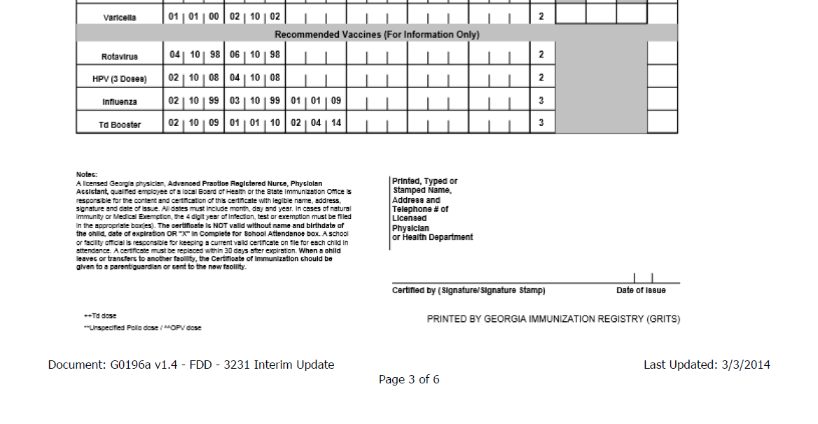
Interim 3231/March 2014
Notes:
This image is the bottom portion of the “interim” 3231
Once all testing is complete, the final version of the certificate will be available. As of Tuesday of this week, providers were notified of instructions for updating their electronic medical records systems to capture the 3231 updates.
Again, The interim certificate will only be printed from GRITS.

Slide 45
Certificate of Immunization
(Form 3231)
A child must have a certificate on file at each facility or school he attends
Photocopies of appropriately completed and signed certificates are acceptable
If a certificate is not on file for each child attending, the facility is held legally responsible
A licensed Georgia physician, APRN, PA or public health official is responsible for the interpretation of and compliance with the requirements for vaccines and completing the certificate
Only physician offices and health clinics can obtain blank certificates
Notes:
Certificate of Immunization (Form 3231)
(Refer to Policy Guide 3231 INS)
Again these details for completing certificates are outlined in the policy Guide 3231INS: Section 3 “How to file and maintain certificates” and Section 4, “Instructions for completing certificates”:
*A child must have a certificate on file at each facility or school he attends. For example, if a child is enrolled in school and attends a child care facility after school, he must have a certificate on file at each facility.
Photocopies of appropriately completed and signed certificates are acceptable.
If a certificate is not on file for each child attending, the facility is held legally responsible.
A licensed Georgia physician, APRN, PA or public health official is responsible for the interpretation of and compliance with the requirements for vaccines and completing the certificate. (See both policy guides: 3231 REQ addresses the number of doses and 3231 INS addresses the completion of certificates.)
*This means that only physician offices and health clinics can obtain blank certificates.

Slide 46
X “Marks the Spot”
If child is under four years of age, a certificate:
  Must be marked with a “Date of Expiration”
  Must have vaccine administration dates, year of disease diagnosis, positive serology, disease history, or medical exemption
If child is over four years of age, a certificate must be completed with:
  Vaccine administration dates, year of disease diagnosis, positive serology, disease history, or medical exemption; and
  A mark in the “Complete for K-6th Grade“ box along with a “Date of Expiration”; or
  A mark in the “Complete for 7th Grade or higher” box if all required vaccines for school attendance have been documented
Notes:
When completing and/or evaluating a certificate, what standards should be used?
The age of a child determines how a certificate should be completed and what you should review for validity.
If child is under four years of age, a certificate
Must be marked with a “Date of Expiration”. This provides an opportunity to ensure that preschool children are immunized according to the current childhood immunization schedule recommendations, including Hib, hepatitis A, and pneumococcal vaccine.
Must have vaccine administration dates, year of diagnosis, positive serology, disease history, or medical exemption
If over four years of age must be completed with:
Vaccine administration dates;
The dates of vaccine administration must be filled in with month/day/year and/or a year in the disease diagnosis, positive serology, disease history, or medical exemption boxes as indicated.
You will note that the blacked out boxes should not be completed with dates. Immunity or medical exemption may be marked only in those boxes for which that specific criteria is acceptable. For example, only a date of positive serology or medical exemption is acceptable in lieu of a vaccine administration date for hepatitis B, measles, mumps, rubella, hepatitis A, or varicella.
The categories for physician’s diagnosis or history of disease apply to varicella only.
and
A “Date of Expiration”; or
A mark in the “Complete for School Attendance “box

Slide 47
Certificate Expiration Date
Expires on the date entered as “Expiration Date”
Must be replaced with a current certificate within 30 days after the expiration date, or child is excluded from attending
Allows for a child who does not meet all the immunization requirements to attend child care or school while he is catching up
Required for all children four years and older who have not completed vaccine requirement for 7th grade
Required if a medical exemption for a vaccine(s) is marked
Should not be completed if “Complete for 7th Grade or higher” is marked
Notes:
The date of expiration is further explained in the 3rd section of Policy Guide 3231INS. An expiration date on the certificate:
Expires on the date entered as “Expiration Date”
The certificate must be replaced within 30 days after the “Expiration Date” or the child must be excluded from attending.
Allows a child who does not meet all the immunization requirements to attend child care or school while he is catching up. This is indicated on the certificate by marking a new expiration date each time the child gets a vaccine until all the requirements for school entry are met.
And, as explained earlier is:
Required for all children under four years of age
Required if a medical exemption for a vaccine(s) is marked
Should not be completed if “Complete for School” is marked

Slide 48
“Complete for School Attendance”
Do not expire
May be issued only to children who:
  Are four years of age or older; and
  Have met all the requirements for school attendance as outlined in the Policy Guide 3231REQ; and
  Have all the required vaccine administration dates or natural immunity dates filled in; and
  Do not have a “Date of Expiration” completed
Notes:
The criteria for certificates marked “Complete for School Attendance” are explained in the 3rd section of Policy Guide 3231INS, “How to File and Maintain the Certificates.” To summarize, the standards state that the certificates marked as “Complete for School Attendance”:
Do not expire
May be issued only to children who:
Are four years of age or older (This would apply to children who are four years of age, attending a Pre-K program, and have completed all vaccines required for school entry, including those required for child care attendance such as Hib, Hepatitis A and pneumococcal vaccine); and
-Have met all the requirements for school attendance as outlined in the Policy Guide 3231REQ (“Vaccine Requirements for Attending Facilities and Schools”); and
Have completed all the required vaccine administration dates, or natural immunity dates. The health care provider is responsible for accurately completing this information.
-Do not have a “Date of Expiration” indicated on the same certificate
Let’s review the criteria for documenting natural immunity and medical exemption as outlined in Section 5, number 1.

Slide 49
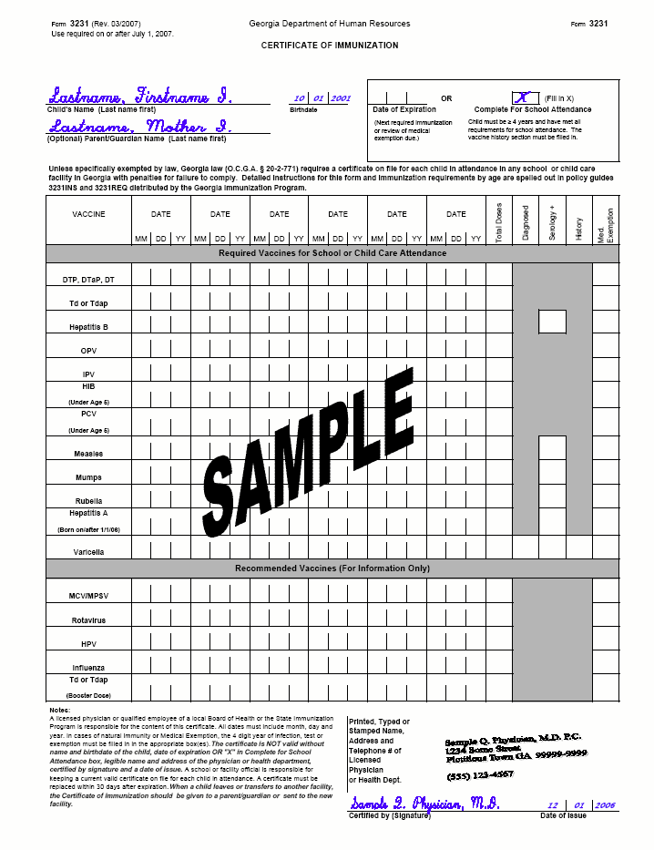
Immunity and Medical Exemptions
Medical Exemption
Serology
Diagnosed
History
Notes:
There have been no additional changes for documenting diagnosed disease, serology, disease history or medical exemptions.
Immunity may be marked only for those boxes for which that specific criteria is indicated. You will note that the blacked out boxes should not be completed with dates. Many of you who have computer generated certificates may have to hand-write this information in. For example:
A date of positive serology is acceptable in lieu of a vaccine administration date for hepatitis B, measles, mumps, rubella, hepatitis A, or varicella
The categories for physician’s diagnosis or history of disease apply to varicella only
Varicella disease history is defined in #8 of section four in the Policy Guide 3231INS as a health care provider’s interpretation that a parent/guardian description of chickenpox disease history is indicative of past infection; filling in a 4-digit year for the year of infection is required.
If the parent/guardian description of the chickenpox disease history is not clear, or there is any question that the child had the disease, the ACIP recommendation is to vaccinate.
Georgia law provides for two exemptions: Medical and Religious
Medical: medical exemptions should be documented on the 3231 in the last column. Lets discuss exemptions in a little more detail

Slide 50
Exemptions
Medical:
  Should be used only when there is a physical disability or condition that contraindicates immunization for that specific vaccine
  Should be documented in the medical exemption box indicated for each vaccine
  Should be reviewed annually
Notes:
As a quick review and also for those providers who may be new to immunizations, the Official Code of Georgia provides for only two types of exemptions from immunization requirements. Section 5 of the 3231 INS, Standards for Issuing and Filing Certificates of Immunization outlines the standards for “Exemptions:” The first exemption is medical which
Should be used only when there is a condition that contraindicates the administration of a required vaccine
Should be documented in the medical exemption box indicated for each vaccine
Should be reviewed annually and the certificate must be reissued with or without indication of exemption
O.C.G.A. § 20-2-771 (d)

Slide 51
Exemptions
Religious:
  Not documented on the certificate
  No special certificate available or needed
  Documented by a notarized affidavit stating that immunization conflicts with the parent/guardian’s religious belief
  Notarized statement should be kept on file by the school or facility in lieu of a Certificate of Immunization
  Do not expire
Notes:
The next exemption covered in Section 5 of the 3231 INS Standards for Issuing and Filing Certificates of Immunization is Religious which is:
Not documented on the certificate
There is not a special certificate available or needed to document religious exemption.
Documented by a notarized affidavit stating that immunization conflicts with the parent/guardian’s religious belief
Notarized statement should be kept on file by the school or facility in lieu of a Certificate of Immunization
Do not expire
Under both exemptions, in the event of an outbreak, the law states that a child must be excluded from attending child care or school until protected by immunization or natural immunity or all danger is passed.
O.C.G.A. § 20-2-771 (e)

Slide 52
Responsibilities
Physicians and Public Health Clinics:
  Know current legal requirements for attendance and accurately completing the certificate
  Administering immunizations according to the current Recommended Childhood and Adolescent Immunization Schedule
  Report the occurrence of any disease listed on the “Notifiable Disease List”
  Report any adverse event following the administration of a vaccine to VAERS
Child Care and School :
  Review the certificates for validity prior to accepting
  Develop a system for immunization certificate management/Tickler system
  Have certificates available for inspection and audit by health officials
  Report the occurrence of any disease listed on the “Notifiable Disease List”
Notes:
Let’s discuss some of the responsibilities of health care providers and day care facilities and schools that are required by the Rules and Regulations.
Physicians and Public Health Clinics:
Knowing the current legal immunization requirements for attendance and accurately completing the certificate. We will discuss these today. To assist with this discussion, we will be using the 3231REQ, which has charts showing the requirements.
Administering immunizations according to the current Recommended Childhood and Adolescent Immunization Schedule. You will see from today’s discussion, that basically if you follow this schedule, your patients will meet the requirements for child care and school attendance. In addition you will be following the standards for “best practice” outlined in the “Standards for Pediatric Immunization Practice” which are published by the US Public Health Service and endorsed by the AAP.
Reporting the occurrence of any disease listed on the “Notifiable Disease List”
Reporting any adverse event that occurs following the administration of any of the recommended childhood vaccines to the Vaccine Adverse Event Reporting System (VAERS). This reporting will help determine if there is a problem with a particular vaccine as well as help maintain our credibility.
Child Care and Schools:
Principals and child care facility directors are held legally liable for enforcing the requirements.
Review the certificates for validity prior to accepting.
Develop a system for immunization certificate management. Keep certificates files current. Send notices home to parents for certificates that are going to expire within the next month. If it is 30 days or more after a certificate has expired, exclude the child from school or child care.
Have certificates available for inspection and audit by health officials. The document that can help outline this is the 3231INS, or Standards for Issuing and Filing Certificates.
Report the occurrence of any disease listed on the “Notifiable Disease List.”

Slide 53
Responsibilities
Parents
-Take child to health care provider well check ups and immunizations at the recommended times
-Review all vaccine facts that they receive before their child is immunized
-Discuss any questions or concerns about vaccines with the child’s doctor or nurse
-Keep child’s personal immunization record and take it with them on each visit to the health care provider to be assessed and updated
-Mark the child’s vaccination due date and stay on schedule
Obtain appropriate certificate for child care and school attendance from health care provider
-Give a copy of the certificate to each facility the child attends
Notes:
All of these legal requirements have resulted in the need for collaborative partnerships between parents, child care facilities, schools, and health care providers. Let’s now look at specific responsibilities of each partner as they relate to the implementation and enforcement of the requirements.
The Responsibilities of Parents or Caregivers are:
Take child to health care provider for well check ups and immunizations at the recommended times
Review all vaccine facts that they receive before their child is immunized
Discuss any questions or concerns about vaccines with the child’s doctor or nurse
Keep child’s personal immunization record and take it with them on each visit to the health care provider to be assessed and updated.
Mark the date that a child’s vaccination is due and stay on schedule
Obtain certificate for child care and school attendance from health care provider
Give a copy of the certificates to each facility the child attends

Slide 54
Child Care Vaccine Requirements
The number of doses for each required vaccine depends on the child’s age at the time of child care attendance.
  If under 4 years of age, child will always need more doses and Certificate of Immunization should have a current “Expiration Date” indicated.
  If 4 years or older, and has met all requirements for school entry, the Certificate of Immunization is marked as “Complete for K through 6th Grade,” with a “Date of Expiration” indicated for 7th Grade vaccination requirements.
Notes:
In regards to the vaccine dose requirements for day care:
A child attending day care be age appropriately immunized with all the required vaccines while he attends. This is not new.
The number of doses for each vaccine depends on the child’s age at the time of day care attendance.

Slide 55
School Vaccine Requirements
A “new entrant” enrolling in a Georgia school at any grade or level, must be age appropriately immunized with all the required vaccines.
The number of doses for each vaccine depends on the child’s age at the time of school entry
Once enrolled and a “Complete for 7th Grade or higher ” certificate is on file, further immunizations may be recommended but are not required.
  Exception: Check for one dose of Tdap and one dose of MCV4 at entry into 7th grade for those students born on or after 1-1-2002 and all “new entrants” 8th through 12th grades
  Also double check for 2 doses of measles, mumps, and varicella or immunity status
Notes:
New Vaccine Dose Requirements
A new entrant enrolling in a GA school at any grade or level, must be age appropriately immunized with all required vaccines. (i.e. this could be at kindergarten or 12th grade).
Remember the new definition of “1st time entrant” or “new entrant” is any child entering for the 1st time, or after having been absent from a Georgia school or facility for more than 12 months or one school year. GRITS does not document “New Entrant”
The number of doses for each vaccine now depends on the child’s age at the time of school attendance.
Each dose of all the required vaccines or the immunity status for each must be documented on the certificate.

Slide 56
School Immunization Assessments
New school requirements on or after 7-1-14:
  Children entering kindergarten, 7th grade and all “new entrants”, must adhere to new school requirements based on the revised rules and regulations.
  Students K-6 that have a Form 3231 that is marked as “Complete for School Attendance” must obtain a new 3231 prior to 7th grade reflecting all new required vaccines.
  Children who have certificates that will expire after 7-1-14 are considered to be current until the “Date of Expiration”. They should obtain a new 3231.
  Children in 7th grade or higher born prior to January 1, 2002 and have a “Complete for School” certificate on file, do not need to obtain a revised certificate.
Notes:
On or after 7-1-14:
For children entering kindergarten, 7th grade and all “new entrants”, base on the revised rules and regulations.
New school requirements on or after 7-1-14:
Children entering kindergarten, 7th grade and all “new entrants”, must adhere to new school requirements based on the revised rules and regulations.
Students K-6 that have a Form 3231 that is marked as “Complete for School Attendance” must obtain a new 3231 prior to 7th grade reflecting all new required vaccines.
Children who have certificates that will expire after 7-1-14 are considered to be current until the “Date of Expiration”. They should obtain a new 3231.
Children in 7th grade or higher born prior to January 1, 2002 and have a “Complete for School” certificate on file, do not need to obtain a revised certificate.

Slide 57
Immunization Assessments
The following information is recorded during the immunization assessment:
    Number of children enrolled
    Number of children who have valid current certificates
    Number of children with expired certificates
    Number of children with current 30-day waivers
    Number of children with religious exemptions
    Number of children with medical exemptions
    Number of children with certificates marked “complete” but missing required doses
    Number of children with no documentation on file
Notes:
Optional for Health Care provider presentation
When assessments are performed, the health department or state immunization program representative is checking for the following information. By assessing the information obtained, public health is able to evaluate the levels of immunization coverage for children enrolled in day care and schools. If you have maintained your records as recommended and outlined in the policy guide 3231 INS or Form 3258, you will find that this is not a dreaded task, but a time to validate that a high rate of your children are protected against the vaccine preventable diseases:
-What is the total number of children enrolled?
-How many children have valid certificates (certificates with current expiration dates)
For a child care facility, how many children have a certificate marked with a current “Date of Expiration”? (Dates in future or < 30 days expired)
For child care/ school facilities , how many children (should be 4 yrs of age and older) have certificates marked as “Complete for School Attendance”?
How many children have certificates with expired “Date of Expiration”?
How many children have certificates certified as “Complete” but have required missing doses?
How many children have been enrolled in the day care or school less than the allowed waiver time period? (Thirty days)
How many children have nothing on file and are not within the waiver period?
How many children have religious exemptions?
How many children have medical exemptions?
Certificates should also be marked with a current “Date of Expiration” (within 12 months of the date of issue)

Slide 58
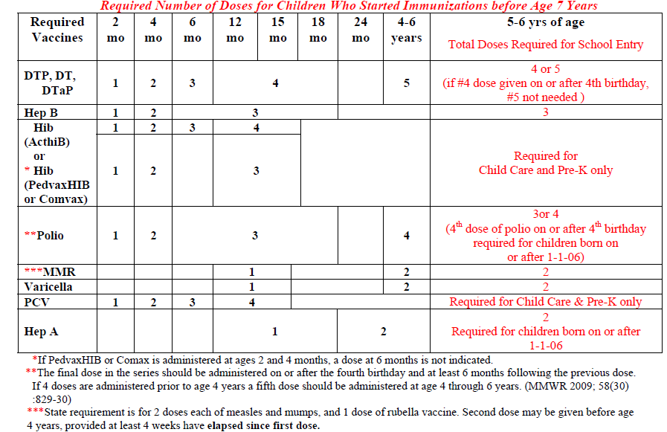
Required Number of Doses For Children Who Started Immunizations Before Age 7 Years
Notes:
This slide is a screen shot of the Summary of Georgia Immunizations for childcare and school attendance.
The top portion is indicates the required number of doses for children who started immunizations before age 7 years.

Slide 59
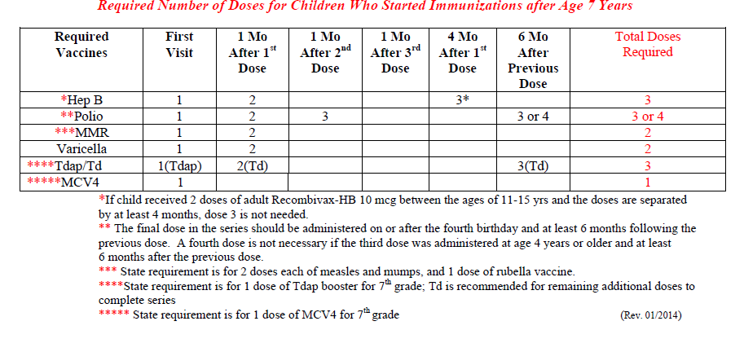
Required Number of Doses For Children Who Started
Immunizations After Age 7 Years
Notes:
The bottom portion indicates the required number of doses for children who started immunizations after age 7 years.

Slide 60
Top Ten Certificate “Bloopers”
3: Completing both boxes: When all requirements have not been met
10: “Complete for School” checked for child under age 4
9: No dose DTaP after 4th birthday
2: Doses Hep B spaced incorrectly
7: 1st dose MMR given before age 1 yr.
5: Varicella Immunity not documented by vaccine or hx/dx/serology date
6: 1st dose varicella given before age 1 yr.
8: No 2nd dose varicella documented
4: Address and/or contact information not completed
1: No physician, APRN or PA signature
Notes:
Current bloopers; will update with new bloopers once new certificate is in place.
10. “Complete for School” checked for child under age 4.
9. No DTP/DTaP/DT given on or after the 4th birthday.
8. No 2nd dose of varicella documented.
7. 1st dose MMR given before age 1 yr.
6. 1st dose varicella given before age 1 yr.
5. Varicella immunity not documented. A vaccine administration date, or a 4 year digit in the
box for diagnosed/serology/history is required.
4. Address and/or contact information not completed.
3. Writing in an expiration date AND checking the “Complete for School Attendance” box. It
should be one or the other. The most common mistake is that some providers fill in the date
for the Tdap/Td booster here. Students in Georgia are encouraged but not routinely required to
have this booster.
2. Doses of Hepatitis B spaced incorrectly. Frequently the 3rd dose is given before 24 wks. of
age, the absolute minimum age.
1. No physician signature. By law, the form must be signed by a physician, Advance Practice Registered Nurse, or Physician Assistant licensed in Georgia, public health official, or state immunization program personnel. A stamp of a physician, APRN or PA’s written signature is permissible when cosigned by an office staff member.

Slide 61
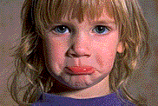
Maintenance of Certificates
To be valid, certificates must be current
  Certificate becomes invalid on the “Date of Expiration”
  Child must submit a current certificate within 30 days after the expiration date or be excluded from attendance
  Facility or school is responsible for notifying parent/guardian of an upcoming expiration date and requesting a current certificate be submitted
  Any school/facility official who does not enforce the requirements shall be guilty of a misdemeanor
Notes:
Certificates must be legibly completed with all the information we have discussed.
To be valid, certificates must be current:
A certificate becomes invalid on the “Date of Expiration.”
Child must submit a current certificate within 30 days after the expiration date or be excluded from attendance.
Facility or School is responsible for notifying parent/guardian of an upcoming expiration date and requesting a current certificate be submitted.
Any school/ facility official who does not enforce the requirements shall be guilty of a misdemeanor.

Slide 62
Filing of Certificates
All children enrolled must have a valid Certificate of Immunization on file
Certificates must be available for inspection by health officials
If child attends more than one facility, a photocopy to the second facility is acceptable
If child leaves or transfers to another school or facility, the certificate should be given to a parent/guardian or sent to the new school/facility
In the case of religious exemption, a dated notarized statement must be on file
Notes:
Schools and child care facilities have the responsibility of developing and maintaining a system for certificate management.
The standards for maintaining files are outlined in the third section of the Policy Guide 3231INS.
Additional details can be found in the brochure entitled “Immunization Guidelines for Child Care Facility Operators and School Personnel,” Form 3258. This brochure can be located on the Georgia Immunization website under School and Child Care Resources
As mentioned earlier, all children enrolled must have a valid Certificate of Immunization on file.
Certificates must be available for inspection by health officials.
If child attends more than one facility, a photocopy to the second facility is acceptable.
If child leaves or transfers to another school or facility, the certificate should be given to a parent/guardian or sent to the new school/facility.
If a child has a religious exemption, a dated notarized statement from the parent/legal guardian stating that immunizations are against his religious beliefs is required to be on file in lieu of the Certificate of Immunization.

Slide 63
Tickler Filing System
Immunization Guidelines for Child Care Facility Operators & School Personnel (Form 3258) provides “how to” instructions
Tickler system is method for filing and maintaining current certificates (set up by month and year)
Remind parents or care givers
Give parents information sheet about requirements
Document follow-up
Enforce requirements
Notes:
The best method for maintaining current files is to develop an organized, user friendly, simple tickler filing system.
Specific details for setting up a tickler system are outlined in the Immunization Guidelines for Child Care Facility Operators and School Personnel (Form 3258).
Basically, a tickler system is a method for filing the immunization certificate for each child attending and for maintaining current certificates. Usually, these systems are set up by the month and year. A child’s certificate is filed under the month and year that it will expire or that a new certificate needs to be obtained. Also you need to keep track of those new attendees who are given 30 days by the facility or school official to obtain a certificate. (This applies to new students only). Thirty days may be granted by a facility or school official to students to obtain a certificate either showing complete for school or an expiration date indicating they are in the process of receiving the needed vaccines.)
You have the responsibility of reminding parents of upcoming expiration dates. It is a good idea to notify them at least a month ahead of time. (Suggestion: organize a sample tickler certificate notebook and offer to let attendees look at it at the break or after the presentation.)
Also, when a parent inquires about enrolling his child in day care or school, give him information about the immunization requirements. Refer to handouts:
“ Child Care Center/School’s Policy about Your Child’s Immunization Certificate” is a sample sheet of information you can personalize and copy for your facility to give parents to inform them at the time of enrollment about the requirements for a certificate.
“Summary of Georgia Immunization Requirements for Child Care and School Attendance” (Form 3193-English) or (Form 3194-Spanish)
Document follow up or any notices you give to parents reminding them of need to take child in for next immunization and obtain an updated certificate.
Enforce requirements. Once you have reminded parents of the need to have child’s immunizations reevaluated and a new certificate obtained, and it has been over 30 days after the certificate expires, it is your responsibility to exclude the child from attending until the requirements have been met.
Maintaining an organized certificate management system enables you to provide more efficient follow up in the incidence of an occurrence of a disease in which contact notification and follow up is needed and also provides for a method for quickly assessing and auditing records.

Slide 64
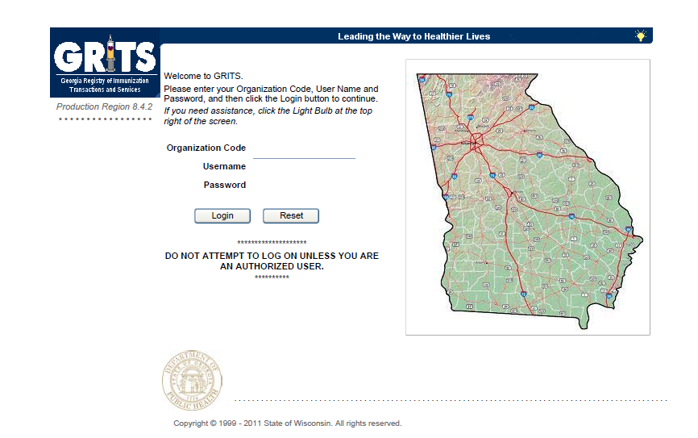
Georgia Registry of Immunization Transactions and Services (GRITS)
Notes:
GRITS is a statewide Web-based system that stores immunization information about residents of Georgia from birth to death.
The GRITS immunization information system allows for a child’s history to be stored in a secure database. Doctors’ offices, clinics, schools and childcare facilities enrolled as GRITS providers can access a child’s vaccination history quickly and easily.
GRITS determines the vaccinations that are due or overdue and those that are valid or invalid based on minimum age and time intervals from the Advisory Committee on Immunization Practices (ACIP). GRITS also:
Provides guidance to healthcare providers about which vaccines a child should receive at each visit.
Creates and prints valid immunization certificates (Form 3231).
Features a demographic screen where users can view and print data and access a child’s full immunization history.
Enables schools and childcare providers to print signed copies of Form 3231 if the child is current on his immunizations.
Allows schools and childcare facilities to create reports and manage immunization coverage within their facility.
GRITS offers a variety of training methods, including onsite training and interactive CDs. Contact GRITS at 404-463-0807 for more information about how your facility can access GRITS.

Slide 65
School & Child Care Requirements
Some of the new vaccines that are RECOMMENDED for particular age groups, may NOT BE REQUIRED for school or child care attendance.
Remember, GRITS
  Calculates validity based on recommendations
  Prints certificates based on requirements
Notes:
Some of the new vaccines previously discussed are RECOMMENDED for particular age groups, but MAY NOT BE REQUIRED for school or child care attendance.
Remember, GRITS:
Calculates validity based on recommendations
Prints certificates based on requirements, which are first based on the recommendations.
Revised certificates are available from the GA Immunization Program Office
Can be printed from the GA Registry of Immunization Transactions and Services (GRITS) (7/1/14)
Can be printed from office software systems
Providers requests permission and receives approval for the certificate from the Georgia Immunization Program
Provider has to be an active participant in GRITS
Certificate must include exact information and have same appearance as DPH Certificate to be approved

Slide 66
GA Requirement Trivia
Case #1 Elizabeth
-DOB: 7/1/11
-Health check visit today 8/1/13; will be starting daycare on tomorrow 8/2/13
-No medical hx, NKDA
Vaccine history:
DTaP: 9/1/11
Hep B: 7/1/11, 9/1/11
Hib: 9/1/11
IPV: 9/1/11
Can a certificate be issued today without administering vaccines?
Which table on the policy guide should be utilized to determine the required vaccines for childcare attendance?
No
3231 REQ/Side 1
What vaccines if any should be administered today?
#2 DTaP; #2 HIB, #3 Hep B, #2 IPV,
#1 MMR, #1 Varicella, #1 PCV13 , and
#1 Hep A
Notes:
Case #1: Elizabeth... Continued:
Can a certificate be issued today without administering any vaccines?
No
Which tables should be utilized to determine the required vaccines and minimal time intervals for doses if indicated?
Required Doses for Attendance in Facilities and Schools For Children Who Started Immunization Before Age 7 Years; and
Minimal Intervals Between Doses
What vaccines if any should routinely be given today?
#2 DTaP
#2 Hib
#3 Hep B
#2 IPV
#1 MMR
#1 Varicella
#1 PCV13 (required for attendance as of 7-1-07)
#1 Hep A (recommended for child care attendance but not required since she was born before 1-1-06)
or
Pediarix
#2 Hib
#1 MMR
#1 Varicella ( if available, could give MMR and varicella as MMRV)
#1 PCV7
#1 Hep A

Slide 67
Healthcare Worker Immunization
HCW immunization is an important safety measure
Medical facilities providing direct patient care should formulate an immunization policy for their employees.
Recommended for Healthcare Workers |  | Recommended for HCWs with Other Risk Factors
Hepatitis B |  | Hepatitis A
Flu |  | Pneumococcal
MMR |  | Meningococcal
Varicella
Diphtheria,Tetanus, & Pertussis
Notes:
It is important to establish employee immunizations as a safety measure:
“Because of their contact with patients or infective material from patients, many health-care workers (HCWs), such as physicians, nurses, nursing students, lab technicians, volunteers, and administrative staff are at risk for exposure to and possible transmission of vaccine-preventable diseases. Maintenance of immunity is therefore an essential part of prevention and infection control programs for HCWs.”
“Any medical facility or health department that provides direct patient care is encouraged to formulate a comprehensive immunization policy for all HCWs.”
Both of these quotes come from the ACIP statement, “Immunization of Health-Care Workers,” MMWR, 12-26-97.
Also, this table is derived from that statement and also from the Adult Immunization Schedule, based on perceived risks for the different populations. (Review table.)
The left side of the table indicates those diseases for which HCWs should have immunity, either through history of disease (which could be MMR, varicella, hepatitis B), or documentation of vaccination, or positive serology.
The right side of the table indicates other vaccines which may be needed by some HCWs who have additional medical risks.
This information can also be seen in the 2009 Adult Immunization Schedule, as well as the information about immunization of persons with other conditions, such as pregnancy, diabetes, immunodeficiency, etc. which could pertain to HCWs as well.
Another excellent resource is the IAC document, Item #P2017, “Healthcare Worker Vaccination Recommendations.” This is a one page summary of the above information which would make a good handout.

Slide 68
Vaccine Adverse Event Reporting System
The Vaccine Adverse Event Reporting System (VAERS) is a national vaccine safety surveillance program co-sponsored by the Centers for Disease Control and Prevention and the Food and Drug Administration.
What Can Be Reported to VAERS?
Who Reports to VAERS?
Does VAERS Provide General Vaccine Information?
http://vaers.hhs.gov/ or 1-800-822-7967
Notes:
VAERS provides a nationwide mechanism by which adverse events following immunization may be reported, analyzed, and made available to the public.
The primary objectives of VAERS are to:
Detect new, unusual, or rare vaccine adverse events;
Monitor increases in known adverse events;
Identify potential patient risk factors for particular types of adverse events;
Identify vaccine lots with increased numbers or types of reported adverse events; and
Assess the safety of newly licensed vaccines.
What Can Be Reported to VAERS?
VAERS encourages the reporting of any clinically significant adverse event that occurs after the administration of any vaccine licensed in the United States.
Who Reports to VAERS?
Anyone can file a VAERS report, including parents, health care providers, manufacturers, and vaccine recipients.
Does VAERS Provide General Vaccine Information?
No. VAERS only collects and analyzes adverse event reports. In another example, VAERS determined that there may be a potential for a small increase in risk for Guillain-Barre syndrome after the meningococcal conjugate vaccine, Menactra. As a result of this finding, a history of Guillain-Barre syndrome became a contraindication to the vaccine and further controlled studies are currently underway to research this issue.
The VAERS website for reporting is: http:vaers.hhs.gov/ or you can call to report at 1-800-822-7967

Slide 69
Vaccine Injury Compensation Program (VICP)
National Vaccine Injury Compensation Program
provides compensation to individuals found to be injured by or have died from certain childhood vaccines.
  Established in 1988 by NCVIA
  Federal “no fault” system to compensate those injured
  Claim must be filed by individual, parent or guardian
  Must show that injury is on “Vaccine Injury Table”
Notes:
On October 1, 1988, the National Childhood Vaccine Injury Act of 1986 created the National Vaccine Injury Compensation Program (VICP). The VICP was established to ensure an adequate supply of vaccines, stabilize vaccine costs, and establish and maintain an accessible and efficient forum for individuals found to be injured by certain vaccines. The VICP is a no-fault alternative to the traditional public legal system for resolving vaccine injury claims that provides compensation to people found to be injured by certain vaccines.
The National Childhood Vaccine Injury Act (NCVIA) set forth 3 basic requirements for all vaccination providers, which are:
Providers must give the patient (or parent/legal representative of a minor) a copy of the relevant federal "Vaccine Information Statement" (VIS) for the vaccine they are about to receive.
Providers must record certain information about the vaccine(s) administered in the patient's medical record or a permanent office log.
Providers must document any adverse event following the vaccination that the patient experiences and that becomes known to the provider, whether or not it is felt to be caused by the vaccine, and submit the report to the Vaccine Adverse Event Reporting System (VAERS).

Slide 70
Additional Resources
Notes:
The Immunization team has developed resources for parents, students, school nurses, public health staff and private providers.
We wanted to make a comprehensive guide for school and public health nurses to use as a quick reference.
1. The first document is the “New 7th Grade Vaccination Requirements/Guidance for School Nurses & Public Health Nurses”
-this is a Q&A document that provides you with a gamut of questions; it includes talking points for communicating with parents and caregivers. It also provides questions related to GRITS, Exemptions, and Reporting.
2. The next document is the “Immunization Guidelines for Schools and Childcare Facilities”
-this is an updated version of form 3258 with the addition of the new requirements
3. The next form is the parent flyer which is fun and animated; this particular form can be used by the schools to attach to progress reports, daily bulletins and report cards to remind parents of the upcoming requirements (available in Spanish)
4. The parent teaching sheet is an informational form for parents to educate them on the new requirements as well as provide them with disease based information about pertussis and meningococcal disease; this form has a front and back (available in Spanish)
5. The last form that was updated is the “Give Em Your Best Shot” brochure; this brochure was designed to educate parents on all of the required vaccines for School and Childcare attendance in Georgia. It also includes a new animated look that will hopefully encourage a conversation between parents and their children about the importance of getting vaccinated against these deadly diseases. (available in Spanish)
All of these documents are available electronically and will be accessible on the Immunization Program Website. Also, we have received a shipment of the new “Give Em Your Best Shot” brochure and they can be ordered via form 3184 from the State Office.
Lastly, please keep in mind that everyday we are getting new questions and/or concerns regarding documents and forms and sometimes even with many eyes looking over words and content sometimes things have to be tweaked and you may receive updated versions even after everything is said and done.

Slide 71


Resources
Local health department
District Immunization Coordinator
GA Immunization Program Office
  On call Help line: 404-657-3158
  GRITS Help Line:1-866-483-2958
  VFC Help Line:1-800-848-3868
  Website http://dph.georgia.gov/immunization-section
  Your local Immunization Program Consultant (IPC)
GA Chapter of the AAP
GA Academy of Family Physicians
Notes:
If you need further information about the changes, or to ask questions later, please contact the GA Immunization Office and our partners GA AAP and GA AFP
Your Local health department
District Immunization Coordinator (IPCs)
GA Immunization Program Office
404-657-3158
Website http://health.state.ga.us/programs/immunization
GA Chapter of the AAP
GAFP

Slide 72
http://dph.georgia.gov/immunization-section
Notes:
For those who have not logged onto the Immunization page website here is the link to the main page.

Slide 73
Take Away Message
Vaccines are our best defense for preventing vaccine preventable diseases
Georgia law requires that all children attending a facility or school must be immunized according to the rules and regulations established by the Department of Public Health (DPH)
It is the responsibility of physicians, public health clinics, childcare facilities, schools and parents to ensure that all children are properly immunized for childcare and school attendance

