Slide 1
Breastfeeding Presentation
Presentation to: Nutrition Services Directors
Breastfeeding Coordinators
Presented by: Patricia Cwiklinski RD, LD, CLC
Shlonda Smith, CLC
Angela Hammond-Damon, IBCLC
Date: July 8, 2015

Slide 2
Peer Counselor (PC) Program
Core WIC service
Providing additional time & skilled breastfeeding help when needed.
Updates:
Issue, Follow up, CANNOT track or clean breast pumps
Can teach/support breastfeeding classes WITH CPA
Encourage PCs to attend 2015 GA WIC Conference

Slide 3
Peer Counselor Database (PCDB)
Central place for data storage
Utilized by PCs and Lactation Specialists (LS) to facilitate communication
Allows the State WIC Office (SWO) to collect data for required reports
Prioritizes participants needing PC/LS follow up
Tracks relevant breastfeeding support information
COMING SOON!!!

Slide 4
Peer Counselor Database (PCDB)
COMING SOON!!!!

Slide 5
Peer Counselor Training
Tentative Dates/Location:
September 14th & 15th
September 28, 2015
Middle Georgia State College Macon, GA

Slide 6
Breastfeeding Women
Food Packages for

Slide 7
Percent of Contract Formula Packages (State)
Amount of Formula | Percent of Packages
Full Formula Package | 88.2%
Mostly BF Package | 7.4%
Some BF (¾) Package | 4.4%
*FFF package includes infants listed as some breastfeeding
**Based on packages printed in March 2015

Slide 8
Breastfeeding Package Goals
Amount of Formula | March 2015 Percentage | Goal | Districts Meeting
FFF* | 88.2% | < 85% | 5
MBF* | 7.4% | > 10% | 4
EBF Pkg | 9.5% | > 9 % | 11
EBF participant | 9.1% | > 9% | 7
* Percent of Contract/non-contact infant food packages, special formulas not included
** Percent of Contract/non-contract + EBF packages, special formulas not included

Slide 9
How to Meet Breastfeeding Food Package Goals
Goal 1
Issue SBF women, the “P” package
Goal 2
Promote advantages of MBF over SBF
Goal 3
Increase duration of EBF
Choose no formula option for MBF first month
Goal 4
Increase duration of EBF

Slide 10
How do we reduce the amount of formula being issued?
How does the large amount of formula given to breastfed infants affect our duration rates?
What message are we giving participants?
How can we change the infant feeding culture of GA WIC?

Slide 11
The Right Formula Package
Feeding Type | Cans | Daily Intake | Weekly Intake | Monthly Intake
MBF | 1 | 3 oz | 14 -20 oz | 60-90 oz
MBF | 2 | 6 oz | 21-41 oz | 91-180 oz
MBF | 3 | 9 oz | 42-62 oz | 181-270 oz
MBF | 4 | 12 oz | 63-83 oz | 271-360 oz
MBF | 5 | 16 oz | 84-102 oz | 361-450 oz
SBF | 6 | 18 oz | 105-125 oz | 451-540 oz
SBF | 7 | 21 oz | 126-146 oz | 541-630 oz

Slide 12
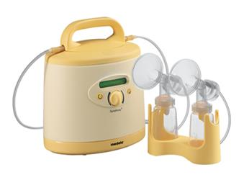
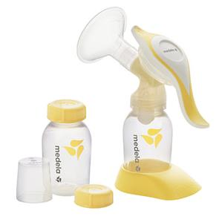
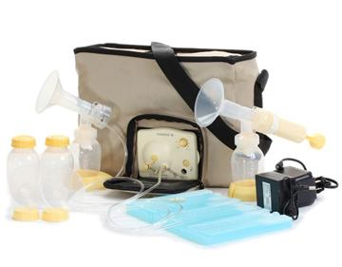
Breast Pumps
Inventory for

Slide 13
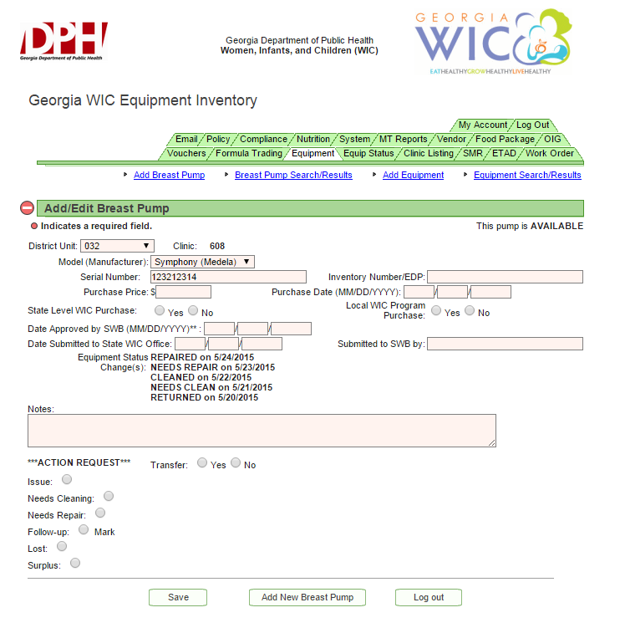

Slide 14
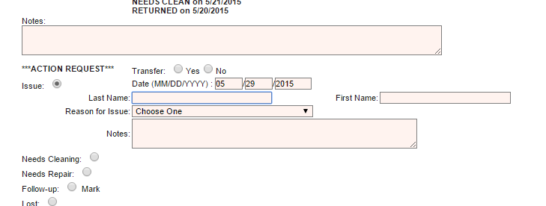

Slide 16
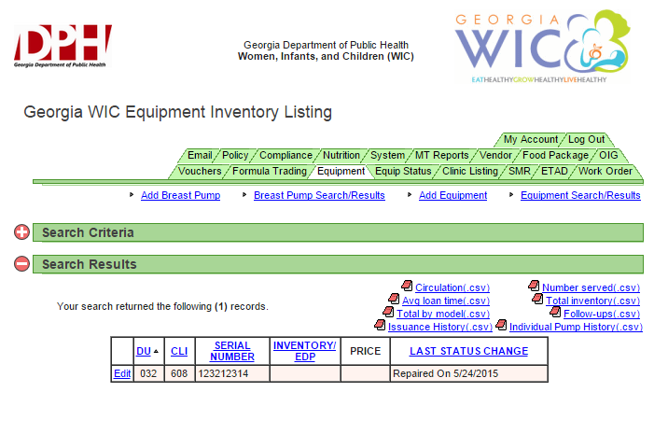

Slide 17
Breast Pump Policy
(Georgia WIC Draft)

