Slide 1
Burden of Tobacco Use in Georgia: Surveillance Update
Tobacco Advisory & Coalition Board
Alina Chung, MPH, Epidemiologist
July 22, 2015

Slide 2
outline Goal area 1. Preventing Tobacco Use Initiation among Youth and Young Adults 2. Promote Tobacco cessation 3. Eliminate exposure to secondhand smoke and Create tobacco-free places 4. eliminate the disparities associated with tobacco use and exposure

Slide 3
Goal Area 1: Preventing Tobacco Use Initiation among Youth and Young Adults

Slide 4
Percent of middle school students who used any tobacco product, by sex, GA, 2003-2013
Obj. by 2020:
↓ youth tobacco use to 8%
Data Source: Youth Risk Factor Surveillance System (YRBS)

Slide 5
Percent of middle school students who used any tobacco product, by race/ethnicity , GA, 2003-2013
Data Source: Youth Risk Factor Surveillance System (YRBS)

Slide 6
Percent of high school students who used any tobacco product, by sex, GA, 2003-2013
Data Source: Youth Risk Factor Surveillance System (YRBS)

Slide 7
Percent of high school students who used any tobacco product, by race/ethnicity, GA, 2003-2013
Obj. by 2020:
↓ youth tobacco use to 8%
Data Source: Youth Risk Factor Surveillance System (YRBS)

Slide 8
Percent of youth who smoked a whole cigarette, by age, GA, 2013
Before age of 11
Before age of 13
Data Source: Youth Risk Factor Surveillance System (YRBS)

Slide 9
Percent of high school students who smoked a whole cigarette, by race/ethnicity, GA, 2013
Before age of 11
Before age of 13
Data Source: Youth Risk Factor Surveillance System (YRBS)

Slide 10
How Much Did We Do?
Cumulative Number of Model Policies Adopted by School Districts in Georgia
Obj. by 2020:
↑ # of 100% TFS policy
100% (total 181)
1,319,358
youth and thousands
of employees
from 1,737 schools
are covered
Currently, 102 (56%) out of 181 school districts have adopted the model policy.

Slide 11
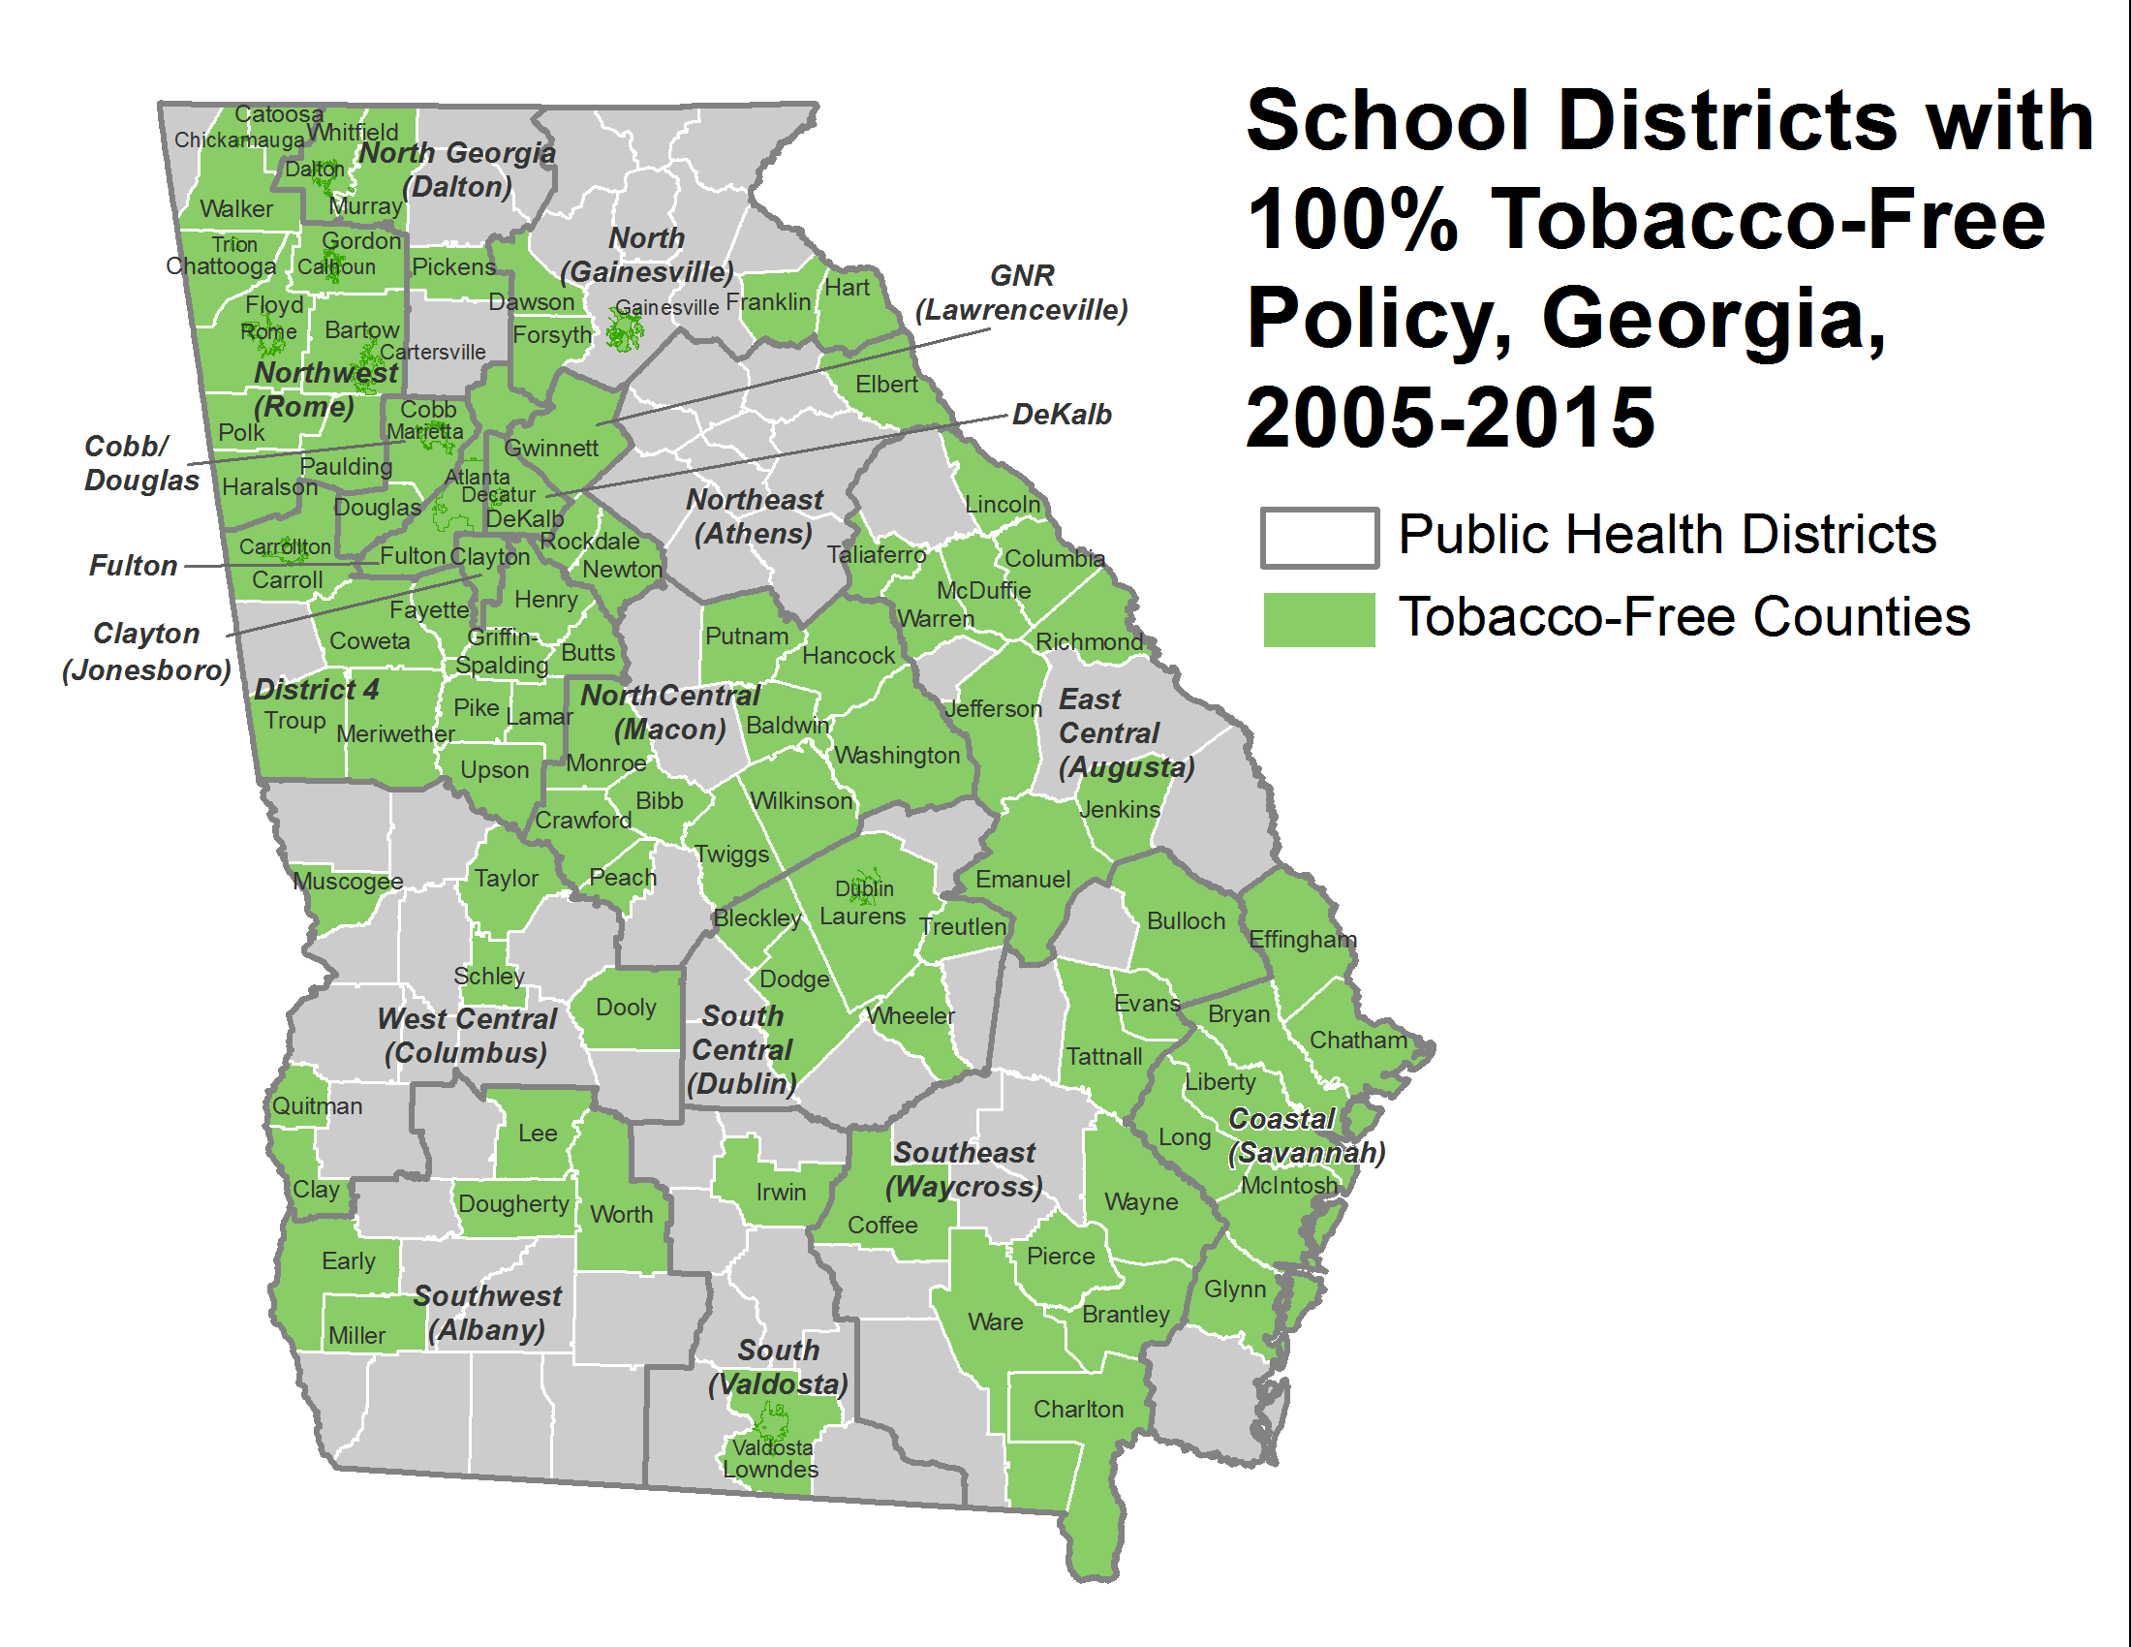
Obj. by 2020:
↑ # of 100% TFS policy
100% (total 181)
N = 102

Slide 12
How Much Did We Do?
Cumulative Number of 100% Tobacco Free* Policies Adopted by Colleges & Universities in Georgia
Obj. by 2020:
↑ # of 100% TFS policy
100% (total 128)
374,018+
students and
thousands
of employees
are covered
*No forms of tobacco products allowed indoors and outdoors
(ANR- Americans for Non-Smokers’ Rights)

Slide 13
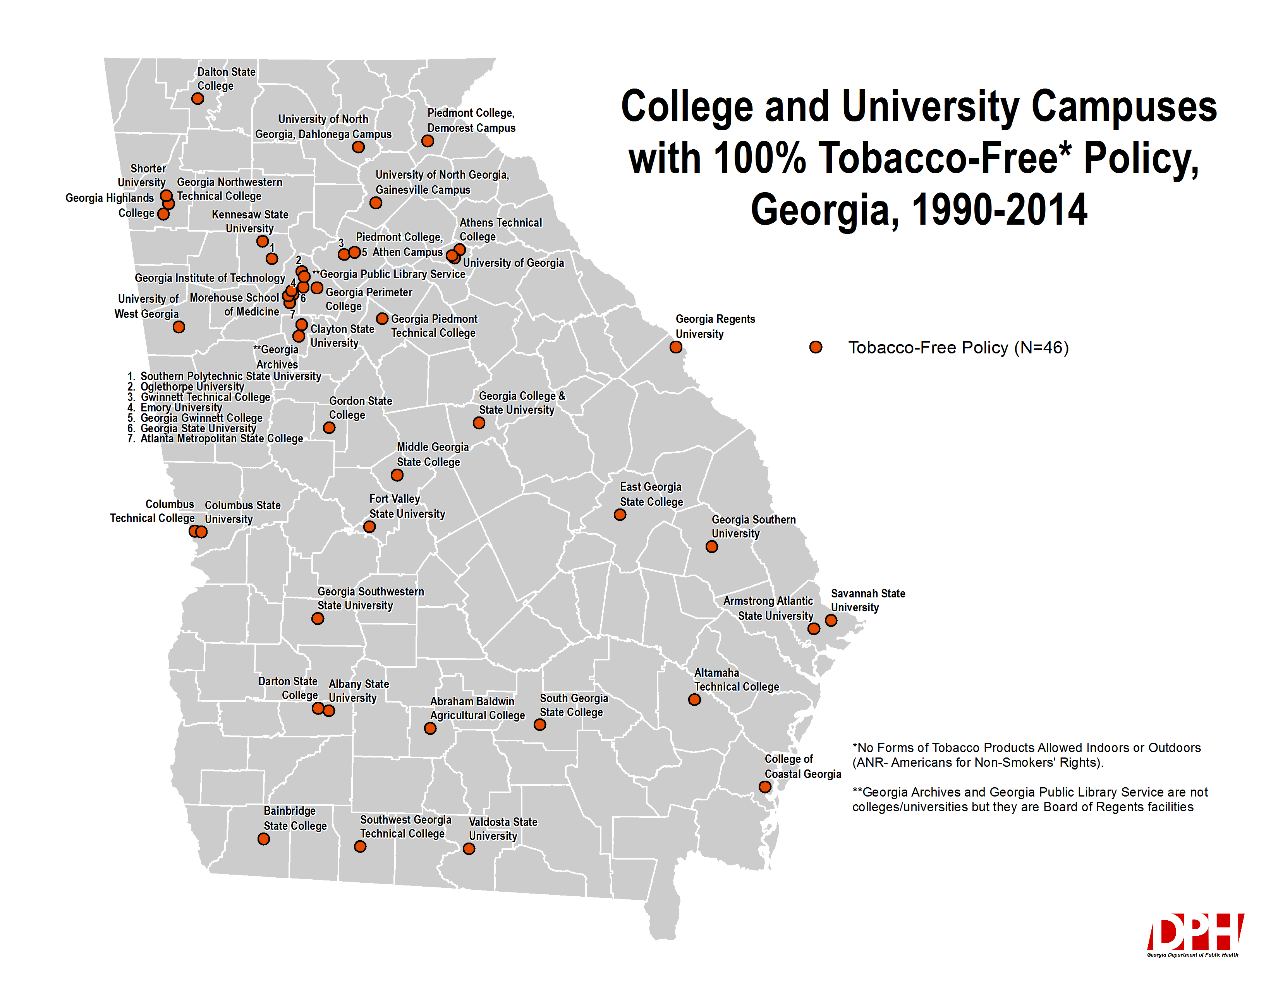
Obj. by 2020:
↑ # of 100% TFS policy
100% (total 128)

Slide 14
How Much Did We Do?
Cumulative Number of 100% Tobacco-free & Smoke-free Policies Adopted by Park and Recreation Facilities in Georgia
Obj. by 2020:
↑ # of 100% TF policy
100% (total 203)
1
1
2,505,368+
youth and adults
are now free from the
dangers of secondhand
smoke in parks and
recreation facilities
Out of 203 parks and recreation association facilities, 19 (9%) have adopted 100% Tobacco-free model policies and 8 (4%) Smoke-free policies
*Kennesaw City and **Troup County smoke-free policies became tobacco-free; currently 27 total facilities are exclusively
100% tobacco-free or smoke-free

Slide 15
Obj. by 2020:
↑ # of 100% TF policy
100% (total 203)

Slide 16
Goal Area 2: Promote Tobacco Cessation

Slide 17
Percent of high school students who tried to quit smoking cigarettes, GA, 2003-2013
Obj. by 2020: ↑ # of quit attempts by youth to 60%
Data Source: Youth Risk Factor Surveillance System (YRBS)

Slide 18
Adult Cigarette Smoking Quit Ratio*, by sex and race/ethnicity, GA, 2013
Data Source: Behavioral Risk Factor Surveillance System (BRFSS)
*Quit Ratio= % of adult former smokers among ever smokers

Slide 19
Adult Cigarette Smoking Quit Ratio*, by age groups, GA, 2013
Data Source: Behavioral Risk Factor Surveillance System (BRFSS)
*Quit Ratio= % of adult former smokers among ever smokers

Slide 20
Adult Cigarette Smoking Quit Ratio*, by education level, GA, 2013
Data Source: Behavioral Risk Factor Surveillance System (BRFSS)
*Quit Ratio= % of adult former smokers among ever smokers

Slide 21
Goal Area 3: Eliminate Exposure to Secondhand Smoke and Create Tobacco-Free Places

Slide 22
Percent of youth who were exposed to secondhand smoke in the past week, by location, Georgia, 2013
Obj. by 2020: ↓ in public place to 22% & ↑ smoke-free home to 100%
Data Source: Youth Tobacco Survey (YTS)

Slide 23
Percent of middle school students who exposed to secondhand smoke, by location and race/ethnicity, GA, 2013
Data Source: Youth Tobacco Survey (YTS)

Slide 24
Percent of high school students who exposed to secondhand smoke, by location and race/ethnicity, GA, 2013
Data Source: Youth Tobacco Survey (YTS)

Slide 25
Percent of youth who live with a smoker, by smoking status, GA, 2013
Data Source: Youth Tobacco Survey (YTS)

Slide 26
Percent of adults exposed to secondhand smoke in the past 7 days, by location, GA, 2014
Data Source: Adult Tobacco Survey (ATS)

Slide 27
Percent of adults supporting smoke-free policies, by smoking status, GA, 2014
Data Source: Adult Tobacco Survey (ATS)

Slide 28
Percent of adults who work in smoke-free* workplaces, by sex and smoking status, GA, 2014
Data Source: Adult Tobacco Survey (ATS)
*smoking never allowed indoor areas at the workplace

Slide 29
Percent of adults who live in smoke-free* homes by sex and smoking status, GA, 2014
Data Source: Adult Tobacco Survey (ATS)
*smoking never allowed inside the home

Slide 30
Goal Area 4: Eliminate the Disparities Associated with Tobacco Use and Exposure

Slide 31
Youth Summary
Highest tobacco use
Hispanic males among MS
NH White males among HS
Youth who live with adult smokers at home
Highest smoking initiation
NH White males for MS before age of 11
Hispanic females for HS before age of 13
Highest secondhand smoke exposure
NH White in vehicle, home,
and public places

Slide 32
Adult Summary
Highest cigarette use
NH White males
25-34 age group
Less than HS
Highest smokeless tobacco use
NH White males
18-24 age group
Less than HS
Highest quit ratio
NH White females
65+ age group
college graduated
Highest secondhand smoke exposure
Male smoker at workplace
Female smoker at home

Slide 33
Data Availability
Georgia Tobacco Use Surveillance
http://dph.georgia.gov/georgia-tobacco-use-surveillance
OASIS on YRBS and BRFSS (most updated 2013)
https://oasis.state.ga.us/oasis/yrbs/
https://oasis.state.ga.us/oasis/brfss/qryBRFSS.aspx
CDC Smoking and Tobacco Use
http://www.cdc.gov/tobacco/index.htm
Trends of Youth and Adult Smoking Data on Handouts

Slide 34
Thank you! Questions?

