Slide 1
Partnering to PREVENT Cancer!
Presentation to: Chronic Disease University
Presented by: Tamira M. Moon, MPH, MCHES
Program Director | GA Comprehensive Cancer Control Program
Date: July 18, 2018

Slide 2
Objectives:
By the conclusion of the presentation, CDU attendees will have a better understanding of:
The Georgia Comprehensive Cancer Control Program
Partnerships between DPH’s cancer programs
How your organization can partner to prevent cancer in Georgia

Slide 3
Georgia Comprehensive Cancer Control Program Overview
Program Goals:
To bring together key partners and organizations to develop, implement and evaluate a plan to reduce the number of community members who get or die from cancer.
To utilize the Georgia cancer plan as a road map for comprehensive cancer prevention and control that focus on the following eight priority areas:
1) Cancer risk reduction – tobacco and obesity
2) Vaccination for human papilloma virus
3) Breast and cervical cancer screening
4) Colorectal cancer screening
5) Lung cancer screening
6) Quality cancer diagnosis and treatment
7) Access to palliative care and survivorship
8) Patient Case Management and Care Coordination

Slide 4
Overview
Partnerships across the government, academic, research, business, and non-profit sectors.
Roadmap for cancer control in Georgia.
Builds on the first statewide plan, issued in 2007.
Establishes priorities; allocates responsibilities and resources; and, sets targets for prevention and control that will help to continue to move us forward together toward the same goals.

Slide 5
Internal Partnerships
Comprehensive Cancer Control Program
+
Breast & Cervical Cancer Program
+
Cancer State Aid
_______________________________________
Collective efforts to achieve prevention, early detection & screening

Slide 6
Collaborative Efforts
Georgia Cancer Control Consortium (GC3) Steering Team
Georgia Cancer Programs Leadership Team
I Will Survive, Inc. (Breast Cancer Awareness Project)
Cervical Cancer Awareness Day at the Georgia Capitol
Wednesday, January 30, 2019
National Cancer Survivors Month (June)
Cancer Survivors Fair (Thursday, June 6, 2019)
Cancer Survivors Panel Discussion (Wednesday, June 12, 2019)

Slide 7

Cancer PREVENTION

Slide 8
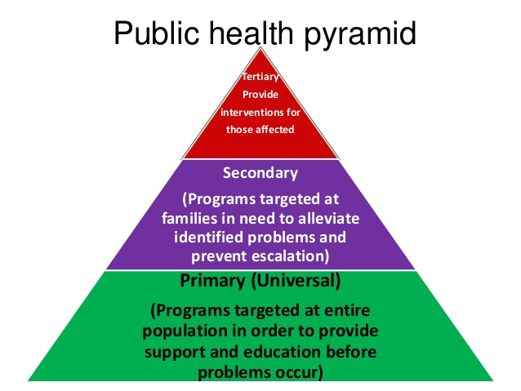

Slide 9
Cancer PREVENTION Projects
Pathways to Freedom (Tobacco Cessation)
-National African American Tobacco Prevention Network
Youth Healthy Eating Cancer Prevention Project
-Logan Wilkes Foundation
HPV Cancer-related Awareness Project
-Cancer Pathways
-Someone You Love

Slide 10
How Can Your Organization Partner with Us to PREVENT Cancer?
Join a GC3 workgroup.
Host a Someone You Love screening.
Promote the HPV vaccination for our youth.
Join us on June 30, 2019 for Cervical Cancer Awareness Day at the Georgia Capitol.
Participate in the Cancer Survivors Fair on June 6, 2019.
Attend and/or recommend a cancer survivor panelist for the Cancer Survivors Panel Discussion on June 12, 2019.
Get involved and promote our cancer prevention activities.

Slide 11

Tamira.Moon@dph.ga.gov 404-657-6315

Slide 12
BREAST AND CERVICAL CANCER PROGRAM
CHRONIC DISEASE UNIVERSITY
Cathy Broom, Program Manager
July 18, 2018

Slide 13
Implementation of the National Breast and Cervical Early Detection Program
In 1990, Congress passed the National Breast and Cervical Cancer Mortality Prevention Act because of the number of low-income and uninsured women being diagnosed with breast cancer.
Authorized the CDC to establish the NBCCEDP to provide high quality and timely breast and cervical cancer screening and diagnostic services to low-income, uninsured women.
NBCCEDP began in 1991 and in 1993 Congress amended the act to allow CDC to fund American Indian and Alaska Native tribes and tribal organizations.
By 1996, the program was providing cancer screening across the U.S.
Georgia was funded in 1995. Currently there are 67 programs, including all 50 states, DC, 5 US territories, and 11 tribes or tribal organizations.

Slide 14
Breast and Cervical Cancer Prevention & Treatment Act
Legislation authorized the NBCCEDP included reimbursement for screening and diagnostic services but prohibited the use of program funds for breast and cervical cancer treatment.
In 2000, Congress passed the Breast and Cervical Cancer Prevention & Treatment Act, which authorized states and territories to provide Medicaid coverage as an option for treatment of women dx through the NBCCEDP with breast or cervical cancer or precancerous conditions.
A partnership was established between the CDC, CMS, state Medicaid directors, and directors of state and tribal cooperative agreement programs.
By October 2008, all 50 states and DC were participating.

Slide 15
Georgia’s Breast and Cervical Cancer Program
CDC funded Georgia in 1995 (a little over $2 million)
With the competitive cooperative grant, Georgia was awarded $4.5 million
We also receive funds from the Tobacco Master Settlement fund for screening and diagnostic evaluation.
BCCP also has the Breast Cancer Genomics Program conducted in the Family Planning program in local health departments across the state.

Slide 16
Who’s Eligible in Georgia?
Women with no health insurance or are under-insured
Income cannot exceed 200% of the FPL
Must be a resident of Georgia
For breast cancer screening must be between 40-64 years of age
For cervical cancer screening must be between 21-64 years of age

Slide 17
Chronic Disease University Georgia Cancer State Aid (CSA)
Yolanda L. Palmer
Program Manager, Georgia CSA
Office of Prevention, Screening and Treatment
Georgia Department of Public Health
July 18, 2018

Slide 18
Georgia Cancer State Aid Program
Program Purpose:
Established in 1937 by the Georgia legislature at the request of physicians, the Georgia Cancer State Aid (CSA) Program supports diagnostic and cancer treatment services for Georgia adults who are uninsured and under-insured. The CSA Program provides re-imbursement to participating facilities with the intent of preventing the pauperization of cancer patients and their families due to the rising cost of cancer treatment services.
Funding total: $6,600,000 (90% of funding covers patient benefits)
Funding source: Tobacco MSA Funds (4054930391)

Slide 19
Special Populations Impacted
Uninsured adults at or below 250% FPL who do not meet eligibility requirements for coverage under indigent, Medicaid or Medicare health coverage options.
Underinsured adults who have health plans that do not cover cancer treatment services or have payment caps on such services.
A percentage of the estimated 240,000 uninsured Georgians who fall into the coverage gap and are ineligible for indigent services, Medicaid or Medicare coverage.
Uninsured and under-insured adults with limited annual household income who may qualify but cannot afford monthly health insurance premiums and, therefore, do not enroll for such coverage.
Source: Georgia Department of Public Health. (2018) Georgia Cancer State Aid Program (CSA) Website
Georgia Watch. (June 7, 2018) A Look At Georgia’s Coverage Gap. Accessed July 13, 2018.

Slide 20
Georgia Cancer State Aid Program Goals
In an effort to reduce the burden of cancer, the Georgia CSA Program strives to address Healthy People 2020 National Objectives and state priorities by meeting the following goals:
Goal 1: To increase access to early cancer detection and treatment.
Goal 2: To provide funding for cancer-related diagnostic services.
Goal 3: To provide funding for cancer staging and treatment planning for Georgians who have a cancer diagnosis, but have not yet received a comprehensive medical workup.
Goal 4: To provide funding for standard cancer treatment services for patients whose prognosis and planned treatments are medically eligible.

Slide 21
Georgia Cancer State Aid Program Medical Priorities
Priority 1:
Diagnosis and staging to be established. A condition medically evaluated to be "highly suspicious for cancer" may be eligible for diagnostic services. Eligible patients with some confirmation of cancer but inadequate staging may be approved to complete the staging and allow proposal of a treatment plan.
Priority 2:
Active standard cancer treatment. Due to limited funds a prognosis triage is performed based on nationally published five year survivals; patients with less than a 25% predicted five year survival are ineligible for funding.

Slide 22
Georgia Cancer State Aid Program FY 18 Measurable Objectives
Maintain program funding and enrollment activities in line with prior year (PY) approvals.
Maintain established network of providers for the provision of cancer care in line with PY participation.
Continue recruitment efforts to increase the number of participating treatment sites, especially in underserved areas of the state (PH Districts 6, 9-1 and 10).
Adhere to standards for determining eligibility of patients for diagnosis or treatment through quarterly application audits.
Maintain contractual relationships with oncology consultants in the state to develop standard cancer treatment guidelines throughout each fiscal year.
Participate in or fund educational programs through collaborations with other state and local agencies for the purpose of preventing cancer throughout the State of Georgia.
Work with state level, facility and community based organizations to obtain additional cancer resource options to share with patients in need.
Monitor and reconcile refund request and deposit activities monthly to promote timely return of funds to the program and/or state budget.

Slide 23
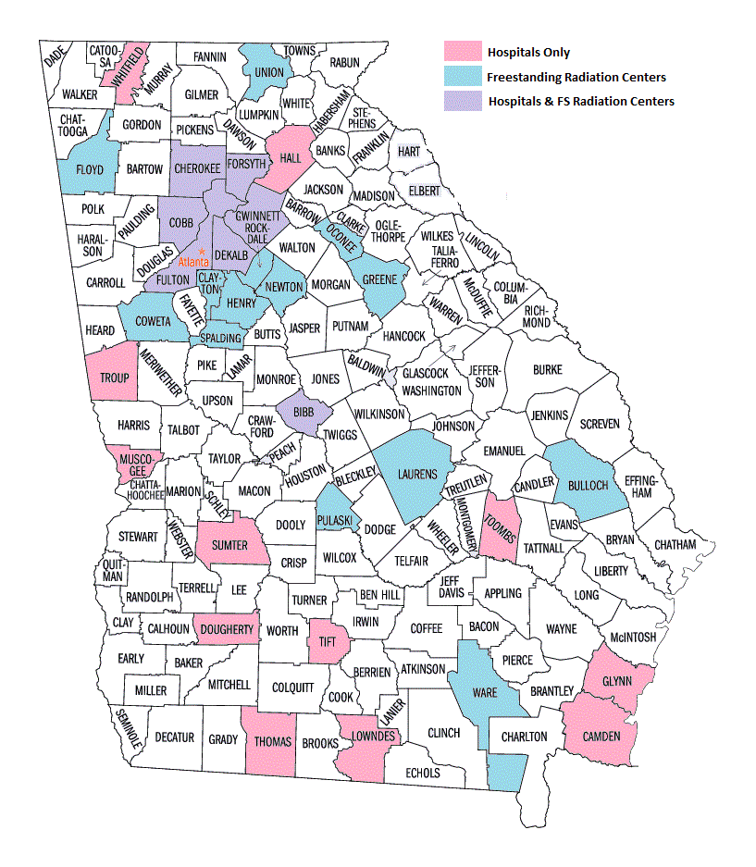
CSA Facility Participation by County

Slide 24
Sources Cited
Georgia Watch. (June 7, 2018) A Look At Georgia’s Coverage Gap. Retrieved July 13, 2018. http://www.georgiawatch.org/a-look-at-georgias-coverage-gap/
Georgia Department of Public Health. (2018) Georgia Cancer State Aid Program (CSA) https://dph.georgia.gov/cancer-state-aid-2

