Slide 1
Death Record Amendment Process
Notes:
Greetings, this presentation will cover the State Office of Vital Records, death record amendment process.

Slide 2
(404)-679-4793
2600 Skyland Drive
Atlanta, GA 30319
DPH-VRDEATH.CORRECTION@DPH.GA.GOV
Notes:
All current year death corrections (less than a year) request can be submitted by: Fax, Mail, or Email.

Slide 3
Amendments Over 1 Year
A fee of $10.00 MUST be collected and paid to the State Office of Vital Records.
Notes:
Amendments over one year, REQUIRE a fee of $10.00, to be collected and paid to the State Office of Vital Records. This can be paid by cash, check, money order, or credit/debit card. If proof of payment is not received. The record will not be updated.

Slide 4
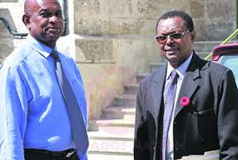
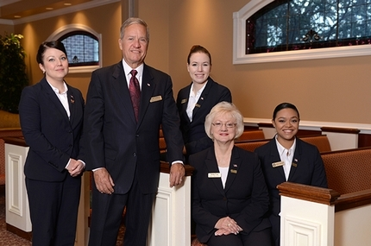
Amendments Requested by Funeral Directors
If the funeral director is making the request, a statement on their letter head stationery along with EVIDENCE will be sufficient.
Notes:
To correct the spelling of the decedent’s name will require a copy of the decedent’s birth certificate, driver’s license, social security card, or other legal document
To correct the date of birth or place of birth will require a certified copy of the decedent’s birth certificate or other legal document such as military paper, social security verification, marriage application, or previous child’s birth certificate. LIFE INSURANCE POLICY CANNOT BE USED.
To correct the residence will require a document that shows the legal residence at the time of the death such as most recent tax bill, voter’s registration, motor vehicle tag bill, property deed, or utility bill.
To correct the residence will require a document that shows the legal residence at the time of the death such as most recent tax bill, voter’s registration, motor vehicle tag bill, property deed, or utility bill.
To correct the parent’s name will require a certified copy of the decedent’s birth certificate, social security verification, or other legal document.
To correct the disposition information will require a statement from the funeral home shown on the certificate.
To correct the social security number will require a copy of the social security card, social security verification, most recent income tax copy, or military paper.

Slide 5
Amendments Requiring Court Order
Notes:
Next, we will cover amendments requiring a court order. The State Office of Vital Records, does not get involved with personal matters. If an amendment requires a court order, that is our ONLY concern.

Slide 6
To change the marital status from “divorced” to “married”,requires a court order.
To change the martial status from “divorced” to “never married”, requires a court order.

Slide 7
Amendments Requiring Medical Certifier Letterhead Stationery
Notes:
Now, we will cover amendments that require a letterhead stationary from the designated medical certifier. This can be a coroner, physician, or medical examiners. are the only personnel authorized to change ANY medical data on a decedent's record.

Slide 8
Changing the cause of death requires a letterhead stationery from a physician, coroner, or medical examiner.
*If the coroner or medical examiner is no longer available to correct the cause of death, the new coroner/medical examiner having access to the medical records or previous investigation records may request to correct the cause of death.*
To correct the date of death, date pronounced, time pronounced, or tobacco use will require a statement from the certifier and pronouncer on their letterhead stationery. The statement may also be obtained from the hospital or institution medical records.
Notes:
Changing the cause of death requires a letterhead stationary from a physician, coroner, or medical examiner.
*If the coroner or medical examiner is no longer available to correct the cause of death, the new coroner/medical examiner having access to the medical records or previous investigation records may request to correct the cause of death.*
To correct the date of death, date, pronounced, time pronounced, or tobacco use will require a statement from the certifier and pronouncer on their letterhead stationery. The statement may also be obtained from the hospital or institution medical records.
REMEMBER, coroner, physicians, and medical examiners, are the only personnel authorized to change ANY medical data on a decedent's record.

Slide 9
Amendments Requiring Notarized Statement
Notes:
Next, we will cover amendments that only require a notarized statement.

Slide 10
To change the informant will require a notarized statement from the person listed as the informant stating that they did not give the information and furnish the information of the actual informant.
To correct a spouse’s maiden name will require a notarized statement and a copy of the spouse’s birth certificate, marriage certificate, or previous child’s birth certificate.
To correct the spelling of the name or address of the informant will require a notarized statement from the person listed as the informant and a copy of their driver’s license.
Notes:
To change the informant will require a notarized statement from the person listed as the informant stating that they did not give the information and furnish the information of the actual informant.
To correct a spouse’s maiden name will require a notarized statement and a copy of the spouse’s birth certificate, marriage certificate, or precious child’s birth certificate.
To correct the spelling of the name or address of the informant will require a notarized statement from the person listed as the informant and a copy of their driver’s license.

Slide 11
Questions
Vital Records - Customer Service
404-679-4702
8:00 AM - 4:30 PM M-F
Report GAVERS Issue
Notes:
For questions regarding the death record amendment process. Please contact the State Office of Vital Records, customer service desk at, 404.679.4702. Office hours are from 8AM-4:30PM, Monday-Friday. The “Report GAVERS Issue” link, is another avenue you can utilize, if your question can not be answered , with our official operating hours.

Slide 12
Notes:
Thank you watching the death record amendment process presentation. We are looking forward to serving YOU.

