Slide 1
Death Registration In Georgia, Our Strategy, & Electronic Death Regulation Changes 1.24.18
Gwendolyn Duffin
Deputy Director, Records Management & Support
Joseph Little
Regional Training & Support Manager
Justin Davis
Regional Consultant-North Region

Slide 2
Welcome & introductions

Slide 3
Georgia Death Registration Cycle Time
Process Improvement to Require Registration Locally
Sep 2014
Realized benefits from adoption and local registration
Asking Physicians to Register in GAVERS
New
death module introduced
June 2013
‘10
116 days
‘11
82
days
‘12
64
days
‘13
57
days
‘14
36
days
‘15
21
days
‘16
19
days
‘17
19
days
2010
116 days
37%
42%

Slide 4
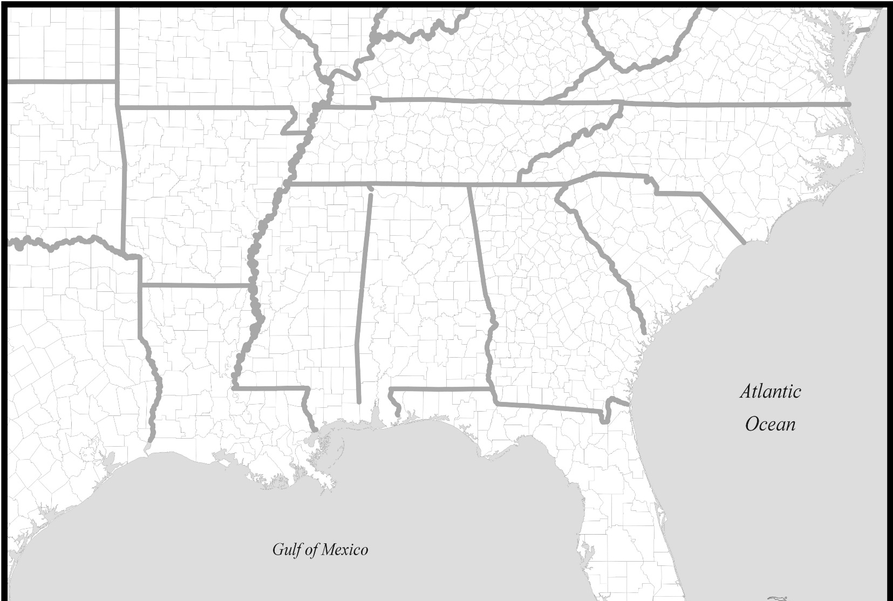
Other States’ Benchmarks
6 days
4 days
13 days
49 days
24 days
2 days
26
days
6 days
8 days
19 days
2 days
6
days
Source: 2015 NCHS (National Center for Health Statistics)

Slide 5
Why Is Faster Better? The Voice of the Customer
Better for Georgia families as they are able to get finalized death certificates to take care of financial accounts, filing insurance benefits, and settling affairs.
Better for funeral homes because they are business men and women; they often rely on payment for funeral expenses out of insurance benefits.
Better for SSA because the largest population of fraud and identity theft is on deceased persons.
Better for the CDC and Department of Public Health would use more timely death data for surveillance and epidemic tracking
Better for history because the closer to an event it is recorded, the more likely it is to be correct.

Slide 6
State Office of Vital Records
Strategy for Death Registration
Physicians, Regulation, and Collaboration
Targeted Approach: Target 1600 that certify 80% of the death records; initial subset of the first 300 that certify 50% of the death records
Give them their USERID, password, & pin in an email from the Commissioner on the requirement for electronic filing
Provide training and a resource for questions
Work with external stakeholder groups for communications & implementation
Leverage the relationships we already have locally with the county registrars, funeral homes, & coroners

Slide 7
Edrs regulation changes 11.14.17
Changes were vetted over several months with feedback from external stakeholder groups including funeral homes, coroners, GHA, GFDA, and internal groups including DPH staff and local county registrars
Why?
Simplify the regulations and make them more comprehensive in regards to the reporting of death information
Clear obsolete language and update them to reflect the modern reality that vital events are increasingly being reported through electronic means
Serve the public by providing faster and more efficient electronic means for reporting death information
Affected 7 regulations: DPH Rule 511-1-3-.19 has been replaced in its entirety including a title change; DPH Rules 511-1-3-.21, -.23, -.25, -.26, and -.38 have been amended; and DPH Rule 511-1-3-.20 has been repealed

Slide 8
Amended & Title Change: 511-1-3-.19 Reporting of Deaths
(2) Manner of reporting . Death reports, including the certification of cause of death, shall be filed electronically with the Office of Vital Records in such manner as may be determined by the State Registrar.
(5) Cause of death. The electronic death report filed in accordance with subsections (1) through (4) of this Rule shall be supplemented by an electronic report of the cause of death.
(6) When reporting is due. (a) The report of death shall be made within three calendar days after death.
Certification of the cause of death shall be made within three calendar days after death, however, if the death occurred without medical attendance, or in cases subject to inquiry under Title 45, by the county coroner or medical examiner.
If for any reason the cause of death cannot be determined within 48 hours after death then “under review” shall be entered on the death report and amended promptly after the determination is made. Until the cause of death is certified, final disposition of the body shall not be made unless authorized by the attending physician or, with regard to a body subject to inquiry under Title 45, by the county coroner or medical examiner.

Slide 9
Amended & Title Change: 511-1-3-.23 PERMITS for disposition, disinterment, and reinterment
Three Major Changes
“Jointly”
Expanding options for the 24/7 requirement to the local registrar
A disposition permit cannot be issued for cremation, donation, or transport out of state until the cause of death is known or the decedent’s attending physician or coroner/ME gives you approval

Slide 10
Amended: 511-1-3-.23 Permits for Disposition, Disinterment and Reinterment
(1) An authorization for disinterment and reinterment of a dead body shall be issued by the local registrar upon receipt of an order of a court of competent jurisdiction directing such disinterment, or upon receipt of a written application signed jointly by the surviving spouse, or the next of kin in the absence of a surviving spouse; the owner of the cemetery plot; and the person who is in charge of the disinterment.
(3) The local registrar shall make arrangements to ensure that disposition permits may be issued 24 hours a day, seven days a week. For this purpose, the local registrar may appoint local persons or entities, including hospitals, hospices, and funeral homes, to serve as deputy local registrars for the limited purpose of issuing disposition permits in accordance with this Rule.
(4) A disposition permit shall not be issued until the cause of death has been certified by a person authorized to do so under DPH Rule 511-1-3-.19(5); authorization given by the decendent’s attending physician; or, with regard to a body subject to inquiry under Title 45, Chapter 16, Article 2, until the county coroner or medical examiner has given approval for disposition.

Slide 11
How Can a local registrar Expand their Options for the 24/7 Requirement?
Consider who works 24/7 and who has the information and the knowledge to make decisions on your behalf
Here’s How: Add Section 22 to Section 23
Existing Section 22
Before removing a dead body or fetus from the place of death, the person removing such body or fetus shall: (a) obtain assurance from the attending physician, associate physician or the chief medical officer of the institution in which death occurred that the death is from natural causes and that the physician will assume responsibility for certifying the cause of death or fetal death and receive written permission to remove the body from the place of death; or (b) Notify the coroner or medical examiner if the cause comes within his or her jurisdiction or, if the physician cannot certify the cause of death, obtain assurance from the coroner or medical examiner that he or she will assume responsibility for certifying the cause of death, and obtain written permission to remove the body.
Revised Section 23
The local registrar shall make arrangements to ensure that disposition permits may be issued 24 hours a day, seven days a week. For this purpose, the local registrar may appoint local persons or entities, including hospitals, hospices, and funeral homes, to serve as deputy local registrars for the limited purpose of issuing disposition permits in accordance with this Rule.

Slide 12
Amended: 511-1-3-.25 All Other Amendments.
(5) The affidavit to correct a death certificate under the provisions of this Rule, may be accepted from the informant, the funeral director responsible for completing the certificate, the person who originally certified cause of death, or a family member of the decedent.
Major Change: Addition of the Certifying Physician

Slide 13
Amended: 511-1-3-.26 Who May Apply to Amend a Vital Record.
2) To amend a death certificate or a spontaneous fetal death certificate, application may be made by the informant listed on the certificate, a family member, their legal representative, or the funeral director or person acting as such who signed the death certificate or spontaneous fetal death certificate. Application to amend the cause of death may be made only by the physician who originally certified cause of death, the attending physician of the decedent, or the coroner or medical examiner.

Slide 14
Amended: 511-1-3-.38 Transmittal of Certificates and Reports.
Unless otherwise provided in this Chapter, a completed report of the live birth, death, or spontaneous fetal death filed with a local registrar shall be transmitted to the State Office of Vital Records within two business days of receipt by the local registrar.
Major Change: From 10 to 2 business days

Slide 15
forms and letters permit for Disposition of human remains application to disinter/reinter human remains appointment letter for deputy registrar disposition permits dear local funeral home

Slide 16
Permit for Disposition of Human Remains

Slide 17
Application to Disinter/Reinter Human Remains

Slide 18
Dear Local Funeral Home

Slide 19
Appointment Letter for Deputy Registrar Disposition Permits

Slide 20
For a copy of the updated regulations from the STATE Registrar Visit the DPH Website at dph.georgia.gov/directors-governance

Slide 21
Thank you

