Slide 1

Adolescent HIV In Metro Atlanta: Updates & Opportunities

Slide 2
Youth HIV in Metro Atlanta: The basics
From 2008-2012, 4,423 youth ages 13-24 were diagnosed with HIV in the Atlanta EMA.
13-24 year olds represented nearly a quarter of all new HIV infections in the Atlanta EMA in 2011.
Youth with HIV are the least likely age group to be linked to HIV medical care and take medication to treat HIV.
A recent study showed that young, Black, gay men in Atlanta have a 60% of contracting HIV before age 30.
  Racial differences in HIV risk are more attributable to structural factors than differences in behavior.
Metro Atlanta has high rates of STIs, homelessness, poverty and income inequality relative to many other cities.

Slide 3
Youth Dx with HIV in Metro Atlanta
(Est. New Dx 2008-2012 among 13-24 y/o- GDPH- N=4423)
Metro Atlanta youth with HIV are disproportionately African-American and male
Race
Many infections occur as a result of male-to-male sexual contact
Transmission
Sex at Birth
Female
N= 1032
23%
Male
N= 3380
77%

Slide 4
Adults and adolescents diagnosed with HIV infection, by age (years), Atlanta EMA 2011
Age at diagnosis (years) | N | Linked N (%) |  | Engaged N (%) |  | Retained N (%) |  | Viral suppression N (%)
13-24 | 420 | 211 | 50% | 255 | 61% | 155 | 37% | 138 | 33%
25-34 | 561 | 326 | 58% | 367 | 65% | 264 | 47% | 239 | 43%
35-44 | 442 | 290 | 66% | 307 | 69% | 218 | 49% | 233 | 53%
45-54 | 345 | 232 | 67% | 245 | 71% | 190 | 55% | 188 | 54%
55+ | 155 | 101 | 65% | 103 | 66% | 77 | 50% | 83 | 54%
Youth 13-24 have the worst rates of linkage, engagement and retention in care of all age groups.
Following HIV diagnosis, only half of youth received follow-up medical care.
2/3 were not virally suppressed.
Notes:
This table shows the number and proportion of adults and adolescents diagnosed with HIV infection, linked, engaged, retained and virally suppressed by age at diagnosis (in years), diagnosed in 2011, and living in the Atlanta EMA
Linkage, engagement, retention and viral suppression are all lowest in the youngest age group and generally increase with increasing age.
Viral suppression ranges from 33% for age 13-24 years to 54% for those age 45-54 years and 55+ years

Slide 5
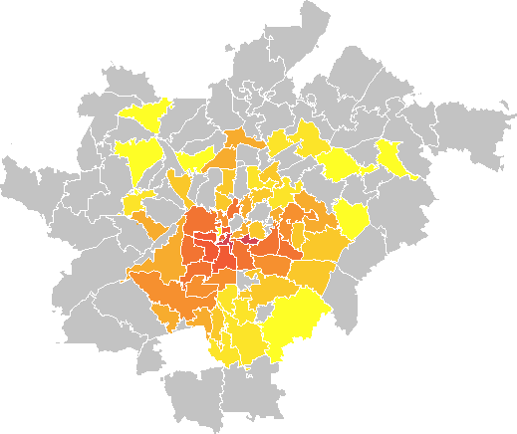
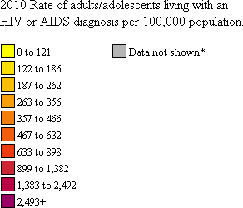
Rates of people 13-24 living with HIV in Atlanta, by zip code, 2010 (AIDSVu.org)
These Atlanta zip codes have the city’s highest rates of HIV among youth 13-24:
  30317 (East Lake, Kirkwood)
  30312 (Mechanicsville, Grant Pk.)
  30315
  30310 (West End, Adair Park)
* Data are not shown to protect privacy because of a small number of cases and/or a small population size.
Notes. Rates include persons living with an HIV or AIDS diagnosis in Clayton, Cobb, DeKalb, Fulton, and Gwinnett Counties at the end of 2010 and who were reported as of 04/01/2013. Data have not been adjusted for reporting delays.
Data Source: Georgia Department of Public Health, Division of Health Protection, Epidemiology Program, HIV/AIDS Epidemiology Section.

Slide 6

Notes:
Jacquel: While implementing routine screening posed its own set of challenges…we also viewed the challenges for screening and linking teens as a great opportunity to begin advocating for more coordinated, youth positive care and treatment options.
PLUG provider group/ ACFLY

Slide 7




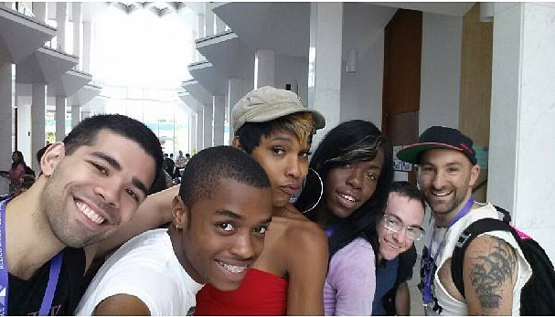


HIV Screening and Adolescents:
Lessons Learned and Questions Raised while Integrating Routine HIV Screening
Natasha Ray, MHA & Jacquel Clemons, MPH
Notes:
Natasha

Slide 8
Routine Screening
  2006 CDC Recommendation on HIV Screening
  Consent language added to general consent for treatment.
  Brochures developed for pre-test counseling requirement
  CMA’s/Provider process
  Electronic Health Record modifications
  Linkage to care
  Quality Program monitoring data outcomes (PCMH and UDS reporting requirement for 2014)
Notes:
Jacquel:
Both settings are CHC’s so our implementation is very similar…
Linkage to care at SMC is a little different…their primary care docs provide

Slide 9
AIDS 2014
Unequal progress and cause for concern: differences in HIV-related risk behavior trends among subgroups of US adolescents, 1991-2013
L. Kann¹, R. Lowry², E. Olsen², S. Zaza²
¹Centers for Disease Control and Prevention, Division of Adolescent and School Health, Atlanta, United States, ²Centers for Disease Control and Prevention, Atlanta, United States
Notes:
Background: In 1991, black students were nearly two-thirds more likely to have had sexual intercourse and almost three times more likely to have had multiple (4+) sex partners than white and Hispanic students; rates of condom use were similar. The Youth Risk Behavior Surveillance System, the largest public health surveillance system in the US measuring risk behaviors among youth, monitors how these behaviors have changed during the past 22 years.
Methods: Twelve national school-based surveys were conducted during 1991-2013. Each cross-sectional survey employed a three-stage sample of students in grades 9-12 (ages 14-17). Black and Hispanic students were oversampled. Secular trends were analyzed using logistic regression analyses controlling for sex, grade, and race/ethnicity and assessing both linear and non-linear (quadratic) changes.
Results: Among female, black, and Hispanic students, prevalence of lifetime sexual intercourse decreased during 1991-2013. However, overall and among male and white students, prevalence of lifetime sexual intercourse decreased during 1991 through 2001, 1997, and 2003, respectively, then leveled off. Among female, black, and Hispanic students, prevalence of multiple partners decreased during 1991-2013. However, overall and among male and white students, prevalence of multiple partners decreased during 1991 through 2003 and 1997, respectively, and then leveled off and among white students prevalence of multiple partners decreased during 1991-2009 and then increased during 2009-2013. Overall and among all sex and racial/ethnic subgroups, condom use increased from 1991 at least through 1999. However, condom use prevalence has not changed significantly among male, white, and Hispanic students since at least 2005 and overall and among female and black students, the prevalence has decreased since 1999 or more recently.
Conclusions: While the gap has narrowed between white, black, and Hispanic students and some progress has been made in reducing HIV-related risk behaviors, decreases in condom use and unequal progress across sex and race/ethnicity subgroups is concerning and may help explain disproportionate rates of HIV infection among adolescents.

Slide 10
Notes:
Jacquel: While implementing routine screening posed its own set of challenges…we also viewed the challenges for screening and linking teens as a great opportunity to begin advocating for more coordinated, youth positive care and treatment options.
PLUG provider group/ ACFLY

Slide 11
Case Presentation
17 year old female presents for HIV screening at a CBO outreach event.
Question: Can she be screened?

Slide 12
Case Presentations
16 year old, male screens positive as a result of routine screening for HIV at local community health care center.
Question: What is the patient linkage to care options?

Slide 13
Notes:
Natasha

Slide 14
ACTION STEPS: What can your organization do?
Promote routine screening and linkage
Increase awareness of adolescent rights to sexual health services for both parents and adolescents
Advocate for comprehensive sex education
Cultivate infrastructure adolescent HIV testing and linkage to care
Notes:
We all know that testing testing offers a public health benefit across the continum of HIV care…including testing and engagement in care
Opt out testing based on the recommendations help increase serostatus awareness and reduces stigma…but there are other parameters to consider if we as professionals in the field want to adequately address the structural issues to we should
parental involvement
Allies /adovacatesfor youth
Comprehensive sex education

Slide 15
Youth HIV in Metro Atlanta: Get Involved
Atlanta Coalition for LGBTQ Youth (ACFLY) has an HIV subcommittee working to advocate for the following:
  Increasing awareness among young people and parents about HIV.
    Comprehensive sex ed advocacy
    Parent education
  Increasing awareness among AIDS Service Organizations and healthcare organizations about how to serve young people better.
    Education about GA laws and policies governing testing and treatment of minors
    Measuring the total number of HIV tests before and after
  Increasing awareness among youth-serving organizations about LGBTQ-specific competency
    Providing cultural competency trainings and resources specific to youth-specific providers
Other ACFLY activities: LGBTQ youth housing & homelessness, healthcare access for LGBTQ youth, collaboration across sectors
  Next meeting + cultural competency training this Wednesday.

Slide 16
World AIDS Day- Atlanta
ACFLY organizations and others will host a youth-focused World AIDS Day 2014 (December 1st)
Global theme “Getting to Zero”
Local theme: Young people have a right to learn about HIV, get tested for HIV, treated for HIV, and live free from HIV stigma.
Four tiers of events:
  High school & college performing arts and PSA competitions
  Legislators’ breakfast to inform policymakers of youth HIV
  Parent HIV education workshops
  ASO workshops to improve youth-specific services.
Contact me to get involved: Emily.Brown2@Emory.edu

