Slide 1
Babies Can’t Wait – Part C Early Intervention
FFY22 Annual Performance Report (APR) Data

Slide 2
Annual Performance Report (APR)
Submitted annually to the Office of Special Education Programs (OSEP)
Evaluates the state's efforts to implement the requirements and purposes of Part C
The APR includes Compliance and Performance Indicators
Compliance Indicators: Indicators where 100% compliance is the requirement
Indicator 1: Timely Service Delivery
Indicator 7: 45-Day Timeline
Indicator 8: Early Childhood Transition
Performance Indicators: Indicators that focus on system and child and family outcomes
Indicator 2: Settings Indicator 5: Child Find Birth to 1
Indicator 3: Child Outcomes Indicator 6: Child Find Birth to 3
Indicator 4: Family Outcomes

Slide 3
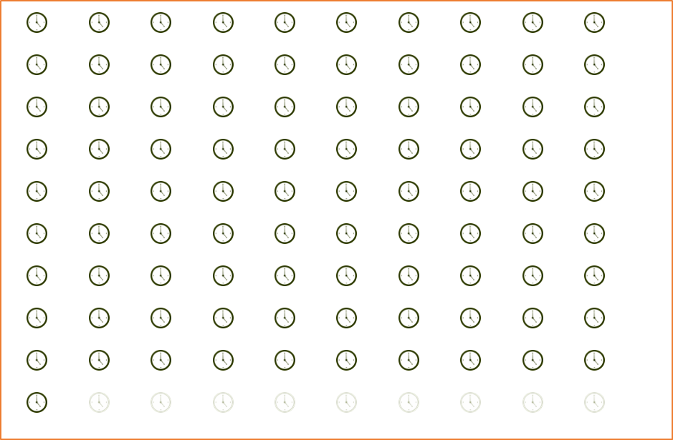
Indicator 1: Timely Services Delivery
Percent of infants and toddlers with Individualized Family Service Plans (IFSP) who receive early intervention services on their IFSPs in a timely manner
97.1
%
91
%
*State Target: 100%
In FFY2022, 97.1% of infants and toddlers received timely services
Timely: <=45 days between service consent date and initial date of service
IFSP: Individualized Family Service Plan

Slide 4
Indicator 7: 45-Day Timeline
Percent of eligible infants and toddlers with IFSPs for whom an evaluation and assessment and an initial IFSP meeting were conducted within Part C’s 45-day timeline
89.3
%
91
%
*State Target: 100%
In FFY2021, 89.3% of infants and toddlers received an initial evaluation, assessment and initial IFSP meeting within 45 days
Timely: <=45 days between primary referral date and initial IFSP date
IFSP: Individualized Family Service Plan

Slide 5
Indicator 8: Early Childhood Transition
Percent of all children exiting Part C who received timely transition planning to support the child's transition to preschool and other appropriate community services by their third birthday including:
8A: Timely Transition Steps and Services;
8B: Timely Notification to SEA & LEA; and
8C: Timely Transition Conference
*State Target is 100%
SEA: State Education Agency
LEA: Local Education Agency

Slide 6
Indicator 8: Early Childhood Transition
100%
99.5%
8A: Transition Steps & Services
8B: Notification
8C: Transition Conference
*8A Timely: Developed an IFSP with transition steps and services at least 90 days and not more than 9 months prior to the toddler’s 3rd birthday
*8B Timely: Notified the State Educational Agency (SEA) and the Local Educational Agency (LEA) at least 90 days and not more 9 months prior to the toddler’s 3rd birthday for toddlers potentially eligible for Part B preschool services
*8C Timely: Conducted the transition conference at least 90 days and not more than 9 months prior to the toddler’s 3rd birthday for toddlers potentially eligible for Part B preschool services

Slide 7
Indicator 2: Settings
Percent of infants and toddlers with IFSPs who primarily receive early intervention services in the home or community-based settings
92.3
%
*State Target: 98%
In FFY2021, 90.0%* of infants and toddlers received services in a home or community setting
*Based on children with IFSPs as of 12/1/2022
Notes:
Due to an error in the SY 2022-23 EMAPS IDEA Part C Child Count and Settings Survey; Section A: Child Count and Settings by Age, the number of infants and toddlers with IFSPs who primarily receive early intervention services in the home or community-based settings should be 8,092, not 8,702. Therefore, FFY 2022 data should be 92.99%, not 100.00%. Georgia Part C regrets this error.

Slide 8
Indicator 3: Child Outcomes
Percent of infants and toddlers with IFSPs who demonstrate improved outcomes during their time in Part C including:
3A: Positive social-emotional skills (including social relationships);
3B: Acquisition and use of knowledge and skills (including early language/communication); and
3C: Use of appropriate behaviors to meet their needs

Slide 9
Indicator 3: Child Outcomes Progress
Progress for child outcomes is summarized and reported to OSEP using two summary statements:
Summary Statement 1 (SS1): Of those children who entered the program below age expectations in each outcome, the percent who substantially increased their rate of growth by the time they turned 3 years or exited the program
c + d
a + b + c + d
Summary Statement 2 (SS2): The percent of children who were functioning within age expectations in each outcome by the time they turned three years or exited the program
d + e
a + b + c + d + e

Slide 10
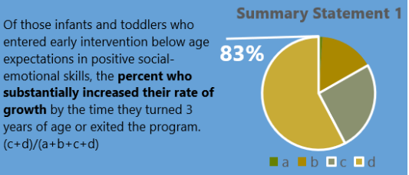
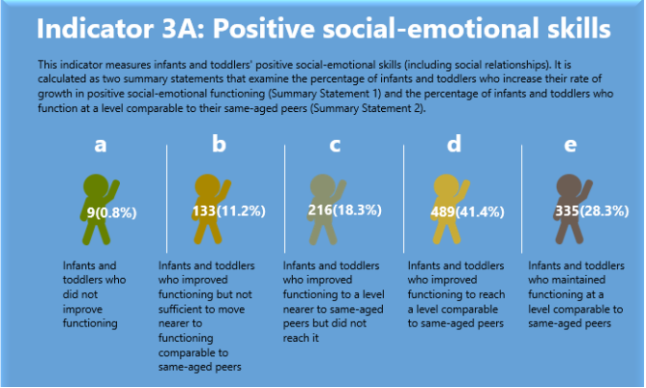
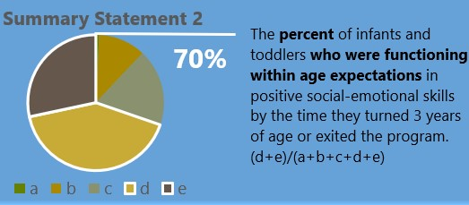
Indicator 3A: Positive social-emotional skills
80.1%
26 (0.3%)
696 (13.9%)
1,109 (23%)
1,802 (34.4%)
1,386 (28.5%)
*Summary Statement 1 State Target: 85%
62.9%
*Summary Statement 2 State Target: 65%

Slide 11
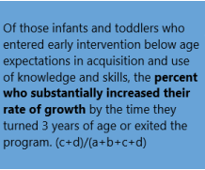
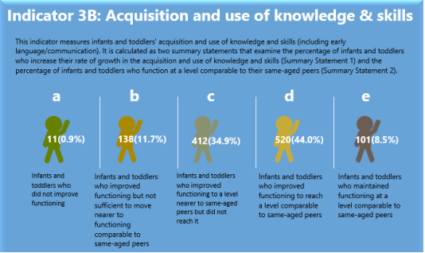
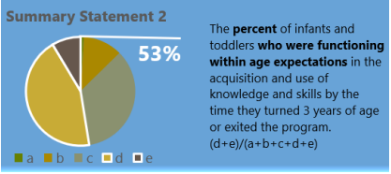
Indicator 3B: Acquisition & use of knowledge & skills
83%
23 (0.3%)
741 (15.4%)
1,778 (37.1%)
2,075 (38.7%)
402 (8.6%)
*Summary Statement 1 State Target: 87.5%
47.3%
*Summary Statement 2 State Target: 51%

Slide 12
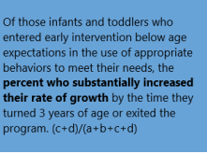
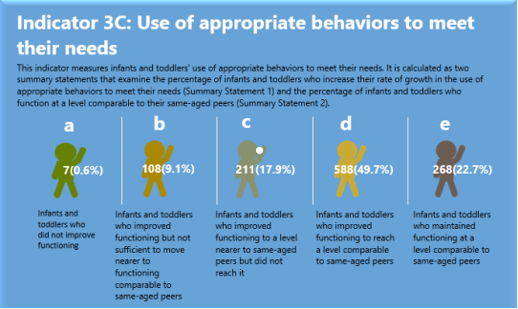
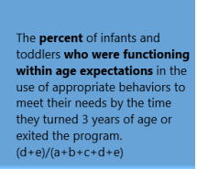
Indicator 3C: Use of appropriate behaviors to meet their needs
83%
21 (0.4%)
581 (12.5%)
1,009 (20%)
2,209 (42.8%)
1,199 (24.4%)
*Summary Statement 1 State Target: 86.1%
67.1%
*Summary Statement 2 State Target: 68.2%

Slide 13
Indicator 4: Family Outcomes
Percent of families participating in Part C who report that early intervention services have helped the family:
4A: Know their rights;
4B: Effectively communicate their children’s needs; and
4C: Help their children develop and learn

Slide 14
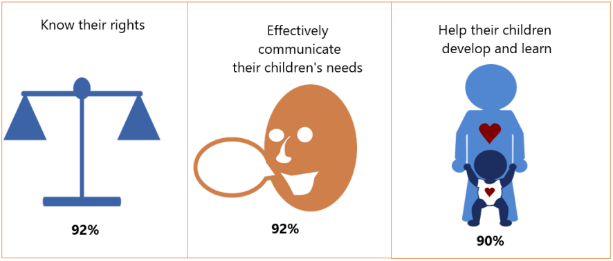
Indicator 4: Family Outcomes
94%
93.3%
91%
4A
*State Target: 91.2%
4B
*State Target: 90.5%
4C
*State Target: 86.5%

Slide 15
Indicators 5 & 6: Child Find Birth to 1 & Birth to 3
Indicator 5: Child Find, Ages Birth to 1
Indicator 6: Child Find, Ages Birth to 3
*Data based on infants and toddlers with IFSPs as of 12/1/2022

Slide 16
Indicator 5 & 6: Children Served, Birth to 3
Sex
N = 17,545
Race/Ethnicity
Age
In Fiscal Year 2022, a total of 17,545 children ages birth through 3 years were served by the Georgia Part C Babies Can’t Wait Program
*American Indian or Alaska Native, Native Hawaiian or Pacific Islander, and Multiracial

Slide 17
Babies Can’t Wait – Part C Early Intervention
FFY22 Local Program Performance

Slide 18
Indicator 1: Timely Services
Percent of infants and toddlers with IFSPs who receive early intervention services on their IFSPs in a timely* manner (State Target = 100%)
District | % with Timely Services | Met State Target? |  | District | % with Timely Services | Met State Target?
Rome (1-1) | 99.3% | Not Met |  | Dublin (5-1) | 97.0% | Not Met
Dalton (1-2) | 99.6% | Not Met |  | Macon (5-2) | 90.9% | Not Met
Gainesville (2) | 97.6% | Not Met |  | Augusta (6) | 95.9% | Not Met
Cobb (3-1) | 97.0% | Not Met |  | Columbus (7) | 99.3% | Not Met
Fulton (3-2) | 90.9% | Not Met |  | Valdosta (8-1) | 97.0% | Not Met
Clayton (3-3) | 96.6% | Not Met |  | Albany (8-2) | 96.9% | Not Met
Gwinnett (3-4) | 98.8% | Not Met |  | Coastal (9-1) | 98.8% | Not Met
DeKalb (3-4) | 96.7% | Not Met |  | Waycross (9-2) | 100% | Met
LaGrange (4) | 98.9% | Not Met |  | Athens (10) | 99.0% | Not Met
- Data: This data is based on the 2022-2023 Annual Performance Report (APR) where all indicators are more fully addressed.
- Timely* services must have been started within 45 days of consent date for a child to be considered having timely received services.

Slide 19
Indicator 2: Natural Settings
Percent of infants and toddlers with IFSPs who primarily receive early intervention services in the home or community-based settings as of 12/1/2021 (State Target = 98%)
District | % in Natural Settings | Met State Target? |  | District | % in Natural Settings | Met State Target?
Rome (1-1) | 68.5% | Not Met |  | Dublin (5-1) | 100% | Met
Dalton (1-2) | 97.0% | Not Met |  | Macon (5-2) | 99.3% | Met
Gainesville (2) | 87.2% | Not Met |  | Augusta (6) | 90.8% | Not Met
Cobb (3-1) | 96.6% | Not Met |  | Columbus (7) | 100% | Met
Fulton (3-2) | 90.7% | Not Met |  | Valdosta (8-1) | 96.1% | Not Met
Clayton (3-3) | 97.2% | Not Met |  | Albany (8-2) | 100% | Met
Gwinnett (3-4) | 87.7% | Not Met |  | Coastal (9-1) | 89.7% | Not Met
DeKalb (3-4) | 91.4% | Not Met |  | Waycross (9-2) | 100% | Met
LaGrange (4) | 98.8% | Met |  | Athens (10) | 90.6% | Not Met
Data: This data is based on infants and toddlers with IFSPs as of 12/1/2022 submitted under the IDEA Section 618 Child Count Data.

Slide 20
Indicator 3: Child Outcomes
A. Percent of infants and toddlers with IFSPs who demonstrate improved positive social-emotional skills, including social relationships (SS1 State Target = 85%)
District | % Met SS1* | Met State Target? |  | District | % Met SS1* | Met State Target?
Rome (1-1) | 86.1% | Not Met |  | Dublin (5-1) | 87.5% | Met
Dalton (1-2) | 71.5% | Not Met |  | Macon (5-2) | 90.5% | Met
Gainesville (2) | 95.6% | Met |  | Augusta (6) | 62.5% | Not Met
Cobb (3-1) | 71.3% | Not Met |  | Columbus (7) | 66.0% | Not Met
Fulton (3-2) | 66.3% | Not Met |  | Valdosta (8-1) | 92.5% | Met
Clayton (3-3) | 79.0% | Not Met |  | Albany (8-2) | 77.3% | Not Met
Gwinnett (3-4) | 69.3% | Not Met |  | Coastal (9-1) | 93.6% | Met
DeKalb (3-4) | 68.6% | Not Met |  | Waycross (9-2) | 81.0% | Not Met
LaGrange (4) | 84.5% | Not Met |  | Athens (10) | 81.8% | Not Met
*Summary Statement 1 (SS1): Of those children who entered the program below age expectations in each outcome, the percent who substantially increased their rate of growth by the time they turned three years of age or exited the program.

Slide 21
Indicator 3: Child Outcomes
A. Percent of infants and toddlers with IFSPs who demonstrate improved positive social-emotional skills, including social relationships (SS2 State Target = 65%)
District | % Met SS2* | Met State Target? |  | District | % Met SS2* | Met State Target?
Rome (1-1) | 57.3% | Not Met |  | Dublin (5-1) | 57.9% | Not Met
Dalton (1-2) | 65.1% | Met |  | Macon (5-2) | 66.4% | Met
Gainesville (2) | 60.9% | Not Met |  | Augusta (6) | 64.1% | Not Met
Cobb (3-1) | 52.4% | Not Met |  | Columbus (7) | 58.3% | Not Met
Fulton (3-2) | 67.1% | Met |  | Valdosta (8-1) | 52.6% | Not Met
Clayton (3-3) | 39.7% | Not Met |  | Albany (8-2) | 76.0% | Met
Gwinnett (3-4) | 75.4% | Met |  | Coastal (9-1) | 80.0% | Met
DeKalb (3-4) | 59.3% | Not Met |  | Waycross (9-2) | 61.0% | Not Met
LaGrange (4) | 49.2% | Not Met |  | Athens (10) | 63.9% | Not Met
*Summary Statement 2 (SS2): The percent of children who were functioning within age expectations in each outcome by the time they turned three years of age or exited the program.

Slide 22
Indicator 3: Child Outcomes
B. % of infants and toddlers with IFSPs who demonstrate improved acquisition and use of knowledge and skills, including early language/communication (SS1 State Target = 87.5%)
District | % Met SS1* | Met State Target? |  | District | % Met SS1* | Met State Target?
Rome (1-1) | 87.0% | Not Met |  | Dublin (5-1) | 77.8% | Not Met
Dalton (1-2) | 81.1% | Not Met |  | Macon (5-2) | 96.5% | Met
Gainesville (2) | 97.0% | Met |  | Augusta (6) | 74.5% | Not Met
Cobb (3-1) | 71.0% | Not Met |  | Columbus (7) | 66.9% | Not Met
Fulton (3-2) | 78.4% | Not Met |  | Valdosta (8-1) | 96.0% | Met
Clayton (3-3) | 82.1% | Not Met |  | Albany (8-2) | 87.2% | Not Met
Gwinnett (3-4) | 78.0% | Not Met |  | Coastal (9-1) | 94.8% | Met
DeKalb (3-4) | 75.5% | Not Met |  | Waycross (9-2) | 79.0% | Not Met
LaGrange (4) | 85.4% | Not Met |  | Athens (10) | 78.2% | Not Met
IFSP – Individual Family Service Plan
*Summary Statement 1 (SS1): Of those children who entered the program below age expectations in each outcome, the percent who substantially increased their rate of growth by the time they turned three years of age or exited the program.

Slide 23
Indicator 3: Child Outcomes
B. % of infants and toddlers with IFSPs who demonstrate improved acquisition and use of knowledge and skills, including early language/communication (SS2 State Target = 51%)
District | % Met SS2* | Met State Target? |  | District | % Met SS2* | Met State Target?
Rome (1-1) | 49.4% | Not Met |  | Dublin (5-1) | 47.4% | Not Met
Dalton (1-2) | 47.8% | Not Met |  | Macon (5-2) | 39.7% | Not Met
Gainesville (2) | 47.8% | Not Met |  | Augusta (6) | 31.1% | Not Met
Cobb (3-1) | 37.1% | Not Met |  | Columbus (7) | 50.3% | Not Met
Fulton (3-2) | 47.9% | Not Met |  | Valdosta (8-1) | 33.1% | Not Met
Clayton (3-3) | 32.5% | Not Met |  | Albany (8-2) | 41.4% | Not Met
Gwinnett (3-4) | 56.8% | Met |  | Coastal (9-1) | 57.8% | Met
DeKalb (3-4) | 52.2% | Met |  | Waycross (9-2) | 47.0% | Not Met
LaGrange (4) | 41.1% | Not Met |  | Athens (10) | 52.5% | Met
*Summary Statement 2 (SS2): The percent of children who were functioning within age expectations in each outcome by the time they turned three years of age or exited the program.

Slide 24
Indicator 3: Child Outcomes
C. Percent of infants and toddlers with IFSPs who demonstrate improved use of appropriate behaviors to meet their needs (SS1 State Target = 86.1%)
District | % Met SS1* | Met State Target? |  | District | % Met SS1* | Met State Target?
Rome (1-1) | 86.9% | Met |  | Dublin (5-1) | 93.8% | Met
Dalton (1-2) | 79.3% | Not Met |  | Macon (5-2) | 92.8% | Met
Gainesville (2) | 97.3% | Met |  | Augusta (6) | 81.9% | Not Met
Cobb (3-1) | 68.6% | Not Met |  | Columbus (7) | 66.9% | Not Met
Fulton (3-2) | 73.0% | Not Met |  | Valdosta (8-1) | 94.1% | Met
Clayton (3-3) | 79.3% | Not Met |  | Albany (8-2) | 81.8% | Not Met
Gwinnett (3-4) | 80.2% | Not Met |  | Coastal (9-1) | 94.1% | Met
DeKalb (3-4) | 74.2% | Not Met |  | Waycross (9-2) | 83.0% | Not Met
LaGrange (4) | 82.0% | Not Met |  | Athens (10) | 80.7% | Not Met
*Summary Statement 1 (SS1): Of those children who entered the program below age expectations in each outcome, the percent who substantially increased their rate of growth by the time they turned three years of age or exited the program.

Slide 25
Indicator 3: Child Outcomes
C. Percent of infants and toddlers with IFSPs who demonstrate improved use of appropriate behaviors to meet their needs (SS2 State Target = 68.2%)
District | % Met SS2* | Met State Target? |  | District | % Met SS2* | Met State Target?
Rome (1-1) | 65.7% | Met |  | Dublin (5-1) | 63.2% | Not Met
Dalton (1-2) | 73.5% | Met |  | Macon (5-2) | 74.0% | Met
Gainesville (2) | 62.9% | Not Met |  | Augusta (6) | 61.7% | Not Met
Cobb (3-1) | 59.6% | Not Met |  | Columbus (7) | 57.8% | Not Met
Fulton (3-2) | 67.9% | Not Met |  | Valdosta (8-1) | 59.7% | Not Met
Clayton (3-3) | 38.4% | Not Met |  | Albany (8-2) | 76.9% | Met
Gwinnett (3-4) | 81.7% | Met |  | Coastal (9-1) | 81.6% | Met
DeKalb (3-4) | 59.7% | Not Met |  | Waycross (9-2) | 72.0% | Met
LaGrange (4) | 48.3% | Not Met |  | Athens (10) | 72.5% | Met
*Summary Statement 2 (SS2): The percent of children who were functioning within age expectations in each outcome by the time they turned three years of age or exited the program.

Slide 26
Indicator 4: Family Outcomes
A. Percent of families who report that early intervention services have helped the family to know their rights (State Target = 91.2%)
District | % Reporting Helpfulness | Met State Target? |  | District | % Reporting Helpfulness | Met State Target?
Rome (1-1) | 89.0% | Not Met |  | Dublin (5-1) | 100% | Met
Dalton (1-2) | 96.0% | Met |  | Macon (5-2) | 89.0% | Met
Gainesville (2) | 92.0% | Met |  | Augusta (6) | 84.0% | Not Met
Cobb (3-1) | 100% | Met |  | Columbus (7) | 100% | Met
Fulton (3-2) | 25.0% | Not Met |  | Valdosta (8-1) | 100% | Met
Clayton (3-3) | 100% | Met |  | Albany (8-2) | 100% | Met
Gwinnett (3-4) | 97.0% | Met |  | Coastal (9-1) | 90.0% | Not Met
DeKalb (3-4) | 100% | Met |  | Waycross (9-2) | 99.0% | Met
LaGrange (4) | 90% | Not Met |  | Athens (10) | 87.0% | Not Met
Data: This data is based on the 2022-2023 Annual Performance Report (APR) where all indicators are more fully addressed.
Percentages based on 1-4 responses are not shown and are indicated by an *.

Slide 27
Indicator 4: Family Outcomes
B. Percent of families who report that early intervention services have helped the family to effectively communicate their children’s needs (State Target = 90.5%)
District | % Reporting Helpfulness | Met State Target? |  | District | % Reporting Helpfulness | Met State Target?
Rome (1-1) | 92.0% | Met |  | Dublin (5-1) | 67.0% | Not Met
Dalton (1-2) | 96.0% | Met |  | Macon (5-2) | 89.0% | Not Met
Gainesville (2) | 91.0% | Met |  | Augusta (6) | 84.0% | Not Met
Cobb (3-1) | 83.0% | Not Met |  | Columbus (7) | 94.0% | Met
Fulton (3-2) | 25.0% | Not Met |  | Valdosta (8-1) | 100% | Met
Clayton (3-3) | 100% | Met |  | Albany (8-2) | 100% | Met
Gwinnett (3-4) | 95.0% | Met |  | Coastal (9-1) | 93.0% | Met
DeKalb (3-4) | 100% | Met |  | Waycross (9-2) | 97.0% | Met
LaGrange (4) | 93% | Met |  | Athens (10) | 89.0% | Not Met
Data: This data is based on the 2022-2023 Annual Performance Report (APR) where all indicators are more fully addressed.
Percentages based on 1-4 responses are not shown and are indicated by an *.

Slide 28
Indicator 4: Family Outcomes
C. Percent of families who report that early intervention services have helped their children develop and learn (State Target = 86.5%)
District | % Reporting Helpfulness | Met State Target? |  | District | % Reporting Helpfulness | Met State Target?
Rome (1-1) | 92.0% | Met |  | Dublin (5-1) | 67.0% | Not Met
Dalton (1-2) | 93.0% | Met |  | Macon (5-2) | 89.0% | Not Met
Gainesville (2) | 94.0% | Met |  | Augusta (6) | 74.0% | Not Met
Cobb (3-1) | 92.0% | Met |  | Columbus (7) | 97.0% | Met
Fulton (3-2) | 25.0% | Not Met |  | Valdosta (8-1) | 100% | Met
Clayton (3-3) | 80.0% | Not Met |  | Albany (8-2) | 98.0% | Met
Gwinnett (3-4) | 89.0% | Met |  | Coastal (9-1) | 93.0% | Met
DeKalb (3-4) | 67.0% | Not Met |  | Waycross (9-2) | 94.0% | Met
LaGrange (4) | 86.0% | Not Met |  | Athens (10) | 85.0% | Not Met
Data: This data is based on the 2022-2023 Annual Performance Report (APR) where all indicators are more fully addressed.
Percentages based on 1-4 responses are not shown and are indicated by an *.

Slide 29
Indicator 5: Child Find (Birth to One)
Percent of infants and toddlers ages birth to one year with IFSPs* (State Target = 0.75%)
District | % with an IFSP as of 12/1/2022 | Met State Target? |  | District | % with an IFSP as of 12/1/2022 | Met State Target?
Rome (1-1) | 1.13% | Met |  | Dublin (5-1) | 0.74% | Not Met
Dalton (1-2) | 1.36% | Met |  | Macon (5-2) | 0.27% | Not Met
Gainesville (2) | 1.14% | Met |  | Augusta (6) | 0.72% | Not Met
Cobb (3-1) | 0.28% | Not Met |  | Columbus (7) | 0.64% | Not Met
Fulton (3-2) | 0.36% | Not Met |  | Valdosta (8-1) | 0.45% | Not Met
Clayton (3-3) | 0.57% | Not Met |  | Albany (8-2) | 0.29% | Not Met
Gwinnett (3-4) | 0.78% | Met |  | Coastal (9-1) | 0.71% | Not Met
DeKalb (3-4) | 0.62% | Not Met |  | Waycross (9-2) | 0.78% | Met
LaGrange (4) | 0.49% | Not Met |  | Athens (10) | 0.44% | Not Met
IFSP – Individualized Family Service Plan
IDEA – Individuals with Disabilities Education Act
*Data based on Georgia’s infants and toddlers with IFSPs as of 12/1/2022 submitted under the IDEA Section 618 Child Count Data.

Slide 30
Indicator 6: Child Find (Birth to Three)
Percent of infants and toddlers ages birth to three years with IFSPs* (State Target = 2.35%)
District | % with an IFSP as of 12/1/2022 | Met State Target? |  | District | % with an IFSP as of 12/1/2022 | Met State Target?
Rome (1-1) | 3.36% | Met |  | Dublin (5-1) | 1.33% | Not Met
Dalton (1-2) | 3.89% | Met |  | Macon (5-2) | 1.44% | Not Met
Gainesville (2) | 2.92% | Met |  | Augusta (6) | 2.10% | Not Met
Cobb (3-1) | 1.74% | Not Met |  | Columbus (7) | 2.25% | Not Met
Fulton (3-2) | 1.75% | Not Met |  | Valdosta (8-1) | 2.61% | Met
Clayton (3-3) | 1.95% | Not Met |  | Albany (8-2) | 1.28% | Not Met
Gwinnett (3-4) | 2.70% | Met |  | Coastal (9-1) | 2.30% | Not Met
DeKalb (3-4) | 1.87% | Not Met |  | Waycross (9-2) | 2.85% | Met
LaGrange (4) | 1.96% | Not Met |  | Athens (10) | 2.90% | Met
IFSP – Individualized Family Service Plan
IDEA – Individuals with Disabilities Education Act
*Data based on Georgia’s infants and toddlers with IFSPs as of 12/1/2022 submitted under the IDEA Section 618 Child Count Data.

Slide 31
Indicator 7: 45-Day Timeline
Percent of infants and toddlers with IFSPs for whom an evaluation and assessment and an initial IFSP meeting were conducted within Part C’s 45-day timeline (State Target = 100%)
District | % Within 45 Day Timeline | Met State Target? |  | District | % Within 45 Day Timeline | Met State Target?
Rome (1-1) | 99.1% | Not Met |  | Dublin (5-1) | 84.0% | Not Met
Dalton (1-2) | 98.9% | Not Met |  | Macon (5-2) | 89.9% | Not Met
Gainesville (2) | 98.6% | Not Met |  | Augusta (6) | 85.0% | Not Met
Cobb (3-1) | 72.8% | Not Met |  | Columbus (7) | 98.1% | Not Met
Fulton (3-2) | 97.6% | Not Met |  | Valdosta (8-1) | 98.8% | Not Met
Clayton (3-3) | 90.9% | Not Met |  | Albany (8-2) | 97.9% | Not Met
Gwinnett (3-4) | 94.6% | Not Met |  | Coastal (9-1) | 77.7% | Not Met
DeKalb (3-4) | 97.3% | Not Met |  | Waycross (9-2) | 98.6% | Not Met
LaGrange (4) | 92.7% | Not Met |  | Athens (10) | 96.0% | Not Met
*This indicator is addressed more fully in the Annual Performance Report (APR).

Slide 32
Indicator 8: Early Childhood Transition
A: Percent of children exiting Part C that received timely* transition steps and services (State Target = 100%)
District | % Timely | Met State Target? |  | District | % Timely | Met State Target?
Rome (1-1) | 97.7% | Not Met |  | Dublin (5-1) | 70.0% | Not Met
Dalton (1-2) | 96.9% | Not Met |  | Macon (5-2) | 99.3% | Not Met
Gainesville (2) | 96.4% | Not Met |  | Augusta (6) | 86.9% | Not Met
Cobb (3-1) | 97.7% | Not Met |  | Columbus (7) | 100% | Met
Fulton (3-2) | 96.1% | Not Met |  | Valdosta (8-1) | 95.4% | Not Met
Clayton (3-3) | 100% | Met |  | Albany (8-2) | 100% | Met
Gwinnett (3-4) | 99.3% | Not Met |  | Coastal (9-1) | 98.8% | Not Met
DeKalb (3-4) | 98.1% | Not Met |  | Waycross (9-2) | 100% | Met
LaGrange (4) | 97.1% | Not Met |  | Athens (10) | 97.5% | Not Met
*Timely: Developed an IFSP with transition steps and services at least 9 months prior to the toddler’s third birthday.
This indicator is addressed more fully in the Annual Performance Report (APR).

Slide 33
Indicator 8: Early Childhood Transition
B: Percent of children exiting Part C that received timely* notification to SEA and LEA (State Target = 100%)
District | % Timely | Met State Target? |  | District | % Timely | Met State Target?
Rome (1-1) | 100% | Met |  | Dublin (5-1) | 100% | Met
Dalton (1-2) | 100% | Met |  | Macon (5-2) | 100% | Met
Gainesville (2) | 100% | Met |  | Augusta (6) | 100% | Met
Cobb (3-1) | 100% | Met |  | Columbus (7) | 100% | Met
Fulton (3-2) | 100% | Met |  | Valdosta (8-1) | 100% | Met
Clayton (3-3) | 100% | Met |  | Albany (8-2) | 100% | Met
Gwinnett (3-4) | 100% | Met |  | Coastal (9-1) | 100% | Met
DeKalb (3-4) | 100% | Met |  | Waycross (9-2) | 100% | Met
LaGrange (4) | 100% | Met |  | Athens (10) | 100% | Met
*Timely: Notified (consistent with any opt-out adopted by the State) the State Educational Agency (SEA) and the Local Educational Agency (LEA) where the toddler resides at least 90 days and not more than 9 months prior to the toddler’s third birthday for toddlers potentially eligible for Part B preschool services.

Slide 34
Indicator 8: Early Childhood Transition
C: Percent of children exiting Part C that received timely* transition conference (State Target = 100%)
District | % Timely | Met State Target? |  | District | % Timely | Met State Target?
Rome (1-1) | 97.7% | Not Met |  | Dublin (5-1) | 70.0% | Not Met
Dalton (1-2) | 96.9% | Not Met |  | Macon (5-2) | 99.3% | Not Met
Gainesville (2) | 96.4% | Not Met |  | Augusta (6) | 86.9% | Not Met
Cobb (3-1) | 97.7% | Not Met |  | Columbus (7) | 100% | Met
Fulton (3-2) | 96.1% | Not Met |  | Valdosta (8-1) | 95.4% | Not Met
Clayton (3-3) | 100% | Met |  | Albany (8-2) | 100% | Met
Gwinnett (3-4) | 99.3% | Not Met |  | Coastal (9-1) | 98.8% | Not Met
DeKalb (3-4) | 98.1% | Not Met |  | Waycross (9-2) | 100% | Met
LaGrange (4) | 97.1% | Not Met |  | Athens (10) | 97.5% | Not Met
*Timely: Conducted the transition conference at least 90 days and not more than 9 months prior to the toddler’s third birthday for toddlers potentially eligible for Part B preschool services.

