Slide 1
Georgia Pregnancy Risk Assessment Monitoring System (PRAMS)
Presented to: WIC Breastfeeding Coordinators
Presented by: Florence Kanu, MPH
Date: October 4, 2017

Slide 2
PRAMS Overview

Slide 3
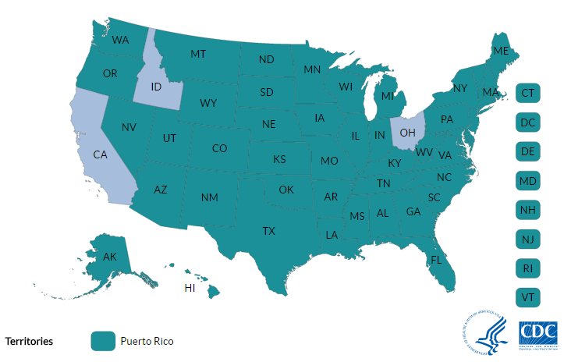
What is PRAMS?
CDC-funded research project
Recent mothers
Mixed-mode
Weighted
Surveillance system

Slide 4

What is PRAMS?
CDC funded research project
Recent mothers
Mixed-mode
Weighted
Surveillance system

Slide 5

What is PRAMS?
CDC funded research project
Recent mothers
Mixed-mode
Weighted
Surveillance system

Slide 6
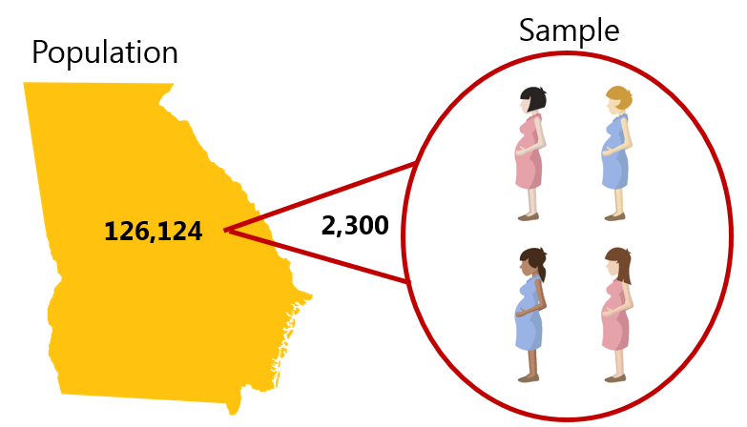
What is PRAMS?
CDC funded research project
Recent mothers
Mixed-mode
Weighted
Surveillance system

Slide 7
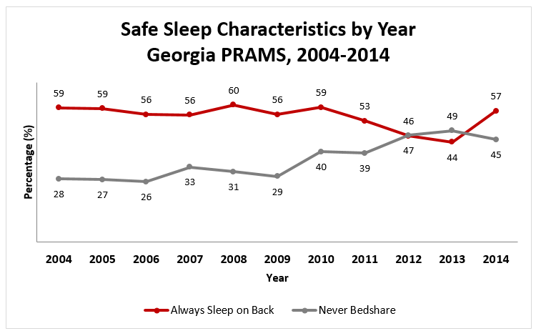
What is PRAMS?
CDC funded research project
Recent mothers
Mixed-mode
Weighted
Surveillance system

Slide 8

Goal of Georgia PRAMS
Provide data on maternal experiences and behaviors before, during, and after pregnancy as well as early infancy which can be used to improve the health of mothers and babies in Georgia

Slide 9
Late/No Prenatal Care: 8.8%
Tobacco Use: 5.2%
Preterm: 11.2%
Low Birth Weight: 9.8%
Source: Birth Certificate Data, 2016; https://oasis.state.ga.us/

Slide 10
PRAMS Provides Context
Experiences
Behaviors
Attitudes
CURRENT PRAMS SURVEY TOPICS
Oral Health
Contraceptive Use
Preconception Health
Baby Friendly 10 Steps
Health Insurance Status
Infant Safe Sleep Practices
Type of Tobacco Consumption

Slide 11
PRAMS sampling & Survey implementation

Slide 12

Sampling
Baby is born

Slide 13

Sampling
Baby is born
Birth certificate clerk enters & submits data to Vital Records

Slide 14
Sampling
Baby is born
Birth certificate clerk enters & submits data to Vital Records
Receive data from Vital Records

Slide 15
Sampling
Baby is born
Birth certificate clerk enters & submits data to Vital Records
Receive data from Vital Records
Create monthly sample

Slide 16
Survey Implementation
Team enters the data into PRAMS Integrated Data Collection System (PIDS) & sends pre-letter
Sample is drawn

Slide 17
Survey Implementation
Team enters the data into PRAMS Integrated Data Collection System (PIDS) & sends pre-letter
Sample is drawn
3 – 7 days
Send Mail 1

Slide 18
Survey Implementation
Team enters the data into PRAMS Integrated Data Collection System (PIDS) & sends pre-letter
Sample is drawn
3 – 7 days
Send Mail 1
7 – 10 days
Send Tickler

Slide 19
Survey Implementation
Team enters the data into PRAMS Integrated Data Collection System (PIDS) & sends pre-letter
Sample is drawn
3 – 7 days
Send Mail 1
7 – 10 days
Send Mail 2
Send Tickler
7 – 14 days

Slide 20
Survey Implementation
Team enters the data into PRAMS Integrated Data Collection System (PIDS) & sends pre-letter
Sample is drawn
3 – 7 days
Send Mail 3
Send Mail 1
7 – 10 days
7 – 14 days
Send Mail 2
Send Tickler
7 – 14 days

Slide 21

Survey Implementation
Sample is drawn
Team enters the data into PIDS & sends Pre-letter
3 – 7 days
Send Mail 3
Send Mail 1
7 – 10 days
7 – 14 days
Send Mail 2
Send Tickler
7 – 14 days

Slide 22

Survey Implementation
Survey Completed!
Gift Card Sent

Slide 23
We Have Data. Now What?
Sole source for several MCH indicators
Monitor changes in MCH indicators over time
Measure progress towards goals
Evaluate policies and program activities
Provide state-level data specific to Georgia
Identify groups at high risk
Investigate emerging issues

Slide 24
Data Spotlight – Breastfeeding

Slide 25

Importance of Breastfeeding
One of the most effective preventive measures to protect the health of a baby
  Reduces risk of infant mortality
  Reduces risk of ovarian and breast cancers
  Helps infant recover quickly from illnesses
  Helps mothers to space pregnancies

Slide 26

Recommendations
American Academy of Pediatrics (AAP)
  Exclusive breastfeeding for six months
  Continued breastfeeding as foods are introduced
  Continued breastfeeding for one year or longer as mutually desired by mom and baby

Slide 27
Breastfeeding Behavior by WIC Status, Georgia PRAMS, 2012-2014
87% of WIC Moms spoke with a Peer Counselor or other WIC staff.

Slide 28
Reasons for Never Breastfeeding by WIC Status, Georgia PRAMS, 2012-2014

Slide 29
Reasons for Breastfeeding Cessation by WIC Status, Georgia PRAMS, 2012-2014

Slide 30

Feedback from Georgia Moms
“Women need access to IBCLC (International Board Certified Lactation Consultant) lactation consultants and have financial and material support for breastfeeding. WIC stores should be able to rent pumps and breastfeeding supplies. GA needs labor laws that support all mothers…but especially breastfeeding mothers. I can’t imagine needing to return to a [minimum] wage or hourly job when my baby is 6 [weeks] old and continuing to breastfeed. It is so hard and I stay at home right now!”
“The hospital staff were very pro-breastfeeding and there were plenty of breastfeeding education resources.”
Source: Georgia PRAMS, 2012-2014

Slide 31
PRAMS Data to Action

Slide 32
Georgia PRAMS Data to Action
Details Georgia’s use of PRAMS data
Assists with programmatic tracking and evaluation
Assists with policy development and advocacy
At least two examples are provided to CDC PRAMS for review annually

Slide 33
How Can We Encourage WIC Breastfeeding Moms?
Increase availability of peer counseling services for all WIC participants
  While Georgia PRAMS data show that 87% of WIC moms spoke with a peer counselor or other WIC staff about breastfeeding, all WIC moms could benefit from peer counseling.
  Evidence shows that multifaceted interventions with peer support are effective in increasing the initiation, duration, and exclusivity of breastfeeding.

Slide 34
How Can We Encourage WIC Breastfeeding Moms?
Improve quality of existing peer counseling services
  Forty-four percent (44%) of WIC moms never breastfed
  Sixty-seven percent (67%) of WIC moms who never breastfeed stated that they did not want to breastfeed.
  Providing additional support for moms by increasing peer counselor contact hours, improving peer counselor training, and making prenatal visits earlier may help to encourage more WIC moms to breastfeed.

Slide 35
How Can We Encourage WIC Breastfeeding Moms?
Provide peer counselors with support and supervision
  Georgia PRAMS respondents commented on their need for access to International Board Certified Lactation Consultants (IBCLCs).
  IBCLCs would be able to provide additional breastfeeding expertise and support to WIC moms.

Slide 36
Any other recommendations for data to action?

Slide 37
Data Dissemination

Slide 38
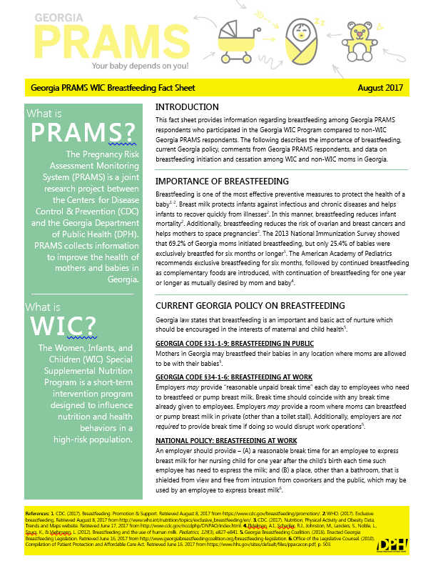

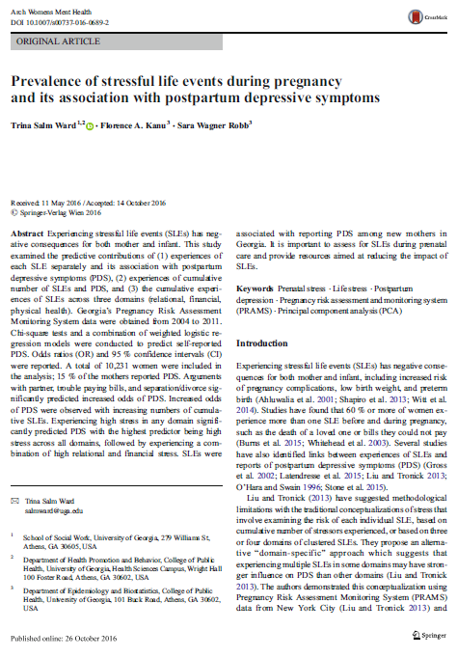
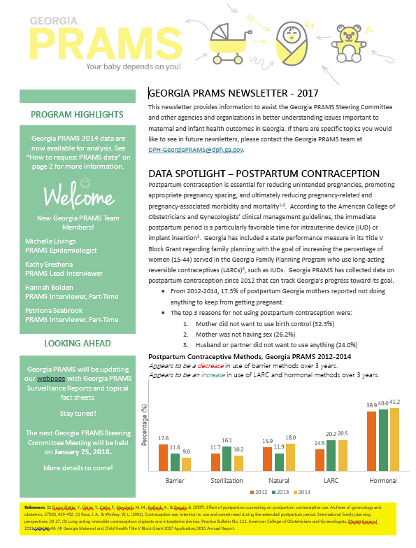
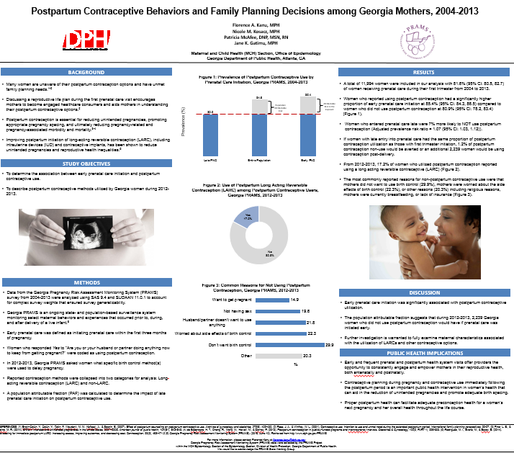
PRAMS Data Dissemination
GA PRAMS Website
  Fact Sheets
  Newsletters
  Data Reports
  Surveillance Reports
Guest Lectures
Scientific Journals
State and National Conferences

Slide 39
THANK YOU
Florence Kanu, MPH
MCH EPI Surveillance Manager
DPH-GeorgiaPRAMS@dph.ga.gov
Georgia Department of Public Health
Maternal and Child Health Epidemiology
2 Peachtree St. NW., 14th Floor, Atlanta, GA 30303
Visit us at dph.ga.gov/PRAMS

Slide 40
Questions?

