Slide 1
Epidemiology and Surveillance in Chronic Disease Prevention and Control
Ping Johnson, PhD
Professor
Department of Health Promotion and Physical Education

Slide 2
Objectives
By the end of the presentation, the participant will be able to:
Describe the common tasks and role of epidemiology in chronic disease prevention and control
Discuss the functions of surveillance in chronic disease control and prevention
Identify the multiple risk factors associated with common chronic diseases
Compare and contrast the foci and activities of the three levels of prevention in public health

Slide 3
Basic Concepts
Epidemiology
Study the distribution and determinants of health problems
Apply the study results to prevention and control of health problems
Distribution
Study of frequency and pattern of health events in the population
Frequency – number, and number in relation to the population
Pattern – the health-related state or event by person, place, and time characteristics
Determinants
Search for causes and other factors of health-related states or events
Base on systematic and objective approach to data collection, analysis, and interpretation

Slide 4
Epidemiology Common Tasks
Identifying risk factors for disease, injury, and death
Describing the natural history of disease
Identifying individuals and populations at greatest risk for disease
Identifying where the public health problem is greatest
Monitoring diseases and other health-related events over time

Slide 5
Evaluating the efficacy and effectiveness of prevention and treatment programs
Providing information useful in health planning and decision making for establishing health programs with appropriate priorities
Assisting in carrying out public health programs
Being a resource person
Communicating public health information
Merrill, R. M. 2017. Introduction to Epidemiology (7th Ed.) Sudbury, MA: Jones and Bartlett Publishers.

Slide 6
Role of Epidemiology
Epidemiological findings contribute to
Preventing and controlling disease, injury, disability, death by
Providing information that leads to
informed public health policy and planning
individual health decision making
Selected type of epidemiologic information
Public health assessment
Causes of disease
Completing the clinical picture
Program evaluation
Efficacy
Effectiveness

Slide 7
Epidemiology helps answer questions of
Diagnosis:
Is there such a problem as myalgic encephalitis?
Is prostate specific antigen a good test for prostate cancer?
Causes:
Why did this patient suffer from a stroke?
Is obesity the cause of metabolic syndrome?
Treatment:
Is this the best treatment for Parkinson’s disease?
Is my surgery as good as that of everyone else?
Prognosis:
What are the chances of a recurrent heart attack?
How long will this knee joint prosthesis last?

Slide 8
Health promotion and protection:
Do current school meals harm children’s future health?
Will the Irish smoking ban in public places work better than the English policy?
Health and disease surveillance:
Why are there tenfold international differences in suicide rates?
When will the next influenza pandemic occur?
Health inequalities:
Why should life expectancy be nearly five years lower in unskilled manual workers?
Do health services reduce or increase health inequalities?
Merrill, R. M. 2017. Introduction to Epidemiology (7th Ed.) Sudbury, MA: Jones and Bartlett Publishers.

Slide 9
Objectives
By the end of the presentation, the participant will be able to:
Describe the common tasks and role of epidemiology in chronic disease prevention and control
Discuss the functions of surveillance in chronic disease control and prevention
Identify the multiple risk factors associated with common chronic diseases
Compare and contrast the foci and activities of the three levels of prevention in public health

Slide 10
Surveillance
Medical surveillance
Close observation of individuals exposed to a communicable disease
Detect early cases
Prompt isolation and control
Public health surveillance
Systematic ongoing collection, analysis, interpretation, and dissemination of health data
Identify outbreaks: early warning => public health emergencies
Inform prevention and control measures
Merrill, R. M. 2017. Introduction to Epidemiology (7th Ed.) Sudbury, MA: Jones and Bartlett Publishers.

Slide 11
Public Health Surveillance Functions
Monitoring
Identify sudden changes in occurrence
Follow long-term trends and patterns
Identify changes in risk factors
Document program impact, progress
Help identify
Whether a health problem exists
Whether the problem is getting worse
Help set priorities
Help develop public health policy and strategies

Slide 12
Public Health Surveillance Functions
An effective surveillance system has the following functions:
detection and notification of health events
collection and consolidation of pertinent data
investigation and confirmation (epidemiological, clinical and/or laboratory) of cases or outbreaks
routine analysis and creation of reports
feedback of information to those providing the data
feed-forward (i.e. the forwarding of data to more central levels)
reporting data to the next administrative level

Slide 13
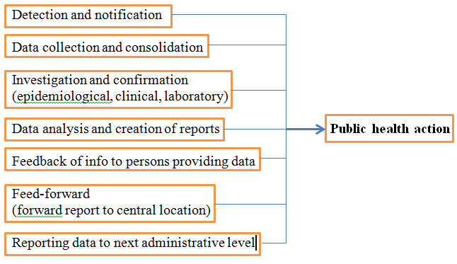
Public Health Surveillance Functions
http://www.who.int/immunization/monitoring_surveillance/burden/vpd/en/

Slide 14
Public Health Surveillance Functions
Evaluation
Health programs may be aimed at
Increasing vaccination levels
Reducing smoking
Increasing fruit and vegetable consumption
Increasing physical activity
Decreasing obesity
Increasing screening
Merrill, R. M. 2017. Introduction to Epidemiology (7th Ed.) Sudbury, MA: Jones and Bartlett Publishers.

Slide 15
Surveillance Example
Vaccine Preventable Disease
State public health officials monitor vaccine preventable disease rates
May signal that the vaccination program is not reaching specific at-risk populations
Monitoring rates by racial/ethnic groups
E.g.: increasing rate exists among a given minority group
Do barriers exist related to culture, language, and access to care?
The vaccination program should then be altered to address these barriers
Merrill, R. M. 2017. Introduction to Epidemiology (7th Ed.) Sudbury, MA: Jones and Bartlett Publishers.

Slide 16
To set objectives of surveillance, ask:
What is the health-related event under surveillance? What is its case definition?
What is the purpose and what are the objectives of surveillance?
What are the planned uses of the surveillance data?
What is the legal authority for any data collection?
Where is the organizational home of the surveillance?
Is the system integrated with other surveillance and health information systems?
What is the population under surveillance?

Slide 17
What is the frequency of data collection (weekly, monthly, annually)?
What data are collected and how? Would a sentinel approach or sampling be more effective?
What are the data sources? What approach is used to obtain data?
During what period should surveillance be conducted? Does it need to be continuous, or can it be intermittent or short-term?

Slide 18
How are the data processed and managed? How are they routed, transferred, stored? Does the system comply with applicable standards for data formats and coding schemes? How is confidentiality maintained?
How are the data analyzed? By whom? How often? How thoroughly?
How is the information disseminated? How often are reports distributed? To whom? Does it get to all those who need to know, including the medical and public health communities and policymakers?
https://www.cdc.gov/OPHSS/CSELS/DSEPD/SS1978/Lesson5/Section2.html#_edn10

Slide 19
Objectives
By the end of the presentation, the participant will be able to:
Describe the common tasks and role of epidemiology in chronic disease prevention and control
Discuss the functions of surveillance in chronic disease control and prevention
Identify the multiple risk factors associated with common chronic diseases
Compare and contrast the foci and activities of the three levels of prevention in public health

Slide 20
Epidemiology Triangle for Infectious Disease
Merrill, R. M. 2017. Introduction to Epidemiology (7th Ed.) Sudbury, MA: Jones and Bartlett Publishers.

Slide 21
Advanced epidemiology triangle for chronic diseases and behavioral disorders
Merrill, R. M. 2017. Introduction to Epidemiology (7th Ed.) Sudbury, MA: Jones and Bartlett Publishers.

Slide 22
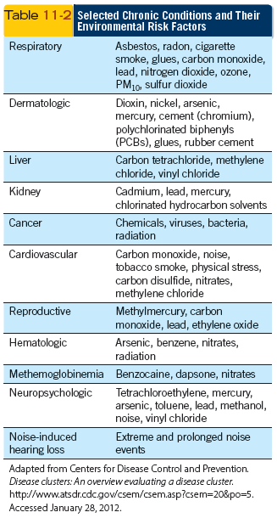
Environment and Chronic Health Problems
The aggregate of external conditions and influences affecting the health status of people
Physical
Chemical
Biological
Social factors
Merrill, R. M. 2017. Introduction to Epidemiology (7th Ed.) Sudbury, MA: Jones and Bartlett Publishers.

Slide 23
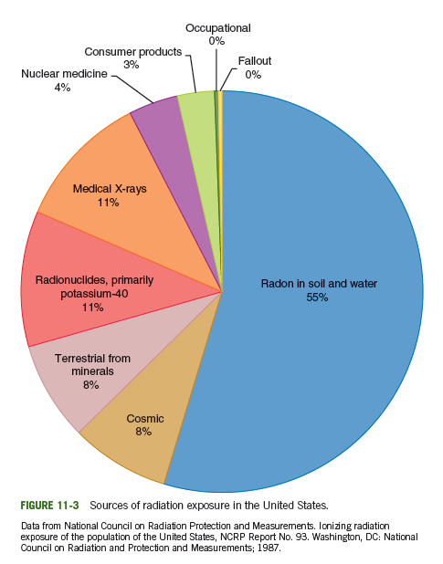
Physical Stresses And Health
Excessive heat, cold, and noise
Radiation (electromagnetic, ultrasound, microwave, x-irradiation)
Vehicular collisions
Workplace injuries
Climate change
Ozone depletion
Housing
...
Merrill, R. M. 2017. Introduction to Epidemiology (7th Ed.) Sudbury, MA: Jones and Bartlett Publishers.

Slide 24
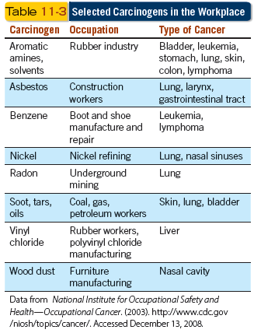
Chemicals and Health
Several chemicals in the environment are capable of causing chronic disease and adverse health conditions
Drugs
Acids
Alkali
Heavy metals (e.g., lead)
Poisons
Some enzymes
Merrill, R. M. 2017. Introduction to Epidemiology (7th Ed.) Sudbury, MA: Jones and Bartlett Publishers.

Slide 25
Biologic Agents and Health
Merrill, R. M. 2017. Introduction to Epidemiology (7th Ed.) Sudbury, MA: Jones and Bartlett Publishers.

Slide 26
Social Environment And Health
War – Mental and physical disabilities
Families and households – Dietary behaviors
Social networks and social supports – foster the ability to deal with and survive chronic health problems
Neighborhoods and communities – may include environments that facilitate physical activity (e.g., parks and recreational centers, bike paths, and safe walking areas), which in turn reduces the risk of certain chronic conditions
Public health policy (e.g., no smoking in public places) – may reduce exposure to individuals of risk factors for certain chronic diseases
Merrill, R. M. 2017. Introduction to Epidemiology (7th Ed.) Sudbury, MA: Jones and Bartlett Publishers.

Slide 27
Behavior and Chronic Health Problems
Many of the diseases and conditions today are influenced by lifestyles of modern populations
Career pressures
Sedentary lifestyles
High density population living
Poor diet
Crime
Drugs
Gangs
Poverty
Pollution
Fear
Stress
Economic struggles
Merrill, R. M. 2017. Introduction to Epidemiology (7th Ed.) Sudbury, MA: Jones and Bartlett Publishers.

Slide 28
Multifactorial etiology in chronic disease epidemiology
Prevention and control of noninfectious diseases and conditions is often much more complicated than that of infectious diseases
The interaction between behavior, environment, genetic, and social risk factors often make prevention efforts complex and sometimes infeasible
Prevention programs need to be specifically tailored to given societies and cultures
Despite the complexities of primary prevention, it provides the greatest potential for minimizing public suffering and health-care costs
Merrill, R. M. 2017. Introduction to Epidemiology (7th Ed.) Sudbury, MA: Jones and Bartlett Publishers.

Slide 29
Objectives
By the end of the presentation, the participant will be able to:
Describe the common tasks and role of epidemiology in chronic disease prevention and control
Discuss the functions of surveillance in chronic disease control and prevention
Identify the multiple risk factors associated with common chronic diseases
Compare and contrast the foci and activities of the three levels of prevention in public health

Slide 30
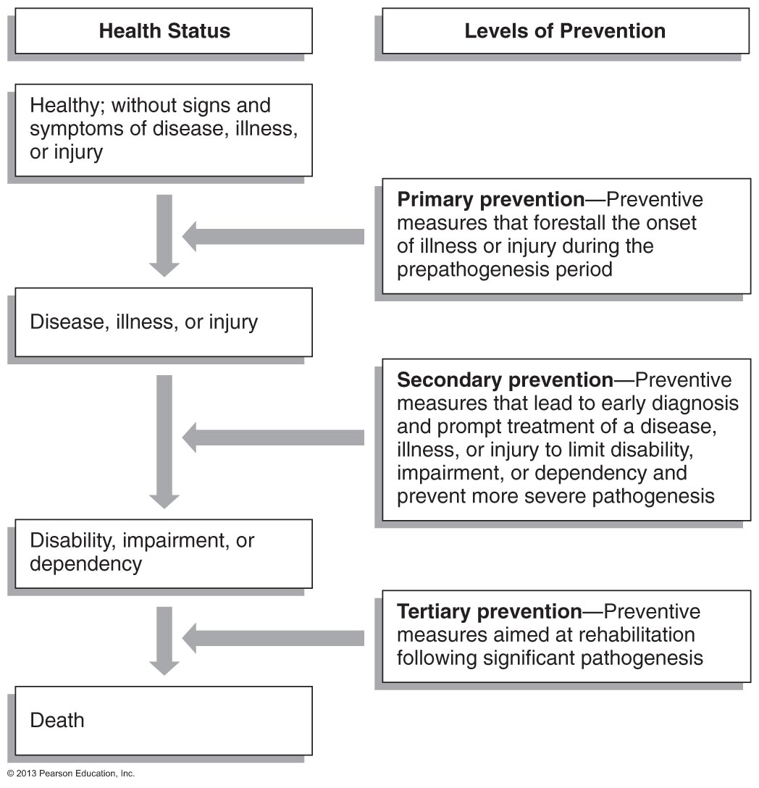
Three Levels of Prevention
McKenzie, J.F., Neiger, B.L., Thackeray, R. (2012) (6th ed) Planning, Implementing, and Evaluating Health Promotion Programs: A Primer. San Francisco, CA: Pearson Education, Inc.

Slide 31
Primary Prevention
Active Primary Prevention
Requires behavior change on part of subject
Wearing protective devices
Health promotion
Lifestyle changes
Community health education
Ensuring healthy conditions at home, school, and workplace
Passive Primary Prevention
Does not require behavior change
Vitamin-fortified foods
Fluoridation of public water supplies
Merrill, R. M. 2017. Introduction to Epidemiology (7th Ed.) Sudbury, MA: Jones and Bartlett Publishers.

Slide 32
Secondary Prevention
Occurs to reduce the progress of disease
The disease already exists in the person
Cancer screening – Cancer already present; the goal is to detect the cancer before clinical symptoms arise in order to improve prognosis and prevent conditions from progressing and from spreading
Merrill, R. M. 2017. Introduction to Epidemiology (7th Ed.) Sudbury, MA: Jones and Bartlett Publishers.

Slide 33
Tertiary Prevention
To reduce the limitation of disability from disease
The disease has already occurred
Physical therapy for stroke victims
Halfway houses for recovering alcoholics
Shelter homes for the developmentally disabled
Fitness programs for heart attack patients
Merrill, R. M. 2017. Introduction to Epidemiology (7th Ed.) Sudbury, MA: Jones and Bartlett Publishers.

Slide 34
Examples

Slide 35
British Doctors Study
Doll R, Hill AB (1954). "The mortality of doctors in relation to their smoking habits". BMJ. 328 (7455): 1529–1533.
Doll, R; Hill AB (November 1956). "Lung cancer and other causes of death in relation to smoking; a second report on the mortality of British doctors". British Medical Journal. 2 (5001): 1071–1081.
Doll R, Peto R, Boreham J, Sutherland I (2004). "Mortality in relation to smoking: 50 years' observation on male British doctors". BMJ. 328 (7455): 1519.

Slide 36
Age-adjusted lung cancer death rates and per capita consumption of males and females in the US

Slide 37
Framingham Heart Study
Research Milestones (selected)
1960 | Cigarette smoking found to increase the risk of heart disease
1961 | Cholesterol level, blood pressure, and electrocardiogram abnormalities found to increase the risk of heart disease
1967 | Physical activity found to reduce the risk of heart disease and obesity to increase the risk of heart disease
1970 | High blood pressure found to increase the risk of stroke
 | Atrial fibrillation increases stroke risk 5-fold
1988 | High levels of HDL cholesterol found to reduce risk of death
1998 | Atrial fibrillation is associated with an increased risk of all-cause mortality
1999 | Lifetime risk at age 40 years of developing coronary heart disease is one in two for men and one in three for women
2001 | High-normal blood pressure is associated with an increased risk of cardiovascular disease

Slide 38
Research Milestones (selected)
2002 | Obesity is a risk factor for heart failure
2007 | Network phenomena appear to be relevant to the biologic and behavioral trait of obesity Obesity appears to spread through social ties
2008 | Social networks exert key influences on decision to quit smoking
2009 | Parental dementia may lead to poor memory in middle-aged adults
 | High leptin levels may protect against Alzheimer's disease and dementia
2010 | Sleep apnea tied to increased risk of stroke
 | Fat around the abdomen associated with smaller, older brains in middle-aged adults Occurrence of stroke by age 65 years in a parent increased risk of stroke in offspring by 3-fold

Slide 39
Nurses' Health Study
The largest, longest running investigations of women’s health
Starting with the original Nurses’ Health Study in 1976
Now in the third generation with Nurses’ Health Study 3 (which is still enrolling male and female nurses) and count more than 275,000 participants
Key research findings

Slide 41
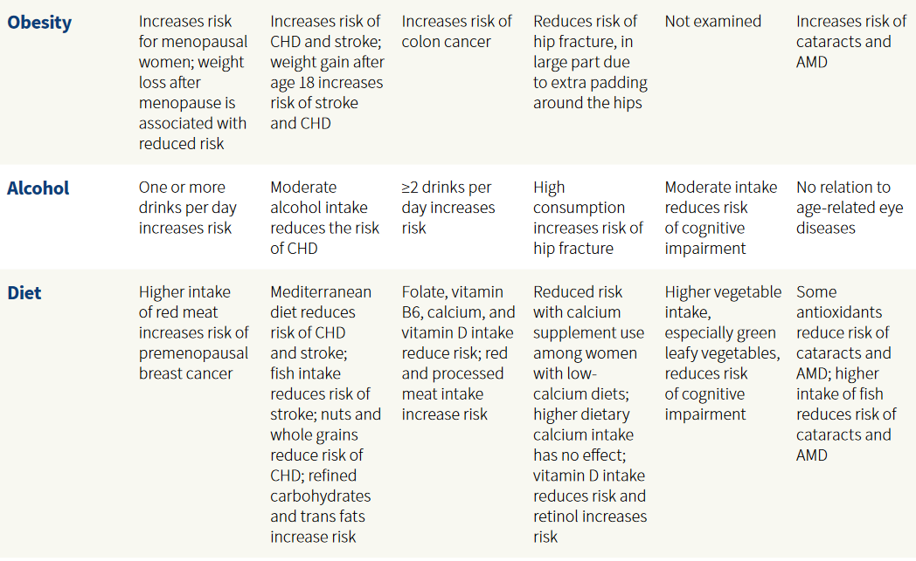

Slide 42
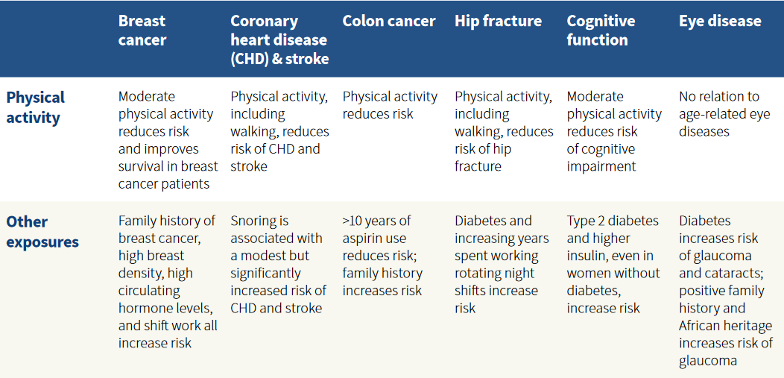

Slide 43
Cancer Prevention Studies
Conducted by American Cancer Society
Hammond-Horn Study: 1952-1955
helped to establish cigarette smoking as a cause of death from lung cancer and coronary heart disease
CPS-1: 1959-1972
demonstrated sharp increase in lung cancer death rates among US women between 1959 and 1972 occurred only in smokers
First study to show a relationship between obesity and shortened overall survival
CPS-2: 1982- last survey questionnaire sent in 2007
CPS-3: 2006-current

Slide 44
Other key findings from CPS studies
Cigarettes with reduced yield of tar and nicotine do not reduce the risk of lung cancer.
Obesity is associated with increased death rates from at least ten cancer sites, including colon and post-menopausal breast cancer.
Discovery of the link between aspirin use and lower risk of colon cancer opened the door to research on chronic inflammation and cancer.
Relationships of other potentially modifiable factors such as physical inactivity, prolonged hormone use and certain dietary factors with cancer risk.
Air pollution, especially small particulates and ozone, increase death rates from heart and lung conditions. CPS-II findings helped to motivate the Environmental Protection Agency to propose more stringent limits on air pollution.

Slide 45
GA Chronic Disease Prevention Programs (selected)
Georgia Asthma Control Program (GACP)
Georgia Comprehensive Cancer Control Program (CCCP)
Hypertension Management and Outreach Program (HMOP)
Georgia Stroke and Heart Attack Prevention Program (Georgia SHAPP)
Georgia Tobacco Use Prevention Program (GTUPP)
Georgia Tobacco Quit Line (GTQL)

Slide 46
Questions?
Thank you!

