Slide 1
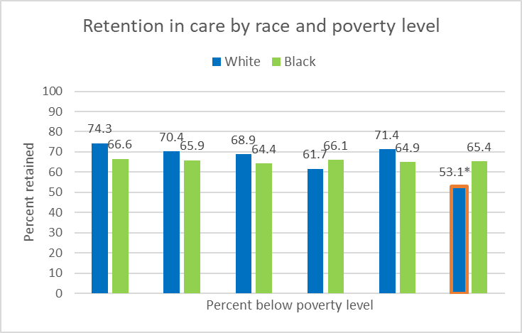
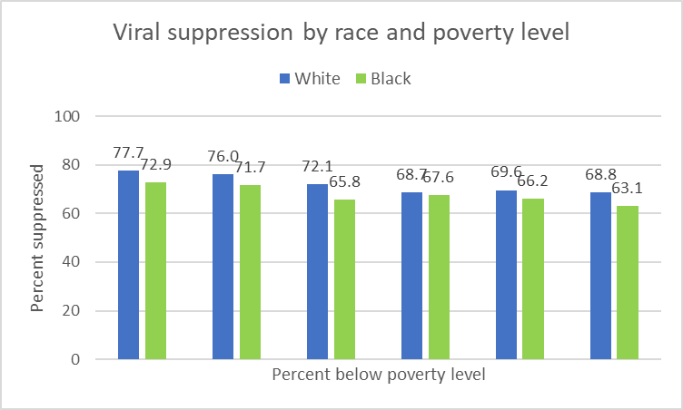
Black-White Differences in HIV Retention in Care and Viral Suppression by Census Tract Poverty Level, Georgia
Daniel Mauck, PhD, MPH, MS*; Pascale Wortley, MD, MPH; Cherie Drenzek, DVM, MS
HIV/AIDS Epidemiology Section, Georgia Department of Public Health, Atlanta, GA
Introduction
Results
Results
Background:
In 2019, Georgia had the highest rate of new HIV diagnoses in the US among states (23.1 per 100,000) (1).
Retention in care and viral suppression are important to slow HIV disease progression and reduce transmission to others (2).
Suboptimal HIV care outcomes have been reported by race and census tract poverty level (2).
Blacks and Hispanics living with HIV were less likely to achieve and maintain suppressed viral load than Whites in studies in NYC and San Francisco (2).
Blacks and Hispanics were more likely to live in the most impoverished census tracts than Whites in NYC study (2).
Blacks living in the most impoverished census tracts had the lowest proportion of viral suppression in NYC study (2).
Whites living in the least impoverished census tracts had highest proportion of viral suppression in NYC study (2).
Census tracts are subdivisions of counties (3).
Population size is between 1,200 and 8,000 people with an average of 4,000 people (3).
Population of a ZIP code can exceed 100,000 people (4).
Objective:
Examine effect of census tract poverty on retention in care and viral suppression among Blacks and Whites with HIV.
Overall:
4,645 people were diagnosed in 2018 and 2019 in Georgia and geocoded to census tract.
3,315 (71.4%) were Black and 721 (15.5%) were White.
Within 12 months of diagnosis, 65.4% of Blacks and 68.9% of Whites achieved retention in care while 67.3% of Blacks and 73.0% of Whites achieved viral suppression.
As poverty increased, retention in care and viral suppression percentages decreased.
Viral suppression decreased more than retention in care as poverty increased.
Retention in care by poverty level:
Retention in care did not vary much among Blacks by poverty (Figure 2).
Retention in care was usually higher among Whites than Blacks, regardless of poverty (Figure 2).
Viral suppression by poverty level:
Viral suppression decreased as poverty increased for Blacks and Whites (Figure 3).
Viral suppression was usually higher among Whites than Blacks, regardless of poverty level (Figure 3).
Figure 2. Retention in care by race and poverty level.
Figure 3. Viral suppression by race and poverty level.
*N=17
Figure 1. Percent below poverty level by census tract.
Methods
Discussion and conclusions
Data set:
Data came from Georgia’s enhanced HIV/AIDS Reporting System (eHARS) and 2015–2019 American Community Survey (ACS).
Study population included individuals newly diagnosed during 2018–2019 whose residence at diagnosis could be geocoded to census tract.
Variables from eHARS included race, census tract at HIV diagnosis, state at HIV diagnosis, and lab data (CD4 count and viral load tests)
CD4 counts and viral load measures were used as proxies for HIV care visits.
Retention in care was defined as at least two CD4/viral load (VL) tests 90 days apart during the 12 months after diagnosis.
Viral suppression was defined as last VL <200 copies per milliliter during the 12 months after diagnosis.
The percent of people whose income in past 12 months was below the poverty level was obtained from the ACS by census tract (5).
Categorized as 0–6.99% below poverty level, 7–10.99%, 11–17.99%, 18–24.99%, 25–39.99%, and >40% (Figure 1).
Retention in care was less affected by poverty than viral suppression.
Retention in care and viral suppression were usually higher among Whites.
Black-White gap in retention in care and viral suppression remained approximately the same across poverty levels.
Census tract poverty may be useful to identify people needing additional public health programmatic/policy support to improve retention in care and viral suppression and reduce HIV transmission.
Limitations:
No individual-level measure of poverty was available.
References
1. Centers for Disease Control and Prevention. HIV Surveillance Report, 2019; vol. 32. http://www.cdc.gov/hiv/library/reports/hiv-surveillance.html. Published May 2021. Accessed January 3, 2022.
2. Xia, Q., Robbins, R.S., Lazar, R., et al. (2017). Racial and socioeconomic disparities in viral suppression among persons living with HIV in New York City. Annals of Epidemiology, 27(5), 335-341.
3. Glossary. US Census Bureau. Available at https://www.census.gov/programs-surveys/geography/about/glossary.html. Accessed January 3, 2022.
4. 10 Reasons to use Census Tract Versus ZIP Code Geography & Demographics. Proximity One. Available at http://proximityone.com/tracts_zips.htm. Accessed January 3, 2022.
5. Explore census data. US Census Bureau. Available at https://data.census.gov/cedsci/. Accessed January 3, 2022.
Acknowledgements
*Author contact email: daniel.mauck@dph.ga.gov
The authors wish to thank the HIV Core Surveillance staff in the HIV/AIDS Epidemiology Section at the Georgia Department of Public Health for their efforts to obtain complete data.

