Slide 1
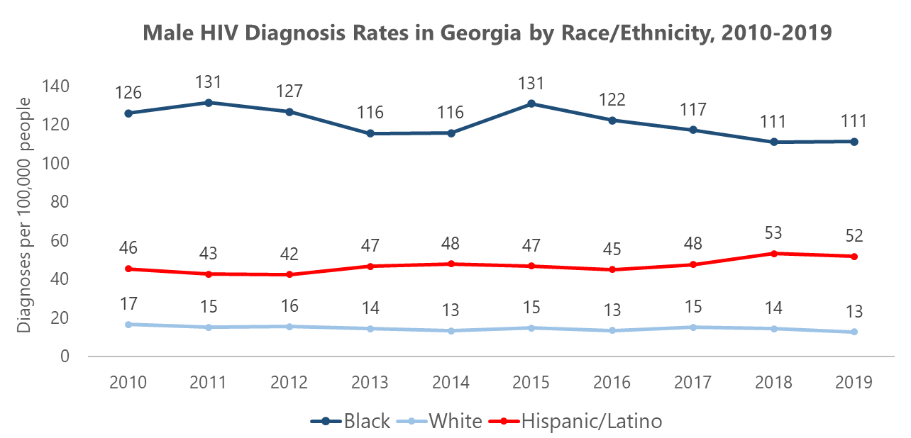
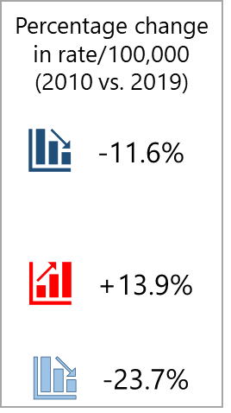
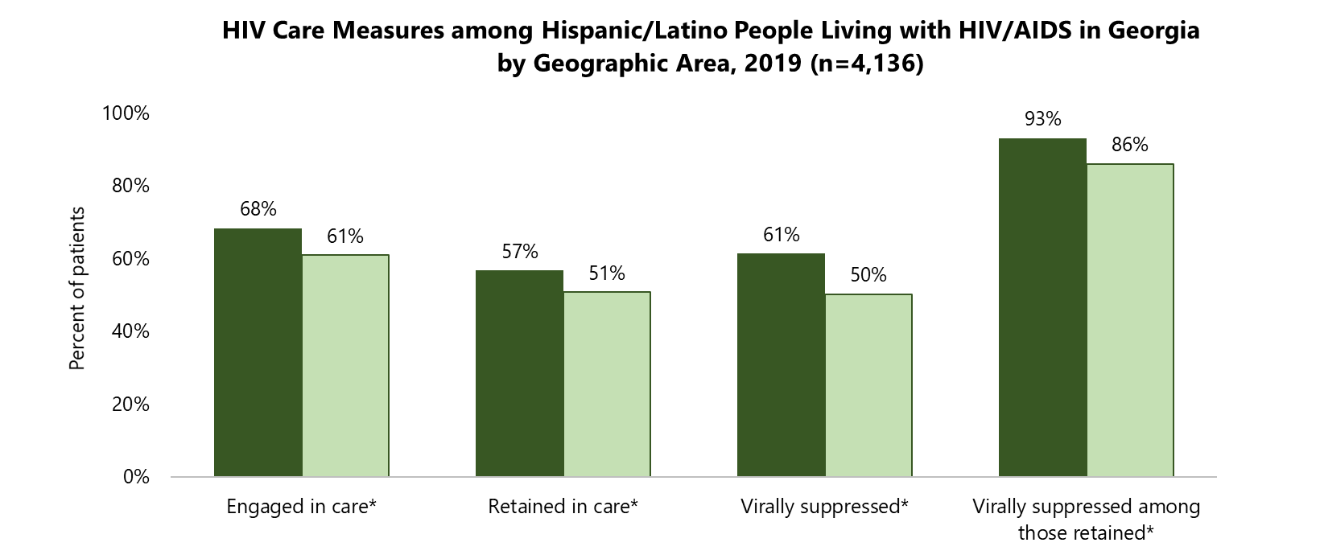
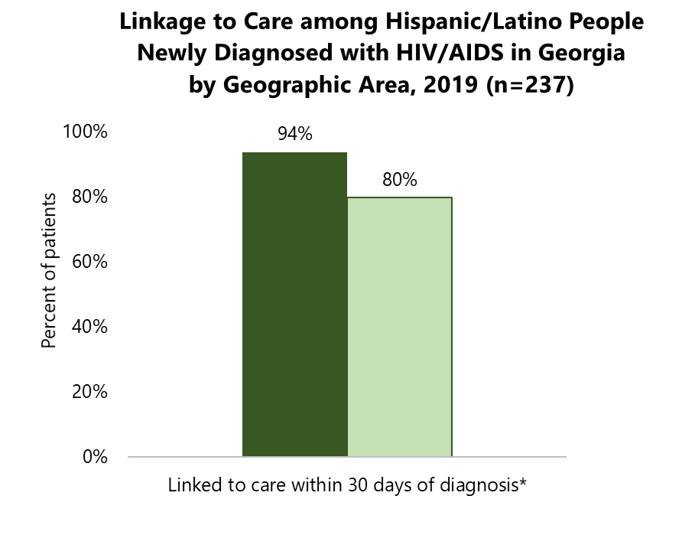
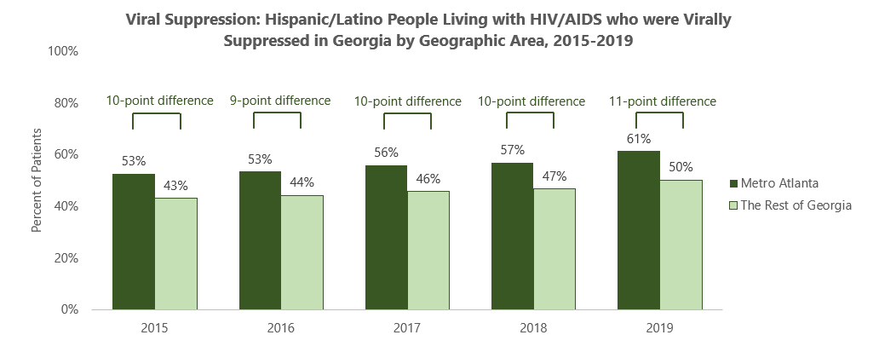
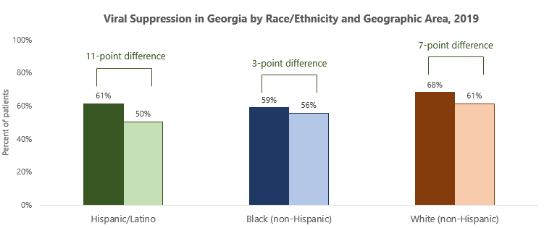
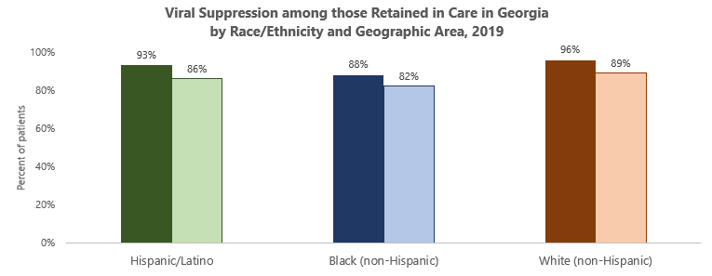
Disparities in Viral Suppression and HIV Care Measures among Hispanic/Latino People Living in Metro Atlanta and Georgia, 2015-2019
Eleanor (Nellie) Garlow, MPH¹, Pascale Wortley, MD, MPH¹, Cherie Drenzek DVM, MS¹ (1) Georgia Department of Public Health
Introduction
Results
Results (continued)
HIV diagnoses among the Hispanic/Latino population in Georgia have increased over the past 10 years, a trend not seen among Black or White populations.
Hispanic/Latino HIV diagnosis rates have risen especially quickly in Gwinnett County (15/100,000 in 2014 to 39/100,000 in 2019).
In a preliminary investigation into this trend, we examined demographic differences in access to HIV care among Hispanics/Latinos in GA through the lens of five care continuum measures. When focusing on viral suppression (one of the five measures), we saw that the largest demographic disparity occurred by geography (62% virally suppressed in metro Atlanta vs. 50% in the rest of GA).
Primary study aim: To examine geographic disparities in HIV care continuum measures among Hispanic/Latino populations to better understand which subpopulations may need additional public health interventions.
Additional study aims: 1) Compare geographic disparities for care measures between Hispanic/Latino, Black, and White populations, 2) Investigate changes in geographic disparities for care measures over time among Hispanic/Latino populations.
Analysis 1: Geographic HIV Care Disparities among
Hispanic/Latino Populations, 2019
Analysis 3: Changes in Geographic HIV Care Disparities Over Time among Hispanic/Latino Populations, 2015-2019
In 2019, attainment of all five HIV care measures was higher among Hispanic/Latino populations living in metro Atlanta compared to the rest of Georgia (p<0.01).
For viral suppression, Hispanic/Latino populations living in metro Atlanta had higher viral suppression (61%) compared to Hispanic/Latino populations living in the rest of GA (50%).
A lower proportion of Hispanics/Latinos living in the rest of GA were engaged in care (61%) and retained in care (51%) compared to Hispanics/Latinos living in metro Atlanta (68% and 57% respectively).
Between 2015-2019, there was no clear signal that HIV care disparities were decreasing for any of the five care continuum measures among Hispanic/Latino populations living in metro Atlanta vs. the rest of GA.
Most gaps remained stable overtime with metro Atlanta having higher levels of attainment compared to the rest of GA, and some gaps may be increasing slightly.
For example, the geographic disparity for engagement in care grew from a 5-percentage point difference in 2015 (61% in metro Atlanta vs. 56% in the rest of GA) to a 7-percentage point difference in 2019 (68% in metro Atlanta vs. 61% in the rest of GA).
While viral suppression levels did increase overtime for Hispanics/Latinos living in metro Atlanta and the rest of GA, geographic disparities between the two groups remained stable (10-percentage point difference in 2015 vs. 11-percentage point difference in 2019).
Analysis 2: Comparison of Geographic HIV Care Disparities Between
Three Racial/Ethnic Groups
For viral suppression, Hispanic/Latino populations had an 11-percentage point difference between those living in metro Atlanta vs. the rest of GA, which was the largest geographic care disparity when compared to Black and White populations.
Hispanics/Latinos who lived in the rest of GA had the absolute lowest levels of viral suppression (at 50%) compared to all other groups.
For the other HIV care measures, Hispanics/Latinos who lived in the rest of GA (i.e. not metro Atlanta) also had the lowest levels of engagement in care (61%) and retention in care (51%) compared to all other groups by race/ethnicity and geographic area.
However, among those retained in care who lived in the rest of GA, viral suppression was higher for Hispanics/Latinos (at 86%) compared to Blacks (at 82%), but lower compared to Whites (at 89%).
Methods
Discussion
Data source: Georgia’s 2015-2019 enhanced HIV/AIDS Reporting System (eHARS) data
Five HIV care continuum measures: We calculated attainment for each measure. (Note: lab encounters serve as a proxy for an HIV care visit)
Linkage to care: $≥$1 lab encounter (CD4/viral load [VL]) within 30 days of diagnosis
Engagement in care: $≥$ 1 lab encounter (CD4/VL) during the year
Retention in care: $≥$ 2 lab encounters (CD4/VL) at least 90 days apart during the year
Viral suppression: Most recent VL test in year was <200 copies/ml
Viral suppression among those retained in care: Among those with $≥$2 lab encounters during the year, most recent VL test was <200 copies/ml
Our analyses placed emphasis on the viral suppression measure because achieving viral suppression is critical for both the patient’s health and preventing forward transmission.
Key takeaways:
Among Hispanic/Latino populations in GA, geographic disparities existed for all five HIV care continuum measures and there was no indication that these geographic disparities were improving over time.
Among those residents who lived in the rest of GA, Hispanic/Latino populations had the lowest measures of care visits (that is, engagement in care and retention in care) as compared to Black and White populations. This likely explains why Hispanic/Latino populations ultimately had the lowest levels of viral suppression.
However, this pattern ceased among those who were retained in care: Hispanics/Latinos who lived in the rest of GA had higher levels of viral suppression compared to Blacks who lived in the rest of GA.
Post-analysis investigation:
We noticed that rates of viral suppression were low in several Public Health Districts with Immigration Customs Enforcement (ICE) facilities. We suspected that patients whose last lab came from an ICE facility and who did not have a viral load test in 2019 may no longer be living in GA.
We conducted a sensitivity analysis that excluded all patients whose last lab was from an ICE facility to understand whether the geographic disparities seen in this analysis were related to missing data on the current location of such persons. After excluding this group from the analysis, care gaps persisted for all care continuum measures except for viral suppression among those retained in care.
Work is underway to collect additional data on patients at ICE facilities. Future work should focus on better understanding the challenges Hispanics/Latinos who do not live in metro Atlanta may face in accessing and utilizing HIV care.
Darker color: Metro Atlanta
Lighter color: The Rest of GA
Geographic comparison:
Metro Atlanta (EMA² counties)
The Rest of Georgia (non-EMA counties)
Data analyses:
Analysis 1: Geographic Care Disparities Compared the five HIV care measures between Hispanics/Latinos living in metro Atlanta vs. the rest of GA using chi-square tests.
Analysis 2: Care Disparities by Race/Ethnicity Compared geographic care disparities among Hispanics/Latinos, Blacks, and Whites using percentage point differences.
Analysis 3: Changes in Disparities Over Time Examined changes in geographic disparities from 2015-2019 for Hispanics/Latinos using percentage point differences.
Map of Atlanta EMA Counties
Darker color: Metro Atlanta
Lighter color: The Rest of GA
Corresponding Author Contact Information
Eleanor (Nellie) Garlow, MPH
HIV Epidemiologist, Georgia Department of Public Health
Eleanor.Garlow@dph.ga.gov
² The 20 Atlanta EMA (Eligible Metropolitan Area) counties are eligible for Ryan White HIV/AID Program Part A Grants.

