Slide 1
This PowerPoint file can be utilized by EMS agencies to educate your EMS staff for the transition to NEMSIS v3.5 data set.
This PowerPoint file is not an official DPH Office of EMS and Trauma document and should not be advertised as such.

Slide 2
NEMSIS v3.5 Data Transition
NEMSIS v3.5 Data Transition for GEMSIS Elite Users

Slide 3
Agenda
GEMSIS/NEMSIS v3.5 Transition
Resources Available
Data Dictionary
Definitions of data fields/elements of new required data fields
Other Data fields/elements
Current Issues with Documentation
Hospital Hub

Slide 4
Georgia EMS Information System (GEMSIS Elite)
Georgia’s state EMS data repository
Stores EMS data from all Georgia licensed EMS agencies:
Ground Ambulance
Air Ambulance
Medical First Responder
Neonatal services
A universal standard dataset for how incident data resulting from a response is collected for Georgia.

Slide 5
NEMSIS
The National Emergency Medical Services Information System (NEMSIS): is the national database that is used to store EMS data from the U.S. States and Territories.
Universal standard dataset
A collaborative system to improve patient care through the standardization, aggregation, and utilization of point of care EMS data at a local, state and national level
NEMSIS is a product of NHTSA’s Office of EMS
NEMSIS provides the framework for collecting, storing, and sharing standardized EMS data from States nationwide.
NEMSIS uniform dataset and database help local, state and national EMS stakeholders more accurately assess EMS needs and performance, as well as support better strategic planning for the EMS systems of tomorrow.

Slide 6
Why Transition to NEMSIS v3.5?
The National objectives for these changes are to:
Reduce less data entry errors
Make data collection more intuitive, usable, and exchangeable
Increase in data accuracy
Our goal with implementing these changes is to:
Maintain National compliance
Improve users’ ability to effortlessly navigate through the incident record
Reduce provider frustrations with lengthy documentation
Better incident flow

Slide 7
What does “Transition” mean?
Transition means we are switching from one version (current NEMSIS v3.4) to a new one (NEMSIS v3.5).
How does it affect EMS Agencies in GEMSIS Elite?
All current EMS Agencies are set on the v3.4 version in the system.
What will OEMST have to do in GEMSIS Elite to transition an EMS Agency?
We will have to switch the default version in GEMSIS Elite from v3.4 to v3.5
This will allow you to document calls using the new EMS form, Print Report, and new validation rules created to v3.5

Slide 8
What does this mean for EMS Agencies?
NEMSIS v3.5
Total of 293 Validation Rules
97 rules from v3.4 converted to v3.5
14 new rules created to include v3.5 changed elements and values
182 current rules updated to include v3.5 changed elements and values
Updated the current state EMS and EMS/Fire ePCR form and Print Report in the system with any field changes.
Phase 1:
Transition of GEMSIS Elite agencies to v3.5 (July 2023)
GEMSIS Elite Validation (Compatibility) Process (ePCR Vendor Compliance Testing)
Phase 2: Transition of 3rd Party ePCR agencies.
All EMS agencies transitioned to v3.5 by November 1st
All states must be fully transitioned to v3.5 before 2024

Slide 9
Expectations of EMS Agencies
Review the new two data policies published by OEMST and confirm your EMS agency is compliant with these two policies (available on DPH EMS Website).
EMS Agencies are responsible for educating their medics on the updated ePCR documentation including data element and value changes, new validation rules, current documentation issues, etc.)
EMS Agencies are responsible to complete all the transition preparation steps as soon as possible.
Use the recommended checklists and other transition materials created to assist with transition (available on DPH EMS Website).
Communicate with OEMST about your agency’s transition plan or any other changes.
OEMST will start transitioning EMS Agencies using GEMSIS Elite beginning of July.

Slide 10
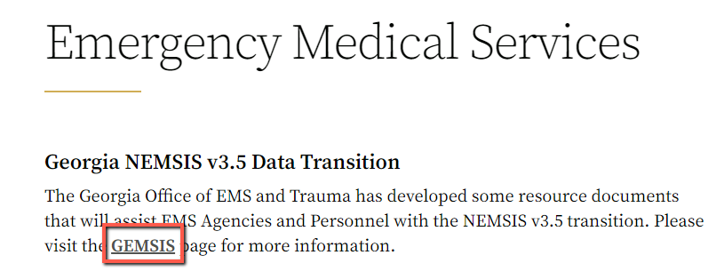
Where to Find All Resources for v3.5
GA EMS Website: https://dph.georgia.gov/EMS

Slide 12
Georgia Emergency Medical Services Information System (GEMSIS)

Slide 13
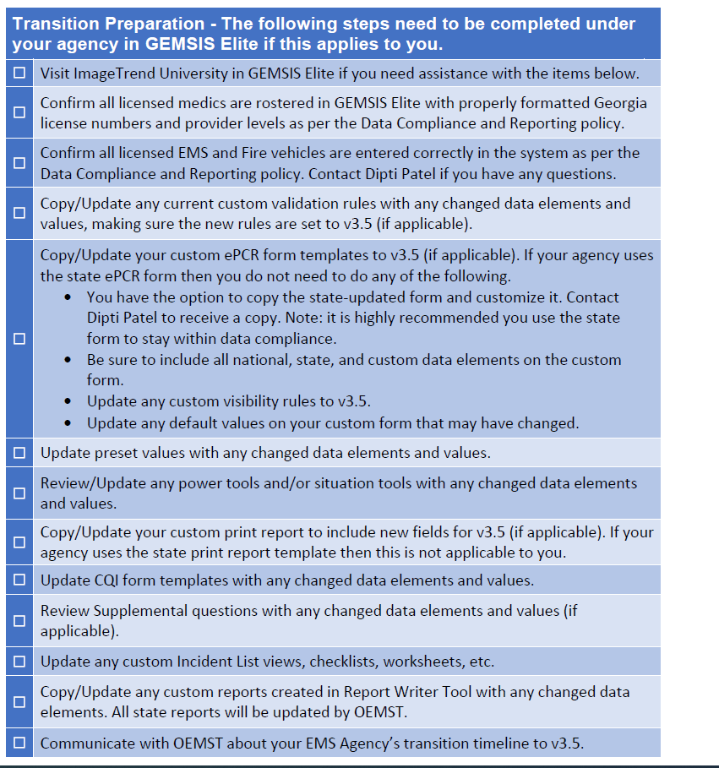
v3.5 Checklist Recommendations

Slide 14
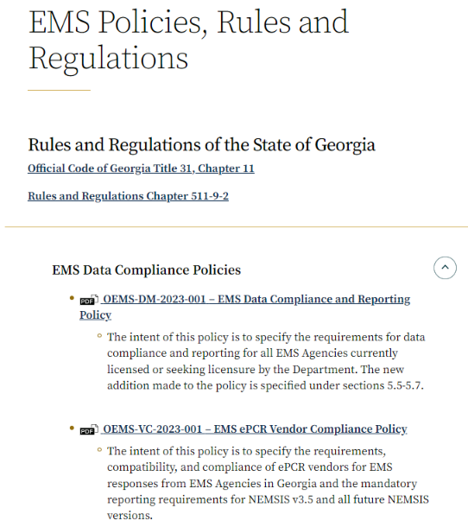
OEMST Data Policies
OEMS-DM-2023-001:
EMS Data Compliance and Reporting Policy
OEMS-VC-2023-002:
EMS ePCR Vendor Compliance Policy

Slide 15
NEMSIS Resources www.nemsis.org

Slide 16
NEMSIS Resources

Slide 17
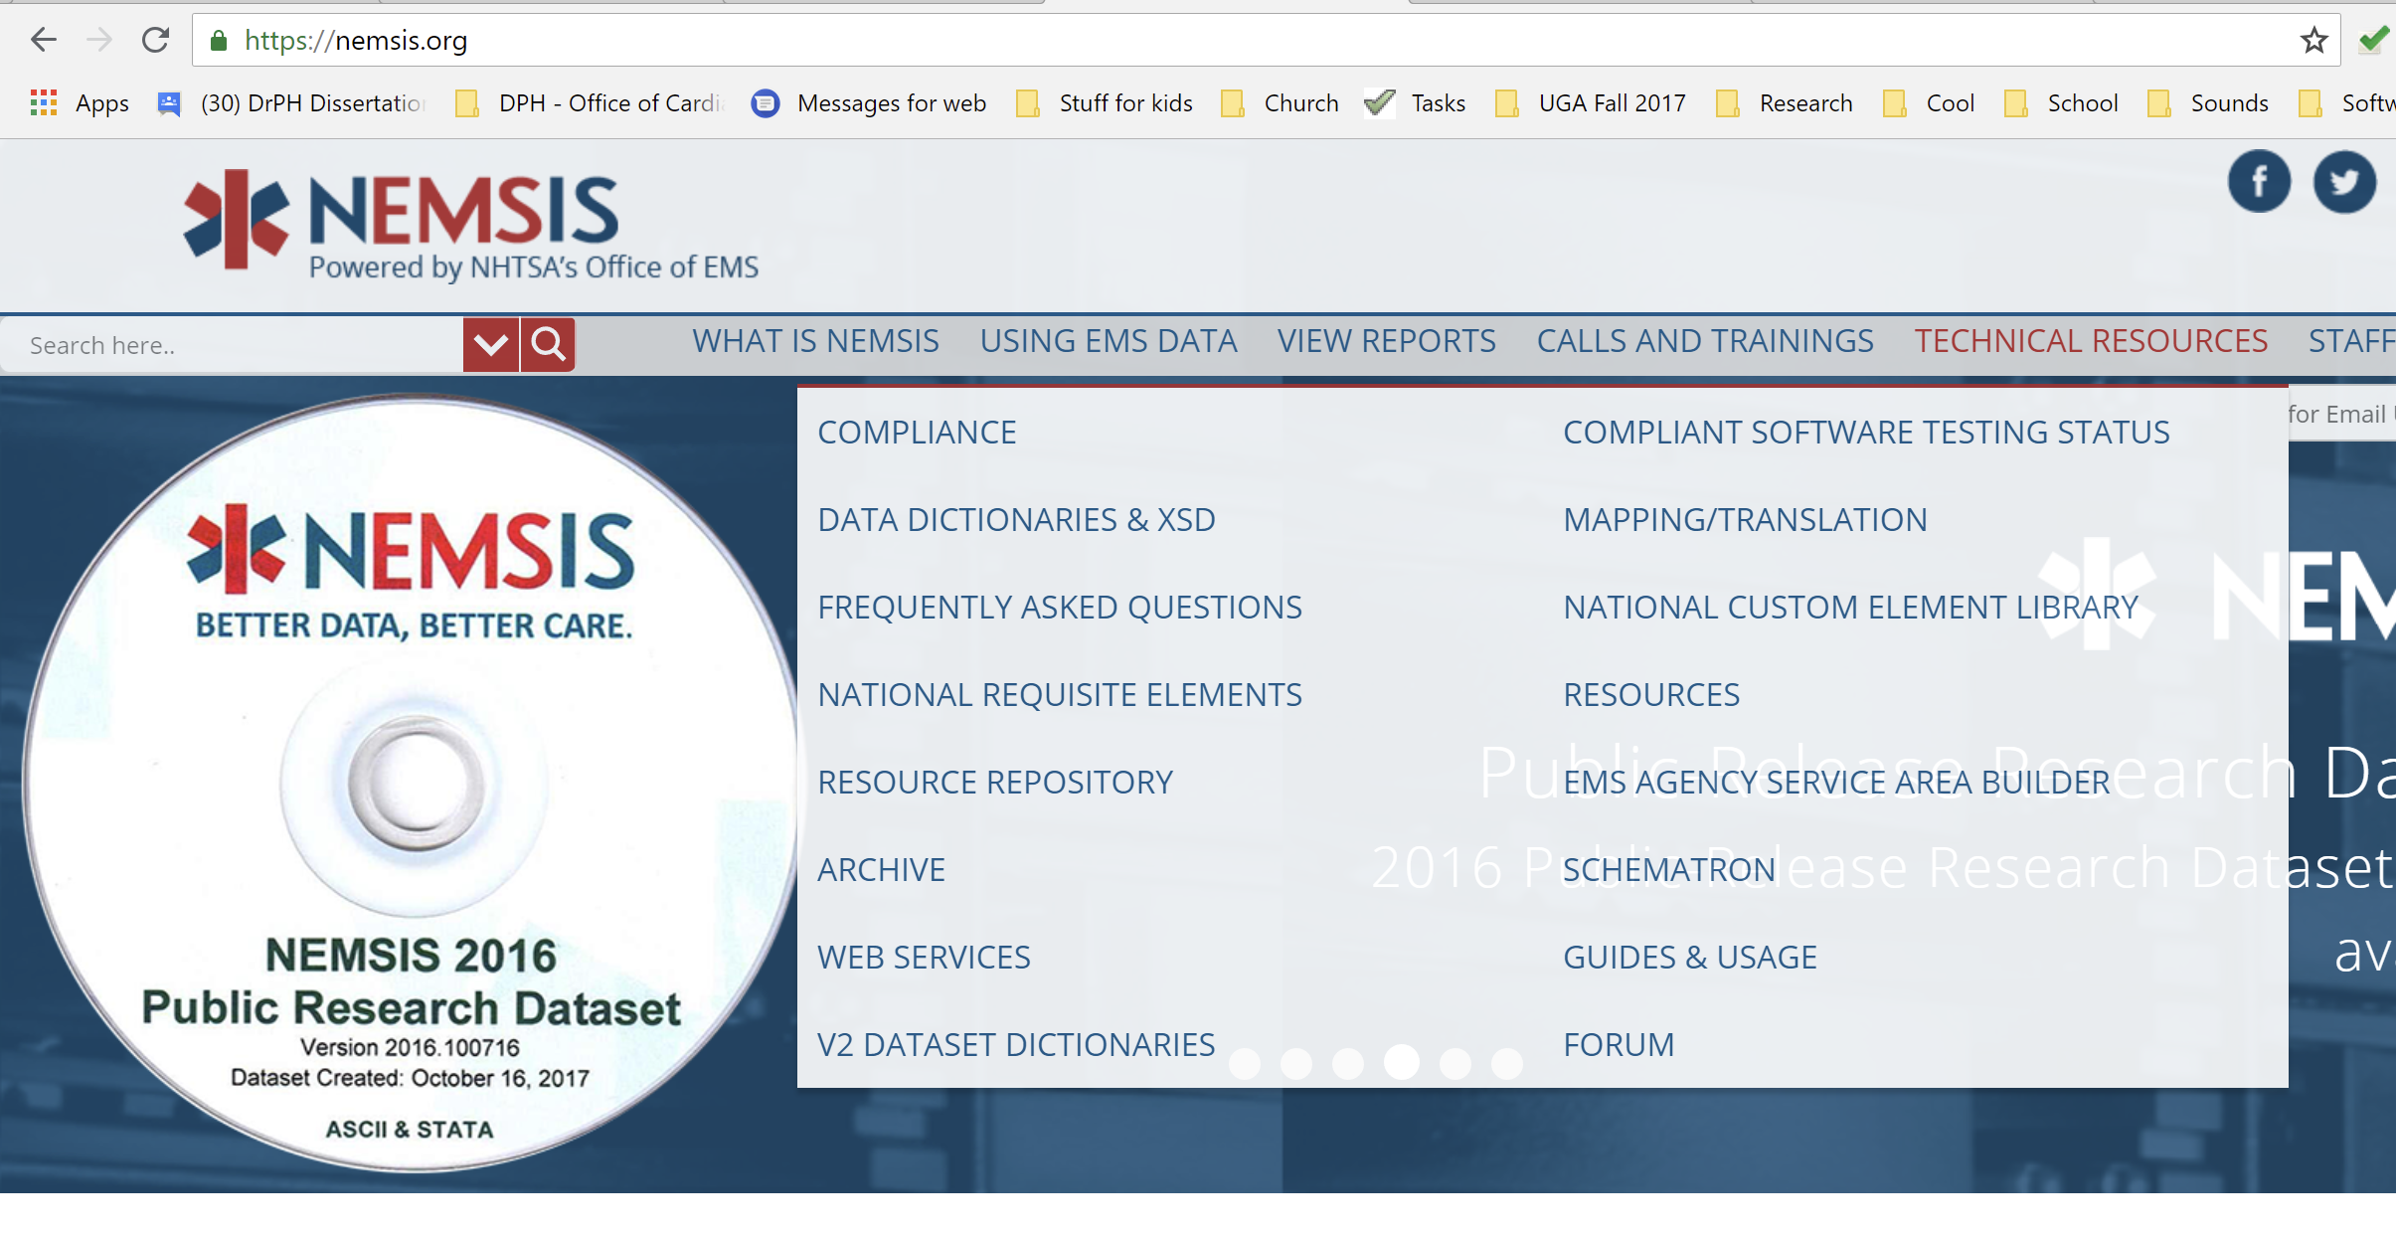
How to find the Data Dictionary
1 – Go to www.nemsis.org
2 – hover over Technical Resources
3 – Click on Data Dictionaries & XSD

Slide 18
NEMSIS Data Dictionary

Slide 19
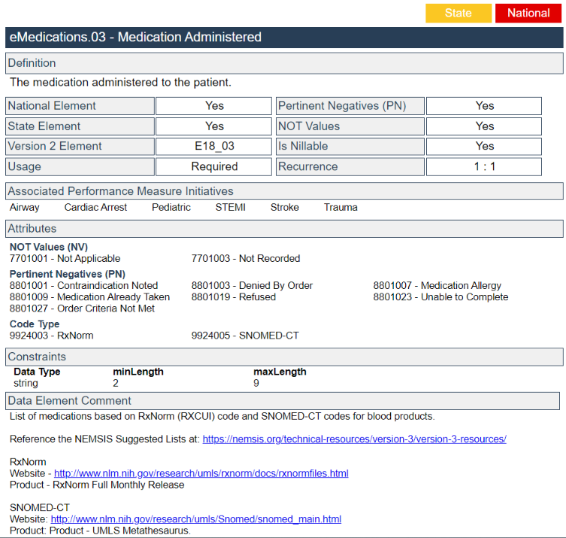
Data Dictionary – Sample
Element # & Name
Definition of Field
Not Values & Pertinent Negative(s)
Pick List Options
Data Clarification Comment

Slide 20
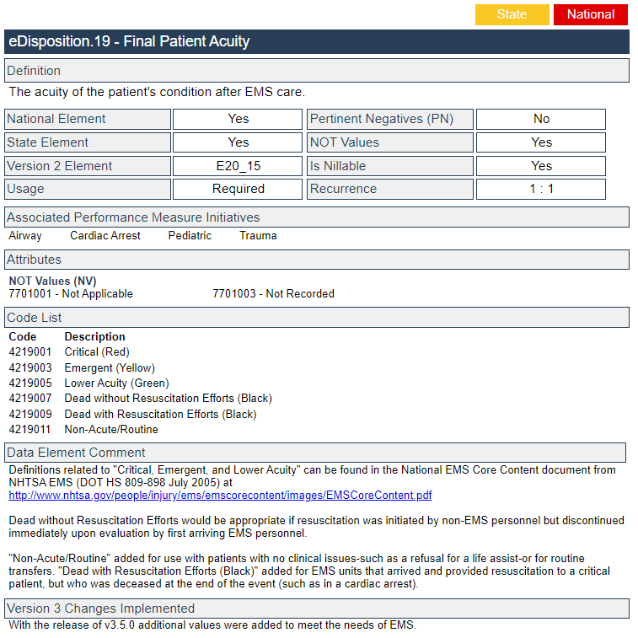
Data Dictionary - Sample
Element # & Name
Definition of Field
Not Values & Pertinent Negative(s)
Pick List Options
Data Clarification Comment

Slide 21
Data Dictionary – Data Element Comment

Slide 22
Not Values (NV)
Not Values: Are used when the data element has no real value or is unknown.
Not Applicable: The data element is not applicable or pertinent to the EMS event, assessment or, intervention. This value should be available to the data‐entry user (medic).
Not Recorded: The data element is considered applicable to the EMS event, but was left blank by the data‐entry user. The EMS software should auto‐populate blank fields with "Not Recorded" at the time of export. This value should not be available to the data‐entry user (medic).

Slide 23
Not Values (NV)
Example:
Medication Administration Time
Provider’s Secondary Impressions

Slide 24
Pertinent Negatives (PN)
Not all data elements accept Pertinent Negative Values.
Pertinent Negative Values are documented as "an attribute" of an element. It allows the documentation of pertinent negative value in addition to the documentation of a "real" value.
Pertinent Negatives are used to document why the Medic did not perform a procedure, select an option for the field, etc.
Examples of Pertinent Negatives:
Refused, None Reported, Unable to Complete, Unresponsive, Contraindicated, etc.

Slide 25
Pertinent Negatives (PN)
Example – Medication History:
Patient is not currently taking any medications.

Slide 26
Pertinent Negatives (PN)
Example: Patient First and/or Last Name
You are unable to obtain the patient’s name due to:
Patient refuses to give you his/her name
Patient is unresponsive and you have no identification

Slide 27
NEMSIS v3.5 Transition Overview

Slide 28
Data Element Changes

Slide 29
Data Element Change Types
Element Name/Number | Changes | Revision Summary
Cardiac Arrest – eArrest.01 | Updated | Element and Code description modified to align with CARES
Tube Depth - eAirway.05 | Updated | Changed to allow values as small as 4.0
Who First Initiated CPR – eArrest.20 | New | New element added to align with CARES
Lung Assessment Finding Location – eExam.22 | New | New element added to better document lung assessment
CPR Care Provided Prior to EMS Arrival – eArrest.05 | Removed | Element removed to align with CARES

Slide 30
v3.5 New Elements Added (11) - Required
Element Number | Element Name | National | State
eDisposition.27 | Unit Disposition | National | State
eSituation.20 | Reason for Interfacility Transfer/Medical Transport | National | State
eArrest.20 | Who First Initiated CPR | National | State
eArrest.21 | Who First Applied the AED | National | State
eArrest.22 | Who First Defibrillated the Patient | National | State
eDisposition.28 | Patient Evaluation/Care | National | State
eDisposition.29 | Crew Disposition | National | State
eDisposition.30 | Transport Disposition | National | State
eDisposition.31 | Reason for Refusal/Release
eDisposition.32 | Level of Care Provided per Protocol | National | State
eSituation.19 | Justification for Transfer or Encounter |  | State

Slide 31
v3.5 Additional New Elements (11) - Optional
Element Number | Element Name | Usage
ePatient.22 | Alternate Home Residence | Optional
eTimes.17 | Unit Arrived at Staging Area Date/Time | Optional
ePayment.59 | Insurance Company Phone Number | Optional
ePayment.60 | Date of Birth of the Insured | Optional
eArrest.10 | Therapeutic Hypothermia by EMS | Optional
eHistory.20 | Current Medication Frequency | Optional
eExam.22 | Lung Assessment Finding Location | Optional
eExam.23 | Lung Assessment | Optional
eExam.24 | Chest Assessment Finding Location | Optional
eExam.25 | Chest Assessment | Optional
eScene.24 | First Other EMS or Public Safety Agency at Scene to Provide Patient Care | Optional

Slide 32
New Data Fields added to EMS Form
All current and NEW (optional and required) v3.5 data elements have been added to the State EMS ePCR form and Print Report that are available in the NEMSIS data dictionary.
EMS Agencies will be responsible to add all the new optional and required fields on your custom ePCR form and print report (if applicable).

Slide 33
Additional Fields Added to EMS Form
Also added additional data elements to current and v3.5 ePCR form and Print Report.
Stoke Scale Severity Score (itVitals.096)
Patient Identification Number (MRN #) and Patient Identification Number (Armband #)
External Report Id, Number Type (eOutcome.03)
External Report ID/Number (eOutcome.04)
Another Provider on scene (non-EMS) (supplemental question)
Telehealth/Nurse Navigator, etc. programs
Alternative Disposition Offer and Result (et3Disposition.01)

Slide 34
Data Element Additions
Element Name/Number | Changes | Summary of Revision
Incident/Patient Disposition –eDisposition.12 | Removed | Split into 5 elements: eDisposition.27, eDisposition.28, eDisposition.29, eDisposition.30, eDisposition.31
Unit Disposition – eDisposition.27 | Added
Patient Evaluation/Care – eDisposition.28 | Added
Crew Disposition – eDisposition.29 | Added
Transport Disposition – eDisposition.30 | Added
Reason for Refusal/Release – eDisposition.31 | Added

Slide 35
eDisposition changes
v3.5 Disposition of Incident -> 5 data fields (eDisposition.27 – eDisposition.31) contains multiple options to document what happened during the incident. Will allow for better understanding of each response and outcome of the response.
Data element is broken down into multiple elements with fewer codes
Less opportunity for data entry errors
Increased data accuracy

Slide 36
Unit Disposition (eDisposition.27)
The patient disposition for an EMS event identifying whether patient contact was made.
Patient Contact Made
Cancelled on Scene
Cancelled Prior to Arrival at Scene
No Patient Contact
No Patient Found
Non-Patient Incident (Not Otherwise Listed)

Slide 37
Patient Evaluation/Care (eDisposition.28)
The patient disposition for an EMS event identifying whether a patient was evaluated and care or services were provided.
Patient Evaluated and Care Provided
Patient Evaluated and Refused Care
Patient Evaluated, No Care Required
Patient Refused Evaluation/Care
Patient Support Services Provided

Slide 38
Crew Disposition (eDisposition.29)
The crew disposition for this EMS event identifying which crew provided primary patient care or whether support services were required.
Initiated and Continued Primary Care
Initiated Primary Care and Transferred to Another EMS Crew
Provided Care Supporting Primary EMS Crew
Assumed Primary Care from Another EMS Crew
Incident Support Services Provided (Including Standby)
Back in Service, No Care/Support Services Required
Back in Service, Care/Support Services Refused

Slide 39
Transport Disposition (eDisposition.30)
The transport disposition for an EMS event identifying whether a transport occurred and by which unit.
Transport by This EMS Unit (This Crew Only)
Transport by This EMS Unit, with a Member of Another Crew
Transport by Another EMS Unit
Transport by Another EMS Unit, with a Member of This Crew
Patient Refused Transport
Non-Patient Transport (Not Otherwise Listed)
No Transport

Slide 40
Reason for Refusal/Release (eDisposition.31)
Describes reason(s) for the patient's refusal of care/transport OR the EMS clinician's decision to release the patient.
Against Medical Advice
Patient/Guardian Indicates Ambulance Transport is Not Necessary
Released Following Protocol Guidelines
Released to Law Enforcement
Patient/Guardian States Intent to Transport by Other Means
DNR
Medical/Physician Orders for Life Sustaining Treatment
Other, Not Listed

Slide 41
Level of Care Provided per Protocol (eDisposition.32)
The general level of care provided to this patient as defined per provider level in local EMS protocols or clinical guidelines.
BLS - All Levels
ALS - AEMT/Intermediate
ALS - Paramedic
EMS and Other Health-Care Staff
Critical Care
Integrated Health Care
No Care Provided
The level of care should be defined by the situation, medications, and procedures provided to the patient based on what is allowed in the local EMS protocols. This is not a reflection of the provider levels providing care, but the actual care given-for example, BLS care provided by a paramedic would be entered as "BLS". This element benefits reviews of performance, resource demand and utilization, and reimbursement coding.

Slide 42
Patient Contact with Transport
Unit Disposition (eDisposition.27)
Patient Contact Made
Patient Evaluation/Care (eDisposition.28)
Patient Evaluated and Care Provided
Crew Disposition (eDisposition.29)
Initiated and Continued Primary Care
Transport Decision (eDisposition.30)
Transport by This EMS Unit (This Crew Only)
Final Patient Acuity (eDisposition.19)
Select the most appropriate choice
Level of Care Provided Per Protocol (eDispostion.32)
Select the most appropriate choice

Slide 43
Patient Contact / Patient Refusal
Unit Disposition (eDisposition.27)
Patient Contact Made
Patient Evaluation/Care (eDisposition.28)
Select the most appropriate choice
Crew Disposition (eDisposition.29)
Select the most appropriate choice
Transport Decision (eDisposition.30)
Select the most appropriate choice
Reason for Refusal/Release (eDisposition.31)
Select the most appropriate choice
Final Patient Acuity (eDisposition.19)
Select the most appropriate choice
Level of Care Provided per Protocol (eDisposition.32)
Select the most appropriate choice

Slide 44
Cardiac Arrest/DOA with No Resuscitation
Unit Disposition (eDisposition.27)
Patient Contact Made
Patient Evaluation/Care (eDisposition.28)
Patient Evaluated, No Care Required
Crew Disposition (eDisposition.29)
Back in Service, No Care/Support Service Required
Transport Decision (eDisposition.30)
No Transport
Reason for Refusal/Release (eDisposition.31)
Released Following Protocol Guideline
Final Patient Acuity (eDisposition.19)
Dead without Resuscitation Efforts (Black)
Level of Care Provided Per Protocol (eDispostion.32)
No Care Provided

Slide 45
Cardiac Arrest/DOA with Resuscitation, No Transport
Unit Disposition (eDisposition.27)
Patient Contact Made
Patient Evaluation/Care (eDisposition.28)
Patient Evaluated and Care Provided
Crew Disposition (eDisposition.29)
Select the most appropriate choice
Transport Decision (eDisposition.30)
No Transport
Reason for Refusal/Release (eDisposition.31)
Released Following Protocol Guideline
Final Patient Acuity (eDisposition.19)
Dead with Resuscitation Efforts (Black)
Level of Care Provided Per Protocol (eDispostion.32)
Select the most appropriate choice

Slide 46
Public Assist (Including Standby)
Unit Disposition (eDisposition.27)
No Patient Contact or Non-Patient Incident (Not Otherwise Listed)
Patient Evaluation/Care (eDisposition.28)
Patient Support Services Provided
Crew Disposition (eDisposition.29)
Incident Support Services Provided (Including Standby) or Back in Service, No Care/Support Services Required
Transport Decision (eDisposition.30)
Not Applicable/Not Required
Final Patient Acuity (eDisposition.19)
Not Applicable/Not Required
Level of Care Provided Per Protocol (eDispostion.32)
No Care Provided

Slide 47
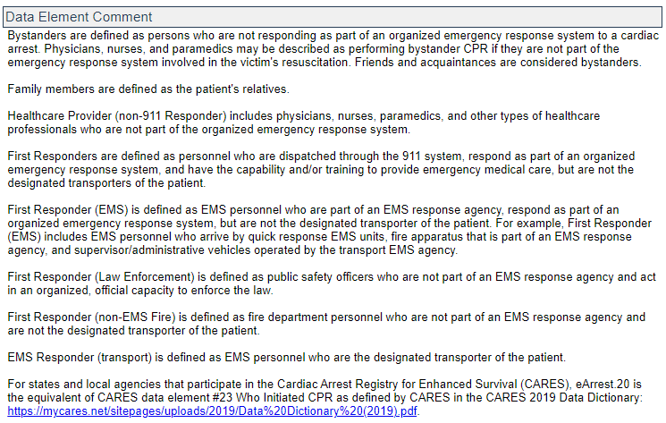
Who First Initiated CPR (eArrest.20)
Definition: Who first initiated CPR for this EMS event.
Pick List Options:
Bystander
Family Member
Healthcare Provider (non-911 Responder)
First Responder (EMS)
First Responder (Law Enforcement)
First Responder (non-EMS Fire)
EMS Responder (transport EMS)
* This was a GA custom element in v3.4 that has now become a national element.

Slide 48
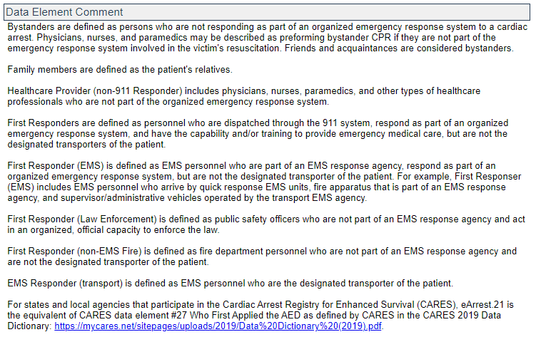
Who First Applied the AED (eArrest.21)
Definition: Documentation of who first applied the AED for this EMS event.
Pick List Options:
Bystander
Family Member
Healthcare Provider (non-911 Responder)
First Responder (EMS)
First Responder (Law Enforcement)
First Responder (non-EMS Fire)
EMS Responder (transport EMS)
* This was a GA custom element in v3.4 that has now become a national element.

Slide 49
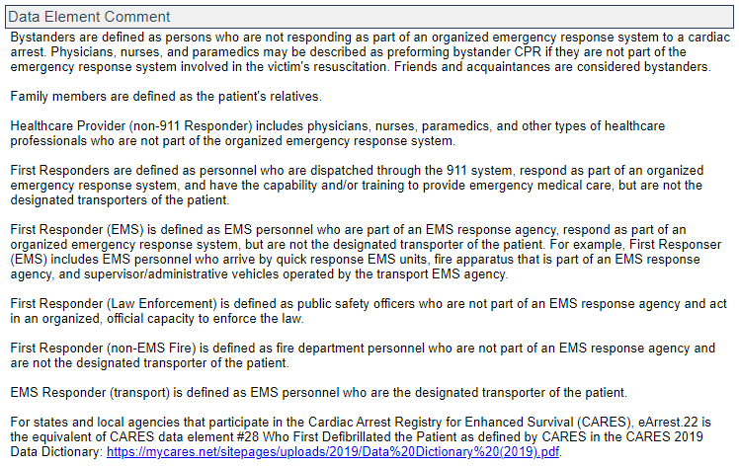
Who First Defibrillated the Patient (eArrest.22)
Definition: Documentation of who first defibrillated the patient.
Pick List Options:
Bystander
Family Member
Healthcare Provider (non-911 Responder)
First Responder (EMS)
First Responder (Law Enforcement)
First Responder (non-EMS Fire)
EMS Responder (transport EMS)
* This was a GA custom element in v3.4 that has now become a national element.

Slide 50
Justification for Transfer or Encounter (eSituation.19)
Definition: The ordering physician or medical provider diagnosis or stated reason for a hospital-to-hospital transfer, other medical transport, or Mobile Integrated Healthcare encounter.
Free Text Field (1-255 characters)

Slide 51
Reason for Interfacility Transfer/Medical Transport (eSituation.20)
Definition: The general categories of the reason for an interfacility transfer/other medical transport.
Data Element Comment:
This supports and works in combination with eSituation.19 Justification for Transfer or Encounter to provide defined categories for an interfacility transfer or other medical transport. This documentation provides support for reimbursement and a means for regions and states to evaluate transfer patterns and types.
Pick List Options:
Cardiac Specialty
Convenience Transfer (Patient Request)
Diagnostic Testing
Dialysis
Drug and/or Alcohol Rehabilitation Care
Extended Care
Maternal/Neonatal
Medical Specialty Care (Other, Not Listed)
Neurological Specialty Care
Palliative/Hospice Care (Home or Facility)
Pediatric Specialty Care
Psychiatric/Behavioral Care
Physical Rehabilitation Care
Return to Home/Residence
Surgical Specialty Care (Other, Not Listed)
Trauma/Orthopedic Specialty Care

Slide 52
Current Fields (elements) with Confusion/Changes

Slide 53
Type of Service Requested (eResponse.05)
Emergency Response (Primary Response Area) (911 Response Scene)
Emergency Response (Intercept)
Emergency Response (Mutual Aid)
Hospital-to-Hospital Transfer
Hospital to Non-Hospital Facility Transfer
Non-Hospital Facility to Non-Hospital Facility Transfer
Non-Hospital Facility to Hospital Transfer
Other Routine Medical Transport
Public Assistance
Standby
Support Services
Non-Patient Care Rescue/Extrication
Crew Transport Only
Transport of Organs or Body Parts
Mortuary Services
Mobile Integrated Health Care Encounter
Evaluation for Special Referral/Intake Programs
Administrative Operations

Slide 54
Type of Destination (eDisposition.21)
The type of destination the patient was delivered or transferred to.
Home
Hospital-Emergency Department (Triage, waiting room, or bed in the ED)
Hospital-Non-Emergency Department Bed
Clinic
Morgue/Mortuary
Other
Other EMS Responder (air)
Other EMS Responder (ground)
Police/Jail
Urgent Care
Freestanding Emergency Department
Dialysis Center
Diagnostic Services
Assisted Living Facility
Mental Health Facility
Nursing Home
Other Recurring Care Center
Physical Rehabilitation Facility
Drug and/or Alcohol Rehabilitation Facility
Skilled Nursing Facility
Hospital In-Patient Destination (eDisposition.22)

Slide 55
Hospital In-Patient Destination (eDisposition.22)
The location within the hospital that the patient was taken directly by EMS (e.g., Cath Lab, ICU, etc.).
Hospital-Burn
Hospital-Cath Lab
Hospital-CCU
Hospital-Endoscopy
Hospital-Hospice
Hospital-Hyperbaric Oxygen Treatment
Hospital-ICU
Hospital-Labor and Delivery
Hospital-Med/Surg
Hospital-Mental Health
Hospital-MICU
Hospital-Nursery
Hospital-Peds (General)
Hospital-Peds ICU
Hospital-OR
Hospital-Orthopedic
Hospital-Other
Hospital-Out-Patient Bed
Hospital-Radiology Services - MRI
Hospital-Radiology Services - CT/PET
Hospital-Radiology Services - X-Ray
Hospital-Radiation
Hospital-Rehab
Hospital-SICU
Hospital-Oncology
Hospital-Outpatient Surgery

Slide 56
Hospital Capability (eDisposition.23)
The primary hospital capability associated with the patient's condition for this transport (e.g., Trauma, STEMI, Peds, etc.).
Behavioral Health
Burn Center
Critical Access Hospital
Hospital (General)
Neonatal Center
Pediatric Center
Rehab Center
Trauma Center Level 1
Trauma Center Level 2
Trauma Center Level 3
Trauma Center Level 4
Trauma Center Level 5
Cardiac-STEMI/PCI Capable
Cardiac-STEMI/PCI Capable (24/7)
Cardiac-STEMI/Non-PCI Capable
Stroke-Acute Stroke Ready Hospital (ASRH)
Stroke-Primary Stroke Center (PSC)
Stroke-Thrombectomy-Capable Stroke Center (TSC)
Stroke-Comprehensive Stroke Center (CSC)
Cancer Center
Labor and Delivery

Slide 57
Destination Team Pre-Arrival Alert or Activation (eDisposition.24)
Indication that an alert (or activation) was called by EMS to the appropriate destination healthcare facility team. The alert (or activation) should occur prior to the EMS Unit arrival at the destination with the patient.
No
Yes-Adult Trauma
Yes-Cardiac Arrest
Yes-Obstetrics
Yes-Other
Yes-Pediatric Trauma
Yes-STEMI
Yes-Stroke
Yes-Trauma (General)
Yes-Sepsis

Slide 58
Date/Time of Symptom Onset (eSituation.01)
The date and time the symptom began (or was discovered) as it relates to this EMS event. This is described or estimated by the patient, family, and/or healthcare professionals.
* This is when the patient’s symptoms began

Slide 59
Date/Time Last Known Well (eSituation.18)
The estimated date and time the patient was last known to be well or in their usual state of health. This is described or estimated by the patient, family, and/or bystanders.
* This is when the patient was last seen in their “normal state”
Additional information to the definition

Slide 60
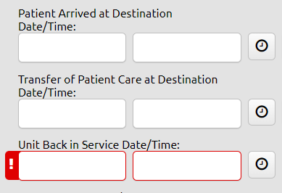
Destination Patient Transfer of Care Date/Time (eTimes.12)
The date/time that patient care was transferred to the destination healthcare staff.
This transfer of care time may not coincide with the time of signature at the receiving facility.

Slide 61
APOT: Calendar Year 2022

Slide 62
APOT: Jan – March 2023

Slide 63
Ambulance Patient Offload Time (APOT)
Patient Offload: is the difference in minutes between the time of the patient arrival at destination (eTimes.11) and the time of patient transfer of care (eTimes.12).
Notes:
etimes.11-Patient Arrived at Destination = The date/time the responding unit arrived with the patient at the destination or transfer point.
etimes.12 – Time of Patient Transfer of Care = The date/time that patient care was transferred to the destination healthcare staff.
etimes.13 - Unit Back in Service Date/Time = The date/time the unit back was back in service and available for response (finished with call, but not necessarily back in home location).
If arrival at destination (etimes.11) or time of patient transfer of care (etimes.12) is missing from the record, then APOT can’t be computed, and the record will be counted in the “Not Reported” count

Slide 64
Delay Element Fields

Slide 65
Hospital Hub

Slide 66
Hospital Hub
The GEMSIS hospital platform to obtain EMS PCRs for patients transported to their facility.

Slide 67
Hospital Hub

Slide 68
Hospital Hub

Slide 69
Hospital Hub – PCR linkage and Outcome data

Slide 70
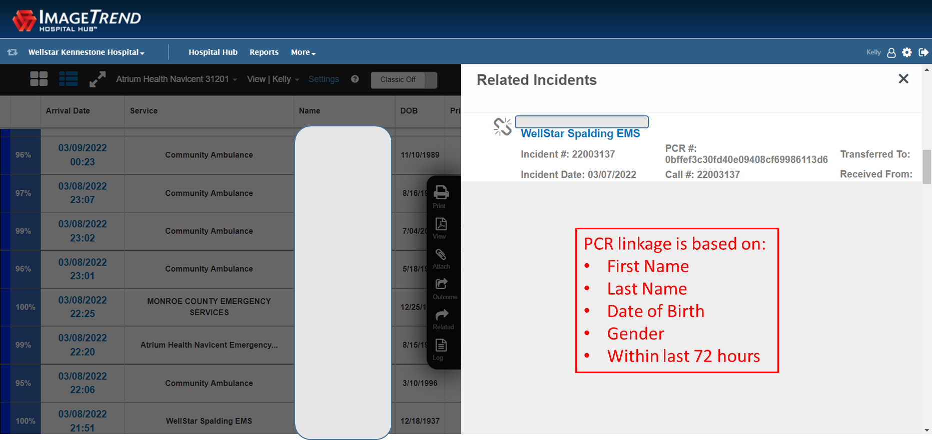
Hospital Hub – PCR Linkage

Slide 71
Summary

Slide 72
v3.5 Transition for EMS Agencies
Each agency is responsible for educating your staff on v3.5 changes.
Phase 1: Transition of GEMSIS Elite agencies to v3.5 beginning in July 2023
Don’t wait until the last minute to complete your transition.

Slide 73
Questions? And Open Discussion

