Slide 1
Nutrition Education & Risk Criteria Update
Presentation to: Nutrition Services Directors
Presented by: Barbara Stahnke, MEd, RD, LD
Date: September 13, 2016

Slide 2
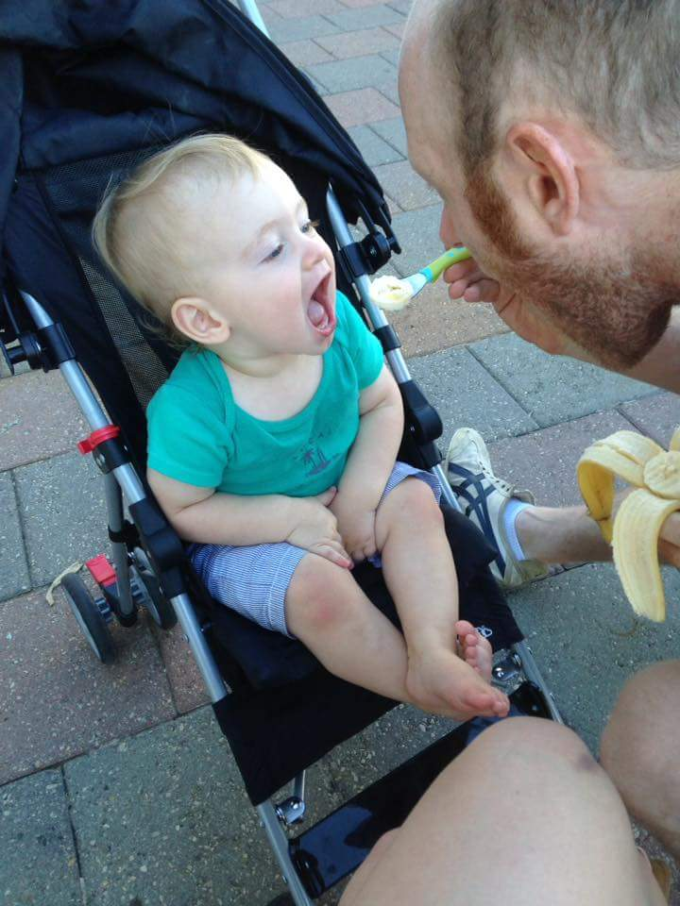
Laura Iberkleid’s Baby Simon in Cleveland Ohio – Loving his fruits and his Daddy

Slide 3
Objectives:
Participants will be able to:
Identify questions and comments for the Educational Materials Task Force and name the contact person for the current approved list
Describe the progress on Counseling Skills development through Strong4Life collaboration

Slide 4
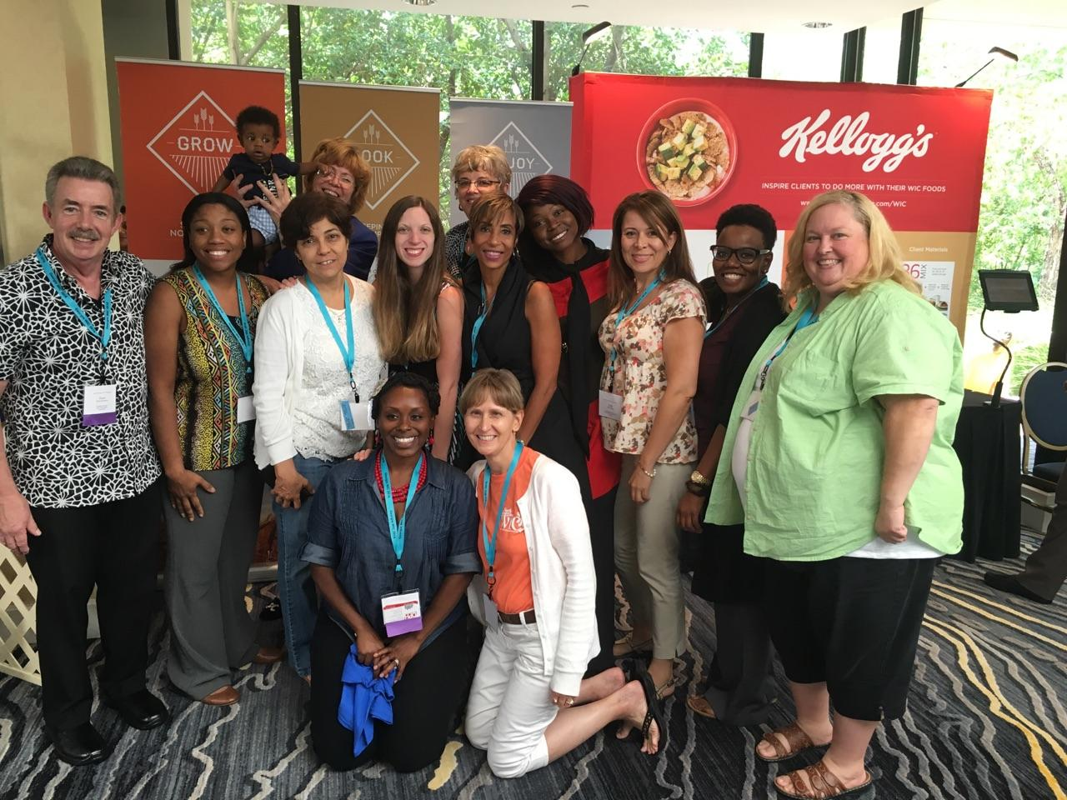
Approved Nutrition Education Materials List
Georgia WIC Nutrition Education

Slide 5
Purchasing Guidance
Reminder: Assure that your Nutrition Ed Materials List is up to date for materials on hand.
Contact Barbara Stahnke for the current approved materials list.
  Any purchases initiated as of today must be on the approved Education Materials List
  The Education Materials Task Force (EMTF) continues to meet - additional reinforcement materials still needed
    Children’s materials are complete
    Prenatal materials are complete
    Breastfeeding material’s are complete

Slide 6
Purchasing Guidance
Contact Barbara Stahnke for the current Education Materials List
  Working on adding the education materials list to the District Resources Web Page
  Story books, recipe books and activity books are included in the list
    Story books are targeted for infants and children
    Must include a lesson plan that the book supports with the purchase justification
  Local agency should think through reasonable and necessary cost justification with all purchases

Slide 7
Purchasing Guidance
Materials used in the clinic to educate and encourage participants do not require prior approval for purchase:
  Food Models
  Posters
  Flip Charts
If you are giving it to the participant it is an educational reinforcement material and needs to be on the approval list.

Slide 8
Education Reinforcement Materials
Children Materials: Working to identify materials for…
  Immunizations
  Exit Counseling (temporary material identified and on list)
  Water
  Constipation
  Choking

Slide 9
Education Reinforcement Materials
Prenatal Materials: Working to identify materials for…
  Exit Counseling (temporary material identified and on list)
  Constipation
  Food Safety: Listeria and Bacteria
  Mercury

Slide 10
Education Reinforcement Materials
Breastfeeding: Working to identify missing topics

Slide 11
Education Reinforcement Materials
Next Steps:
  Strategic Planning in September
  Development of Georgia WIC Branded Materials
  Action memo for materials to be discarded:
    Out of date
    Non-evidenced based
    Still being drafted

Slide 12
Education Reinforcement Materials
Core Messages:
  Breastfeeding
  Make Half Your Plate Vegetables and Fruits – balanced plate
  Be Active
  Healthy Beverage Consumption
  Responsive Feeding (Baby Behavior / Stress Free Feeding)

Slide 13
Education Reinforcement Materials
Overarching Themes:
  WIC Cares
  Health Literacy
  Positive
  Aesthetically Appealing
  Up to Date
  Quality
  Convenient Sizes
  Offers Connection and Support Resources

Slide 14
Education Reinforcement Materials
Branded Materials
  Awaiting revised

Slide 15
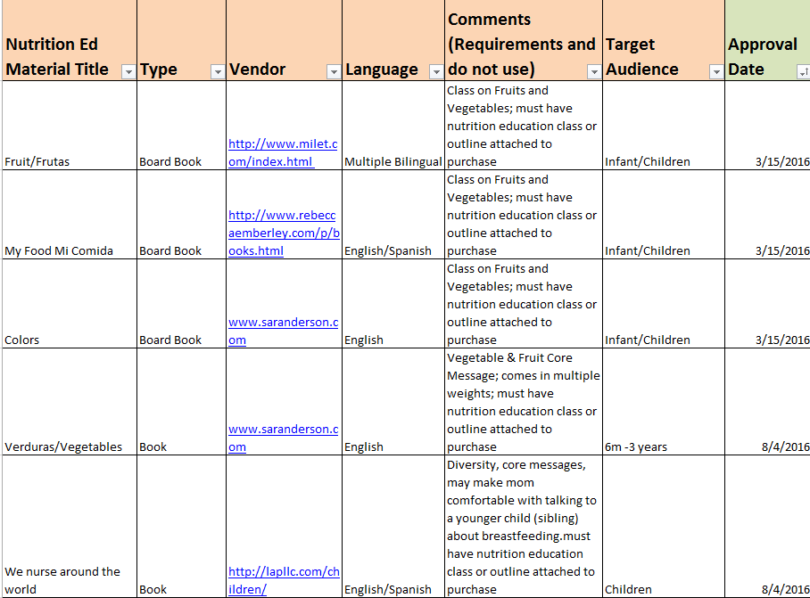
Education Materials List
Contact Barbara Stahnke Barbara.Stahnke@dph.ga.gov for current approved list

Slide 16
Nutrition Ed Committee Vs. Education Materials Task Force
Nutrition Education Committee
Quarterly meetings – Next meeting TBD
Nutrition Service Plan Goals
Reporting on Special Projects
Reporting on Educational Materials Task Force

Slide 17
Motivational Interviewing & Strong4Life Collaboration
Georgia WIC Nutrition Education

Slide 18
Action Memo 16-20
WIC Champion: Required Strong4Life Counseling Observations
  Goal - Improve counseling skills
  10% of ALL CPAs should be observed and coached for counseling skills statewide
  Different from Monitoring Tool observations
  Certification or High Risk Secondary Education
  Observation entered into the Redcap Database http://j.mp/1ReMJ3p

Slide 20
Children’s-SHAPE-WIC Partnership
2016 – Progress Report
Strong4Life Basic Training
  Web-based Orientation Module (in development)
    Interactive orientation modules
      Finalizing PowerPoint for training
Introduction Video
  https://vimeo.com/tomorrowpictures/review/176368393/c5923dd8a7

Slide 21
Children’s-SHAPE-WIC Partnership
2016 – Progress Report
Advanced skills course
  Open Ended Questions
  Reflective Listening
  Goals Setting Process
Applying to Shape for a second series in 2017

Slide 22
Children’s-SHAPE-WIC Partnership 2016
Research project with Medical Provider – WIC – Strong4Life
  Forty-three participants as of September 9, 2016
  Children’s is working to improve the Medical Provider side of the project – four communication returns
  Next step – Seeking Grant Funding for technology solution
  Applying for Shape Grant to continue project

Slide 23
Nutrition Education: Georgia WIC
Contact:
Meredith Peirce
404-463-2091
Meredith.Peirce@dph.ga.gov

