Slide 1
Board of Public Health Meeting
Tuesday, February 10, 2015

Slide 2
Commissioner’s Update
Brenda Fitzgerald, MD
Commissioner, DPH

Slide 3
March of Dimes Banner Program:
A March of Dimes, DPH and Georgia Hospital Association Initiative
Seema Csukas, MD, PhD
Maternal and Child Health Section Director

Slide 4

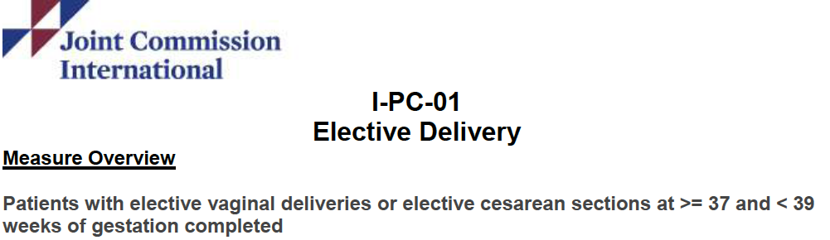
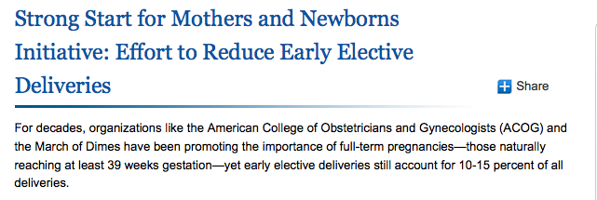
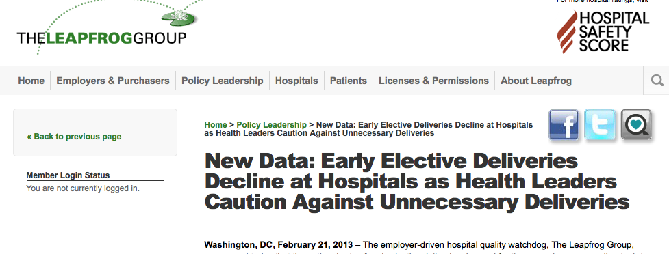
Notes:
Julie Zaharatos
For decades ACOG has advised against non medically indicated deliveries before 39 weeks, but this practices was increasing in the United States.
In the last few years there has been growing attention to this issue with multiple organizations including the March of Dimes, Joint Commission, LeapFrog, CMS all making the reduction of early elective deliveries before 39 weeks a top priority.

Slide 5



Statewide Partnership

Slide 6
The Results

Slide 7
Early Elective Deliveries: Before
34-36 Weeks Gestation
37-38 Weeks Gestation
14
28
25
48
19
15
36
24
21
62
32
9
60
34
26
47
31
52
49
63
57
6
33
38
61
17
27
5
12
50
1
58
55
54
39
51
37
Facilities with >500 Births per year (ID)
20
8
13
42
29
3
45
41
59
11
23
53
46
10
44
43
56
35
22
4
7
40
30
2
16
18
60
55
50
45
40
35
30
25
20
15
10
5
0
5
10
15
20
25
30
35
40
45
50
55
60
Percentage of Births
Data Source: 2006 Georgia Birth-Hospital Discharge linked file
Notes:
Maria

Slide 8
Early Elective Deliveries: After
34-36 Weeks Gestation
37-38 Weeks Gestation
14
28
25
48
19
15
36
24
21
62
32
9
60
34
26
47
31
52
49
63
57
6
33
38
61
17
27
5
12
50
1
58
55
54
39
51
37
Facilities with >500 Births per year (ID)
20
8
13
42
29
3
45
41
59
11
23
53
46
10
44
43
56
35
22
4
7
40
30
2
16
18
60
55
50
45
40
35
30
25
20
15
10
5
0
5
10
15
20
25
30
35
40
45
50
55
60
Percentage of Births
Data Source: 2012 Georgia Birth-Hospital Discharge linked file
Notes:
Maria

Slide 9
Recognizing Success

Slide 10
Georgia EED Banner Recognition Initiative
Purpose:
To work collectively to improve neonatal outcomes by supporting policies and practices to reduce EED <39 weeks
Content:
Statewide Pledge
Quality Recognition: March of Dimes Banner
Public Education
Goal:
Hospital EED Rates <5% by Sept. 2015

Slide 11
Eligibility for Banner
Rate of EED below 5% as defined by The Joint Commission PC-01 performance measure
Data provided for a least two consecutive quarters showing rate below 5% for each quarter – must include monthly data with numerators and denominators
Hospitals have a written policy in place regarding non-medically indicated deliveries <39 weeks gestational age
The written policy clearly defines medical indications for deliveries less than 39 weeks
Hospitals have a process to track and monitor the rate of non-medically indicated deliveries <39 weeks gestational age

Slide 12

March of Dimes Banner Program

Slide 13
Congratulations!
Cartersville Medical Center
Wellstar Kennestone Regional Medical Center
Barrow Regional Medical Center
Clearview Regional Medical Center
Doctor’s Hospital of Augusta
Floyd Medical Center
Grady Health System
Habersham Medical Center
Houston Medical Center
Newton Medical Center
Phoebe Putney Memorial Hospital
Phoebe Sumter Medical Center
Notes:
We Recognize These Hospitals for Achieving a <5% EED Rate

Slide 14
Budget Update
Kate Pfirman, CPA
Chief Financial Officer, DPH

Slide 15
Amended FY2015
Total Budget: $621,152,294
Attached agencies not included

Slide 16
Amended FY2015 Budget

Slide 17
FY2016 Governor’s Recommendation

Slide 18
FY2016
Total Budget: $628,630,991
Attached agencies not included

Slide 19
FY2016 Changes by Program
Statewide Changes (All budget programs) - $6,647,862
 | *Merit Based pay adjustments and employee recruitment and retention initiatives | $2,441,096
 | *Increase funds to reflect and adjustment in the employer share of the Employee's Retirement System | $4,206,766
Administration - ($38,574)
 | *Adjustment to agency premiums | ($92,918)
 | *Adjustment in Teamworks billings | $54,344
PH Formula Grants to Counties - $1,521,306
 | *Fifth-year phase-in for the general grant-in-aid formula to hold harmless all counties | $1,388,991
 | *Increase funds for personal services | $132,315
 | TOTAL STATE FUND CHANGES | $8,130,594
Notes:
Add House tracking document numbers.

Slide 20
FY2016 Budget

Slide 21
General Obligation Bonds
$10,000,000
$9,300,000
Clinical Billing Information Technology system.
$400,000
Replacement of second chiller at Decatur Lab
$300,000
Replacement of walk-in coolers at the Decatur Lab
Notes:
Add the update on where we are with the project.

Slide 22
Accreditation Update
Scott A. Uhlich, MCP, REHS

Slide 23

National Standards for Public Health Departments
12 Domains
32 Standards
109 Measures
Documentation

Slide 24
Accreditation Requirements
Prerequisites
Georgia Statewide Community Health Assessment
Georgia Statewide Community Health Improvement Plan
Georgia DPH Strategic Plan
Documentation
12 Domains

Slide 25
Accreditation Structure
Steering Committee - James Howgate, Pat O’Neal, Yvette Daniels, Carol Jakeway, Jean O’Conner, Christine Greene, Tom Wade, Scott Uhlich and Chanelle Jefferson
CHA/CHIP Committee – Jean O’Conner, Carol Jakeway, Gordon Freymann, Cherie Drenzek, David Bayne, Chris Rustin, Scott Uhlich
12 Domain Leads
Document Review Committee (PHAB site visitors) – James Howgate, Tom Wade, Jean O’Conner, Scott Uhlich
Performance Management/Quality Improvement – Chanelle Jefferson

Slide 26
CHA/CHIP Development
Mobilizing Action through Planning & Partnership (MAPP) strategic approach for CHA/CHIP development approved
CHA/CHIP committee - MAPP Oversight
Developing 4 assessment teams (Health Status Assessment, Community Themes and Strengths, State Public Health System Assessment and Forces of Change).

Slide 27
Health Status Assessment
Gordon Freymann – Lead
Assembling and Organizing Data
Presentation “Georgia Annual Health Status Measures 2014”
CHA Table of Contents

Slide 28
Community Themes and Strengths
Daniel Thompson - Lead
Facilitated Focus Group sessions
Georgia Southern University
Regional facilitated sessions.
GSU will capture the primary discussion points at each session and generate a summary report for each session.
List of Community Assets / Partners

Slide 29
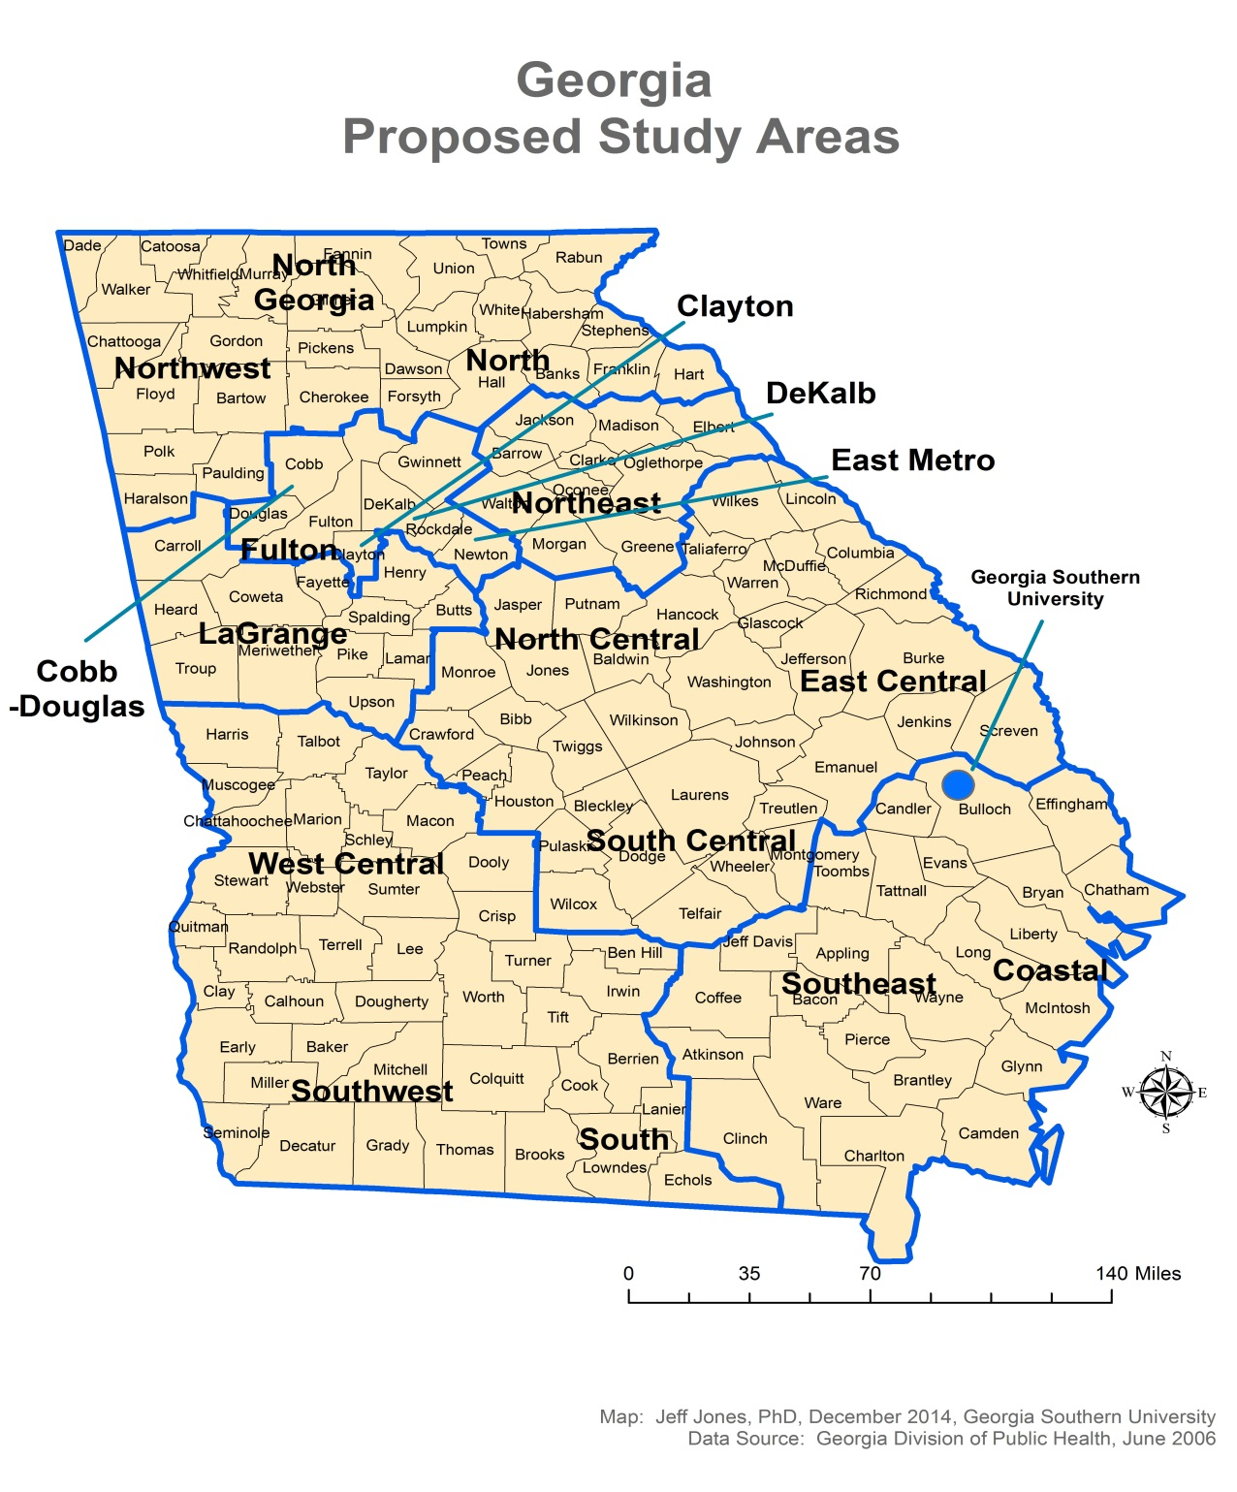

Slide 30
Public Health System Assessment
Terry Dumas - Lead
Survey on 10 Essential Public Health Services
District Public Health staff
County Public Health Staff
Board of Health members

Slide 31
Forces of Change
David Bayne – Lead
Group discussion on the future of public health.

Slide 32
CHA/CHIP Timeline
2/2015
Update DPH Board and DHD on the MAPP strategy
Organizing health status assessment data
Develop CHA Table of Contents
Develop format for program area narrative for CHA
3/2015
Draft Georgia Annual Health Status Measures Presentation
Develop narrative program pages for CHA
4-5/2015
Health Status Measures presentation to DPH Board and DHD
6/2015
Health Status Measures presentation – final
Draft Community Health Assessment

Slide 33
CHA/CHIP Timeline
7/1/15
Release draft CHA to public and key stakeholders
7 -12/2015
Present Health Status Assessment to Focus Groups
Distribute DPH Public Health System Assessment survey
Forces of Change discussion
Present CHA to DPH for final comment and approval

Slide 34
Community Health Improvement Plan Timeline
1/1/16
Prioritize the key issues, develop action plans with measurable outcomes, policy changes and responsible parties.
7/1/16
Release draft CHIP to public and key stakeholders
Present draft CHIP to DPH for final comment and approval

Slide 35
QI Program/Performance Management System Timeline
Chanelle Jefferson – Director
Priorities
QI training
Establish a QI Council
Develop a QI Plan
7/1/15
Identify QI projects
Develop an action plan for performance management system; timeline, responsible parties, goals and objectives

Slide 36
Documentation Timeline
3/1/15
Formal review of existing documents meeting PHAB standards/measures
5/1/15
Identify gaps in documentation, develop action plans for completing documentation
7/1/16
Complete documentation creation and updating process to bridge identified gaps in existing documentation

Slide 38
PHAB application readiness
7/1/16 – Prerequisites Completed
CHA
CHIP
Strategic Plan
7/1/16 – Documentation assembled
10/1/16 – Documentation reviewed by DRC
12/1/16 - Ready to apply to PHAB

Slide 39
QUESTIONS?
Scott A. Uhlich, MCP, REHS
Scott.Uhlich@dph.ga.gov

Slide 40
Heart Disease in Georgia
Jean O’Connor, JD, DrPH
Director, Chronic Disease Prevention, DPH
Shana Scott, JD, MPH,
Chronic Disease Team Lead, DPH
Marsi Thrash
Advocacy Director, AHA

Slide 41
Leading* Causes of Death, Georgia Number of Deaths 2009-2013
Notes:
41

Slide 42
Leading* Causes of Premature Deaths (before age 75), Georgia Years of Potential Life Lost 2009-2013

Slide 43
Leading Actual Causes of Death*, Georgia
Notes:
43
DEATHS
Over 10,000 Georgians die every year from smoking-related illnesses – 1 out of every 6 adult Georgians who die.
More adult males (6,700) than adult females (3,900) die from smoking-related illnesses.
Cancer accounts for 40% of all adult deaths due to smoking, while cardiovascular diseases and respiratory diseases account for 35% and 25% of all adult deaths due to smoking, respectively.
Adult smokers lose an average of 16 years of life compared to adult non-smokers.

Slide 44
Notes:
Baseline:129.2 coronary heart disease deaths per 100,000 population occurred in 2007 (age adjusted to the year 2000 standard population)Target:103.4 deaths per 100,000 population

Slide 45
Notes:
Baseline:43.5 stroke deaths per 100,000 population occurred in 2007 (age adjusted to the year 2000 standard population)Target:34.8 deaths per 100,000 population

Slide 46
Notes:
REMOVE

Slide 47
Georgia Tobacco Quitline and Coverdell Stroke Registry est.
Federal cigarette excise tax increased
GA Cig. Excise Tax Increased to $.37
GA Smoke-free Indoor Air Law Enacted
Funding cut to GTUPP
Funding cuts to SHAPP
Notes:
Correlation, not causation, but interesting to look at the policy context.

Slide 48
Evidence on the Relationship Between Tobacco Use/Exposure and Heart Disease
Secondhand smoke exposure increases CHD risk by 25% to 30%
Risk of acute coronary syndrome (ACS) falls rapidly after smoking cessation, even brief cessation
Community-level studies suggest a reduction in secondhand smoke exposure after enactment of ordinances reduces hospital admissions for ACS from a range of 11% to 40%
Random-effects meta-analysis and a meta-regression of several studies to measure AMI reductions in affected communities found—
A reduction of approximately 15% in hospital ACS admission rates during the first year, and
Continuing exponential declines reaching approximately 36% in the 3 years following the implementation of comprehensive smoke-free legislation.
Gupta R, Luo J, Anderson RH, Ray A. Clean indoor air regulation and incidence of hospital admissions for acute coronary syndrome in Kanawha County, West Virginia. Prev Chronic Dis 2011;8(4):A77.http://www.cdc.gov/pcd/issues/2011/jul/10_0200.htm. Accessed [8 Feb 2015].

Slide 49


AHA Community Involvement
Priority population focus
Community programs (including faith-based)
Sodium reduction
Blood pressure checks
Healthy food access
Smoke and tobacco-free indoor air ordinances

Slide 50

American Heart Association Partners with DPH in Chronic Disease Prevention
Key Facts
Take Action—Make the Pledge to follow the ABC’S
Cardiovascular disease is the #1 killer in Georgia
$2.2 billion annual health cost to state
About another quarter are attributable to poor quality care or lack of access to care
About a quarter are attributable to poor nutrition or lack of physical activity
About half are attributed to tobacco use or secondhand smoke exposure
Notes:
AHA 2020 Mission includes reducing death rates from cardiovascular disease by 20% while improving cardiovascular health for all populations by 20% by the year 2020
AHA prevention focuses on school nutrition, youth physical activity, reducing disparities, improving transportation barriers, healthy workplaces, and shared use policies

Slide 51
American Heart Association and DPH Partnership on Smoke-free Georgia Cities
Georgia 2005 Clean Indoor Air Act
Exempts bars and restaurants that exclude minors
Exempts hotels
Does not include hospitals or physicians offices
Allows stronger city or county ordinances to be passed
AHA Partners on DPH 5 Cities Project
Augusta
Columbus
Atlanta
Out of the 60 most populated cities in the U.S., 45 have passed a comprehensive smoking ban
Atlanta is among those that have not passed a ban
Even New Orleans recently passed a comprehensive smoke-free ordinance, including casinos
Notes:
Pooler most recent Georgia city to pass a comprehensive ordinance after putting it on the November ballot
Approved by 83% of the voting public
Ordinance prohibits smoking in enclosed public places, including workplaces, outdoor arenas, stadiums and playgrounds
Require smokers to maintain a distance of at least 10 feet from entrances or windows
Ban similar to Savannah’s existing ordinance

Slide 52

Georgia’s Heart Disease Prevention Strategy Request for Input
State Public Health Actions to Prevent and Control Diabetes, Heart Disease, Obesity and Associated Risk Factors and Promote School Health (CDC RFA DP13-1305).
Planning now for funding of approximately $1.3 million in this Cooperative Agreement in SFY16
Support statewide implementation of cross-cutting approaches to promote health and prevent and control chronic diseases and other risk factors including heart disease and stroke prevention, (3) nutrition, and (4) school health.
Notes:
Tobacco is funded separately.

Slide 53
Georgia’s Heart Disease Prevention Strategy Request for Input
1305 Cooperative Agreement Heart Disease and Selected Worksite Performance Measures
1 | Proportion of health care systems reporting on National Quality Forum (NQF) Measure 0018
2 | Proportion of adults in the state aware they have high blood pressure
3 | Proportion of health care systems with EHRs appropriate for treating patients with high blood pressure
4 | Proportion of patients that are in health care systems that have EHRs appropriate for treating patients with high blood pressure
5 | Proportion of adults with high blood pressure in adherence to medication regimens
6 | Proportion of patients with high blood pressure that have a self-management plan (may include medication adherence, self-monitoring of blood pressure levels, increased consumption of nutritious food and beverages, increased physical activity, maintaining medical appointments)
7 | Proportion of adults with known high blood pressure who have achieved blood pressure control
8 | Proportion of health care systems with policies or systems to encourage a multi-disciplinary team approach to blood pressure control
9 | Proportion of patients that are in health care systems that have policies or systems to encourage a multi-disciplinary approach to blood pressure control
10 | Proportion of health care systems with policies or systems to encourage patient self-management of high blood pressure
11 | Proportion of health care systems that engage CHWs to link adult patients with high blood pressure to community resources that promote self-management
12 | Number of worksites that develop and/or adopt policies to implement food service guidelines/nutrition standards, including sodium (cafeterias, vending, snack bars)
13 | Number of employees who work in worksites that have developed and/or adopted policies to implement food service guidelines/nutrition standards
14 | Number of community settings that develop and/or adopt policies to implement food service guidelines/nutrition standards, including sodium (cafeterias, vending, snack bars)
15 | Number of persons who access community settings that have developed and/or adopted policies to implement food service guidelines/nutrition standards
Notes:
This does not include any tobacco-related performance measures.

Slide 54
Vital Records
Transformation Update
Donna Moore, MBA, PMP
Vital Records Director, DPH

Slide 55
Back in October….
Talked of Plans for Transformation through People, Processes, Electronic & Physical Space
Today’s Agenda
Results from our Data Integrity Strategy and the deployment of 4 Regional Consultants in Territories
Using Data to Manage our Business
Strategic Agenda for the Future

Slide 56
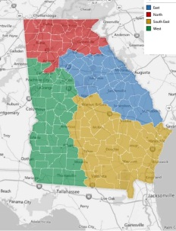
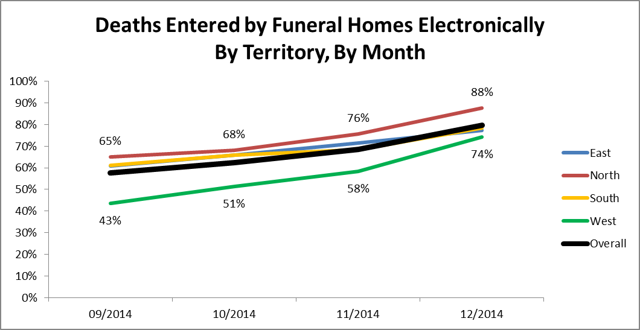
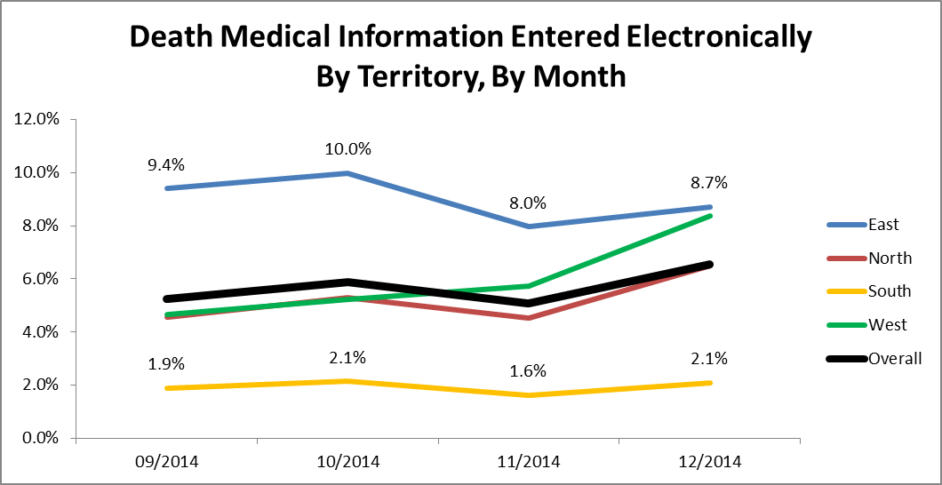
Data Integrity Strategy
“Integrity” defined as completeness and accuracy via how data is created, modified, reported, & retained
4 regional consultants in territories working with stakeholders who create data
Using data and information to manage our business
Able to track penetration rates of each stakeholder group to plan future programs and initiatives
From 58% to 80% overall
From 5.2% to 6.5% overall

Slide 57
Data Integrity Strategy
“Integrity” defined as completeness and accuracy
Tracking data captured and entered into the system
Surveillance of data to explain business results and surveillance to focus efforts
Information that is integral to refreshing and implementing programs through DPH’s Health Promotion and Health Protection divisions
Metrics since launching the Quality Birth Report | Sep ’14 | Oct ’14 | Nov ’14 | Dec ‘14 | Jan ’14
Avg # Days to Register a Birth | 8.4 days | 7.5 days | 6.7 days | 8.8 days | 7.3 days
% Births Registered Late | 51% | 42% | 35% | 53% | 41%

Slide 58
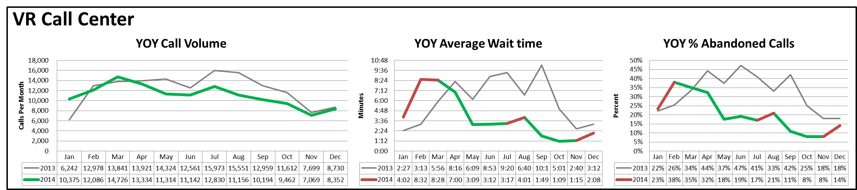
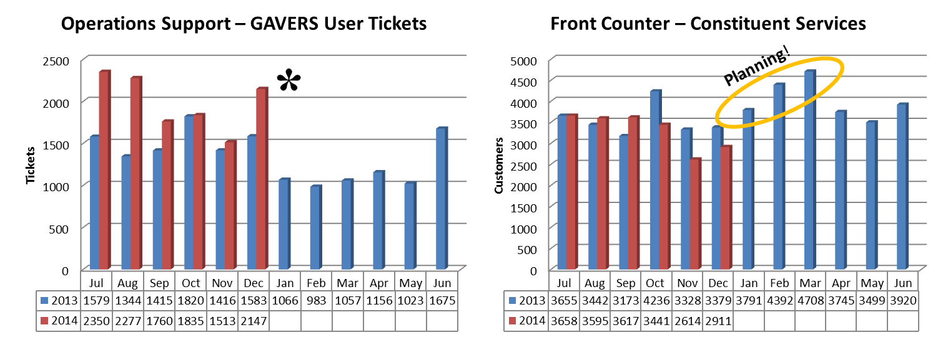
Monthly Scorecard Using Data to Explain our Business Results and Predict Needs

Slide 59
Strategic Agenda
Goals
Build the Vital Records Organization of the Future
Work Smarter
Shift the Paradigm from a Paper to an Electronic Record
Vision
Be known as an operationally excellent
unit of DPH
Goals
Promote Data Integrity
High-grade the Customer Experience
Secure New Revenue Contracts
Mission
Create, maintain, protect, and provide access to vital event records in order to implement programs that promote health and well-being of
Georgia constituents

Slide 60
Strategic Agenda
Future State Targets:
New State Office vital records organization in place by 6.30.15
85% of births registered within 5 days
85% of deaths registered within 10 days
85% of key data fields populated in new records
85% of amendments processed within 15 days
85% of State Office front counter transactions processed within 15 minutes

Slide 61
Strategic Agenda
Strategies:
Implement the New Organizational Design and Performance Management System
Leverage Regional Resources to Deepen Relationships with Data Creation Partners and Record Providers
Position the State Office as the Centralized Authority and Governance of Local Registrar Operations
Standardize Processes, Policies, Offerings, and Metrics for All Vital Records Operations
Enhance the Customer Experience Through Automation, Value-Added Service, and Communications
Establish the OVOT (“one version of the truth”) Data Integrity Strategy
Re-engineer Inefficient, Ineffective, or Broken Processes
Seek Partners for Data Contracts and Maximize Value of Existing Contracts

Slide 62
Closing Comments
Kathryn Cheek, MD, FAAP
Chair

Slide 63
The next Board of Public Health meeting is currently scheduled on
Tuesday, March 10, 2015 @ 1:00 PM.
To get added to the notification list for upcoming meetings, send an e-mail to huriyyah.lewis@dph.ga.gov

