Slide 1
VPDs and Georgia Requirements for Childcare Attendance
Presented by:
Date:

Slide 2
Topics
Review vaccine preventable diseases
Discuss Georgia immunization requirements for child care attendance
Review process for maintaining immunization certificates
Discuss reliable immunization resources
Notes:
45 min presentation with 30 min for Q&A
Review of childhood vaccine preventable diseases and why we immunize
GA immunization requirements for child care and preschool
How to monitor, follow up and enforce the requirements for the certificates of attendance
Helpful resources

Slide 3
The Impact of Vaccines
Disease | Average Annual Reported Cases Pre-vaccine* | Cases in U.S. 2015** | Provisional Cases in U.S. 2016** | Provisional % Reduction In U.S. 2016
Smallpox | 48,164 | Eradicated worldwide in 1980
Diphtheria | 175,885 | 0 | 0 | 100%
Measles | 503,282 | 188 | 69 | >99.9%
Mumps | 152,209 | 1,329 | 5,311 | 96.5%
Pertussis | 147,271 | 20,762 | 15,737 | 89.3%
Polio (paralytic) | 16,316 | 0 | 0 | 100%
Rubella | 47,745 | 5 | 5 | >99.9%
Congenital Rubella Syndrome | 823 | 1 | 1 | >99.9%
Tetanus | 1,314 | 29 | 33 | 98.1%
H. Influenzae Type b Age<5 years | 20,000 | 29 | 22 | 99.9%
*MMWR 48(12);243-248 April 2, 1999
**MMWR 64(52), ND-924-ND-941, January 6, 2017
Notes:
This table shows the impact of vaccines on the annual reported cases of some vaccine preventable diseases in the United States.
Column 2 shows the average number of reported cases of a specific disease prior to the licensure of the vaccine.
Column 3 shows the number of reported cases in the United States in 2015.
Column 4 shows the provisional number of reported cases in the U.S in 2016.
Column 5 shows the percentage decrease in reported cases in the United States based on the provisional number of reported cases in 2016 compared with the pre-vaccine years.
About a week ago, the State Epidemiology team released a “mumps alert”. During 2017, over 5,629 cases were reported in the U.S. to the CDC; 110 mumps cases were reported to DPH during the same time period. Despite high vaccination levels with MMR, mumps cases remain elevated- primarily due to a number of outbreaks in settings of prolonged close contact with others who have mumps, such as within classrooms, sports teams, campus dorms, and other crowded environments.
GA DPH urges healthcare providers to maintain heightened awareness for mumps and reminds providers that all suspect cases of mumps should be reported at the time of testing to the Health Department. For additional information please contact Ebony Thomas or Jessica Tuttle at the State Office. 404-657-2588
Reference:
Achievements in Public Health, 1900-1999 Impact of Vaccines Universally Recommended for Children - United States, 1990-1998 MMWR April 02, 1999 / 48(12);243-248
MMWR 65(52);ND-924-ND-941, January 6, 2017

Slide 4
VPD | Vaccination Rate Needed for Herd Immunity
Measles | 92-94%
Pertussis | 92-94%
Diphtheria | 83-85%
Rubella | 83-85%
Mumps | 75-86%
Influenza | 30-75%
Notes:
Herd immunity is the term most frequently used that refers to a situation in which a high percentage of a population is immune to a disease, essentially stopping the disease in its tracks because it cannot find new hosts. This chart illustrates the vaccination rate needed for each of the VPDs listed.
The threshold for herd immunity varies, depending on the disease, with more virulent infectious agents requiring vaccination of a higher percentage of the population to create the desired community immunity. The creation of herd immunity is especially important in crowded environments which facilitate the spread of disease, like schools. It is also extremely important to receive regular boosters, as some vaccines lose their efficacy over time, leaving people vulnerable to an outbreak. Herd immunity led to the eradication of smallpox, and it explains why diseases such as polio and diphtheria are rare in developed nations with established vaccination policies.
According to the 2016 National Immunization Study, Georgia ranks higher than US national averages for recommended childhood vaccines.
Georgia coverage rates for children 19-35 months for:
•Measles, mumps and rubella vaccine (MMR) (1 or more doses) is at 93.2% (91.1% US) (94.2% in 2015)
•DTaP (>/= 4 doses) 90.0% (83.4% US)
•Hepatitis B birth dose 76.7% (71.1% US)
For the combined vaccine series 4:3:1:3:1:4 is 77.3 (70.7%US)
Coverage with recommended vaccines for children aged 19–35 months continues to be high and stable but remains below 90% for vaccines that require booster doses during the second year of life (≥4 doses of DTaP and PCV as well as Hib full series) and for other recommended vaccines (HepB birth dose, rotavirus, and HepA). Disparities in coverage persisted for black children and those living below the poverty level, and coverage was generally lower for children who were uninsured or covered by Medicaid than among those with private insurance. These disparities indicate that improvements are needed in access to and delivery of age-appropriate immunization to all children, regardless of insurance or financial status (i.e., “the immunization safety net”).
So, What does this mean for public health practice?
Continued collaboration between CDC and state immunization programs to further elucidate and address disparities in coverage by poverty status should provide valuable information as strategies are needed for improving access to and delivery of age-appropriate immunization. Health care providers can increase vaccination coverage using evidence-based strategies such as provider reminders, standing orders to provide vaccination whenever appropriate, and immunization information systems.

Slide 5

Advisory Committee on Immunization Practices (ACIP)
15 voting members with expertise in one or more of the following:
Vaccinology
Immunology
Infectious diseases
Pediatrics
Internal Medicine
Preventive medicine
Public health
Consumer perspectives and/or social and community aspects of immunization programs
ACIP develops recommendations and schedules for the use of
licensed vaccines
Notes:
Ask the audience if they are familiar with the ACIP. If they are familiar with the ACIP the presenter can spend a minimal amount of time on this slide.
The dramatic reduction of vaccine preventable diseases in the United States can be attributed to the availability of vaccines, as well as recommendations and an organized vaccine schedule developed by the Advisory Committee on Immunization Practices (ACIP).
The Advisory Committee on Immunization Practices (ACIP) consists of 15 experts in fields associated with immunization who have been selected by the Secretary of the U. S. Department of Health and Human Services to provide advice and guidance to the Secretary, the Assistant Secretary for Health, and the Centers for Disease Control and Prevention (CDC) on the most effective means to prevent vaccine-preventable diseases.
The Committee develops written recommendations for the routine administration of vaccines to the pediatric and adult populations, along with schedules regarding the appropriate periodicity, dosage, and contraindications applicable to the vaccines. ACIP is the only entity in the federal government which makes such recommendations.
The overall goals of the ACIP are to provide advice which will assist the Department and the Nation in reducing the incidence of vaccine preventable diseases and to increase the safe usage of vaccines and related biological products.
For more information: http://www.cdc.gov/vaccines/acip/index.html

Slide 6
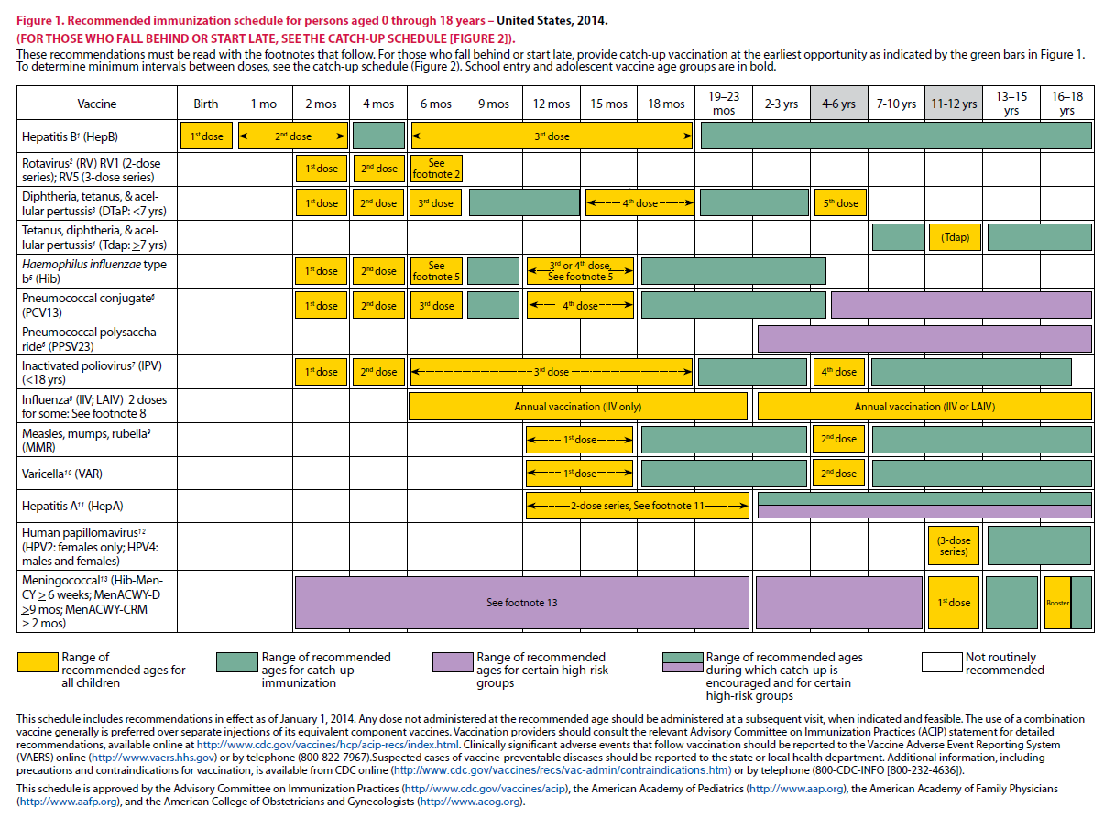
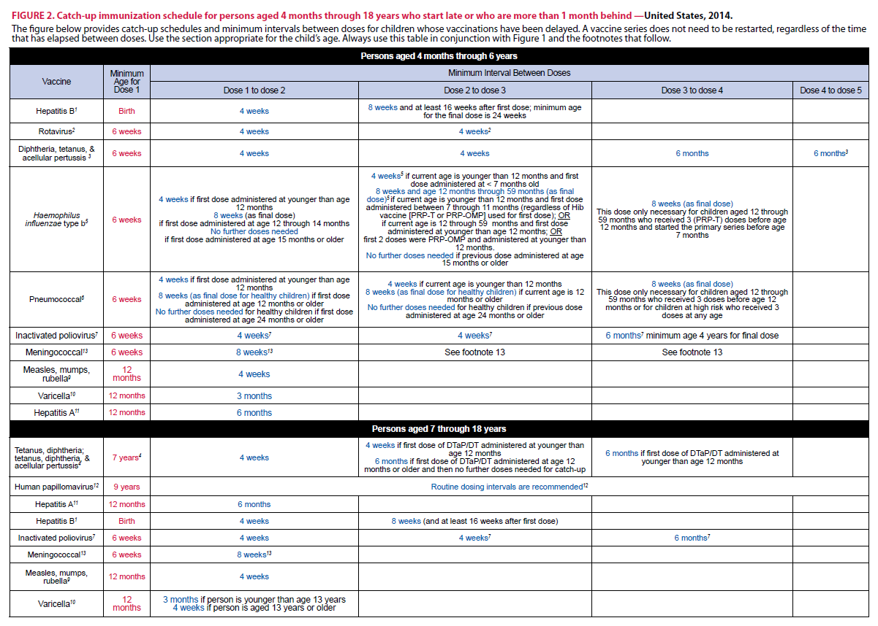
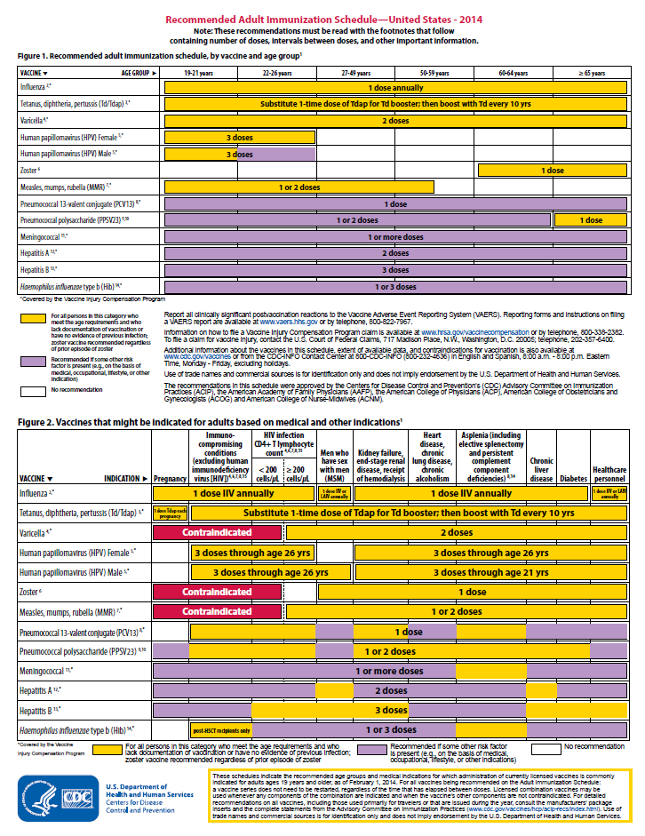
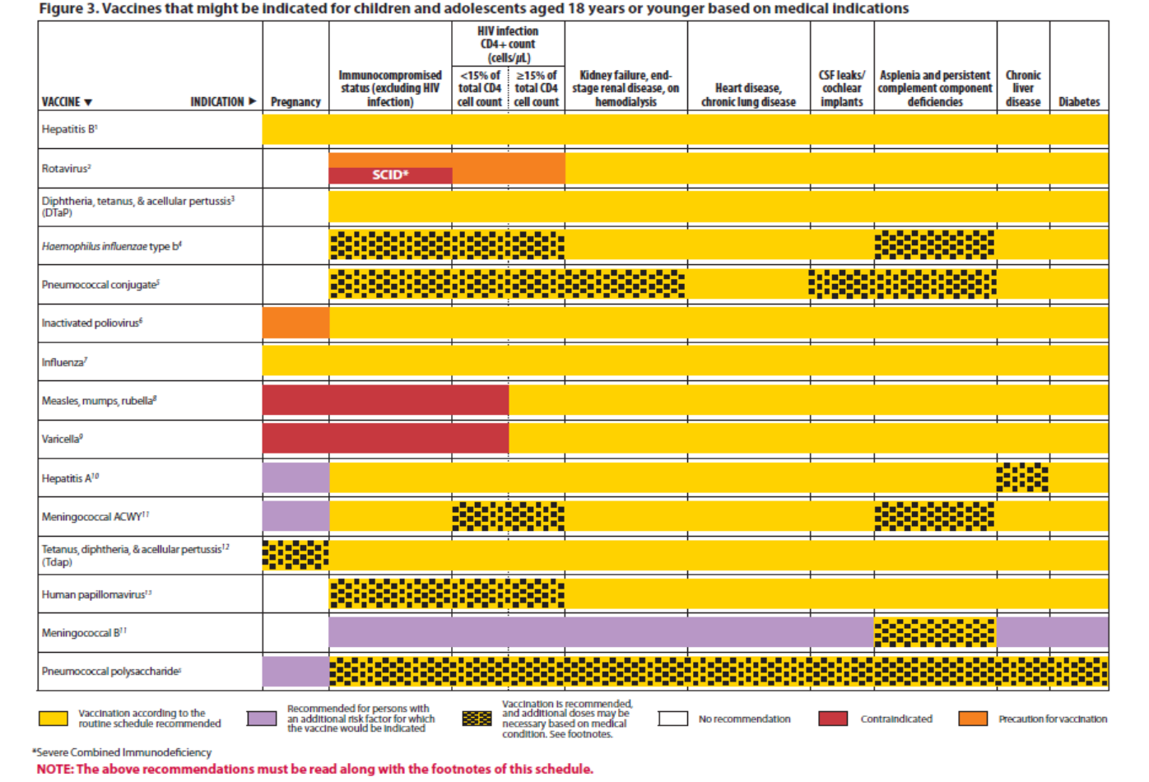
Immunization Schedule Updates
All staff must use the same
immunization schedule
Schedules:
  Children & Adolescents
  0 through 18 years
  Catch-up schedule for
  ages 4 months -18 years
  Children and Adolescents 18 years or younger based on medical indications
  Adult 19 years and older
  Adult based on medical
  and other indications
READ THE FOOTNOTES
http://www.cdc.gov/vaccines/schedules/hcp/child-adolescent.html
http://www.cdc.gov/vaccines/schedules/hcp/adult.html
Notes:
6
6
In February 2018, the 2018 Immunization Schedule for Children and Adolescents birth through 18 years became effective, as recommended by the ACIP and approved by the CDC.
It is important to remember that:
-All staff and providers should use the same immunization schedule
Overall, the general schedule collapsed; a table has been added outlining vaccine type, abbreviation, and brand names for vaccines discussed in the child/adolescent schedule. The footnotes are presented in a new simplified format. The goal was to remove unnecessary text while preserving all pertinent information and maintaining clarity. This was accomplished by a transition from complete sentences to bullets, removal of unnecessary or redundant language, and formatting changes. Manufacturing of MenHibrix vaccine has been discontinued in the US and all available doses have expired and is no longer mentioned on the schedule. The medical conditions collapsed; the medical indications figure (figure 3) changes include: The HIV column provides a reference providing additional information regarding HIV laboratory parameters and use of live vaccine. Hepatitis (Hep B) vaccine collapsed; the hepatitis B vaccine footnote was revised to include information regarding vaccination of < 2,000 gram infants born to HBsAg-negative mothers. The influenza vaccine footnote has been updated to indicate the LAIV should not be used during the 2017-2018 influenza season. A reference link to the 2017-2018 season influenza recommendations has been added. The MMR footnote was updated to include guidance regarding the use of a 3rd dose of mumps-containing vaccine during a mumps outbreak. The meningococcal vaccine footnote has been edited to create separate footnotes for MenACWY and MenB vaccines. The inactivated poliovirus rows of the catch-up schedule have been edited to clarify the catch-up recommendations for children 4 years of age and older. The poliovirus vaccine footnote was revised to include updated guidance for persons who received oral polio vaccine as part of their vaccination series. The maximum ages for the first and last doses of the rotavirus series have been added to the rotavirus vaccine row of the catch-up schedule.

Slide 7
What Does It All Mean?
Indication
-Information about the appropriate use of the vaccine
Recommendation
-ACIP statement that broadens and further delineates the Indication
found in the package insert
-Basis for standards for best practice
Requirement
-Mandate by a state that a particular vaccine must be administered and documented before entrance to child care and/or school
Notes:
7
It is important providers understand the difference between an indication, recommendation and a requirement when assessing immunization need.
An indication provides information about the appropriate use of the vaccines; the prescribing information
EXAMPLE of an indication:
ADACEL vaccine is indicated for active booster immunization for the prevention of tetanus, diphtheria and pertussis as a single dose in persons 10 through 64 years of age.
BOOSTRIX® is indicated for active booster immunization against tetanus, diphtheria, and pertussis as a single dose in individuals 10 years and older.
The Recommendation is the ACIP statement that broadens and delineates the indication found in the package insert.
So an EXAMPLE of a recommendation:
The ACIP recommendation for Tdap would be, “Administer 1 dose of Tdap vaccine to all adolescents aged 11 through 12 years.” The recommendation may include other information and guidance on epidemiology of the disease, appropriate timing, dosage, contraindications to the vaccine and guidance for use in special populations. The recommendation appears first as “provisional recommendation” but once approved, it appears in the MMWR as a full recommendation.
A vaccine requirement is consistent with the ACIP Recommended Childhood/Adolescent Immunization Schedule. The state mandates that a particular vaccine must be administered and documented before entrance to school or child care.
EXAMPLE of a state vaccine requirements:
Requirements are consistent with the Recommended Childhood and Adolescent Immunization Schedule. GA DPH rules and regulations state that children entering any school or child care facility in GA must be age appropriately immunized against each of these diseases: Hepatitis B, Diphtheria, Tetanus, Pertussis, Polio, Hib, Pneumococcus, Measles, Mumps, Rubella, Varicella, Hepatitis A and Meningococcal.
Remember that GRITS:
Calculates validity based on recommendations; Prints certificates based on requirements, which are first based on the recommendations. Some of the new vaccines previously discussed are RECOMMENDED for particular age groups, but MAY NOT BE REQUIRED for school or child care attendance.

Slide 8
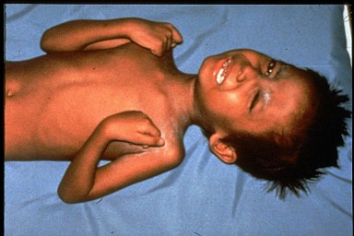

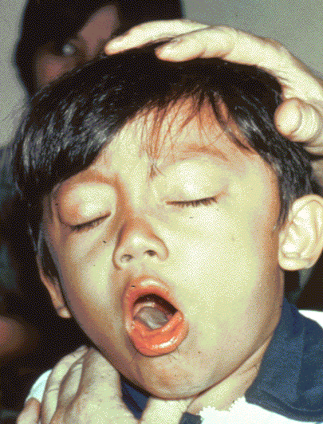

Diphtheria
Tetanus
Required for child care and school attendance
Pertussis
Notes:
Ask participants what are: Diphtheria, tetanus and pertussis?
Whooping cough (pertussis), tetanus, and diphtheria are serious diseases caused by bacteria.
Whooping cough and diphtheria are spread person-to-person through the air. Tetanus gets into the body through cuts or wounds.
Whooping cough can trigger such bad coughing that babies can’t breathe. Babies are most likely to die from whooping cough and can have complications such as seizures and brain damage. Tetanus can cause extremely painful muscle cramps all over the body. Diphtheria can lead to severe breathing problems, heart problems, and paralysis. All these diseases can be deadly.
ACIP recommends:
A 5 dose series of DTaP: Administered at 2, 4, 6, 15-18 months and 4-6 years (Do not administer after age 6)
Optional Information:
Diphtheria, tetanus, and pertussis are illustrated on this slide
The top left picture is of a throat of a child who has diphtheria. You can see the thick gray coating over the back of the throat. This coating can eventually expand down through the airway, and if not treated, a person could die from suffocation, or suffer other complications such as paralysis, heart failure, or coma.
In the top right picture, this child is experiencing painful muscle spasms from tetanus. It is nearly impossible for him to move or control the muscles in his body. He cannot eat because the muscles in his mouth have become so tight and it is difficult for him to swallow. Other possible complications are broken bones from muscle spasms, breathing problems, and death.
The bottom picture shows a child who is suffering from pertussis, commonly know as “whooping cough”. He is experiencing coughing spasms, which produce a “whooping” sound. The sound occurs because the child is trying to catch his breath before the next round of coughing. Often children have difficulty breathing and experience vomiting and exhaustion from the severe coughing.

Slide 9
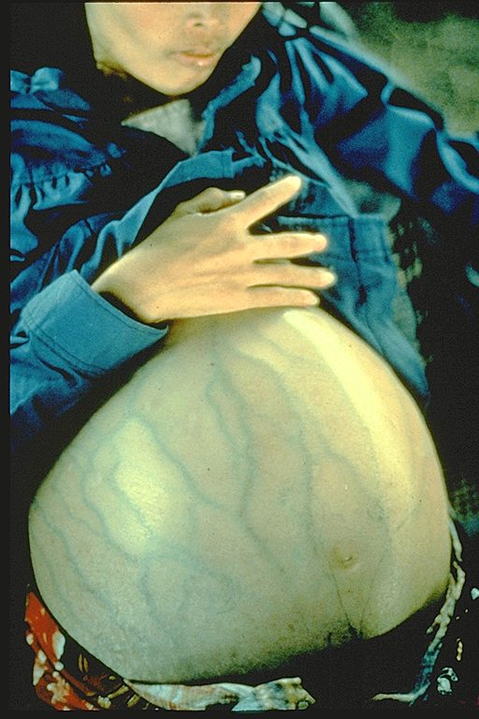
Hepatitis B
Required for child care and school attendance
Notes:
Review Hepatitis B virus:
Hepatitis B is a serious liver disease caused by a virus. Your can get infected with hepatitis B if you come in contact with an infected person’s blood or other body fluids. Babies can get the virus from their infected mothers at birth or if they live with or are cared for by an infected person. The virus can be spread just by sharing a toothbrush with an infected person. For some people, the virus remains in their body for years. During this time, the virus can attack the liver and cause serious problems like liver failure or cancer.
Presenter may want to use Hepatitis one-pager to discuss vaccine usage during slide.
Children and adolescents
Babies normally get 3 doses of hepatitis B vaccine:
1st Dose: Birth, 2nd Dose: 1-2 months of age, 3rd Dose: 6-18 months of age. Some babies might get 4 doses, for example, if a combination vaccine containing hepatitis B is used. (This is a single shot containing several vaccines.) The extra dose is not harmful. The final (third or fourth) dose in the HepB vaccine series should be administered no earlier than age 24 weeks. Administration of a total of 4 doses of HepB vaccine is permitted when a combination vaccine containing HepB is administered after the birth dose. Anyone through 18 years of age who didn’t get the vaccine when they were younger should also be vaccinated.
Adults
All unvaccinated adults at risk for hepatitis B infection should be vaccinated. This includes: sex partners of people infected with hepatitis B, men who have sex with men, people who inject street drugs, people with more than one sex partner, People with chronic liver or kidney disease, people under 60 years of age with diabetes, people with jobs that expose them to human blood or other body fluids, household contacts of people infected with hepatitis B, residents and staff in institutions for the developmentally disabled, Kidney dialysis patients, people who travel to countries where hepatitis B is common, people with HIV infection. Other people may be encouraged by their doctor to get hepatitis B vaccine; for example, adults 60 and older with diabetes. Anyone else who wants to be protected from hepatitis B infection may get the vaccine. Pregnant women who are at risk for one of the reasons stated previously should be vaccinated. Other pregnant women who want protection may be vaccinated. Adults getting hepatitis B vaccine should get 3 doses—with the second dose given 4 weeks after the first and the third dose 5 months after the second. Your doctor can tell you about other dosing schedules that might be used in certain circumstances.
Staff should work with other programs to make sure there are standing orders to vaccinate these vulnerable populations.

Slide 10
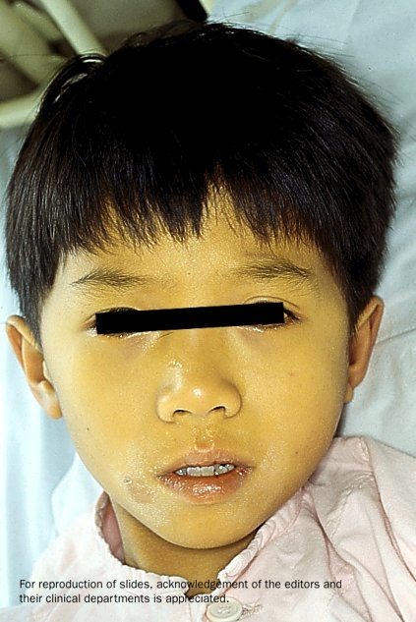

Hepatitis A
Required for school or child care attendance for children born on or after 1-1-06
Notes:
Hepatitis A is a serious liver disease caused by a virus. The virus is found in the feces (poop) of infected people. The hepatitis A virus is spread when invisible particles of feces (poop) get into a person’s mouth. You can get hepatitis A by eating contaminated food or drinking contaminated water, during sex, or just by living with an infected person. Hepatitis A can your skin and eyes turn yellow. You can get very sick for weeks, need to be hospitalized, and even die. Some people don’t look or feel sick, but they can still spread hepatitis A to others. Everyone is at some risk for getting infected with hepatitis A. People who travel outside the U.S. have an increased chance of getting infected.
For children, the first dose should be given at 12 through 23 months of age. Children who are not vaccinated by 2 years of age can be vaccinated at later visits.
The persons on this slide have hepatitis A . Note the jaundice of the skin and the sclera of the eye.
Optional information:
The nature of hepatitis A disease is that it is cyclical. Children plan an important role in HAV transmission. Symptomatic infection is uncommon in children, so they may be a source of infection for household or other close contacts. Almost half of persons with hepatitis A do not have an identified source of their infection. Groups of persons at risk for hepatitis A are international travelers, men who have sex with men, and illegal drug users. Food handlers are not at risk.

Slide 11
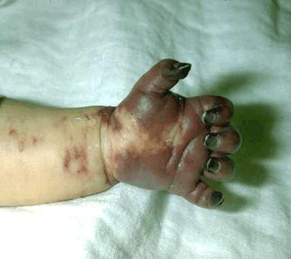
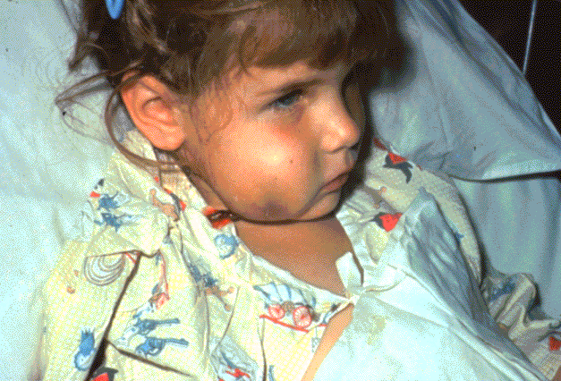
Haemophilus influenzae Type b (Hib)
Required only for child care and pre-K attendance
Notes:
What causes Hib disease? Hib disease is caused by a bacterium, Haemophilus influenzae type b. There are six different types of these bacteria (a through f). Type b organisms account for 95% of all strains that cause invasive disease, and this is the type against which the Hib vaccine
protects.
How does Hib disease spread? Hib disease is spread person-to-person by direct contact or through respiratory droplets. Usually the organisms
remain in the nose and throat, but occasionally the bacteria spread to the lungs or bloodstream and cause a serious infection in the individual.
How serious is Hib disease? Hib disease can be very serious. The most common type of invasive Hib disease is meningitis, an infection of the membranes covering the brain (50%–65% of cases).
ACIP recommends:
3-4 doses of Hib (depending on brand)
Dose 1 @ 2 months of age
Dose 2 @ 4 months of age
Dose 3 @ 6 months of age
(Not required if Pedvax HIB® is administered at 2 and 4 months of age)
Booster dose @ 12 through 15 months of age
One dose of Hib may be given to adults with immunocompromising conditions.

Slide 12
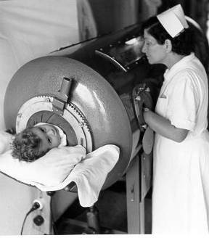
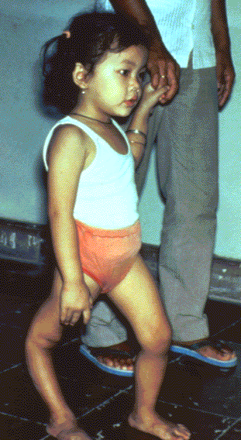
Polio
Required for child care and school attendance
Ref. MMWR 2009; 58 (30);829-830 (August 7, 2009)
Source: World Health Organization
Notes:
12
12
12
Discuss pictures on the slide. Pictures show a child in an iron lung due to weak respiratory muscles (common in polio era) and a child with muscle weakness, as a result of polio, requiring the assistance of braces and crutches in order to walk.
Polio, also called poliomyelitis and infantile paralysis is caused by an Enterovirus (Serotypes 1,2,3)
Infection acquired through mouth, virus replicates in pharynx and GI tract, then spreads to lymphatics and other tissues.
Attacks motor neurons in spinal cord & brain stem
in 2015, Nigeria was removed from the list of polio-endemic countries. The only 2 polio endemic countries now are Pakistan and Afghanistan. Remind staff to evaluate travelers for the need of polio vaccine if traveling to endemic countries.
ACIP recommends:
Four dose series of IPV at : 2, 4, 6 through 18 months
and 4 through 6 years of age.
Minimum interval from dose 3 to dose 4
is six months
Final dose at 4 years of age or older regardless of the number of previous doses
A booster dose may be recommended, depending on length of stay and the timing of the last dose of polio vaccine, for persons traveling to countries experiencing polio outbreaks.
For additional information about polio refer to: Epidemiology and Prevention of Vaccine-Preventable Diseases, 13th edition 2015. HHS, CDC.

Slide 13
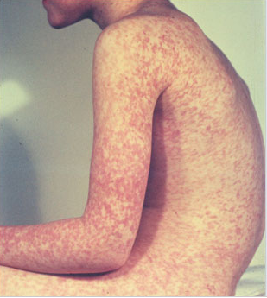
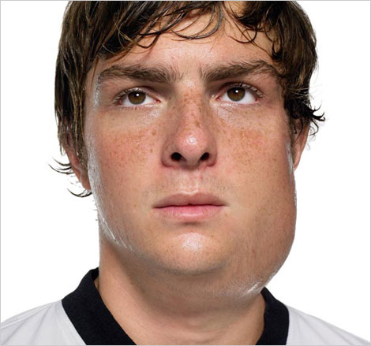
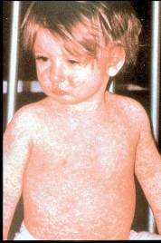
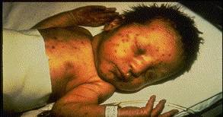
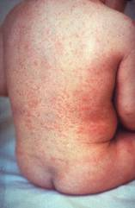
Measles, Mumps, Rubella
Measles (M)
Source: Creative Commons
Source: American Academy of Pediatrics
Red Book On Line Visual Library
Mumps (M)
Required for child care and school attendance
Rubella (R)
Congenital Rubella (R)
Notes:
13
13
MEASLES (caused by paramyxovirus)
Slide shows two children with typical measles rash and conjunctivitis in younger child
MUMPS (caused by paramyxovirus)
Slide shows an adolescent with parotitis due to mumps
Parotitis (inflammation of parotid gland) occurs in 30-40% of infected persons, 40-50% have only nonspecific or respiratory symptoms; Complications include aseptic meningitis, & deafness; Post pubertal individuals may have orchitis (inflammation of testicles), ovarian inflammation, & pancreatitis
RUBELLA (Caused by rubella virus and spread from person to person {togavirus})
In children, the rash may be the first manifestation of infection. Adults may have low-grade fever, malaise, URI, and lymphadenopathy prior to rash. Arthralgia and arthritis is common in adults, especially women. Complications include encephalitis and hemorrhagic manifestations
Rubella is no longer endemic in the U.S. However, it is still present in other countries and can be imported
CONGENITAL RUBELLA
Slide shows an adult and child with a typical rash from rubella and an infant with congenital rubella syndrome Infant was infected in utero and has “blueberry muffin spots” on skin due to petechial lesions, cataracts, hearing loss and congenital heart lesion and will most likely be developmentally delayed.
All woman of child bearing age should be certain they are immune to rubella.
For additional information refer to: Epidemiology and Prevention of Vaccine-Preventable Diseases, 12th edition May 2012. HHS, CDC.

Slide 14
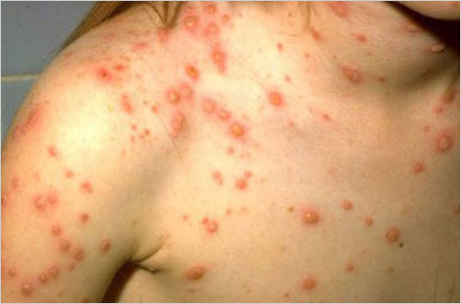
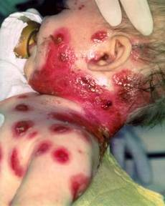
Varicella
(Chickenpox)
Required for child care and school attendance
© Copyright American Academy of Pediatrics
Notes:
Chicken pox is an illness caused by the varicella zoster virus. It was one an almost universal childhood experience. Now it’s much less common in the U.S. owing to widespread vaccination.
Why get vaccinated?
It is usually mild, but it can be serious, especially in young infants and adults. Most people who get chickenpox vaccine will not get chickenpox. But if someone who has been vaccinated does get chickenpox, it is usually very mild. They will have fewer blisters, are less likely to have a fever, and will recover faster. This slide shows an adolescent with a typical varicella rash and infant with secondary bacterial infected varicella lesions, probably due to staph or strep.
ACIP recommends:
Children who have never had chickenpox should get 2 doses of chickenpox vaccine at these ages:
1st Dose: 12–15 months of age
2nd Dose: 4–6 years of age (may be given earlier, if at least 3 months after the 1st dose)
People 13 years of age and older (who have never had chickenpox or received chickenpox vaccine) should get two doses at least 28 days apart.
Catch-up
Anyone who is not fully vaccinated, and never had chickenpox, should receive one or two doses of
chickenpox vaccine. The timing of these doses depends on the person’s age. Chickenpox vaccine may be given at the same time as other vaccines.
Reference: Prevention of Varicella - Recommendations of the Advisory Committee on Immunization
Practices (ACIP) MMWR (2007);56(No. RR-4):23

Slide 15


Pneumococcal Disease
Required for child care and pre-K attendance
Notes:
Pneumococcal disease is caused by a bacterium, Streptococcus pneumoniae, also called pneumococcus (about 90 known serotypes); Causes pneumonia, bacteremia, meningitis and otitis media; Highest rate of invasive disease is in children less than 2 years. Increased risk of infection in children with HIV infection, sickle cell disease, asplenia, day care attendees and in certain ethnic groups (African Americans, Alaskan natives and Native Americans). Increased risk in children & adults with cardiovascular disease, pulmonary disease, diabetes, alcoholism, cirrhosis, immunocompromising conditions; Individuals who have asthma and those who smoke cigarettes are also at increased risk. Estimated cases in the US each year are more than any other vaccine-preventable disease. Some serotypes of pneumococcus have become resistant to antibiotics.
PCV13 is routinely given to children at 2, 4, 6, and 12–15 months of age. Children in this age range are at greatest risk for serious diseases caused by pneumococcal infection.
This vaccine is a requirement for pre-K and childcare attendance.

Slide 16
Requirements for School and Childcare Attendance
Notes:
Now we will shift into the GA School and childcare requirements portion of the presentation.
As a federally funded Program, the Georgia Immunization Program is required to:
1) Assess vaccination coverage and exemption levels on each vaccine appropriate for kindergarten entry according to local/state requirements, using a CDC-approved survey methodology, and to the extent possible, assess coverage and exemption levels on each vaccine according to the ACIP recommendations, including age at vaccination and intervals between vaccination doses.
2) Document school vaccinations and exemption requirements.
3) Provide feedback to schools, school districts and state Departments of Education on kindergarten coverage and exemption rates by school, and work with these partners to improve coverage with local/ state required vaccines.
State Requirements:
1) Vaccination coverage among children entering kindergarten and seventh grade is assessed annually by the state. Each school year, the health department, school nurse, or other school personnel assess the schools to determine vaccination coverage, as defined by state and local school requirements established to protect children from vaccine preventable diseases.
2) Document school vaccinations and exemption requirements.
3) Provide feedback to child care facilities, schools, school districts, state Departments of Education and community stakeholders on kindergarten coverage and seventh grade and exemption rates by school, and work with these partners to improve coverage with local/state required vaccines.
The Georgia Law, along with DPH rules and regulations (Official Code of Georgia, Annotated, Section 20-2-771, Section 49-4-182 and Section 49-4-183) defines the target population for which immunity to specified diseases is required and sets standards for the use of immunization certificates. Vaccines required for school and childcare attendance are consistent with the recommended childhood and adolescent immunization schedule and require children to be age appropriately immunized against each of the specified vaccine preventable diseases.

Slide 17
Goal
Vaccines work
Goal 100 % compliance rate
Immunization Laws work
Partnerships work
Notes:
Our goal is to have 100% of all children attending child care and schools appropriately immunized for their age with all the recommended and required vaccinations.
The laws that we have in place were established as a means to ensure that infants and children are adequately vaccinated and that high levels of immunization are maintained in all communities throughout Georgia.
And lastly, partnerships have been developed between health care providers, parents, child care facilities, and schools. Each partner has specific responsibilities and plays an important role in ensuring that Georgia’s children are adequately protected from vaccine preventable diseases. As a result of the collaborative efforts of each partner, immunization rates are maintained and the incidence of disease remains low.

Slide 18
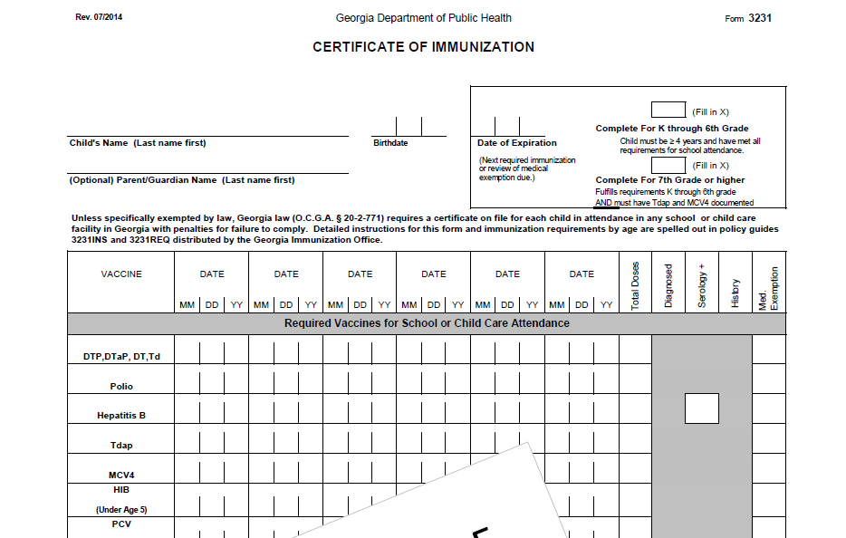
Form 3231
Notes:
Presenter will review form 3231 with audience while discussing slide.
The Immunization certificate was revised July 1, 2014 for new immunization requirements for 7th grade.
The two boxes in the right upper corner; the top box is labeled “Complete For K through 6th Grade” and the bottom box is “Complete for 7th Grade or higher”. The instructions on how these two boxes are completed will are outlined on the 3231 INS.
Additional updates include:
-”Td” has been added to the first line with the DTP, DTaP, DT section; Td will be designated with a (++) symbol and the Td explanation text will appear in the bottom left corner of the form when printed
-”Polio” is now on one line; no separate line for “IPV”/”OPV”; OPV is designated with (^^) symbol, the polio explanation text “**unspecified polio dose/OPV dose appears in the bottom left corner of the form when printed
-“Tdap” and “MCV4” are listed on their own separate lines; MCV4 row was moved up to the required section; only Menactra, Menveo and MCV4 unspecified doses will display; Menomune, MenB and Meningococcal unspecified do not display.

Slide 19
Certificate of Immunization
(Form 3231)
Certificate on file at each facility or school
Photocopies acceptable
A licensed Georgia physician, APRN, PA or public health official is responsible for completing the certificate
Only physician offices and health clinics can obtain blank certificates
Notes:
Certificate of Immunization (Form 3231)
-A child must have a certificate on file at each facility or school he/she attends
-Photocopies of appropriately completed and signed certificates are acceptable
-If a certificate is not on file for each child attending, the facility is held legally responsible
-A licensed Georgia physician, APRN, PA or public health official is responsible for the interpretation of and compliance with the requirements for vaccines and completing the certificate
-Only physician offices and health clinics can obtain blank certificates (can order using form 3184)

Slide 20
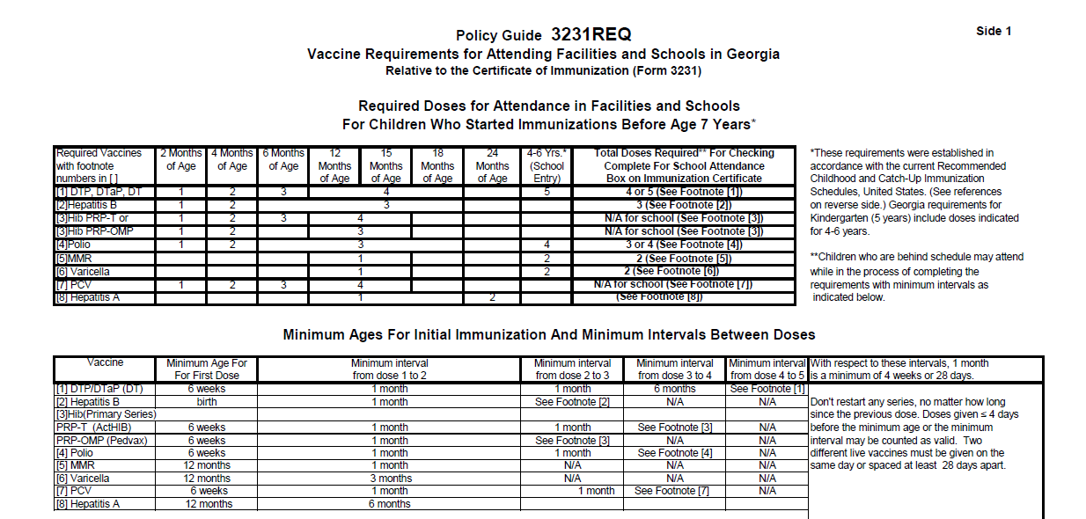
3231 REQ
Notes:
The 3231 REQ highlights those “Vaccine Requirements for Attending Facilities and Schools in Georgia; “ This guide is relative to the certificate of Immunization (form 3231) and was established in accordance with the current Recommended Childhood and Catch-up Immunization Schedules. The guide is helpful for those school and public health nurses trained to perform assessments and also valuable for providers to understand what vaccines are required for child care and school attendance when immunizing and scheduling patients for future appointments:
The REQ has two sides; On side 1, the table relates to children who started receiving their vaccines prior to age 7 years and side 2 relates only to those children who start their immunizations at age 7 years or older.

Slide 21
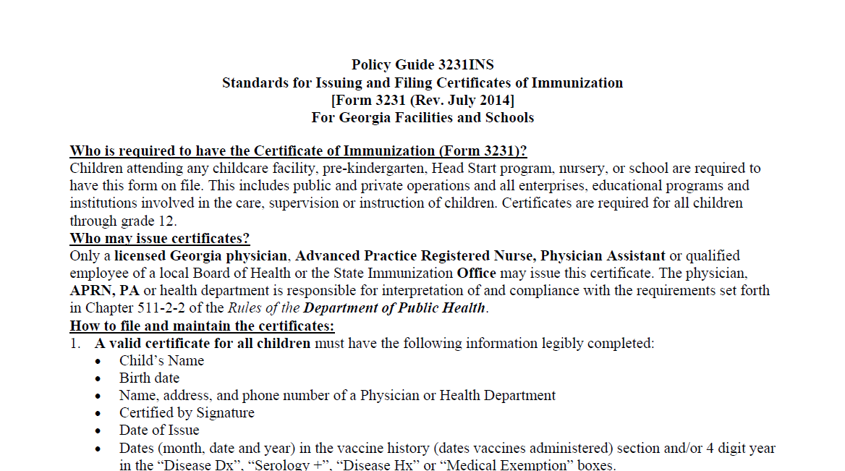
3231 INS
Notes:
The Policy Guide 3231INS is the “Standards for Issuing and Filing Certificates of Immunization”
Providers have the responsibility of knowing and enforcing the immunization requirements as outlined in the Policy Guide 3231INS.
The 3231INS provides instructions on who is required to have the certificate of Immunizations (form 3231), who may issue a certificate, how to file and maintain certificates, instructions for completing certificates, and guidelines for the two recognized GA state immunization exemptions.

Slide 22
Exemptions
Medical:
Physical disability or condition
Documented in the medical exemption box indicated for each vaccine
Reviewed annually
Notes:
As a quick review and also for those providers who may be new to immunizations, the Official Code of Georgia provides for only two types of exemptions from immunization requirements. Section 5 of the 3231 INS, Standards for Issuing and Filing Certificates of Immunization outlines the standards for “Exemptions:” The first exemption is medical which should be used only when there is a condition that contraindicates the administration of a required vaccine; should be documented in the medical exemption box indicated for each vaccine; should be reviewed annually and the certificate must be reissued with or without indication of exemption
O.C.G.A. § 20-2-771 (d)

Slide 23
Exemptions
Religious:
Documented on form 2208
Form kept on file by the school or facility in lieu of a Certificate of Immunization (form 3231)
Do not expire
Notes:
Religious exemption is covered in Section 5 of the 3231 INS Standards for Issuing and Filing Certificates of Immunization. As of June 2015 a new Religious exemption form was adopted by the state. The form can not have any additions, alterations, strikeouts or disclaimers. Our regulation says they either sign it as is or they can’t claim the exemption. This form must be on file in lieu of the certificate of immunization for any students filing a religious exemption after 8/2015.
Religious Exemptions are:
-Documented on form 2208
-Kept on file by the school or facility in lieu of a Certificate of Immunization (form 3231)
-Do not expire
Under both exemptions, in the event of an outbreak, the law states that a child must be excluded from attending child care or school until protected by immunization or natural immunity or all danger is passed.
O.C.G.A. § 20-2-771 (e)

Slide 24

Valid Certificates
All certificates must be marked with :
  Child’s name
  Birth date
  Name and Address of Physician, APRN, PA, Qualified Board of Health official or State Immunization Office Official
  Certified Signature
  Date of Issue
Notes:
It is important to explain to facilities that they are responsible for checking the validity of the certificates. They are not responsible for the accuracy of the immunization information filled in by the health care providers.
To be valid, all certificates should be legibly completed with:
Child’s Name
Birthdate
Date of Expiration
Name and Address of Physician or Health Department
Certified Signature
Date of Issue
*The name of parent or guardian is not required to make the certificate valid.. This information is still important to help in identifying the child but is no longer required.

Slide 25
Expiration Date
Expires on the date entered as “Expiration Date”
Must be replaced with a current certificate within 30 days
Required for all children less than age four years
Required for all children ages four through ten years who have not completed K through 6th grade requirements or children 10 years and older who have not completed 7th grade or higher requirements
Required if a medical exemption for a vaccine(s) is marked
Notes:
The date of expiration is further explained in the 3rd section of Policy Guide 3231INS. An expiration date on the certificate:
-Expires on the date entered as “Expiration Date”
-The certificate must be replaced within 30 days after the “Expiration Date” or the child must be excluded from attending.
-Allows a child who does not meet all the immunization requirements to attend child care or school while he is catching up. This is indicated on the certificate by marking a new expiration date each time the child gets a vaccine until all the requirements for school entry are met.
And, as explained earlier is:
Required for all children under four years of age, Required if a medical exemption for a vaccine(s) is marked, and Should not be completed if “Complete for School” is marked

Slide 26

Child Care Requirements
Number of vaccine doses
Always need more doses
Must have a current “expiration date”
Notes:
In regards to the vaccine dose requirements for Child care:
A child attending childcare must be age appropriately immunized with all the required vaccines while he attends. This is not new.
-The number of doses for each required vaccine depends on the child’s age at the time of childcare attendance.
-If under 4 years of age, child will always need more doses and Certificate of Immunization should have a current “Expiration Date” indicated.
-If 4 years or older, and has met all requirements for school entry, the Certificate of Immunization is marked as “Complete for K through 6th Grade,” with a “Date of Expiration” indicated for 7th Grade vaccination requirements.

Slide 27
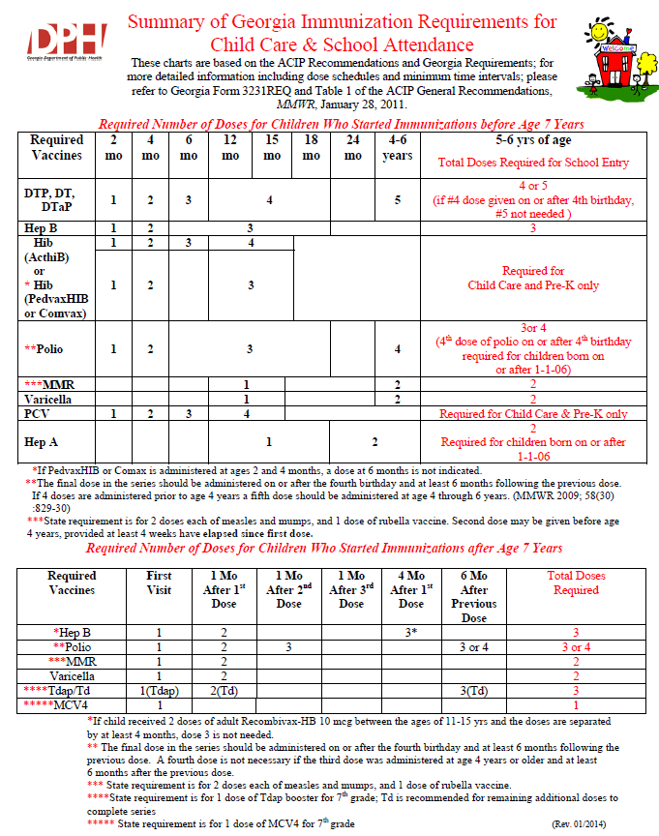

Notes:
This slide is a screen shot of the Summary of Georgia Immunizations for childcare and school attendance. This document can be used to determine the number of doses of each antigen is needed for child care and school attendance.
The top portion is indicates the required number of doses for children who started immunizations before age 7 years.
For Example: A child attending a child care facility and is 4 months of age should have at least 2 doses of DTaP, 2 doses of Hep B, 2 doses of Hib, 2 doses of Polio and 2 doses PCV13.
The bottom portion indicates the required number of doses for children who started immunizations after age 7 years.
This document can be accessed from the GA Immunization Webpage under school resources

Slide 28

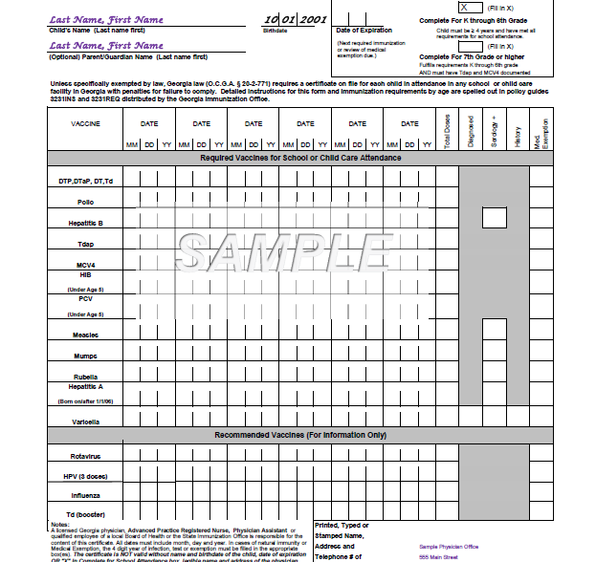
3: Completing both boxes: When all requirements have not been met
10: “Complete for School” checked for child under age 4
9: No dose DTaP after 4th birthday
2: Doses Hep B spaced incorrectly
11. No dose of Tdap or MCV4 for students born on or after 1-1-2002 entering 7th grade or “new entrants”
7: 1st dose MMR given before age 1 yr.
5: Varicella Immunity not documented by vaccine or hx/dx/serology date
6: 1st dose varicella given before age 1 yr.
8: No 2nd dose varicella documented
4: Address and/or contact information not completed
1: No physician, APRN or PA signature
Notes:
Here are the “Top Certificate Bloopers”
11. No dose of Tdap or MCV4 for students born on or after 1-1-2002 entering 7th grade or “new entrants”
10. “Complete for School” checked for child under age 4.
9. No DTP/DTaP/DT given on or after the 4th birthday.
8. No 2nd dose of varicella documented.
7. 1st dose MMR given before age 1 yr.
6. 1st dose varicella given before age 1 yr.
5. Varicella immunity not documented. A vaccine administration date, or a 4 year digit in the
box for diagnosed/serology/history is required.
4. Address and/or contact information not completed.
3. Placing an “X” in both “Complete for School Attendance” boxes when all requirements have not been met.
2. Doses of Hepatitis B spaced incorrectly. Frequently the 3rd dose is given before 24 wks. of
age, the absolute minimum age.
1. No physician signature. By law, the form must be signed by a physician, Advance Practice Registered Nurse, or Physician Assistant licensed in Georgia, public health official, or state immunization program personnel. A stamp of a physician, APRN or PA’s written signature is permissible when cosigned by an office staff member.

Slide 29

Filing of Certificates
Available for inspection by health officials
Photocopy acceptable
Sent copy to the new school/facility
In the case of religious exemption, form 2208 must be on file in lieu of form 3231
Notes:
Schools and child care facilities have the responsibility of developing and maintaining a system for certificate management.
The standards for maintaining files are outlined in the third section of the Policy Guide 3231INS.
Additional details can be found in the brochure entitled “Immunization Guidelines for Child Care Facility Operators and School Personnel,” Form 3258. This brochure can be located on the Georgia Immunization website under School and Child Care Resources
As mentioned earlier, all children enrolled must have a valid Certificate of Immunization on file.
-Certificates must be available for inspection by health officials.
-If child attends more than one facility, a photocopy to the second facility is acceptable.
-If child leaves or transfers to another school or facility, the certificate should be given to a parent/guardian or sent to the new school/facility.
-If a child has a religious exemption, form 2208 is required to be on file in lieu of the Certificate of Immunization as of 8/2015; it does not expire and should go with child if child leaves or transfers to another school or facility.

Slide 30
Tickler Filing System
Instructions located in the Immunization Guidelines for Child Care Facility Operators & School Personnel (Form 3258)
Set up by month and year
Parent reminders
Summary of GA Immunization requirements
Document follow-up
Enforce requirements
Notes:
The best method for maintaining current files is to develop an organized, user friendly, simple tickler filing system. Specific details for setting up a tickler system are outlined in the Immunization Guidelines for Child Care Facility Operators and School Personnel (Form 3258).
tickler system is a method for filing the immunization certificate for each child attending and for maintaining current certificates. Usually, these systems are set up by the month and year. A child’s certificate is filed under the month and year that it will expire or that a new certificate needs to be obtained. Also you need to keep track of those new attendees who are given 30 days by the facility or school official to obtain a certificate. (This applies to new students only). Thirty days may be granted by a facility or school official to students to obtain a certificate either showing complete for school or an expiration date indicating they are in the process of receiving the needed vaccines.)
You have the responsibility of reminding parents of upcoming expiration dates. It is a good idea to notify them at least a month ahead of time. (Suggestion: organize a sample tickler certificate notebook and offer to let attendees look at it at the break or after the presentation.)
Also, when a parent inquires about enrolling his child in day care or school, provide information about the immunization requirements. Refer to handouts:
“ Child Care Center/School’s Policy about Your Child’s Immunization Certificate” is a sample sheet of information you can personalize and copy for your facility to give parents to inform them at the time of enrollment about the requirements for a certificate.
“Summary of Georgia Immunization Requirements for Child Care and School Attendance” (Form 3193-English) or (Form 3194-Spanish)
Document follow up or any notices you give to parents reminding them of need to take child in for next immunization and obtain an updated certificate.
Enforce requirements. Once you have reminded parents of the need to have child’s immunizations reevaluated and a new certificate obtained, and it has been over 30 days after the certificate expires, it is your responsibility to exclude the child from attending until the requirements have been met.
Maintaining an organized certificate management system enables you to provide more efficient follow up in the incidence of an occurrence of a disease in which contact notification and follow up is needed and also provides for a method for quickly assessing and auditing records.

Slide 31
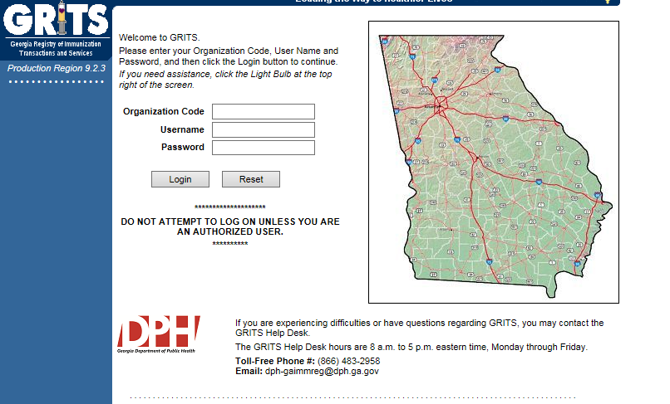
GRITS
Notes:
GRITS is a statewide Web-based registry system that stores immunization information about residents of Georgia from birth to death. The GRITS immunization information system allows for a child’s history to be stored in a secure database. Schools and childcare facilities enrolled as GRITS providers can access a child’s vaccination history quickly and easily. GRITS determines the vaccinations that are due or overdue and those that are valid or invalid based on minimum age and time intervals from the Advisory Committee on Immunization Practices (ACIP).
GRITS :
-Provides guidance to healthcare providers about which vaccines a child should receive at each visit.
-Creates and prints valid immunization certificates (Form 3231).
-Features a demographic screen where users can view and print data and access a child’s full immunization history.
-Enables schools and childcare providers to print signed copies of Form 3231 if the child is current on his immunizations.
-Allows schools and childcare facilities to create reports and manage immunization coverage within their facility.
GRITS offers a variety of training methods, including onsite training and interactive CDs.
Remember that GRITS:
Calculates validity based on recommendations
Prints certificates based on requirements, which are first based on the recommendations.
Some of the new vaccines previously discussed are RECOMMENDED for particular age groups, but MAY NOT BE REQUIRED for school or child care attendance.

Slide 32
School & Child Care Requirements
Some of the new vaccines that are RECOMMENDED for particular age groups, may NOT BE REQUIRED for school or child care attendance.
Remember, GRITS
  Calculates validity based on recommendations
  Prints certificates based on requirements
Notes:
Explain to audience that some of the new vaccines previously discussed are RECOMMENDED for a particular age group, but MAY NOT BE REQUIRED (i.e.…..HPV, Influenza, Rotavirus) for school or child care attendance.
Remember, GRITS:
Calculates validity based on recommendations
Prints certificates based on requirements, which are first based on the recommendations.
Inform parents that the nurse will review his or her child’s record prior to vaccine administration.

Slide 33

Responsibilities
Physicians and Public Health Clinics
Child Care and School
Parent/Caregiver
Notes:
With all of the rules and regulations surrounding school and child care attendance, the need for cooperation and collaboration between parents, child care facilities, schools, and health care providers is imperative. There are specific responsibilities of each partner as they relate to the implementation and enforcement of the requirements:
Physicians and Public Health Clinics are responsible for:
-Knowing the current legal immunization requirements for attendance and accurately completing the certificate.
-Administering immunizations according to the current Recommended Childhood and Adolescent Immunization Schedule.
-Reporting the occurrence of any disease listed on the “Notifiable Disease List”
-Reporting any adverse event that occurs following the administration of any of the recommended childhood vaccines to the Vaccine Adverse Event Reporting System (VAERS).
Child Care and Schools are responsible for:
-Enforcing the requirements and are held legally liable
-Reviewing the certificates for validity prior to accepting.
-Developing a system for immunization certificate management. Keep certificates files current. Send notices home to parents for certificates that are going to expire within the next month. If it is 30 days or more after a certificate has expired, exclude the child from school or child care.
-Having certificates available for inspection and audit by health officials.
-Reporting the occurrence of any disease listed on the “Notifiable Disease List.”
Parents/Caregivers are responsible for:
-Taking child to health care provider for well check ups and immunizations at the recommended times
-Review all vaccine facts that they receive before their child is immunized
-Discuss any questions or concerns about vaccines with the child’s doctor or nurse
-Keeping child’s personal immunization record and take it with them on each visit to the health care provider to be assessed and updated.
-Obtain certificate for child care and school attendance from health care provider
-Give a copy of the certificates to each facility the child attends

Slide 34
VAERS
Public Health Reports should be faxed or mailed to the State Immunization Program. Fax number (404)657-1463
Notes:
Established in 1990, the Vaccine Adverse Event Reporting System (VAERS) is a national early warning system to detect possible safety problems in U.S.-licensed vaccines. VAERS is co-managed by the Centers for Disease Control and Prevention (CDC) and the U.S. Food and Drug Administration (FDA). VAERS accepts and analyzes reports of adverse events (possible side effects) after a person has received a vaccination. Anyone can report an adverse event to VAERS. Healthcare professionals are required to report certain adverse events and vaccine manufacturers are required to report all adverse events that come to their attention. VAERS is a passive reporting system, meaning it relies on individuals to send in reports of their experiences to CDC and FDA. VAERS is not designed to determine if a vaccine caused a health problem, but is especially useful for detecting unusual or unexpected patterns of adverse event reporting that might indicate a possible safety problem with a vaccine. This way, VAERS can provide CDC and FDA with valuable information that additional work and evaluation is necessary to further assess a possible safety concern.
VAERS Data Limitations
Millions of vaccines are given each year to children less than 1 year old in the United States, usually between 2 and 6 months of age. At this age, infants are at greatest risk for certain medical adverse events, including high fevers, seizures, and sudden infant death syndrome (SIDS). Some infants will experience these medical events shortly after a vaccination by coincidence. These coincidences make it difficult to know whether a particular adverse event resulted from a medical condition or from a vaccination. Therefore, vaccine providers are encouraged to report all adverse events following vaccination, whether or not they believe the vaccination was the cause.
The primary objectives of VAERS are to:
Detect new, unusual, or rare vaccine adverse events; Monitor increases in known adverse events; Identify potential patient risk factors for particular types of adverse events; Assess the safety of newly licensed vaccines;
Determine and address possible reporting clusters (e.g., suspected localized [temporally or geographically] or product-/batch-/lot-specific adverse event reporting); Recognize persistent safe-use problems and administration errors;
Provide a national safety monitoring system that extends to the entire general population for response to public health emergencies, such as a large-scale pandemic influenza vaccination program.
Two Ways to Submit an Online Report to VAERS:
-Report Online
-Report using writable PDF (Public Health will complete PDF and send reports to the Immunization Program State Office via fax or mail)
What Can Be Reported to VAERS?
VAERS encourages the reporting of any clinically significant adverse event that occurs after the administration of any vaccine licensed in the United States.
Who Reports to VAERS?
Anyone can file a VAERS report, including parents, health care providers, manufacturers, and vaccine recipients.
Does VAERS Provide General Vaccine Information?
No. VAERS only collects and analyzes adverse event reports. In another example, VAERS determined that there may be a potential for a small increase in risk for Guillain-Barre syndrome after the meningococcal conjugate vaccine, Menactra. As a result of this finding, a history of Guillain-Barre syndrome became a contraindication to the vaccine and further controlled studies are currently underway to research this issue.

Slide 35
Vaccine Injury Compensation Program (VICP)
National Vaccine Injury Compensation Program
provides compensation to individuals found to be injured by or have died from certain childhood vaccines.
  Established in 1988 by NCVIA
  Federal “no fault” system to compensate those injured
  Claim must be filed by individual, parent or guardian
  Must show that injury is on “Vaccine Injury Table”
Notes:
The National Vaccine Injury Compensation Program is a no-fault alternative to the traditional legal system for resolving vaccine injury petitions. It was created in the 1980s, after lawsuits against vaccine companies and health care providers threatened to cause vaccine shortages and reduce U.S. vaccination rates, which could have caused a resurgence of vaccine preventable diseases. Any individual, of any age, who received a covered vaccine and believes he or she was injured as a result, can file a petition. Parents, legal guardians and legal representatives can file on behalf of children, disabled adults, and individuals who are deceased. The purpose of VICP is to ensure that individuals injured by certain vaccines are provided with fair and efficient compensation and to ensure a stable vaccine supply by limiting liability for vaccine manufacturers and vaccine administrators. The National Vaccine Injury Compensation Program covers most vaccines given routinely in the U.S. For a vaccine to be covered, the category of vaccine must be recommended for routine administration to children or pregnant women by the Centers for Disease Control and Prevention and subject to an excise tax by Federal law.
The following three organizations have a role in VICP:
-The VICP is administered through the Department of Health and Human Services (HHS)
-The Department of Justice (DOJ) represents HHS in Court
-The U.S. Court of Federal Claims (the Court) makes the final decision regarding whether a petitioner should be compensated

Slide 36

Healthcare Personnel (HCP) and Other Adults Need These Immunizations:
Annual influenza vaccine
Tdap or Td
Hepatitis B (exposure risk) Check immunity
Validate immune status of:
Varicella
Measles, Mumps & Rubella(MMR)
Are YOU up to date?
Notes:
36
Review with audience the vaccines recommended for HCP and other adults.
Un-immunized HCP
Un-immunized healthcare workers are at risk of infecting patients, family members and community contacts
Immunized HCP
Protect patients from VPD’s
Help offices avoid potential liability cases. (The practice can be liable if an unimmunized HCP becomes infected with a vaccine preventable disease and infects a patient.)
Maintain productivity
Reduce illness and illness-related absenteeism
Evidence of Immunity to MMR
Documented administration of two doses of measles and mumps vaccine and one dose of rubella vaccine OR
Laboratory evidence of immunity or laboratory confirmation of disease (measles, mumps and rubella) OR
Born before 1957 (measles, mumps and rubella)
References: 1. General Recommendations on Immunization, Recommendations of the Advisory Committee on Immunization Practices (ACIP). MMWR (RR-2); January 28, 2011
2. Immunization of Health-Care Personnel: Recommendations of ACIP MMWR; November 25, 2011 / 60(RR07);1-45
3. CDC Guidance for Evaluating Health-Care Personnel for Hepatitis B Virus Protection and for Administering Postexposure Management (Recommendations and Reports / Vol. 62 / No. 10 December 20, 2013)

Slide 37


State Resources
Local health department
District Immunization Coordinator
GA Immunization Program Office
  On call Help line: 404-657-3158
  GRITS Help Line:1-866-483-2958
  VFC Help Line:1-800-848-3868
  Website http://dph.georgia.gov/immunization-section
  Your local Immunization Regional Program Consultant (IRC)
  Epidemiology: 1-866-782-4584
GA Chapter of the AAP
GA Academy of Family Physicians
Notes:
If you need further information about the changes, or to ask questions later, please contact the GA Immunization Office and our partners GA AAP and GA AFP
Your Local health department
District Immunization Coordinator (IPCs)
GA Immunization Program Office
404-657-3158
Website http://health.state.ga.us/programs/immunization
GA Chapter of the AAP
GAFP

Slide 38

It’s a Team Effort!
High Immunization rates begin with a team designed plan!
What can your team do to improve rates?
Notes:
38
Remind your audience that “It is a team effort to immunize successfully”. Do not underestimate the
office team’s ability to affect immunization rates. It takes the physician, physician’s assistant, nurse
practitioner, nurse, medical assistant, and clerical staff working together to improve the office practice
and raise immunization rates.
Take any questions from the audience.
Ask participants how, based on the information presented, will they change the way they administer
vaccines.
Ask the audience what will they do to improve rates?
Ask participants to develop a plan to improve the immunization rates in their office
Jot down the plans the practice makes so that we can follow-up with them.

