Slide 1
Review of the Recommended Immunization Schedule
Notes:
Presenter will use this presentation to train clinicians on the ACIP Recommended Immunization Schedule for children, adolescents and adults.

Slide 2
Disclosure Statements
Neither the planners of this session nor I have any financial relationship with pharmaceutical companies, biomedical device manufacturers, or corporations whose products and services are related to the vaccines we discuss.
There is no commercial support being received for this event.
The mention of specific brands of vaccines in this presentation is for the purpose of providing education and does not constitute endorsement.
The GA Immunization Program utilizes ACIP recommendations as the basis for this presentation and for our guidelines, policies, and recommendations.
For certain vaccines this may represent a slight departure from or off-label use of the vaccine package insert guidelines.
Notes:
[Presenter is required to read this information to the audience before the program begins.]
Neither the planners of this session nor I have any financial relationship with pharmaceutical companies, biomedical device manufacturers, or corporations whose products and services are related to the vaccines we discuss.
There is no commercial support being received for this event.
The mention of specific brands of vaccines in this presentation is for the purpose of providing education and does not constitute endorsement.
The GA Immunization Program utilizes ACIP recommendations as the basis for this presentation and for our guidelines, policies, and recommendations.
For certain vaccines this may represent a slight departure from or off-label use of the vaccine package insert guidelines.

Slide 3
Disclosure Statement
To obtain nursing contact hours for this session, you must be present for the entire session and complete an evaluation.
Continuing education will be provided through the Georgia Department of Public Health
Georgia Department of Public Health is an approved provider of continuing nursing education by the Alabama State Nurses Association, an accredited approver by the American Nurses Credentialing Center’s Commission of Accreditation

Slide 4
Objectives
At the end of this presentation, participants
will be able to:
Recall the role vaccines have played in preventing diseases
Discuss the importance of vaccines for children, adolescents and adults
Discuss the role of a vaccine champion
List at least two reliable sources for immunization information
Notes:
4
At the end of this presentation, you will be able to:
Recall the role vaccines have played in preventing diseases
Discuss the importance of vaccines for children, adolescents and adults
Discuss GA Immunization law and DPH rules and regulations for schools and childcare attendance
Discuss the role of a vaccine champion
List at least two reliable sources for immunization information

Slide 5
The Impact of Vaccines
Disease | Average Annual Reported Cases Pre-vaccine* | Cases in U.S. 2015** | Provisional Cases in U.S. 2016** | Provisional % Reduction In U.S. 2016
Smallpox | 48,164 | Eradicated worldwide in 1980
Diphtheria | 175,885 | 0 | 0 | 100%
Measles | 503,282 | 188 | 69 | >99.9%
Mumps | 152,209 | 1,329 | 5,311 | 96.5%
Pertussis | 147,271 | 20,762 | 15,737 | 89.3%
Polio (paralytic) | 16,316 | 0 | 0 | 100%
Rubella | 47,745 | 5 | 5 | >99.9%
Congenital Rubella Syndrome | 823 | 1 | 1 | >99.9%
Tetanus | 1,314 | 29 | 33 | 98.1%
H. Influenzae Type b Age<5 years | 20,000 | 29 | 22 | 99.9%
*MMWR 48(12);243-248 April 2, 1999
**MMWR 64(52), ND-924-ND-941, January 6, 2017
Notes:
This table shows the impact of vaccines on the annual reported cases of some vaccine preventable diseases in the United States.
Column 2 shows the average number of reported cases of a specific disease prior to the licensure of the vaccine.
Column 3 shows the number of reported cases in the United States in 2015.
Column 4 shows the provisional number of reported cases in the U.S in 2016.
Column 5 shows the percentage decrease in reported cases in the United States based on the provisional number of reported cases in 2016 compared with the pre-vaccine years.
About a week ago, the State Epidemiology team released a “mumps alert”. During 2017, over 5,629 cases were reported in the U.S. to the CDC; 110 mumps cases were reported to DPH during the same time period. Despite high vaccination levels with MMR, mumps cases remain elevated- primarily due to a number of outbreaks in settings of prolonged close contact with others who have mumps, such as within classrooms, sports teams, campus dorms, and other crowded environments.
GA DPH urges healthcare providers to maintain heightened awareness for mumps and reminds providers that all suspect cases of mumps should be reported at the time of testing to the Health Department. For additional information please contact Ebony Thomas or Jessica Tuttle at the State Office. 404-657-2588
Reference:
Achievements in Public Health, 1900-1999 Impact of Vaccines Universally Recommended for Children - United States, 1990-1998 MMWR April 02, 1999 / 48(12);243-248
MMWR 65(52);ND-924-ND-941, January 6, 2017

Slide 6
VPD | Vaccination Rate Needed for Herd Immunity
Measles | 92-94%
Pertussis | 92-94%
Diphtheria | 83-85%
Rubella | 83-85%
Mumps | 75-86%
Influenza | 30-75%
Notes:
Herd immunity is the term most frequently used that refers to a situation in which a high percentage of a population is immune to a disease, essentially stopping the disease in its tracks because it cannot find new hosts. This chart illustrates the vaccination rate needed for each of the VPDs listed.
The threshold for herd immunity varies, depending on the disease, with more virulent infectious agents requiring vaccination of a higher percentage of the population to create the desired community immunity. The creation of herd immunity is especially important in crowded environments which facilitate the spread of disease, like schools. It is also extremely important to receive regular boosters, as some vaccines lose their efficacy over time, leaving people vulnerable to an outbreak. Herd immunity led to the eradication of smallpox, and it explains why diseases such as polio and diphtheria are rare in developed nations with established vaccination policies.
According to the 2016 National Immunization Study, Georgia ranks higher than US national averages for recommended childhood vaccines.
Georgia coverage rates for children 19-35 months for:
•Measles, mumps and rubella vaccine (MMR) (1 or more doses) is at 93.2% (91.1% US) (94.2% in 2015)
•DTaP (>/= 4 doses) 90.0% (83.4% US)
•Hepatitis B birth dose 76.7% (71.1% US)
For the combined vaccine series 4:3:1:3:1:4 is 77.3 (70.7%US)
Coverage with recommended vaccines for children aged 19–35 months continues to be high and stable but remains below 90% for vaccines that require booster doses during the second year of life (≥4 doses of DTaP and PCV as well as Hib full series) and for other recommended vaccines (HepB birth dose, rotavirus, and HepA). Disparities in coverage persisted for black children and those living below the poverty level, and coverage was generally lower for children who were uninsured or covered by Medicaid than among those with private insurance. These disparities indicate that improvements are needed in access to and delivery of age-appropriate immunization to all children, regardless of insurance or financial status (i.e., “the immunization safety net”).
So, What does this mean for public health practice?
Continued collaboration between CDC and state immunization programs to further elucidate and address disparities in coverage by poverty status should provide valuable information as strategies are needed for improving access to and delivery of age-appropriate immunization. Health care providers can increase vaccination coverage using evidence-based strategies such as provider reminders, standing orders to provide vaccination whenever appropriate, and immunization information systems.

Slide 7

Advisory Committee on Immunization Practices (ACIP)
15 voting members with expertise in one or more of the following:
Vaccinology
Immunology
Infectious diseases
Pediatrics
Internal Medicine
Preventive medicine
Public health
Consumer perspectives and/or social and community aspects of immunization programs
ACIP develops recommendations and schedules for the use of
licensed vaccines
Notes:
Ask the audience if they are familiar with the ACIP. If they are familiar with the ACIP the presenter can spend a minimal amount of time on this slide.
The dramatic reduction of vaccine preventable diseases in the United States can be attributed to the availability of vaccines, as well as recommendations and an organized vaccine schedule developed by the Advisory Committee on Immunization Practices (ACIP).
The Advisory Committee on Immunization Practices (ACIP) consists of 15 experts in fields associated with immunization who have been selected by the Secretary of the U. S. Department of Health and Human Services to provide advice and guidance to the Secretary, the Assistant Secretary for Health, and the Centers for Disease Control and Prevention (CDC) on the most effective means to prevent vaccine-preventable diseases.
The Committee develops written recommendations for the routine administration of vaccines to the pediatric and adult populations, along with schedules regarding the appropriate periodicity, dosage, and contraindications applicable to the vaccines. ACIP is the only entity in the federal government which makes such recommendations.
The overall goals of the ACIP are to provide advice which will assist the Department and the Nation in reducing the incidence of vaccine preventable diseases and to increase the safe usage of vaccines and related biological products.
For more information: http://www.cdc.gov/vaccines/acip/index.html

Slide 8
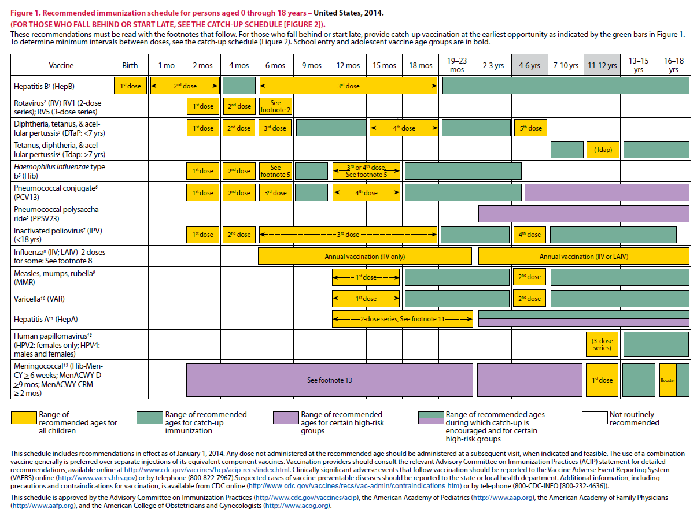
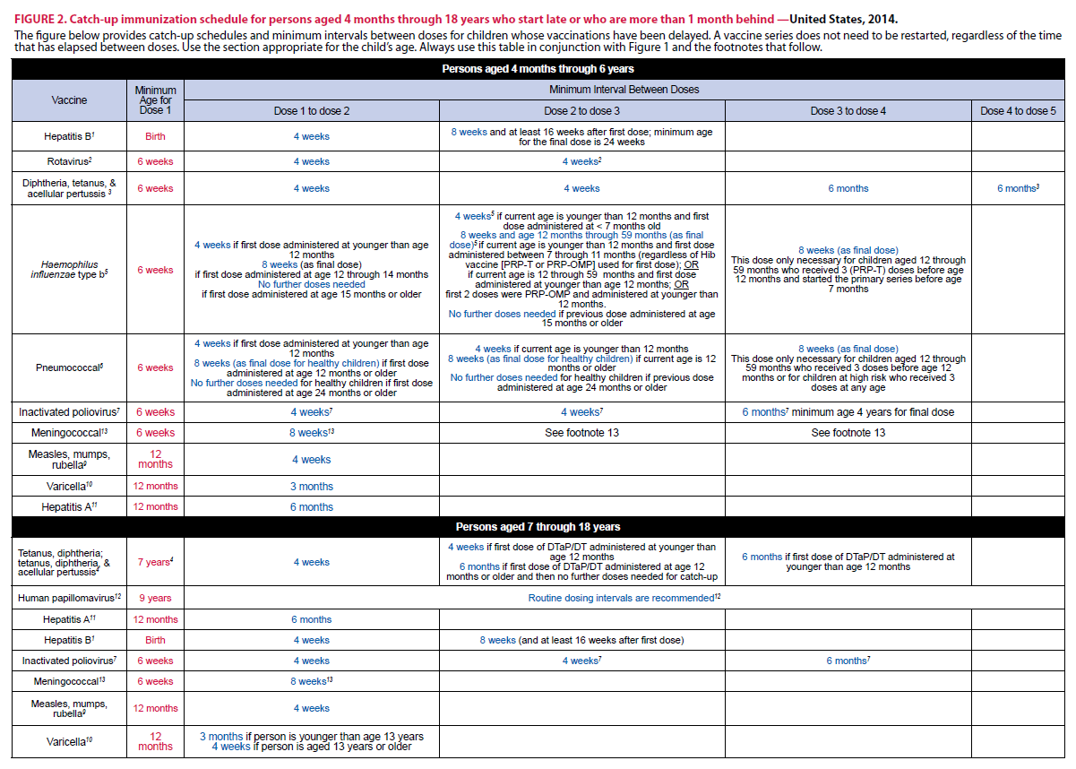
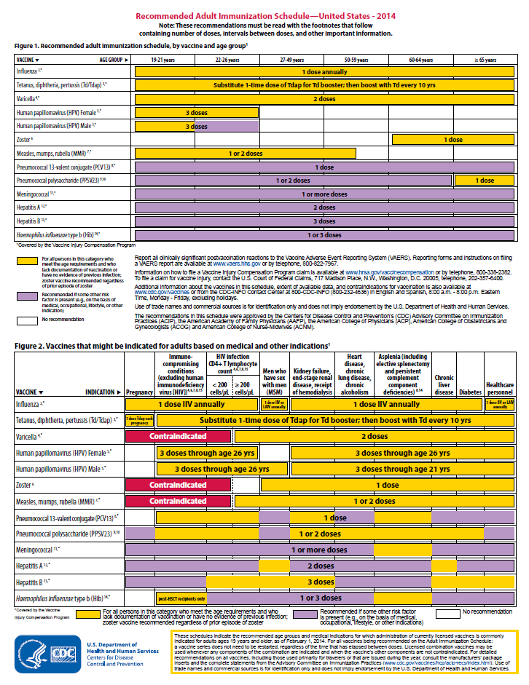
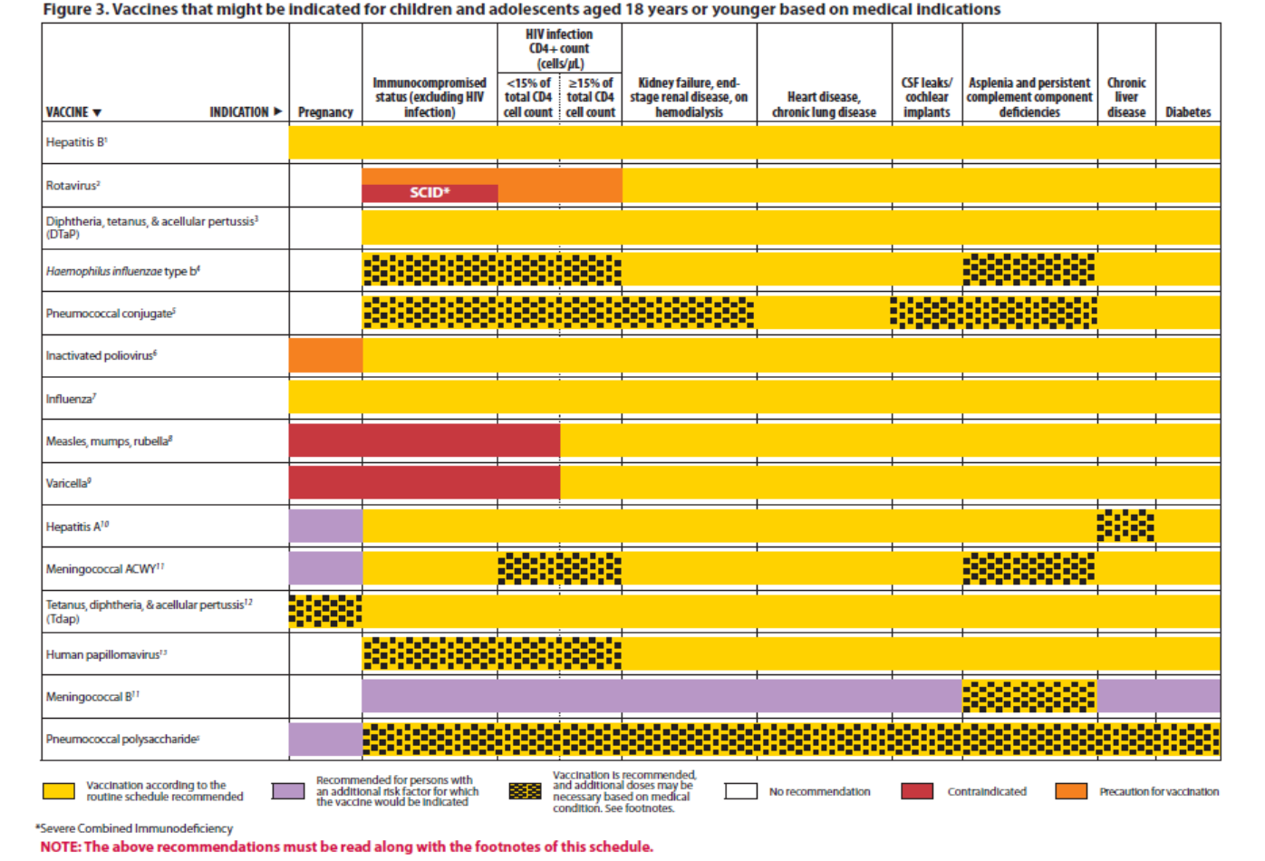
Immunization Schedule Updates
All staff must use the same
immunization schedule
Schedules:
  Children & Adolescents
  0 through 18 years
  Catch-up schedule for
  ages 4 months -18 years
  Children and Adolescents 18 years or younger based on medical indications
  Adult 19 years and older
  Adult based on medical
  and other indications
READ THE FOOTNOTES
http://www.cdc.gov/vaccines/schedules/hcp/child-adolescent.html
http://www.cdc.gov/vaccines/schedules/hcp/adult.html
Notes:
8
8
In February 2018, the 2018 Immunization Schedule for Children and Adolescents birth through 18 years became effective, as recommended by the ACIP and approved by the CDC.
It is important to remember that:
-All staff and providers should use the same immunization schedule
Overall, the general schedule collapsed; a table has been added outlining vaccine type, abbreviation, and brand names for vaccines discussed in the child/adolescent schedule. The footnotes are presented in a new simplified format. The goal was to remove unnecessary text while preserving all pertinent information and maintaining clarity. This was accomplished by a transition from complete sentences to bullets, removal of unnecessary or redundant language, and formatting changes. Manufacturing of MenHibrix vaccine has been discontinued in the US and all available doses have expired and is no longer mentioned on the schedule. The medical conditions collapsed; the medical indications figure (figure 3) changes include: The HIV column provides a reference providing additional information regarding HIV laboratory parameters and use of live vaccine. Hepatitis (Hep B) vaccine collapsed; the hepatitis B vaccine footnote was revised to include information regarding vaccination of < 2,000 gram infants born to HBsAg-negative mothers. The influenza vaccine footnote has been updated to indicate the LAIV should not be used during the 2017-2018 influenza season. A reference link to the 2017-2018 season influenza recommendations has been added. The MMR footnote was updated to include guidance regarding the use of a 3rd dose of mumps-containing vaccine during a mumps outbreak. The meningococcal vaccine footnote has been edited to create separate footnotes for MenACWY and MenB vaccines. The inactivated poliovirus rows of the catch-up schedule have been edited to clarify the catch-up recommendations for children 4 years of age and older. The poliovirus vaccine footnote was revised to include updated guidance for persons who received oral polio vaccine as part of their vaccination series. The maximum ages for the first and last doses of the rotavirus series have been added to the rotavirus vaccine row of the catch-up schedule.

Slide 9
Notes:
Table outlining vaccine type, abbreviation, and brand names for vaccines discussed in the child/adolescent schedule

Slide 10
Notes:
The footnotes are presented in a new simplified format. The goal was to remove unnecessary text while preserving all pertinent information and maintaining clarity. This was accomplished by a transition from complete sentences to bullets, removal of unnecessary or redundant language, and formatting changes.

Slide 11
What Does It All Mean?
Indication
-Information about the appropriate use of the vaccine
Recommendation
-ACIP statement that broadens and further delineates the Indication
found in the package insert
-Basis for standards for best practice
Requirement
-Mandate by a state that a particular vaccine must be administered and documented before entrance to child care and/or school
Notes:
11
It is important providers understand the difference between an indication, recommendation and a requirement when assessing immunization need.
An indication provides information about the appropriate use of the vaccines; the prescribing information
EXAMPLE of an indication:
ADACEL vaccine is indicated for active booster immunization for the prevention of tetanus, diphtheria and pertussis as a single dose in persons 10 through 64 years of age.
BOOSTRIX® is indicated for active booster immunization against tetanus, diphtheria, and pertussis as a single dose in individuals 10 years and older.
The Recommendation is the ACIP statement that broadens and delineates the indication found in the package insert.
So an EXAMPLE of a recommendation:
The ACIP recommendation for Tdap would be, “Administer 1 dose of Tdap vaccine to all adolescents aged 11 through 12 years.” The recommendation may include other information and guidance on epidemiology of the disease, appropriate timing, dosage, contraindications to the vaccine and guidance for use in special populations. The recommendation appears first as “provisional recommendation” but once approved, it appears in the MMWR as a full recommendation.
A vaccine requirement is consistent with the ACIP Recommended Childhood/Adolescent Immunization Schedule. The state mandates that a particular vaccine must be administered and documented before entrance to school or child care.
EXAMPLE of a state vaccine requirements:
Requirements are consistent with the Recommended Childhood and Adolescent Immunization Schedule. GA DPH rules and regulations state that children entering any school or child care facility in GA must be age appropriately immunized against each of these diseases: Hepatitis B, Diphtheria, Tetanus, Pertussis, Polio, Hib, Pneumococcus, Measles, Mumps, Rubella, Varicella, Hepatitis A and Meningococcal.
Remember that GRITS:
Calculates validity based on recommendations; Prints certificates based on requirements, which are first based on the recommendations. Some of the new vaccines previously discussed are RECOMMENDED for particular age groups, but MAY NOT BE REQUIRED for school or child care attendance.

Slide 12
General Best Practice Guidelines
Timing and Spacing of Immunobiologics
Contraindications and Precautions
Preventing and Managing Adverse Reactions
Vaccine Administration
Storage and Handling of Immunobiologics
Altered Immunocompetence
Special Situations
Vaccination Records
Vaccination Programs
Vaccine Information Sources
Notes:
On April 20, 2017 ACIP published The General Best Practice Guidelines for Immunization: Best Practices Guidance of the Advisory Committee on Immunization Practices (ACIP). The General Best Practice Guidelines for Immunization publication updates and replaces the General Recommendations on Immunization: Recommendations of the Advisory Committee on Immunization Practices (ACIP) last published in 2011. The Centers for Disease Control and Prevention (CDC) recommends routine vaccination to prevent 17 vaccine-preventable diseases that occur in infants, children, adolescents, or adults. This report provides information for clinicians and other health care providers about concerns that commonly arise when vaccinating persons of various ages. Providers and patients must navigate numerous issues, such as the timing of each dose, screening for contraindications and precautions, the number of vaccines to be administered, the educational needs of patients and parents, and interpreting and responding to adverse events. Vaccination providers help patients understand the substantial body of (occasionally conflicting) information about vaccination.
The guidance is organized in the following 10 documents: 1) Timing and Spacing of Immunobiologics; 2) Contraindications and Precautions; 3) Preventing and Managing Adverse Reactions; 4) Vaccine Administration; 5) Storage and Handling of Immunobiologics; 6) Altered Immunocompetence; 7) Special Situations; 8) Vaccination Records; 9) Vaccination Programs; and 10) Vaccine Information Sources. A glossary follows (see Appendix 1: Glossary).
This report will help vaccination providers to assess vaccine benefits and risks, use recommended administration practices, understand the most effective strategies for ensuring that vaccination coverage in the population remains high, and communicate the importance of vaccination to reduce the effects of vaccine-preventable disease. These best practice guidelines are intended for use in the United States; vaccine availability, use, and epidemiologic circumstances might differ in other countries and might warrant different guidance.

Slide 13
General Best Practice Updates
The 4-day grace period should not be applied to the 4-week interval between 2 different live vaccines
Allowances for alternate administration route (subcutaneous instead of intramuscular) for hepatitis A vaccine
An age cutoff of 12 years through 17 years of age for validating a dose of intradermal influenza vaccine if given in error
Notes:
This vaccination best practice guidance is intended for clinicians and other health care providers who vaccinate patients in varied settings, including hospitals, provider offices, pharmacies, schools, community health centers, and public health clinics. Here are just a few examples of the updates in the General Best Practice Manual.
-The 4-day grace period should not be applied to the 4-week interval between 2 different live vaccines
-Allowances for alternate administration route (subcutaneous instead of intramuscular) for hepatitis A vaccine
-An age cutoff of 12 years through 17 years of age for validating a dose of intradermal influenza vaccine if given in error
Optional: This is a list of all updated guidelines to review if needed.
The updated guidelines include 1) new information on simultaneous vaccination and febrile seizures; 2) enhancement of the definition of a “precaution” to include any condition that might confuse diagnostic accuracy; 3) confirmation that if a patient is not acutely moderately or severely ill, vaccination during hospitalization is a best practice; 4) more descriptive characterization of anaphylactic allergy; 5) incorporation of protocols for management of anaphylactic allergy; 6) allowances for alternate route (subcutaneous instead of intramuscular) for hepatitis A vaccination; 7) an age cutoff of 12 years through 17 years of age for validating a dose of intradermal influenza vaccine; 8) deletion of much of the content from storage and handling, including storage units, temperature monitoring, and expiration dates (because this content is now codified and continually updated in the CDC’s Vaccine Storage and Handling Toolkit.); 9) incorporation of Infectious Diseases Society of America guidance on vaccination of persons with altered immunocompetence; 10) timing of intramuscular administration in patients with bleeding disorders; 11) updated data on vaccination record policy; 12) additional impacts of the Affordable Care Act (1,2) on adult vaccination; and 13) updated programmatic contact information on source material for vaccine information.
Here are just a few of the General Best Practice Updates:
The 4-day grace period may be used to shorten the minimum interval between doses of the same vaccine, but should not be applied to this 4-week interval between 2 different live vaccines. Confusion about this prohibition may arise when 2 live vaccines whose intervals are identical are administered simultaneously. For example, if MMR and varicella vaccines are administered on the same day, the second dose of each vaccine could come due 4 weeks later (depending on the patient’s age). If either vaccine had been given alone at both time points, the 4-day grace period could be applied to the second dose. But in this situation the live vaccine rule prevents the grace period from being applied to the second dose of either vaccine, because Varicella-2, if administered earlier than 4 weeks, could potentially be affected by MMR1, and likewise MMR2 could be affected by Varicella-1. Note that this prohibition also applies if the combination MMRV is used rather than individual MMR and varicella vaccines.
Major changes to the best practice guidance include 1) allowances for alternate administration route (subcutaneous instead of intramuscular) for hepatitis A vaccine and 2) an age cutoff of 12 years through 17 years of age for validating a dose of intradermal influenza vaccine if given in error.

Slide 14
“It’s The Law”
Notes:
Ask the audience when should the VIS be given to a patient and to see how many different responses you receive.
After a provider has determined the vaccines recommended for a patient the next step is to provide the patient with a Vaccine Information Statement.
As required under the National Childhood Vaccine Injury Act, all health care providers in the US who administer to any child or adult, any of the following vaccines diphtheria, tetanus, pertussis, measles, mumps, rubella, polio, hepatitis A & B, HIB, influenza, pneumococcal, meningococcal, rotavirus, HPV and varicella shall, prior to administration of each dose of the vaccine, provide a copy to keep of the relevant current edition vaccine information materials that have been produced by the CDC.
Presenter may include a copy of the handout for the Top 10 facts about the VIS to review with staff.
The top 10 facts about VIS are:
-It’s federal law, VIS are required for both public and private sectors, VIS must be provided before vaccine administered, must provide current VIS for each dose of vaccine, must provide VISs for combination vaccines too, VISs are available in other formats, including 30 languages (you may use laminated copies of VISs for patients and parents to read and return before leaving the clinic, but you must also offer the patient/parent a printed copy of the VIS to take home. If they prefer to download the VIS onto a mobile device, direct them to CDC’s VIS mobile Downloads web page: http://m.cdc.gov/VIS. Federal law does not require signed consent in order for a person to be vaccinated. To verify that a VIS was given, providers must record in the patient’s chart the published date of VIS, date the VIS was given, name, address and title of the person who administers vaccine, date vaccine administered, and vaccine manufacturer and lot number of each dose administered. VISs should not be altered. Provide VISs to all patients.

Slide 15
Diphtheria, Tetanus, and Pertussis Vaccines
Routine Recommendations
DTaP: 5 dose series administered at 2, 4, 6, 15-18 months and 4-6 years
Tdap: 1 dose administered at 11-12 years of age; administer 1 dose to pregnant adolescent (preferably during the early part of gestational weeks 27-36)
Notes:
ACIP recommends:
DTaP: 5 dose series administered at 2, 4, 6, 15-18 months and 4-6 years; The fourth dose may be administered as early as age 12 months, provided at least 6 months have elapsed since the third dose. Inadvertent administration of fourth DTaP dose early; If the fourth dose of DTaP was administered at least 4 months after the third dose of DTaP and the child was 12 months of age or older, it does not need to be repeated.
Tdap: 1 dose administered at 11-12 years of age; administer 1 dose to pregnant adolescent (preferably during the early part of gestational weeks 27-36) for each pregnancy.
Additional guidance:
One dose of Tdap:
For children and adolescents starting at 11 or 12 years of age; Tdap can be administered regardless of the interval since the last tetanus and diphtheria toxoid-containing vaccine; The new recommendations also clarify that children age 7 through 10 years who receive Tdap as part of a catch-up series may be given an additional Tdap for the routinely recommended adolescent dose at 11-12 years of age.**
For all adults aged 19 years and older who have not had Tdap previously; For adults 65 years and older Boostrix should be used, when feasible; however, either vaccine product provides protection and is considered valid.
All pregnant women should receive a dose of Tdap during each pregnancy, irrespective of prior history of receiving Tdap. As stated, in October, ACIP voted to recommend administering Tdap vaccination early in the 27 through 36 week “window” to maximize passive antibody transfer to the infant. If a dose is given early in that same pregnancy, do NOT repeat it at 27-36 weeks. If not given during pregnancy, give Tdap immediately postpartum.

Slide 16
Tdap for Pregnant Women
ACIP recommends:
One dose of Tdap each pregnancy
Optimal timing early in the 27 through 36 week gestation window
If not given during pregnancy; administer immediately postpartum
Ref: Advisory Committee on Immunization Practices. Updated ACIP statement for pertussis, tetanus and diphtheria vaccines presented by Jennifer L. Liang, October 19, 2016.
Notes:
Guidance on use of Tdap products for pregnant women:
ACIP Recommends:
All pregnant women should receive a dose of Tdap during each pregnancy, irrespective of prior history of receiving Tdap. As stated, in October, ACIP voted to recommend administering Tdap vaccination early in the 27 through 36 week “window” to maximize passive antibody transfer to the infant. If a dose is given early in that same pregnancy, do NOT repeat it at 27-36 weeks. If not given during pregnancy, give Tdap immediately postpartum.
References:
1. Advisory Committee on Immunization Practices. Updated ACIP statement for per
2. MMWR, February 22, 2013, Vol 62, #7
3. www.immunize.org, Ask the Experts, Tetanus section, IAC, Sept. 2013

Slide 17
Test Your Knowledge!
Twelve month old Lucas was given his fourth dose of DTaP 4 months after his third dose of DTaP, does it need to be repeated?
What should be done?
IAC Ask the Experts - Reviewed July 2014
Notes:
Twelve month old Lucas was given his fourth dose of DTaP 4 months after his third dose of DTaP, does it need to be repeated?
In the case of inadvertent early administration of the fourth DTaP dose; If the fourth dose of DTaP was administered at least 4 months after the third dose of DTaP and the child was 12 months of age or older, it does not need to be repeated.

Slide 18
Test Your Knowledge!
Twelve month old Lucas was given his fourth dose of DTaP 4 months after his third dose of DTaP, does it need to be repeated?
What should be done?
No, In the case of inadvertent early administration of the fourth DTaP dose; If the fourth dose of DTaP was administered at least 4 months after the third dose of DTaP and the child was 12 months of age or older, it does not need to be repeated.
IAC Ask the Experts - Reviewed July 2014
Notes:
Twelve month old Lucas was given his fourth dose of DTaP 4 months after his third dose of DTaP, does it need to be repeated?
In the case of inadvertent early administration of the fourth DTaP dose; If the fourth dose of DTaP was administered at least 4 months after the third dose of DTaP and the child was 12 months of age or older, it does not need to be repeated.

Slide 19
Test Your Knowledge!
Logan is a 7 year old boy who was not fully immunized with DTaP and received 1 dose of Tdap in the catch-up series. Can he receive an additional dose of Tdap vaccine at 11 through 12 years?
Ref: Recommended Immunization Schedule for Children and Adolescents Aged 18 years or younger, United States, 2017
Notes:
Logan is a 7 year old boy who was not fully immunized with DTaP and received 1 dose of Tdap in the catch-up series. Can he receive an additional dose of Tdap vaccine at 11 through 12 years?
Yes, he can receive an adolescent Tdap vaccine dose at age 11 through 12 years.
Catch-up vaccination:
-Persons aged 7 years and older who are not fully immunized with DTaP vaccine should receive Tdap vaccine as 1 dose (preferably the first) in the catch-up series; if additional doses are needed, use Td vaccine. For children 7 through 10 years who receive a dose of Tdap as part of the catch-up series, an adolescent Tdap vaccine dose at age 11 through 12 years may be administered.
Additional Information:
-Persons aged 11 through 18 years who have not received Tdap vaccine should receive a dose, followed by tetanus and diphtheria toxoids (Td) booster doses every 10 years thereafter.
Inadvertent doses of DTaP vaccine:
-If administered inadvertently to a child aged 7 through 10 years, the dose may count as part of the catch-up series. This dose may count as the adolescent Tdap dose, or the child may receive a Tdap booster dose at age 11 through 12 years.
-If administered inadvertently to an adolescent aged 11 through 18 years, the dose should be counted as the adolescent Tdap booster.

Slide 20
Test Your Knowledge!
Logan is a 7 year old boy who was not fully immunized with DTaP and received 1 dose of Tdap in the catch-up series. Can he receive an additional dose of Tdap vaccine at 11 through 12 years?
Yes, he can receive an adolescent Tdap vaccine dose at age 11 through 12 years.
Ref: Recommended Immunization Schedule for Children and Adolescents Aged 18 years or younger, United States, 2017
Notes:
Logan is a 7 year old boy who was not fully immunized with DTaP and received 1 dose of Tdap in the catch-up series. Can he receive an additional dose of Tdap vaccine at 11 through 12 years?
Yes, he can receive an adolescent Tdap vaccine dose at age 11 through 12 years.
Catch-up vaccination:
-Persons aged 7 years and older who are not fully immunized with DTaP vaccine should receive Tdap vaccine as 1 dose (preferably the first) in the catch-up series; if additional doses are needed, use Td vaccine. For children 7 through 10 years who receive a dose of Tdap as part of the catch-up series, an adolescent Tdap vaccine dose at age 11 through 12 years may be administered.
Additional Information:
-Persons aged 11 through 18 years who have not received Tdap vaccine should receive a dose, followed by tetanus and diphtheria toxoids (Td) booster doses every 10 years thereafter.
Inadvertent doses of DTaP vaccine:
-If administered inadvertently to a child aged 7 through 10 years, the dose may count as part of the catch-up series. This dose may count as the adolescent Tdap dose, or the child may receive a Tdap booster dose at age 11 through 12 years.
-If administered inadvertently to an adolescent aged 11 through 18 years, the dose should be counted as the adolescent Tdap booster.

Slide 21
Hepatitis B Vaccine
Routine Recommendations
Dose 1 @ birth*
Dose 2 @ 4 months of age
  at least 1 month after first dose
Dose 3 @ 6-18 months of age:
  Minimum of 4 months after the first dose
  Minimum of 2 months after the second dose but not before an infant is 24 weeks of age
Notes:
In January, 2018, ACIP published the new updates for Hepatitis B; universal hep B vaccination within 24 hours of birth for medically stable infants weighing greater than or equal to 2,000 grams; testing HBsAg-positive women for hep B DNA; postvaccination serologic testing for infants whose mother’s HBsAg status remains unknown indefinitely (e.g., when a parent or person with lawful custody surrenders an infant confidentiality shortly after birth; single-dose revaccination for infants born to HBsAg-positive women not responding to the initial vaccine series; removal of permissive language for delaying the birth dose until after hospital discharge.
Required for child care and school attendance
Review Hepatitis B virus:
Hepatitis B is a serious liver disease caused by a virus. Your can get infected with hepatitis B if you come in contact with an infected person’s blood or other body fluids. Babies can get the virus from their infected mothers at birth or if they live with or are cared for by an infected person. The virus can be spread just by sharing a toothbrush with an infected person. For some people, the virus remains in their body for years. During this time, the virus can attack the liver and cause serious problems like liver failure or cancer.

Slide 22
Hepatitis B
Transmission:
ACIP recommends hepatitis B vaccine also for:
All children and adolescents less than 19 years of age who did not complete the series as an infant.
All adults at risk for hepatitis B infection, including those aged 19 through 59 years with diabetes mellitus
Persons of any age at risk for infection by sexual exposure
All other adults seeking protection from HBV infection.
MMWR, December 23, 2005, Vol 54, #RR16 MMWR, December 8, 2006, Vol 55, #RR16 MMWR, December 22, 2011 Vol 60 #50
Notes:
Optional Slide
Hepatitis transmission from percutaneous or mucosal exposure to blood or body fluids including contaminated surfaces, or exposure by sexual contact or perinatal infection from HBsAg+ mothers. Incubation period from time of infection to onset of symptoms is 45 to 160 days (average, 90 days). Approximately 10% of acute hepatitis B infections progress to chronic Hepatitis B infection. 90% of infants and 30-50% of children 1-5 years of age with acute hepatitis B infection become carriers. Many with chronic infection are asymptomatic. Chronic infection may progress to cirrhosis, liver failure & hepatocellular carcinoma.
ACIP recommends hepatitis B vaccine for:
-All newborns before discharge from the nursery using single antigen vaccine and completion of the series per schedule.
-All children and adolescents less than 19 years of age who did not complete the series as an infant.
-All adults at risk for hepatitis B infection, including those aged 19 through 59 years with diabetes mellitus
-Persons of any age at risk for infection by sexual exposure
-All other adults seeking protection from HBV infection.
References:
1. A Comprehensive Immunization Strategy to Eliminate Transmission of Hepatitis B Virus Infection in the United States. Recommendations of the Advisory Committee on Immunization Practices (ACIP) Part 1: Immunization of Infants, Children and Adolescents MMWR Vol. 54/ No. RR-16 December 23, 2005
2. A Comprehensive Immunization Strategy to Eliminate Transmission of Hepatitis B Virus Infection in the United States. Recommendations of the Advisory Committee on Immunization Practices (ACIP) Part 2: Immunization of Adults MMWR Vol. 55/ No. RR-16 December 8, 2006

Slide 23
Hepatitis A Vaccine
Routine Recommendations
Administer 2 doses of hepatitis A separated by 6-18 months between the 1st and 2nd birthdays
Catch-up vaccination
Administer 2 doses to children 2 years of age or older separated by 6 months
Special Populations
Administer 2 doses to persons who anticipate close, personal contact with an international adoptee during the first 60 days after arrival in the U.S.
MMWR, May 19, 2006, Vol 55, #RR-07
Notes:
Routine Recommendations
Administer 2 doses of hepatitis A separated by 6-18 months between the 1st and 2nd birthdays
Catch-up vaccination
Administer 2 doses to children 2 years of age or older separated by 6 months
Special Populations
Administer 2 doses to persons who anticipate close, personal contact with an international adoptee during the first 60 days after arrival in the U.S. from a country with high or intermediate endemicity (administer the 1st dose as soon as the adoption is planned—ideally at least 2 weeks before the adoptee’s arrival.
Required for child care attendance
Hepatitis A is a serious liver disease caused by a virus. The virus is found in the feces (poop) of infected people. The hepatitis A virus is spread when invisible particles of feces (poop) get into a person’s mouth. You can get hepatitis A by eating contaminated food or drinking contaminated water, during sex, or just by living with an infected person. Hepatitis A can your skin and eyes turn yellow. You can get very sick for weeks, need to be hospitalized, and even die. Some people don’t look or feel sick, but they can still spread hepatitis A to others. Everyone is at some risk for getting infected with hepatitis A. People who travel outside the U.S. have an increased chance of getting infected.
Optional information:
The nature of hepatitis A disease is that it is cyclical. Children plan an important role in HAV transmission. Symptomatic infection is uncommon in children, so they may be a source of infection for household or other close contacts. Almost half of persons with hepatitis A do not have an identified source of their infection. Groups of persons at risk for hepatitis A are international travelers, men who have sex with men, and illegal drug users. Food handlers are not at risk.
For others at risk, the hepatitis A vaccine series may be started whenever a person wishes to be protected or is at risk of infection. For travelers, it is best to start the vaccine series at least one month before traveling. (Some protection may still result if the vaccine is given on or closer to the travel date.) Some people who cannot get the vaccine before traveling, or for whom the vaccine might not be effective, can get a shot called immune globulin (IG). IG gives immediate, temporary protection.
Prevention of Hepatitis A Through Active or Passive Immunization - Recommendations of the Advisory Committee on Immunization Practices (ACIP) MMWR Vol. 55/No. RR-7 May 19, 2006

Slide 24
Hepatitis A Vaccine for Adults
ACIP recommends:
      Those traveling or working in countries with high or intermediate endemicity of infection
      Men who have sex with men
      Users of injecting and non-injecting drugs
      Persons working with HAV positive primates or with HAV in research laboratory settings
MMWR, May 19, 2006, Vol 55, #RR-07 MMWR, September 18, 2009, Vol 58 #36
Notes:
ACIP recommends hepatitis A vaccine for adults who are at high-risk of acquiring hepatitis A infection:
Those traveling or working in countries with high or intermediate endemicity of infection
Men who have sex with men
Users of injecting and non-injecting drugs
Persons working with HAV positive primates or with HAV in research laboratory settings
For others at risk, the hepatitis A vaccine series may be started whenever a person wishes to be protected or is at risk of infection. For travelers, it is best to start the vaccine series at least one month before traveling. (Some protection may still result if the vaccine is given on or closer to the travel date.) Some people who cannot get the vaccine before traveling, or for whom the vaccine might not be effective, can get a shot called immune globulin (IG). IG gives immediate, temporary protection.
References:
1. Prevention of Hepatitis A Through Active or Passive Immunization - Recommendations of the Advisory Committee on Immunization Practices (ACIP) MMWR Vol. 55/No. RR-7 May 19, 2006
2. Notice to Readers: FDA Approval of an Alternate Dosing Schedule for a Combined Hepatitis A and B Vaccine (Twinrix®) MMWR 56(40);1057 October 12, 2007
3. Updated Recommendations from the Advisory Committee on Immunization Practices (ACIP) for Use of Hepatitis A Vaccine in Close Contacts of Newly Arriving International Adoptees MMWR 58(36);1006-1007 September 18, 2009

Slide 25
Hepatitis A
ACIP voted unanimously to pass the following recommendations to Hepatitis A:
Hep A vaccine should be administered for post-exposure for all persons age 12 months or older
Hep A vaccine or IG may be administered to persons age 40 years or older, depending on the provider’s risk assessment
Hep A vaccine should be administered to infants age 6-11 months traveling outside the U.S. when protection against hepatitis A is recommended
Notes:
ACIP voted unanimously to pass the following recommendations to Hepatitis A:
Hep A vaccine should be administered for post-exposure for all persons age 12 months or older
Hep A vaccine or IG may be administered to persons age 40 years or older, depending on the provider’s risk assessment
Hep A vaccine should be administered to infants age 6-11 months traveling outside the U.S. when protection against hepatitis A is recommended

Slide 26
Haemophilus influenzae type b (Hib)
Routine Recommendation
4-dose series at 2, 4, 6, and 12-15 months (ActHIB, Hiberix, or Pentacel)
3-dose series at 2, 4, and 12-15 months (PedvaxHIB)
Refer to Catch-up Immunization Schedule for children who start their vaccination series at 7 months and older
Notes:
Presenter may use Hib one-pager to discuss and review slide.
ACIP recommends:
3-4 doses of Hib (depending on brand)
Dose 1 @ 2 months of age
Dose 2 @ 4 months of age
Dose 3 @ 6 months of age
(Not required if Pedvax HIB® is administered at 2 and 4 months of age)
-Booster dose at 12 through 15 months of age
-Unvaccinated children aged 15-59 months, administer one dose
-One dose of Hib for unimmunized persons 5 through 18 years who have asplenia, sickle cell disease or HIV infection
-Refer to Special Situations for children who are high risk
Required for school and child care attendance
Haemophilus influenzae type B vaccine updates: Within the Haemophilus influenzae type b vaccine (Hib) footnote, Comvax was removed from the routine vaccination portion of footnote. This vaccine has been removed from the market, and all available doses have expired. Additionally, Hiberix has been added to the list of vaccines that may be used for the primary vaccination series.
What causes Hib disease? Hib disease is caused by a bacterium, Haemophilus influenzae type b. There are six different types of these bacteria (a through f). Type b organisms account for 95% of all strains that cause invasive disease, and this is the type against which the Hib vaccine
protects.
How does Hib disease spread? Hib disease is spread person-to-person by direct contact or through respiratory droplets. Usually the organisms
remain in the nose and throat, but occasionally the bacteria spread to the lungs or bloodstream and cause a serious infection in the individual.
How serious is Hib disease? Hib disease can be very serious. The most common type of invasive Hib disease is meningitis, an infection of the membranes covering the brain (50%–65% of cases).

Slide 27
Polio
Routine Recommendation
4- dose series at 2, 4, 6 through 18 months, and 4 through 6 years
Final dose after the fourth birthday and at least 6 months after the previous dose
Catch-up
A 4th dose is not necessary if the 3rd dose was given on or after the 4th birthday and at least 6 months after the previous dose
IPV is not routinely recommended for U.S. residents 18 years and older
Evaluate travelers for the need of polio vaccine if traveling to endemic countries.
Notes:
ACIP recommends:
Four dose series of IPV at : 2, 4, 6 through 18 months and 4 through 6 years of age. Final dose after fourth birthday and at least 6 months after the previous dose.
Catch-up
A 4th dose is not necessary if the 3rd dose was given on or after the 4th birthday and at least 6 months after the previous dose
IPV is not routinely recommended for U.S. residents 18 years and older
Evaluate travelers for the need of polio vaccine if traveling to endemic countries.
A booster dose may be recommended, depending on length of stay and the timing of the last dose of polio vaccine, for persons traveling to countries experiencing polio outbreaks.
Series containing OPV, either mixed OPV-IPV or OPV-only series:
-Total number of doses needed to complete the series is the same as that recommended for the U.S. IPV schedule
-Only trivalent OPV counts toward the U.S. vaccination requirements
Polio, also called poliomyelitis and infantile paralysis is caused by an Enterovirus (Serotypes 1,2,3)
Infection acquired through mouth, virus replicates in pharynx and GI tract, then spreads to lymphatics and other tissues. Attacks motor neurons in spinal cord & brain stem in 2015, Nigeria was removed from the list of polio-endemic countries. The only 2 polio endemic countries now are Pakistan and Afghanistan. Remind staff to evaluate travelers for the need of polio vaccine if traveling to endemic countries.

Slide 28
Measles, Mumps, Rubella
Routine Recommendation
2- dose series at ages 12 through 15 months and 4 through 6 years (dose 2 may be given as early as 4 weeks after the 1st dose)
1-dose of mumps-containing vaccine to persons 12 months of age or older during a mumps outbreak*
Notes:
ACIP Recommends that Children get 2 doses of MMR vaccine:
-First Dose: 12–15 months of age
-Second Dose: 4–6 years of age; may be given earlier, if at least 28 days (4 weeks) after the 1st dose
-Some infants younger than 12 months should get a dose of MMR if they are traveling out of the country. (This
dose will not count toward their routine series.)
Mumps outbreak: Persons 12 months and older who previously received greater less than or equal to 2 doses of mumps-containing vaccine and are identified by public health authorities to be at increased risk during a mumps outbreak should receive a dose of mumps-virus containing vaccine.
Required for school and child care attendance
Optional:
Acceptable evidence of immunity to measles, mumps, or rubella in adults is: born before 1957, documentation of receipt of MMR, or laboratory evidence of immunity of disease. Documentation of healthcare provider-diagnosed disease without laboratory confirmation is not acceptable evidence of immunity. Birth date not acceptable evidence of rubella immunity for women who could become pregnant
Adults born in 1957 or later without acceptable evidence of immunity to measles, mumps, or rubella should receive 1 dose of MMR unless they have a medical contraindication to the vaccine, e.g., pregnancy or severe immunodeficiency
MEASLES (caused by paramyxovirus); Slide shows child with typical measles rash and conjunctivitis
MUMPS (caused by paramyxovirus); Slide shows an adolescent with parotitis due to mumps; Parotitis (inflammation of parotid gland) occurs in 30-40% of infected persons, 40-50% have only nonspecific or respiratory symptoms; Complications include aseptic meningitis, & deafness; Post pubertal individuals may have orchitis (inflammation of testicles), ovarian inflammation, & pancreatitis
RUBELLA (Caused by rubella virus and spread from person to person {togavirus}); In children, the rash may be the first manifestation of infection. Adults may have low-grade fever, malaise, URI, and lymphadenopathy prior to rash. Arthralgia and arthritis is common in adults, especially women. Complications include encephalitis and hemorrhagic manifestations
Rubella is no longer endemic in the U.S. However, it is still present in other countries and can be imported
CONGENITAL RUBELLA Slide shows an adult and child with a typical rash from rubella and an infant with congenital rubella syndrome Infant was infected in utero and has “blueberry muffin spots” on skin due to petechial lesions, cataracts, hearing loss and congenital heart lesion and will most likely be developmentally delayed.
All women of child bearing age should be certain they are immune to rubella.

Slide 29
Varicella
Routine Recommendation
2-dose series at 12 through 15 months and 4 through 6 years
The 2nd dose may be given as early as 3 months after the 1st dose (a dose given after a 4-week interval may be counted
Catch-up
Administer 2 doses to persons 7-18 years without evidence of immunity
Ages 7-12 years routine interval between doses 3 months (minimum interval: 4 weeks)
Ages 13 years and older minimum interval 4 weeks between doses
Notes:
Routine vaccination:
2-dose series: 12–15 months and 4–6 years.
The 2nd dose may be given as early as 3 months after the 1st dose (a dose given after a 4-week interval may be counted).
Catch-up vaccination:
Ensure persons 7–18 years without evidence of immunity have 2 doses of varicella vaccine:
Ages 7–12: routine interval 3 months (minimum interval: 4 weeks).
Ages 13 and older: minimum interval 4 weeks.
Chicken pox is an illness caused by the varicella zoster virus. It was one an almost universal childhood experience. Now it’s much less common in the U.S. owing to widespread vaccination.
Why get vaccinated?
It is usually mild, but it can be serious, especially in young infants and adults. Most people who get chickenpox vaccine will not get chickenpox. But if someone who has been vaccinated does get chickenpox, it is usually very mild. They will have fewer blisters, are less likely to have a fever, and will recover faster. This slide shows an adolescent with a typical varicella rash and infant with secondary bacterial infected varicella lesions, probably due to staph or strep.
Required for school and child care attendance
Reference: Prevention of Varicella - Recommendations of the Advisory Committee on Immunization
Practices (ACIP) MMWR (2007);56(No. RR-4):23

Slide 30
Varicella Immunity
ACIP considers evidence of immunity to varicella to be:
•Documentation of 2 doses of vaccine given no earlier than age 12 months, with at least 3 months between doses for children younger than age 13 years, or at least 4 weeks between doses for people age 13 years and older
•U.S.-born before 1980*
•A healthcare provider's diagnosis of varicella or verification of history of varicella disease
•History of herpes zoster, based on healthcare provider diagnosis
•Laboratory evidence of immunity or laboratory confirmation of disease
*Note: year of birth is not considered as evidence of immunity for healthcare personnel, immunosuppressed people, and pregnant women.
MMWR 2007;56(RR-4); 16-17
Notes:
Evidence of immunity to varicella includes any of the following:
•Documentation of 2 doses of vaccine given no earlier than age 12 months, with at least 3 months between doses for children younger than age 13 years, or at least 4 weeks between doses for people age 13 years and older
•Laboratory evidence of immunity or laboratory confirmation of disease
•Birth in the United States before 1980; *Note: year of birth is not considered as evidence of immunity for healthcare personnel, immunosuppressed people, and pregnant women.
•Diagnosis or verification of a history of varicella or herpes zoster by a health care provider
To verify a history of varicella, health care providers should inquire about:
•an epidemiologic link to another typical varicella case or to a laboratory confirmed case, or
•evidence of laboratory confirmation, if testing was performed at the time of acute disease
Persons who have neither an epidemiologic link nor laboratory confirmation of varicella should not be considered as having a valid history of disease. For these persons, a second dose of vaccine is recommended if they previously received only one dose. If a health care provider verifies the diagnosis based on the above criteria, then vaccination is not needed.
Additional Information
A recent study demonstrated that only 75% of unvaccinated children aged 12 months--4 years who reported a positive history of varicella were in fact immune (confirmed by serological testing), compared with 89% of children aged 5--9 years and 10--14 years (134). To limit the number of false-positive reports and ensure immunity, ACIP recommends that evidence of immunity should be either a diagnosis of varicella by a health-care provider or a health-care provider verification of a history of disease rather than parental or self-reporting.

Slide 31
MMRV (ProQuad®)
Routine Recommendation
May be administered to children 12 months through 12 years of age
MMRV is not licensed for people 13 years of age or older
A third dose of MMRV might be recommended in certain mumps outbreaks situations*
Notes:
Each 0.5-mL dose of ProQuad is administered subcutaneously. The first dose is usually administered at 12 to 15 months of age but may be given anytime through 12 years of age. If a second dose of measles, mumps, rubella, and varicella vaccine is needed, ProQuad may be used. This dose is usually administered at 4 to 6 years of age. At least 1 month should elapse between a dose of a measles-containing vaccine such as M-M-R® II (measles, mumps, and rubella virus vaccine live) and a dose of ProQuad. At least 3 months should elapse between a dose of varicella-containing vaccine and ProQuad.
Contraindications/Precautions:
History of anaphylactic reaction to neomycin or hypersensitivity to gelatin or any other component of the vaccine. Primary or acquired immunodeficiency states. Family history of congenital or hereditary immunodeficiency. Immunosuppressive therapy. Active untreated tuberculosis or febrile illness (>101.3°F or >38.5°C). Pregnancy.
Administration of ProQuad (dose 1) to children 12 to 23 months old who have not been previously vaccinated against measles, mumps, rubella, or varicella, nor had a history of the wild-type infections, is associated with higher rates of fever and febrile seizures at 5 to 12 days after vaccination when compared to children vaccinated with M-M-R® II and VARIVAX® administered separately. Use caution when administering ProQuad to children with a history of cerebral injury or seizures or any other condition in which stress due to fever should be avoided. Use caution when administering ProQuad to children with anaphylaxis or immediate hypersensitivity to eggs or contact hypersensitivity to neomycin. Use caution when administering ProQuad to children with thrombocytopenia. Avoid close contact with high-risk individuals susceptible to varicella since transmission of varicella vaccine virus may occur between vaccinees and susceptible contacts. Defer vaccination for at least 3 months following blood or plasma transfusions, or administration of immune globulins (IG). Avoid using salicylates for 6 weeks after vaccination with ProQuad. Avoid pregnancy for 3 months following vaccination with measles, mumps, rubella, and/or varicella vaccines.

Slide 32
Spacing of Live Virus Vaccines and Other Products
PPD and live virus vaccine
  Apply PPD at same visit as MMR
  If MMR given first, delay PPD 4 weeks or longer if not given during the same visit
  If PPD given first, administer MMR when client returns for skin test reading
Spacing with antibody-containing products such as immune globulin (IG)
Notes:
PPD and live virus vaccine
Apply PPD at same visit as MMR
If MMR given first, delay PPD 4 weeks or longer if not given during the same visit
If PPD given first, administer MMR when client returns for skin test reading
Spacing with antibody-containing products such as immune globulin (IG)
Spacing with antibody-containing products such as immune globulin (IG)
---Antibody containing products (for example immune globulin) interact less with inactivated vaccines than with live vaccines. Administering inactivated vaccines either simultaneously or at any time interval before or after receiving an antibody containing product should not impair the immune response. The vaccine and antibody product should be administered at different sites using the standard recommended dose.
---Recommended intervals between receipt of various blood products and measles-containing vaccine and varicella vaccine are listed in Table 4 of the ACIP’s General recommendations on Immunization dated Feb. 8, 2002. If a dose of live virus vaccine is administered shorter than the recommended interval in Table 4, the vaccine dose should be repeated.
Source: ACIP General Recommendations on Immunization pages 6-8. Feb. 8, 2002.

Slide 33
Five-year-old Tonia received her second MMR a week ago. How long should she wait before receiving live attenuated influenza vaccine (LAIV)?
Test Your Knowledge!
LAIV can be administered simultaneously with another live vaccine (for example, MMR, varicella), but if not given at the same time, ACIP recommends waiting four weeks before administering the second live vaccine.
IAC Ask the Experts - Reviewed January 2014

Slide 34
Pneumococcal Vaccines
(PCV13) (PPSV23)
Routine Recommendation for PCV13
4-dose series at 2, 4, 6, and 12-15 months
Catch-up vaccination with PCV13
1-dose for healthy children 24-59 months with any incomplete* PCV13 schedule
Notes:
Pneumococcal vaccines. (minimum age: 6 weeks [PCV13], 2 years [PPSV23])
Routine vaccination with PCV13:
4-dose series at 2, 4, 6, and 12–15 months.
Catch-up vaccination with PCV13:
1 dose for healthy children aged 24–59 months with any incomplete* PCV13 schedule
Required for school and child care attendance
Pneumococcal disease is caused by a bacterium, Streptococcus pneumoniae, also called pneumococcus (about 90 known serotypes); Causes pneumonia, bacteremia, meningitis and otitis media; Highest rate of invasive disease is in children less than 2 years. Increased risk of infection in children with HIV infection, sickle cell disease, asplenia, day care attendees and in certain ethnic groups (African Americans, Alaskan natives and Native Americans). Increased risk in children & adults with cardiovascular disease, pulmonary disease, diabetes, alcoholism, cirrhosis, immunocompromising conditions; Individuals who have asthma and those who smoke cigarettes are also at increased risk. Estimated cases in the US each year are more than any other vaccine-preventable disease. Some serotypes of pneumococcus have become resistant to antibiotics.

Slide 35
Pneumococcal Vaccines
(PCV13) (PPSV23)
Special situations: High-risk conditions: Administer PCV13 doses before PPSV23 if possible.
Chronic heart disease (particularly cyanotic congenital heart disease and cardiac failure); chronic lung disease (including asthma treated with high-dose, oral, corticosteroids); diabetes mellitus)
Cerebrospinal fluid leak; cochlear implant
Sickle cell disease and other hemoglobinopathies; anatomic or functional asplenia; congenital or acquired immunodeficiency; HIV infection; chronic renal failure; nephrotic syndrome; malignant neoplasms, leukemias, lymphomas, Hodgkin disease, and other diseases associated with treatment with immunosuppressive drugs or radiation therapy; solid organ transplantation; multiple myeloma
Chronic liver disease, alcoholism
Notes:
-ACIP recommends PPSV23 for children 2 years and older with
-Administer ≥8 weeks after last indicated dose of PCV13
Refer to the 2018 Childhood Immunization Schedule for specific number of doses for special situations/high risk groups
At the February ACIP there was a discussion around pneumococcal vaccines.
Pneumococcal conjugate vaccine is used routinely in childhood immunization (PCV13). As a consequence, invasive pneumococcal disease due to the 13 serotypes in the vaccine has been profoundly reduced in children. PCV13 also substantially reduces pneumococcal carriage in children–thus they do not transmit these to adults. Pneumococcal conjugate vaccines have dramatically reduced invasive pneumococcal disease (IPD) in adults through indirect
effects
-ACIP recommended routine use of 13-valent pneumococcal conjugate vaccine (PCV13) in series with 23-valent pneumococcal polysaccharide vaccine (PPSV23) for adults aged ≥65 years in 2014
-PCV13 effective against IPD including pneumonia with bacteremia
-PCV13 demonstrated 45% efficacy against vaccine-type
-non-bacteremic pneumococcal pneumonia
In 2014, ACIP said that in 2018 would evaluate the benefits expected from continued use of PCV13 in adults ≥65 years old.
PCV13 coverage among adults ≥65 years old around 40%
▪ Lower among 19-64 year old's, varies by indication ▪ Pneumococcal carriage among adults ≥65 years old
▪ Very low pneumococcal carriage (1.8%) ▪ PCV13-type carriage 0.2% in 2015-2016 ▪ Invasive pneumococcal disease (IPD) ▪ PCV13-type IPD declined among all age groups ▪ IPD incidence in adults ≥65 years old plateaued in 2014-2016 ▪ Modeled direct and indirect PCV13 effects on IPD in adults ≥65 years old project relatively few cases prevented directly
Continued updates about PCV13 impact on pneumonia ▪ Model estimating public health impact and costeffectiveness of different policy options including:
▪ No PCV13 for adults ≥65 years old
▪ Expanding indications for adults <65 years old

Slide 36
Pneumococcal Conjugate Vaccine for Adults (PCV13)
ACIP recommends 1 dose of PCV13 for:
Adults 19 years and older with the following (PCV13 should be given first followed by PPSV23 8 weeks later):
Immunocompromising conditions
Functional or anatomic asplenia
Sickle cell disease
CSF leaks
Cochlear implants
Adults 65 years and older (PCV13 should be given first, followed by PPSV23 1 year later).
MMWR 2014;Vol. 63 #37:822-5 MMWR, 2015 , Vol. 64, #34:944-7
Notes:
Two randomized, multicenter, immunogenicity studies conducted in the United States and Europe among older adults showed that PCV13 induced an immune response as good as or better than that induced by PPSV23. In two randomized studies, Immunocompetent adults aged 50 years and older received a single dose of PCV13 and PPSV23. In adults aged 60-64 years older, PCV13 had comparable antibody titers or higher than the antibody responses to PPSV23. In adults aged ≥70 years who previously had been immunized with a single dose of PPSV23 ≥5 years before enrollment, PCV13 elicited antibody responses that were comparable with those elicited by PPSV23 for two serotypes and higher for 10 serotypes.
Individuals who were given PCV13 1 year after receiving PPSV23 had lower antibody responses compared to the ones that received PCV13 as the initial dose. Approximately, 20%–25% of IPD cases and 10% of community-acquired pneumonia cases in adults aged ≥65 years are caused by PCV13 serotypes and are potentially preventable with the use of PCV13 in this population (3,4). Broader protection is expected to be provided through use of both PCV13 and PPSV23 in series.
Prevnar 13 and Pneumovax 23 should not be administered simultaneously or at an interval less than 8 weeks. However, in adults, if Prevnar 13 and Pneumovax 23 are administered simultaneously or at an interval less than 8 weeks, neither dose needs to be repeated.
MMWR, September 19, 2014 / 63(37);822-825.
MMWR. September 4, 2015 / 64(34);944-947

Slide 37
Pneumococcal Polysaccharide Vaccine for Adults (PPSV23)
ACIP recommends 1 dose of PPSV23 for:
  Adults 65 years and older
  Persons aged 2 through 64 years with medical conditions that increase their risk for pneumococcal infection
  Persons 19 through 64 years with asthma
  Cigarette smokers 19 years of age and older
  Revaccination not recommended for most persons until they reach age 65
Persons at highest risk, such as those with immunocompromising conditions, and/or functional or anatomic asplenia, who received a dose before age 65, should receive a 2nd dose 5 years after dose 1, and a 3rd dose at age 65.
MMWR, September 3, 2010, Vol 59, #34 MMWR, October 12,2012, Vol 61 #40
Notes:
ACIP recommends 1 dose of PPSV23 for:
Adults 65 years and older
Persons aged 2 through 64 years with medical conditions that increase their risk for pneumococcal infection
Persons 19 through 64 years with asthma
Cigarette smokers 19 years of age and older
Revaccination not recommended for most persons until they reach age 65
Persons at highest risk, such as those with immunocompromising conditions, and/or functional or anatomic asplenia, who received a dose before age 65, should receive a 2nd dose 5 years after dose 1, and a 3rd dose at age 65.
Ref: Updated Recommendations for Prevention of Invasive Pneumococcal Disease Among Adults Using the 23-Valent Pneumococcal Polysaccharide Vaccine (PPSV23) MMWR 2010; 59(34);1102-1106 September 3, 2010

Slide 38
Influenza Vaccines for 2017-2018 Season in the U.S.
Trivalent Vaccines (IIV3):
  A/Michigan/45/2015 (H1N1) (NEW)
  A/Hong Kong/4801/2014 (H3N2)-like virus
  B/Brisbane/60/2008-like virus
Quadrivalent Vaccines (IIIV4) will also include:
  B/Phuket/3073/2013-like virus
  ACIP recommends annual influenza vaccine for all persons 6 months of age and older who do not have contraindications.
Recommendations and Reports Vol. 66 / No. 2 MMWR / August 25, 2017
Notes:
The Food and Drug Administration's Vaccines and Related Biologics Advisory Committee (VRBPAC) endorsed the WHO-recommended vaccine viruses for use in all U.S. seasonal flu vaccines for the 2017-2018 flu season.
Centers for Disease Control and Prevention, National Center for Immunization and Respiratory Diseases (NCIRD)
Trivalent Vaccines (IIV3):
A/Michigan/45/2015 (H1N1) (NEW)
A/Hong Kong/4801/2014 (H3N2)-like virus
B/Brisbane/60/2008-like virus
Quadrivalent Vaccines (IIIV4) will also include:
B/Phuket/3073/2013-like virus
Influenza vaccines. (minimum age: 6 months)
Routine vaccination:
Administer an age-appropriate formulation and dose of influenza vaccine annually.

Slide 39
Product Updates
FDA licensure and labeling changes:
Approval of Afluria Quadrivalent (Seqirus) and Flublok Quadrivalent (Protein Sciences)
Expansion of the age indication for FluLaval Quadrivalent (GSK) and Fluarix Quadrivalent (GSK) to age 6 months and older (previously licensed for people 3 years and older)
Expansion of the age indication for Afluria (Seqirus) to include persons 5 years and older (previously recommended for persons 9 years and older)
Notes:
FDA licensure and labeling changes including:
Approval of Afluria Quadrivalent (Seqirus) and Flublok Quadrivalent (Protein Sciences);
Expansion of the age indication for FluLaval Quadrivalent (GSK) and Fluarix Quadrivalent (GSK) to age 6 months and older (previously licensed for people 3 years and older);
Expansion of the age indication for Afluria (Seqirus) to include persons 5 years and older (previously recommended for persons 9 years and older)

Slide 40
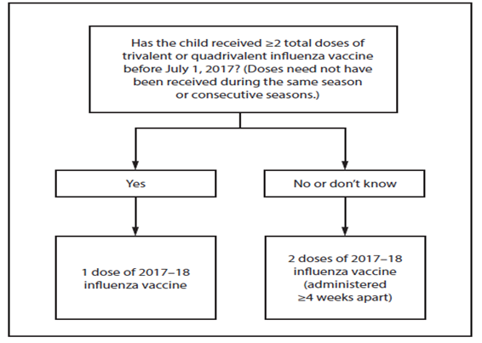
Dosing Algorithm for Children
Notes:
Influenza vaccine dosing algorithm for children aged 6 months through 8 years — Advisory Committee on Immunization Practices, United States, 2017–18 influenza season.
-Children 6 months–8 years who did not receive at least 2 doses of influenza vaccine before July 1, 2017 should receive 2 doses separated by at least 4 weeks.
-Persons 9 years and older 1 dose
GSK Influenza Vaccine, Fluarix Quadrivalent, is now FDA approved for patients aged 6 months and older with the same dose (0.5-mL).
-Live attenuated influenza vaccine (LAIV) not recommended for the 2017–18 season.

Slide 41
Influenza Vaccination of Persons with a History of Egg Allergy
Persons with a history of egg allergy who have experienced only urticarial (hives) after exposure to egg should receive influenza vaccine.
Persons who report having had reactions to egg involving symptoms other than urticarial (hives), such as angioedema, respiratory distress, lightheadedness, or recurrent emesis; or who required epinephrine or another emergency medical intervention, may similarly receive any licensed and recommended influenza vaccine (i.e., any IIV or RIV) that is otherwise appropriate for the recipient’s age and health status.
A previous severe allergic reaction to influenza vaccine is a contraindication to future receipt of the vaccine.
Recommendations and Reports Vol. 65 / No. 5 MMWR / August 26, 2016
Notes:
1. Persons with a history of egg allergy who have experienced only urticarial (hives) after exposure to egg should receive influenza vaccine. Any licensed and recommended influenza vaccine (i.e., any IIV or RIV) that is otherwise appropriate for the recipient’s age and health status may be used.
2. Persons who report having had reactions to egg involving symptoms other than urticarial (hives), such as angioedema, respiratory distress, lightheadedness, or recurrent emesis; or who required epinephrine or another emergency medical intervention, may similarly receive any licensed and recommended influenza vaccine (i.e., any IIV or RIV) that is otherwise appropriate for the recipient’s age and health status. The selected vaccine should be administered in an inpatient or outpatient medical setting (including, but not necessarily limited to, hospitals, clinics, health departments, and physician offices). Vaccine administration should be supervised by a health care provider who is able to recognize and manage severe allergic conditions.
3. A previous severe allergic reaction to influenza vaccine, regardless of the component suspected of being responsible for the reaction, is a contraindication to future receipt of the vaccine.
EPIC 2017

Slide 42
Can a child who needs 2 doses of influenza receive 1 dose of quadrivalent vaccine and 1 dose of trivalent vaccine?
Test Your Knowledge!
Yes. You can give these two vaccines, as long as the 2 doses are appropriately spaced.
IAC Ask the Experts - Reviewed December 2016

Slide 43
Serogroup A, C, W, Y Meningococcal Vaccines
Routine Recommendation
2-dose series at 11-12 years and 16 years
Age 13-15 years administer 1-dose and booster at age 16-18 years (minimal interval 8 weeks)
1-dose at age 16-18 years
Notes:
Serogroup A, C, W, Y meningococcal vaccines. (Minimum age: 2 months [Menveo], 9 months [Menactra].
Routine:
2-dose series: 11-12 years and 16 years.
Catch-Up:
Age 13-15 years: 1 dose now and booster at age 16-18 years. Minimum interval 8 weeks.
Age 16-18 years: 1 dose.
After a booster dose of meningococcal conjugate vaccine, antibody titers are higher than after the first dose and are expected to protect adolescents through the period of increased risk through age 21 years. Persons who receive their first dose of meningococcal conjugate vaccine at or after age 16 years do not need a booster dose. Routine vaccination of healthy persons who are not at increased risk for exposure to N. meningitidis is not recommended after age 21 years.
Optional:
The minimum interval between doses of meningococcal conjugate vaccine is 8 weeks.
No data are available on the interchangeability of vaccine products. Whenever feasible, the same brand of vaccine should be used for all doses of the vaccination series. If vaccination providers do not know or have available the type of vaccine product previously administered, any product should be used to continue or complete the series.
The most common clinical presentations of meningococcal disease are meningitis and meningococcemia.
-Neisseria meningitidis contains 13 serogroups, the most common being A, B, C, W, and Y. About 5-10% of adults are asymptomatic nasopharyngeal carriers of this organism. Individuals with meningococcemia may die within 24 hours of the onset of symptoms even with prompt treatment with appropriate antimicrobials and supportive care in an intensive care unit. Meningitis makes up about ~50% of cases and has a 9-10% fatality rate
Meningococcemia- 5%-20% of cases; Up to 40% fatality rate; symptoms include Rash, Vascular damage, Disseminated intravascular coagulation, Multi-organ failure, Shock, and Death can occur in 24 hours); 11-19% of survivors have permanent sequelae (an abnormal condition resulting from a previous disease)
Reference: 1. Epidemiology and Prevention of Vaccine-Preventable Diseases, 13th edition. 2015 HHS, CDC.
2. AAP Redbook 2015
3. Meningococcal Disease. About the Disease. http://www.cdc.gov/meningococcal/about/index.html

Slide 44
Meningococcal Vaccines for Special Populations and Situations
Anatomic or functional asplenia, sickle cell disease, HIV infection, persistent complement component deficiency (including eculizumab use)
Children who travel to or live in countries where meningococcal disease is hyperendemic or epidemic, including countries in the African meningitis belt or during the Hajj, or exposure to an outbreak attributable to a vaccine serogroup
Notes:
Special populations and situations:
Anatomic or functional asplenia, sickle cell disease, HIV infection, persistent complement component deficiency (including eculizumab use):
Menveo:
1st dose at 8 weeks: 4-dose series at 2, 4, 6, and 12 months.
1st dose at 7–23 months: 2 doses (2nd dose at least 12 weeks after the 1st dose and after the 1st birthday).
1st dose at 24 months or older: 2 doses at least 8 weeks apart.
Menactra
Persistent complement component deficiency:
9–23 months: 2 doses at least 12 weeks apart
24 months or older: 2 doses at least 8 weeks apart
Anatomic or functional asplenia, sickle cell disease, or HIV infection: 24 months or older: 2 doses at least 8 weeks apart. Menactra must be administered at least 4 weeks after completion of PCV13 series.
-Children who travel to or live in countries where meningococcal disease is hyperendemic or epidemic, including countries in the African meningitis belt or during the Hajj, or exposure to an outbreak attributable to a vaccine serogroup:
Children <24 months of age:
Menveo (2-23 months):
1st dose at 8 weeks: 4-dose series at 2, 4, 6, and 12 months.
1st dose at 7-23 months: 2 doses (2nd dose at least 12 weeks after the 1st dose and after the 1st birthday).
Menactra (9-23 months):
2 doses (2nd dose at least 12 weeks after the 1st dose. 2nd dose may be administered as early as 8 weeks after the 1st dose in travelers).
Children 2 years or older: 1 dose of Menveo or Menactra.
Note: Menactra should be given either before or at the same time as DTaP.
The same vaccine product should be used for all doses. ACIP recommends HIV-infected infants 2 through 23 months should receive MenACWY-CRM (Menveo). HIV-infected children < 2 years should not receive MenACWY-D(Menactra) due to immune interference with PCV13.
Reference:
MMWR, November 4, 2016, Vol 65(43).

Slide 45
Serogroup B Meningococcal Vaccines
ACIP Recommendation
May be given at clinical discretion to adolescents 16-23 years (preferred age 16-18 years) who are not at increased risk
  Bexsero: 2 doses at least 1 month apart
  Trumenba: 2 doses at least 6 months apart. If 2nd dose given earlier than 6 months, give 3rd dose at least 4 months after the 2nd dose
Notes:
MenB is a Category B- permissive recommendation- Category B means the recommendation allows for individual clinical decision making, but with Category A recommendations all persons in an age or risk factor based group may get the vaccine. Category B classification enables coverage by the VFC program and most insurance plans. ACIP recommends routine MenB vaccination of certain high risk groups for those 10 years and older.
Serogroup B meningococcal vaccines (minimum age: 10 years [Bexsero, Trumenba].
Clinical discretion: Adolescents not at increased risk for meningococcal B infection who want MenB vaccine.
MenB vaccines may be given at clinical discretion to adolescents 16–23 years (preferred age 16–18 years) who are not at increased risk.
Bexsero: 2 doses at least 1 month apart.
Trumenba: 2 doses at least 6 months apart. If the 2nd dose is given earlier than 6 months, give a 3rd dose at least 4 months after the 2nd.
Data presented to ACIP in June 2015 demonstrated that the estimated incidence of serogroup B meningococcal disease among college students aged 18-23 years was low (0.09 cases/100,000) and was similar to that of
non-college students during 2009-2013. CDC shared plans to improve surveillance and report updated findings to
ACIP on the incidence of disease in college students once additional data became available.
Summary
▪ Incidence of serogroup B meningococcal disease in college students is low; however, college students aged 18-21 years are at increased risk compared to non-college students
– Incidence of serogroups C, W, and Y in this age group is lower and similar in college students and non-college students, likely in part due to the adolescent MenACWY program
▪ Serogroup B college outbreaks are an important factor, though the risk remains elevated among college students even when excluding outbreak associated cases
Although the risk of serogroup B meningococcal disease is increased among college students, the number of preventable cases is low and number needed to vaccinate to prevent a case is high
▪ Limited duration of protection of MenB vaccines and the lack of evidence for impact on carriage may limit the ability to protect college students through the period of greatest risk
– MenB vaccination should occur as close to college entry as possible
▪ While achieving high MenB coverage during college outbreaks has been challenging, routine vaccination of all college students would also be difficult
▪ Awareness and uptake of MenB vaccines is currently low
Conclusion
▪ The Work Group does not propose any changes to the current MenB vaccine recommendations
▪ CDC could provide more guidance around clinical decision-making during precollege health visits

Slide 46
Serogroup B for Special Populations and Situations
Anatomic or functional asplenia, sickle cell disease, persistent complement component deficiency (including eculizumab use), serogroup B meningococcal disease outbreak
  Bexsero: 2-doses at least 1 month apart
  Trumenba: 3-dose series at 0, 1-2, and 6 months
Bexsero and Trumenba are not interchangeable
Notes:
Serogroup B meningococcal vaccines (minimum age: 10 years [Bexsero, Trumenba].
Special populations and situations:
Anatomic or functional asplenia, sickle cell disease, persistent complement component deficiency (including eculizumab use), serogroup B meningococcal disease outbreak
Bexsero: 2-dose series at least 1 month apart.
Trumenba: 3-dose series at 0, 1-2, and 6 months.
Note: Bexsero and Trumenba are not interchangeable.
MenB is a Category B- permissive recommendation- Explain to audience the difference between a Category A and Category B recommendation. Category B means the recommendation allows for individual clinical decision making, but with Category A recommendations all persons in an age or risk factor based group may get the vaccine. Category B classification enables coverage by the VFC program and most insurance plans.
A Men B vaccine series may be administered to adolescents and young adults 16 through 23 years of age to provide short-term protection against most strains of Men B. Preferred age is 16-18 years.

Slide 47
I have a 24-month-old patient with HIV infection and I want to use Menactra (Sanofi Pasteur) because this is the only vaccine we have available in our clinic. However, this child received DTaP vaccine yesterday at another clinic. Can I administer Menactra today?
Test Your Knowledge!
ACIP recommends that you wait 4 weeks from the dose of DTaP to administer the dose of Menactra. This is because data suggest a reduced response to the Menactra if given within a month after DTaP. If Menactra is to be administered to a child at increased risk for meningococcal disease, including children who have HIV infection, Menactra should be given either before or at the same visit as DTaP. Menveo brand MenACWY vaccine (GSK) can be given at any time before or after DTaP.
IAC Ask the Experts - Reviewed December 2016
Notes:
ACIP recommends that you wait 4 weeks from the dose of DTaP to administer the dose of Menactra. This is because data suggest a reduced response to the Menactra if given within a month after DTaP. If Menactra is to be administered to a child at increased risk for meningococcal disease, including children who have HIV infection, Menactra should be given either before or at the same visit as DTaP. Menveo brand MenACWY vaccine (GSK) can be given at any time before or after DTaP.

Slide 48
I have an HIV-positive 64 year old patient who received MenACWY vaccine last week. Was this the correct vaccine for this patient or should he have gotten meningococcal polysaccharide vaccine (MPSV4, Sanofi Pasteur) due to his age? Also, should this patient get another dose in 2 months?
Test Your Knowledge!
MenACWY was the correct vaccine in this situation. The 2013 ACIP recommendations on MenACWY vaccination recommend the use of meningococcal conjugate vaccine in adults age 56 years and older who were vaccinated previously with MenACWY and now need revaccination, or are recommended to receive multiple doses. A person of this age with HIV infection should receive 2 doses of MenACWY separated by 8-12 weeks. Both MenACWY vaccines are licensed for use in people through age 55 years, which means that the use of these vaccines in people age 56 and older is off-label but recommended by ACIP.
IAC Ask the Experts - Reviewed December 2016
Notes:
I have an HIV-positive 64 year old patient who received MenACWY vaccine last week. Was this the correct vaccine for this patient or should he have gotten meningococcal polysaccharide vaccine (MPSV4, Sanofi Pasteur) due to his age? Also, should this patient get another dose in 2 months?
MenACWY was the correct vaccine in this situation. The 2013 ACIP recommendations on MenACWY vaccination recommend the use of meningococcal conjugate vaccine in adults age 56 years and older who were vaccinated previously with MenACWY and now need revaccination, or are recommended to receive multiple doses. A person of this age with HIV infection should receive 2 doses of MenACWY separated by 8-12 weeks. Both MenACWY vaccines are licensed for use in people through age 55 years, which means that the use of these vaccines in people age 56 and older is off-label but recommended by ACIP.

Slide 49
HPV Vaccine
Routine recommendation for adolescents 11-12 years (can start at age 9)
Number of doses dependent on age at initial vaccination
>Age 9-14 years: 2-dose series at 0 and 6-12 months
>Age 15 years or older: 3-dose series at 0, 1-2 months, and 6 months
Persons who completed a valid series with any HPV vaccine do not need any additional doses
Special Situations
>History of sexual abuse or assault: begin series at age 9 years
>Immunocompromised: aged 9-26 years administer 3-dose series
>Pregnancy: vaccination not recommended, but if administered
inadvertently while pregnant delay remaining doses until after
pregnancy.
Notes:
Routine recommendation for adolescents 11-12 years (can start at age 9)
Number of doses dependent on age at initial vaccination
>Age 9-14 years: 2-dose series at 0 and 6-12 months
>Age 15 years or older: 3-dose series at 0, 1-2 months, and 6 months
Persons who completed a valid series with any HPV vaccine do not need any additional doses
Special Situations
>History of sexual abuse or assault: begin series at age 9 years
>Immunocompromised: aged 9-26 years administer 3-dose series
>Pregnancy: vaccination not recommended, but there is no evidence the vaccine is harmful. No intervention is needed for women who inadvertently receive a dose of HPV vaccine while pregnant. Delay remaining doses until after pregnancy. Pregnancy testing not needed before vaccination.
Persons not previously vaccinated (catch-up); females through as 26 years, males through age 21 years; makes 22-26 years with immunocompromising conditions (including HIV), who are transgender, and who have sex with men (including men identify as gay or bisexual, or who intend to have sex with men).
Clinicians also need to emphasize the importance of immunizing preteens and teens early because of the following:
-Higher antibody level attained when given to pre-teens rather than to older adolescents or women
-At this age, more likely to be administered before onset of sexual activity
-HPV can be transmitted by other skin-to-skin contact, not just sexual intercourse
-This is an anti-cancer vaccine
According to the 2016 NIS Data; in Georgia, coverage with >/= 1 HPV dose vaccine among females and males combined and females separately increased compared with 2015. In 2016, 45.6% of adolescents were up-to-date with the HPV vaccine series (55.4% among females and 36.2% among males. In 2016, coverage with >/= 3 HPV doses among female and male were similar to 2015 estimates.
Persons who have completed a valid series with any HPV vaccine do not need any additional doses.
Special situations:
-History of sexual abuse or assault: Begin series at age 9 years.
-Immunocompromised* (including HIV) aged 9–26 years: 3-dose series at 0, 1–2 months, and 6 months.
-Pregnancy: Vaccination not recommended, but there is no evidence the vaccine is harmful. No intervention is needed for women who inadvertently received a dose of HPV vaccine while pregnant. Delay remaining doses until after pregnancy. Pregnancy testing not needed before vaccination.

Slide 50
Notes:
Communication Strategies when talking with parents about HPV.
Use the CASE acronym to help answer these questions.
Why does my child need the HPV vaccine?
C= Cancer Prevention; “HPV can cause certain cancers, and the vaccine helps prevent HPV-related cancers and diseases caused by 9 HPV types. I want to help protect your child from these cancers.”
Why is the HPV vaccine given at age 11 or 12?
A= Adolescent Vaccination; “As with other recommended adolescent vaccines, we need to vaccinate your child well before he/she is exposed”.
Is the HPV vaccine safe?
S= Safety Profile; “The HPV vaccine has been studied in both males and females. The most common side effects include pain, swelling, redness, itching bruising, bleeding, and a lump where your child got the shot, and headache, fever, nausea, dizziness, tiredness, diarrhea, abdominal pain, and sore throat. Fainting can happen after getting the vaccine”.
How common is HPV?
E=Exposure; “HPV is widespread, with 14 million new infections every year in the U.S. For most people, HPV clears on its own, but for others who don’t clear the virus it could cause certain cancers and diseases”

Slide 51
Rotavirus Vaccine
Routine Recommendation
Rotarix: 2-dose series at 2 and 4 months
RotaTeq: 3-dose series at 2, 4, and 6 months
If any dose in the series is either RotaTeq or unknown, default to 3-dose series
Notes:
Rotavirus vaccines. (minimum age: 6 weeks)
Routine vaccination:
Rotarix: 2-dose series at 2 and 4 months.
RotaTeq: 3-dose series at 2, 4, and 6 months.
If any dose in the series is either RotaTeq or unknown, default to 3-dose series.
Catch-up vaccination:
Do not start the series on or after age 15 weeks, 0 days.
The maximum age for the final dose is 8 months, 0 days.
Why get vaccinated?
Rotavirus is a virus that causes diarrhea, mostly in babies and young children. The diarrhea can be severe, and lead to dehydration. Vomiting and fever are also common in babies with rotavirus. Before rotavirus vaccine, rotavirus disease was a common and serious health problem for children in the United States. Almost all children in the U.S. had at least one rotavirus infection before their 5th birthday.
Every year:
More than 400,000 young children had to see a doctor for illness caused by rotavirus,
More than 200,000 had to go to the emergency room,
55,000 to 70,000 had to be hospitalized, and 20 to 60 died.
Rotavirus vaccine has been used since 2006 in the United States. Because children are protected by the vaccine, hospitalizations, and emergency visits for rotavirus have dropped dramatically.

Slide 52
Test Your Knowledge!
If dose #1 of HPV vaccine was given before the 15th birthday and it has been more than a year since that dose was given, would the series be complete with just one additional dose?
Yes. Adolescents and adults who started the HPV vaccine series prior to the 15th birthday and who are not immunocompromised are considered to be adequately vaccinated with just one additional dose of HPV vaccine.

Slide 53
Test Your Knowledge!
Will the 2-dose recommendation be retroactive for children and teens vaccinated prior to 2016?
Yes. Any person who ever received 2 doses of any combination of HPV vaccines can be considered fully vaccinated if dose #1 was given before the 15th birthday and the 2 doses were separated by at least 5 months.

Slide 54
Zostavax
Herpes zoster or shingles, occurs through reactivation of latent varicella-zoster virus
Live attenuated virus vaccine; administered subcutaneous
51% fewer episodes of zoster and less severe disease
66% less post-herpetic neuralgia
Protection wanes within the first 5 years and duration of protection beyond 5 years is uncertain
ACIP recommends one dose for adults 60 years and older, including those who have experienced previous episodes of shingles.
It is not necessary to ask patient about a history of varicella or to do serologic testing for immunity.
Notes:
Zostavax is licensed for use in persons 50 years and older
Overall Efficacy
51% fewer episodes of zoster and less severe disease
66% less postherpetic neuralgia
Protection wanes within the first 5 years and duration of protection beyond 5 years is uncertain
ACIP recommends one dose for adults 60 years and older, including those who have experienced previous episodes of shingles. It is not necessary to ask patient about a history of varicella or to do serologic testing for immunity.
Optional Information:
Insurance reimbursement for Zostavax will vary based on the patient’s insurance plan. Patients need to verify coverage with their insurance company. Zostavax is covered by Medicare under Part D, but there are many different plans available under Part D. Patients covered by Medicare should make sure the Part D plan they have selected covers Zostavax or they will be responsible for full payment. Many practices are not offering Zostavax to their patients because physicians can not bill Part D, unless their practice is approved to dispense prescription drugs. In Georgia, pharmacists who are trained in vaccine administration can give Zostavax and bill Medicare for the cost of the vaccine and an administrative charge, if the patient’s Part D plan covers the vaccine.

Slide 55
SHINGRIX (RZV) NEW
Administer 2 doses of recombinant zoster vaccine (RZV) 2-6 months apart to adults aged 50 years or older regardless of past episode of herpes zoster or receipt of zoster live (ZVL)
Administer 2 doses of RZV 2-6 months apart to adults who previously received ZVL at least 2 months after ZVL
For Adults aged 60 years or older, administer either RZV or ZVL (RZV is preferred)
Notes:
In October 2017, the Advisory Committee on Immunization Practices (ACIP) made the following three recommendations:
1.Recombinant zoster vaccine (RZV) is recommended for the prevention of herpes zoster and related complications for immunocompetent adults aged ≥50 years.
2.RZV is recommended for the prevention of herpes zoster and related complications for immunocompetent adults who previously received zoster vaccine live (ZVL).
3.RZV is preferred over ZVL for the prevention of herpes zoster and related complications.
These recommendations serve as a supplement to the existing recommendations for the use of ZVL in immunocompetent adults aged ≥60 years.
General information
-Administer 2 doses of recombinant zoster vaccine (RZV) 2–6 months apart to adults aged 50 years or older regardless of past episode of herpes zoster or receipt of zoster vaccine live (ZVL)
-Administer 2 doses of RZV 2–6 months apart to adults who previously received ZVL at least 2 months after ZVL
-For adults aged 60 years or older, administer either RZV or ZVL (RZV is preferred)
Special populations
ZVL is contraindicated for pregnant women and adults with severe immunodeficiency

Slide 56
SHINGRIX (RZV)
SHINGRIX delivered 90% efficacy against shingles
Recombinant vaccine; do not freeze
For intramuscular administration only
Reconstitute and use immediately; reconstituted vaccine is stable for 6 hours refrigerated between 36-46°F and should be discarded after 6 hours
Contraindicated for a history of severe allergic reaction (e.g., anaphylaxis) to any component of the vaccine or after a previous dose of SHINGRIX
Notes:
-SHINGRIX delivered 90% efficacy against shingles
-Recombinant vaccine; do not freeze
-For intramuscular administration only
-Reconstitute and use immediately; reconstituted vaccine is stable for 6 hours refrigerated between 36-46°F and should be discarded after 6 hours
-Contraindicated for a history of severe allergic reaction (e.g., anaphylaxis) to any component of the vaccine or after a previous dose of SHINGRIX
An adjuvant is an ingredient of a vaccine that helps create a stronger immune response in the patient’s body. In other words, adjuvants help vaccines work better. Some vaccines made from weakened or dead germs contain naturally occurring adjuvants and help the body produce a strong protective immune response. However, most vaccines developed today include just small components of germs, such as their proteins, rather than the entire virus or bacteria. These vaccines often must be made with adjuvants to ensure the body produces an immune response strong enough to protect the patient from the germ he or she is being vaccinated against.
Talking Points
We’ve heard from some of the districts that when they look up a client in TransactRx the client’s Medicare Part D plan will cover Shingrix vaccine. We don’t know at this time when Shingrix will be supplied through the GA Immunization Program

Slide 57
Test Your Knowledge!
Hazel is 61 years old. She had major surgery one month ago requiring a blood transfusion. During her visit to your office today she tells you she would like to get the shingles vaccine.
How would you respond to her request?
Zoster vaccine can be given to persons who have recently received blood products. The amount of antigen in zoster vaccine is so substantial that it overpowers any antibody to herpes zoster that may be in the blood product.
Ref: Immunization Action Coalition - Ask the Experts – September 2011

Slide 58
Test Your Knowledge!
Sixty five year old Nadine requests the shingles vaccine. In addition, she needs pneumococcal and influenza vaccine.
Should she receive all 3 vaccines on the same day?
Yes. Although Merck reports one study showing a reduced immune response to Zostavax when administered at the same time as Pneumovax compared to administration 4 weeks apart, ACIP has not made this recommendation.

Slide 59
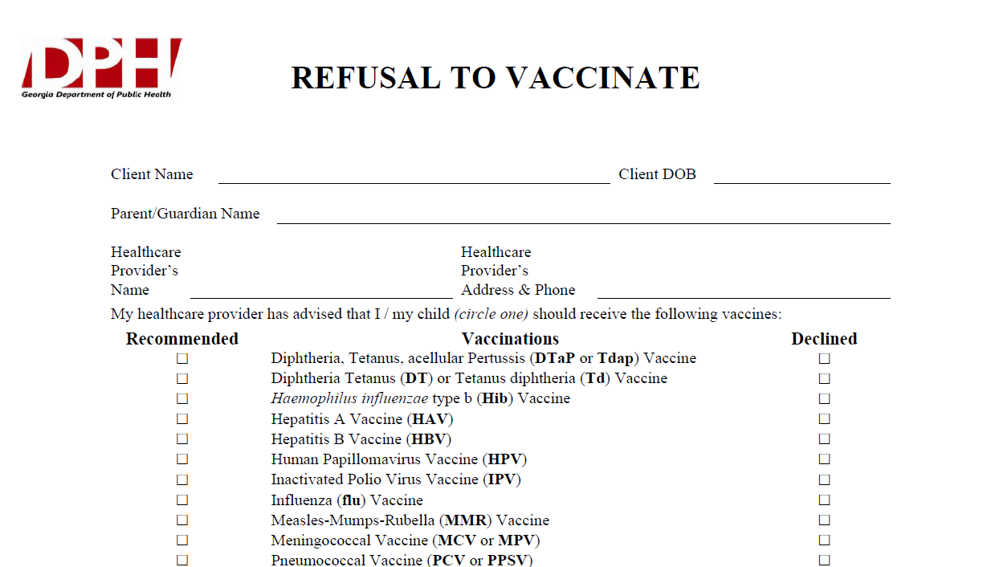
Notes:
What If Parents Refuse to Vaccinate?
Excluding children from your practice when their parents decline immunizations is not recommended. It can put the child at risk of many different health problems—not just vaccine-preventable diseases. Remember, unvaccinated infants did not decide for themselves to remain unvaccinated. They need your care. Make sure that parents are fully informed about clinical presentations of vaccine-preventable diseases, including early symptoms. Diseases like pertussis and measles are highly contagious and may present early as a non-specific respiratory illness. Parents who refuse vaccines should be reminded at every visit to call before bringing the child into the office, clinic, or emergency department when the child is ill so appropriate measures can be taken to protect others.
If a parent refuses to vaccinate, you can share the fact sheet
If You Choose Not to Vaccinate Your Child, Understand the Risks and Responsibilities (http://www.cdc.gov/vaccines/conversations),
which explains the risks involved with this decision including risks to other members of their community, and the additional responsibilities for parents, including the fact that, when their child is ill, they should always alert health care personnel to their child’s vaccination status to prevent the possible spread of vaccine-preventable diseases. You may wish to have them sign DPH’s Refusal to Vaccinate form in English or Spanish (https://dph.georgia.gov/sites/dph.georgia.gov/files/Immunizations/Health-Care-Professionals-Refusal-to-Vaccinate-Form-English_1.pdf) each time a vaccine is refused so that you have a record of their refusal in their child’s medical file.

Slide 60
Just as a reminder……
Regardless of:
  the availability of vaccine
  the funding of the vaccine (VFC, state-supplied, or private stock)
  whether the vaccine is required for school or child care or not……….
FOLLOW ACIP Recommendations!!!
Notes:
There seems to be some confusion among providers that
if there are vaccine shortages or the supply is low because it’s a new vaccine, or
if the patient doesn’t fit in a certain funding category, or
if the vaccine isn’t required for school or child care:
then they don’t feel they need to be concerned about whether to recommend or discuss that vaccine with the client or the parent. But the bottom line is-------the ACIP recommendation is the most important thing!! For instance, if a vaccine is recommended and the child is not VFC eligible, then give them your private stock of that vaccine if you have it. If not, refer the child out to receive it, but don’t ignore the fact that according to the ACIP Recommended schedule, he should have it.
Please be sure to emphasize this to any groups that you are educating about the recommended schedule.

Slide 61

Become a Vaccine Champion!!
Critical Elements
Appropriate storage and handling of all vaccines.
Correct administration of vaccines
Education of patients and parents about vaccines
Every office and clinic needs a vaccine champion.
Notes:
As Immunization Providers there are Critical Elements that must be maintained for Immunization Services:
-Appropriate storage and handling of all vaccines.
-Correct administration of vaccines
-Education of patients and parents about vaccines
-Every office and clinic needs a vaccine champion.
Ask your audience “Who is your vaccine champion?” and then “Who is this person’s backup?” Every providers should have vaccine champions. Key characteristics of a vaccine champion include:
The vaccine champion will:
-Lead your immunization team.
-Educate all staff about new vaccines and recommendations.
-Educate new staff about vaccine storage, handling, & administration.
-Initiate processes to improve immunization rates in your practice/facility.
-Assure immunizations of all staff are up-to-date.
Improving Access to immunizations
-Immunization only visits
-Walk-ins for immunizations
-Implement standing orders
-Early, extended, or weekend hours
-Mass vaccination clinics
These 5 methods listed above can help patients access immunizations more readily but some of these methods may not be the right fit for some practices. The approach to improving access must be determined by individual practitioners and staff. Each practice must decide which method works best for their situation. In large practices or clinics this may be an administrative decision.

Slide 62
Vaccine Champion
Key Characteristics
Lead your immunization team.
Educate all staff about new vaccines and recommendations.
Educate new staff about vaccine storage, handling, & administration.
Initiate processes to improve immunization rates in your practice/facility.
Assure immunizations of all staff are up-to-date.
Notes:
Ask your audience “Who is your vaccine champion?” and then “Who is this person’s backup?” Every providers should have vaccine champions. Key characteristics of a vaccine champion include:
The vaccine champion will:
-Lead your immunization team.
-Educate all staff about new vaccines and recommendations.
-Educate new staff about vaccine storage, handling, & administration.
-Initiate processes to improve immunization rates in your practice/facility.
-Assure immunizations of all staff are up-to-date.

Slide 63
Improve Access To Immunizations
Immunization only visits
Walk-ins for immunizations
Implement standing orders
Early, extended, or weekend hours
Mass vaccination clinics
Notes:
Improving Access to immunizations
-Immunization only visits
-Walk-ins for immunizations
-Implement standing orders
-Early, extended, or weekend hours
-Mass vaccination clinics
These 5 methods listed above can help patients access immunizations more readily but some of these methods may not be the right fit for some practices. The approach to improving access must be determined by individual practitioners and staff. Each practice must decide which method works best for their situation. In large practices or clinics this may be an administrative decision.

Slide 64
VAERS
Public Health Reports should be faxed or mailed to the State Immunization Program. Fax number (404)657-1463
Notes:
Established in 1990, the Vaccine Adverse Event Reporting System (VAERS) is a national early warning system to detect possible safety problems in U.S.-licensed vaccines. VAERS is co-managed by the Centers for Disease Control and Prevention (CDC) and the U.S. Food and Drug Administration (FDA). VAERS accepts and analyzes reports of adverse events (possible side effects) after a person has received a vaccination. Anyone can report an adverse event to VAERS. Healthcare professionals are required to report certain adverse events and vaccine manufacturers are required to report all adverse events that come to their attention. VAERS is a passive reporting system, meaning it relies on individuals to send in reports of their experiences to CDC and FDA. VAERS is not designed to determine if a vaccine caused a health problem, but is especially useful for detecting unusual or unexpected patterns of adverse event reporting that might indicate a possible safety problem with a vaccine. This way, VAERS can provide CDC and FDA with valuable information that additional work and evaluation is necessary to further assess a possible safety concern.
VAERS Data Limitations
Millions of vaccines are given each year to children less than 1 year old in the United States, usually between 2 and 6 months of age. At this age, infants are at greatest risk for certain medical adverse events, including high fevers, seizures, and sudden infant death syndrome (SIDS). Some infants will experience these medical events shortly after a vaccination by coincidence. These coincidences make it difficult to know whether a particular adverse event resulted from a medical condition or from a vaccination. Therefore, vaccine providers are encouraged to report all adverse events following vaccination, whether or not they believe the vaccination was the cause.
The primary objectives of VAERS are to:
Detect new, unusual, or rare vaccine adverse events; Monitor increases in known adverse events; Identify potential patient risk factors for particular types of adverse events; Assess the safety of newly licensed vaccines;
Determine and address possible reporting clusters (e.g., suspected localized [temporally or geographically] or product-/batch-/lot-specific adverse event reporting); Recognize persistent safe-use problems and administration errors;
Provide a national safety monitoring system that extends to the entire general population for response to public health emergencies, such as a large-scale pandemic influenza vaccination program.
Two Ways to Submit an Online Report to VAERS:
-Report Online
-Report using writable PDF (Public Health will complete PDF and send reports to the Immunization Program State Office via fax or mail)
What Can Be Reported to VAERS?
VAERS encourages the reporting of any clinically significant adverse event that occurs after the administration of any vaccine licensed in the United States.
Who Reports to VAERS?
Anyone can file a VAERS report, including parents, health care providers, manufacturers, and vaccine recipients.
Does VAERS Provide General Vaccine Information?
No. VAERS only collects and analyzes adverse event reports. In another example, VAERS determined that there may be a potential for a small increase in risk for Guillain-Barre syndrome after the meningococcal conjugate vaccine, Menactra. As a result of this finding, a history of Guillain-Barre syndrome became a contraindication to the vaccine and further controlled studies are currently underway to research this issue.

Slide 65
Vaccine Injury Compensation Program (VICP)
National Vaccine Injury Compensation Program
provides compensation to individuals found to be injured by or have died from certain childhood vaccines.
  Established in 1988 by NCVIA
  Federal “no fault” system to compensate those injured
  Claim must be filed by individual, parent or guardian
  Must show that injury is on “Vaccine Injury Table”
Notes:
The National Vaccine Injury Compensation Program is a no-fault alternative to the traditional legal system for resolving vaccine injury petitions. It was created in the 1980s, after lawsuits against vaccine companies and health care providers threatened to cause vaccine shortages and reduce U.S. vaccination rates, which could have caused a resurgence of vaccine preventable diseases. Any individual, of any age, who received a covered vaccine and believes he or she was injured as a result, can file a petition. Parents, legal guardians and legal representatives can file on behalf of children, disabled adults, and individuals who are deceased. The purpose of VICP is to ensure that individuals injured by certain vaccines are provided with fair and efficient compensation and to ensure a stable vaccine supply by limiting liability for vaccine manufacturers and vaccine administrators. The National Vaccine Injury Compensation Program covers most vaccines given routinely in the U.S. For a vaccine to be covered, the category of vaccine must be recommended for routine administration to children or pregnant women by the Centers for Disease Control and Prevention and subject to an excise tax by Federal law.
The following three organizations have a role in VICP:
-The VICP is administered through the Department of Health and Human Services (HHS)
-The Department of Justice (DOJ) represents HHS in Court
-The U.S. Court of Federal Claims (the Court) makes the final decision regarding whether a petitioner should be compensated

Slide 66
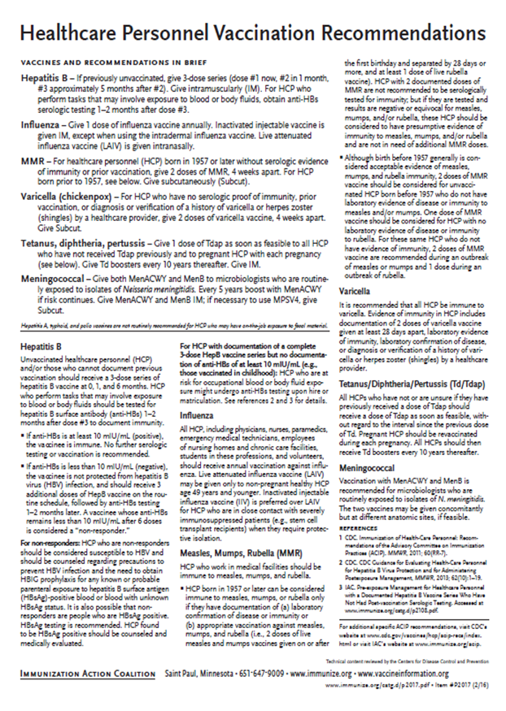
Recommended Healthcare Personnel Vaccinations
ARE YOU UP TO DATE??
Hepatitis B
Influenza
Measles, Mumps, Rubella (MMR)
Varicella (Chickenpox)
Tetanus, Diphtheria, Pertussis (Tdap)
Meningococcal
Notes:
Un-immunized HCP
Un-immunized healthcare workers are at risk of infecting patients, family members and community contacts
Immunized HCP
Protect patients from VPD’s
Help offices avoid potential liability cases. (The practice can be liable if an unimmunized HCP becomes infected with a vaccine preventable disease and infects a patient.)
Maintain productivity
Reduce illness and illness-related absenteeism
Evidence of Immunity to MMR
Documented administration of two doses of measles and mumps vaccine and one dose of rubella vaccine OR
Laboratory evidence of immunity or laboratory confirmation of disease (measles, mumps and rubella) OR
Born before 1957 (measles, mumps and rubella)
Because of their contact with patients or infective material from patients, many HCP are at risk for exposure to (and possible transmission of) vaccine-preventable diseases. Employers and HCP have a shared responsibility to prevent occupationally acquired infections and avoid causing harm to patients by taking reasonable precautions to prevent transmission of vaccine-preventable diseases.
Optimal use of recommended vaccines helps maintain immunity and safeguard HCP from infection, thereby helping protect patients from becoming infected. The recommendations for vaccination of HCP are presented in two categories: 1) those diseases for which routine vaccination or documentation of immunity is recommended for HCP because of risks to HCP in their work settings and, should HCP become infected, to the patients they serve and 2) those diseases for which vaccination of HCP might be indicated in certain circumstances. Vaccines recommended in the first category are hepatitis B, seasonal influenza, measles, mumps, and rubella, pertussis, and varicella vaccines. Vaccines in the second category are meningococcal, typhoid, and polio vaccines.
1. General Recommendations on Immunization, Recommendations of the Advisory Committee on Immunization Practices (ACIP). MMWR (RR-2); January 28, 2011
MMWR; November 25, 2011 / 60(RR07);1-45

Slide 67
PRE-EXPOSURE EVALUATION FOR HEALTH-CARE PERSONNEL
PREVIOUSLY VACCINATED WITH COMPLETE, ≥3-DOSES OF HEP B VACCINE
SERIES WHO HAVE NOT HAD POSTVACCINATION SEROLOGIC TESTING
Measure antibody to hepatitis B surface antigen (anti-HBs) anti-HBs ≥10 mIU/mL
Below adequate level
anti-HBs ≥10mIU/mL
1 dose of HepB vaccine,
4-6 wks.--- serologic testing
No Action for
Hepatitis B prophylaxis
(regardless of source patient hepatitis B surface antigen status)
Below adequate level
At or above adequate level
2 more doses of HepB vaccine,
4-6 wks.--- serologic testing
Vaccinated HCP whose anti-HBs remains <10 mIU/mL after revaccination (i.e., after receiving a total of 6 doses) should be tested for HBsAg and anti-HBc to determine infection status.
Below adequate level
At or above adequate level
HCP need to receive hepatitis B evaluation for all exposures
MMWR, December 20, 2013, Vol 62. RR # 10
Notes:
Postvaccination Serologic Testing
Testing unvaccinated HCP for HBV infection is not generally indicated for persons being evaluated for hepatitis B protection because of occupational risk.
Prevaccination serologic testing is indicated for:
all persons born in geographic regions with HBsAg prevalence of ≥2% (e.g., much of Eastern Europe, Asia, Africa, the Middle East, and the Pacific Islands)
certain indigenous populations from countries with overall low HBV endemicity (<2%)
persons with behavioral exposures to HBV (e.g., men who have sex with men and past or current injection drug users)
persons receiving cytotoxic or immunosuppressive therapy
persons with liver disease of unknown etiology.
Testing HCP at risk for HBV infection should consist of a serologic assay for HBsAg, in addition to either anti-HBc or anti-HBs. For unvaccinated HCP at risk for previous HBV infection, blood should be drawn for testing before the first dose of vaccine is administered.
HCP who have written documentation of a complete, ≥3-dose HepB vaccine series and subsequent postvaccination anti-HBs ≥10 mIU/mL are considered hepatitis B immune. Immunocompetent persons have long-term protection against HBV and do not need further periodic testing to assess anti-HBs levels.
All HCP recently vaccinated or recently completing HepB vaccination who are at risk for occupational blood or body fluid exposure should undergo anti-HBs testing. Anti-HBs testing should be performed 1–2 months after administration of the last dose of the vaccine series when possible. HCP with documentation of a complete ≥3-dose HepB vaccine series but no documentation of anti-HBs ≥10 mIU/mL who are at risk for occupational blood or body fluid exposure might undergo anti-HBs testing upon hire or matriculation. Testing should use a quantitative method that allows detection of the protective concentration of anti-HBs (≥10 mIU/mL) (e.g., enzyme-linked immunosorbent assay [ELISA]).
Completely vaccinated HCP with anti-HBs ≥10 mIU/mL are considered hepatitis B immune. Immunocompetent persons have long-term protection and do not need further periodic testing to assess anti-HBs levels.
Completely vaccinated HCP with anti-HBs <10 mIU/mL should receive an additional dose of HepB vaccine, followed by anti-HBs testing 1–2 months later. HCP whose anti-HBs remains <10 mIU/mL should receive 2 additional
vaccine doses (usually 6 doses total), followed by repeat anti-HBs testing 1–2 months after the last dose. Alternatively, it might be more practical for very recently vaccinated HCP with anti-HBs <10 mIU/mL to receive 3 consecutive additional doses of HepB vaccine (usually 6 doses total), followed by anti-HBs testing 1–2 months after the last dose.
Ref: CDC Guidance for Evaluating Health-Care Personnel for Hepatitis B Virus Protection and for Administering Post Exposure Management MMWR Recommendations and Reports /Vol. 62/No. 10 December 20, 2013

Slide 68









Resources for Factual & Responsible Vaccine Information
www.immunize.org
Notes:
68
68
These are sources for scientific and credible information
See information sheet in participant packet
http://www.cdc.gov/vaccines/vac-gen/safety/default.htm
www.idsociety.org/vaccine/index.html
www.who.int
www.gaaap.org
www.aap.org
www.cispimmunize.org
www.aafp.org
www.acponline.org
www.immunize.org/resources This site is a good resource for healthcare providers and for information written specifically for patient and parents.
www.immunizationinfo.org
www.pkids.org (support and counseling for children with infectious diseases)
www.vaccine.org
The Allied Vaccine Group (AVG) (www.vaccine.org) was formed for the purpose of making it easier for patients/parents/providers to find reliable, science-based information about vaccines and immunization on the internet. This web site was designed to counter the many anti-vaccine web sites that are now available on the internet.

Slide 69

Internet Resources
Georgia Department of Public Health
  http://dph.georgia.gov/immunization-section
  https://dph.georgia.gov/train-trainer
CDC Immunization information
  http://www.cdc.gov/vaccines/
CDC Flu information
  http://www.cdc.gov/flu/
Immunization Action Coalition
  www.immunize.org

Slide 70


State Resources
GA Immunization Program Office
  On call Help line: 404-657-3158
  GRITS Help Line:1-866-483-2958
  VFC Help Line:1-800-848-3868
  Website http://dph.georgia.gov/immunization-section
  Your local Immunization Regional Program Consultant (IRC)
  Epidemiology: 1-866-782-4584
GA Chapter of the AAP
GA Academy of Family Physicians
Notes:
If you need further information about the changes, or to ask questions later, please contact the GA Immunization Office and our partners GA AAP and GA AFP
Your Local health department
District Immunization Coordinator (IPCs)
GA Immunization Program Office
404-657-3158
Website http://health.state.ga.us/programs/immunization
GA Chapter of the AAP
GAFP

Slide 71

It’s a Team Effort!
High Immunization rates begin with a team designed plan!
What can your team do to improve rates?
Notes:
71
Remind your audience that “It is a team effort to immunize successfully”. Do not underestimate the
office team’s ability to affect immunization rates. It takes the physician, physician’s assistant, nurse
practitioner, nurse, medical assistant, and clerical staff working together to improve the office practice
and raise immunization rates.
Take any questions from the audience.
Ask participants how, based on the information presented, will they change the way they administer
vaccines.
Ask the audience what will they do to improve rates?
Ask participants to develop a plan to improve the immunization rates in their office
Jot down the plans the practice makes so that we can follow-up with them.

