Slide 1
Vaccine Administration Technique
Presented by:
Date:

Slide 2
Disclosure Statements
Neither the planners of this session nor I have any conflicts of interest or financial relationship with pharmaceutical companies, biomedical device manufacturers, or corporations whose products and services are related to the vaccines we discuss.
There is no commercial support being received for this event.
The mention of specific brands of vaccines in this presentation is for the purpose of providing education and does not constitute endorsement.
The GA Immunization Program utilizes ACIP recommendations as the basis for this presentation and for our guidelines, policies, and recommendations.
For certain vaccines this may represent a slight departure from or off- label use of the vaccine package insert guidelines.
Notes:
[Presenter is required to read this information to the audience before the program begins.]
Neither the planners of this session nor I have any financial relationship with pharmaceutical companies, biomedical device manufacturers, or corporations whose products and services are related to the vaccines we discuss.
There is no commercial support being received for this event.
The mention of specific brands of vaccines in this presentation is for the purpose of providing education and does not constitute endorsement.
The GA Immunization Program utilizes ACIP recommendations as the basis for this presentation and for our guidelines, policies, and recommendations.
For certain vaccines this may represent a slight departure from or off-label use of the vaccine package insert guidelines.

Slide 3
Disclosure Statement
To obtain nursing contact hours for this session, you must be present for the entire session and complete an evaluation.
Continuing education will be provided through the Georgia Department of Public Health
Georgia Department of Public Health is an approved provider of continuing nursing education by the Alabama State Nurses Association, an accredited approver by the American Nurses Credentialing Center’s Commission of Accreditation
Notes:
To obtain nursing contact hours for this session, you must be present for the entire session and complete an evaluation.
Continuing education will be provided through the Georgia Department of Public Health
Georgia Department of Public Health is an approved provider of continuing nursing education by the Alabama State Nurses Association, an accredited approver by the American Nurses Credentialing Center’s Commission of Accreditation

Slide 4
Objectives
Discuss staff training needs and strategies for communication
List positioning, comforting and pain control techniques
Discuss vaccine preparation, administration routes, sites, and needle sizes
Explain vaccine administration special situations and documentation
Discuss avoiding vaccine administration errors and managing adverse events
Notes:
We will briefly discuss each of these key issues that should be considered when administering vaccines.
Discuss staff training needs and strategies for communication
List positioning, comforting and pain control techniques
Discuss vaccine preparation, administration routes, sites, and needle sizes
Explain vaccine administration special situations and documentation
Discuss avoiding vaccine administration errors and managing adverse events

Slide 5
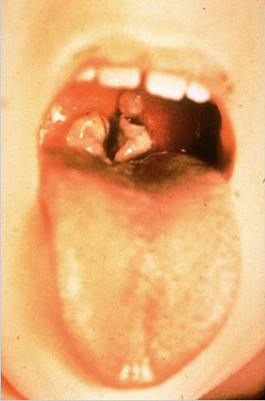
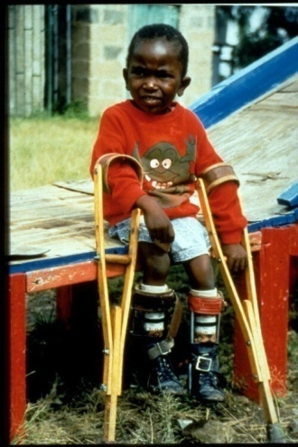
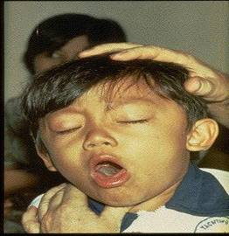
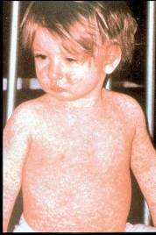
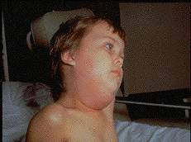
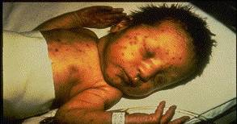
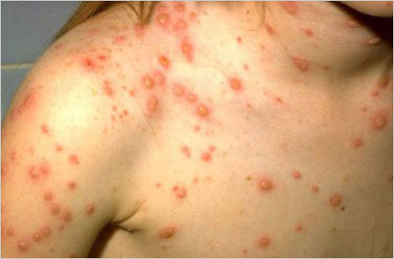
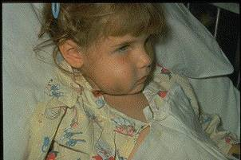
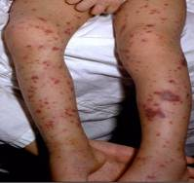
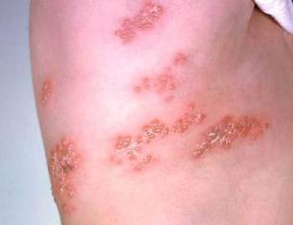
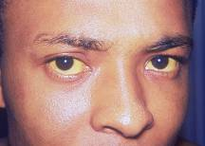
Why Do We Immunize?
We Immunize To Prevent These Diseases
Notes:
Why do we immunize? These pictures represent the vaccine preventable diseases that we immunize to prevent.
We know that it is probably unrealistic to believe we can immunize everyone appropriately. We also know that there will always be young infants who have not received all recommended vaccines because of their age and a significant number of adults who are not adequately immunized. Herd immunity is the term most frequently used that refers to a situation in which a high percentage of a population is immune to a disease, essentially stopping the disease in its tracks because it cannot find new hosts. This chart illustrates the vaccination rate needed for each of the VPDs listed. For example, because measles is extremely contagious and can spread through the air, the immunity threshold needed to protect a community is high. The vaccination rate needed for measles is around 92-94%.
The threshold for herd immunity varies, depending on the disease, with more virulent infectious agents requiring vaccination of a higher percentage of the population to create the desired community immunity. The creation of herd immunity is especially important in crowded environments which facilitate the spread of disease, like schools. It is also extremely important to receive regular boosters, as some vaccines lose their efficacy over time, leaving people vulnerable to an outbreak. Herd immunity led to the eradication of smallpox, and it explains why diseases such as polio and diphtheria are rare in developed nations with established vaccination policies.
According to the 2015 National Immunization Study, coverage for childhood vaccines remains high.
-The majority of parents are vaccinating their young children against potentially serious diseases.
-The percentage of children who receive no vaccinations remains low, less than 1% (0.8%).
-Nationally, there were no significant changes in vaccination coverage among children 19-35 months of age for routinely recommended childhood vaccinations in 2015.*
-Vaccination coverage remained over 90% for measles, mumps, rubella (MMR), poliovirus, hepatitis B, and varicella.
If we look at the coverage rate for children 19-35 months for:
•Measles, mumps and rubella vaccine (MMR) (1 or more doses) was 92%; and specifically for Georgia the rate is at 94.2%
•Polio vaccine series (3 or more doses) was 94%
•Hepatitis B vaccine series (3 or more doses) was 93%
•Varicella vaccine ( 1 or more doses) was 92%

Slide 6
The Impact of Vaccines
Disease | Average Annual Reported Cases Pre-vaccine* | Cases in U.S. 2014** | Provisional Cases in U.S. 2015** | Provisional % Reduction In U.S. 2015
Smallpox | 48,164 | Eradicated worldwide in 1980
Diphtheria | 175,885 | 1 | 0 | 100%
Measles | 503,282 | 667 | 189 | >99.9%
Mumps | 152,209 | 1,196 | 1,057 | 99.3%
Pertussis | 147,271 | 32,118 | 18,166 | 87.7%
Polio (paralytic) | 16,316 | 0 | 0 | 100%
Rubella | 47,745 | 6 | 5 | >99.9%
Congenital Rubella Syndrome | 823 | 1 | 1 | >99.9%
Tetanus | 1,314 | 23 | 25 | 98.1%
H. Influenzae Type b Age<5 years | 20,000 | 40 | 23 | 99.9%
*MMWR 48(12);243-248 April 2, 1999
**MMWR 64(52), ND-923-ND-940, January 8, 2016
Notes:
This table shows the impact of vaccines on the annual reported cases of some vaccine preventable diseases in the United States.
Column 2 shows the average number of reported cases of a specific disease prior to the licensure of the vaccine.
Column 3 shows the number of reported cases in the United States in 2014.
Column 4 shows the provisional number of reported cases in the U.S in 2015.
Column 5 shows the percentage decrease in reported cases in the United States based on the provisional number of reported cases in 2015 compared with the pre-vaccine years.
*** If we look at the highlighted rows, over the past couple of years we have seen a spike in measles and mumps cases in the U.S. On January 10, 2017, DPH released a mumps advisory for colleges and universities signed by Dr. Fitzgerald outlining the high number of mumps cases reported to the CDC in 2016 (5, 311), noting the highest number of cases since 2006. Many cases were associated with outbreaks in college/university settings. At this time, a small number of mumps cases have been identified on college/university campuses in Georgia.
Reference:
Achievements in Public Health, 1900-1999 Impact of Vaccines Universally Recommended for Children - United States, 1990-1998 MMWR April 02, 1999 / 48(12);243-248
MMWR 63(53);733-746, January 9, 2015
MMWR 64(52);ND-923-ND-940, January 8, 2016

Slide 7
Proper Vaccine Administration
Key to ensuring vaccination is as safe and effective as possible, incorporate:
Professional standards for medication administration
Manufacturer’s vaccine-specific guidelines
Evidence-based safe injection practices
Notes:
Proper vaccine administration is a critical component of a successful immunization program. It is a key part of ensuring that vaccination is as safe and effective as possible.
The Key to ensuring vaccination is as safe and effective as possible, providers must incorporate:
◦professional standards for medication administration
◦manufacturer’s vaccine-specific guidelines
◦evidence-based safe injection practices which can be located on the CDC website; the CDC’s Injection Safety Information for Providers webpage

Slide 8
Staff Training and Education
Before administering vaccines, all personnel who administer vaccines should:
receive competency-based training
validate knowledge and skills
Integrate training into:
new staff orientation
annual education requirements
when vaccine administration recommendations are updated
when new vaccines are added to the inventory
Notes:
Improper administration of vaccines may result in injuries or prevent the vaccines from providing optimal protection. All personnel who will administer vaccines should receive comprehensive, competency-based training regarding vaccine administration policies and procedures before administering vaccines. Providers need to validate staff’s knowledge and skills regarding vaccine administration with a skills checklist.
Competency-based training should be integrated into existing staff education programs such as new staff orientation and annual education requirements. Staff should receive ongoing education, such as whenever vaccine administration recommendations are updated, or when new vaccines are added to the facility’s inventory, to maintain staff competency. Accountability checks should be put in place to ensure policies and procedures are followed. Trainings should also be offered to temporary personnel who may be filling in on days when the facility is short staffed or helping during peak times such as flu season.
You can obtain templates for “Skills Checklist for Immunization” at www.eziz.org/assets/docs/IMM-694.pdf).
http://www.immunize.org/handouts/administering-vaccines.asp

Slide 9
Communication
•Consider patient’s age and stage of development
•Encourage participation of parent/guardian and patient
•Use simple strategies to ease vaccination process
positive attitude
soft, calm voice
eye contact
explain why the vaccine is needed
honest about what to expect
Notes:
Vaccine safety concerns and the need for multiple injections have increased anxiety associated with immunizations for patients, parents and health-care personnel. Health-care providers need to display confidence and establish an environment that promotes a sense of security and trust. Everyone involved should work to provide immunizations in the safest and least stressful way possible. Simple strategies that can be used by both parents and providers to make receiving vaccines easier include:
•Displaying a positive attitude through facial expressions, body language, and comments
•Using a soft and calm tone of voice
•Making eye contact, even with small children
•Explaining why vaccines are needed (e.g., “this medicine will protect you from getting sick” or “this shot is a shield to protect your body against infection”)
•Being honest and explaining what to expect (e.g., do not say that “the injection won’t hurt”)

Slide 10
Positioning and Comforting
•Encourage parent/guardian to hold child
•Sitting, rather than lying down
•Be aware of syncope (fainting)
have patient seated or lying down during vaccination
be aware of symptoms that precede syncope
if patient faints, provide supportive care and protect patient from injury
observe patient (seated or lying down) for at least 15 minutes after vaccination
Notes:
When determining patient positioning and restraint, consider the patient’s comfort, safety, age, activity level, and the site of administration. Parent participation has been shown to increase the child’s comfort. When vaccines are being administered to infants and small children, the parent/guardian should be encouraged to hold the child during administration. The parent/guardian should be instructed on how to help the child stay still so the vaccine can be administered safely. If the parent is uncomfortable, another person may assist or the patient may be positioned safely.
Research supports the belief that children are less fearful and experience less pain when receiving an injection if they are sitting up rather than lying down. The exact mechanism behind this phenomenon is unknown; it may be that the child’s anxiety level is reduced, which in turn reduces the child’s perception of pain. Parents should be instructed to hold infants and children in a position comfortable for the child and parent, in which one or more limbs are exposed for injections. All providers who administer vaccines to older children, adolescents, and adults should be aware of the potential for syncope (fainting) after vaccination and the related risk of injury caused by falls. Clinicians should: (1) make sure the person who is being vaccinated is always seated or lying down; (2) be aware of symptoms that precede fainting (e.g. weakness, dizziness, pallor); and (3) provide supportive care and take appropriate measures to prevent injuries if such symptoms occur. The Advisory Committee on Immunization Practices (ACIP) also recommends that providers consider observing the patient (with patient seated or lying down) for 15 minutes after vaccination.

Slide 11
Test Your Knowledge!
What is the term used to describe the fear of “needles”?
Coulrophobia
Ophidiophobia
Trypanophobia
Acrophobia
Notes:
What is the term used to describe the fear of “needles”?
a) Coulrophobia
b) Ophidiophobia
c) Trypanophobia
d) Acrophobia

Slide 12
Test Your Knowledge!
What is the term used to describe the fear of “needles”?
c). Trypanophobia- is the fear of needles, blood draws, or injections, and is often simply called needle phobia
Notes:
Yes. Since there is not a Beyond Use Date (BUD) noted in the package insert, if the vaccine is stored and handled properly and is normal in appearance, it can be used until the expiration date on the vial.

Slide 13
Pain Control
Evidence-based strategies to ease pain:
breastfeeding
sweet tasting solutions
injection technique (aspiration may increase pain)
order of injections (administer most painful vaccine last)
tactile stimulation (rub/stroke near injection site prior to and during injection
distraction
topical anesthetic
Notes:
Concern and anxiety about injections are common for all ages. Fear of injections and needlestick pain are often cited as reasons why children and adults, including health-care personnel, refuse vaccines. Immunizations are the most common source of iatrogenic pain and are administered repeatedly to children throughout infancy, childhood and adolescence. If not addressed, this pain can have long term effects such as pre-procedural anxiety, fear of needles and avoidance of healthcare behaviors through the lifetime. It has been estimated that up to 25% of adults have a fear of needles, with most fears developing in childhood. Decreasing pain associated with immunizations during childhood may help to prevent this distress and future healthcare avoidance behaviors. Pain is a subjective phenomenon influenced by multiple factors, including an individual’s age, anxiety level, previous healthcare experiences, and culture. Although pain from immunizations is, to some extent, unavoidable, there are some things that parents and healthcare providers can do to help when children and adults need vaccines. Evidence-based strategies to ease the pain associated with the injection process include:
Breastfeeding- has been demonstrated as a soothing measure for infants up to 12 months of age receiving injections. Several aspects of breastfeeding are thought to decrease pain, including holding the child, skin-to-skin contact, sweet-tasting milk and the act of sucking.
Sweet tasting solutions- are an analgesic for infants up to 12 months of age
Injection technique (aspiration may increase pain)- A 2007 study from Canada compared infants’ pain response using slow injection, aspiration, and slow withdrawal with another group using rapid injection, no aspiration, and rapid withdrawal. Based on behavioral and visual pain scales, the group that received the vaccine rapidly without aspiration experienced less pain. No adverse events were reported with either injection technique.
Order of injections (administer most painful vaccine last)- Some vaccines are associated with more pain than others. Because procedure pain can increase with each injection, the order the vaccines are administered may effect the overall pain response. Some vaccines cause a painful or stinging sensation when the injecting the vaccine; examples include measles, mumps and rubella (MMR) and human papillomavirus (HPV) vaccines. Injecting the most painful vaccine (e.g., MMR, PCV13, or HPV) last when multiple injections are being administered can decrease the pain associated with the injections.
Tactile stimulation (rub/stroke near injection site prior to and during injection- Rubbing or stroking the skin near the injection site prior to and during the injection process with moderate intensity may decrease pain in older children (4 years and older) and adults. The mechanism for this is thought to be that the sensation of touch competes with the feeling of pain from the injection, and thereby results in less pain.
Distraction- is defined as using tactics which are intended to take the patient’s attention away from the procedure. Distraction can be led by the provider, child or parent. Certain types of parental behaviors (e.g., nonprocedural talk, suggestions on how to cope, humor) have been related to decreases in children’s distress and pain, whereas others (e.g., reassurances, apologies) have been related to increases in children’s distress and pain. Parents should be encouraged to use distraction methods and instructed in appropriate distraction techniques. Distraction can be accomplished through a variety of techniques (e.g., playing music, books, pretending to blow away the pain, deep breathing techniques).
Topical anesthetic- Topical analgesia may be applied to decrease pain at the injection site. These products (e.g., 5% lidocaine-prilocaine emulsion) should be used only for the ages recommended and as directed by the product manufacturer. Parents should be educated in the appropriate use of topical analgesics including the exact site(s) the medication should be applied. These analgesics often need to be applied before (20 to 60 minutes depending on the product) vaccine administration to be effective.
*Antipyretics - An age-appropriate dose of a non-aspirin-containing pain reliever may be considered to decrease discomfort and fever if it should occur after vaccination. ACIP does not recommend the prophylactic use of analgesics before or at the time of vaccination. On Oct. 17, 2009, The Lancet published a study that found that infants who received 3 doses of acetaminophen following immunization had reduced immune responses to certain vaccines. Based on these findings, should we stop recommending acetaminophen for fever or discomfort after infant immunization?
A: Evidence from this study discourages the prophylactic use of paracetamol (acetaminophen) prior to or immediately following vaccination. Acetaminophen can be used to treat pain or fever if it should occur following vaccination. In the upcoming 2010 General Recommendations on Immunization, CDC will remove all recommendations for prophylactic use of acetaminophen or other analgesics BEFORE or AT THE TIME OF vaccination. AAP has already removed such recommendations from the Red Book.

Slide 14
Infection Control
Handwashing
-Critical to prevent the spread of illness and disease
Gloves
-OSHA regulations do not require gloves to be worn when administering
Equipment Disposal
-Used needles should not be recapped, cut or detached from the syringes before disposal
-Filled sharps containers should be disposed of properly
DHR Rule 290-5-60,”Sharps Injury Prevention
Notes:
Healthcare providers should follow Standard Precautions to minimize the risks of spreading disease during the administration of vaccines.
Handwashing - Handwashing is critical to prevent the spread of illness and disease. Hands should be washed thoroughly with soap and water or cleansed with an alcohol-based waterless antiseptic before vaccine preparation, between patients, and any time hands become soiled, e.g. diapering or cleansing excreta.
Gloves - Occupational Safety and Health Administration (OSHA) regulations do not require gloves to be worn when administering vaccines unless the person administering the vaccine is likely to come into contact with potentially infectious body fluids or has open lesions on the hands. If gloves are worn, they should be changed between patients. Gloves will not prevent needle stick injuries. Any needle stick injury should be reported immediately to the site supervisor, with appropriate care and follow-up given as directed by local/state guidelines.
Equipment Disposal - Used needles should NOT be recapped, cut, or detached from the syringes before disposal. All used syringe/needle devices should be placed in puncture proof containers to prevent accidental needle sticks and reuse. Empty or expired vaccine vials are considered medical waste and should be disposed of according to state regulations. Discard syringe and needle in a puncture proof sharps container.
Filled sharps containers should be disposed of properly; never dispose of sharps containers or empty vaccine vials at an outreach site.
DHR Rule 290-5-60,”Sharps Injury Prevention”

Slide 15
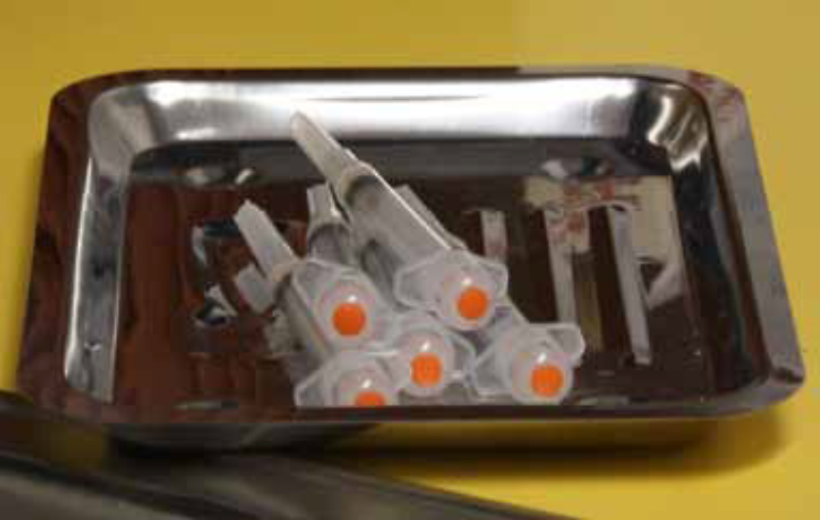
Vaccine Preparation
Syringe/Needle Selection
Inspecting Vaccine
Reconstitution
Filling Syringes
Diluent + Lyophilized Powder = Reconstituted Vaccine
Notes:
Proper vaccine handling and preparation is critical in maintaining the integrity of the vaccine during transfer from the manufacturer’s vial to the syringe and ultimately to the patient. Vaccines should be drawn up in a designated clean medication area that is not adjacent to areas where potentially contaminated items are placed. Multidose vials to be used for more than one patient should not be kept or accessed in the immediate patient treatment area. This is to prevent inadvertent contamination of the vial through direct or indirect contact with potentially contaminated surfaces or equipment that could then lead to infections in subsequent patients. If a multidose vial enters the immediate patient treatment area, it should be discarded after use.
Equipment Selection
-Syringe Selection/Needle Selection -A separate needle and syringe should be used for each injection. A parenteral vaccine may be delivered in either a 1-mL or 3-mL syringe as long as the prescribed dosage is delivered. OSHA requires that safety-engineered injection devices (e.g., needle-shielding syringes or needle-free injectors) be used for injectable vaccination in all clinical settings to reduce risk for injury and disease transmission. Personnel who will be using these products should be involved in evaluation and selection of these products and should receive training with these devices before using them in the clinical area. Some syringes and needles are packaged with an expiration date. This can be a consideration when ordering injection supplies. Never administer medications from the same syringe to more than one patient, even if the needle is changed. Typically, vaccines are not highly viscous so a fine gauge needle (22- to 25-gauge) can be used
Inspecting Vaccine - Each vaccine and diluent vial should be carefully inspected for damage or contamination prior to use. The expiration date printed on the vial or box should be checked. Expired vaccine or diluent should never be used.
Reconstitution - Vaccines should be reconstituted according to manufacturer guidelines using only the specific diluent supplied by the manufacturer for that vaccine. If the wrong diluent is used, the vaccine dose is not valid and will need to be repeated using the correct diluent. Reconstitute vaccine just before using. Use all of the diluent supplied for a single dose and then draw up all of the vaccine after it is thoroughly reconstituted. Once reconstituted, the vaccine must be either administered within the time guidelines specified in the manufacturer’s product information or discarded. Changing the needle between drawing vaccine from the vial and administering the vaccine is not necessary unless the needle is contaminated or damaged.
Beyond Use Date (BUD)
Some vaccines should be used within a certain time frame after the first time a needle is inserted into a multidose vial (commonly referred to as “entering” the vial.) For other vaccines, this time frame is based on the date/time the vaccine was reconstituted. This time frame is called the “beyond use date” or BUD. The BUD is the date or time after which the vaccine should not be used. It may not be the same as the expiration date printed on the vial by the manufacturer. The BUD varies among vaccines and can be found in the package insert. Check the package insert to determine if the vaccine has a BUD and for the correct time frame (e.g., days, hours) the vaccine can be stored once the vial has been entered or has been reconstituted. Calculate the beyond use date using the time interval found in the vaccine’s package insert. Label the vaccine with the correct beyond use date/time and your initials. If the reconstituted vaccine is not used immediately, write the BUD and your initials on the label and store it properly.
• Filling Syringes - Agitate (shake) the vial to mix the vaccine thoroughly and obtain a uniform suspension prior to withdrawing each dose. Whenever solution and container permit, inspect vaccine visually for particulate matter and/or discoloration prior to administration. If problems are noted (e.g., vaccine cannot be re-suspended), the vaccine should not be administered. Standard medication preparation guidelines should be followed for drawing a dose of vaccine into a syringe. A vaccine dose should not be drawn into the syringe until it is to be administered. Sometimes providers pre-fill many syringes themselves. This practice is strongly discouraged by CDC. Instilling air into a multi-dose vial prior to withdrawing a vaccine dose may not be necessary. It could cause a “spritz” of vaccine to be lost each time the air is injected, which through time can decrease the amount of vaccine in the vial and lead to the loss of a dose (e.g., obtaining only 9 full doses from a 10-dose vial).
Pink Book Appendix D

Slide 16
Test Your Knowledge!
The manufacturer does not specify when IPV expires after opening the multi-dose vial. Is it okay to use the vaccine until the expiration date on the vial if properly handled and not contaminated?
Notes:
The manufacturer does not specify when IPV expires after opening the multi-dose vial. Is it okay to use the vaccine until the expiration date on the vial if properly handed and not contaminated?

Slide 17
Test Your Knowledge!
The manufacturer does not specify when IPV expires after opening the multi-dose vial. Is it okay to use the vaccine until the expiration date on the vial if properly handled and not contaminated?
Yes. Since there is not a Beyond Use Date (BUD) noted in the package insert, if the vaccine is stored and handled properly and is normal in appearance, it can be used until the expiration date on the vial.
Notes:
Yes. Since there is not a Beyond Use Date (BUD) noted in the package insert, if the vaccine is stored and handled properly and is normal in appearance, it can be used until the expiration date on the vial.

Slide 18

Route and Site
Vaccine Preparation “Nevers”
•Never combine vaccines into a single syringe except when specifically approved by the FDA and packaged for that specific purpose
•Never transfer vaccine from one syringe to another
•Never draw partial doses of vaccine from separate vials to obtain a full dose
Notes:
The recommended route and site for each vaccine are based on clinical trials, practical experience and theoretical considerations. This information is included in the manufacturer’s product information for each vaccine. There are five routes used to administer vaccines. Deviation from the recommended route may reduce vaccine efficacy or increase local adverse reactions.
Vaccine Preparation “Nevers”
•Never combine vaccines into a single syringe except when specifically approved by the FDA and packaged for that specific purpose
•Never transfer vaccine from one syringe to another
•Never draw partial doses of vaccine from separate vials to obtain a full dose
It is important to administer vaccines correctly to:
Insure optimal vaccine efficacy
Decreased Localized and Systemic reaction
Decreased Pain

Slide 19
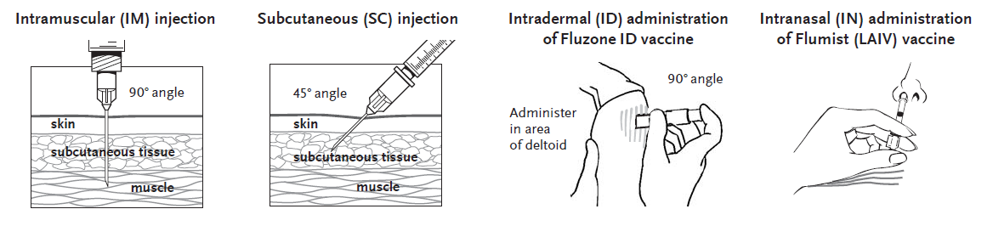
Routes of Administration
Notes:
It is important to inset the needle at the appropriate angle to insure delivery to the muscle or subcutaneous tissue.
IM: The angle of the needle is perpendicular to the skin, generally, though one can use a 45 degree angle if it is a certain muscle being reached. Introduce the needle with a quick thrust. Retain pressure on the skin around the injection site with the thumb and index fingers of the other hand for the entire time the needle is being inserted.
SC: The angle of the needle insertion is 45 degrees to the skin. Pinching up a bit of the subcutaneous tissue with the other hand may help prevent inadvertent IM injection.
ID: The syringe should be gently shaken before the needle cap is removed. Hold the syringe between the thumb and the middle finger. Using a short quick motion insert the needle perpendicular to the skin into the deltoid region of the upper arm. Push on the plunger with the index finger without aspirating. Because the needle is very short the vaccine will be delivered just under the skin into the dermal layer. This vaccine should NOT be administered into the volar aspect of the forearm or by the intradermal technique used to administer a tuberculin skin test.
Oral (PO) Route - Rotavirus vaccines (RV1/Rotarix, RV5/RotaTeq) and oral typhoid (TY21a/Vivotif) are the only U.S.-licensed vaccines that are administered by the oral route. RV1/Rotarix requires reconstitution prior to oral administration. Oral vaccines should generally be administered prior to administering injections or performing other procedures that might cause discomfort. Administer the liquid slowly down one side of the inside of the cheek (between the cheek and gum) toward the back of the infant’s mouth. Care should be taken not to go far enough back to initiate the gag reflex. Never administer or spray (squirt) the vaccine directly into the throat.

Slide 20
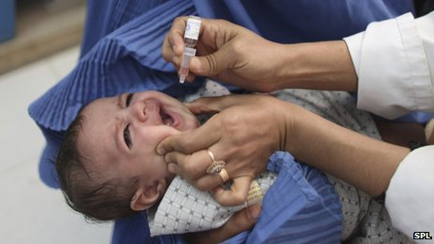
Oral (PO) Route
-Administer prior to injections
-Administer slowly
-Careful not to initiate gag reflex
-Never administer or squirt directly into the throat
Notes:
• Oral (PO) Route - Rotavirus vaccines (RV1/Rotarix, RV5/RotaTeq) and oral typhoid (TY21a/Vivotif) are the only U.S.-licensed vaccines that are administered by the oral route. RV1/Rotarix requires reconstitution prior to oral administration. Oral vaccines should generally be administered prior to administering injections or performing other procedures that might cause discomfort. Administer the liquid slowly down one side of the inside of the cheek (between the cheek and gum) toward the back of the infant’s mouth. Care should be taken not to go far enough back to initiate the gag reflex. Never administer or spray (squirt) the vaccine directly into the throat.
ACIP does not recommend re-administering a dose of rotavirus vaccine to an infant who regurgitates, spits out, or vomits during or after administration. No data exist on the benefits or risks associated with re-administering a dose. The infant should receive the remaining recommended doses of rotavirus vaccine following the routine schedule (with a 4-week minimum interval between doses). There are no restrictions on the infant’s consumption of breast milk or any other liquid before or after administration of either of these vaccines.

Slide 21
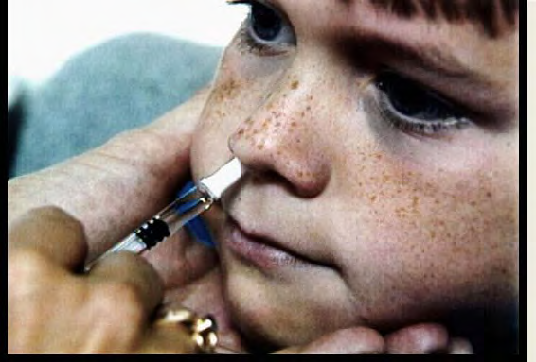
Intranasal (IN) Route
-LAIV, FluMist
-Seated upright position with head tilted back
-Breathe normally
-Tip of sprayer inserted slightly in naris
-Do Not repeat if patient coughs, sneezes, or expels dose
Notes:
• Intranasal Route -The live attenuated influenza vaccine (LAIV, FluMist) is currently the only vaccine administered by the nasal route
The patient should be seated in an upright position with head tilted back. Instruct the patient to breathe normally. The provider should gently place a hand behind the patient’s head. The tip of the nasal sprayer should be inserted slightly into the naris. Half of the contents of the sprayer (0.1 mL) are sprayed into the nostril; the dose-divider clip is then removed and the procedure is repeated in the other nostril.
The dose does not need to be repeated if the patient coughs, sneezes, or expels the dose in any other way.

Slide 22
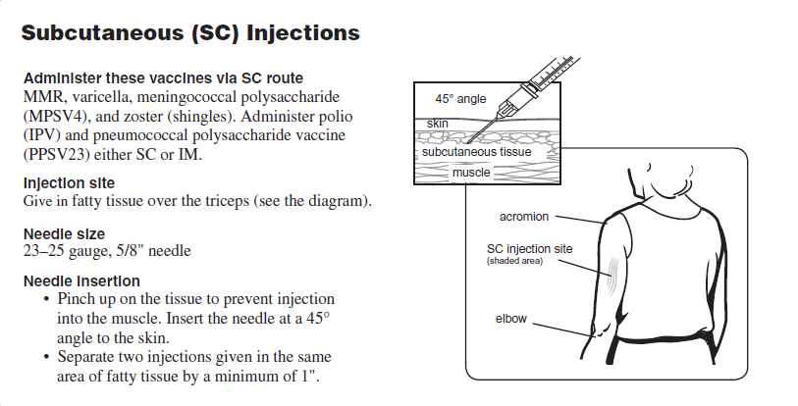
SC Injections
Notes:
Make copy for handouts
SC: Needle should be short enough and must be inserted at a 45 degree angle to avoid the muscle. (5/8” ; 23-25 gauge)
Infants- should use the anterolateral aspect of the thigh
Toddlers, children and adults- use outer aspect of upper arm. May also use fatty area of anterolateral thigh for toddlers.
Pinching up a bit of the subcutaneous tissue with the other hand may help prevent inadvertent IM injection.
Vaccines administered SC:
MMR
MMRV
IPV (inactivated polio)
Pneumococcal (polysaccharide); can also be administered IM
Varicella
Meningococcal (polysaccharide)
Herpes zoster

Slide 23
Vaccines Administered SC
Notes:
MMR, MMRV, IPV(inactivated polio), Pneumococcal (polysaccharide), Varicella, Meningococcal (polysaccharide), Herpes zoster
AGE: Infants (birth-12 months) administer in fatty tissue over the anterolateral thigh muscle using a 5/8” needle 23-25 gauge; for children 12 mos.-older administer in fatty tissue over the anterolateral thigh or fatty tissue over triceps (upper arm) using a 5/8” needle 23-25 gauge.

Slide 24
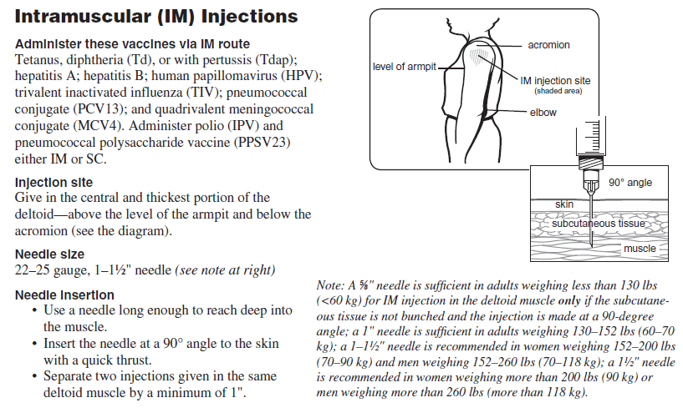
IM Injections
Notes:
Make copy for handouts
Two routinely recommended IM sites: Anterolateral thigh and deltoid; Injection at these sites reduces the chance of involving neural or vascular structures. The site depends on the age of the individual and the degree of muscle development. Because there are no large blood vessels in the recommended sites, aspiration before injection of vaccines is not necessary. The muscles of the buttock are not used for administration of vaccines in infants and children because of concern about potential injury to the sciatic nerve, which is well documented after injection of antimicrobial agents into the buttock. If the gluteal muscle must be used, care should be taken to define the anatomic landmarks.
IM: The angle of the needle is perpendicular to the skin. Introduce the needle with a quick thrust. Retain pressure on the skin around the injection site with the thumb and index fingers of the other hand for the entire time the needle is being inserted.
IM Vaccines:
DTaP, DT, Tdap, and Td ; Hepatitis A and B; Hib ; Influenza; IPV; Pneumococcal (polysaccharide); Pneumococcal (conjugate);Meningococcal (conjugate); Human Papillomavirus (HPV)

Slide 25
Vaccines Administered IM
Notes:
What sites are appropriate for infants? Vastus Lateralis in the anterolateral aspect of the middle or upper thigh, needs to be used for infants and may be used for children up to three years of age or older. For infants under 1 month of age, you might use a 5/8” needle (General Recommendations, 12/6/06, Table 7.) but after that, a 1” needle should be used and a 22-25 gauge.
What sites are appropriate for toddlers? By age 12 months, the deltoid may have developed sufficiently to be used. This muscle is shallow and can accommodate only a small volume of fluid. Requires individual decision based on child’s muscle mass. Anterolateral aspect of mid or upper thigh is also acceptable. Both ACIP and the Red Book recommend 1”-1 ¼” for thigh muscle. A 5/8” needle could be used in the deltoid but it would be necessary to evaluate the individual patient. Both resources recommend 22-25 gauge needle
What sites are appropriate for older children, adolescents, and adults?
The deltoid muscle is recommended for routine intramuscular vaccinations. The anterolateral thigh also can be used.
What size needle is appropriate for adolescents and adults?
1-1 ½”, 20-25 gauge
With hepatitis B vaccine, it is important to always use longer size to reach the muscle.
Do not use gluteus muscle for any vaccine except IG.
Needle length can also depend on whether the tissue at the injection site is stretched flat or bunched. For further details, please see the ACIP statement, General Recommendations, MMWR 12/1/06, Vol. 55, No. RR-13.

Slide 26
SIRVA
Shoulder Injury Related to Vaccine Administration
Incorrect injection technique
Antigen into tissues and structures
Severe, persistent shoulder pain and prolonged restriction of function
Symptoms develop within 24 to 48 hours of vaccination
Notes:
Incorrect injection technique can result in serious shoulder injuries called SIRVA (shoulder injury related to vaccine administration), rare but can occur with incorrect injection technique. SIRVA is thought to occur as a result of unintentional injection of a vaccine antigen into tissues and structures underlying the deltoid muscle or trauma from the needle into and around the underlying bursa. After a vaccine some patients may experience severe, persistent shoulder pain and prolonged restriction of function, which are thought to occur as a result of an inflammatory reaction. Most patients develop symptoms within 24 to 48 hours of vaccination. When presenting to their provider, patients may be diagnosed with deltoid bursitis, or other conditions, such as tendonitis, rotator cuff tear, frozen shoulder, impingement syndrome, adhesive capsulitis, and shoulder bursitis.
It is recommended that both patient and provider be seated to avoid administering too high; administer in the thickest and most central portion of the deltoid. Injections are given to adults in the middle of the deltoid, meatiest part of the muscle, which provides a lot of space to both maximize the immune response and minimize adverse reactions.
Between 2011 and 2014 there were 136 claims to the National Vaccine Injury Compensation Program and 102 claims were awarded compensation for $16 million dollars. SIRVA has be proposed to be added to the program’s list of covered injuries.
http://news.nationalpost.com/health/needle-in-the-wrong-spot-can-turn-injection-into-a-big-pain?__lsa=4eb5-2b72

Slide 27
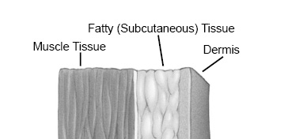
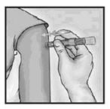
Intradermal (ID) Route
-Fluzone licensed for use in persons 18 through 64 years
-Deltoid region of upper arm used
-Patient seated with arm bent at elbow and hand on hip to ensure proper administration
-Not administered into the volar aspect of the forearm or by the intradermal technique used to administer a tuberculin skin test
Notes:
• Intradermal (ID) Route. Fluzone Intradermal is the only U.S.-licensed vaccine that is administered by the intradermal route. It is approved only for use in persons 18 through 64 years of age. This Fluzone formulation is not the same as intramuscular formulations of inactivated influenza vaccine (IIV). Other IIV formulations should NOT be administered by the intradermal route.
-Site - The site of administration is the deltoid region of the upper arm. The patient should be seated with the arm bent at the elbow and the hand on the hip to ensure that the site of administration is prominent.
-Technique
The syringe should be gently shaken before the needle cap is removed. Hold the syringe between the thumb and the middle finger. Using a short quick motion insert the needle perpendicular to the skin into the deltoid region of the upper arm. Push on the plunger with the index finger without aspirating. Because the needle is very short the vaccine will be delivered just under the skin into the dermal layer. This vaccine should NOT be administered into the volar aspect of the forearm or by the intradermal technique used to administer a tuberculin skin test.
Intradermal (ID)
PPD (¼ - ¾”) Volar surface 25-27 gauge of forearm
Fluzone (ID)18-64Yrs; Deltoid area

Slide 28
Multiple Vaccines
Administer each vaccine at different anatomic site
Use anterolateral thigh for infants and young children
Use deltoid for older children and adults if muscle adequate
Separate injections by at least 1 inch
Use separate limb for most reactive vaccines (tetanus toxoid-containing and PCV13) if possible
Use combination vaccines when appropriate
Notes:
Administer each vaccine at a different anatomic site
Use anterolateral thigh for infants and young children
Use deltoid for older children and adults if muscle mass is adequate
Separate injections by at least 1 inch, or more if possible
Use a separate limb for most reactive vaccines (e.g., tetanus toxoid-containing and PCV13), if possible
Use combination vaccines when appropriate to reduce the number of injections

Slide 29
Test Your Knowledge!
Are there any guidelines on how many vaccines can be administered at one time?
Notes:
Are there any guidelines on how many vaccines can be administered at one time?

Slide 30
Test Your Knowledge!
Are there any guidelines on how many vaccines can be administered at one time?
There are no limits, which means that as many as nine vaccines could be administered at one visit. This would be in a circumstance where many doses have been missed previously. In this circumstance, one useful method to decrease the number of injections is the choice of combination vaccines, which combine antigens in one injection.
Notes:
There are no limits, which means that as many as nine vaccines could be administered at one visit. This would be in a circumstance where many doses have been missed previously. In this circumstance, one useful method to decrease the number of injections is the choice of combination vaccines, which combine antigens in one injection.

Slide 31
Bleeding Disorders
May develop hematomas in (IM) injection sites
Administer by recommended (IM) route if can be safely administered
Instruct about risk of hematoma
Schedule shortly after antihemophilia or similar therapy
Use 23-guage or finer needle
Apply firm pressure to site at least 2 minutes
Do NOT rub or massage injection site
Notes:
Individuals with bleeding disorder or receiving anticoagulant therapy may develop hematomas in IM injection sites
Administer vaccines by recommended IM route IF physician familiar with patient’s bleeding risk determines vaccine can be safely administered
Prior to vaccination, instruct about risk of hematoma
Schedule shortly after antihemophelia or similar therapy
Use 23-gauge or finer needle and apply firm pressure to injection site for at least 2 minutes after injection
Do NOT rub or massage injection site

Slide 32
Non-Standard Administration
Revaccination is recommended if:
Hep B vaccine administered by any route other than (IM) or in any site of an adult other than deltoid or anterolateral thigh
Rabies administered in gluteal site
HPV administered by any route other than (IM)
Less than standard dose/partial dose
Notes:
CDC discourages deviation from recommended route, site, dosage, or number of vaccine doses
Revaccination is recommended if :
hepatitis B vaccine is administered by any route other than IM or in any site of an adult other than deltoid or anterolateral thigh
rabies vaccine is administered in gluteal site
HPV vaccine is administered by any route other than IM
less than the standard dose is administered unless serologic testing indicates an adequate response
if a partial dose of a parenteral vaccine is administered because the syringe or needle leaks or the patient jerks away

Slide 33
Managing Acute Vaccine Reactions
Thorough screening for contraindications and precautions
Procedures in place for managing reaction
Be familiar with the signs & symptoms of anaphylaxis
Know staff role in the event of an emergency
CPR certified
Emergency cart & equipment available
Notes:
Managing Acute Vaccine Reactions - Severe, life-threatening anaphylactic reactions following vaccination are rare. Thorough screening for contraindications and precautions prior to vaccination can often prevent reactions. Staff must have in place and be familiar with procedures for managing a reaction. Staff should be familiar with the signs and symptoms of anaphylaxis because they usually begin within minutes of vaccination. These signs and symptoms can include, but are not limited to: flushing, facial edema, urticaria, itching, swelling of the mouth or throat, wheezing, and difficulty breathing. Each staff member should know their role in the event of an emergency and all vaccination providers should be certified in cardiopulmonary resuscitation (CPR). Epinephrine and equipment for maintaining an airway should be available for immediate use. Additional drugs may also be used (see ACIP General Recommendations, Table 8 for more detailed information). After the patient is stabilized, arrangements should be made for immediate transfer to an emergency facility for additional evaluation and treatment. (See “Medical Management of Vaccine Reactions in Children and Teens” at http://www.immunize.org/catg.d/p3082a.pdf and “Medical Management of Vaccine Reactions in Adult Patients” at http://www.immunize.org/catg.d/p3082.pdf.

Slide 34
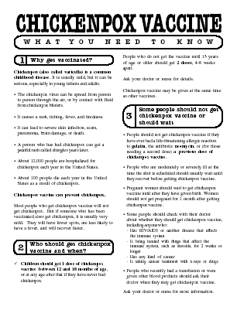
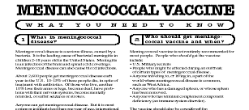
Always Document…
Accept only written documentation of prior immunizations
After vaccine administration, document:
Publication date of VIS & date VIS given
Date, site, route, antigen(s), manufacturer, lot #
Person administering vaccine, practice name and address
Vaccine refusals with a signed “Refusal to Vaccinate Form”
GA law does not require signed consent for immunizations
Notes:
34
Required for vaccines covered by National Childhood Vaccine Injury Act
date of administration, vaccine manufacturer, vaccine lot number, name and title of person who administered, vaccine and address of facility where permanent record will reside, vaccine information statement (VIS), date on VIS
date provided to patient or parent/guardian
Best practice documentation
vaccine type (ACIP abbreviation), route, dosage (volume), site, Document vaccine refusal, Immunization Information System (IIS)/ Registry, Confidential, population-based, computerized database, All providers are encouraged to use IIS/registry, Some state IIS utilize barcoding technology, 2D barcodes on some vaccine vials and VISs

Slide 35
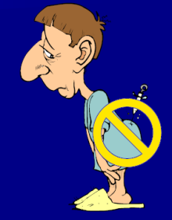
The 7 Rights of Vaccine Administration
Right Patient
Right Vaccine or Diluent
Right Time*
Right Dosage
Right Route, Needle Length, Technique
Right Site for route indicated
Right Documentation
* Correct age, appropriate interval, and administer before vaccine or diluent expires
Ref: Epidemiology and Prevention of Vaccine-Preventable Diseases. 12th Edition, May 2012.
Notes:
35
Be sure to check package insert for correct route, correct sites for the route and correct needle length.
Much of this information is available in the ACIP General Recommendations document.
*Make a chart of this information for use in your office*. Or have a VACS FACS available in your office.
Ref: General Recommendations on Immunization MWR 2011; 60 (No. RR-2) Jan 28, 2011

Slide 36
Avoiding Vaccine Errors
When possible, involve staff in selection of vaccine products
Keep current reference materials on each vaccine
Rotate vaccines
Consider the potential for product mix-up
Triple Check Your work
Notes:
Strategies to Prevent Administration Errors
Vaccine administration errors can result in a patient receiving an ineffective immunization. This can leave the person vulnerable to infection. Vaccine administration errors may also diminish patient confidence in their healthcare providers. Common vaccine administration errors include. In addition to strict adherence to the “Rights of Medication Administration” and ongoing training and education of staff, listed below are other strategies that can be implemented to help prevent administration errors:
--When possible, involve staff in the selection of vaccine products to be used in your facility. Different brands of the same vaccine can have different schedules, age indications, or other indications. Stocking multiple brands might lead to staff confusion and vaccine administration errors.
--Keep current reference materials available for staff on each vaccine used in your facility. Keep reference sheets for timing and spacing, recommended sites, routes, and needle lengths posted for easy reference in your medication preparation area.
--Rotate vaccines so that those with the shortest expiration dates are in the front of the storage unit. Use these first and frequently check the storage unit to remove any expired vaccine.
--Consider the potential for product mix-ups when storing vaccines. Do not store sound-alike and look-alike vaccines next to each other (e.g., DTaP and Tdap). Consider color coding labels on vaccine storage containers and/or including the vaccine type and age indications.
Administer only vaccines that you have prepared for administration.
--Triple check your work before you administer a vaccine and ask other staff to do the same.
Counsel parents and patients about vaccines to be administered and on how important it is for them to maintain immunization records on all family members. Educated clients may notice a potential error and help prevent it.

Slide 37
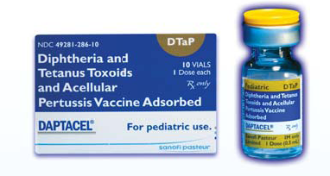
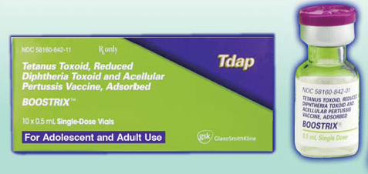
Avoiding Vaccine Errors
DTaP
Tdap
Notes:
Consider the potential for product mix-ups when storing vaccines. Do not store sound-alike and look-alike vaccines next to each other (e.g., DTaP and Tdap). Consider color coding labels on vaccine storage containers and/or including the vaccine type and age indications.

Slide 38
Test Your Knowledge!
Four month old Lucas was given Tdap instead of DTaP.
What should be done?

Slide 39
Test Your Knowledge!
Four month old Lucas was given Tdap instead of DTaP.
What should be done?
If Tdap was inadvertently given to a child under age 7 years, it should not be counted as either the first, second, or third dose of DTaP. The dose should be repeated with DTaP. Continue vaccinating on schedule. If the dose of Tdap was administered for the fourth or fifth DTaP dose, the Tdap dose can be counted as valid. Please remind your staff to always check the vaccine vial at least 3 times before administering any vaccine.
IAC Ask the Experts - Reviewed July 2014
Notes:
If Tdap was inadvertently given to a child under age 7 years, it should not be counted as either the first, second, or third dose of DTaP. The dose should be repeated with DTaP. Continue vaccinating on schedule. If the dose of Tdap was administered for the fourth or fifth DTaP dose, the Tdap dose can be counted as valid. Please remind your staff to always check the vaccine vial at least 3 times before administering any vaccine.

Slide 40
Test Your Knowledge!
Lillian, a 50 year old grandmother, was given DTaP instead of Tdap.
Does she need to receive one dose of Tdap?

Slide 41
Test Your Knowledge!
Lillian, a 50 year old grandmother, was given DTaP instead of Tdap.
Does she need to receive one dose of Tdap?
Lillian received the appropriate amount of tetanus toxoid and MORE diphtheria toxoid and pertussis antigen than is recommended. Count the dose as Tdap. The patient does not need a repeat dose of Tdap.
Take measures to prevent this error in the future.
IAC Ask the Experts - Reviewed July 2014
Notes:
Lillian received the appropriate amount of tetanus toxoid and MORE diphtheria toxoid and pertussis antigen than is recommended. Count the dose as Tdap. The patient does not need a repeat dose of Tdap.
Take measures to prevent this error in the future.

Slide 42
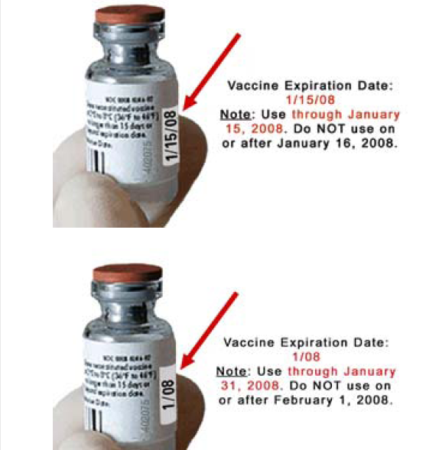
Check Expiration Dates
Notes:
Rotate vaccines so that those with the shortest expiration dates are in the front of the storage unit. Use these first and frequently check the storage unit to remove any expired vaccine.

Slide 43
Five-year-old Tonia received her second MMR a week ago. How long should she wait before receiving live attenuated influenza vaccine (LAIV)?
Test Your Knowledge!

Slide 44
Five-year-old Tonia received her second MMR a week ago. How long should she wait before receiving live attenuated influenza vaccine (LAIV)?
Test Your Knowledge!
LAIV can be administered simultaneously with another live vaccine (for example, MMR, varicella), but if not given at the same time, ACIP recommends waiting four weeks before administering the second live vaccine.
IAC Ask the Experts - Reviewed January 2014

Slide 45
Vaccine Injury Compensation Program (VICP)
National Vaccine Injury Compensation Program provides compensation to individuals found to be injured by or have died from certain childhood vaccines.
Established in 1988 by NCVIA
Federal “no fault” system to compensate those injured
Claim must be filed by individual, parent or guardian
Must show that injury is on “Vaccine Injury Table”
Notes:
On October 1, 1988, the National Childhood Vaccine Injury Act of 1986 created the National Vaccine Injury Compensation Program (VICP). The VICP was established to ensure an adequate supply of vaccines, stabilize vaccine costs, and establish and maintain an accessible and efficient forum for individuals found to be injured by certain vaccines. The VICP is a no-fault alternative to the traditional public legal system for resolving vaccine injury claims that provides compensation to people found to be injured by certain vaccines.
The National Childhood Vaccine Injury Act (NCVIA) set forth 3 basic requirements for all vaccination providers, which are:
Providers must give the patient (or parent/legal representative of a minor) a copy of the relevant federal "Vaccine Information Statement" (VIS) for the vaccine they are about to receive.
Providers must record certain information about the vaccine(s) administered in the patient's medical record or a permanent office log.
Providers must document any adverse event following the vaccination that the patient experiences and that becomes known to the provider, whether or not it is felt to be caused by the vaccine, and submit the report to the Vaccine Adverse Event Reporting System (VAERS).

Slide 46
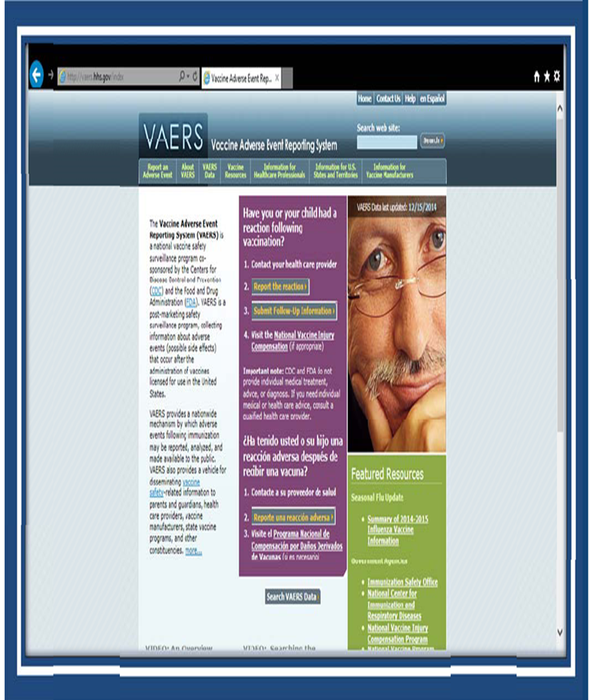
VAERS
What can be reported to VAERS?
Who reports to VAERS?
Does VAERS provide general vaccine information?
Notes:
The Vaccine Adverse Event Reporting System (VAERS) is a national vaccine safety surveillance program co-sponsored by the Centers for Disease Control and Prevention (CDC) and the Food and Drug Administration (FDA). VAERS is a post-marketing safety surveillance program, collecting information about adverse events (possible side effects) that occur after the administration of vaccines licensed for use in the United States. VAERS is also standard #11 for the Standards for child, adolescent and adult immunization practices.
VAERS has demonstrated its public health importance by providing health scientists with signals about possible adverse events following immunization. In one instance, VAERS detected reports for intussusception over that what would be expected to occur by chance alone after the RotaShield rotavirus vaccine in 1999. Epidemiologic studies confirmed an increased risk, and these data contributed to the product's removal from the US market. In another example, VAERS determined that there may be a potential for a small increase in risk for Guillain-Barre' syndrome (GBS) after the meningococcal conjugate vaccine, Menactra. As a result of this finding, a history of GBS became a contraindication to the vaccine and further controlled studies are currently underway to research this issue.
The primary objectives of VAERS are to:
Detect new, unusual, or rare vaccine adverse events;
Monitor increases in known adverse events;
Identify potential patient risk factors for particular types of adverse events;
Identify vaccine lots with increased numbers or types of reported adverse events; and
Assess the safety of newly licensed vaccines.
What Can Be Reported to VAERS?
VAERS encourages the reporting of any clinically significant adverse event that occurs after the administration of any vaccine licensed in the United States.
Who Reports to VAERS?
Anyone can file a VAERS report, including parents, health care providers, manufacturers, and vaccine recipients.
Does VAERS Provide General Vaccine Information?
No. VAERS only collects and analyzes adverse event reports. In another example, VAERS determined that there may be a potential for a small increase in risk for Guillain-Barre syndrome after the meningococcal conjugate vaccine, Menactra. As a result of this finding, a history of Guillain-Barre syndrome became a contraindication to the vaccine and further controlled studies are currently underway to research this issue.

Slide 47

Are YOU up to date? Healthcare Personnel (HCP) Need These Immunizations
Annual influenza vaccine
Tdap or Td
Hepatitis B (exposure risk) Check immunity
Validate immune status of:
Varicella
Measles, Mumps & Rubella(MMR)
Notes:
47
HCP are defined as all paid and unpaid persons working in health-care settings who have the potential for exposure to patients and/or to infectious materials, including body substances, contaminated medical supplies and equipment, contaminated environmental surfaces, or contaminated air. HCP might include (but are not limited to) physicians, nurses, nursing assistants, therapists, technicians, emergency medical service personnel, dental personnel, pharmacists, laboratory personnel, autopsy personnel, students and trainees, contractual staff not employed by the health-care facility, and persons (e.g., clerical, dietary, housekeeping, laundry, security, maintenance, administrative, billing, and volunteers) not directly involved in patient care but potentially exposed to infectious agents that can be transmitted to and from HCP and patients (2).
Hepatitis B vaccine is recommended for health-care personnel with potential exposure to blood or body fluids. The antibody status of these health-care personnel should be checked 1-2 months after the 3rd dose. If a person fails to develop an adequate antibody titer after three doses of vaccine, follow current CDC recommendations for additional doses of hepatitis B vaccine. Some health-care providers may have received three doses of hepatitis B vaccine as children, adolescents or adults but have never had serologic testing to check for immunity. Follow the CDC Guidance for Evaluating Health-Care Personnel for Hepatitis B Virus Protection and for Administering Postexposure Management (Recommendations and Reports / Vol. 62 / No. 10 December 20, 2013)
Un-immunized HCP
Un-immunized healthcare workers are at risk of infecting patients, family members and community contacts
Immunized HCP
Protect patients from VPD’s
Help offices avoid potential liability cases. (The practice can be liable if an unimmunized HCP becomes infected with a vaccine preventable disease and infects a patient.)
Maintain productivity
Reduce illness and illness-related absenteeism
Evidence of Immunity to MMR
Documented administration of two doses of measles and mumps vaccine and one dose of rubella vaccine OR
Laboratory evidence of immunity or laboratory confirmation of disease (measles, mumps and rubella) OR
Born before 1957 (measles, mumps and rubella)
References: 1. General Recommendations on Immunization, Recommendations of the Advisory Committee on Immunization Practices (ACIP). MMWR (RR-2); January 28, 2011
2. Immunization of Health-Care Personnel: Recommendations of ACIP MMWR; November 25, 2011 / 60(RR07);1-45
3. CDC Guidance for Evaluating Health-Care Personnel for Hepatitis B Virus Protection and for Administering Postexposure Management (Recommendations and Reports / Vol. 62 / No. 10 December 20, 2013)

Slide 48


Resources
Local health department
District Immunization Coordinator
GA Immunization Program Office
On call Help line: 404-657-3158
GRITS Help Line:1-866-483-2958
VFC Help Line:1-800-848-3868
Website http://dph.georgia.gov/immunization-section
Your local Immunization Regional Consultant (IRC)
GA Chapter of the AAP
GA Academy of Family Physicians
Notes:
If you need further information about the changes, or to ask questions later, please contact the GA Immunization Office and our partners GA AAP and GA AFP
Your Local health department
District Immunization Coordinator (IPCs)
GA Immunization Program Office
404-657-3158
Website http://health.state.ga.us/programs/immunization
GA Chapter of the AAP
GAFP

Slide 49
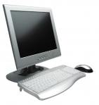
Internet Resources
Georgia Department of Public Health
http://dph.georgia.gov/immunization-section
CDC Immunization information
http://www.cdc.gov/vaccines/
CDC Flu information
http://www.cdc.gov/flu/
Immunization Action Coalition
www.immunize.org

Slide 50
QUESTIONS?

