Slide 1
A Pediatric Guide: Caring for Infants Born to Hepatitis B Infected Mothers
Georgia Pediatric Providers
Tracy Kavanaugh, MS, MCHES Georgia Perinatal Hepatitis B Prevention Program Coordinator
December 11, 2017

Slide 2
Disclosure
We have no financial relationship with pharmaceutical companies, biomedical device manufacturers, or corporations whose products and services are related to the vaccines we discuss.
There is no commercial support for this event.
Mention of specific vaccine brands in this training is for the purpose of providing education and does not constitute endorsement.
The Georgia Immunization Program utilizes the recommendations of the Advisory Committee on Immunization Practices (ACIP) as the basis for this training and our guidelines, policies, and recommendations.

Slide 3
Disclosure Statement
To obtain nursing contact hours for this session, you must be present for the entire hour and complete an evaluation.
Continuing education will be provided through the Georgia Department of Public Health
Georgia Department of Public Health is an approved provider of continuing nursing education by the Alabama State Nurses Association, an accredited approver by the American Nurses Credentialing Center’s Commission of Accreditation

Slide 4
Objectives
At the end of the training, participants will be able to:
Describe the implications of perinatal hepatitis B infection .
Assess infants and children for perinatal hepatitis B exposure
List the recommended immunization schedule for infants exposed to hepatitis B at birth
Identify the laboratory tests included in post-vaccination serologic testing
Collaborate with the Georgia Perinatal Hepatitis B Prevention Program on case management

Slide 5
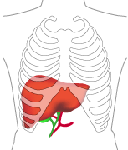
Hepatitis B Infection
Hepatitis B is viral infection that attacks the liver.
Globally
HBV infection affects approximately 240 million people
An estimated 786,000 people worldwide die from HBV-related liver disease each year
United States
An estimated 800,000–1.4 million persons in the United States have chronic HBV infection
Each year about 2,000 to 4,000 people die in the United States from cirrhosis or liver cancer caused by hepatitis B

Slide 6
Hepatitis B Epidemiology
Infectious Agent: | Hepatitis B Virus (HBV)
Incubation Period: | Symptoms begin an average of 90 days (range: 45–160 days) after exposure to HBV
Transmission: | Contact with infected blood or body fluids
Communicability: | Persons who are HBsAg (+) are potentially infectious
Clinical Presentation: | Acute or Chronic Illness

Slide 7
Acute Hepatitis B Infection
Acute hepatitis B virus infection is a short-term illness that occurs within the first 6 months after someone is exposed to the hepatitis B virus. Acute infection can — but does not always — lead to chronic infection.
Symptoms of acute hepatitis B infection:
Nausea | Abdominal pain
Vomiting | Dark urine
Fever | Jaundice
Loss of appetite | Gray-colored stools
Fatigue | Asymptomatic

Slide 8
Acute HBV Infection continued…
Most people with acute disease recover with no lasting liver damage; acute illness is rarely fatal.
1% -2 % acutely infected persons develop fulminant hepatitis
About 200 to 300 Americans die each year

Slide 9
Likelihood of Developing Acute Hepatitis B Symptoms
The likelihood of developing symptoms of acute hepatitis B is age dependent:
Infants less than 1 year of age | Less than 1% have symptoms
1-5 years of age | 5% - 15% have symptoms
5 years of age and older | 30% - 50% have symptoms

Slide 10
Chronic Hepatitis B Infection
Chronic hepatitis B virus infection is defined as continued infection for more than six months. The age at infection also influences outcome.
Infants: 90% become chronic HBV carriers
Children Ages 1-5: 30%-50%
Older children and adults: 5%
Increased lifetime risk for cirrhosis and hepatocellular carcinoma
Major reservoir for continued HBV transmission

Slide 11
Hepatitis B Serology Overview
Hepatitis B surface antigen (HBsAg): The presence of HBsAg indicates that the person is infectious.
Hepatitis B “e” antigen (HBeAg): Marker associated with the number of infective HBV particles in the serum.
IgM antibody to hepatitis B core antigen (IgM anti-HBc): Positivity indicates recent infection with HBV (<6 months). Indicates acute infection.
Hepatitis B surface antibody (anti-HBs): The presence indicates recovery and immunity from HBV. It develops in people who have been successfully vaccinated.
Total hepatitis B core antibody (anti-HBc): Appears at the onset of infection and persists for life. Presence indicates previous or ongoing infection.

Slide 12
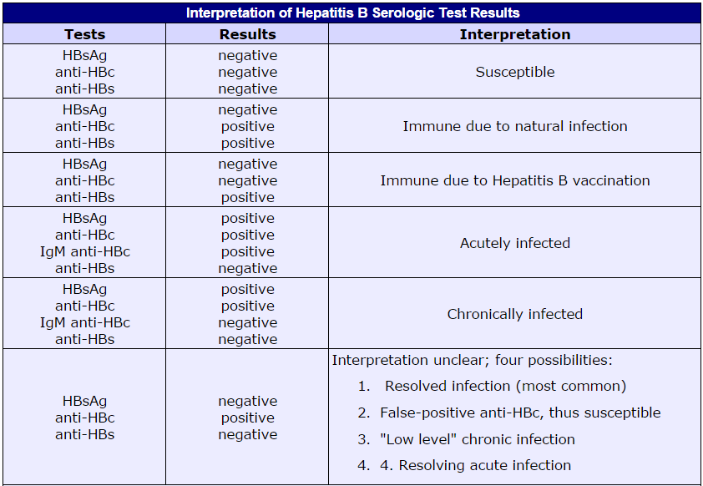

Slide 13
How is Hepatitis B transmitted?
Contact with infectious blood, semen and other body fluids:
Spread from an infected mother to her baby during birth
Sex with an infected partner
Direct contact with the blood of an infected person
Exposure to blood from needle sticks or other sharp instruments
Sharing needles, syringes, or other drug-injection equipment
Sharing items such as razors or toothbrushes with an infected person
Modes of transmission for infants/children:
From infected mother to infant during delivery
From infected household contact (including mother) to infant

Slide 14
Perinatal HBV Transmission
Perinatal transmission from mother to infant at birth is highly efficient.
Transmission usually occurs from blood exposure during labor and delivery
In utero transmission of HBV is rare (accounts for less than 2% of perinatal infections)
Risk of an infant acquiring HBV at birth without postexposure prophylaxis:
Mother is HBsAg-positive & HBeAg-positive
70%-90% will be come infected without PEP
Mother is HBsAg-positive only
<10% will become infected without PEP

Slide 15
Breastfeeding and HBV
Breastfeeding is not contraindicated for HBsAg-positive mothers
Studies suggest breastfeeding does not increase the risk for acquisition of HBV

Slide 16
Household transmission
Frequent interpersonal contact:
Nonintact skin with or mucous membranes with blood-containing secretions
Open skin lesions
Blood-containing saliva
Sharing inanimate objects
Nail clippers
Toothbrushes
Razors

Slide 17
ACIP’s HBV Prevention Strategies
Routine screening of all pregnant women
Immunoprophylaxis of infants born to HBsAg-positive women and women with unknown HBsAg status
Universal immunization of infants at birth
Routine immunization of children who have previously not been immunized

Slide 18
HBV Postexposure Prophylaxis
Hepatitis B Immune Globulin (HBIG)
Made from human blood samples that contain antibodies against the Hepatitis B virus.
Provides short-term protection (approximately 3-6 months) against Hepatitis B.
HBIG must be given to contacts within 7 days of blood exposure to be effective.
Hepatitis B Vaccine (HepB)
Administer HBIG & HepB within 12 hours of birth

Slide 19
Hepatitis B Birth Dose
Recommended for all medically stable infants weighing 2,000 grams or more
Administer within 24 hours of birth
For infants <2000g, administer HepB vaccine by 1 month of age or before hospital discharge, whichever is first
Provides a “safety net” for infants
Increases likelihood that child will complete the series on schedule

Slide 20
Hepatitis B Vaccine
Single-Antigen / Monovalent Formulation:
Recombivax HB®
Engerix-B®
Combination Formulation:
Pediarix®

Slide 21
Newborn Exam - Hospital
All mothers and their infants:
Ensure that all mothers have been tested for HBsAg prenatally or at the time of admission
Verify the mother’s HBsAg result using an original laboratory report
Do not rely on the prenatal flow sheet!
Administer a dose of single-antigen hepatitis B vaccine to all infants weighing >2,000 grams within 24 hours of birth

Slide 22
ACIP Recommendations PEP: Maternal HBsAg-Positive All birth weights
Infants born to HBsAg-positive women (all birth weights)
Administer HBIG and single antigen hepatitis B vaccine within 12 hours of birth (separate injection sites)
Document date and time of administration

Slide 23
ACIP Recommendations PEP: Maternal HBsAg Unknown Infant Low Birth weight (Less than 2,000 grams)
Infants born to women with Unknown HBsAg status and birth weight <2000 grams
Administer both HBIG and monovalent hepatitis B vaccine within 12 hours of birth at separate injection sites
Test mother, document, and communicate HBsAg results to mother’s provider(s)

Slide 24
ACIP Recommendations PEP: Maternal HBsAg Status Unknown Infant Birth Weight ≥2000 grams
Infants born to women with Unknown HBsAg status and birth weight ≥2000 grams
Test mother for HBsAg as soon as possible
Administer monovalent hepatitis B vaccine within 12 hours of birth –
Do not wait for mother’s results
If results are positive, administer HBIG to infant within 7 days
If infant is discharged before results known, inform
Mother
Pediatric provider
Perinatal Hepatitis B Prevention Coordinator

Slide 25
Hepatitis B Vaccine
The hepatitis B vaccine is usually given as a series of 3 shots over a 6-month period.
Age | Monovalent HepB (Engerix-B & Recomvivax HB) | Combination HepB (Pediarix)
Birth | X | Administer Monovalent HepB*
1-2 Months | X | X
4 Months |  | X
6 Months | X | X
*Pediarix is licensed for children 6 weeks through 6 years of age.

Slide 26
Low Birth Weight Infants
Preterm infants born to HBsAg-positive women and women with unknown HBsAg status must receive immunoprophylaxis with hepatitis B vaccine and hepatitis B immune globulin (HBIG) within 12 hours of birth.
Preterm infants with low birthweight (i.e., less than 2,000 grams or 4.4 lbs) have a decreased response to hepatitis B vaccine administered before 1 month of age. Preterm infants should receive 4 doses of hepatitis B vaccine.

Slide 27
Low Birth Weight infants born to HBsAg-positive women (Birth weight <2,000 grams)
DO NOT COUNT Birth Dose of Hepatitis B in Series
If using single antigen vaccine for series, administer:
Dose #1 at birth
Dose #2 at 1 month of age
Dose #3 at 2 months of age
Dose #4 at 6 months of age (not before 24 weeks of age)
If using combination vaccine for series, administer:
Dose #1 at birth
Dose #2 at 2 months
Dose #3 at 4 months
Dose #4 at 6 months (not before 24 weeks of age)

Slide 28
Infants born to HBsAg-positive mothers should complete the HepB vaccine series at 6 months of age.
American Academy of Pediatrics (Red Book)
Transmission of perinatal HBV infection can be prevented in approximately 95% of infants born to HBsAg-positive mothers by early active and passive immunoprophylaxis of the infant (ie, immunization and HBIG administration within 12 hours of birth). Immunization subsequently should be completed during the first 6 months of life. Hepatitis B immunization alone, initiated at or shortly after birth, also is highly effective for preventing perinatal HBV infections. (AAP Red Book 2015: page 419.)
Epidemiology and Prevention of Vaccine-Preventable Diseases (Pink Book)
Hepatitis B vaccination is recommended for all infants soon after birth and before hospital discharge. Infants and children younger than 11 years of age should receive 0.5 mL (5 mcg) of pediatric or adult formulation Recombivax HB (Merck) or 0.5 mL (10 mcg) of pediatric Engerix-B (GlaxoSmithKline). Primary vaccination consists of three intramuscular doses of vaccine. The usual schedule is 0, 1 to 2, and 6 to 18 months. Infants whose mothers are HBsAg positive or whose HBsAg status is unknown should receive the last (third or fourth) dose by 6 months of age (12 to 15 months if Comvax is used).
(Pink Book 2015: p. 161)
Control of Communicable Diseases Manual
Vaccines licensed in different parts of the world may have varying dosages and schedules; in the USA they are most commonly administered in 3 IM doses: for infants, the first dose is given at birth or at 1-2 months of age with subsequent doses 1 to 2 and 6 to 18 months later. For infants born to HBsAg positive women, the schedule should be birth, 1-2 and 6 months of age. (Control of Communicable Diseases Manual 2008; page 288)

Slide 29
HepB Vaccine Effectiveness
After 3 doses of HepB vaccine, more than 90% of healthy adults and more than 95% of infants, children, and adolescents (from birth to 19 years of age) develop adequate antibody response.
Protection by Age Group and Dose
Dose | Infants | Teens and Adults
1 | 16% - 40% | 20% -30%
2 | 80% - 95% | 75% - 80%
3 | 98% - 100% | 90% - 95%

Slide 30
Post Vaccination Serologic Testing (PVST)
High-risk infants must have a PVST between 9-12 months of age (generally done at the 9 month well-check visit)
PVST should not be performed before 9 months of age
PVST must be drawn a minimum of 30 days after last hepatitis B vaccine dose
Transient HBsAg antigenemia
PVST consists of two lab tests:
Hepatitis B Surface Antigen (HBsAg)
Lab result indicates if HBV infection is present
Hepatitis B Surface Antibody (anti-HBs)
Lab result indicates if child developed immunity

Slide 31
Post-Vaccination Testing FAQs
Why is the PVST necessary?
Without testing infant’s HBsAg status is unknown
Is child protected, infected or still susceptible to HBV?
What tests should be ordered?
HBsAg and Anti-HBs
Do NOT test for antibody to hepatitis B core antigen (Anti-HBc)
Passively acquired maternal Anti-HBc can be detected to age 24 months

Slide 32
PVST FAQs continued…
Why wait and test at 9 months of age or older?
To determine true Anti-HBs status
Earlier testing may detect Anti-HBs from HBIG administered at birth and not response to vaccination
To detect late occurring infection
Why wait to test 1-2 months after series completion?
Transient HBsAg-positivity can occur up to 3 weeks after vaccination
Can the testing wait until the infant is older?
Currently, ACIP recommends testing between 9-12 months (usually at the next well child visit)
Be aware that after completion of the primary hepatitis B vaccine series the Anti-HBs levels decline rapidly in the first year

Slide 33
Management of Nonresponse to HepB
Persons who lack antibody response should receive additional HepB vaccine
Administer challenge dose of single-antigen HepB vaccine and complete and collect PVST: 30-60 days after dose
If infant did not develop adequate antibody after challenge dose, administer two additional HepB doses followed by PVST 30-60 days after final dose (must be at least 8 weeks between HepB dose #2 & dose #3 and at least 16 weeks between dose #1 and dose #3)
Fewer than 5% of persons fail to develop immunity after six doses
Hyporesponder
Chronic infection
No further doses are recommended
Counsel client
Risk Reduction

Slide 34
Georgia Perinatal Hepatitis B Prevention Program (PHBPP)
The Georgia Perinatal Hepatitis B Prevention Program (PHBPP) identifies pregnant women infected with hepatitis B virus (HBV) and provides case management activities for the women and their newborn infants.
18 District PHBPP Case Managers:
Identify hepatitis B-infected pregnant women
Ensure hepatitis B immune globulin (HBIG) and hepatitis B vaccine are administered within 12 hours of birth
Ensure hepatitis B vaccines are administered at the recommended intervals
Coordinate post-vaccination serologic testing (PVST) at 9-12 months of age

Slide 35
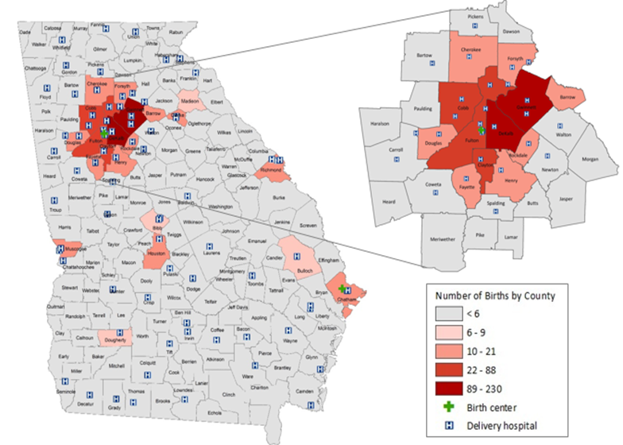
Identified HBV-Exposed Births by County, Georgia, 2013-2015

Slide 36
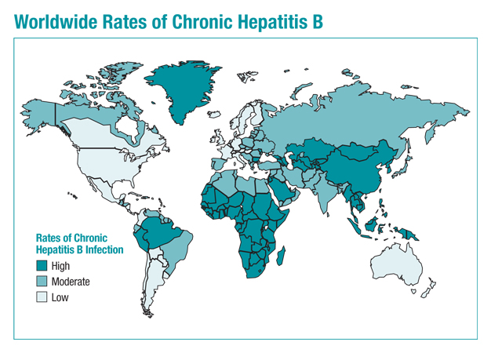
Mother’s Country of Birth HBV-Exposed Infants – Georgia Summary
GA Birth Cohort 2015
United States
China
Vietnam
Nigeria
Burma
Ghana
Ethiopia
Liberia
Korea
Philippines

Slide 37
Georgia Perinatal Case Management Summary
Track 4 birth cohorts concurrently
Track each case an average of 14 months
Birth Cohort Year | Infants Case Managed | Tested & Developed Immunity | Developed Immunity (%) | HBV-Infected Infants
2013 | 312 | 226 | 72% | 0
2014 | 311 | 238 | 77% | <5
2015 | 386 | 226 | 72% | 0
TOTAL | 937 | 690 | 74% | <5

Slide 38
Pediatric Best Practices
Newborn exam - Verify that HBIG & HepB were administered to exposed infants
Review hospital discharge papers
Check GRITS for birth dose & HBIG
Ask parent or legal guardian about the mother’s HBV status
Administer HepB vaccines at recommended intervals
Complete HepB series at 6 months of age

Slide 39
Best Practices continued…
Report vaccines to GRITS in a timely manner
Immunizations are required to reported to DPH within 30 days of administration.
GRITS web address: www.grits.state.ga.us
Order post-vaccination serologic testing at 9 months of age
Administer additional doses infants lacking immunity
Screen siblings of tracked cases & children born in endemic areas (adoptees)
Report findings to Public Health

Slide 40
Intervention by Age
Birth
-Administer HBIG and HepB birth dose within 12 hours of birth
1-2 Months
-Administer HepB dose #2
4 Months
-Administer HepB dose #3 if using combination vaccine
6 Months
9 Months
-Administer HepB dose #3 if using monovalent vaccine
-Administer HepB dose #4 if using combination vaccine
-Conduct post-vaccination serologic testing (HBsAg and anti-HBs)

Slide 41
Resources
Georgia Perinatal Hepatitis B Prevention Program Webpage http://dph.georgia.gov/perinatal-hepatitis-b
Epidemiology and Prevention of Vaccine Preventable Disease (“The Pink Book”) http://www.cdc.gov/vaccines/pubs/pinkbook/hepb.html
Red Book: 2015 Report of the Committee on Infectious Diseases
http://redbook.solutions.aap.org/
MMWR - A Comprehensive Immunization Strategy to Eliminate Transmission of Hepatitis B Virus Infection in the United States http://www.cdc.gov/mmwr/preview/mmwrhtml/rr5416a1.htm?s_cid=rr5416a1_e

Slide 42
Contact Information
Tracy Kavanaugh, MS, MCHES
Georgia Perinatal Hepatitis B Program Coordinator
Georgia Department of Public Health
Acute Disease Epidemiology Section
2 Peachtree Street NW, Suite 14-263
Atlanta, GA 30303-3142
Office: 404-651-5196
Fax: 404-657-6871
Email: Tracy.Kavanaugh@dph.ga.gov

