Slide 1
Georgia Board of Public Health
Nov. 12, 2019

Slide 2
Agenda
Call to order James Curran, M.D., Board Chair
Roll Call Mitch Rodriguez, M.D., Secretary
Approval/Adoption of Minutes Mitch Rodriguez, M.D., Secretary
Commissioner’s Update Kathleen E. Toomey, M.D., M.P.H., Commissioner

Slide 3
Delta Omega Honor Society
Georgia State University Gamma Upsilon Chapter
Amna Tariq, Ph.D., M.P.H., Chapter Vice President

Slide 4
Epidemiology Update:
Outbreak of Vaping-Associated Lung Injury
Board of Public Health / Cherie L. Drenzek, DVM, MS / State Epidemiologist & Chief Science Officer /Nov. 12, 2019

Slide 5
Multi-state Outbreak of Lung Injury Associated with Vaping — United States, 2019
In July 2019, the Wisconsin and Illinois state health departments received reports of 53 young persons with severe lung injury associated with vaping.
CDC launched a multi-state outbreak investigation and released a national health alert on August 30, 2019.
A national case definition was established so that cases could be identified and counted in a standard way.
As of November 5, 2,051 cases have been identified nationally from 49 states (with 39 reported deaths).
Geographic Distribution of Case-Patients, Nov 5, 2019
27 cases in Georgia (3 fatal)

Slide 6
Clinical Characteristics
Case-patients reported respiratory symptoms such as cough, shortness of breath, or chest pain as well as gastrointestinal symptoms like nausea, vomiting, or diarrhea.
Symptoms developed over a period of days to weeks (and worsened)
Almost all case-patients were hospitalized with evidence of pneumonia, more than half in ICU for respiratory failure, and about 1/3 needed mechanical ventilation (esp. >50 years old).
Notes:
CDC/Georgia patients

Slide 7
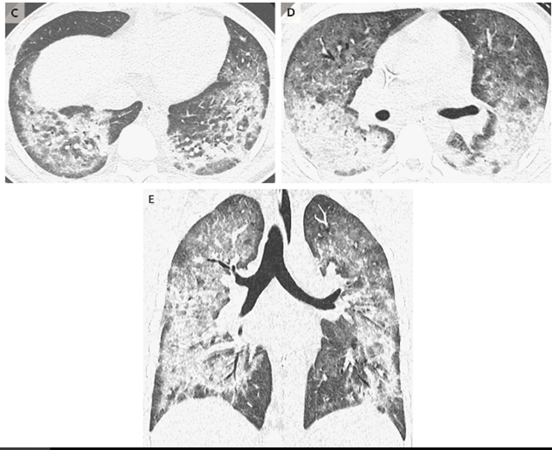
Imaging and Treatment
All case-patients had pulmonary infiltrates, seen as opacities on plain film X-rays or with characteristic ground-glass opacities on chest CT.
No infectious causes found (extensive testing)
Most patients responded to steroid treatment--however, the optimal treatment regimen and the long-term effects of this lung injury are uncertain.

Slide 8
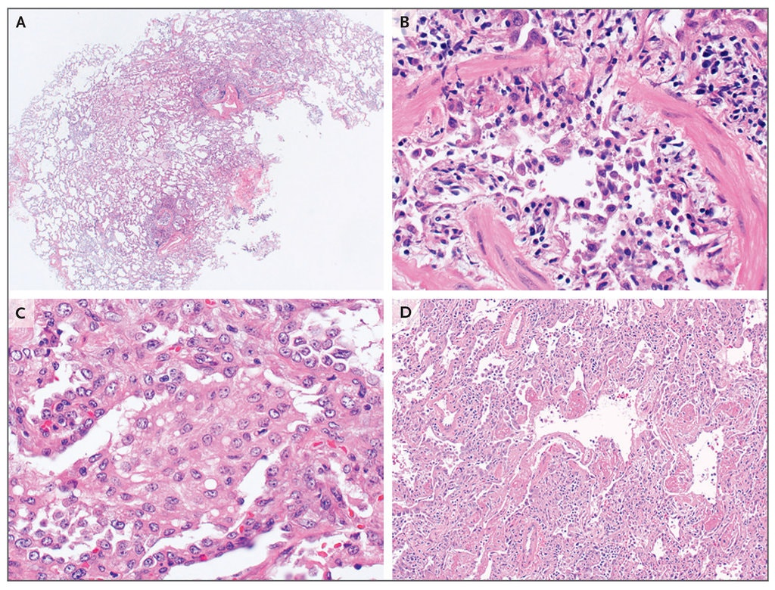
Lung Injuries: Pathology/Histopathology
Varies
A cluster of 5 case-patients in North Carolina exhibited “lipoid pneumonia”, which is an inflammatory response to aspiration of oil into the lungs
A recent Mayo Clinic study of 17 case- patients from around the US showed a pattern of injury in the lung that looked like a chemical burn; did not see oil accumulation in lungs
More than one mechanism of injury? More than one chemical?

Slide 9
Epidemiologic Investigation, U.S.
CDC coordinating the national investigation, with FDA lab support (testing retained vaping liquids/products from case-patients)
Of the 2,051 cases nationally, 70% are male, 79% are under 35 years, and the median age is 24 years (range 13-75 years); fatal cases older (median 45 years)
THC products play a major role in the outbreak; about 86% patients reported vaping THC products, or both THC and nicotine.
Nearly all THC products were packaged, prefilled cartridges that were primarily acquired from informal sources such as friends, family members, illicit dealers, or off the street.

Slide 10
Breaking News: Possible Laboratory Breakthrough
Although CDC and FDA had previously not identified any single chemical or product that was linked to all cases, a breakthrough in the investigation was reported last week.
CDC tested 29 bronchoalveolar lavage (BAL) fluids from known case-patients in 10 states and found Vitamin E acetate in all of them (THC was found in 82% of the BAL samples).
This is significant because this is the first time that a toxic chemical was found in biologic samples from case-patients, actually at the site of injury--the lung.
Vitamin E acetate was also previously reported to be found in some product testing done by FDA and state health labs.
Vitamin E acetate is an oil usually used as a diluent or cutting agent in the THC-containing vaping products, particularly in the "informal" networks.
CDC says this might not be the ONLY cause of the lung injuries, there may be another chemical(s) as well but are focusing here now.

Slide 12
Epidemiologic Investigation, Georgia
Goals are to conduct surveillance for cases of vaping-associated lung injury (case finding), characterize them to see if they meet the national case definition, identify potential exposures, and support the national investigation by collecting products for testing by FDA and CDC.

Slide 13
Epidemiologic Investigation: Georgia (11/12/2019)
Total reported cases: 27 (3 deaths)
Gender: 56% male
Geography: 15 counties around the state, but ~60% cases from metro Atlanta
Overall age range: 18-68 years
Median age overall: 33 years
Median age fatal cases: 54 years
% Hospitalized: 100%
% ICU: 67%
% Ventilated: 37%
Exposures: 63% self-report any THC vaping, 26% any CBD vaping, 14% nicotine only
Numbers updated weekly: https://dph.georgia.gov/vapinglunginjury
Notes:
Update from case tracking form or here https://dph.georgia.gov/vapinglunginjury

Slide 14
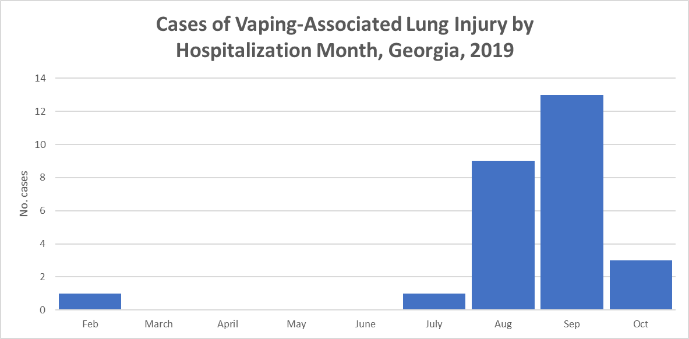

Slide 15
Implications/Recommendations
The new lab findings reinforce the recommendation not to vape any THC-containing products, especially those acquired through informal networks, but because there may be other causes as well, CDC still recommends that people not vape at all until this is determined.
Persons should not return to traditional cigarettes but consider tobacco cessation (1-877-270-STOP).
Clinicians should continue to report possible cases to DPH via the GA Poison Center (1-800-282-5846) for further investigation (i.e. whether they meet the national case definitions, what products and devices were used, the source(s) of the product, and whether any remains for testing).

Slide 17
Breaking News: Measles

Slide 18
Confirmed Measles in Cobb County
Measles infection was confirmed in an unvaccinated child from Cobb County on November 8, 2019.
This is our eighth measles case of 2019; all were among unvaccinated children
Current investigation ongoing
Overarching goal is to stop spread by identifying exposed contacts, particularly those who may be susceptible to measles and: 1) offer prophylaxis (MMR or IG) as appropriate; 2) educate them about symptoms and infectious period; 3) monitor for development of symptoms; 4) recommend exclusion from venues where spread may occur.

Slide 19
Questions?
Cherie Drenzek, DVM, MS
State Epidemiologist & Chief Science Officer
Georgia Department of Public Health
(404) 657-2609
cherie.drenzek@dph.ga.gov
For more information, please contact:

Slide 20
Opioid Response and Drug Misuse Program
Board of Public Health Meeting / Chris Rustin, DrPH, M.S., R.E.H.S., Director of Health Protection, Laura Edison DVM, MPH, CDC Career Epidemiology Field Officer / Nov. 12, 2019

Slide 21
DPH Opioid and Substance Use Program
Started in 2016 with 3 CDC grants
Three program areas
Epidemiology and surveillance (Drug Surveillance Unit)
Prescription Drug Monitoring Program (PDMP)
Statewide Strategic Planning and Prevention
Now supported by the CDC Overdose Data to Action (OD2A) grant and Bureau of Justice-ODMAP grant
OD2A-September 2019 - August 2022
Combined surveillance and prevention into one grant
ODMAP-September 1, 2019-August 31, 2021
https://dph.georgia.gov/stopopioidaddiction

Slide 22
OD2A District Public Health Analysts
PHAs to work on the opioid crisis in each health district to inform prevention and response efforts
GIA sent to all 18 PH districts
Assist with:
Developing district opioid prevention and response strategies through collaboration
Promote and enroll first responders in using ODMAP
Participate in stakeholder workgroups and provide education
Develop list of medical providers in each health district to refer affected patients if their medical provider is closed
Development of districtwide opioid outbreak response plan

Slide 23
OD2A PDMP Integrations
Facilitate PDMP data and information sharing with other states
Integrate the Georgia PDMP data with electronic health records (EHRs)
Epic
Athena Health
Cerner
EclinicalWorks
NextGen
PioneerRx
Implement prescriber report cards

Slide 24
OD2A Prevention Activities
Continue statewide strategic planning
Develop and conduct educational presentations for emergency department staff on fostering a culture of recovery with the goal of improving linkages to care from their facilities when caring for patients with substance abuse
Develop and distribute a best practices document to improve the management of overdose and opioid use disorder patients in Georgia emergency departments
Various other educational campaigns

Slide 25
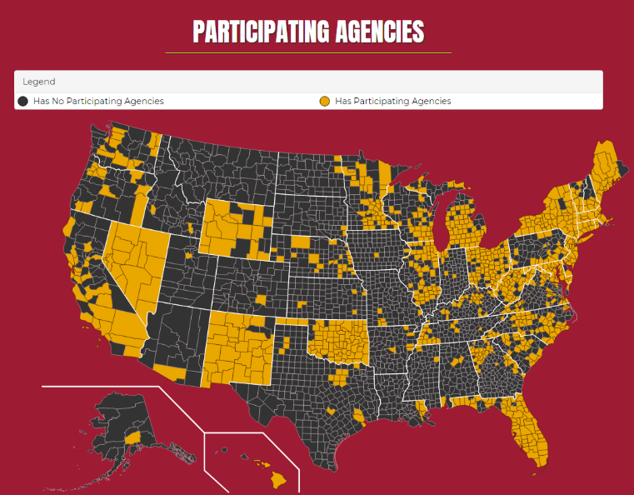
ODMAP Overdose Detection Mapping Application Program
ODMAP provides near real-time suspected overdose surveillance data across jurisdictions to support public safety and public health efforts to mobilize an immediate response to a sudden increase, or spike in overdose events.
Continue to roll out ODMAP across the state by enrolling first responders and electronically integrate EMS records into ODMAP

Slide 26
OD2A Drug Overdose Surveillance
Support the DPH Drug Surveillance Unit
Continue to produce and improve surveillance reports
Opioid overdose surveillance reports
2016-2018 annual and county-level data tables
Quarterly reports coming soon
PDMP reports
2016-2018 annual and county-level data tables
Monthly reports as of August 2019
Monthly Syndromic Surveillance reports
SUDORS detailed death investigation report
Coming soon
Annual county profiles
Stimulants report
https://dph.georgia.gov/drug-surveillance-unit
Notes:
Data repository will be used to integrate data sources
Sidenote: Due to the constant changing nature of this epidemic, we look at data for all drug overdoses (not just overdoses related to opioids)

Slide 28
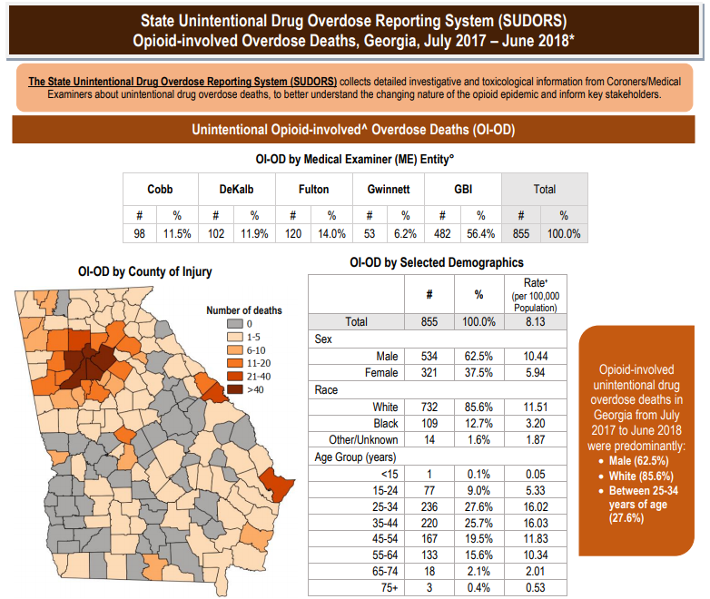
OD2A Overdose Death Surveillance
State Unintentional Drug Overdose Surveillance (SUDORS)
Review medical examiner and coroner (ME/C) reports, toxicology, EMS records and PDMP records for ALL drug overdose deaths
Increase use of the suspect overdose checkbox in the electronic vital records system to identify opioid overdose deaths within 30 days
Continue developing and implementing the Coroner Death Investigation Database
Free web-based database free for all Coroners to use. Will facilitate data access for many DPH programs
Support expanded post-mortem opioid testing through direct funding to GBI and multiple county MEs

Slide 29
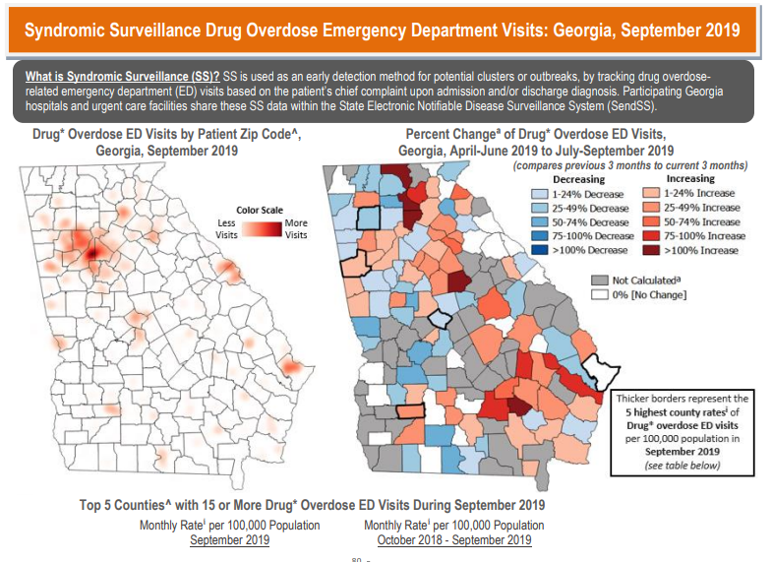
OD2A Overdose Syndromic Surveillance
Continue to monitor syndromic surveillance for spikes in drug overdoses
Notify districts of clusters, and support response to suspect or confirmed outbreaks
Support districts to develop overdose outbreak response plans
Improve syndromic surveillance data by onboarding new hospitals and increasing data completeness
Share aggregate level emergency department, hospitalization discharge data with CDC
Work with surrounding states to identify interjurisdictional outbreaks
Integrate EMS data into syndromic surveillance

Slide 30
OD2A Other Surveillance Activities
Continue to produce and widely distribute timely surveillance reports using multiple data sources
https://dph.georgia.gov/drug-surveillance-unit
Match PDMP data to multiple data sources for predictive analyses to identify possible intervention points prior to overdose
Create a data visualizing platform
Improve internal data analysis
Create a public facing data dashboard to improve data access
GPHL will begin to perform toxicology testing and offer free testing to hospitals, and support ME/Cs with testing as needed
And more!

Slide 31
Questions?
For more information, please contact:
Chris Rustin, DrPH, M.S., R.E.H.S.
Director, Division of Health Protection
404-657-6534
chris.rustin@dph.ga.gov
Laura Edison, D.V.M., M.P.H
CDC Career Epidemiology Field Officer
404-657-6452
laura.edison@dph.ga.gov

Slide 32
Georgia Evidenced-Based Home Visiting
Supporting Parents, Improving Child Well-Being
Board of Public Health / Twanna Nelson / Nov. 12, 2019

Slide 33
What Is Home Visiting?
Home Visiting is an evidenced-based program that helps pregnant women and parents of children from birth to five access resources and hone skills needed to ensure children are physically, socially and emotionally healthy and ready to learn.
Notes:
EBHV is a crosscutting intervention with proven outcomes in our state and nation wide.
Provide home visits as the primary service delivery strategy.
Offer services on a voluntary basis.
Provide services to at-risk pregnant women or families with children birth to kindergarten entry.
Target specific participant outcomes that promote family functioning and child well-being.

Slide 34
What Is Home Visiting?
Goals:
Improve maternal and child health
Prevent child abuse and neglect
Encourage positive parenting
Promote child development and school readiness
Funding:
Maternal, Infant, Early Childhood Home Visiting (MIECHV) federal grant
Title V Block Grant
Notes:
EBHV is a crosscutting intervention with proven outcomes in our state and nation wide.
Provide home visits as the primary service delivery strategy.
Offer services on a voluntary basis.
Provide services to at-risk pregnant women or families with children birth to kindergarten entry.
Target specific participant outcomes that promote family functioning and child well-being.

Slide 35
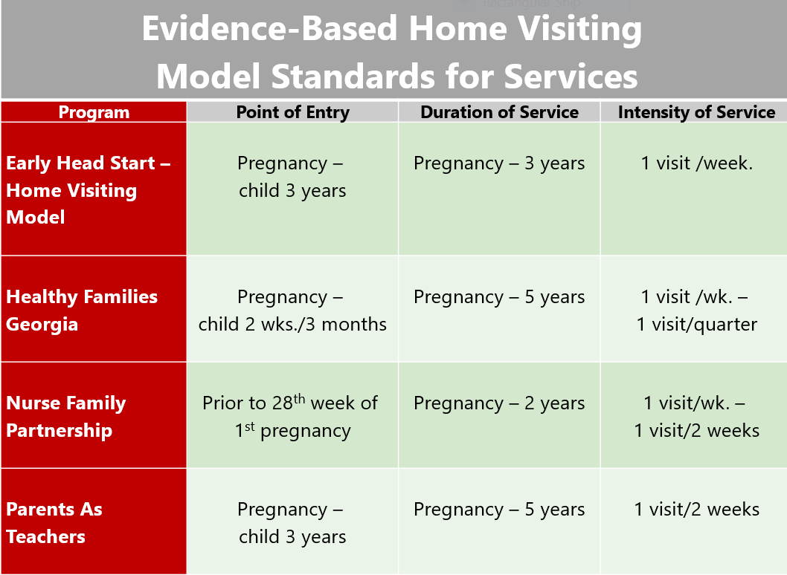

Slide 36
Home Visiting Services
Provide
Education on a variety of topics
Linkage to resources
Support to families
Screenings and referrals
Group Connections
Promote
Utilization of health care resources
Goal Setting
Well-child visits
Early brain development
Positive parenting skills
Screen and Assess
Ages and Stages 3 (ASQ3) Developmental Screening
Ages and Stages Social Emotional screening (ASQ-SE)
Edinburgh Depression Screening
Maternal and Child Health Assessment
Hurt, Insulted, Threatened with Harm and Screamed (HITS) Domestic Violence Screening
Notes:
Education – Utilizing the evidence base curriculum the home visitor provides education on may topics including developmental growth and milestones, nutrition, oral health, discipline, positive parent child interactions and more.
Linkage to resources – employment, food pantries, domestic violence, mental health services, quality rated childcare.
Linkages are made based upon the needs identified by needs assessment that is administered to all families
Screening and Referrals – Major part of Evidenced Home Visiting is screening and assessments. All children receive the developmental screenings at the prescribed intervals and if there are every any alerts based upon the screenings, referrals will be made. ( Early screening and detection with appropriate linkage to service is key.
Early Brain Development – Families are encouraged to read and talk with their babies to encourage brain development. As a standard practice, the PAT programs provide a book to the family with each visit and some programs help families develop an in-home library.
Goal Setting – families are encouraged to set individual and family goals to improve their family well-being. The goals can range from obtaining employment with a certain salary or

Slide 37
2018 Home Visiting Data
Service Utilization Data
1,489 families served
19,385 home visits completed
316 pregnant women
1,489 primary caregivers
1,360 children
Risk Factors
70% of families served are low income
9% had a child with a developmental delay
8% had previous involvement with Child Protective Services
*Data collected from 10/1/2017-9/30/2018 for the Maternal, Infant, and Early Childhood Home Visiting funded programs – Data accurate as of 10/1/2018.

Slide 38
2018 Home Visiting Data (10/01/2017 – 9/30/2018)
80% of primary caregivers were screened for depression
78% of children received an on-time screening for developmental delays
95% of children had someone who read or sang to them daily
69% of primary caregivers were specifically assessed for their parent-child interactions
29% of primary caregivers referred due to positive screen for depression received mental health services
67% of children referred due to positive screen for developmental delays received services in a timely manner
Notes:
The performance measures are intended to help tell the story of home visiting in Georgia. The data shown are only MIECHV-Funded home visiting in Georgia from 10/1/2017 – 9/30/2018
81% of children received their last well child check up
76% of mothers received a postpartum visit with 8 weeks of delivery
9% of women enrolled prenatally delivered preterm

Slide 39
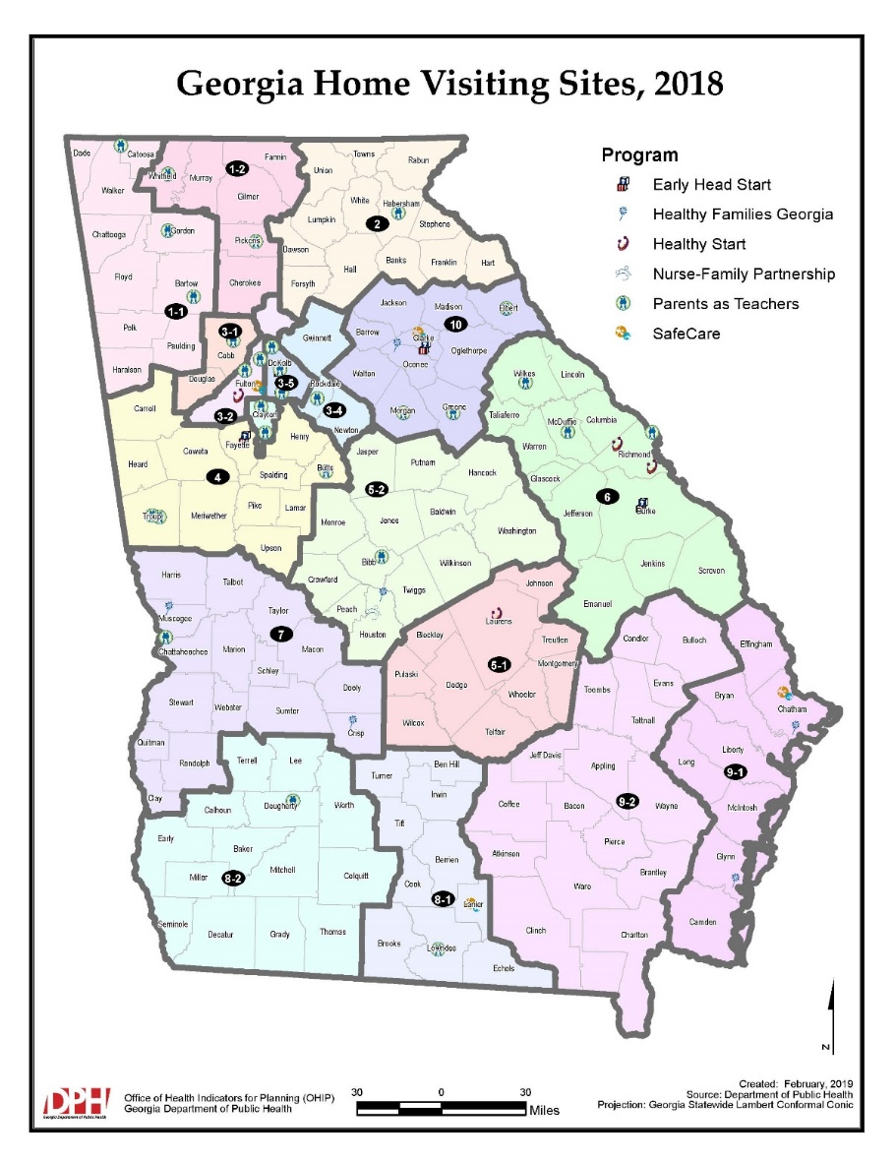
Counties Served
Bartow
Bibb
Chatham
Chattahoochee
Clarke
Clayton
Crisp
DeKalb
Dooly
Echols
Fulton
Glynn
Houston
Jackson
Liberty
Lowndes
Muscogee
Peach
Richmond
Whitfield

Slide 40
Home Visiting At Work in Georgia
https://www.healthyfamiliesamerica.org/success-stories/healthy_families_athens/?fbclid=IwAR0n8RitZ5LYo8wuRmttbMubNxR_s108B6s3U1TS3E9npnarASiT3PdkmDw
Notes:
Home visiting transforms lives. A knock at the front door can bring parents the support they need to feel empowered to improve their lives and to nurture their young child’s healthy development.

Slide 41
Questions?
For more information, please contact:
Twanna L. Nelson Deputy Director, Family and Community Supports Maternal and Child Health
404-657-2465
twanna.nelson@dph.ga.gov

Slide 42
Next Meeting
The next Board of Public Health meeting is scheduled for Tuesday, Dec. 10, 2019 @1 p.m.

