Slide 1
Georgia Board of Public Health
Oct. 8, 2019

Slide 2
Agenda
Call to order James Curran, M.D., Board Chair
Roll Call Mitch Rodriguez, M.D., Secretary
Approval/Adoption of Minutes Mitch Rodriguez, M.D., Secretary
Commissioner’s Update Kathleen E. Toomey, M.D., M.P.H., Commissioner

Slide 3
Infectious Disease Epidemiology Update
Hepatitis A Outbreak, Georgia
Board of Public Health / Cherie L. Drenzek, DVM, MS / State Epidemiologist & Chief Science Officer / Sept. 10, 2019

Slide 4
Hepatitis A Virus (HAV) Infections in Georgia, June 1, 2018-Sep.24, 2019* (n=668)
Total confirmed HAV infections: 668
Median Age: 45 (3-86 Years)
66% male, 78% White
Hospitalizations: 456 (68%)
Deaths: 7 (1.0%)

Slide 5
Geographic Distribution of Confirmed HAV Infections, Georgia, June 1, 2018- Sep. 21, 2019 (n=668)

Slide 6
Confirmed HAV Infections, by Public Health District, Georgia, June 1, 2018- Sep 28, 2019* (n=686)
Notes:
Rome 64 cases
Dalton 17 cases
Augusta 19
Macon, Fulton, Coastal – monitoring closely

Slide 7

Identified Risk Factors, Confirmed HAV Infections, Georgia, June 1, 2018 – Sep. 28, 2019* (n=686)
Georgia
Fulton County

Slide 8
Any Recent Changes in the Epidemiology of the Hepatitis A Outbreak in Georgia?
Documented additional hepatitis A deaths (7 total to date)
New match to death data—occurred earlier in year
Reflects population at risk— numerous chronic and infectious comorbidities
Increasing number of hepatitis A cases among MSM across metro Atlanta area
Grindr collaboration
PRIDE vaccine outreach events
Decreasing number of cases in the two hotspots (Northwest Georgia and Augusta area)

Slide 9
Any Recent Changes in the Epidemiology of the Hepatitis A Outbreak in Georgia?
Confirmed HAV Infections, District 1-1,
June 1, 2018 to Sep. 28, 2019 (n= 291)
Confirmed HAV Infections, District 6-0, June 1, 2018 to Sep 28, 2019 (n=137)

Slide 10
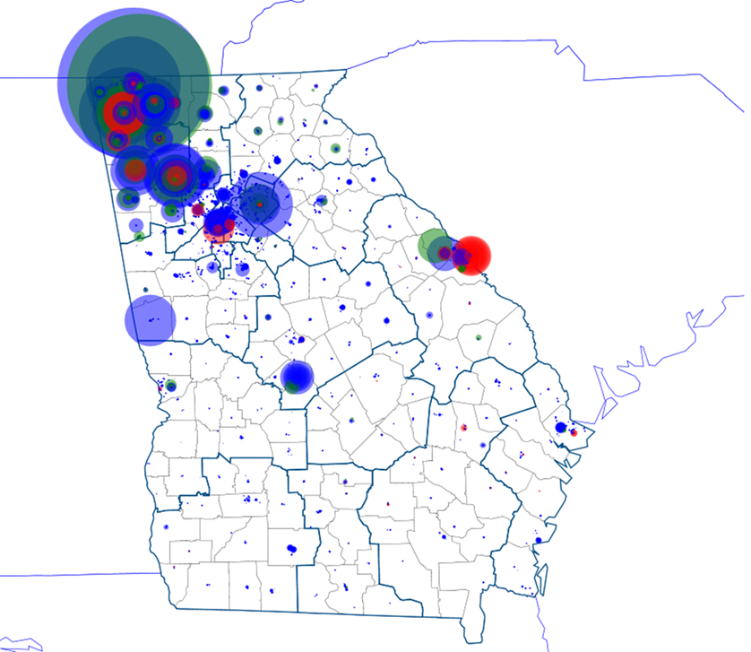

Overarching response strategy: target hepatitis vaccination to populations at risk.
Blue circles = Hep A vaccines given (private + public) = ~75K
Red circles = Hep A cases
Green circles = DPH Hep A Vaccine Outreach Events =~14K

Slide 11
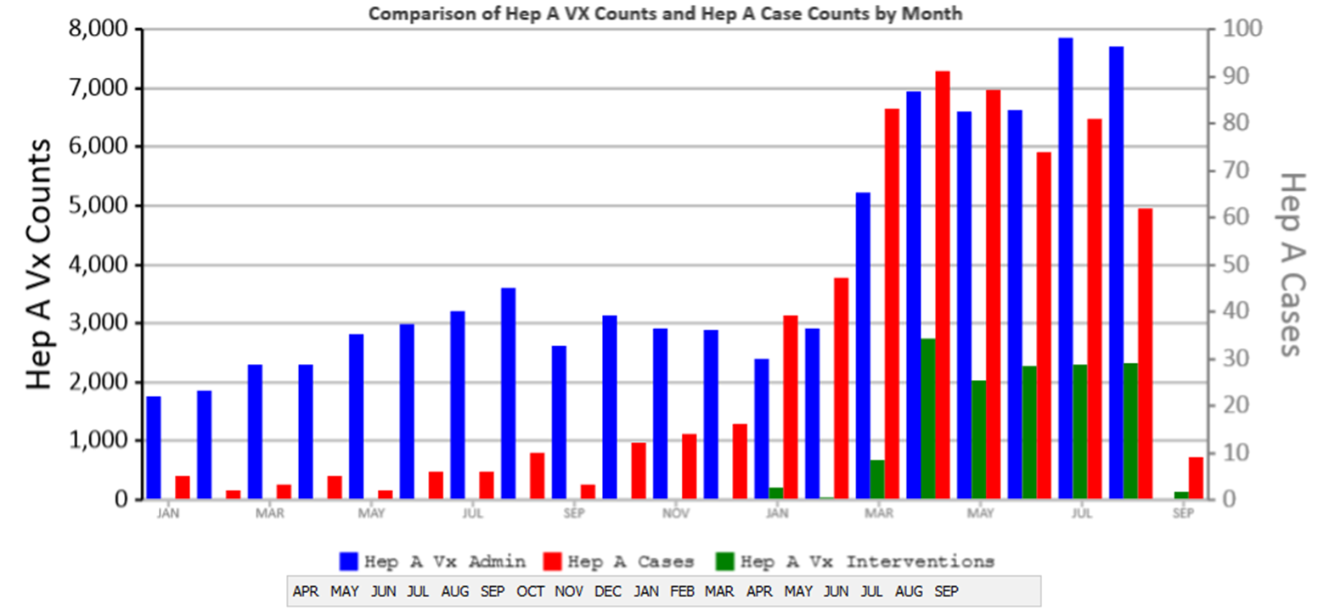
Hepatitis A Case Counts and Vaccine Administration, Georgia, 2018-2019

Slide 12

Good News
We received some good news last week from the CDC Hepatitis A Outbreak Response Team:
“We interpret Georgia’s hepatitis A vaccination events as being well targeted towards high-risk populations, with a minimal amount of vaccines going towards the low-risk populations, particularly in your northwest districts. Georgia’s sustained, targeted vaccination efforts may have blunted the rate of rise and will continue to do so.”
But we cannot be complacent!
Florida and Tennessee outbreaks still on the upswing (~2,600 cases each)
Increases among MSM in metro Atlanta

Slide 13
Questions?
Cherie Drenzek, DVM
State Epidemiologist & Chief Science Officer
Georgia Department of Public Health
(404) 657-2609
cherie.drenzek@dph.ga.gov
For more information, please contact:
Notes:
Intro Dr. Taylor here

Slide 14
Hepatitis A Outbreak, District 1-2
Board of Public Health / Zachary Taylor, MD, MS / North Georgia District Health Director / Oct. 8, 2019

Slide 15
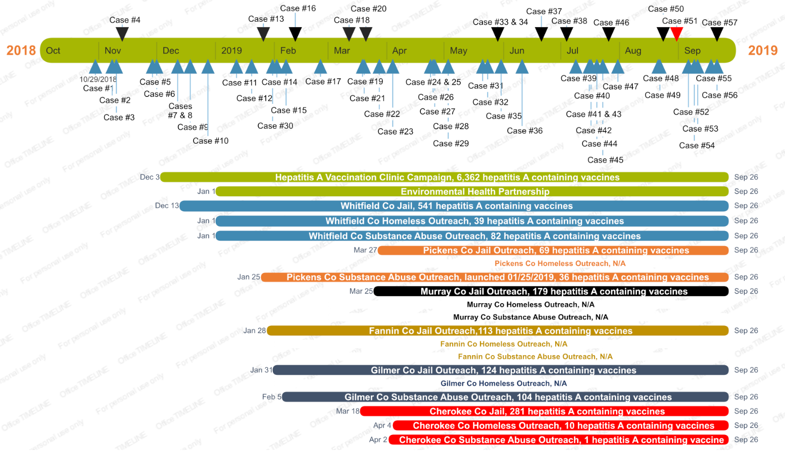

Slide 16
Identified Risk Factors, Confirmed HAV Infections

Slide 17
District Response
Vaccination
Contacts
Outreach
Jails
Substance Abuse Treatment Centers and Drug Courts
Homeless providers
Removal of financial barriers
Food service workers
Environmental Health
Social Media

Slide 18
Lessons Learned and Challenges
Early vaccination outreach
Records and procedures
Social media
Partnerships with correctional facilities, courts, drug treatment facilities
MSM?

Slide 19
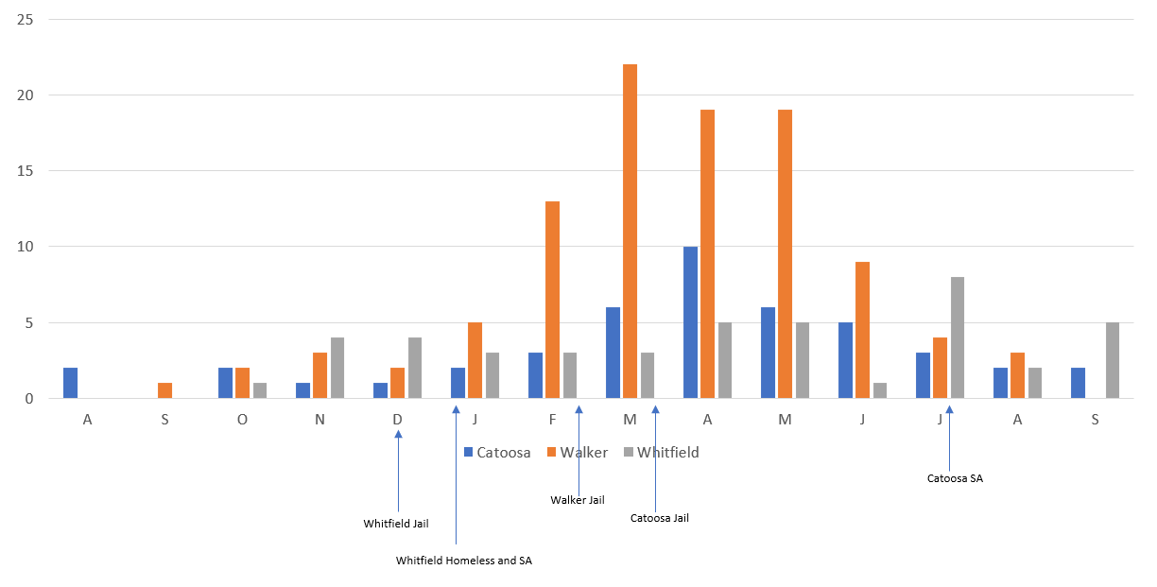
Hepatitis A Cases – 3 NW Georgia Counties

Slide 20
Questions
For More Information:
Zachary Taylor, MD, MS
North Georgia Health District Director
706-529-5757
zachary.taylor@dph.ga.gov

Slide 21
Babies Can’t Wait
Board of Public Health / Lisa Pennington, MS, MA, LPC / Oct. 8, 2019

Slide 22
What is Babies Can’t Wait?
Part C of the Individuals with Disabilities Education Act (IDEA) guarantees all eligible children ages birth to 36 months, regardless of their disability, have access to services that will enhance their development.
Babies Can’t Wait (BCW) is Georgia’s Part C early intervention program for families of infants and toddlers with developmental delays and disabilities.

Slide 23
What are Early Intervention Services?
Assistive technology devices
Audiology
Behavioral intervention
Evaluation and assessment
Family training and counseling
Health & medical services
Nutrition services
Physical & Occupational Therapy
Psychological services
Service coordination
Social work
Special instruction
Speech-language pathology
Vision services

Slide 24
Services Provided at No Cost
Screening
Evaluation
Assessment
Individualized Family Service Plan (IFSP) Development
Service Coordination
Procedural Safeguards

Slide 25
Benefits of Early Intervention
Minimize need for special education and support services in the future.
Help children develop to their fullest potential and support families & children fully participate in their communities.
Support families in developing natural support systems that will last after BCW.
Empower families to advocate for their child’s needs.
Notes:
Families are an integral member of the team, as they are the experts on their children. Goals will be developed with families to assist the child in functioning as independently as possible.

Slide 26
Referrals
Referrals of children birth to 5 years of age to public health services including early intervention services provided through BCW, come through Children 1st.
Children 1st is the single point of entry for DPH’s Maternal and Child Health program.
Referral Children 1st BCW
(Pending Ages & Stages Questionnaire Results)
Notes:
Referral sources, such as child care or physician communities, are informed through a variety of methods about referral procedures and the benefits of referring children birth to 5 years of age through Children 1st.
Referrals may come directly to BCW from families, other agencies or the public. Family information will be gathered on the Children 1st Screening and Referral form and sent to Children 1st in order to be presented at the weekly staffing meeting to be reviewed by the Birth to Five Review Team, to ensure the most appropriate referral(s) are made on behalf of the child and family.

Slide 27
Eligibility Determination
A diagnosed medical condition that places the child at risk for developmental delay OR
A significant developmental delay in at least one area of development or two moderate delays
If the child is determined eligible, an ongoing family service coordinator is chosen and an Individualized Family Service Plan (IFSP) is developed
If the child is determined ineligible, appropriate referrals are made to other community programs
Notes:
A child with a diagnosed physical or mental condition (such as blindness, Down Syndrome, or Spina Bifida) which is known to result in a developmental delay is automatically eligible to receive services through BCW program.

Slide 28
Individualized Family Service Plan
The IFSP is reviewed every six months to evaluate progress or whenever a parent requests a change.
It is also reviewed annually with the family, providers, and other individuals specified by the family.
Notes:
This plan is used to identify goals, strategies, and services that will enhance and promote the child’s development.
Other community programs such as Early Head Start, Private Daycare, Private Therapy, etc.
Although IFSPs are reviewed every 6 months, a team member (including a parent) can call a review at any time to discuss services or changes to the plan.

Slide 29
Service Delivery-Primary Service Provider Model
Each family is assigned to a team, which may include a variety of providers
Service Coordinator
Speech-language pathologist
Special Instructor
Occupational Therapist
Physical Therapist
Others
Notes:
The Individuals with Disabilities Education Act states that services should be provided in Natural Environments-- settings that are natural or normal for the child's age peers who have no disabilities.
Providing services in natural environments means supporting families in promoting the child’s learning opportunities in the context of daily routines, activities, and events of everyday life. Examples include home, daycare, family members home….anywhere the child normally would be on a consistent basis. This is important because it allows the parent/caregiver to be engaged in the activities and be able to implement those activities outside of scheduled sessions with a provider.

Slide 30
BCW Providers
BCW contracts with most of its providers to deliver the required services within the program:
Speech/Language Pathologists - 241
Occupational Therapists - 138
Physical Therapists - 130
Special Instructors - 379
Service Coordinators (Case Managers) - 116
Board Certified Behavior Analysts & Registered Behavior Technicians - 20
Clinical Social Workers/Licensed Professional Counselors - 5
Psychologists - 4
Notes:
The BCW program experienced a statewide loss of 21% of contracted providers and 37% of service coordinators from FY 17 to FY19. Rural areas have been most severely impacted due to chronic provider shortages in these areas. As a result, Special Instructors, who are generalists with education and experience in the human service and education field, are often utilized to address a variety of developmental challenges often with coaching from licensed professionals such as Physical Therapists, Occupational Therapists and Speech Language Pathologists in an effort to assist in addressing provider capacity challenges.

Slide 31
Teleintervention Services
Teleintervention pilot with Waycross Public Health District September 2018
Teleintervention physical therapy (PT) and speech (SP) services
Occupational therapy (OT) services added July 2019
Services to date:
33 children have received PT
2 children have received OT
32 children have received SP services
Pilot expanding into Dublin, Valdosta and Gainesville Districts
Notes:
This pilot has been extremely successful in the following areas:
Increased access to services for those families who participated; either in home or in the community
Family interest and excitement about availability of services
Increased coaching opportunities within teams
Increased capacity building of providers across all spectrums.
Less travel for providers & fewer no shows = less loss of income for providers; which we are hoping will help providers see more patients and help the district recruit and retain more providers.
Facilitates confidence and competence for families to have greater involvement in routines-based practices
Reduces exposure to external factors for medically fragile children in some instances and complications related to traveling for families with medically fragile children
Increase in referrals secondary to increase confidence from medical professionals in the area

Slide 32

Transition & Exit
Prior to the child’s third birthday, the family’s Service Coordinator will discuss transition options with the family. The family then chooses what option best meets their needs, such as:
Private Child Care
Public Preschool
Head Start
Home
Private Preschool
Private Therapy Services
Notes:
Transition meeting typically occurs prior to child reaching 30 months.
If given consent, families will have the opportunity to meet with a representative from the local school system to discuss services provided through the school system. The school system has their own eligibility process that includes evaluation and if eligible, placement of services within the school system and development of an Individual Education Plan (IEP).

Slide 33
Questions
Lisa Pennington, MS, MA, LPC
Deputy Director, Early Intervention
Georgia Department of Public Health
404-651-5995
Lisa.Pennington@dph.ga.gov
For more information, please contact:

Slide 34
Next Meeting
The next Board of Public Health meeting is scheduled for Tuesday, Nov. 12, 2019 @1 p.m.

