Slide 1
Quarterly Revenue Data Collection Process
Revision Date 3/23/2017

Slide 2
Objectives
1
Review the process for submitting Shelf Prices, Food Sales Data, and UPC Code submissions.
Learning Objectives
2
Review the steps needed to successfully submit Sales and Use Documents (ST3’s).

Slide 3

Please Note…
All vendors who are approved to submit UPC codes are required to complete the Food Sales Assessment and submit Sales and Use Documents (ST3’s) through the SENDSS website.
Vendors completing the Shelf Price survey (vendors who do not submit UPC’s) are required to complete the Shelf Price Survey, Food Sales Assessment and submit Sales and Use Documents (ST3’s) through the SENDSS website.

Slide 4
Two Categories for Submission
Vendors submitting UPC Codes must:
Vendors who do not submit UPC Codes must:
Submit UPC Codes for all WIC Approved items.
Complete the Food Sales Assessment.
Submit Sales and Use documents (ST3’s) via the SENDSS website.
Complete the Shelf Price Survey.
Complete the Food Sales Assessment.
Submit Sales and Use documents (ST3’s) via the SENDSS website.

Slide 5
Logging into the SENDSS website

Slide 6
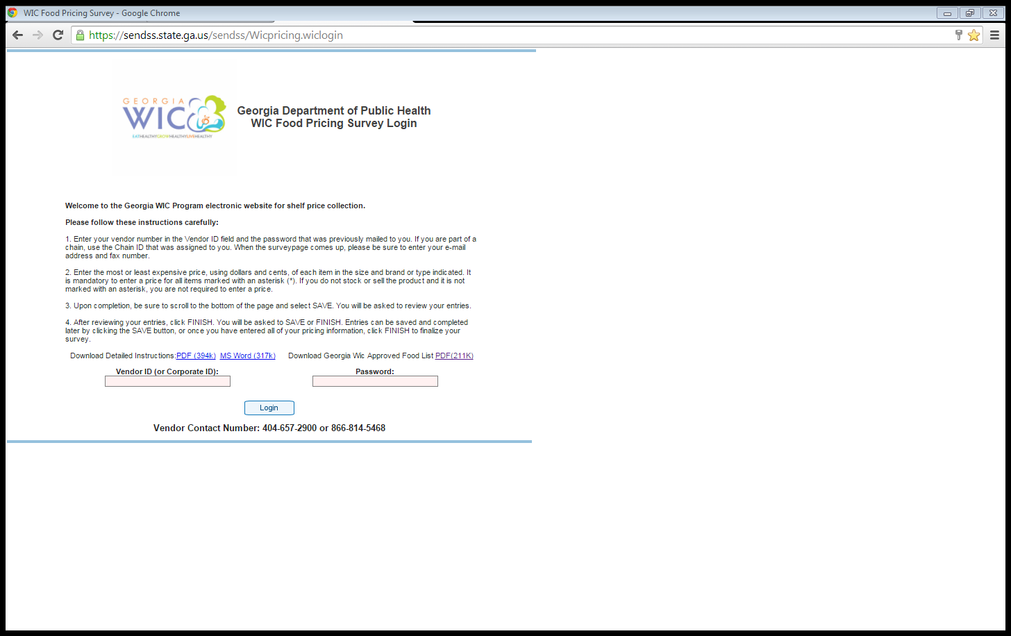
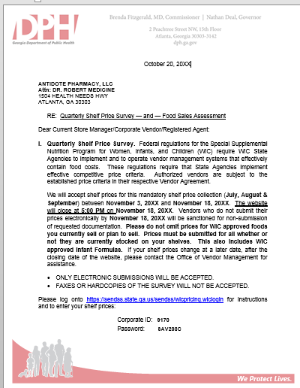
Logging into the Survey
Log-In using the username (Vendor Number)and password provided in the letter received from the Office of Vendor Management. Click on the Login icon.
Keep your log-in information handy. The login credentials remain effective until the next quarterly survey.

Slide 7
If you have been authorized to submit UPC Codes, please skip this section and move on to the UPC Submission Section.
Shelf Price Submissions

Slide 8
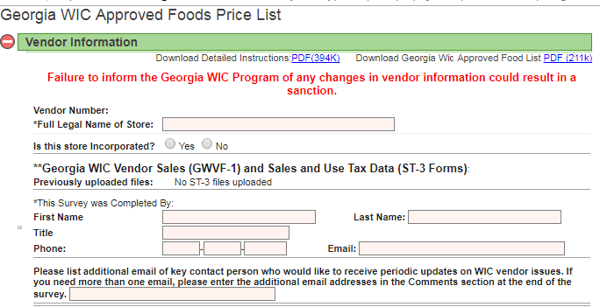
Vendor Information Screen
Click on the plus sign to expand the “Vendor Information” section or any other section on this screen.

Slide 9
Completing the Shelf Price Section
The Vendor information is pre-populated. However, you can enter updates or any missing information.
Provide the name and phone number of the person completing the survey.

Slide 10
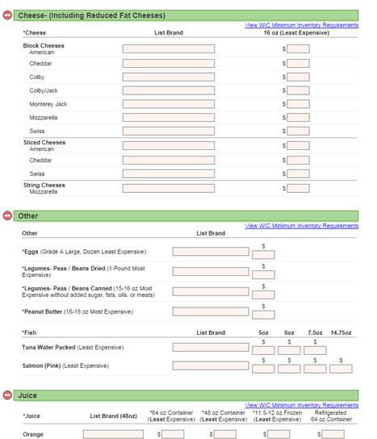
Price Listing Completion
Input the brand and prices in the appropriate sections.
Nacho Libre
2.22
Better Cheddar
4.44
An asterisk (*) indicates you must fill in the price. Any missing information will be asked for when you finalize the survey.
Humpty Dumpty
2.34
Something Fishy
3.45

Slide 11
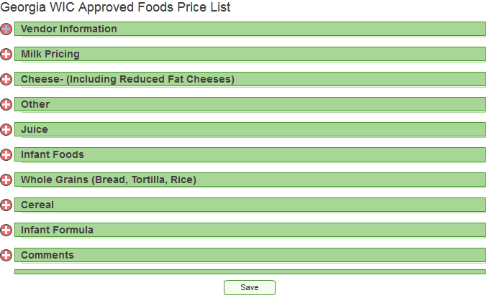
Saving a Partially Completed Survey
You are not required to complete the entire survey in one session. A save feature allows you to save what has been entered and return later to continue the survey .
To save, go to the bottom of the screen and select “Save”.

Slide 12
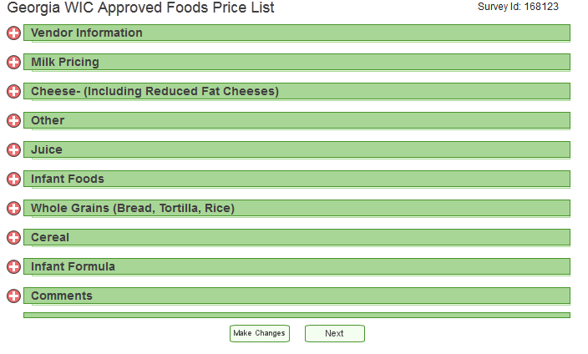
Saving a Partially Completed Survey
After clicking “Save”, a screen will appear that will allow you to review your survey and make changes.
Clicking on “Next” will display a dialogue box to either finalize the survey or finish later.
To make changes, click on “Make Changes”.

Slide 13
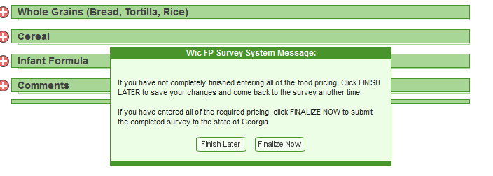
Saving a Partially Completed Survey
”Finalize Now”. If you have completed the survey, select this option. Once selected, the system will check that all fields have been entered correctly. Any fields that have not been entered will be reported back to you.
“Finish Later”. This option can be used when you want to return later to complete the survey.

Slide 14
Finalizing a Completed Survey
Once you have completed the survey go to the bottom of the page and select “Save”. The window below will appear.
You will be asked if you are sure you want to finalize the survey. Click “OK”.
A dialog box will be displayed. Click on “Finalize Now”.

Slide 15
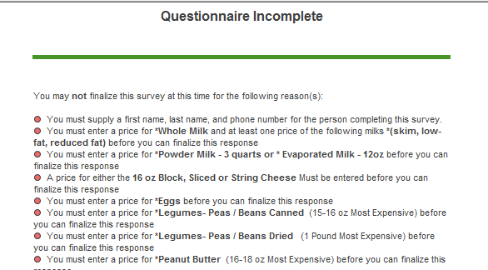
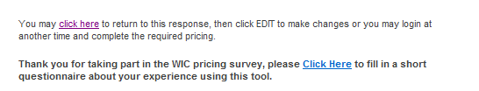
Missing Data Screen
If the survey questionnaire is incomplete, the survey will prompt you in a new page.
Click on the hyperlink to return to the incomplete response, then click edit to make the necessary changes.

Slide 16
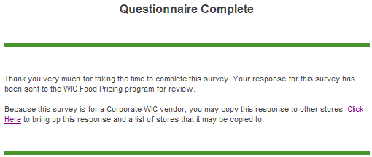
Survey Completed
If the survey questionnaire is complete, the survey will prompt you in a new page.
As a corporate vendor, you will click on “Click Here” to take you back to the survey to copy the information for additional stores.

Slide 17
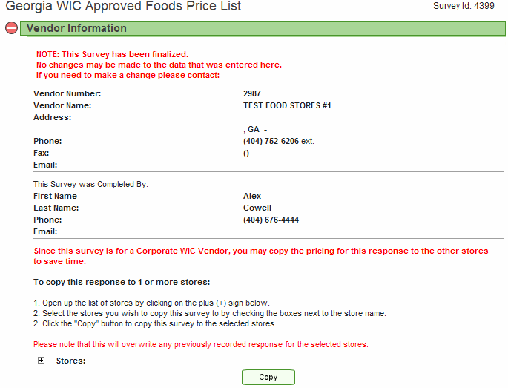
Copying Multiple Stores
After selecting the “Click Here” hyperlink, the following screen will appear.
The “+” will not appear until the survey is completed and finalized. Click the “+” sign here.

Slide 18
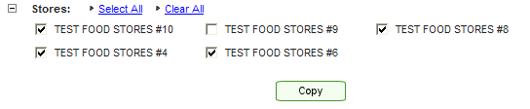
Copying Multiple Stores
After selecting the “+”, the stores will appear at the bottom.
Select the stores you wish to copy the information to.
Click on the “Copy” icon. A message will appear instructing you to wait for the copy process to finish.

Slide 19
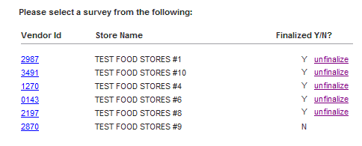
Copying Multiple Stores
Click the refresh icon on your browser and now the selected stores are now finalized.
NOTE: In this example, since we used Vendor ID 2870, it will not show as finalized. It is considered the primary for this example.
Using the Corporate Vendor ID, the primary Vendor ID (in this case 2870) would be selected to update the survey from this screen or to access the survey from the Login screen.

Slide 20
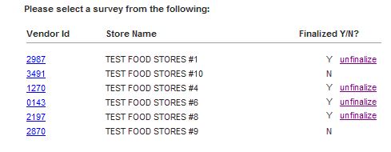
Making Changes to Finalized Surveys
This feature is for stores that have price variations for WIC approved items.
Click on the Vendor ID and the survey will open in edit mode. In edit mode you can make price changes. In this example, we unfinalized vendor #3491

Slide 21
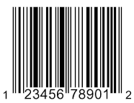
If you have not been authorized to submit UPC Codes, please skip this section and move on to the Shelf Price Submission Section.
UPC Code Submissions

Slide 22
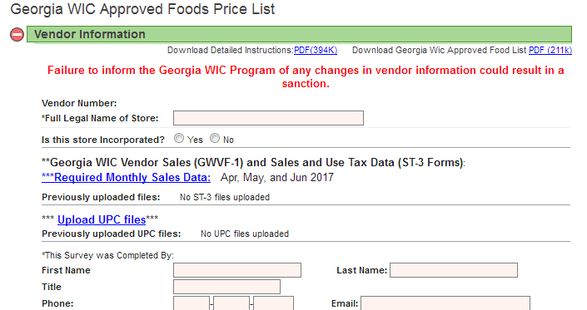
Vendor Information Screen
Click on the plus sign to expand the “Vendor Information” section or any other section on this screen.
Click on the Upload UPC Files hyperlink.

Slide 23
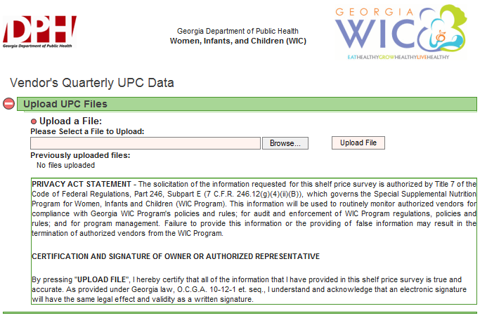
Uploading UPC Files
Click on the “Browse” icon to open window explorer to choose a file to upload.

Slide 24
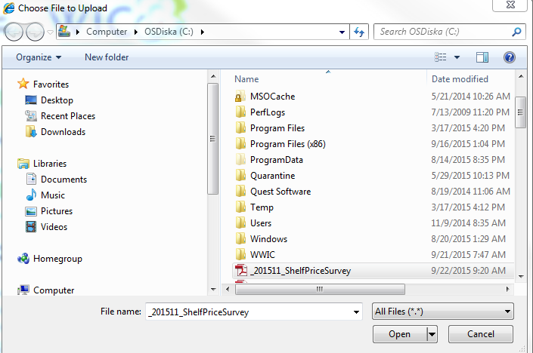
Uploading UPC Files
Please Note: The UPC file being submitted must be in Microsoft Excel or CSV (Comma Delimited) format.
Select the file the UPC files are saved as.
UPC Files Quarter 1
UPC Files Quarter 1
Click the Open button on the window explorer in order to show the selected file. The file will show in the Select File box.

Slide 25
Uploading UPC Files
UPC Files Quarter 1
Click on the “Upload File” icon to upload the UPC File.

Slide 26
Food Sales Data Submissions

Slide 27
Food Sales Data Entry
Click on the link “Required Monthly Sales Data”

Slide 28
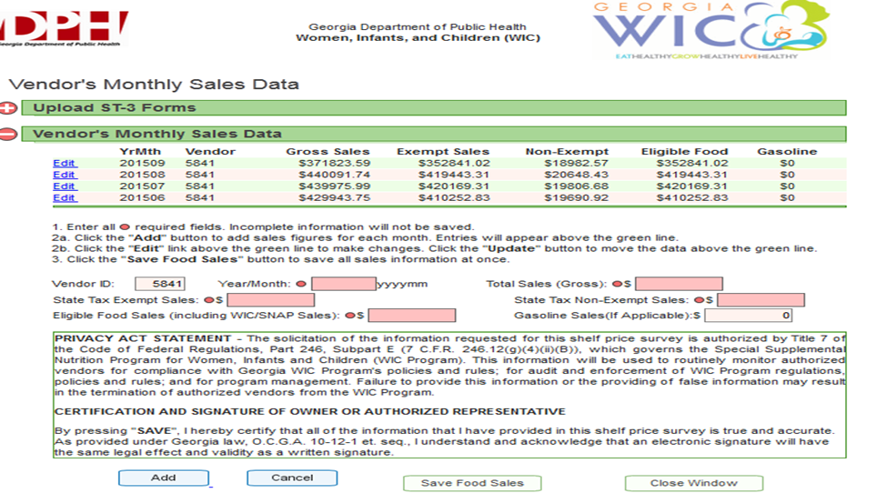
Monthly Sales Data Entry
Click on the plus sign to expand the Vendor’s Monthly Sales Data Section.
Enter all required fields in which a red dot is next to the field entry.
Click on “Add” to add the sales figures.

Slide 29
Monthly Sales Data Entry
After clicking the “Add” button, entries will appear here. Click the “Edit” hyperlink to make changes and click the “Update” button.
Click the “Save Food Sales” button to save the entered information.

Slide 30
Retrieving Sales and Use Documents (ST3)

Slide 31
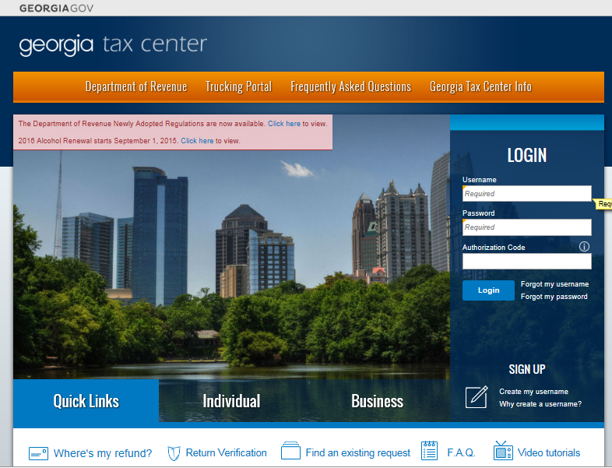
Logging In to the GA Tax Center
Step 1: Log-In using the username and password provided by the GA Department of Revenue.
Please Note: If you forgot the username and password, click on the “Forgot Username” or “Forgot Password” link.

Slide 32
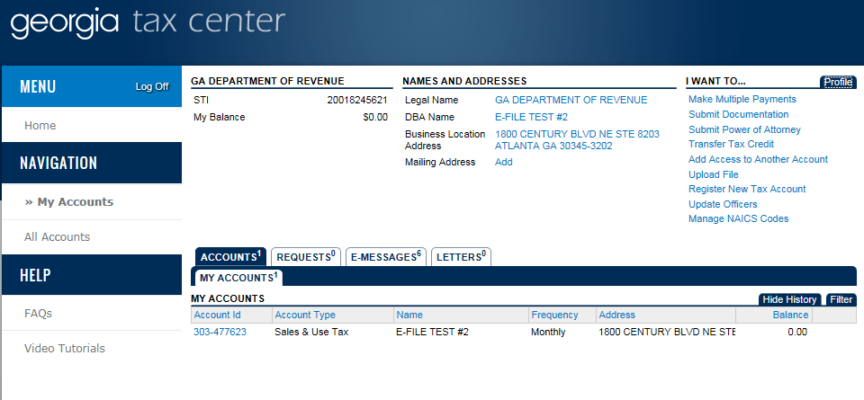
Selecting an Account
Step 2: Click on the “Accounts” tab.
Step 3: Click on your account number.

Slide 33
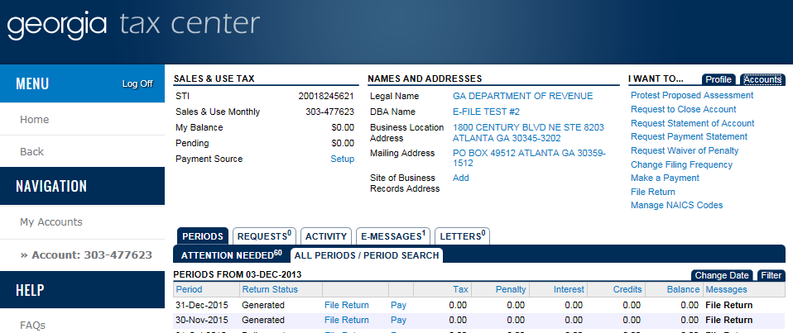
Searching and Selecting a Tax Period
Step 4: Click on the sub-tab “All Periods/Period”.
Step 5: Search under the “Periods” tab.

Slide 34
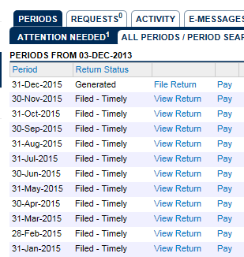
Searching and Selecting a Tax Period
Step 6: Click on “View Return” and select the return period you wish to review.
Reminder: The selected document can be saved to PDF. The print tab gives you the option to save the selected file.

Slide 35
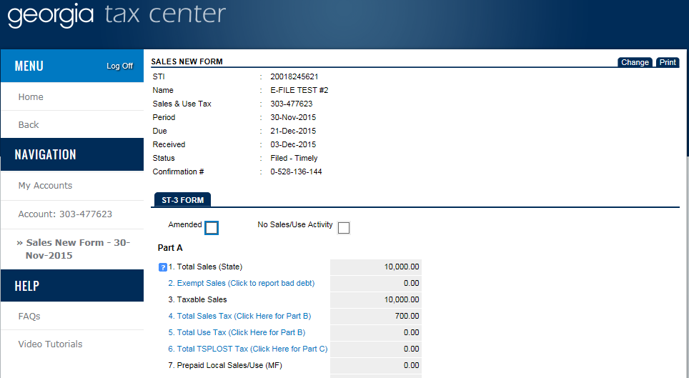
Printing and Saving the Document
Step 7: In the upper right hand corner, click on the “Print” tab.
Reminder: The selected document can be saved to PDF. The print tab gives you the option to save the selected file. A separate tab will open to save the file. Make sure your Pop-Up blocker is turned off in order to do so.

Slide 36
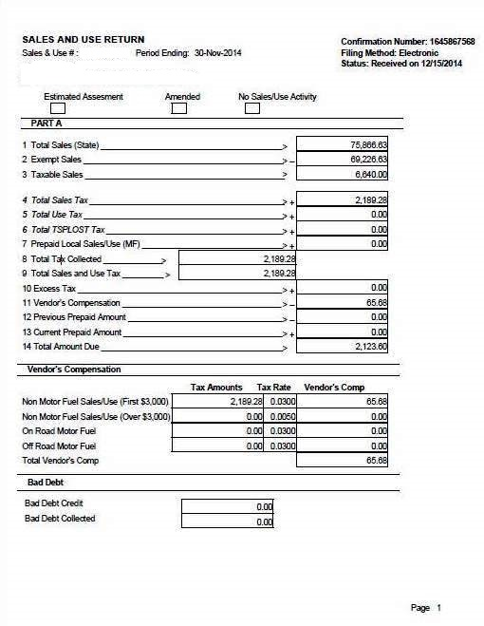
Sales and Use Return Example
Confirmation Number
Period End Date

Slide 37
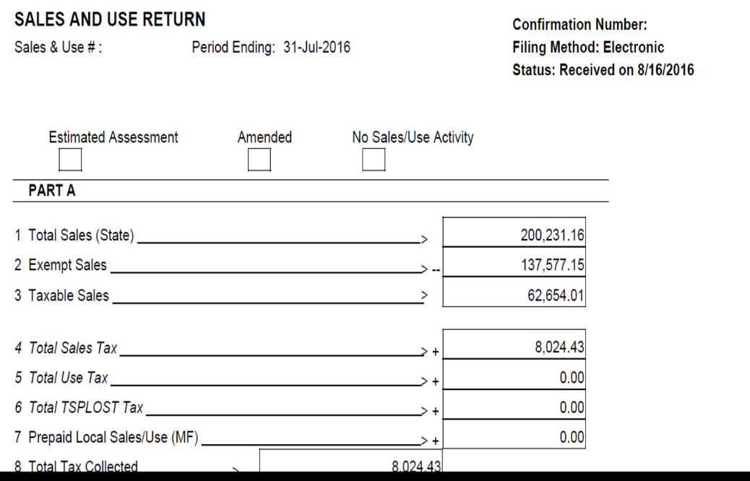
Corporate Spreadsheet Example
NOTE: Corporate vendors must provide an itemized spreadsheet separating total state sales, exempt sales, and taxable sales for each WIC authorized store.
Sales and Use Return Example
Corporate Spreadsheet Example
Break down the Total Sales for each store.
Break down the Total Exempt Sales for each store.
Break down the Total Non-Exempt Sales for each store.
Total Sales = State Exempt Sales + State Taxable Sales
State Exempt Sales = The sales that are exempt from state taxes. Please reference the attachment for a complete listing.
State Taxable Sales = Total Sales – State Exempt Sales

Slide 38
Sales and Use Documents (ST3)Submissions

Slide 39
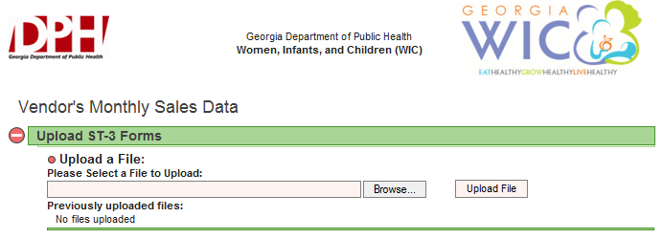
Uploading Sales and Use Documents
(ST-3 Forms)
As part of the Shelf Price Survey, Sales and Use documents (ST-3 Form) must be uploaded to the SENDSS website.
Click on the “Browse” icon to open window explorer to choose a file to upload.

Slide 40
Uploading Sales and Use Documents
(ST-3 Forms)
Select the file the ST-3 is saved as.
Click the Open button on the window explorer in order to show the selected file. The file will show in the Select File box.

Slide 41
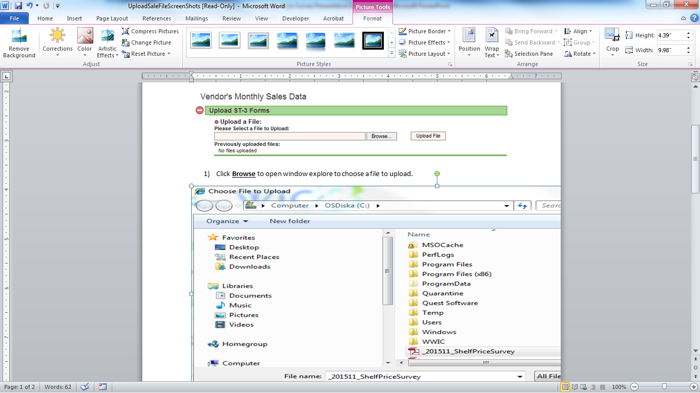
Uploading Sales and Use Documents
(ST-3 Forms)
Click on the “Upload” file icon.

Slide 42
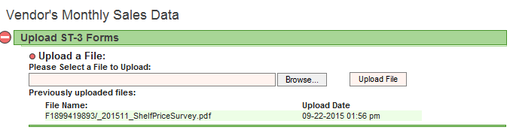
Uploading Sales and Use Documents
(ST-3 Forms)
Once you click “Upload” the file name will appear here with the time and date.

Slide 43
Sales and Use Document Submission
Don’t forget to submit your Sales and Use Documents (ST3’s) for the 3 month period within the requested quarter. (see example)
The Sales and Use document (ST3’s) can be submitted via the Shelf Price Survey section. Please see the Shelf price Survey Instructions for more detail.

Slide 44
Contact Information
For UPC Submissions only
Nicole Monroe, WIC Vendor Senior Data Analyst
Office: (404) 657-2898
nichole.monroe@dph.ga.gov
For Food Sales Data Information
Vendor Relations Information
Office: (404) 657-2900 and 866-814-5468
wic-vendor.relations@dph.ga.gov

