Slide 1
State Office of Vital Records
Records Management Webinar
September 27, 2017
10- 11am

Slide 2
Records Management 101
Presented by: Doug Rollo
Asst. Director, Records Management
Georgia State Archives

Slide 3
Table of Contents
What is Records Management
Common Myths
Ways to Track Records
Records Retention Policy
What is a Record

Slide 4
Table of Contents Continued
6. Electronic Records
Hard Copy Records
Records Supplies
Destruction

Slide 5
What is Records Management?
Records management, or RM, is the practice of maintaining the records of an organization from the time they are created up to their eventual disposal. This may include classifying, storing, securing, and destruction (or in some cases, archival preservation) of records.

Slide 6

What Records Management Is
Records Creation
Filing and Storage
Tracking
Ethical Walls
Destruction

Slide 7

What Records Management Is Cont.
Anything that has to do with a record during its lifecycle and beyond

Slide 8
What Records Management Can Do !
Save Money
Save Time
Lessen Liability

Slide 9
Common Misperceptions
We are required to keep all records forever
What are the requirements?
Birth Records 100 years
Death Records 75 years

Slide 10

More Common Misperceptions
Always have three copies of everything
It’s better to have the records than not to have them

Slide 11
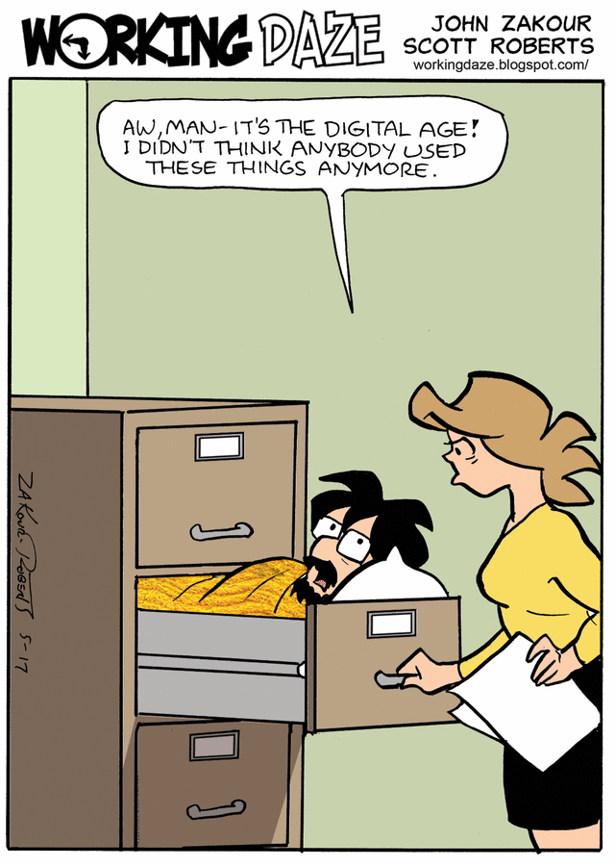

Slide 12
Common Myths
Personal Records
Non Records
Unofficial Records

Slide 13
Tracking Records
Records Management Software
Access
Excel
Notebooks
Memory

Slide 14


Electronic Records Locations
Hard Drives
Tape Drives
Thumb Drives
Wireless Devices

Slide 15
Records Supplies
File Folders
Shelving
Boxes

Slide 16
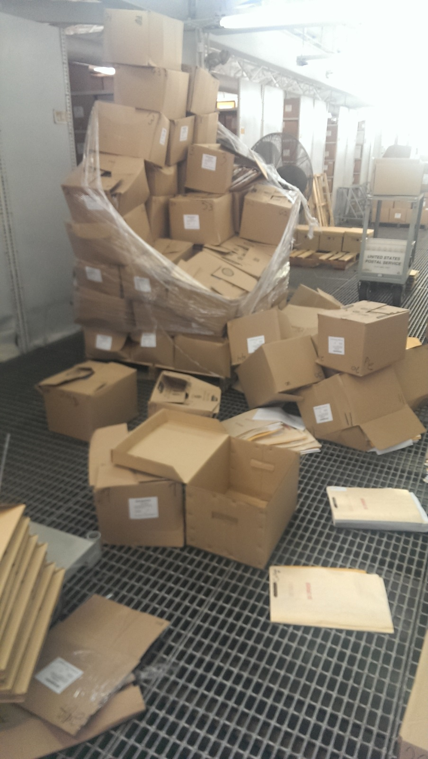

Slide 17
Labeling Box
What information should go on the box?
What information should not go on the box?

Slide 18
Records Centers
Should active and inactive records be stored together?
How should a records room be set up?
How is the space to be allocated?
Should departments have their own space?

Slide 19
Records Storage Facility
Cleanliness
Shelving
Critters
Weather
Security

Slide 20
www.georgiaarchives.org

Slide 21
Contact Info.
Doug Rollo
Asst. Director, Records Management
Georgia State Archives
doug.rollo@usg.edu
404.756.4866

Slide 22
Vital Records – Retention Period
Forms | Retention Period
Drop to Paper | 3 years
Long Form Death Report | 3 years
Paternity Acknowledgement | Check GAVERS ( if update is complete – destroy)
Amendments | Check GAVERS ( if correction is made – destroy)
Disposition Permits | Permanently
Custodial Copies | Check GAVERS ( if correction is made – destroy)
Customer Request Forms (with fee) | 1 year

Slide 23
Questions ?????

