Slide 1
Childhood, Adolescent, and Adult Immunization Schedule
Review of the Recommended Schedule
Healthcare Professionals/State Immunization Program Staff/On-Demand

Slide 2
Disclosure Statements
Neither the planners of this session nor I have any financial relationship with pharmaceutical companies, biomedical device manufacturers, or corporations whose products and services are related to the vaccines we discuss
There is no commercial support being received for this event
The mention of specific brands of vaccines in this presentation is for the purpose of providing education and does not constitute endorsement
The GA Immunization Program utilizes ACIP recommendations as the basis for this presentation and for our guidelines, policies, and recommendations
For certain vaccines this may represent a slight departure from, or off-label use of the vaccine package insert guidelines
Notes:
Prior to beginning I will review the disclosure statements

Slide 3
Disclosure Statements
This activity has been approved for 2 contact hours of nursing continuing professional development.
To obtain nursing contact hours for this session, you must be present for the entire session and complete an evaluation
Continuing Education credit will be provided through the Georgia Department of Public Health
Georgia Department of Public Health is an approved provider of continuing nursing education by the Georgia Nurses Association, an accredited approver by the American Nurses Credentialing Center's Commission on Accreditation

Slide 4
Objectives
At the end of this presentation, participants will be able to:
Recall the role vaccines have played in preventing diseases
Discuss the importance of vaccines for children, adolescents and adults
Discuss the role of a vaccine champion
List at least two reliable sources for immunization information
Notes:
Let’s review our objectives. At the end of this presentation, participants will be able to:
Recall the role vaccines have played in preventing diseases
Discuss the importance of vaccines for children, adolescents, and adults
Discuss the role of a vaccine champion
List at least two reliable sources for immunization information

Slide 5
The Impact of Vaccines in the United States
CDC. National Notifiable Diseases Surveillance System, 2017 Annual Tables of Infectious Disease Data. https://wonder.cdc.gov/nndss/nndss_annual_tables_menu.asp
Notes:
This table shows the impact of vaccines on the annual reported cases of some vaccine preventable diseases in the United States.
Column 2 shows the average number of reported cases of a specific disease prior to the licensure of the vaccine.
Column 3 shows the number of reported or estimated cases in the United States in 2017 (most recently reported is for 2019)
Column 4 shows the percentage decrease in reported cases in the United States compared with the pre-vaccine years.
For additional information on outbreaks and reporting, please contact the Epidemiology Program at the State Office.
References:
CDC. National Notifiable Diseases Surveillance System, 2017 Annual Tables of Infectious Disease Data. Available at www.cdc.gov/nndss/infectious-tables.html. NNDSS finalized annual data as of November 28, 2018.
https://wonder.cdc.gov/nndss/nndss_annual_tables_menu.asp

Slide 6
Herd Immunity
VPD | Vaccination Rate Needed for Herd Immunity
Measles | 92-94%
Pertussis | 92-94%
Diphtheria | 83-85%
Rubella | 83-85%
Mumps | 75-86%
Influenza | 30-75%
Notes:
Herd immunity is the term most frequently used that refers to a situation in which a high percentage of a population is immune to a disease, essentially stopping the disease in its tracks because it cannot find new hosts. This chart illustrates the vaccination rate needed for each of the VPDs listed.
The threshold for herd immunity varies, depending on the disease, with more virulent infectious agents requiring vaccination of a higher percentage of the population to create the desired community immunity. The creation of herd immunity is especially important in crowded environments which facilitate the spread of disease, like schools. It is also extremely important to receive regular boosters, as some vaccines lose their efficacy over time, leaving people vulnerable to an outbreak. Herd immunity led to the eradication of smallpox, and it explains why diseases such as polio and diphtheria are rare in developed nations with established vaccination policies.
According to the 2017 National Immunization Study, Georgia ranks higher than US national averages for some of the recommended childhood vaccines.
Georgia coverage rates for children 19-35 months for 2017:
• Polio (>/= 3 doses) 92.8% (92.7% US) (97.0% in 2016)
• Hepatitis B (>/= 3 doses) 93.3% (91.4% US) (95.5% in 2016)
• Hepatitis B birth dose 75.7% (71.4% US) (80.9% in 2016)
• Varicella (>/= 1 dose) 92.4% (91.0% US) (93.2% in 2016)
• Hepatitis A (>/= 2 doses) 64.3% (59.7% US) (69.9% in 2016)
Coverage with recommended vaccines for children aged 19–35 months continues to be below 90% and with further decrease for vaccines that require booster doses during the second year of life (≥4 doses of DTaP and PCV as well as Hib full series) and for other recommended vaccines (HepB birth dose, rotavirus, and HepA). Disparities in coverage persisted for black children and those living below the poverty level, and coverage was generally lower for children who were uninsured or covered by Medicaid than among those with private insurance. These disparities indicate that improvements are needed in access to and delivery of age-appropriate immunization to all children, regardless of insurance or financial status (i.e., “the immunization safety net”).
So, What does this mean for public health practice?
Continued collaboration between CDC and state immunization programs to further elucidate and address disparities in coverage by poverty status should provide valuable information as strategies are needed for improving access to and delivery of age-appropriate immunization. Health care providers can increase vaccination coverage using evidence-based strategies such as provider reminders, standing orders to provide vaccination whenever appropriate, and immunization information systems.
References:
1. MMWR. 2017 Nov 3; 66(43): 1171–1177

Slide 7
ACIP
15 voting members with expertise in one or more of the following:
Vaccinology
Immunology
Infectious diseases
Pediatrics
Internal Medicine
Preventive Medicine
Public Health
Consumer perspectives and/or social and community aspects of immunization programs
ACIP develops recommendations and schedules for the use of licensed vaccines
https://www.cdc.gov/vaccines/acip/members/index.html
Notes:
Ask the audience if they are familiar with the ACIP. If they are familiar with the ACIP the presenter can spend a minimal amount of time on this slide.
The dramatic reduction of vaccine preventable diseases in the United States can be attributed to the availability of vaccines, as well as recommendations and an organized vaccine schedule developed by the Advisory Committee on Immunization Practices (ACIP).
The Advisory Committee on Immunization Practices (ACIP) consists of 15 experts in fields associated with immunization who have been selected by the Secretary of the U. S. Department of Health and Human Services to provide advice and guidance to the Secretary, the Assistant Secretary for Health, and the Centers for Disease Control and Prevention (CDC) on the most effective means to prevent vaccine-preventable diseases.
The Committee develops written recommendations for the routine administration of vaccines to the pediatric and adult populations, along with schedules regarding the appropriate periodicity, dosage, and contraindications applicable to the vaccines. ACIP is the only entity in the federal government which makes such recommendations.
The overall goals of the ACIP are to provide advice which will assist the Department and the Nation in reducing the incidence of vaccine preventable diseases and to increase the safe usage of vaccines and related biological products.
Reference:
https://www.cdc.gov/vaccines/acip/members/index.html

Slide 8
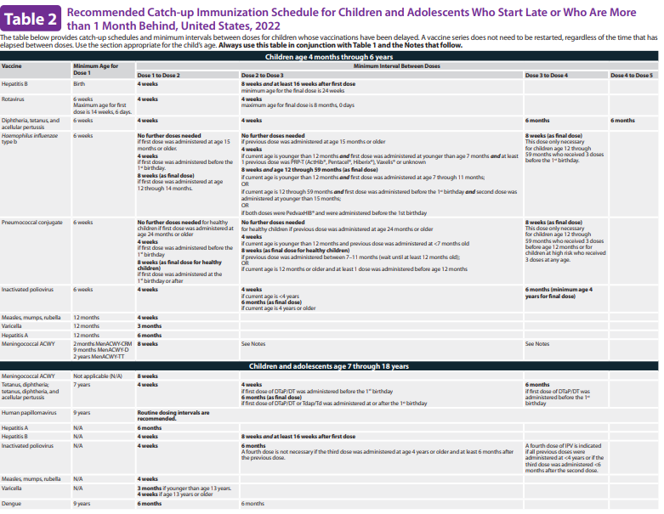
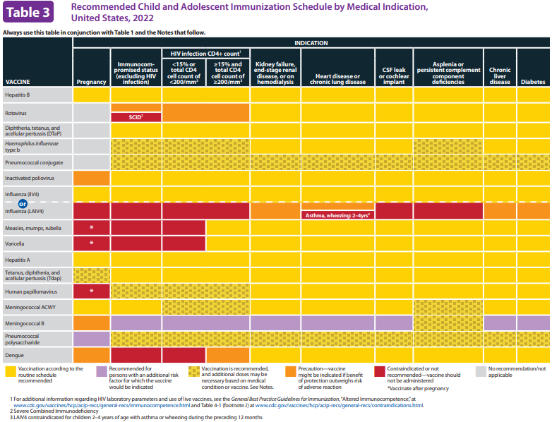
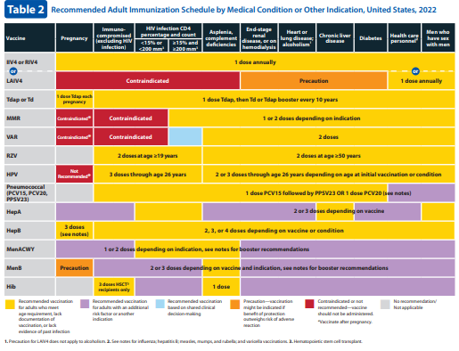
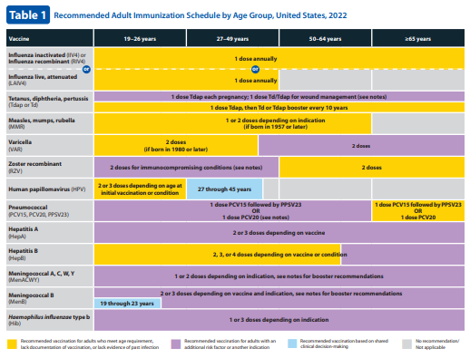
Immunization Schedule Updates
All staff must use the same immunization schedule
Schedules:
Children & Adolescents 0 through 18 years
Catch-up schedule for ages 4 months -18 years
Children and Adolescents 18 years or younger based on medical indications
Appendix
Adults 19 years and older
Adults based on medical and other indications
Appendix
READ THE NOTES
Notes:
ACIP has developed immunization schedules for children, adolescents and adults in which recommendations are given to aid in the prevention of vaccine preventable diseases. In last year’s November meeting, ACIP along with other partnering organizations met and approved the 2022 Recommended Child and Adolescent Immunization Schedule for ages 18 years or younger. These changes became effective when the MMWR was published.
It is important to remember that:
-All staff and providers should use the same immunization schedule. Please ensure you are using this most up to date version.
References:
http://www.cdc.gov/vaccines/schedules/hcp/child-adolescent.html
2. http://www.cdc.gov/vaccines/schedules/hcp/adult.html

Slide 9
https://www.cdc.gov/vaccines/schedules/hcp/imz/child-adolescent.html
Notes:
So, diving in, we’ll start with the cover page in which:
The layout remains the same, and where you can still find the “How To Use” table, a table with acronyms and brand names for vaccines listed in the schedule, list of organizations that participate in the approval of the schedule, VAERS Reporting Information and a Helpful Information section.
Changes include:
• Dengue vaccine (DENGVAXIA) has been added to the table of vaccine abbreviations and trade names.
• A 5th step asking health care providers to review the appendix, which lists the contraindications and precautions for each vaccine type has been added to the “How to use” table.
• Instructions on how health care providers can contact CDC with questions and comments about the schedule have been added.
• The helpful information’s section was updated to include information on accessing Vaccine Information Statements.
• A QR code for providers to access the immunization schedule online has been added.
References:
https://www.cdc.gov/vaccines/schedules/hcp/imz/child-adolescent.html, Child and Adolescent Immunization Schedule, Recommendations for Ages 18 years or Younger, United States, 2022

Slide 10
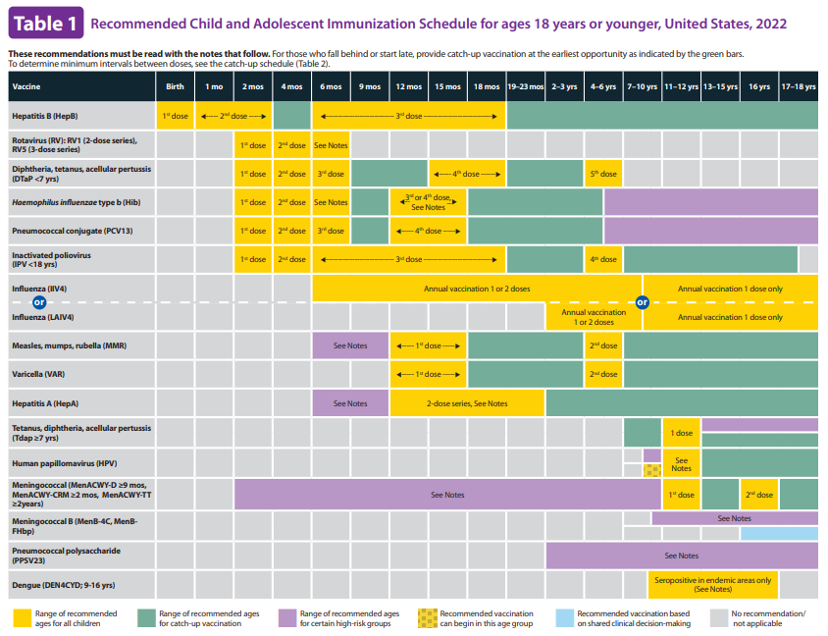
https://www.cdc.gov/vaccines/schedules/hcp/imz/child-adolescent.html
Notes:
Changes to Table 1 for 2022 include:
• The color of the columns for children aged 4–6 years, children aged 11–12 years, and adolescents aged 16 years has been changed from gray to black to align with the color of the other age range columns. The sentence in the table header stating “School entry and adolescent vaccine age groups are shaded in gray” has been deleted.
• Tdap row: The overlying text in the column for children aged 11–12 years has been changed from “Tdap” to “1 dose” to be consistent with the format used for other vaccines in the table.
• HPV row: The asterisk that was previously present for children aged 9–10 years and its associated descriptive text in the table legend (i.e., “*can be used in this age group”) have been deleted. Instead, the color for children aged 9–10 years has been changed from blue to checked yellow, which is a new color in Table 1. Within the table’s legend, a new checked yellow box has been added, which now indicates that “Recommended vaccination can begin in this age group.”
• Dengue row: A new row has been added with the boxes for children and adolescents aged 9–16 years highlighted in yellow to indicate the recommended age for routine dengue vaccination. The overlying text “Seropositive in endemic areas only (see notes)” has been added to the yellow boxes.
References:
https://www.cdc.gov/vaccines/schedules/hcp/imz/child-adolescent.html, Child and Adolescent Immunization Schedule, Recommendations for Ages 18 years or Younger, United States, 2022

Slide 11
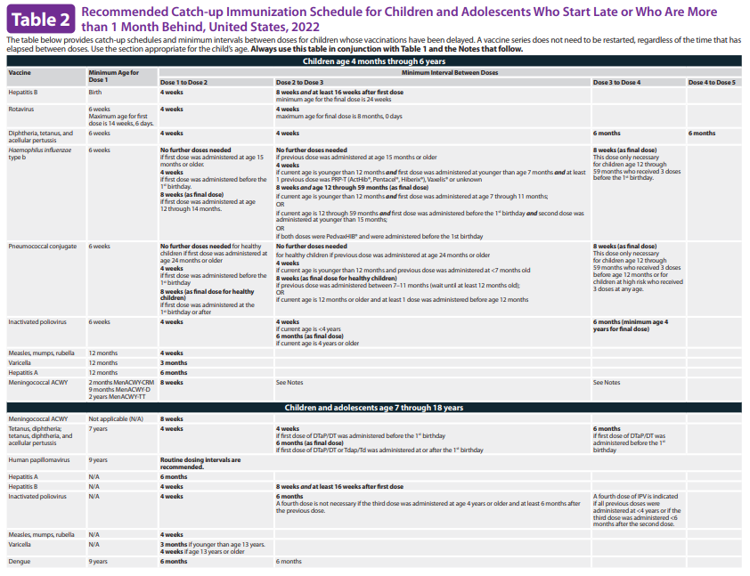
https://www.cdc.gov/vaccines/schedules/hcp/imz/child-adolescent.html
Notes:
Changes to Table 2 for 2022 include:
• Hib row: The text for the 4-week minimum interval between doses 2 and 3 has been revised to include recommendations for DTaP-IPV-Hib-HepB (Vaxelis). The text now reads, “if current age is younger than 12 months and first dose was administered at younger than age 7 months and at least 1 previous dose was PRP-T (ActHib, Pentacel, Hiberix), Vaxelis, or unknown.” In addition, Hib-HepB (Comvax) was deleted from the text for the 8-week minimum interval between doses 2 and 3 because this vaccine product is no longer available.
• Dengue row: A new row has been added for the dengue vaccine outlining the minimum age and minimum interval between doses.
References:
https://www.cdc.gov/vaccines/schedules/hcp/imz/child-adolescent.html, Child and Adolescent Immunization Schedule, Recommendations for Ages 18 years or Younger, United States, 2022

Slide 12
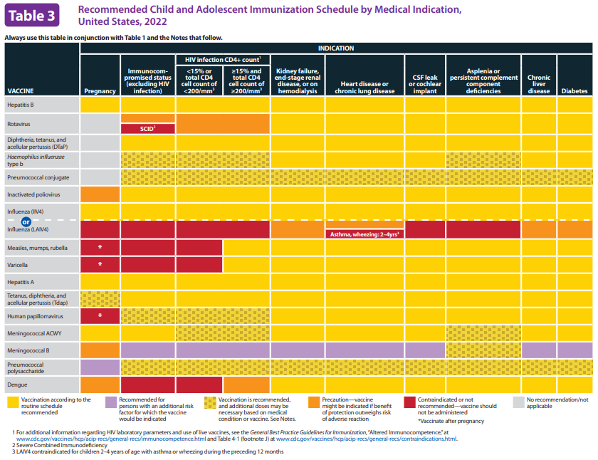
https://www.cdc.gov/vaccines/schedules/hcp/imz/child-adolescent.html
Notes:
Changes to Table 3 (Medical Indication) for 2022 include:
• The definition of severe immunosuppression because of HIV infection has been revised to be consistent with ACIP’s General Best Practice Guidelines for Immunization and now reads, “<15% or total CD4 cell count of <200/mm³.”
• Legend: The text that defines the red box in the table’s legend has been edited for clarity and now reads, “Contraindicated or not recommended—vaccine should not be administered.” In addition, the text that defines the checked yellow box in the table’s legend has been edited and now reads, “Vaccination is recommended, and additional doses might be necessary based on medical condition or vaccine. See Notes.”
• Dengue: A new row has been added for dengue vaccine recommendations by medical conditions or other indications.
References:
https://www.cdc.gov/vaccines/schedules/hcp/imz/child-adolescent.html, Child and Adolescent Immunization Schedule, Recommendations for Ages 18 years or Younger, United States, 2022

Slide 13
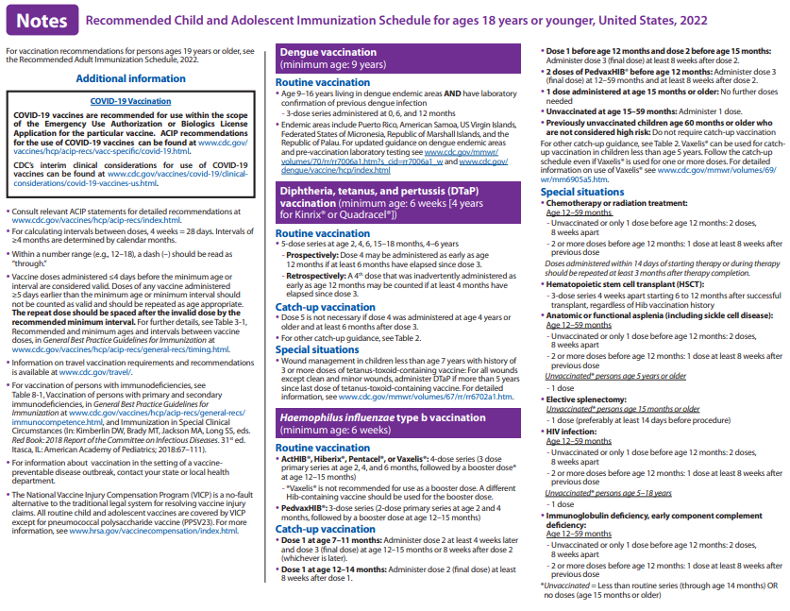
https://www.cdc.gov/vaccines/schedules/hcp/imz/child-adolescent.html
Notes:
Changes to the 2022 Notes section includes:
• Additional information: The text for COVID-19 vaccination has been updated to include a hyperlink to the webpage for CDC’s interim clinical considerations for use of COVID-19 vaccines currently approved or authorized in the United States.
• Dengue: This new section was added to provide details for routine dengue vaccination in areas with endemic dengue. In addition, a hyperlink referring health care providers to the latest guidance on areas with endemic dengue and pre-vaccination laboratory testing is included.
• Hib: The note was updated to include the recommendations for routine and catch-up vaccination when DTaP-IPV-Hib-HepB (Vaxelis) is used.
References:
https://www.cdc.gov/vaccines/schedules/hcp/imz/child-adolescent.html, Child and Adolescent Immunization Schedule, Recommendations for Ages 18 years or Younger, United States, 2022

Slide 14
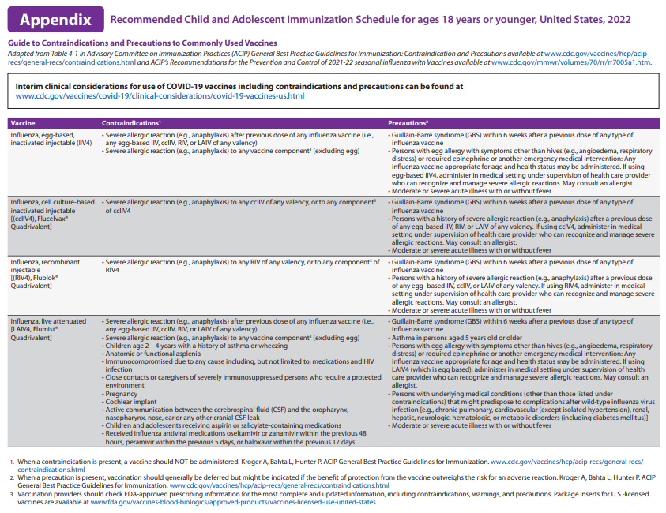
https://www.cdc.gov/vaccines/schedules/hcp/imz/child-adolescent.html
Notes:
A newly created appendix listing the contraindications and precautions for each vaccine type included in the 2022 child and adolescent immunization schedule has been added. The information in the appendix is adapted from ACIP General Best Practice Guidelines for Immunization and ACIP recommendations for use of 2021–22 influenza vaccines.
References:
https://www.cdc.gov/vaccines/schedules/hcp/imz/child-adolescent.html, Child and Adolescent Immunization Schedule, Recommendations for Ages 18 years or Younger, United States, 2022

Slide 15
What Does It All Mean?
Indication: Information about the appropriate use of the vaccine
Recommendation: ACIP statement that broadens and further delineates the indication found in the package insert
-Basis for standards for best practice
Requirement: Mandate by a state that a vaccine must be administered and documented before entrance to childcare and/or school
Notes:
It is important that providers understand the difference between an indication, recommendation and a requirement when assessing immunization need.
An indication provides information about the appropriate use of the vaccines; the prescribing information. FDA decides whether to approve (also known as to license) the vaccine for use in the United States. If FDA approves the vaccine, the company is permitted to market it in the United States for use in the population for which it is approved.
EXAMPLE of an indication:
ADACEL vaccine is indicated for active booster immunization for the prevention of tetanus, diphtheria and pertussis as a single dose in persons 10 through 64 years of age.
BOOSTRIX® is indicated for active booster immunization against tetanus, diphtheria, and pertussis as a single dose in individuals 10 years and older.
A recommendation is the ACIP statement that broadens and delineates the indication found in the package insert. ACIP develops written recommendations for the routine administration of vaccines, along with schedules regarding appropriate timing, dosage, and contraindications.
EXAMPLE of a recommendation:
The ACIP recommendation for Tdap would be, “Administer 1 dose of Tdap vaccine to all adolescents aged 11 through 12 years.” The recommendation may include other information and guidance on epidemiology of the disease, appropriate timing, dosage, contraindications to the vaccine and guidance for use in special populations. The recommendation appears first as “provisional recommendation” but once approved, it appears in the MMWR as a full recommendation.
A vaccine requirement is consistent with the ACIP Recommended Childhood/Adolescent Immunization Schedule. The state mandates that a particular vaccine must be administered and documented before entrance to school or childcare.
EXAMPLE of a state vaccine requirement:
Requirements are consistent with the Recommended Childhood and Adolescent Immunization Schedule. GA DPH rules and regulations state that children entering any school or childcare facility in GA must be age appropriately immunized against each of these diseases: Hepatitis B, Diphtheria, Tetanus, Pertussis, Polio, Hib, Pneumococcus, Measles, Mumps, Rubella, Varicella, Hepatitis A and Meningococcal.
Remember that GRITS: Calculates validity based on recommendations; Prints certificates based on requirements, which are first based on the recommendations. Some of the vaccines that will be discussed are RECOMMENDED for particular age groups, but MAY NOT BE REQUIRED for school or childcare attendance. (i.e. HPV, MenB).

Slide 16
General Best Practice Guidelines
Timing and Spacing of Immunobiologics
Contraindications and Precautions
Preventing and Managing Adverse Reactions
Vaccine Administration
Storage and Handling of Immunobiologics
Altered Immunocompetence
Special Situations
Vaccination Records
Vaccination Programs
Vaccine Information Sources
https://www.cdc.gov/vaccines/hcp/acip-recs/general-recs/index.html
Notes:
On April 20, 2017, ACIP published The General Best Practice Guidelines for Immunization. Providers and patients must navigate numerous issues, such as the timing of each dose, screening for contraindications and precautions, the number of vaccines to be administered, the educational needs of patients and parents, and interpreting and responding to adverse events. Vaccination providers help patients understand the substantial body of (occasionally conflicting) information about vaccination.
This report will help vaccination providers to assess vaccine benefits and risks, use recommended administration practices, understand the most effective strategies for ensuring that vaccination coverage in the population remains high, and communicate the importance of vaccination to reduce the effects of vaccine-preventable disease. These best practice guidelines are intended for use in the United States; vaccine availability, use, and epidemiologic circumstances might differ in other countries and might warrant different guidance.
Reference:
https://www.cdc.gov/vaccines/hcp/acip-recs/general-recs/index.html

Slide 17
General Best Practice Guidelines Updates
January 24, 2022
Contraindications and Precautions: Table 4-1 is updated with contraindications and precautions for dengue vaccine.
Contraindications and Precautions: A footnote in Table 4-1 is added to inactivated influenza vaccine and live attenuated influenza vaccine to describe the change in allergy-related contraindications and precautions. A history of severe allergic reaction (e.g., anaphylaxis) is now tied to the history of specific influenza vaccine brands.
Storage and Handling of Immunobiologics: The correct storage temperature range is applied to MMR vaccine in Table 7-1. The vaccine portion (but not the diluent) can be stored at freezer or refrigerator temperature. Hence the storage range is -50° C – 8° C (5° F – 46° F).
https://www.cdc.gov/vaccines/hcp/acip-recs/general-recs/general-recs-errata.html
Notes:
Here are some of the most recent updates for 2022. As always, please make sure you are going online under the ACIP Recs Home page to stay up to date on any changes.
References:
1. https://www.cdc.gov/vaccines/hcp/acip-recs/general-recs/general-recs-errata.html

Slide 18
General Best Practice Guidelines Updates
February 17, 2022
Altered Immunocompetence: Zoster vaccine has been added to the list of vaccines for which altered immunocompetence is an indicated (specifically a “risk-based indicated”) recommendation for vaccination, in persons 19 years old and older.
Altered Immunocompetence: The term “anti-B-cell antibodies” has been replaced with “anti-B-cell agents” because the term “anti-B-cell antibodies” is not sufficiently broad to encompass the scope of drugs directed against B cells which compromise the immunity of the recipient. In other words, many are composed of factors that are not antibodies but other components of the immune system.
https://www.cdc.gov/vaccines/hcp/acip-recs/general-recs/general-recs-errata.html
Notes:
Here are some of the most recent updates for 2022. As always, please make sure you are going online under the ACIP Recs Home page to stay up to date on any changes.
References:
1. https://www.cdc.gov/vaccines/hcp/acip-recs/general-recs/general-recs-errata.html

Slide 19
Diphtheria, Tetanus, and Pertussis Vaccines (DTaP & Tdap)
Routine vaccination
DTaP: 5 dose series administered at 2, 4, 6, 15-18 months and 4-6 years
Tdap: 1 dose administered at 11-12 years of age; administer 1 dose to pregnant adolescent (preferably during the early part of gestational weeks 27-36)
Catch-up vaccination
A 5th dose of DTaP is not necessary if dose 4 was administered at age 4 years or older and at least 6 months after 3rd dose
Children ages 7 through 9 years who receive DTaP or Tdap inadvertently or as part of a catch-up series should receive Tdap for the routinely recommended adolescent dose at 11-12 years of age
For other catch-up guidance, please refer to immunization schedule notes
MMWR / April 27, 2018 / 67(2);1-44 MMWR / January 24, 2020 / 69(3);77-83 https://www.cdc.gov/vaccines/schedules/hcp/imz/child-adolescent.html https://www.cdc.gov/vaccines/schedules/downloads/child/job-aids/dtap.pdf https://www.cdc.gov/vaccines/schedules/downloads/child/job-aids/tdap-1.pdf https://www.cdc.gov/vaccines/schedules/downloads/child/job-aids/tdap-2.pdf
Notes:
***Required for childcare attendance***
Routine vaccination
The fourth dose may be administered as early as age 12 months, provided at least 6 months have elapsed since the third dose.
Inadvertent administration of fourth DTaP dose early: If the fourth dose of DTaP was administered at least 4 months after the third dose of DTaP and the child was 12 months of age or older, it does not need to be repeated.
All pregnant women should receive a dose of Tdap during EACH pregnancy, irrespective of prior history of receiving Tdap. Per ACIP, it is recommended that the Tdap vaccination is administered early in the 27 through 36 week “window” to maximize passive antibody transfer to the infant. If a dose is given early in that same pregnancy, do NOT repeat it at 27-36 weeks. If not given during pregnancy, give Tdap immediately postpartum, if the patient has NEVER received a dose of Tdap before. Repeat postpartum vaccination is not an ACIP recommendation as it takes about 2 weeks after receipt of vaccine for mother to be protected, which can put her at risk of contracting or spreading the disease to her vulnerable newborn during this time.
No minimum interval between doses of Td and Tdap
Catch up vaccination
DTaP 5th dose/inadvertent administration
The 2020 schedule has been updated to clarify that a 5th dose of DTaP is not necessary if dose 4 was administered at age 4 years or older and at least 6 months after 3rd dose
DTaP inadvertently administered to children ages 7-9 years, DTaP may count as part of the catch-up series; routine Tdap dose at age 11-12 years old should be administered. For children ages 10-18 years, the DTaP dose will be counted as the adolescent Tdap dose.
One dose of Tdap
For children and adolescents starting at 11 or 12 years of age; Tdap can be administered regardless of the interval since the last tetanus and diphtheria toxoid-containing vaccine. The 2021-2022 recommendations have been updated to reflect that children aged 7 through 9 years who receive Tdap as part of a catch-up series should be given an additional Tdap for the routinely recommended adolescent dose at 11-12 years of age.** However, children aged 10 that receive a dose of Tdap as part of the catch-up series, do not need to receive the routine Tdap dose at ages 11-12.
For all adults aged 19 years and older who have not had Tdap previously, 1 dose of Tdap followed by 1 dose of Td OR Tdap with a minimal interval of 4 weeks is recommended and another dose of Td 6-12 months after the last Td dose should be given (Tdap can be substituted for any Td dose but is preferred as the first dose); then a Td booster is to be given ever 10 years thereafter.
Additional Info:
Adacel is licensed for persons 10 through 64 years
Boostrix is licensed for persons 10 years and older
For adults 65 years and older Boostrix should be used, when feasible; however, either vaccine product provides protection and is considered valid.
Notes:
5th dose of DTaP is not necessary if dose 4 was administer at age 4 years or older and at least 6 months after 3rd dose.
DTaP inadvertently administered to children ages 7-9 years, DTaP may count as part of the catch-up series; routine Tdap dose at age 11-12 years old should be administered. For children ages 10-18 years, the DTaP dose will be counted as the adolescent Tdap dose.
either Td or Tdap is allowed as an option for decennial tetanus booster doses and catch-up series doses in persons who have previously received Tdap.
Children aged 7 through 9 years who receive Tdap as part of a catch-up series should be given an additional Tdap for the routinely recommended adolescent dose at 11-12 years of age.** However, children aged 10 that receive a dose of Tdap as part of the catch-up series, do not need to receive the routine Tdap dose at ages 11-12; it will be counted as the adolescent Tdap booster.
Optional Info:
Presenter may use one-pagers to discuss vaccine usage.
The diphtheria germ lives in the throat and mouth of the infected person. The disease is spread through direct contact with the infected person. We don’t see as much of this disease in the United States now.
The tetanus germ lives in dirt and the intestines and the feces of animals. The germ enters the body through cuts, punctures, burns, and other wounds. However, there are still outbreaks throughout the world, and the danger is for an international traveler to bring infection into the US. Most cases of tetanus reported occur in adults who have not been immunized or who are under immunized; i.e., they have not received boosters to maintain a level of protection.
The pertussis germ lives in the mouth, nose, and throat of the infected person. The germ is spread from person to person by coughing and sneezing. Pertussis vaccine is given to prevent pertussis in infants and children. Other complications include pneumonia, seizures, and death. Adults may also get pertussis, but they usually do not get very sick and may not be aware they have the disease.
Job Aids: catch-up guidance links included above
References:
Prevention of Pertussis, Tetanus, and Diphtheria with Vaccines in the United States: Recommendations of the Advisory Committee on Immunization Practices (ACIP); MMWR/ April 27, 2018 / 67 (2);1-44
Use of Tetanus Toxoid, Reduced Diphtheria Toxoid, and Acellular Pertussis Vaccines: Updated Recommendations of the Advisory Committee on Immunization Practices (ACIP) — United States, 2019; MMWR/ January 24, 2020 / 69(3);77-83
https://www.cdc.gov/vaccines/schedules/hcp/imz/child-adolescent.html, Child and Adolescent Immunization Schedule, Recommendations for Ages 18 years or Younger, United States, 2022
https://www.cdc.gov/vaccines/schedules/downloads/child/job-aids/dtap.pdf
https://www.cdc.gov/vaccines/schedules/downloads/child/job-aids/tdap-1.pdf
https://www.cdc.gov/vaccines/schedules/downloads/child/job-aids/tdap-2.pdf

Slide 20
Haemophilus influenzae type b (Hib)
Routine vaccination
4-dose series at 2, 4, 6, and 12-15 months (ActHIB, Hiberix, or Pentacel)
3-dose series at 2, 4, and 12-15 months (PedvaxHIB)
Vaxelis is not recommended for booster dose
Catch-up vaccination
Administer 1 dose for unvaccinated children ages 15-59 months; Vaxelis can be used for catch-up vaccination in children less than 5 years of age
Previously unvaccinated children aged 5 years (60 months) or older who are not high risk, do not require catch-up vaccination
Refer to catch-up immunization schedule for other catch-up guidance
Special situations
Refer to immunization schedule notes for guidance when vaccinating high risk children with medical indications (i.e., chemo, radiation, HSCT, asplenia, elective splenectomy, HIV and immunoglobulin deficiency, early complement deficiency)
MMWR/ February 18, 2022 / 71(7);234-237 https://www.cdc.gov/vaccines/schedules/hcp/imz/child-adolescent.html https://www.cdc.gov/vaccines/schedules/downloads/child/job-aids/hib-actHib.pdf https://www.cdc.gov/vaccines/schedules/downloads/child/job-aids/hib-pedvax.pdf
Notes:
***Required for school and childcare attendance***
Optional Info:
Haemophilus influenzae type B vaccine updates: Within the Haemophilus influenzae type b vaccine (Hib) footnote, Comvax was removed from the routine vaccination portion of footnote. This vaccine has been removed from the market, and all available doses have expired. Additionally, Hiberix has been added to the list of vaccines that may be used for the primary vaccination series.
What causes Hib disease? Hib disease is caused by a bacterium, Haemophilus influenzae type b. There are six different types of these bacteria (a through f). Type b organisms account for 95% of all strains that cause invasive disease, and this is the type against which the Hib vaccine protects.
How does Hib disease spread? Hib disease is spread person-to-person by direct contact or through respiratory droplets. Usually, the organisms remain in the nose and throat, but occasionally the bacteria spread to the lungs or bloodstream and cause a serious infection in the individual.
How serious is Hib disease? Hib disease can be very serious. The most common type of invasive Hib disease is meningitis, an infection of the membranes covering the brain (50%–65% of cases).
Routine vaccination:
*Vaxelis® is not recommended for use as a booster dose. A different Hib-containing vaccine should be used for the booster dose.
Catch-up vaccination:
Dose 1 at age 7–11 months: Administer dose 2 at least 4 weeks later and dose 3 (final dose) at age 12–15 months or 8 weeks after dose 2 (whichever is later).
Dose 1 at age 12–14 months: Administer dose 2 (final dose) at least 8 weeks after dose 1.
Dose 1 before age 12 months and dose 2 before age 15 months: Administer dose 3 (final dose) at least 8 weeks after dose 2.
2 doses of PedvaxHIB® before age 12 months: Administer dose 3 (final dose) at 12–59 months and at least 8 weeks after dose 2.
Job Aids: Please see links above
References:
Advisory Committee on Immunization Practices Recommended Immunization Schedule for Children and Adolescents Aged 18 Years or Younger — United States, 2022; MMWR / Weekly / February 18, 2022 / 71(7);234–237
https://www.cdc.gov/vaccines/schedules/hcp/imz/child-adolescent.html, Child and Adolescent Immunization Schedule, Recommendations for Ages 18 years or Younger, United States, 2022
https://www.cdc.gov/vaccines/schedules/downloads/child/job-aids/hib-actHib.pdf
https://www.cdc.gov/vaccines/schedules/downloads/child/job-aids/hib-pedvax.pdf

Slide 21
Hepatitis A Vaccine
Routine vaccination
Administer 2 dose series beginning at age 12 months (Havrix 6-12 months apart or Vaqta 6-18 months apart)
Catch-up vaccination
Administer 2 doses, separated by 6 months, to all children and adolescents ages 2-18 years who have not previously been vaccinated
International travel
Infants aged 6-11 months: 1 dose before departure; revaccinate with 2 doses (separated by 6-18 months), between 12 to 23 months of age
Unvaccinated children aged 12 months and older: Administer 1st dose as soon as travel in considered
MMWR/ November 2, 2018 / 67(43);1216-1220 MMWR / February 18, 2022 / 71(7));234-237 http://www.cdc.gov/vaccines/schedules/hcp/child-adolescent.html
Notes:
***Required for childcare attendance***
Hepatitis A is a serious liver disease caused by a virus. The virus is found in the feces (poop) of infected people. The hepatitis A virus is spread when invisible particles of feces (poop) get into a person’s mouth. You can get hepatitis A by eating contaminated food or drinking contaminated water, during sex, or just by living with an infected person. Hepatitis A can turn your skin and eyes turn yellow. You can get very sick for weeks, need to be hospitalized, and even die. Some people don’t look or feel sick, but they can still spread hepatitis A to others. Everyone is at some risk for getting infected with hepatitis A. People who travel outside the U.S. have an increased chance of getting infected.
Routine vaccination
Intervals for Havrix (2 dose series 6-12 months apart) and Vaqta (6-18 months apart with min of 6 months).
Catch-up vaccination
Adolescents 18 years or older may receive Twinrix (combined HepA and HepB vaccine) as a 3-dose series of 0, 1, 6 months or 4-dose series of 0, 7, and 21-30 days, followed by a dose at 12 months.
International travel
For travelers, it is best to start the vaccine series at least one month before traveling. (Some protection may still result if the vaccine is given on or closer to the travel date.) Some people who cannot get the vaccine before traveling, or for whom the vaccine might not be effective, can get a shot called immune globulin (IG). IG gives immediate, temporary protection.
Adoption: Administer 2 doses to persons who anticipate close, personal contact with an international adoptee during the first 60 days after arrival in the U.S. from a country with high or intermediate endemicity (administer the 1st dose as soon as the adoption is planned—ideally at least 2 weeks before the adoptee’s arrival).
HepA and MMR vaccine: The antibodies in immune globulin (IG) typically used to prevent HAV infection in infants before the first birthday can interfere with the effectiveness of MMR vaccine. An infant who is given IG should not be vaccinated with MMR or varicella vaccines for at least 6 months after IG administration. If an infant age 6 through 11 months is traveling to a destination where protection from infection with HAV is desired, ACIP recommends off-label use of HepA vaccine (not IG) in addition to MMR. The HepA and MMR doses administered before the first birthday do not count toward the routine vaccination series of either vaccine: these infant travelers will still need two doses of HepA and two doses of MMR when age appropriate.
Optional Info: The nature of hepatitis A disease is cyclical. Children play an important role in HAV transmission. Symptomatic infection is uncommon in children, so they may be a source of infection for household or other close contacts. Almost half of people with hepatitis A do not have an identified source of their infection. Groups of persons at risk for hepatitis A are international travelers, men who have sex with men, and illegal drug users. Food handlers are not at risk. For others at risk, the hepatitis A vaccine series may be started whenever a person wishes to be protected or is at risk of infection.
References:
Recommendations of the Advisory Committee on Immunization Practices for Use of Hepatitis A Vaccine for Postexposure Prophylaxis and for Preexposure Prophylaxis for International Travel; MMWR / Weekly / November 2, 2018 / 67(43);1216-1220
Advisory Committee on Immunization Practices Recommended Immunization Schedule for Children and Adolescents Aged 18 Years or Younger — United States, 2022; MMWR / Weekly / February 18, 2022 / 71(7);234–237
https://www.cdc.gov/vaccines/schedules/hcp/imz/child-adolescent.html, Child and Adolescent Immunization Schedule, Recommendations for Ages 18 years or Younger, United States, 2022

Slide 22
Hepatitis B Vaccine
Routine vaccination
Dose 1 within 24 hours of birth
Dose 2 @ 1-2 months of age, at least 1 month after first dose
Dose 3 @ 6-18 months of age, minimum of 4 months after the first dose
and minimum of 2 months after the second dose, but not before an infant is 24 weeks of age
Administration of 4 doses is permitted when a combination vaccine containing HepB is used after the birth dose
Catch-up vaccination
3-dose series at 0, 1-2, and 6 months for all unvaccinated persons
Alternative 2-dose series (Recombivax HB only), with at least 4 months between doses, for persons ages 11-15
Alternative series for persons 18 years or older
For other catch-up guidance, please refer to immunization schedule notes
Special situations
Revaccination may be recommended for certain populations
MMWR / February 18, 2022 / 71(7));234-237 https://www.cdc.gov/vaccines/schedules/hcp/imz/child-adolescent.html
Notes:
***Required for childcare and school attendance***
Optional Info:
Hepatitis B is a serious liver disease caused by a virus. Your can get infected with hepatitis B if you come in contact with an infected person’s blood or other body fluids. Babies can get the virus from their infected mothers at birth or if they live with or are cared for by an infected person. The virus can be spread just by sharing a toothbrush with an infected person. For some people, the virus remains in their body for years. During this time, the virus can attack the liver and cause serious problems like liver failure or cancer.
Routine vaccination:
Universal hep B vaccination: first dose within 24 hours of birth for all medically stable infants weighing greater than or equal to 2,000 grams (monovalent HepB, Engerix-B, to be used for doses administered before 6 weeks
Hep B virus DNA (HBsAg)
Infants less than 2,000 grams should receive a dose at the chronological age of 1 month or at hospital discharge, whichever comes first, independent of weight (HBsAg-negative mother)
Infant less than 2,000 grams, should receive 3 additional doses of the vaccine (total of 4 doses) beginning at age 1 month
HBsAg-positive mother: 1 dose of HepB vaccine and hepatitis B immune globulin (HBIG) in separate limbs within 12 hours of birth, regardless of birth weight
HBsAg status unknown: 1 dose of HepB vaccine within 12 hours; if infant is less than 2,000 grams, administer HBIG in separate limbs, within 12 hours of birth. Determine HBsAg status as soon as possible. If positive, HBIG should be administered no later than 7 days of age for infants weighing 2,000 grams or greater
Catch-up vaccination:
Alternative series for adolescents 18 years and older:
Heplisav-B, as a 2-dose series to be administered at least 4 weeks apart
Combined HepA and HepB vaccine, Twinrix, as a 3-dose series (0,1, and 6 months) or a 4-dose series (0,7, and 21-30 days, followed by a booster dose at 12 months)
Special Situations:
Revaccination may be recommended (i.e., infants born to HBs-Ag positive mothers, hemodialysis patients and other immunocompromised persons)
References:
Advisory Committee on Immunization Practices Recommended Immunization Schedule for Children and Adolescents Aged 18 Years or Younger — United States, 2022; MMWR / Weekly / February 18, 2022 / 71(7);234–237
https://www.cdc.gov/vaccines/schedules/hcp/imz/child-adolescent.html, Child and Adolescent Immunization Schedule, Recommendations for Ages 18 years or Younger, United States, 2022

Slide 23
HPV Vaccine
Routine vaccination
All adolescents 11-12 years old (can start at age 9)
Number of doses dependent on age at initial vaccination
Age 9-14 years: 2-dose series at 0 and 6-12 months (minimum interval of 5 months; repeat dose if administered too soon)
Age 15 years or older: 3-dose series at 0, 1-2 months, and 6 months
Persons who completed a valid series with any HPV vaccine do not need any additional doses
Catch up Vaccination
All persons through 26 years of age, if not previously adequately vaccinated
MMWR / August 16, 2019/ 68(32);698–702 MMWR / February 18, 2022 / 71(7);234-237 https://www.cdc.gov/vaccines/schedules/hcp/imz/child-adolescent.html
Notes:
Clinicians also need to emphasize the importance of immunizing preteens and teens early because of the following:
Higher antibody level attained when given to pre-teens rather than to older adolescents or women
At this age, more likely to be administered before onset of sexual activity
HPV can be transmitted by other skin-to-skin contact, not just sexual intercourse
This is an anti-cancer vaccine
Catch up Vaccination
All persons ((harmonization of catch-up vaccination for males and females) through 26 years of age, if not previously adequately vaccinated
Special situations
History of sexual abuse or assault: begin series at age 9
Pregnancy: vaccine is not recommended during pregnancy
If administered inadvertently while pregnant, no intervention needed-delay further doses until after pregnancy
Pregnancy testing not needed before vaccination
References:
Human Papillomavirus Vaccination for Adults: Updated Recommendations of the Advisory Committee on Immunization Practices; MMWR / Weekly / August 16, 2019/ 68(32);698–702
Advisory Committee on Immunization Practices Recommended Immunization Schedule for Children and Adolescents Aged 18 Years or Younger — United States, 2022; MMWR / Weekly / February 18, 2022 / 71(7);234–237
https://www.cdc.gov/vaccines/schedules/hcp/imz/child-adolescent.html, Child and Adolescent Immunization Schedule, Recommendations for Ages 18 years or Younger, United States, 2022

Slide 24
HPV Vaccine Special Situations
Special situations
Immunocompromising conditions, including HIV infection: administer a 3-dose series, even for those who began the series at ages 9 through 14
History of sexual abuse or assault: begin series at age 9
Pregnancy: vaccine is not recommended during pregnancy
If administered inadvertently while pregnant, no intervention needed-delay further doses until after pregnancy (pregnancy testing not needed before vaccination)
MMWR / August 16, 2019/ 68(32);698–702 MMWR / February 18, 2022 / 71(7);234-237 https://www.cdc.gov/vaccines/schedules/hcp/imz/child-adolescent.html
Notes:
Special situations
History of sexual abuse or assault: begin series at age 9
Pregnancy: vaccine is not recommended during pregnancy
If administered inadvertently while pregnant, no intervention needed-delay further doses until after pregnancy
Pregnancy testing not needed before vaccination
References:
Human Papillomavirus Vaccination for Adults: Updated Recommendations of the Advisory Committee on Immunization Practices; MMWR / Weekly / August 16, 2019/ 68(32);698–702
Advisory Committee on Immunization Practices Recommended Immunization Schedule for Children and Adolescents Aged 18 Years or Younger — United States, 2022; MMWR / Weekly / February 18, 2022 / 71(7);234–237
https://www.cdc.gov/vaccines/schedules/hcp/imz/child-adolescent.html, Child and Adolescent Immunization Schedule, Recommendations for Ages 18 years or Younger, United States, 2022

Slide 25
Influenza (IIV, ccIIV4, LAIV4, RIV4)
Routine vaccination
Vaccination with any influenza vaccine appropriate for age (minimum age of 6 months) and health status annually
Special situations
Egg allergy, hives only: any influenza vaccine appropriate for age and health status annually
Please refer to Appendix listing contraindications and precautions for egg allergy with symptoms other than hives (angioedema, respiratory distress) or required epinephrine or another emergency medical intervention; and for severe allergic reaction (anaphylaxis) to a vaccine component or a previous dose of any influenza vaccine
MMWR / August 27, 2021 / 70(5);1–28 MMWR/ February 18, 2022 / 71(7);234-237 https://www.cdc.gov/vaccines/schedules/hcp/imz/child-adolescent.html
Notes:
Routine vaccination
Routine annual influenza vaccination is recommended for all persons aged ≥6 months who do not have contraindications.
2 doses, separated by at least 4 weeks, for children ages 6 months–8 years who have received fewer than 2 influenza vaccine doses before July 1, 2021, or whose influenza vaccination history is unknown (administer dose 2 even if the child turns 9 between receipt of dose 1 and dose 2)
1 dose for children ages 6 months–8 years who have received at least 2 influenza vaccine doses before July 1, 2021
1 dose for all persons ages 9 years and older
Special situations
Egg allergy, hives only: any influenza vaccine appropriate for age and health status annually
Please refer to Appendix listing contraindications and precautions for egg allergy with symptoms other than hives (angioedema, respiratory distress) or required epinephrine or another emergency medical intervention; and for severe allergic reaction (anaphylaxis) to a vaccine component or a previous dose of any influenza vaccine
References:
Prevention and Control of Seasonal Influenza with Vaccines: Recommendations of the Advisory Committee on Immunization Practices — United States, 2021–22 Influenza Season; MMWR/ Recommendations and Reports / August 27, 2021 / 70(5);1–28
Advisory Committee on Immunization Practices Recommended Immunization Schedule for Children and Adolescents Aged 18 Years or Younger — United States, 2022; MMWR / Weekly / February 18, 2022 / 71(7);234–237
https://www.cdc.gov/vaccines/schedules/hcp/imz/child-adolescent.html, Child and Adolescent Immunization Schedule, Recommendations for Ages 18 years or Younger, United States, 2022

Slide 26
FluMist Medimmune Nasal Spray (LAIV4)
FluMist Medimmune pre-filled single-use nasal spray is licensed for healthy persons 2-49 years of age
Administration
Ensure patient is in upright position. Spray 0.1mL into first nostril, then remove the dose divider from the sprayer to administer second half of dose (remaining 0.1mL) into other nostril
MMWR / August 27, 2021 / 70(5);1–28 https://www.cdc.gov/flu/prevent/nasalspray.html https://www.cdc.gov/vaccines/schedules/hcp/imz/child-adolescent.html
Notes:
For the 2020–2021 U.S. influenza season, providers may choose to administer any licensed, age-appropriate influenza vaccine (IIV, recombinant influenza vaccine [RIV], or LAIV4). LAIV4 is an option for those for whom it is otherwise appropriate.
Administration
If the vaccine recipient sneezes immediately after administration, the dose should not be repeated. However, if nasal congestion is present that might impede delivery of the vaccine to the nasopharyngeal mucosa, deferral of administration should be considered until resolution of the illness, or another appropriate vaccine should be administered instead.
References:
Prevention and Control of Seasonal Influenza with Vaccines: Recommendations of the Advisory Committee on Immunization Practices — United States, 2021–22 Influenza Season; MMWR/ Recommendations and Reports / August 27, 2021 / 70(5);1–28
https://www.cdc.gov/flu/prevent/nasalspray.htm
https://www.cdc.gov/vaccines/schedules/hcp/imz/child-adolescent.html, Child and Adolescent Immunization Schedule, Recommendations for Ages 18 years or Younger, United States, 2022

Slide 27
FluMist Medimmune Nasal Spray (LAIV4) Contraindications
History of severe allergic reaction (e.g., anaphylaxis) to a previous dose of any influenza vaccine or to any vaccine component (excluding egg)
Children 2-17 years of age who are receiving aspirin or salicylate-containing medications
Certain at-risk population (anatomic or functional asplenia, cochlear implant, CSF leak)
Children 2-4 years of age with a history of asthma or wheezing
Persons who are immunocompromised, due to any cause , but not limited to, medications and HIV
Close contacts and caregivers of severely immunosuppressed persons who require a protected environment
Pregnancy
Persons who have received influenza antiviral medications, oseltamivir or zanamivir within the previous 48 hours, peramivir within the previous 5 days, or baloxavir within the previous 17 days
MMWR / August 27, 2021 / 70(5);1–28 https://www.cdc.gov/flu/prevent/nasalspray.html https://www.cdc.gov/vaccines/schedules/hcp/imz/child-adolescent.html
Notes:
Contraindications
Children younger than 2 years of age and/or adults 50 years and older (not licensed)
History of severe allergic reaction to a previous dose of any influenza vaccine or to any vaccine component (excluding egg)
Children 2-4 years of age with a diagnosis of asthma or who have had a history of wheezing in the past 12 months, as reported by a parent or caregiver that a HCP has told them the child has had wheezing or asthma or whose medical record indicates an episode within the last 12 months
Children 2-17 years of age who are receiving aspirin or salicylate-containing medications
Persons who are immunocompromised, due to any cause (includes but is not limited to medications and HIV infection)
Certain at-risk population including anatomic or functional asplenia, cochlear implants, cerebrospinal fluid-oropharyngeal communication
Close contacts and caregivers of severely immunosuppressed persons who require a protected environment
Pregnancy
Persons who have received influenza antiviral medications within the previous 48 hours
Precautions include:
Moderate or severe acute illness with/without fever (general precaution for vaccination)
A history of Guillain Barre syndrome 6 weeks after receipt of a previous dose of the influenza vaccine (precaution for use of all influenza vaccine presentations)
Asthma in people 5 yrs. of age and older
Presence of an underlying medical condition (other than those previously listed in which LAIV4 should not be used) that might predispose to severe illness with wild-type influenza virus infection such as lung disease, heart disease (excluding isolated hypertension), kidney disease (i.e. diabetes), kidney or liver disorders, neurologic/neuromuscular, or metabolic disorders
References:
Prevention and Control of Seasonal Influenza with Vaccines: Recommendations of the Advisory Committee on Immunization Practices — United States, 2021–22 Influenza Season; MMWR/ Recommendations and Reports / August 27, 2021 / 70(5);1–28
https://www.cdc.gov/flu/prevent/nasalspray.htm
https://www.cdc.gov/vaccines/schedules/hcp/imz/child-adolescent.html, Child and Adolescent Immunization Schedule, Recommendations for Ages 18 years or Younger, United States, 2022

Slide 28
Flu Vaccine Dosing Algorithm for Children
MMWR / August 27, 2021 / 70(5);1–28
Notes:
This is the Influenza vaccine dosing algorithm for children aged 6 months through 8 years developed by ACIP for the 2021-22 influenza season.
For those aged 6 months through 8 years, the number of doses of influenza vaccine needed for the 2021–22 influenza season is determined as follows:
Those who have previously received ≥2 total doses of trivalent or quadrivalent influenza vaccine ≥4 weeks apart before July 1, 2021, require only 1 dose for 2021-22. The 2 previous doses of influenza vaccine do not need to have been administered in the same season or consecutive seasons.
Those who have not previously received ≥2 doses of trivalent or quadrivalent influenza vaccine ≥4 weeks apart before July 1, 2021, or whose previous influenza vaccination history is unknown, require 2 doses for 2021-22. The interval between the 2 doses should be ≥4 weeks. Two doses are recommended even if the child turns age 9 years between receipt of dose 1 and dose 2.
1 dose for all persons ages 9 years and older
References:
1. Prevention and Control of Seasonal Influenza with Vaccines: Recommendations of the Advisory Committee on Immunization Practices — United States, 2021–22 Influenza Season; MMWR / Recommendations and Reports / August 27, 2021 / 70(5);1–28

Slide 29
Influenza Vaccines for 2021-2022 Season
All are quadrivalent, containing hemagglutinin (HA) from the below
Quadrivalent Vaccines (IIV4, ccIIV4, RIV4, LAIV4)
A/Victoria/2570/2019 (H1N1)pdm09-like-virus (for egg-based vaccines)
A/Wisconsin/588/2019 (H1N1)pdm09-like-virus (for cell culture-based and recombinant vaccines)
A/Cambodia/e0826360/2020 (H3N2)-like virus
B/Washington/02/2019 (Victoria lineage)
B/Phuket/3073/2013-like virus (Yamagata lineage)
As of March 2021, Flucelvax Quadrivalent (ccIIV4) is now approved for ages 2 years and older
Guidance regarding administration of influenza vaccines with other vaccines has been updated to reflect consideration of COVID-19 vaccination
MMWR / August 27, 2021 / 70(5);1–28 https://www.cdc.gov/vaccines/covid-19/clinical-considerations/covid-19-vaccines-us.html
Notes:
For the 2021-22 season:
All seasonal influenza vaccines expected to be available for the 2021–22 season are quadrivalent, containing hemagglutinin (HA) derived from one influenza A(H1N1)pdm09 virus, one influenza A(H3N2) virus, one influenza B/Victoria lineage virus, and one influenza B/Yamagata lineage virus.
The composition of the 2021–22 U.S. seasonal influenza vaccines includes updates to the influenza A(H1N1)pdm09 and influenza A(H3N2) components. For the 2021–22 season, U.S.-licensed influenza vaccines will contain an influenza A/Victoria/2570/2019 (H1N1)pdm09-like virus (for egg-based vaccines) or an influenza A/Wisconsin/588/2019 (H1N1)pdm09-like virus (for cell culture–based and recombinant vaccines); an influenza A/Cambodia/e0826360/2020 (H3N2)-like virus; an influenza B/Washington/02/2019 (Victoria lineage)-like virus; and an influenza B/Phuket/3073/2013 (Yamagata lineage)-like virus.
Interim clinical guidance for the use of COVID-19 vaccines is available at https://www.cdc.gov/vaccines/covid-19/clinical-considerations/covid-19-vaccines-us.html.
References:
Prevention and Control of Seasonal Influenza with Vaccines: Recommendations of the Advisory Committee on Immunization Practices — United States, 2021–22 Influenza Season; MMWR/ Recommendations and Reports / August 27, 2021 / 70(5);1–28
https://www.cdc.gov/vaccines/covid-19/clinical-considerations/covid-19-vaccines-us.html

Slide 30
Measles, Mumps, Rubella
Routine vaccination
2- dose series at ages 12 through 15 months and 4 through 6 years (dose 2 may be given as early as 4 weeks after the 1st dose)
Catch-up vaccination
Unvaccinated children and adolescents: 2 doses at least 4 weeks apart
Special situations
International travel: 1 dose prior to departure for infants ages 6-11 months followed by routine 2 dose series at 12-15 months (12 months for children in high-risk areas) and dose 2 as early as 4 weeks
Administer a 2-dose series at least 4 weeks apart for unvaccinated children 12 months and older, prior to departure
MMWR/ February 18, 2022 / 71(7);234-237 https://www.cdc.gov/vaccines/schedules/hcp/imz/child-adolescent.html
Notes:
Routine vaccination
First Dose: 12–15 months of age; Note: for dose 1 in children aged 12–47 months, it is recommended to administer MMR and varicella vaccines separately. MMRV may be used if parents or caregivers express a preference.
Second Dose: 4–6 years of age; may be given earlier, if at least 28 days (4 weeks) after the 1st dose
Either MMR or MMRV can be administered
Catch-up vaccination
Maximum age for MMRV use is 12 years old with minimum interval between MMRV doses of 3 months
Special situations
Some infants younger than 12 months should get a dose of MMR if they are traveling out of the country. (This dose will not count toward their routine series.)
***Required for school and childcare attendance***
Optional Info:
Acceptable evidence of immunity to measles, mumps, or rubella in adults is born before 1957, documentation of receipt of MMR, or laboratory evidence of immunity of disease. Documentation of healthcare provider-diagnosed disease without laboratory confirmation is not acceptable evidence of immunity. Birth date not acceptable evidence of rubella immunity for women who could become pregnant
Adults born in 1957 or later without acceptable evidence of immunity to measles, mumps, or rubella should receive 1 dose of MMR unless they have a medical contraindication to the vaccine, e.g., pregnancy or severe immunodeficiency
MEASLES (caused by paramyxovirus): Initial symptoms are runny nose, followed by increasing fever (103º-105º), cough, conjunctivitis, Koplik spots, and a maculopapular rash that lasts 5-6 days. Complications include otitis media (7%), pneumonia (6%), and acute encephalitis (0.1%) 1 in 1000 cases, death (0.2%) Although measles elimination was declared in the United States in 2000 , importation of measles cases continues to occur.
MUMPS (caused by paramyxovirus): Parotitis (inflammation of parotid gland) occurs in 30-40% of infected persons, 40-50% have only nonspecific or respiratory symptoms; Complications include aseptic meningitis, & deafness; Post pubertal individuals may have orchitis (inflammation of testicles), ovarian inflammation, & pancreatitis.
RUBELLA:(Caused by rubella virus and spread from person to person {togavirus}); In children, the rash may be the first manifestation of infection. Adults may have low-grade fever, malaise, URI, and lymphadenopathy prior to rash. Arthralgia and arthritis is common in adults, especially women. Complications include encephalitis and hemorrhagic manifestations
Rubella is no longer endemic in the U.S. However, it is still present in other countries and can be imported.
CONGENITAL RUBELLA: displays like “blueberry muffin spots” on skin due to petechial lesions, cataracts, hearing loss and congenital heart lesion and will most likely be developmentally delayed. All women of child-bearing age should be certain they are immune to rubella.
References:
Advisory Committee on Immunization Practices Recommended Immunization Schedule for Children and Adolescents Aged 18 Years or Younger — United States, 2022; MMWR / Weekly / February 18, 2022 / 71(7);234–237
https://www.cdc.gov/vaccines/schedules/hcp/imz/child-adolescent.html, Child and Adolescent Immunization Schedule, Recommendations for Ages 18 years or Younger, United States, 2022

Slide 31
MMRV (ProQuad®)
Routine Recommendation
May be administered to children 12 months through 12 years of age
Maximum age for MMRV use is 12 years old
Notes:
Routine Recommendation
May be administered to children 12 months through 12 years of age
Maximum age for MMRV use is 12 years old
Administration:
Each 0.5-mL dose of ProQuad is administered subcutaneously. The first dose is usually administered at 12 to 15 months of age but may be given anytime through 12 years of age. If a second dose of measles, mumps, rubella, and varicella vaccine is needed, ProQuad may be used. This dose is usually administered at 4 to 6 years of age. At least 1 month should elapse between a dose of a measles-containing vaccine such as M-M-R® II (measles, mumps, and rubella virus vaccine live) and a dose of ProQuad. At least 3 months should elapse between a dose of varicella-containing vaccine and ProQuad.
Contraindications/Precautions:
History of anaphylactic reaction to neomycin or hypersensitivity to gelatin or any other component of the vaccine.
Primary or acquired immunodeficiency states.
Family history of congenital or hereditary immunodeficiency. Immunosuppressive therapy.
Active untreated tuberculosis or febrile illness (>101.3°F or >38.5°C).
Pregnancy.
*Administration of ProQuad (dose 1) to children 12 to 23 months old who have not been previously vaccinated against measles, mumps, rubella, or varicella, nor had a history of the wild-type infections, is associated with higher rates of fever and febrile seizures at 5 to 12 days after vaccination when compared to children vaccinated with M-M-R® II and VARIVAX® administered separately. Use caution when administering ProQuad to children with a history of cerebral injury or seizures or any other condition in which stress due to fever should be avoided. Use caution when administering ProQuad to children with anaphylaxis or immediate hypersensitivity to eggs or contact hypersensitivity to neomycin. Use caution when administering ProQuad to children with thrombocytopenia. Avoid close contact with high-risk individuals susceptible to varicella since transmission of varicella vaccine virus may occur between vaccines and susceptible contacts. Defer vaccination for at least 3 months following blood or plasma transfusions, or administration of immune globulins (IG). Avoid using salicylates for 6 weeks after vaccination with ProQuad. Avoid pregnancy for 3 months following vaccination with measles, mumps, rubella, and/or varicella vaccines.

Slide 32
Spacing of Live Virus Vaccines and Other Products
PPD and live virus vaccine
Apply PPD at same visit as MMR
If MMR given first, delay PPD 4 weeks or longer if not given during the same visit
If PPD given first, administer MMR when client returns for skin test reading
Spacing with antibody-containing products such as immune globulin (IG) with live vaccines
MMWR / 2007 / 56(RR-4);16-17
Notes:
Spacing with antibody-containing products such as immune globulin (IG)
Antibody containing products (for example immune globulin) interact less with inactivated vaccines than with live vaccines. Administering inactivated vaccines either simultaneously or at any time interval before or after receiving an antibody containing product should not impair the immune response. The vaccine and antibody product should be administered at different sites using the standard recommended dose.
Recommended intervals between receipt of various blood products and measles-containing vaccine and varicella vaccine are listed in Table 4 of the ACIP’s General recommendations on Immunization dated Feb. 8, 2002. If a dose of live virus vaccine is administered shorter than the recommended interval in Table 4, the vaccine dose should be repeated.
References:
1. ACIP General Recommendations on Immunization pages 6-8. Feb. 8, 2002

Slide 33
Serogroup A, C, W, Y Meningococcal Vaccines
Routine vaccination
2-dose series to be administered at 11-12 years old and 16 years old
May be administered during pregnancy, if indicated
Catch-up vaccination
Age 13-15 years, administer 1-dose and booster at age 16-18 years (minimal interval 8 weeks)
1-dose at age 16-18 years old
Special situations
1 dose for first year college students who live in residential housing (if not previously vaccinated at age 16 years or older) or military recruits
Refer to immunization schedule notes for additional guidance when vaccinating clients with medical indications and/or traveling to hyperendemic or epidemic countries
MenACWY vaccines may be administered simultaneously with MenB vaccines if indicated, but at different anatomical sites, if feasible
MMWR/ February 18, 2022 / 71(7);234-237 https://www.cdc.gov/vaccines/schedules/hcp/imz/child-adolescent.html
Notes:
***Required for school attendance***
Serogroup A, C, W, Y meningococcal vaccines. (Minimum age: 2 months [Menveo], 9 months [Menactra].
Routine vaccination
2-dose series: 11-12 years and 16 years
May be administered during pregnancy, for children and adolescents, if indicated. *No changes made to the adult schedule-remains as recommended for persons with an additional risk factor for which the vaccine would be indicated.
Catch-up vaccination
Age 13-15 years: 1 dose now and booster at age 16-18 years. Minimum interval 8 weeks
Age 16-18 years: 1 dose
Special situations
1 dose for first year college students who live in residential housing (if not previously vaccinated at age 16 years or older) or military recruits
Adolescent vaccination of children who received MenACWY prior to age 10 years:
Children for whom boosters are recommended because of an ongoing increased risk of meningococcal disease (e.g., those with complement deficiency, HIV, or asplenia): Follow the booster schedule for persons at increased risk (see below).
Children for whom boosters are not recommended (e.g., those who received a single dose for travel to a country where meningococcal disease is endemic): Administer MenACWY
according to the recommended adolescent schedule with dose 1 at age 11–12 years and dose 2 at age 16 years
Menactra should be administered either before or at the same time as DTaP. For persons at increased risk, ages 24 months and older, Menactra must be administered at least 4 weeks after completion of the PCV13 series. MenACWY vaccines may be administered simultaneously with MenB vaccines if indicated, but at a different anatomic site, if feasible.
Refer to immunization schedule notes for additional guidance when vaccinating clients with medical indications and/or traveling to hyperendemic or epidemic countries.
MenACWY vaccines may be administered simultaneously with MenB vaccines if indicated, but at different anatomical sites, if feasible
After a booster dose of meningococcal conjugate vaccine, antibody titers are higher than after the first dose and are expected to protect adolescents through the period of increased risk through age 21 years. Persons who receive their first dose of meningococcal conjugate vaccine at or after age 16 years do not need a booster dose. Routine vaccination of healthy persons who are not at increased risk for exposure to N. meningitidis is not recommended after age 21 years.
Guidance added for adolescent vaccination for children who received MCV4 before age 10 years added (Booster dose may be recommended for children who received MenACWY prior to age 10)
Optional Info:
The most common clinical presentations of meningococcal disease are meningitis and meningococcemia.
The minimum interval between doses of meningococcal conjugate vaccine is 8 weeks.
No data are available on the interchangeability of vaccine products.
Whenever feasible, the same brand of vaccine should be used for all doses of the vaccination series. If vaccination providers do not know or have available the type of vaccine product previously administered, any product should be used to continue or complete the series.
References:
Advisory Committee on Immunization Practices Recommended Immunization Schedule for Children and Adolescents Aged 18 Years or Younger — United States, 2022; MMWR / Weekly / February 18, 2022 / 71(7);234–237
https://www.cdc.gov/vaccines/schedules/hcp/imz/child-adolescent.html, Child and Adolescent Immunization Schedule, Recommendations for Ages 18 years or Younger, United States, 2022

Slide 34
Serogroup B Meningococcal Vaccine Special Situations
Special situations
For persons 10 years or older with anatomical or functional asplenia, sickle cell disease, persistent complement component deficiency (including eculizumab use)
Bexsero: 2-doses at least 1 month apart
Trumenba: 3-dose series at 0, 1-2, and 6 months
ACIP recommends a booster dose 1 year after completion of the series and every 2-3 years thereafter, for as long as increased risk remains
Bexsero and Trumenba are not interchangeable***
https://www.cdc.gov/vaccines/schedules/hcp/imz/child-adolescent.html
Notes:
MenB is a Category B- permissive recommendation- Category B means the recommendation allows for individual clinical decision making, but with Category A recommendations all persons in an age or risk factor-based group may get the vaccine. Category B classification enables coverage by the VFC program and most insurance plans. ACIP recommends routine MenB vaccination of certain high-risk groups for those 10 years and older.
Medical Indication
For persons 10 years or older with anatomical or functional asplenia, sickle cell disease, persistent complement component deficiency (including eculizumab use) or microbiologists
Bexsero: 2-doses at least 1 month apart
Trumenba: 3-dose series at 0, 1-2, and 6 months
ACIP recommends a booster dose 1 year after completion of the series and every 2-3 years thereafter, for as long as increased risk remains
***Bexsero and Trumenba are not interchangeable***
References:
https://www.cdc.gov/vaccines/schedules/hcp/imz/child-adolescent.html, Child and Adolescent Immunization Schedule, Recommendations for Ages 18 years or Younger, United States, 2022

Slide 35
Serogroup B Meningococcal Vaccine Outbreaks
For persons 10 years or older determined by public health officials to be at increased risk during an outbreak
A one-time booster dose is recommended if it has been a year or more since the series completion
Depending on the specific outbreak, vaccination strategy and the projected duration of elevated risk, public health officials may consider a booster dose interval of greater than or equal to 6 months
https://www.cdc.gov/vaccines/schedules/hcp/imz/child-adolescent.html
Notes:
Outbreaks
For persons 10 years or older determined by public health officials to be at increased risk during an outbreak a one-time booster dose is recommended if it has been a year or more since the series completion. Depending on the specific outbreak, vaccination strategy and the projected duration of elevated risk, public health officials may consider a booster dose interval of greater than or equal to 6 months.
References:
https://www.cdc.gov/vaccines/schedules/hcp/imz/child-adolescent.html, Child and Adolescent Immunization Schedule, Recommendations for Ages 18 years or Younger, United States, 2022

Slide 36
Pneumococcal Vaccines (PCV13) (PPSV23)
Routine vaccination with PCV13
4-dose series at 2, 4, 6, and 12-15 months
Catch-up vaccination with PCV13
1-dose for healthy children 24-59 months with any incomplete* PCV13 schedule
Special situations
High risk conditions include chronic heart disease, chronic lung disease, diabetes, CSF leak, cochlear implants, asplenia, sickle cell, asplenia, HIV, lymphomas, Hodgkin disease, chronic liver disease, alcoholism, etc.
When both PCV13 and PPSV23 are indicated, administer PCV13 first; PCV13 and PPSV23 should not be administered during the same visit
https://www.cdc.gov/vaccines/schedules/hcp/imz/child-adolescent.html https://www.cdc.gov/vaccines/schedules/downloads/child/job-aids/pneumococcal.pdf
Notes:
***Required for school and childcare attendance***
Routine vaccination with PCV13
4-dose series at 2, 4, 6, and 12–15 months
Catch-up vaccination for PCV13
1 dose for healthy children aged 24–59 months with any incomplete* PCV13 schedule
Optional Info:
Pneumococcal disease is caused by a bacterium, Streptococcus pneumoniae, also called pneumococcus (about 90 known serotypes); Causes pneumonia, bacteremia, meningitis and otitis media; Highest rate of invasive disease is in children less than 2 years. Increased risk of infection in children with HIV infection, sickle cell disease, asplenia, day care attendees and in certain ethnic groups (African Americans, Alaskan natives and Native Americans). Increased risk in children & adults with cardiovascular disease, pulmonary disease, diabetes, alcoholism, cirrhosis, immunocompromising conditions; Individuals who have asthma and those who smoke cigarettes are also at increased risk. Estimated cases in the US each year are more than any other vaccine-preventable disease. Some serotypes of pneumococcus have become resistant to antibiotics.
Job Aid: for catch up guidance in link above
References:
https://www.cdc.gov/vaccines/schedules/hcp/imz/child-adolescent.html, Child and Adolescent Immunization Schedule, Recommendations for Ages 18 years or Younger, United States, 2022
https://www.cdc.gov/vaccines/schedules/downloads/child/job-aids/pneumococcal.pdf

Slide 37
Polio
Routine vaccination
4- dose series at 2, 4, 6 through 18 months, and 4 through 6 years
Final dose on or after the fourth birthday, and at least 6 months after the previous dose
4 or more doses of IPV can be administered before the 4th birthday when a combination vaccine containing IPV is used. However, a final dose at or after age 4 years, and at least 6 months after the previous dose is still recommended
Catch-up vaccination
Final dose to be given on or after the 4th birthday, and at least 6 months after the previous dose, regardless of the number of previous doses
IPV is not routinely recommended for U.S. residents 18 years and older
Only trivalent OPV (tOPV) counts towards U.S. vaccination requirements
In the first six months of life, use minimum ages and intervals only for travel to a polio-endemic region or during an outbreak
https://www.cdc.gov/vaccines/schedules/hcp/imz/child-adolescent.html https://www.cdc.gov/vaccines/schedules/downloads/child/job-aids/ipv.pdf
Notes:
Routine vaccination:
Four dose series of IPV at : 2, 4, 6 through 18 months and 4 through 6 years of age.
Final dose on or after fourth birthday and at least 6 months after the previous dose.
4 or more doses of IPV can be administered before the 4th birthday when a combination vaccine containing IPV is used. However, a final dose at or after age 4 years, and at least 6 months after the previous dose is still recommended.
Catch-up vaccination:
Final dose to be given on or after the 4th birthday and at least 6 months after the previous dose, regardless of the number of previous doses.
IPV is not routinely recommended for U.S. residents 18 years and older
Only trivalent OPV (tOPV) counts towards U.S. vaccination requirements
Series containing OPV, either mixed OPV-IPV or OPV-only series:
Total number of doses needed to complete the series is the same as that recommended for the U.S. IPV schedule
Only trivalent OPV counts toward the U.S. vaccination requirements
OPV
Detailed information added regarding which oral poliovirus vaccine (OPV) doses may be counted towards the US vaccination requirements.
Doses of OPV administered before April 1, 2016, should be counted (unless specifically noted as administered during a campaign).
Doses of OPV administered on or after April 1, 2016, should NOT be counted.
Travelers:
Remind staff to evaluate travelers for the need of polio vaccine if traveling to endemic countries, as a booster dose may be recommended. The U.S. has been polio free since 1979.
Check https://wwwnc.cdc.gov/travel/destinations/list for most current information as booster dose is dependent on length of stay, timing of the last dose of vaccine and/or current polio outbreaks.
In the first six months of life, use minimum ages and intervals only for travel to a polio-endemic region or during an outbreak
Optional Info:
Polio, also called poliomyelitis and infantile paralysis is caused by an Enterovirus (Serotypes 1,2,3)
Infection acquired through mouth; virus replicates in pharynx and GI tract, then spreads to lymphatics and other tissues. It attacks motor neurons in spinal cord & brain stem.
Job Aid: catch-up guidance in link above
Resources:
https://www.cdc.gov/vaccines/schedules/hcp/imz/child-adolescent.html, Child and Adolescent Immunization Schedule, Recommendations for Ages 18 years or Younger, United States, 2022
https://www.cdc.gov/vaccines/schedules/downloads/child/job-aids/ipv.pdf

Slide 38
Rotavirus Vaccine
Routine vaccination
Rotarix: 2-dose series at 2 and 4 months
RotaTeq: 3-dose series at 2, 4, and 6 months
If any dose in the series is either RotaTeq or unknown, default to 3-dose series
Catch-up vaccination
Do not start the series on or after age 15 weeks, 0 days
Maximum age for final dose is 8 months, 0 days
https://www.cdc.gov/vaccines/schedules/hcp/imz/child-adolescent.html
Notes:
Routine vaccination
Rotarix: 2-dose series at 2 and 4 months.
RotaTeq: 3-dose series at 2, 4, and 6 months.
If any dose in the series is either RotaTeq or unknown, default to 3-dose series.
Catch-up vaccination
Do not start the series on or after age 15 weeks, 0 days. (max age is 14 weeks and 6 days)
The maximum age for the final dose is 8 months, 0 days.
Optional Info:
Rotavirus is a virus that causes diarrhea, mostly in babies and young children. The diarrhea can be severe, and lead to dehydration. Vomiting and fever are also common in babies with rotavirus. Before rotavirus vaccine, rotavirus disease was a common and serious health problem for children in the United States. Almost all children in the U.S. had at least one rotavirus infection before their 5th birthday.
Every year:
More than 400,000 young children had to see a doctor for illness caused by rotavirus,
More than 200,000 had to go to the emergency room,
55,000 to 70,000 had to be hospitalized, and 20 to 60 died.
Rotavirus vaccine has been used since 2006 in the United States. Because children are protected by the vaccine, hospitalizations, and emergency visits for rotavirus have dropped dramatically.
Resources:
https://www.cdc.gov/vaccines/schedules/hcp/imz/child-adolescent.html, Child and Adolescent Immunization Schedule, Recommendations for Ages 18 years or Younger, United States, 2022

Slide 39
Varicella
Routine Recommendation
2-dose series at 12 through 15 months and 4 through 6 years
The 2nd dose may be given as early as 3 months after the 1st dose (a dose given after a 4-week interval may be counted)
Catch-up vaccination
Administer 2 doses to persons 7-18 years without evidence of immunity
Ages 7-12 years routine interval between doses 3 months (minimum interval: 4 weeks)
Ages 13 years and older routine interval between doses 4-8 weeks (minimum interval: 4 weeks)
The maximum age for use of MMRV is 12 years old
MMWR/ February 18, 2022 / 71(7);234-237 https://www.cdc.gov/vaccines/schedules/hcp/imz/child-adolescent.html
Notes:
***Required for school and childcare attendance***
Optional Info:
Chicken pox is an illness caused by the varicella zoster virus. It was one an almost universal childhood experience. Now it’s much less common in the U.S. owing to widespread vaccination.
Why get vaccinated?
It is usually mild, but it can be serious, especially in young infants and adults. Most people who get chickenpox vaccine will not get chickenpox. But if someone who has been vaccinated does get chickenpox, it is usually very mild. They will have fewer blisters, are less likely to have a fever, and will recover faster. This slide shows an adolescent with a typical varicella rash and infant with secondary bacterial infected varicella lesions, probably due to staph or strep.
References:
Advisory Committee on Immunization Practices Recommended Immunization Schedule for Children and Adolescents Aged 18 Years or Younger — United States, 2022; MMWR / Weekly / February 18, 2022 / 71(7);234–237
https://www.cdc.gov/vaccines/schedules/hcp/imz/child-adolescent.html, Child and Adolescent Immunization Schedule, Recommendations for Ages 18 years or Younger, United States, 2022

Slide 40
COVID-19 Vaccines
COVID-19 vaccines are recommended within the scope of Emergency Use Authorization (EUA) or Biologics License Application (BLA) and is based on age, medical condition and appropriate vaccine product.
Vaccine Types and Products
mRNA: Pfizer-BioNTech (Cominarty)
Orange cap (5-11 years old, requires diluent)
Gray cap (12 years and older, no diluent)
Purple cap (12 years and older, requires diluent)
mRNA: Moderna
Red cap (18 years and older, no diluent)
Viral vector: Johnson & Johnson (Janssen)
Blue cap (18 years and older, no diluent)
https://www.cdc.gov/vaccines/covid-19/clinical-considerations/interim-considerations-us.html#recommendations
Notes:
References:
https://www.cdc.gov/coronavirus/2019-ncov/vaccines/recommendations/adolescents.html

Slide 41
COVID-19 Vaccines Age Groups
Ages Groups:
5-11 years old
12-17 years old
18 years and older
https://www.cdc.gov/vaccines/covid-19/clinical-considerations/interim-considerations-us.html#recommendations
Notes:
References:
https://www.cdc.gov/coronavirus/2019-ncov/vaccines/recommendations/adolescents.html

Slide 42
COVID-19 Vaccines for Ages 5-11
Ages 5-11:
Administer 2 doses of Pfizer-BioNTech COVID-19 vaccine, (minimum interval of 3 weeks between dose 1 and dose 2) to children ages 5 to 11 who are not moderately or severely immunocompromised as part of the primary series.
A booster dose should be administered at least 5 months after dose 2
Administer 3 doses of Pfizer-BioNTech COVID-19 vaccine (minimum interval of 3 weeks between dose 1 and dose 2 and 4 weeks between dose 2 and dose 3) to children ages 5 to 11 who are moderately or severely immunocompromised as part of the primary series
A booster dose should be administered at least 3 months after dose 3
https://www.cdc.gov/vaccines/covid-19/clinical-considerations/interim-considerations-us.html#recommendations https://www.cdc.gov/vaccines/covid-19/downloads/COVID-19-immunization-schedule-ages-5yrs-older.pdf
Notes:
References:
https://www.cdc.gov/coronavirus/2019-ncov/vaccines/recommendations/adolescents.html

Slide 43
COVID-19 Vaccines for Ages 12-17
Ages 12-17:
Administer 2 doses of Pfizer-BioNTech COVID-19 vaccine, (minimum interval of 3-8 weeks between dose 1 and dose 2) to children ages 5 to 11 who are not moderately or severely immunocompromised as part of the primary series
A booster dose should be administered at least 5 months after dose 2
Administer 3 doses of Pfizer-BioNTech COVID-19 vaccine (minimum interval of 3 weeks between dose 1 and dose 2 and 4 weeks between dose 2 and dose 3) to children ages 5 to 11 who are moderately or severely immunocompromised as part of the primary series
A booster dose should be administered at least 12 weeks after dose 3
https://www.cdc.gov/vaccines/covid-19/clinical-considerations/interim-considerations-us.html#recommendations https://www.cdc.gov/vaccines/covid-19/downloads/COVID-19-immunization-schedule-ages-5yrs-older.pdf
Notes:
References:
https://www.cdc.gov/coronavirus/2019-ncov/vaccines/recommendations/adolescents.html

Slide 44
Dengue Vaccine (Dengvaxia)
The only dengue vaccine that is FDA approved and recommended for routine use by ACIP. It is a tetravalent, live-attenuated vaccine that prevents dengue caused by all four dengue virus serotypes.
Routine vaccination
A 3-dose series administered at 0, 6, and 12 months for children between the ages of 9–16 years living in dengue endemic areas AND with laboratory confirmation of previous dengue infection
Endemic areas include Puerto Rico, American Samoa, US Virgin Islands, Federated States of Micronesia, Republic of Marshall Islands, and the Republic of Palau
MMWR / December 17, 2021 / 70(6);1-16 MMWR/ February 18, 2022 / 71(7);234-237 https://www.cdc.gov/vaccines/schedules/hcp/imz/child-adolescent.html
Notes:
References:
Dengue Vaccine: Recommendations of the Advisory Committee on Immunization Practices, United States, 2021 Recommendations and Reports / December 17, 2021 / 70(6);1–16
Advisory Committee on Immunization Practices Recommended Immunization Schedule for Children and Adolescents Aged 18 Years or Younger — United States, 2022; MMWR / Weekly / February 18, 2022 / 71(7);234–237
https://www.cdc.gov/vaccines/schedules/hcp/imz/child-adolescent.html, Child and Adolescent Immunization Schedule, Recommendations for Ages 18 years or Younger, United States, 2022
https://www.cdc.gov/dengue/vaccine/hcp/index.html

Slide 45
Schedule for Adults 19 Years or Older

Slide 46
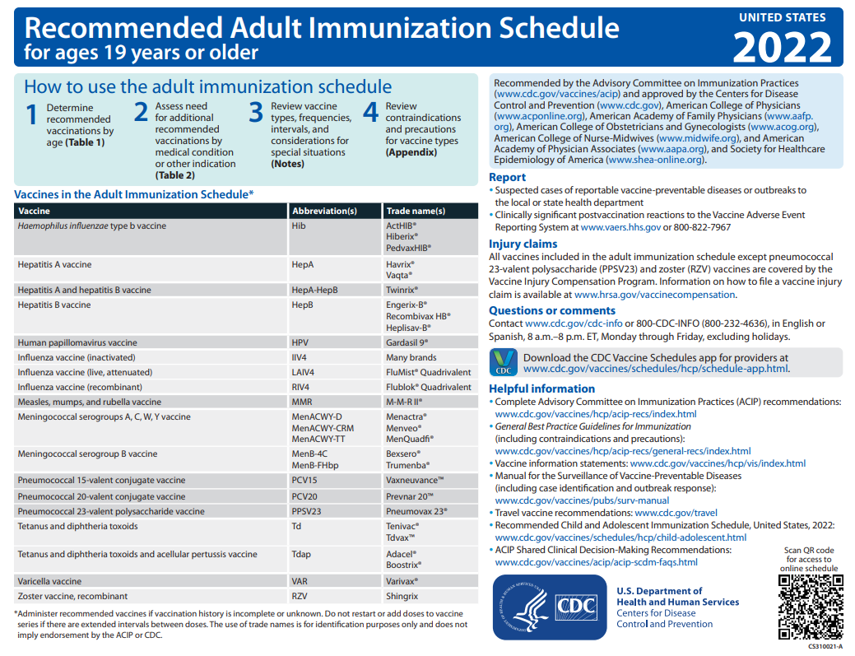
https://www.cdc.gov/vaccines/schedules/hcp/imz/adult.html
Notes:
The cover page of the adult schedule now includes:
• A 4th step instructing providers to review the newly added appendix has been added to the “How to use” table.
• The Society for Healthcare Epidemiology of America has been added as a partner organization approving the adult schedule.
• PCV15 (Vaxneuvance) and PCV20 (Prevnar 20) have been added to the table of vaccine abbreviations and trade names.
• PCV13 (Prevnar 13) has been removed from the list of vaccine abbreviations and trade names.
• A QR code has been added at the bottom of the cover page for health care providers to access the online schedule.
References:
1. https://www.cdc.gov/vaccines/schedules/hcp/imz/adult.html, Adult Immunization Schedule, Recommendations for Ages 19 Years or Older, United States, 2022

Slide 47
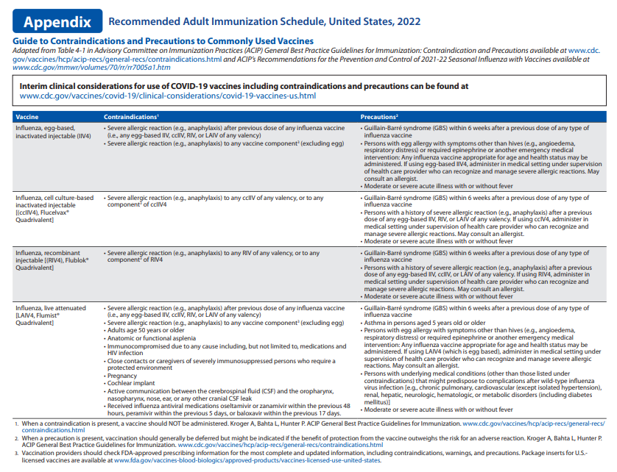
https://www.cdc.gov/vaccines/schedules/hcp/imz/adult.html
Notes:
• The appendix includes all the contraindications to and precautions for each of the vaccines listed in the 2022 adult immunization schedule. The information presented in this appendix is adapted from the 2021–22 influenza vaccine recommendations and from ACIP General Best Practice Guidelines for
References:
1. https://www.cdc.gov/vaccines/schedules/hcp/imz/adult.html, Adult Immunization Schedule, Recommendations for Ages 19 Years or Older, United States, 2022

Slide 48
Hepatitis A
Routine vaccination
Administer a 2-dose series (Havrix 6-12 months apart or Vaqta 6-18 months apart) or 3-dose series (HepA-HepB, Twinrix, at 0, 1, and 6 months) for adults not at risk but wanting protection from HepA
MMWR / July 3, 2020 / 69(5);1-38 https://www.cdc.gov/vaccines/schedules/hcp/imz/adult.html
Notes:
Review of Hepatitis A virus:
Hepatitis A is a serious liver disease caused by a virus. The virus is found in the feces (poop) of infected people. The hepatitis A virus is spread when invisible particles of feces (poop) get into a person’s mouth. You can get hepatitis A by eating contaminated food or drinking contaminated water, during sex, or just by living with an infected person. Hepatitis A can turn your skin and eyes turn yellow. You can get very sick for weeks, need to be hospitalized, and even die. Some people don’t look or feel sick, but they can still spread hepatitis A to others. Everyone is at some risk for getting infected with hepatitis A. People who travel outside the U.S. have an increased chance of getting infected.
References:
Prevention of Hepatitis A Virus Infection in the United States: Recommendations of the Advisory Committee on Immunization Practices, 2020, MMWR / Recommendations and Reports / July 3, 2020 / 69(5);1–38
https://www.cdc.gov/vaccines/schedules/hcp/imz/adult.html, Adult Immunization Schedule, Recommendations for Ages 19 Years or Older, United States, 2022

Slide 49
Hepatitis A Special Situations
Administer a 2-dose series (HepA) or 3-dose series (HepA-HepB) to at risk population:
Chronic liver disease, HIV infection in persons 1 year or older, MSM, injection and non injection drug users, homelessness, work with HepA virus (i.e., in research labs or nonhuman primates with HepA infection)
Travel to countries with high or intermediate endemic hepatitis A
Persons who anticipate close, personal contact with an international adoptee during the first 60 days after arrival in the U.S. from a country with high or intermediate endemicity (administer the 1st dose as soon as the adoption is planned, at least 2 weeks before the adoptee’s arrival)
Pregnancy: if at risk for infection or severe outcome from infection
Settings for exposure (i.e., health care settings targeting services to injection or non injection drug users, group homes and nonresidential day care facilities for developmentally disabled persons, prisons, etc.)
MMWR / July 3, 2020 / 69(5);1-38 https://www.cdc.gov/vaccines/schedules/hcp/imz/adult.html
Notes:
References:
Prevention of Hepatitis A Virus Infection in the United States: Recommendations of the Advisory Committee on Immunization Practices, 2020, MMWR / Recommendations and Reports / July 3, 2020 / 69(5);1–38
https://www.cdc.gov/vaccines/schedules/hcp/imz/adult.html, Adult Immunization Schedule, Recommendations for Ages 19 Years or Older, United States, 2022

Slide 50
Hepatitis B
Routine vaccination
Administer a 2-dose series (Heplisav-B at least 4 weeks apart,), a 3-dose series (Engerix-B or Recombivax HB at 0, 1, and 6 months), or a 3-dose HepA-HepB series (Twinrix at 0, 1, and 6 months) for all adults ages 19 through 59 years
A 4-dose series of HepA-HepB (Twinrix) may be administered at an accelerated schedule of 3 doses at 0, 7, and 21–30 days, followed by a booster dose at 12 months
A 4-dose series of Engerix-B may be administered at 0, 1, 2, and 6 months for persons on adult hemodialysis (note: each dosage is double that of normal adult dose, i.e., 2 mL instead of 1 mL)
Special situations
Persons of any age at risk for infection by sexual exposure or IDU*
All other adults seeking protection from HBV infection
MMWR, December 23, 2005, Vol 54, #RR16 MMWR, December 8, 2006, Vol 55, #RR16 MMWR, December 22, 2011 Vol 60 #50
Notes:
All pregnant women should be tested routinely for HBsAg
90% of healthy adults & 95% of infants, children & adolescents develop adequate antibody response after a complete series. If no antibody response after 6 doses, person is a non-responder and is susceptible to hepatitis B. Booster doses NOT recommended for any age group
Optional Information:
Review Hepatitis B virus:
Hepatitis B is a serious liver disease caused by a virus. Your can get infected with hepatitis B if you come in contact with an infected person’s blood or other body fluids. Babies can get the virus from their infected mothers at birth or if they live with or are cared for by an infected person. The virus can be spread just by sharing a toothbrush with an infected person. For some people, the virus remains in their body for years. During this time, the virus can attack the liver and cause serious problems like liver failure or cancer.
References:
MMWR, December 23, 2005, Vol 54, #RR16
MMWR, December 8, 2006, Vol 55, #RR16
MMWR, December 22, 2011 Vol 60 #50

Slide 51
HEPLISAV-B (HepB-CpG)
Administration
2-dose vaccine series administered at least 4 weeks apart (0, 1 month) via IM injection
Licensed for use in persons ≥ 18 years
Dosing Schedule
The 2-dose series ONLY applies when both doses are Heplisav
A series consisting of 1 dose of Heplisav and a different Hep B vaccine, should consist of 3 total doses using the 3-dose schedule minimum intervals
Doses administered at less than the recommended minimum interval should be repeated
Serologic Testing
Post vaccination Serologic Testing is recommended 1-2 months after final dose for:
Hemodialysis patients; immunocompromised persons, including those with HIV; healthcare personnel and/or partners of HBsAg-positive persons
Heplisav-B not recommended in pregnancy due to lack of safety data in pregnant women
MMWR / Recommendations and Reports / Vol. 67 / No. 15 / April 20, 2018 https://www.cdc.gov/vaccines/schedules/vacc-updates/heplisav-b.html
Notes:
HEPLISAV-B
The vaccine is administered as 2 doses, 1 month apart
The 2-dose series ONLY applies when both doses are Heplisav, administered at least 4 weeks apart.
A series consisting of 1 dose of Heplisav and a different Hep B vaccine, should consist of 3 total doses. Adhere to the 3-dose schedule minimum intervals of 4 weeks between dose 1 and 2, 8 weeks between dose 2 and 3, and 16 weeks between dose 1 and 3. However, if HepB-CpG is substituted for dose 2 of HepB-alum, a provider has the option of administering the next dose of HepB-CpG a minimum of 4 weeks from the previous dose for a complete series
Doses administered at less than the recommended minimum interval should be repeated
Post vaccination Serologic Testing recommended 1-2 months after final dose for: hemodialysis patients; immunocompromised persons, including those with HIV; healthcare personnel and/or partners of HBsAg-positive persons
Special populations: There are no clinical studies of HepB-CpG (Heplisav-B) in pregnant women. Available human data on HepB-CpG (Heplisav-B) administered to pregnant women are insufficient to inform assessment of vaccine-associated risks in pregnancy. Until safety data are available for HepB-CpG (Heplisav-B), providers should continue to vaccinate pregnant women needing HepB vaccination with a vaccine from a different manufacturer.
References:
Recommendations of the Advisory Committee on Immunization Practices for Use of a Hepatitis B Vaccine with a Novel Adjuvant; MMWR/ Recommendations and Reports / Vol. 67/ No. 15 / April 20, 2018
https://www.cdc.gov/vaccines/schedules/vacc-updates/heplisav-b.html

Slide 52
HPV Vaccine in Adults 27-45 Years Old
On October 5, 2018, the FDA announced approval of expanded use of Merck’s Gardasil 9 (HPV9) vaccine to include adults ages 27-45 years old
In June 2019, ACIP updated recommendations for catch up and for vaccination of adults older than the recommended catch-up age
For adults ages 27-45 years, ACIP recommends vaccination based on shared clinical decision-making for those who have not been adequately vaccinated and might benefit from the vaccine
***HPV vaccines are not licensed for use in persons older than 45 years of age***
MMWR / August 16, 2019 / 68(32);698–702
Notes:
On October 5, 2018, using results from 4vHPV clinical trials in women aged 24 through 45 years, and bridging immunogenicity and safety data in women and men, the Food and Drug Administration expanded the approved age range for 9vHPV use from 9 through 26 years to include adults ages 27-45 years old
In June 2019, after reviewing evidence related to HPV vaccination of adults, ACIP updated recommendations for catch-up vaccination and for vaccination of adults older than the recommended catch-up age, due to recognition of the risk for new HPV infections in this age range.
References:
MMWR / Human Papillomavirus Vaccination for Adults: Updated Recommendations of the Advisory Committee on Immunization Practices/ Weekly / August 16, 2019 / 68(32);698–702

Slide 53
What is Shared Clinical Decision Making?
Shared clinical decision making is a process in which clinicians and patients work together to make decisions based on clinical evidence that balances risks and expected outcomes with the patient’s preferences and values
https://www.healthit.gov/sites/default/files/nlc_shared_decision_making_fact_sheet.pdf
Notes:
References:
https://www.healthit.gov/sites/default/files/nlc_shared_decision_making_fact_sheet.pdf

Slide 54
Measles, Mumps, Rubella
Routine vaccination
1 dose for persons with no evidence of immunity to measles, mumps, or rubella
ACIP considers evidence of immunity to MMR if born before 1957, documentation of receipt of MMR vaccine, or laboratory evidence of immunity or disease (diagnosis of disease without lab confirmation is not considered evidence)
MenACWY vaccines may be administered simultaneously with MenB vaccines if indicated, but at different anatomical sites, if feasible
MMWR / February 18, 2022 / 71(7);229-233 https://www.cdc.gov/vaccines/schedules/hcp/imz/adult.html
Notes:
Routine vaccination
Birth date not acceptable evidence of rubella immunity for women who could become pregnant. Non-pregnant women of childbearing age with no evidence of immunity to rubella should receive 1 dose of MMR.
Optional Info:
Serious respiratory diseases
MEASLES: (caused by paramyxovirus): Initial symptoms are runny nose, followed by increasing fever (103º-105º), cough, conjunctivitis, Koplik spots, and a maculopapular rash that lasts 5-6 days. Complications include otitis media (7%), pneumonia (6%), and acute encephalitis (0.1%) 1 in 1000 cases, death (0.2%) Although measles elimination was declared in the United States in 2000 , importation of measles cases continues to occur. Spread through air droplets and can remain active for up to 1 hour after the person has left the room.
MUMPS: (caused by paramyxovirus): Parotitis (inflammation of parotid gland) occurs in 30-40% of infected persons, 40-50% have only nonspecific or respiratory symptoms; Complications include aseptic meningitis, & deafness; Post pubertal individuals may have orchitis (inflammation of testicles), ovarian inflammation, & pancreatitis.
RUBELLA: (caused by rubella virus and spread from person to person {togavirus}); in children, the rash may be the first manifestation of infection. Adults may have low-grade fever, malaise, URI, and lymphadenopathy prior to rash. Arthralgia and arthritis is common in adults, especially women. Complications include encephalitis and hemorrhagic manifestations. Displays like “blueberry muffin spots” on skin due to petechial lesions, cataracts, hearing loss and congenital heart lesions; child will most likely be developmentally delayed. All women of childbearing age should be certain they are immune to rubella. Rubella is no longer endemic in the U.S. However, it is still present in other countries and can be imported.
What should I do if I’m not sure I was vaccinated against measles?
Check with your health care provider. If you were born before 1957 it’s likely you have been exposed to the virus and are immune. If you were born between 1957 and 1971, the vaccine you received may not have been as reliable. Ask your doctor if you’ve been properly vaccinated.
References:
Advisory Committee on Immunization Practices Recommended Immunization Schedule for Adults Aged 19 Years or Older — United States, 2022 /MMWR / Weekly / February 18, 2022 / 71(7);229–233
https://www.cdc.gov/vaccines/schedules/hcp/imz/adult.html, Adult Immunization Schedule, Recommendations for Ages 19 Years or Older, United States, 2022

Slide 55
Measles, Mumps, Rubella Special Situations
MMR is contraindicated during pregnancy and in persons with severe immunocompromising conditions
1 dose (if previously received 1 dose of MMR), or 2 dose series at least 4 weeks apart, for college students, international travelers, and household or close personal contacts of immunocompromised persons, not previously immunized
Refer to immunization schedule notes for guidance when vaccinating healthcare personnel, or other medical indications
MMWR / February 18, 2022 / 71(7);229-233 https://www.cdc.gov/vaccines/schedules/hcp/imz/adult.html
Notes:
Special situations
MMR is contraindicated during pregnancy and in persons with severe immunocompromising conditions: 1 dose of MMR recommended after pregnancy (before discharge from a health care facility)
Refer to immunization schedule notes for guidance when vaccinating healthcare personnel, or other medical indications: Healthcare personnel born in 1957 or later with no evidence of immunity to measles, mumps, or rubella: 2 dose series of MMR at least 4 weeks apart for measles or mumps or at least 1 dose of MMR for rubella; for healthcare personnel born before 1957, consider 2-dose series at least 4 weeks apart for measles or mumps or at least 1 dose of MMR for rubella. A 2-dose series of MMR at least 4 weeks apart, is recommended for persons with HIV infection with CD4 count >/=200 cells/ul for at least 6 months and no evidence of immunity; MMR is contraindicated in HIV infection with CD4 count <200 cells/ul.
References:
Advisory Committee on Immunization Practices Recommended Immunization Schedule for Adults Aged 19 Years or Older — United States, 2022 /MMWR / Weekly / February 18, 2022 / 71(7);229–233
https://www.cdc.gov/vaccines/schedules/hcp/imz/adult.html, Adult Immunization Schedule, Recommendations for Ages 19 Years or Older, United States, 2022

Slide 56
Serogroup B Meningococcal Vaccines
Shared clinical decision-making for MenB
May be given based on shared clinical decision-making to adolescents 16-23 years who are not at increased risk (preferred age 16-18 years)
Bexsero: 2 doses at least 1 month apart
Trumenba: 2 doses at least 6 months apart. If 2nd dose given earlier than 6 months, give 3rd dose at least 4 months after the 2nd dose
MMWR / February 18, 2022 / 71(7);229-233 https://www.cdc.gov/vaccines/schedules/hcp/imz/adult.html
Notes:
MenB is a Category B- permissive recommendation- Category B means the recommendation allows for individual clinical decision making, but with Category A recommendations all persons in an age or risk factor-based group may get the vaccine. Category B classification enables coverage by the VFC program and most insurance plans. ACIP recommends routine MenB vaccination of certain high-risk groups for those 10 years and older.
Serogroup B meningococcal vaccines (minimum age: 10 years [Bexsero, Trumenba].
Optional Info:
Data presented to ACIP in June 2015 demonstrated that the estimated incidence of serogroup B meningococcal disease among college students aged 18-23 years was low (0.09 cases/100,000) and was similar to that of non-college students during 2009-2013. CDC shared plans to improve surveillance and report updated findings to ACIP on the incidence of disease in college students once additional data became available.
Summary
Incidence of serogroup B meningococcal disease in college students is low; however, college students aged 18-21 years are at increased risk compared to non-college students
Incidence of serogroups C, W, and Y in this age group is lower and similar in college students and non-college students, likely in part due to the adolescent MenACWY program
Serogroup B college outbreaks are an important factor, though the risk remains elevated among college students even when excluding outbreak associated cases
Although the risk of serogroup B meningococcal disease is increased among college students, the number of preventable cases is low, and number needed to vaccinate to prevent a case is high
Limited duration of protection of MenB vaccines and the lack of evidence for impact on carriage may limit the ability to protect college students through the period of greatest risk
MenB vaccination should occur as close to college entry as possible
While achieving high MenB coverage during college outbreaks has been challenging, routine vaccination of all college students would also be difficult
Awareness and uptake of MenB vaccines is currently low
Conclusion
The Work Group does not propose any changes to the current MenB vaccine recommendations
CDC could provide more guidance around clinical decision-making during precollege health visits
References:
Advisory Committee on Immunization Practices Recommended Immunization Schedule for Adults Aged 19 Years or Older — United States, 2022 /MMWR / Weekly / February 18, 2022 / 71(7);229–233
https://www.cdc.gov/vaccines/schedules/hcp/imz/adult.html, Adult Immunization Schedule, Recommendations for Ages 19 Years or Older, United States, 2022

Slide 57
Serogroup B Meningococcal Vaccines Special Situations
Anatomic or functional asplenia, sickle cell disease, persistent complement component deficiency (including eculizumab use), or microbiologists routinely exposed to Neisseria meningitidis
Bexsero: 2-doses at least 1 month apart
Trumenba: 3-dose series at 0, 1-2, and 6 months
Bexsero and Trumenba are not interchangeable
Delay MenB vaccine until after pregnancy unless at increased risk and vaccination benefits outweigh potential risks
MMWR / February 18, 2022 / 71(7);229-233 https://www.cdc.gov/vaccines/schedules/hcp/imz/adult.html
Notes:
References:
Advisory Committee on Immunization Practices Recommended Immunization Schedule for Adults Aged 19 Years or Older — United States, 2022 /MMWR / Weekly / February 18, 2022 / 71(7);229–233
https://www.cdc.gov/vaccines/schedules/hcp/imz/adult.html, Adult Immunization Schedule, Recommendations for Ages 19 Years or Older, United States, 2022

Slide 58
Pneumococcal Conjugate Vaccines for Adults (PCV13, PCV15, PCV20 )
Routine vaccination
1 dose of PCV15 (Vaxneuvance) or PCV20 (Prevnar20) for adults 65 years or older who have not previously received a pneumococcal conjugate vaccine or whose previous vaccination history is unknown. If PCV20 (Prevnar20) is used, the pneumococcal series is complete.
If PCV15 is used, a dose of PPSV23 should be administered at least 1 year after. A minimum interval of 8 weeks can be considered in adults with an immunocompromising condition, cochlear implant, or cerebrospinal fluid leak.
Adults who have previously received PCV13 (Prevnar13) should complete the previous PPSV23 recommendations. If PPSV23 is not available, one dose of PCV20 may be used to complete the series.
MMWR / January 28, 2022 / 71(4);109-117 https://www.cdc.gov/vaccines/schedules/hcp/imz/adult.html
Notes:
References:
Use of 15-Valent Pneumococcal Conjugate Vaccine and 20-Valent Pneumococcal Conjugate Vaccine Among U.S. Adults: Updated Recommendations of the Advisory Committee on Immunization Practices (ACIP); MMWR / Weekly / January 28, 2022 / 71(4);109-117
https://www.cdc.gov/vaccines/schedules/hcp/imz/adult.html, Adult Immunization Schedule, Recommendations for Ages 19 Years or Older, United States, 2022

Slide 59
Pneumococcal Conjugate Vaccines (PCV13, PCV15, PCV20 ) Special Situations
1 dose of PCV15 or PCV20, at least 1 year apart, for adults who have previously received PPSV23 but who have not received any pneumococcal conjugate vaccine, regardless of which vaccine is used.
1 dose of PCV15 or PCV20 for adults 19-64 years old with certain underlying medical conditions or other risk factors who have not previously received a pneumococcal conjugate vaccine or whose previous vaccination history is unknown. A minimum interval of 8 weeks can be considered in adults with an immunocompromising condition, cochlear implant, or cerebrospinal fluid leak.
MMWR / January 28, 2022 / 71(4);109-117 https://www.cdc.gov/vaccines/schedules/hcp/imz/adult.html
Notes:
References:
Use of 15-Valent Pneumococcal Conjugate Vaccine and 20-Valent Pneumococcal Conjugate Vaccine Among U.S. Adults: Updated Recommendations of the Advisory Committee on Immunization Practices (ACIP); MMWR / Weekly / January 28, 2022 / 71(4);109-117
https://www.cdc.gov/vaccines/schedules/hcp/imz/adult.html, Adult Immunization Schedule, Recommendations for Ages 19 Years or Older, United States, 2022

Slide 60
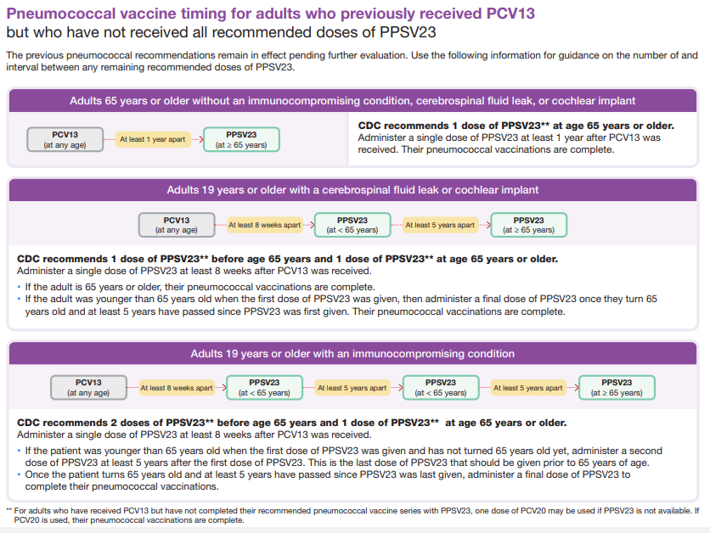
https://www.cdc.gov/vaccines/vpd/pneumo/downloads/pneumo-vaccine-timing.pdf

Slide 61
Pneumococcal Polysaccharide Vaccine for Adults (PPSV23)
Special situations
1 dose of PPSV23 (Pneumovax) for:
Adults 65 years and older who have received PCV13 (Prevnar13) or PCV15 (Vaxneuvance) at least 1 year prior.
Persons aged 2 through 18 years who have received PCV13 (Prevnar13) with certain medical conditions that increase their risk for pneumococcal infection (a second dose may be required).
Persons 19 through 64 years who have received PCV13 or PCV15 with an underlying medical condition or risk factor. A minimum interval of 8 weeks can be considered in adults with an immunocompromising condition, cochlear implant, or cerebrospinal fluid leak.
Revaccination not recommended for most persons until they reach age 65
MMWR / January 28, 2022 / 71(4);109-117 https://www.cdc.gov/vaccines/schedules/hcp/imz/adult.html
Notes:
References:
References:
Use of 15-Valent Pneumococcal Conjugate Vaccine and 20-Valent Pneumococcal Conjugate Vaccine Among U.S. Adults: Updated Recommendations of the Advisory Committee on Immunization Practices (ACIP); MMWR / Weekly / January 28, 2022 / 71(4);109-117
https://www.cdc.gov/vaccines/schedules/hcp/imz/adult.html, Adult Immunization Schedule, Recommendations for Ages 19 Years or Older, United States, 2022

Slide 62
Varicella Immunity
ACIP considers evidence of immunity to varicella to be:
• Documentation of 2 doses of vaccine given no earlier than age 12 months, with at least 3 months between doses for children younger than age 13 years, or at least 4 weeks between doses for people aged 13 years and older
• U.S.-born before 1980* (year of birth is not considered as evidence of immunity for healthcare personnel, and pregnant women)
• A healthcare provider's diagnosis of herpes zoster, varicella or history of varicella disease
• Laboratory evidence of immunity to or confirmation of disease
MMWR / June 22, 2007 /56(RR-4);16-17
Notes:
Only doses of varicella vaccines for which written documentation of the date of administration is presented should be considered valid. Neither a self-reported dose nor a history of vaccination provided by a parent is, by itself, considered adequate evidence of immunity. Persons who lack documentation of adequate vaccination or other evidence of immunity should be vaccinated.
A recent study demonstrated that only 75% of unvaccinated children aged 12 months--4 years who reported a positive history of varicella were in fact immune (confirmed by serological testing), compared with 89% of children aged 5--9 years and 10--14 years (134). To limit the number of false-positive reports and ensure immunity, ACIP recommends that evidence of immunity should be either a diagnosis of varicella by a health-care provider or a health-care provider verification of a history of disease rather than parental or self-reporting.
References:
1. Prevention of Varicella, Recommendations of the Advisory Committee on Immunization Practices (ACIP); MMWR / Recommendations and Reports / June 22, 2007 / 56(RR-4);16-17

Slide 63
Zoster (RZV)
Routine vaccination
Administer 2 doses of the recombinant zoster vaccine (RZV, Shingrix) 2-6 months apart (minimal interval: 4 weeks) to adults aged 50 years or older regardless of past episode of herpes zoster or receipt of zoster live vaccine (ZVL, Zostavax); dose should be repeated if administered too soon
For adults who previously received ZVL, administer 2 doses of RZV at least 2 months after ZVL
Zostavax is no longer available in the United States
Special situations
There is currently no ACIP recommendation for RZV during pregnancy; consider delaying until after pregnancy
Persons ages 19 years or older with immunocompromising conditions, including HIV
MMWR / February 18, 2022 / 71(7);229-233 https://www.cdc.gov/vaccines/schedules/hcp/imz/adult.html
Notes:
Special situations
There is currently no ACIP recommendation for RZV during pregnancy; consider delaying until after pregnancy
Persons ages 19 years or older with immunocompromising conditions, including HIV: RZV recommended for use in persons ages 19 years or older who are or will be immunodeficient or immunosuppressed because of disease or therapy.
References:
Advisory Committee on Immunization Practices Recommended Immunization Schedule for Adults Aged 19 Years or Older — United States, 2022 /MMWR / Weekly / February 18, 2022 / 71(7);229–233
https://www.cdc.gov/vaccines/schedules/hcp/imz/adult.html, Adult Immunization Schedule, Recommendations for Ages 19 Years or Older, United States, 2022

Slide 64
COVID-19 Vaccines for Adults (mRNA)
Administer 2 doses of any mRNA COVID-19 vaccine, (minimum interval of 3-8 weeks between dose 1 and dose 2 for Pfizer-BioNTech; 4-8 weeks between dose 1 and dose 2 for Moderna) to adults 18 years or older who are not moderately or severely immunocompromised as part of the primary series, with a booster dose recommended at least 5 months after dose 2
Administer 3 doses of any mRNA COVID-19 vaccine (minimum interval of 3 weeks between dose 1 and dose 2 for Pfizer-BioNTech; 4 weeks between dose 1 and dose 2 for Moderna; and 4 weeks between dose 2 and dose 3) to adults 18 years or older who are moderately or severely immunocompromised as part of the primary series, with a booster dose recommended at least 12 weeks after dose 3
https://www.cdc.gov/coronavirus/2019-ncov/vaccines/recommendations/adolescents.html https://www.cdc.gov/vaccines/covid-19/clinical-considerations/interim-considerations-us.html#recommendations https://www.cdc.gov/vaccines/covid-19/downloads/COVID-19-immunization-schedule-ages-5yrs-older.pdf
Notes:
References:
https://www.cdc.gov/coronavirus/2019-ncov/vaccines/recommendations/adolescents.html
https://www.cdc.gov/vaccines/covid-19/clinical-considerations/interim-considerations-us.html#recommendations
https://www.cdc.gov/vaccines/covid-19/downloads/COVID-19-immunization-schedule-ages-5yrs-older.pdf

Slide 65
COVID-19 Vaccines for Adults (Viral vector)
Administer 1 dose of the Janssen COVID-19 vaccine to adults 18 years or older who are not moderately or severely immunocompromised as part of the primary series, with a booster dose recommended at least 8 weeks after dose 1
Administer 2 doses of the Janssen COVID-19 vaccine to adults 18 years or older who are moderately or severely immunocompromised (minimum interval of 28 days between dose 1 and dose 2) as part of the primary series, with a booster dose recommended at least 8 weeks after dose 2
https://www.cdc.gov/coronavirus/2019-ncov/vaccines/recommendations/adolescents.html https://www.cdc.gov/vaccines/covid-19/clinical-considerations/interim-considerations-us.html#recommendations https://www.cdc.gov/vaccines/covid-19/downloads/COVID-19-immunization-schedule-ages-5yrs-older.pdf
Notes:
References:
https://www.cdc.gov/coronavirus/2019-ncov/vaccines/recommendations/adolescents.html
https://www.cdc.gov/vaccines/covid-19/clinical-considerations/interim-considerations-us.html#recommendations
https://www.cdc.gov/vaccines/covid-19/downloads/COVID-19-immunization-schedule-ages-5yrs-older.pdf

Slide 66
COVID-19 Vaccines Special Considerations
COVID-19 vaccines can be co-administered with other vaccines.
A different COVID-19 vaccine product than the primary series may be administered for the booster dose. An mRNA COVID-19 vaccine is preferred.
An 8-week interval may be optimal for some people, including males 12-39 years of age because of the small risk of myocarditis associated with mRNA COVID-19 vaccines. Vaccine effectiveness may also be increased with an interval longer than 3 or 4 weeks (depending on the product).
Persons 50 years of age and older may receive a 2nd mRNA booster dose at least 4 months after the last dose.
Doses administered up to 4 days before the minimum interval (4-day grace period) are considered valid. Doses administered at any time after the recommended interval are valid.
Persons with a recent SARS-CoV-2 infection may consider delaying their first or second COVID-19 vaccine booster dose by 3 months from symptom onset or positive test (if infection was asymptomatic).
https://www.cdc.gov/coronavirus/2019-ncov/vaccines/recommendations/adolescents.html https://www.cdc.gov/vaccines/covid-19/clinical-considerations/interim-considerations-us.html#recommendations https://www.cdc.gov/vaccines/covid-19/downloads/COVID-19-immunization-schedule-ages-5yrs-older.pdf
Notes:
References:
https://www.cdc.gov/coronavirus/2019-ncov/vaccines/recommendations/adolescents.html
https://www.cdc.gov/vaccines/covid-19/clinical-considerations/interim-considerations-us.html#recommendations
https://www.cdc.gov/vaccines/covid-19/downloads/COVID-19-immunization-schedule-ages-5yrs-older.pdf

Slide 67
Healthcare Personnel (HCP)
Annual influenza vaccine
Tdap or Td
Hepatitis B (exposure risk) Check immunity
Meningococcal (exposure risk)
COVID-19
Validate immune status of:
Varicella
Measles, Mumps & Rubella (MMR)
Notes:
Healthcare workers (HCWs) are at risk for exposure to serious, and sometimes deadly, diseases. If you work directly with patients or handle material that could spread infection, you should get appropriate vaccines to reduce the chance that you will get or spread vaccine-preventable diseases. Protect yourself, your patients, and your family members. Make sure you are up-to-date with recommended vaccines.
One dose of an influenza vaccine annually
One time dose of Tdap if you have not received a dose previously (regardless of when previous Td dose was received); Td or Tdap booster every 10 years thereafter. Pregnant healthcare workers need to get a dose of Tdap during each pregnancy
3 dose series of Rocombivax HB or Engerix-B, or 2 dose series of Heplisav if no documented evidence of completed series or serologic evidence of immunity prior to vaccination. Hepatitis B vaccine is recommended for health-care personnel with potential exposure to blood or body fluids. The antibody status of these health-care personnel should be checked 1-2 months after the 3rd dose. If a person fails to develop an adequate antibody titer after three doses of vaccine, follow current CDC recommendations for additional doses of hepatitis B vaccine. Some health-care providers may have received three doses of hepatitis B vaccine as children, adolescents or adults but have never had serologic testing to check for immunity. Follow the CDC Guidance for Evaluating Health-Care Personnel for Hepatitis B Virus Protection and for Administering Post exposure Management (Recommendations and Reports / Vol. 62 / No. 10 December 20, 2013)
Microbiologist routinely exposed to the virus should get an MCV4 vaccine and MenB vaccine.
For additional COVID-19 vaccination information, please visit https://www.cdc.gov/vaccines/covid-19/clinical-considerations/covid-19-vaccines-us.html.
Un-immunized HCP
Un-immunized healthcare workers are at risk of infecting patients, family members and community contacts
Immunized HCP
Protect patients from VPD’s
Help offices avoid potential liability cases. (The practice can be liable if an unimmunized HCP becomes infected with a vaccine preventable disease and infects a patient).
Maintain productivity
Reduce illness and illness-related absenteeism
Evidence of Immunity to MMR
Documented administration of two doses of measles and mumps vaccine and one dose of rubella vaccine OR
Laboratory evidence of immunity or laboratory confirmation of disease (measles, mumps and rubella) OR
Born before 1957 (measles, mumps and rubella)
References:
1. General Recommendations on Immunization, Recommendations of the Advisory Committee on Immunization Practices (ACIP). MMWR (RR-2); January 28, 2011
2. Immunization of Health-Care Personnel: Recommendations of ACIP MMWR; November 25, 2011 / 60(RR07);1-45
3. CDC Guidance for Evaluating Health-Care Personnel for Hepatitis B Virus Protection and for Administering Postexposure Management (Recommendations and Reports / Vol. 62 / No. 10 December 20, 2013)

Slide 68
PRE-EXPOSURE EVALUATION FOR HEALTH-CARE PERSONNEL
SERIES WHO HAVE NOT HAD POSTVACCINATION SEROLOGIC TESTING PREVIOUSLY VACCINATED WITH COMPLETE, ≥3-DOSES OF HEP B VACCINE
Measure antibody to hepatitis B surface antigen (anti-HBs)
anti-HBs <10 mIU/mL
anti-HBs ≥10mIU/mL
Administer 1 dose of HepB vaccine,
postvaccination serologic testing
No Action for
Hepatitis B prophylaxis
(regardless of source patient hepatitis B surface antigen status)
anti-HBs <10 mIU/mL
anti-HBs ≥ 10 mIU/mL
Administer 2 more doses of
HepB vaccine,
postvaccination serologic testing
anti-HBs <10 mIU/mL
anti-HBs ≥ 10mIU/mL
HCP need to receive hepatitis B evaluation for all exposures
Notes:
Optional Slide
Post-vaccination Serologic Testing
Testing unvaccinated HCP for HBV infection is not generally indicated for persons being evaluated for hepatitis B protection because of occupational risk. Pre-vaccination serologic testing is indicated for all persons born in geographic regions with HBsAg (Hepatitis B surface antigen) prevalence of ≥2% (e.g., much of Eastern Europe, Asia, Africa, the Middle East, and the Pacific Islands) and certain indigenous populations from countries with overall low HBV endemicity (<2%); persons with behavioral exposures to HBV (e.g., men who have sex with men and past or current injection drug users); persons receiving cytotoxic or immunosuppressive therapy; and persons with liver disease of unknown etiology.
Testing HCP at risk for HBV infection should consist of a serologic assay for HBsAg ((Hepatitis B surface antigen), in addition to either anti-HBc (Total hepatitis B core antibody) or anti-HBs (Hepatitis B surface antibody). For unvaccinated HCP at risk for previous HBV infection, blood should be drawn for testing before the first dose of vaccine is administered.
HCP who have written documentation of a complete, ≥3-dose HepB vaccine series and subsequent post-vaccination (Hepatitis B surface antibody) anti-HBs ≥10 mIU/mL (milli-international units per milliliter) are considered hepatitis B immune. Immunocompetent persons have long-term protection against HBV and do not need further periodic testing to assess anti-HBs (Hepatitis B surface antibody) levels.
All HCP recently vaccinated or recently completing HepB vaccination who are at risk for occupational blood or body fluid exposure should undergo anti-HBs testing (Hepatitis B surface antibody). Anti-HBs (Hepatitis B surface antibody) testing should be performed 1–2 months after administration of the last dose of the vaccine series when possible. HCP with documentation of a complete ≥3-dose HepB vaccine series but no documentation of anti-HBs ≥10 mIU/mL who are at risk for occupational blood or body fluid exposure might undergo anti-HBs testing upon hire or matriculation. Testing should use a quantitative method that allows detection of the protective concentration of anti-HBs (≥10 mIU/mL) (e.g., enzyme-linked immunosorbent assay [ELISA]).
Completely vaccinated HCP with anti-HBs ≥10 mIU/mL are considered hepatitis B immune. Immunocompetent persons have long-term protection and do not need further periodic testing to assess anti-HBs levels.
Completely vaccinated HCP with anti-HBs <10 mIU/mL should receive an additional dose of HepB vaccine, followed by anti-HBs testing 1–2 months later. HCP whose anti-HBs remains <10 mIU/mL should receive 2 additional vaccine doses (usually 6 doses total), followed by repeat anti-HBs testing 1–2 months after the last dose. Alternatively, it might be more practical for very recently vaccinated HCP with anti-HBs <10 mIU/mL to receive 3 consecutive additional doses of HepB vaccine (usually 6 doses total), followed by anti-HBs testing 1–2 months after the last dose.
Ref: CDC Guidance for Evaluating Health-Care Personnel for Hepatitis B Virus Protection and for Administering Post Exposure Management MMWR Recommendations and Reports /Vol. 62/No. 10 December 20, 2013

Slide 69
Become a Vaccine Champion
Critical Elements
Key Characteristics
Appropriate storage and handling of all vaccines
Correct administration of vaccines
Education of patients and parents about vaccines
Every office and clinic needs a vaccine champion
Lead your immunization team
Educate all staff about new vaccines and recommendations
Educate new staff about vaccine storage, handling, & administration
Initiate processes to improve immunization rates in your practice/facility
Assure immunizations of all staff are up-to-date
Notes:
As Immunization Providers there are Critical Elements that must be maintained for Immunization Services (review critical elements)
Ask your audience “Who is your vaccine champion?” and then “Who is this person’s backup?” Every providers should have vaccine champions. Key characteristics of a vaccine champion include:
The vaccine champion will:
Lead your immunization team
Educate all staff about new vaccines and recommendations
Educate new staff about vaccine storage, handling, & administration
Initiate processes to improve immunization rates in your practice/facility
Assure immunizations of all staff are up-to-date

Slide 70
Improve Access To Immunizations
Immunization only visits
Walk-ins for immunizations
Implement standing orders
Early, extended, or weekend hours
Mass vaccination clinics
Notes:
These 5 methods listed above can help patients access immunizations more readily but some of these methods may not be the right fit for some practices. The approach to improving access must be determined by individual practitioners and staff. Each practice must decide which method works best for their situation. In large practices or clinics this may be an administrative decision.

Slide 71
Public Health Reports
Public Health Reports should be faxed or mailed to the State Immunization Program.
Fax number (404)657-1463
Notes:
Established in 1990, the Vaccine Adverse Event Reporting System (VAERS) is a national early warning system to detect possible safety problems in U.S.-licensed vaccines. VAERS is co-managed by the Centers for Disease Control and Prevention (CDC) and the U.S. Food and Drug Administration (FDA). VAERS accepts and analyzes reports of adverse events (possible side effects) after a person has received a vaccination. Anyone can report an adverse event to VAERS. Healthcare professionals are required to report certain adverse events and vaccine manufacturers are required to report all adverse events that come to their attention. VAERS is a passive reporting system, meaning it relies on individuals to send in reports of their experiences to CDC and FDA. VAERS is not designed to determine if a vaccine caused a health problem but is especially useful for detecting unusual or unexpected patterns of adverse event reporting that might indicate a possible safety problem with a vaccine. This way, VAERS can provide CDC and FDA with valuable information that additional work and evaluation is necessary to further assess a possible safety concern.
VAERS Data Limitations
Millions of vaccines are given each year to children less than 1 year old in the United States, usually between 2 and 6 months of age. At this age, infants are at greatest risk for certain medical adverse events, including high fevers, seizures, and sudden infant death syndrome (SIDS). Some infants will experience these medical events shortly after a vaccination by coincidence. These coincidences make it difficult to know whether a particular adverse event resulted from a medical condition or from a vaccination. Therefore, vaccine providers are encouraged to report all adverse events following vaccination, whether or not they believe the vaccination was the cause.
The primary objectives of VAERS are to:
Detect new, unusual, or rare vaccine adverse events; Monitor increases in known adverse events; Identify potential patient risk factors for particular types of adverse events; Assess the safety of newly licensed vaccines;
Determine and address possible reporting clusters (e.g., suspected localized [temporally or geographically] or product-/batch-/lot-specific adverse event reporting); Recognize persistent safe-use problems and administration errors;
Provide a national safety monitoring system that extends to the entire general population for response to public health emergencies, such as a large-scale pandemic influenza vaccination program.
Two Ways to Submit an Online Report to VAERS:
1. Report Online (for private providers)
Incidents are sent directly to the CDC
2. Report using writable PDF (for Public Health)
Please download pdf and type in incident then send reports to the Immunization Program State Office via fax or mail
What Can Be Reported to VAERS?
VAERS encourages the reporting of any clinically significant adverse event that occurs after the administration of any vaccine licensed in the United States.
Who Reports to VAERS?
Anyone can file a VAERS report, including parents, health care providers, manufacturers, and vaccine recipients.
Does VAERS Provide General Vaccine Information?
No. VAERS only collects and analyzes adverse event reports. In another example, VAERS determined that there may be a potential for a small increase in risk for Guillain-Barre syndrome after the meningococcal conjugate vaccine, Menactra. As a result of this finding, a history of Guillain-Barre syndrome became a contraindication to the vaccine and further controlled studies are currently underway to research this issue.

Slide 72
Vaccine Injury Compensation Program (VICP)
The National Vaccine Injury Compensation Program provides compensation to individuals found to be injured by or have died from certain childhood vaccines.
Established in 1988 by NCVIA
Federal “no fault” system to compensate those injured
Claim must be filed by individual, parent or guardian
Must show that injury is on “Vaccine Injury Table”
Notes:
The National Vaccine Injury Compensation Program is a no-fault alternative to the traditional legal system for resolving vaccine injury petitions. It was created in the 1980s, after lawsuits against vaccine companies and health care providers threatened to cause vaccine shortages and reduce U.S. vaccination rates, which could have caused a resurgence of vaccine preventable diseases. Any individual, of any age, who received a covered vaccine and believes he or she was injured as a result, can file a petition. Parents, legal guardians and legal representatives can file on behalf of children, disabled adults, and individuals who are deceased. The purpose of VICP is to ensure that individuals injured by certain vaccines are provided with fair and efficient compensation and to ensure a stable vaccine supply by limiting liability for vaccine manufacturers and vaccine administrators. The National Vaccine Injury Compensation Program covers most vaccines given routinely in the U.S. For a vaccine to be covered, the category of vaccine must be recommended for routine administration to children or pregnant women by the Centers for Disease Control and Prevention and subject to an excise tax by Federal law.
The following three organizations have a role in VICP:
The VICP is administered through the Department of Health and Human Services (HHS)
The Department of Justice (DOJ) represents HHS in Court
The U.S. Court of Federal Claims (the Court) makes the final decision regarding whether a petitioner should be compensated

Slide 73
State Resources
Local Health Department
GA Immunization Program Office
On Call Help Line: 404-657-3158
GRITS Help Line: 1-866-483-2958
VFC Help Line: 1-800-848-3868
Website: https://dph.georgia.gov/immunization-section
Your local Immunization Regional Program Consultant (IRC)
Epidemiology: 1-866-782-4584
GA Chapter of the AAP
GA Academy of Family Physicians

Slide 74
It’s a Team Effort!
High Immunization rates begin with a team designed plan!
What can your team do to improve rates?
Notes:
74
Remind your audience that “It is a team effort to immunize successfully”. Do not underestimate the office team’s ability to affect immunization rates. It takes the physician, physician’s assistant, nurse practitioner, nurse, medical assistant, and clerical staff working together to improve the office practice and raise immunization rates.
Take any questions from the audience.
Ask participants how, based on the information presented, will they change the way they administer vaccines.
Ask the audience what will they do to improve rates?
Ask participants to develop a plan to improve the immunization rates in their office
Jot down the plans the practice makes so that we can follow-up with them.

Slide 75
Questions

