Slide 1
Childhood, Adolescent, and Adult Immunization Schedule
Review of the Recommended Schedule
Healthcare Professionals/State Immunization Program Staff/On-Demand

Slide 2
Objectives
At the end of this presentation, participants will be able to:
Recall the role vaccines have played in preventing diseases
Discuss the importance of vaccines for children, adolescents and adults
Discuss the role of a vaccine champion
List at least two reliable sources for immunization information
Notes:
Let’s review our objectives. At the end of this presentation, participants will be able to:
Recall the role vaccines have played in preventing diseases
Discuss the importance of vaccines for children, adolescents, and adults
Discuss the role of a vaccine champion
List at least two reliable sources for immunization information

Slide 3
The Impact of Vaccines in the United States
https://www.immunize.org/wp-content/uploads/catg.d/p4037.pdf
Notes:
This table shows the impact of vaccines on the annual reported cases of some vaccine preventable diseases in the United States.
Column 2 shows the average number of reported cases of a specific disease prior to the licensure of the vaccine
Column 3 shows the number of reported or estimated cases in the United States in 2019
Column 4 shows the percentage decrease in reported cases in the United States compared with the pre-vaccine years
For additional information on outbreaks and reporting, please contact the Epidemiology Program at the State Office.
References:
https://www.immunize.org/wp-content/uploads/catg.d/p4037.pdf

Slide 4
Community Immunity
VPD | Vaccination Rate Needed for Community Immunity
Measles | 92-94%
Pertussis | 92-94%
Diphtheria | 83-85%
Rubella | 83-85%
Mumps | 75-86%
Influenza | 30-75%
Notes:
Community immunity is the term most frequently used that refers to a situation in which a high percentage of a population is immune to a disease, essentially stopping the disease in its tracks because it cannot find new hosts. This chart illustrates the vaccination rate needed for each of the VPDs listed.
The threshold for community immunity varies, depending on the disease, with more virulent infectious agents requiring vaccination of a higher percentage of the population to create the desired community immunity. The creation of herd immunity is especially important in crowded environments which facilitate the spread of disease, like schools. It is also extremely important to receive regular boosters, as some vaccines lose their efficacy over time, leaving people vulnerable to an outbreak. Herd immunity led to the eradication of smallpox, and it explains why diseases such as polio and diphtheria are rare in developed nations with established vaccination policies.

Slide 5
ACIP
Comprised of 15 voting member responsible for making vaccine recommendations and schedules for the use of licensed vaccines, with expertise in the following:
14 voting members with expertise in one or more of the following: vaccinology, immunology, infectious diseases, pediatrics, nursing, family medicine, virology, internal medicine, preventive medicine, and/or public health.
1 voting member with expertise in consumer perspectives and/or social and community aspects of immunization programs.
https://www.cdc.gov/vaccines/acip/members/index.html
Notes:
Ask the audience if they are familiar with the ACIP. If they are familiar with the ACIP the presenter can spend a minimal amount of time on this slide.
The dramatic reduction of vaccine preventable diseases in the United States can be attributed to the availability of vaccines, as well as recommendations and an organized vaccine schedule developed by the Advisory Committee on Immunization Practices (ACIP).
The Advisory Committee on Immunization Practices (ACIP) consists of 15 experts in fields associated with immunization who have been selected by the Secretary of the U. S. Department of Health and Human Services to provide advice and guidance to the Secretary, the Assistant Secretary for Health, and the Centers for Disease Control and Prevention (CDC) on the most effective means to prevent vaccine-preventable diseases.
The Committee develops written recommendations for the routine administration of vaccines to the pediatric and adult populations, along with schedules regarding the appropriate periodicity, dosage, and contraindications applicable to the vaccines. ACIP is the only entity in the federal government which makes such recommendations.
The overall goals of the ACIP are to provide advice which will assist the Department and the Nation in reducing the incidence of vaccine preventable diseases and to increase the safe usage of vaccines and related biological products.
References:
https://www.cdc.gov/vaccines/acip/members/index.html

Slide 6
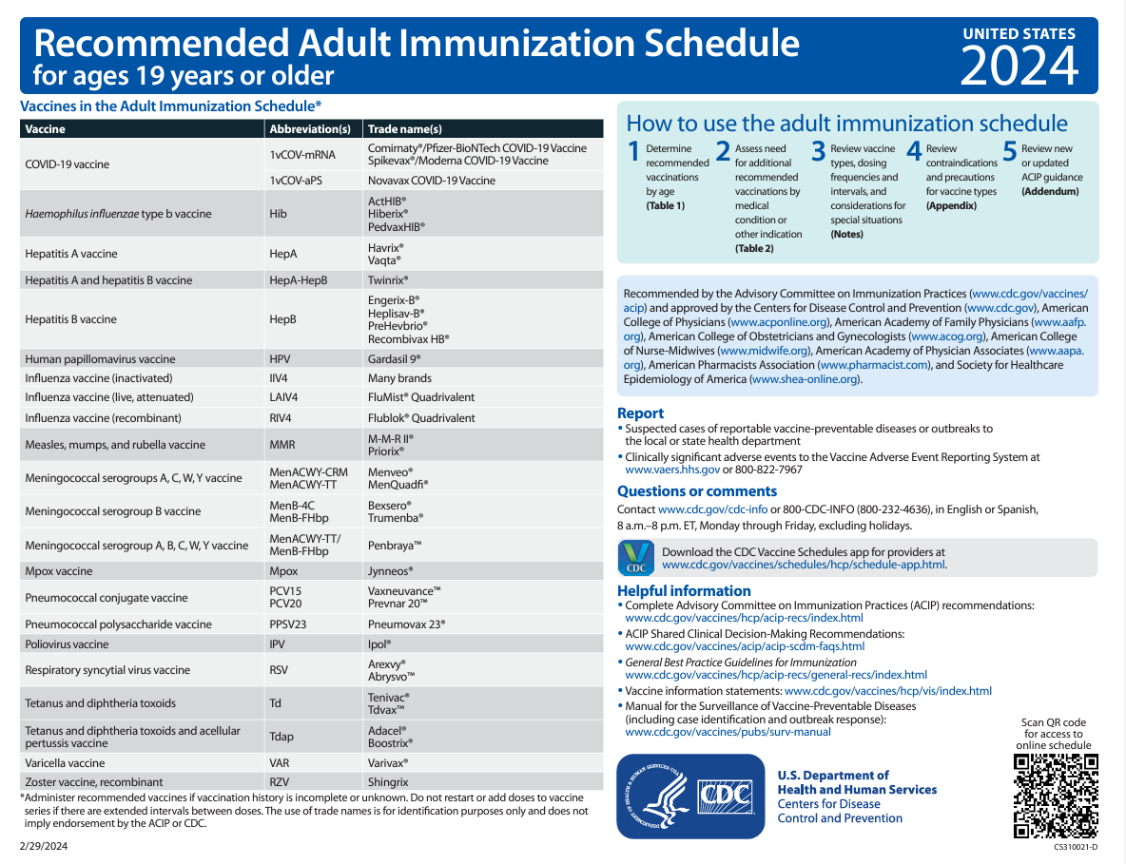
Immunization Schedule Updates
All staff must use the same immunization schedule
Immunization Schedules:
Child & Adolescent 18 years or younger
Tables (Recommended, Catch-up, Medical indication
Notes (make sure to always read the notes)
Appendix
Addendum
Adults 19 years or older (includes Tables, Notes, Appendix and an Addendum)
http://www.cdc.gov/vaccines/schedules/hcp/child-adolescent.html
Notes:
ACIP has developed immunization schedules for children, adolescents and adults in which recommendations are given to aid in the prevention of vaccine preventable diseases. In last year’s October meeting, ACIP along with other partnering organizations met and approved the 2024 Recommended Child and Adolescent Immunization Schedule for ages 18 years or younger and the 2024 Recommended Adult Immunization Schedule for Ages 19 years or older. These changes became effective on October 26, 2023.
It is important to remember that:
-All staff and providers should use the same immunization schedule. Please ensure you are using this most up to date version.
References:
http://www.cdc.gov/vaccines/schedules/hcp/child-adolescent.html
2. http://www.cdc.gov/vaccines/schedules/hcp/adult.html

Slide 7
MMWR/ January 11, 2024 / 73(1); 6-10 https://www.cdc.gov/vaccines/schedules/hcp/imz/child-adolescent.html
Notes:
So, diving in, we’ll start with the cover page in which:
Changes for 2024 include:
• In the table of abbreviations and trade names, the column header was changed from “vaccine” to “vaccines and other immunizing agents” to account for the inclusion of the newly licensed RSV monoclonal antibody (nirsevimab).
• A sixth step in the “How to Use the Child and Adolescent Immunization Schedule” box was added directing health care providers to review the new Addendum section that lists new or updated ACIP recommendations that occur before the next annual update of the child and adolescent immunization schedule.
• 20-valent pneumococcal conjugate vaccine (PCV20), RSV-mAb (nirsevimab), RSV for maternal vaccination (Abrysvo), Mpox (Jynneos), and pentavalent meningococcal vaccine (MenACWY-TT/MenB-FHbp, [Penbraya]) have been added to the table listing abbreviations and trade names of vaccines and other immunizing agents.
• Diphtheria and Tetanus Toxoid Adsorbed vaccine (DT), 13-valent pneumococcal conjugate vaccine (PCV13), MenACWY-D (Menactra), and bivalent mRNA COVID-19 vaccines were removed from the table listing abbreviations and trade names of vaccines and other immunizing agents, because they are no longer distributed or recommended for use in the United States.
References:
Advisory Committee on Immunization Practices Recommended Immunization Schedule for Children and Adolescents Aged 18 Years or Younger — United States, 2024, MMR / Weekly / January 11, 2024 / 73(1); 6-10
https://www.cdc.gov/vaccines/schedules/hcp/imz/child-adolescent.html, Recommended Child and Adolescent Immunization Schedule for Ages 18 Years or Younger, United States, 2024

Slide 8
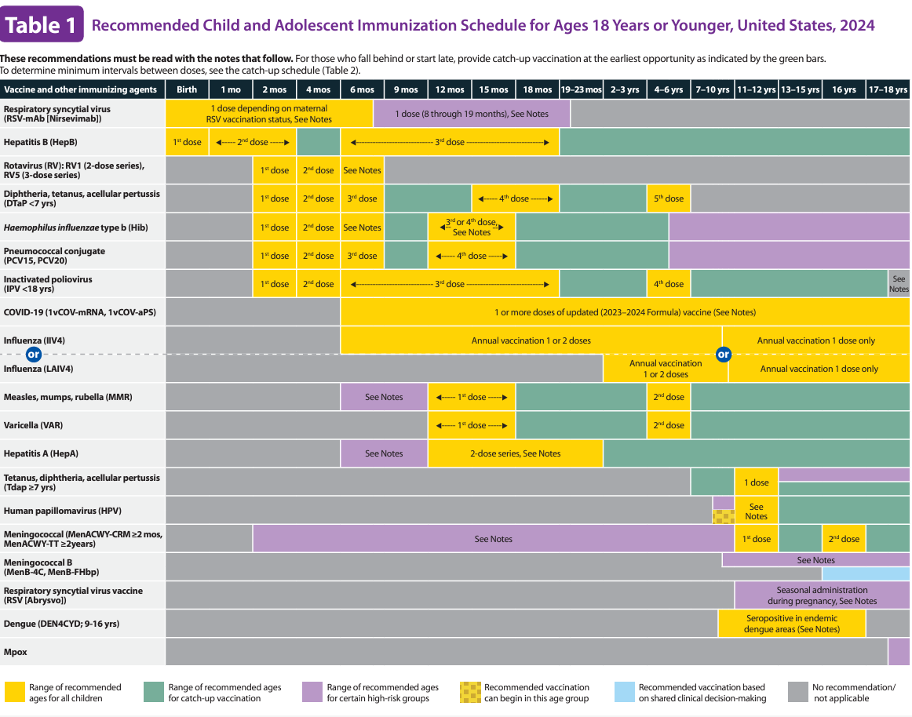
MMWR/ January 11, 2024 / 73(1); 6-10 https://www.cdc.gov/vaccines/schedules/hcp/imz/child-adolescent.html
Notes:
Changes to Table 1 for 2024 include:
• The column header was changed from “vaccine” to “vaccines and other immunizing agents” to account for the inclusion of the newly licensed RSV monoclonal antibody (nirsevimab).
• COVID-19 row: The text overlay was revised to reflect updated vaccination recommendations. This text overlay now states, “1 or more doses of updated (2023–2024 Formula) vaccine.”
• MenACWY row: Menactra has been deleted.
• Mpox row: A new row was added for Jynneos with the column for age 18 years highlighted in purple reflecting the risk-based recommendation for this age group.
• Pneumococcal conjugate row: PCV20 has been added and PCV13 has been deleted.
• Pneumococcal polysaccharide vaccine (PPSV23) row: This row has been deleted because PPSV23 is no longer routinely recommended for all children and adolescents aged ≥2 years at increased risk for invasive pneumococcal disease. It is still recommended in certain circumstances.
• RSV-mAb row: A new row has been added with the columns for ages birth–7 months highlighted in yellow to indicate the recommended age for routine immunization. The overlaying text, “1 dose depending on maternal RSV vaccination status” was also added. In addition, age 8–19 months is highlighted in purple to reflect the risk-based recommendation for this age group.
• RSV row: A new row was added for Abrysvo (Pfizer Inc.) and ages 11–18 years are highlighted in purple with the overlaying text, “Seasonal administration during pregnancy” added to reflect the recommendation for the use of Abrysvo (Pfizer Inc.) during pregnancy.
References:
Advisory Committee on Immunization Practices Recommended Immunization Schedule for Children and Adolescents Aged 18 Years or Younger — United States, 2024, MMR / Weekly / January 11, 2024 / 73(1); 6-10
https://www.cdc.gov/vaccines/schedules/hcp/imz/child-adolescent.html, Recommended Child and Adolescent Immunization Schedule for Ages 18 Years or Younger, United States, 2024

Slide 9
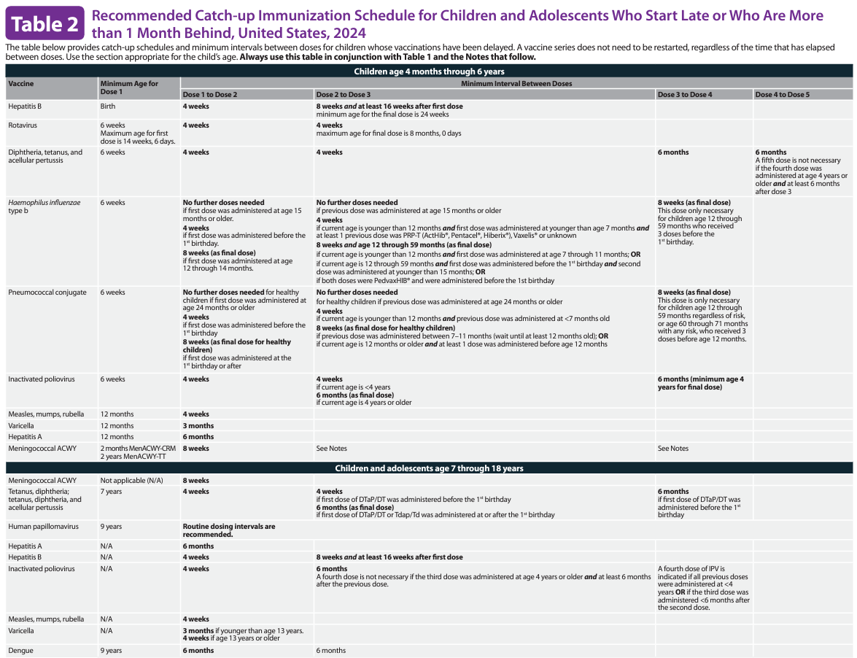
MMWR/ January 11, 2024 / 73(1); 6-10 https://www.cdc.gov/vaccines/schedules/hcp/imz/child-adolescent.html
Notes:
Changes to Table 2 for 2024 include:
• DTaP row: Language for the minimum interval between doses 4 and 5 was added to clarify when a fifth dose is indicated. The text reads, “A fifth dose is not necessary if the fourth dose was administered at age ≥4 years and ≥6 months after dose 3.”
• MenACWY row: Menactra has been deleted.
References:
Advisory Committee on Immunization Practices Recommended Immunization Schedule for Children and Adolescents Aged 18 Years or Younger — United States, 2024, MMR / Weekly / January 11, 2024 / 73(1); 6-10
https://www.cdc.gov/vaccines/schedules/hcp/imz/child-adolescent.html, Recommended Child and Adolescent Immunization Schedule for Ages 18 Years or Younger, United States, 2024

Slide 10
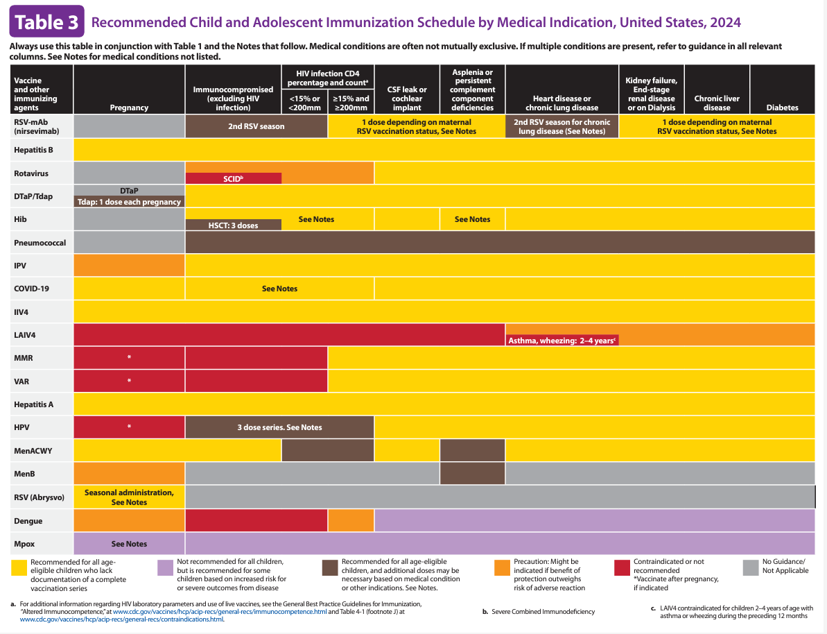
MMWR/ January 11, 2024 / 73(1); 6-10 https://www.cdc.gov/vaccines/schedules/hcp/imz/child-adolescent.html
Notes:
Changes to Table 3 (Medical Indication) for 2024 include:
• A sentence was added to the header of Table 3 stating that medical conditions are often not mutually exclusive and that health care providers should review all relevant columns in the Table if multiple conditions are present.
• The column header was changed from “vaccine” to “vaccines and other immunizing agents” to account for the inclusion of the newly licensed RSV monoclonal antibody (nirsevimab).
• Legend: The definitions of the yellow, purple, and gray colors boxes in the legend were revised. Based on the revised definitions, the colors for many of the rows in this table have changed. In addition, the checked yellow color was changed to a brown color to harmonize with the 2024 adult immunization schedule.
• Mpox row: A new row was added for Jynneos. Across all medical indications listed, the entire row is purple reflecting the risk-based recommendation for Mpox vaccination. In the pregnancy column, an overlaying text, “See Notes” has been added, directing health care providers to review the pregnancy bullet in the Mpox vaccination notes.
• RSV-mAb row: A new row was added to summarize nirsevimab immunization recommendations by medical condition. The columns for both immunocompromised status (excluding HIV infection) and HIV infection with CD4 <15% or <200 cells per mm³ is highlighted in brown and an overlaying text “2nd RSV season” was added. In addition, the column for heart disease or chronic lung disease is also highlighted in brown with the overlaying text “2nd RSV season for chronic lung disease.”
• RSV row: A new row was added for use of Abrysvo (Pfizer Inc.) during 32–36 weeks’ gestation. The pregnancy column is highlighted in yellow with overlaying text of “seasonal administration” added to indicate that the maternal RSV vaccination recommendation is based on RSV seasonality.
References:
Advisory Committee on Immunization Practices Recommended Immunization Schedule for Children and Adolescents Aged 18 Years or Younger — United States, 2024, MMR / Weekly / January 11, 2024 / 73(1); 6-10
https://www.cdc.gov/vaccines/schedules/hcp/imz/child-adolescent.html, Recommended Child and Adolescent Immunization Schedule for Ages 18 Years or Younger, United States, 2024

Slide 11
Immunization Schedule Notes Section Update
• Additional information: Text for vaccine injury compensation revised to add Mpox and RSV to the list of vaccines not covered by the National Vaccine Injury Compensation Program. Mpox is covered by the Countermeasures Injury Compensation Program.
• COVID-19: Language revised to reflect the current COVID-19 vaccination recommendations for children and adolescents; hyperlinks to current COVID-19 vaccination schedules and EUA indications included.
• DTaP: Language revised to clarify primary and booster doses.
• HPV: recommendation for interrupted schedules removed from Routine vaccination section; wording added to improve clarity on bullet point regarding when no additional doses needed.
• Influenza: Hyperlink to the 2023–24 and bullet for the 2024–25 influenza recommendations added; all bullets with recommendations for persons with a history of egg allergy removed and note to Special situations section added.
• MMR: MMRV minimum interval note was moved; all other sections revised to clarify minimal interval applicable to all sections.
• MenACWY: Menactra removed; information on use of newly licensed Penbraya included.
• MenB: Note summarizing recommendations for Penbraya added; resource link for providers and shared clinical decision making for MenB added.
MMWR/ January 11, 2024 / 73(1); 6-10 https://www.cdc.gov/vaccines/schedules/hcp/imz/child-adolescent.html
Notes:
Changes to the 2024 Notes section includes:
The notes for each vaccine and related agent are presented in alphabetical order. Edits have been made throughout the Notes section to harmonize language, to the greatest extent possible, with that in the adult immunization schedule.
• Additional information: The text for vaccine injury compensation was revised to add Mpox and RSV to the list of vaccines not covered by the National Vaccine Injury Compensation Program. Mpox is covered by the Countermeasures Injury Compensation Program.
• COVID-19: The language in the “Routine vaccination” and “Special situations” sections was revised to reflect the current COVID-19 vaccination recommendations for children and adolescents. The number of doses needed and intervals between doses might vary on the basis of a patient’s previous vaccination history, immunocompromised status, and the vaccine product used. The “Routine vaccination” section describes the recommendations for the general population, and the “Special situations” section describes the recommendations for persons who are moderately or severely immunocompromised. In addition, hyperlinks to the current COVID-19 vaccination schedules as well as Emergency Use Authorization indications for COVID-19 vaccines are included.
• DTaP: Language in the “Routine vaccination” section was revised to clarify primary and booster doses.
• HPV: In the “Routine vaccination” section, the recommendation for interrupted schedules was removed because that information is also presented on the Cover Page and applicable to all vaccines. In addition, to improve clarity, the words, “of any valency” were added to the bullet, “No additional dose recommended when any HPV vaccine series of any valency has been completed using the recommended dosing intervals.”
• Influenza: A hyperlink to the 2023–24 influenza recommendations and a bullet for the 2024–25 influenza recommendations were added. In the “Special situations” section, all bullets describing recommendations for persons with a history of egg allergy were removed. Persons with a history of egg allergy of any severity can be vaccinated with any influenza vaccine indicated for the recipient’s age and health status, with no additional safety considerations. A note describing this recommendation was added at the end of the “Special situations” section.
• MMR: The bullet, “If MMRV is used, the minimum interval between MMRV doses is 3 months” was moved to the end of the notes section. In addition, the “Routine vaccination,” “Catch-up vaccination,” and “Special situations” sections were revised to clarify that this minimal interval is applicable to all sections.
• MenACWY: All reference to Menactra was removed because this vaccine is no longer distributed in the United States, and any remaining doses of this product expired in October 2023. In addition, information about the use of the newly licensed pentavalent meningococcal vaccine (Penbraya) is included at the end of the MenACWY notes.
• MenB: A note summarizing recommendations for Penbraya was added. In addition, a link to a resource to assist health care providers with shared clinical decision-making recommendations for MenB vaccination was added.
References:
Advisory Committee on Immunization Practices Recommended Immunization Schedule for Children and Adolescents Aged 18 Years or Younger — United States, 2024, MMR / Weekly / January 11, 2024 / 73(1); 6-10
https://www.cdc.gov/vaccines/schedules/hcp/imz/child-adolescent.html, Recommended Child and Adolescent Immunization Schedule for Ages 18 Years or Younger, United States, 2024

Slide 12
Immunization Schedule Notes Section Update
• Mpox: New section with recommendations for use of Jynneos in adolescents aged 18 years added.
• Pneumococcal: Sections updated with new recommendations for use of PCV15, PCV20, and PPSV23; PCV13 deleted; medical conditions added to list for increased risk of invasive pneumococcal disease.
• Poliovirus: New language added and updated recommendations for adolescents aged 18 years to Catch-up vaccination section; Special situations section revised with criteria for one-time, lifetime IPV booster.
• RSV-mAb: New section added on the use of nirsevimab in infants and young children.
• RSV: New section added with recommendations for maternal RSV vaccination with Abrysvo using seasonal administration.
• Tdap: Routine vaccination and Catch-up vaccination sections revised to clarify that Tdap dose recommended at age 11–12 years is adolescent booster dose.
MMWR/ January 11, 2024 / 73(1); 6-10 https://www.cdc.gov/vaccines/schedules/hcp/imz/child-adolescent.html
Notes:
Changes to the 2024 Notes section cont.:
• Mpox: A new section describing the recommendations for use of Jynneos in adolescents aged 18 years, including sexual risk factors and vaccination during pregnancy, was added.
• Pneumococcal: The “Routine vaccination,” “Catch-up vaccination,” and “Special situations” sections have been updated with the new recommendations for use of 15-valent pneumococcal conjugate vaccine (PCV15), PCV20, and PPSV23. PCV13 was deleted from all sections. Chronic kidney disease, chronic liver disease, and moderate persistent or severe persistent asthma were added to the list of medical conditions that increase the risk for invasive pneumococcal disease.
• Poliovirus: The “Catch up vaccination” section has been revised to include updated recommendations for adolescents aged 18 years. Language was added stating that most adolescents aged 18 years who were born and raised in the United States can assume to be vaccinated against poliovirus as children. The “Special situations” section was revised to describe administering a one-time, lifetime IPV booster to adolescents aged 18 years who have completed the primary series and are at increased risk for exposure to poliovirus.
• RSV-mAb: A new section was added to provide details on the use of nirsevimab in infants and young children. The “Routine immunization” section outlines the recommendations for infants aged <8 months. The “Special situations” section describes recommendations for age-eligible children who are undergoing cardiac surgery with cardiopulmonary bypass, and children aged 8–19 months who are at increased risk for severe RSV disease. Information describing timing of immunization, including guidance for jurisdictions with RSV seasonality that differs from most of the continental United States, was included.
• RSV: A new section was added outlining recommendations for maternal RSV vaccination with Abrysvo (Pfizer Inc.) using seasonal administration. Language was added to clarify that health care providers should take one of two approaches to prevent severe respiratory syncytial virus disease in infants: either administer Abrysvo (Pfizer Inc.) to pregnant persons at 32–36 weeks’ gestation or administer nirsevimab to the infant. Information describing vaccination timing, including guidance for jurisdictions with RSV seasonality that differs from most of the continental United States, was included.
• Tdap: The “Routine vaccination” and “Catch-up vaccination” sections were revised to clarify that the Tdap dose recommended at age 11–12 years is the adolescent Tdap booster dose.
References:
Advisory Committee on Immunization Practices Recommended Immunization Schedule for Children and Adolescents Aged 18 Years or Younger — United States, 2024, MMR / Weekly / January 11, 2024 / 73(1); 6-10
https://www.cdc.gov/vaccines/schedules/hcp/imz/child-adolescent.html, Recommended Child and Adolescent Immunization Schedule for Ages 18 Years or Younger, United States, 2024

Slide 13
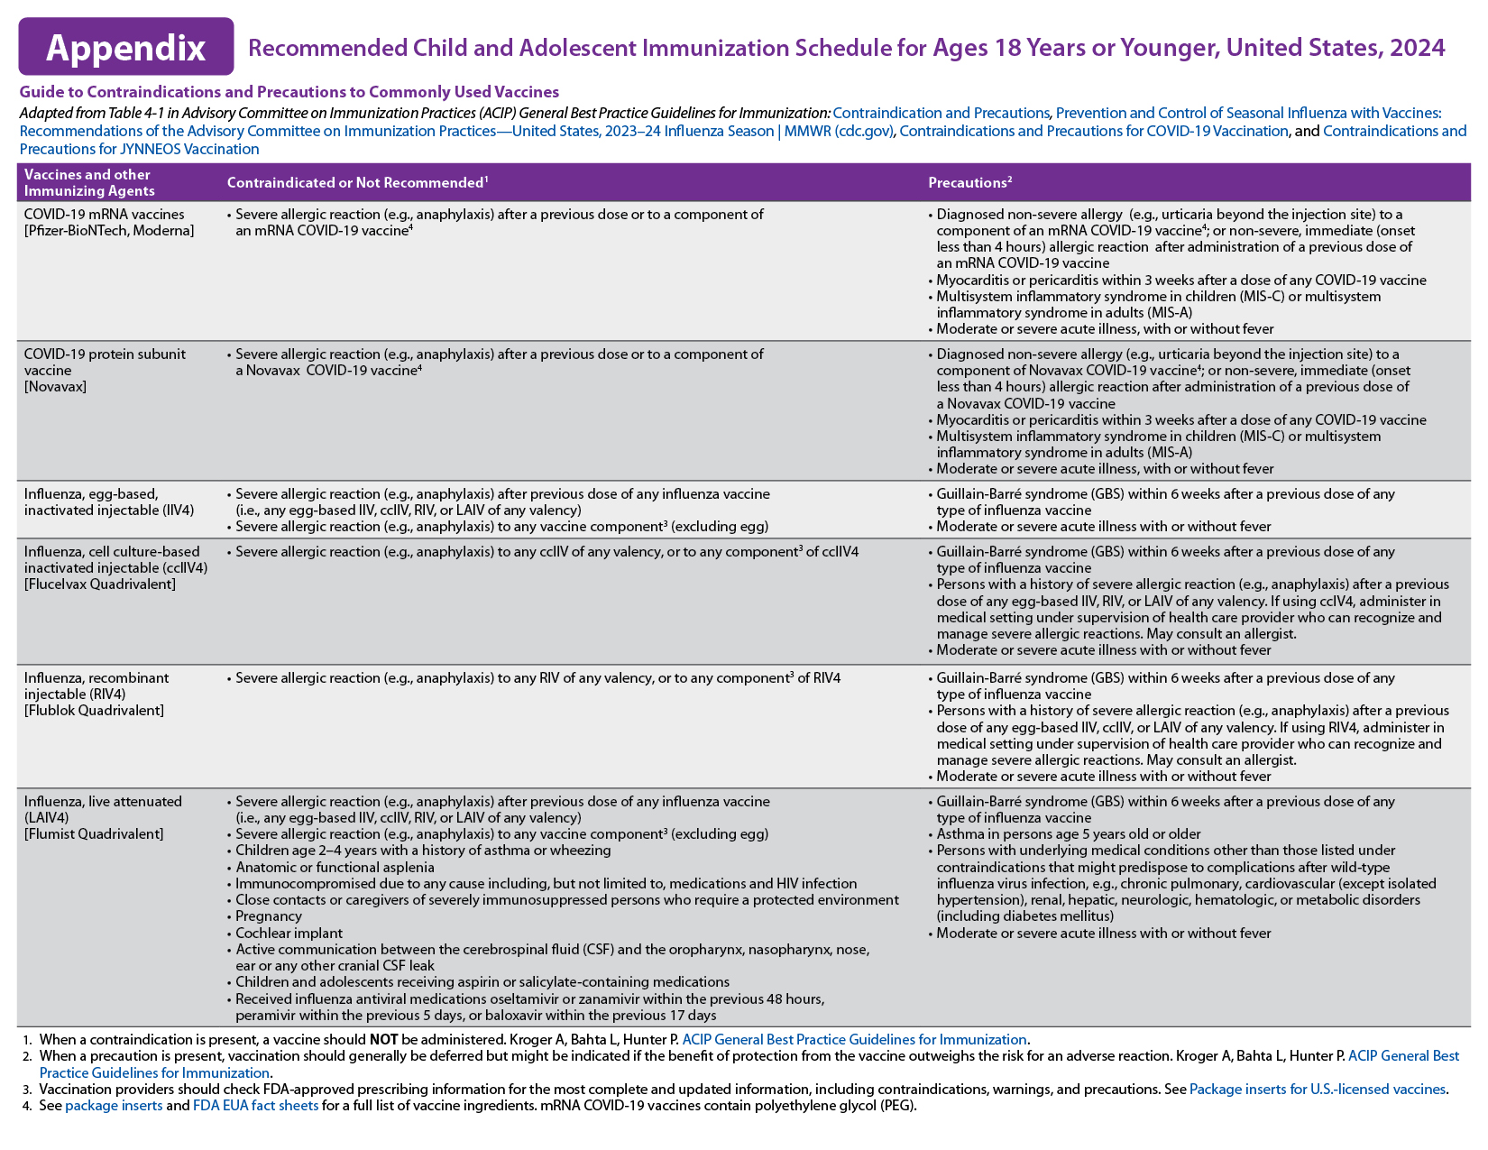
https://www.cdc.gov/vaccines/schedules/hcp/imz/child-adolescent.html
Notes:
2024 Appendix Updates:
• The header sentence of the Appendix was revised to include all the sources used to create the Appendix.
• The column header was changed from “Vaccine” to “Vaccines and other immunizing agents” to account for the inclusion of the newly licensed RSV monoclonal antibody (nirsevimab).
• COVID-19 row: Two new rows for COVID-19 vaccines were added to describe contraindications and precautions to COVID-19 vaccination. The first row lists contraindications and precautions to receipt of mRNA vaccines (Pfizer-BioNTech and Moderna), and the second row lists contraindications and precautions to receipt of the protein subunit vaccine (Novavax).
• DTaP and DT row: DT was deleted because this vaccine is no longer distributed in the United States.
References:
https://www.cdc.gov/vaccines/schedules/hcp/imz/child-adolescent.html, Recommended Child and Adolescent Immunization Schedule for Ages 18 Years or Younger, United States, 2024

Slide 14
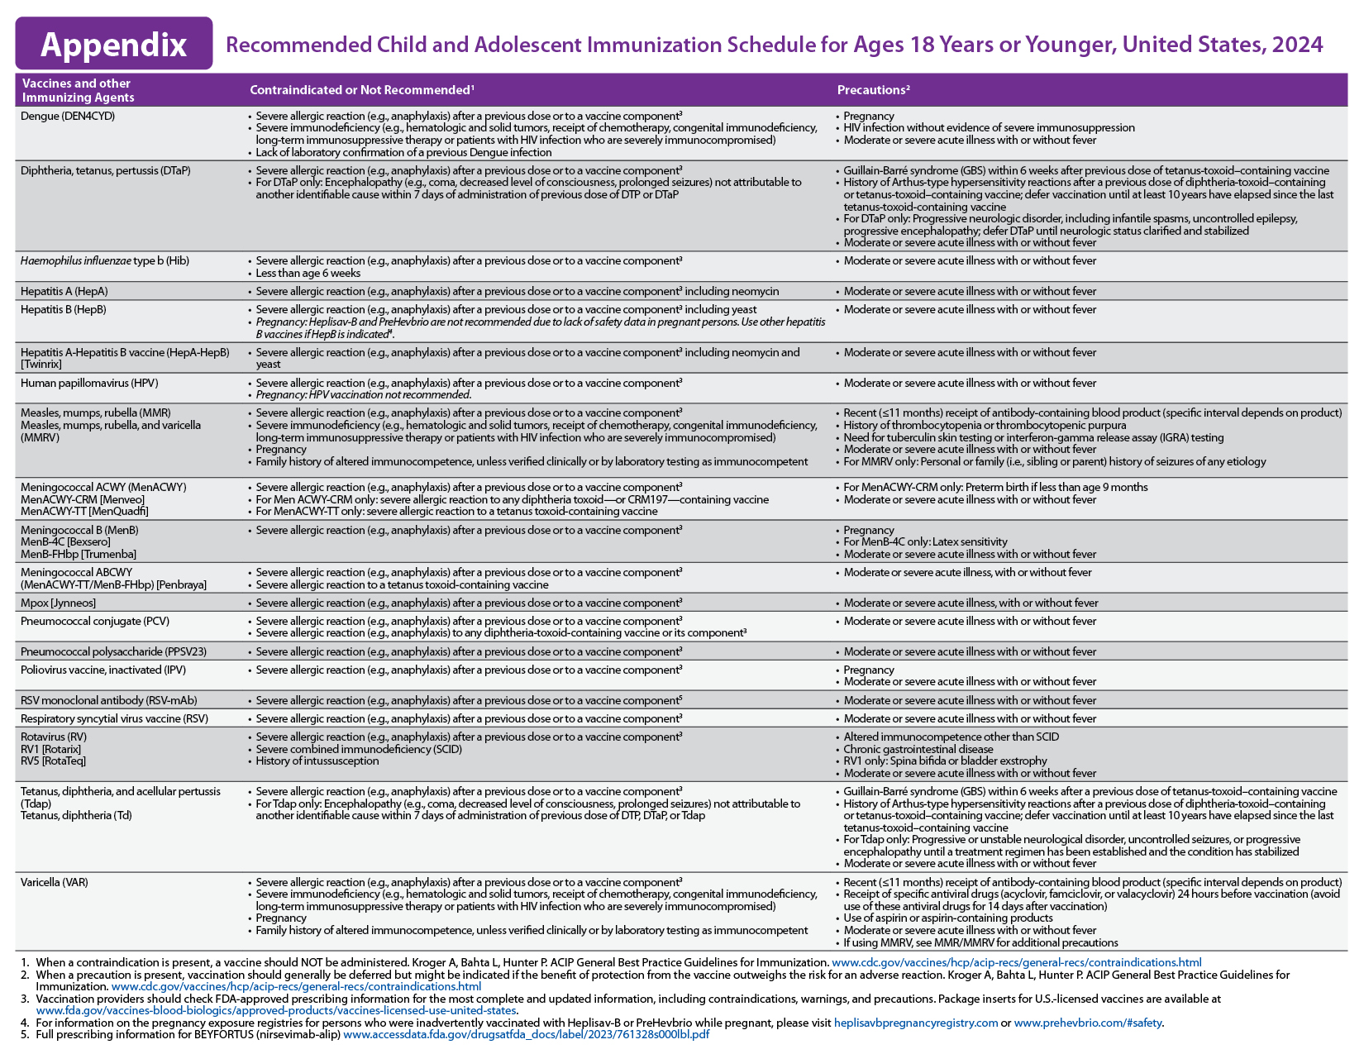
https://www.cdc.gov/vaccines/schedules/hcp/imz/child-adolescent.html
Notes:
2024 Appendix Updates:
• DTaP and DT row: DT was deleted because this vaccine is no longer distributed in the United States.
• Hib row: In the “Contraindicated or Not Recommended” column, the bullet describing history of severe allergic reaction to dry natural latex was removed because most vials of Hib products no longer contain latex.
• Meningococcal ACWY row: Menactra was removed because this product is no longer distributed in the United States. Any remaining doses expired in October 2023.
• Meningococcal ABCWY row: A new row was added to describe contraindications and precautions to vaccination with the new pentavalent meningococcal vaccine, Penbraya.
• RSV-mAb row: A new row for nirsevimab was added to describe contraindications and precautions to nirsevimab.
• RSV row: A new row for RSV (Abrysvo [Pfizer Inc.]) was added describing the contraindications and precautions to RSV vaccination.
References:
https://www.cdc.gov/vaccines/schedules/hcp/imz/child-adolescent.html, Recommended Child and Adolescent Immunization Schedule for Ages 18 Years or Younger, United States, 2024

Slide 15
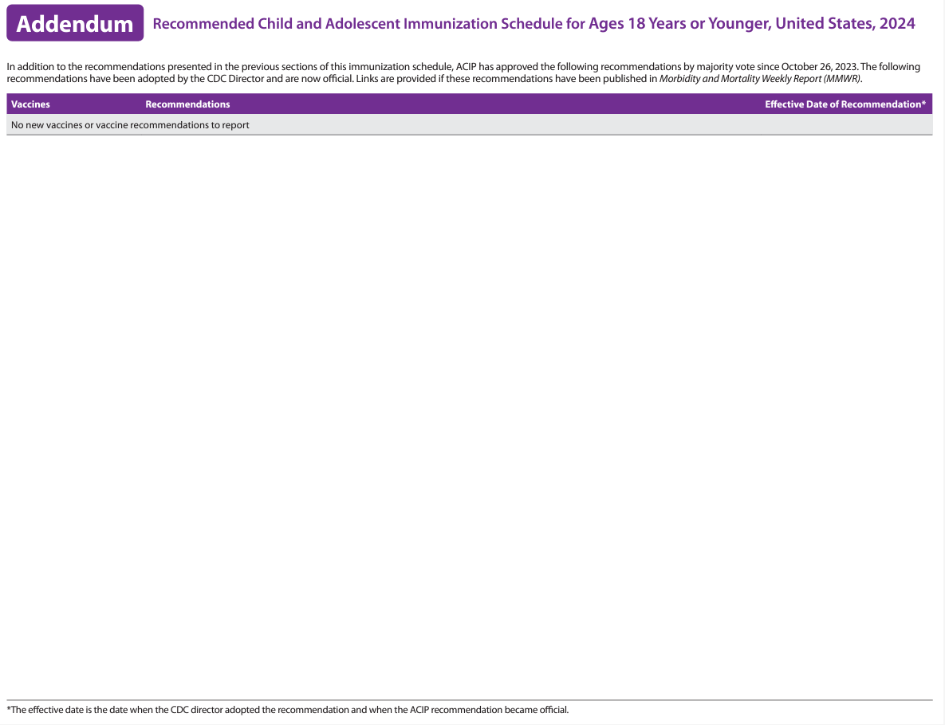
Notes:
A new Addendum section was added to the child and adolescent immunization schedule to summarize new and updated ACIP recommendation(s) that occur before the next annual update to the child and adolescent immunization schedule.
Currently, there are no new vaccines/vaccine recommendations to report.
References:
https://www.cdc.gov/vaccines/schedules/hcp/imz/child-adolescent.html, Recommended Child and Adolescent Immunization Schedule for Ages 18 Years or Younger, United States, 2024

Slide 16
What Does It All Mean?
Indication: Information about the appropriate use of the vaccine
Recommendation: ACIP statement that broadens and further delineates the indication found in the package insert
-Basis for standards for best practice
Requirement: Mandate by a state that a vaccine must be administered and documented before entrance to childcare and/or school
Notes:
It is important that providers understand the difference between an indication, recommendation and a requirement when assessing immunization need.
An indication provides information about the appropriate use of the vaccines; the prescribing information. FDA decides whether to approve (also known as to license) the vaccine for use in the United States. If FDA approves the vaccine, the company is permitted to market it in the United States for use in the population for which it is approved.
A recommendation is the ACIP statement that broadens and delineates the indication found in the package insert. ACIP develops written recommendations for the routine administration of vaccines, along with schedules regarding appropriate timing, dosage, and contraindications.
A vaccine requirement is consistent with the ACIP Recommended Childhood/Adolescent Immunization Schedule. The state mandates that a particular vaccine must be administered and documented before entrance to school or childcare.
Remember that GRITS: Calculates validity based on recommendations; Prints certificates based on requirements, which are first based on the recommendations. Some of the vaccines that will be discussed are RECOMMENDED for particular age groups, but MAY NOT BE REQUIRED for school or childcare attendance. (i.e., HPV, MenB).

Slide 17
What is Shared Clinical Decision Making?
Shared clinical decision making is a process in which the health care provider and patient or parent/guardian work together to make decisions based on clinical evidence and is individually based.
https://www.cdc.gov/vaccines/acip/acip-scdm-faqs.html
Notes:
References:
https://www.cdc.gov/vaccines/acip/acip-scdm-faqs.html

Slide 18
General Best Practice Guidelines
Timing and Spacing of Immunobiologics
Contraindications and Precautions
Preventing and Managing Adverse Reactions
Vaccine Administration
Storage and Handling of Immunobiologics
Altered Immunocompetence
Special Situations
Vaccination Records
Vaccination Programs
Vaccine Information Sources
https://www.cdc.gov/vaccines/hcp/acip-recs/general-recs/index.html
Notes:
On April 20, 2017, ACIP published The General Best Practice Guidelines for Immunization. Providers and patients must navigate numerous issues, such as the timing of each dose, screening for contraindications and precautions, the number of vaccines to be administered, the educational needs of patients and parents, and interpreting and responding to adverse events. Vaccination providers help patients understand the substantial body of (occasionally conflicting) information about vaccination.
This report will help vaccination providers to assess vaccine benefits and risks, use recommended administration practices, understand the most effective strategies for ensuring that vaccination coverage in the population remains high, and communicate the importance of vaccination to reduce the effects of vaccine-preventable disease. These best practice guidelines are intended for use in the United States; vaccine availability, use, and epidemiologic circumstances might differ in other countries and might warrant different guidance.
Here are some of the most recent updates. As always, please make sure you are going online under the ACIP Recs Home page to stay up to date on any changes.
August 3, 2023
Timing and Spacing of Immunobiologics: Respiratory syncytial virus (RSV) vaccine was added to Table 3-1.
Altered Immunocompetence: Use of PCV15 and PCV20 vaccines in patients who have received hematopoietic stem cell transplants (HSCT) was added.
Altered Immunocompetence: The interval from recombinant zoster vaccine (RZV) to anti-B cell agents was added to harmonize with vaccine-specific recommendations.
References:
https://www.cdc.gov/vaccines/hcp/acip-recs/general-recs/index.html
. https://www.cdc.gov/vaccines/hcp/acip-recs/general-recs/general-recs-errata.html

Slide 19
Diphtheria, Tetanus, and Pertussis Vaccines (DTaP & Tdap)
Routine vaccination
DTaP: 5 dose series administered at 2, 4, 6, 15-18 months and 4-6 years
Tdap: 1 dose administered at 11-12 years of age; administer 1 dose to pregnant adolescent (preferably during the early part of gestational weeks 27-36)
Catch-up vaccination
A 5th dose of DTaP is not necessary if dose 4 was administered at age 4 years or older and at least 6 months after 3rd dose
Children ages 7 through 9 years who receive DTaP or Tdap inadvertently or as part of a catch-up series should receive Tdap for the routinely recommended adolescent dose at 11-12 years of age
Children and adolescents ages 7 through 18 years who are not fully vaccinated with DTaP, should receive 1 dose of Tdap as part of the catch-up series; Td or Tdap should be used if additional doses are indicated
Adolescents ages 13 through 18 years who have not received Tdap should receive 1 booster dose
Refer to special situations in the Notes section for guidance on wound management
MMWR / April 27, 2018 / 67(2);1-44 MMWR / January 24, 2020 / 69(3);77-83 https://www.cdc.gov/vaccines/schedules/hcp/imz/child-adolescent.html https://www.cdc.gov/vaccines/schedules/downloads/child/job-aids/dtap.pdf https://www.cdc.gov/vaccines/schedules/downloads/child/job-aids/tdap-1.pdf https://www.cdc.gov/vaccines/schedules/downloads/child/job-aids/tdap-2.pdf
Notes:
***Required for childcare attendance***
Routine vaccination
The fourth dose may be administered as early as age 12 months, provided at least 6 months have elapsed since the third dose.
Inadvertent administration of fourth DTaP dose early: If the fourth dose of DTaP was administered at least 4 months after the third dose of DTaP and the child was 12 months of age or older, it does not need to be repeated.
All pregnant women should receive a dose of Tdap during EACH pregnancy, irrespective of prior history of receiving Tdap. Per ACIP, it is recommended that the Tdap vaccination is administered early in the 27 through 36 week “window” to maximize passive antibody transfer to the infant. If a dose is given early in that same pregnancy, do NOT repeat it at 27-36 weeks. If not given during pregnancy, give Tdap immediately postpartum, if the patient has NEVER received a dose of Tdap before. Repeat postpartum vaccination is not an ACIP recommendation as it takes about 2 weeks after receipt of vaccine for mother to be protected, which can put her at risk of contracting or spreading the disease to her vulnerable newborn during this time.
No minimum interval between doses of Td and Tdap
Catch up vaccination
DTaP 5th dose/inadvertent administration
A 5th dose of DTaP is not necessary if dose 4 was administered at age 4 years or older and at least 6 months after 3rd dose.
DTaP inadvertently administered to children ages 7-9 years, DTaP may count as part of the catch-up series; routine Tdap dose at age 11-12 years old should be administered. For children ages 10-18 years, the DTaP dose will be counted as the adolescent Tdap dose.
Children and adolescents ages 7 through 18 years who are not fully vaccinated with DTaP, should receive 1 dose of Tdap as part of the catch-up series; Td or Tdap should be used if additional doses are indicated
One dose of Tdap
For children and adolescents starting at 11 or 12 years of age; Tdap can be administered regardless of the interval since the last tetanus and diphtheria toxoid-containing vaccine. Children aged 7 through 9 years who receive Tdap as part of a catch-up series should be given an additional Tdap for the routinely recommended adolescent dose at 11-12 years of age.** However, children aged 10 that receive a dose of Tdap as part of the catch-up series, do not need to receive the routine Tdap dose at ages 11-12.
Adolescents ages 13 through 18 years who have not received Tdap should receive 1 booster dose
Special situations
Wound management in persons aged 7 years or older with history of 3 or more doses of tetanus-toxoid-containing vaccine: For clean and minor wounds, administer Tdap or Td if more than 10 years since last dose of tetanus-toxoid containing vaccine; for all other wounds, administer Tdap or Td if more than 5 years since last dose of tetanus-toxoid containing vaccine. Tdap is preferred for persons aged 11 years or older who have not previously received Tdap or whose Tdap history is unknown. If a tetanus-toxoid-containing vaccine is indicated for a pregnant adolescent, use Tdap.
Additional Info:
Adacel is licensed for persons 10 through 64 years
Boostrix is licensed for persons 10 years and older
For adults 65 years and older Boostrix should be used, when feasible; however, either vaccine product provides protection and is considered valid.
Notes:
5th dose of DTaP is not necessary if dose 4 was administer at age 4 years or older and at least 6 months after 3rd dose.
DTaP inadvertently administered to children ages 7-9 years, DTaP may count as part of the catch-up series; routine Tdap dose at age 11-12 years old should be administered. For children ages 10-18 years, the DTaP dose will be counted as the adolescent Tdap dose.
either Td or Tdap is allowed as an option for decennial tetanus booster doses and catch-up series doses in persons who have previously received Tdap.
Children aged 7 through 9 years who receive Tdap as part of a catch-up series should be given an additional Tdap for the routinely recommended adolescent dose at 11-12 years of age.** However, children aged 10 that receive a dose of Tdap as part of the catch-up series, do not need to receive the routine Tdap dose at ages 11-12; it will be counted as the adolescent Tdap booster.
Optional Info:
The diphtheria germ lives in the throat and mouth of the infected person. The disease is spread through direct contact with the infected person. We don’t see as much of this disease in the United States now.
The tetanus germ lives in dirt and the intestines and the feces of animals. The germ enters the body through cuts, punctures, burns, and other wounds. However, there are still outbreaks throughout the world, and the danger is for an international traveler to bring infection into the US. Most cases of tetanus reported occur in adults who have not been immunized or who are under immunized; i.e., they have not received boosters to maintain a level of protection.
The pertussis germ lives in the mouth, nose, and throat of the infected person. The germ is spread from person to person by coughing and sneezing. Pertussis vaccine is given to prevent pertussis in infants and children. Other complications include pneumonia, seizures, and death. Adults may also get pertussis, but they usually do not get very sick and may not be aware they have the disease.
Job Aids: catch-up guidance in slide links above
References:
Prevention of Pertussis, Tetanus, and Diphtheria with Vaccines in the United States: Recommendations of the Advisory Committee on Immunization Practices (ACIP); MMWR/ April 27, 2018 / 67 (2);1-44
Use of Tetanus Toxoid, Reduced Diphtheria Toxoid, and Acellular Pertussis Vaccines: Updated Recommendations of the Advisory Committee on Immunization Practices (ACIP) — United States, 2019; MMWR/ January 24, 2020 / 69(3);77-83
https://www.cdc.gov/vaccines/schedules/hcp/imz/child-adolescent.html, Recommended Child and Adolescent Immunization Schedule for Ages 18 Years or Younger, United States, 2024
https://www.cdc.gov/vaccines/schedules/downloads/child/job-aids/dtap.pdf
https://www.cdc.gov/vaccines/schedules/downloads/child/job-aids/tdap-1.pdf
https://www.cdc.gov/vaccines/schedules/downloads/child/job-aids/tdap-2.pdf

Slide 20
Td Vaccines
Previously, 2 Td vaccines available for use in the United States:
TdVaxTM
Tenivac®
MassBiologics has discontinued production of TdVaxTM
Supply shortages anticipated during 2024
Tdap vaccines available
Guidance for vaccination providers:
Transition to use of Tdap vaccine in lieu of Td vaccine whenever possible
Tdap vaccine is an acceptable alternative to Td vaccine, including when a tetanus booster is indicated for wound management
Tdap vaccine is NOT an acceptable alternative only when a person has a specific contraindication to pertussis-containing vaccines, which is very rare
https://www.cdc.gov/vaccines/vpd/dtap-tdap-td/hcp/recommendations.html#constrained-supply-2024
Notes:
Sanofi has increased their available U.S. supply of Tenivac®. However, it is still anticipated that the supply of Td vaccine in the U.S. market will be constrained during 2024.
Temporary ordering controls are currently in place in the public and private sectors to help manage the gap in supply. Diphtheria, tetanus, and acellular pertussis (Tdap) vaccines are currently available without supply constraints.
Guidance for vaccination providers:
The limited supply of Td vaccine needs to be preserved for those with a contraindication to receiving pertussis-containing vaccines.
Transition to use of Tdap vaccine in lieu of Td vaccine whenever possible while Td vaccine supplies are constrained.
Tdap vaccine is an acceptable alternative to Td vaccine, including when a tetanus booster is indicated for wound management.
Tdap vaccine isn’t an acceptable alternative only when a person has a specific contraindication to pertussis-containing vaccines, which is very rare.
References:
1. https://www.cdc.gov/vaccines/vpd/dtap-tdap-td/hcp/recommendations.html#constrained-supply-2024

Slide 21
Haemophilus influenzae type b (Hib)
Routine vaccination
4-dose series at 2, 4, 6, and 12-15 months (ActHIB, Hiberix, or Pentacel)
3-dose series at 2, 4, and 12-15 months (PedvaxHIB)
Vaxelis is not recommended for booster dose
Catch-up vaccination
Administer 1 dose for unvaccinated children ages 15-59 months; Vaxelis can be used for catch-up vaccination in children less than 5 years of age
Previously unvaccinated children aged 5 years (60 months) or older who are not high risk, do not require catch-up vaccination
Refer to catch-up immunization schedule for other catch-up guidance
Special situations
Refer to immunization schedule notes for guidance when vaccinating high risk children with medical indications
https://www.cdc.gov/vaccines/schedules/hcp/imz/child-adolescent.html https://www.cdc.gov/vaccines/schedules/downloads/child/job-aids/hib-actHib.pdf https://www.cdc.gov/vaccines/schedules/downloads/child/job-aids/hib-pedvax.pdf
Notes:
***Required for school and childcare attendance***
Optional Info:
What causes Hib disease? Hib disease is caused by a bacterium, Haemophilus influenzae type b. There are six different types of these bacteria (a through f). Type b organisms account for 95% of all strains that cause invasive disease, and this is the type against which the Hib vaccine protects.
How does Hib disease spread? Hib disease is spread person-to-person by direct contact or through respiratory droplets. Usually, the organisms remain in the nose and throat, but occasionally the bacteria spread to the lungs or bloodstream and cause a serious infection in the individual.
How serious is Hib disease? Hib disease can be very serious. The most common type of invasive Hib disease is meningitis, an infection of the membranes covering the brain (50%–65% of cases).
Routine vaccination:
*Vaxelis® is not recommended for use as a booster dose. A different Hib-containing vaccine should be used for the booster dose.
Catch-up vaccination:
Dose 1 at age 7–11 months: Administer dose 2 at least 4 weeks later and dose 3 (final dose) at age 12–15 months or 8 weeks after dose 2 (whichever is later).
Dose 1 at age 12–14 months: Administer dose 2 (final dose) at least 8 weeks after dose 1.
Dose 1 before age 12 months and dose 2 before age 15 months: Administer dose 3 (final dose) at least 8 weeks after dose 2.
2 doses of PedvaxHIB® before age 12 months: Administer dose 3 (final dose) at 12–59 months and at least 8 weeks after dose 2.
Special situations
Refer to immunization schedule notes for guidance when vaccinating high risk children with medical indications (i.e., chemo, radiation, HSCT, asplenia, elective splenectomy, HIV and immunoglobulin deficiency, early complement deficiency)
Job Aids: Please see slide links above
References:
https://www.cdc.gov/vaccines/schedules/hcp/imz/child-adolescent.html, Recommended Child and Adolescent Immunization Schedule for Ages 18 Years or Younger, United States, 2024
https://www.cdc.gov/vaccines/schedules/downloads/child/job-aids/hib-actHib.pdf
https://www.cdc.gov/vaccines/schedules/downloads/child/job-aids/hib-pedvax.pdf

Slide 22
Hepatitis A Vaccine
Routine vaccination
Administer 2 dose series beginning at age 12 months (Havrix 6-12 months apart or Vaqta 6-18 months apart)
Catch-up vaccination
Administer 2 doses, separated by 6 months, to all children and adolescents ages 2-18 years who have not previously been vaccinated
Dose 2 should be given at least 6 months after dose 1 for children and adolescents who previously received 1 dose at age 12 months or older
International travel
Infants aged 6-11 months: 1 dose before departure; revaccinate with 2 doses (separated by 6-18 months), between 12 to 23 months of age
Unvaccinated children aged 12 months and older: Administer 1st dose as soon as travel in considered
MMWR/ November 2, 2018 / 67(43);1216-1220 MMWR/ July 3, 2020 / 69(5);1-5 http://www.cdc.gov/vaccines/schedules/hcp/child-adolescent.html
Notes:
***Required for childcare attendance***
Hepatitis A is a serious liver disease caused by a virus. The virus is found in the feces (poop) of infected people. The hepatitis A virus is spread when invisible particles of feces (poop) get into a person’s mouth. You can get hepatitis A by eating contaminated food or drinking contaminated water, during sex, or just by living with an infected person. Hepatitis A can turn your skin and eyes turn yellow. You can get very sick for weeks, need to be hospitalized, and even die. Some people don’t look or feel sick, but they can still spread hepatitis A to others. Everyone is at some risk for getting infected with hepatitis A. People who travel outside the U.S. have an increased chance of getting infected.
Routine vaccination
Intervals for Havrix (2 dose series 6-12 months apart) and Vaqta (6-18 months apart with min of 6 months).
Catch-up vaccination
Children and adolescents who previously received 1 dose at age 12 months or older, should receive dose 2 at least 6 months after dose 1.
Adolescents 18 years or older may receive Twinrix (combined HepA and HepB vaccine) as a 3-dose series of 0, 1, 6 months or 4-dose series of 0, 7, and 21-30 days, followed by a dose at 12 months.
International travel
For travelers, it is best to start the vaccine series at least one month before traveling. (Some protection may still result if the vaccine is given on or closer to the travel date.) Some people who cannot get the vaccine before traveling, or for whom the vaccine might not be effective, can get a shot called immune globulin (IG). IG gives immediate, temporary protection.
Adoption: Administer 2 doses to persons who anticipate close, personal contact with an international adoptee during the first 60 days after arrival in the U.S. from a country with high or intermediate endemicity (administer the 1st dose as soon as the adoption is planned—ideally at least 2 weeks before the adoptee’s arrival).
HepA and MMR vaccine: The antibodies in immune globulin (IG) typically used to prevent HAV infection in infants before the first birthday can interfere with the effectiveness of MMR vaccine. An infant who is given IG should not be vaccinated with MMR or varicella vaccines for at least 6 months after IG administration. If an infant age 6 through 11 months is traveling to a destination where protection from infection with HAV is desired, ACIP recommends off-label use of HepA vaccine (not IG) in addition to MMR. The HepA and MMR doses administered before the first birthday do not count toward the routine vaccination series of either vaccine: these infant travelers will still need two doses of HepA and two doses of MMR when age appropriate.
Optional Info: The nature of hepatitis A disease is cyclical. Children play an important role in HAV transmission. Symptomatic infection is uncommon in children, so they may be a source of infection for household or other close contacts. Almost half of people with hepatitis A do not have an identified source of their infection. Groups of persons at risk for hepatitis A are international travelers, men who have sex with men, and illegal drug users. Food handlers are not at risk. For others at risk, the hepatitis A vaccine series may be started whenever a person wishes to be protected or is at risk of infection.
References:
Recommendations of the Advisory Committee on Immunization Practices for Use of Hepatitis A Vaccine for Postexposure Prophylaxis and for Preexposure Prophylaxis for International Travel; MMWR / Weekly / November 2, 2018 / 67(43);1216-1220
Prevention of Hepatitis A Virus Infection in the United States: Recommendations of the Advisory Committee on Immunization Practices; MMWR / Recommendations and Reports / July 3, 2020 / 69(5);1-38
https://www.cdc.gov/vaccines/schedules/hcp/imz/child-adolescent.html, Recommended Child and Adolescent Immunization Schedule for Ages 18 Years or Younger, United States, 2024

Slide 23
Hepatitis B Vaccine
Routine vaccination
Dose 1 within 24 hours of birth
Dose 2 @ 1-2 months of age, at least 1 month after first dose
Dose 3 @ 6-18 months of age, minimum of 4 months after the first dose
and minimum of 2 months after the second dose, but not before an infant is 24 weeks of age
Administration of 4 doses is permitted when a combination vaccine containing HepB is used after the birth dose
Catch-up vaccination
3-dose series at 0, 1-2, and 6 months for all unvaccinated persons
Alternative 2-dose series (Recombivax HB only), with at least 4 months between doses, for persons ages 11-15
Alternative series for persons 18 years or older
For other catch-up guidance, please refer to immunization schedule notes
Special situations
Revaccination may be recommended for certain populations
MMWR / February 18, 2022 / 71(7));234-237 https://www.cdc.gov/vaccines/schedules/hcp/imz/child-adolescent.html
Notes:
***Required for childcare and school attendance***
Optional Info:
Hepatitis B is a serious liver disease caused by a virus. Your can get infected with hepatitis B if you come in contact with an infected person’s blood or other body fluids. Babies can get the virus from their infected mothers at birth or if they live with or are cared for by an infected person. The virus can be spread just by sharing a toothbrush with an infected person. For some people, the virus remains in their body for years. During this time, the virus can attack the liver and cause serious problems like liver failure or cancer.
Routine vaccination:
Universal hep B vaccination: first dose within 24 hours of birth for all medically stable infants weighing greater than or equal to 2,000 grams (monovalent HepB, Engerix-B, to be used for doses administered before 6 weeks)
Hep B virus DNA (HBsAg)
Infants less than 2,000 grams should receive a dose at the chronological age of 1 month or at hospital discharge, whichever comes first, independent of weight (HBsAg-negative mother)
Infant less than 2,000 grams, should receive 3 additional doses of the vaccine (total of 4 doses) beginning at age 1 month
HBsAg-positive mother: 1 dose of HepB vaccine and hepatitis B immune globulin (HBIG) in separate limbs within 12 hours of birth, regardless of birth weight
HBsAg status unknown: 1 dose of HepB vaccine within 12 hours; if infant is less than 2,000 grams, administer HBIG in separate limbs, within 12 hours of birth. Determine HBsAg status as soon as possible. If positive, HBIG should be administered no later than 7 days of age for infants weighing 2,000 grams or greater
Catch-up vaccination:
Alternative series for adolescents 18 years and older:
Heplisav-B, as a 2-dose series to be administered at least 4 weeks apart
PreHevbrio as a 3-dose series to be administered at 0, 1, and 6 months apart (the only 3 antigen HepB vaccine); recommended by ACIP in February of 2022
Combined HepA and HepB vaccine, Twinrix, as a 3-dose series (0,1, and 6 months) or a 4-dose series (0,7, and 21-30 days, followed by a booster dose at 12 months)
Special Situations:
Revaccination may be recommended (i.e., infants born to HBs-Ag positive mothers, hemodialysis patients and other immunocompromised persons)
References:
Advisory Committee on Immunization Practices Recommended Immunization Schedule for Children and Adolescents Aged 18 Years or Younger — United States, 2022; MMWR / Weekly / February 18, 2022 / 71(7);234–237
https://www.cdc.gov/vaccines/schedules/hcp/imz/child-adolescent.html, Recommended Child and Adolescent Immunization Schedule for Ages 18 Years or Younger, United States, 2024

Slide 24
HPV Vaccine
Routine vaccination
All adolescents 11-12 years old (can start at age 9)
Number of doses dependent on age at initial vaccination
Age 9-14 years: 2-dose series at 0 and 6-12 months (minimum interval of 5 months; repeat dose if administered too soon)
Age 15 years or older: 3-dose series at 0, 1-2 months, and 6 months
Persons who completed a valid series with any HPV vaccine do not need any additional doses
Catch up Vaccination
All persons through 26 years of age, if not previously adequately vaccinated
MMWR / August 16, 2019/ 68(32);698–702 MMWR / February 18, 2022 / 71(7);234-237 https://www.cdc.gov/vaccines/schedules/hcp/imz/child-adolescent.html
Notes:
Clinicians also need to emphasize the importance of immunizing preteens and teens early because of the following:
Higher antibody level attained when given to pre-teens rather than to older adolescents or women
At this age, more likely to be administered before onset of sexual activity
HPV can be transmitted by other skin-to-skin contact, not just sexual intercourse
This is an anti-cancer vaccine
Catch up Vaccination
All persons ((harmonization of catch-up vaccination for males and females) through 26 years of age, if not previously adequately vaccinated
Special situations
History of sexual abuse or assault: begin series at age 9
Pregnancy: vaccine is not recommended during pregnancy
If administered inadvertently while pregnant, no intervention needed-delay further doses until after pregnancy
Pregnancy testing not needed before vaccination
References:
Human Papillomavirus Vaccination for Adults: Updated Recommendations of the Advisory Committee on Immunization Practices; MMWR / Weekly / August 16, 2019/ 68(32);698–702
Advisory Committee on Immunization Practices Recommended Immunization Schedule for Children and Adolescents Aged 18 Years or Younger — United States, 2022; MMWR / Weekly / February 18, 2022 / 71(7);234–237
https://www.cdc.gov/vaccines/schedules/hcp/imz/child-adolescent.html, Recommended Child and Adolescent Immunization Schedule for Ages 18 Years or Younger, United States, 2024

Slide 25
HPV Vaccine Special Situations
Special situations
Immunocompromising conditions, including HIV infection: administer a 3-dose series, even for those who began the series at ages 9 through 14
History of sexual abuse or assault: begin series at age 9
Pregnancy: vaccine is not recommended during pregnancy
If administered inadvertently while pregnant, no intervention needed-delay further doses until after pregnancy (pregnancy testing not needed before vaccination)
MMWR / August 16, 2019/ 68(32);698–702 MMWR / February 18, 2022 / 71(7);234-237 https://www.cdc.gov/vaccines/schedules/hcp/imz/child-adolescent.html
Notes:
Special situations
History of sexual abuse or assault: begin series at age 9
Pregnancy: vaccine is not recommended during pregnancy
If administered inadvertently while pregnant, no intervention needed-delay further doses until after pregnancy
Pregnancy testing not needed before vaccination
References:
Human Papillomavirus Vaccination for Adults: Updated Recommendations of the Advisory Committee on Immunization Practices; MMWR / Weekly / August 16, 2019/ 68(32);698–702
Advisory Committee on Immunization Practices Recommended Immunization Schedule for Children and Adolescents Aged 18 Years or Younger — United States, 2022; MMWR / Weekly / February 18, 2022 / 71(7);234–237
https://www.cdc.gov/vaccines/schedules/hcp/imz/child-adolescent.html, Recommended Child and Adolescent Immunization Schedule for Ages 18 Years or Younger, United States, 2024

Slide 26
Influenza (IIV4, aIIV4, ccIIV4, LAIV4, RIV4)
Routine vaccination
Routine annual influenza vaccination is recommended for all persons aged ≥6 months who do not have contraindications.
2 doses, separated by at least 4 weeks, for children ages 6 months–8 years who have received fewer than 2 influenza vaccine doses before July 1, 2023, or whose influenza vaccination history is unknown
1 dose for children ages 6 months–8 years who have received at least 2 influenza vaccine doses before July 1, 2023, or whose influenza vaccination history is unknown
1 dose for all children ages 9 years and older
Special situations
Close contacts of severely immunosuppressed persons who require a protected environment
Egg allergy: any influenza vaccine appropriate for age and health status annually
Refer to Appendix for listing of contraindications and precautions
MMWR / August 25, 2023 / 72(2);1–25 MMWR/ January 11, 2024 / 73(1);6-10 https://www.cdc.gov/vaccines/schedules/hcp/imz/child-adolescent.html
Notes:
This is the Influenza vaccine dosing algorithm for children aged 6 months through 8 years developed by ACIP for the 2023-24 influenza season.
Routine vaccination
Routine annual influenza vaccination is recommended for all persons aged ≥6 months who do not have contraindications with any trivalent or quadrivalent influenza vaccine.
2 doses, separated by at least 4 weeks, for children ages 6 months–8 years who have received fewer than 2 influenza vaccine doses before July 1, 2023, or whose influenza vaccination history is unknown (administer dose 2 even if the child turns 9 between receipt of dose 1 and dose 2). Children aged 6 months through 8 years who require 2 doses of influenza vaccine should receive their first dose as soon as possible (including during July and August, if vaccine is available) to allow the second dose (which must be administered ≥4 weeks later) to be received, ideally, by the end of October.
1 dose for children ages 6 months–8 years who have received at least 2 influenza vaccine doses before July 1, 2023, or whose influenza vaccination history is unknown. The 2 previous doses of influenza vaccine do not need to have been administered in the same season or consecutive seasons.
1 dose for all children ages 9 years and older. Two doses are recommended even if the child turns age 9 years between receipt of dose 1 and dose 2.
Special situations:
Close contacts (household contacts) of severely immunosuppressed persons who require a protected environment: should not receive LAIV4. If LAIV4 is given, contact with such immunosuppressed persons should be avoided for 7 days after vaccination
Egg allergy: Persons with an egg allergy can receive any influenza vaccine (egg-based and non-egg based) appropriate for age and health status. Persons with an egg allergy no longer require additional safety measures for influenza vaccination beyond those recommended for any recipient of any vaccine, regardless of severity of previous reaction to egg.
Please refer to Appendix listing contraindications and precautions for severe allergic reaction (anaphylaxis) to a vaccine component or a previous dose of any influenza vaccine
References:
Prevention and Control of Seasonal Influenza with Vaccines: Recommendations of the Advisory Committee on Immunization Practices — United States, 2023–24 Influenza Season; MMWR / Recommendations and Reports / August 25, 2023 / 72(2);1–25
Advisory Committee on Immunization Practices Recommended Immunization Schedule for Children and Adolescents Aged 18 Years or Younger — United States, 2022; MMWR / Weekly / January 11, 2024 / 73(1);6–10
https://www.cdc.gov/vaccines/schedules/hcp/imz/child-adolescent.html, Recommended Child and Adolescent Immunization Schedule for Ages 18 Years or Younger, United States, 2024

Slide 27
FluMist Medimmune Nasal Spray (LAIV4)
FluMist Medimmune pre-filled single-use nasal spray is licensed for healthy persons 2-49 years of age
Administration
Ensure patient is in upright position. Spray 0.1mL into first nostril, then remove the dose divider from the sprayer to administer second half of dose (remaining 0.1mL) into other nostril
MMWR / August 25, 2023 / 72(2);1–25 https://www.cdc.gov/flu/prevent/nasalspray.htm https://www.cdc.gov/vaccines/schedules/hcp/imz/child-adolescent.html
Notes:
For the 2023–24 U.S. influenza season, providers may choose to administer any licensed, age-appropriate influenza vaccine (IIV4, recombinant influenza vaccine [RIV], or LAIV4). LAIV4 is an option for those for whom it is otherwise appropriate.
Administration
If the vaccine recipient sneezes immediately after administration, the dose should not be repeated. However, if nasal congestion is present that might impede delivery of the vaccine to the nasopharyngeal mucosa, deferral of administration should be considered until resolution of the illness, or another appropriate vaccine should be administered instead.
Contraindications
Children younger than 2 years of age and/or adults 50 years and older (not licensed)
History of severe allergic reaction to a previous dose of any influenza vaccine or to any vaccine component (excluding egg)
Children 2-4 years of age with a diagnosis of asthma or who have had a history of wheezing in the past 12 months, as reported by a parent or caregiver that a HCP has told them the child has had wheezing or asthma or whose medical record indicates an episode within the last 12 months
Children 2-17 years of age who are receiving aspirin or salicylate-containing medications
Persons who are immunocompromised, due to any cause (includes but is not limited to medications and HIV infection)
Certain at-risk population including anatomic or functional asplenia, cochlear implants, cerebrospinal fluid-oropharyngeal communication
Close contacts and caregivers of severely immunosuppressed persons who require a protected environment
Pregnancy
Persons who have received influenza antiviral medications within the previous 48 hours
Precautions include:
Moderate or severe acute illness with/without fever (general precaution for vaccination)
A history of Guillain Barre syndrome 6 weeks after receipt of a previous dose of the influenza vaccine (precaution for use of all influenza vaccine presentations)
Asthma in people 5 yrs. of age and older
Presence of an underlying medical condition (other than those previously listed in which LAIV4 should not be used) that might predispose to severe illness with wild-type influenza virus infection such as lung disease, heart disease (excluding isolated hypertension), kidney disease (i.e. diabetes), kidney or liver disorders, neurologic/neuromuscular, or metabolic disorders
References:
Prevention and Control of Seasonal Influenza with Vaccines: Recommendations of the Advisory Committee on Immunization Practices — United States, 2023–24 Influenza Season; MMWR / Recommendations and Reports / August 25, 2023 / 72(2);1–25
https://www.cdc.gov/flu/prevent/nasalspray.htm
https://www.cdc.gov/vaccines/schedules/hcp/imz/child-adolescent.html, Recommended Child and Adolescent Immunization Schedule for Ages 18 Years or Younger, United States, 2024

Slide 28
Influenza Vaccines for 2023-2024 Season
All are quadrivalent, containing the flu lineage virus below:
Egg-based vaccines (IIV4, aIIV4, LAIV4)
A/Victoria/4897/2022 (H1N1)pdm09-like virus (Updated)
A/Darwin/9/2021 (H3N2)-like virus
B/Austria/1359417/2021 (B/Victoria lineage)-like virus
B/Phuket/3073/2013 (B/Yamagata lineage)-like virus
Cell- or recombinant-based vaccines (ccIIV4, RIV4)
A/Wisconsin/67/2022 (H1N1)pdm09-like virus (Updated)
A/Darwin/6/2021 (H3N2)-like virus
B/Austria/1359417/2021 (B/Victoria lineage)-like virus
B/Phuket/3073/2013 (B/Yamagata lineage)-like virus
Guidance regarding administration of influenza vaccines with other vaccines has been updated to reflect consideration of COVID-19 vaccination and RSV vaccination
MMWR / August 25, 2023 / 72(2);1–25 https://www.cdc.gov/vaccines/covid-19/clinical-considerations/covid-19-vaccines-us.html https://www.cdc.gov/flu/prevent/coadministration.htm https://www.cdc.gov/flu/season/faq-flu-season-2023-2024.htm
Notes:
For the 2023-24 season:
All seasonal influenza vaccines expected to be available for the 2023–24 season are quadrivalent, derived from one influenza A(H1N1)pdm09 virus, one influenza A(H3N2) virus, one influenza B/Victoria lineage virus, and one influenza B/Yamagata lineage virus.
Interim clinical guidance for the use of COVID-19 vaccines is available at https://www.cdc.gov/vaccines/covid-19/clinical-considerations/covid-19-vaccines-us.html
Guidance regarding administration of influenza vaccines with other vaccines has been updated to reflect consideration of COVID-19 vaccination and RSV vaccination
References:
Prevention and Control of Seasonal Influenza with Vaccines: Recommendations of the Advisory Committee on Immunization Practices — United States, 2023–24 Influenza Season; MMWR / Recommendations and Reports / August 25, 2023 / 72(2);1–25
https://www.cdc.gov/vaccines/covid-19/clinical-considerations/covid-19-vaccines-us.html
https://www.cdc.gov/flu/prevent/coadministration.htm
https://www.cdc.gov/flu/season/faq-flu-season-2023-2024.htm

Slide 29
Influenza Vaccines for 2024-2025 Season
All are trivalent, containing the flu lineage virus below:
Egg-based vaccines (IIV4, aIIV4, LAIV4)
A/Victoria/4897/2022 (H1N1)pdm09-like virus
A/Thailand/8/2022 (H3N2)-like virus (Updated)
B/Austria/1359417/2021 (B/Victoria lineage)-like virus
Cell- or recombinant-based vaccines (ccIIV4, RIV4)
A/Wisconsin/67/2022 (H1N1)pdm09-like virus
A/Massachusetts/18/2022 (H3N2)-like virus (Updated)
B/Austria/1359417/2021 (B/Victoria lineage)-like virus
https://www.cdc.gov/flu/prevent/vaccine-selection.htm https://www.cdc.gov/flu/season/faq-flu-season-2024-2025.htm
Notes:
All flu vaccines for the 2024-2025 season are anticipated to be trivalent in the United States.
Trivalent flu vaccines are formulated to protect against three flu viruses: an A(H1N1) virus, an A(H3N2) virus, and a B/Victoria virus.
Using global surveillance from WHO and CDC, B/Yamagata flu lineage viruses have not been detected in the population after March 2020. Therefore, the influenza B/Yamagata lineage vaccine virus component will be excluded from the 2024-25 flu vaccines.
References:
https://www.cdc.gov/flu/prevent/vaccine-selection.htm
https://www.cdc.gov/flu/season/faq-flu-season-2024-2025.htm

Slide 30
Measles, Mumps, Rubella
Routine vaccination
2- dose series at ages 12 through 15 months and 4 through 6 years (dose 2 may be given as early as 4 weeks after the 1st dose)
Catch-up vaccination
Unvaccinated children and adolescents: 2 doses at least 4 weeks apart
Special situations
International travel: 1 dose prior to departure for infants ages 6-11 months followed by routine 2 dose series at 12-15 months (12 months for children in high-risk areas) and dose 2 as early as 4 weeks
Administer a 2-dose series at least 4 weeks apart for unvaccinated children 12 months and older, prior to departure
MMRV (ProQuad®) may be administered to children 12 months-12 years of age
MMWR/ February 18, 2022 / 71(7);234-237 https://www.cdc.gov/vaccines/schedules/hcp/imz/child-adolescent.html
Notes:
Routine vaccination
First Dose: 12–15 months of age; Note: for dose 1 in children aged 12–47 months, it is recommended to administer MMR and varicella vaccines separately. MMRV may be used if parents or caregivers express a preference.
Second Dose: 4–6 years of age; may be given earlier, if at least 28 days (4 weeks) after the 1st dose
Either MMR or MMRV can be administered
Catch-up vaccination
Maximum age for MMRV use is 12 years old with minimum interval between MMRV doses of 3 months
Special situations
Some infants younger than 12 months should get a dose of MMR if they are traveling out of the country. (This dose will not count toward their routine series.)
***Required for school and childcare attendance***
MMRV (ProQuad)
May be administered to children 12 months through 12 years of age
Maximum age for MMRV use is 12 years old
Optional Info:
MMRV Administration:
Each 0.5-mL dose of ProQuad is administered subcutaneously. The first dose is usually administered at 12 to 15 months of age but may be given anytime through 12 years of age. If a second dose of measles, mumps, rubella, and varicella vaccine is needed, ProQuad may be used. This dose is usually administered at 4 to 6 years of age. At least 1 month should elapse between a dose of a measles-containing vaccine such as M-M-R® II (measles, mumps, and rubella virus vaccine live) and a dose of ProQuad. At least 3 months should elapse between a dose of varicella-containing vaccine and ProQuad.
Contraindications/Precautions:
History of anaphylactic reaction to neomycin or hypersensitivity to gelatin or any other component of the vaccine.
Primary or acquired immunodeficiency states.
Family history of congenital or hereditary immunodeficiency. Immunosuppressive therapy.
Active untreated tuberculosis or febrile illness (>101.3°F or >38.5°C).
Pregnancy.
*Administration of ProQuad (dose 1) to children 12 to 23 months old who have not been previously vaccinated against measles, mumps, rubella, or varicella, nor had a history of the wild-type infections, is associated with higher rates of fever and febrile seizures at 5 to 12 days after vaccination when compared to children vaccinated with M-M-R® II and VARIVAX® administered separately. Use caution when administering ProQuad to children with a history of cerebral injury or seizures or any other condition in which stress due to fever should be avoided. Use caution when administering ProQuad to children with anaphylaxis or immediate hypersensitivity to eggs or contact hypersensitivity to neomycin. Use caution when administering ProQuad to children with thrombocytopenia. Avoid close contact with high-risk individuals susceptible to varicella since transmission of varicella vaccine virus may occur between vaccines and susceptible contacts. Defer vaccination for at least 3 months following blood or plasma transfusions, or administration of immune globulins (IG). Avoid using salicylates for 6 weeks after vaccination with ProQuad. Avoid pregnancy for 3 months following vaccination with measles, mumps, rubella, and/or varicella vaccines.
Optional Info:
Acceptable evidence of immunity to measles, mumps, or rubella in adults is born before 1957, documentation of receipt of MMR, or laboratory evidence of immunity of disease. Documentation of healthcare provider-diagnosed disease without laboratory confirmation is not acceptable evidence of immunity. Birth date not acceptable evidence of rubella immunity for women who could become pregnant
Adults born in 1957 or later without acceptable evidence of immunity to measles, mumps, or rubella should receive 1 dose of MMR unless they have a medical contraindication to the vaccine, e.g., pregnancy or severe immunodeficiency
MEASLES (caused by paramyxovirus): Initial symptoms are runny nose, followed by increasing fever (103º-105º), cough, conjunctivitis, Koplik spots, and a maculopapular rash that lasts 5-6 days. Complications include otitis media (7%), pneumonia (6%), and acute encephalitis (0.1%) 1 in 1000 cases, death (0.2%) Although measles elimination was declared in the United States in 2000 , importation of measles cases continues to occur.
MUMPS (caused by paramyxovirus): Parotitis (inflammation of parotid gland) occurs in 30-40% of infected persons, 40-50% have only nonspecific or respiratory symptoms; Complications include aseptic meningitis, & deafness; Post pubertal individuals may have orchitis (inflammation of testicles), ovarian inflammation, & pancreatitis.
RUBELLA:(Caused by rubella virus and spread from person-to-person {togavirus}); In children, the rash may be the first manifestation of infection. Adults may have low-grade fever, malaise, URI, and lymphadenopathy prior to rash. Arthralgia and arthritis is common in adults, especially women. Complications include encephalitis and hemorrhagic manifestations
Rubella is no longer endemic in the U.S. However, it is still present in other countries and can be imported.
CONGENITAL RUBELLA: displays like “blueberry muffin spots” on skin due to petechial lesions, cataracts, hearing loss and congenital heart lesion and will most likely be developmentally delayed. All women of child-bearing age should be certain they are immune to rubella.
References:
Advisory Committee on Immunization Practices Recommended Immunization Schedule for Children and Adolescents Aged 18 Years or Younger — United States, 2022; MMWR / Weekly / February 18, 2022 / 71(7);234–237
https://www.cdc.gov/vaccines/schedules/hcp/imz/child-adolescent.html, Recommended Child and Adolescent Immunization Schedule for Ages 18 Years or Younger, United States, 2024

Slide 31
Spacing of Live Virus Vaccines and Other Products
PPD and live virus vaccine
Apply PPD at same visit as MMR
If MMR given first, delay PPD 4 weeks or longer if not given during the same visit
If PPD given first, administer MMR when client returns for skin test reading
Spacing with antibody-containing products such as immune globulin (IG) and blood products with live vaccines
https://www.cdc.gov/vaccines/hcp/acip-recs/general-recs/timing.html#t-06
Notes:
Spacing with antibody-containing products such as immune globulin (IG)
Antibody containing products (for example immune globulin) interact less with inactivated vaccines than with live vaccines. Administering inactivated vaccines either simultaneously or at any time interval before or after receiving an antibody containing product should not impair the immune response. The vaccine and antibody product should be administered at different sites using the standard recommended dose.
Recommended intervals between receipt of antibody-containing products (i.e., various blood products, IG, etc.) and measles-containing vaccine and varicella vaccine are listed in Tables 3-5 and 3-6 of the ACIP’s General Best Practice Guidelines recommendations for Immunization under the Timing and Spacing of Immunobiologics section. If a dose of live virus vaccine is administered shorter than the recommended interval in Table 3-6, the vaccine dose should be repeated or test for seroconversion after the recommended interval.
References:
1. https://www.cdc.gov/vaccines/hcp/acip-recs/general-recs/timing.html#t-06

Slide 32
Serogroup A, C, W, Y Meningococcal Vaccines
Routine vaccination
2-dose series to be administered at 11-12 years old and 16 years old
May be administered during pregnancy, if indicated
Catch-up vaccination
Age 13-15 years, administer 1-dose and booster at age 16-18 years (minimal interval 8 weeks)
1-dose at age 16-18 years old
Special situations
1 dose for first year college students who live in residential housing (if not previously vaccinated at age 16 years or older) or military recruits
Refer to immunization schedule notes for additional guidance when vaccinating clients with medical indications and/or traveling to hyperendemic or epidemic countries
MenACWY vaccines may be administered simultaneously with MenB vaccines if indicated, but at different anatomical sites, if feasible
MMWR/ September 25, 2020 / 69(9);1-41 https://www.cdc.gov/vaccines/schedules/hcp/imz/child-adolescent.html
Notes:
***Required for school attendance***
Serogroup A, C, W, Y meningococcal vaccines. (Minimum age: 2 months [Menveo], 2 years [MenQuadfi], 10 years [Penbraya])
Menactra is no distributed in the United States. Any remaining doses expired in October 2023.
Routine vaccination
2-dose series: 11-12 years and 16 years
May be administered during pregnancy, for children and adolescents, if indicated. *No changes made to the adult schedule-remains as recommended for persons with an additional risk factor for which the vaccine would be indicated.
Catch-up vaccination
Age 13-15 years: 1 dose now and booster at age 16-18 years. Minimum interval 8 weeks
Age 16-18 years: 1 dose
Special situations
1 dose for first year college students who live in residential housing (if not previously vaccinated at age 16 years or older) or military recruits
Adolescent vaccination of children who received MenACWY prior to age 10 years:
Children for whom boosters are recommended because of an ongoing increased risk of meningococcal disease (e.g., those with complement deficiency, HIV, or asplenia): Follow the booster schedule for persons at increased risk (see below).
Children for whom boosters are not recommended (e.g., those who received a single dose for travel to a country where meningococcal disease is endemic): Administer MenACWY
according to the recommended adolescent schedule with dose 1 at age 11–12 years and dose 2 at age 16 years
Menactra should be administered either before or at the same time as DTaP. For persons at increased risk, ages 24 months and older, Menactra must be administered at least 4 weeks after completion of the PCV13 series. MenACWY vaccines may be administered simultaneously with MenB vaccines if indicated, but at a different anatomic site, if feasible.
Refer to immunization schedule notes for additional guidance when vaccinating clients with medical indications and/or traveling to hyperendemic or epidemic countries.
MenACWY vaccines may be administered simultaneously with MenB vaccines if indicated, but at different anatomical sites, if feasible. Children 10 years or older may receive a single dose of Penbraya as an alternative to separate administration of MenACWY and MenB when both vaccines are indicated and would be given on the same clinic day.
After a booster dose of meningococcal conjugate vaccine, antibody titers are higher than after the first dose and are expected to protect adolescents through the period of increased risk through age 21 years. Persons who receive their first dose of meningococcal conjugate vaccine at or after age 16 years do not need a booster dose. Routine vaccination of healthy persons who are not at increased risk for exposure to N. meningitidis is not recommended after age 21 years.
Guidance added for adolescent vaccination for children who received MCV4 before age 10 years added (Booster dose may be recommended for children who received MenACWY prior to age 10)
Optional Info:
The most common clinical presentations of meningococcal disease are meningitis and meningococcemia.
The minimum interval between doses of meningococcal conjugate vaccine is 8 weeks.
No data are available on the interchangeability of vaccine products.
Whenever feasible, the same brand of vaccine should be used for all doses of the vaccination series. If vaccination providers do not know or have available the type of vaccine product previously administered, any product should be used to continue or complete the series.
References:
Meningococcal Vaccination: Recommendations of the Advisory Committee on Immunization Practices, United States, 2020; MMWR / Recommendations and Reports / September 25, 2020 / 69(9);1-41
https://www.cdc.gov/vaccines/schedules/hcp/imz/child-adolescent.html, Recommended Child and Adolescent Immunization Schedule for Ages 18 Years or Younger, United States, 2024

Slide 33
Serogroup B Meningococcal Vaccines
Shared clinical decision-making
Adolescents 16-23 years old (preferred 16-18 years old) not at increased risk
Bexsero: 2-doses at least 1 month apart
Trumenba: 3-dose series at 0, 1-2, and 6 months
Special situations
For persons 10 years or older with anatomical or functional asplenia, sickle cell disease, persistent complement component deficiency (including eculizumab use)
Bexsero: 2-doses at least 1 month apart
Trumenba: 3-dose series at 0, 1-2, and 6 months
ACIP recommends a booster dose 1 year after completion of the series and every 2-3 years thereafter, for as long as increased risk remains
Bexsero and Trumenba are not interchangeable***
MMWR/ September 25, 2020 / 69(9);1-41 https://www.cdc.gov/vaccines/schedules/hcp/imz/child-adolescent.html
Notes:
MenB is a Category B- permissive recommendation- Category B means the recommendation allows for individual clinical decision making, but with Category A recommendations all persons in an age or risk factor-based group may get the vaccine. Category B classification enables coverage by the VFC program and most insurance plans. ACIP recommends routine MenB vaccination of certain high-risk groups for those 10 years and older.
Shared clinical decision-making
Adolescents 16-23 years old (preferred 16-18 years old) not at increased risk
Bexsero: 2-doses at least 1 month apart
Trumenba: 3-dose series at 0, 1-2, and 6 months
Special situations
For persons 10 years or older with anatomical or functional asplenia, sickle cell disease, persistent complement component deficiency (including eculizumab use) or microbiologists
Bexsero: 2-doses at least 1 month apart
Trumenba: 3-dose series at 0, 1-2, and 6 months
ACIP recommends a booster dose 1 year after completion of the series and every 2-3 years thereafter, for as long as increased risk remains
***Bexsero and Trumenba are not interchangeable***
References:
Meningococcal Vaccination: Recommendations of the Advisory Committee on Immunization Practices, United States, 2020; MMWR / Recommendations and Reports / September 25, 2020 / 69(9);1-41
https://www.cdc.gov/vaccines/schedules/hcp/imz/child-adolescent.html, Recommended Child and Adolescent Immunization Schedule for Ages 18 Years or Younger, United States, 2024

Slide 34
Penbraya (MenABCWY Vaccine)
FDA approved the first and only pentavalent meningococcal vaccine to prevent against 5 serogroups (ABCWY) of meningococcal disease in October 2023
1 dose for people 10 years or older who are receiving MenACWY and MenB vaccines at the same clinic visit; minimum interval of 6 months between doses
If person receives Penbraya, which includes Trumenba (MenB), and additional MenB dose(s) are indicated:
Trumenba should be used for additional MenB dose(s) when MenACWY vaccination is not indicated
Any MenACWY vaccine may be used when MenB is NOT indicated
Booster doses may be indicated for people with prolonged increased risk for serogroup A,C,W,or Y and B meningococcal disease.
Refer to Appendix in the schedule for information on contraindications and precautions
https://www.cdc.gov/vaccines/vpd/mening/hcp/recommendations.html
Notes:
If a patient is receiving MenACWY and MenB vaccines at the same visit, MenABCWY may be given instead.
If a patient receives MenABCWY vaccine, which includes Trumenba®, then administer:
Trumenba® for additional MenB dose(s) when MenACWY isn’t indicated
Any MenACWY vaccine when MenB isn’t indicated
The minimum interval between MenABCWY doses is 6 months.
People with prolonged increased risk for serogroup A, C, W, or Y and B meningococcal disease need regular boosters. However, the recommended interval between doses varies by age and vaccine type. MenABCWY vaccine can be used only when both MenACWY and MenB vaccines are indicated at the same visit. Otherwise, MenACWY and MenB vaccines should be given separately as appropriate.
Contraindications
Do not administer meningococcal vaccines to:
A person who has ever had a severe allergic reaction (e.g., anaphylaxis) after a previous dose
A person who has a severe allergy to any vaccine component
Precautions
If otherwise indicated, vaccine providers may administer to:
Pregnant or breastfeeding women who are at increased risk for serogroup A, C, W, or Y and serogroup B meningococcal disease if the provider and patient deem that the benefits of vaccination outweigh the risks.
A person who has a moderate or severe acute illness with or without fever if the provider and parent or patient deems the benefits to outweigh the risks.
References:
1. https://www.cdc.gov/vaccines/vpd/mening/hcp/recommendations.html

Slide 35
Serogroup B Meningococcal Vaccine Outbreaks
For persons 10 years or older determined by public health officials to be at increased risk during an outbreak
A one-time booster dose is recommended if it has been a year or more since the series completion
Depending on the specific outbreak, vaccination strategy and the projected duration of elevated risk, public health officials may consider a booster dose interval of greater than or equal to 6 months
https://www.cdc.gov/meningococcal/outbreaks/index.html https://www.cdc.gov/meningococcal/downloads/meningococcal-outbreak-guidance.pdf
Notes:
Outbreaks
For persons 10 years or older determined by public health officials to be at increased risk during an outbreak a one-time booster dose is recommended if it has been a year or more since the series completion. Depending on the specific outbreak, vaccination strategy and the projected duration of elevated risk, public health officials may consider a booster dose interval of greater than or equal to 6 months.
Job Aid: meningococcal outbreak guidance in slide link above
References:
https://www.cdc.gov/meningococcal/outbreaks/index.html
https://www.cdc.gov/meningococcal/downloads/meningococcal-outbreak-guidance.pdf

Slide 36
Pneumococcal Vaccines (PCV15, PCV20)
Routine vaccination with PCV
4-dose series at 2, 4, 6, and 12-15 months
Catch-up vaccination with PCV
1-dose for healthy children 2-4 years of age with any incomplete PCV schedule
PCV20 is not indicated for children without risk conditions that have already received 4 doses of PCV13, PCV15, or another age appropriate PCV series
https://www.cdc.gov/vaccines/schedules/hcp/imz/child-adolescent.html https://www.cdc.gov/vaccines/schedules/downloads/child/job-aids/pneumococcal.pdf
Notes:
***Required for school and childcare attendance***
Routine vaccination with PCV
4-dose series at 2, 4, 6, and 12-15 months
Catch-up vaccination with PCV
1-dose for healthy children 2-4 years of age with any incomplete PCV schedule
PCV20 is not indicated for children without risk conditions that have already received 4 doses of PCV13, PCV15, or another age appropriate PCV series
Optional Info:
Pneumococcal disease is caused by a bacterium, Streptococcus pneumoniae, also called pneumococcus (about 90 known serotypes); Causes pneumonia, bacteremia, meningitis and otitis media; Highest rate of invasive disease is in children less than 2 years. Increased risk of infection in children with HIV infection, sickle cell disease, asplenia, day care attendees and in certain ethnic groups (African Americans, Alaskan natives and Native Americans). Increased risk in children & adults with cardiovascular disease, pulmonary disease, diabetes, alcoholism, cirrhosis, immunocompromising conditions; Individuals who have asthma and those who smoke cigarettes are also at increased risk. Estimated cases in the US each year are more than any other vaccine-preventable disease. Some serotypes of pneumococcus have become resistant to antibiotics.
Job Aid: catch up guidance in slide link above
References:
https://www.cdc.gov/vaccines/schedules/hcp/imz/child-adolescent.html, Recommended Child and Adolescent Immunization Schedule for Ages 18 Years or Younger, United States, 2024
https://www.cdc.gov/vaccines/schedules/downloads/child/job-aids/pneumococcal.pdf

Slide 37
Special Situations for Ages 2-5 years
Children with certain underlying medical conditions, immunocompromising conditions*, or other risk factors:
Any incomplete PCV series who has received:
3 PCV doses: 1 PCV dose at least 8 weeks after the most recent PCV dose
Less than 3 PCV doses: 2 PCV doses at least 8 weeks after the most recent PCV dose
Completed PCV series but has not received PPSV23:
If child received at least 1 dose of PCV20, no further PCV or PPSV23 needed
Administer 1 dose of PCV20 or PPSV23 (at least 8 wees after the most recent PCV dose) if child did not previously receive PCV20. If PPSV23 is used, administer 1 dose of PCV20 or 2nd dose of PPSV23 at least 5 years after 1st dose of PPSV23 for children on maintenance dialysis or with immunocompromising conditions*
https://www.cdc.gov/vaccines/schedules/hcp/imz/child-adolescent.html
Notes:
Special situations
Children with CSF leak; chronic heart disease; chronic kidney disease (excluding maintenance dialysis and nephrotic syndrome); chronic liver disease; chronic lung disease (including moderate persistent or severe persistent asthma); cochlear implant; or diabetes mellitus with:
Any incomplete PCV series who has received:
3 PCV doses: 1 PCV dose at least 8 weeks after the most recent PCV dose
Less than 3 PCV doses: 2 PCV doses at least 8 weeks after the most recent PCV dose
Completed PCV series but has not received PPSV23:
If child received at least 1 dose of PCV20, no further PCV or PPSV23 needed
Administer 1 dose of PCV20 or PPSV23 (at least 8 wees after the most recent PCV dose) if child did not previously receive PCV20
*Children on maintenance dialysis, or with immunocompromising conditions such as nephrotic syndrome; congenital or acquired asplenia or splenic dysfunction; congenital or acquired immunodeficiencies; diseases and conditions treated with immunosuppressive drugs or radiation therapy, including malignant neoplasms, leukemias, lymphomas, Hodgkin disease, and solid organ transplant; HIV infection; or sickle cell disease or other hemoglobinopathies:
Any incomplete PCV series who has received:
3 PCV doses: 1 PCV dose at least 8 weeks after the most recent PCV dose
Less than 3 PCV doses: 2 PCV doses at least 8 weeks after the most recent PCV dose
Completed PCV series but has not received PPSV23:
If child received at least 1 dose of PSV20, no further PCV or PPSV23 needed
Administer 1 dose of PCV20 OR PPSV23 (at least 8 weeks after the most recent PCV dose). If PPSV23 is used, administer 1 dose of PCV20 or 2nd dose of PPSV23 at least 5 years after 1st dose of PPSV23
References:
https://www.cdc.gov/vaccines/schedules/hcp/imz/child-adolescent.html, Recommended Child and Adolescent Immunization Schedule for Ages 18 Years or Younger, United States, 2024

Slide 38
Special Situations for Ages 6-18 years
Children and adolescents with certain underlying medical conditions, immunocompromising conditions*, or other risk factors:
Any incomplete PCV series: Administer 1 dose of PCV15 or PCV20. If PCV 15 used and no prior receipt of PPSV23, administer 1 dose of PPS23 at least 8 weeks after the PCV15 dose
Received PCV before age 6 but no PPSV23:
No further PCV or PPSV23 doses needed if previously received at least 1 dose of PCV20
1 dose PCV20 OR PPSV23 administered at least 8 weeks after the most recent PCV dose if not previously received PCV20. Refer to schedule and notes for guidance on immunocompromising conditions*
Received PCV13 only at or after age 6 years: Administer 1 dose PCV20 OR 1 dose PPSV23 at least 8 weeks after the most recent PCV13 dose. Refer to schedule and notes for guidance on immunocompromising conditions*
Received 1 dose PCV13 and 1 dose PPSV23 at or after age 6 years: No further doses of any PCV or PPSV23 indicated. Refer to schedule and notes for guidance on immunocompromising conditions*
https://www.cdc.gov/vaccines/schedules/hcp/imz/child-adolescent.html
Notes:
Children and adolescents with CSF leak; chronic heart disease; chronic kidney disease (excluding maintenance dialysis and nephrotic syndrome); chronic liver disease; chronic lung disease (including moderate persistent or severe persistent asthma); cochlear implant; or diabetes mellitus
Ages 6-18 years
Any incomplete PCV series: Administer 1 dose of PCV15 or PCV20. If PCV 15 used and no prior receipt of PPSV23, administer 1 dose of PPS23 at least 8 weeks after the PCV15 dose
Received PCV before age 6 but no PPSV23:
No further PCV or PPSV23 doses needed if previously received at least 1 dose of PCV20
1 dose PCV20 OR PPSV23 administered at least 8 weeks after the most recent PCV dose if not previously received PCV20
Received PCV13 only at or after age 6 years: Administer 1 dose PCV20 OR 1 dose PPSV23 at least 8 weeks after the most recent PCV13 dose
Received 1 dose PCV13 and 1 dose PPSV23 at or after age 6 years: No further doses of any PCV or PPSV23 indicated
*Children and adolescents on maintenance dialysis, or with immunocompromising conditions such as nephrotic syndrome; congenital or acquired asplenia or splenic dysfunction; congenital or acquired immunodeficiencies; diseases and conditions treated with immunosuppressive drugs or radiation therapy, including malignant neoplasms, leukemias, lymphomas, Hodgkin disease, and solid organ transplant; HIV infection; or sickle cell disease or other hemoglobinopathies:
Ages 6-18 years
Any incomplete PCV series: Administer 1 dose of PCV15 or PCV20. If PCV 15 used and no prior receipt of PPSV23, administer 1 dose of PPS23 at least 8 weeks after the PCV15 dose
Received PCV before age 6 but no PPSV23:
No further PCV or PPSV23 doses needed if previously received at least 1 dose of PCV20
1 dose PCV20 OR PPSV23 administered at least 8 weeks after the most recent PCV dose. If PPSV23 is used, administer 1 dose of PCV20 or 2nd dose of PPSV23 at least 5 years after 1st dose of PPSV23
Received PCV13 only at or after age 6 years: Administer 1 dose PCV20 OR 1 dose PPSV23 at least 8 weeks after the most recent PCV13 dose. If PPSV23 is used, administer 1 dose of PCV20 or 2nd dose of PPSV23 at least 5 years after 1st dose of PPSV23
Received 1 dose PCV13 and 1 dose PPSV23 at or after age 6 years: Administer 1 dose PCV20 OR 1 dose PPSV23 at least 8 weeks after the most recent PCV13 dose and at least 5 years after 1st dose of PPSV23
References:
https://www.cdc.gov/vaccines/schedules/hcp/imz/child-adolescent.html, Recommended Child and Adolescent Immunization Schedule for Ages 18 Years or Younger, United States, 2024

Slide 39
Polio
Routine vaccination
4- dose series at 2, 4, 6 through 18 months, and 4 through 6 years
Final dose on or after the fourth birthday, and at least 6 months after the previous dose
4 or more doses of IPV can be administered before the 4th birthday when a combination vaccine containing IPV is used. However, a final dose at or after age 4 years, and at least 6 months after the previous dose is still recommended
Catch-up vaccination
Final dose to be given on or after the 4th birthday, and at least 6 months after the previous dose, regardless of the number of previous doses
Adolescents aged 18 years known/suspected to be unvaccinated or incompletely vaccinated should receive remaining doses indicated to complete a 3-dose primary series
Only trivalent OPV (tOPV) counts towards U.S. vaccination requirements
Please refer to schedule and notes for guidance on special situations
https://www.cdc.gov/vaccines/schedules/hcp/imz/child-adolescent.html https://www.cdc.gov/vaccines/schedules/downloads/child/job-aids/ipv.pdf
Notes:
Routine vaccination:
Four dose series of IPV at : 2, 4, 6 through 18 months and 4 through 6 years of age.
Final dose on or after fourth birthday and at least 6 months after the previous dose.
4 or more doses of IPV can be administered before the 4th birthday when a combination vaccine containing IPV is used. However, a final dose at or after age 4 years, and at least 6 months after the previous dose is still recommended.
Catch-up vaccination:
Final dose to be given on or after the 4th birthday and at least 6 months after the previous dose, regardless of the number of previous doses.
Adolescents aged 18 years known or suspected to be unvaccinated or incompletely vaccinated: administer remaining doses (1, 2, or 3 IPV doses) to complete a 3-dose primary series.* Unless there are specific reasons to believe they were not vaccinated, most persons aged 18 years or older born and raised in the United States can assume they were vaccinated against polio as children.
Only trivalent OPV (tOPV) counts towards U.S. vaccination requirements
Series containing OPV, either mixed OPV-IPV or OPV-only series:
Total number of doses needed to complete the series is the same as that recommended for the U.S. IPV schedule
Only trivalent OPV counts toward the U.S. vaccination requirements
OPV
Detailed information added regarding which oral poliovirus vaccine (OPV) doses may be counted towards the US vaccination requirements.
Doses of OPV administered before April 1, 2016, should be counted (unless specifically noted as administered during a campaign).
Doses of OPV administered on or after April 1, 2016, should NOT be counted.
Special situations:
Travel
Remind staff to evaluate travelers for the need of polio vaccine if traveling to endemic countries, as a booster dose may be recommended. The U.S. has been polio free since 1979.
Check https://wwwnc.cdc.gov/travel/destinations/list for most current information as booster dose is dependent on length of stay, timing of the last dose of vaccine and/or current polio outbreaks.
In the first six months of life, use minimum ages and intervals only for travel to a polio-endemic region or during an outbreak
Increased risk
Adolescents aged 18 years old at increased risk of exposure to poliovirus who have completed a primary series may receive one lifetime booster dose of IPV
Optional Info:
Polio, also called poliomyelitis and infantile paralysis is caused by an Enterovirus (Serotypes 1,2,3)
Infection acquired through mouth; virus replicates in pharynx and GI tract, then spreads to lymphatics and other tissues. It attacks motor neurons in spinal cord & brain stem.
Job Aid: catch-up guidance in slide link above
References:
https://www.cdc.gov/vaccines/schedules/hcp/imz/child-adolescent.html, Recommended Child and Adolescent Immunization Schedule for Ages 18 Years or Younger, United States, 2024
https://www.cdc.gov/vaccines/schedules/downloads/child/job-aids/ipv.pdf

Slide 40
Rotavirus Vaccine
Routine vaccination
Rotarix: 2-dose series at 2 and 4 months (new formulation)
RotaTeq: 3-dose series at 2, 4, and 6 months
If any dose in the series is either RotaTeq or unknown, default to 3-dose series
Catch-up vaccination
Do not start the series on or after age 15 weeks, 0 days
Maximum age for final dose is 8 months, 0 days
https://www.cdc.gov/vaccines/schedules/hcp/imz/child-adolescent.html
Notes:
Routine vaccination
Rotarix: 2-dose series at 2 and 4 months (new formulation is fully liquid and does not require dilution or reconstitution and comes as an oral dosing applicator ONLY presentation).
RotaTeq: 3-dose series at 2, 4, and 6 months.
If any dose in the series is either RotaTeq or unknown, default to 3-dose series.
Catch-up vaccination
Do not start the series on or after age 15 weeks, 0 days. (max age is 14 weeks and 6 days)
The maximum age for the final dose is 8 months, 0 days.
Optional Info:
Rotavirus is a virus that causes diarrhea, mostly in babies and young children. The diarrhea can be severe, and lead to dehydration. Vomiting and fever are also common in babies with rotavirus. Before rotavirus vaccine, rotavirus disease was a common and serious health problem for children in the United States. Almost all children in the U.S. had at least one rotavirus infection before their 5th birthday.
Every year:
More than 400,000 young children had to see a doctor for illness caused by rotavirus,
More than 200,000 had to go to the emergency room,
55,000 to 70,000 had to be hospitalized, and 20 to 60 died.
Rotavirus vaccine has been used since 2006 in the United States. Because children are protected by the vaccine, hospitalizations, and emergency visits for rotavirus have dropped dramatically.
References:
https://www.cdc.gov/vaccines/schedules/hcp/imz/child-adolescent.html, Recommended Child and Adolescent Immunization Schedule for Ages 18 Years or Younger, United States, 2024

Slide 41
Varicella
Routine vaccination
2-dose series at 12 through 15 months and 4 through 6 years
The 2nd dose may be given as early as 3 months after the 1st dose (a dose given after a 4-week interval may be counted)
Catch-up vaccination
Administer 2 doses to persons 7-18 years without evidence of immunity
Ages 7-12 years routine interval between doses 3 months (minimum interval: 4 weeks)
Ages 13 years and older routine interval between doses 4-8 weeks (minimum interval: 4 weeks)
The maximum age for use of MMRV is 12 years old
MMWR/ February 18, 2022 / 71(7);234-237 https://www.cdc.gov/vaccines/schedules/hcp/imz/child-adolescent.html
Notes:
***Required for school and childcare attendance***
Optional Info:
Chicken pox is an illness caused by the varicella zoster virus. It was one an almost universal childhood experience. Now it’s much less common in the U.S. owing to widespread vaccination.
Why get vaccinated?
It is usually mild, but it can be serious, especially in young infants and adults. Most people who get chickenpox vaccine will not get chickenpox. But if someone who has been vaccinated does get chickenpox, it is usually very mild. They will have fewer blisters, are less likely to have a fever, and will recover faster. This slide shows an adolescent with a typical varicella rash and infant with secondary bacterial infected varicella lesions, probably due to staph or strep.
References:
Advisory Committee on Immunization Practices Recommended Immunization Schedule for Children and Adolescents Aged 18 Years or Younger — United States, 2022; MMWR / Weekly / February 18, 2022 / 71(7);234–237
https://www.cdc.gov/vaccines/schedules/hcp/imz/child-adolescent.html, Recommended Child and Adolescent Immunization Schedule for Ages 18 Years or Younger, United States, 2024

Slide 42
COVID-19 Vaccines (2023-2024 Formula)
COVID-19 vaccines are recommended within the scope of Emergency Use Authorization (EUA) or Biologics License Application (BLA) and is based on age, medical condition and appropriate vaccine product.
Vaccine Types and Products
mRNA: Pfizer-BioNTech COVID-19 Vaccine / (Cominarty)
Yellow cap, yellow label multidose vial (6 months-4 years of age, requires diluent)
Blue cap, blue label single-dose vial (5-11 years of age)
Gray cap, gray label single-dose vial or manufacturer-filled syringe (12 years+)
mRNA: Moderna COVID-19 vaccine / (Spikevax)
Dark blue cap, green label single-dose vial (6 months-4 years of age)
Dark blue cap, green box label single-dose vial (5-11 years of age)
Dark blue cap, blue box label single-dose vial or manufacturer-filled syringe (12 years+)
Protein subunit: Novavax COVID-19 Vaccine, Adjuvanted
Blue cap, blue label multidose vial (12 years+, no diluent required)
https://www.cdc.gov/vaccines/covid-19/clinical-considerations/interim-considerations-us.html#recommendations https://www.cdc.gov/vaccines/covid-19/info-by-product/index.html
Notes:
The 2023-2024 formula has been updated to a monovalent vaccine based on the Omicron XBB.1.5 sublineage of SARS-CoV-2
Pfizer-BioNTech COVID-19 Vaccine approved under EUA for ages 6 months-11 years of age
Cominarty FDA approved from 12 years and older
Moderna COVID-19 Vaccine approved under EUA for ages 6 months-11 years of age
Spikevax FDA approved for 12 years and older
Novavax COVID-19 Vaccine, Adjuvanted approved under EUA for ages 12 years and older
References:
https://www.cdc.gov/vaccines/covid-19/clinical-considerations/interim-considerations-us.html#recommendations
https://www.cdc.gov/vaccines/covid-19/info-by-product/index.html

Slide 43
COVID-19 Vaccines Age Groups
Age Groups for 2023-2024 Formula:
6 months- 4 years of age
5-11 years of age
12 years and older
https://www.cdc.gov/vaccines/covid-19/clinical-considerations/interim-considerations-us.html#recommendations
Notes:
There is no preferential recommendation for the use of one COVID-19 vaccine over another when more than one recommended age-appropriate vaccine is available.
References:
https://www.cdc.gov/vaccines/covid-19/clinical-considerations/interim-considerations-us.html#recommendations

Slide 44
COVID-19 Vaccines (Ages 6 months-4 years)
Routine vaccination for Moderna and Pfizer BioNTech
Unvaccinated: 2-dose series of updated Moderna at 0, 4-8 weeks or 3-dose series of updated (2023-2024 Formula) Pfizer –BioNTech at 0,3-8, 11-16 weeks
Refer to schedule and notes for guidance on infants and children previously vaccinated with Moderna and/or Pfizer BioNTech
Special situations
Unvaccinated: 3-dose series of updated (2023-2024 Formula) Moderna at 0, 4-8 weeks or 3-dose series of updated Pfizer –BioNTech at 0, 3, 11 weeks for moderately or severely immunocompromised infants and children
Refer to schedule and notes for guidance on immunocompromised infants and children previously vaccinated with Moderna and/or Pfizer BioNTech
https://www.cdc.gov/vaccines/schedules/hcp/imz/child-adolescent.html
Notes:
Routine vaccination
Unvaccinated: 2-dose series of updated Moderna at 0, 4-8 weeks or 3-dose series of updated Pfizer –BioNTech at 0,3-8, 11-16 weeks
Previously vaccinated (Moderna):
Administer 1 dose of updated (2023-24 Formula) Moderna 4-8 weeks after the most recent dose for infants and children who have previously received 1 dose of any Moderna
Administer 1 dose of updated (2023-24 Formula) Moderna at least 8 weeks after the most recent dose for infants and children who have previously received 2 or more doses of any Moderna
Previously vaccinated (Pfizer BioNTech):
Administer 2-dose series of updated (2023-24 Formula) Pfizer BioNTech at 0, 8 weeks for infants and children who have previously received 1 dose of any Pfizer BioNTech (minimum interval of 3-8 weeks between previous Pfizer BioNTech dose and dose 1 of updated (2023-24) Pfizer BioNTech dose)
Administer 1 dose of updated (2023-24 Formula) Pfizer BioNTech at least 8 weeks after the most recent dose for infants and children who have previously received 2 or more doses of any Pfizer BioNTech
Special Situations for Moderna and Pfizer-BioNTech: (persons who are moderately or severely immunocompromised)
Unvaccinated: 3-dose series of updated (2023-2024 Formula) Moderna at 0, 4-8 weeks or 3-dose series of updated Pfizer –BioNTech at 0, 3, 11 weeks for moderately or severely immunocompromised infants and children
Previously vaccinated: Moderna
Administer 2-dose series of updated (2023-24 Formula) Moderna at 0, 4 weeks after most recent dose for infants and children who have previously received 1 dose of any Moderna
Administer 1 dose of updated (2023-24 Formula) Moderna at least 4 weeks after most recent dose for infants and children who have previously received 2 or more doses of any Moderna (8 weeks minimum interval for infants and children with 3 or more previous doses of any Moderna)
Previously vaccinated: Pfizer-BioNTech
Administer 2-dose series of updated (2023-24 Formula) Pfizer BioNTech at 0, 8 weeks for infants and children who have previously received 1 dose of any Pfizer-BioNTech
Administer 1 dose of updated (2023-24 Formula) Pfizer BioNTech at least 8 weeks after most recent dose for infants and children who have previously received 2 or more doses of any Pfizer-BioNTech
Note: Previously vaccinated is defined as having received any Original monovalent or bivalent COVID-19 vaccine (Janssen, Moderna, Novavax, Pfizer-BioNTech) prior to the updated 2023–2024 formulation.
References:
https://www.cdc.gov/vaccines/schedules/hcp/imz/child-adolescent.html, Recommended Child and Adolescent Immunization Schedule for Ages 18 Years or Younger, United States, 2024

Slide 45
COVID-19 Vaccines for Ages 5-11
Routine vaccination for Moderna and Pfizer-BioNTech
Unvaccinated:
Administer 1 dose of updated (2023-2024 Formula) Moderna or Pfizer –BioNTech
Refer to schedule and notes for guidance on children previously vaccinated with Moderna and/or Pfizer BioNTech
Special situations
Unvaccinated: 3-dose series of updated (2023–2024 Formula) Moderna at 0, 4, 8 weeks or 3-dose series of updated (2023–2024 Formula) Pfizer-BioNTech at 0, 3, 7 weeks
Refer to schedule and notes for guidance on immunocompromised children previously vaccinated with Moderna and/or Pfizer BioNTech
https://www.cdc.gov/vaccines/schedules/hcp/imz/child-adolescent.html
Notes:
Routine vaccination for Moderna and Pfizer BioNTech
Unvaccinated: 1 dose of updated (2023-2024 Formula) Moderna or Pfizer –BioNTech
Previously vaccinated:
Administer 1 dose of updated (2023-24 Formula) Moderna at least 8 weeks after the most recent dose for infants and children who have previously received 1 or more doses of any Moderna or Pfizer BioNTech
Special situations for Moderna and Pfizer-BioNTech for persons who are moderately or severely immunocompromised
Unvaccinated: 3-dose series of updated (2023–2024 Formula) Moderna at 0, 4, 8 weeks - 3-dose series updated (2023–2024 Formula) Pfizer-BioNTech at 0, 3, 7 weeks.
Previously vaccinated: Moderna
Administer 2-dose series of updated (2023-24 Formula) Moderna at 0, 4 weeks after most recent dose for children who have previously received 1 dose of any Moderna (minimum interval between previous Moderna and dose 1: 4 weeks).
Administer 1 dose of updated (2023–2024 Formula) Moderna at least 4 weeks after the most recent dose for children who have previously received 2 dose of any Moderna
Previously vaccinated: Pfizer BioNTech
Administer 2-dose series of updated (2023-24 Formula) Pfizer-BioNTech at 0, 4 weeks after most recent dose for children who have previously received 1 dose of any Pfizer-BioNTech (minimum interval between previous Pfizer-BioNTech and dose 1: 3 weeks).
Administer 1 dose of updated (2023–2024 Formula) Pfizer-BioNTech at least 4 weeks after the most recent dose for children who have previously received 2 dose of any Pfizer-BioNTech
Note: Previously vaccinated is defined as having received any Original monovalent or bivalent COVID-19 vaccine (Janssen, Moderna, Novavax, Pfizer-BioNTech) prior to the updated 2023–2024 formulation.
References:
https://www.cdc.gov/vaccines/schedules/hcp/imz/child-adolescent.html, Recommended Child and Adolescent Immunization Schedule for Ages 18 Years or Younger, United States, 2024

Slide 46
COVID-19 Vaccines for Ages 12-18 years
Routine vaccination for Moderna, Pfizer-BioNTech and/or Novavax
Unvaccinated:
Administer 1 dose of updated (2023-2024 Formula) Moderna or Pfizer –BioNTech or 2-dose series of updated (2023-2024) Novavax at 0,3-8 weeks
Refer to schedule and notes for guidance on adolescents previously vaccinated with Moderna, Pfizer BioNTech, and/or Novavax
Special situations
Unvaccinated: 3-dose series of updated (2023–2024 Formula) Moderna at 0, 4, 8 weeks or 3-dose series of updated (2023–2024 Formula) Pfizer-BioNTech at 0, 3, 7 weeks or 2-dose series of updated (2023-2024 Formula) Novavax at 0, 3 weeks
Refer to schedule and notes for guidance on immunocompromised adolescents previously vaccinated with Moderna, Pfizer BioNTech, and/or Novavax
https://www.cdc.gov/vaccines/schedules/hcp/imz/child-adolescent.html
Notes:
Routine vaccination for Moderna, Pfizer-BioNTech, and Novavax
Unvaccinated:
Administer 1 dose of updated (2023-2024 Formula) Moderna or Pfizer –BioNTech or 2-dose series of updated (2023-2024) Novavax at 0,3-8 weeks
Previously vaccinated:
Administer 1 dose of any updated (2023-24 Formula) COVID-19 vaccine at least 8 weeks after the most recent dose for children and adolescents
Special situations for Moderna, Pfizer-BioNTech, and/or Novavax for persons who are moderately or severely immunocompromised
Unvaccinated: 3-dose series of updated (2023–2024 Formula) Moderna at 0, 4, 8 weeks or 3-dose series of updated (2023–2024 Formula) Pfizer-BioNTech at 0, 3, 7 weeks or 2-dose series of updated (2023-2024 Formula) Novavax at 0, 3 weeks
Previously vaccinated: Moderna
Administer 2-dose series of updated (2023-24 Formula) Moderna at 0, 4 weeks after most recent dose for adolescents who have previously received 1 dose of any Moderna
Administer 1 dose of updated (2023–2024 Formula) Moderna at least 4 weeks after the most recent dose for adolescents who have previously received 2 dose of any Moderna
Previously vaccinated: Pfizer BioNTech
Administer 2-dose series of updated (2023-24 Formula) Pfizer-BioNTech at 0, 4 weeks after most recent dose for adolescents who have previously received 1 dose of any Pfizer-BioNTech
Administer 1 dose of updated (2023–2024 Formula) Pfizer-BioNTech at least 4 weeks after the most recent dose for adolescents who have previously received 2 dose of any Pfizer-BioNTech
Previously vaccinated: Novavax
Administer 1 dose of any updated (2023–2024 Formula) COVID-19 vaccine at least 8 weeks after the most recent dose to adolescents previously vaccinated with 1 or more doses of Janssen or Novavax or with or without dose(s) of any original monovalent or bivalent COVID-19 vaccine.
If previously vaccinated 3 or more doses of any Moderna or Pfizer BioNTech, 1 dose of any updated (2023-2024 Formula) COVID-19 vaccine at least 8 weeks after the most recent dose recommended
Note: Previously vaccinated is defined as having received any Original monovalent or bivalent COVID-19 vaccine (Janssen, Moderna, Novavax, Pfizer-BioNTech) prior to the updated 2023–2024 formulation.
References:
https://www.cdc.gov/vaccines/schedules/hcp/imz/child-adolescent.html

Slide 47
Dengue Vaccine (Dengvaxia)
The only dengue vaccine that is FDA approved and recommended for routine use by ACIP. It is a tetravalent, live-attenuated vaccine that prevents dengue caused by all four dengue virus serotypes.
Routine vaccination
A 3-dose series administered at 0, 6, and 12 months for children between the ages of 9–16 years living in dengue endemic areas AND with laboratory confirmation of previous dengue infection
Endemic areas include Puerto Rico, American Samoa, US Virgin Islands, Federated States of Micronesia, Republic of Marshall Islands, and the Republic of Palau
MMWR / December 17, 2021 / 70(6);1-16 MMWR/ February 18, 2022 / 71(7);234-237 https://www.cdc.gov/vaccines/schedules/hcp/imz/child-adolescent.html https://www.cdc.gov/dengue/vaccine/hcp/index.html
Notes:
References:
Dengue Vaccine: Recommendations of the Advisory Committee on Immunization Practices, United States, 2021 Recommendations and Reports / December 17, 2021 / 70(6);1–16
Advisory Committee on Immunization Practices Recommended Immunization Schedule for Children and Adolescents Aged 18 Years or Younger — United States, 2022; MMWR / Weekly / February 18, 2022 / 71(7);234–237
https://www.cdc.gov/vaccines/schedules/hcp/imz/child-adolescent.html, Recommended Child and Adolescent Immunization Schedule for Ages 18 Years or Younger, United States, 2024
https://www.cdc.gov/dengue/vaccine/hcp/index.html

Slide 48
RSV Immunization (Beyfortus)
Routine immunization
Infants born October-March in most of the continental United States* should receive 1 dose (50 mg for infants <5 kg and 100 mg for infants ≥5 kg) of nirsevimab within 1 week of birth in hospital/outpatient setting if:
Mother did not receive RSV vaccine or RSV vaccination status is unknown
Mother received RSV vaccine less than 14 days prior to delivery
Infants born April-September in most of the continental United States* should receive 1 dose (50 mg for infants <5 kg and 100 mg for infants ≥5 kg) of nirsevimab shortly before the start of RSV season if:
Mother did not receive RSV vaccine or RSV vaccination status is unknown
Mother received RSV vaccine less than 14 days prior to delivery
Nirsevimab is not needed if the infant’s mother received RSV vaccine at least 14 days prior to delivery (refer to notes section for additional guidance under rare circumstances)
Refer to Appendix for contraindications and precautions
https://www.cdc.gov/vaccines/schedules/hcp/imz/child-adolescent.html https://www.cdc.gov/vaccines/vpd/rsv/hcp/child-faqs.html https://www.cdc.gov/vaccines/vpd/rsv/hcp/child.html
Notes:
Routine immunization
Infants born October-March in most of the continental United States* should receive 1 dose (50 mg for infants <5 kg and 100 mg for infants ≥5 kg) of nirsevimab within 1 week of birth in hospital/outpatient setting if:
Mother did not receive RSV vaccine or RSV vaccination status is unknown
Mother received RSV vaccine less than 14 days prior to delivery
Premature infants with prolonged birth hospitalization discharged October through March should be immunized shortly before or promptly after discharge.
*Note: While the timing of the onset and duration of RSV season may vary, nirsevimab may be administered October through March in most of the continental United States. Providers in jurisdictions with RSV seasonality that differs from most of the continental United States (e.g., Alaska, jurisdiction with tropical climate) should follow guidance from public health authorities (e.g., CDC, health departments) or regional medical centers on timing of administration based on local RSV seasonality. Although optimal timing of administration is just before the start of the RSV season, nirsevimab may also be administered during the RSV season to infants and children who are age-eligible.
Infants born April-September in most of the continental United States* should receive 1 dose (50 mg for infants <5 kg and 100 mg for infants ≥5 kg) of nirsevimab shortly before the start of RSV season if:
Mother did not receive RSV vaccine or RSV vaccination status is unknown
Mother received RSV vaccine less than 14 days prior to delivery
Nirsevimab is not needed if the infant’s mother received RSV vaccine at least 14 days prior to delivery but can be considered in rare circumstances at the discretion of healthcare providers (see special populations and situations at www.cdc.gov/vaccines/vpd/rsv/hcp/child-faqs.html)
Refer to Appendix for contraindications and precautions
Nirsevimab is contraindicated in infants and children with a history of severe allergic reactions (e.g., anaphylaxis) to nirsevimab or to any of its components.
It should be given with caution to infants and children with bleeding disorders. See General Best Practice Guidelines for Immunization for details on vaccinating persons with increased risk for bleeding.
Children who have a moderate or severe acute illness should usually wait until they recover before getting nirsevimab.
Optional Info:
RSV is a common respiratory virus that usually causes mild, cold-like symptoms but can also affect the lungs. Symptoms of RSV infection may include runny nose, decrease in appetite, coughing, sneezing, fever, or wheezing. Anyone can become infected by RSV, and almost all children get an RSV infection by the time they are 2 years old. While most children recover from an RSV infection in a week or two, RSV infection can be dangerous for infants and some young children, causing difficulty breathing, low oxygen levels, and dehydration. In the United States, RSV is the most common cause of bronchiolitis (inflammation of the small airways in the lungs) and pneumonia (infection of the lungs) in children younger than 1 year of age. Children who get sick from RSV may need to be hospitalized, and some might even die.
The RSV preventive antibody (generic name nirsevimab, trade name Beyfortus) is a shot that prevents severe RSV disease in infants and young children. Antibodies are proteins that the body’s immune system uses to fight off harmful germs. Like traditional vaccines, preventive antibodies are immunizations that provide protection against a specific pathogen. While both are immunizations, the way they provide immunity is different. Nirsevimab is an immunization that provides antibodies directly to the recipient. Traditional vaccines are immunizations that stimulate the recipient’s immune system to produce antibodies.
References:
https://www.cdc.gov/vaccines/schedules/hcp/imz/child-adolescent.html, Recommended Child and Adolescent Immunization Schedule for Ages 18 Years or Younger, United States, 2024
https://www.cdc.gov/vaccines/vpd/rsv/hcp/child-faqs.html
https://www.cdc.gov/vaccines/vpd/rsv/hcp/child.html

Slide 49
Special Situations for RSV Immunization
Administer 1 dose (200 mg) of nirsevimab shortly before the start of second RSV season to:
Infants and children ages 8–19 months with chronic lung disease of prematurity requiring medical support any time during the 6-month period before the start of the second RSV season; severe immunocompromise; cystic fibrosis with either weight for length <10th percentile or manifestation of severe lung disease
Infants and children ages 8–19 months who are American Indian or Alaska Native
1 additional dose of nirsevimab after surgery indicated for infants and children who are age-eligible and undergoing cardiac surgery with cardiopulmonary bypass
https://www.cdc.gov/vaccines/schedules/hcp/imz/child-adolescent.html https://www.cdc.gov/vaccines/vpd/rsv/hcp/child-faqs.html
Notes:
Administer 1 dose (200 mg) of nirsevimab shortly before the start of second RSV season to:
Infants and children ages 8–19 months with chronic lung disease of prematurity requiring medical support (e.g., chronic corticosteroid therapy, diuretic therapy, or supplemental oxygen) any time during the 6-month period before the start of the second RSV season; severe immunocompromise; cystic fibrosis with either weight for length <10th percentile or manifestation of severe lung disease (e.g., previous hospitalization for pulmonary exacerbation in the first year of life or abnormalities on chest imaging that persist when stable)
Infants and children ages 8–19 months who are American Indian or Alaska Native
1 additional dose of nirsevimab after surgery indicated for infants and children who are age-eligible and undergoing cardiac surgery with cardiopulmonary bypass
References:
https://www.cdc.gov/vaccines/schedules/hcp/imz/child-adolescent.html, Recommended Child and Adolescent Immunization Schedule for Ages 18 Years or Younger, United States, 2024
https://www.cdc.gov/vaccines/vpd/rsv/hcp/child-faqs.html

Slide 50
RSV Vaccine (Abrysvo)
Routine vaccination
1 dose RSV vaccine to person pregnant at 32 weeks 0 days through 36 weeks and 6 days gestation (regardless of previous RSV infection) from September through January in most of the continental United States
RSV vaccine is not recommended for all other pregnant persons
Abrysvo is ONLY for pregnant persons and should not be confused with all other RSV products
https://www.cdc.gov/vaccines/schedules/hcp/imz/child-adolescent.html
Notes:
Routine vaccination
1 dose RSV vaccine to person pregnant at 32 weeks 0 days through 36 weeks and 6 days gestation (regardless of previous RSV infection) from September through January in most of the continental United States
RSV vaccine is not recommended for all other pregnant persons
Abrysvo is ONLY for pregnant persons and should not be confused with all other RSV products. Either maternal RSV vaccination or infant immunization with nirsevimab (RSV monoclonal antibody aka Beyfortus) is recommended to prevent respiratory syncytial virus lower respiratory tract infection in infants.
RSV vaccination in subsequent pregnancies is currently not recommended. No data are available to inform whether additional doses are needed in later pregnancies.
References:
https://www.cdc.gov/vaccines/schedules/hcp/imz/child-adolescent.html, Recommended Child and Adolescent Immunization Schedule for Ages 18 Years or Younger, United States, 2024

Slide 51
Mpox Vaccine (JYNNEOS)
Special situations
2-dose series administered 4 weeks apart to adolescents aged 18 years at risk for Mpox infection based on certain sexual risk factors
Authorized under EUA:
for people less than 18 years of age by subcutaneous injection
for people 18 years and older by subcutaneous injection or intradermal injection
Please refer to clinical considerations for simultaneous administration of the orthopoxvirus vaccine and other vaccines
https://www.cdc.gov/poxvirus/mpox/interim-considerations/jynneos-vaccine.html
Notes:
JYNNEOS vaccine is licensed as a series of two doses administered 28 days (4 weeks) apart to adolescents aged 18 years at risk for Mpox infection based on certain sexual risk factors
Risk factors include:
Persons who are gay, bisexual, and other MSM, transgender or nonbinary people who in the past 6 months have had a new diagnosis of at least 1 sexually transmitted disease, more than 1 sex partner, sex at a commercial sex venue, and/or sex in association with a large public event in a geographic area where Mpox transmission is occurring
Persons who are sexual partners of the persons described above
Persons who anticipate experiencing any of the situations described above
The standard regimen involves a subcutaneous route of administration with an injection volume of 0.5mL. The standard regimen is the FDA-approved dosing regimen.
Since August 9, 2022, the standard regimen (0.5mL subcutaneous) has also been authorized for people aged <18 years under an Emergency Use Authorization.
An alternative regimen (0.1mL intradermal) may be used for people age ≥18 years under an Emergency Use Authorization which was issued on August 9, 2022. The authorized alternative regimen involves an intradermal (ID) route of administration with an injection volume of 0.1mL. The alternative regimen, when feasible, is preferred because this could increase the number of available JYNNEOS vaccine doses by up to five-fold.
Either the standard (0.5mL subcutaneous) or the alternative (0.1mL ID) regimen may be used. Providers may discuss with patients to determine which route of administration each patient prefers.
Simultaneous administration with other vaccines:
JYNNEOS typically may be administered without minimum intervals in between most other vaccines, including simultaneous administration of JYNNEOS and other vaccines on the same day.
Simultaneous administration of COVID-19 vaccines and an orthopoxvirus vaccine (JYNNEOS or ACAM2000)
There is no required minimum interval between receiving a dose of any COVID-19 vaccine and an orthopoxvirus vaccine, either JYNNEOS or ACAM2000 vaccine (e.g., for mpox prevention), regardless of which vaccine is administered first.
Use of JYNNEOS vaccine should be prioritized over ACAM2000 when co-administering a COVID-19 vaccine and an orthopoxvirus vaccine.
People, particularly adolescent or young adult males, who are recommended to receive both vaccines might consider waiting 4 weeks between vaccines. This is because of the observed risk for myocarditis and pericarditis after receipt of ACAM2000 orthopoxvirus vaccine and COVID-19 vaccines, and the hypothetical risk for myocarditis and pericarditis after JYNNEOS vaccine. However, if a patient’s risk for mpox or severe disease due to COVID-19 is increased, administration of mpox and COVID-19 vaccines should not be delayed.
References:
1. https://www.cdc.gov/poxvirus/mpox/interim-considerations/jynneos-vaccine.html

Slide 52
Schedule for Adults 19 Years or Older

Slide 53
MMWR/ January 11, 2024 / 73(1);11-15 https://www.cdc.gov/vaccines/schedules/hcp/imz/adult.html
Notes:
The cover page of the adult schedule now includes:
• A fifth step in the “How to Use the Adult Immunization Schedule” box was added directing health care providers to review the new addendum section that lists new or updated ACIP recommendations that occur before the next annual update to the adult immunization schedule.
• Information on injury claims, travel vaccine recommendations and a hyperlink to the 2024 child and adolescent immunization schedule was removed from the Cover Page and moved to a new “Additional Information” section on the first page of the Notes. This was done to harmonize presentation of this information with the 2024 child and adolescent immunization schedule.
• Mpox (Jynneos), pentavalent meningococcal vaccine (MenACWY-TT/MenB-FHbp [Penbraya]), and RSV vaccines (Abrysvo [Pfizer Inc.] and Arexvy [GSK]) were added to the table of vaccine abbreviations and trade names.
• MenACWY-D (Menactra) was removed from the table of vaccine abbreviations and trade names because it is no longer distributed in the United States, and any remaining doses of this product expired in October 2023.
• The bivalent mRNA COVID-19 vaccines were removed from the table of vaccine abbreviations and trade names because current mRNA COVID-19 vaccines are all monovalent, and the bivalent mRNA COVID-19 vaccines used in the United States during 2022–2023 are no longer recommended.
References:
1. https://www.cdc.gov/vaccines/schedules/hcp/imz/adult.html, Recommended Adult Immunization Schedule for Ages 19 Years or Older, United States, 2024

Slide 54
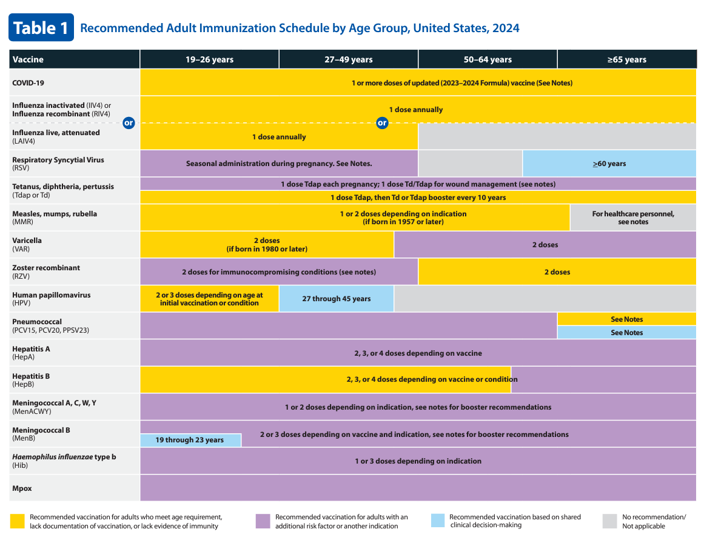
MMWR/ January 11, 2024 / 73(1);11-15 https://www.cdc.gov/vaccines/schedules/hcp/imz/adult.html
Notes:
Changes to Table 1 for the 2024 Adult Immunization Schedule include:
COVID-19 row: The text overlay was revised to reflect updated vaccination recommendations. This text overlay now states, “1 or more doses of updated (2023–2024 Formula) vaccine.”
RSV row: The RSV vaccination is a new addition to this table. The color of this row is purple for adults aged 19–49 years, with overlaying text “seasonal administration during pregnancy,” reflecting the recommendation for the use of Abrysvo (Pfizer Inc.) during 32–36 weeks’ gestation. The row is light blue for adults aged ≥60 years, indicating that the recommendation for RSV vaccination with either Abrysvo (Pfizer Inc.) or Arexvy (GSK) among adults aged ≥60 years is based on shared clinical decision-making.
Mpox row: A new row was added for Jynneos, with a purple bar across all ages reflecting the risk-based recommendation for Mpox vaccination.
References:
1. https://www.cdc.gov/vaccines/schedules/hcp/imz/adult.html, Recommended Adult Immunization Schedule for Ages 19 Years or Older, United States, 2024

Slide 55
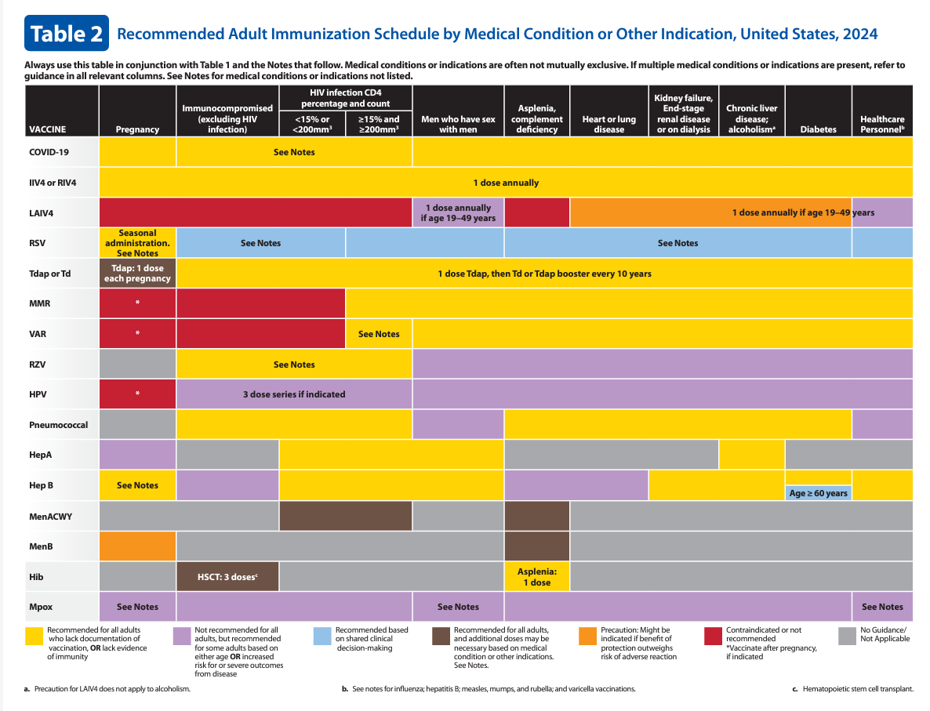
MMWR/ January 11, 2024 / 73(1);11-15 https://www.cdc.gov/vaccines/schedules/hcp/imz/adult.html
Notes:
Changes to Table 2 for the 2024 Adult Immunization Schedule include:
/A header sentence was added to Table 2 stating that medical conditions or indications are often not mutually exclusive and advising health care providers to review all relevant columns in the table if multiple conditions or indications are present.
Legend: The definitions of the yellow, purple, and gray colors in the legend were revised. The new definitions of these colors are intended to be more focused and narrower, such that the recommendation for vaccination based on that medical indication is more readily apparent. In addition, brown was introduced as a new legend color, indicating that additional doses of vaccine might be necessary based on medical condition or other indication. To account for these revised color definitions, many of the vaccine rows in Table 2 were recolored.
HepB row: Under the diabetes column, a blue bar was added to indicate that the recommendation for vaccination for persons aged ≥60 years with diabetes is based on shared clinical decision-making.
RSV row: The RSV vaccination is a new addition to this table. For use during pregnancy, the color is yellow with overlaying text of “seasonal administration” to indicate that the use of Abrysvo (Pfizer Inc.) in pregnancy is based on RSV seasonality. For the rest of the medical indications listed, the color is light blue reflecting that the recommendation for vaccination among adults aged ≥60 years is based on shared clinical decision-making.
Mpox row: A new row was added for Jynneos. Across all medical indications listed, the entire row is purple reflecting the risk-based recommendation for Mpox vaccination. In the pregnancy column, an overlaying text “See Notes” was added to encourage health care providers to review the pregnancy bullet in the Mpox vaccination notes.
References:
1. https://www.cdc.gov/vaccines/schedules/hcp/imz/adult.html, Recommended Adult Immunization Schedule for Ages 19 Years or Older, United States, 2024

Slide 56
Immunization Schedule Notes Section Update
Additional information: New section added. Text for vaccine injury compensation revised to add Mpox and RSV to the list of vaccines not covered by the National Vaccine Injury Compensation Program. Mpox is covered by the Countermeasures Injury Compensation Program.
COVID-19: All adults are now recommended to receive at least 1 dose of an updated (2023–2024 Formula) COVID-19 vaccine; number of doses needed and intervals between doses might vary; notes section divided into Routine vaccinations and Special situations sections.
HepA: Bullet in the Routine vaccination section revised to “Any person who is not fully vaccinated and requests vaccination with HepA vaccine regimen described in detail.
HepB: Routine vaccination section, additional details added to bullets describing the risk-based vaccination recommendation for persons aged ≥60 years; note added at end of Routine vaccination section describing shared clinical decision-making recommendation for persons aged ≥60 years with diabetes.
HPV: Guidance on interrupted schedules removed from Routine vaccination section; age ranges reordered to be in chronological order; wording added to improve clarity on bullet point regarding when no additional doses needed; resource link added to assist health care providers with shared clinical decision-making recommendations for HPV vaccination.
MMWR/ January 11, 2024 / 73(1);11-15 https://www.cdc.gov/vaccines/schedules/hcp/imz/adult.html
Notes:
Changes to Notes for the 2024 Adult Immunization Schedule include:
A new “Additional Information” section now begins the Notes section of the 2024 adult immunization schedule. This section mirrors the “Additional Information” section in the Notes section of the 2024 child and adolescent immunization schedule and contains similar information. Bullets that were previously on the Cover Page (such as injury claims and travel vaccine recommendations, etc.) have now been incorporated into the new “Additional Information” section of the Notes section. The text for vaccine injury compensation was revised to add Mpox and RSV to the list of vaccines not covered by the National Vaccine Injury Compensation Program. Mpox is covered by the Countermeasures Injury Compensation Program.
COVID-19: All adults are now recommended to receive at least 1 dose of an updated (2023–2024 Formula) COVID-19 vaccine. The number of doses needed and intervals between doses might vary based on a patient’s previous vaccination history, immunocompromise status, and the vaccine product used. In addition, the COVID-19 notes section is divided into a “Routine vaccination” section that describes the vaccination recommendations for the general population and a “Special situations” section that describes the vaccine recommendations for persons who are moderately or severely immunocompromised.
HepA: To better align the language with ACIP policy, the bullet in the “Routine vaccination” section was revised to, “Any person who is not fully vaccinated and requests vaccination.” The HepA vaccine regimen is described in detail later in that bullet.
HepB: In the “Routine vaccination” section, additional context and details were added to the bullets describing the risk-based vaccination recommendation for persons aged ≥60 years. In addition, a note was added at the end of the “Routine vaccination” section describing the shared clinical decision-making recommendation for persons aged ≥60 years with diabetes.
HPV: In the “Routine vaccination” section, the guidance on interrupted schedules was removed because that information is presented on the Cover Page. Age ranges were reordered to be in chronological order. In addition, to improve clarity, the words “of any valency” were added to the bullet, “No additional dose recommended when any HPV vaccine series of any valency has been completed using the recommended dosing intervals.” Lastly, a link to a resource was added to assist health care providers with shared clinical decision-making recommendations for HPV vaccination.
References:
Advisory Committee on Immunization Practices Recommended Immunization Schedule for Adults Aged 19 Years or Older — United States, 2024, MMWR / Weekly / January 11, 2024 / 73(1);11-15
https://www.cdc.gov/vaccines/schedules/hcp/imz/adult.html, Recommended Adult Immunization Schedule for Ages 19 Years or Older, United States, 2024

Slide 57
Immunization Schedule Notes Section Update
• Influenza: Hyperlink to the 2023–24 and bullet for the 2024–25 influenza recommendations added; all bullets with recommendations for persons with a history of egg allergy removed and note to Special situations section added; bullet describing Guillain-Barré syndrome removed.
MMR: Language clarity improved to Routine vaccination section.
• Meningococcal: Menactra removed; information on use of newly licensed Penbraya included.
• Mpox: New section with risk factors for routine vaccination of Jynneos in adults added; bullets for use of Jynneos among health care providers and pregnant persons also provided.
• Pneumococcal: Guidance and minimum intervals between doses of pneumococcal vaccines provided to Routine vaccination and Special situations sections.
Poliovirus: Updated recommendations for adults to Routine vaccination section on completing the 3-dose IPV primary series; Special situations section revised with criteria for one-time, lifetime IPV booster.
RSV: New section added with recommendations for RSV vaccination with Abrysvo or Arexvy of persons aged ≥60 years with seasonal administration guidance and resource link to assist health care providers with shared clinical decision-making recommendations for RSV vaccination.
Tdap: Note added to clarify that Tdap dose received at 10 years may be counted as the adolescent booster dose.
MMWR/ January 11, 2024 / 73(1);11-15 https://www.cdc.gov/vaccines/schedules/hcp/imz/adult.html
Notes:
Changes to Notes for the 2024 Adult Immunization Schedule continued:
Influenza: A hyperlink to the 2023–24 influenza recommendations and a bullet regarding the 2024–25 influenza recommendations were added. In the “Special situations” section, all bullets that discuss history of egg allergy were removed, and a note was added at the end of the “Special situations” section stating that persons with a history of egg allergy can be vaccinated with any influenza vaccine indicated for the recipient’s age and health status (4). Finally, the bullet describing Guillain-Barré syndrome was removed because this information is presented in the Appendix section on contradictions and precautions.
MMR: Minor changes were made to the “Routine vaccination” section to improve language clarity.
Meningococcal: All references to Menactra were removed because this product is no longer distributed in the United States. A link to a resource was added to assist health care providers with shared clinical decision-making recommendations for MenB vaccination. Lastly, information about the use of the newly licensed pentavalent meningococcal vaccine (Penbraya) is provided at the end of the meningococcal notes section.
Mpox: Mpox vaccination is a new addition to the Notes section of the adult immunization schedule. Risk factors that warrant routine Jynneos vaccination are listed. Bullets about the use of Jynneos among health care providers and in pregnant persons are provided at the end of the Mpox notes section.
Pneumococcal: Minor edits were made throughout the “Routine vaccination” and “Special situations” sections to provide clarity on the guidance and minimum intervals between doses of pneumococcal vaccines.
Poliovirus: Additional context was added to the “Routine vaccination” section. This section now calls for adults who are known or suspected to be unvaccinated or incompletely vaccinated to complete the 3-dose IPV primary vaccination series. A statement was added stating that most adults who were born and raised in the United States can assume that they were vaccinated against polio as children. The “Special situations” section describes administering a one-time, lifetime IPV booster dose to adults who have completed the primary series and who are at increased risk for exposure to poliovirus.
RSV: A new RSV notes section was added this year. The section begins with a “Routine vaccination” section that describes the use of Abrysvo (Pfizer Inc.) in pregnant persons during 32–36 weeks’ gestation from September through January in most of the continental United States. In addition, a sub-bullet was added stating that either maternal RSV vaccination or infant immunization with nirsevimab (RSV monoclonal antibody) is recommended to prevent respiratory syncytial virus lower respiratory tract infection in infants. A note was added at the end of the RSV notes section to acknowledge that certain jurisdictions might have RSV seasonality that differs from most of the continental United States, and that providers should follow guidance from public health authorities regarding the timing of maternal RSV vaccine administration, based on local RSV seasonality. The “Special situations” section describes the shared clinical decision-making recommendation for vaccination of persons aged ≥60 years; either Abrysvo (Pfizer Inc) or Arexvy (GSK) may be used. In addition, a link to a resource was added to assist health care providers with shared clinical decision-making recommendations for RSV vaccination. Finally, a note was added that lists risk factors and medical conditions that health care providers should consider when thinking through a patient’s risk for severe RSV disease and potential benefit from vaccination.
Tdap: A note was added at the end of the Tdap section to clarify that a dose of Tdap received at age 10 years may be counted as the adolescent dose routinely recommended at age 11–12 years.
References:
Advisory Committee on Immunization Practices Recommended Immunization Schedule for Adults Aged 19 Years or Older — United States, 2024, MMWR / Weekly / January 11, 2024 / 73(1);11-15
https://www.cdc.gov/vaccines/schedules/hcp/imz/adult.html, Recommended Adult Immunization Schedule for Ages 19 Years or Older, United States, 2024

Slide 58
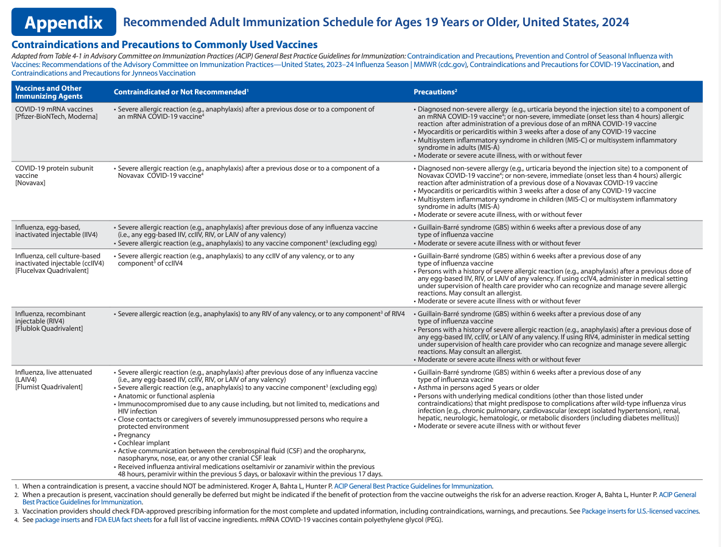
MMWR/ January 11, 2024 / 73(1);11-15 https://www.cdc.gov/vaccines/schedules/hcp/imz/adult.html
Notes:
Changes to Appendix for the 2024 Adult Immunization Schedule include:
• The header sentence of the Appendix was revised to include all the sources used to create the Appendix.
• COVID-19 row: Two new rows for COVID-19 vaccines were added describing the contraindications and precautions to COVID-19 vaccination. The first row lists the contraindications and precautions to mRNA vaccines (Pfizer-BioNTech and Moderna), and the second row lists the contraindications and precautions to the protein subunit vaccine (Novavax).
References:
Advisory Committee on Immunization Practices Recommended Immunization Schedule for Adults Aged 19 Years or Older — United States, 2024, MMWR / Weekly / January 11, 2024 / 73(1);11-15
https://www.cdc.gov/vaccines/schedules/hcp/imz/adult.html, Recommended Adult Immunization Schedule for Ages 19 Years or Older, United States, 2024

Slide 59
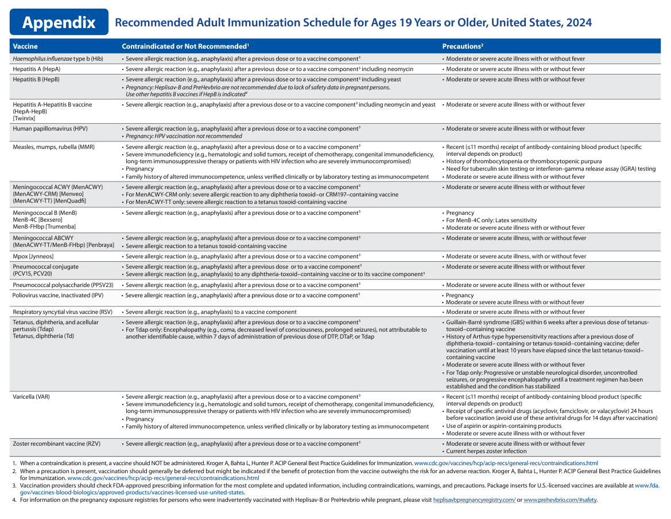
MMWR/ January 11, 2024 / 73(1);11-15 https://www.cdc.gov/vaccines/schedules/hcp/imz/adult.html
Notes:
Changes to Appendix for the 2024 Adult Immunization Schedule include:
• Hib row: In the “Contraindicated or Not Recommended” column, the bullet describing history of severe allergic reaction to dry natural latex was removed because vials of Hib products no longer contain latex.
• Meningococcal rows: All references to Menactra were removed because this product is no longer distributed in the United States. Contraindications and precautions to vaccination with the new pentavalent meningococcal vaccine (MenACWY-TT/MenB-FHbp [Penbraya]) were added.
• Mpox row: A new row for Mpox was added describing the contraindications and precautions to Mpox vaccination.
• RSV row: A new row for RSV was added describing the contraindications and precautions to RSV vaccination.
References:
Advisory Committee on Immunization Practices Recommended Immunization Schedule for Adults Aged 19 Years or Older — United States, 2024, MMWR / Weekly / January 11, 2024 / 73(1);11-15
https://www.cdc.gov/vaccines/schedules/hcp/imz/adult.html, Recommended Adult Immunization Schedule for Ages 19 Years or Older, United States, 2024

Slide 60
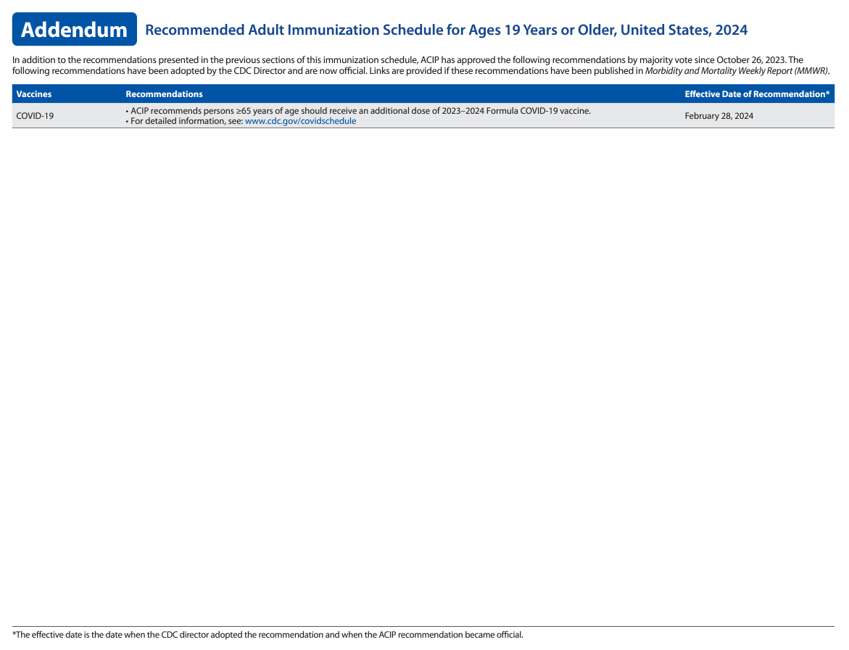
https://www.cdc.gov/vaccines/schedules/hcp/imz/adult.html
MMWR/ January 11, 2024 / 73(1);11-15
Notes:
A new addendum section was added to the adult immunization schedule to summarize new and updated ACIP recommendations that occur before the next annual update to the adult immunization schedule.
Effective February 28, 2024, ACIP recommends persons 65 years of age and older receive an additional dose of the 2023-2024 Formula COVID-19 vaccine.
References:
Advisory Committee on Immunization Practices Recommended Immunization Schedule for Adults Aged 19 Years or Older — United States, 2024, MMWR / Weekly / January 11, 2024 / 73(1);11-15
https://www.cdc.gov/vaccines/schedules/hcp/imz/adult.html, Recommended Adult Immunization Schedule for Ages 19 Years or Older, United States, 2024

Slide 61
Haemophilus influenzae type b (Hib)
Special situations
Administer 1 dose for persons with anatomical or functional asplenia (including sickle cell disease), if no prior Hib vaccination history
For elective splenectomy, 1 dose at least 14 days before surgery preferred
Administer 3-dose series, 4 weeks apart for persons with hematopoietic stem cell transplant (HSCT), regardless of Hib vaccination history, starting at 6-12 months after successful transplant
https://www.cdc.gov/vaccines/schedules/hcp/imz/adult.html
Notes:
Special situations
Administer 1 dose for persons with anatomical or functional asplenia (including sickle cell disease), if no prior Hib vaccination history
For elective splenectomy, 1 dose at least 14 days before surgery preferred
Administer 3-dose series, 4 weeks apart for persons with hematopoietic stem cell transplant (HSCT), regardless of Hib vaccination history, starting at 6-12 months after successful transplant
Optional Info:
What causes Hib disease? Hib disease is caused by a bacterium, Haemophilus influenzae type b. There are six different types of these bacteria (a through f). Type b organisms account for 95% of all strains that cause invasive disease, and this is the type against which the Hib vaccine protects.
How does Hib disease spread? Hib disease is spread person-to-person by direct contact or through respiratory droplets. Usually, the organisms remain in the nose and throat, but occasionally the bacteria spread to the lungs or bloodstream and cause a serious infection in the individual.
How serious is Hib disease? Hib disease can be very serious. The most common type of invasive Hib disease is meningitis, an infection of the membranes covering the brain (50%–65% of cases).
References:
https://www.cdc.gov/vaccines/schedules/hcp/imz/adult.html, Recommended Adult Immunization Schedule for Ages 19 Years or Older, United States, 2024

Slide 62
Hepatitis A
Routine vaccination
Administer a 2-dose series (Havrix 6-12 months apart or Vaqta 6-18 months apart) or 3-dose series (HepA-HepB, Twinrix, at 0, 1, and 6 months) for adults not at risk but wanting protection from HepA
Special situations
Administer a 2-dose series (HepA) or 3-dose series (HepA-HepB) to at risk population (i.e., chronic liver disease, HIV, MSM, pregnancy, settings for exposure, etc.).
Please refer to schedule and notes for complete list of at-risk population, and guidance for international adoptees and travel
MMWR / July 3, 2020 / 69(5);1-38 https://www.cdc.gov/vaccines/schedules/hcp/imz/adult.html
Notes:
Routine vaccination
Administer a 2-dose series (Havrix 6-12 months apart or Vaqta 6-18 months apart) or 3-dose series (HepA-HepB, Twinrix, at 0, 1, and 6 months) for adults not at risk but wanting protection from HepA
Special situations
Administer a 2-dose series (HepA) or 3-dose series (HepA-HepB) to at risk population:
Chronic liver disease, HIV infection in persons 1 year or older, MSM, injection and non injection drug users, homelessness, work with HepA virus (i.e., in research labs or nonhuman primates with HepA infection)
Travel to countries with high or intermediate endemic hepatitis A
Persons who anticipate close, personal contact with an international adoptee during the first 60 days after arrival in the U.S. from a country with high or intermediate endemicity (administer the 1st dose as soon as the adoption is planned, at least 2 weeks before the adoptee’s arrival)
Pregnancy: if at risk for infection or severe outcome from infection
Settings for exposure (i.e., health care settings targeting services to injection or non injection drug users, group homes and nonresidential day care facilities for developmentally disabled persons, prisons, etc.)
Review of Hepatitis A virus:
Hepatitis A is a serious liver disease caused by a virus. The virus is found in the feces (poop) of infected people. The hepatitis A virus is spread when invisible particles of feces (poop) get into a person’s mouth. You can get hepatitis A by eating contaminated food or drinking contaminated water, during sex, or just by living with an infected person. Hepatitis A can turn your skin and eyes turn yellow. You can get very sick for weeks, need to be hospitalized, and even die. Some people don’t look or feel sick, but they can still spread hepatitis A to others. Everyone is at some risk for getting infected with hepatitis A. People who travel outside the U.S. have an increased chance of getting infected.
References:
Prevention of Hepatitis A Virus Infection in the United States: Recommendations of the Advisory Committee on Immunization Practices, 2020, MMWR / Recommendations and Reports / July 3, 2020 / 69(5);1–38
https://www.cdc.gov/vaccines/schedules/hcp/imz/adult.html, Recommended Adult Immunization Schedule for Ages 19 Years or Older, United States, 2024

Slide 63
Hepatitis B
Routine vaccination
Administer a 2-dose series (Heplisav-B at least 4 weeks apart,), a 3-dose series (Engerix-B, PreHevbrio, or Recombivax HB at 0, 1, and 6 months), or a 3-dose HepA-HepB series (Twinrix at 0, 1, and 6 months) for all adults ages 19 through 59 years and 60 years or older with known risk factors for HepB or who request HepB vaccination
A 4-dose series of HepA-HepB (Twinrix) may be administered at an accelerated schedule of 3 doses at 0, 7, and 21–30 days, followed by a booster dose at 12 months
Based on shared clinical decision making, adults 60 years or older without known risk factors or diabetes may receive a 2-, 3-, or 4-dose series.
Special situations
A 3- dose series of Recombivax HB at 0, 1, and 6 months or a 4-dose series of Engerix-B may be administered at 0, 1, 2, and 6 months for persons on dialysis
Heplisav-B and PreHevbrio are not recommended in pregnancy due to lack of safety data in pregnant persons
https://www.cdc.gov/vaccines/schedules/hcp/imz/adult.html
Notes:
Routine vaccination:
Risk factors for hepatitis B virus infection include chronic liver disease e.g., persons with hepatitis C, cirrhosis, fatty liver disease, alcoholic liver disease, autoimmune hepatitis, alanine aminotransferase (ALT) or aspartate aminotransferase (AST) level greater than twice the upper limit of normal)
HIV infection
Sexual exposure risk e.g., sex partners of hepatitis B surface antigen (HBsAg)-positive persons, sexually active persons not in mutually monogamous relationships, persons seeking evaluation or treatment for a sexually transmitted infection, men who have sex with men
Current or recent injection drug use
Percutaneous or mucosal risk for exposure to blood e.g., household contacts of HBsAg positive persons, residents and staff of facilities for developmentally disabled persons, health care and public safety personnel with reasonably anticipated risk for exposure to blood or blood-contaminated body fluids; persons on maintenance dialysis (including in-center or home hemodialysis and peritoneal dialysis), persons who are predialysis, and patients with diabetes*
Incarceration
Travel in countries with high or intermediate endemic hepatitis B
Special situations
Patients on dialysis
A 3- dose series of Recombivax HB at 0, 1, and 6 months (use Dialysis Formulation 1 mL = 40 mcg) or
A 4-dose series of Engerix-B may be administered at 0, 1, 2, and 6 months for persons on adult hemodialysis (note: each dosage is double that of normal adult dose, i.e., 2 mL instead of 1 mL)
Heplisav-B and PreHevbrio are not recommended in pregnancy due to lack of safety data in pregnant persons.
There are no clinical studies of HepB-CpG (Heplisav-B) in pregnant women. Available human data on HepB-CpG (Heplisav-B) administered to pregnant women are insufficient to inform assessment of vaccine-associated risks in pregnancy. Until safety data are available for HepB-CpG (Heplisav-B), providers should continue to vaccinate pregnant women needing HepB vaccination with a vaccine from a different manufacturer.
All pregnant women should be tested routinely for HBsAg
90% of healthy adults & 95% of infants, children & adolescents develop adequate antibody response after a complete series. If no antibody response after 6 doses, person is a non-responder and is susceptible to hepatitis B. Booster doses NOT recommended for any age group
Optional Information:
HEPLISAV-B
The 2-dose series ONLY applies when both doses are Heplisav, administered at least 4 weeks apart
A series consisting of 1 dose of Heplisav and a different Hep B vaccine, should consist of 3 total doses. Adhere to the 3-dose schedule minimum intervals of 4 weeks between dose 1 and 2, 8 weeks between dose 2 and 3, and 16 weeks between dose 1 and 3. However, if HepB-CpG is substituted for dose 2 of HepB-alum, a provider has the option of administering the next dose of HepB-CpG a minimum of 4 weeks from the previous dose for a complete series
Doses administered at less than the recommended minimum interval should be repeated
Post vaccination Serologic Testing recommended 1-2 months after final dose for: hemodialysis patients; immunocompromised persons, including those with HIV; healthcare personnel and/or partners of HBsAg-positive persons
Review Hepatitis B virus
Hepatitis B is a serious liver disease caused by a virus. Your can get infected with hepatitis B if you come in contact with an infected person’s blood or other body fluids. Babies can get the virus from their infected mothers at birth or if they live with or are cared for by an infected person. The virus can be spread just by sharing a toothbrush with an infected person. For some people, the virus remains in their body for years. During this time, the virus can attack the liver and cause serious problems like liver failure or cancer.
References:
1. https://www.cdc.gov/vaccines/schedules/hcp/imz/adult.html, Recommended Adult Immunization Schedule for Ages 19 Years or Older, United States, 2024

Slide 64
HPV Vaccine in Adults 27-45 Years Old
Shared clinical decision-making
For adults ages 27-45 years, complete a 2- or 3-dose series, based on shared clinical decision-making, depending on age at initial vaccination
Special situations
Administer 3-dose series, for immunocompromising conditions, including HIV (even for people who initiate series at 9-14 years of age)
***HPV vaccines are not licensed for use in persons older than 45 years of age***
MMWR / August 16, 2019 / 68(32);698–702 https://www.cdc.gov/vaccines/schedules/hcp/imz/adult.html
Notes:
Shared clinical decision-making
For adults ages 27-45 years, complete a 2- or 3-dose series, based on shared clinical decision-making, depending on age at initial vaccination (2-dose series if initiated age 9-14) (3-dose series if initiated >/= 15 years old)
Special situations
Administer 3-dose series, for immunocompromising conditions, including HIV (even for people who initiate series at 9-14 years of age)
***HPV vaccines are not licensed for use in persons older than 45 years of age***
Additional Info:
On October 5, 2018, using results from 4vHPV clinical trials in women aged 24 through 45 years, and bridging immunogenicity and safety data in women and men, the Food and Drug Administration expanded the approved age range for 9vHPV use from 9 through 26 years to include adults ages 27-45 years old
In June 2019, after reviewing evidence related to HPV vaccination of adults, ACIP updated recommendations for catch-up vaccination and for vaccination of adults older than the recommended catch-up age, due to recognition of the risk for new HPV infections in this age range.
References:
MMWR / Human Papillomavirus Vaccination for Adults: Updated Recommendations of the Advisory Committee on Immunization Practices/ Weekly / August 16, 2019 / 68(32);698–702
https://www.cdc.gov/vaccines/schedules/hcp/imz/adult.html, Recommended Adult Immunization Schedule for Ages 19 Years or Older, United States, 2024

Slide 65
Influenza Vaccines
Routine vaccination
Administer 1 dose of any influenza vaccine appropriate for age and health status annually to adults 19 years and older
For ages 65 years or older: Any one of quadrivalent high-dose inactivated influenza vaccine (HDIIV4), quadrivalent recombinant influenza vaccine (RIV4), or quadrivalent adjuvanted inactivated influenza vaccine (aIIV4) is preferred
Special situations
Do not administer LAIV4 to close contacts of severely immunosuppressed persons who require a protected environment. If given, contact with/caring for such immunosuppressed persons should be avoided for 7 days after vaccination
https://www.cdc.gov/vaccines/schedules/hcp/imz/adult.html
Notes:
Routine vaccination
Administer 1 dose of any influenza vaccine appropriate for age and health status annually to adults 19 years and older.
Age 65 years or older: Any one of quadrivalent high-dose inactivated influenza vaccine (HDIIV4), quadrivalent recombinant influenza vaccine (RIV4), or quadrivalent adjuvanted inactivated influenza vaccine (aIIV4) is preferred. If none of these three vaccines are available, then any other age-appropriate influenza vaccine should be used.
Note: Persons with an egg allergy can receive any influenza vaccine (egg-based and non-egg based) appropriate for age and health status.
Special situations
Close contacts (e.g., caregivers, healthcare workers) of severely immunosuppressed persons who require a protected environment: should not receive LAIV4. If LAIV4 is given, they should avoid contact with/caring for such immunosuppressed persons for 7 days after vaccination.
References:
https://www.cdc.gov/vaccines/schedules/hcp/imz/adult.html, Recommended Adult Immunization Schedule for Ages 19 Years or Older, United States, 2024

Slide 66
Measles, Mumps, Rubella
Routine vaccination
1 dose for persons with no evidence of immunity to measles, mumps, or rubella
ACIP considers evidence of immunity to MMR if born before 1957, documentation of receipt of MMR vaccine, or laboratory evidence of immunity or disease (diagnosis of disease without lab confirmation is not considered evidence)
Special situations
MMR is contraindicated during pregnancy and in persons with severe immunocompromising conditions
1 dose (if previously received 1 dose of MMR) or nonpregnant persons of childbearing age not previously immunized, or 2-dose series at least 4 weeks apart, for college students, international travelers, and household or close personal contacts of immunocompromised persons, not previously immunized
Refer to schedule and notes for guidance when vaccinating healthcare personnel, or other medical indications
MMWR / February 18, 2022 / 71(7);229-233 https://www.cdc.gov/vaccines/schedules/hcp/imz/adult.html
Notes:
Routine vaccination
Birth date not acceptable evidence of rubella immunity for women who could become pregnant. Non-pregnant women of childbearing age with no evidence of immunity to rubella should receive 1 dose of MMR.
Special situations
MMR is contraindicated during pregnancy and in persons with severe immunocompromising conditions: 1 dose of MMR recommended after pregnancy (before discharge from a health care facility)
1 dose (if previously received 1 dose of MMR) or nonpregnant persons of childbearing age not previously immunized, or 2-dose series at least 4 weeks apart, for college students, international travelers, and household or close personal contacts of immunocompromised persons, not previously immunized
Refer to immunization schedule notes for guidance when vaccinating healthcare personnel, or other medical indications:
Healthcare personnel born in 1957 or later with no evidence of immunity to measles, mumps, or rubella: 2-dose series of MMR at least 4 weeks apart for measles or mumps or at least 1 dose of MMR for rubella; for healthcare personnel born before 1957, consider 2-dose series at least 4 weeks apart for measles or mumps or at least 1 dose of MMR for rubella.
A 2-dose series of MMR at least 4 weeks apart, is recommended for persons with HIV infection with CD4 count >/=200 cells/ul for at least 6 months and no evidence of immunity; MMR is contraindicated in HIV infection with CD4 count <200 cells/ul
Optional Info:
Serious respiratory diseases
MEASLES: (caused by paramyxovirus): Initial symptoms are runny nose, followed by increasing fever (103º-105º), cough, conjunctivitis, Koplik spots, and a maculopapular rash that lasts 5-6 days. Complications include otitis media (7%), pneumonia (6%), and acute encephalitis (0.1%) 1 in 1000 cases, death (0.2%) Although measles elimination was declared in the United States in 2000 , importation of measles cases continues to occur. Spread through air droplets and can remain active for up to 1 hour after the person has left the room.
MUMPS: (caused by paramyxovirus): Parotitis (inflammation of parotid gland) occurs in 30-40% of infected persons, 40-50% have only nonspecific or respiratory symptoms; Complications include aseptic meningitis, & deafness; Post pubertal individuals may have orchitis (inflammation of testicles), ovarian inflammation, & pancreatitis.
RUBELLA: (caused by rubella virus and spread from person-to-person {togavirus}); in children, the rash may be the first manifestation of infection. Adults may have low-grade fever, malaise, URI, and lymphadenopathy prior to rash. Arthralgia and arthritis is common in adults, especially women. Complications include encephalitis and hemorrhagic manifestations. Displays like “blueberry muffin spots” on skin due to petechial lesions, cataracts, hearing loss and congenital heart lesions; child will most likely be developmentally delayed. All women of childbearing age should be certain they are immune to rubella. Rubella is no longer endemic in the U.S. However, it is still present in other countries and can be imported.
What should I do if I’m not sure I was vaccinated against measles?
Check with your health care provider. If you were born before 1957 it’s likely you have been exposed to the virus and are immune. If you were born between 1957 and 1971, the vaccine you received may not have been as reliable. Ask your doctor if you’ve been properly vaccinated.
References:
Advisory Committee on Immunization Practices Recommended Immunization Schedule for Adults Aged 19 Years or Older — United States, 2022 /MMWR / Weekly / February 18, 2022 / 71(7);229–233
https://www.cdc.gov/vaccines/schedules/hcp/imz/adult.html, Recommended Adult Immunization Schedule for Ages 19 Years or Older, United States, 2024

Slide 67
Serogroup A, C, W, Y Meningococcal Vaccines
Special situations
2-dose series (minimum interval of 8 weeks) for persons with certain medical conditions
1 dose for persons traveling to hyperendemic or epidemic countries and/or microbiologists
1 dose for first year college students who live in residential housing (if not previously vaccinated at age 16 years or older) or military recruits
MenACWY vaccines may be administered simultaneously with MenB vaccines if indicated, but at different anatomical sites, if feasible
People 10 years or older may receive a single dose of Penbraya as an alternative to separate administration of MenACWY and MenB when both vaccines are indicated and would be given on the same clinic day
MMWR/ September 25, 2020 / 69(9);1-41 https://www.cdc.gov/vaccines/schedules/hcp/imz/child-adolescent.html
Notes:
Serogroup A, C, W, Y meningococcal vaccines. (Minimum age: 2 months [Menveo], 2 years [MenQuadfi], 10 years [Penbraya])
Menactra is no distributed in the United States. Any remaining doses expired in October 2023.
Routine vaccination of healthy persons who are not at increased risk for exposure to N. meningitidis is not recommended after age 21 years.
Special situations
2-dose series at least 8 weeks apart and revaccinate every 5 years if risk remains for persons with certain medical conditions (anatomical or functional asplenia (including sickle cell disease), HIV infection, persistent complement component deficiency, complement inhibitor (e.g., eculizumab, ravulizumab) use
1 dose for persons traveling to countries with hyperendemic or epidemic meningococcal disease, or microbiologists routinely exposed to Neisseria meningitidis and revaccinate every 5 years if risk remains
1 dose for first year college students who live in residential housing (if not previously vaccinated at age 16 years or older) or military recruits
MenACWY vaccines may be administered simultaneously with MenB vaccines if indicated, but at different anatomical sites, if feasible.
People 10 years or older may receive a single dose of Penbraya as an alternative to separate administration of MenACWY and MenB when both vaccines are indicated and would be given on the same clinic day.
1 dose for people 10 years or older who are receiving MenACWY and MenB vaccines at the same clinic visit; minimum interval of 6 months between doses
If person receives Penbraya, which includes Trumenba (MenB), and additional MenB dose(s) are indicated:
Trumenba should be used for additional MenB dose(s) when MenACWY vaccination is not indicated
Any MenACWY vaccine may be used when MenB is NOT indicated
Booster doses may be indicated for people with prolonged increased risk for serogroup A,C,W,or Y and B meningococcal disease.
Refer to Appendix in the schedule for information on contraindications and precautions
Optional Info:
The most common clinical presentations of meningococcal disease are meningitis and meningococcemia.
The minimum interval between doses of meningococcal conjugate vaccine is 8 weeks.
No data are available on the interchangeability of vaccine products.
Whenever feasible, the same brand of vaccine should be used for all doses of the vaccination series. If vaccination providers do not know or have available the type of vaccine product previously administered, any product should be used to continue or complete the series.
References:
Meningococcal Vaccination: Recommendations of the Advisory Committee on Immunization Practices, United States, 2020; MMWR / Recommendations and Reports / September 25, 2020 / 69(9);1-41
https://www.cdc.gov/vaccines/schedules/hcp/imz/child-adolescent.html, Recommended Child and Adolescent Immunization Schedule for Ages 18 Years or Younger, United States, 2024

Slide 68
Serogroup B Meningococcal Vaccines
Shared clinical decision-making for MenB
May be given based on shared clinical decision-making to adolescents 16-23 years who are not at increased risk (preferred age 16-18 years)
Special situations
Anatomic or functional asplenia, sickle cell disease, persistent complement component deficiency (including eculizumab use), or microbiologists routinely exposed to Neisseria meningitidis
Bexsero: 2-doses at least 1 month apart
Trumenba: 3-dose series at 0, 1-2, and 6 months
Bexsero and Trumenba are not interchangeable
Delay MenB vaccine until after pregnancy
MMWR / February 18, 2022 / 71(7);229-233 https://www.cdc.gov/vaccines/schedules/hcp/imz/adult.html
Notes:
MenB is a Category B- permissive recommendation- Category B means the recommendation allows for individual clinical decision making, but with Category A recommendations all persons in an age or risk factor-based group may get the vaccine. Category B classification enables coverage by the VFC program and most insurance plans. ACIP recommends routine MenB vaccination of certain high-risk groups for those 10 years and older.
Serogroup B meningococcal vaccines (minimum age: 10 years [Bexsero, Trumenba]
Shared clinical decision-making for MenB
May be given based on shared clinical decision-making to adolescents 16-23 years who are not at increased risk (preferred age 16-18 years)
Bexsero: 2 doses at least 1 month apart
Trumenba: 2 doses at least 6 months apart. If 2nd dose given earlier than 6 months, give 3rd dose at least 4 months after the 2nd dose
Special situations
Anatomic or functional asplenia, sickle cell disease, persistent complement component deficiency (including eculizumab use), or microbiologists routinely exposed to Neisseria meningitidis
Bexsero: 2-doses at least 1 month apart
Trumenba: 3-dose series at 0, 1-2, and 6 months
Bexsero and Trumenba are not interchangeable
Delay MenB vaccine until after pregnancy unless at increased risk and vaccination benefits outweigh potential risks
Optional Info:
Data presented to ACIP in June 2015 demonstrated that the estimated incidence of serogroup B meningococcal disease among college students aged 18-23 years was low (0.09 cases/100,000) and was similar to that of non-college students during 2009-2013. CDC shared plans to improve surveillance and report updated findings to ACIP on the incidence of disease in college students once additional data became available.
References:
Advisory Committee on Immunization Practices Recommended Immunization Schedule for Adults Aged 19 Years or Older — United States, 2022 /MMWR / Weekly / February 18, 2022 / 71(7);229–233
https://www.cdc.gov/vaccines/schedules/hcp/imz/adult.html, Recommended Adult Immunization Schedule for Ages 19 Years or Older, United States, 2024

Slide 69
Mpox Vaccine (JYNNEOS)
Special situations
2-dose series administered 4 weeks apart to any person at risk for Mpox infection based on certain risk factors
May be administered Subcut or ID for adults 18 years or older
Pregnant persons with any risk factors described may receive Jynneos
Healthcare personnel without risk factors described should NOT received Jynneos
Please refer to clinical considerations for simultaneous administration of the orthopoxvirus vaccine and other vaccines
https://www.cdc.gov/poxvirus/mpox/interim-considerations/jynneos-vaccine.html
Notes:
JYNNEOS vaccine is licensed as a series of two doses administered 28 days (4 weeks) apart to any person at risk for Mpox infection based on certain risk factors
Risk factors include:
Persons who are gay, bisexual, and other MSM, transgender or nonbinary people who in the past 6 months have had a new diagnosis of at least 1 sexually transmitted disease, more than 1 sex partner, sex at a commercial sex venue, and/or sex in association with a large public event in a geographic area where Mpox transmission is occurring
Persons who are sexual partners of the persons described above
Persons who anticipate experiencing any of the situations described above
Pregnancy: There is currently no ACIP recommendation for Jynneos use in pregnancy due to lack of safety data in pregnant persons. Pregnant persons with any risk factor described above may receive Jynneos.
Healthcare personnel: Except in rare circumstances (e.g. no available personal protective equipment), healthcare personnel who do not have any of the sexual risk factors described above should not receive Jynneos.
Simultaneous administration with other vaccines:
JYNNEOS typically may be administered without minimum intervals in between most other vaccines, including simultaneous administration of JYNNEOS and other vaccines on the same day.
Simultaneous administration of COVID-19 vaccines and an orthopoxvirus vaccine (JYNNEOS or ACAM2000)
There is no required minimum interval between receiving a dose of any COVID-19 vaccine and an orthopoxvirus vaccine, either JYNNEOS or ACAM2000 vaccine (e.g., for mpox prevention), regardless of which vaccine is administered first.
Use of JYNNEOS vaccine should be prioritized over ACAM2000 when co-administering a COVID-19 vaccine and an orthopoxvirus vaccine.
People, particularly adolescent or young adult males, who are recommended to receive both vaccines might consider waiting 4 weeks between vaccines. This is because of the observed risk for myocarditis and pericarditis after receipt of ACAM2000 orthopoxvirus vaccine and COVID-19 vaccines, and the hypothetical risk for myocarditis and pericarditis after JYNNEOS vaccine. However, if a patient’s risk for mpox or severe disease due to COVID-19 is increased, administration of mpox and COVID-19 vaccines should not be delayed.
References:
1. https://www.cdc.gov/poxvirus/mpox/interim-considerations/jynneos-vaccine.html

Slide 70
Pneumococcal Conjugate Vaccines for Adults (PCV13, PCV15, PCV20, PPSV23 )
Routine vaccination
Adults 65 years or older:
Who have not previously received a pneumococcal conjugate vaccine or whose previous vaccination history is unknown: Administer 1 dose PCV15 or PCV20
Who have previously only received PCV7: Follow routine vaccination above
Who have previously only received PCV13: Administer 1 dose PCV20 OR PPSV23 at least 1 year after the last PCV13 dose
Who have previously only received PPSV23: Administer 1 dose PCV15 OR PCV20. If PCV15 used, no additional PPSV23 doses
Who have previously received both PCV13 and PPSV23 but NO PPSV23 at age 65 years or older: Administer 1 dose of PCV20 OR PPSV23
Who have previously received both PCV13 and PPSV23 AND PPSV23 was received at age 65 years or older: Administer 1 dose of PCV20 at least 5 years after the last pneumococcal vaccine
MMWR / January 28, 2022 / 71(4);109-117 https://www.cdc.gov/vaccines/schedules/hcp/imz/adult.html
Notes:
Routine vaccination
Adults 65 years or older:
Who have not previously received a pneumococcal conjugate vaccine or whose previous vaccination history is unknown: Administer 1 dose PCV15 or PCV20
If PCV15 is used, 1 dose of PPSV23 should be administered at least 1 year after. A minimum interval of 8 weeks can be considered in adults with an immunocompromising condition, cochlear implant, or cerebrospinal fluid leak.
Who have previously only received PCV7: Follow routine vaccination above
Who have previously only received PCV13: Administer 1 dose PCV20 OR PPSV23 at least 1 year after the last PCV13 dose. (If PPSV23 is used, a minimum interval of 8 weeks can be considered in adults with an immunocompromising condition, cochlear implant, or cerebrospinal fluid leak)
Who have previously only received PPSV23: Administer 1 dose PCV15 OR PCV20 (at least 1 year after the last PPSV23 dose). If PCV15 is used, no additional PPSV23 doses are recommended.
Who have previously received both PCV13 and PPSV23 but NO PPSV23 at age 65 years or older: Administer 1 dose of PCV20 OR PPSV23
If PCV20 is given, administer at least 5 years after the last pneumococcal vaccine
If PPSV23 is given, follow dosing schedule at www.cdc.gov/vaccines/vpd/pneumo/downloads/ pneumo-vaccine-timing.pdf
Who have previously received both PCV13 and PPSV23 AND PPSV23 was received at age 65 years or older: Administer 1 dose of PCV20 at least 5 years after the last pneumococcal vaccine
References:
Use of 15-Valent Pneumococcal Conjugate Vaccine and 20-Valent Pneumococcal Conjugate Vaccine Among U.S. Adults: Updated Recommendations of the Advisory Committee on Immunization Practices (ACIP); MMWR / Weekly / January 28, 2022 / 71(4);109-117
https://www.cdc.gov/vaccines/schedules/hcp/imz/adult.html, Recommended Adult Immunization Schedule for Ages 19 Years or Older, United States, 2024

Slide 71
http://www.cdc.gov/vaccines/vpd/pneumo/downloads/pneumo-vaccine-timing.pdf

Slide 72
Special Situations for Pneumococcal Conjugate Vaccines (PCV13, 15, 20 & PPSV23)
Special situations
Adults aged 19–64 years with certain underlying medical conditions or other risk factors:
Who have not previously received a pneumococcal conjugate vaccine or whose previous vaccination history is unknown: Administer 1 dose PCV15 or PCV20. If PCV15 is used, 1 dose of PPSV23 should be administered at least 1 year after. A minimum interval of 8 weeks can be considered in adults with an immunocompromising condition, cochlear implant, or cerebrospinal fluid leak.
Who have previously only received PCV7: Follow routine vaccination above
Who have previously only received PCV13: Administer 1 dose PCV20 OR PPSV23 at least 1 year after the last PCV13 dose (if PPSV23 is used, follow the dosing schedule).
Who have previously only received PPSV23: Administer 1 dose PCV15 OR PCV20 (at least 1 year after the last PPSV23 dose). If PCV15 is used, no additional PPSV23 doses are recommended.
Who have previously received PCV13 and 1 dose PPSV23: Administer 1 dose PCV20 OR PPSV23. If PCV20 is selected, administer at least 5 years after the last pneumococcal vaccine dose (if PPSV23 is selected, follow dosing schedule).
MMWR / January 28, 2022 / 71(4);109-117 https://www.cdc.gov/vaccines/schedules/hcp/imz/adult.html
Notes:
Special situations
Adults aged 19–64 years with certain underlying medical conditions or other risk factors:
Note:
Immunocompromising conditions include chronic renal failure, nephrotic syndrome, immunodeficiencies, iatrogenic immunosuppression, generalized malignancy, HIV infection, Hodgkin disease, leukemia, lymphoma, multiple myeloma, solid organ transplant, congenital or acquired asplenia, or sickle cell disease or other hemoglobinopathies.
Note:
Underlying medical conditions or other risk factors include alcoholism, chronic heart/liver/ lung disease, chronic renal failure, cigarette smoking, cochlear implant, congenital or acquired asplenia, CSF leak, diabetes mellitus, generalized malignancy, HIV infection, Hodgkin disease, immunodeficiencies, iatrogenic immunosuppression, leukemia, lymphoma, multiple myeloma, nephrotic syndrome, solid organ transplant, or sickle cell disease or other hemoglobinopathies.
Who have not previously received a pneumococcal conjugate vaccine or whose previous vaccination history is unknown: Administer 1 dose PCV15 or PCV20
If PCV15 is used, 1 dose of PPSV23 should be administered at least 1 year after. A minimum interval of 8 weeks can be considered in adults with an immunocompromising condition, cochlear implant, or cerebrospinal fluid leak.
Who have previously only received PCV7: Follow routine vaccination above
Who have previously only received PCV13: Administer 1 dose PCV20 OR PPSV23 at least 1 year after the last PCV13 dose. (If PPSV23 is used, follow the dosing schedule at www.cdc.gov/vaccines/vpd/pneumo/downloads/ pneumo-vaccine-timing.pdf)
Who have previously only received PPSV23: Administer 1 dose PCV15 OR PCV20 (at least 1 year after the last PPSV23 dose). If PCV15 is used, no additional PPSV23 doses are recommended.
Who have previously received PCV13 and 1 dose PPSV23: Administer 1 dose PCV20 OR PPSV23. If PCV20 is selected, administer at least 5 years after the last pneumococcal vaccine dose (if PPSV23 is selected, follow dosing schedule).
References:
Use of 15-Valent Pneumococcal Conjugate Vaccine and 20-Valent Pneumococcal Conjugate Vaccine Among U.S. Adults: Updated Recommendations of the Advisory Committee on Immunization Practices (ACIP); MMWR / Weekly / January 28, 2022 / 71(4);109-117
https://www.cdc.gov/vaccines/schedules/hcp/imz/adult.html, Recommended Adult Immunization Schedule for Ages 19 Years or Older, United States, 2024

Slide 73
Poliovirus Vaccine
Routine vaccination
Administer remaining doses (1, 2, or 3 IPV doses) to complete a 3-dose primary series to adults known or suspected to be unvaccinated or incompletely vaccinated
Special situations
Adults at increased risk of exposure to poliovirus who completed primary series may receive one lifetime IPV booster dose
https://www.cdc.gov/vaccines/schedules/hcp/imz/adult.html
Notes:
Routine vaccination
Administer remaining doses (1, 2, or 3 IPV doses) to complete a 3-dose primary series to adults known or suspected to be unvaccinated or incompletely vaccinated.
Special situations
Adults at increased risk of exposure to poliovirus who completed primary series may receive one lifetime IPV booster dose.
References:
https://www.cdc.gov/vaccines/schedules/hcp/imz/adult.html, Recommended Adult Immunization Schedule for Ages 19 Years or Older, United States, 2024

Slide 74
RSV Vaccination Special Situations
Based on shared clinical decision-making, administer 1 dose RSV vaccine (Arexvy® or Abrysvo™) to adults ages 60 years or older
Persons most likely to benefit from vaccination are those considered to be at increased risk for severe RSV disease
https://www.cdc.gov/vaccines/schedules/hcp/imz/adult.html
Notes:
Based on shared clinical decision-making, administer 1 dose RSV vaccine (Arexvy® or Abrysvo™) to adults ages 60 years or older
Persons most likely to benefit from vaccination are those considered to be at increased risk for severe RSV disease.
Adults ages 60 years or older who are at increased risk for severe RSV disease include those with chronic medical conditions such as: lung diseases (e.g., chronic obstructive pulmonary disease, asthma), cardiovascular diseases (e.g., congestive heart failure, coronary artery disease), neurologic or neuromuscular conditions, kidney disorders, liver disorders, hematologic disorders, diabetes mellitus, and moderate or severe immune compromise (either attributable to a medical condition or receipt of immunosuppressive medications or treatment); those who are considered to be frail; those of advanced age; those who reside in nursing homes or other long-term care facilities; and those with other underlying medical conditions or factors that a health care provider determines might increase the risk of severe respiratory disease.
References:
https://www.cdc.gov/vaccines/schedules/hcp/imz/adult.html, Recommended Adult Immunization Schedule for Ages 19 Years or Older, United States, 2024

Slide 75
Varicella Immunity
ACIP considers evidence of immunity to varicella to be:
• Documentation of 2 doses of vaccine given no earlier than age 12 months, with at least 3 months between doses for children younger than age 13 years, or at least 4 weeks between doses for people aged 13 years and older
• U.S.-born before 1980* (year of birth is not considered as evidence of immunity for healthcare personnel, and pregnant women)
• A healthcare provider's diagnosis of herpes zoster, varicella or history of varicella disease
• Laboratory evidence of immunity to or confirmation of disease
MMWR / June 22, 2007 /56(RR-4);16-17
Notes:
Only doses of varicella vaccines for which written documentation of the date of administration is presented should be considered valid. Neither a self-reported dose nor a history of vaccination provided by a parent is, by itself, considered adequate evidence of immunity. Persons who lack documentation of adequate vaccination or other evidence of immunity should be vaccinated.
References:
1. Prevention of Varicella, Recommendations of the Advisory Committee on Immunization Practices (ACIP); MMWR / Recommendations and Reports / June 22, 2007 / 56(RR-4);16-17

Slide 76
Zoster (RZV)
Routine vaccination
Administer 2-dose series of recombinant zoster vaccine (RZV, Shingrix) 2-6 months apart (minimal interval: 4 weeks) to adults aged 50 years or older regardless of past episode of herpes zoster or previous receipt of zoster live vaccine (ZVL, Zostavax); dose should be repeated if administered too soon
Special situations
Administer 2-dose series of recombinant zoster vaccine (RZV, Shingrix) 2-6 months apart (minimal interval: 4 weeks) to persons ages 19 years or older with immunocompromising conditions, including HIV
There is currently no ACIP recommendation for RZV during pregnancy; consider delaying until after pregnancy
MMWR / February 18, 2022 / 71(7);229-233 https://www.cdc.gov/vaccines/schedules/hcp/imz/adult.html
Notes:
Routine vaccination
Administer 2-dose series of recombinant zoster vaccine (RZV, Shingrix) 2-6 months apart (minimal interval: 4 weeks) to adults aged 50 years or older regardless of past episode of herpes zoster or previous receipt of zoster live vaccine (ZVL, Zostavax); dose should be repeated if administered too soon
Special situations
Administer 2-dose series of recombinant zoster vaccine (RZV, Shingrix) 2-6 months apart (minimal interval: 4 weeks) to persons ages 19 years or older with immunocompromising conditions, including HIV
There is currently no ACIP recommendation for RZV during pregnancy; consider delaying until after pregnancy
References:
Advisory Committee on Immunization Practices Recommended Immunization Schedule for Adults Aged 19 Years or Older — United States, 2022 /MMWR / Weekly / February 18, 2022 / 71(7);229–233
https://www.cdc.gov/vaccines/schedules/hcp/imz/adult.html, Recommended Adult Immunization Schedule for Ages 19 Years or Older, United States, 2024

Slide 77
COVID-19 Vaccines for Adults (19+ years)
Routine vaccination for Moderna, Pfizer-BioNTech and/or Novavax
Unvaccinated:
Administer 1 dose of updated (2023-2024 Formula) Moderna or Pfizer –BioNTech or 2-dose series of updated (2023-2024) Novavax at 0,3-8 weeks for adults 19 years and older
Refer to schedule and notes for guidance on adults previously vaccinated with Moderna, Pfizer BioNTech, and/or Novavax
Special situations
Unvaccinated: Administer 3-dose series of updated (2023–2024 Formula) Moderna at 0, 4, 8 weeks or 3-dose series of updated (2023–2024 Formula) Pfizer-BioNTech at 0, 3, 7 weeks or 2-dose series of updated (2023-2024 Formula) Novavax at 0, 3 weeks for persons who are moderately or severely immunocompromised
Refer to schedule and notes for guidance on immunocompromised adults previously vaccinated with Moderna, Pfizer BioNTech, and/or Novavax
https://www.cdc.gov/vaccines/schedules/hcp/imz/adult.html
Notes:
Routine vaccination for Moderna, Pfizer-BioNTech and Novavax
Unvaccinated:
Administer 1 dose of updated (2023-2024 Formula) Moderna or Pfizer –BioNTech or 2-dose series of updated (2023-2024) Novavax at 0,3-8 weeks for adults 19 years and older
Previously vaccinated:
Administer 1 dose of any updated (2023-24 Formula) COVID-19 vaccine at least 8 weeks after the most recent COVID-19 vaccine dose for adults 19 years and older
Special situations for Moderna, Pfizer-BioNTech, and Novavax for persons who are moderately or severely immunocompromised
Unvaccinated: 3-dose series of updated (2023–2024 Formula) Moderna at 0, 4, 8 weeks or 3-dose series of updated (2023–2024 Formula) Pfizer-BioNTech at 0, 3, 7 weeks or 2-dose series of updated (2023-2024 Formula) Novavax at 0, 3 weeks for persons who are moderately or severely immunocompromised
Previously vaccinated: Moderna
Administer 2-dose series of updated (2023-24 Formula) Moderna at 0, 4 weeks after most recent dose for adolescents who have previously received 1 dose of any Moderna
Administer 1 dose of updated (2023–2024 Formula) Moderna at least 4 weeks after the most recent dose for adolescents who have previously received 2 dose of any Moderna
Previously vaccinated: Pfizer BioNTech
Administer 2-dose series of updated (2023-24 Formula) Pfizer-BioNTech at 0, 4 weeks after most recent dose for adolescents who have previously received 1 dose of any Pfizer-BioNTech
Administer 1 dose of updated (2023–2024 Formula) Pfizer-BioNTech at least 4 weeks after the most recent dose for adolescents who have previously received 2 dose of any Pfizer-BioNTech
If previously vaccinated 3 or more doses of any Moderna or Pfizer BioNTech, 1 dose of any updated (2023-2024 Formula) COVID-19 vaccine at least 8 weeks after the most recent dose recommended
Previously vaccinated: Novavax
Administer 1 dose of any updated (2023–2024 Formula) COVID-19 vaccine at least 8 weeks after the most recent dose to adults previously vaccinated with 1 or more doses of Janssen or Novavax or with or without dose(s) of any original monovalent or bivalent COVID-19 vaccine.
Note: Previously vaccinated is defined as having received any Original monovalent or bivalent COVID-19 vaccine (Janssen, Moderna, Novavax, Pfizer-BioNTech) prior to the updated 2023–2024 formulation.
References:
https://www.cdc.gov/vaccines/schedules/hcp/imz/adult.html, Recommended Adult Immunization Schedule for Ages 19 Years or Older, United States, 2024

Slide 78
COVID-19 Vaccines Special Considerations
Persons ages 65 years and older should receive an additional dose of the 2023-2024 Formula COVID-19 vaccine
COVID-19 vaccines can be co-administered with other vaccines
Doses administered up to 4 days before the minimum interval (4-day grace period) are considered valid. Doses administered at any time after the recommended interval are valid
Persons with a recent SARS-CoV-2 infection may consider delaying their first or second COVID-19 vaccine booster dose by 3 months from symptom onset or positive test (if infection was asymptomatic)
https://www.cdc.gov/vaccines/schedules/hcp/imz/child-adolescent.html https://www.cdc.gov/vaccines/covid-19/clinical-considerations/interim-considerations-us.html#recommendations
Notes:
References:
https://www.cdc.gov/vaccines/schedules/hcp/imz/child-adolescent.html
https://www.cdc.gov/vaccines/covid-19/clinical-considerations/interim-considerations-us.html#recommendations

Slide 79
Healthcare Personnel (HCP)
Annual influenza vaccine
Tdap or Td
Hepatitis B (exposure risk) Check immunity
Meningococcal (exposure risk)
COVID-19
Validate immune status of:
Varicella
Measles, Mumps & Rubella (MMR)
Notes:
Healthcare workers (HCWs) are at risk for exposure to serious, and sometimes deadly, diseases. If you work directly with patients or handle material that could spread infection, you should get appropriate vaccines to reduce the chance that you will get or spread vaccine-preventable diseases. Protect yourself, your patients, and your family members. Make sure you are up-to-date with recommended vaccines.
One dose of an influenza vaccine annually
One time dose of Tdap if you have not received a dose previously (regardless of when previous Td dose was received); Td or Tdap booster every 10 years thereafter. Pregnant healthcare workers need to get a dose of Tdap during each pregnancy
3-dose series of Recombivax HB, PreHevbrio, or Engerix-B, or 2-dose series of Heplisav if no documented evidence of completed series or serologic evidence of immunity prior to vaccination. Hepatitis B vaccine is recommended for health-care personnel with potential exposure to blood or body fluids. The antibody status of these health-care personnel should be checked 1-2 months after the 3rd dose. If a person fails to develop an adequate antibody titer after three doses of vaccine, follow current CDC recommendations for additional doses of hepatitis B vaccine. Some health-care providers may have received three doses of hepatitis B vaccine as children, adolescents or adults but have never had serologic testing to check for immunity. Follow the CDC Guidance for Evaluating Health-Care Personnel for Hepatitis B Virus Protection and for Administering Post exposure Management (Recommendations and Reports / Vol. 62 / No. 10 December 20, 2013)
Microbiologist routinely exposed to the virus should get an MCV4 vaccine and MenB vaccine.
For additional COVID-19 vaccination information, please visit https://www.cdc.gov/vaccines/covid-19/clinical-considerations/covid-19-vaccines-us.html.
Un-immunized HCP
Un-immunized healthcare workers are at risk of infecting patients, family members and community contacts
Immunized HCP
Protect patients from VPD’s
Help offices avoid potential liability cases. (The practice can be liable if an unimmunized HCP becomes infected with a vaccine preventable disease and infects a patient).
Maintain productivity
Reduce illness and illness-related absenteeism
Evidence of Immunity to MMR
Documented administration of two doses of measles and mumps vaccine and one dose of rubella vaccine OR
Laboratory evidence of immunity or laboratory confirmation of disease (measles, mumps and rubella) OR
Born before 1957 (measles, mumps and rubella)
References:
1. General Recommendations on Immunization, Recommendations of the Advisory Committee on Immunization Practices (ACIP). MMWR (RR-2); January 28, 2011
2. Immunization of Health-Care Personnel: Recommendations of ACIP MMWR; November 25, 2011 / 60(RR07);1-45
3. CDC Guidance for Evaluating Health-Care Personnel for Hepatitis B Virus Protection and for Administering Postexposure Management (Recommendations and Reports / Vol. 62 / No. 10 December 20, 2013)

Slide 80
PRE-EXPOSURE EVALUATION FOR HEALTH-CARE PERSONNEL
SERIES WHO HAVE NOT HAD POSTVACCINATION SEROLOGIC TESTING PREVIOUSLY VACCINATED WITH COMPLETE, ≥3-DOSES OF HEP B VACCINE
Measure antibody to hepatitis B surface antigen (anti-HBs)
anti-HBs <10 mIU/mL
anti-HBs ≥10mIU/mL
Administer 1 dose of HepB vaccine,
postvaccination serologic testing
No Action for
Hepatitis B prophylaxis
(regardless of source patient hepatitis B surface antigen status)
anti-HBs <10 mIU/mL
anti-HBs ≥ 10 mIU/mL
Administer 2 more doses of
HepB vaccine,
postvaccination serologic testing
anti-HBs <10 mIU/mL
anti-HBs ≥ 10mIU/mL
HCP need to receive hepatitis B evaluation for all exposures
Notes:
Optional Slide
Post-vaccination Serologic Testing
Testing unvaccinated HCP for HBV infection is not generally indicated for persons being evaluated for hepatitis B protection because of occupational risk. Pre-vaccination serologic testing is indicated for all persons born in geographic regions with HBsAg (Hepatitis B surface antigen) prevalence of ≥2% (e.g., much of Eastern Europe, Asia, Africa, the Middle East, and the Pacific Islands) and certain indigenous populations from countries with overall low HBV endemicity (<2%); persons with behavioral exposures to HBV (e.g., men who have sex with men and past or current injection drug users); persons receiving cytotoxic or immunosuppressive therapy; and persons with liver disease of unknown etiology.
Testing HCP at risk for HBV infection should consist of a serologic assay for HBsAg ((Hepatitis B surface antigen), in addition to either anti-HBc (Total hepatitis B core antibody) or anti-HBs (Hepatitis B surface antibody). For unvaccinated HCP at risk for previous HBV infection, blood should be drawn for testing before the first dose of vaccine is administered.
HCP who have written documentation of a complete, ≥3-dose HepB vaccine series and subsequent post-vaccination (Hepatitis B surface antibody) anti-HBs ≥10 mIU/mL (milli-international units per milliliter) are considered hepatitis B immune. Immunocompetent persons have long-term protection against HBV and do not need further periodic testing to assess anti-HBs (Hepatitis B surface antibody) levels.
All HCP recently vaccinated or recently completing HepB vaccination who are at risk for occupational blood or body fluid exposure should undergo anti-HBs testing (Hepatitis B surface antibody). Anti-HBs (Hepatitis B surface antibody) testing should be performed 1–2 months after administration of the last dose of the vaccine series when possible. HCP with documentation of a complete ≥3-dose HepB vaccine series but no documentation of anti-HBs ≥10 mIU/mL who are at risk for occupational blood or body fluid exposure might undergo anti-HBs testing upon hire or matriculation. Testing should use a quantitative method that allows detection of the protective concentration of anti-HBs (≥10 mIU/mL) (e.g., enzyme-linked immunosorbent assay [ELISA]).
Completely vaccinated HCP with anti-HBs ≥10 mIU/mL are considered hepatitis B immune. Immunocompetent persons have long-term protection and do not need further periodic testing to assess anti-HBs levels.
Completely vaccinated HCP with anti-HBs <10 mIU/mL should receive an additional dose of HepB vaccine, followed by anti-HBs testing 1–2 months later. HCP whose anti-HBs remains <10 mIU/mL should receive 2 additional vaccine doses (usually 6 doses total), followed by repeat anti-HBs testing 1–2 months after the last dose. Alternatively, it might be more practical for very recently vaccinated HCP with anti-HBs <10 mIU/mL to receive 3 consecutive additional doses of HepB vaccine (usually 6 doses total), followed by anti-HBs testing 1–2 months after the last dose.
Ref: CDC Guidance for Evaluating Health-Care Personnel for Hepatitis B Virus Protection and for Administering Post Exposure Management MMWR Recommendations and Reports /Vol. 62/No. 10 December 20, 2013

Slide 81
Become a Vaccine Champion
Critical Elements
Key Characteristics
Appropriate storage and handling of all vaccines
Correct administration of vaccines
Education of patients and parents about vaccines
Every office and clinic needs a vaccine champion
Lead your immunization team
Educate all staff about new vaccines and recommendations
Educate new staff about vaccine storage, handling, & administration
Initiate processes to improve immunization rates in your practice/facility
Assure immunizations of all staff are up-to-date
Notes:
As Immunization Providers there are Critical Elements that must be maintained for Immunization Services (review critical elements)
Ask your audience “Who is your vaccine champion?” and then “Who is this person’s backup?” Every providers should have vaccine champions. Key characteristics of a vaccine champion include:
The vaccine champion will:
Lead your immunization team
Educate all staff about new vaccines and recommendations
Educate new staff about vaccine storage, handling, & administration
Initiate processes to improve immunization rates in your practice/facility
Assure immunizations of all staff are up-to-date

Slide 82
Improve Access To Immunizations
Immunization only visits
Walk-ins for immunizations
Implement standing orders
Early, extended, or weekend hours
Mass vaccination clinics
Notes:
These 5 methods listed above can help patients access immunizations more readily but some of these methods may not be the right fit for some practices. The approach to improving access must be determined by individual practitioners and staff. Each practice must decide which method works best for their situation. In large practices or clinics this may be an administrative decision.

Slide 83
Public Health Reports should be faxed or mailed to the State Immunization Program.
Fax number (404)657-1463
Notes:
Established in 1990, the Vaccine Adverse Event Reporting System (VAERS) is a national early warning system to detect possible safety problems in U.S.-licensed vaccines. VAERS is co-managed by the Centers for Disease Control and Prevention (CDC) and the U.S. Food and Drug Administration (FDA). VAERS accepts and analyzes reports of adverse events (possible side effects) after a person has received a vaccination. Anyone can report an adverse event to VAERS. Healthcare professionals are required to report certain adverse events and vaccine manufacturers are required to report all adverse events that come to their attention. VAERS is a passive reporting system, meaning it relies on individuals to send in reports of their experiences to CDC and FDA. VAERS is not designed to determine if a vaccine caused a health problem but is especially useful for detecting unusual or unexpected patterns of adverse event reporting that might indicate a possible safety problem with a vaccine. This way, VAERS can provide CDC and FDA with valuable information that additional work and evaluation is necessary to further assess a possible safety concern.
VAERS Data Limitations
Millions of vaccines are given each year to children less than 1 year old in the United States, usually between 2 and 6 months of age. At this age, infants are at greatest risk for certain medical adverse events, including high fevers, seizures, and sudden infant death syndrome (SIDS). Some infants will experience these medical events shortly after a vaccination by coincidence. These coincidences make it difficult to know whether a particular adverse event resulted from a medical condition or from a vaccination. Therefore, vaccine providers are encouraged to report all adverse events following vaccination, whether or not they believe the vaccination was the cause.
The primary objectives of VAERS are to:
Detect new, unusual, or rare vaccine adverse events; Monitor increases in known adverse events; Identify potential patient risk factors for particular types of adverse events; Assess the safety of newly licensed vaccines;
Determine and address possible reporting clusters (e.g., suspected localized [temporally or geographically] or product-/batch-/lot-specific adverse event reporting); Recognize persistent safe-use problems and administration errors;
Provide a national safety monitoring system that extends to the entire general population for response to public health emergencies, such as a large-scale pandemic influenza vaccination program.
Two Ways to Submit an Online Report to VAERS:
1. Report Online (for private providers)
Incidents are sent directly to the CDC
2. Report using writable PDF (for Public Health)
Please download pdf and type in incident then send reports to the Immunization Program State Office via fax or mail
What Can Be Reported to VAERS?
VAERS encourages the reporting of any clinically significant adverse event that occurs after the administration of any vaccine licensed in the United States; vaccine administration errors.
Who Reports to VAERS?
Anyone can file a VAERS report, including parents, health care providers, manufacturers, and vaccine recipients.
Does VAERS Provide General Vaccine Information?
No. VAERS only collects and analyzes adverse event reports. In another example, VAERS determined that there may be a potential for a small increase in risk for Guillain-Barre syndrome after the meningococcal conjugate vaccine, Menactra. As a result of this finding, a history of Guillain-Barre syndrome became a contraindication to the vaccine and further controlled studies are currently underway to research this issue.
Resources:
1. https://www.cdc.gov/vaccinesafety/ensuringsafety/monitoring/vaers/index.html

Slide 84
Vaccine Injury Compensation Program (VICP)
The National Vaccine Injury Compensation Program provides compensation to individuals found to be injured by or have died from certain childhood vaccines.
Established in 1988 by NCVIA
Federal “no fault” system to compensate those injured
Claim must be filed by individual, parent or guardian
Must show that injury is on “Vaccine Injury Table”
Reporting an adverse event to VAERS does not create a claim for compensation with the VICP
Notes:
The National Vaccine Injury Compensation Program is a no-fault alternative to the traditional legal system for resolving vaccine injury petitions. It was created in the 1980s, after lawsuits against vaccine companies and health care providers threatened to cause vaccine shortages and reduce U.S. vaccination rates, which could have caused a resurgence of vaccine preventable diseases. Any individual, of any age, who received a covered vaccine and believes he or she was injured as a result, can file a petition. Parents, legal guardians and legal representatives can file on behalf of children, disabled adults, and individuals who are deceased. The purpose of VICP is to ensure that individuals injured by certain vaccines are provided with fair and efficient compensation and to ensure a stable vaccine supply by limiting liability for vaccine manufacturers and vaccine administrators. The National Vaccine Injury Compensation Program covers most vaccines given routinely in the U.S. For a vaccine to be covered, the category of vaccine must be recommended for routine administration to children or pregnant women by the Centers for Disease Control and Prevention and subject to an excise tax by Federal law.
The following three organizations have a role in VICP:
The VICP is administered through the Department of Health and Human Services (HHS)
The Department of Justice (DOJ) represents HHS in Court
The U.S. Court of Federal Claims (the Court) makes the final decision regarding whether a petitioner should be compensated
Resources:
1. https://www.hrsa.gov/vaccine-compensation

Slide 85
State Resources
Local Health Department
GA Immunization Program Office
On Call Help Line: 404-657-3158
GRITS Help Line: 1-866-483-2958
VFC Help Line: 1-800-848-3868
Website: https://dph.georgia.gov/immunization-section
Your local Immunization Regional Program Consultant (IRC)
Epidemiology: 1-866-782-4584
GA Chapter of the AAP
GA Academy of Family Physicians

Slide 86
It’s a Team Effort!
High Immunization rates begin with a team designed plan!
What can your team do to improve rates?
Notes:
86
Remind your audience that “It is a team effort to immunize successfully”. Do not underestimate the office team’s ability to affect immunization rates. It takes the physician, physician’s assistant, nurse practitioner, nurse, medical assistant, and clerical staff working together to improve the office practice and raise immunization rates.
Take any questions from the audience.
Ask participants how, based on the information presented, will they change the way they administer vaccines.
Ask the audience what will they do to improve rates?
Ask participants to develop a plan to improve the immunization rates in their office
Jot down the plans the practice makes so that we can follow-up with them.

Slide 87
Questions

