Slide 1
Get Hip Get Connected Social Networking Strategy
Notes:
Get Hip Get Connect is a local campaign targeting MSM (Men who Sleep with Men) throughout the Metro Atlanta Area. The Goal is to know your Status and get tested every 6 months. GHGC also informs MSM about their health and building a relationship with a healthcare provider while maintaining an annual physical exam.

Slide 2
Mercy Care Services was created in 1985 by volunteer nurses and physicians and grew from modest beginnings into a "medical home“. Our clinic services are available to the uninsured, underinsured, persons of low income, the homeless and HIV-positive individuals on a sliding-fee scale according to a patient's ability to pay. We provides an excellent, integrated system of primary medical care for adults and children, dental care, behavioral health, optometry and vision services, education and social services.

Slide 3
HIV SERVICES
CDC Prevention Grant since 1990 – Pat Parsons; Coordinator
HRSA Ryan White Grant since 1991 – Mikki Hollinger; Coordinator
The Edgewood since 1995 - Independent living, support services (intake through The Living Room) – Anitra Walker; Director of Behavioral Health
Gilead FOCUS Grant since 2013 – Jacquel Clemons; Coordinator
Notes:
Mercy Care has 3 main programs as it relates to HIV Prevention(Outreach, testing, L2C), Primary Care (routine testing) and Care and Treatment.

Slide 4
Social Network Strategy
CDC demonstration project showed there was a 6-13% positivity rate for HIV and the rates were the highest in MSM (13%) and transgender individuals (13%).
The SNS for CTR is based on the principles that people in the same network share the same risks and risk behaviors for HIV, and people also know and trust the members of their social network. They are then more likely to respond to positive messages about HIV testing.
SJMCS received grant through Atlanta AIDS Fund in 2013 - wanted to hire staff with different credentials other than prevention experience.
Staff developed own concept of reaching individuals within MSM, transgender communities; Get Hip Get Connected (GHGC).
Use a diverse approach through introduction of SJMCS medical services as a way to get clients more interested in testing.
Social Media, Marketing of GHGC Project, Partnering with community agencies for “L2C & Community”, attending community events, etc.

Slide 5
Social Engagement
Notes:
Engagement is how we connect with our target Audience. Social Networks have always been around but we now have to add technology into the mix. While we still have traditional Clubs, organizations, and events the way we communicate has changed. Social networking platforms take’s precedence on some now face to face interaction. You can now easily become part of a social circle via the internet with just an request. The most highly participated social engagement for MSM is night life events. I would like to show you my intervention MAP.

Slide 6
Education and Counseling
Education and Counseling is key and due to the short period of interaction providing packaging that the client find useful extends the learning process.
Notes:
As health care providers we should always assume ignorance unless otherwise corrected. The client should be educated beyond HIV/STI and given overall information in referral form about general health. MSM health is more than HIV and we are just focusing on one aspect of a stigma based disease and not an overall prevention intervention.

Slide 7
Testing
Locating testing sites for your targeted audience.
Acquiring client history of testing so it is outside of the window period of 3-6 months.
Update of knowing your status.
Notes:
While this testing strategy uses Ora Quick a 20min test the traditional location and time is key in finding MSM without their sexual orientation being exposed. Many will not take the test due to being assumed gay in traditional settings. A move to after hours is needed at a larger scale to be more effective with testing and provide new locations of test site.

Slide 8
Evaluation
While user are taking risk assessment survey it should also include risky behavior education.
With the use of technology we can integrate short video and campaign that makes them think about their behavior!
Notes:
With the use of survey we can identify high risk individual and their sexual habits. While there is stigma, collected data will not be accurate. While taking the survey the client should be educated on what High Risk behaviors are. Cursing, attend sex parties, commercial sex, and anonymous partners, are activities that put them at risk. Due to the number of HIV transmission in metro Atlanta, it is my personal opinion that all MSM are consider High Risk.

Slide 9
Referral
Without referral the intervention is not on going.
Traditional African American men do not have a relationship with a health provider and this number doubles when it comes to sexual orientation.
Notes:
The missing factor in client engagement is building a relationship with your client and referral to a general health service provider and or support groups. Almost all MSM growing up have no same gender sexual health conversation at home or with their health provider.

Slide 10
Linkage to Care & Community
Partnerships with community agencies for Testing, Outreach, Education and Linkages
Grady IDP ↓ | STAND, Inc. ↓ | NAESM ↓ | AID ATLANTA Evolution Project ↓ | Tabernacle/Vision Churches ↓
Test NID and sent here for L2C Study Ages 18-28 | L2C ↓ 8 week education program (Dekalb only) | STD Tests ↓ If positive, L2C based on zip code | MSM, Black Gay Men (self ID) 18-28 – safer sex education | Linkage to Support Groups

Slide 11
January-June 2014 Stats
Average HIV Testing | 25 per month YTD(150) with 4 positives
Average Linkage to Care | 3 per month
Average face to face interaction | 75 per week
Online Social engagement (Health promotion) | 3000 users per month
Condom distribution (safe sex kit) | 700 per month

Slide 12
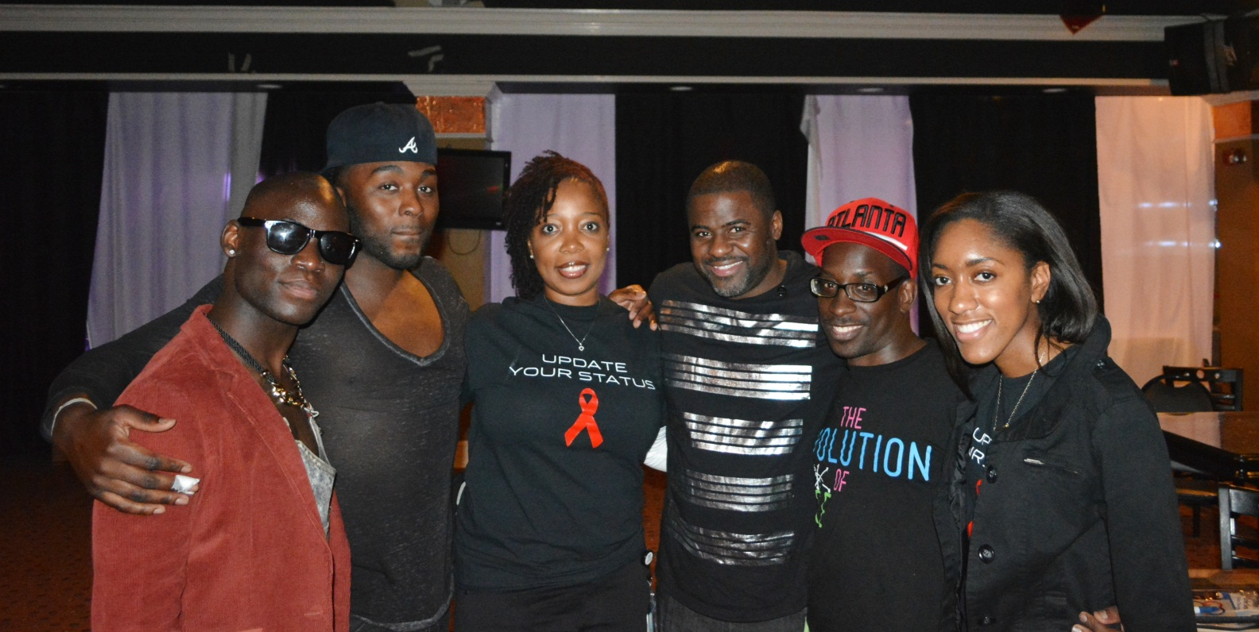
Notes:
Get Hip Get Connected is a HIV Testing, Prevention and Health promotion campaign. Partnering is key to developing solid relationships with others who have similar goals in mind.

Slide 13
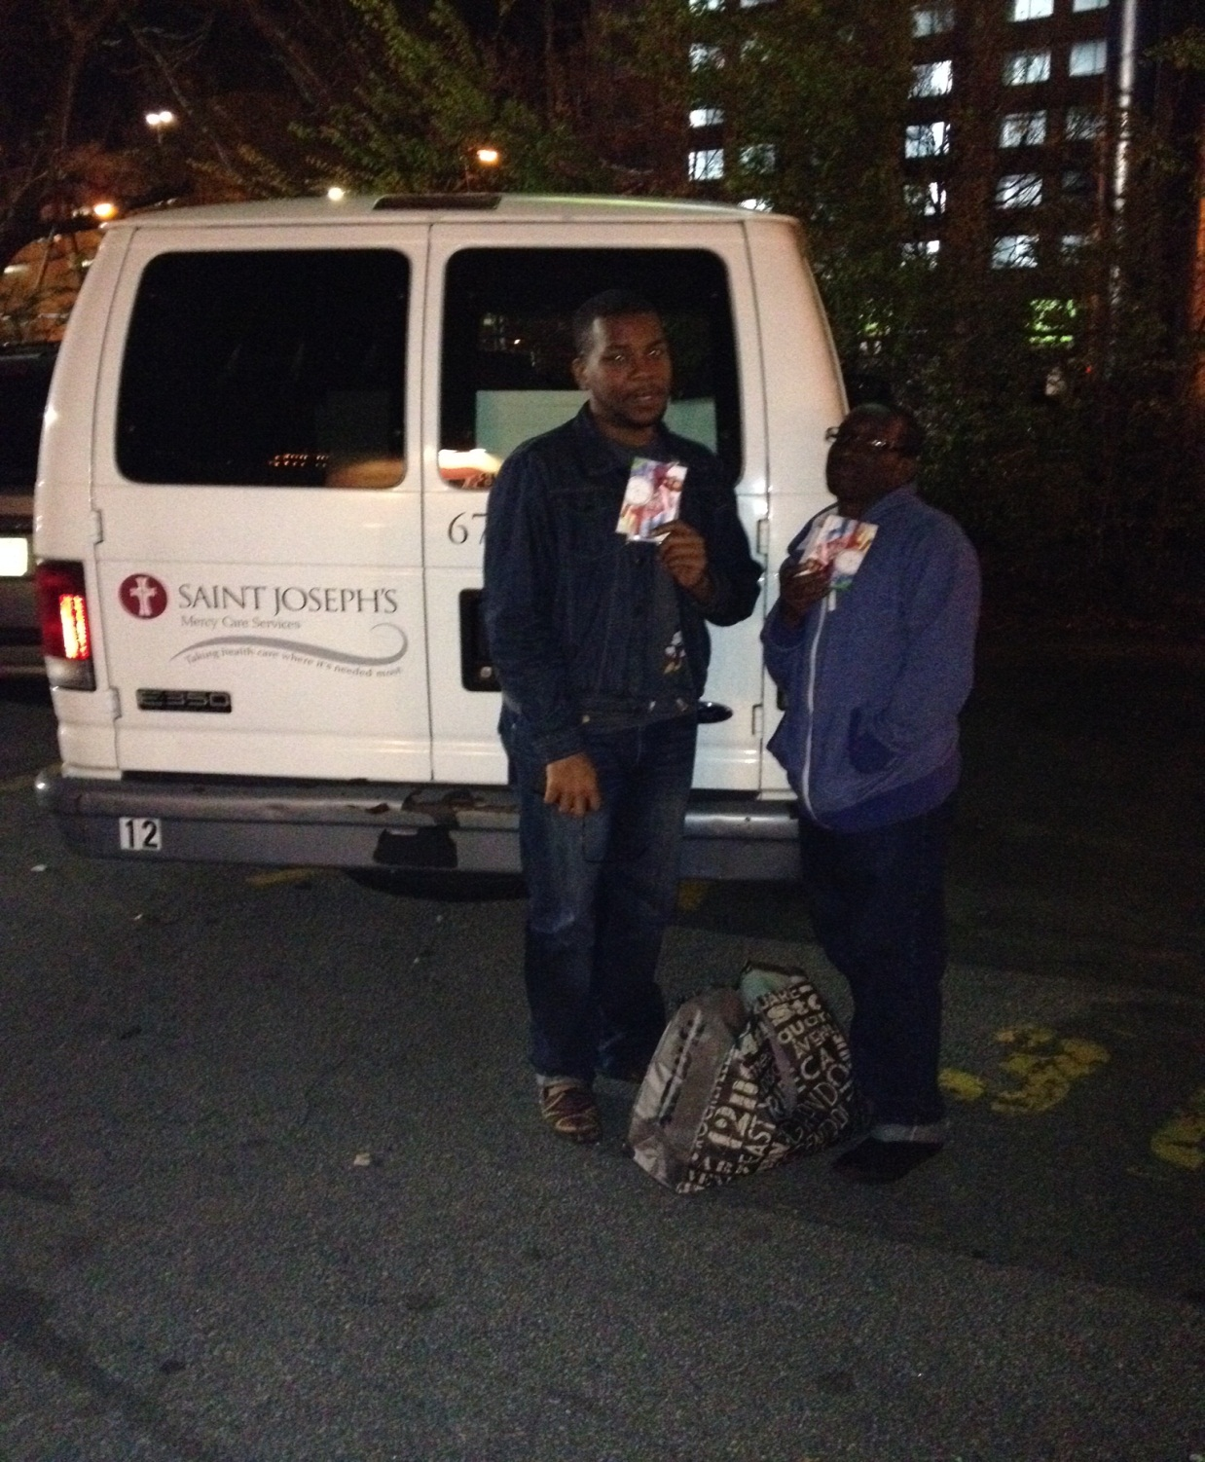
Notes:
Mercy Care’s van used during street outreach at night.

Slide 14
THANK YOU! QUESTIONS?
Patricia E. Parsons; HIV Prevention Coordinator
678.843.8930
Rameses Frederick; Peer Support Specialist
678.843.8518

