Slide 1
State Office of Vital Records Spring 2018 Registrar Meeting

Slide 3
Not On File-Notification (NOF)

Slide 4
Before a NOF is generated…
We may contact the county for additional information
Extensive search by Records Management is conducted

Slide 5
Challenges with searching
Search of GAVERS may not produce results
Search on Microfiche may not have data
Custodial copy was never filed with the SOVR
Customer may not have provided correct information

Slide 6
Didn’t Find The Record?
A NOF (Not On File) letter will be prepared by the State Office Of Vital Records when a BC or DC search does not yield a registered certificate
The State Office of Vital Records will notify interested parties by email, fax or other electronic method

Slide 7
Letter Must Include:
NOF Letter must include – First and Last name of applicant searched, date of event, years searched by the State Office of Vital Records
NOF Letter from the State must include – Name\Contact information of the Search Supervisor
NOF Letter from the County must include – Signature of local State Office Registrar

Slide 8
Letter Must Include:
Before a NOF letter is issued to an applicant, the Local Registrars must print or photocopy the letter on the green paper (traditionally used for death certificates) and must place their seal on the green paper to be issued
The applicant must also be provided with a prepared package containing the details regarding evidentiary documents required to establish a delayed birth certificate

Slide 9
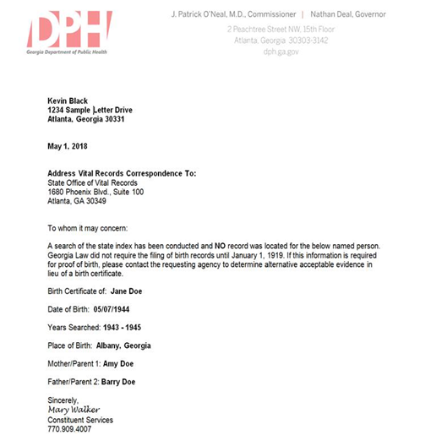

Slide 10
Pronouncement of Death Form

Slide 11
Pronouncement of Death The Final Medical Act
Document the date and time of death
Document the name of pronouncer
Provide a brief statement of cause of death
Document the certifier

Slide 12
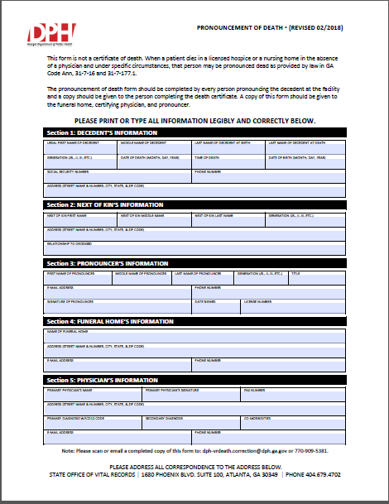
Pronouncement Of Death
Plan of Action
DPH-Government Relation Department
Medical Association of Georgia (MAG)
Georgia State Medical Association (GSMA)
American Medical Association (AMA)
Medical Association of Atlanta (MAA)
Hospitals/ Administration
Coroners
Funeral Homes
Local Vital Records

Slide 13
Permit for Disposition of Human Remains

Slide 14
Disposition Permits

Slide 15
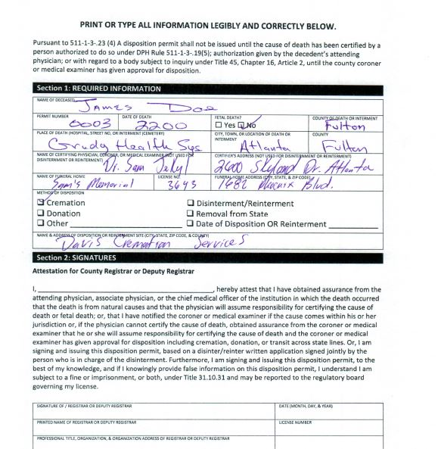
What is a disposition permit?
A disposition permit is a document that outlines how human remains will be disposed.

Slide 16
When is a disposition permit required?
Cremation

Slide 17
Donations

Slide 18
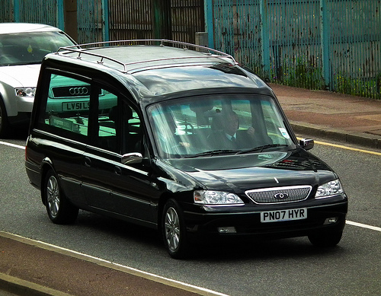
Transporting/Removing Remains Out of State

Slide 19
AMENDED & Title Change: 511-1-3-.23 PERMITS for disposition, disinterment, and reinterment
Three Major Changes
“Jointly”
A disposition permit cannot be issued for cremation, donation, or transport out of state until the cause of death is known or the decedent’s attending physician or coroner/ME gives you approval
Expanding options for the 24/7 requirement to the local registrar
Can a disposition permit be issued even though a death certificate has not been issued?
Yes, but only if cause of death has been certified, or the county coroner/medical examiner or attending physician gives approval.

Slide 20
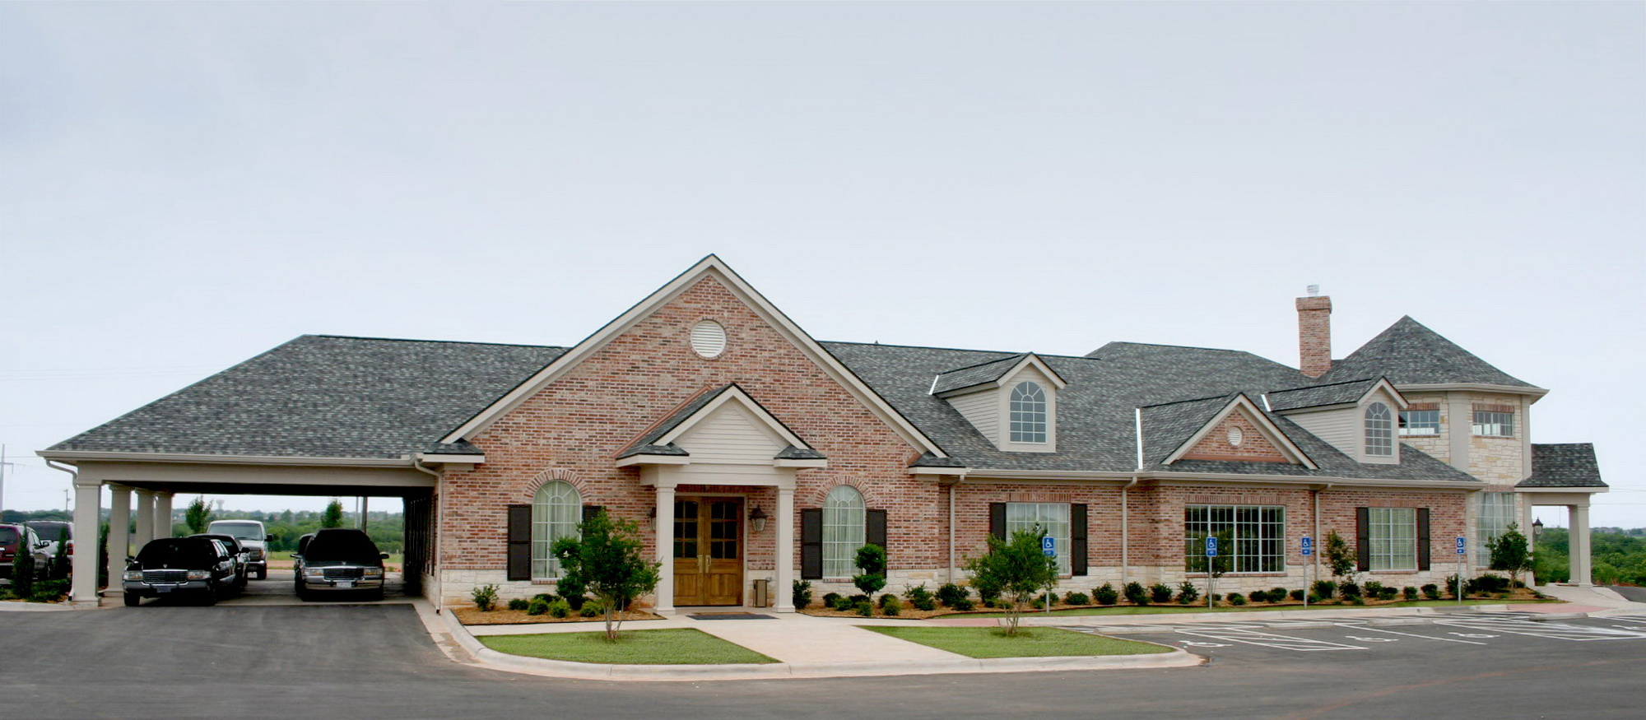
How Can I Expand My Options for the 24/7 Requirement?
• Consider who works 24/7 and who has the information and the knowledge to make decisions on your behalf
Funeral Home Personnel

Slide 21
Hospice Personnel

Slide 22
Hospital Personnel

Slide 23
Steps for Issuing a Disposition Permit
Step 1: Funeral director or administrative personnel, will complete section one of the disposition permit.

Slide 24
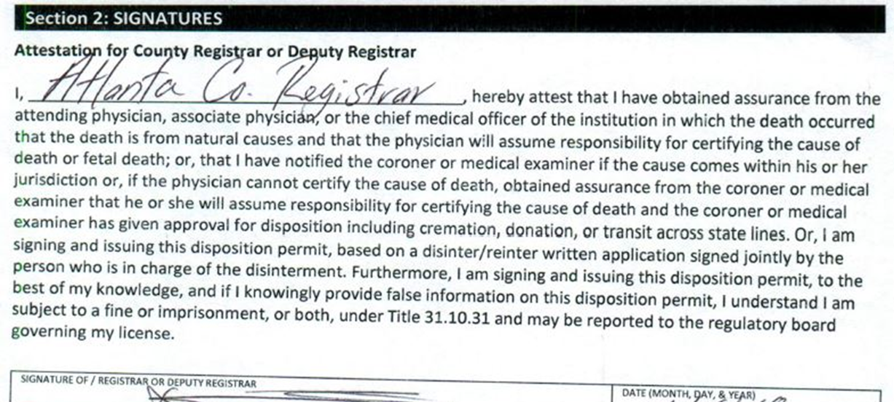
Steps for Issuing a Disposition Permit
Step 2: After receiving the disposition form, the county registrar will complete section two of the disposition permit.

Slide 25
Steps for Issuing a Disposition Permit
Step 3: Send a copy of the completed disposition permit back to the funeral home and file the original disposition permit in your office.

Slide 26
Mentimeter Questions

Slide 27
VITAL RECORD REQUESTS FOR
GENEALOGICAL PURPOSES, LAW ENFORCEMENT, MILITARY, AND VETERANS

Slide 28
GENEALOGY
In practice, the counties will:
Release any death record for genealogical purposes
Charge a $25 search fee for the record printed
Issue the record on white paper only with:
a stamp,
watermark, or
handwritten statement on face document, “For genealogy purposes only”.
Redact the social security number on a death record
See 511-1-3-.33 Disclosure of Records.

Slide 29
GENEALOGY
Counties should not:
Release certified birth nor death records for genealogical purposes- only white copies
Possess death records older than 75 years or birth records older than 100 years
See 511-1-3-.33 Disclosure of Records.

Slide 30
MILITARY REQUESTS
The recruit and the recruiter must comply with the following:
Complete the standard military affidavit
Complete the Search Request for Birth Records Form.
Submit recruit’s photo ID and a copy of the recruiter’s photo ID
Note: Only the record of the recruit is available for the recruiter.
See 511-1-3-.33 Disclosure of Records.

Slide 31
MILITARY REQUESTS
Phone verifications of a vital event are strictly prohibited.
For verifications, the recruiter must present:
The DD Form 372
Request for Verification of Birth for completion
Purchase a certified copy of the record at a cost of $25
See 511-1-3-.33 Disclosure of Records.

Slide 32
LAW ENFORCEMENT
Law Enforcement includes the following officers:
Police
Probation & Parole
District Attorneys
Solicitor General
Inspector General
Federal Agents
Immigration and Customs Enforcement (ICE)
Note: This is not an exhaustive list. Please call the State Office if you are unsure of an agency’s status
FBI and US Secret Service inquiries should be directed to the State Office.
Requirements for release of records:
Present request on official agency letterhead with the requestor’s hand-written signature affixed
Provide copy of their official government ID*
*Representatives of agencies prohibited from providing copies of ID may provide their badge number. Please be sure to verify.

Slide 33
LAW ENFORCEMENT
Redact the social security number on death certificates
Fees:
There is no fee for white copies of birth or death certificates
Police, Probation, Federal Agencies must pay for certified copies
There is no fee for white or certified copies for:
Attorney General
Solicitor General
District Attorney
*Please call the State Office if you are unsure of an agency’s status.
See 511-1-3-.33 Disclosure of Records.

Slide 34
VETERAN REQUESTS
A veteran is defined as any person, who served honorably on active duty in the armed forces of the United States. Active duty military personnel are not veterans. Please note that discharge status is found on the veterans DD214.
Requests for vital records of veterans may be fulfilled free of charge when requested by the veterans, their dependents, the Department of VA or veterans’ organizations.
Such records include marital, birth, divorce or death. There is no restriction on the amount of records that can be requested. However, use your better judgement when issuing birth records. Birth records are breeder documents.
The requested record is restricted to the veteran named on the certificate and not members of the veteran’s family.
See 511-1-3-.33 Disclosure of Records.

Slide 35
VETERAN REQUESTS
Record may be requested in writing or by completing the request for search of birth form found on the DPH website.
Requirements for veteran’s death certificate:
Proof of decedent's veteran status
DD214,
photocopy of military or a retiree ID card, or letter of verification from the Veterans Administration
Copy of government-issued picture ID card of requestor
Please refer to O.C.G.A. 38-1-1 (2010) for additional information.

Slide 36
Mentimeter Questions

Slide 37
Fee and Issuance Reports

Slide 38
New Module, New Reports

Slide 39
Highly Recommended Reports
Revenue Summary Report
High-level overview of revenue and source
Issuance and Activity History Report
Detailed information on every completed transaction

Slide 40
Revenue Summary Report
Can be run for long periods of time, several months or years
Recommend PDF format

Slide 41
Revenue Summary Report

Slide 42
Issuance and Activity History Report
Recommend no more than a few months. Every transaction and every certificate copy will get a separate row.
Report produces a lot of rows. Recommend Excel to allow sorting and filtering of the data

Slide 43
Birth and Death Matching

Slide 44
GA Code 31-10-30 Matching of birth and death certificates
(a) To protect the integrity of vital records and to prevent the fraudulent use of birth certificates of deceased persons, the state registrar is authorized to match birth and death certificates, in accordance with written standards promulgated by the state registrar to prove beyond a reasonable doubt the fact of death and to post the facts of death to the appropriate birth certificate and index. Copies issued from birth certificates marked deceased shall be similarly marked.

Slide 45
Key Points: Fraud Prevention + Data Integrity

Slide 46
Old Process
New Process

Slide 47
What does this mean for GAVERS?

Slide 48
Problem? Wrong Record?
Report GAVERS Issue(s)

Slide 49
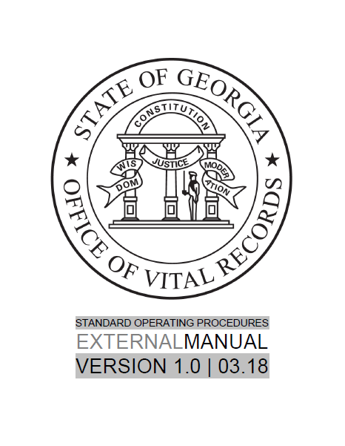
EXTERNAL STANDARD OPERATING PROCEDURES MANUAL (EOPM)

Slide 50
EXTERNAL STANDARD OPERATING
PROCEDURES MANUAL (EOPM)
Document created by:
SOVR Compliance & Communications Department
Who is it for?
County/Local Registrars
Staff of County/Local Registrars
Funeral Homes
Medical Certifiers
Probate Judges
Staff of Probate Judges
Why was it created?
Compliance
Easy Reference
Governance Communique
Standardization of Policies & Procedures

Slide 51
EXTERNAL STANDARD OPERATING
PROCEDURES MANUAL (EOPM)
What’s inside…….
County/Local Registrar roles/responsibilities
GAVERS access
Ordering birth and death paper
Court Orders
Disposition Permits
Legitimations
Paternity Acknowledgements
Governance
And much more…

Slide 52
EXTERNAL STANDARD OPERATING
PROCEDURES MANUAL (EOPM)
Features:
Accessible 24 hours from any electronic device
Password protected
Embedded links to codes and regulations
Easy to navigate/searchable
Appendix
Glossary of frequently used terms
Quarterly updates
Contact Regional Consultant

Slide 53
WEBSITE
Resource Area>Training Materials
Registrars
Birthing Centers
Funeral Homes
Publications and Forms
Vital Connections Newsletter
Fillable PDF Format
External Operating Procedure Manual
Training Tools
YouTube Channel Link
Webinars

Slide 54
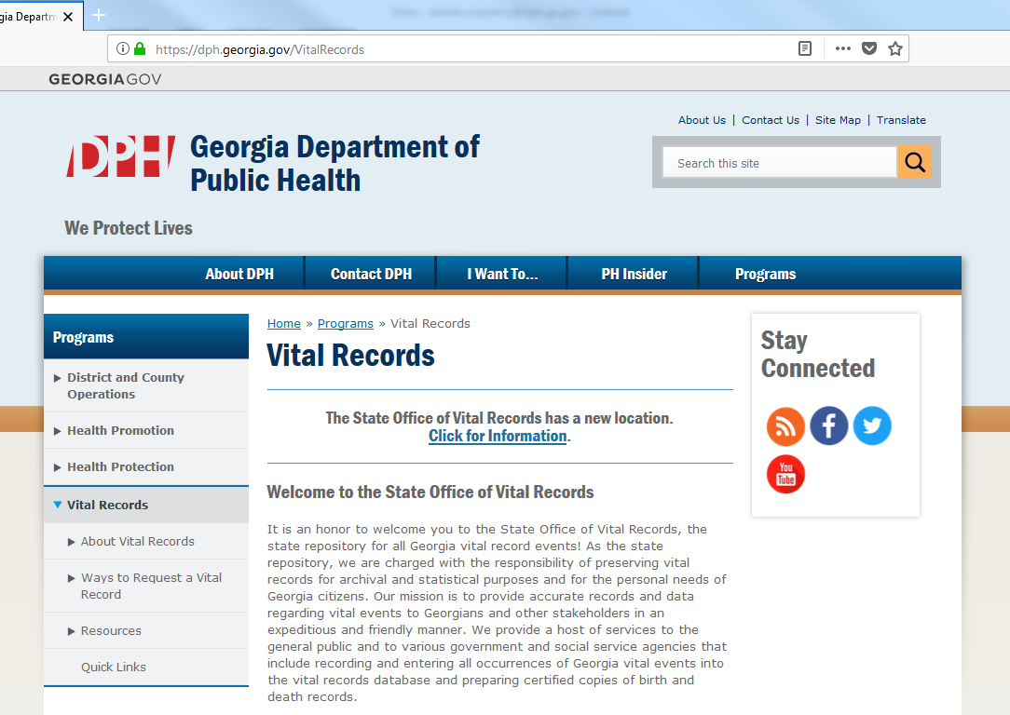
WEBSITE

Slide 55
VR FORMS & DPH WEBSITE
To access the forms via the DPH website:
Open the browser of your choice.
Type dph.georgia.gov in the address bar.
On the main menu hover your mouse over programs.
Scroll down and select Vital Records.
On the left hand menu click the Resources tab.
Select forms under the resources menu.

Slide 56
THE VITAL CONNECTION
Released around the 22nd of each month
Posted to website under Vital News

Slide 57
QUESTIONS

