Slide 1
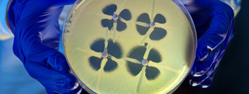
Train-the-Trainer Interacting with your laboratory colleagues
Customize this presentation with your organization’s logo, etc.

Slide 2
Interacting with your laboratory colleagues
Nimalie D. Stone, MD,MS
(with significant help from Dr. Eileen Burd)
GA CRE Collaborative
Learning Session 1
March 20, 2014
National Center for Emerging and Zoonotic Infectious Diseases
Division of Healthcare Quality Promotion

Slide 3
Presentation Objectives
Basic terms used in the microbiology lab
Understand carbapenem-resistance in gram-negative bacteria
Describe laboratory testing for carbapenem-resistance
Examine your process for communicating with the laboratory
Disclosure – Dr. Stone is NOT a microbiologist
Acknowledgement – Dr. Burd, Director of Clinical Microbiology at Emory University Hospital provided content for many of these slides

Slide 4
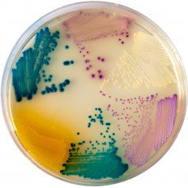
Microbiology 101: Identification
Growing the bacteria
Traditional culture
Uses gram stain, biochemical reactions for identification
Selective culture media
Example: CHROMagar
Examining parts of the bacteria
Molecular diagnostic tests
Identify specific fragments of DNA/RNA of organisms
Nucleic acid amplification tests (NAAT);Polymerase chain reaction (PCR)
Matrix-assisted laser desorption/ionization (MALDI-TOF)
Very new technology: Uses mass spectrometry to identify bacteria based on weight and charge of ions

Slide 5
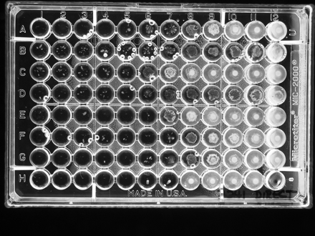
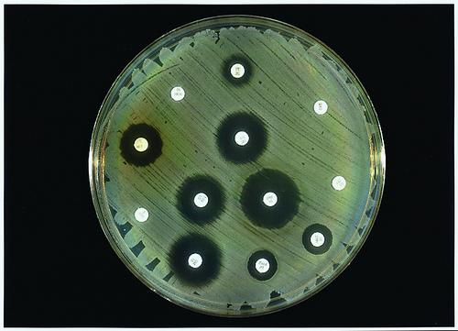
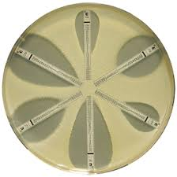
Microbiology 101: Susceptibility
Testing the growth in the presence of antibiotic
Determining the minimum inhibitory concentration (MIC) – lowest amount of drug needed to stop growth
Broth micro-dilution, Disk diffusion, E-test strips
Identifying resistance genes
Molecular diagnostic tests – detect presence of specific resistance genes (NAAT, PCR)

Slide 6
Microbiology 101: Automated testing
Systems with identification and susceptibility in one platform
Special growth panels contain biochemicals for identification and antibiotics for susceptibility testing
Bacteria of interest are innoculated onto panels and placed into system
Computer will identify organism and susceptibility interpretation
Uses pre-programmed algorithms based on growth patterns of bacteria on the panel
Example systems (trade names): Microscan, Walkaway, VITEK 2, Phoenix, Sensititre

Slide 7
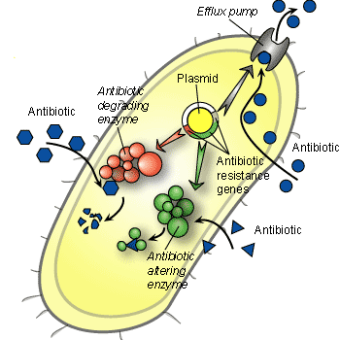
Mechanisms of antibiotic resistance
Production of proteins that destroy antibiotics
Beta-lactamases
Cephalosporinases
Carbapenemases
Change their cell structure
Block s binding and function of antibiotics
Reduce exposure
Pump antibiotics out
Increase cell barriers to block entry
http://bioinfo.bact.wisc.edu/themicrobialworld/bactresanti.html

Slide 8
Case scenario
Drug | Result
Amikacin | Susceptible
Ampicillin | Resistant
Amp/Sulbactam | Resistant
Aztreonam | Resistant
Cefazolin | Resistant
Cefepime | Resistant
Ceftazidime | Resistant
Ceftriaxone | Resistant
Cefuroxime | Resistant
Gentamicin | Susceptible
Levofloxcin | Resistant
Meropenem | Susceptible
Piperacillin/Tazobactam | Resistant
Tobramycin | Susceptible
Trimethoprim/Sulfa | Resistant
70 year old admitted from hospital to nursing home
Treated with Ceftriaxone for catheter-associated UTI x7 days before transfer
Catheter still in place recently transferred
Repeat urine culture ordered by MD prior to removing catheter
Organism: E. coli, >10⁵ cfu

Slide 9
Remember the good old days…
Cephalosporin resistance in gram-negative bacteria
Some organisms had resistance genes within their chromosomes (Example: AmpC)
Bacteria already had the capability to be resistant
Resistance was uncovered with overexpression of the gene
Consider in bugs like Serratia, Pseudomonas, Acinetobacter
Other organisms acquired resistance genes through mobile elements
Example: Extended spectrum Beta-lactamases (ESBLs)
Consider in E. Coli, Klebsiella
Now we see both types of cephalosporin-resistance expressed in different bacteria
Does mechanism of resistance matter?

Slide 10
Changes in defining cephalosporin susceptibility (2010)
Changing the MICs redefines the susceptibility of bacteria
From a laboratory testing perspective, lowering the MIC that defines “susceptible” should increase identification of resistance
 | Old Breakpoints |  |  |  | New Breakpoints
 | MIC (µg/ml) |  |  |  | MIC (µg/ml)
 | S | I | R |  | S | I | R
Cefazolin | ≤ 8 | 16 | ≥ 32 |  | ≤1 | 2 | ≥ 4
Ceftriaxone | ≤ 8 | 16-32 | ≥64 |  | ≤1 | 2 | ≥ 4
Ceftazidime | ≤ 8 | 16 | ≥ 32 |  | ≤4 | 8 | ≥ 16
Cefepime | ≤ 8 | 16 | ≥ 32 |  | ≤ 8 | 16 | ≥ 32

Slide 11
Case scenario #2
Drug | Result
Amikacin | Intermediate
Ampicillin | Resistant
Amp/Sulbactam | Resistant
Aztreonam | Resistant
Cefazolin | Resistant
Cefepime | Resistant
Ceftazidime | Resistant
Ceftriaxone | Resistant
Cefuroxime | Resistant
Gentamicin | Resistant
Levofloxcin | Resistant
Meropenem | Resistant
Piperacillin/Tazobactam | Resistant
Tobramycin | Resistant
Trimethoprim/Sulfa | Resistant
70 year old admitted from hospital to nursing home
Had complicated history including surgery, ICU care, ventilator-weaning
On transfer, has PICC line, tracheostomy, PEG tube, urinary catheter and large sacral pressure ulcer
MD sends culture from tracheostomy secretions
Organism: Klebsiella pneumoniae, >10⁵ cfu

Slide 12
Carbapenem-resistance in gram-negative bacteria
Carbapenems are reserved for severe, complicated infections with multiple and often resistant bacteria
Recall: “Extremely broad-spectrum”
Resistance significantly limits treatment options for life-threatening infections
No new antibiotics in development for gram-negative bacteria
Emerging resistance mechanisms can be spread
Carbapenemases are found on mobile genetic elements
Detection of carbapenemases and implementation of infection control practices are necessary to prevent spread

Slide 13
Carbapenem-resistance: Mechanisms
Enterobacteriaceae | Cephalosporinase + porin loss
 | Carbapenemase
P. Aeruginosa | Cephalosporinase + porin loss
 | Up-regulated efflux pump
 | Carbapenemase
Acinetobacter spp. | Cephalosporinase + porin loss
 | Carbapenemase
Slide courtesy of Dr. Eileen Burd, Emory University Hospital

Slide 14
Types of carbapenemases
Classification | Enzyme | Most Common Bacteria
Class A | KPC, SME, IMI, NMC, GES | Enterobacteriaceae (rare reports in P. aeruginosa)
Class B (metallo-β-lactamase) | NDM, IMP, VIM, GIM, SPM | P. aeruginosa Enterobacteriaceae Acinetobacter spp.
Class D | OXA-48 | Acinetobacter spp. (reports in Enterobacteriaceae)
Slide courtesy of Dr. Eileen Burd, Emory University Hospital

Slide 15
Why focus on carbapenemases?
The genetic material creating carbapenemases sits on highly mobile elements
These resistance elements can be shared between different bacteria very easily
Similar to concern with ESBL spreading cephalosporin-resistance
Two carbapenemases getting lots of attention
Klebsiella pneumoniae carbapenemase (KPC)
New Delhi metallo-beta-lactamase (NDM-1)
Identifying/containing bacteria which produce carbapenemase will prevent the spread of resistance to other people and other organisms

Slide 16
Can laboratories identify carbapenemases?
Recall: Labs look for susceptibility to carbapenems by manual or automatic testing methods
Challenges:
Identification of carbapenem-resistance varies by which carbapenem is used for susceptibility testing
Low-levels of carbapenem resistance that may not be detected by automated testing
Even if carbapenem resistance is detected – Not all carbapenem-resistance means the bacteria produces a carbapenemase

Slide 17
Susceptibility of KPC-Producers to Imipenem
S*
I
R
*12% of isolates test susceptible to imipenem
Slide courtesy of Dr. Eileen Burd, Emory University Hospital

Slide 18
Susceptibility of KPC-Producers to Meropenem
S*
I
R
*9% of isolates test susceptible to meropenem
Slide courtesy of Dr. Eileen Burd, Emory University Hospital

Slide 19
Susceptibility of KPC-Producers to Ertapenem
S
I
R
None of the isolates test susceptible to ertapenem
Slide courtesy of Dr. Eileen Burd, Emory University Hospital

Slide 20
Can Carbapenem Susceptibility of “I” or “R” detect KPC-producers?
Method | Sens/Spec (%) for Detection of KPC-mediated R
 | Imipenem | Meropenem | Ertapenem
Ref BMD | 94/93 | 94/98 | 97/89
Disk Diffusion | 42/96 | 71/96 | 97/82
Etest | 55/96 | 58/96 | 90/84
Vitek Legacy | 55/96 | 52/98 | N/A
Vitek 2 | 71/98 | 48/96 | 94/93
MicroScan | 74/96 | 84/98 | 100/89
Phoenix | 81/96 | 61/98 | N/A
Low sensitivity = might miss true KPC;
Low specificity = might over-call carbapenem resistance.
Anderson KF et al., 2007. J. Clin. Microbiol. 45:2723-5.

Slide 21
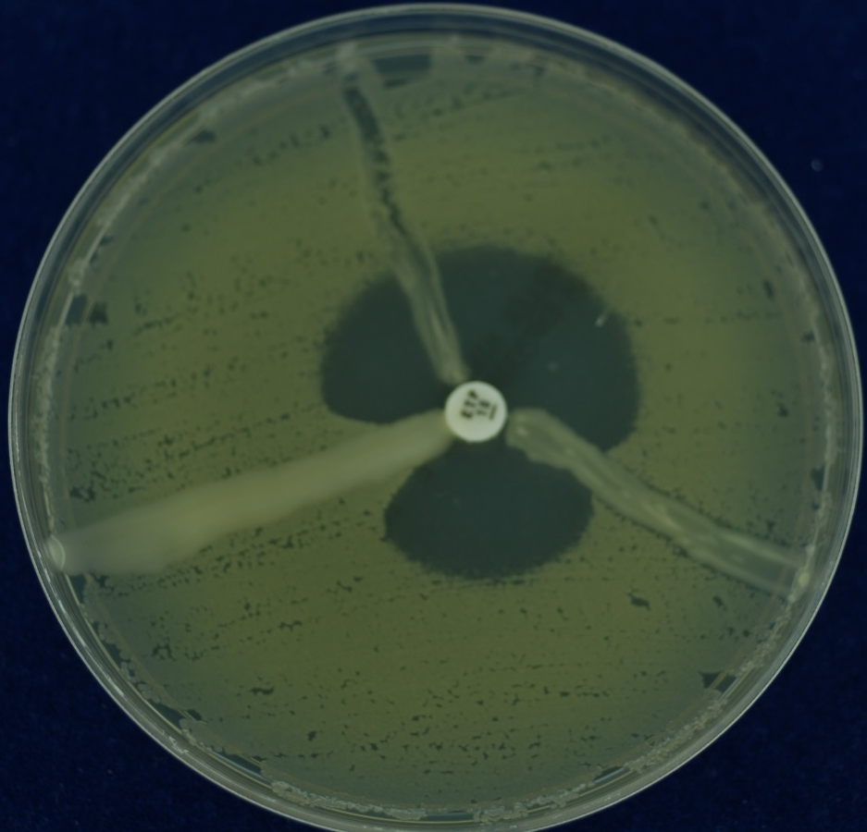
Confirming carbapenemase by growth: Modified Hodge test
Mueller Hinton Agar plate
Lawn of E. coli ATCC 25922
Carbapenem disc in center
Instead of a clear zone of inhibition, the zone gets distorted when carbapemase is present
Negative
Control
K. pneumoniae
E. coli
Described by Lee K et al. Clinical Microbiology and Infection 7: 88-102, 2001.
Notes:
Preliminary results suggest that any of the three carbapenem disks work in the modified Hodge test – CDC recommends ertapenem or meropenem
Tells you that you have a beta-lactamase but does not distinguish metallo-B lactamase vs KPC or other

Slide 22
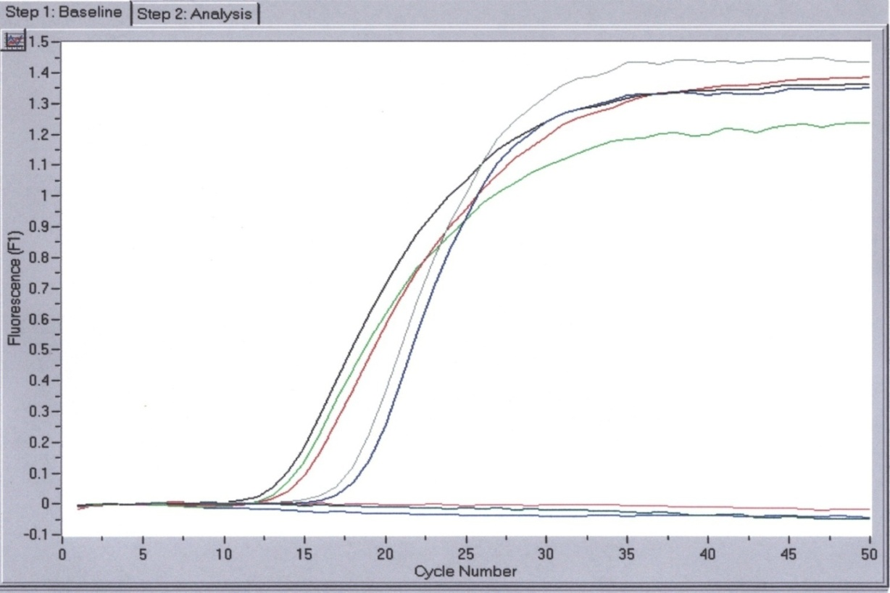
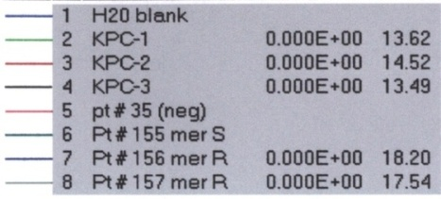
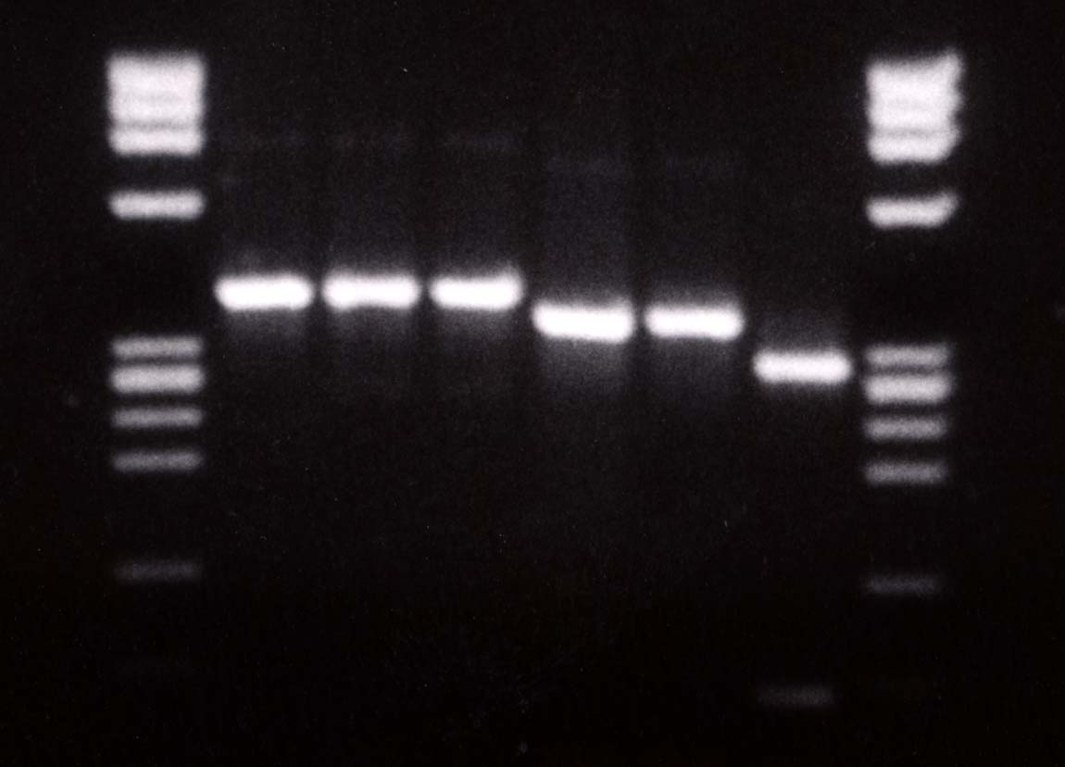
Confirming carbapemase by molecular detection methods
KPC Isoenzyme Differentiation
KPC – 1 (U)
KPC – 2 (U)
KPCs 1-3
KPC – 3 (U)
KPC – 1 (C)
KPC – 2 (C)
603
KPC – 3 (C)
2 KPC (+) patients
310
KPC-1 and KPC-2 have
identical digestion pattern
bla_{KPC} PCR
Forward primer 5’-TCTGGACCGCTGGGAGCTGG-3’
Reverse primer 5’-TGCCCGTTGACGCCCAATCC-3’
Probe 5’FAM-CGCGCGCCGTGACGGAAAGC-TAMRA3’
118
Slide courtesy of Dr. Eileen Burd, Emory University Hospital

Slide 23
Changes in defining carbapenem susceptibility (2010-2012)
Changing the MICs will redefine susceptibility of bacteria
From a laboratory testing perspective, lowering the MIC that defines “susceptible” should increase identification of resistance
 | Old Breakpoints |  |  |  | New Breakpoints
 | MIC (µg/ml) |  |  |  | MIC (µg/ml)
 | S | I | R |  | S | I | R
Eratpenem | ≤ 2 | 4 | ≥ 8 |  | ≤0.5 | 1 | ≥ 2
Imipenem | ≤ 4 | 8 | ≥16 |  | ≤1 | 2 | ≥ 4
Meropenem | ≤ 4 | 8 | ≥ 16 |  | ≤1 | 2 | ≥ 4
Doripenem | -- | -- | -- |  | ≤1 | 2 | ≥ 4

Slide 24
What does it all mean??
Many mechanisms can cause carbapenem-resistance in gram-negative bacteria
Microbiology labs may use different strategies for detecting carbapenem-resistance
Reliable detection may vary by testing method being used
Labs may NOT do the additional confirmatory testing to determine if resistance is from a carbapenemase
Requires additional knowledge, supplies/resources, time and technology
Understanding the methods/capacity of your laboratory is a critical step in determining the burden of carbapenem-resistance in your facility
May be over or under-estimated

Slide 25
Starting the conversation with your lab
Talk with the director of microbiology for your laboratory
Share your interest in understanding the carbapenem resistance in gram-negative bacteria identified in your facility
Ask what methods are used for identification and antibiotic susceptibility
Is it an automated method? Can they flag organisms with carbapenem-resistance?
Ask whether they can to perform “confirmatory” testing for carbapenemase-production (e.g., modified Hodge)
Could this be done if requested?
Discuss a strategy for notifying infection prevention when a carbapenem-resistant bacteria is identified

Slide 26
Training Wrap-up
Collaborative Participants:
Submit training sign-in sheets and evaluations to Michelle Nelson at
mynelson@dhr.state.ga.us
or
fax to 404-657-2608

