Slide 1
Understanding and Addressing
Vaccine Hesitancy
Presentation to:
Presented by:
Date:
Notes:
Development of safe and effective vaccines is one the greatest medical triumphs. However, despite high immunization rates in the United States, 85% of health care providers will have a parent refuse a vaccine for his or her child each year. HCPs have the greatest influence on a parent's decision to vaccinate his or her child. To effectively communicate with vaccine-hesitant parents, HCPs must first understand the concerns of parents regarding immunization and understand influences that can lead to misinformation about the safety and effectiveness of vaccines. HCPs should establish an open, non confrontational dialogue with vaccine-hesitant parents at an early stage. Personal stories of patients and parents affected by vaccine-preventable diseases and reports of disease outbreaks serve as useful reminders of the need to maintain high immunization rates.

Slide 2
How Recommendations and Schedules Are Developed: ACIP Committee
National committee
Membership:
  Experts in fields of epidemiology and infectious diseases
  Represent areas of academia, research, and public and private providers
Meets 3 times a year
Has sole authority to add vaccines to the VFC Program
Notes:
Before we discuss some of the general recommendations that apply to vaccine administration, it is important that you understand how these recommendations and the recommended schedules are developed.
Recommendations for each vaccine licensed by the FDA are developed by the Advisory Committee on Immunization Practices (ACIP):
National committee coordinated by CDC
Membership consists of experts in the fields of epidemiology and infectious diseases
Represents areas of academia, research, and public and private providers
Meets 3 times a year to review and discuss recommendations for each new vaccine that is approved by the FDA and to discuss any recommended changes for existing vaccines
Has sole authority to add vaccines to the VFC Program
A subcommittee of the ACIP, representing the AAP, AAFP, and CDC annually develop the Harmonized Recommended Childhood Immunization Schedule for the upcoming year.

Slide 3
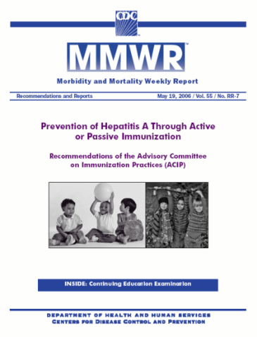
Publication of Recommendations and Schedules
MMWR (official notification)
  Free Subscription per internet:
  http://www.cdc.gov/mmwr/mmwrsubscribe.html
ACIP Recommendations for each vaccine located at CDC web sites:
  http://www.cdc.gov/vaccines/pubs/ACIP-list.htm
  http://www.cdc.gov/vaccines/recs/provisional/default.htm
American Academy of Pediatrics licensure chart and recommendations:
  http://aapredbook.aappublications.org/news/vaccstatus.shtml
Notes:
Publication of the Recommendations and Schedules
MMWR (official notification). You can get a free email copy of the weekly MMWR by going to this site and sending in your email information. This usually comes late on Thursday afternoon, and is “officially” published the next day.
The ACIP committee also develops recommendations for the use and administration of other vaccines, not just those included on the childhood schedule. These recommendations are published as Statements and are available on the CDC National Immunization Program web site. We follow the ACIP Recommendations as official policy regarding immunization issues. The statements are all available on the CDC web site listed here.
The 2nd web address here is to the page containing the Provisional Recommendations. The only vaccines left at this point are use of Tdap in pregnant adults and zoster.
The chart at this AAP website contains a listing of the most recently FDA-approved vaccines, plus those that have been submitted for licensure. It gives the status of the vaccine in that licensure process, and is similar to the tables in the previous slides.
Discuss development of guidelines for Immunization Program Manual from these documents.

Slide 4
Recommended Childhood & Adolescent Immunization Schedule - United States
Vaccines are listed under the routinely recommended ages for children through age 18 years
Sentence under the title “For those who fall behind or start late, see the catch-up schedule.”
Gold bars indicate range of recommended ages for immunization
Purple bars indicated vaccines that may be needed by certain high risk groups.
Notes:
Now let’s discuss some general guidelines regarding the format and use of the schedule and recommendations.
Vaccines are listed under the routinely recommended ages for children through age 18 years.
Sentence under the title “For those who fall behind or start late, see the catch-up schedule.”
Gold bars indicate range of recommended ages for immunization
Purple bars indicated vaccines that may be needed by certain high risk groups.

Slide 5
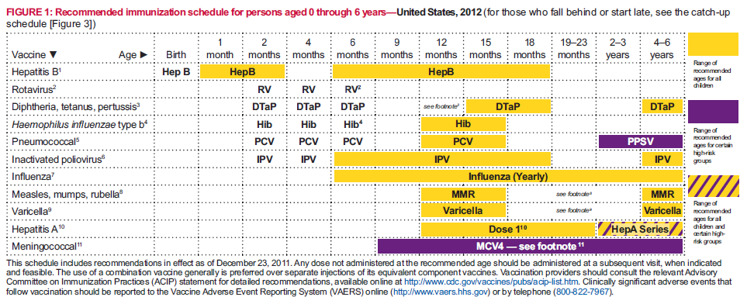
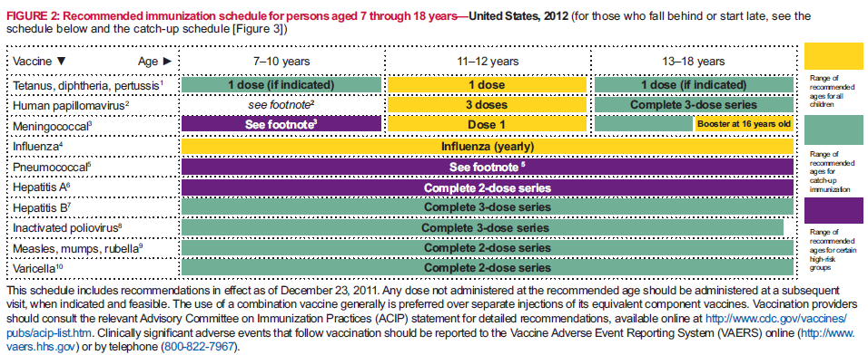
2012 Recommended Childhood and Adolescent Immunization Schedule
Ages 0-6 years
Ages 7-18 years
Notes:
Changes to the previous schedules include the following:
Updates to Figure 1 “Recommended immunization schedule for persons aged 0 through 6 years”):
Quadrivalent meningococcal conjugate vaccine (MCV4) purple bar has been extended to reflect licensure of MCV4-D (Menactra) use in children as young as age 9 months.
A wording change has been introduced in the hepatitis A (HepA) vaccine yellow bar; wording now states, “Dose 1.” A new yellow and purple bar has been added to reflect HepA vaccine recommendations for children aged 2 years and older.
Guidance is provided for administration of hepatitis B (HepB) vaccine in infants with birthweights <2,000 grams and ≥2,000 grams. Clarification is provided for doses after administration of the birth dose of HepB vaccine.
Rotavirus (RV) vaccine footnotes have been condensed.
Haemophilus influenzae type b (Hib) conjugate vaccine footnotes have been condensed, and use of Hiberix for the booster (final) dose has been clarified. Guidance for use of Hib vaccine in persons aged 5 years and older in the catch-up schedule has been updated.
Pneumococcal vaccine footnotes have been condensed.
Guidance is provided for use of measles, mumps, and rubella (MMR) vaccine in infants aged 6 through 11 months. Footnotes in the catch-up schedule have been condensed.
HepA vaccine footnotes have been updated to clarify that the second dose of HepA vaccine should be administered 6–18 months after dose 1.
MCV4 footnotes have been updated to reflect recent recommendations published in MMWR.
Influenza vaccine footnotes have been updated to provide guidance on live, attenuated influenza vaccine (LAIV) contraindications.
Influenza vaccine footnotes also have been updated to clarify dosing for children aged 6 months through 8 years for the 2011–12 and 2012–13 seasons.
Figure 2 (“Recommended immunization schedule for persons aged 7 through 18 years”) has been updated to include number of doses for each vaccine. Information regarding the recommended age (16 years) for the booster dose of MCV4 has been added.
Tdap vaccine recommendations for children aged 7 through 10 years have been updated.
Human papillomavirus (HPV) vaccine footnotes have been updated to include routine recommendations for vaccination of males.
Varicella (VAR) vaccine footnotes have been condensed.
Inactivated poliovirus vaccine (IPV) footnotes have been updated to include upper age limit for routine vaccination. IPV footnotes in the catch-up schedule have been condensed, and relevant wording added to Figure 3 (“Catch-up immunization schedule for persons aged 4 months through 18 years who start late or who are more than 1 month behind”).
In the catch-up immunization schedule, HepA vaccine and HepB vaccine footnotes have been removed. Relevant wording has been added to Figure 3.
MCV4 vaccine has been added to Figure 3 along with corresponding footnotes.

Slide 6
Vaccine Hesitant Parent Profile
Most often, these moms can be defined as:
Ages 30-45
College graduates
Upper income
Planned pregnancy – read all the books!
Worried about being a good mom
Worried about her children’s progress relative to development stages
Engaged in mom groups - PEPS, church, daycare
Information seekers
Notes:
• Who are these parents? Review Profile above
Parents are encountering messages in popular media and from friends about risks of vaccination. This is prompting more of them to wonder if fully vaccinating their children is safe. In some communities, vaccination rates are dropping, posing a significant public health threat that needs to be proactively addressed.
The primary audience is moms with young children, ages 0-5, who have varying degrees of questions and concerns about vaccination, but do not strongly object to childhood vaccinations. With the right education and information from the right sources, these moms will make the best decision for their children’s health—to vaccinate.

Slide 7
Vaccine Hesitant Parents Profile
WebMD is the most used and influential website, followed by CDC, AAP, Mayo Clinic, and blogs by other parents
Listens to NPR, watches Oprah, reads parenting magazines, follows the mommyblogs, etc.
Risk adverse
Environmentally responsible
Health-conscious
Organic-food-buying
• Talks to her family practice doctor – does not always get answers and is probably a bit frustrated
Notes:
Continuation of vaccine hesitant parent.

Slide 8
Parents Who Refuse Vaccines
Concerns about vaccine safety
  Cause harm 69%
  Overload immune systems 49%
Child not at risk for disease 37%
Disease not dangerous 21%
Notes:
Compared to parents who immunize their children, parents who refuse vaccines generally are older, better educated, non-Hispanic white.
Their bigger concern is vaccine safety with:
69% thinking they will cause harm
49 % thinks it will overload immune systems
Because we have been so successful in eliminating the majority of VPD 37 % of vaccine hesitant parents think their child not at risk for disease.
And interesting enough 21% think particular Vaccine Preventable Diseases not dangerous.

Slide 9
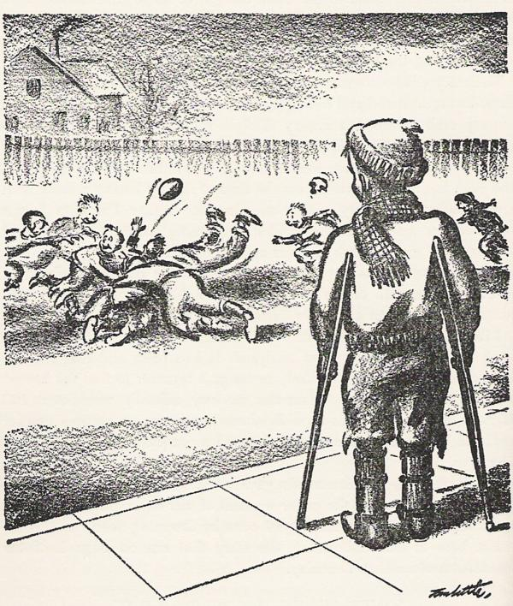
Belief that vaccine-preventable diseases no longer pose any risk
Notes:
Because of the success of vaccines, many parents and even young physicians have not seen cases of measles, chickenpox, or Haemophilus influenzae type b (Hib) infection. This has caused parents and some physicians to feel complacent about the risks. One physician, Bob Sears, published his own non evidenced-based delayed immunization schedule, The Vaccine Book: Making the Right Decisions for Your Child, which unfortunately gained acceptance with some anti-vaccine and vaccine-hesitant parent groups. Dr Sears has been soundly criticized for perpetuating this complacency that puts so many children at risk.
The recent resurgence in measles, pertussis, and Hib infections proves that vaccine refusal and delay can have deadly consequences. A record number of measles cases (156) were reported in the United States in the first half 2011. In 2008, invasive Hib disease occurred in 5 unvaccinated or under-vaccinated children in Minnesota, one of whom died. Another case of Hib meningitis was reported in Maine in 2009. In 2010, 1337 cases of pertussis were reported in California, 5 of which involved infants younger than 2 months of age who died.
Making parents aware of these statistics may be enough to convince them that their decision not to vaccinate is putting their child’s life at risk. Unfortunately, the benefits to the community are not obvious to a child or parent until a vaccine-preventable disease develops in someone within their family or social network.

Slide 10
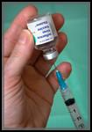
Doubt about the vaccine safety profile
What are ingredients?
What are side effects?
Who has tested them?
Notes:
It is impossible to live life risk-free: there are risks in driving your car, flying on an airplane, and yes being vaccinated. However, one can significantly increase their risk of injury by not wearing a seat belt or by not receiving a vaccine. Parents should be made aware that any vaccine can cause adverse effects and that the risk of serious vaccine-associated complications is very low
To reassure skeptical parents, pediatricians can share their own experience; whether any children in their practice have had serious adverse effects after receiving the vaccine. They can also take extra time to review the vaccine information handout and refer parents to the CDC Web site on “Possible Side-effects from Vaccines.”

Slide 11
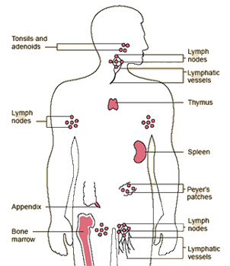
Belief that multiple vaccines overload the child’s immune system
Notes:
Parents are unaware of the fact that children are exposed to thousands of antigens every day on common surfaces, such as toys, doorknobs, and playground equipment. Patients certainly have more shots than they did years ago; however, the total number of antigens they receive is smaller than in the past (eg, smallpox vaccine had more than 200 antigens in 1 injection). Children who receive all the required vaccines are exposed to fewer than 130 antigens.

Slide 12
Vaccines over the past 100 years
Date | Vaccine | Proteins/Sugars Totals | Totals
1900 | Smallpox | ~200 | ~200
1960 | Smallpox | ~200 | ~3,217
 | Diphtheria | 1
 | Tetanus | 1
 | Whole cell Pertussis | ~3,000
 | Polio | 15
1980 | Diphtheria | 1 | ~3,041
 | Tetanus | 1
 | Whole cell Pertussis | ~3,000
 | Polio | 15
 | Measles | 10
 | Mumps | 9
 | Rubella | 5
Notes:
One hundred years ago, children received 1 vaccine (the smallpox vaccine) which contained over 3000 antigens in the vaccine to stimulate the immune system to develop immunity to smallpox. Forty years ago, children received 5 vaccines routinely (diphtheria, pertussis, tetanus, polio, and smallpox vaccines) and as many as 8 shots by 2 years of age.

Slide 13
Date | Vaccine | Proteins/Sugars Totals | Totals
2000 | Diphtheria | 1 | 133-136
 | Tetanus | 1
 | Acellular pertussis | 2-5
 | Polio | 15
 | Measles | 10
 | Mumps | 9
 | Rubella | 5
 | Hib | 2
 | Varicella | 69
 | Pneumococcus | 8
 | Hepatitis B | 1
 | Influenza | 10
Offit PA, et al. Addressing parents' concerns: Do vaccines weaken or overwhelm the infant's immune system? Pediatrics 2002;109:124-129.
Notes:
Today, children receive 11 vaccines routinely and as many as 20 shots by 2 years of age. The increased number of vaccines given to children and the increased percentage of children receiving vaccines have resulted in a dramatic decrease in the number of vaccine-preventable diseases yet the number of antigens a child receives is less than 140.
Most young parents today have never seen many of the diseases that vaccines prevent. As a possible consequence of these trends, recent national surveys found that 23% of parents questioned the number of shots recommended for their children and 25% were concerned that vaccines might weaken the immune system.

Slide 14





Belief that certain vaccines have been linked to autism
Notes:
The earlier studies that proposed a vaccine-autism link have now been retracted and debunked. Many well-designed trials have shown no causal relationship between vaccines and autism.²⁰ Because of the many vaccines required within the first 2 years of life, people want to believe that any adverse health event before age 2 years can be ascribed to vaccines. Although vaccines are given around the same time that autism becomes apparent, it does not mean that vaccines cause autism. When describing the difference between causal and temporal, I often use the analogy of the rooster who crows every morning and believes he makes the sun come up. When the rooster has laryngitis, he realizes that the sun still rises despite his inability to crow.
Classic autism is generally apparent in children by the age of 18 months. The signs of abnormal speech, poor joint attention skills, and repetitive and restrictive behaviors may predate this time. It is easy for parents who notice a loss of developmental milestones (regressive autism) in their child around the time of his or her last vaccination to surmise that the vaccine may have been the cause. Current research suggests that genetics and the environment play a collaborative role in the development of autism. Without a definitive cause of autism, vaccines will probably continue to be a target because of the timing of when they are given, even though they have been exonerated by research.

Slide 15
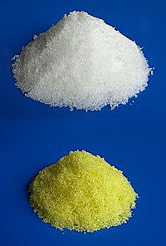
Belief that certain ingredients (thimerosal and aluminum salts) in vaccines are dangerous
Notes:
Aluminum salts may be included in some vaccines as an adjuvant to enhance the immune response. Aluminum adjuvant-containing vaccines have a demonstrated safety profile and associated local reactions are uncommon.²² The most common source of exposure to aluminum is actually in our daily exposure to food and water.
Q. I have heard that aluminum in vaccines is safe because we are exposed to it in the environment. I am not comfortable with this explanation because with vaccines the aluminum is injected. Isn’t that more dangerous?
A. Regardless of how aluminum enters the body, it is treated the same way once it gets into the bloodstream. A protein in the blood, known as transferrin, binds the aluminum and transports it to the kidneys where it is eliminated. About half of the aluminum is eliminated within 24 hours. Aluminum becomes a problem when someone’s kidneys are not functioning properly or not at all AND when large quantities of aluminum are administered, such as in antacids. The quantities of aluminum in vaccines are so minute that they do not cause a detectable change to aluminum levels in the blood.

Slide 16
Why Parents Change Their Minds
Adapted from D Opel, 2011; Gust et al, Pediatrics, 2008
Notes:
Evidence to support this observation that vaccine hesitant parents are amenable to changing their minds about vaccines came from a study done by Deb Gust at the CDC. Using a survey of a national sample of parents, she asked parents who indicated that they initially planned to delay or not get a vaccination for their child but changed their mind, why they change their mind. Almost 40% responded because of information or assurances from their child’s doctor. More than any other response, parents who changed their mind did so after talking with their child’s doctor. For vaccine hesitant parents, then, again, the child’s provider plays an influential role.
Adapted from D Opel, 2011; Gust et al, Pediatrics, 2008

Slide 17
AAA
Ask – Identify hesitant parents
Acknowledge – Questions and concerns
Advise – Answer specific questions
Notes:
It is important that clinicians take the time to listen to these concerns. Parents stated that reassurance from their health care provider was the biggest reason that they followed-through with immunizations, despite fears.
But not all parents will be satisfied with the same clinician explanations — some might just need quick reassurance, whereas others may ask for more detailed scientific information. Be sure to tailor your response to the individual.
What many parents are really looking for is emotional reassurance. They need you to acknowledge their concerns and to be empathetic, not recite a litany of facts.
This does not mean that clinicians should avoid factual information, but rather, that the information presented is easy to understand. Personal stories can also be helpful. If clinicians can share that they have vaccinated their own children or grandchildren, that can really be helpful.

Slide 18
Strategies for Communicating with Vaccine-Hesitant Parents
Do you have any cultural, religious, or personal belief regarding immunization?
Has your child or any child you know has a serious adverse event after an immunization?
Do you have any vaccine safety concerns?
What vaccine safety information can I provide?
Notes:
To determine parental concerns, ask the following questions.
As the occurrence of vaccine-preventable disease declines, the challenge of communicating the risk of not being immunized increases. Every situation is unique; parents have diverse concerns for various reasons.
Positive messages about vaccination generally rate much more convincing and believable than negative messages
• Messages that cite data, scientific studies, and figures are not resonating
• Emotional, personal messages and stories are most effective
• First and foremost, moms depend on their pediatricians for information about vaccines and trust their counsel the most
• Only two-thirds of all parents feel their pediatrician spends enough time explaining the risks and benefits of vaccinations. This percentage is even lower among vaccine-hesitant parents.
• Moms are also influenced by their spouse, media reports, websites, blogs, and friends with experience.

Slide 19
HOW TO COUNSEL THE
VACCINE-HESITANT PARENT
Initiate a dialogue about vaccines early (at the infant’s first visit) to find any underlying hesitancy or misinformation that can be corrected.
Distribute the Vaccine Information Sheets early, usually at the 1-month visit, so parents have time to consider their unspoken questions.
Solicit and welcome questions during vaccine visits and take time to listen (make eye contact), don’t patronize.
Don’t get offended and don’t offend.
Notes:
• Fact-based is very important.
• Statements, such as “very safe” or “low risk,” turn moms off unless they are backed with specific, good facts.
• Good if the information empowers women to make good decisions. They don’t want to be told what is best or made to feel guilty. Moms like information that says : “Here are the facts. But, it’s your decision.” Moms mentioned pediatricians do that – gives the facts and tells about the cases they’ve seen, but then says it’s your choice. This makes moms feel better.
• Overall, messages did not change the moms’ decisions on immunization.
• The news about pertussis outbreaks is chilling. Good to have cause and effect tangible – 2,492 whooping cough is a good example.
• A lot of the messages have phrases that “pull on the heart strings too much,” (e.g. consider children suffer when they get these diseases, we worry about your children. Moms thought this language was condescending and cheesy/not sincere. Makes it sound like doctor cares about my kids more than I do.)
• Limited awareness on the role of public health officials, and their intentions.

Slide 20
HOW TO COUNSEL THE
VACCINE-HESITANT PARENT
Acknowledge benefits and possible risks.
Use clear and simple language.
Respect the parent’s authority and develop the ability to have shared decision making.
Have your practice emphasize the reduction of stress and pain of the shots through the use of sucrose and/or swaddling.
Notes:
If we can help parents be less vaccine-hesitant and not refuse vaccines, we should be able to prevent an outbreak of vaccine-preventable diseases
Additional resource material found on the Immunize Action Coalition Website at http://www.immunize.org/catg.d/p2070.pdf

Slide 21
National Immunization Survey
Children 19-35 Months of Age by State
Notes:
Q1/2010-Q4/2010
Healthy People 2020 Immunization-related Objectives Increase the proportion of children aged 19 to 35 months who receive the recommended doses of DTaP, polio, MMR, Hib, hepatitis B, varicella and PCV vaccines.
What is the purpose of the NIS?
The NIS was established to provide an on-going, consistent data set for analyzing vaccination levels among young children in the US and disseminating this information to interested public health partners. The NIS provides national and state estimates of vaccination coverage-including new vaccines as they are licensed and recommended for use. It also helps us track progress towards Healthy People goals.
How are data for the NIS collected?
We use random-digit-dialing to find households with children aged 19 to 35 months. We ask parents or guardians to tell us the vaccines-with dates-that appear on the child's "shot card" kept in the home, and we also collect demographic and socioeconomic information. At the end of the interview, we ask for permission to contact the child's vaccination providers. Providers are then contacted by mail to verify each child's vaccinations.
What are the strengths of NIS?
The NIS uses a nationally representative sample, and provides estimates of coverage that are weighted to represent the entire population, nationally, and by region, state, and selected large metro areas. The large sample size allows us to stratify (that is, subdivide) the data so that we can examine vaccination rates among different groups, for instance, by income level, race, education level of mothers, and other factors.
National Immunization Survey NIS data from Q1/2010-Q4/2010

Slide 22
Georgia Immunization Study (2010-2011)
Reasons for Incomplete Immunizations by 24 months
Notes:
The Georgia Immunization Study is a retrospective cohort research design to ascertain the up-to-date immunization rate for two-year old children born in Georgia. Immunization history data for 18 health district cohorts of children who turned two in January 2011 were analyzed to calculate these rates. We look at completion of the 4:3:1:3:3:1:4 series (4 DTaP, 3 Polio, 1 MMR, 3 Hib, 3 Hepatitis B, 1 Varicella and 4 PCV) based on the childhood immunization schedule and catch up schedules by the ACIP. The target population of the 2011 GIS included all 24 month old children born in the state of Georgia in 2009. A sample size of 2,973 children born in the month of January 2009 was selected for study.
As you can see, for the state overall there was an increase in hesitancy-related reasons for incomplete immunizations, particularly for children who were incomplete because their parent(s) have decided to refuse 1 or more vaccines (9.0% in 2010 to 17.4% in 2011). There has also been an increase in instances where the physicians decide to delay immunizations (7.9% in 2010 to 12.7% in 2011).
*”Other” category includes the following reasons: Medical Exemption, Temporary Vaccine Shortage, Missed Appointments/Convenience Issue, and Other

Slide 23
Georgia Immunization Study (2011)
Reasons for Incomplete Immunizations by 24 months by WIC Enrollment, 2011
Notes:
Among WIC-enrolled children, there was a greater percentage of children incomplete on their immunizations due to parents choosing a delayed schedule and less because of parents refusing 1 or more vaccines (35% vs. 10%).
Among non WIC-enrolled children, there was almost an equal percentage of children incomplete on their immunizations due to parents choosing a delayed schedule and parents refusing 1 or more vaccines (22% vs. 21%).
Also of note is that “Physician choosing a delayed schedule” occurred more often for WIC-enrolled children than non WIC-enrolled children (20% vs. 9%).
*”Other” category includes the following reasons: Medical Exemption, Temporary Vaccine Shortage, Missed Appointments/Convenience Issue, and Other

Slide 24
Georgia Immunization Study (2010-2011)
Reasons for Incomplete Immunizations by 24 months for children of Hispanic mothers, 2010-2011
Notes:
2010-2011: Children born to Hispanic mothers were significantly more often up to date than children of other groups; in other words, there were not very many Hispanic children to use in the “incomplete” category.
*”Other” category includes the following reasons: Medical Exemption, Temporary Vaccine Shortage, Missed Appointments/Convenience Issue, and Other

Slide 25
Georgia Immunization Study (2010-2011)
Reasons for Incomplete Immunizations by 24 months for children of African American mothers, 2010-2011
Notes:
2010-2011, two-year old children of African American mothers: This graph shows an increase in parents refusing 1 or more vaccines for their child and also an increase in parents choosing a delayed schedule. Overall, the hesitancy-related reasons for incomplete immunizations increased between 2010 and 2011.
*”Other” category includes the following reasons: Medical Exemption, Temporary Vaccine Shortage, Missed Appointments/Convenience Issue, and Other

Slide 26
Georgia Immunization Study (2010-2011)
Reasons for Incomplete Immunizations by 24 months for children of white, non-Hispanic mothers, 2010-2011
Notes:
2010-2011, two-year old children of white, non-Hispanic mothers: This graph shows a slight increase in parents refusing 1 or more vaccines for their child, instead of choosing to use a delayed schedule. Overall, the hesitancy-related reasons for incomplete immunizations remained fairly stable between 2010 and 2011.
*”Other” category includes the following reasons: Medical Exemption, Temporary Vaccine Shortage, Missed Appointments/Convenience Issue, and Other

Slide 27
Georgia Immunization Study (2010)
Reasons for Incomplete Immunizations by 24 months, race-ethnicity differences, 2010
Notes:
2010 Data:
This graph shows that among children who are not UTD on their 2nd birthday immunizations, children of white, non-Hispanic mothers are more often incomplete due to hesitancy-related reasons, approximately 48% vs approximately 20% for children of African American mothers. (This statement excludes the children of Hispanic mothers, as there were only 18 incomplete children from the Hispanic category.)
*”Other” category includes the following reasons: Medical Exemption, Temporary Vaccine Shortage, Missed Appointments/Convenience Issue, and Other

Slide 28
Georgia Immunization Study (2011)
Reasons for Incomplete Immunizations by 24 months, race-ethnicity differences, 2011
Notes:
2011 Data:
This graph shows that among children who are not UTD on their 2nd birthday immunizations, children of white, non-Hispanic mothers are more often incomplete due to hesitancy-related reasons, approximately 49% vs approximately 36% for children of African American mothers. (This statement excludes the children of Hispanic mothers, as there were only 6 incomplete children from the Hispanic category.) However, it should be noted that the percentage of incomplete immunizations due to hesitancy-related reasons has risen among children of African American mothers, since 2010.
*”Other” category includes the following reasons: Medical Exemption, Temporary Vaccine Shortage, Missed Appointments/Convenience Issue, and Other

Slide 29
Immunization Rate History
National Immunization Survey and Georgia Immunization Study,
2000-2011
*2009 data was not collected due to personnel vacancy
Notes:
This graph data is from the 2 year old study done annually in Georgia. During 2001 and the first half of 2002, the United States experienced severe shortages of five of the eight universally recommended vaccines for children. DTAP and pneumococcal conjugate vaccine (PCV7), shortages impacted state immunization programs.
The solid blue line shows the 4:3:1:3:3:1:4 coverage by the 2nd birthday, according to the Georgia Immunization Study (2 year old study). The dotted blue line is also GA Study data, showing how many children were UTD by the end of the data collection period (increase due to parent and provider contact by the data collectors)
Since the shortage was announced in December 2007 and the first two-to three doses of Hib are typically administered to infants less than seven months, the effects of the vaccine shortage, if any, are likely to be seen in this cohort of children.
2008 -2009 Hib shortages. Survey data collected on a 3 dose series, so client may have been complete for series but survey requiring a 3 doses and when this information was not filled in it appears child does not have complete series.
Hib supply put on allocation based on supply and demand. Allocation based on population estimates. Haemophilus influenza Type-B (Hib) shortage,

Slide 30
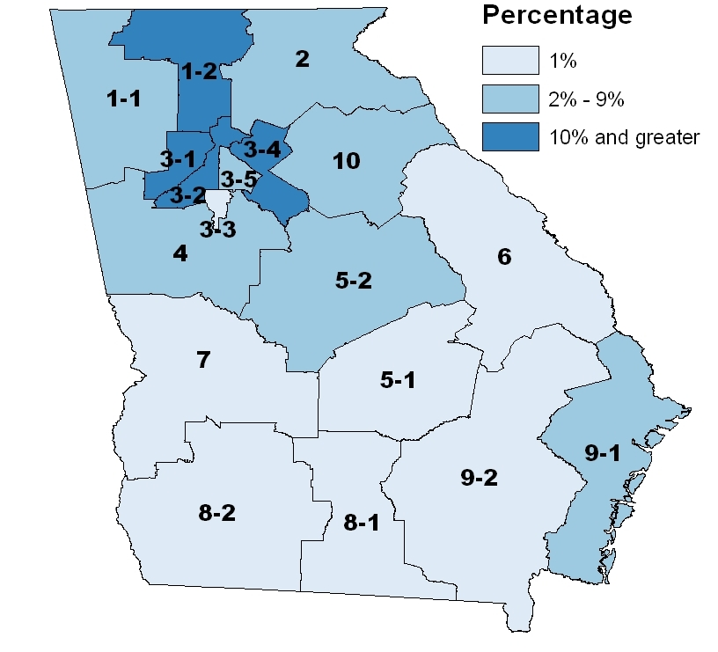
Religious Exemptions by District, 2010
Notes:
SCAD (School and child care assessment data) from 2010.
Most of our religious exemptions in the metro Atlanta area and North Georgia Dalton district.

Slide 31
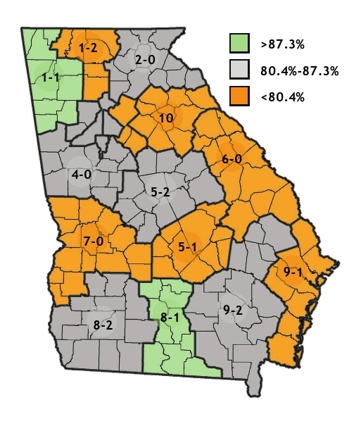
Georgia Immunization Study (2011)
Immunization Rates by Health District, 2011
Notes:
This data is from the 2010 2 year study for immunization rates for 4:3:1:3:3:1:4 by 2 years old.
This is a different data source but there is a correlation in the districts with the highest religious exemptions from last graph they have lower immunization rates with the exception of Cobb Douglas District 3-1

Slide 32
Vaccine Adverse Event Reporting System
The Vaccine Adverse Event Reporting System (VAERS) is a national vaccine safety surveillance program co-sponsored by the Centers for Disease Control and Prevention and the Food and Drug Administration.
What Can Be Reported to VAERS?
Who Reports to VAERS?
Does VAERS Provide General Vaccine Information?
http://vaers.hhs.gov/ or 1-800-822-7967
Notes:
VAERS provides a nationwide mechanism by which adverse events following immunization may be reported, analyzed, and made available to the public.
The primary objectives of VAERS are to:
Detect new, unusual, or rare vaccine adverse events;
Monitor increases in known adverse events;
Identify potential patient risk factors for particular types of adverse events;
Identify vaccine lots with increased numbers or types of reported adverse events; and
Assess the safety of newly licensed vaccines.
What Can Be Reported to VAERS?
VAERS encourages the reporting of any clinically significant adverse event that occurs after the administration of any vaccine licensed in the United States.
Who Reports to VAERS?
Anyone can file a VAERS report, including parents, health care providers, manufacturers, and vaccine recipients.
Does VAERS Provide General Vaccine Information?
No. VAERS only collects and analyzes adverse event reports. In another example, VAERS determined that there may be a potential for a small increase in risk for Guillain-Barre syndrome after the meningococcal conjugate vaccine, Menactra. As a result of this finding, a history of Guillain-Barre syndrome became a contraindication to the vaccine and further controlled studies are currently underway to research this issue.
The VAERS website for reporting is: http:vaers.hhs.gov/ or you can call to report at 1-800-822-7967

Slide 33
National Vaccine Injury Compensation Program (VICP)
National Vaccine Injury Compensation Program
provides compensation to individuals found to be injured by or have died from certain childhood vaccines.
  Established in 1988 by NCVIA
  Federal “no fault” system to compensate those injured
  Claim must be filed by individual, parent or guardian
  Must show that injury is on “Vaccine Injury Table”
Notes:
On October 1, 1988, the National Childhood Vaccine Injury Act of 1986 created the National Vaccine Injury Compensation Program (VICP). The VICP was established to ensure an adequate supply of vaccines, stabilize vaccine costs, and establish and maintain an accessible and efficient forum for individuals found to be injured by certain vaccines. The VICP is a no-fault alternative to the traditional public legal system for resolving vaccine injury claims that provides compensation to people found to be injured by certain vaccines.
The National Childhood Vaccine Injury Act (NCVIA) set forth 3 basic requirements for all vaccination providers, which are:
Providers must give the patient (or parent/legal representative of a minor) a copy of the relevant federal "Vaccine Information Statement" (VIS) for the vaccine they are about to receive.
Providers must record certain information about the vaccine(s) administered in the patient's medical record or a permanent office log.
Providers must document any adverse event following the vaccination that the patient experiences and that becomes known to the provider, whether or not it is felt to be caused by the vaccine, and submit the report to the Vaccine Adverse Event Reporting System (VAERS).

Slide 34


Resources
Local health department
District Immunization Coordinator
GA Immunization Program Office
  On call Help line: 404-657-3158
  GRITS Help Line:1-866-483-2958
  VFC Help Line:1-800-848-3868
  Website http://health.state.ga.us/programs/immunization
  Your local Immunization Program Consultant (IPC)
GA Chapter of the AAP
GA Academy of Family Physicians
Notes:
If you need further information about the changes, or to ask questions later, these are some resources you can to go to help you with that.
Local health department
District Immunization Coordinator
GA Immunization Program Office
404-657-3158
Website http://health.state.ga.us/programs/immunization
GA Chapter of the AAP
GAFP

Slide 35
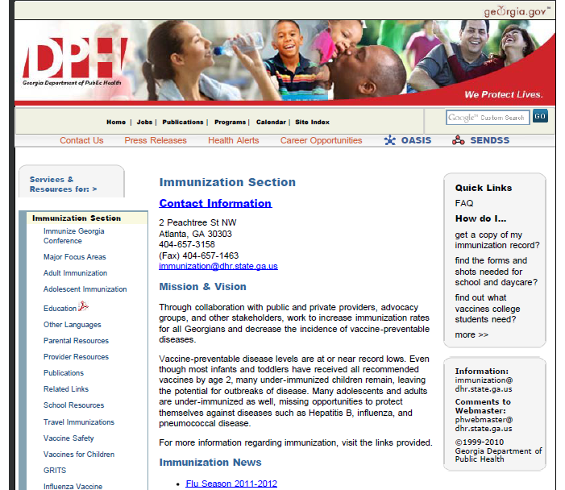
http://health.state.ga.us/programs/immunization
Notes:
The Immunization Office webpage contains various helpful information. The webpage address is at the top of the slide.

