Slide 1
Unique Food for Thought
Varada Divgi MD The Mind Gardener

Slide 2
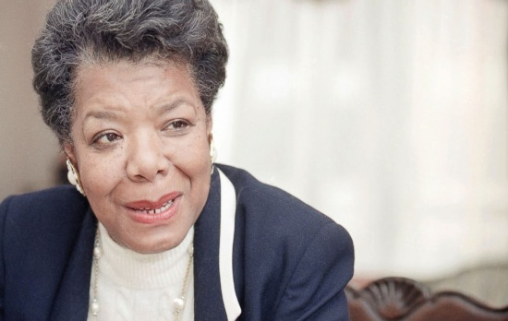
on PREVENTION
“Encouragement to all women is -
let us try to offer help before we have
to offer therapy. That is to say, let's
see if we can't prevent being ill by
trying to offer a love of prevention
before illness.”

Slide 3
My “Inner Child” Saddens when I encounter Two Things:
Childhood Obesity
Mental Health Disorders particularly in Children

Slide 4
Obesity Facts
2-19 year olds: 17% (or 12.7 million)
2 to 5 years olds: 13.9% (2003-2004) to
8.4% (2011-2012).
6- to 11-year-olds: 17.7% of and
12- to 19-year-olds: 20.5%
CDC - Prevalence Data 2011-2012 Division of Nutrition, Physical Activity, and Obesity,

Slide 5

1 in 5 American children have mental disorder
CDC Report
May 8, 2015

Slide 6
So I ASK Myself & INVITE You to ASK
WHAT CAN I DO? Get Aware
Find the ROOT CAUSE
Think of the ways to INTERVENE
With What I HAVE – Time /Talent/treasure
WHEREVER I am – Home / Work / Community
Whose HELP Do I NEED Besides GOD? Power Partners / Key Team Players / MasterMind

Slide 7
Root Cause
Unawareness of
our inner unlimited potential
as we are programmed to
live from outside in rather than
INSIDE OUT!

Slide 8

Who is Minding the Store?
Why Are We Not At Peace?
What are we FEEDING our MIND?
What about the BODY & MIND CONNECTION?

Slide 9

Meditation has been in the Eastern Hemisphere for thousands of years; now it is enticing the Western World!

Slide 10
MIND and BODY Connection
Now is the Golden Era of Research – Reinvention of the facts by the Western World!
Mindfulness Based Stress Reduction Program (MBSR)
Mindfulness Meditation Retreats are now in style!

Slide 11
What about the MIND?
always active, 365 days a year, 24 hours a day, 60 minutes an hour and 60 seconds a minute, without
resting for even a flash of second, since our birth!
How does it look?

Slide 12
STICK PERSON CONCEPT – You
The Stick Person Concept
Five Senses Five Senses +
Environmental Factors
As An ADULT As An INFANT
CONSCIOUS MIND
SUBCONSCIOUS MIND
SUBCONSCIOUS MIND
BODY
BODY
Formation of PARADIGMS our DEFAULT SETTING

Slide 13
Our MIND Only the Questions Arise!
What do we know?
Where is it?
How does it work?
What does it need?
What can help or hurt?
What can we do?

Slide 14
Mental Muscles
1. Will 2. Reasoning
3. Memory 4. Imagination
5. Perception 6. Intuition

Slide 15
What Can We Feed Our Mind?
Unique Diet for
Adults
Children

Slide 16
FOOD TRIANGLE for MIND
NO LIMITS on the SERVINGS, More the BETTER
HOPE
TRUST
VALUES
CREATIVE PLAY
SAFETY & STRUCTURE
UNCONDITIONAL LOVE
in the ENVIRONMENT

Slide 17
Unique Diet Suggestions for ADULTS
Start our day with POSITVE THOUGHT for the day and see how we can use it during our day.
NOTICE what we are noticing and develop our awareness about what we say, feel, think and do or avoid doing.
Develop a habit of PRIORITISING our actions for the day.
ELIMINATE NEGATIVE words from our vocabulary as we eliminate or curb the intake of salt or sugar.
LIVE in the PRESENT MOMENT – NOW! Children only know that. Focus on how we can enjoy that moment fully. Not let past or future interfere.

Slide 18
Unique Diet Suggestions for ADULTS
When facing any challenge, focus our attention and efforts in problem solving it rather than worrying about it.
Meditate or take a “QUIET BREAK” for 20-30 minutes a day. Deep breathing on the break
Develop a HOBBY and give it all we have.
Enjoy at least 7-8 hours of good sleep, healthy diet, plenty of water and regular exercise.

Slide 19
Unique Diet Suggestions for Young Children
Meet their BASIC NEEDS of timely meals, enough water, regular sleep and cleanliness.
Have a regular enjoyable family time together besides the mealtime.
Create a SAFE PLACE for them where they can do what they need to express themselves without any judgment, creating guilt or shame.
Notice their strengths and vulnerabilities, likes and dislikes and encourage them.
GUIDE them to enjoy the Nature and develop the power of observation.

Slide 20
Unique Diet Suggestions for Young Children
ENCOURAGE activities like music, dancing, reading, drawing, listening, swimming, etc
AVOID NEGATIVE media bombardment that goes on all day!
READ POSITIVE STORIES and also ones with vivid imaginations.
Have CLEAR BOUNDARIES about good/bad, help /hurt, play / fight, acceptable /unacceptable ….
Have a clear BEDTIME ROUTINE so that they can fall asleep happy and wake up happy.
ENCOURAGE them to explore their ideas, dreams, hobbies.

Slide 21
“FILL THAT CUP” PROGRAM
Positive Nurturing Raises Extraordinary Children!
Includes Six Sessions –
1. Overview of “FILL THAT CUP”
2. Clarify “THAT”
3. Explore the “CUP”
4. Glimpse of Child’s Developmental Milestones
5. Dissect “FILL” – Why, How and with WHAT
6. CELEBRATE and Enjoy Our Discovery, Our Journey of Awareness.

Slide 23
Just One Request!
Enjoy Every Opportunity to
Enjoy Your Children by Being
100% Present to them,
Every time, Anytime!
Go Have FUN!

Slide 24

Varada Divgi MD
The Mind Gardener
Contact
Email – Varadad.seekbeyond@gmail.com
Tel # 01 404 304 2168

