Slide 1
Georgia Vaccines for Children Program
Equipment Requirements for Vaccine Storage
Revised 03/04/2013

Slide 2
Storage Requirements
Be large enough to hold the year's largest inventory
Have enough room to store water bottles and coolant packs
Have a calibrated thermometer inside each storage unit
Reliably maintain the appropriate vaccine storage temperatures year-round
Dedicated to the storage of vaccines. Food and beverages should NOT be stored in a vaccine storage unit
Notes:
The refrigerator and freezer units must:
Have enough room to store the year’s largest inventory without crowding;
Have enough room to store water bottles (in the refrigerator) and frozen coolant packs (in the freezer) to stabilize the temperatures and minimize temperature excursions that can impact vaccine potency. The addition of water bottles in the refrigerator (not coolant packs) reduces the risk of freezing due to the tremendous latent heat released from water prior to freezing;
Have a calibrated thermometer inside each storage unit; Reliably maintain the appropriate vaccine storage temperatures year-round;
Be dedicated to the storage of vaccines. Food and beverages should NOT be stored in a vaccine storage unit because this practice results in frequent opening of the door and destabilization of the temperature.

Slide 3
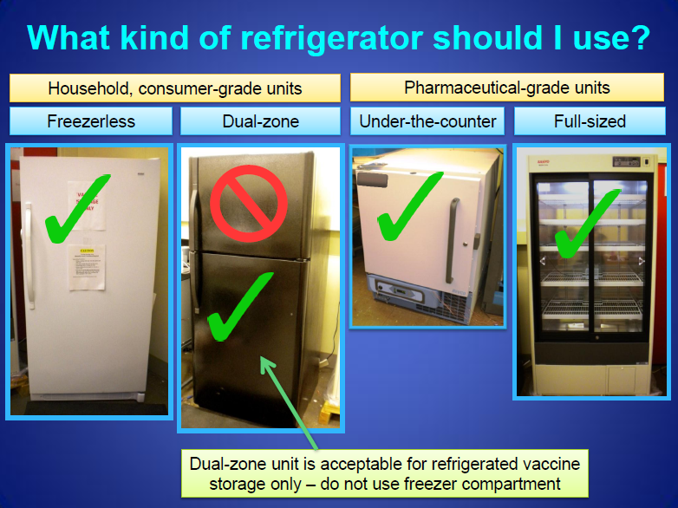
Notes:
While CDC does not recommend specific brands of vaccine storage units, CDC does provide guidance on types of storage units that offer greater assurance of proper temperatures for vaccine storage based on equipment testing by the National Institute of Standards and Technology (NIST).
Purchasing new vaccine storage equipment may require planning and existing equipment may need to be used for a certain amount of time until new equipment can be purchased. In this situation, CDC recommends using a combination refrigerator/freezer unit for refrigerated vaccine only. A separate stand-alone freezer should be used to store frozen vaccines.

Slide 4
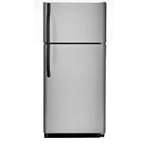
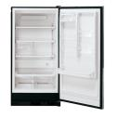

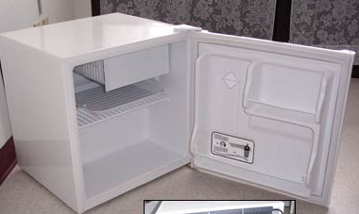
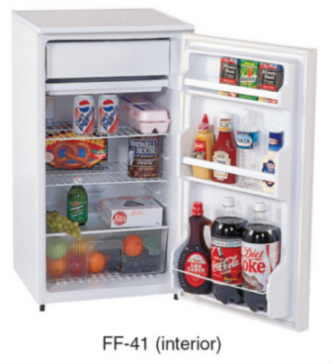
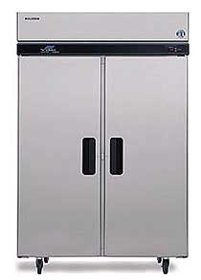
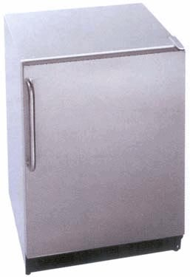

Equipment Requirements for Vaccine Storage
Refrigerator and freezer must have externally separate, sealed doors.
Refrigerator compartment must maintain temperatures between 35º and 46ºF (2º and 8ºC).
Freezer compartment must maintain temperatures 5ºF (-15ºC) or colder.
Household-style units should have separate thermostat/temperature controls for the refrigerator and freezer.
Both the refrigerator and freezer compartments must contain an NIST- or ASTM-certified thermometer.
Acceptable:
NOT Acceptable:
Stand-alone refrigerator (no freezer compartment)
Upright freezer (no refrigerator compartment)
Dorm-style
Household-style used only for refrigerated vaccines
Units with a freezer compartment housed inside of one external door
Commercial-style
Under counter refrigerator-only
Under counter freezer-only

Slide 5
CERTIFIED THERMOMETER GUIDELINES
  Providers enrolled in the VFC Program are required to purchase calibrated thermometers for all refrigerator and freezer compartments used for VFC vaccine storage in order to monitor temperatures .
  Each device is to be covered by a valid Certificate of Traceability and Calibration. The traceability declaration is to confirm that the measurement standards and instruments used during calibration of the product are traceable to an accredited testing laboratory. Providers must be able to present valid certificates to program staff upon request.
  Thermometer calibration must be tested annually or according to manufacturer recommendations. (If calibration testing indicates that your thermometer is no longer accurate within, +/-1°F (+/-.5°C) then your thermometer should be replaced.)
  CDC recommends use of a digital thermometer with a biosafe glycol-encase probe that will measure liquid temperature.
  CDC recommends continuous recording thermometers able to provide continuous data monitoring information in an active display and be placed on the outside of the unit door to allow for reading temperatures without opening the unit door.

Slide 6
CERTIFIED THERMOMETER GUIDELINES
  The digital data logger should also include the following:
    Alarm for out of range temperatures;
    Current temperature, as well as minimum and maximum temperatures;
    Reset button
    Low battery indicator
    Accuracy of +/- 1°F (0.5°C)
    Memory storage of at least 4000 readings, device will not rewrite over old data and stops recording when memory is full
    User programmable logging interval (or reading rate)
  Additional information regarding thermometers is available in the Vaccine Storage and Handling Toolkit located at http://www.cdc.gov/vaccines/recs/storage/toolkit/storage-handling-toolkit.pdf

Slide 7
Thermometers “NOT” Recommended
Fluid filled biosafe liquid thermometers
Bi-metal stem thermometers
Food thermometers and household mercury thermometers
Chart recorders
Infrared thermometers
Thermometers not calibrated
Notes:
These thermometers can have significant limitations in vaccine temperature monitoring. They can be difficult to read and only indicate the temperature at the precise time they are read. Therefore, temperature fluctuations outside the recommended range may not be detected.
Chart recorders are more difficult to read than digital thermometers because they require interpretation of the temperature graph. In addition, the chart paper must be changed when it is filled and there is insufficient room to record readings. Failure to change the chart paper will result in unusable temperature data. If a facility does not have access to a computer, however this paper based logger may be the only other choice for continuous temperature monitoring.
A NIST review of IR thermometers demonstrated that these devices are not reliable or accurate for assessment of vaccine storage temperatures.
Generally, thermometers obtained in hardware and appliance stores are not calibrated instruments and are designed to monitor temperatures for domestic food storage. These thermometers are not accurate enough and can pose a significant risk to losing expensive vaccine.

Slide 8
CERTIFIED THERMOMTER CERTIFICATE REQUIREMENTS
CERTIFICATES MUST INCLUDE:
A title, such as "test report," "calibration certificate," or "calibration report"
Name/address of the laboratory where the tests/calibrations were carried out
A unique identification number on the report (and way for you to match this back to the thermometer)
Identification of method used & indication that the measurement standards/instruments used during the calibration are traceable to an ISO/IEC 17025 accredited testing laboratory, to NIST, or to another internationally recognized standards agency.
Test results and date of the calibration
Date the results are valid until (i.e., expiration date)
Identification (signature/name/title) of person(s) authorizing the calibration certificate

Slide 9
EXAMPLES OF CERTIFIED THERMOMETERS
Products and vendors are referenced for informational purposes only;
listing in this document does not imply endorsement.
CDC recommends using only certified calibrated thermometers for measuring vaccine storage unit temperatures. All thermometers are calibrated during manufacturing, meaning that they are given a temperature scale. Certified calibrated thermometers undergo a second individual calibration against a reference standard from an appropriate agency. Thermometers and temperature monitoring equipment should be calibrated and come with an individually numbered traceable certificate that indicates that the product's calibration is traceable to standards provided by the National Institute of Standards and Technology (NIST) (a U.S. Government agency within the Commerce Department) or a laboratory recognized by NIST. This document is different from the manufacturer's warranty. Traceability requires the establishment of an unbroken chain of comparisons to stated references. NIST assures the traceability of results of measurements or values of standards that NIST itself provides, either directly or through an official NIST program or through collaboration. Keep in mind that calibration can be traceable to NIST using American Society for Testing and Materials (ASTM) methods for the calibration process.
When purchasing thermometers, consider the cost of recalibration as well as purchase price. For some less expensive thermometers, periodic replacement may be more cost-effective than recalibration. Again, verification or calibration of thermometers shall be by an approved NIST procedure or ASTM procedure.
Below are links to NIST traceable thermometers. This is by no means an exhaustive list, and you may find other sources. Scientific and laboratory supply houses are generally good sources for certified thermometers. Thermometers obtained through appliance suppliers are less likely to be certified.
"Bottle" thermometers
http://www.alphamultiservicesinc.com/page/444217592
http://www.streck.com/product.aspx?p=Temp-Chex
“Min/max” (digital)
http://www.streck.com/product.aspx?p=Temp-Chex%20Digital
http://www.fishersci.com/ecomm/servlet/fsproductdetail?aid=203749&&storeId=10652
http://www.control3.com/4048p.htm

