Slide 1
West Central Health District-7 Prevention Program
Emilio Rodriguez B.S. M.S.
Communicable Disease Specialist II

Slide 2
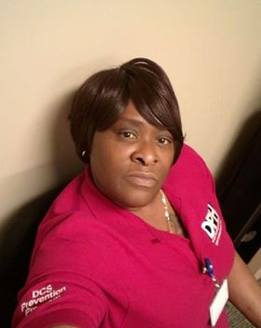
Who We Are
We are a multi-disciplinary team put together to provide optimum education, care, testing, and linkage services to the people of the West Central Health District.
Antonio Lawrence
Stephen Chambers
Andrea Vaughn
STD Program Manager / HIV Prevention Manager
Laboratory Specialist
HIV Prevention Coordinator
Kathy Alford
Jessica Yates
Eboni Holder
Communicable Disease Specialist II
Communicable Disease Specialist II
Linkage Specialist
Emilio Rodriguez
Jennifer Richardson
Angelica Lewis
Communicable Disease Specialist II
Laboratory Specialist
Linkage Specialist

Slide 3
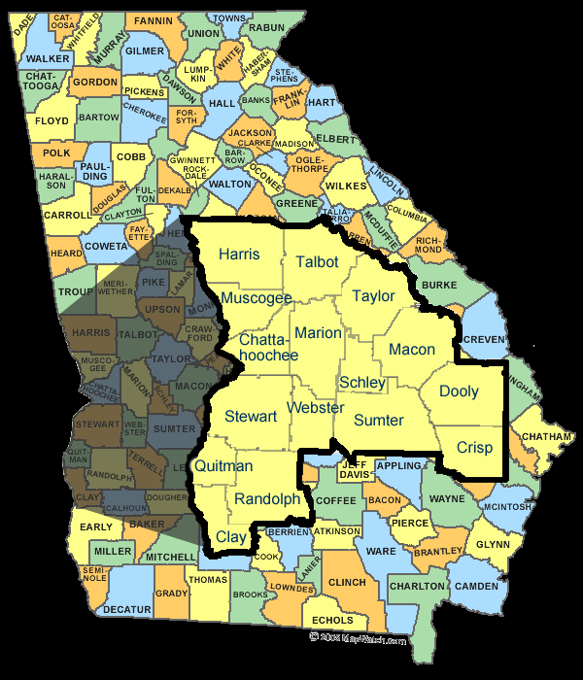
The West Central HD consists of 16 Counties.
Western counties bordering state line of Alabama also see patients from Alabama

Slide 4
Counties In West Central Health District
Chattahoochee
Clay
Crisp
Randolph
Schley
Stewart
Dooly
Harris
Macon
Sumter
Talbot
Taylor
Marion
Muscogee
Quitman
Webster

Slide 5
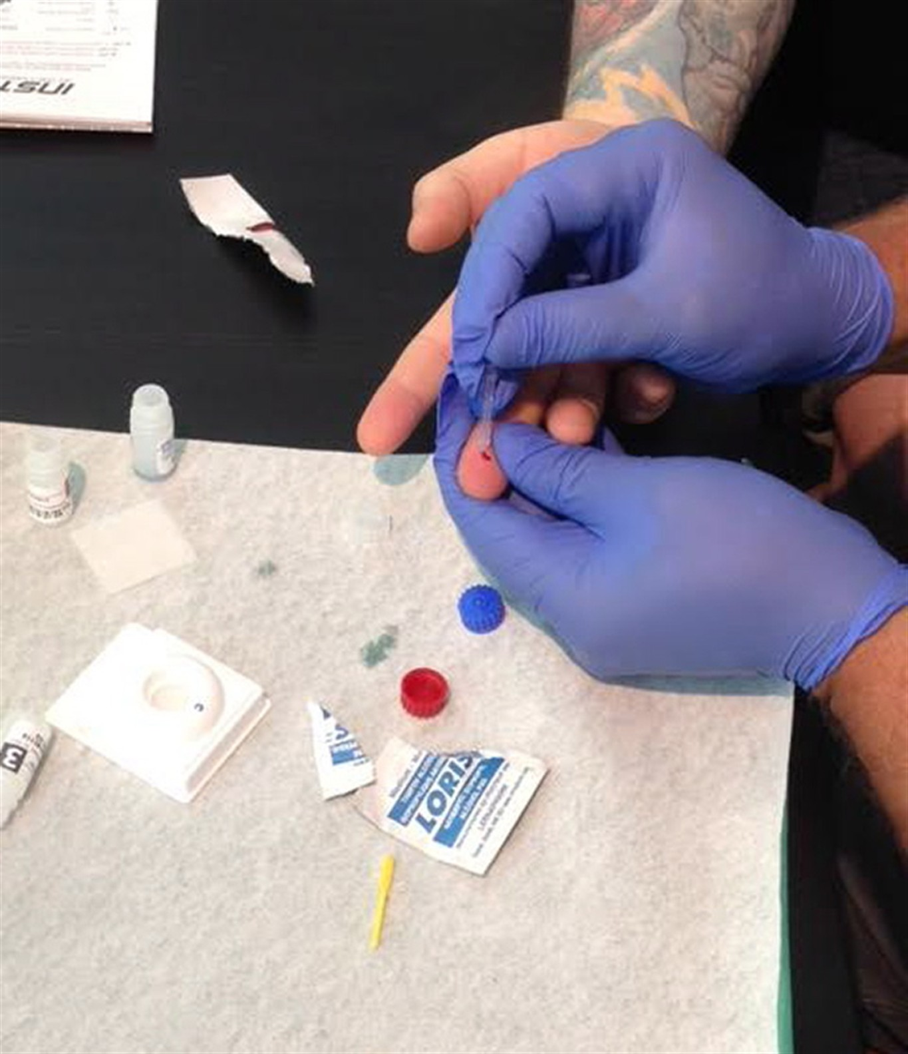
Our Services
The services we offer are designed to reach the maximum amount of people in our community and provide peace of mind; and increase quality of life.
Testing
Linkage
PreP Referrals
We offer free HIV and Syphilis Testing in all 16 Counties
Service to facilitate Newly Dx Patients or PLWH/A access to necessary level of care
Prevention being an integral part of our mission, Access to PreP provides one more measure of prevention for the community

Slide 6
Community Engagement before COVID-19
In 2019 the DCS Prevention Staff participated in approximately 15 Health Fairs within the West Central Health District.
Health Fairs
Outreach
At least 1 Health Fair per county in 2019
Offered HIV testing and Linkage Referrals as needed
Collaborative effort between WCHD:
Local Churches
Colleges/Universities
Local Businesses
Pride Festival
Tri-City Latino Festival
Priority:
Target Groups
Continuing to establish positive footprint in Communities
Educating Public on services:
Local Providers
CBO’s
NPO’s

Slide 7
2019 Numbers for the Prevention Team
Total Tested, Positive Tests, and Linkage.
2,122
22
Total Tested
Total Positives
Total Linked
22
Positivity Rate: 1.0%
Linked to Care: 100%
Our Goal:
1,154

Slide 8
By the Numbers
Breakdown by Demographic (Target Groups)
Testing WCHD Health Departments
Total Tested: 1,789
Total Positive: 3 / Positivity Rate: 0.2%
Linked to Care: 3
Total Tested by Prevention Team and HD’s
- 3,911
- 25 New Dx
- 24 Linked to Care
- AA MSM Goal 125: 184 with 14 New Dx
- Hispanic MSM Goal 38: 22 with 1 New Dx
- Caucasian MSM Goal 57: 65 with 1 New Dx
- IVDU Goal 38: 17 with 1 New Dx
- MSM IVDU Goal 19: 4 with 0 New Dx
- AA Hetero Women Goal 600: 1017 with 1 New Dx
- AA Hetero Men Goal 153: 523 with 2 New Dx
- Hispanic Hetero Women Goal 57: 41 with 0 New Dx
- Hispanic Hetero Men Goal 38: 26 with 0 New Dx
- Trans/Gender Non-Spec Goal 29: 10 with 2 new Dx
- Other (Not to exceed 20% of total: 214

Slide 9
COVID-19 Response

Slide 10
Adapting to Pandemic
Prevention Services
Communicable Disease Specialists
All 16 County Health Departments in WCHD remained open and fully operational
Continued to offer testing, counseling, and linkage services
Continued Disease investigations, testing, and partner services.
Assisted Epidemiology team with Contact Tracing efforts for COVID-19

Slide 11
Upcoming Relocation
Currently, The WCHD Clinic, RWC and other offices of the Columbus HD will be relocating to a new building located on Veteran’s Parkway.
DCS will begin moving on 15June2020
During move, Services will still be available and continue by appt only.

Slide 12
New Contact Information for Columbus Health Department (Physical Address) 5601 Veterans Parkway Columbus, GA 31904 (Mailing Address) PO BOX 2299 Columbus, GA 31902-2299

Slide 13
Final Thoughts

Slide 14
Questions?

Slide 15
Emilio Rodriguez
706-530-4347
Emilio.Rodriguez@dph.ga.gov
www.dph.georgia.gov

