Slide 1
Strong4Life WIC Champions Mid-program Update
Adapted from Presentation at WIC Champions Meeting
Presentation to: Nutrition Service Directors
Presented by: Barbara Stahnke
Date: July 7-8, 2015

Slide 2
Notes:
We want to thank our DPH partners – GA Shape and WIC – for sharing our goal to prevent childhood obesity in our state. This is definitely an issue that requires all hands on deck – it will take all of us working together to tackle childhood obesity.

Slide 3
Georgia WIC Strong 4 Life Training: Improving the Effectiveness of Childhood Obesity Counseling and Goal Setting
SHAPE Funded Collaboration with CHOA Strong 4 Life
Same messaging and skills development as participating medical providers adapted for WIC use
Tools are similar with the same overall messaging
Posters
Handouts
Goal setting & assessment tools

Slide 4
Champion Program
Questions
Input
Support
Resources
Nutritionists
WIC Champion
Strong4Life
Information Sharing
Notes:
You are part of this training today because you are playing a role in the WIC Champion process.
Champions will play a key role in this program – serving as the point person in their district for client-centered counseling and goal setting information for fellow WIC nutritionists.
You will be a vital link between the entire WIC team and the Strong4Life Program team at Children’s Healthcare of Atlanta.
We want to emphasize, for Champions, this is an opportunity for long term skill development in coaching and counseling your colleagues toward improving their skills in client centered counseling and goal setting.
As we move through this process, your fellow WIC staff members will likely come to you with questions, some of which you can answer, and some of which you may need a little help with. This is where Children’s and our Strong4Life team of dietitians come in!
We want to know about your successes and challenges. Just as you will serve as a source of support for WIC staff – we are here to be a source of support for you. We are all in this together.

Slide 5
WIC Champion Responsibilities

Slide 6
WIC Champion Responsibilities
Observations: One per month
Calls with mentor: Every other month
Lead discussion at District meetings related to client centered counseling techniques and tools
August State Conference

Slide 7
Guide to Client-Centered Counseling
Ask, don’t tell
Ask for permission to share
Listen more than you talk
Place responsibility for change with the client
Don’t force change
Notes:
Client centered communication is centered around the client, child/family and working towards their goals and objectives, which may or may not be the same as ours. As part of this process, providers exchange information with families, not just tell information to families. We are part of a team. Providers and families collaborate a game plan together that helps the client help themselves, rather than the sole responsibility falling on your shoulders. We have to remain nonjudgmental, focusing on achieving goals (as small as they may be), and discuss setting behavior goals (not weight goals).
You may also hear this referred to as patient centered counseling or motivational interviewing

Slide 8
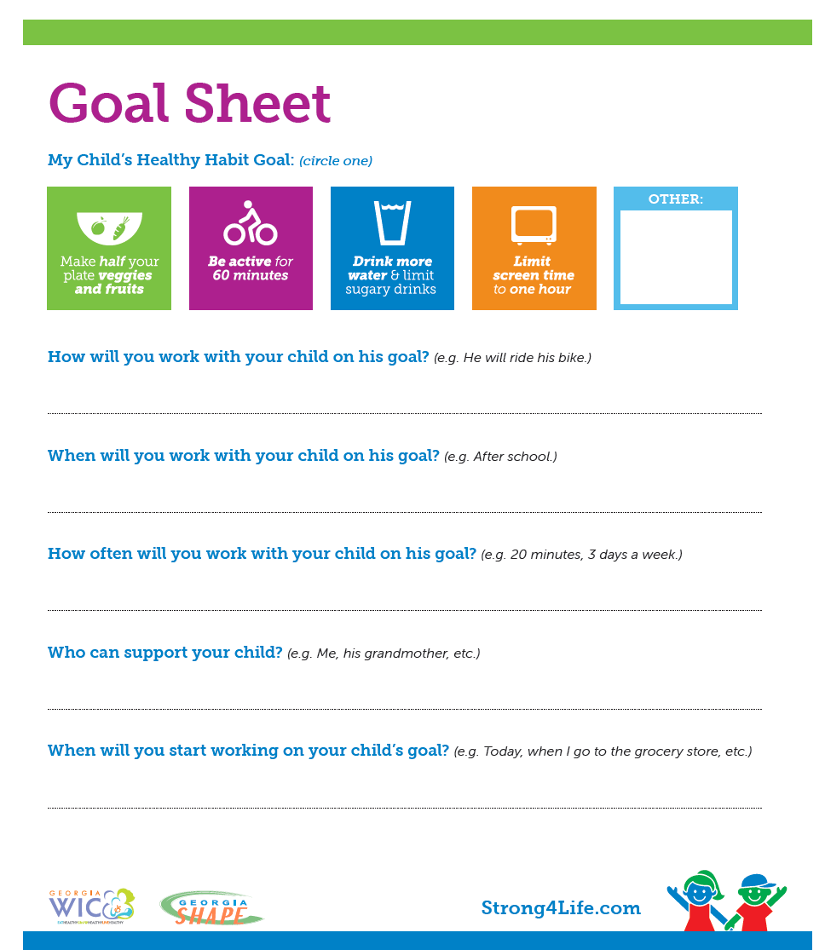
Specific
Measurable
Attainable
Realistic
Timely
I will serve 1% milk instead of juice.
At dinner time
4 days a week
Me, Dad, Grandmother
Today
Notes:
The goal sheet provides a template that can help you agree on and document a SMART goal.
Since you’ve done the assessment you have an idea of what the client/family should be working on; however avoid the temptation to lead the goal setting. Let the client lead the goal setting, meet them where they are.
To set client/families up for success goals should be as clear as possible. Thus make sure goals are Specific, Measurable, Attainable, Realistic and Timed

Slide 9
Champions Program Results

Slide 10
How Are Nutritionists Doing? (n=111)
Goal Setting
Specific | 77%
Measurable | 79%
Attainable | 82%
Realistic | 81%
Time-bound | 70%
MI Techniques
Active Listening | 86%
Reflective Listening | 69%
Praised Positive Behavior | 94%
Assessed Motivation to change | 71%
Asked permission | 40%
Placed responsibility for change with the client | 56%
Notes:
So far we have collected a lot of data from this program. We’ve looked at the monthly observations you are doing to get a snap shot of how the clinics throughout the state are doing, we’ve surveyed the nutritionists you have observed to see what they think of the champions program and how they felt about being observed by you and we’ve asked you how the program is going and now I’m going to tell you about what we’ve found out….
According to your observations, here’s how nutritionists are doing with their goal setting and MI skills
Reflective listening in general was 69%, however, on the next slide you’ll see that specifically using reflective listening while speaking about the child’s weight status was only 38%

Slide 11
How Are Nutritionists Doing? (n=111)
Question | Total
Were open ended questions used to understand the client's feelings about the child's weight status? | 77%
Did the nutritionist summarize the discussion? | 76%
Did the nutritionist assess the client's motivation in setting a new Healthy Habit goal? | 71%
How often did the nutritionist use open ended questions throughout the session. | 68%
Notes:
According to your observations, here’s how nutritionists are doing with their…

Slide 12
How Are Nutritionists Doing? (n=111)
Question | Total
How often did the nutritionist use reflective listening while speaking to the client about their child's weight status? | 38%
Did the nutritionist ask permission to share their concerns with the client? | 40%
Did the nutritionist note that they would be checking back in with the client regarding their goal at the next appointment? | 53%

Slide 13
Nutritionist's Feedback: Strengths
Questions | Results (n=32)
The Champion waited until the end of my client counseling session to share any feedback or concerns with me | 100%
The Champion provided helpful feedback after he/she observed my client counseling session. | 91%
The Champion answered questions I had regarding SMART goals | 75%, N/A 25%
The Champion answered questions I had regarding Motivational Interviewing | 75%, N/A 22%
The Champion answered questions I had about using the Strong4life toolkit | yes-84%, no- 3%, N/A 13%
Notes:
Here is what the nutritionists who you observed said about you. They said 100% of you waited until the end of their client session to share your feedback with them- which is perfect! They said you provided helpful feedback…

Slide 14
Areas of opportunity
Following your client counseling session, did the Champion assist you in setting a goal for yourself?
Yes 53.1%
No 28.1%
I don't know 18.8%
Notes:
Here are some areas of opportunity for you. We would love it if you helped the nutritionists in your clinic to set a counseling goal for themselves. Currently, the observed nutritionists reported that only 53% of the time you are doing this. After you provide your feedback to the nutritionists about how they did while you observed them, work with them to set a counseling goal to strengthen their current skills. We can all strive for better, so I’m sure we can find something to improve upon!

Slide 15
Goals Champions Set with Nutritionists
To use more open ended questions.
To be sure to follow up with clients before they leave
To go over the goal sheet with the client
Work on getting the client to state the goal for herself/child
Remember to ask permission to share concerns/information
Notes:
Some examples of goals Champions are setting with nutritionists are things like using open ended questions…
Just to be clear, these goals should be about nutritionists counseling skills. We are not encouraging you to set a healthy habit goal with your nutritionists like- More vegetables daily. Does anyone have any questions about this?

Slide 16
Nutritionist’s feedback on Champion observation
She was very thorough at giving advice about motivational interviewing on obesity. She also answered any questions or concerns regarding how to appropriately write SMART goals. Since my observation, I feel that I am more comfortable counseling clients about their diets relating to obesity and other health risks associated with it.
Notes:
Nutritionists who were observed also told us that they are really enjoying having you as the Champions in their clinics. Some of their comments included that they feel like you provide them with helpful feedback and good constructive criticism…
Other comments:
Provided helpful feedback and good constructive criticism.
The strong4life champion was very polite and helpful with her suggestions to help improve my nutritional education teaching

Slide 17
Things the Champions told CHOA: Wins
Nutritionists have approached Champions and asked for help with MI and setting SMART goals
Many Champions have noticed big improvements since initial observations in nutritionist’s counseling and goal setting skills!
Many Champions are presenting at monthly meetings and providing trainings on the work as a Champion.
The Champion’s program is a good helpful and valuable resource

Slide 18
Testimonials
One nutritionist had an overweight little boy and her mother was very receptive to the counseling, she actually started crying in the WIC office. The S4L charts really helped mom understand her child’s weight and the she was motivated to work on cutting down the sugary beverages.

Slide 19
Testimonials
Above anything, it has been great to praise people who are doing a great job of communicating with our clients. That has been lost – how to talk to people and be nice – in the past (we’ve been) so focused on the job at hand and seeing clients quickly. It has been encouraging to see them (the nutritionists) interact with clients on a more personable basis.

