Slide 1
HIV Care Continuum Update: Persons Living with HIV, and Persons Diagnosed with HIV, 2020
Georgia, 2020
HIV Epidemiology Section

Slide 2
Persons Living with HIV Care Continuum Methodology, Georgia, 2020
Adults and adolescents are those aged >= 13 years
Diagnosed with HIV by 12/31/2019, living as of 12/31/2020
Last address in 2020 within Georgia
Any care >= 1 CD4 or VL in 2020
Retained in care >= 2 CD4 or VL at least 3 months apart in 2020
Viral suppression (VS) = VL<200 copies/ml in most recent VL in 2020
Each bar in the continuum is independent of those preceding it; all percentages are of the total number of persons (N) diagnosed with HIV in each category

Slide 3
Interpreting HIV Surveillance Data During the COVID-19 Pandemic
At the start of the COVID-19 pandemic in March 2020, access to healthcare services including HIV testing, prevention, and care services was reduced or was temporarily suspended.
The proportion of PLWH with at least one care lab (CD4 or VL) decreased slightly from 71% in 2019 to 69% in 2020 and the percent with two or more care labs decreased from 55% in 2019 to 48% in 2020. The percent achieving viral suppression remained stable at 59%.
Alternatives to in-person care such as telehealth were available to many people who were able to continue to access HIV care without routine laboratory testing. 2020 care continuum data should be interpreted with caution because of missing care lab information.

Slide 4
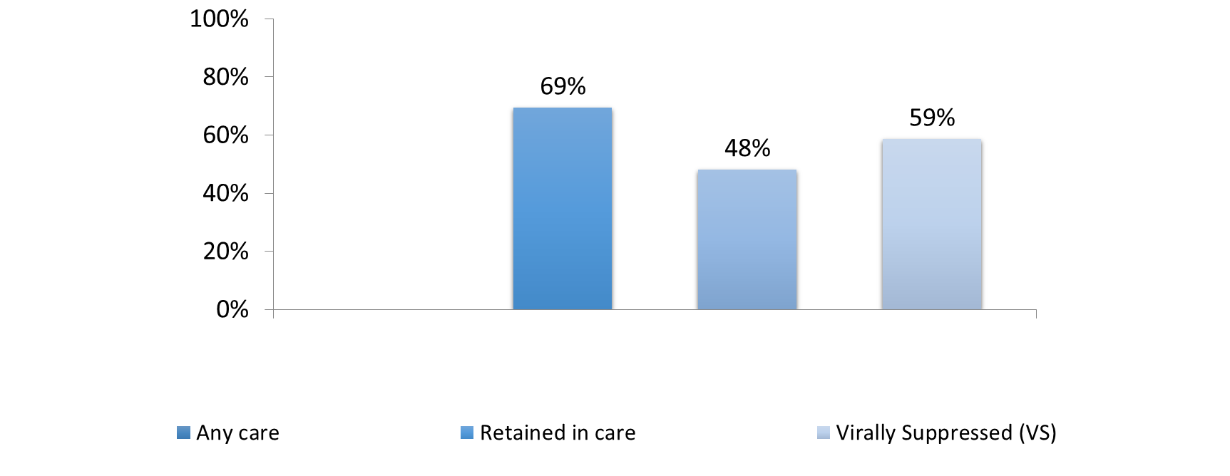
Adults and Adolescents Living with Diagnosed HIV, Georgia, 2020
N=58,054
Adults and adolescents >= age 13, diagnosed by 12/31/2019, living as of 12/31/2020, with a current address in Georgia
Any care >= 1 CD4 or VL in 2020
Retained in care >= 2 CD4 or VL at least 3 months apart in 2020
Viral suppression (VS) = VL<200 copies/ml on most recent viral load in 2020

Slide 5
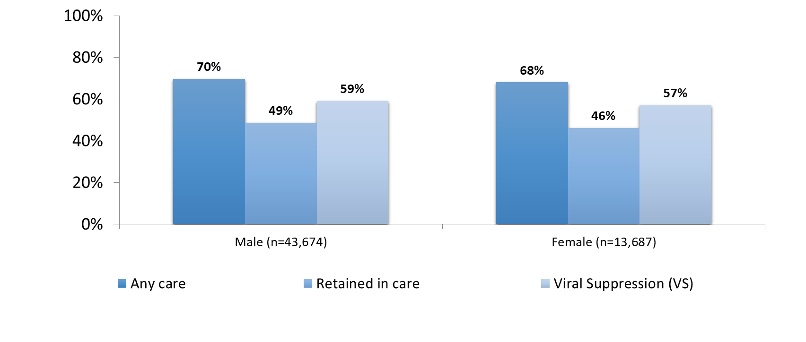
Adults and Adolescents Living with Diagnosed HIV,
by Gender, Georgia, 2020
Adults and adolescents >= age 13, diagnosed by 12/31/2019, living as of 12/31/2020, with a current address in Georgia
Any care >= 1 CD4 or VL in 2020
Retained in care >= 2 CD4 or VL at least 3 months apart in 2020
Viral suppression (VS) = VL<200 copies/ml on most recent viral load in 2020

Slide 6
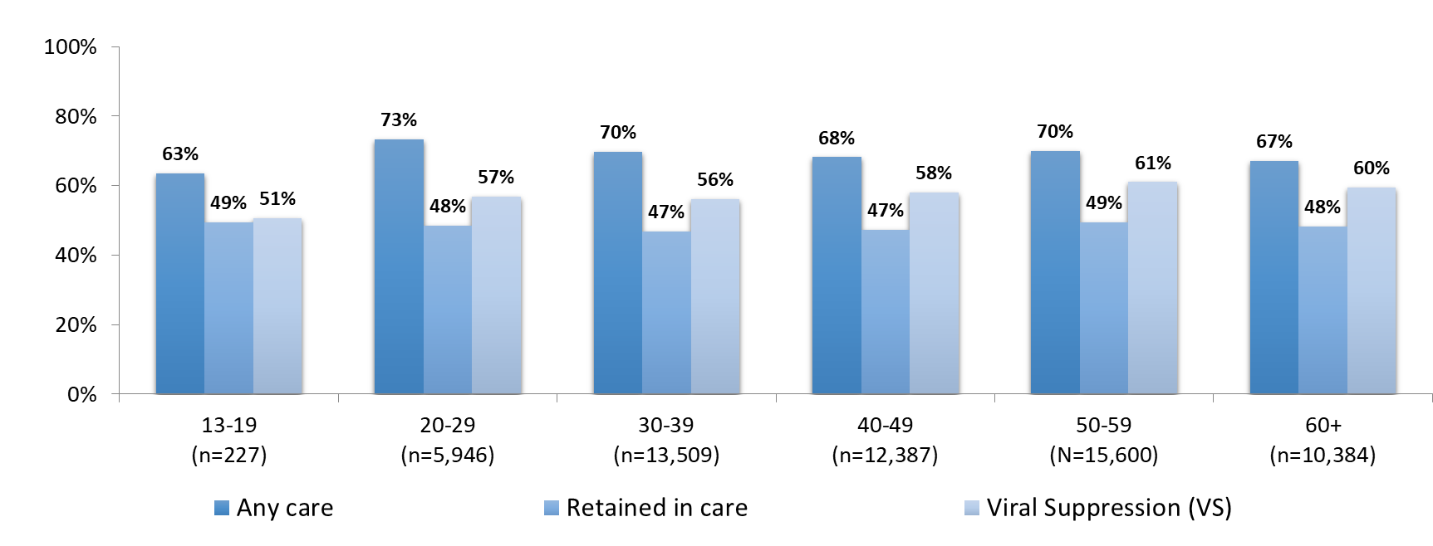
Adults and Adolescents Living with Diagnosed HIV,
by Current Age (in Years), Georgia, 2020
Adults and adolescents >= age 13, diagnosed by 12/31/2019, living as of 12/31/2020, with a current address in Georgia
Any care >= 1 CD4 or VL in 2020
Retained in care >= 2 CD4 or VL at least 3 months apart in 2020
Viral suppression (VS) = VL<200 copies/ml on most recent viral load in 2020

Slide 7
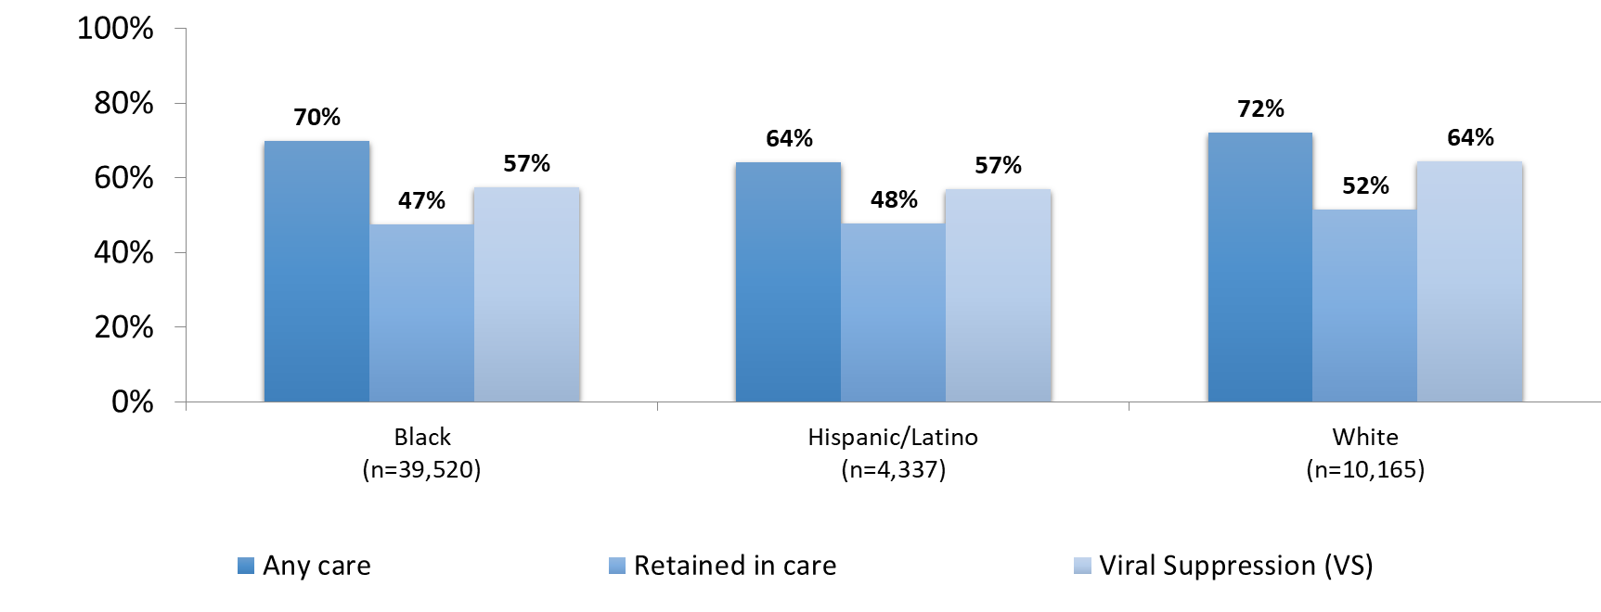
Adults and Adolescents Living with Diagnosed HIV,
by Race/Ethnicity, Georgia, 2020
Adults and adolescents >= age 13, diagnosed by 12/31/2019, living as of 12/31/2020, with a current address in Georgia
Any care >= 1 CD4 or VL in 2020
Retained in care >= 2 CD4 or VL at least 3 months apart in 2020
Viral suppression (VS) = VL<200 copies/ml on most recent viral load in 2020

Slide 8
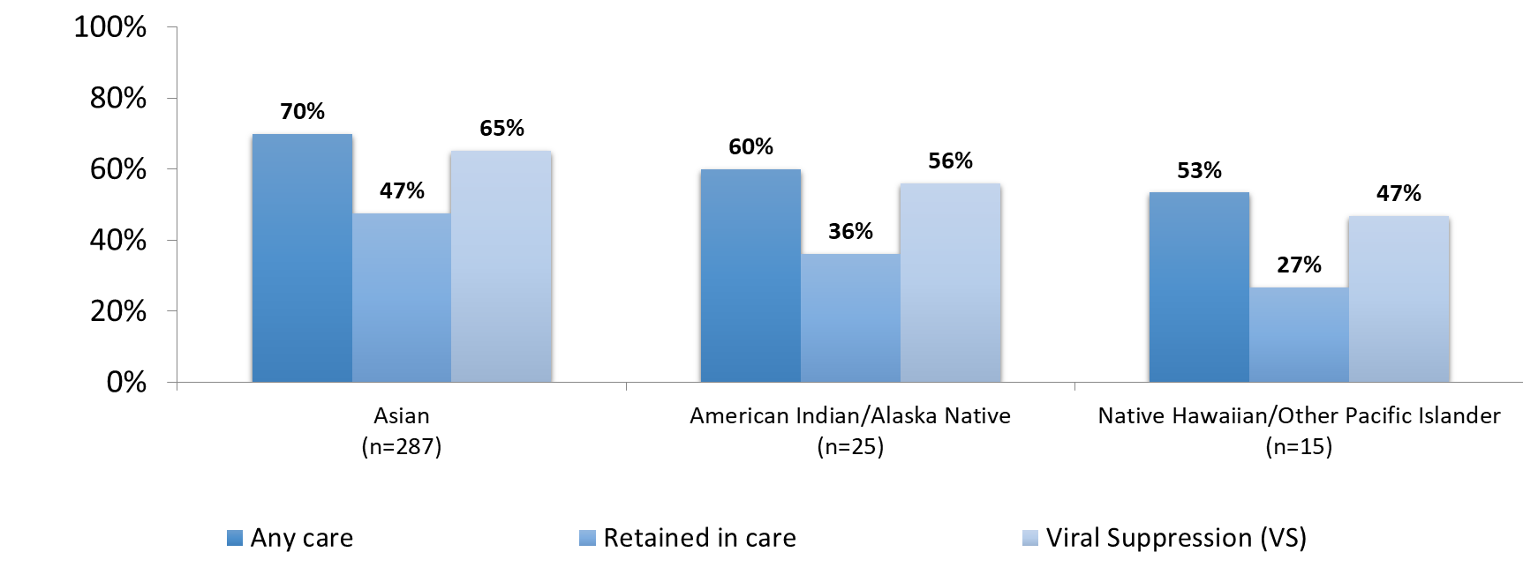
Adults and Adolescents Living with Diagnosed HIV,
by Race/Ethnicity, Georgia, 2020
Adults and adolescents >= age 13, diagnosed by 12/31/2019, living as of 12/31/2020, with a current address in Georgia
Any care >= 1 CD4 or VL in 2020
Retained in care >= 2 CD4 or VL at least 3 months apart in 2020
Viral suppression (VS) = VL<200 copies/ml on most recent viral load in 2020

Slide 9
Transmission Category Definitions
Multiple imputation was used to assign transmission category where missing
MSM = Male to male sexual contact
IDU = Injection drug use
MSM/IDU = Male to male sexual contact and injection drug use
HET = Heterosexual contact with a person known to have, or to be at high risk for, HIV infection

Slide 10
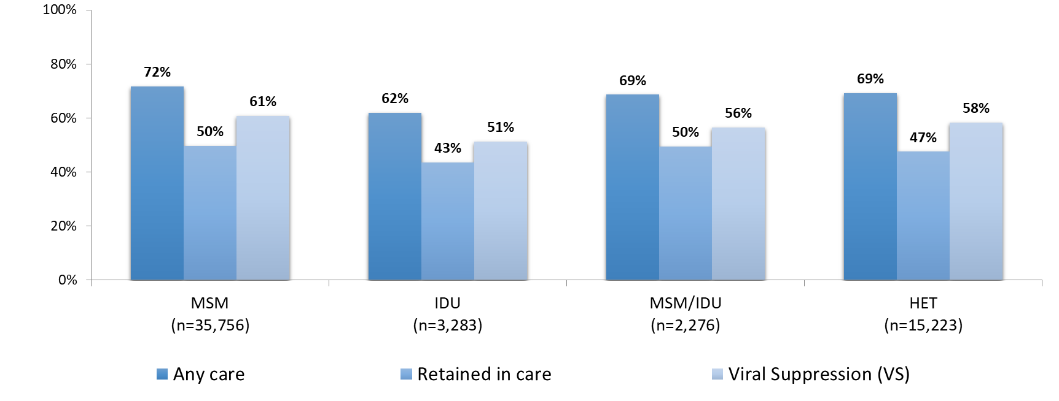
Adults and Adolescents Living with Diagnosed HIV,
by Transmission Category, Georgia, 2020
Adults and adolescents >= age 13, diagnosed by 12/31/2019, living as of 12/31/2020, with a current address in Georgia
Any care >= 1 CD4 or VL in 20120
Retained in care >= 2 CD4 or VL at least 3 months apart in 2020
Viral suppression (VS) = VL<200 copies/ml on most recent viral load in 2020

Slide 11
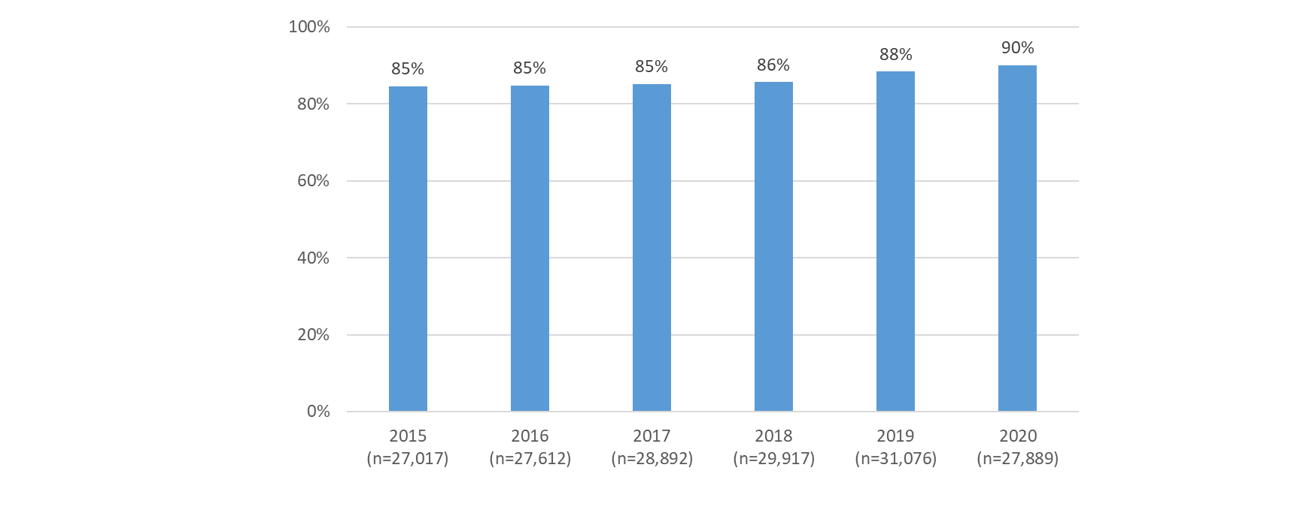
Viral suppression among Adults and Adolescents Retained in Care, Georgia, 2015-2020
N = number retained in care
Adults and adolescents >= age 13
Diagnosed by 12/31 of previous year, living as of 12/31 of reporting year, Georgia
Retained in care >= 2 CD4 or VL at least 3 months apart in reporting year
Viral suppression (VS) = VL<200 copies/ml

Slide 12
New HIV Diagnoses Care Continuum Methodology, Georgia, 2020
Adults and adolescents are those aged >= 13 years
Diagnosed in 2020, living as of 12/31/2021,
Address at HIV diagnosis within Georgia
Linked to care = CD4 or viral load (VL) within 30 days of diagnosis date, including the day of diagnosis

Slide 13
New HIV Diagnoses Care Continuum Methodology, Georgia, 2020, continued
Any care >= 1 CD4 or VL during time period spanning 30 days to 13 months after diagnosis date
Retained in care >= 2 CD4 or VL at least 3 months apart during time period spanning 30 days to 13 months after diagnosis date
Viral suppression (VS) = VL<200 copies/ml in most recent VL during time period spanning 30 days to 13 months after diagnosis date
Each bar in the continuum is independent of those preceding it; all percentages are of the total number of persons (N) diagnosed with HIV in each category

Slide 14
Caveats and Clarifications
Missing laboratory data may result in underestimating care continuum outcomes
The number of individuals (N) in some sub-populations is small. Use caution in interpretation
Methodology for the care continuum and completeness of HIV data varies among jurisdictions, thus limiting direct comparisons with other states or the national care continuum

Slide 15
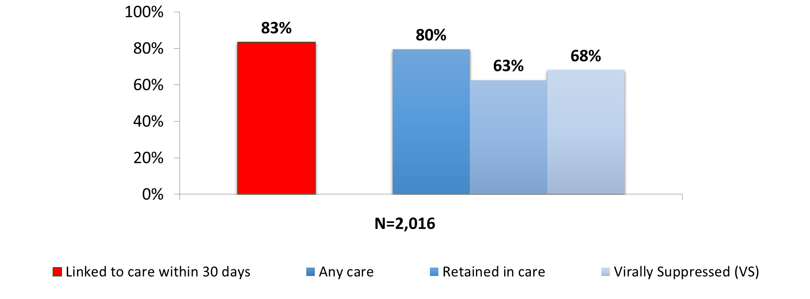
Adults and Adolescents Newly Diagnosed with HIV, Georgia, 2020
Adults and adolescents >= age 13, diagnosed 01/01/20-12/31/20, living as of 12/31/2021
Address at HIV diagnosis Georgia
Linked to care = CD4 or VL within 30 days of diagnosis
Any care >= 1 CD4 or VL during 30 days to 13 months after diagnosis; Retained in care >= 2 CD4 or VL at least 3 months apart during 30 days to 13 months after diagnosis Viral suppression (VS) = VL<200 copies/ml on most recent viral load during 30 days to 13 months after diagnosis

Slide 16
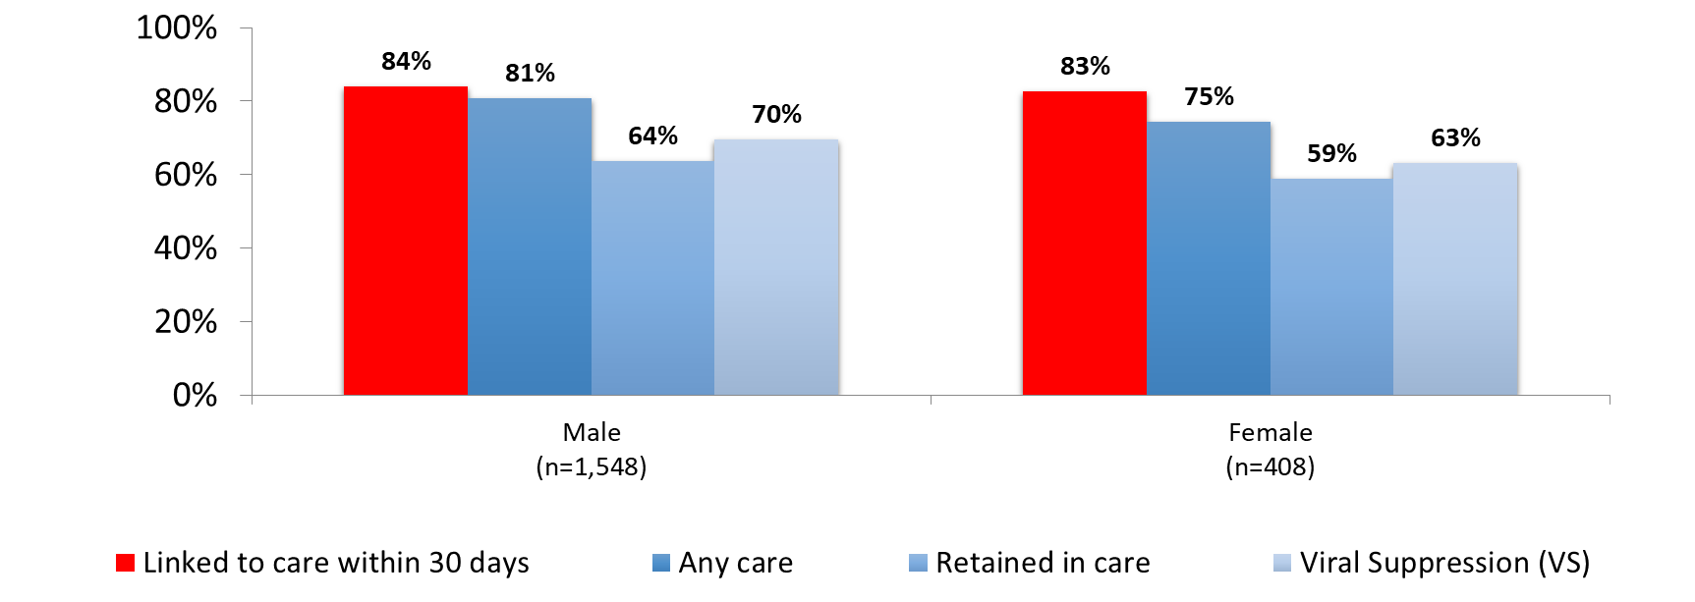
Adults and Adolescents Newly Diagnosed with HIV,
by Gender, Georgia, 2020
Adults and adolescents >= age 13, diagnosed 01/01/20-12/31/20, living as of 12/31/2021
Address at HIV diagnosis Georgia
Linked to care = CD4 or VL within 30 days of diagnosis
Any care >= 1 CD4 or VL during 30 days to 13 months after diagnosis; Retained in care >= 2 CD4 or VL at least 3 months apart during 30 days to 13 months after diagnosis Viral suppression (VS) = VL<200 copies/ml on most recent viral load during 30 days to 13 months after diagnosis

Slide 17
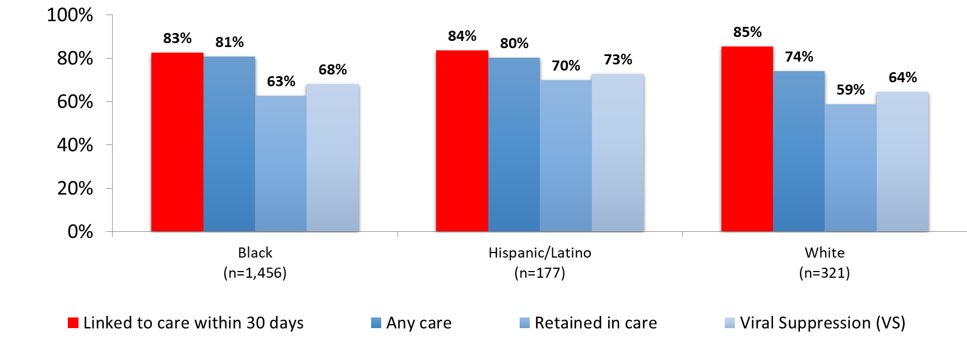
Adults and Adolescents Newly Diagnosed with HIV,
by Race/Ethnicity, Georgia, 2020
Adults and adolescents >= age 13, diagnosed 01/01/20-12/31/20, living as of 12/31/2021
Address at HIV diagnosis Georgia
Linked to care = CD4 or VL within 30 days of diagnosis
Any care >= 1 CD4 or VL during 30 days to 13 months after diagnosis; Retained in care >= 2 CD4 or VL at least 3 months apart during 30 days to 13 months after diagnosis Viral suppression (VS) = VL<200 copies/ml on most recent viral load during 30 days to 13 months after diagnosis

Slide 18
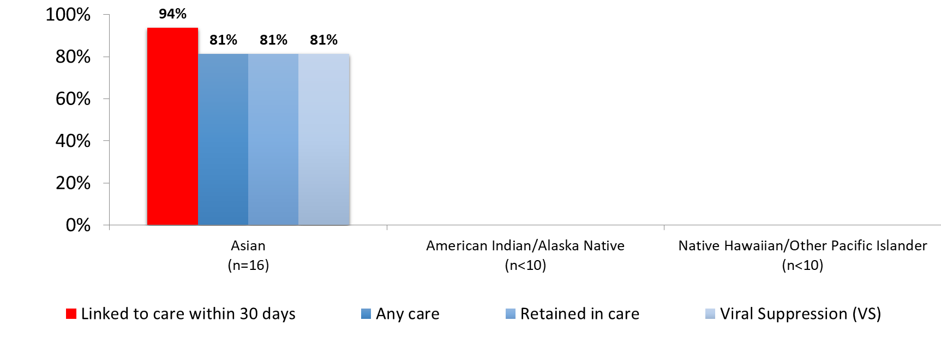
Adults and Adolescents Newly Diagnosed with HIV,
by Race/Ethnicity, Georgia, 2020
Adults and adolescents >= age 13, diagnosed 01/01/20-12/31/20, living as of 12/31/2021
Address at HIV diagnosis Georgia
Linked to care = CD4 or VL within 30 days of diagnosis
Any care >= 1 CD4 or VL during 30 days to 13 months after diagnosis; Retained in care >= 2 CD4 or VL at least 3 months apart during 30 days to 13 months after diagnosis Viral suppression (VS) = VL<200 copies/ml on most recent viral load during 30 days to 13 months after diagnosis
Counts of less than 10 are censored due to being too small

Slide 19
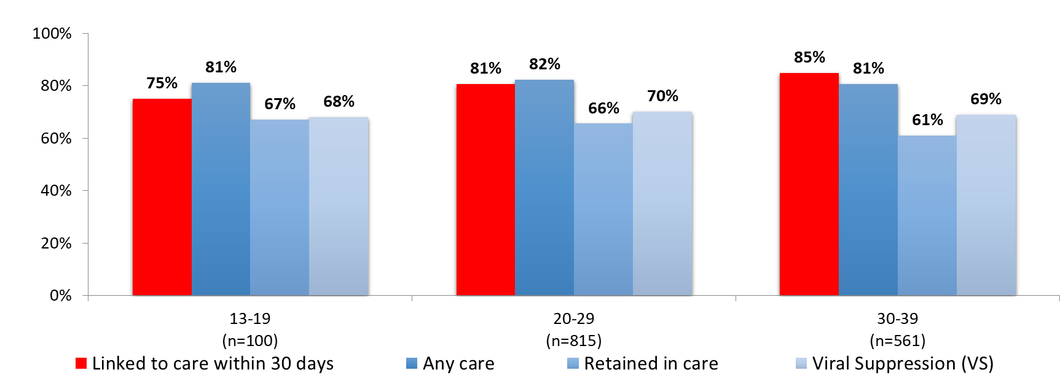
Adults and Adolescents Newly Diagnosed with HIV,
by Current Age (in Years), Georgia, 2020
Adults and adolescents >= age 13, diagnosed 01/01/20-12/31/20, living as of 12/31/2021
Address at HIV diagnosis Georgia
Linked to care = CD4 or VL within 30 days of diagnosis
Any care >= 1 CD4 or VL during 30 days to 13 months after diagnosis; Retained in care >= 2 CD4 or VL at least 3 months apart during 30 days to 13 months after diagnosis Viral suppression (VS) = VL<200 copies/ml on most recent viral load during 30 days to 13 months after diagnosis

Slide 20
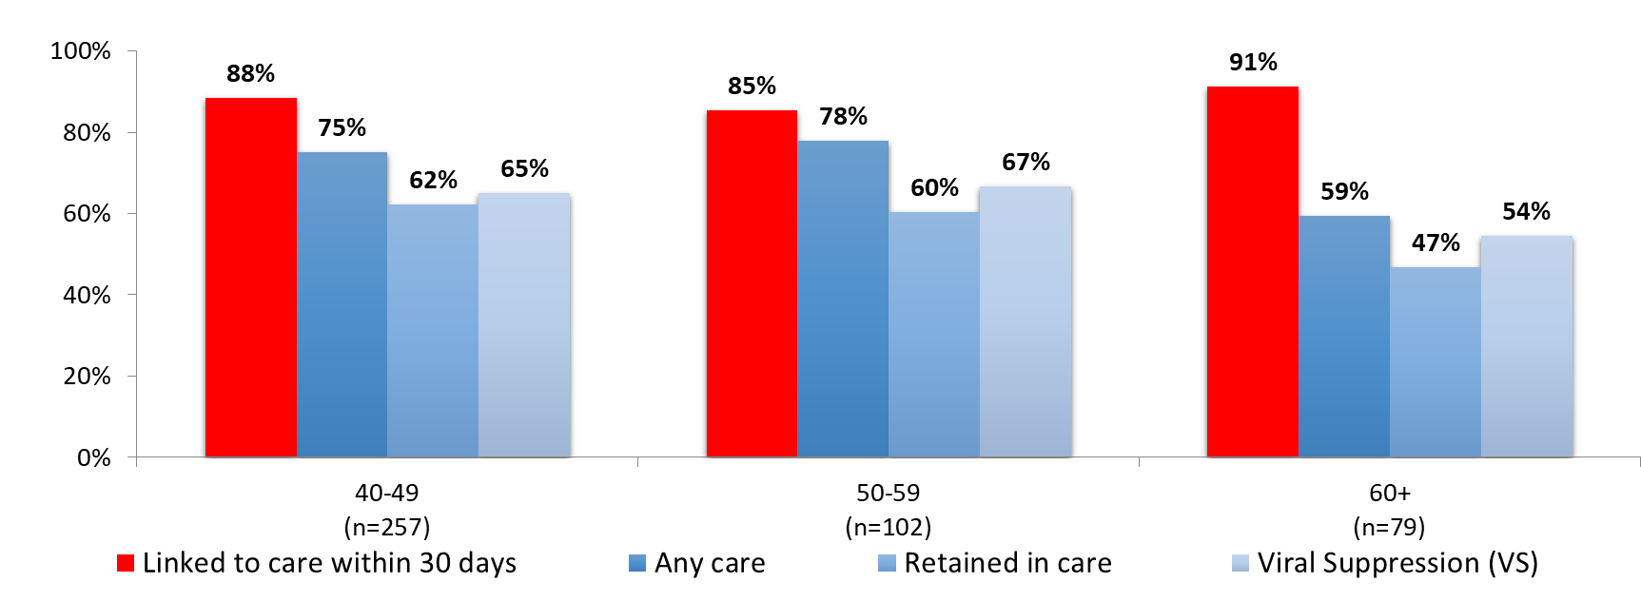
Adults and Adolescents Newly Diagnosed with HIV,
by Current Age (in Years), Georgia, 2020
Adults and adolescents >= age 13, diagnosed 01/01/20-12/31/20, living as of 12/31/2021
Address at HIV diagnosis Georgia
Linked to care = CD4 or VL within 30 days of diagnosis
Any care >= 1 CD4 or VL during 30 days to 13 months after diagnosis; Retained in care >= 2 CD4 or VL at least 3 months apart during 30 days to 13 months after diagnosis Viral suppression (VS) = VL<200 copies/ml on most recent viral load during 30 days to 13 months after diagnosis

Slide 21
Adults and Adolescents Newly Diagnosed with HIV,
by Transmission Category, Georgia, 2020
Adults and adolescents >= age 13, diagnosed 01/01/20-12/31/20, living as of 12/31/2021
Address at HIV diagnosis Georgia
Linked to care = CD4 or VL within 30 days of diagnosis
Any care >= 1 CD4 or VL during 30 days to 13 months after diagnosis; Retained in care >= 2 CD4 or VL at least 3 months apart during 30 days to 13 months after diagnosis Viral suppression (VS) = VL<200 copies/ml on most recent viral load during 30 days to 13 months after diagnosis

Slide 22
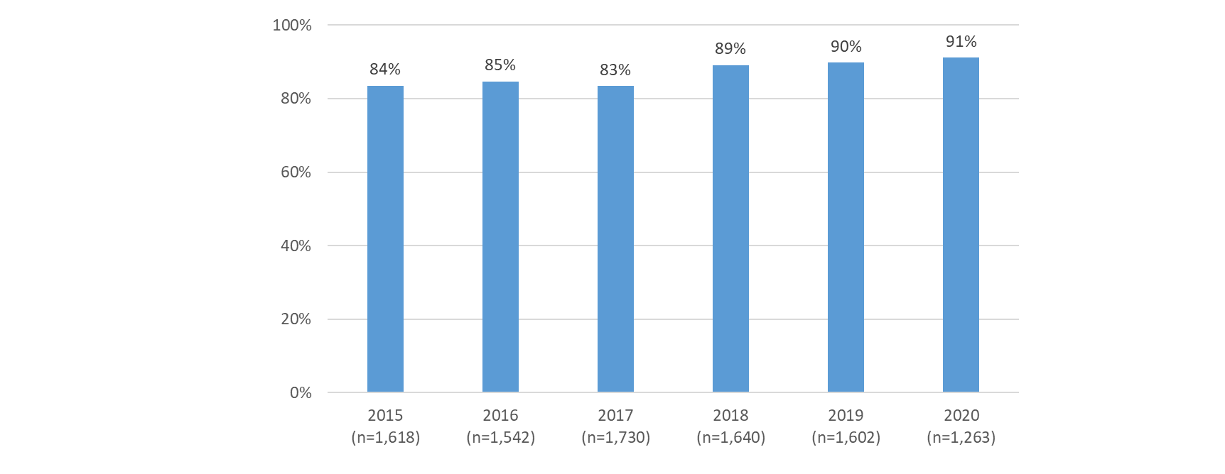
Viral suppression among newly diagnosed adults and adolescents retained in care, Georgia, 2015-2020
N = number retained in care
Adults and adolescents >= age 13
Diagnosed by 12/31 of previous year, living as of 12/31 of reporting year, Georgia
Retained in care >= 2 CD4 or VL at least 3 months apart in reporting year
Viral suppression (VS) = VL<200 copies/ml

