Slide 1
Georgia Framework for Worksite Health
Presented by: Kiley Morgan, PhD, MS, MPH, CHES
Date: February 27, 2014

Slide 2
Georgia Employees
Cardiovascular Disease by Industry, Georgia, 2012
Industry 2002 North American Industry Classification System (NAICS) | Cardiovascular Disease (%)
Employed Adults Overall | 3.5 (2.8-4.4)
Administrative and Support, and Waste Management, and Remediation Services | 7.2 (3.1-15.5)
Retail Trade | 5.9 (3.2-10.6)
Transportation and Warehousing | 5.6 (1.9-15.6)
Data Source: 2012 Georgia Behavioral Risk Factor Surveillance System (BRFSS)
Note: Cardiovascular disease includes heart attack, angina/coronary heart disease, and stroke
Notes:
Georgia has over 4 million employees. Some of these employees work in occupations or industries that expose them to hazards and conditions on the job which may affect their health for the rest of their lives. Some of these employees are living with chronic diseases and conditions, not caused by the job, but which indeed affects their health for the rest of their lives. Since worksites can provide unique opportunities for public health interventions, we wanted to take look at the prevalence of some cardio metabolic conditions (i.e. CVD, Diabetes, and Obesity) among employees by Industry in order know where to focus future prevention and intervention efforts. This table shows the prevalence of cardiovascular disease (which includes, heart attack, angina, coronary heart disease, and stroke) among Georgia employees by industry. In 2012, the prevalence of cardiovascular disease among employed adults overall was 3.5%. Compared to all employees with CVD, the top three industries with the highest prevalence of cardiovascular disease were….

Slide 3
Georgia Employees
Pre-Diabetes by Industry, Georgia, 2012
Industry 2002 North American Industry Classification System (NAICS) | Pre-Diabetes (%)
Employed Adults Overall | 5.9 (4.9-7.1)
*Administrative and Support, and Waste Management, and Remediation Services | 15.0 (7.1-28.7)
Manufacturing | 8.7 (5.1-14.5)
Retail Trade | 6.4 (3.6-11.3)
Educational services | 6.4 (3.9-10.4)
*Significantly higher pre-diabetes prevalence compared to employed adults overall
Data Source: 2012 Georgia Behavioral Risk Factor Surveillance System (BRFSS)
Notes:
This table shows the prevalence of employees who were ever told by a doctor that they have pre- or borderline diabetes. In 2012, about 5.9% of Georgia employees had pre-diabetes. Compared to employed adults overall, employees in the Administrative and Support, Waste Management, and Remediation Services industry had a significantly higher prevalence of pre-diabetes at 15%....followed by employees in manufacturing, retail trade, and educational services industries.

Slide 4
Georgia Employees
Diabetes by Industry, Georgia, 2012
Industry 2002 North American Industry Classification System (NAICS) | Diabetes (%)
Employed Adults Overall | 5.6 (4.7-6.6)
Manufacturing | 10.0 (5.8-15.4)
Administrative and Support, and Waste Management, and Remediation Services | 8.3 (3.1-20.4)
Professional, Scientific, and Technical Services | 7.9 (3.9-15.4)
Data Source: 2012 Georgia Behavioral Risk Factor Surveillance System (BRFSS)
Notes:
Now we will take a look at the prevalence of diabetes among employees by industry. Overall, 5.6% of employees in Georgia had doctor-diagnosed diabetes. The prevalence of diabetes was highest among employees in the manufacturing industry at 10%, followed by the Administrative and support, waste management, and remediation services industry, and the Professional, scientific, and technical services industry

Slide 5
Georgia Employees
Obesity by Industry, Georgia, 2012
Industry 2002 North American Industry Classification System (NAICS) | Obesity (%)
Employed Adults Overall | 29.4 (27.2-31.7)
*Accommodation and Food Services | 44.2 (32.0-57.2)
*Professional, Scientific, and Technical Services | 41.0 (32.6-49.9)
*Educational Services | 39.7 (32.3-47.6)
*Significantly higher obesity prevalence compared to employed adults overall
Data Source: 2012 Georgia Behavioral Risk Factor Surveillance System (BRFSS)
Notes:
This table shows the prevalence of obesity among employees by industry. About 29% of employed adults overall have obesity. Compared to adults overall, employees in the Accommodation and Food Services industry’ the Professional, Scientific, and Technical Services Industry; and Educational Services Industries have a significantly higher prevalence of obesity.

Slide 6
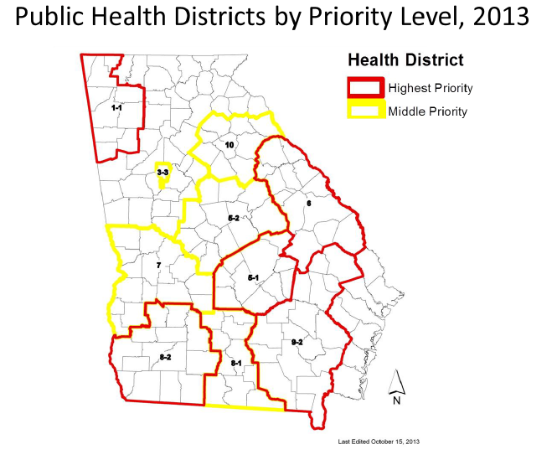
Notes:
To target our interventions related to chronic disease here in Georgia….

Slide 7
Georgia’s
Worksite Model
Assessment &
Data
Policy &
Environment
Planning &
Engagement
Implementation
Evaluation

Slide 8
Georgia’s Worksite Wellness Initiative
How it Works
Partners with worksites in regions that have a burden of chronic disease
Worksites are provided with a worksite wellness toolkit, training, and ongoing technical assistance from the state coordinator and the district health promotion coordinators.
Recommendations for Worksites
Each worksite establish a wellness committee
Assess health needs
Examine health risk assessment and/or claims data
Develop wellness goals and objectives
Adopt and implement model wellness policies
Adopt environmental changes
Approach
Identify and partner with major employer groups, insurers, insurance brokers, county chambers , and city governments.

Slide 9
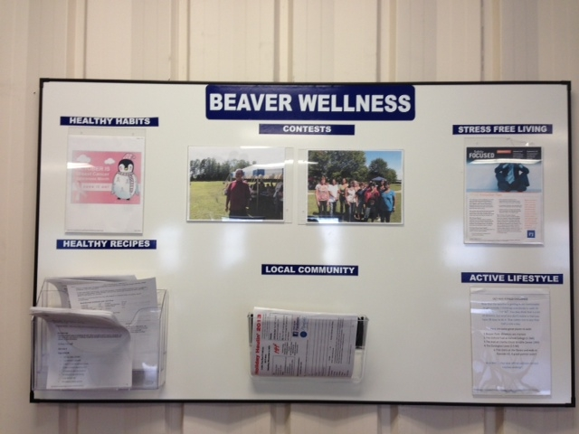
Example: Medium-Sized Manufacturing Company
March 2013: Initial Visit
October 2013: Follow-up visit with Health Promotion Coordinator
Wellness Bulletin Board
  Healthy Habits
  Healthy Recipes
  Contests
  Local Community Resources
  Stress Free Living
  Active Lifestyle
Notes:
March 2013 – Initial Visit
Reported #1 cost driver was weight
Did not have active employee participation in screenings
Needed recommendations on next steps and ideas for their wellness program
Free ice cream in plant facilities
October 2013
Follow-up visit with District Health Coordinator
Included employees in wellness committee
Surveyed employees about wellness program
Employee recognition program
Created wellness boards
Interested in tobacco cessation
Employees participating in 5K challenges
Healthier vending options

Slide 10
Comprehensive Approach
Employee
Worksite
Tools
Evidence-based practices
Provider
COSEHC Project
Pharmacy
pEACHealth
Community
Public Health Districts

Slide 11

COSEHC AT- GOAL Project
Consortium for Southeastern Hypertension Control (COSECH)
AT-GOAL: Aggressively Treating Global Cardio Metabolic Risk Factors to Reduce Cardiovascular Events
Empower healthcare professionals, patients, and the public with better knowledge, tools, and competencies through continuous quality improvement to secure vascular health for all people.

Slide 12
Components of the CME Performance Improvement Program
Patient Records selected based on ICD codes for hypertension, dyslipidemia, and diabetes on 300 randomly selected cardiovascular patients within a practice.
Data will be collected electronically for practices with EMRs, and by COSEHC data abstractor for those without.
Data analyzed to determine current practice performance towards treating cardiovascular risk factors to evidence based therapeutic goals according to current guidelines (JNC, ATP, ADA) .
A customized practice-specific education activity will be implemented and action plan developed by the practice.
Post initial education intervention, clinical data is collected quarterly over the course of two years trending each practice change in performance from baseline.

Slide 13
Data Collected Includes:
Demographics: Visit date, age, sex, ethnicity, and insurance provider identified in the clinical record
Systolic & Diastolic BP, LDL, HDL, triglycerides and HgA1c
Height, weight, and tobacco use and smoking cessation education if recorded in the patient record or included as a discrete field in the EMR

Slide 14
Data Abstraction Process
Practice sites create a list of patients seen within past 18 months for ICD codes 272, 250, and/or 401
Examine your entire population with the above ICD codes who had blood pressure and complete lipid panel
Electronic data abstraction
Collected data analyzed and benchmark reports developed

Slide 15
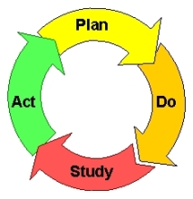
COSEHC Continuous Process Improvement
Identify
Professional
Gaps in
Patient
Outcomes
Baseline
Patient
Outcomes
Assessment
3 Month
Clinical Data
Assessment
Plan
Do
CME
Intervention
Study
ACT
Sir Fracis Bacon (Novum Organum, 1620)
Shewhart, Walter Andrew (1939). Statistical Method from the Viewpoint of Quality Control. New York: Dover
Deming, W. Edwards(1986). Out of the Crisis. MIT Center for Advanced Engineering Study

Slide 16
Results/Benefits
Intervention plan created at CME event by AT-Goal physician faculty member
PRIMARY INTERVENTION:
Bring patients back more frequently
Reduce the cost of a provider visit
Process Measure Improvements
Identify a member of your staff as a process measure champion/team empowerment
Better utilization of EMR system fields for process measures
Implement EMR flags as reminders to obtain process measure information
Outcome Measure Improvement:
Increase access to home BP monitors for uninsured patients
Lower cost of BP check visits to encourage compliance
Increase use of combination therapy
Physician will validate BP on any patient with a high value
More aggressive management of LDL cholesterol
Equally aggressive treatment of LDL in women
Encourage high risk patients to return every e months until controlled
Increase patient education – provide patient a graphic or chart showing current value and goal

Slide 17

2012 Vision
  Georgia Department of Public Health
  South University School of Pharmacy
Uniting
  Patients
  Employers
  Pharmacists
  Medical Providers

Slide 18
Target Population
Primary disease states and conditions
  Hypertension
  Hyperlipidemia
  Diabetes
  Obesity
  Smoking
State counties with high rates of cardiovascular-related morbidity and mortality
County | City/State
Johnson | Wrightsville, GA
Toombs | Lyons/Vidalia, GA
Dodge | Eastman, GA
Laurens | Dublin, GA
Coffee | Douglas, GA

Slide 19
Roll Out
Set-up
  Education on program and disease-states
  Acquisition of monitoring equipment and software
  Distribution of materials
  On-site pharmacy training
Patient recruitment
  Educational sessions
  Pharmacy and worksite screenings

Slide 20
Program Design
Purpose
  To improve blood pressure, cholesterol and blood glucose for participants
  To decrease problems such as hospital and emergency room visits associated with these medical conditions
Structure
  Monthly meetings with pharmacist
    BP, cholesterol, blood glucose, weight, medications (Rx, OTC, & herbals), adherence to medications, diet, exercise, smoking status, and alcohol use
  Findings and recommendations shared with medical providers
  Patient population trends shared with employers

Slide 21
Benefits
  Patient
    Benefits of program and relationship with pharmacist
  Pharmacist
    Benefits of collaboration with patient and provider and advancement of practice
  Pharmacy student
    Educational experience and interactions with patient
  Employer
    Impact on employee satisfaction and work experience

Slide 22
Community
Provide links to community based resources (district coalitions and initiatives)
Continued technical assistance and resources related to policy and environmental changes

Slide 23
Worksite Health
Policy
Environment
Systems

