Slide 1
Cardio-Metabolic Syndrome Guidelines on Education, Detection and Early Treatment Heval Mohamed Kelli, PGY-2 Emory Internal Medicine Residency
no conflict of interest

Slide 2
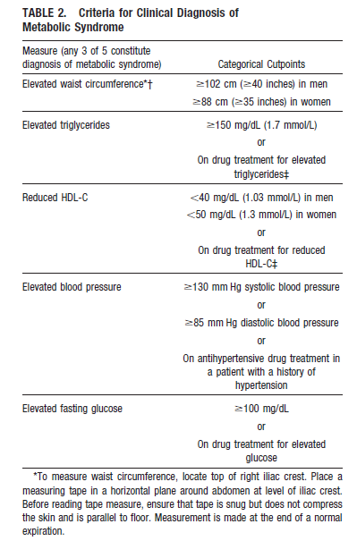
Definition-Prevalence-Risk
34% USA
4.2% among US adolescents
37% Brazil
25% Europe
22-39% India
20.7-37.2% MENA
17% China
2-fold risk of CVD
5-fold risk of DM-II
3-fold risk of dying from colon cancer
1.9-2.6 risk ratio for breast cancer
3.38 odd ratio for chronic kidney disease
Associated with liver disease, sleep apnea and erectile dysfunction.
(Grundy 2005)
Notes:
Although the association of several of these risk factors has been known for more than 80 years,2 the clustering received scant attention until 1988 when Gerry Reaven described syndrome X:
insulin resistance, hyperglycaemia, hypertension, low HDL-cholesterol, and raised VLDL-triglycerides.
Surprisingly, he omitted obesity, now seen by many as an essential component, especially visceral obesity.1 Various
names were subsequently proposed, the most popular being metabolic syndrome.
In 1989, Kaplan5 renamed the syndrome ‘The Deadly Quartet’ and in 1992 it was again renamed ‘The Insulin
Resistance Syndrome’.6 It is now agreed that the wellestablished term ‘metabolic syndrome’ remains the
most usual description of this cluster of metabolic abnormalities.

Slide 3
Metabolic Syndrome
Hypertension
Obesity
Elevated lipids
Impaired blood glucose
Heart disease
Diabetes
Stroke
Cancer
Kidney disease & more

Slide 4
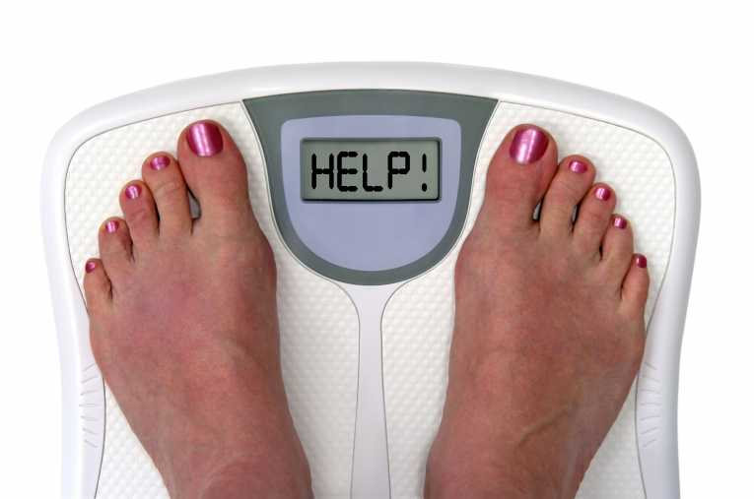
Obesity
Central or abdominal obesity (measured by waist circumference):
Men - Greater than 40 inches
Women - Greater than 35 inches
2013 AHA/ACC/TOS:
Calculate BMI at annual visit
Measure waist circumference at annual visit
Advise about risk of obesity
Counsel about lifestyle sustaining weight reduction 3-5%
Prescribe a low calorie diet
1200-1500 kcal/day for women
1500-1800 kcal/day for men
Referral to comprehensive lifestyle program
Prescribe on site, high intensity (i.e., ≥14 sessions in 6 months) comprehensive weight loss interventions
(Jensen, Ryan et al. 2013)
Notes:
that greater obesity increases risk of CVD, diabetes and all cause mortality

Slide 5
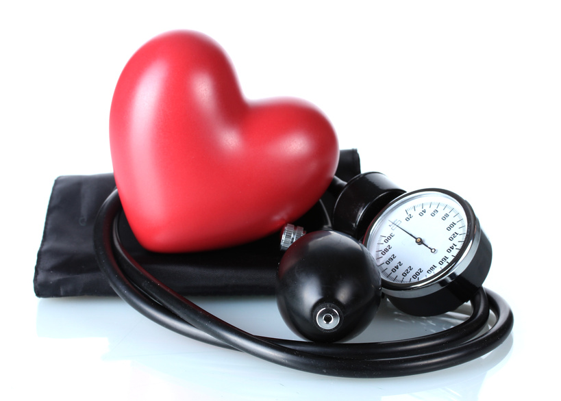
Hypertension
Blood pressure greater than or equal to 130/85
2014 JNC-8 Guideline
>60 years old patients: start treatment if SBP≥150 or DBP ≥ 90
< 60 years old patients: start treatment if BP ≥ 140/90
Treatment:
Weight loss
Exercise
Low salt diet
Medications: ACE/ARB, CCB or diuretics
(James, Oparil et al. 2014)
Notes:
that greater obesity increases risk of CVD, diabetes and all cause mortality

Slide 6
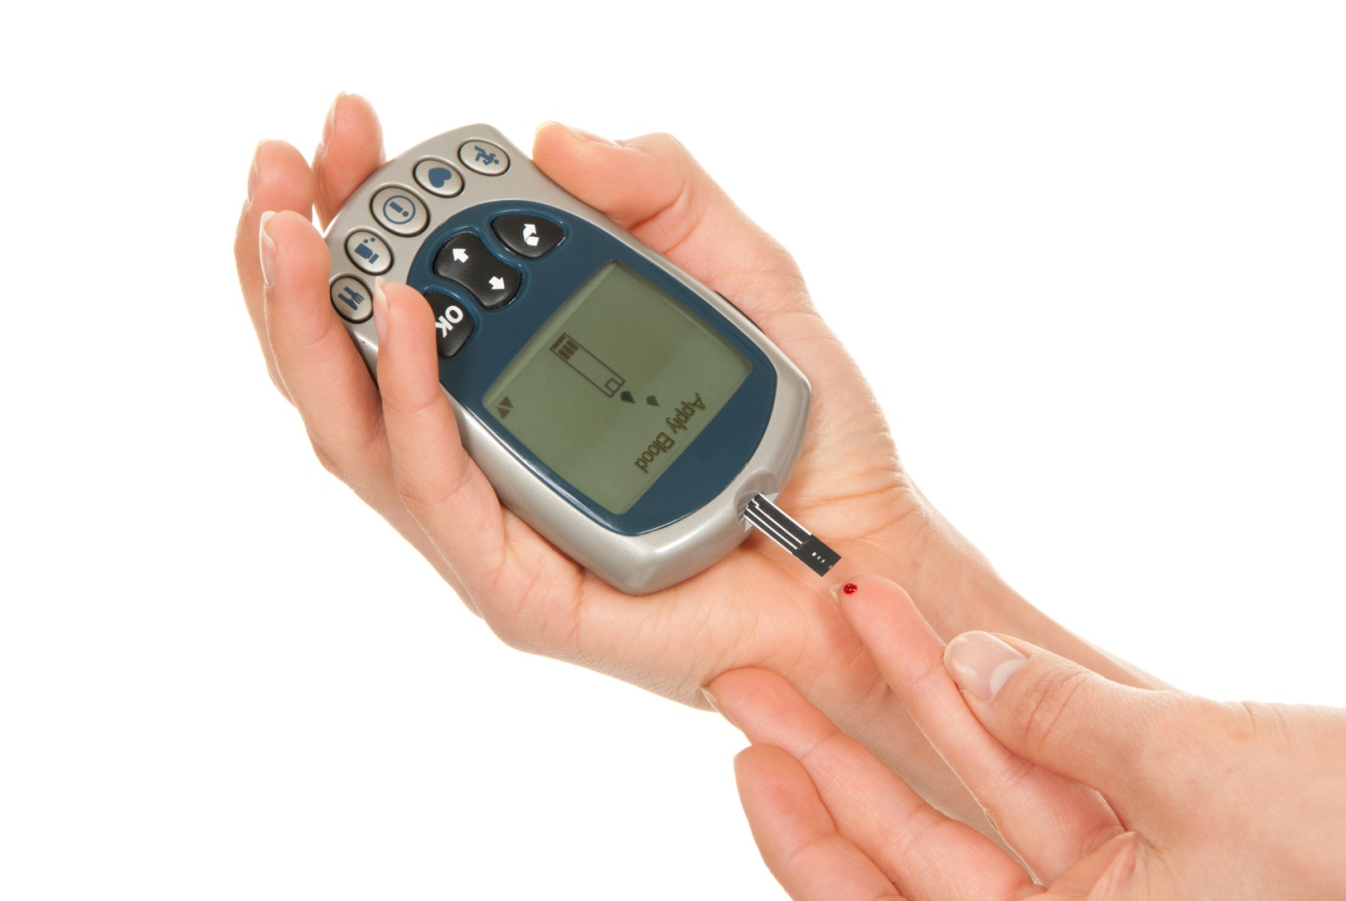
Impaired Fasting Glucose
Fasting glucose greater than or equal to 100 mg/dL
2014 Standards of Medical Care in Diabetes
Testing for Diabetes in Asymptomatic Patients
Overweight (BM>25) with risk factor
Age >45 without risk factor
If normal then every 3 years
Tests: A1C, FPG, or 2-h 75-g OGTT
-If pre-DM then treat CVD risk factors
Prevention of Diabetes
-Weight loss of 7% of body weight
-150 min/week exercise
-Metformin for pre-DM
-Screen and treat CVD risk factors
(2014)
Notes:
that greater obesity increases risk of CVD, diabetes and all cause mortality

Slide 7
High Cholesterol
Total cholesterol ≥200
LDL, goal based on risk factors
Triglycerides ≥150
HDL
Men - Less than 40 mg/dL
Women - Less than 50 mg/dL
2013 ATP-4
“Statin Treats Risk”
Lipid Screening
Men
>35 yrs without risk factors
20-25 with risk factors
Women
>45 without risk factors
>20 with risk factors
Treatment
Moderate-High intensity Statins
Patients ≤75 years with CVD
LDL ≥190
Patients (40-75 years)
- Diabetes 1 or 2
- LDL 70-189 with estimated 10-year cardiovascular risk of 7.5% or more
(Stone, Robinson et al. 2013)
Notes:
surrounding a new risk calculator to identify those at 7.5% CVD risk in 10 years have been voiced. The risk calculator appears to greatly overestimate risk. Joslin will continue to investigate the ongoing debate in regards to the risk calculator. A new risk calculator to identify those at 7.5% CVD risk in 10 years is the litmus for statin prescriptions.

Slide 8
Summary
Screening
Waist circumference and BMI
Blood pressure
Blood glucose
Lipid profile
Prevention
Assess people at risk
Exercise
Diet
Comprehensive lifestyle program
Metformin
Treatment
Prevention & control of risk factors
Metformin
Anti-hypertensive medcations
Statins
Notes:
that greater obesity increases risk of CVD, diabetes and all cause mortality

Slide 9
Reference
(2014). "Executive summary: standards of medical care in diabetes--2014." Diabetes care 37 Suppl 1: S5-13.
Agnoli, C., F. Berrino, et al. "Metabolic syndrome and postmenopausal breast cancer in the ORDET cohort: a nested case-control study." Nutr Metab Cardiovasc Dis 20(1): 41-48.
Chen, J., P. Muntner, et al. (2004). "The metabolic syndrome and chronic kidney disease in U.S. adults." Ann Intern Med 140(3): 167-174.
Ervin, B. (2009). "Prevalence of Metabolic Syndrome Among Adults 20 Years of Age and Over, by Sex, Age, Race and Ethnicity, and Body Mass Index: United States, 2003–2006." National Health Statistics Reports(13).
Grundy, S. M. (2008). "Metabolic syndrome pandemic." Arteriosclerosis, thrombosis, and vascular biology 28(4): 629-636.
James, P. A., S. Oparil, et al. (2014). "2014 evidence-based guideline for the management of high blood pressure in adults: report from the panel members appointed to the Eighth Joint National Committee (JNC 8)." JAMA : the journal of the American Medical Association 311(5): 507-520.
Jensen, M. D., D. H. Ryan, et al. (2013). "2013 AHA/ACC/TOS Guideline for the Management of Overweight and Obesity in Adults: A Report of the American College of Cardiology/American Heart Association Task Force on Practice Guidelines and The Obesity Society." Circulation.
Stocks, T., K. Rapp, et al. (2009). "Blood glucose and risk of incident and fatal cancer in the metabolic syndrome and cancer project (me-can): analysis of six prospective cohorts." PLoS Med 6(12): e1000201.
Stone, N. J., J. Robinson, et al. (2013). "2013 ACC/AHA Guideline on the Treatment of Blood Cholesterol to Reduce Atherosclerotic Cardiovascular Risk in Adults: A Report of the American College of Cardiology/American Heart Association Task Force on Practice Guidelines." Journal of the American College of Cardiology.
Notes:
that greater obesity increases risk of CVD, diabetes and all cause mortality

