Slide 1
Choosing Antibiotics Wisely collaborative in Georgia
November 7, 2018
Ravi Mangal Patel, MD MSc
Associate Professor of Pediatrics
@ravimpatelmd

Slide 2
Disclosures
Ravi Patel receives honorarium and travel funds from Mednax, Inc.

Slide 3
Learning objectives:
Learn about the quality improvement efforts by the GaPQC in improving antimicrobial stewardship for newborns in Georgia.
Understand how the 7 CDC core elements of antimicrobial stewardship practices can be applied to newborns.
Know about successful efforts by centers across the state in improving antimicrobial use in newborns in both intensive care and non-intensive care settings.
Learn about exciting potential opportunities to join a statewide collaborative in 2019 to improve antibiotic use.

Slide 4
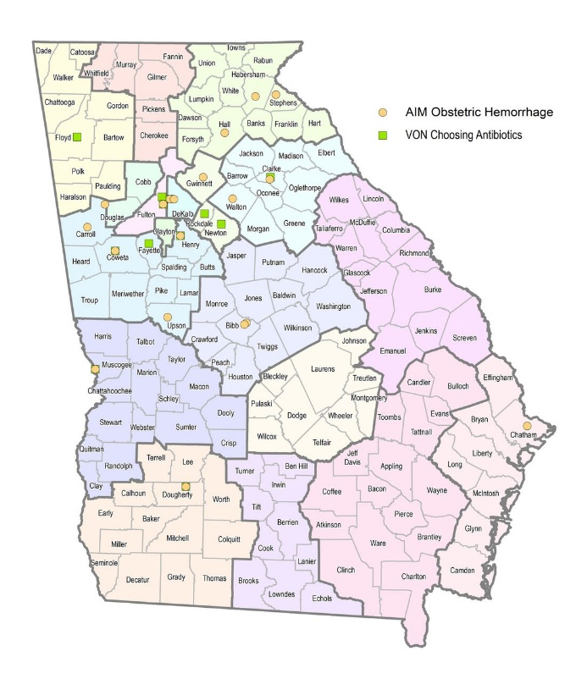
Georgia Perinatal Quality Collaborative (GaPQC)
Formed in 2012
Funded by CDC in 2017
Maternal: obstetric hemorrhage (AIM)
Neonatal: antimicrobial stewardship (VON)
48 hospitals covering ~65% of births in Georgia

Slide 5
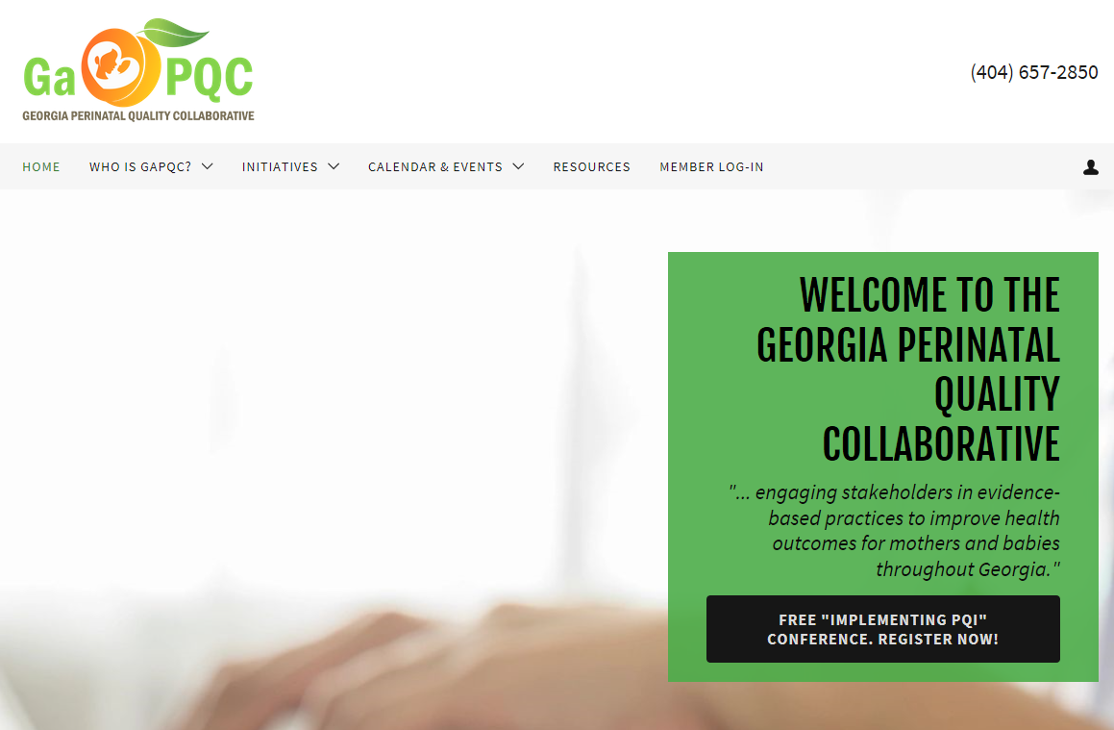
www.georgiapqc.org

Slide 6
www.georgiapqc.org

Slide 7
Georgia joined VON in 2017
as a statewide collaborative
with 8 participating hospitals

Slide 8
Georgia Perinatal Quality Collaborative (GaPQC)
Expanded in 2018 to include data from 13 hospitals
Coverage of 38% of Georgia births (n=37,566 based on 2016 data)

Slide 9
Overview – VON iNICQ
Drive the rapid-cycle update of the CDC Core Elements for Antibiotic Stewardship
Promote the rapid-cycle adoption of critical new guidelines for antibiotic use during the perinatal period
Assist individual centers, health systems and states to aim for a 25% reduction in the use of antibiotics in the newborn population
Source: https://public.vtoxford.org/quality-education/inicq-2018/

Slide 10
Publications on Microbiome
Young. BMJ. 2017

Slide 11
“How early life shapes the infant gut microbiome and risk of disease”

Slide 12
Dynamic Development of Microbiome
From Juliette Madan, Dartmouth

Slide 13
From Juliette Madan, Dartmouth

Slide 14
Prolonged duration of antibiotics

Slide 15
Prolonged duration of antibiotics

Slide 18
Kaiser sepsis risk calculator
https://neonatalsepsiscalculator.kaiserpermanente.org

Slide 19
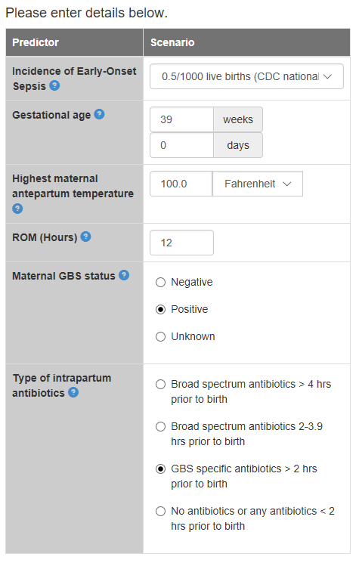
Example of a case
https://neonatalsepsiscalculator.kaiserpermanente.org

Slide 20
Results of risk of EOS
https://neonatalsepsiscalculator.kaiserpermanente.org

Slide 21
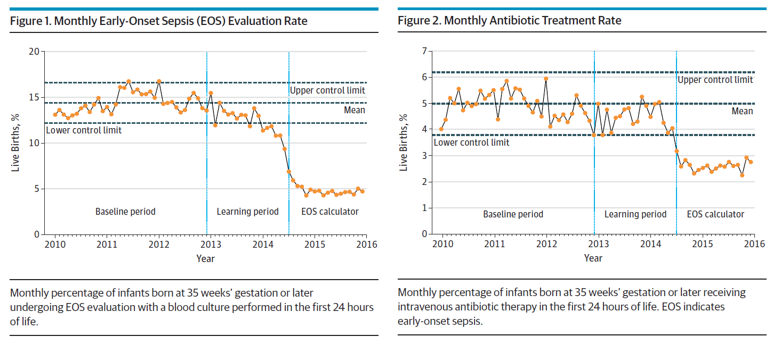
Readmissions for sepsis: baseline 5.2 per 100,000; EOS calculator: 5.3 per 100,000 LB

Slide 23
Infants at low risk
Delivery by cesarean section
Membrane rupture at delivery
Absence of clinical chorioamnionitis

Slide 24
Infants at low risk
Early-onset sepsis 0.5% among infants in low-risk group verse 2.5% in comparison group
Prolonged antibiotics administered to:
34% of low-risk infants
47% of comparison infants

Slide 25
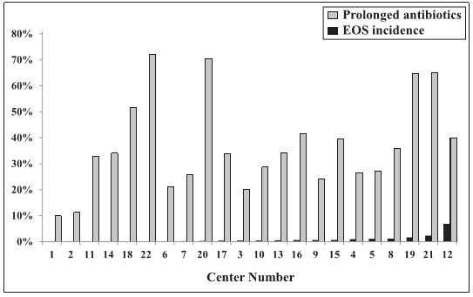

Slide 26
How can we be more judicious with antibiotic use?

Slide 27
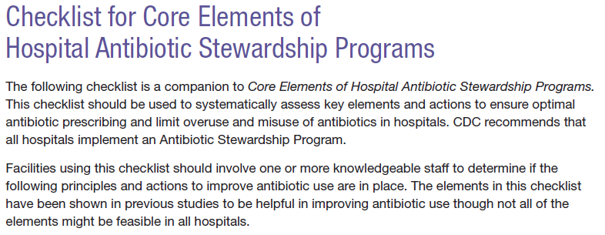

Slide 28
❶ Leadership Commitment
❷ Accountability
❼ Core Elements of antibiotic stewardship
❸ Drug Expertise
Action
❺ Tracking
❻ Reporting
❼ Education

Slide 29
Live Poll: Q1
Does your facility care for newborn infants?
Yes
No

Slide 30
Live Poll: Q2
Does your facility have a neonatal intensive care unit?
Yes
No

Slide 31
Live Poll: Q3
❶ Leadership Commitment

Slide 32
Live Poll: Q4
❷ Accountability

Slide 33
Live Poll: Q5
❸ Drug Expertise

Slide 34
Live Poll: Q6
Action

Slide 35
Live Poll: Q7
❺ Tracking

Slide 36
Live Poll: Q8
❻ Reporting

Slide 37
Live Poll: Q9
❼ Education

Slide 38
Experience of the GaPQC participating hospitals?

Slide 39
❶ Leadership Commitment
Written plan with senior leadership
❷ Accountability
Physician leader
❸ Drug Expertise
Pharmacist leader
❼ Core Elements of antibiotic stewardship
Action
Antibiotic time-out at 48-72 hours
❺ Tracking
Monitoring adherence to guidelines
❻ Reporting
Reporting to NHSN AU module
❼ Education
NICU specific education for staff

Slide 40
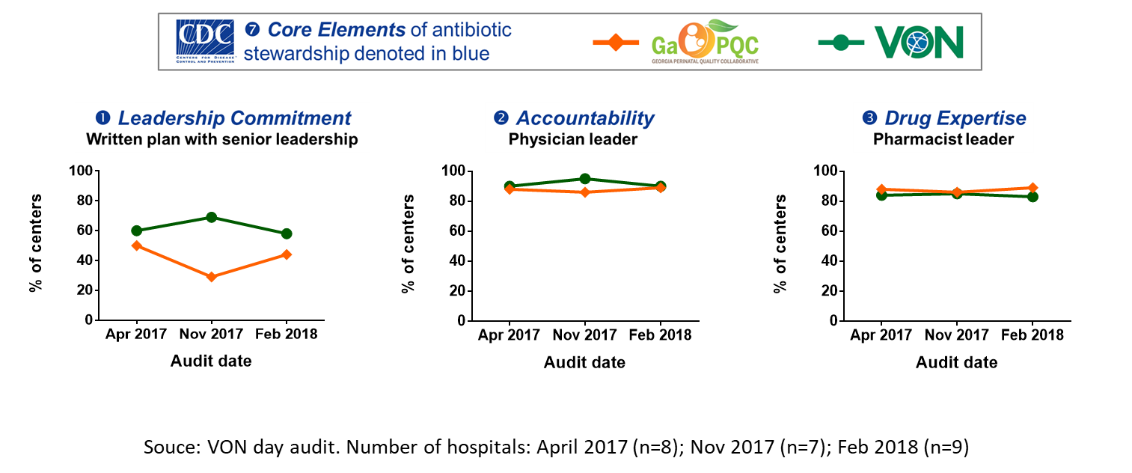
Number of hospitals: April 2017 (n=8); Nov 2017 (n=7); Feb 2018 (n=9)

Slide 41
Number of hospitals: April 2017 (n=8); Nov 2017 (n=7); Feb 2018 (n=9)

Slide 42
Number of hospitals: April 2017 (n=8); Nov 2017 (n=7); Feb 2018 (n=9)

Slide 43
Antibiotic use among centers

Slide 44
Experience of individual GaPQC participating hospitals?

Slide 47
Grady Memorial Hospital NICU
Academically-affiliated, level III NICU with 500 admissions annually and an average daily census of about 30
Primary teaching site of neonatal medicine for the Emory Pediatric Residency program
Medical team includes resident, fellow and attending physicians, neonatal nurse practitioners, and a pharmacist

Slide 48
Tests of change | What did we learn?
PDSA 1: Test retrieval of antibiotic usage data from the systems currently available at Grady Hospital (retrieved 2017 calendar year) | Ampicillin best marker for initial empiric antibiotic utilization. 60% (294/483) of infants admitted to the NICU in 2017 received early empiric antibiotics 27% of infants on antibiotics treated for > 48 hours, with half for 72 hours or less.
PDSA 2: Changed admission order set to default initial empiric antibiotic duration of 48 hours (both ampicillin and gentamicin) | Changes to admission order set does not capture infants with early antibiotics written separate from the admission order. Several missed stops.
PDSA 3: Initial launch of pharmacist-led antibiotic time out at morning huddle and corresponding physician documentation in daily progress note. | Inconsistent implementation due to competing team obligations. Difficult for medical team to identify patients on antibiotics prior to rounds. Need to relaunch effort.
PDSA 4: Relaunch of antibiotic time-out at morning multidisciplinary huddle with sharing of pharmacy’s antibiotic-specific patient list with medical team. | Recent relaunch with primary NICU pharmacist and several part-time pharmacists leading discussion with medical team utilizing shared patient list.

Slide 49
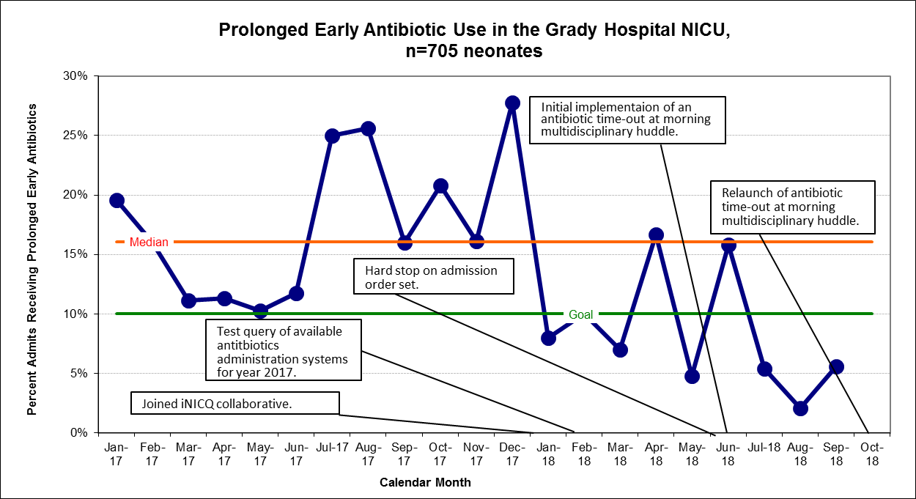
Grady Memorial NICU Antibiotic Stewardship
Zero ‘missed discontinuations’ for months July, August and September and no missed doses in those requiring a full course of treatment.

Slide 51
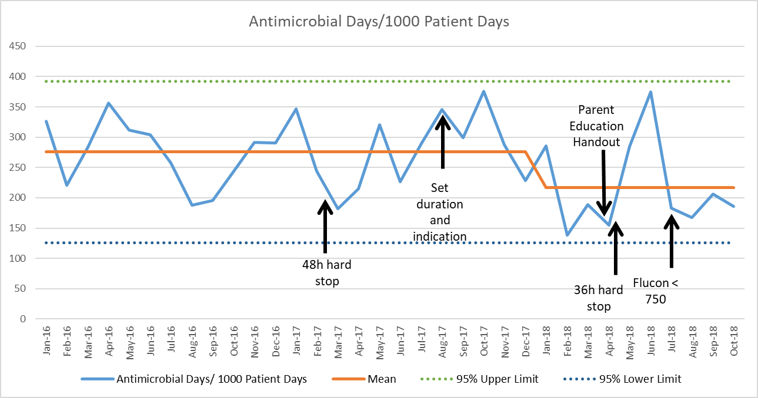

Slide 52
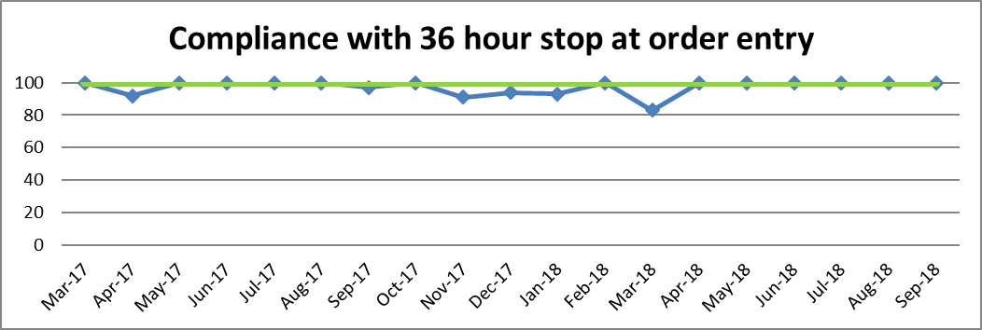
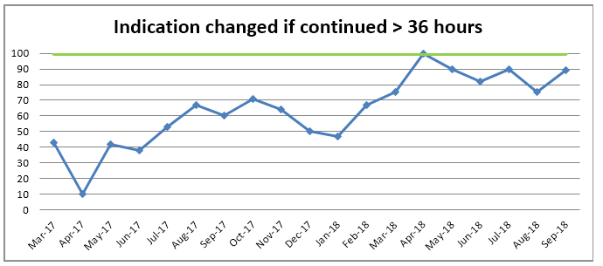

Slide 56
Key Driver Diagram
Primary drivers
Interventions
SMART Aim:
Decrease the percentage of infants receiving empiric antibiotic therapy for greater than 48 hours in the Special Care Nurseries (SCN) from a baseline of 43% to 30% or less by December 31, 2017
Organizational culture
Engage a multidisciplinary stewardship team
Guidelines for antibiotic use
Test, refine and implement early-onset sepsis treatment guidelines
Pharmacy oversight of
Antibiotic use
Address criteria for initiation and discontinuation of antibiotics
Reporting on antibiotic use to staff
Global Aim:
Decrease necrotizing enterocolitis in our Special Care Nursery
Include pharmacist on rounds
Use audits and feedbacks of
antibiotic use

Slide 57
Decrease in % of infants receiving > 48 hours of initial empiric antibiotics from 41% to 31%
PDSA 1: Pharmacy antibiotic use audits
PDSA 2: Provider feedback at rounds
PDSA 3: Testing of EOS guidelines
Mean
GOAL
2017 iNICQ begins
SPC P chart (n=1189)
3σ control limits in red

Slide 58
Summary / Next steps
Over the last 2 years (2017-2018), we observed a decrease in the variation and frequency of antibiotic use among newborns at participating hospitals.
For many teams, hospital pharmacist engagement has been a key element of success.
We would like to spread neonatal antimicrobial stewardship efforts to other hospitals in Georgia.

Slide 59
grace.kang@dph.ga.gov www.georgiapqc.org
Interested in learning more?

Slide 60
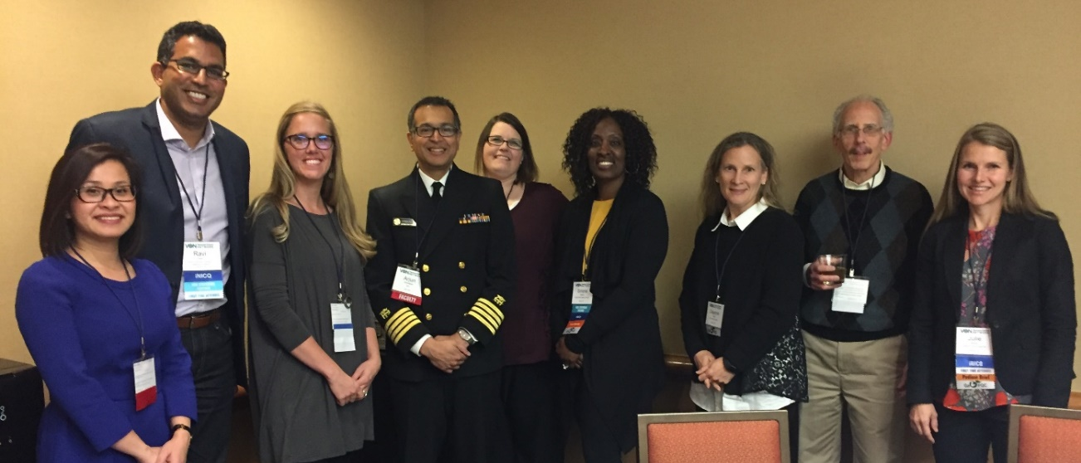
Acknowledgements
David Levine, MD, VON iNICQ lead, Piedmont Columbus Regional, Chair, Neonatal Subcommittee, GaPQC
Julie Martin, MD: iNICQ lead, Piedmont Health System and Piedmont Athens Regional
Laura Drohan, MD: iNICQ lead, Northside Hospital
Jessica Roberts, MD: iNICQ lead, Grady Memorial Hospital
Grace Kang, RN: Perinatal Quality Improvement Manager, Maternal and Child Health Section,
Division of Health Promotion, Georgia Department of Public Health

Slide 61
Funding:
https://georgiapqc.org/

